Slide 1
Systematic Reviews of Research on Online Learners
Presented by: Patrick Lowenthal, Chareen Shelson, Curtis J. Bonk, Ting Sun, Florence Martin, Albert Dieter Ritzhaupt and Carl Westine
Facilitated by:
Ayesha Sadaf (DDL Past President),
Swapna Kumar (DDL President-Elect 2022)
Larisa Olesova (DDL President)
October 25, 2022 9:10 am PDT

Slide 2



FACILITATORS
Ayesha Sadaf
Associate Professor
Educational Leadership
University of North Carolina Charlotte
Swapna Kumar
Clinical Professor
School of Teaching and Learning
University of Florida
Larisa Olesova
Clinical Assistant Professor
School of Teaching and Learning
University of Florida

Slide 3
Panel Description
This presidential panel will present, discuss, and share systematic literature findings about online learners in distance education. Specifically, the panelists will share their systematic reviews and the key findings from their studies on scaffolding effects in online learning, qualitative community and connectedness in online higher education and the impact of distance and online learning. The panelists will discuss current trends in the field of online teaching and learning, their views on the future of the field, and the directions for the areas of further research.

Slide 4
Background
The interest in the field of online teaching and learning is tremendously growing
Systematic reviews shed light on important areas of research in distance education and, specifically, on online learner

Slide 5
Key Differences - Literature Review vs. Systematic Review
Literature review
Does not require justification or search procedures
The paper determines the literature review
Example: Our paper is about X and here’s what’s been written about X topic
Systematic Review
Follows a specific protocol, typically PRISMA, that guides the selection of articles
Use of PRISMA creates trustworthiness by allowing others to replicate the search (Moore & Miller, 2022; Page et al., 2021)
Example: This systematic review examines 24 peer-reviewed articles published between 2009-2020 that examined cognitive presence in online courses.

Slide 6
Key Differences - Literature Review vs. Systematic Review
Literature review
Does not require justification or search procedures
The paper determines the literature review
Example: Our paper is about X and here’s what’s been written about X topic
Systematic Review
Follows a specific protocol, typically PRISMA, that guides the selection of articles
Use of PRISMA creates trustworthiness by allowing others to replicate the search (Moore & Miller, 2022; Page et al., 2021)
Example: This systematic review examines 24 peer-reviewed articles published between 2009-2020 that examined cognitive presence in online courses.

Slide 7
Key Difference - Scoping Review vs. Systematic Review
Scoping Review
Start by reviewing extant research to develop research questions (Powers & Moore, 2021; Snelson & Hsu, 2020)
Systematic Review
Start with research question and use that to identify research (Arksey & O’Malley, 2005; Dennen et al., 2020)

Slide 8
Advantages of Systematic Reviews
Minimized bias
A-priori protocol
Defined search and evaluation methods
Reproducible
High validity of review conclusions
Stratton, S. J. (2019). Literature reviews: methods and applications. Prehospital and disaster medicine, 34(4), 347-349.

Slide 9
PRESENTATIONS

Slide 10



Presenters
Patrick Lowenthal
Professor
Educational Technology
Boise State University
Chareen Snelson
Associate Professor
Educational Technology
Boise State University
Curtis Bonk
Professor
Instructional Systems Technology
Indiana University

Slide 11



Presenters
Florence Martin
Professor
Teacher Education and Learning Sciences
NC State University
Albert Ritzhaupt
Professor
School of Teaching and Learning
University of Florida
Carl Westline
Associate Professor
Educational Leadership
University of North Carolina Charlotte

Slide 12
Chareen Snelson and Patrick Lowenthal

Slide 13
Community and connectedness in online higher education: A scoping review of the literature
Community and connectedness are important concepts in online higher education. However, researchers debate how they are defined, operationalized, or enacted in practice.
A scoping study was conducted to review the research literature on the extent, range, and nature of research in community and connectedness in online higher education.
Trespalacios, J., Snelson, C., Lowenthal, P. R., Uribe-Flórez, L., & Perkins, R. (2021). Community and connectedness in online higher education: A scoping review of the literature. Distance Education, 42(1), 5–21. https://doi.org/10.1080/01587919.2020.1869524

Slide 14
Background
There is ongoing interest in social interaction, community, and learning in online education.
Researchers have found, among other things, a relationship between sense of community and student satisfaction or perceived learning.
Problems:
Terms such as social presence, belongingness, connectedness, and community are used interchangeably.
Strategies for fostering community in online education are unclear.

Slide 15
Methods
Scoping Review
Map the literature on a topic.
Identify key concepts, gaps in the research, or types of evidence.
Five-stage process:
  Identify research questions.
  Select studies following PRISMA guidelines.
  Extract data into spreadsheet.
  Collate, summarize, report.
PRISMA: Preferred Reporting Items for Systematic Reviews and Meta-Analyses.

Slide 16
Results
Characteristics
66 studies from 2001 to 2018.
Majority from USA (81.8%)
Most common definitions and frameworks
Rovai
McMillan and Chavis
Connectedness
Sense of Community
Social Presence
Top strategies for promoting community
Use of instructional strategies
Use of technology for communication
Fostered by faculty/staff/students

Slide 17
Discussion
Similar elements across definitions
Sense of belonging within the online learning environment.
Development of meaningful relationships with instructors and classmates.
Intellectual growth based on similar goals and interests.
Fostering community and connectedness
Design activities to promote community.
  Examples: Instructor presence in discussions, personal introductions, collaborative projects, timely feedback.
Use various technologies to promote communication and community.
  Examples: Audio feedback, Web 2.0, social networking, virtual worlds.

Slide 18
Limitations
A limitation of this scoping review is that the sample of articles is limited to the search and selection strategies described in the Methods section. Thus, it is possible that relevant studies were missed. Future research could expand the search to include additional databases or other levels such as high schools that also adopt online education.

Slide 19
Future Trends and Research
Further investigation is necessary into the use of programs, approaches, and tools, as well as how roles (i.e., faculty, staff, and students) impact community and connectedness.

Slide 20
Curtis J. Bonk (Min Young Doo and Heeok Heo are non-presenting authors)

Slide 21

A meta-analysis of scaffolding effects in online learning in higher education https://doi.org/10.19173/irrodl.v21i3.4638

Slide 22
Background
The current research aimed to synthesize the effects of scaffolding strategies on learning in online learning in higher education using a meta-analysis approach.
1. What is the effect of scaffolding on learning outcomes in an online learning environment?
2. To what extent do the effects of scaffolding influence learning outcomes based on the scaffolding purposes and sources?
Based on the definition of scaffolding by Wood et al. (1976), the three distinctive features of scaffolding include (a) contingency, (b) intersubjectivity, and (c) transfer of responsibility (Belland, 2017; Pea, 2004).
Wood, D., Bruner, J. S., & Ross, G. (1976). The role of tutoring in problem solving. Journal of Child. Psychology and Psychiatry, and Allied Disciplines, 17(2), 89–100. https://doi.org/10.1111/j.1469-7610.1976.tb00381.x

Slide 23
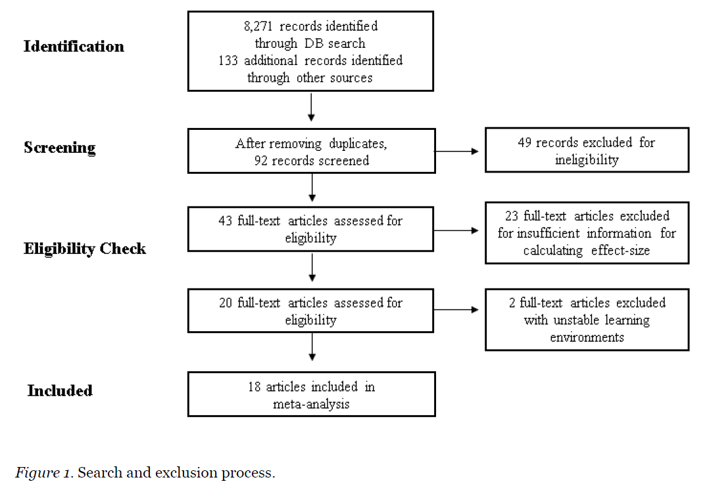
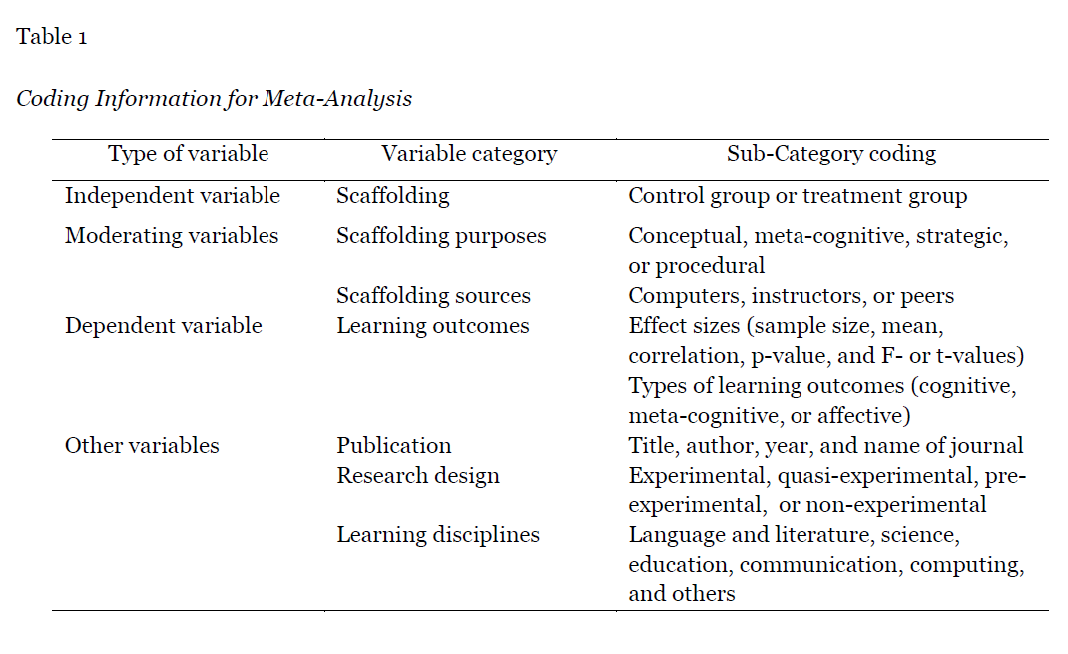
Methods
This meta-analysis included studies with 64 effect sizes from 18 journal articles published in English, in eight countries, from 2010 to 2019.

Slide 24
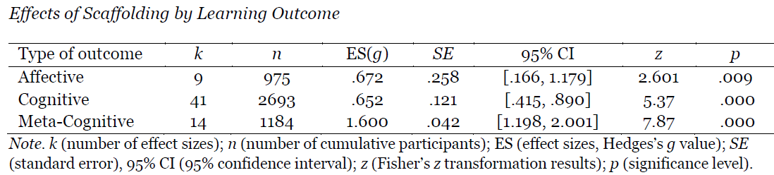
Results
The overall effect size
The overall effect size for the effects of scaffolding on learning outcomes:
g = .866 (95% CI: [.660, 1.072], p < .001, N = 64)
The results indicated that scaffolding produced better learning outcomes than those without scaffolding.
2. Learning outcomes
Cognitive domain (64.0%)
Affective domain (14.1%), and
meta-cognitive domain (21.9%).

Slide 25
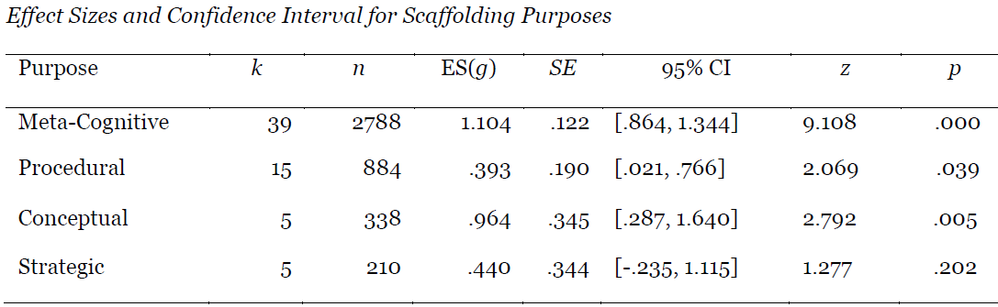
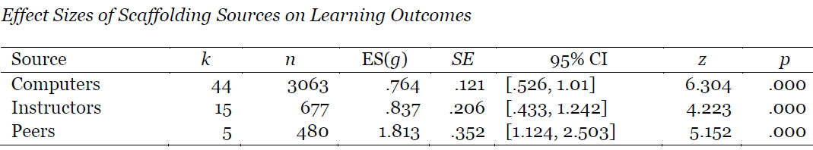
Results
3. Scaffolding purposes
Meta-cognitive scaffolding (60.9%),
procedural scaffolding (23.5%),
conceptual scaffolding (7.8%), and
strategic scaffolding (7.8%)
4. Scaffolding source
Computers or embedded systems (68.8%) outnumbered instructors (23.4%), peers (7.8%).
5. Scaffolding periods
From 80 minutes to 10 weeks (a wide range)

Slide 26
Discussion
Confirmed the effectiveness of scaffolding as an instructional strategy.
Large effect size (g = 0.866) compared to previous meta-analyses; perhaps since all were HE studies. (More higher-order thinking skills and self-regulation than K-12.)
The meta-cognitive domain yielded a larger effect size than did the affective and cognitive domains.

Slide 27
Discussion
The variety of studies included in this review indicate that educators are commonly embedding scaffolded support for learners across a wide spectrum of age groups and content areas. This meta-analysis adds to the support for these practices. Simply put, scaffolded instruction is beneficial, and the benefits seem to increase as learners age.

Slide 28
Limitations
A limited number of studies…only quantitative studies with sufficient information to calculate the effect sizes were eligible.
Setting the literature search to the years 2010 through 2019 limited the pool of relevant studies.

Slide 29
Future Trends and Research
Future research include scaffolding studies published in local languages.
Need to identify specific instructional approaches effective in online environments.
Scaffolding most adopted in the language and literature, but effect sizes were small to moderate. Scaffolding in computing, communications, and education were larger.
Need for research into how scaffolding is implemented in each learning discipline in online learning in HE.
Need to develop guidelines for effective scaffolding strategies & features in different disciplines.

Slide 30
Florence Martin, Albert Ritzhaupt and Carl Westine (Ting Sun is non-presenting author)

Slide 31
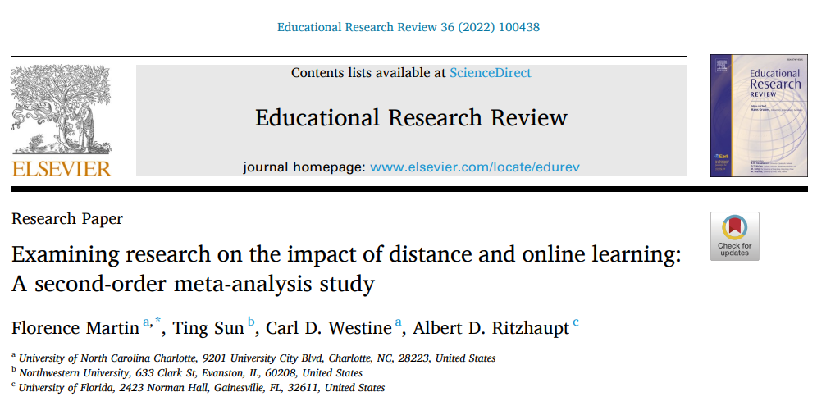
Examining research on the impact of distance and online learning: A second-order meta-analysis study

Slide 32
Background
An increase in distance learning resulted in a number of systematic reviews and meta-analyses (e.g., Camnalbur et al., 2013; Means et al., 2013; Rohwer et al. 2017).
Meta-analyses on distance learning often produced conflicting results so there is a need to conduct second-order meta-analyses to estimate overall average effect as well as the sources of its variation.
Second-order meta-analysis is an approach to summarize the effect of several meta-analyses on a similar topic (Schmidt & Oh, 2013; Tamim et al., 2011).

Slide 33
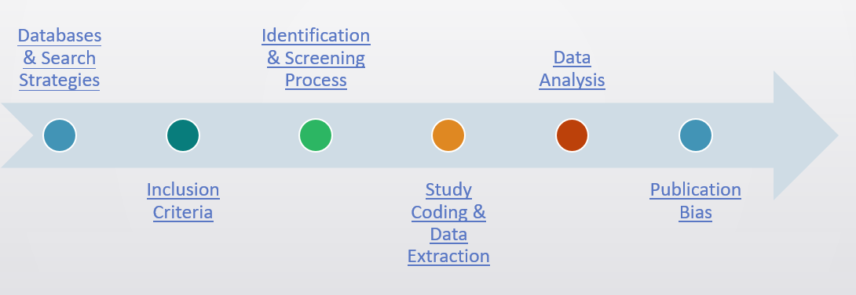
Methods

Slide 34
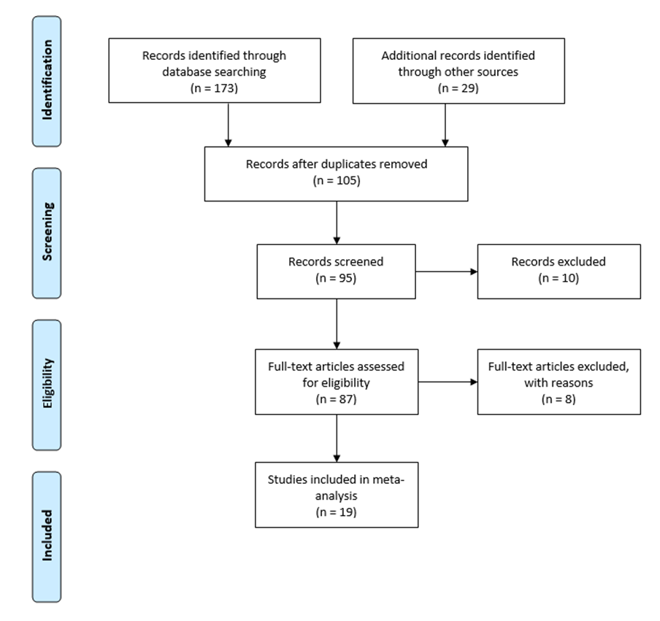
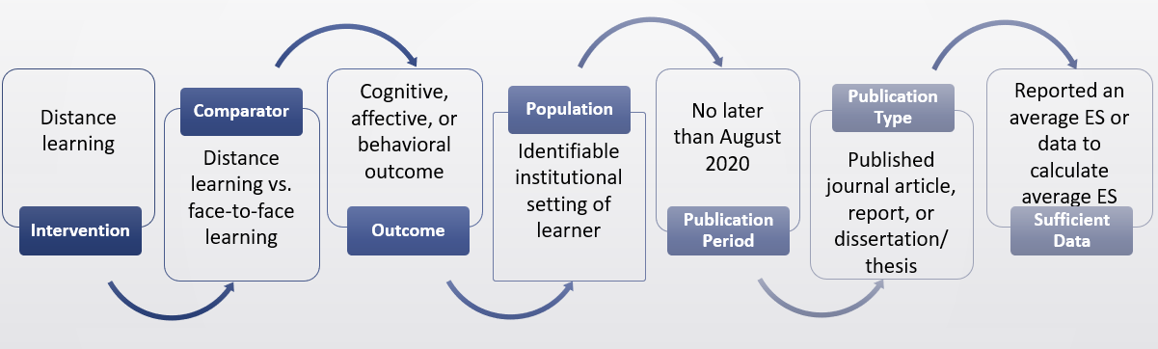
Methods

Slide 35
Results
•Summary Effect Size
•Hedges’ g = 0.156, p < .001
•SE=0.035, 95% CI: 0.087-0.224
•Heterogeneity Test
•Q-value = 600.516 (df = 25, p < .001)
•T^2= 0.021
•I^2 = 95.84%
19 meta analysis
841 primary studies
26 effect sizes

Slide 36
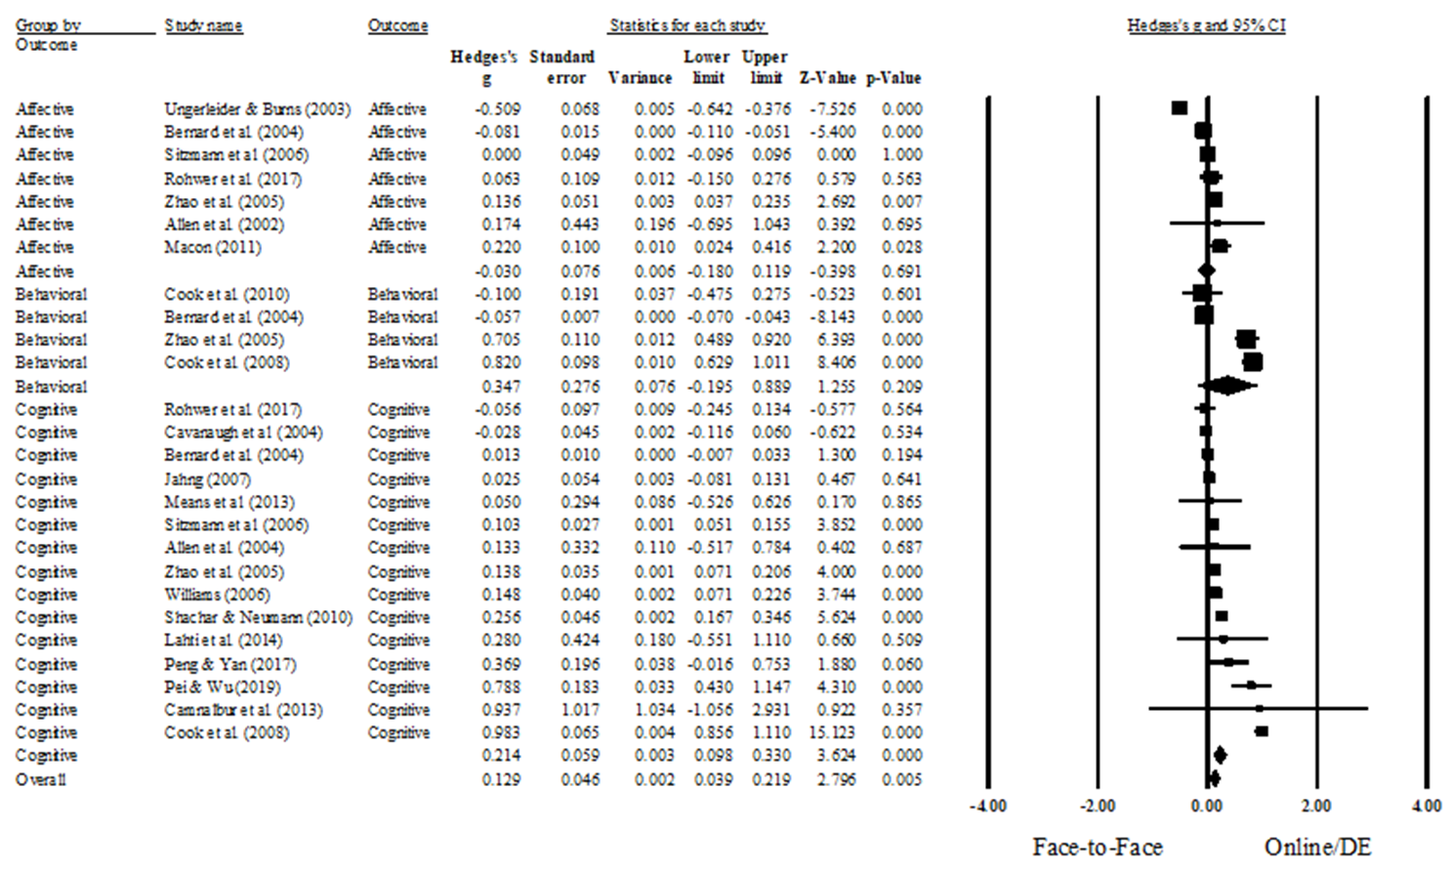

Slide 37
Results
•Distance Learning Generation Level:
•Did not moderate (Q-value = 0.760, p = 0.384)
•Instructional Setting:
•Higher education setting > K-12 setting (Q-value = 11.260, p = .001)
•Combination instructional setting > K-12 setting (Q = 7.555, p = .006)
•Methodological Quality:
•Did not moderate (Z = -0.04, p = .971)
19 meta analysis
841 primary studies
26 effect sizes

Slide 38
Discussion
Distance learning had a small but significantly positive effect on cognitive outcomes in comparison with face-to-face learning, but not on affective or behavioral outcomes.

Slide 39
Limitations
Included only 19 first-order meta-analyses.
Small number of studies in moderator analyses.

Slide 40
Future Trends and Research
Future authors are encouraged to account for different affordances and other pedagogical characteristics of distance/online learning environments in future meta-analytic works, which can have implications for both research and practice.

Slide 41
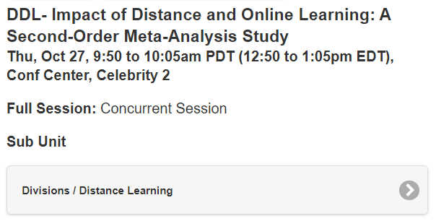
For More Details
Come see us on Thursday!

Slide 42
QA

Slide 43
Summary and Conclusion

