Slide 1

Analysis of Beyond Positive and Negative Emotions: Looking into the Role of Achievement Emotions in Discussion Forums of MOOCs by Wanli Xing, Hengtao Tang, & Bo Pei
Discussants:
Curtis J. Bonk
Meina Zhu
Indiana University
School of Education, IST INDIANA UNIVERSITY BLOOMINGTON

Slide 2
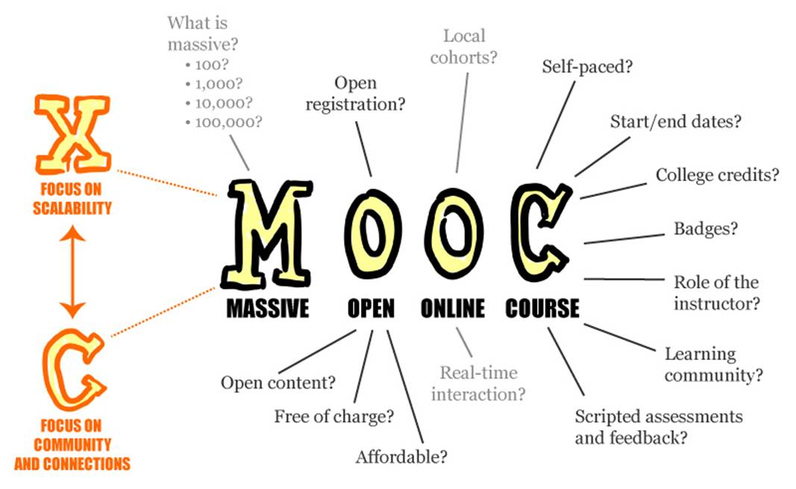

Slide 3

Recent MOOC Data

Slide 4
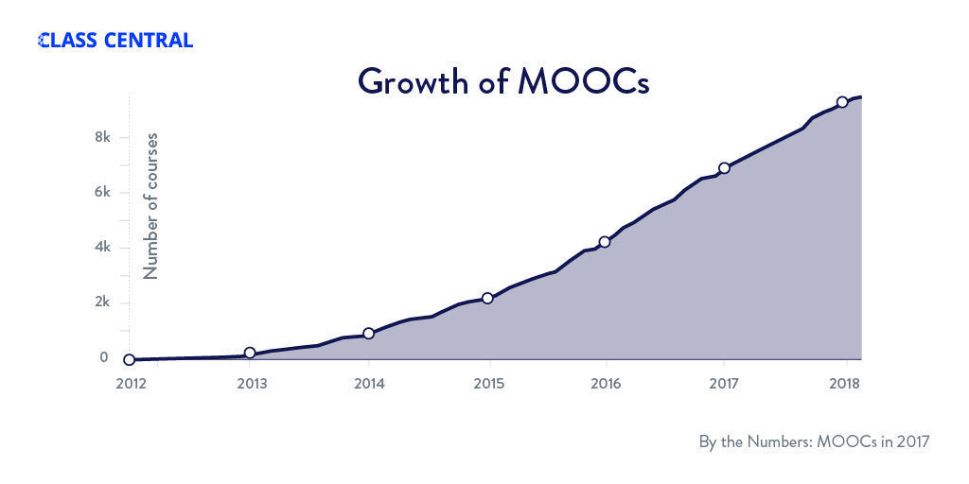
January 22, 2018
A Review of MOOCs Stats and Trends in 2017, Dhawal Shah, Class Central https://www.class-central.com/report/moocs-stats-and-trends-2017/

Slide 5
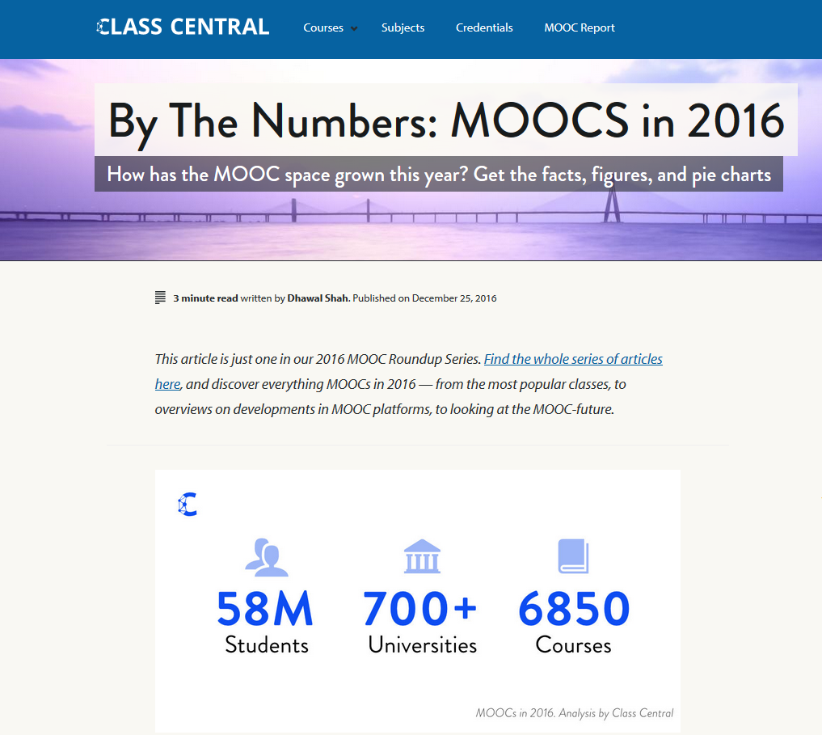

December 25, 2016
A Review of MOOCs Stats and Trends in 2016, Dhawal Shah, Class Central https://www.class-central.com/report/mooc-stats-2016/

Slide 6

January 22, 2018
A Review of MOOCs Stats and Trends in 2017, Dhawal Shah, Class Central https://www.class-central.com/report/moocs-stats-and-trends-2017/

Slide 7
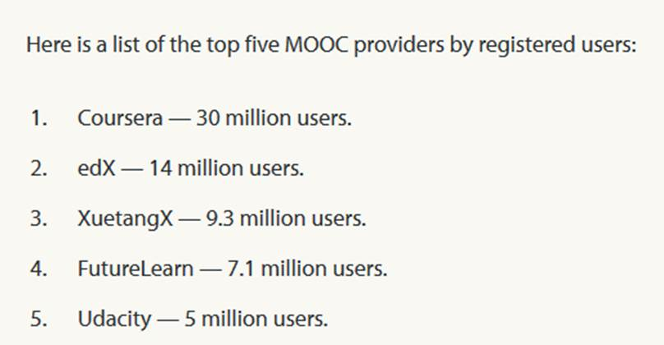
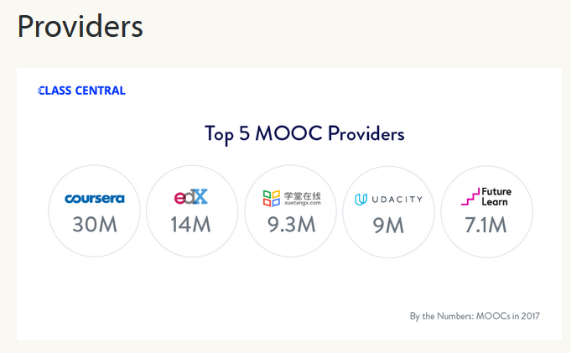


January 22, 2018
A Review of MOOCs Stats and Trends in 2017, Dhawal Shah, Class Central https://www.class-central.com/report/moocs-stats-and-trends-2017/

Slide 8
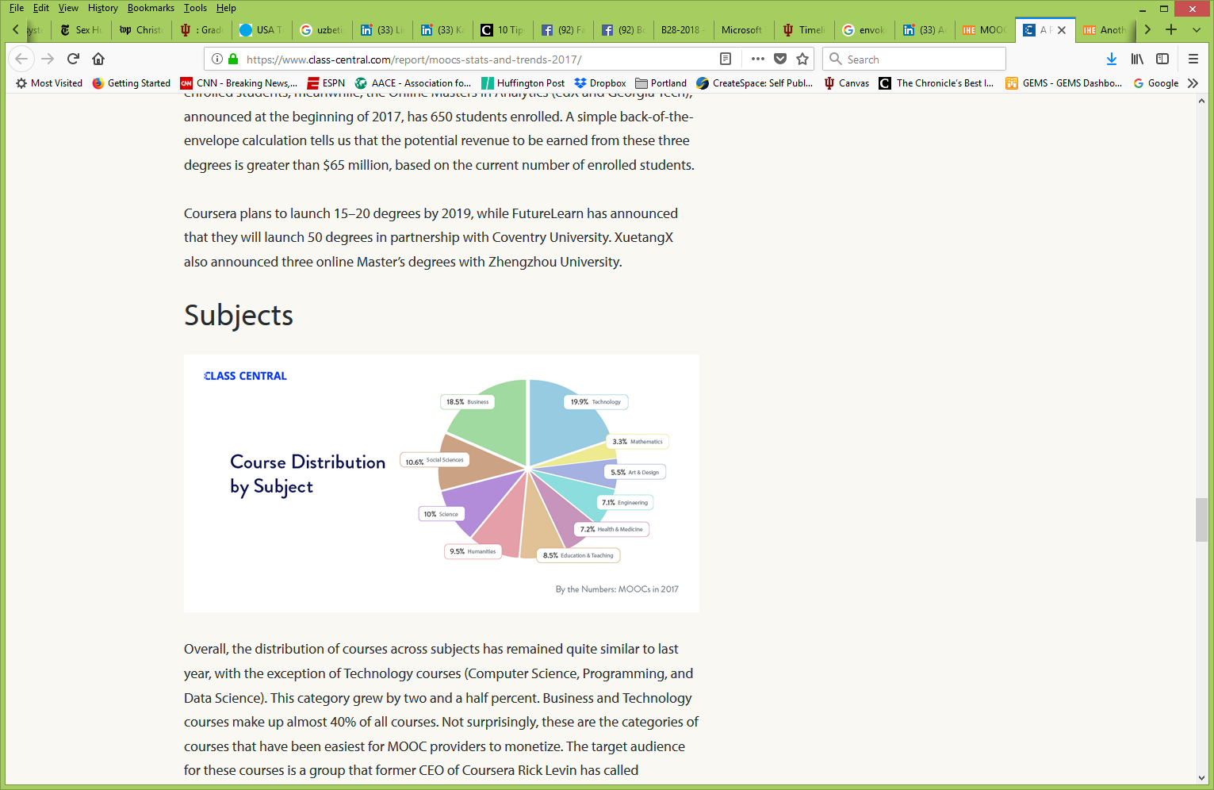
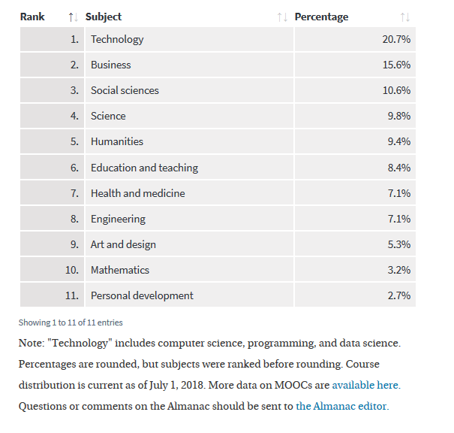

August 19, 2018
MOOC Course Distribution by Subject, 2011-18
Almanac 2018, Chronicle of Higher Education https://www.chronicle.com/article/MOOC-Course-Distribution-by/244091?cid=cp216

Slide 9

Email inbox: June 10, 2018 edX https://www.edx.org/course

Slide 10
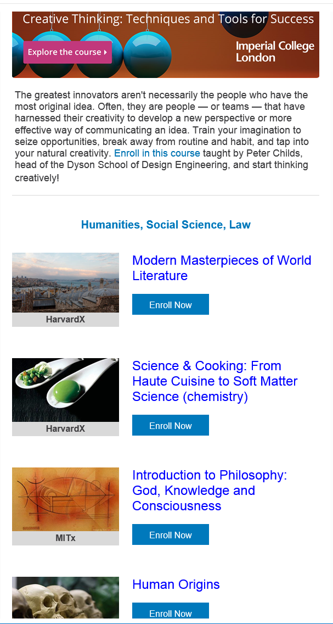
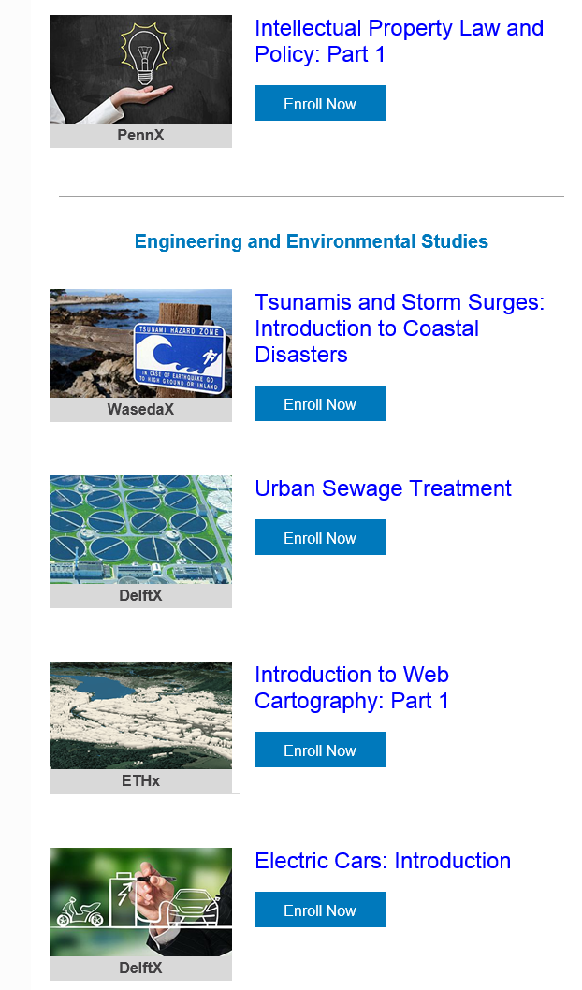

Email inbox: June 10, 2018 edX https://www.edx.org/course

Slide 11
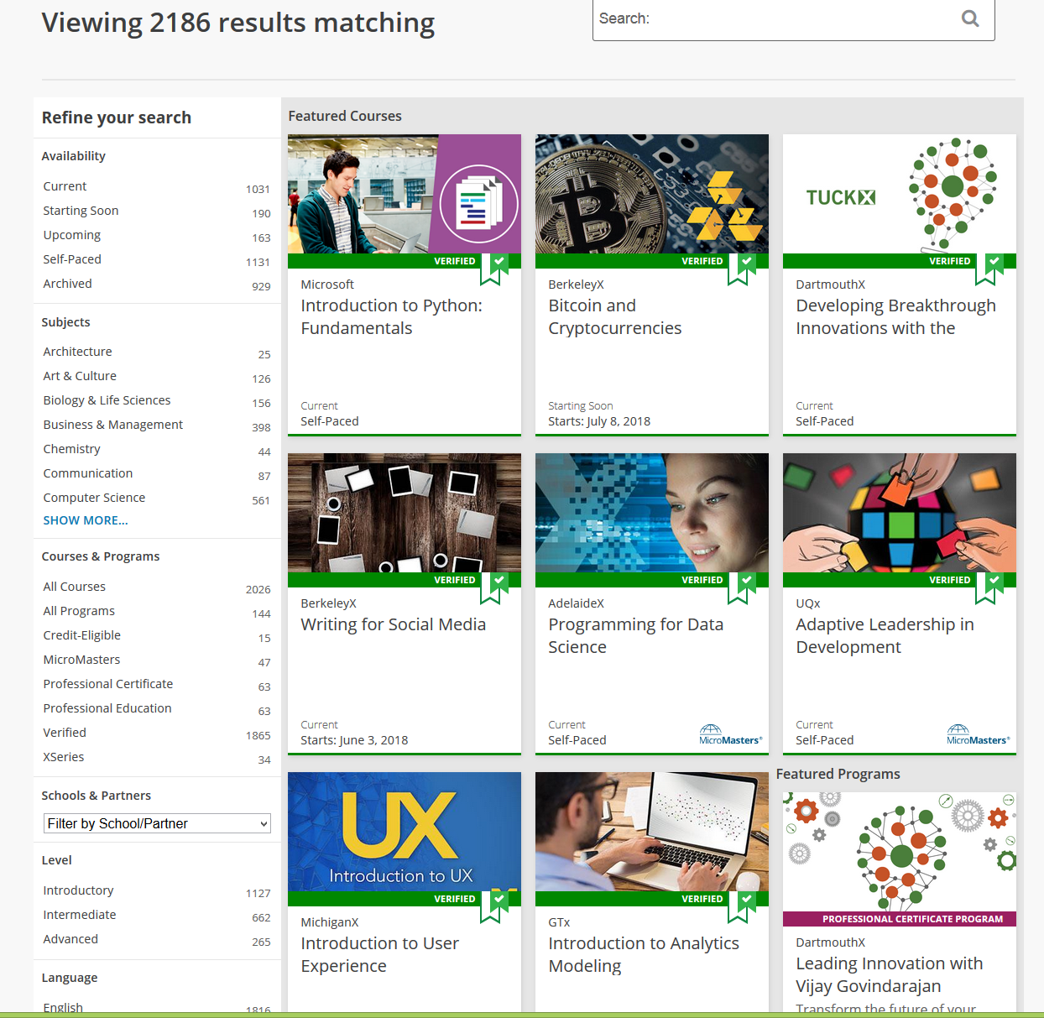

June 10, 2018 edX https://www.edx.org/course

Slide 12



Email inbox: June 11, 2018
Coursera https://www.coursera.org/

Slide 13


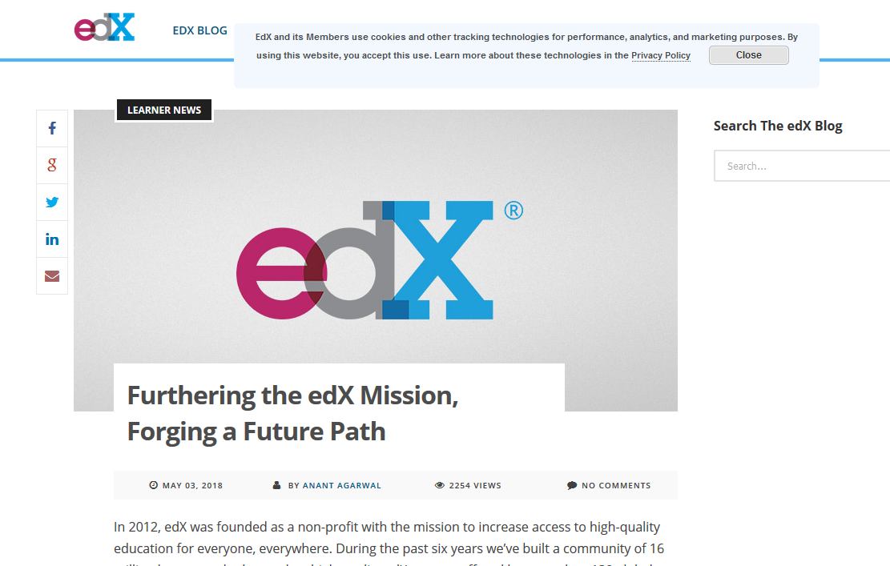
June 14, 2018
Free MOOCs Face the Music
Lindsay McKenzie, Inside Higher Ed https://www.insidehighered.com/news/2018/06/14/edx-introduces-support-fee-free-online-courses

Slide 14
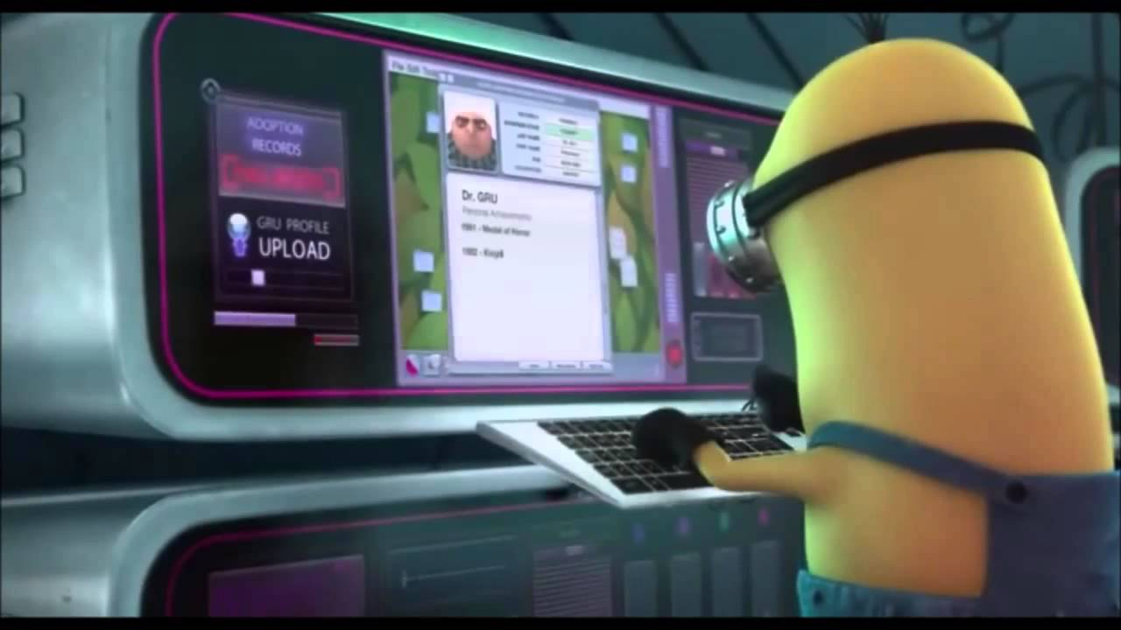
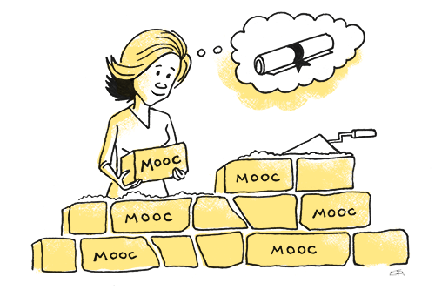

May 21, 2018
The Second Wave of MOOC Hype Is Here, and It’s Online Degrees
Dhawal Shah, Class Central https://www.edsurge.com/news/2018-05-21-the-second-wave-of-mooc-hype-is-here-and-it-s-online-degrees

Slide 15


September 12, 2018
Coursera's CEO on the Evolving Meaning of 'MOOC’
Dian Schaffhauser, Campus Technology https://campustechnology.com/articles/2018/09/12/courseras-ceo-on-the-evolving-meaning-of-mooc.aspx
Jeff Maggioncalda, Coursera CEO

Slide 16


Study Intro…

Slide 17


Are you happy or frustrated when you take a MOOC?

Slide 18


Analysis of: Beyond Positive and Negative Emotions:

Slide 19


Article Premise: Learning is an emotional experience

Slide 20

Who in here has emotions?

Slide 21
Theoretical Framework
  “The control-value theory of achievement emotions (Pekrun, 2006) provides an integrative framework to understand emotions in academic settings.” (p. 6)
  “The theory categorizes achievement emotions into four groups, namely positive activating, positive deactivating, negative activating, and negative deactivating emotions.” (p. 6)

Slide 22


April 24, 2018
Yes! Digital Learners are Emotional – Insights from the Irish 101 MOOC
Elaine Berne, Learning Bits, Bytes and Delights,
The Ideas Lab, National Institute for Digital Learning, Dublin City University https://nidl.blog/2018/04/24/yes-digital-learners-are-emotional-insights-from-the-irish-101-mooc/

Slide 23

Assumptions
  p. 7. “Achievement emotions hold the potential of reinforcing or undermining learning performance and commitment.”

Slide 24


Assumptions
  p. 14. “In this study, we examined how achievement emotions at a time point influenced the subsequent tendency of a student to drop out of the MOOC. Compared with standard regression models, survival analysis can estimate the truncated nature of time series data in a less biased manner (Yang et al, 2011).”

Slide 25

Positive Aspects of this Study

Slide 26
General Comments
  Clear research purpose
  Appropriate research methods
  Results were well presented
  Great discussion by connecting this study to previous studies.
  Good alignment in the entire study

Slide 27
General Comments
  Solid references in top tier journals
  Grounded in psychological literature
  Excellent overall flow to paper
  Important societal topic

Slide 28
Unique Perspectives
  This work focused on exploring achievement emotions and their complex impact on student dropouts in MOOCs.
  Use machine learning to analyze MOOC discussion forum data.
  A survival modeling technique was used to quantify the effect of different achievement emotions on student attrition longitudinally.

Slide 29

Issues and Concerns

Slide 30

Some Little Things…
  Check for typos and grammar.
  Make Figure 1a and Figure 1b separate figures and larger size.
  Check APA in a few of the references.

Slide 31

Clarify Sentence
  “MOOCs can enable thousands of students to take courses at their convenience without cost.” (p. 2)
  -Perhaps add “without cost or low cost”
  -Add citation of this sentence.

Slide 32

Initial MOOC Enrollment?
  p. 10-11
  “2,084 active forums users who posted at least once in the course forum and 13,513 posts.”

Slide 33

What is meant by “Accurate”…How can you be sure it is accurate?
  Abstract:
  “Specifically, we first built an accurate machine learning model to automatically detect the achievement emotions in the forum posts. Then survival analysis was used to quantify the influence of achievement emotions on student dropout.”

Slide 34
Who is “Us”…
  p. 3
  “This suggests that there are students struggling to stay involved. Understanding the participation of struggling students as they struggle and ultimately quit the course can help us find potential ways to provide appropriate intervention and scaffolds to support them.”

Slide 35
Clarify Concepts
  “Many studies explored the relationship between students’ behavioral patterns and MOOC dropouts using the summative measure (e.g., Alraimi, Zo, & Ciganek, 2015). “ (p. 5)
  --Maybe the authors can define the meaning of “drop out” in this study.
  --It would be great if you also provide some detailed examples about this study

Slide 36
Clarify Concepts
  “Nevertheless, these models are usually based on behavioral engagement patterns, and therefore, they have limitations in suggesting pedagogically sound intervention designs. “ (p. 5)
  -What is difference between what you mentioned above and the current study?

Slide 37

Citation
  “Positive activating emotions include enjoyment, hope, and pride. Learners with positive activating emotions are dedicated to the learning activities with positive appraisal of the activities and outcomes. “ (p. 6)
  -Is this from your definition or other papers? If the latter, you might want to cite the paper.

Slide 38
Clarify Concepts
  “For example, Daniels et al. (2009) insisted positive activating emotions (e.g., hope, enjoyment) were indicators of positive valence and agency of the goals and are thus negatively related to dropout rates“ (p. 7)
  -You may want to clarify whether this is in face to face course or online course.

Slide 39
Clarify Concepts
  “Exposed Emotion (four variables): It was calculated by the total number of posts in the threads initiated by the student falling into certain achievement emotions divided by the number of weeks the student initiated a discussion. “ (p. 7)
  -We could not quite understand this one. You may give some examples

Slide 40
Confusing Terms
(Perhaps create a term table…)
  p. 6-7
  Positive activating emotions (e.g., hope, joy, pride)
  Positive deactivating emotions (e.g., relaxation, relief)
  Negative activating emotions (e.g., anger, shame, anxiety)
  Negative deactivating emotions (e.g., boredom, hopelessness)

Slide 41
Confusing and Complex
(do you have an example?)
  p. 8
  “The emotional contagion transfers the affective signals to peers in a shared social setting, and these transferred signals do not only influence the emotional states of peers, but also their cognition, attitudes, and behaviors, as well as the dynamics of the social setting (Barsade, 2002).”

Slide 42
Confusing and Complex
(can we catch a cold cold?)
  p. 8
  “In addition, Hancock et al. (2008) reported that emotional contagion also takes place in text-based computer-mediated communication. That is, achievement emotions emerging from the texts in the forums are also contagious to peers. Furthermore, Barsade (2002) hypothesized that the mechanism for emotional contagion differs by the valence (i.e., positive or negative) of emotions.”

Slide 43
Confusing and Complex
(restate in English…)
  p. 15
Dependent Variable
“Dropout: A student was considered a dropout from the MOOC forum if the student had no activities in the discussion forum. Therefore, student dropout was a binary variable, a true variable if a student has forum activity in the last week, and a false variable otherwise.”

Slide 44

Confusing and Complex
(restate perhaps with an example)
  p. 18
“Since all the variables were standardized in this study, the hazard rate predicted the change of the probability of whether a student left MOOC forums when there was a unit increase in the number of these eight independent variables. Table 5 and Figure 2 show the survival analysis results.”

Slide 45
Confusing and Complex
(give examples)
  p. 18
“Specifically, students expressed positive deactivating emotions one standard deviation more than the average were 50.8% (100% * (1.508 - 1)) more likely to quit the course. The dropout probability for students expressing negative activating emotions was even higher (75.9%) than those who expressed deactivating emotions. Students’ expressed positive activating emotions and negative deactivating emotions had no influence on students’ survival time in the course.”

Slide 46
Confusing and Complex
(ok…so what does this mean? Can a MOOC instructor interpret this?)
  p. 20
“…third, only the exposure to deactivating emotions is positively related to learner survival; especially, the exposure to positive deactivating emotions is the largest positive contributor to learner survival;…”

Slide 47
Confusing and Complex
(and…so what does this mean?)
  p. 21
“…; fourth, surprisingly, neither the students’ expressed nor exposed positive activation has any effect on student survival in the course.”

Slide 48
Confusing and Complex
(If two negatives makes a positive, what do three negatives make?)
  p. 21
“In addition, students expressed negative activating emotions and also the exposures to these emotions are negatively related to learner retention, but the exposures to negative activating emotions have the larger influences on the dropout. Our take-away message from this finding adds to the discussion about the power of different types of emotions during the course of emotional contagions.”

Slide 49
Confusing and Complex
(Say what?)
  p. 21
“The influence of exposures to negative activating emotions is larger than the exposures to any of these two deactivating emotions. So, activation/arousal might be another sector for researchers to determine the power of different types of emotions in contagions.”

Slide 50

Limitations and Future Directions

Slide 51
Limitations…
  “This study just focuses on students who have posted on the forum. Therefore, it might overlook the students who are lurkers, just reading and continuously participating in the MOOC forums.” (p. 24)
  -It is great that the authors pointed out this limitation as most of the learners might watch all the videos without participating any discussion.

Slide 52
Future Research Might Explore…
“Future studies can conduct interviews and surveys with students to examine why they stay or leave the course.” (P24)
“Investigate emotions in multiple MOOCs with diverse subjects to determine the generalizability of the findings.” (P24)
Combine both discussion forum data and student log data to predict student drop out rate.

Slide 53

Future Research Might Explore…
Future studies might compare content areas or disciplines.
Future studies might explore MOOCs of different lengths for indicators of positive and negative emotions.
Future studies might ask students to retrospectively analyze their own data.

Slide 54


Curtis J. Bonk, IU, cjbonk@indiana.edu
Meina Zhu, IU, meinzhu@iu.edu

