Slide 1

MOOC Instructor Research: Motivations, Considerations, and Personalizations in the Design of Instruction for the Masses
Curtis J. Bonk
Indiana University
cjbonk@Indiana.edu
School of Education, IST INDIANA UNIVERSITY BLOOMINGTON

Slide 2


Poll #1: Who in here has taken a MOOC?
Poll #2: Are you happy or frustrated when you take a MOOC?

Slide 3
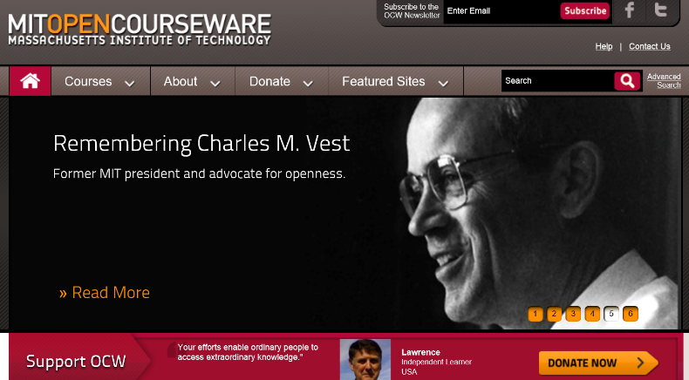


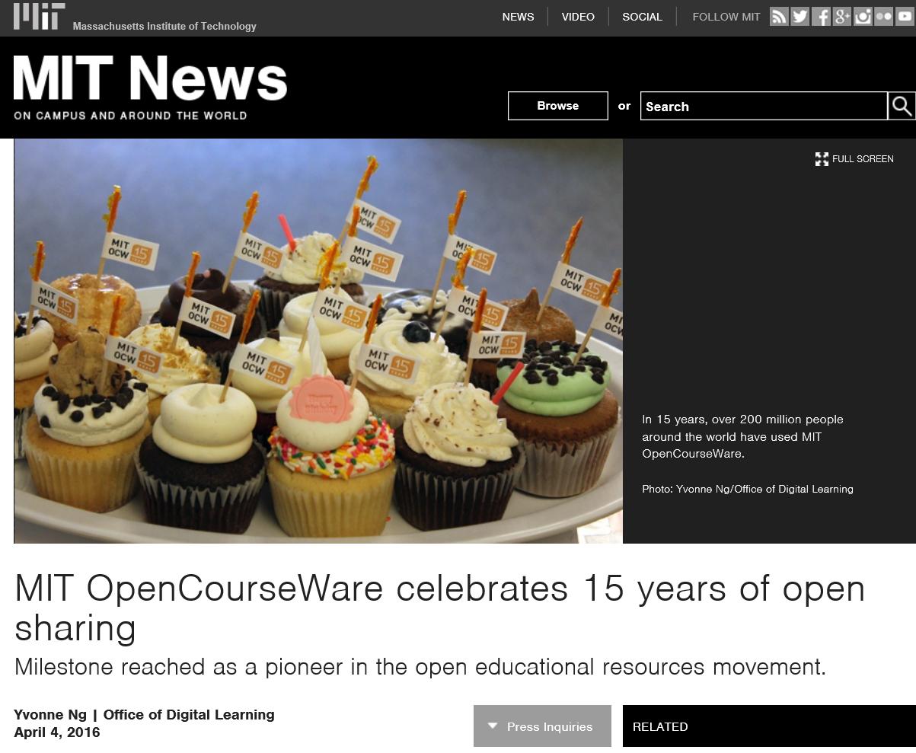

The World of Open Education

Slide 4
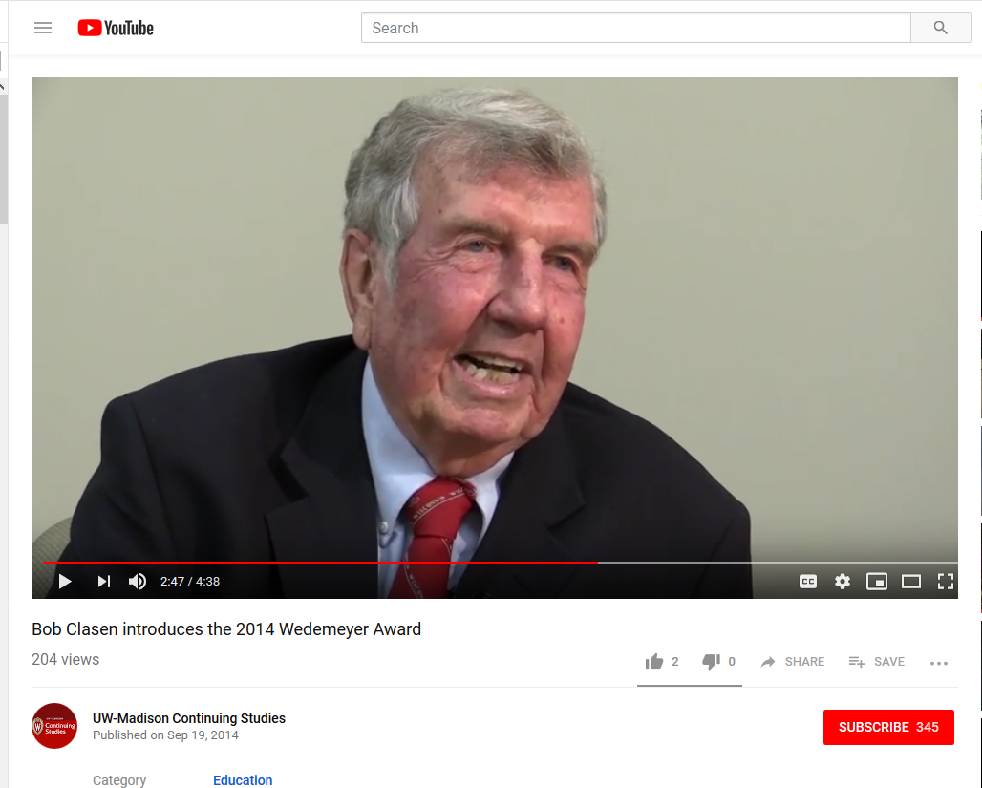

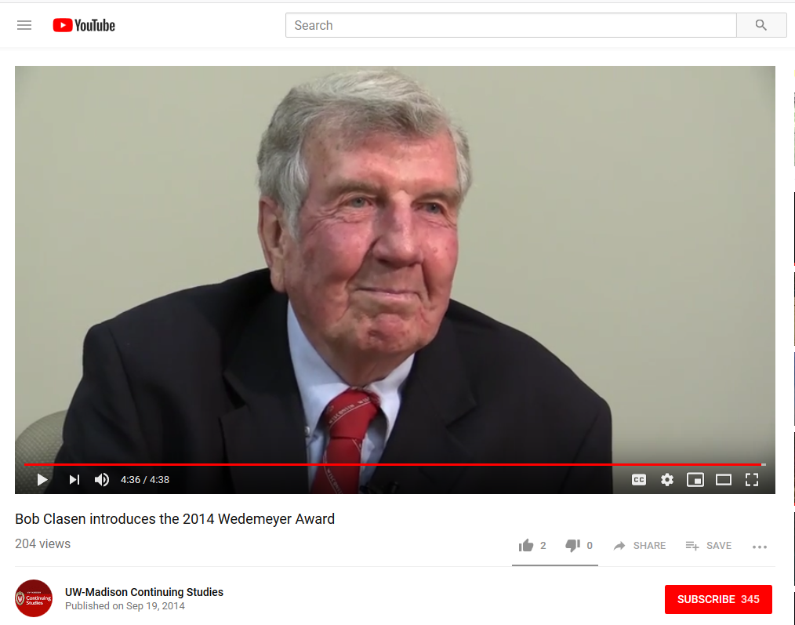
September 19, 2014
Story #1…I am a product of distance learning…
Bob Clasen, University of Wisconsin https://www.youtube.com/watch?v=kCm1_MGaqec&feature=youtu.be
February 27, 1934-March 17, 2018 https://www.cressfuneralservice.com/obituary/249139/Robert-Clasen/

Slide 5
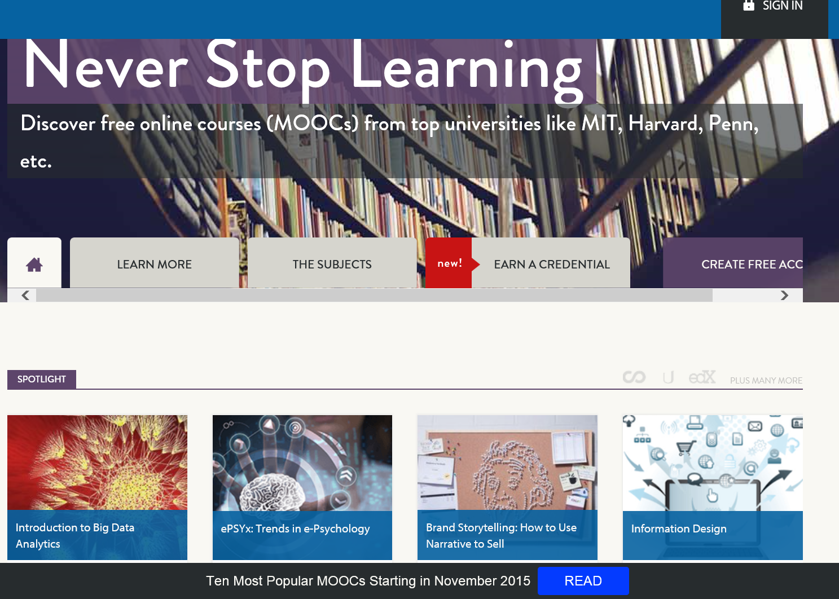



Some Weird Things Going On…

Slide 6
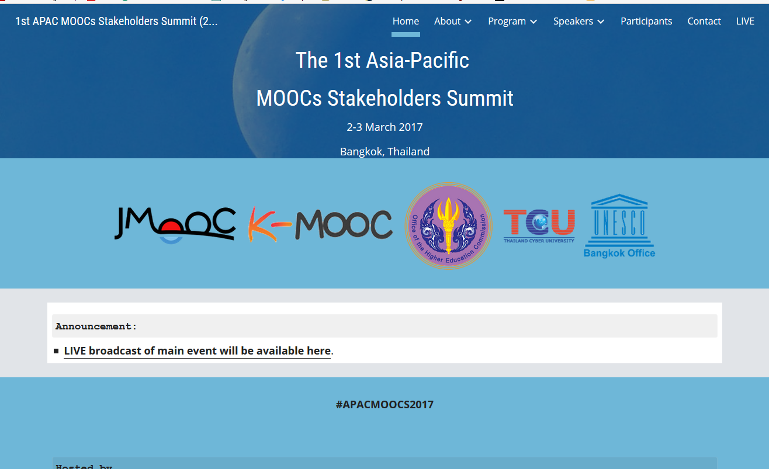

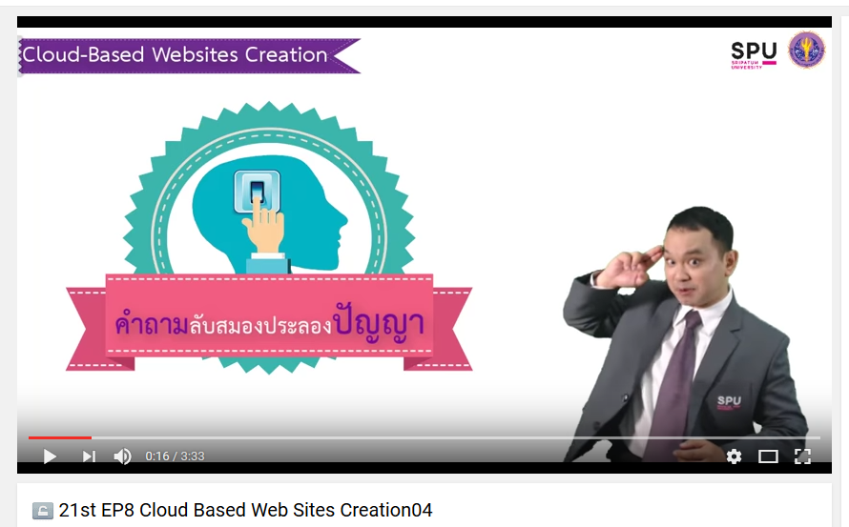

Weirdness #1…
June 15, 2017
Massive List of MOOC Providers Around The World, Class Central
JMOOC, K-MOOC, and T-MOOC? https://www.class-central.com/report/mooc-providers-list/

Slide 7

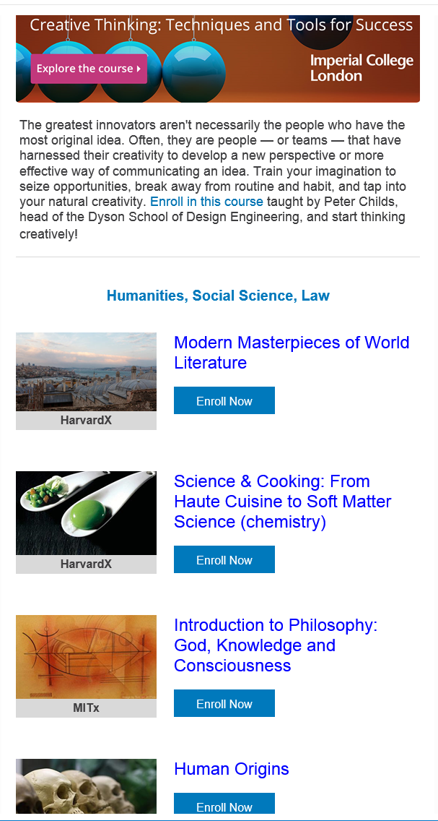
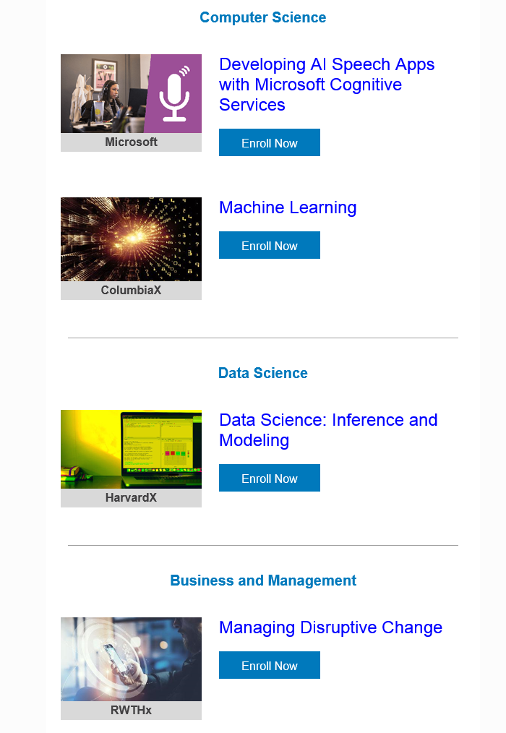
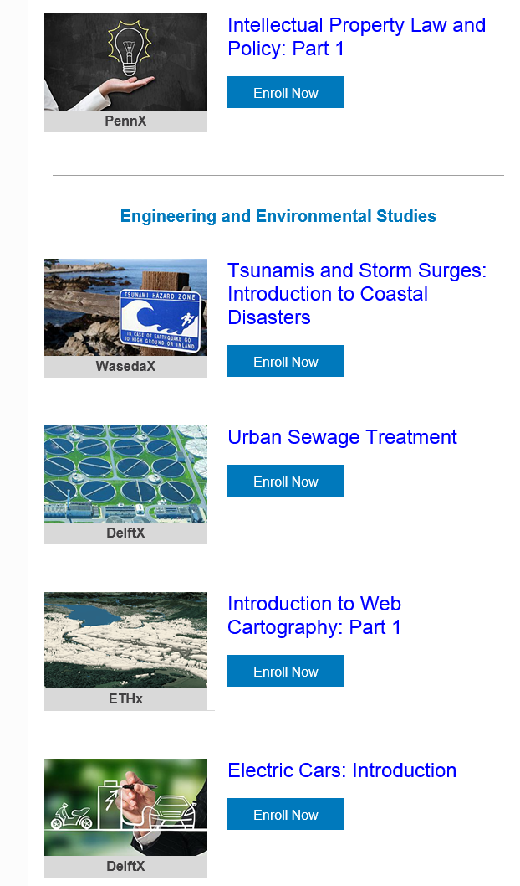
Weirdness #2…
Email inbox: June 10, 2018 edX (Summer discounts) https://www.edx.org/course

Slide 8

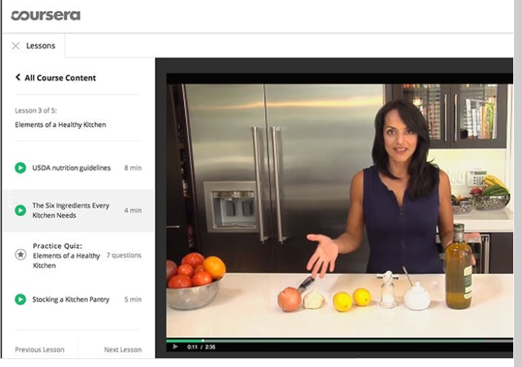
Weirdness #3…
Email inbox: June 11, 2018
Coursera https://www.coursera.org/

Slide 9



Weirdness #4…
September 26, 2018
The Future of Professional Credentialing ... in an Engagement Announcement
Joshua Kim, Inside Higher Ed https://www.insidehighered.com/digital-learning/blogs/technology-and-learning/future-professional-credentialing-engagement

Slide 10

Weirdness #5…April 20, 2015
250 MOOCs and Counting: One Man’s Educational Journey, Chronicle of Higher Education http://chronicle.com/article/250-MOOCsCounting-One/229397/?cid=at
If the MOOC movement has faded, nobody told Jima Ngei. Mr. Ngei, who lives in Port Harcourt, Nigeria, has completed and passed 250.
Jima Ngei: “I had this unrelenting fear that this miracle of free access might evaporate soon.”

Slide 11

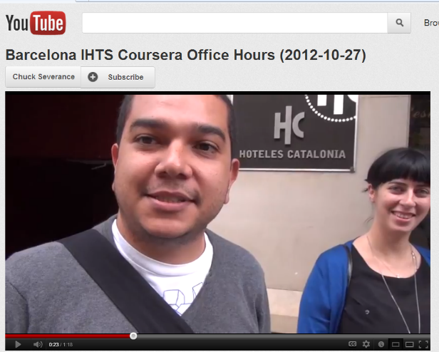
Weirdness #6…Chapter 15: Learning about MOOCs by Talking to Students
Charles Severance, University of Michigan
Figure 3. Internet History, Technology, and Security on the Coursera Platform.

Slide 12


Weirdness #7…October, 2018
Teaching the World
Sarah Fister Gale, CLO https://magazine.clomedia.com/issue/october-2018/teaching-the-world/ https://magazine.clomedia.com/issue/october-2018/

Slide 13
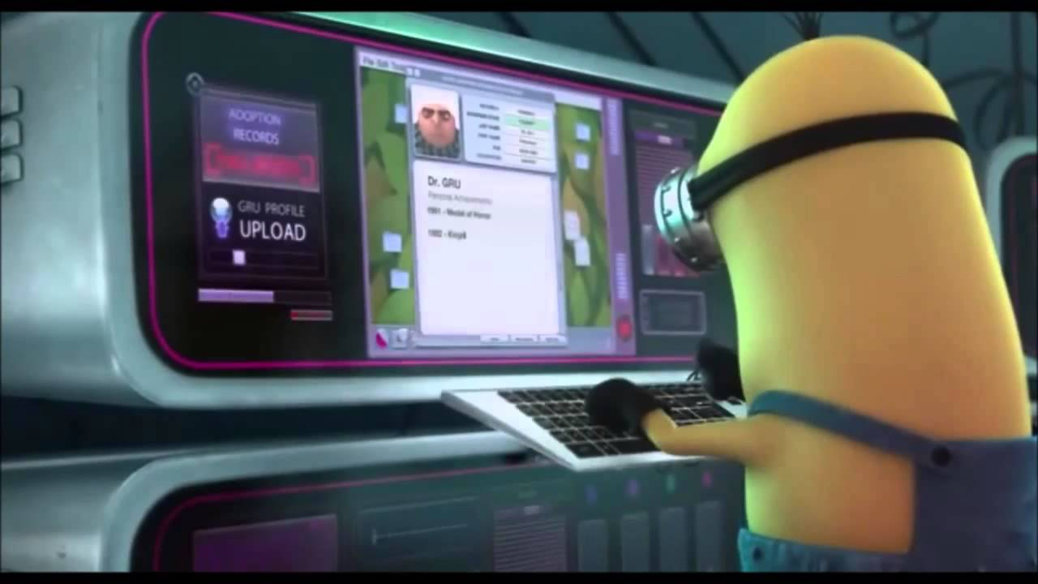
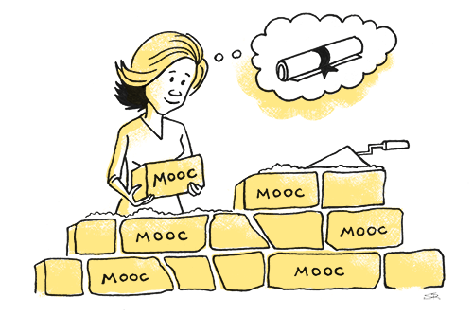

Weirdness #8…(MOOCs are not dead!)
May 21, 2018
The Second Wave of MOOC Hype Is Here, and It’s Online Degrees
Dhawal Shah, Class Central https://www.edsurge.com/news/2018-05-21-the-second-wave-of-mooc-hype-is-here-and-it-s-online-degrees

Slide 14
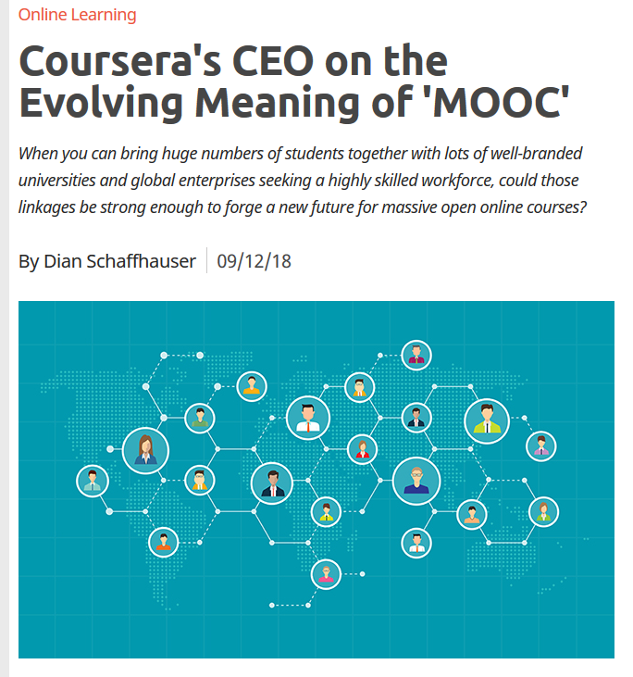

September 12, 2018
Coursera's CEO on the Evolving Meaning of 'MOOC’
Dian Schaffhauser, Campus Technology https://campustechnology.com/articles/2018/09/12/courseras-ceo-on-the-evolving-meaning-of-mooc.aspx
Jeff Maggioncalda, Coursera CEO

Slide 15
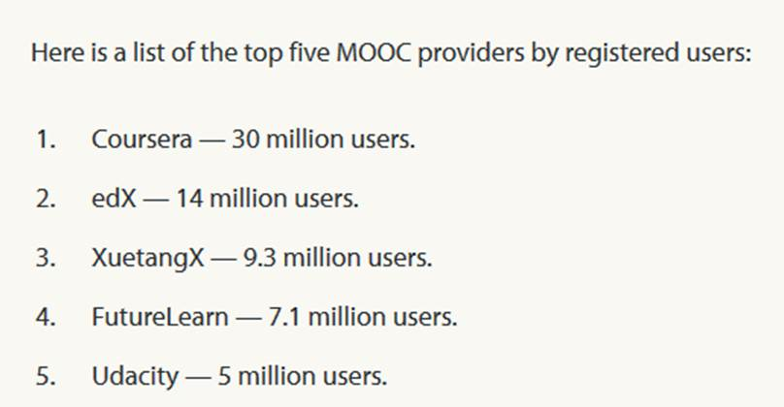
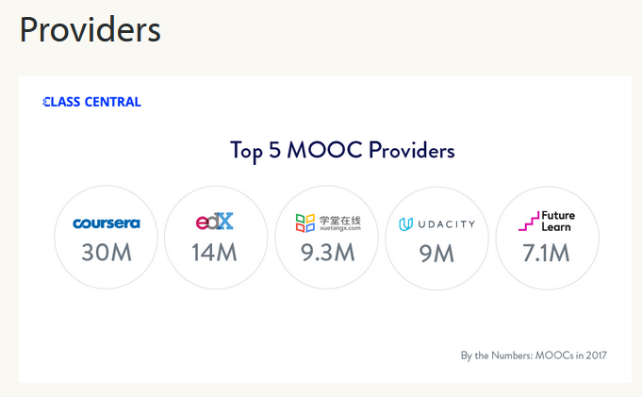


Weirdness #9…January 22, 2018
A Review of MOOCs Stats and Trends in 2017, Dhawal Shah, Class Central https://www.class-central.com/report/moocs-stats-and-trends-2017/

Slide 16
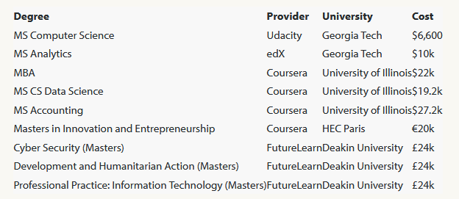
Weirdness #10…August 7, 2017
FutureLearn and Coventry University to Roll Out 50 Online Degrees (Last year Deakin University announced a similar partnership with FutureLearn)
Class Central, Dhawal Shah https://www.class-central.com/report/futurelearn-coventry-university-roll-50-online-degrees/

Slide 17

MOOC Trends and Recent Data

Slide 18
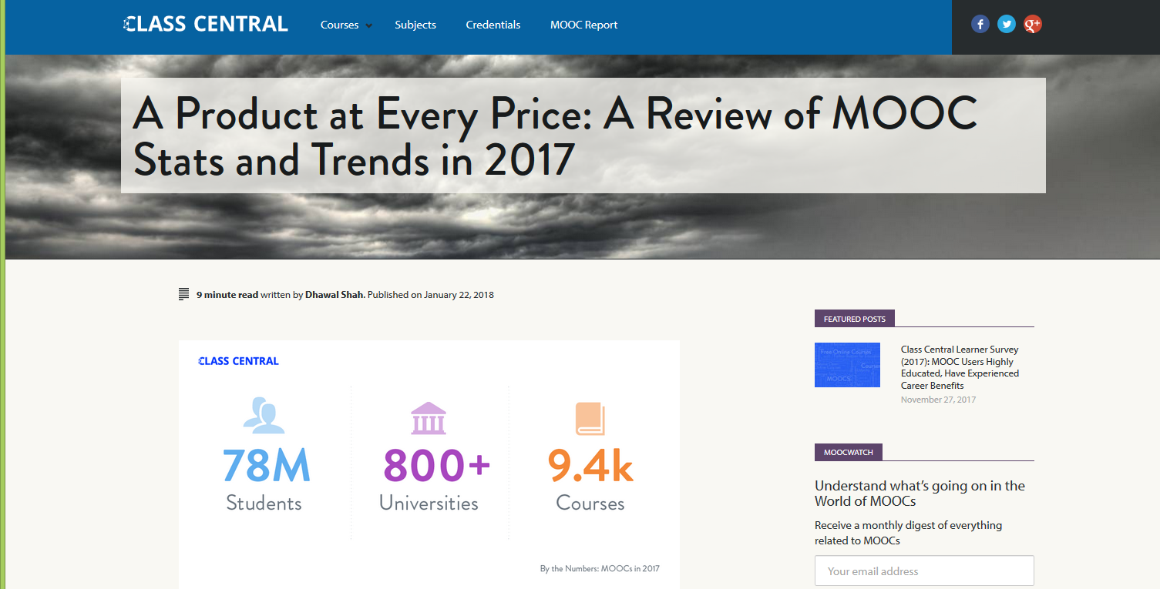
January 22, 2018
A Review of MOOCs Stats and Trends in 2017, Dhawal Shah, Class Central https://www.class-central.com/report/moocs-stats-and-trends-2017/

Slide 19

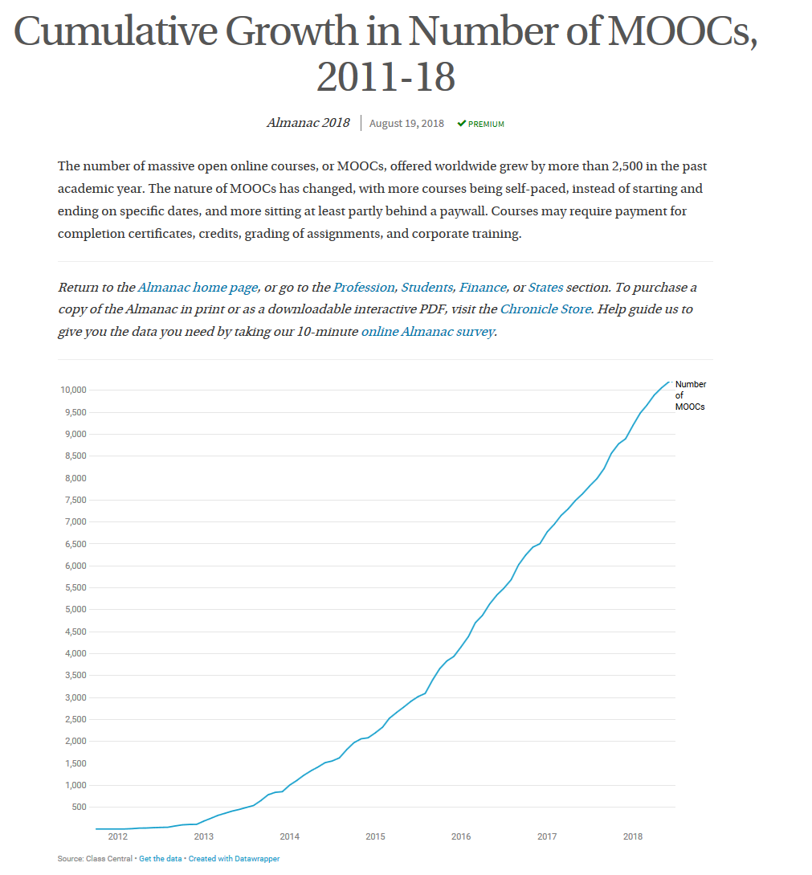
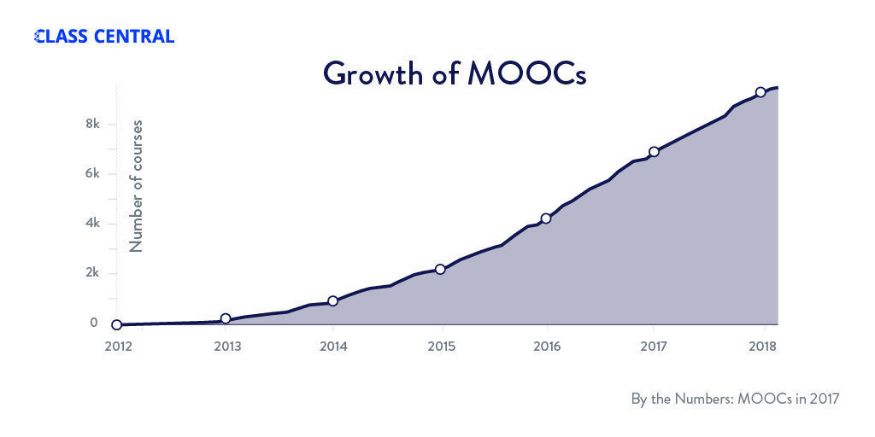
August 19, 2018
Cumulative Growth in Number of MOOCs, 2011-18
Almanac 2018, Chronicle of Higher Education https://www.chronicle.com/article/Top-5-MOOC-Providers-by-Number/244090?cid=cp216

Slide 20
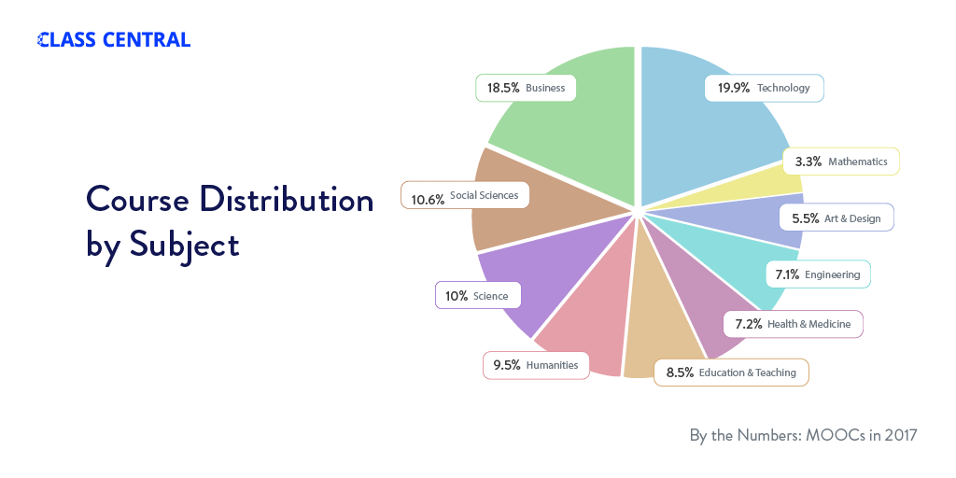
Subject areas (January 22, 2018)

Slide 21
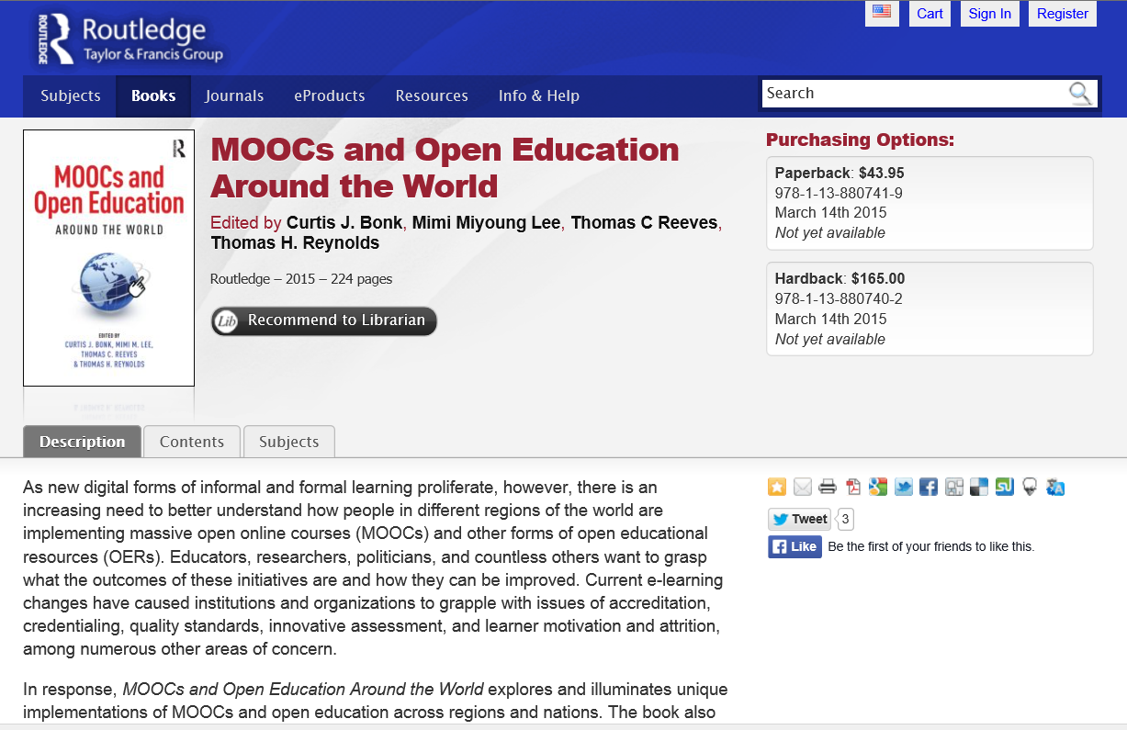






MOOCs and Open Education Around the World (2015) http://moocsbook.com/

Slide 22

Chapter 1: The MOOC Misstep and the Open Education Infrastructure
David Wiley, Co-founder and Chief Academic Officer, Lumen Learning
The Open Education Infrastructure
Open Credentials
Open Assessments
Open Educational Resources
Open Competencies

Slide 23


Chapter 8: MOOCs Downunder:
Insights from the Open2Study Experience
Maggie Hartnett, Mark Brown, and Amy Wilson
Massey University, Dublin City University, and Massey University
Figure 3: Example of the Indigenous Studies subject

Slide 24

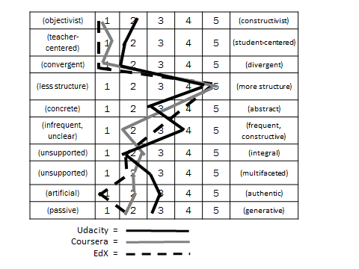
Chapter 10: MOOC Pedagogy
AMP: A Tool for Characterizing the Pedagogical Approaches of MOOCs
Karen Swan, Scott Day, Leonard Bogle, and Traci van Prooyen
University of Illinois Springfield
Figure 3. Ratings Metaphors

Slide 25
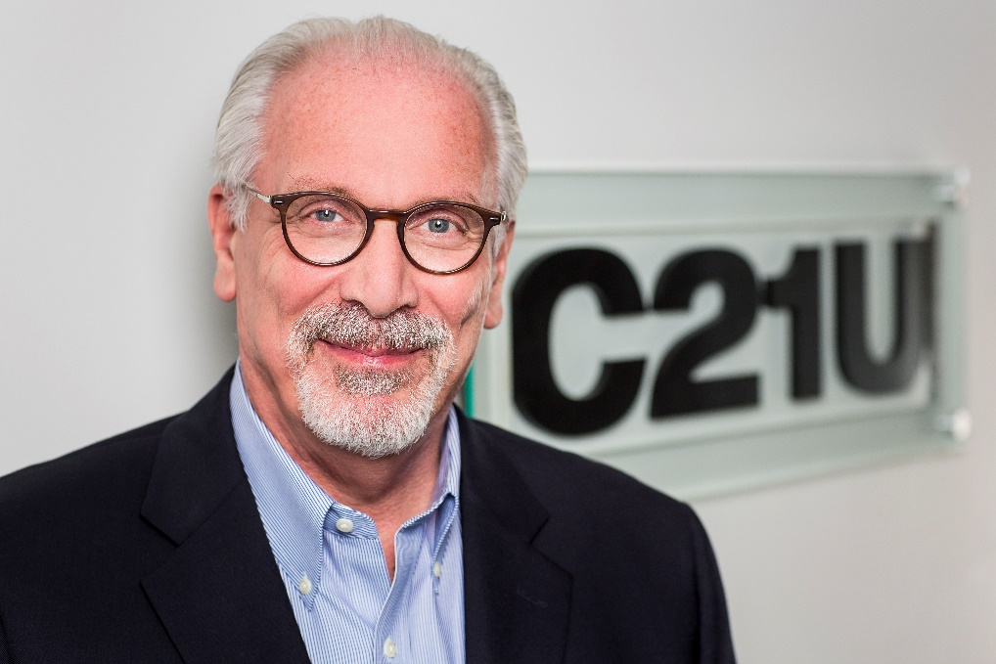
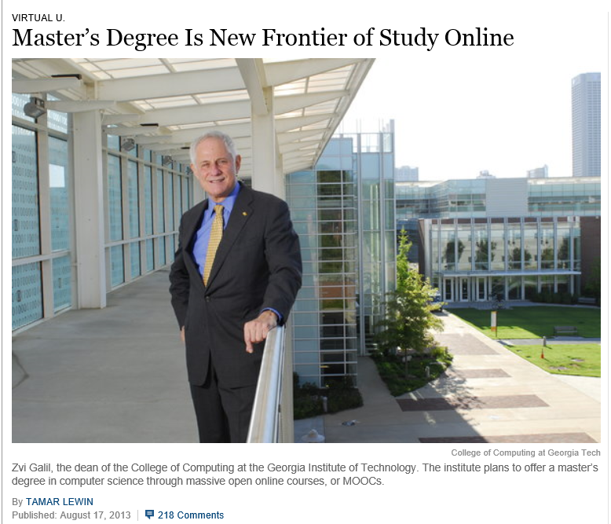
Chapter 13: Unbundling Higher Education and the Georgia Tech Online MS in Computer Science: A Chronicle
Richard DeMillo

Slide 26


Chapter 14: Creating a Temporary Spontaneous Mini-Ecosystem through a MOOC
Paul Kim and Charlie Chung, Stanford University
Figure 2. Twitter thread announcing the MOOC

Slide 27

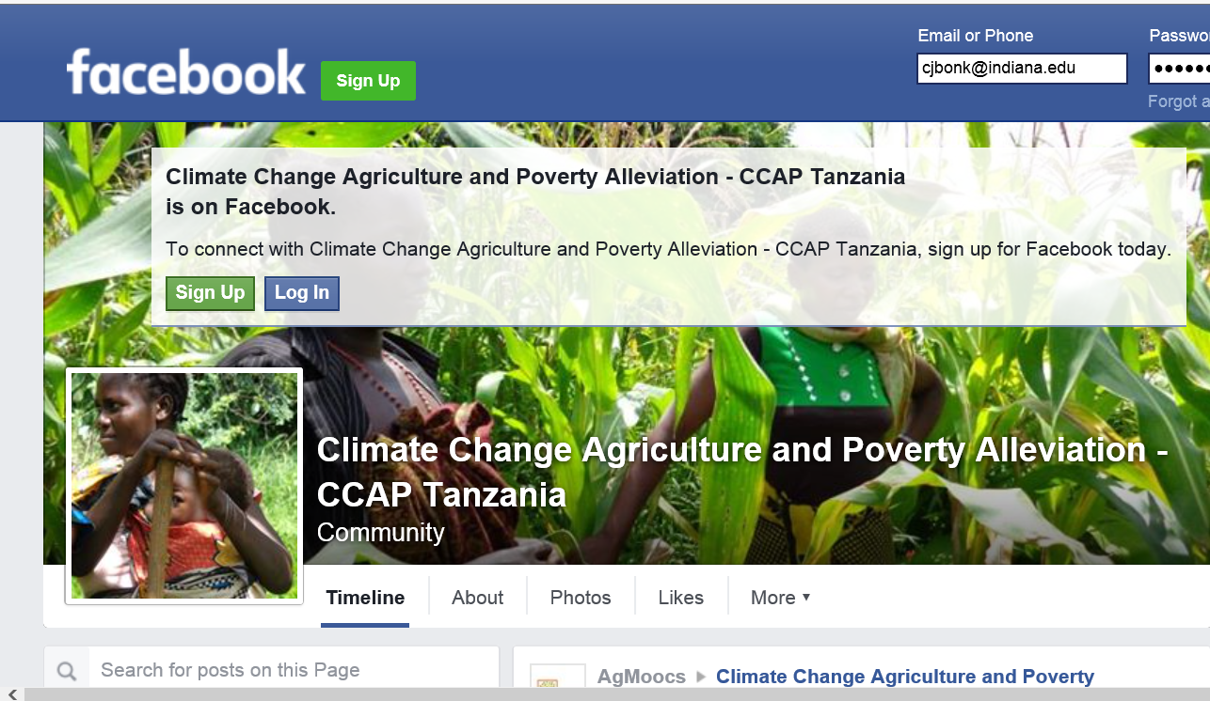

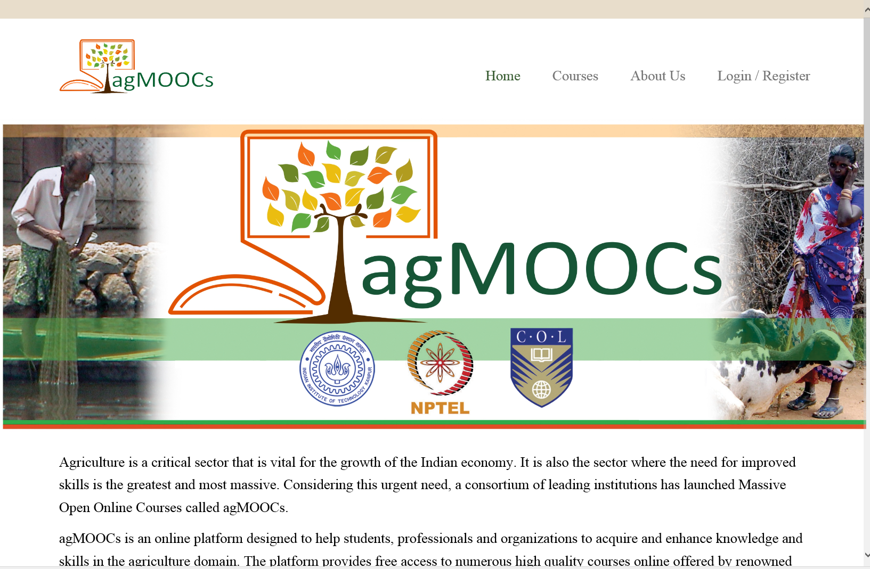
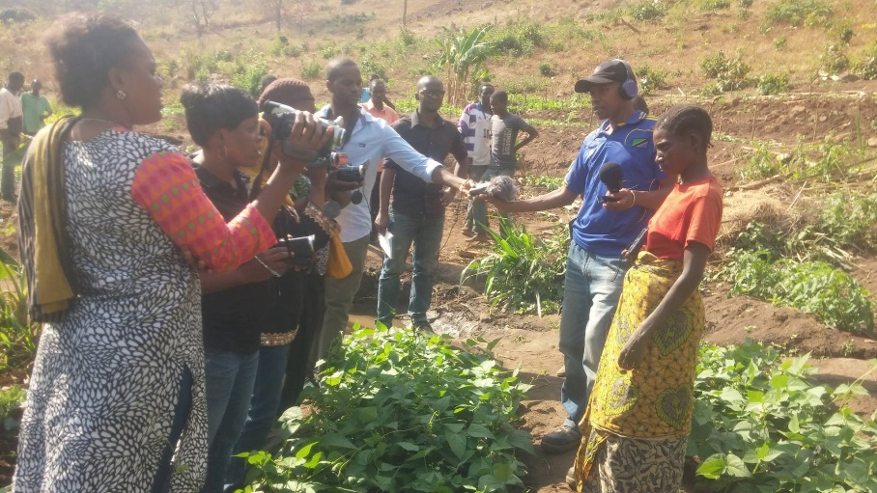
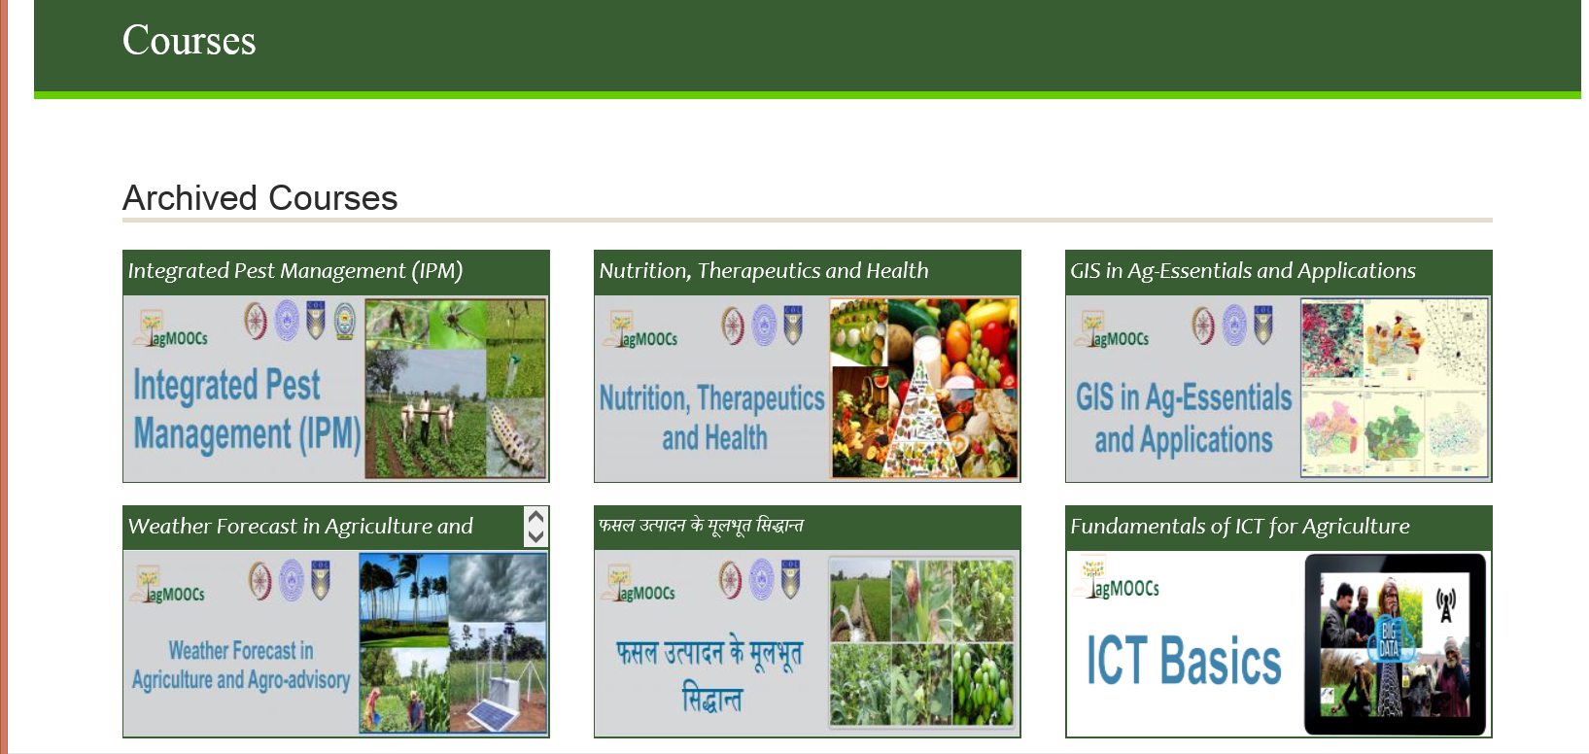
May 20, 2016
Chapter 18: COL
Balaji Venkataraman (agMOOCs in India) http://www.agmoocs.in/

Slide 28


Chapter 19: Harnessing the Power of Open Learning to Share Global Prosperity and Eradicate Poverty
Sheila Jagannathan, World Bank, Washington DC
Figure 1: World Bank Group Twin Goals

Slide 29
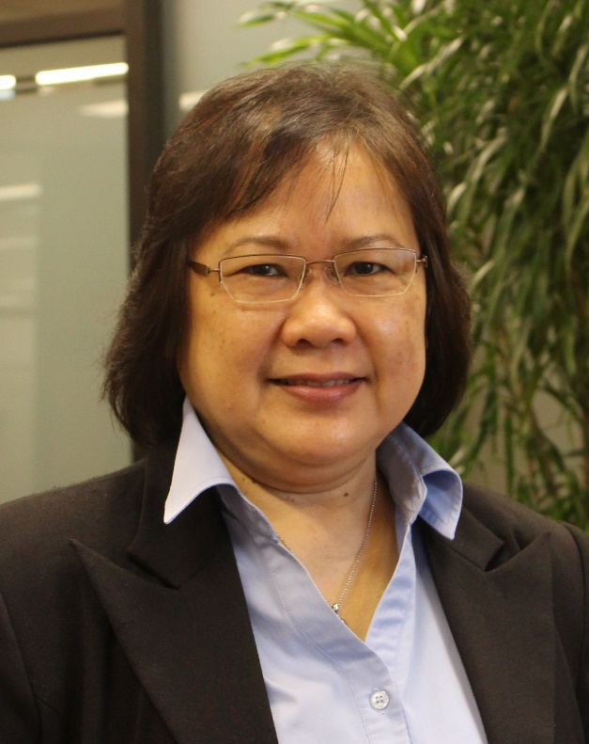
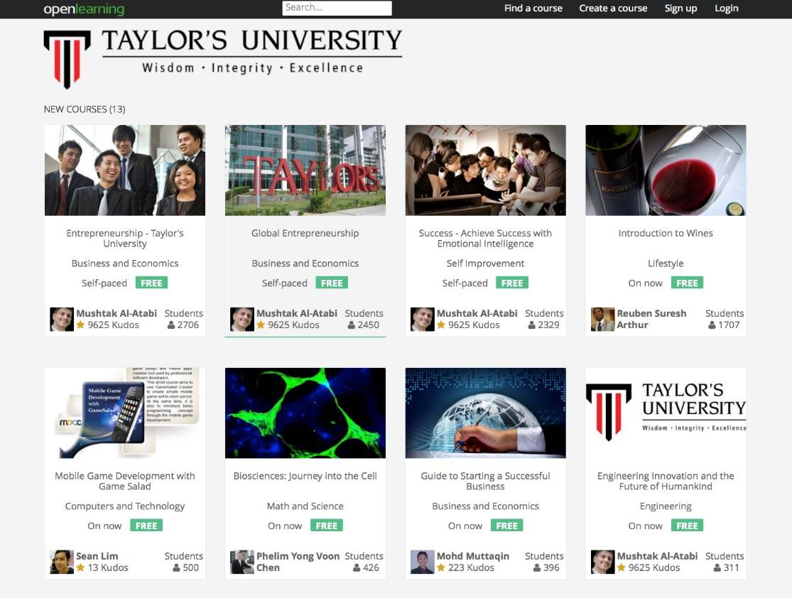
Chapter 20: The Glocalization of MOOCs in Southeast Asia
Zoraini Wati Abas, Ed.D.
Figure 2. Eight of thirteen MOOCs offered by Taylor’s University

Slide 30
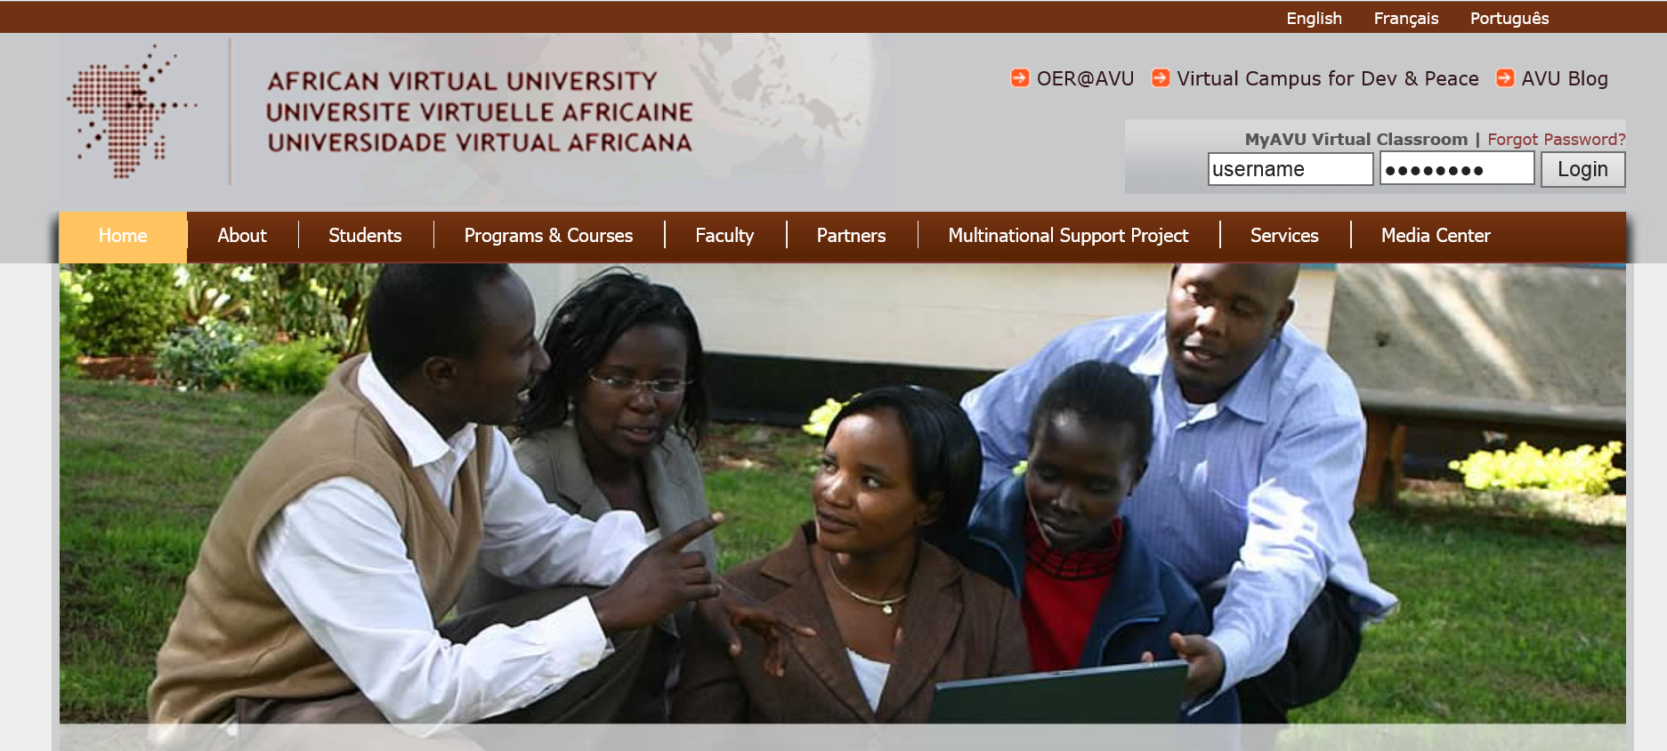
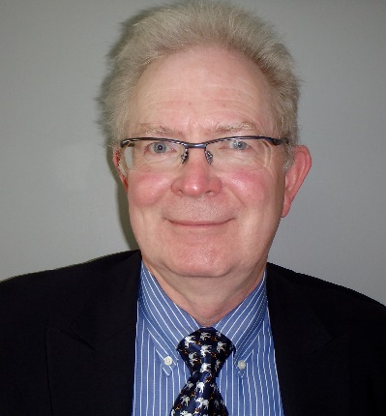

Chapter 22: OER and MOOCs in Africa: The AVU Experience
Griff Richards and Bakary Diallo,
African Virtual University, Nairobi, Kenya
It is estimated that only 6% of Africans can access post-secondary education. The development goal is set at 12% even though North America and Europe are somewhere around 45%.

Slide 31
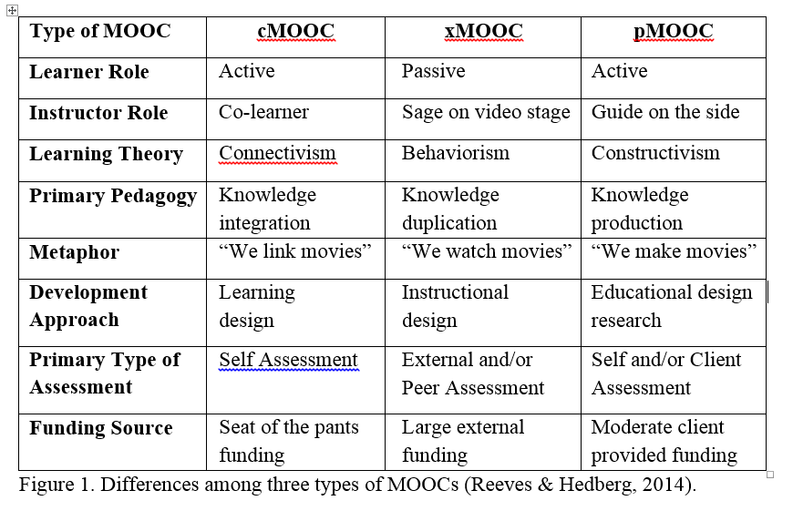
Bonk, C. J., Lee. M. M., Reeves, T. C., & Reynolds, T. H. (in press). The emergence and design of massive open online courses (MOOCs). In R. A. Reiser, & J. V. Demsey (Eds.), Trends and issues in instructional design and technology (4th Ed.), (pp.?). Boston, MA: Pearson Education. Available: http://www.publicationshare.com/3

Slide 32

The Personalization of MOOCs

Slide 33

Chapter 2: Karen Head from Georgia Tech
Be careful with small things like finger pointing—use at least two fingers.
Jokes and humor can easily be misinterpreted.
Be aware of shifting political climates impacting resource access such as YouTube in China.
Many cultures do not have a linear approach (e.g., from A to B) to communication.
Using visual rhetoric (e.g., visual images) to communicate can be a minefield of problems.

Slide 34
Chapter 14 (USA/Stanford):
Paul Kim and Charlie Chung
  Encourage students to download lecture videos and translate them to other languages and perhaps add captions and make available in their local cloud services.
  Encourage students to create low bandwidth versions of videos for those in low bandwidth areas.
  Encourage students to translate videos and add nuances and words understandable in local languages.
  Encourage students to meet locally in teams to share materials and take care of “sensitive matters.”

Slide 35

Chapter 15 (USA/U of Michigan): Chuck Severance
  Avoid troublesome metaphors and examples (e.g., the baseball World Series in the USA).
  Never show lecturer’s face (use audio only)—allows for complete overdubbing in the native language and avoid hand gesture problems.
  Make slides as word free as possible—where possible use symbols

Slide 36
Chapter 18: Canada/COL
Balaji Venkataraman
In the Mooc on mobiles for development the course team received requests from two groups of learners in Sierra Leone and Zambia for the course materials on DVD.
AgMoocs initiative (http://www.agmoocs.in/) uses MooKIT platform designed for access in low bandwidth conditions. It includes a functionality for a learner to hear the voice track on a basic mobile phone.

Slide 37

Chapter 19:
DC/World Bank Institute
Sheila Jagannathan
We try to do badging etc. to give motivation and personal incentives such as champion or expert.
We try to customize the discussion forums with regional and very level forums, topics and moderators.
Google hangouts are also used to customize and personalize at country or institutional levels.

Slide 38

Chapter 21 (the Philippines/The Open U): Melinda Bandalaria
  Strictly avoid references to religion.
  Use acceptable dress code.
  Even when English is the primary or secondary language of the country, consider making MOOC content available in the major dialects of the country.
  …one feature that we have integrated into our MOOCs which I think is one effort to personalize learning is the "Multiple Paths to Learning" or the "Learning on the Go". Through this feature, the learner can choose whether to learn through the video lessons, text lessons or podcast.

Slide 39
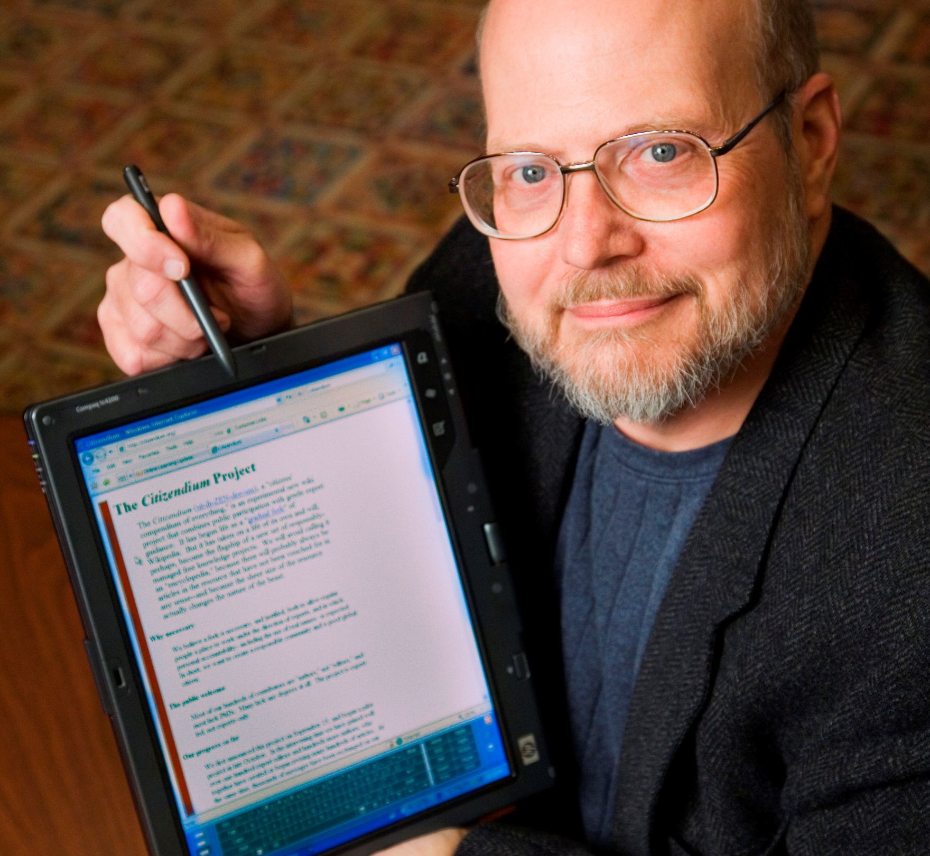
Chapter 25:
USA/Illinois
Ray Schroeder
Most obvious way to personalize is to include group projects, allowing students to self-select into interest areas to conduct collaborative projects that are relevant to the MOOC topic
One of the easiest and most effective ways is to build self-reflection into each module of a MOOC.
Motivated self-determined learners (such as many MOOCers are) do naturally adapt, build upon and scaffold MOOCs to meet their personal learning needs and desires.

Slide 40

MOOC Research Gaps and Summaries

Slide 41
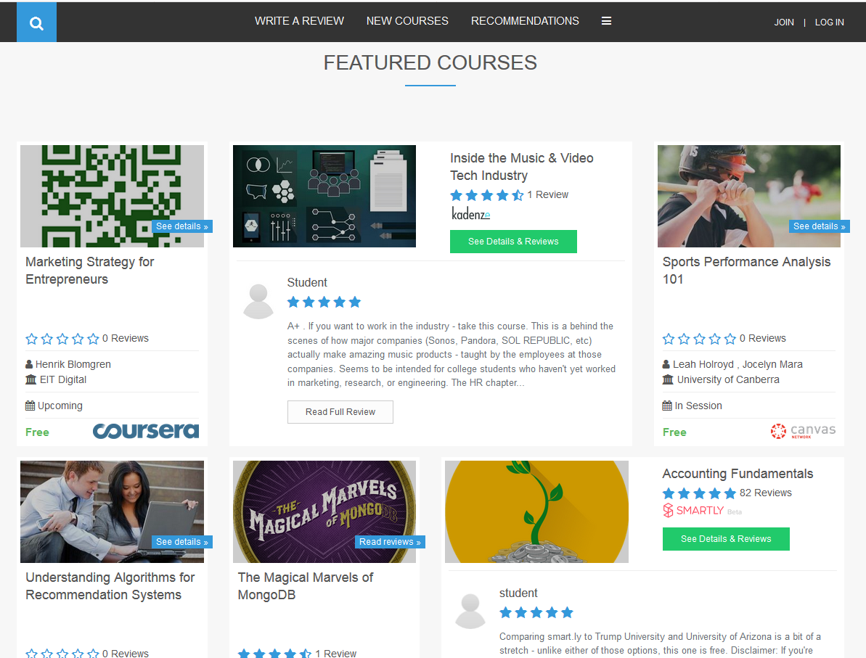
Khe Foon (Timothy) Hew (2018)
Hew, K. F. (2018). Unpacking the Strategies of Ten Highly Rated MOOCs: Implications for Engaging Students in Large Online Courses. Teachers College Record, 120(1). https://www.coursetalk.com/
Hew’s (2018, p. 1) analyzed 4,565 coursetalk review comments of 10 highly rated MOOCs. He found “six key factors that can engage online [MOOC] participants and nine reasons for participant disaffection.”
Problem-centric learning supported by clear explanations.
Active learning supported by timely feedback (e.g., assignments, projects, discussion).
Course resources that cater to participants’ learning needs or preferences.
Instructor attributes (e.g., passion, enthusiasm, humor, variety of examples).
Peer interaction.
Instructor availability.

Slide 42
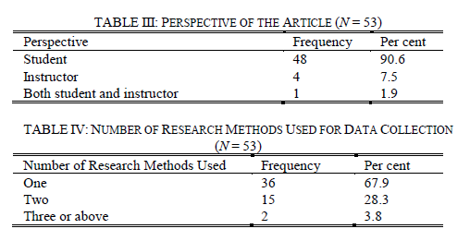
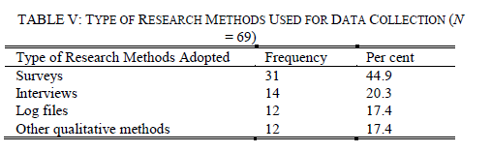


August 2017
A Contemporary Review of Research Methods Adopted to Understand Students’ and Instructors’ Use of Massive Open Online Courses (MOOCs)
Ruiqi Deng and Pierre Benckendorff
“Second, triangulation of a wider range of research methods and data source should be undertaken. Beyond triangulation of surveys and interviews or log files, MOOC scholars are encouraged to combine other research methods to triangulate findings, such as diary studies and focus groups.” (p. 605)

Slide 43
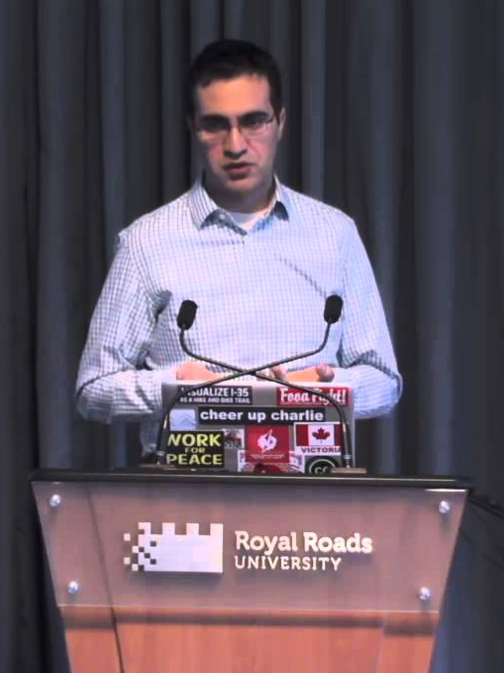
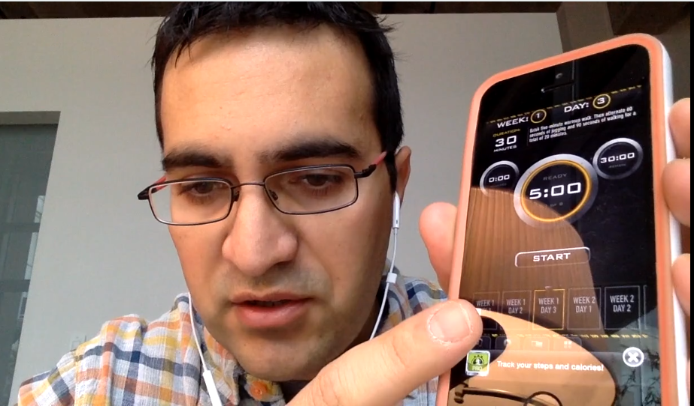

Quotes: Veletsianos et al. (2015-2016)
“To gain a deeper and more diverse understanding of the MOOC phenomenon, researchers need to use multiple research approaches (e.g., ethnography, phenomenology, discourse analysis) add content to them.” (p. 583)
Veletsianos, Collier, & Schneider (2015, May), Digging deeper into learners’ experiences in MOOCs: Participation in social networks outside of MOOCs, notetaking and contexts surrounding content consumption. BJET, 46(3), 570-587.
“Dependence on Particular Research Methods May Restrict our Understanding of MOOCs.”
George Veletsianos & Peter Shepherdson’s Study (2016). Systematic Analysis and Synthesis of the Empirical MOOC Literature Published in 2013-2015. IRRODL. http://www.irrodl.org/index.php/irrodl/article/view/2448/3655

Slide 44


Research Focus and Purpose

Slide 45

MOOC Study #1: MOOC Research
A Systematic Review of Research Methods and Topics of the Empirical MOOC Literature (2014-2016)
Zhu, M., Sari, A., & Lee, M. M. (2018). A Systematic Review of Research Methods and Topics of the Empirical MOOC Literature (2014-2016). The Internet and Higher Education. 37,31-39.

Slide 46
Rationale…
Research Background
  MOOCs can be beneficial to both learners and instructors
    (Hew & Cheung, 2014)
  Instructors are one of the five main components of MOOCs; the other four are learners, topic, material, and context
    (Kop, 2011 )
  Few studies have examined instructional design from MOOC instructors’ perspectives
    (Margaryan et al., 2015; Ross, Sinclair, Knox, Bayne, & Macleod, 2014; Watson et al., 2016)

Slide 47
Systematic Review of Research Methods in MOOCs (2014-2016)
(Zhu, M., Sari, A., & Lee, M. M., 2018)
 | Quantitative | Qualitative | Mixed methods
Student-focused | 39 | 9 | 26
Design-focused | 19 | 12 | 17
Context and impact | 9 | 6 | 5
Instructor-focused | 0 | 3 | 2

Slide 48
Systematic Review of Research Methods in MOOCs (2014-2016)
(Zhu, M., Sari, A., & Lee, M. M., 2018)
No. | Journal | Total
1 | International Review of Research in Open and Distance Learning (IRRODL) | 31
2 | Computers & Education | 12
3 | British Journal of Educational Technology | 9
4 | Online Learning | 7
5 | Distance Education | 5
6 | Educational Media International | 5
7 | Internet and Higher Education | 5
8 | Journal of Computer Assisted Learning | 5
9 | Computers in Human Behavior | 4
10 | Open Learning | 4
11 | Journal of Online Learning and Teaching | 3
12 | Journal of Asynchronous Learning Network | 3

Slide 49
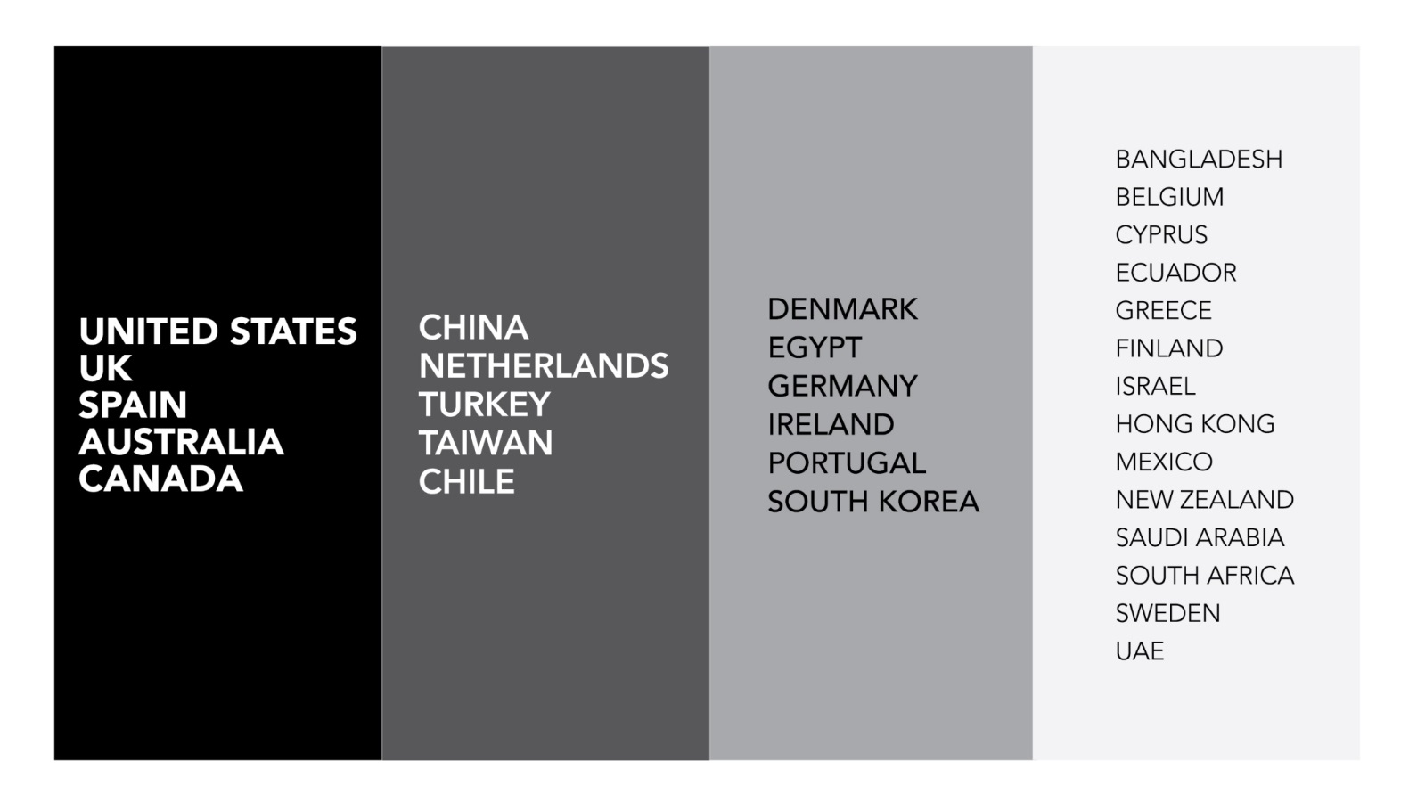
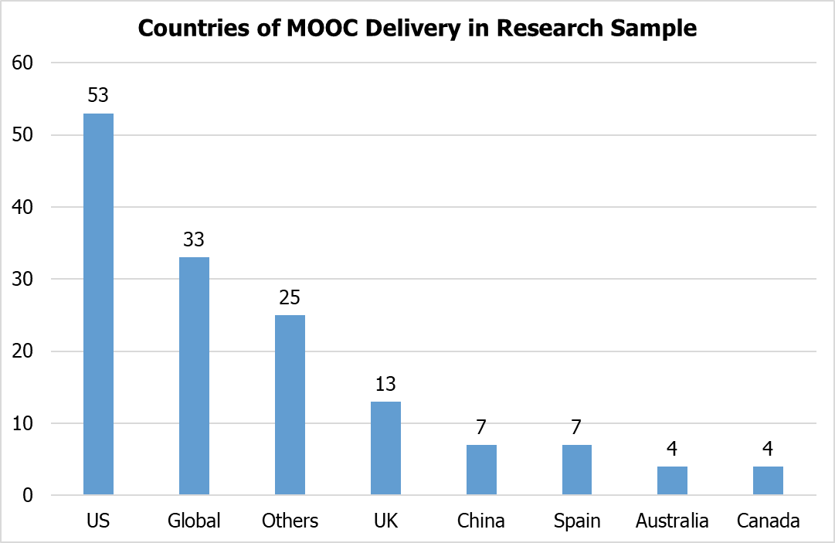

Findings (Zhu, M., Sari, A., & Lee, M. M., 2018)
Country of MOOC Delivery and MOOC Research
Location of MOOC Research Team Members (2014-2016)

Slide 50
Systematic Review of Research Methods in MOOCs (2014-2016)
(Zhu, M., Sari, A., & Lee, M. M., 2018)
RQ1: What are the research methods researchers employed in empirical MOOC studies?

Slide 51
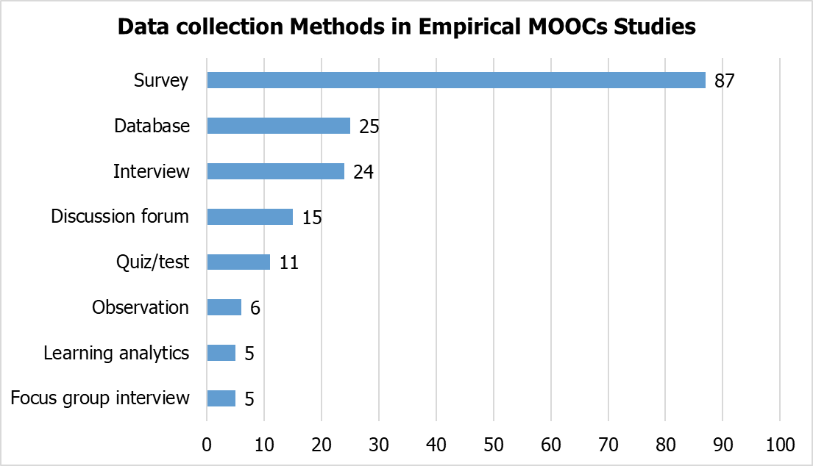
Systematic Review of Research Methods in MOOCs (2014-2016)
(Zhu, M., Sari, A., & Lee, M. M., 2018)
RQ1: What are the research methods researchers employed in empirical MOOC studies?

Slide 52
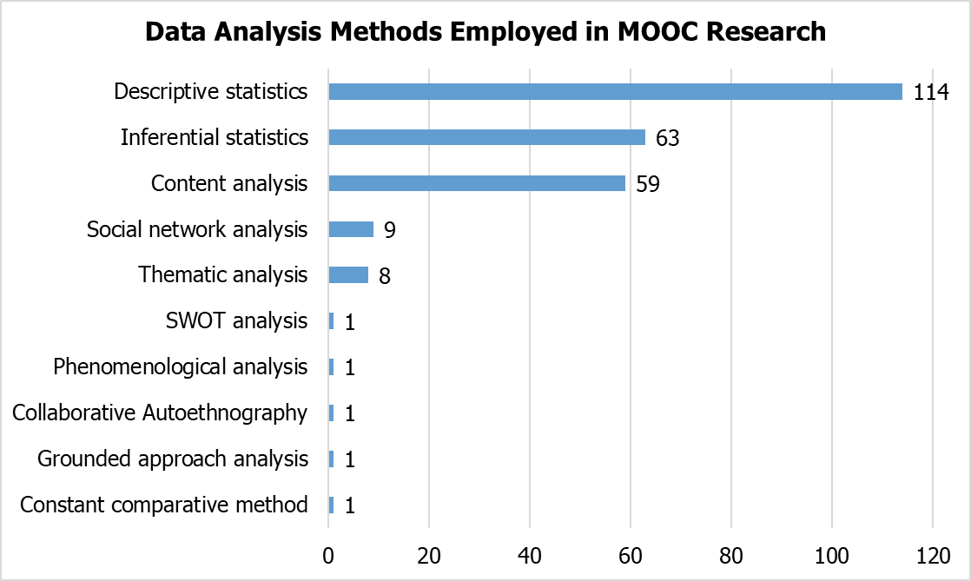
Systematic Review of Research Methods in MOOCs (2014-2016)
(Zhu, M., Sari, A., & Lee, M. M., 2018)
RQ1: What are the research methods researchers employed in empirical MOOC studies?

Slide 53
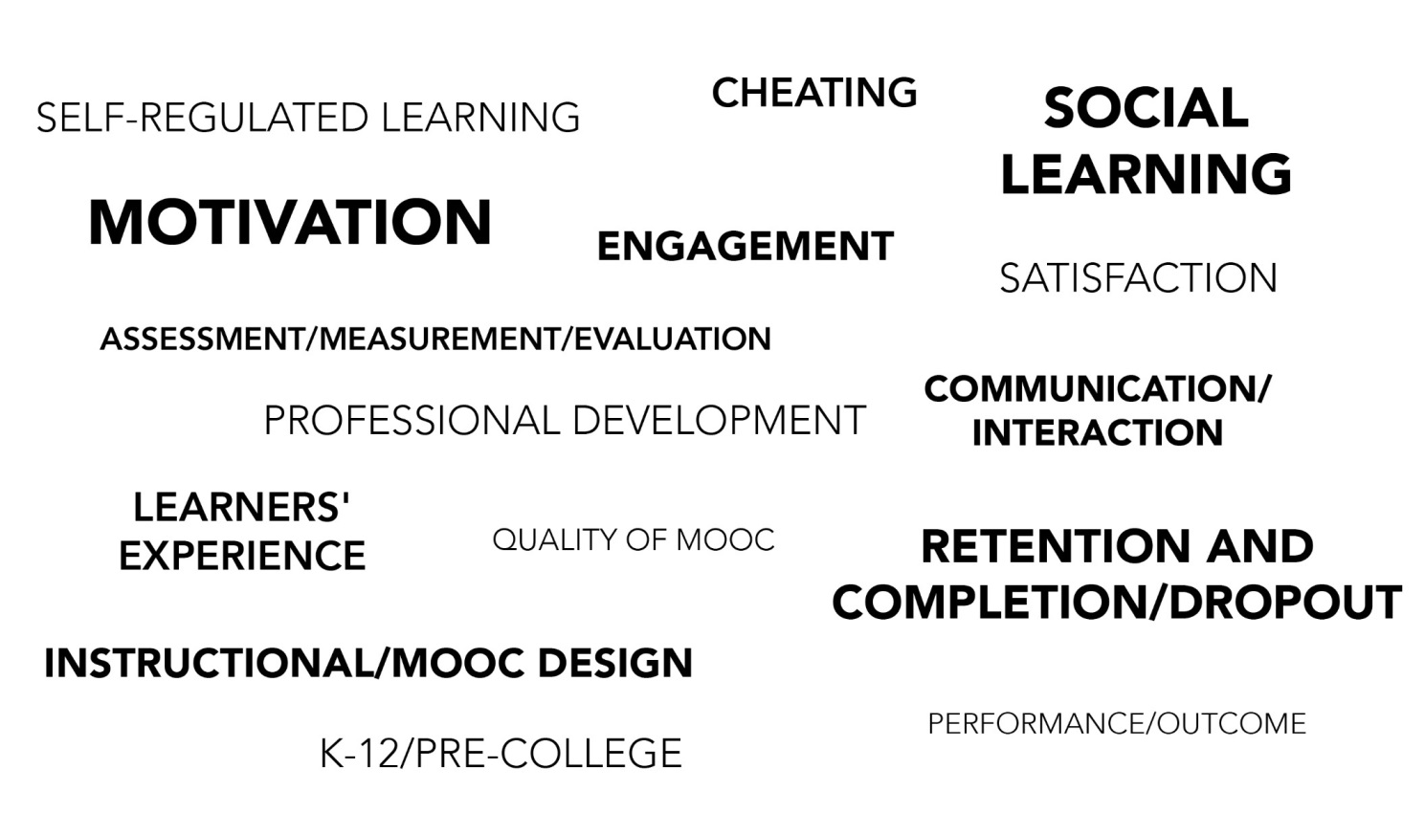
Systematic Review of Research Methods in MOOCs (2014-2016)
(Zhu, M., Sari, A., & Lee, M. M., 2018)
Specific Focus of MOOC Research (2014-2016)

Slide 54
MOOC Study #2: MOOC Research
A Systematic Review of MOOC Research Methods and Topics:
Comparing 2014-2016 and 2016-2017
Zhu, M., Sari, A., & Bonk, C. J. (2018). To be presented at Ed Media Amsterdam.

Slide 55
Systematic Review of Research Methods and Topics in MOOCs: Comparing 2014-2016 and 2016-2017
(Zhu, M., Sari, A., & Bonk, C. J., 2018)
Figure 2. Research methods used in empirical MOOCs studies (2016 – 2017) (n=51)

Slide 56
Systematic Review of Research Methods and Topics in MOOCs: Comparing 2014-2016 and 2016-2017
(Zhu, M., Sari, A., & Bonk, C. J., 2018)
Figure 8. Primary/general focus of MOOC delivery (2016 – 2017) (n=51) (Note: some studies contain more than one area of focus)

Slide 57

Phase 3:The Study has expanded again!

Slide 58
Total Number of Empirical MOOC Studies Published in Different Journals from 2013-2018
Table 1
(Note: the table only includes the top nine journals in terms of the number of empirical MOOC studies)
Journals | Number of empirical studies
International Review of Research in Open and Distributed Learning | 51
Computers & Education | 22
British Journal of Educational Technology | 15
Online Learning | 12
Distance Education | 11
Journal of Online Learning and Teaching | 11
The Internet and Higher Education | 10
Computers in Human Behavior | 10
Open Learning | 8

Slide 59
Research methods used in empirical MOOCs studies
Figure 2. Research methods used in empirical MOOCs studies from 2013-2018 (N=321 studies)

Slide 60
Types of MOOC research methods used in different countries
Figure 3. Types of MOOC research methods used in the five countries with the most MOOC research from 2013-2018 (N=321 studies)

Slide 61
Types of MOOC research methods used by year (2013-2018)
Figure 4. Types of MOOC research methods used in each year from 2013-2018 (N=321 studies)

Slide 62
Data collection methods used in empirical MOOCs studies
Figure 5. Data collection methods used in empirical MOOCs studies from 2013-2018 (N = 321 studies)
(Note: some studies contain more than one data collection method and this figure only includes the main data collection methods)

Slide 63

Tired of MOOCs…?

Slide 64
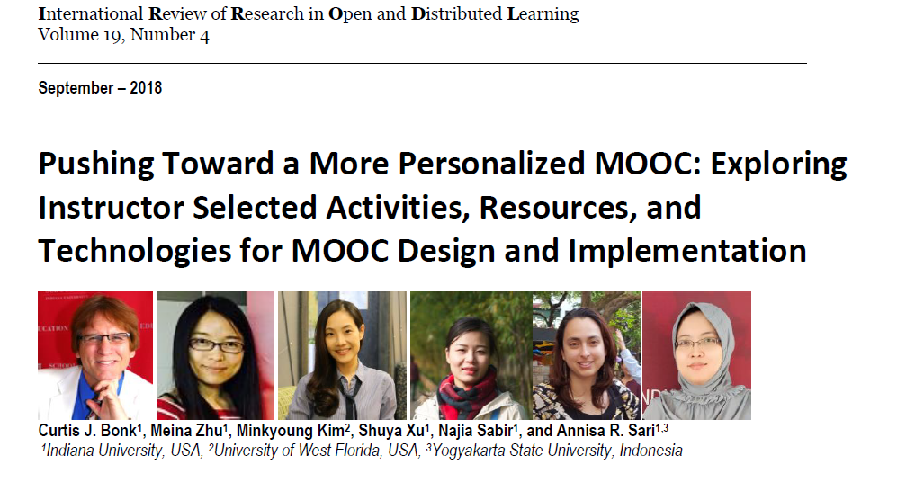
If not, you might read…
MOOC Study #4: MOOC Instructor Personalization and Addressing Learner Diversity http://www.irrodl.org/index.php/irrodl/article/view/3439/4726

Slide 65
Figure 1. MOOC instructor departmental or primary discipline affiliations (n=150)

Slide 66
Figure 2. Size of most recent MOOC enrollments for survey respondents (n= 150)

Slide 67
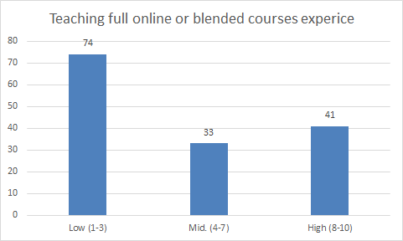
Figure 1. MOOC instructor prior experience teaching fully online and blended courses prior to teaching their most recent MOOC (Note: on a scale of 1 (low) to 10 (high) (n= 148))

Slide 68
Figure 2. MOOC instructor involvement in designing course content for the MOOC (Note: on a scale of 1 (low) to 10 (high) (n=152)

Slide 69
Figure 3 and 4. Effort placed on meeting unique learner needs when designing and delivering most recent MOOC
(Note: on a scale of 1 (low) to 10 (high) (n=144)

Slide 70
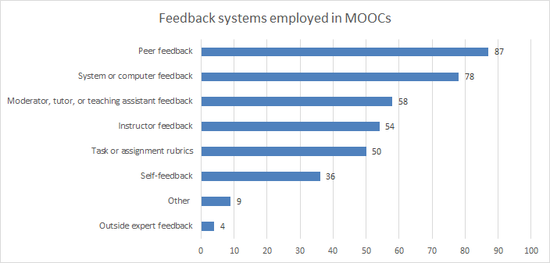
Figure 5. Number of MOOCs that offer different types of learner feedback (n=135)

Slide 71
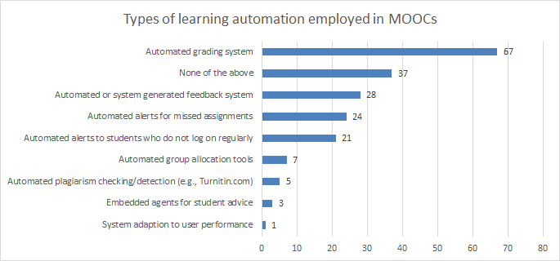
Figure 6. Number of MOOCs that offer different types of learning system automation and adaptation (n=127)

Slide 72
Figure 7. MOOC instructor interest in learning new ways to personalize their next MOOC offering (Note: on a scale of 1 (low) to 10 (high) (n=134)

Slide 73
Figure 8. The perceived effort of MOOC instructors in addressing the needs of individuals from different cultural backgrounds and languages in their most recent MOOC (Note: on a scale of 1 (low) to 10 (high) (n= 141)

Slide 74
Figure 9: MOOC instructors (n=133) instructional practices to address cultural diversity

Slide 75

Table 1. Instructional Practices of MOOC Instructors to Address the Variety of Student Competencies and Needs (n=142)

Slide 76

Table 2. Items instructors provided in their most recent MOOC (n=126)

Slide 77



Slide 78

Study #4: Findings Recap
There is a lack of learner monitoring and feedback (i.e., mostly self and peer monitoring/feedback).
More emphasis on personalization in the design of the course than in the delivery of it.
Subtitles and transcripts are the most common ways to address cultural and linguistic differences.
Automated grading and feedback more prevalent than automated alerts, advice/counseling, and plagiarism detection.
Instructors have high interest in learning techniques for personalization in their next MOOC.

Slide 79

MOOC Study #5: MOOC Instructor Design Challenges and Considerations
Bonk, C., J., Zhu, M., & Sari, A. (2018, April 14). MOOC Instructor Motivations, Innovations, and Designs: Surveys, Interviews, and Course Reviews. Paper presented at the 2018 American Educational Research Association (AERA) annual meeting, New York City, NY.

Slide 80
Research Questions
  What motivates instructors to offer MOOCs?
  What instructional innovations do MOOC instructors perceive?
  What do instructors perceive as the strengths of their MOOCs?
  How would they redesign the MOOC?

Slide 81


Research Design

Slide 82

Research Methods-Data collection
Sequential mixed methods design (Creswell & Clark, 2007)
  Data Collection:
  (1) surveys, (2) interviews, and (3) course reviews.
  Participants:
  143 survey participants (10% response rate)
  12 interviewees

Slide 83
Research Methods-Data collection
  MOOC instructors interviewed
No. | Countries | Subject areas | Platforms
1. | The U.S. | Language and Literacy | Coursera
2. | The U.S. | Education | Coursera
3. | The U.S. | Education | Canvas
4. | The U.S. | Chemistry | Coursera
5. | UK | Public health | FutureLearn
6. | UK | Language and Literacy | FutureLearn
7. | Hong Kong | Math | Coursera
8. | Mainland China | Math | Coursera
9. | Canada | Psychology | Coursera
10. | Australia | Public Health | Open2Study
11. | Sweden | Computer Science | edX
12. | India | Management | edX

Slide 84
Prior Online or Blended Experience

Slide 85
Prior MOOC Experience

Slide 86
Subject Area of MOOC Taught

Slide 87

MOOC Enrollments

Slide 88

MOOC Delivery Format

Slide 89
Involvement in Course Design

Slide 90
Enjoyment in Designing MOOCs

Slide 91
1. Motivational Findings
  RQ1: What motivated instructors to offer MOOCs?

Slide 92
1. Motivational Findings
  RQ1: What motivated instructors to offer MOOCs?
    Many of them wanted to experience instructional innovation with MOOCs.
    U.S.: decided to design MOOCs “just to experiment.”
    U.S.: “expose your university to broader world.”
    Sweden: “summarizes our way to teaching Computer Architecture and then I was very motivated to give a MOOC.”
    U.S. “The initial motivation was to make some video resources for my own students.”

Slide 93
2. Innovation Findings
  RQ2: What instructional innovations do MOOC instructors perceive?
  Cutting videos into small chunks.
  Integrating interactive media.
  Peer review.
  Problem-based learning.
  Service learning.

Slide 94

Address Diverse Learner Needs
Figure 7. Ways used by MOOC instructors to address learner diverse needs

Slide 95
3. MOOC Strengths Findings
  RQ3: What do instructors perceive as the strengths of their MOOCs?
  The topic of the MOOC itself.
  The pedagogical methods employed.
  The impact on participants.

Slide 96
Findings
RQ. How do instructors address the challenges that they perceive related to MOOCs?
Explore other MOOC examples
Seek help from the platform/Colleagues/institutions

Slide 97
Findings
RQ. What are the design considerations of instructors when designing MOOCs?
Learning objectives
Assessment
Time for designing MOOC
Engaging learners

Slide 98
4. MOOC Design Findings
  RQ4: How would they redesign the MOOC?
    Overall, they were satisfied with the current course, especially with the structure.
    One literacy instructor from the UK emphatically stated:
      “Actually no. I'm quite happy with it and we've had good feedback from learners.”

Slide 99
4. MOOC Design Findings
  RQ4: How would they redesign the MOOC?
  Adjusting the difficulty of quizzes.
  Adding lab experiences.
  Adding international perspectives.
  Cancelling peer-grading.
  Increasing instructor-student and peer-to-peer interaction.
  Inviting guest speakers.
  Making the length of the MOOC shorter.
  Using learning analytics before redesigning MOOC.

Slide 100
4. MOOC Design Findings
  RQ4: How would they redesign the MOOC?
    Data from the platform
    He further added:
    “I probably am a much better teacher than I was before…To think about that [i.e., less interaction with students when using prerecorded video] made me a different teacher. I’m sure I’m a different teacher after that. If you want to become a better teacher, you develop a MOOC.”

Slide 101
Study #5: Findings Recap
Growth and relatedness needs were the primary instructor motivations for offering MOOCs.
  Growth needs included curiosity about MOOCs and the exploration of new ways of teaching; such findings align well with the research from Hew and Cheung (2014).
Various pedagogical innovations were mentioned by the interviewees (e.g., guests, PBL, service learning, peer review, interactive media, etc.).
MOOC instructors interviewed were satisfied with the designs of their MOOCs, but did want to make major changes to their course. (Lacking time? And overly rely on positive student feedback.)
Future Research might explore changes in MOOC instructor motivation across several MOOCs or perhaps PD or training impacts in MOOC instructor skills.

Slide 102
Do we have time for another study?

Slide 103

MOOC Study #6: Malaysian and Indonesian MOOC Instructors
Sari, A., Bonk, C., J., & Zhu, M. (2018). MOOCs Design and Challenges: What can be Learned from Existing MOOCs in Indonesia and Malaysia?

Slide 104
Research Questions
1. What are the instructors’ reasons to offer MOOCs?
2. How do instructors design their MOOCs?
3. What challenges do instructors experience in designing their MOOC?

Slide 105
Research Methods-Data collection
Research Design: mixed method design (Creswell, 1999)
Data Collection: Survey, interview, course review Web-based survey: 20 closed-ended questions + 2 open ended questions; 9 interview questions.
Participants: 46 survey participants (15.6%) and 9 interviewees (3 Malaysian + 6 Indonesian)

Slide 106
Preparation for MOOC

Slide 107
Increase Attraction

Slide 108
Increase Participation

Slide 109
Participation Monitoring

Slide 110
Assess Learning

Slide 111
Obtain Feedback

Slide 112
MOOC Instructor Challenges

Slide 113
Help of Advice from…?

Slide 114
Study #6: Findings Recap and Future Directions
  Primary motives, include: (1) personal interest, (2) research purposes, (3) experience teaching a large online course, (4) institutional encouragement, and (5) altruism.
  Offering recognition such as certificate, badge, points, or transfer credit to increase student enrollment.
  Top challenges include encouraging collaboration, fostering engagement, video development, and time.
  Future research might add perspectives from students, affiliated institutions, and MOOC providers

Slide 115
Study #7: MOOC Instructor Perceptions of Participant Self-Directed Learning
Research Purpose
  This study examined instructors’ perceptions of SDL and the design and deliver of MOOCs to facilitate learners’ SDL. The purpose is to find out MOOC instructors’ perceptions of SDL and how MOOC instructors put considerations related to facilitating SDL skills into MOOC designs and delivery.

Slide 116
Research Questions
  How do MOOC instructors perceive participants’ SDL skills?
  How do MOOC instructors perceive their facilitation of participants’ SDL skills?
  How do instructors design and deliver MOOCs to facilitate participant SDL skills?

Slide 117
Research Design

Slide 118

Research Methods-Data collection
  Data Collection:
  (1) surveys, (2) interviews, and (3) course reviews.
  Participants:
  48 survey participants (10% response rate)
  4 interviewees
No. | Countries | Subject areas | Platforms
1. | The UK | Computer Science | Kadenze
2. | The UK | Literacy | FutureLearn
3. | The U.S. | Finance | Coursera
4. | Canada | Geography | Coursera

Slide 119
Research Methods-Data analysis
RQs | Data Sources | Data analysis
RQ1 | Survey Interview MOOC review | Descriptive statistics Content analysis (Elo & Kyngäs, 2008)
RQ2 | Survey Interview MOOC review | Descriptive statistics Content analysis
RQ3 | Interview MOOC review | Content analysis

Slide 120


Demographic Information

Slide 121
Prior Online or Blended Experience

Slide 122
Prior MOOC Experience

Slide 123
MOOC Delivery Format

Slide 124
RQ1:MOOC instructors’ perceptions of self-directed learning

Slide 125
RQ1:MOOC instructors’ perceptions of self-directed learning
One instructor from the UK shared one example of students who have high SDL.
I guess to me it gets really exciting to look at how a number of those students have done projects that really go beyond the simple examples that I showed in lecture, and beyond the simple things up they were asked to do in the assignments. You know they've taken them into the real world… One student who, during the presidential election made a presidential debate voiced motion classifier, that you could run. And it would tell you whether candidates were being angry or not. It was just like really fun stuff that people did.

Slide 126
RQ1:MOOC instructors’ perceptions of self-directed learning
Another instructor from the UK mentioned the his students with high SDL skills:
  We had several students who said this is the 10th or 15th MOOC I have taken. Within a body of students who a very much learning junkies, who are enjoy doing all kinds of different MOOCs. One of them told us I just like all kinds of different things. But you have to be quite disciplined.

Slide 127

RQ1:MOOC instructors’ perceptions of self-directed learning
One instructor from Canada mentioned the he has elder students with high SDL skills:
  We have a very number of sort of sixty plus, retired people taking the course. They're pretty motivated.

Slide 128
RQ2: MOOC instructors’ perceptions of their role in facilitating SDL skills

Slide 129
RQ2: MOOC instructors’ perceptions of their role in facilitating SDL skills
One instructor from the UK stated:
  I mean instructors can absolutely help, and, furthermore, I think the architecture of the MOOC itself that really helped. I think is common practice now, for instance, is to chop up video isn't a ten-minute chunk so that it's really easy for students to watch a little bit at a time, to watch it on the go, also you know [you will] be able to return to a subject that they maybe didn't understand or the first time…
  Similarly, having things like suggested deadlines where it's something that's used as a piece of a way to motivate students to do the next thing, even though there's not any real consequences if they're not doing it.

Slide 130
RQ3: How do instructors design and deliver MOOCs to facilitate participant SDL skills?
The top five SDL skills that their MOOCs facilitated included:
(1) motivates students to learn new information (M=4.38);
(2) helps the student critically evaluate new ideas (M=4.06);
(3) helps the student be in control of his/her learning (M=4.06);
(4) helps the student to be able to find out information related to learning content for him/herself (M=3.94);
(5) helps the student embrace a learning challenge (M=3.92).
However, it seems that their MOOC designs have limited influence on students’ management skills (e.g., managing time and learning resources) (M=3.38) and setting strict time frames for learning (M=3.25).

Slide 131
RQ3: How do instructors design and deliver MOOCs to facilitate participant SDL skills?
An interview with one instructor from Canada revealed a more behaviorally-based tactic that some MOOC instructors use to facilitate students’ SDL skills.
He argued that “I think our quizzes at the end are helpful. And I think…we have reading lists and I update the reading lists for the course on a regular basis.” He added that they “direct people to that” and send reminders through the forum and emails.

Slide 132
RQ3: How do instructors design and deliver MOOCs to facilitate participant SDL skills?
One instructor from Canada mentioned he sent students message to remind students:
    You lose people at the front and so one of the things that I've started to try to do is, because I know who those people are is to sort of send messages out saying “hey, if you haven't started yet just sign up again blah blah blah” and get people started. I figure once we get people started we can keep them in the course like we have a good track record of keeping people in the course.

Slide 133
RQ3: How do instructors design and deliver MOOCs to facilitate participant SDL skills?
One instructor from the UK mentioned she encouraged student reflection:
    One of the things that I tried to do was to give people opportunities for different types of engagement with explicit opportunities for reflection built-in. So, for instance. You know for the second or third assignment, part one is you're asked to go through a set of exercises on your own following from examples in lecture. At the end you're asked some questions about which parts of this were hard, what challenges did you encounter, how would you approach solving those challenges, how successful were you.

Slide 134
RQ3: How do instructors design and deliver MOOCs to facilitate participant SDL skills?
One instructor from the US mentioned she tried to combine the content with student personal life:
    one of the things that we really tried to put in was opportunities for people to take what they were learning and to reflect back how it impacted their own lives. So, we asked people about activities the case studies and things always go back to you...then we say, in your own situation what would you do? So, in that sense I think that helps people to think about not only what's the right answer to a quiz question, perhaps but also how does what I'm learning affect me and how does that what I want to still learn more about. We made this really personal and applicable to them.

Slide 135
RQ3: How do instructors design and deliver MOOCs to facilitate participant SDL skills?
One instructor from the US mentioned she used interactive interview to engage students in MOOC:
    And then we also have these little one-minute like on the street interviews to also try to help students engage with like what's happening. To me so it wasn't all talking heads because that just we didn't think that was going to be helpful for the self-directed learning at all. So, we did try to really think about how could we get people involved.

Slide 136

Discussion,
Significance, and Conclusion

Slide 137
Discussion of Results
Instructors considered SDL as a skill that can be educated.
Most of them felt that MOOC instructors can intentionally create learning environments that foster the development of SDL skills as Kell and Deursen (2002) suggested.
In terms of their design and delivery practices to facilitate SDL via the MOOC, it seems that the impact is mainly on learner self-monitoring and motivation. However, the impact on students’ self-management skills seems limited.

Slide 138



Curtis J. Bonk, IU, cjbonk@indiana.edu
With help from my research team:
Meina Zhu, IU, meinzhu@iu.edu
Annisa Sari, IU, annisa@uny.ac.id
Slides and Proceedings Paper at TrainingShare.com: http://www.trainingshare.com (go to “Archived Talks”)

