Slide 1
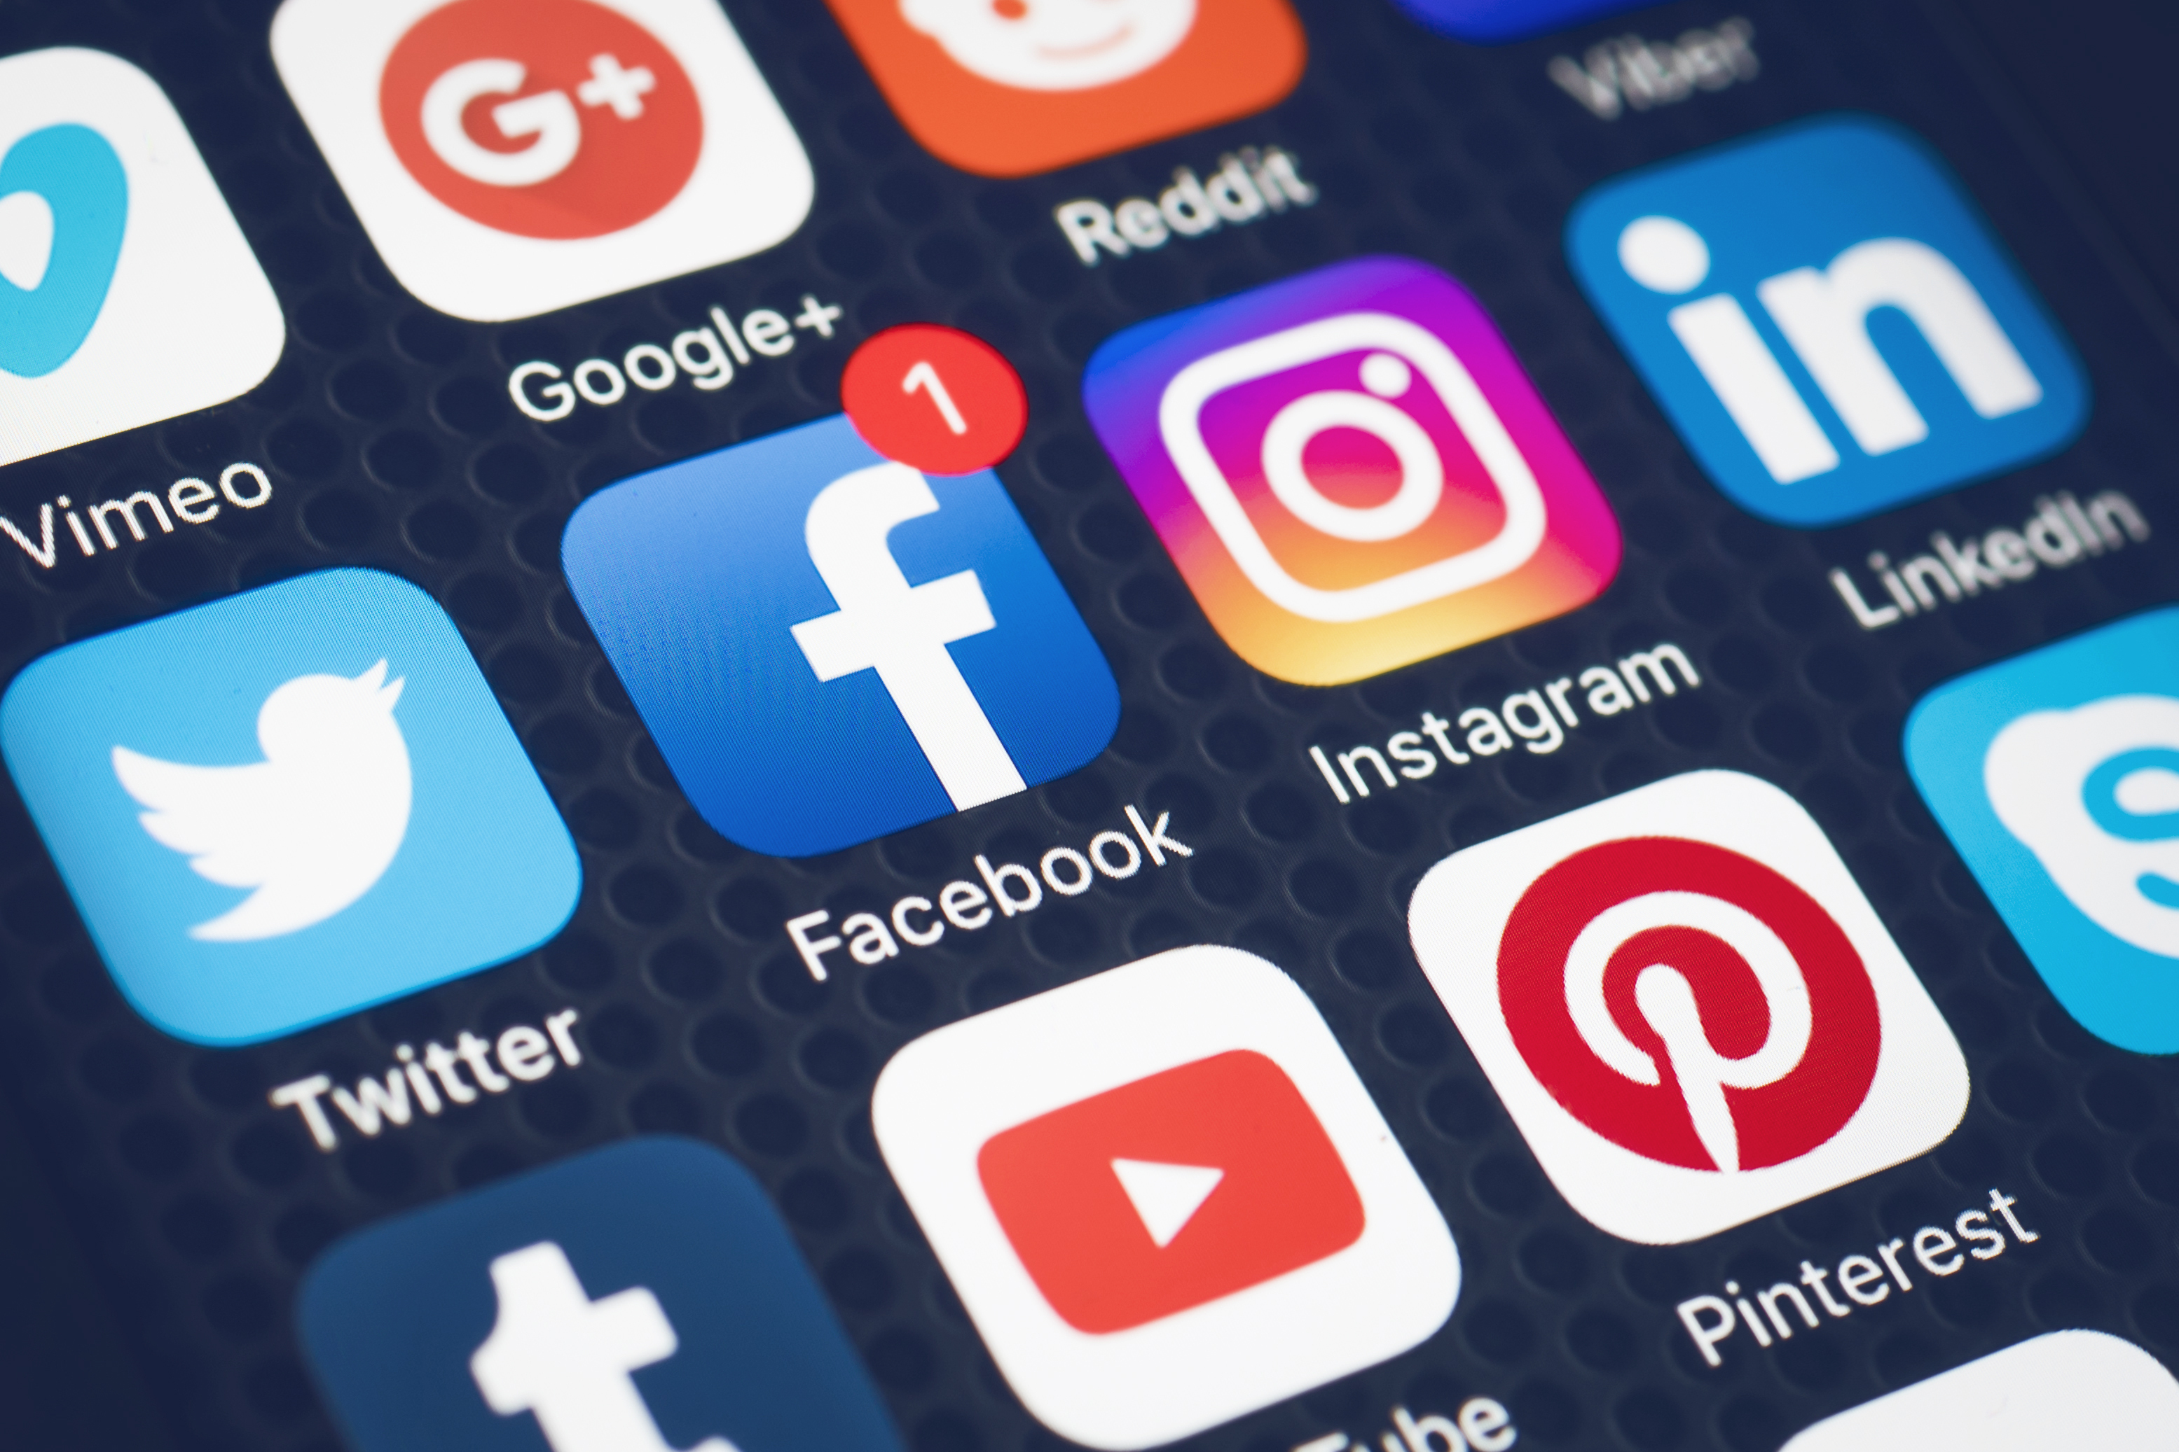
Social Media Use for Learning and Development
Curtis J. Bonk
Meina Zhu
Indiana University
School of Education, IST INDIANA UNIVERSITY BLOOMINGTON

Slide 2
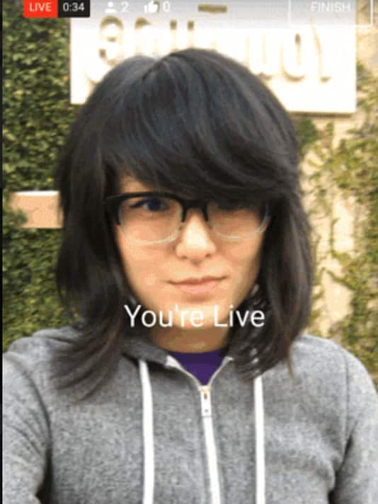
Poll 1: How many of you have posted to a social media account since you arrived in Amsterdam? Poll #2: How many since this morning? February 7, 2017 YouTube takes on Facebook with mobile live Jefferson Graham, USA Today http://www.usatoday.com/story/tech/2017/02/07/youtube-takes-facebook-mobile-live/97566592/

Slide 3
July 11, 2017 Poll #3: Anyone have “phigital” children or students? Going ‘phigital?’ 4 things schools need to know about Generation Z, Todd Kominiak, TrustEd http://trustedk12.com/phigital-digital-learning/ May 15, 2017 3 must know’s about the rising “phigital” student-and why their impact is enormous, Meris Stansbury, eCamous News https://www.ecampusnews.com/campus-administration/education-gen-z-phigital-student/

Slide 4
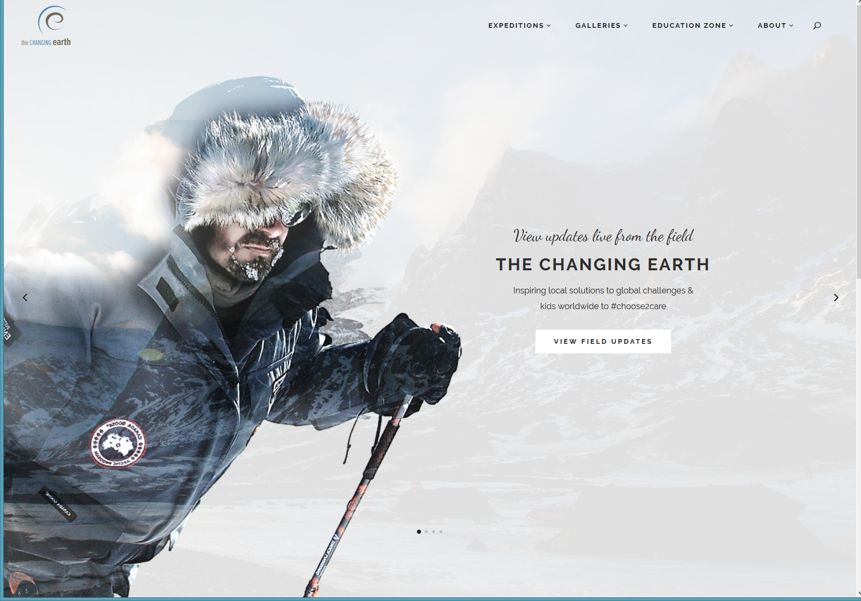
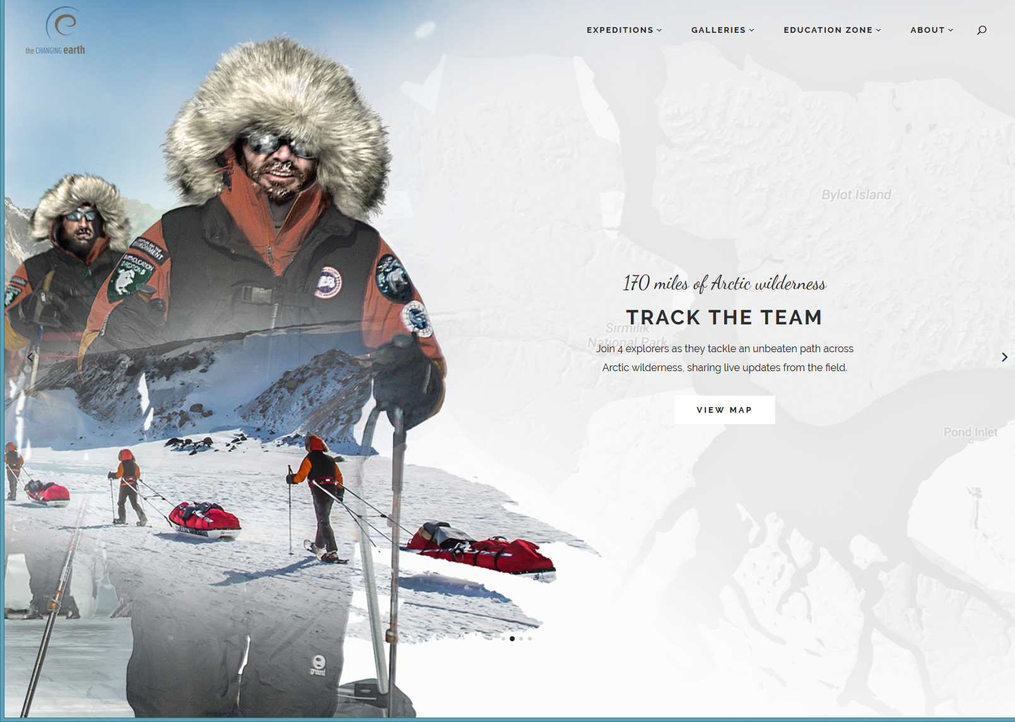
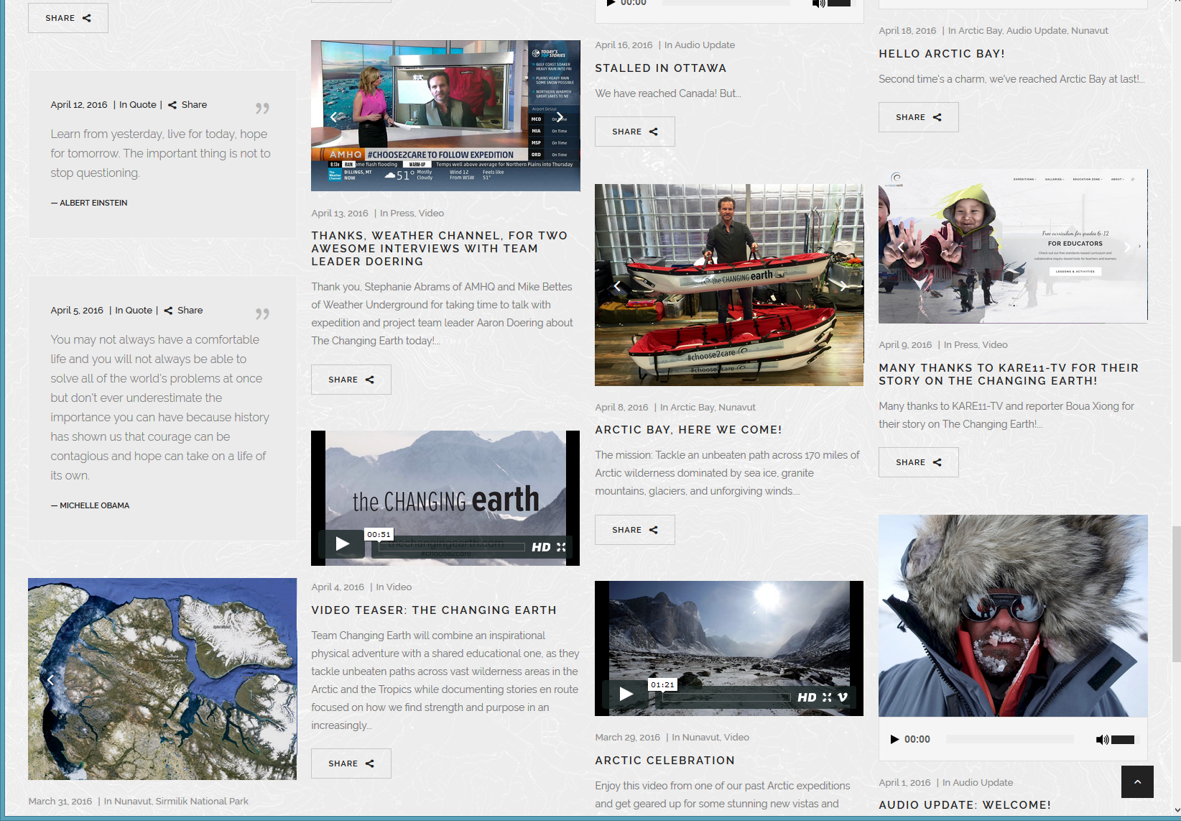
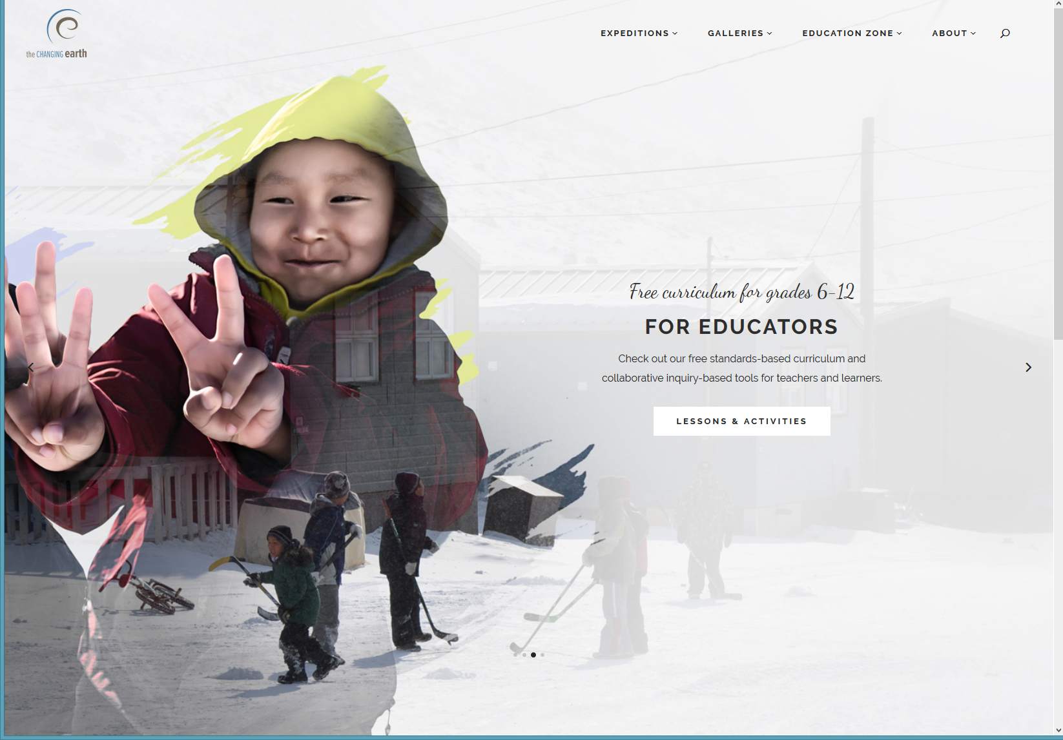
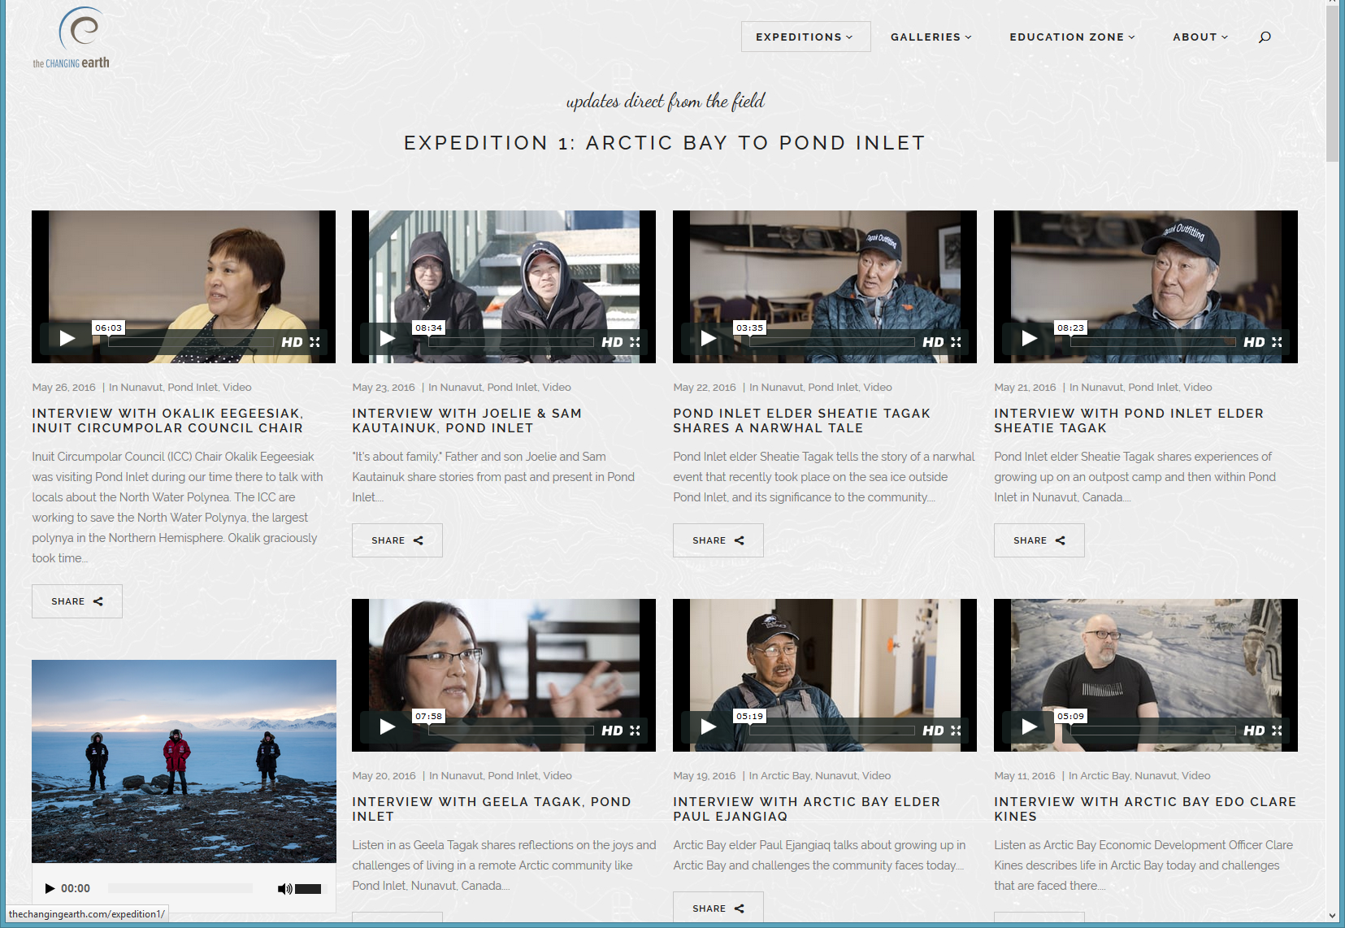
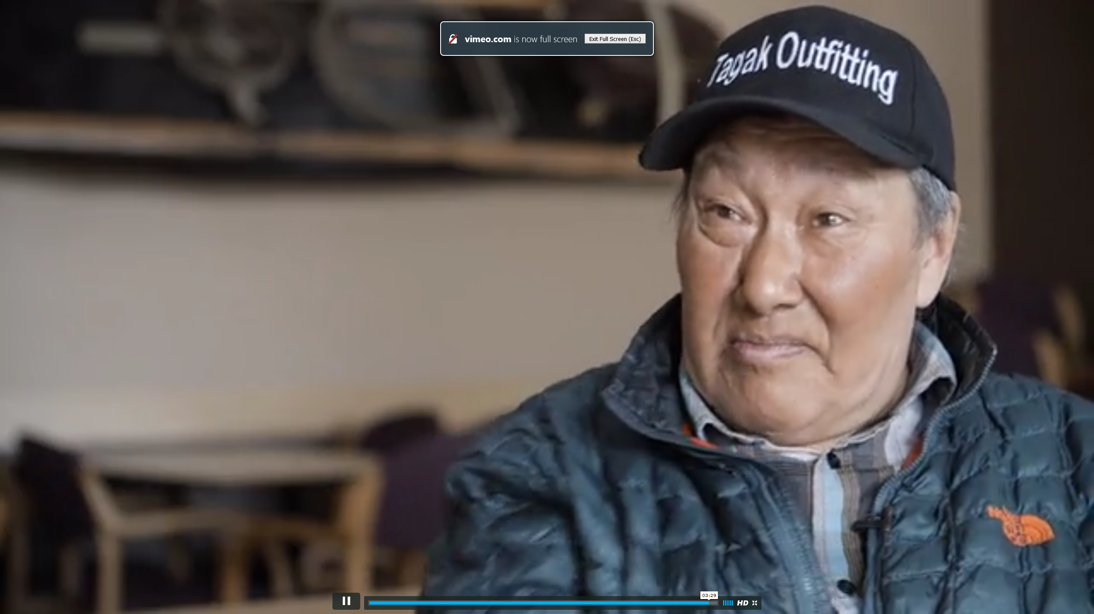
January 20, 2017 Poll #4: How many of you have a blog? The Changing Earth http://thechangingearth.com/

Slide 5
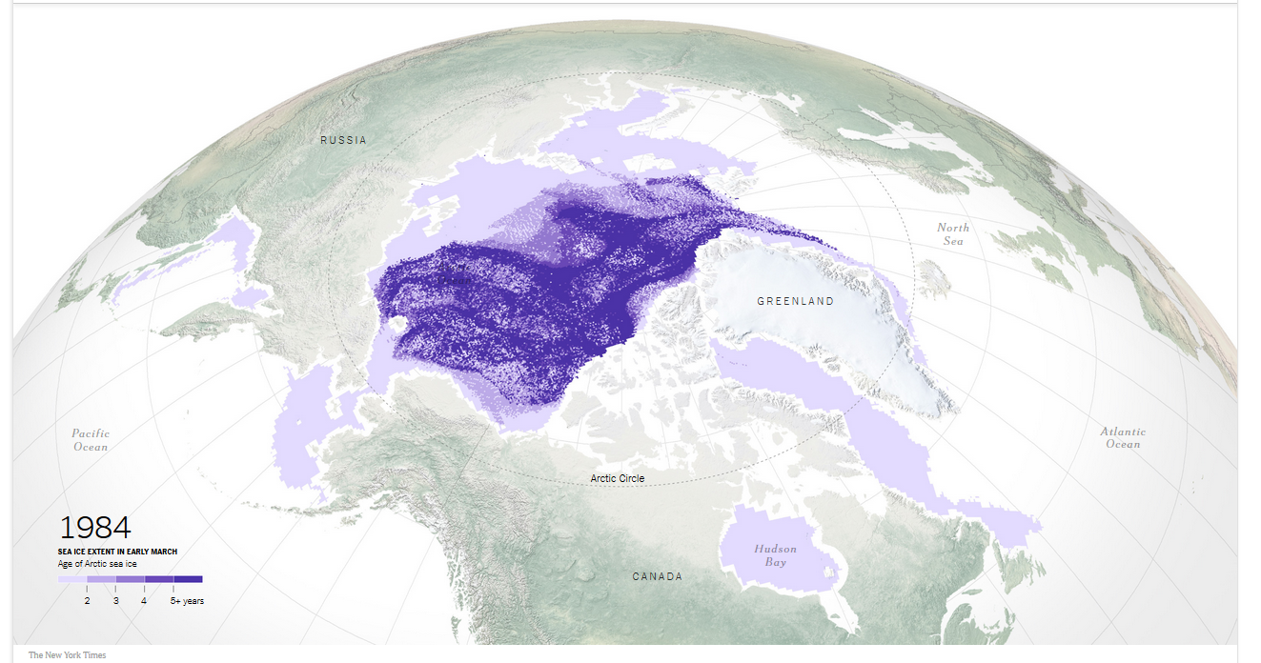
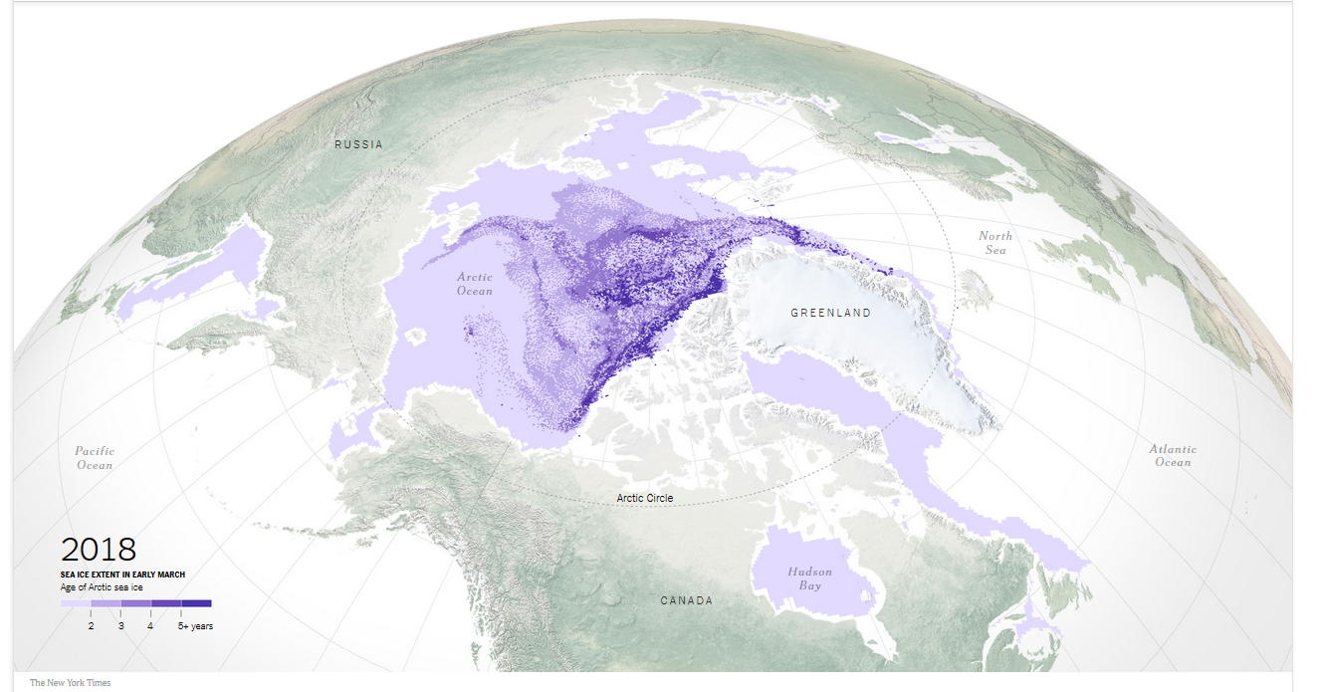
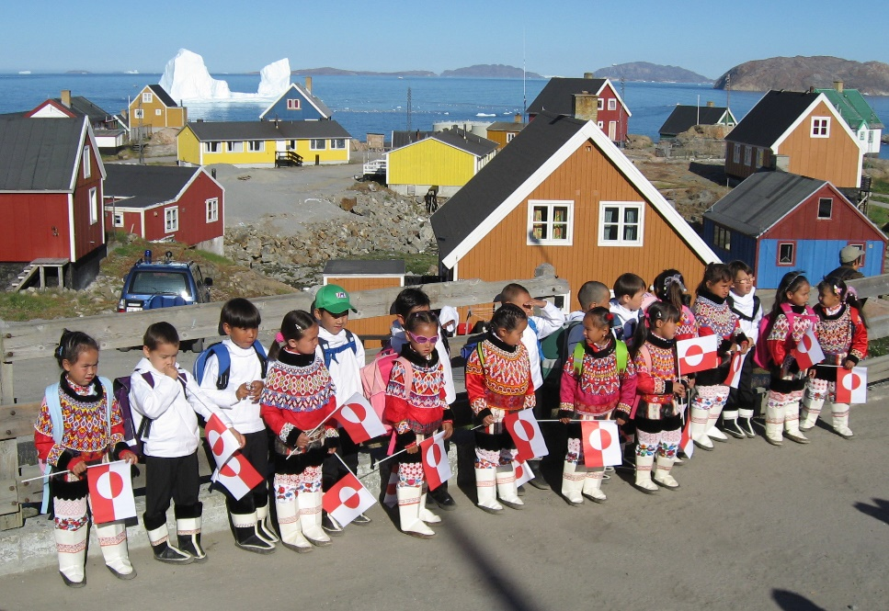
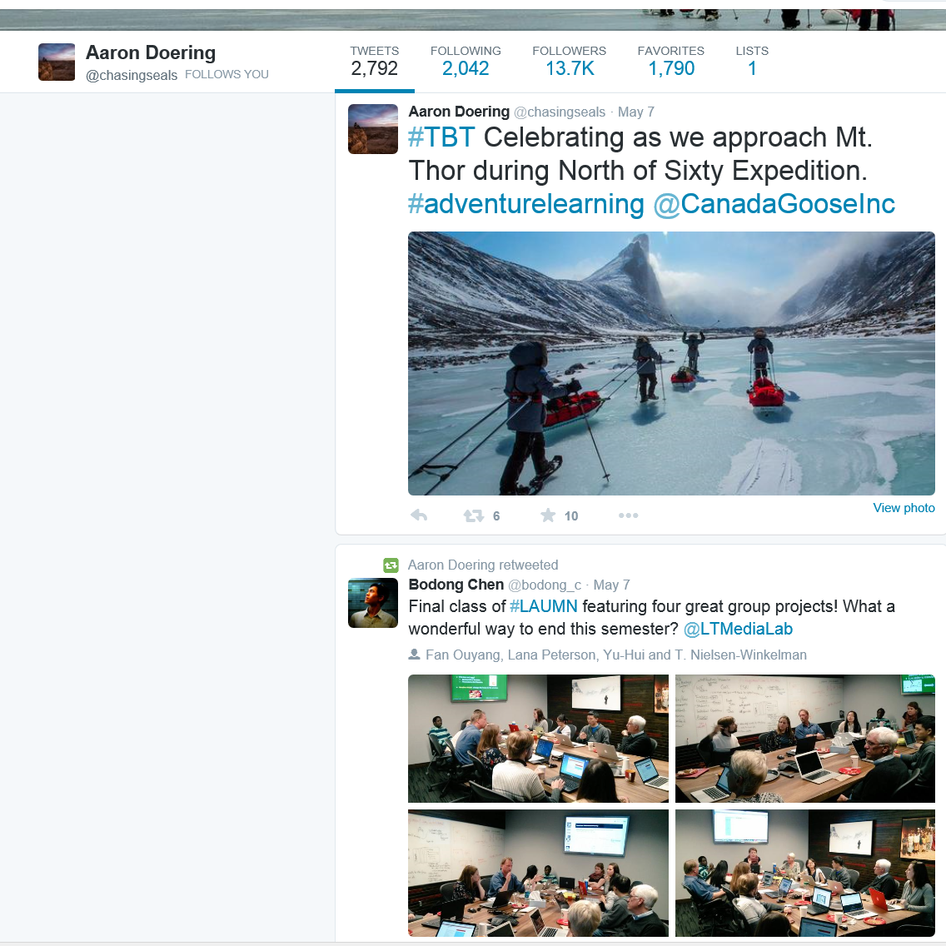
Jan 17, May 14, and June 15, 2018 Poll #5: How many of you have a Twitter Account? Aaron Doering, Chasing Seals, TEDx http://chasingseals.com/ https://twitter.com/chasingseals https://www.nytimes.com/interactive/2018/05/14/climate/arctic-sea-ice.html

Slide 6
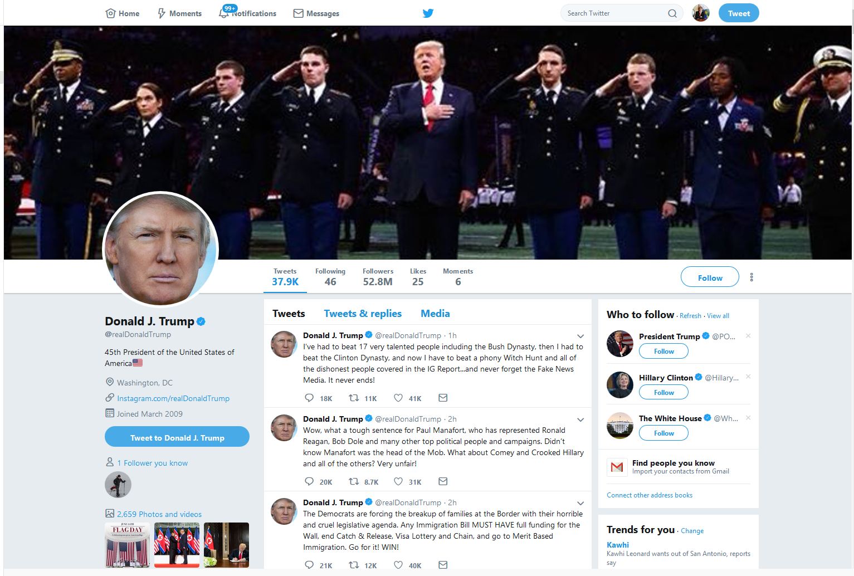
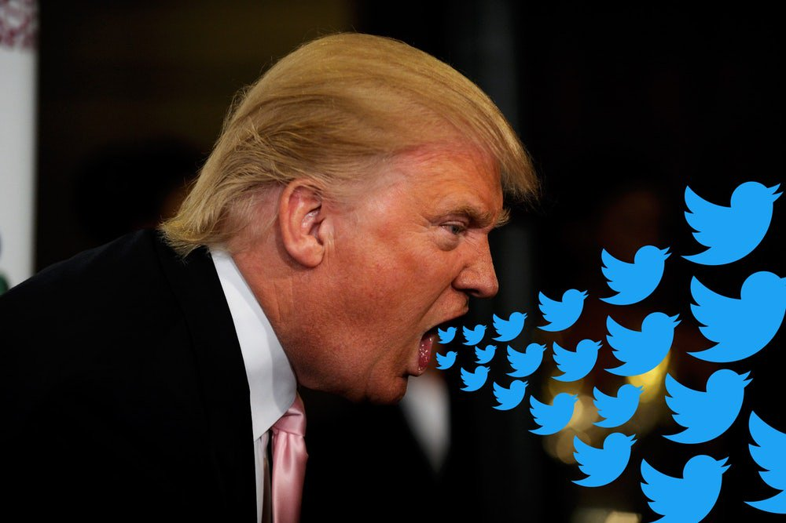
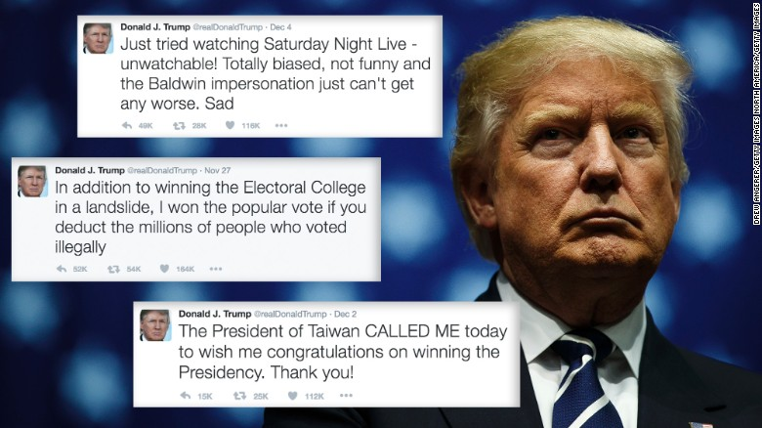
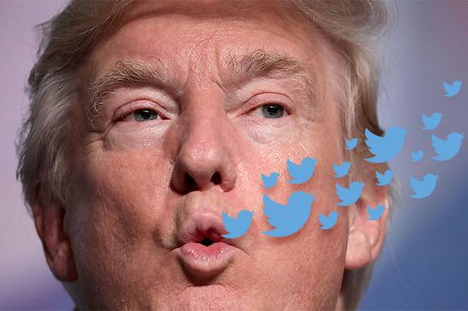
June 15, 2018 Poll #6: How many of you subscribe to a Twitter account? Poll #7: How about this Twitter account? https://twitter.com/realDonaldTrump 8 second snippet: HTML Video #4: http://curtbonk.com/fake-news-4.html HTML Audio #4: http://curtbonk.com/fake-news-audio-4.html 7 second snippet: HTML Video #5: http://curtbonk.com/fake-news-5.html HTML Audio #5: http://curtbonk.com/fake-news-audio-5.html

Slide 7
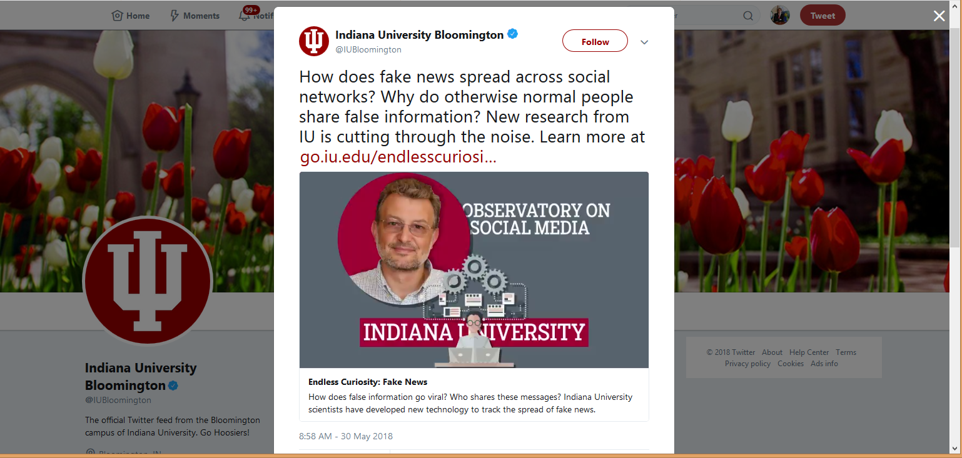
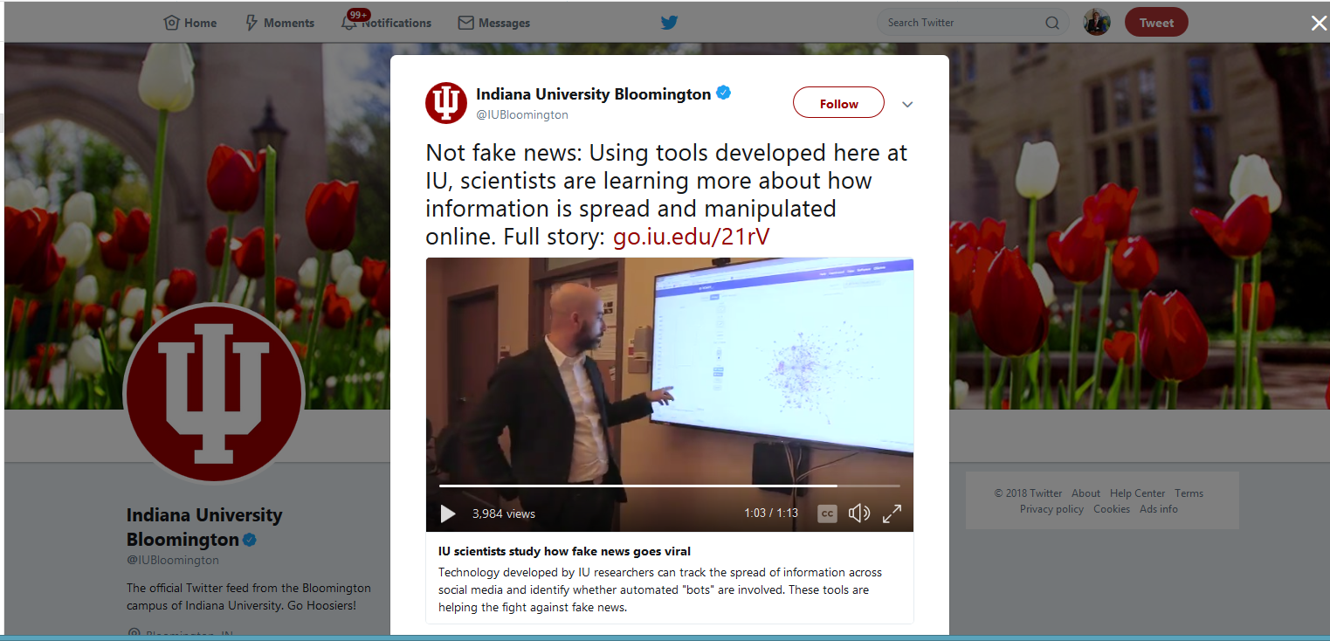
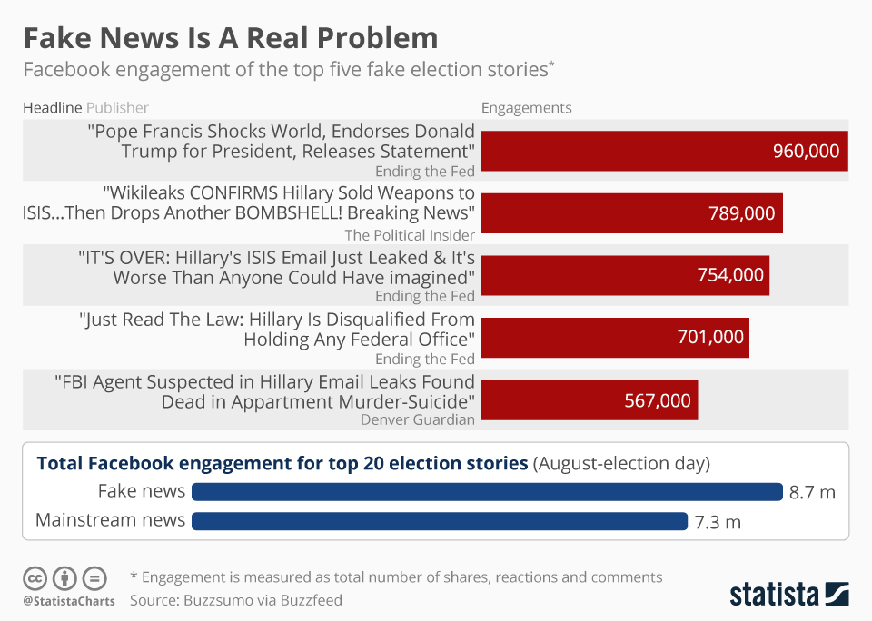
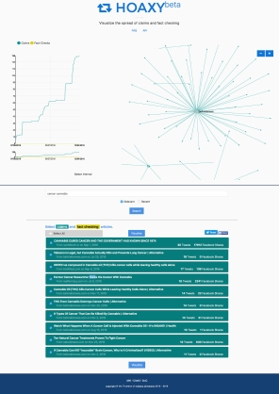
May 30, 2018 Poll #8: Have you heard of Hoaxy? https://hoaxy.iuni.iu.edu/ https://twitter.com/iubloomington/status/1001825139284172801?lang=en https://twitter.com/iubloomington/status/998651640948428801?lang=en

Slide 8
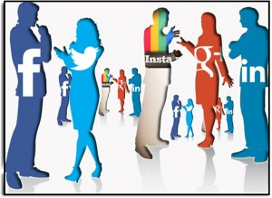
Social Media in General

Slide 9
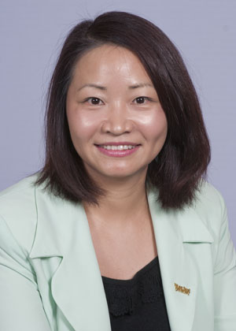
What is Impact of Social Media? Read Review Articles and Systematic Reviews 1. Tess, P. A. (2013). The role of social media in higher education classes (real and virtual)–A literature review. Computers in Human Behavior, 29(5), A60-A68. (e.g., blogs, Twitter, Facebook, LinkedIn, etc.) 2. Gao, F., Luo, T., & Zhang, K. (2012). Tweeting for learning: A critical analysis of research on microblogging in education published in 2008-2011. British Journal of Educational Technology, 43(5), 783-801.

Slide 10
Nada Dabbagh & Anastasia Kitsantas (2012). Personal Learning Environments, social media, and self-regulated learning: A natural formula for connecting formal and informal learning. The Internet and Higher Education, 15(1), 3-8.
Connection between PLE, social media, and self-regulated learning, and provide a framework for using social media to create PLEs that support student self-regulated learning.
Level 1, instructors should encourage students to use social media such as blogs and wikis to create a PLE to engage in self-regulated learning processes (goal setting and planning).
Level 2, instructors should encourage students to use social media to engage in basic sharing and collab activities
Level 3, information aggregation and management, instructors encourage students to use social media to synthesize and aggregate information from Level 1 and 2.

Slide 11
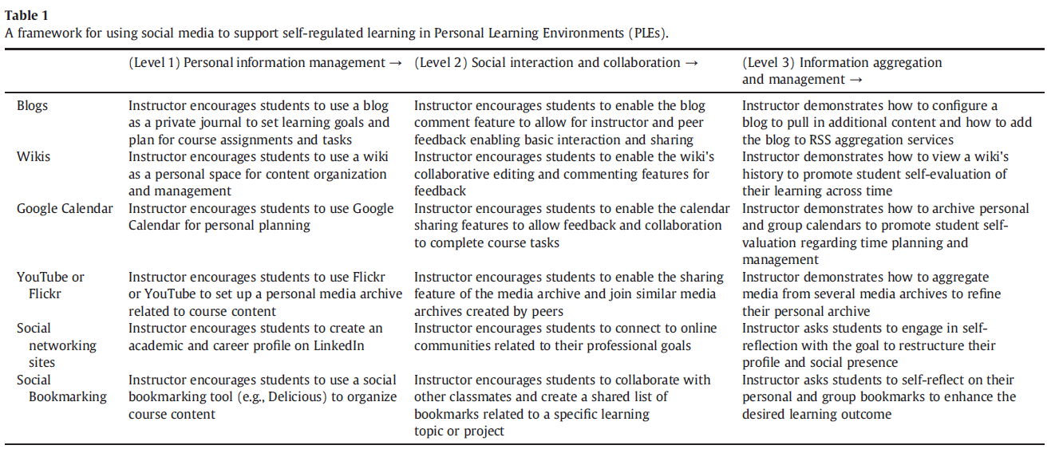
Nada Dabbagh & Anastasia Kitsantas (2012). Personal Learning Environments, social media, and self-regulated learning: A natural formula for connecting formal and informal learning. The Internet and Higher Education, 15(1), 3-8.

Slide 12
Baiyun Chen and Thomas Bryer (2012). Investigating instructional strategies for using social media in formal and informal learning. IRRODL, 13(1), 87-104.
Eight USA public admin instructors participated in telephone interviews about their experiences and perceptions of using social media for teaching and learning.
Informal learning using social media could be facilitated by instructors into formal learning environments for enriched discussions, increased engagement, and broad connections.

Slide 13
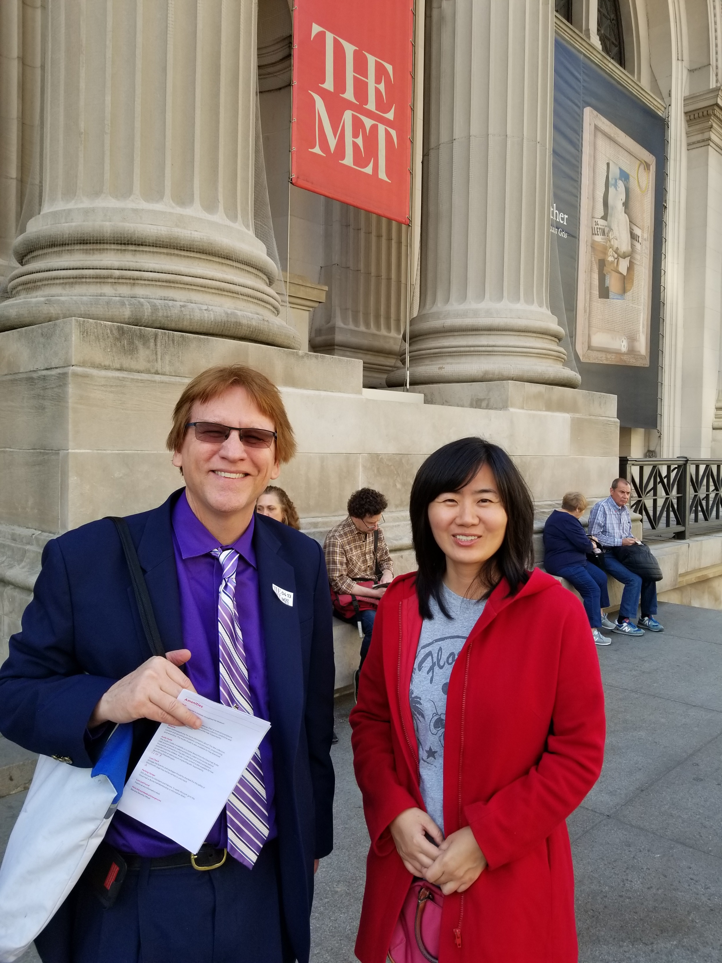
Baiyun Chen and Thomas Bryer (2012). Investigating instructional strategies for using social media in formal and informal learning. IRRODL, 13(1), 87-104.
Conclusions and Advice:
Use social media as tools to facilitate informal discussions and collaborations with clear instructional goals.
Understand that the focus of social media activity for some faculty is learners’ personal interests and preferences, rather than institutional or instructors’ requirements.
Evaluate students’ reflections on their learning via social media in the form of formative assessment.
Use social media as an optional tool inside and outside classes. Provide students with alternative assignments if they choose not to participate.
Educate students about the security and privacy issues of posting personal information online.
Implement institutional policies on the use of social media in the educational environment in light of security/privacy issues, as well as faculty and student support.

Slide 14
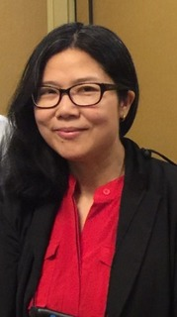
Jin Mao (2014). Social media for learning: A mixed methods study on high school students’ technology affordances and perspectives. Computers in Human Behavior, 33, 213-223.
Investigated high school students’ affordances for social media, their attitudes and beliefs about these new technologies, and related obstacles and issues.
The affordance findings indicate that students depend on social media in their daily lives for leisure and social connections.
Educational uses by teachers for teaching and learning are sporadic.
Uses by students on their own for learning purposes seem to be abundant but also incidental and informal.
Quantitative results suggest that in general, students show positive attitudes and beliefs about social media use in education.

Slide 15
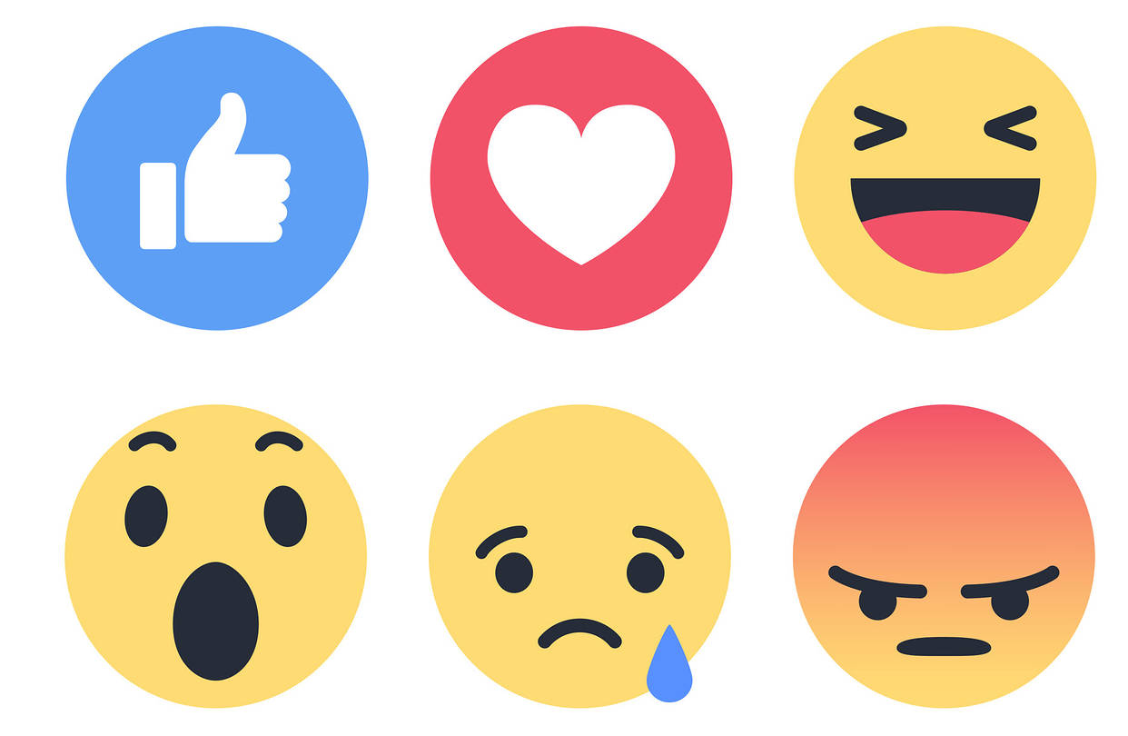
Facebook Research
January 14, 2018, Callum Borchers,
The Washington Post https://www.thestar.com/news/world/2018/01/14/facebook-invites-you-to-live-in-a-bubble-where-youre-always-right.html

Slide 16
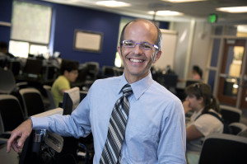
Reynol Junco (2011), The relationship between frequency of Facebook use, participation in Facebook, Computers and Education, 58, 162-171.

Slide 17
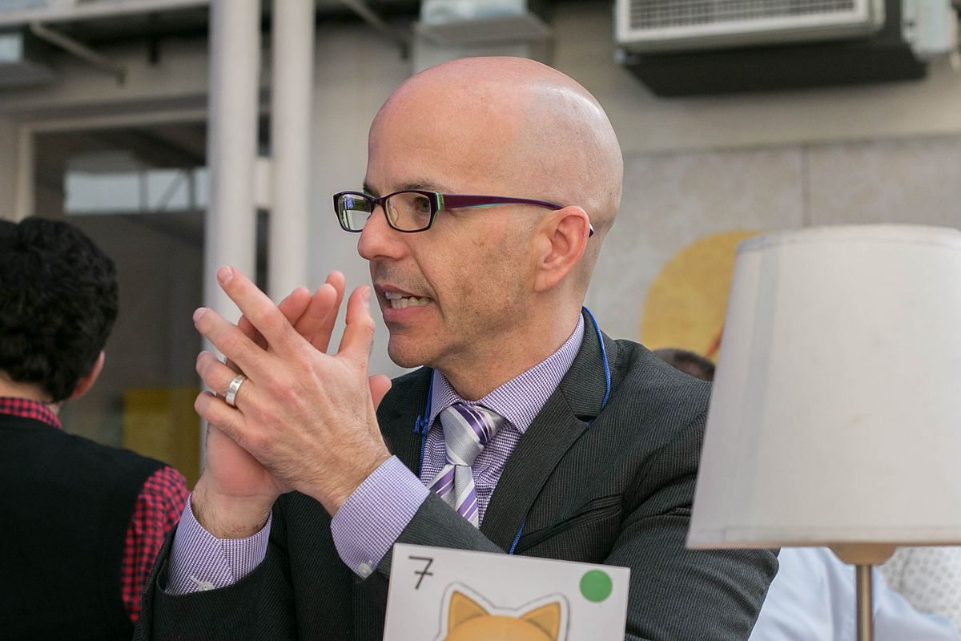
Reynol Junco (2011), The relationship between frequency of Facebook use, participation in Facebook, Computers and Education, 58, 162-171.
Sample = 2,368 college students
Results indicate that Facebook use was significantly negatively predictive of engagement scale score and positively predictive of time spent in co-curricular activities.

Slide 18
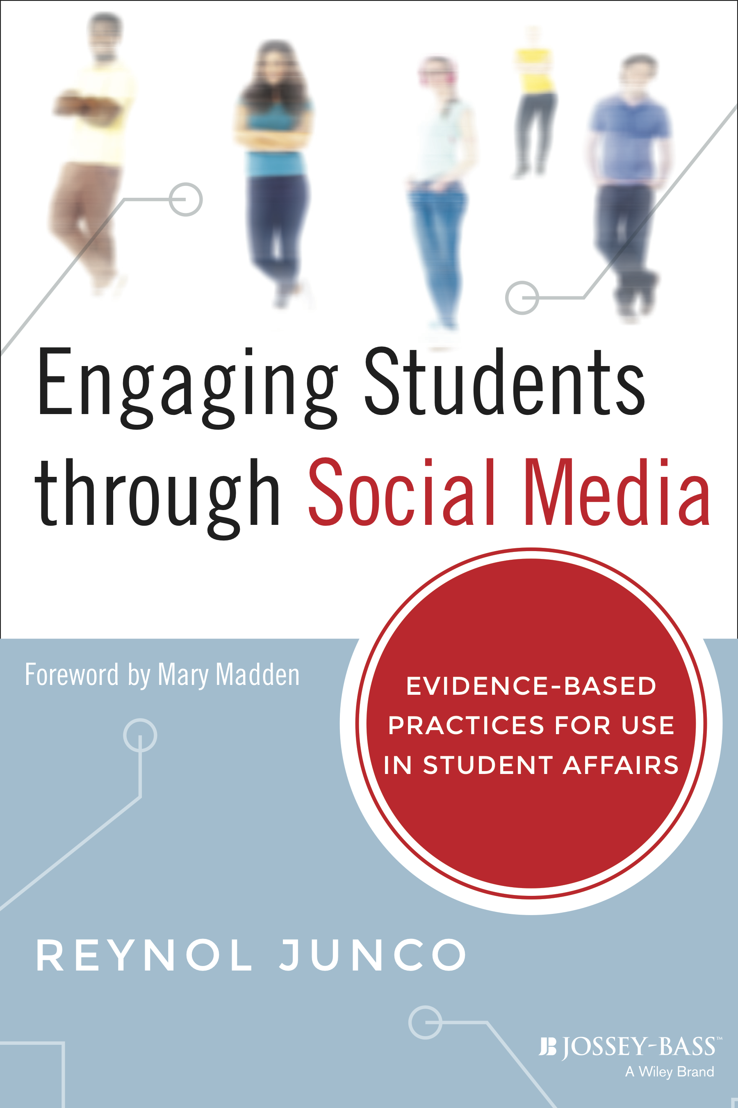
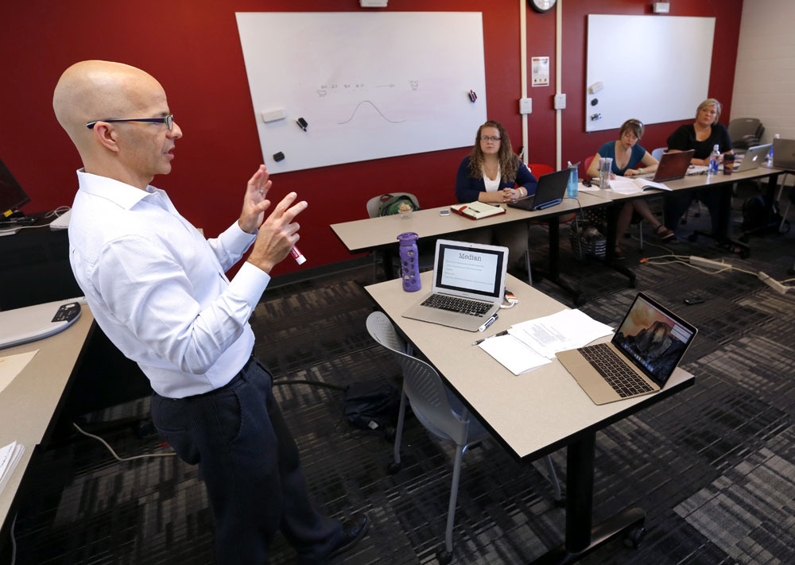
Reynol Junco (2011), Too much face and not enough books: The relationship between multiple indices of Facebook use and academic performance. Computers in Human Behavior.
Sample = 1,839 college students…
Participation in Facebook activities, and time spent preparing for class and actual overall GPA…time spent on Facebook was strongly and significantly negatively related to overall GPA, while only weakly related to time spent preparing for class. Furthermore, using Facebook for collecting and sharing information was positively predictive of the outcome variables while using Facebook for socializing was negatively predictive.

Slide 19
Reynol Junco (2015). Student class standing, Facebook use, and academic performance. Journal of Applied Developmental Psychology, 36, 18-29.
Sample = 1,649 college students…
The results showed that seniors spent significantly less time on Facebook and spent significantly less time multitasking with Facebook than students at other class ranks. Time spent on Facebook was significantly negatively predictive of GPA for freshmen but not for other students. Multitasking with Facebook was significantly negatively predictive of GPA for freshmen, sophomores, and juniors but not for seniors.

Slide 20
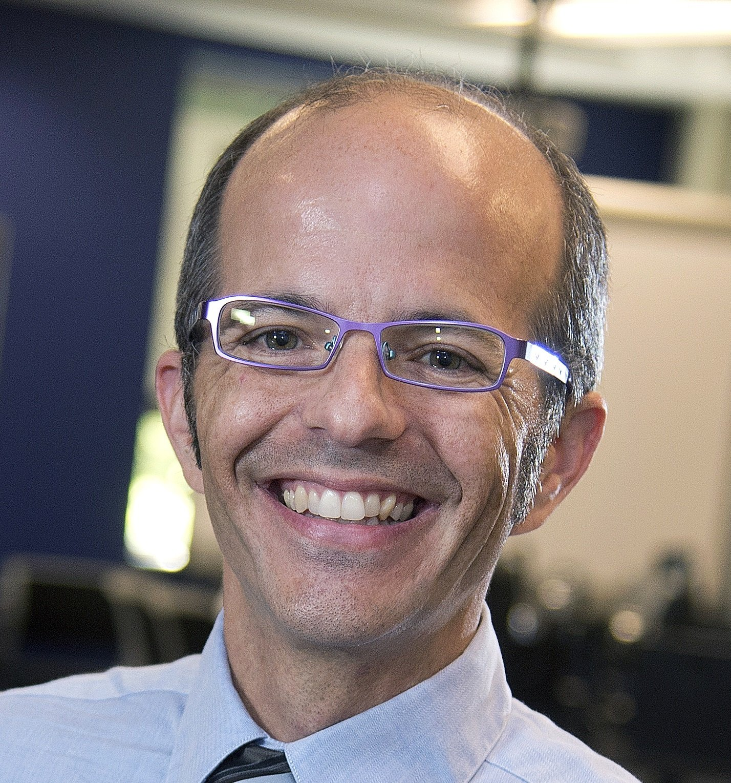
Reynol Junco (2015). Student class standing, Facebook use, and academic performance. Journal of Applied Developmental Psychology, 36, 18-29.

Slide 21
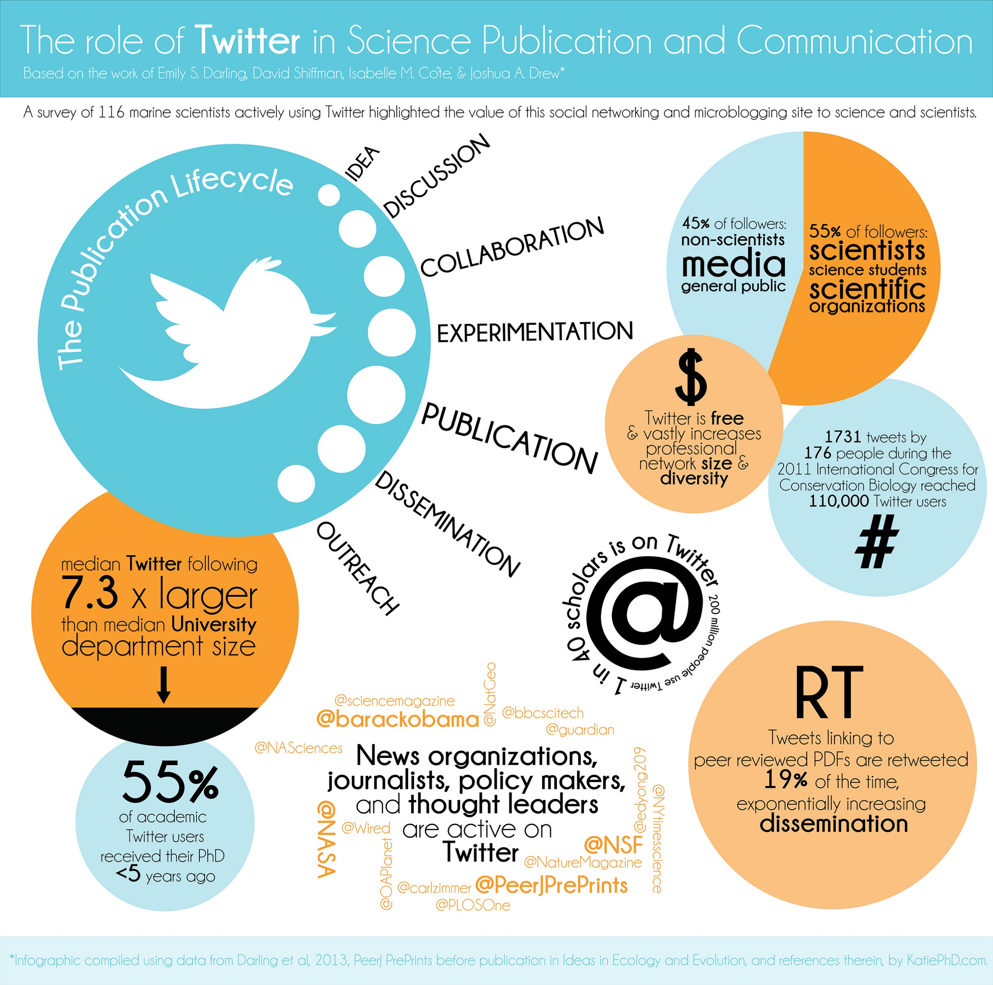
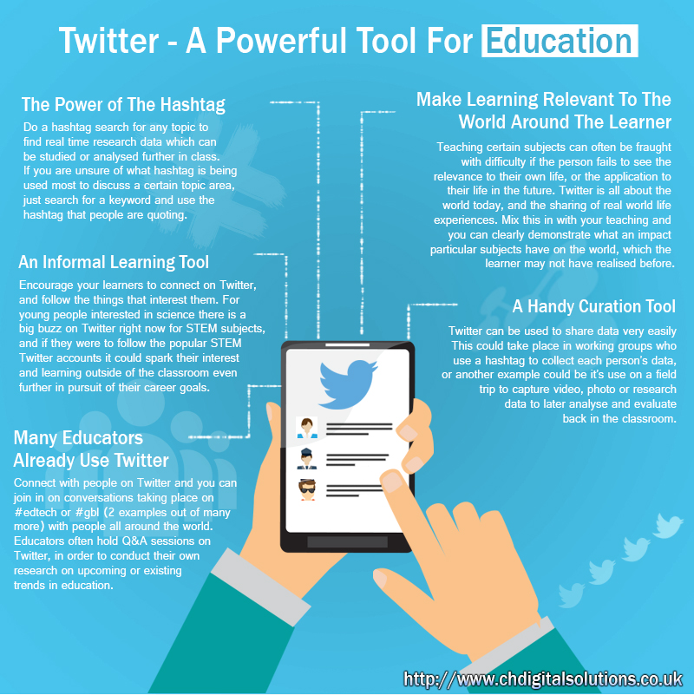
Twitter Research

Slide 22
Reynol Junco, Greg Heiberger, E. Loken (2011) The effect of Twitter on college student engagement and grades. Journal of Computer Assisted Learning, 27(2), 119–132.
Explored 125 students taking a first year seminar course for pre-health professional majors.
Twitter was used for various types of academic and co-curricular discussions.
Engagement Measured by NSSE.
The experimental group had a significantly greater increase in engagement than the control group, as well as higher semester grade point averages.
This study provides experimental evidence that Twitter can be used as an educational tool to help engage students and to mobilize faculty into a more active and participatory role.

Slide 23
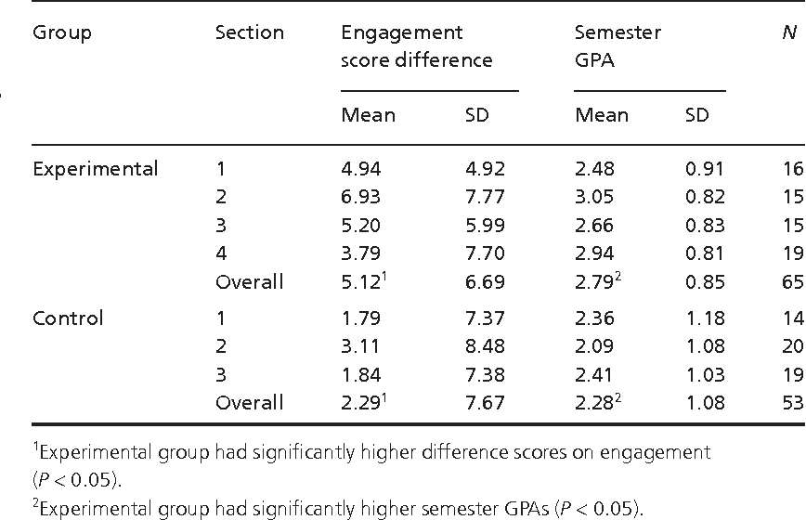
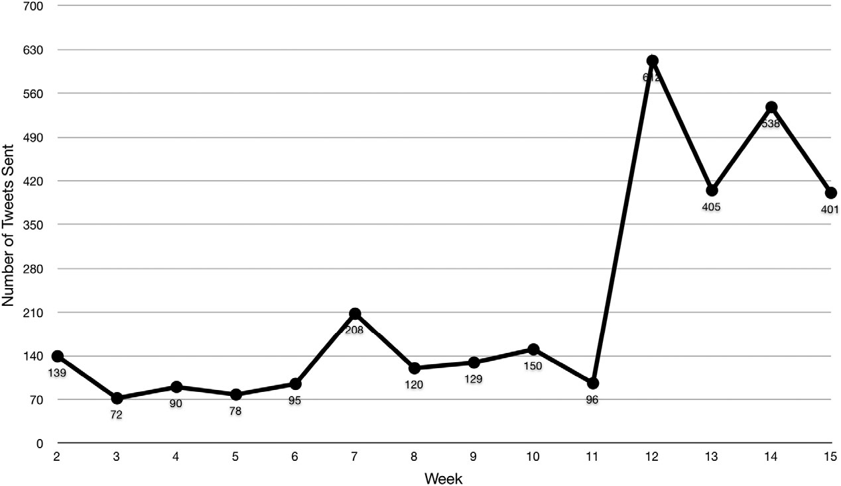
Reynol Junco, Greg Heiberger, E. Loken (2011) The effect of Twitter on college student engagement and grades. Journal of Computer Assisted Learning, 27(2), 119–132.

Slide 24
Reynol Junco, Greg Heiberger, E. Loken (2013) Putting twitter to the test: Assessing outcomes for student collaboration, engagement and success. BJET, 44(2), 273-287.
Study #1 = 125 students (Twitter required half)
Study #2 = 135 students (Twitter voluntary)
Qualitative analyses of tweets and quantitative outcomes show that faculty participation on the platform, integration of Twitter into the course based on a theoretically driven pedagogical model and requiring students to use Twitter are essential components of improved outcomes.

Slide 25
Chris Evans (2014). Twitter for teaching: Can social media be used to enhance the process of learning? BJET, 45(5) Retrieved June 15, 2018 from https://www.learntechlib.org/p/148581/.
Undergraduate students in Business and Management (n = 252) were encouraged to use Twitter for communicating with their tutor and each other during a 12-week course.
Survey amount of Twitter usage and students’ attitudes and experiences.
Positive correlation between amount of Twitter usage and student engagement in university-associated activities including organizing their social lives and sharing information.
Course-related tweeting was not related to interpersonal
relationships between students and their tutor.
Twitter usage did not impact class attendance.

Slide 26
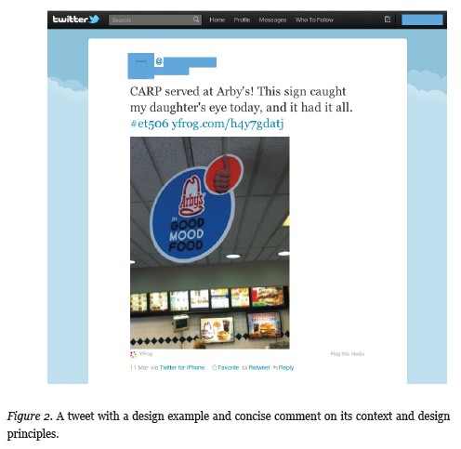
Hsu, Y. C., & Ching, Y. H. (2012). Mobile microblogging: Using Twitter and mobile devices in an online course to promote learning in authentic contexts. IRRODL, 13(4), 211-227.
How best to promote learning in authentic contexts in an online graduate course in instructional message design. The 16 students used Twitter apps on their mobile devices to collect, share, and comment on authentic design examples found in their daily lives.
Positive perceptions toward mobile microblogging.
Students were mainly engaged in assignment-relevant activities.
Appropriately applied design principles and terms.
Spontaneously generated social tweets as related to their own life experiences.
Peer design examples through mobile microblogging were inspiring.

Slide 27
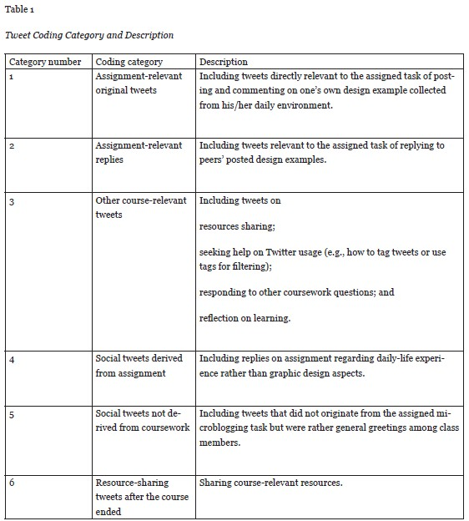
Hsu, Y. C., & Ching, Y. H. (2012). Mobile microblogging: Using Twitter and mobile devices in an online course to promote learning in authentic contexts. IRRODL, 13(4), 211-227.

Slide 28
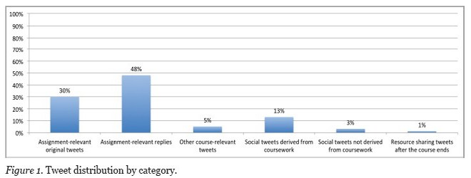
Hsu, Y. C., & Ching, Y. H. (2012). Mobile microblogging: Using Twitter and mobile devices in an online course to promote learning in authentic contexts. IRRODL, 13(4), 211-227.

Slide 29
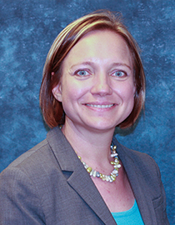
Shannon B. Rinaldo, Suzanne Tapp, Debra A. Laverie (2011). Learning by tweeting: Using Twitter as a pedagogical tool. Journal of Marketing Education, 33(2), 193-203.
Twitter has many benefits for marketing educators who are interested in engaging students in experiential learning.
In a real-time environment for student learning, professors may use Twitter for direct communication with students to generate discussion and interest in the course topics and examples.
Educators can use Twitter to generate interest in a course through social media.
Twitter is a fast, easy method for making announcements, solving student issues, and performing course-related administrative duties.
In three studies, both quantitative and qualitative data suggest that when students engage in Twitter use with the professor, students feel better prepared for future careers. Students indicate that Twitter facilitates achieving traditional educational goals.

Slide 30
Gao, F., Luo, T., & Zhang, K. (2012). Tweeting for learning: A critical analysis of research on microblogging in education published in 2008–2011. BJET, 43(5), 783-801.
This study critically analyzed the current body of published research on microblogging in education (MIE) to build a deep and comprehensive understanding of this increasingly popular phenomenon. Twenty-one studies on MIE in 2008–2011 were selected based on the selection criteria.
The analysis suggests that microblogging has a potential to encourage participation, engagement, reflective thinking as well as collaborative learning under different learning settings. The quality of research, however, varies greatly, suggesting a need for rigorous research on MIE.

Slide 31
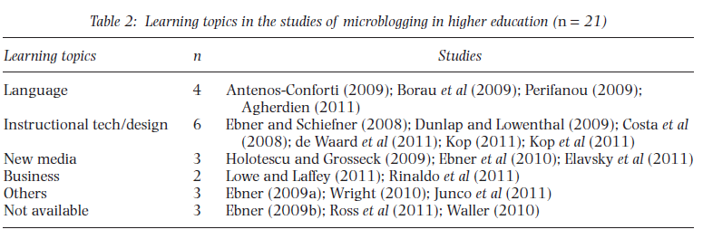
Gao, F., Luo, T., & Zhang, K. (2012). Tweeting for learning: A critical analysis of research on microblogging in education published in 2008–2011. British Journal of Educational Technology, 43(5), 783-801.

Slide 32
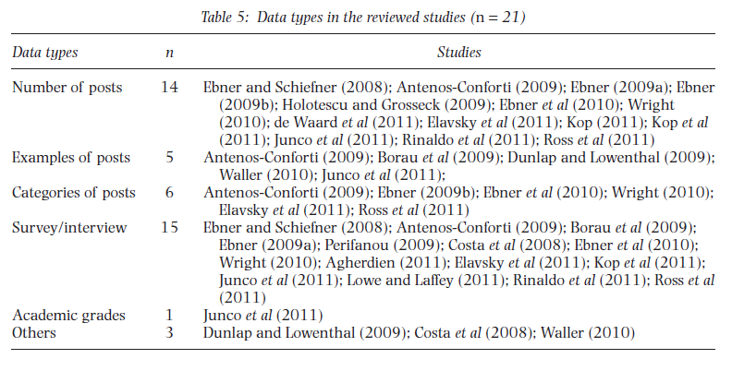
Gao, F., Luo, T., & Zhang, K. (2012). Tweeting for learning: A critical analysis of research on microblogging in education published in 2008–2011. British Journal of Educational Technology, 43(5), 783-801.

Slide 33
Gao, F. & Li, L. (2017). Examining a one-hour synchronous chat in a microblogging-based professional development community. British Journal of Educational Technology. 48(2), 332-347. doi:10.1111/bjet.12384
The purpose of the study is to understand how people interacted in a popular microblogging-based learning community by examining a one-hour synchronous chat event and exploring its network structure, levels of participation, major topics generated, and types of interaction.
The study found that the online synchronous chat that occurred among the members of the #edchat Twitter community for educators was dominated by a group of active members.
These active members not only generated a large volume of tweets but also interacted actively with other participants.
However, about half of all members tweeted only once, and the majority of the members had limited connections with others.

Slide 34
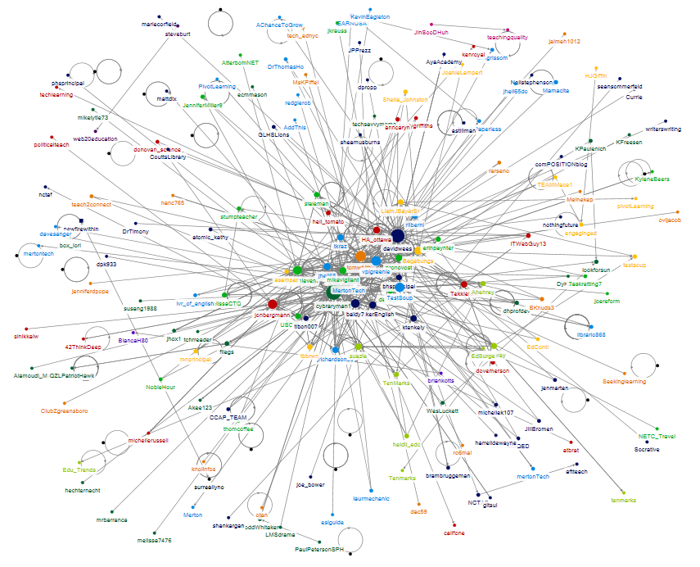
Gao, F. & Li, L. (2017). Examining a one-hour synchronous chat in a microblogging-based professional development community. British Journal of Educational Technology. 48(2), 332-347. doi:10.1111/bjet.12384
Figure 1: Overall networking structure with degree mapped to size

Slide 35
Gao, F. & Li, L. (2017). Examining a one-hour synchronous chat in a microblogging-based professional development community. British Journal of Educational Technology. 48(2), 332-347. doi:10.1111/bjet.12384
Figure 3: Percentages of tweets by types of interaction
GS: General Statement; NT: New Topic; BLD: Building; SP: Supporting; PE: Personal Experience Sharing; SCL: Socializing; FCL: Facilitating; RS: Sharing Resources; RT: Retweeting

Slide 36
Gao, F. & Li, L. (2017). Examining a one-hour synchronous chat in a microblogging-based professional development community. British Journal of Educational Technology. 48(2), 332-347. doi:10.1111/bjet.12384
Figure 4: Number of content-focused tweets generated in every five minutes

Slide 37
Gao, F. & Li, L. (2017). Examining a one-hour synchronous chat in a microblogging-based professional development community. British Journal of Educational Technology. 48(2), 332-347. doi:10.1111/bjet.12384
Figure 5: Percentages of tweets by major topics

Slide 38
Xin, W. & Gao, F. (submitted) Exploring the relationship between online discourse and commitment in Twitter professional learning communities.
Investigated how some key features of online discourse influenced the continued participation of the members of a Twitter-based professional development community.
More than 600,000 tweets generated over six years under the hashtag #edchat were gathered.
Online discourse were deconstructed to the cognitive dimension, the interactive dimension, and the social dimension. Text-mining methods and survival analysis...
The results revealed that the more tweets in the cognitive and interactive dimensions that the members were exposed to, the lower was their risk of dropping out.
Tweets in the interactive dimension had slightly stronger influences than did tweets in the cognitive dimension.

Slide 39
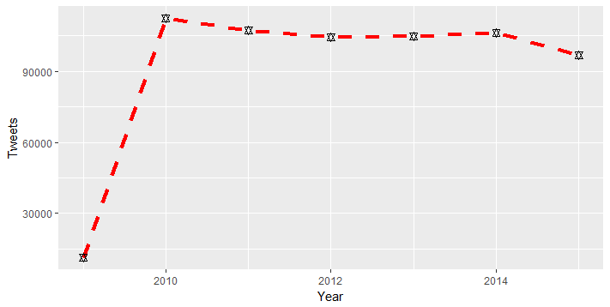
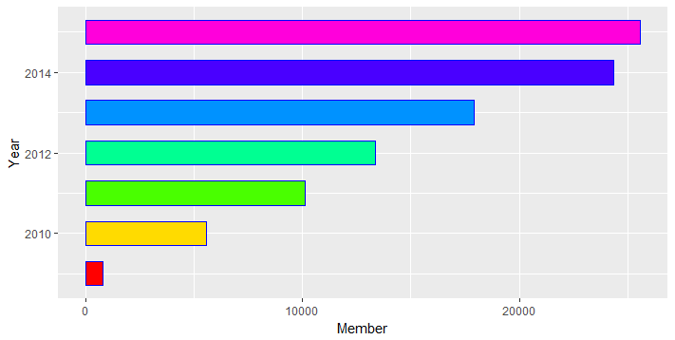
Xin, W. & Gao, F. (submitted) Exploring the relationship between online discourse and commitment in Twitter professional learning communities.
The number of tweets over time.
The number of tweets over time.
Figure 1. Descriptive statistics of the #edchat community

Slide 40
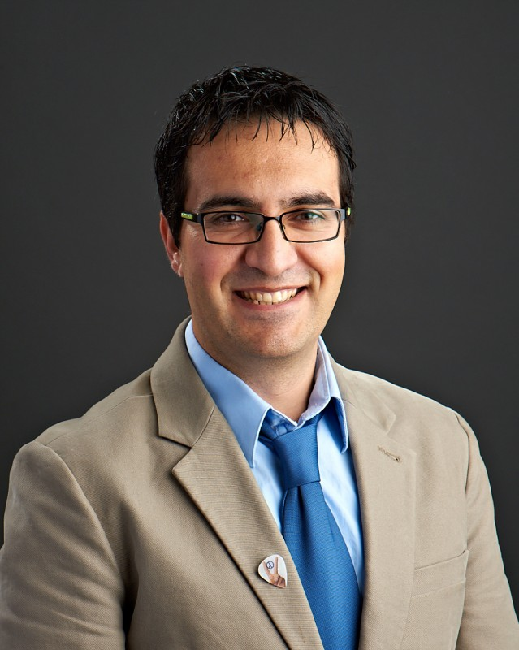
Veletsianos, G. (2012). Higher education scholars' participation and practices on Twitter. Journal of Computer Assisted Learning, 28(4), 336-349.
The study was to understand 45 scholars’ naturalistic practices on Twitter in particular…scholars participating on Twitter:
Shared information, resources, and media relating to their professional practice.
Shared information about their classroom and their students.
Requested assistance from and offered suggestions to others.
Sought to network and make connections with others.

Slide 41
George Veletsianos & Royce Kimmons (2016). Scholars in an increasingly open and digital world: How do education professors and students use Twitter?. The Internet and Higher Education, 30, 1-10.
This study examined education scholars' (professors' and doctoral students') social media participation by using data mining methods to capture a large data set of scholars' participation on Twitter (232 students, 237 professors, 74,814 unique hashtags, and 645,579 tweets).
Significant variation in how ed scholars participate on Twitter.
Question purported egalitarian structures of social media use for scholarship.
Suggest that by focusing on the use of social media for scholarship researchers have only examined a fragment of scholars' online activities, possibly ignoring other areas of online presence.
Implications: Must consider the meaningfulness of alternative metrics for determining scholarly impact.

Slide 42
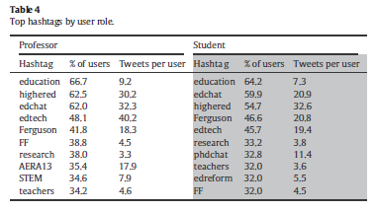
Veletsianos, G., & Kimmons, R. (2016). Scholars in an increasingly open and digital world: How do education professors and students use Twitter?. The Internet and Higher Education, 30, 1-10.

Slide 43
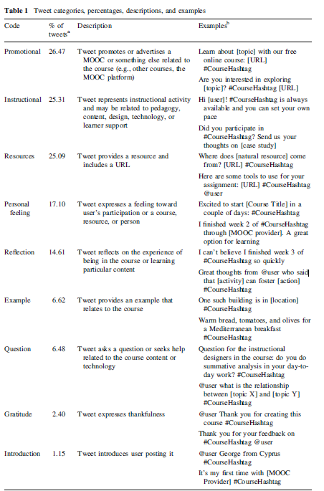
Veletsianos, G. (2017). Toward a generalizable understanding of Twitter and social media use across MOOCs: Who participates on MOOC hashtags and in what ways?. Journal of Computing in Higher Ed., 29(1), 65-80

Slide 44
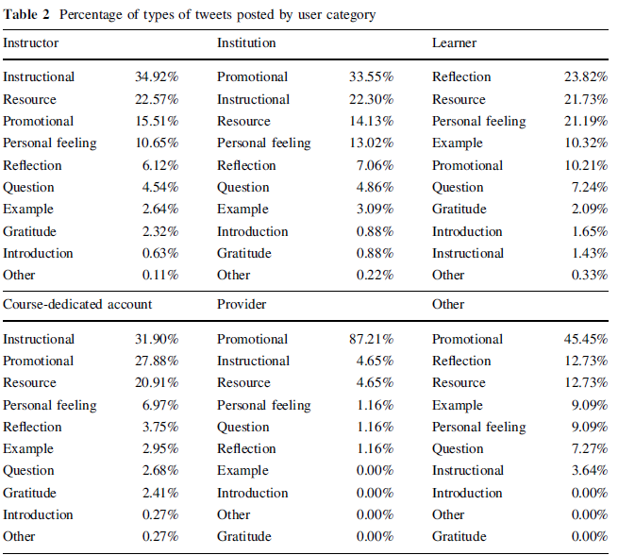
Veletsianos, G. (2017). Toward a generalizable understanding of Twitter and social media use across MOOCs: who participates on MOOC hashtags and in what ways?. Journal of Computing in Higher Ed., 29(1), 65-80

Slide 45
Veletsianos, G. (2017). Toward a generalizable understanding of Twitter and social media use across MOOCs: who participates on MOOC hashtags and in what ways?. Journal of Computing in Higher Ed., 29(1), 65-80
This study provides little evidence to support the claim that social media can increase participation in the context of Twitter as an adjunct to MOOCs.
Results show that learners make up only about 45% of users and contribute only about 35% of tweets. The majority of users contribute minimally, and an active minority of users contributes the preponderance of messages.
Suggests that learners did not find Twitter to be a useful space that provided added value or responded to their needs.
Results demonstrate the need for greater intentionality in integrating social media into MOOCs.

Slide 46
Future Directions
Limited research still exists on the use of social media like Facebook as an online learning platform.
Cross-cultural comparison research might indicate how social media impact learning in different cultures and various regions of the world.
Research could examine whether and in what ways MOOC users’ participation may vary across disciplines and across social media (Veletsianos, 2017).
It would be of considerable interest for future studies to assess which aspects of the learning process can be improved by Twitter and social media more generally (Evans, 2014).

Slide 47
Future Directions (Fei Gao, June 15, 2018)
How to provide guidance or structures in social media-based learning environments to support community building and knowledge co-construction.
How to encourage participants use social media for sustained engagement.
How to effectively combine informal learning with social media with other forms of formal learning.
How to develop automatic grouping mechanism to form groups/communities.
Automate analysis of online discourse to understand the individual or group processes of meaning-making or knowledge building.
Need for social media and AI for just-in-time training/learning.

Slide 48
Curtis J. Bonk, IU, cjbonk@indiana.edu
Meina Zhu, IU, meinzhu@iu.edu
Slides and Proceedings Paper at TrainingShare.com: http://www.trainingshare.com (go to “Archived Talks”)
http://curtbonk.com/Syllabus_R678_Spring_of_2018.htm

