Slide 1
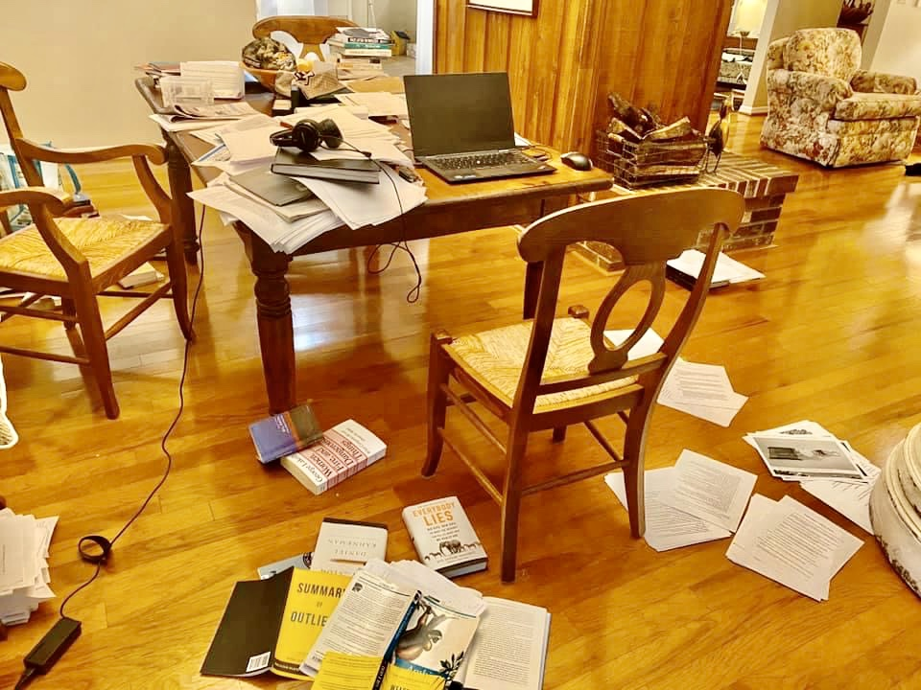
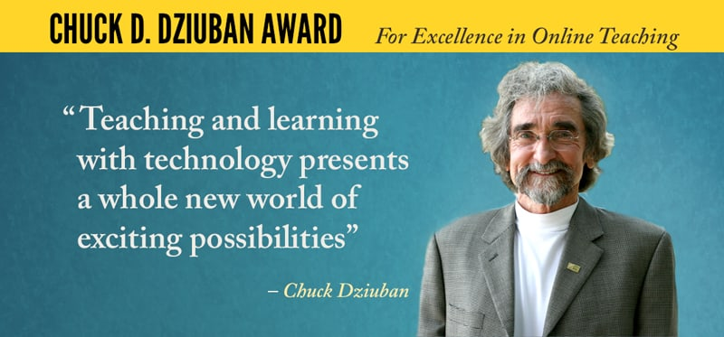
1. Chuck Dziuban, University of Central Florida https://sciences.ucf.edu/statistics/dms/people/board/charles-d-dziuban/ A typical Chuck writing space: 1. The way to learn to write is to write. 2. The first draft is always crap. 3. Progress is best made in bite sized chunks. 4. From Hemingway, “Write drunk, edit sober.” 😃

Slide 2
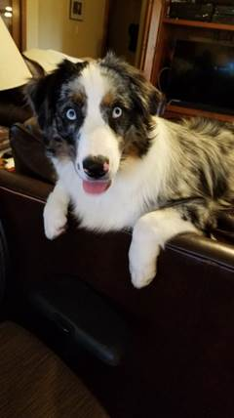
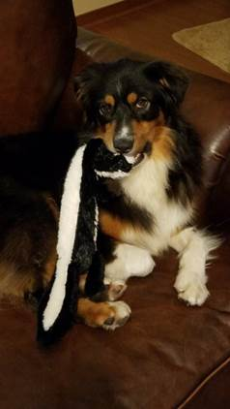
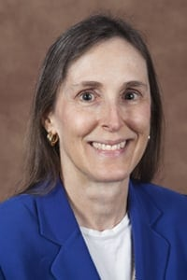
2. Patsy D. Moskal, University of Central Florida Director, Digital Learning Impact Evaluation https://digitallearning.ucf.edu/contact/

Slide 3
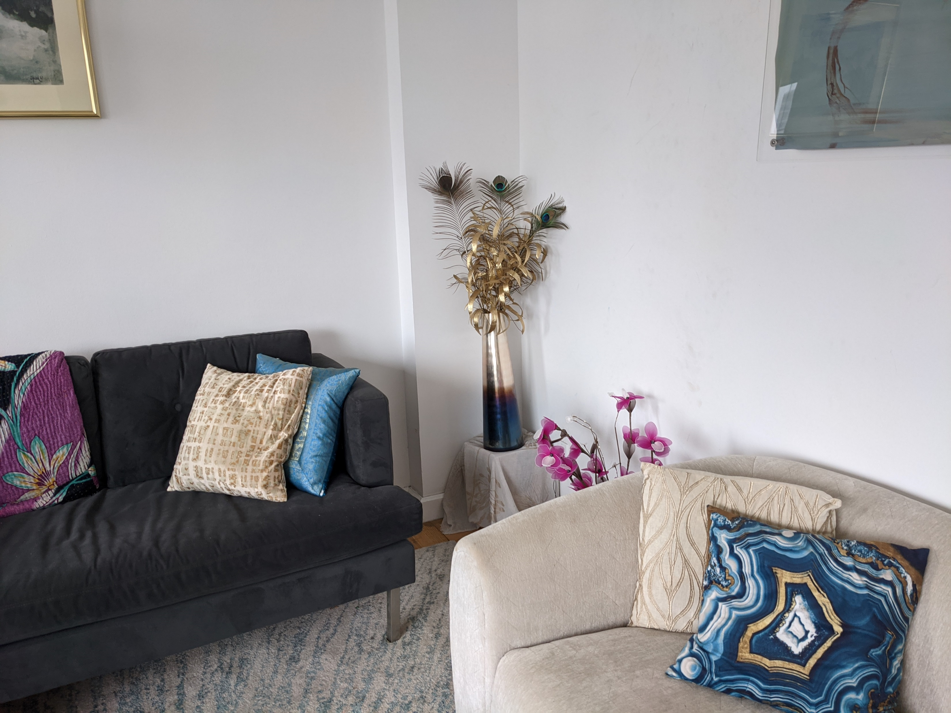
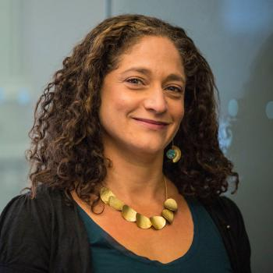
3. Alyssa Friend Wise | Director, NYU Learning Analytics Research Network (NYU-LEARN) Associate Professor of Learning Sciences & Educational Technology | New York University https://steinhardt.nyu.edu/people/alyssa-wise

Slide 4
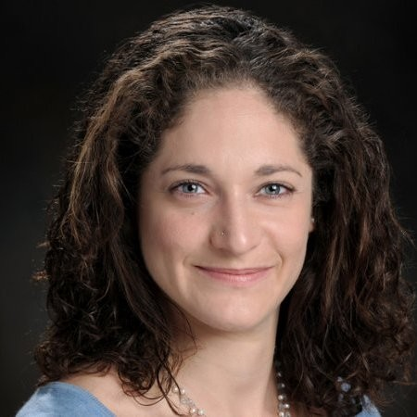
3. Alyssa Friend Wise, Director, NYU Learning Analytics Research Network (NYU-LEARN), Associate Professor of Learning Sciences & Educational Technology, New York University
I've always had my "writing space" separate from my "getting lots of things done efficiently space.”
Find a physical space that helps gets you in the right head space.
Similar with time, find when works for you (for me it is first thing in the morning before I look at email and think about the other things I have to do, and mornings on Friday are especially good b/c I try to hold this as a writing day with few meetings).
And the last one would be, just get words flowing down on paper however you can - editing is *much* easier than creating from scratch and the first version doesn't need to be anywhere close to good. So my first round sentences might look like "Thus, there is an imperative for the field of learning analytics to take a human-centered orientation, both b/c our goal is to make a real difference in the world and XXX" (point being (a) "make a real difference" is not text I would ever put in a published piece, but it gets the idea out for now and (b) I know there is a second reason but can't formulate it yet so I put the X's - both keep me going to get out 10 starting point sentences, rather than stopping to make 1 perfect one).
Oh, and if your logic structure is mess, try backwards outlining!

Slide 5
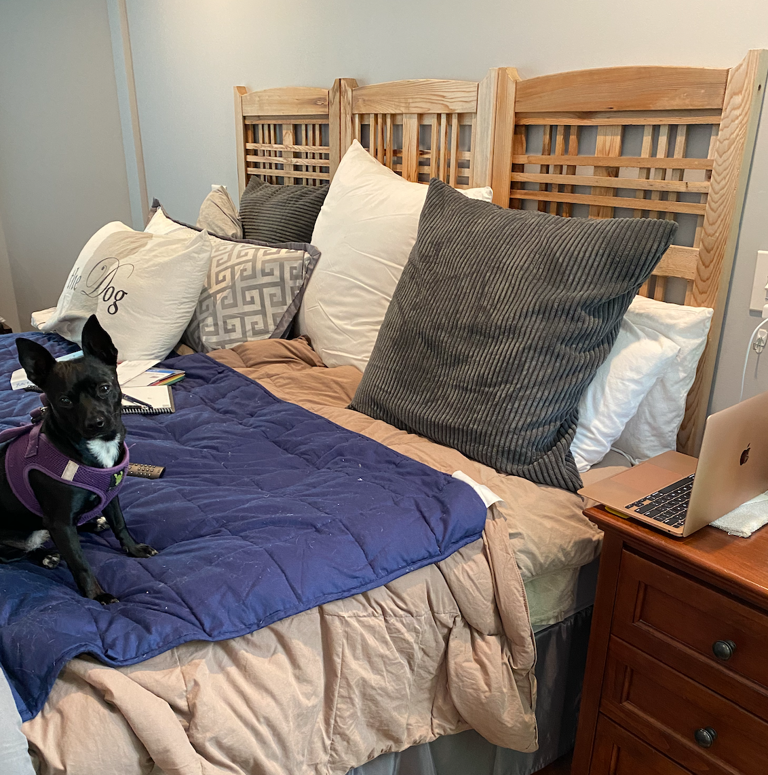
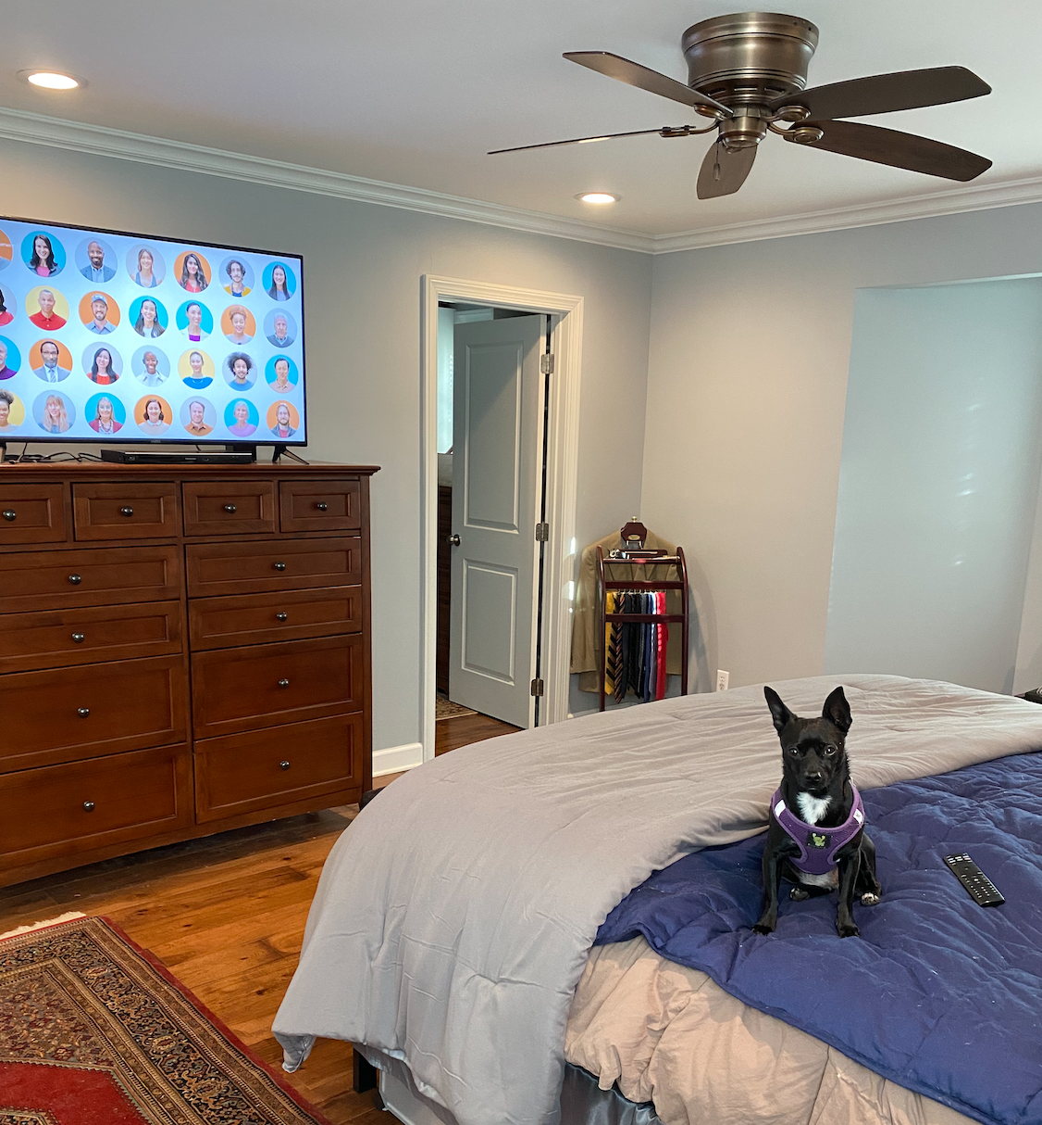
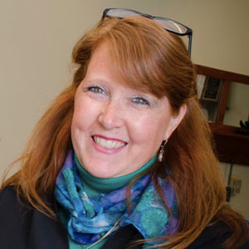
4. Ali Carr-Chellman, Dean University of Dayton https://udayton.edu/directory/education/deans_office/carr-chellman_alison.php

Slide 6
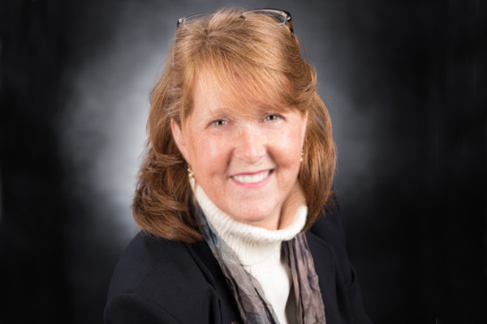
4. Ali Carr-Chellman, Dean University of Dayton https://udayton.edu/directory/education/deans_office/carr-chellman_alison.php
Writing Tips:
Write all the time, if you have 5 minutes use it to write, don’t wait for those big blocks of time just write all the time. And if you are responding with a sigh and rolled eye, ask yourself if you really love writing. Don’t try to be an academic if you don’t really love writing.
Take DEEP WORK DAYS—this is absolutely essential to get some of those larger blocks of time that you need for real reading, reflection and thinking. Take one day a week if at all possible and try to keep everything off the calendar, work from home on that day if it’s a good workplace for you.
Don’t wait till it’s perfect—send your writing into the world as soon as you can stomach it. You will be a significant critic of your own work, so get it out for peer review, submission to journals, etc. as soon as you can stand to do it. Remember, it will never be perfect.
Don’t take it personally—make sure that when you get reviews you put on your thickest skin and don’t be upset by what people say. Reviews are very mediated, so too often reviewers are not kind, they can be mean or cruel. It’s unfortunate, but true. We’ve all dealt with it, and I don’t see that process or the tenor of it changing anytime soon.

Slide 7
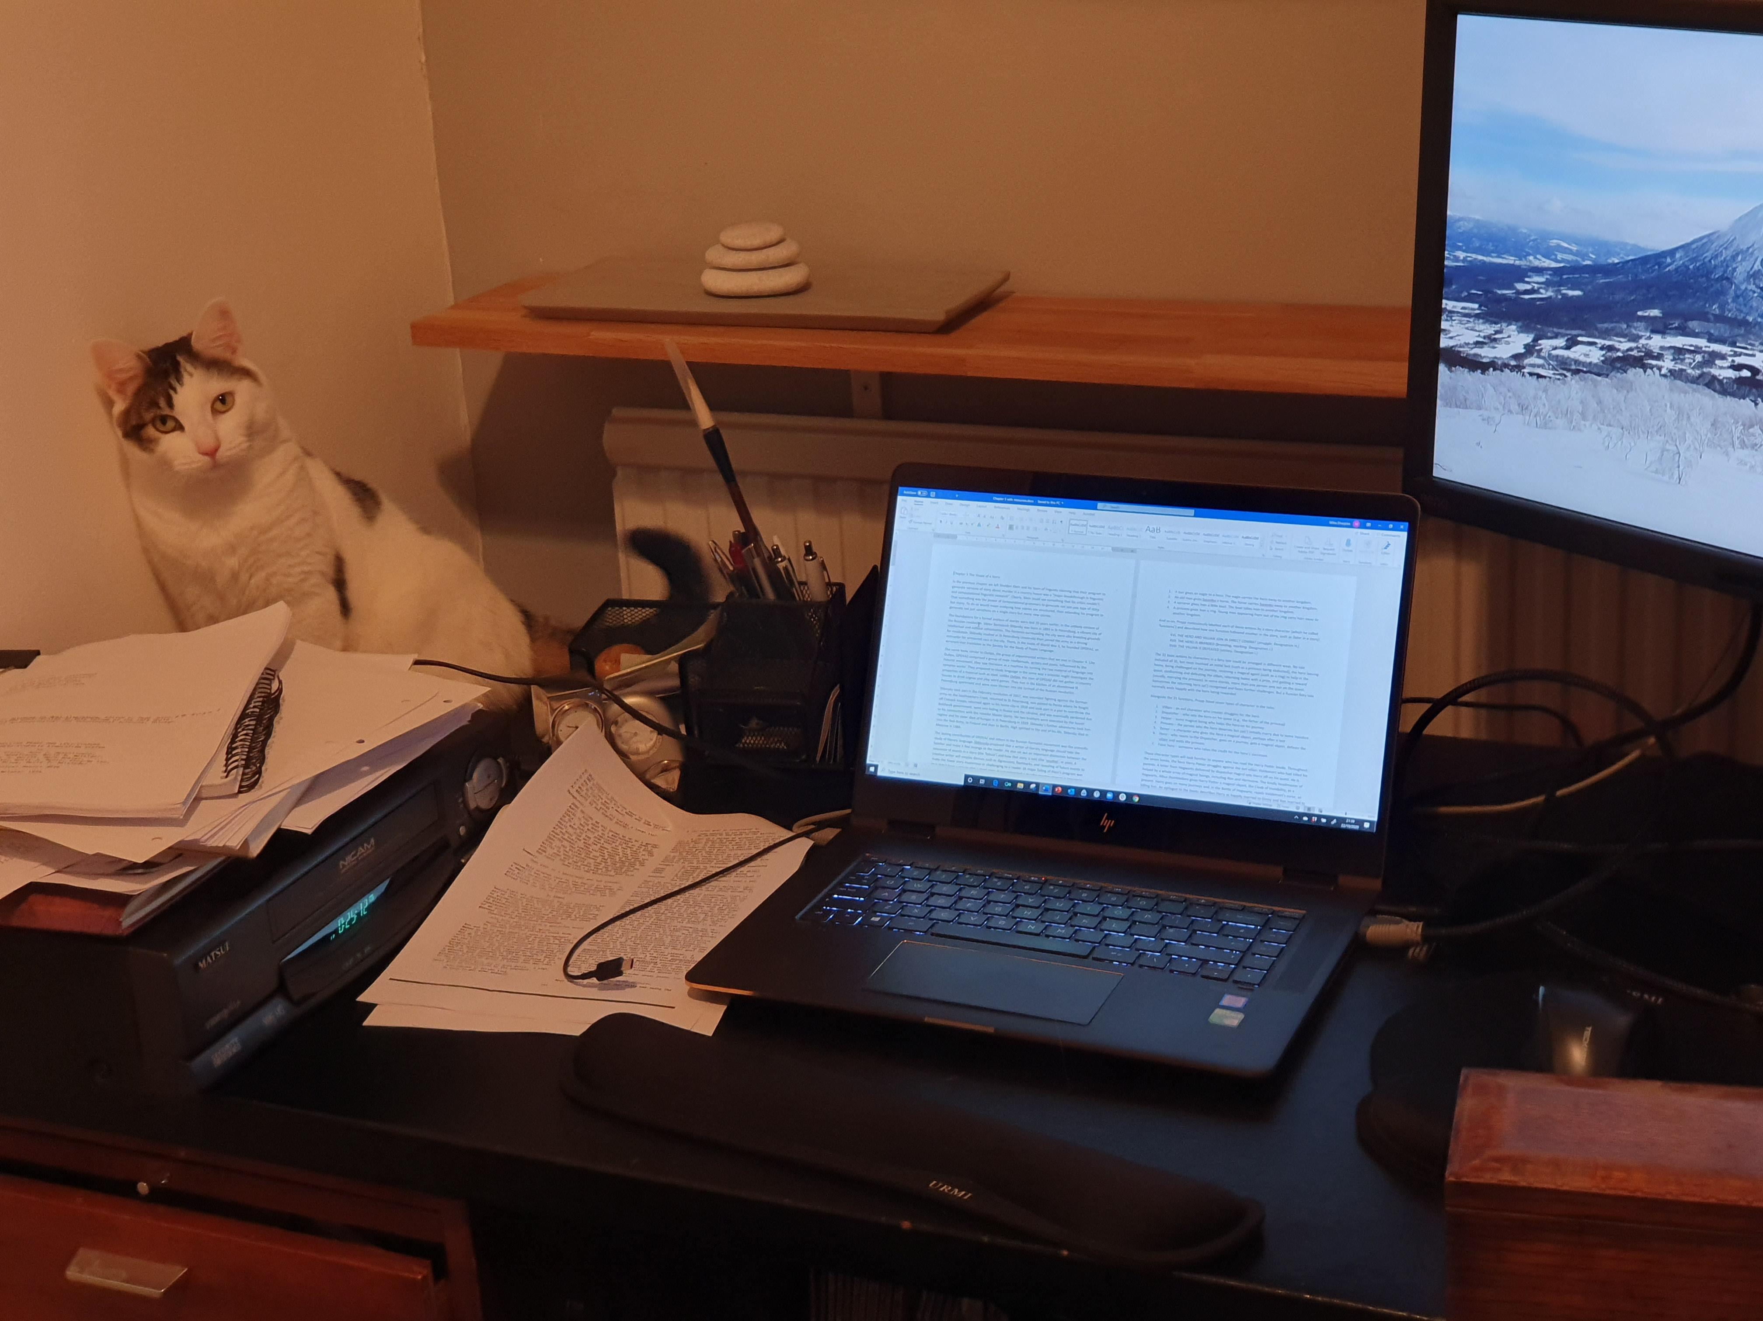
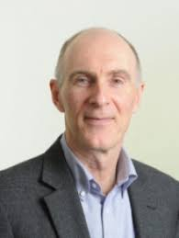
5. Mike Sharples, Open University of UK

Slide 8
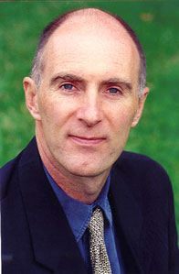
5. Mike Sharples, Open University of UK
Try to write something each day, even if it’s just a sentence
Find your best time for writing (for me it’s 6am) and try to protect it from outside influences (including email and texts)
If you are stuck in writing a book, then consider taking a month’s leave, take yourself off to a secluded cottage, set yourself a word target (e.g. 1000 words) and don’t go to bed until you’ve achieved it
Read (and memorise, and practise) George Orwell’s six rules for writing clear prose (see, e.e. https://www.openculture.com/2016/05/george-orwells-six-rules-for-writing-clear-and-tight-prose.html)
Otherwise, ignore anyone who says that there is a “best” way to write – there isn’t (such as “create an outline plan”, or “write what comes into your mind, then revise”). Successful writers have a variety of writing methods.
And if the words really won’t flow, then don’t force them. Take a walk, or a shower.

Slide 9
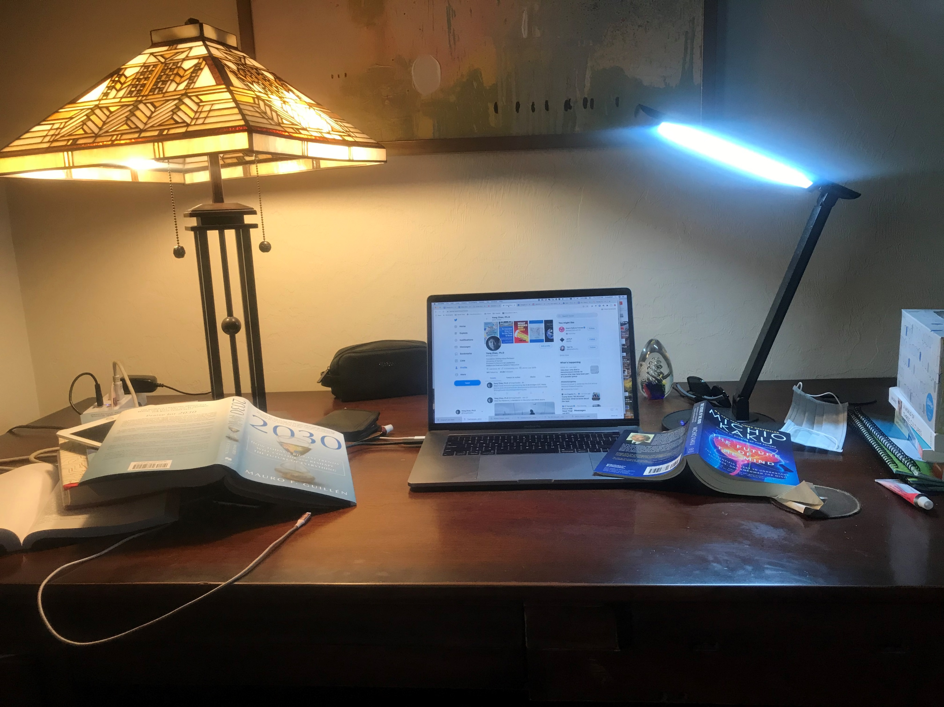
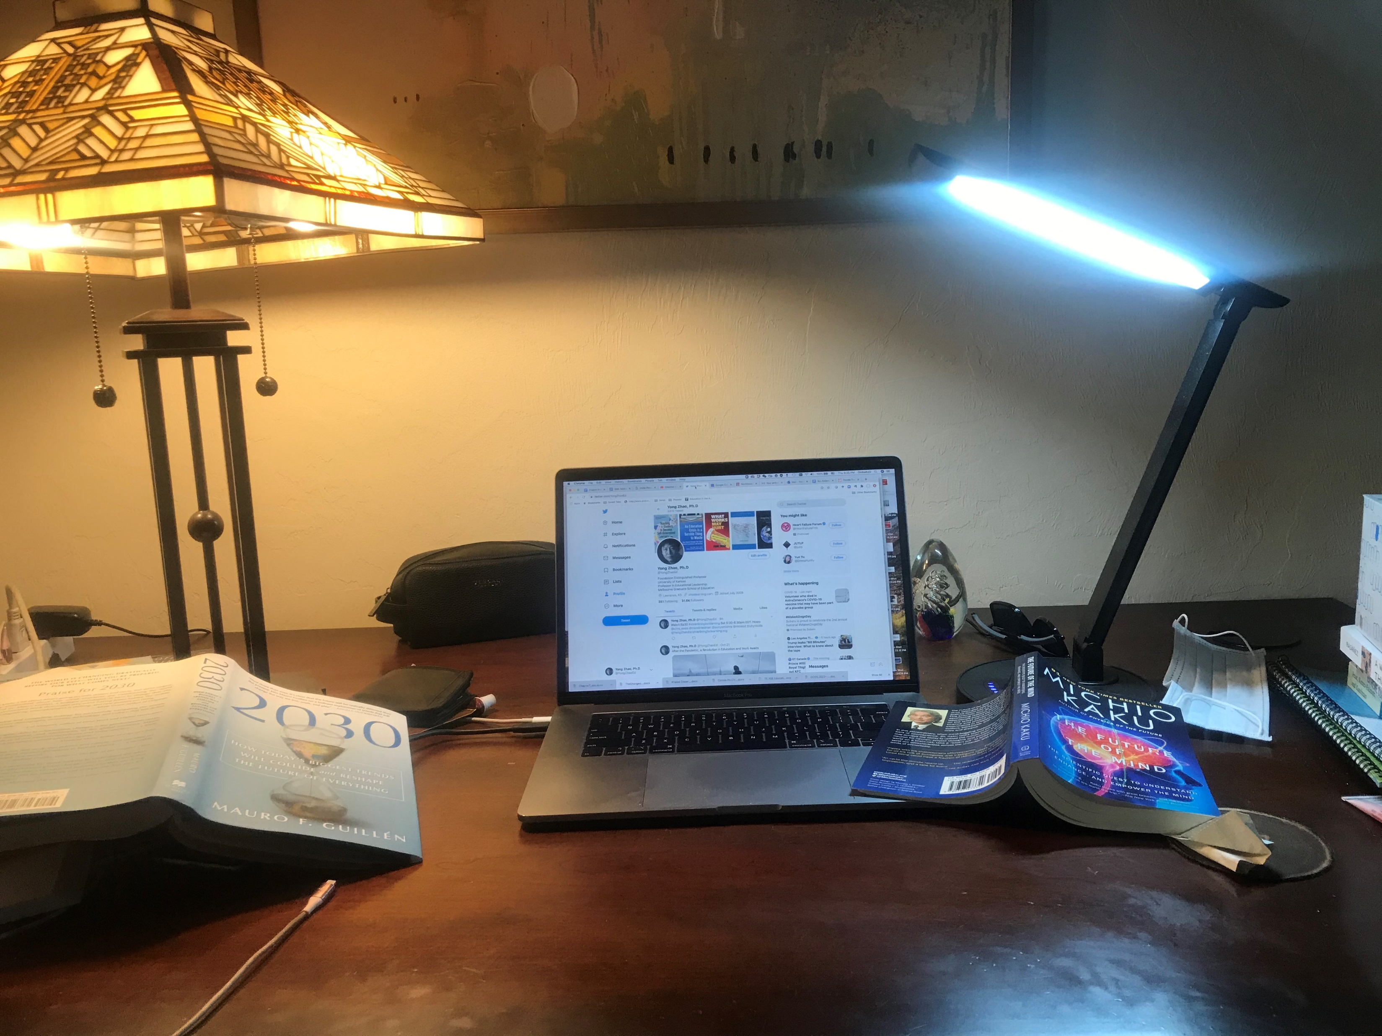
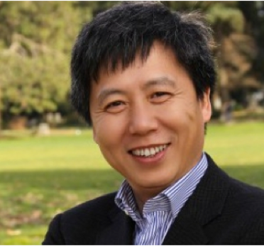
6. Yong Zhao, University of Kansas Suggestion 1: Writing is easy and thinking is hard. I spend all the time thinking and honestly much less time putting my thoughts down. So, keep the ideas in your head and think a lot. Suggestion 2: Read a lot, read things that may or may not be directly relevant to your topic. It's very important for me to read news, stories, science, philosophy, history, and future. Suggestion 3: Keep writing. Writing is what drives me to think and read. https://distinguishedprofessors.ku.edu/professor/zhao-y

Slide 10
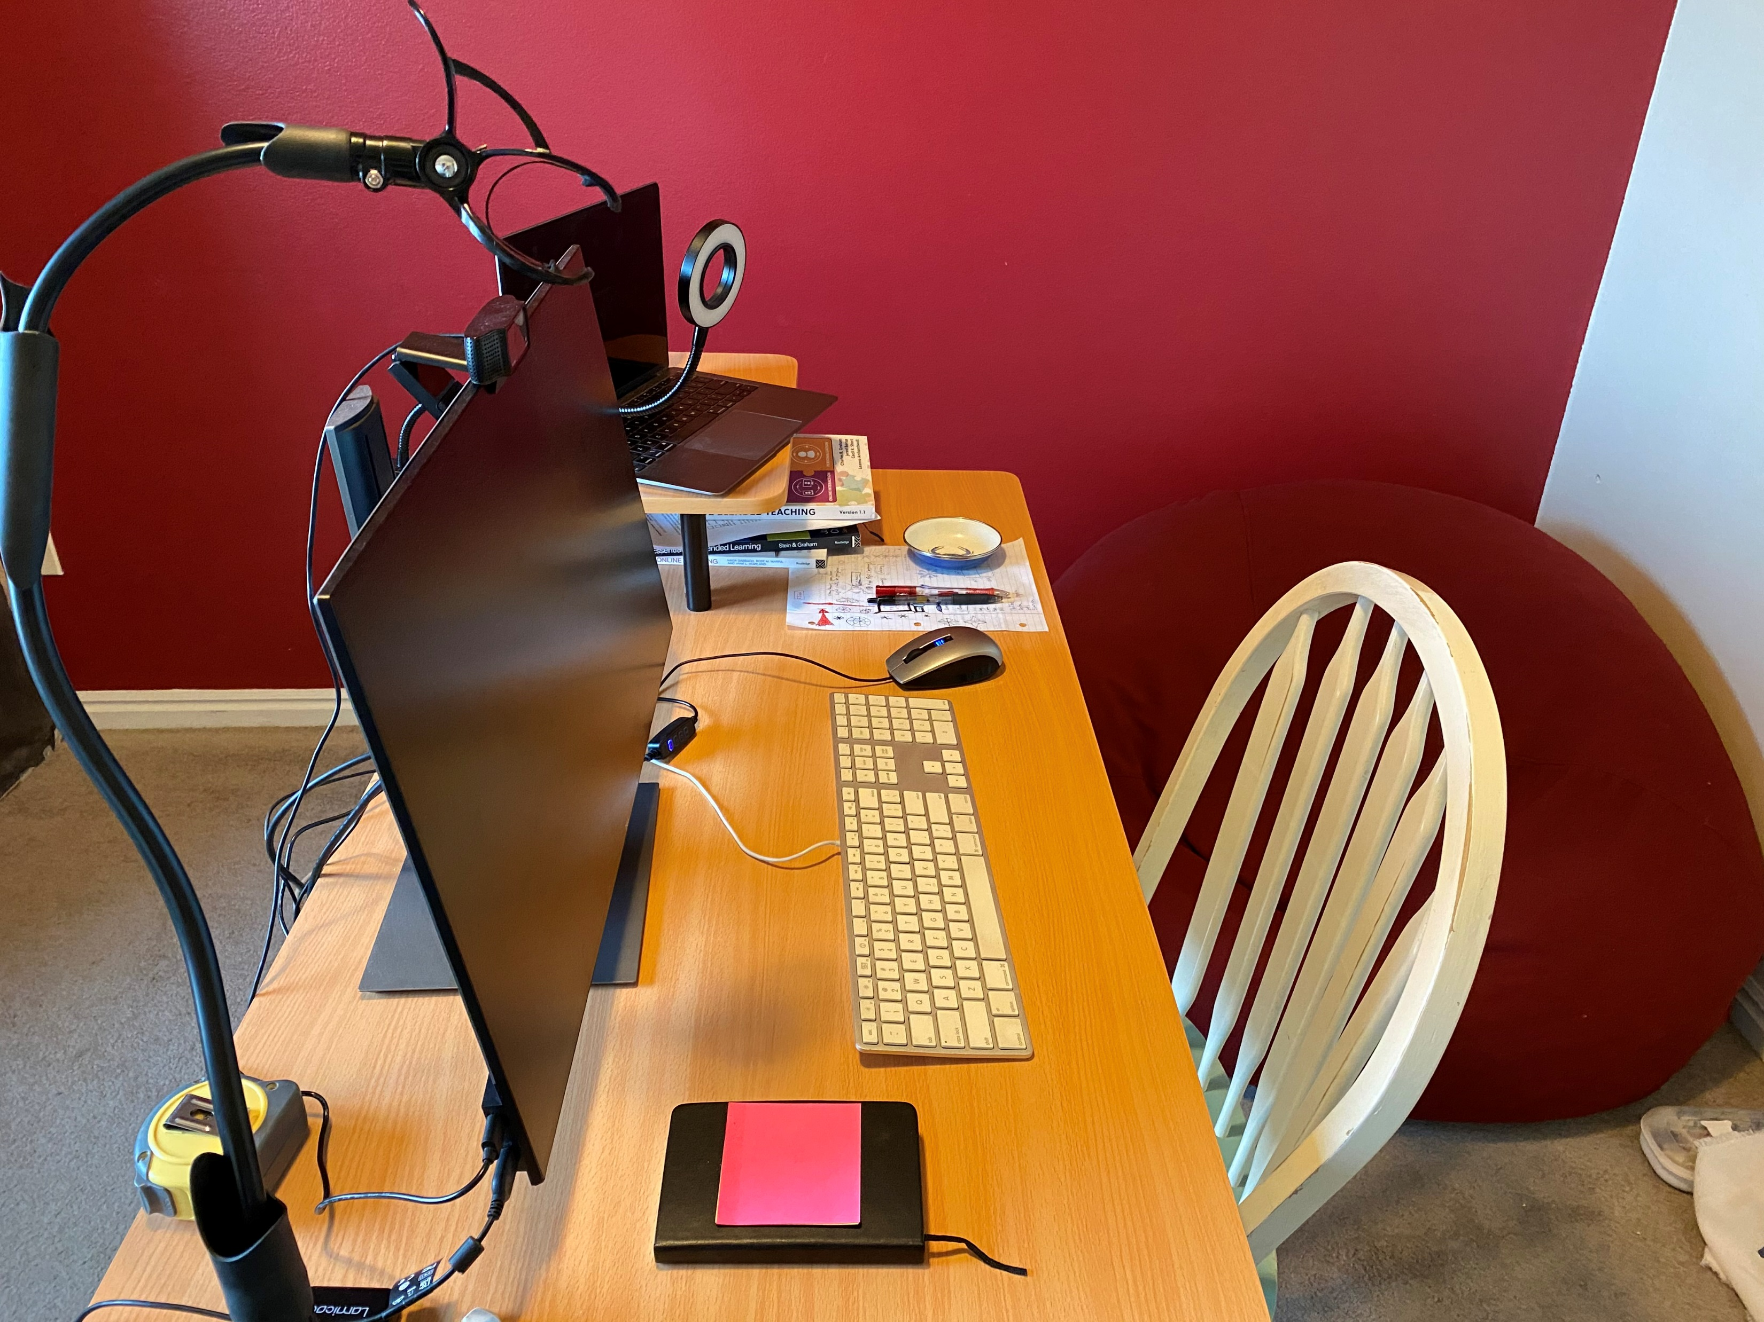
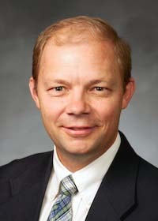
7. Charles Graham, BYU 1. Set aside a couple of blocks of time each week (daily if possible - but this rarely works for me) to dedicate to writing. 2. Collaborate with others on writing because it is funner and commitments to colleagues will motivate you to stay on task when it is hard. 3. Banish discouraging thoughts. . . I have realized that all academic writers experience difficulty and failure. Publishing comes to those who persist and don’t let failure keep them down. https://education.byu.edu/directory/view/charles-graham

Slide 11
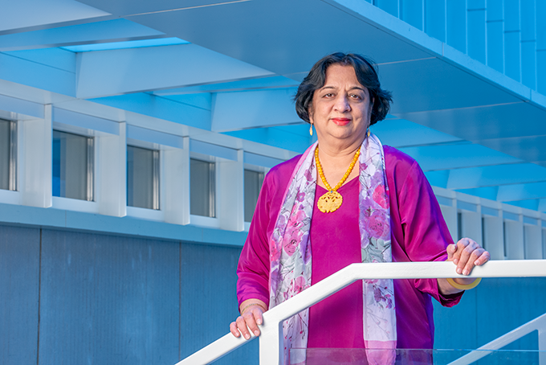
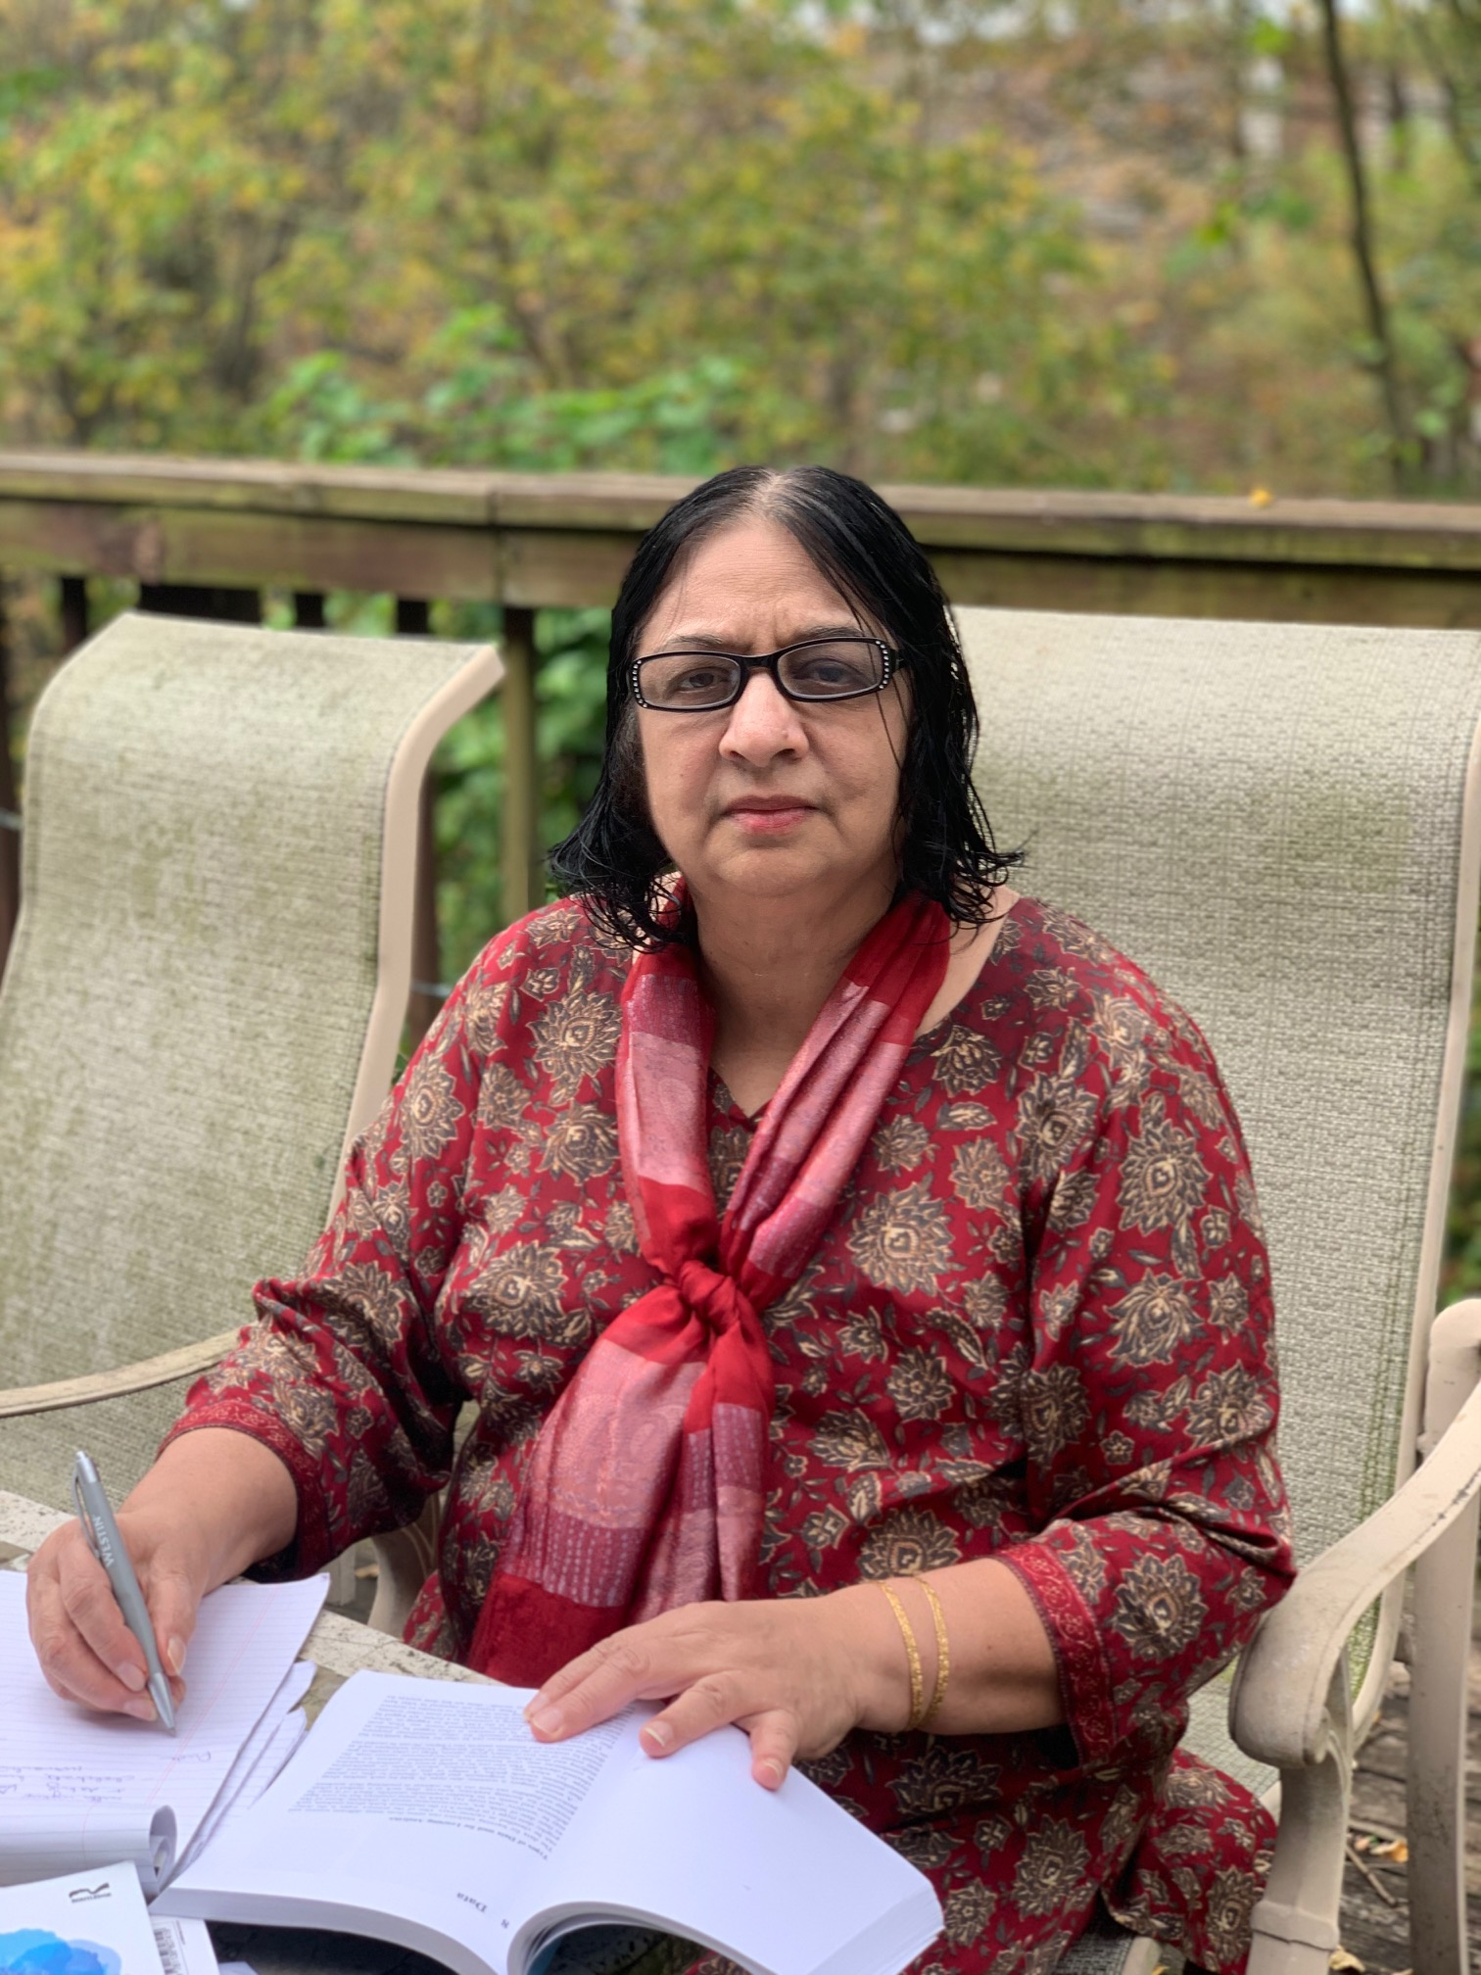
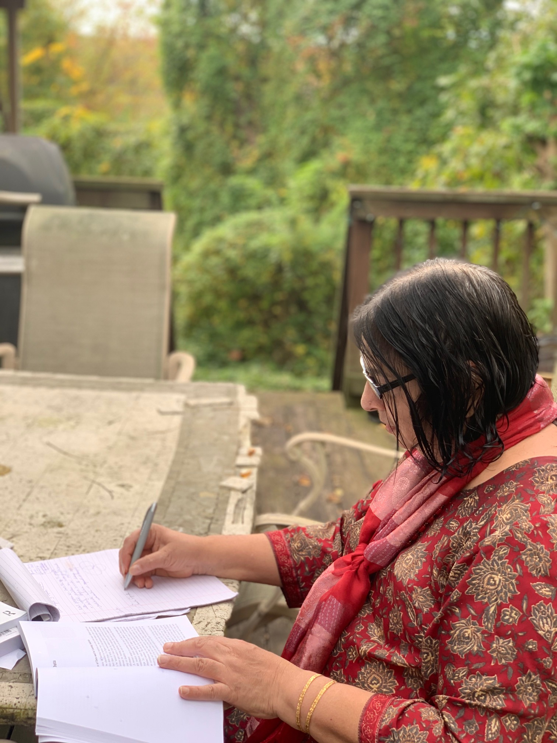
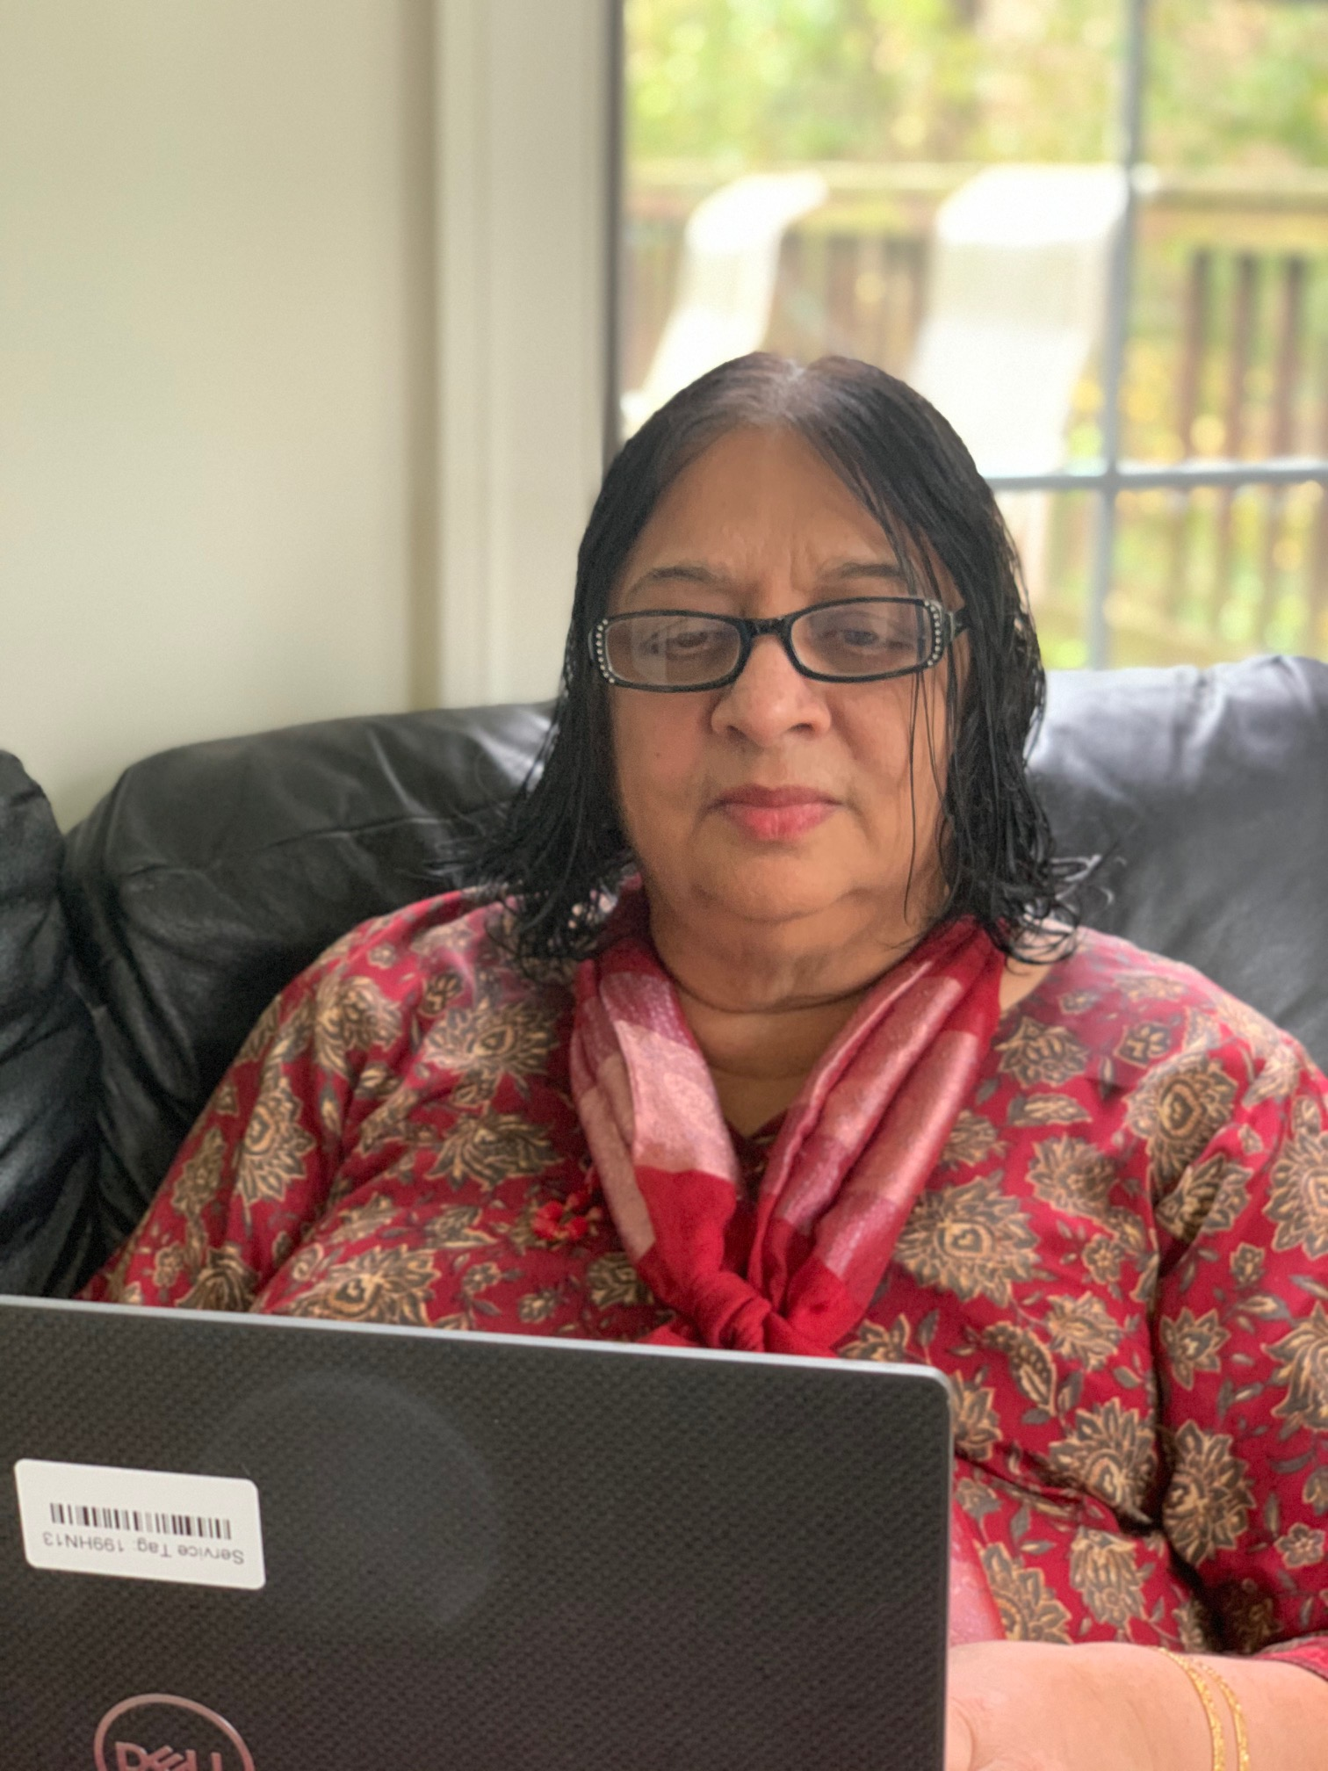
8. Sheila Jagannathan, The World Bank 1. Outline your storyline. 2. Start strong with emotional appeal. 3. Think of catchy title and sub-titles. 4. Bring in lot of examples to make your writing come alive. 5. Add visuals to make the writing stick. 6. End with a call for action.

Slide 12
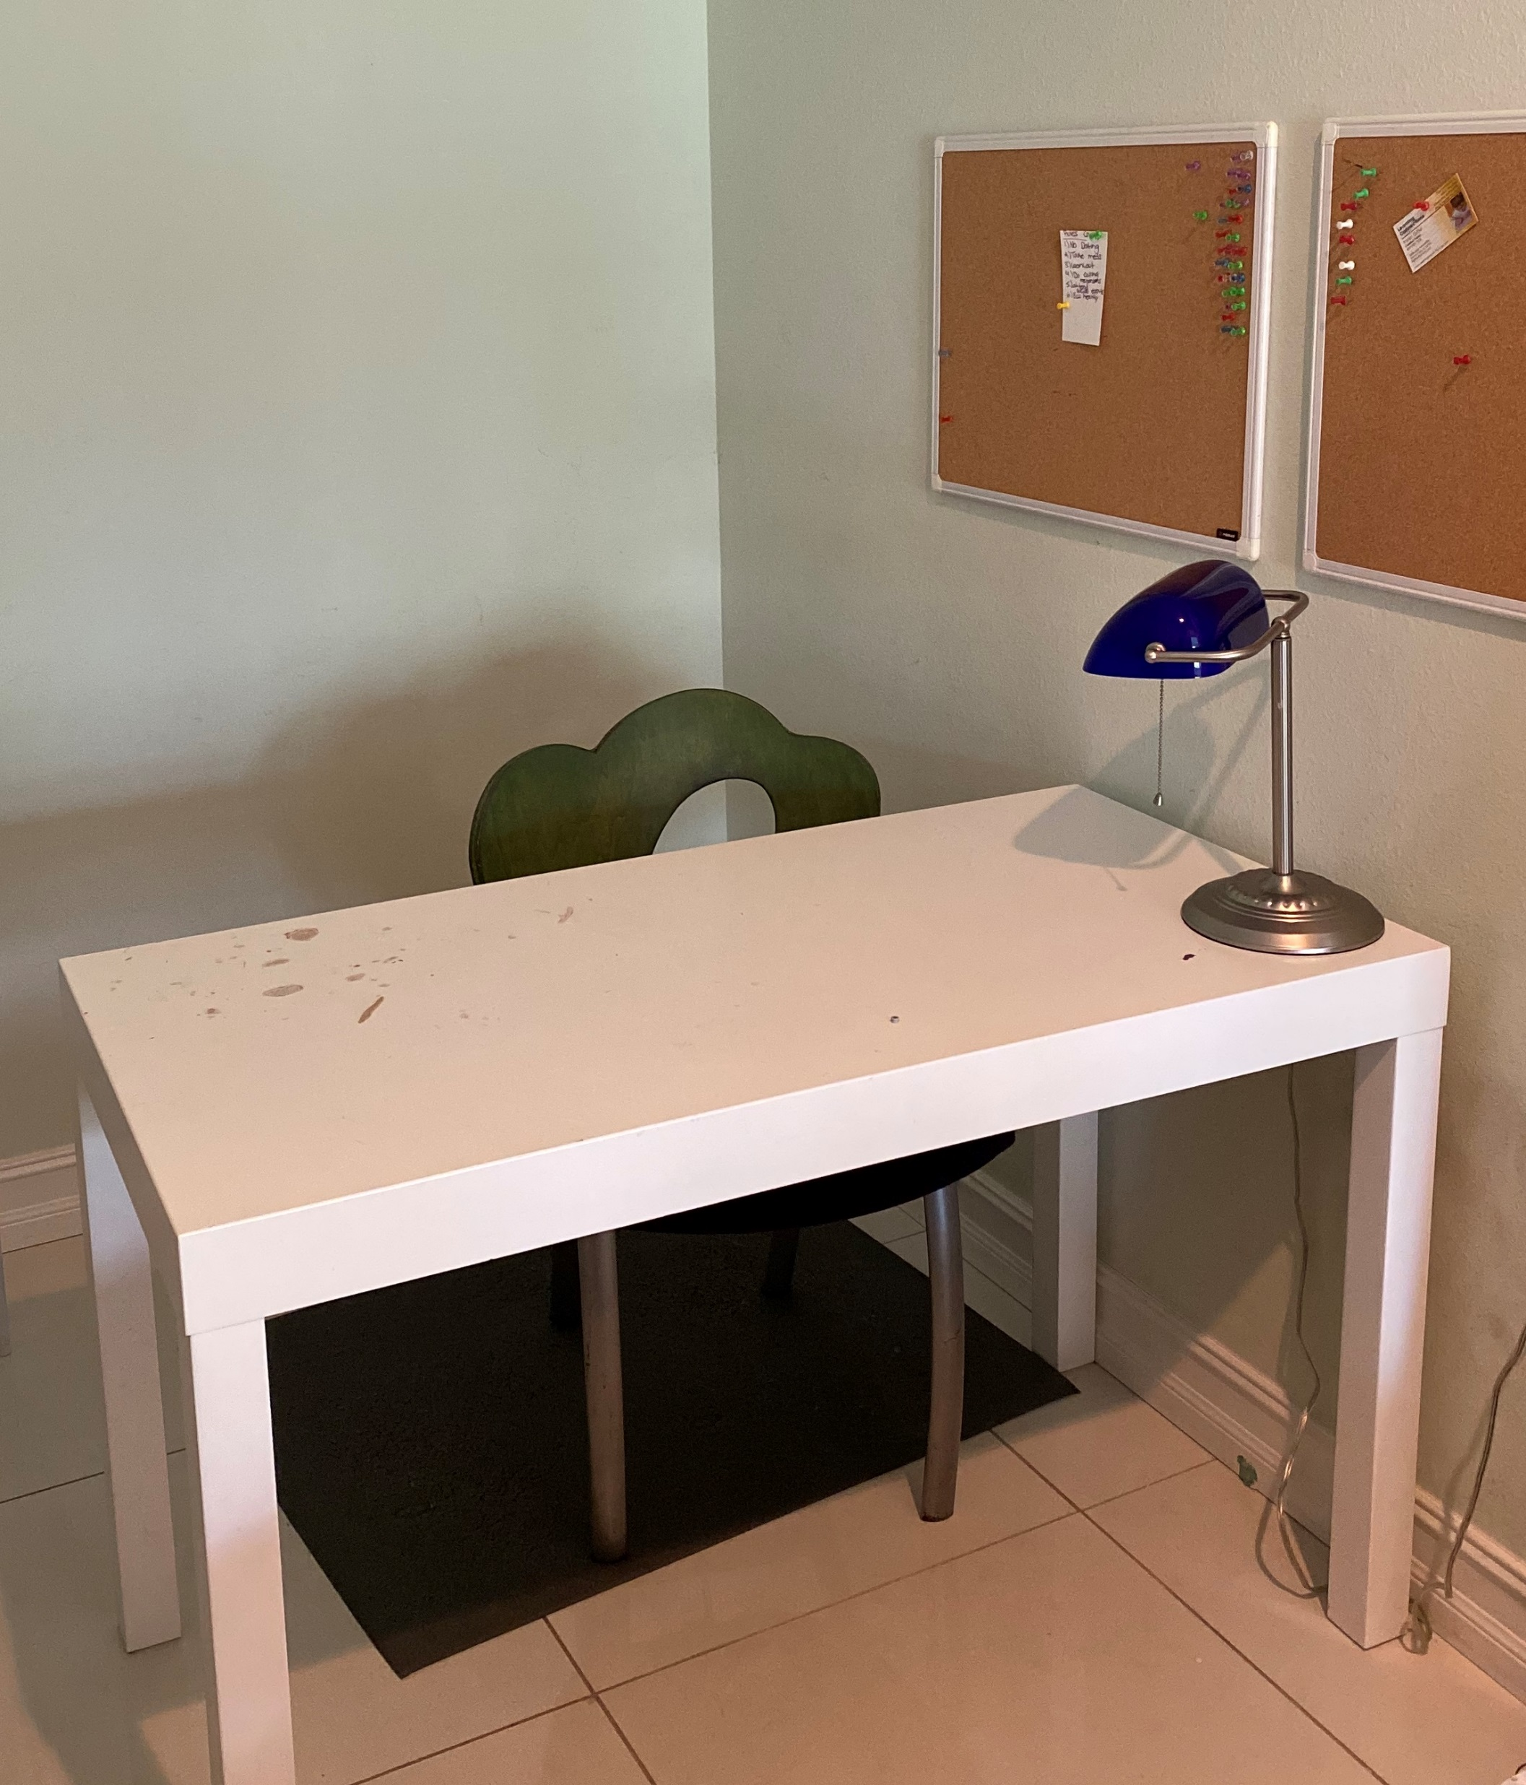
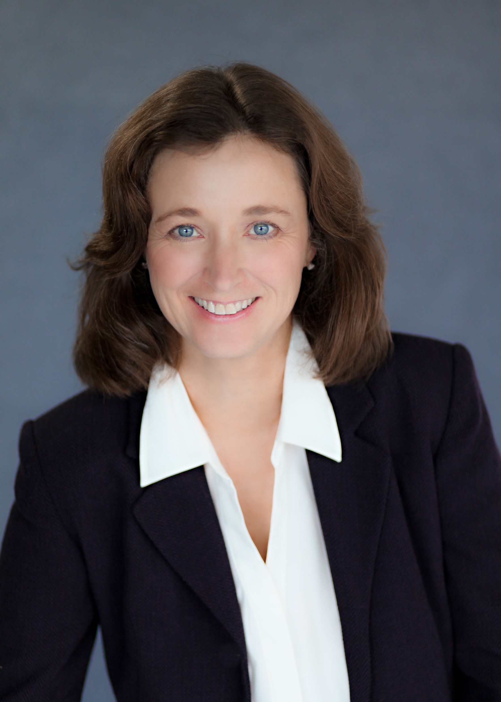
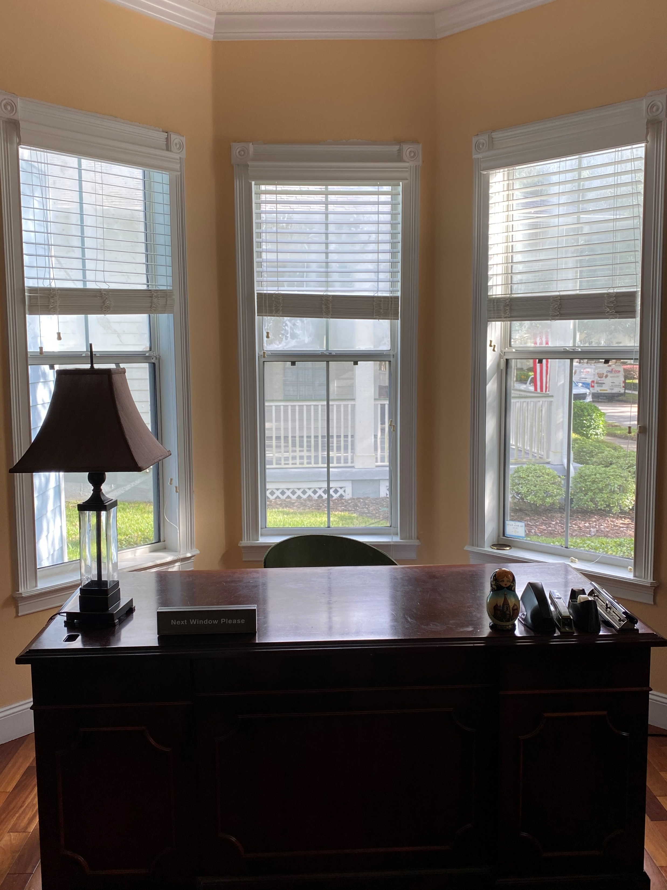
9. Kira King, Director of Instructional Design and Learning Solutions, Decision Simulation I am sending you two photos. One is of my office. You will see my "Next Window" sign. Chris got that for me when a bank was closing. I keep it there to lighten things up. I am also sending you a photo of the kids' study room. I go there if I have writer's block and need seclusion to force myself to sit, uninterrupted and focus.

Slide 13
9. Kira King, Director of Instructional Design and Learning Solutions, Decision Simulation
Writing Tips:
Preparation: I prepare to write by reading all critical literature and typing relevant quotations into a Word document. The act of typing the quotes helps me create a mental schemata of the related concepts. I will then write a summary of my argument at the beginning of the document and organize key quotes into a sequence. Print out the quotation notes and have that handy for reference. Keep all other relevant literature nearby for reference.
Writing: Focus on getting words down on paper. Do not worry about getting the words just right. Use a stream of consciousness to build a moment with all relevant sources there. Getting momentum is far more important than getting the words right the first time. Editing can happen later.
Final Thoughts: As a writing tutor, I learned that often we say what we really want to say at the end of the piece--at the end of the sentence, the paragraph, or the paper. I remember that and scan my work to see if the main theme is actually at the end of what I have written. Then I revise.
Writer's Block: To cure writer's block, first try to remove yourself to a new location. Go to a place with fewer interruptions and silence your phone. Commit to writing uninterrupted. If that does not work, then go back to preparation. Re-read all relevant material and re-write notes. Then try again. Rinse and repeat.
(Sometimes a glass of wine helps too!)

Slide 14
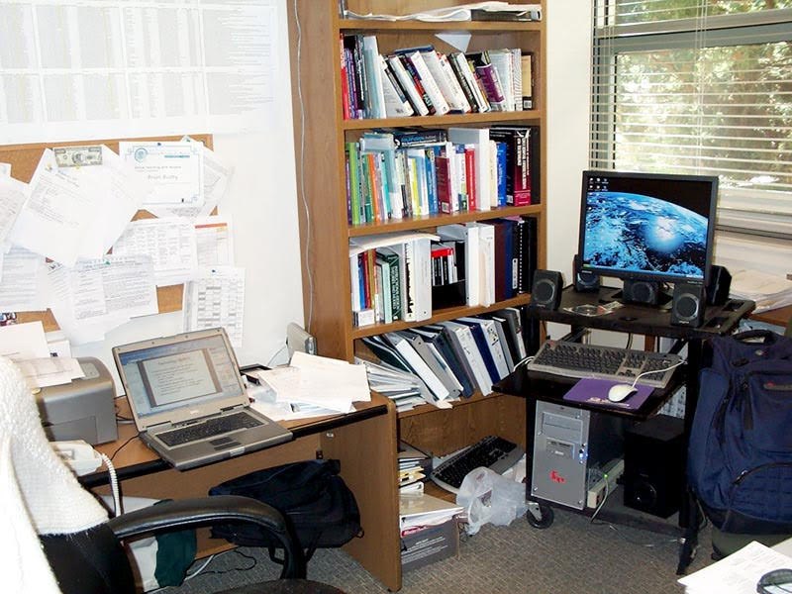
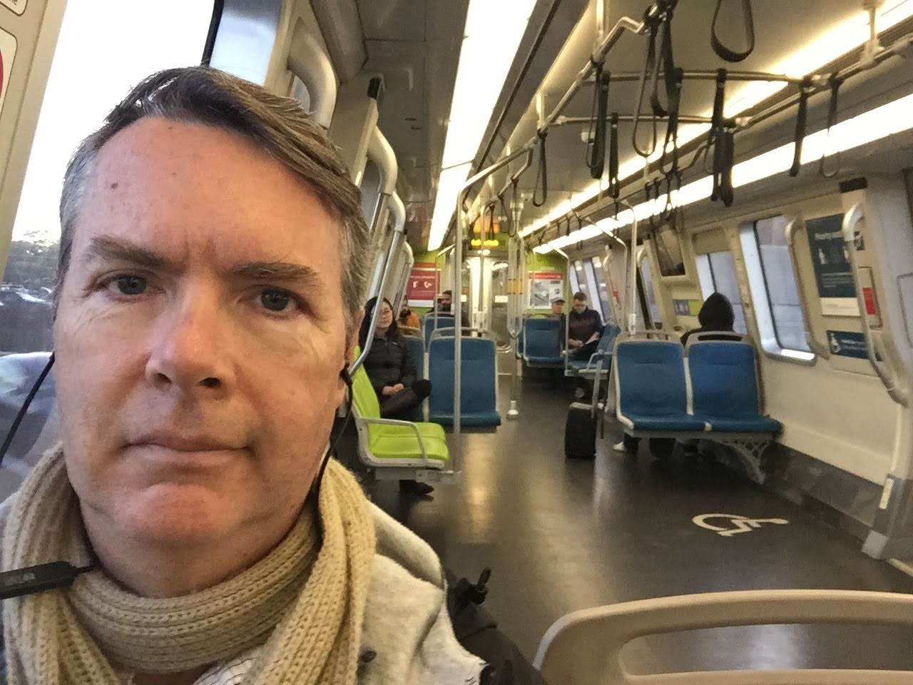
10. Brian Beatty, San Francisco State University https://faculty.sfsu.edu/~bjbeatty/ https://edd.sfsu.edu/content/bios/beatty.html

Slide 15
10. Brian Beatty, San Francisco State University https://faculty.sfsu.edu/~bjbeatty/ https://edd.sfsu.edu/content/bios/beatty.html
Office at SFSU - this was a primary writing space during the initial phases of book writing; research and development, primarily.
Bart train - during this book project I commutes about 3 hours roundtrip every day on the train, so I used that time for writing whenever I could.
Outside deck at home - this was my main writing space on weekends and was especially useful when finishing the book project and editing the chapters contributed by others.
Bonus photo - I found a photo in my archives of your visit to SSFSU in 2005 - this is a nice one of you and Kim in her office on campus.

Slide 16
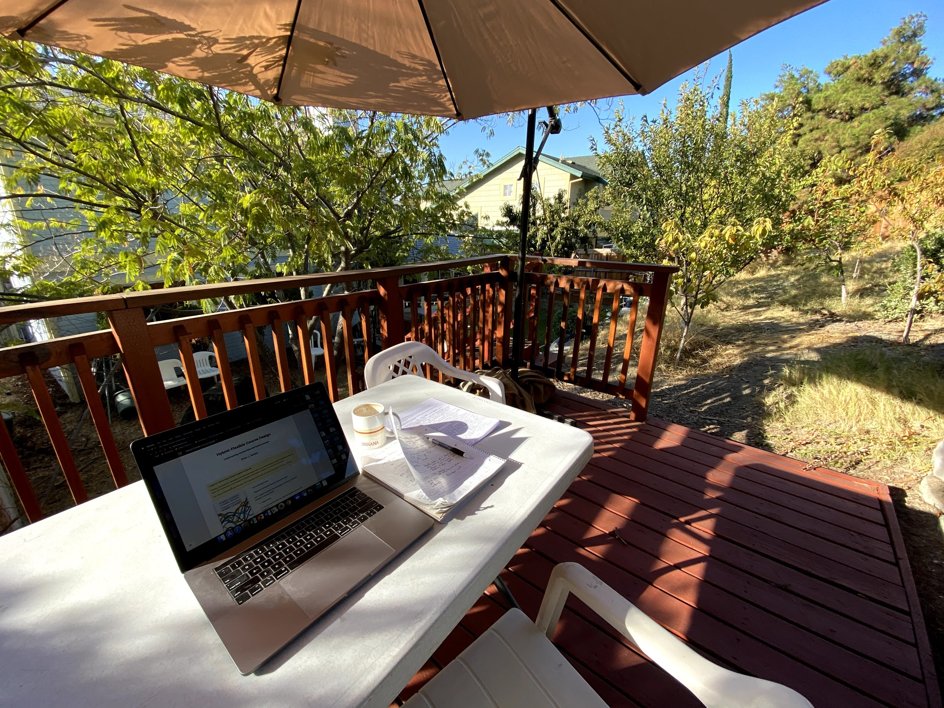
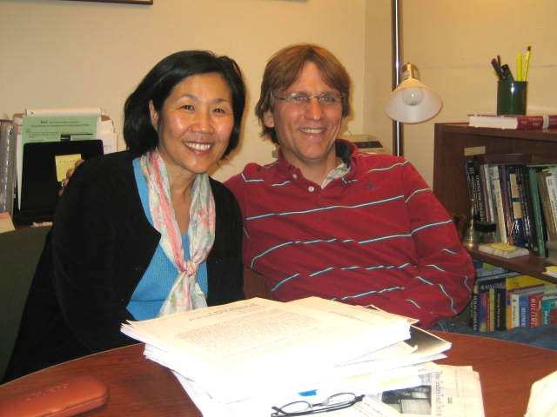
10. Brian Beatty and Kim Foreman, San Francisco State University

Slide 17
10. Brian Beatty, San Francisco State University https://faculty.sfsu.edu/~bjbeatty/ https://edd.sfsu.edu/content/bios/beatty.html
Writing Tips:
Be prepared to "write" wherever you are; capturing ideas while they are fresh and still forming is important, no matter the form - audio, text, stories to discuss with those around you. You will have plenty of time to edit later.
Sometimes we write for others directly; other times we write for ourselves when we have thoughts that we just have to express. But even when we write initially for ourselves, we need to shape that so that it benefits the reader as well.
Write to invite further engagement with your audience; the book or article may be just the beginning of an interesting discussion with your readers.

Slide 18
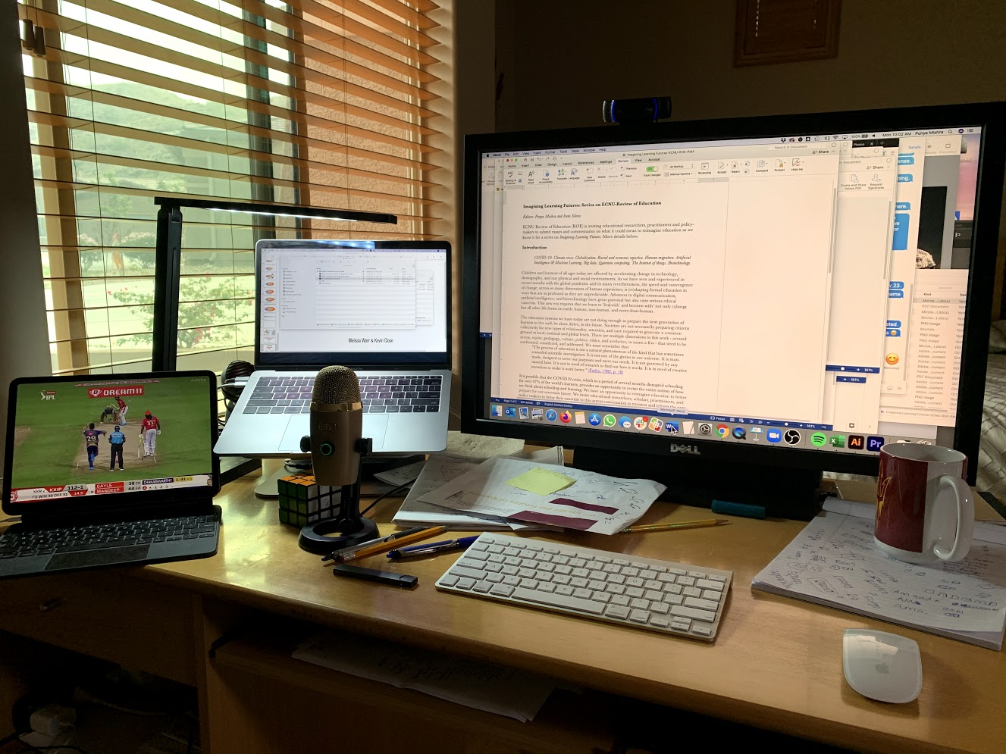
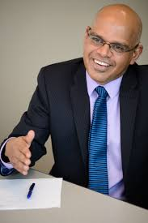
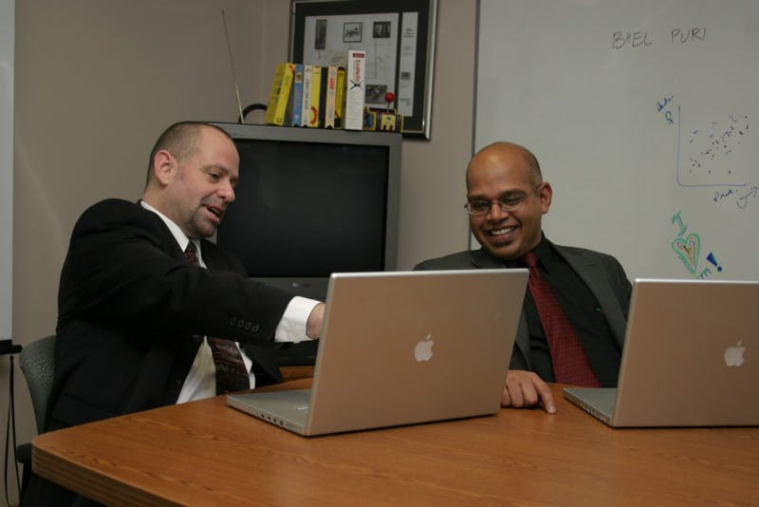
11. Punya Mishra, Arizona State University Associate Dean of Scholarship and Innovation; Professor Rubik cube to help me fidget – as well as assorted papers etc. to doodle. https://education.asu.edu/about/people/punya-mishra https://punyamishra.com/home/

Slide 19
11. Punya Mishra, Arizona State University https://education.asu.edu/about/people/punya-mishra https://punyamishra.com/home/
Writing tips:
Find your voice – even for academic writing. That is hard to do since grad school does such a wonderful job of killing any writing skills you may have come in with. Grad school is the worst teacher of writing. It has taken me years to find my own style and the greatest compliment I have received is something along the lines of “I could hear your voice as I was reading your paper.” So strive for that.
Learn to love writing. Use writing as a tool to think with. I usually start out with a broad idea of where I want to go – and way-find through the act of writing. It reveals gaps in my thinking, weaknesses in logic and flow of ideas. None of that can be addressed without actually putting words down on screen. The trick is to start with a bad draft and then Revise. Revise. Revise. My pieces usually go through 20+ rounds of back and forth between co-authors.

Slide 20
11. Punya Mishra, Arizona State University https://education.asu.edu/about/people/punya-mishra https://punyamishra.com/home/
Writing tips:
Following from the previous point is the need to find good writing partners. I have very few publications that I have written solo (maybe 2 or 3). That said finding the right writing partner is not easy. I have been superbly lucky in this regard first with Matt Koehler and then with Danah Henriksen. I have also had some supremely talented graduate students who have been equal partners in the writing process they include Rohit Mehta, Carmen Richardson and Melissa Warr. Developing trust and recognizing what they bring to the table (thus being willing to listen) is key.
See each piece you write as part of a longer story.
Don’t aim for perfection in each piece. Each piece should be good – but be willing to share versions of your evolving understanding, knowing that you may revise your thoughts down the road. One can actually track how our thinking evolved in the TPACK framework if you look at our publications over time. The same is for our current work on the spaces of design in education. Think of publishing as a way of making your thinking public, soliciting feedback and then going in for the next round. This keeps you honest (and also continually publishing).

Slide 21
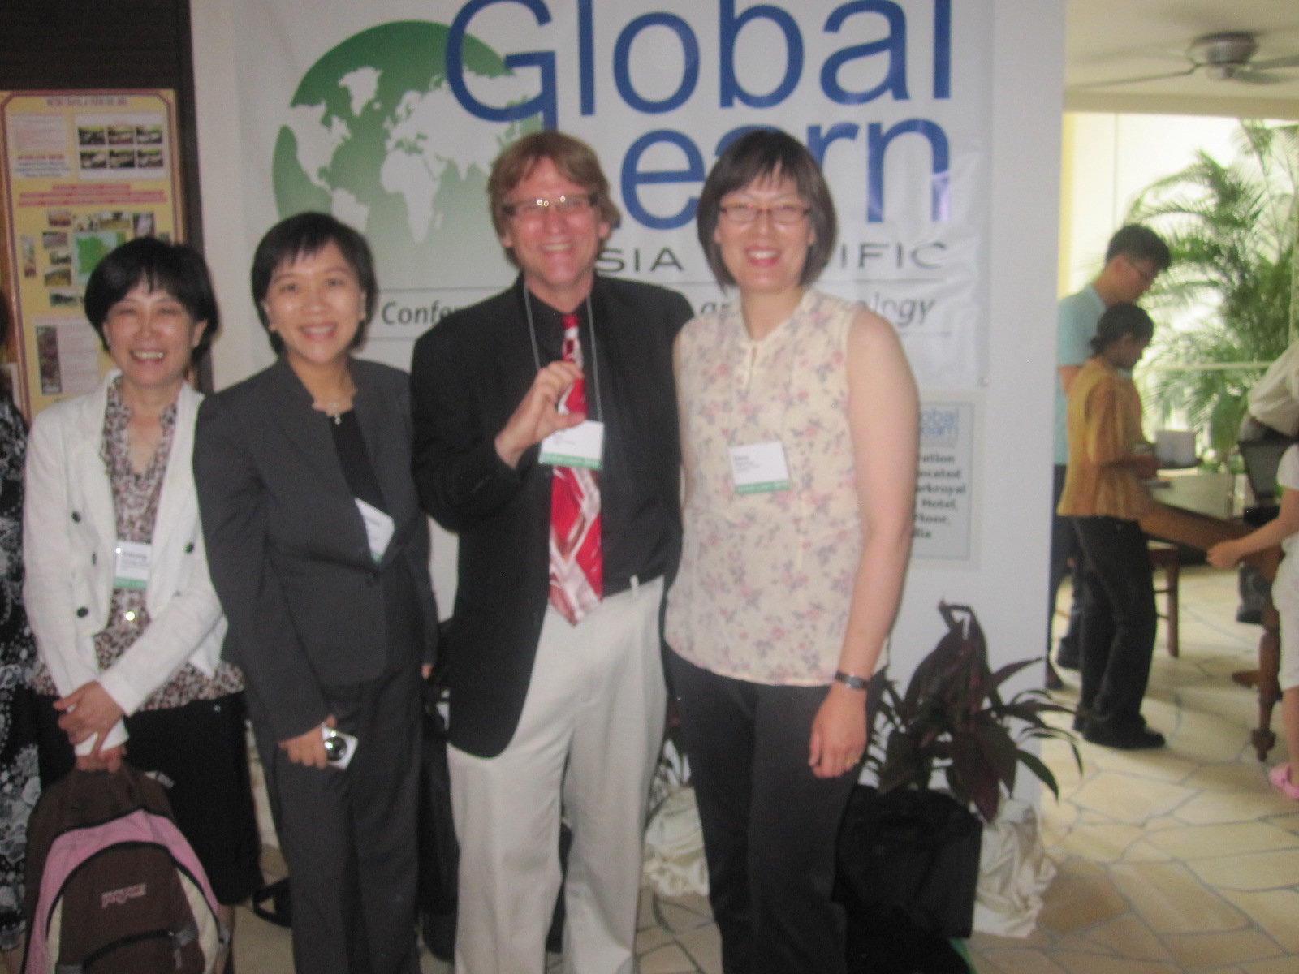
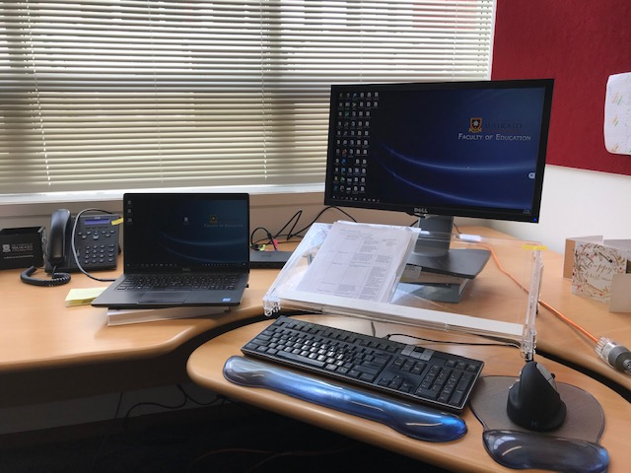
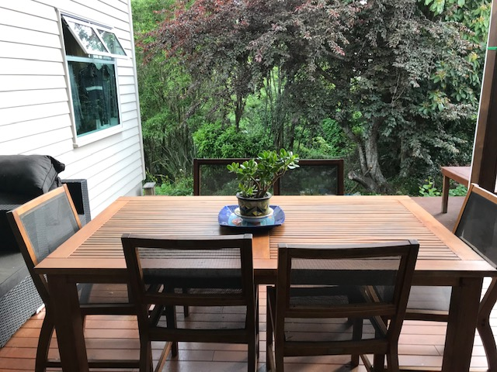
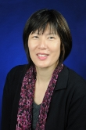
12. Elaine Khoo, University of Waikato, New Zealand Attached are 2 spaces where I normally write at - my office, and on the table overlooking out onto our deck. https://www.waikato.ac.nz/staff-profiles/people/ekhoo

Slide 22
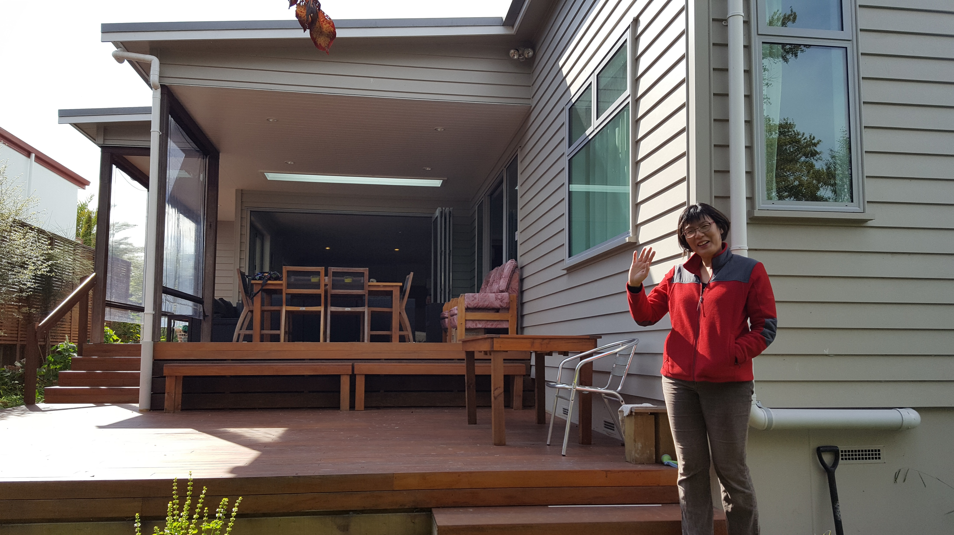
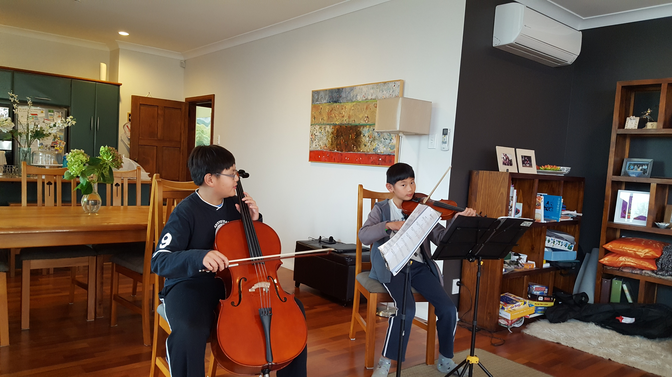
12. Elaine Khoo, University of Waikato, New Zealand Attached are 2 spaces where I normally write at - my office, and on the table overlooking out onto our deck. https://www.waikato.ac.nz/staff-profiles/people/ekhoo

Slide 23
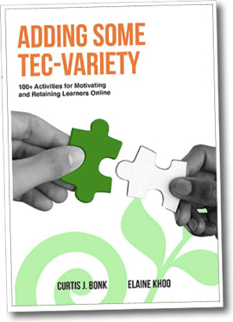
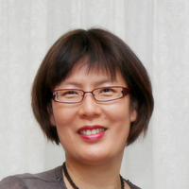
12. Elaine Khoo, University of Waikato, New Zealand https://scholar.google.com/citations?user=kuy1wIUAAAAJ&hl=th
Tips from me:
I normally craft a draft abstract first to pull together my thoughts on what the article is about. A good abstract is a good signpost to the article.
For articles reporting on empirical studies, I start with the methods section first before flushing out the other parts of the paper.
Analysis and writing go hand in hand, remember to jot notes as you are analysing your data to help you identify themes and your main argument.
For non-empirical articles, I start with drafting the key argument first then unpacking the rest of the paper around the key argument.
Write little bits each day, don't be afraid to craft and revise over and over again. No one is perfect the first time.
Do not fear rejection from publishers, try and try again.
Find good colleagues to collaborate with.
Consider your audience and write to address them accordingly (be it your phd examiner, book, academic article), the genre of writing can be quite different.

Slide 24
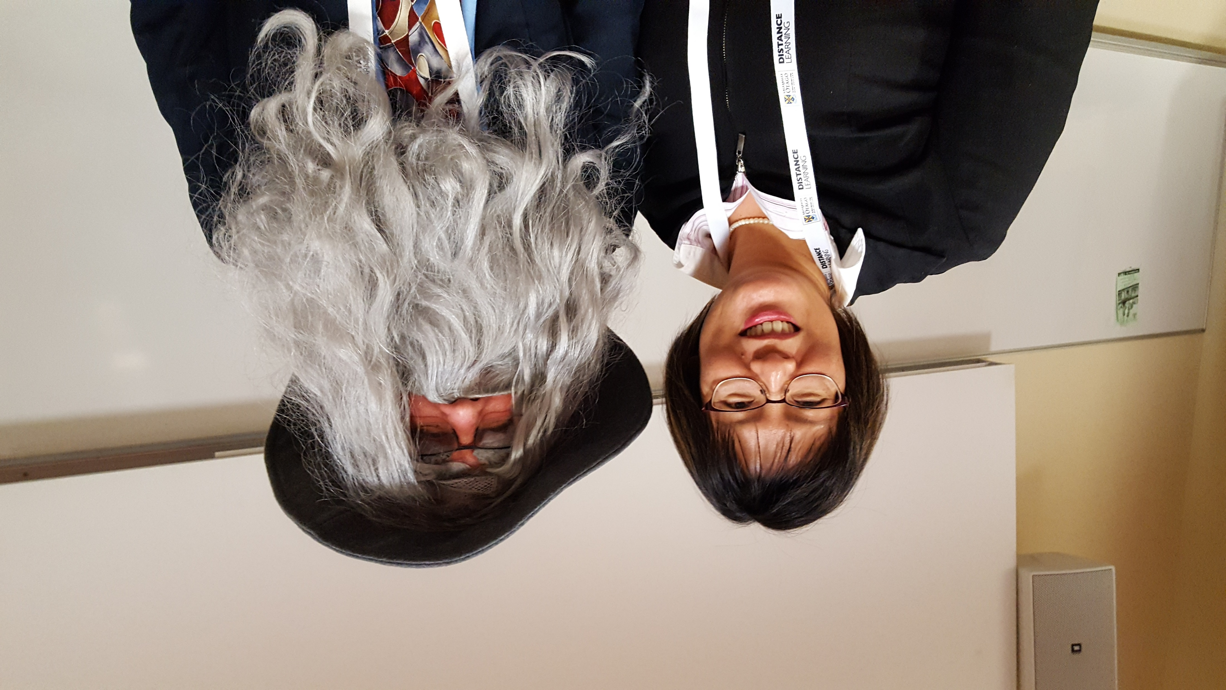
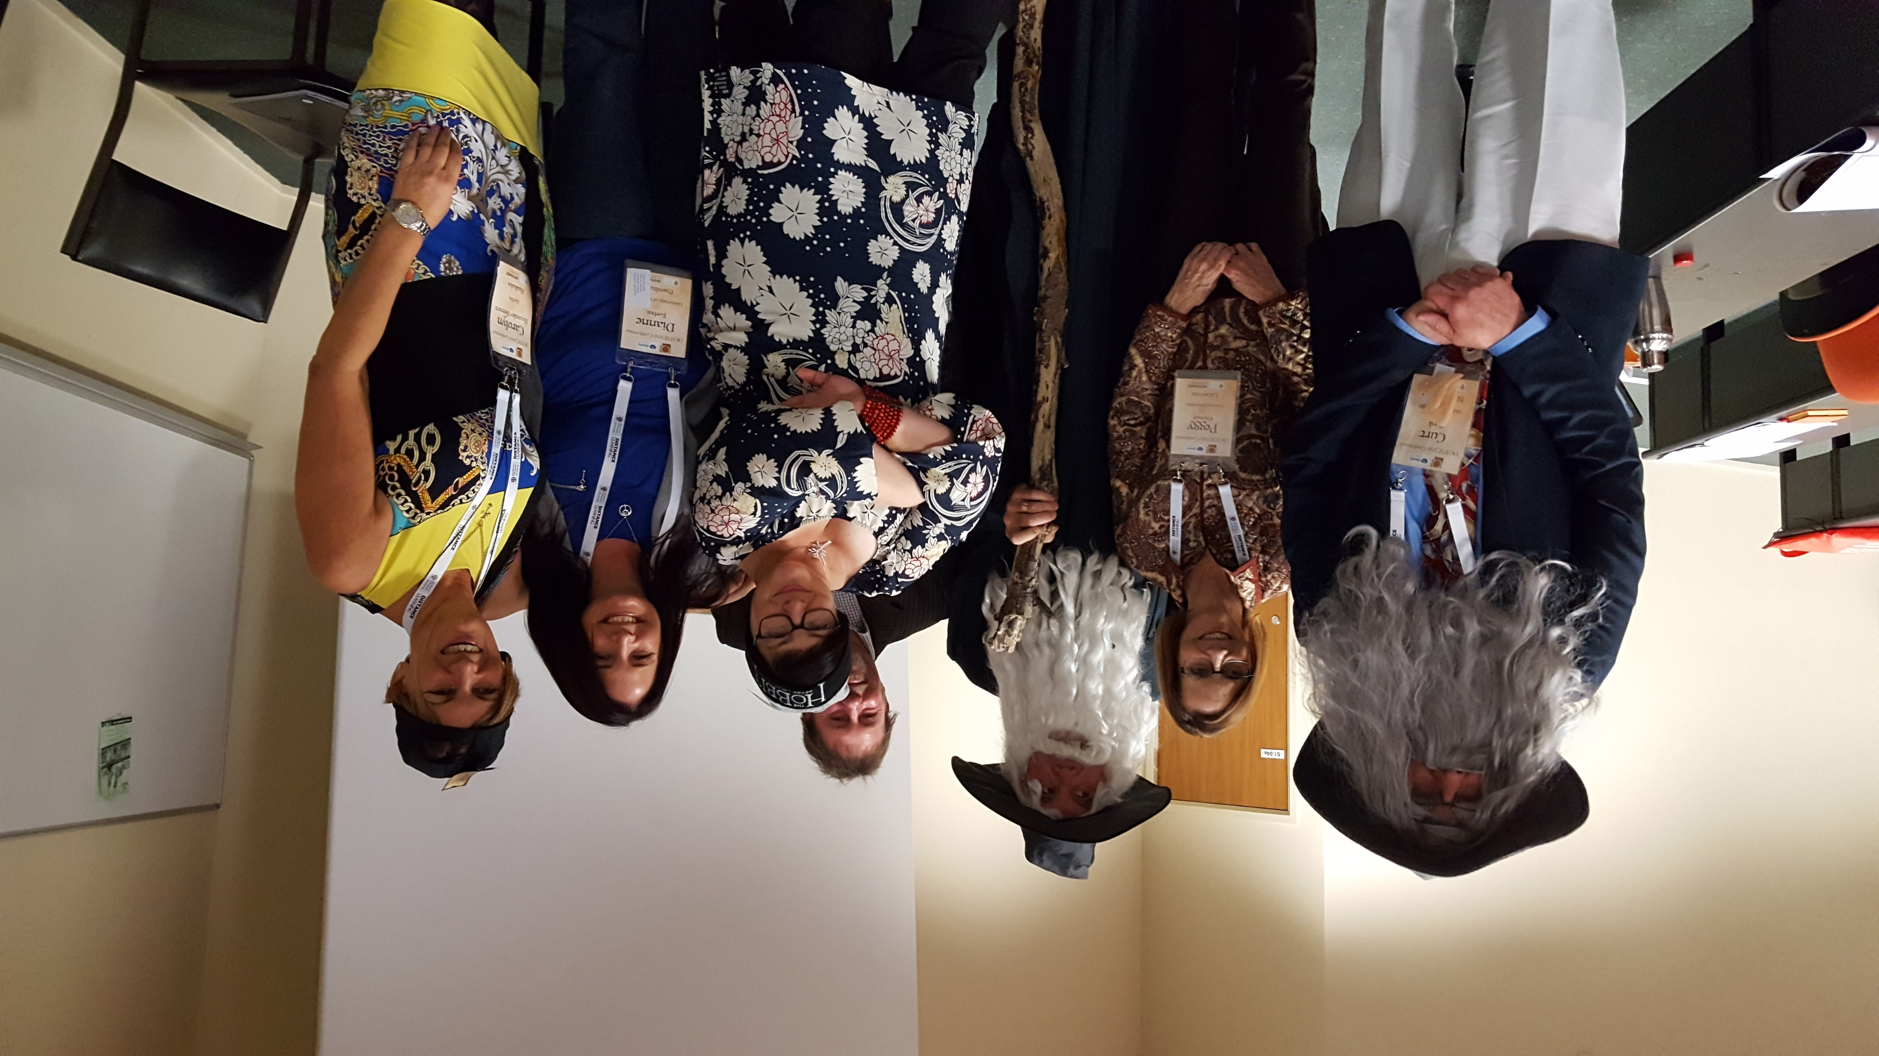
12. Elaine Khoo, University of Waikato, New Zealand Attached are 2 spaces where I normally write at - my office, and on the table overlooking out onto our deck. https://www.waikato.ac.nz/staff-profiles/people/ekhoo

Slide 25
