Slide 2
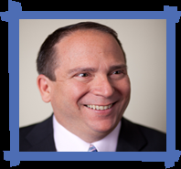
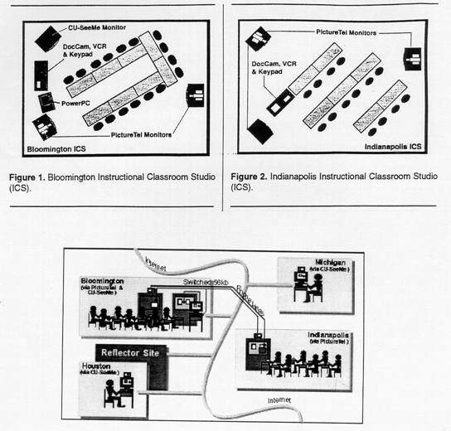
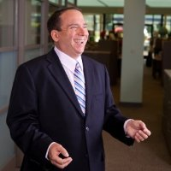
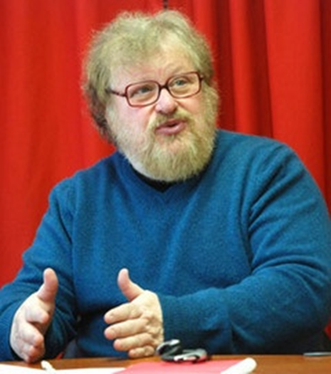
Synchronous + Asynchronous (e.g., Elliot Soloway and David Palumbo, 1995)
Notes:
94
4

Slide 3
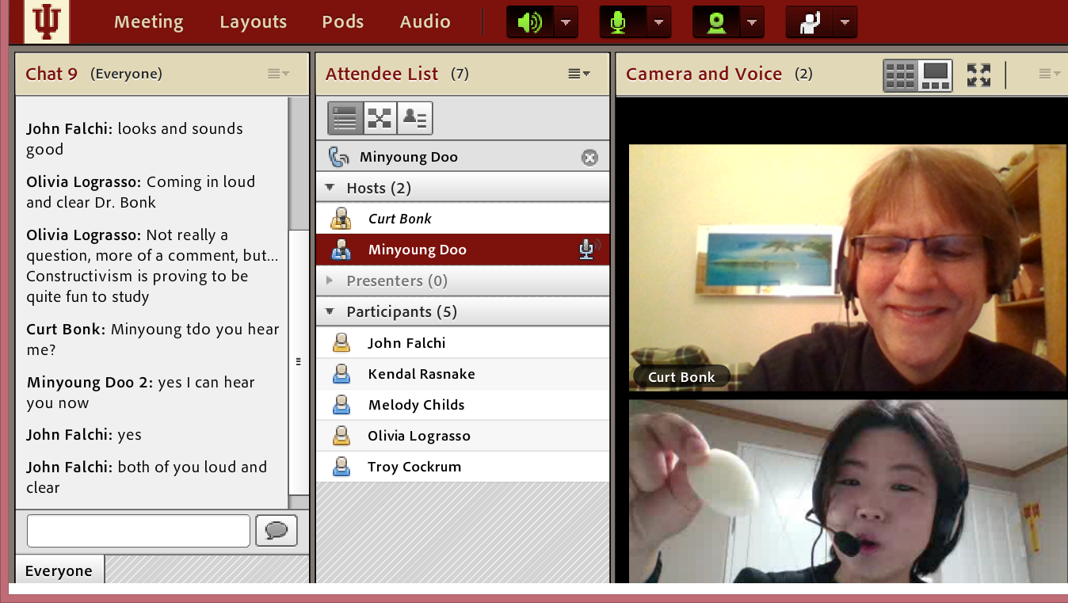
II. Ten Pedagogical Ideas…for Videoconferencing

Slide 4
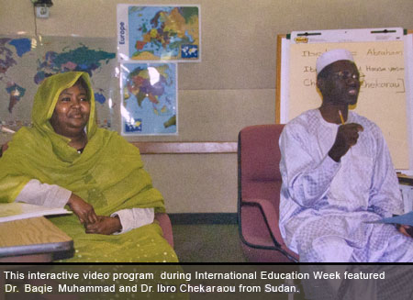
1. Expert Presentations with Audience Questioning and Commenting
The guest expert makes a formal or semi-formal presentation of ideas, activities, cultural norms and practices, or research to the class.

Slide 5
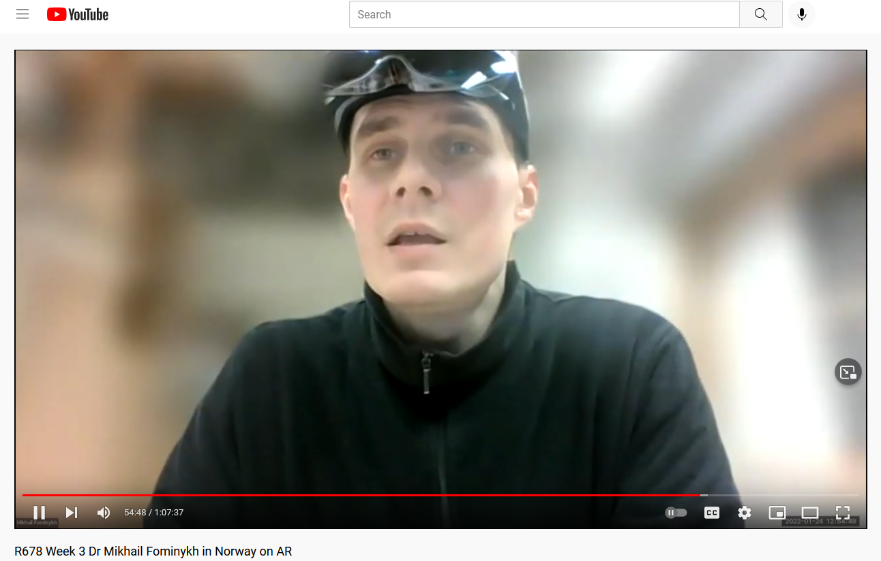
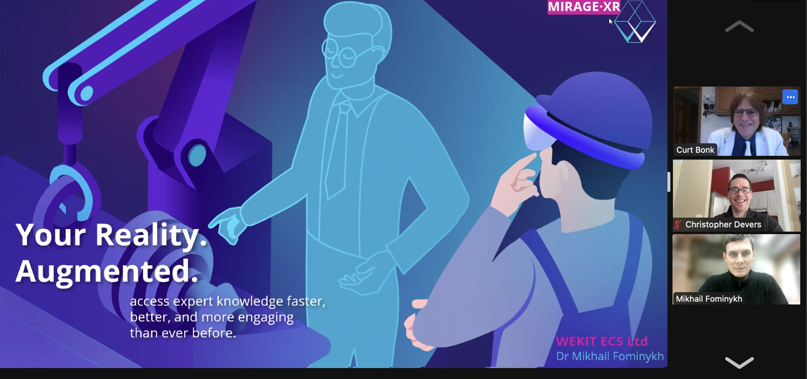
January 24, 2022 Video: 1:07:37: https://youtu.be/IK9dHe4G9nc R678 Week 3 Dr Mikhail Fominykh in Norway on AR Mikhail’s Email: mihail.fominyh@gmail.com Mikhail’s Homepage: mikhailfominykh.com Mikhail’s tech startup https://wekit-ecs.com/ Twitter of event: https://twitter.com/chrisdevers/status/1485677402533642242?s=21

Slide 6
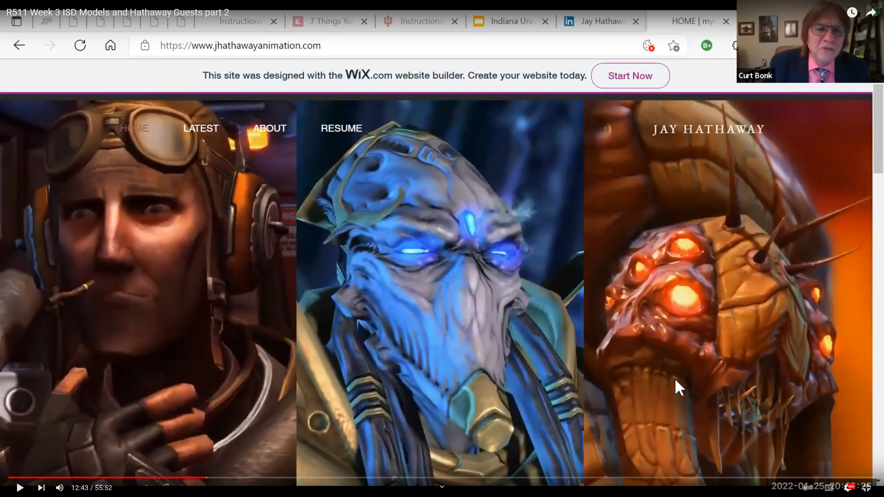
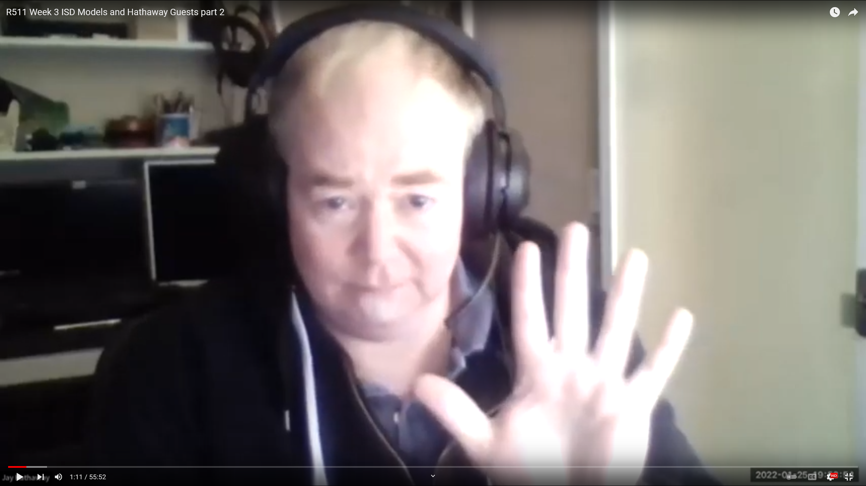
January 25, 2022 R511 Week 3 ISD Models and Hathaway Guests part 2 https://www.youtube.com/watch?v=CKkCgM66pMg

Slide 7
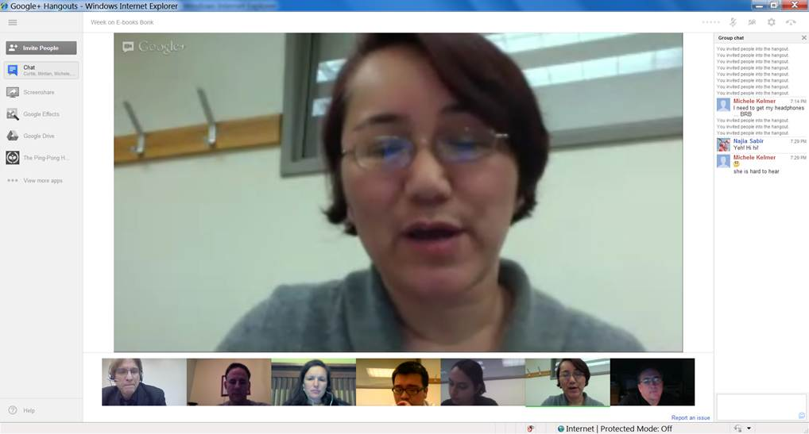
2. Responding to Book or Article Quotes (i.e., Rey Junco)
The learners come to the synchronous session with quotes from those articles or resources for the guest expert to respond to.

Slide 8
3. Responding to Publication Visuals (i.e., Steve Carson, MIT)
Students find visuals from the culture or country of the guest to respond to; alternatively, they might find charts, tables, figures, and graphs from articles, books, or presentations of the guest expert.

Slide 9
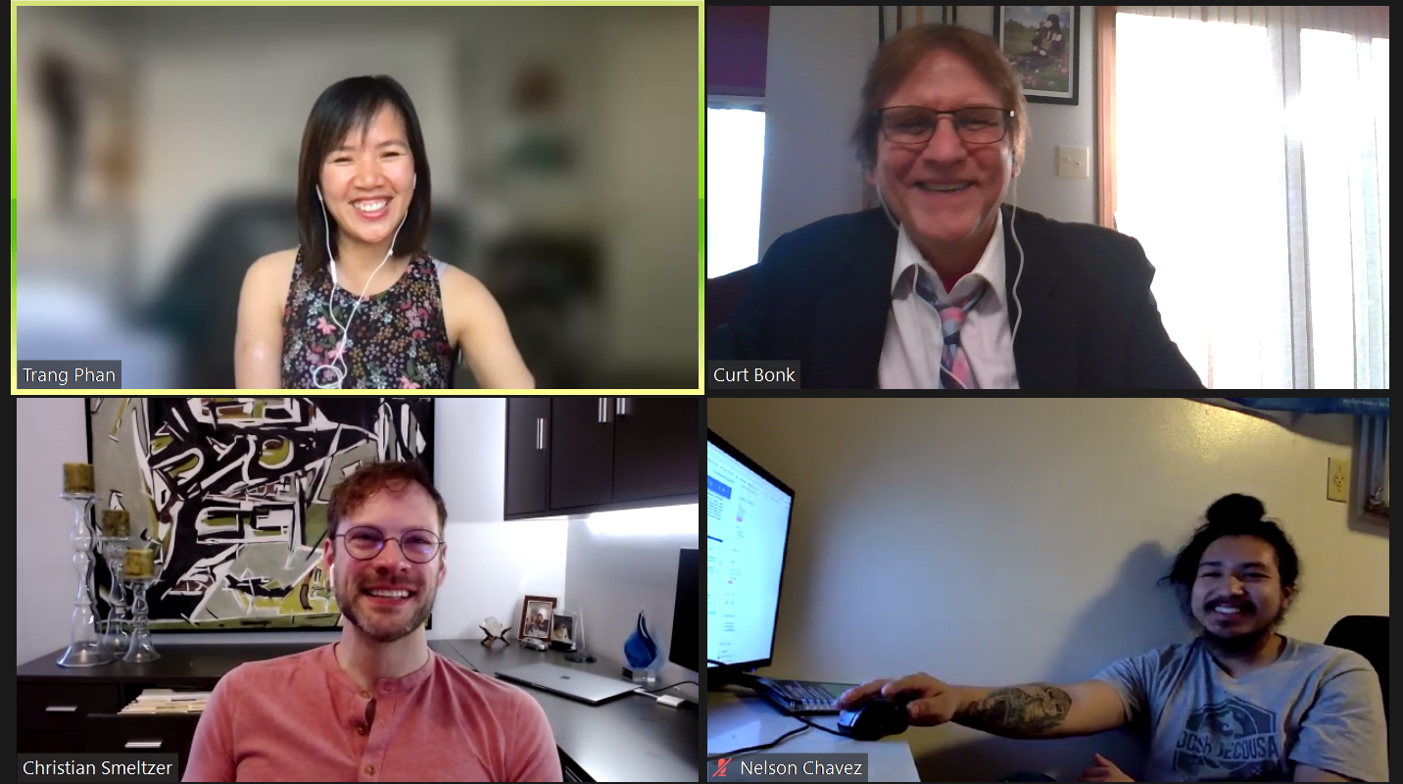
March 14, 2022 Trang Phan

Slide 10
4. Combine Asynchronous and Synchronous Events (e.g., guest was David Merrill, 2007)

Slide 11
5. Solicit Student Recommendations Expert Interviews (Rich Culatta, Acting Director, Office of Educational Technology) September 29, 2021, Anita Vyas, Baylor University Med School Week 6 R511 Guest, https://youtu.be/CLMEbiGrYJs

Slide 12
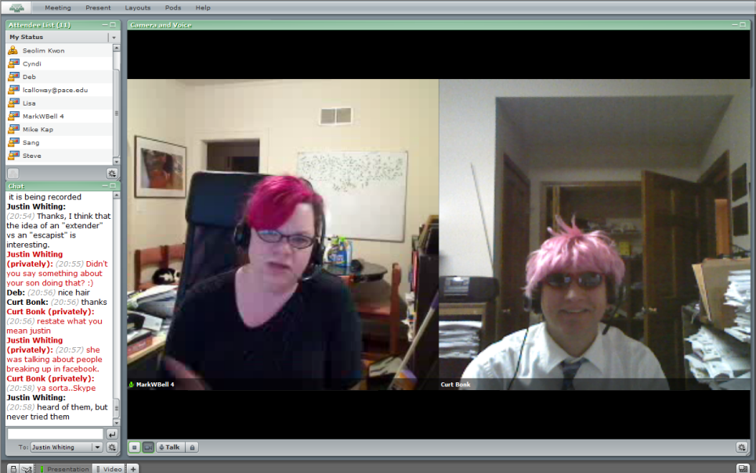
6. Make a List of Those You Know October 18, 2021, Week 9 with Punya Mishra (1:06:19), https://youtu.be/jBFIiB11N5I

Slide 13
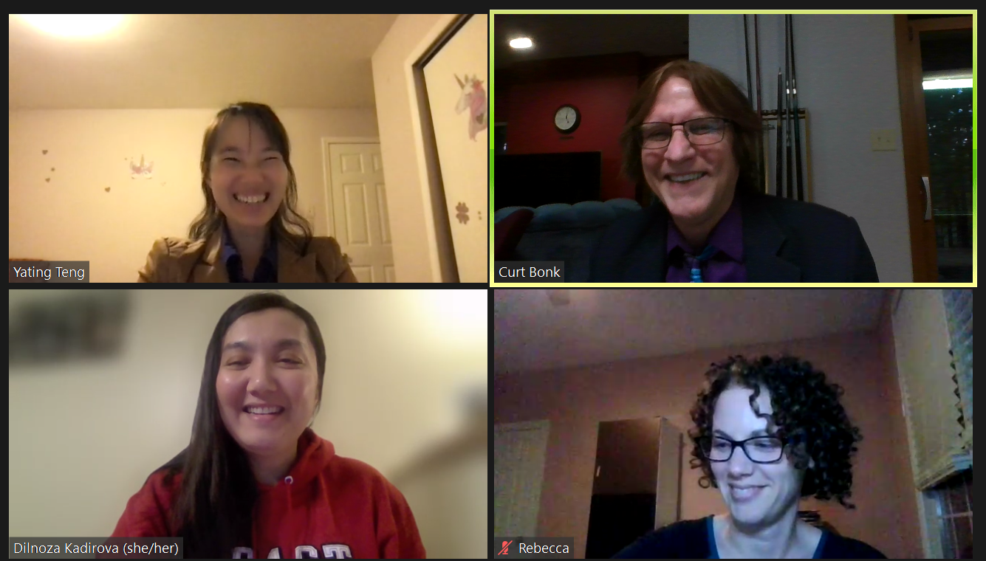
October 26, 2021 YaTing Teng, R511 Corporate Training

Slide 14
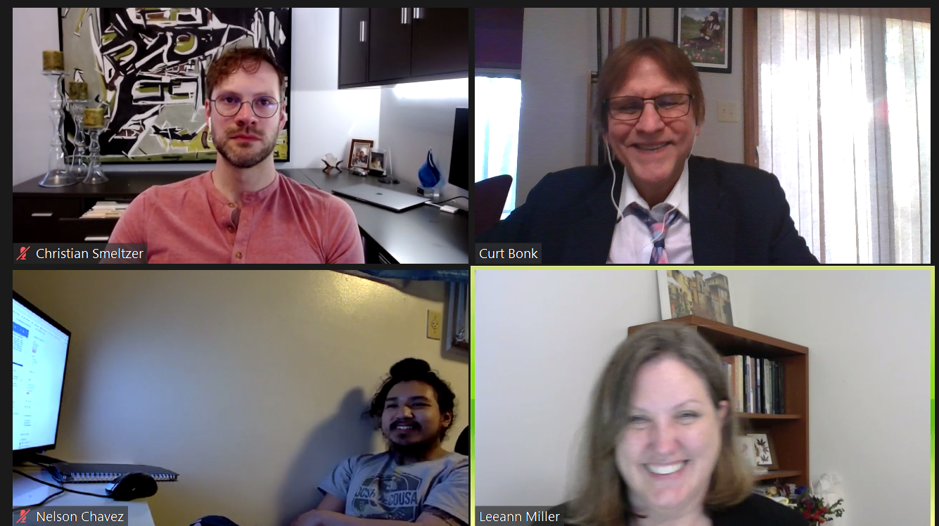
March 14, 2022 Lee Ann (Hill) Miller, Healthcare Technology (Simulations) R678 Week 9-10 Lee Ann Miller West Virginia University Hospitals https://youtu.be/zJgWxk12YlE

Slide 15
R511 Spring 2021

Slide 16
R511 Spring 2021

Slide 17
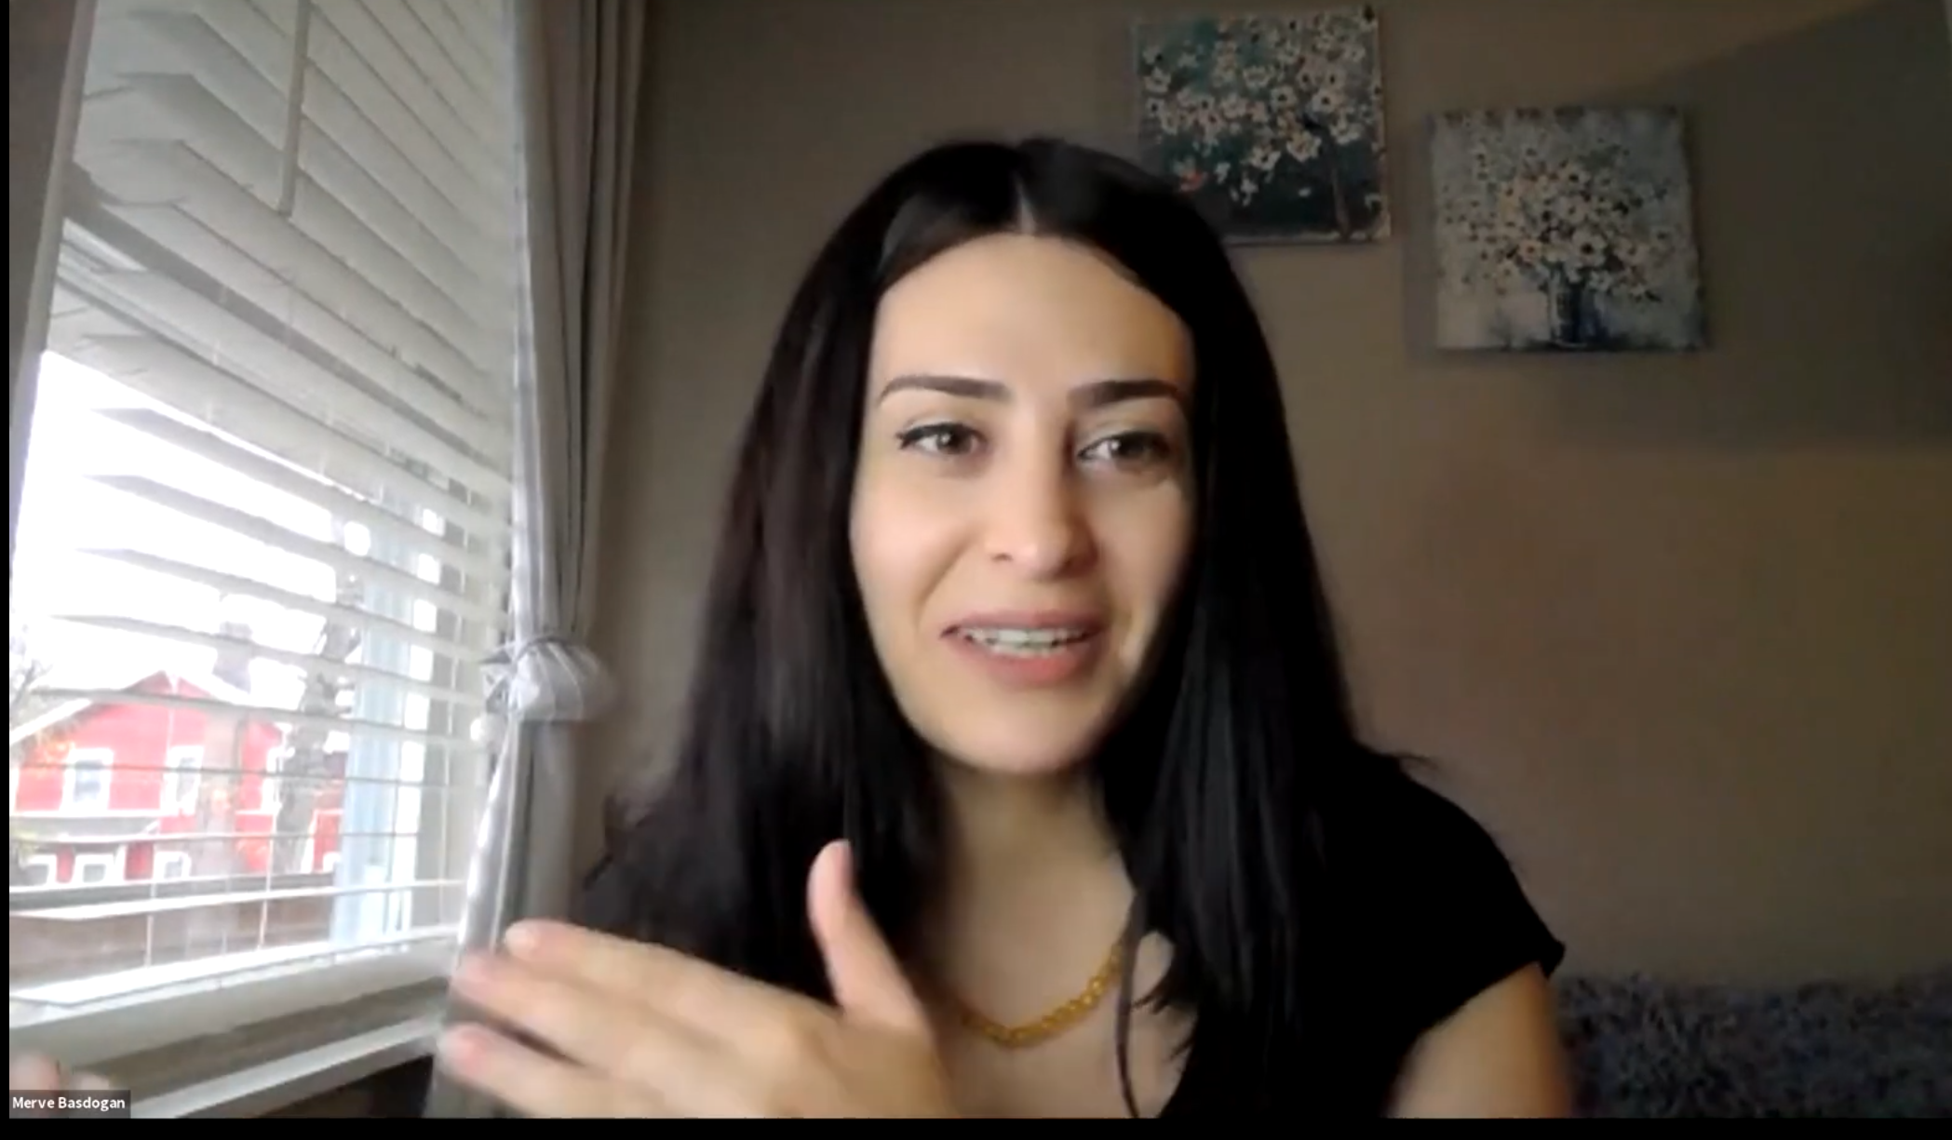
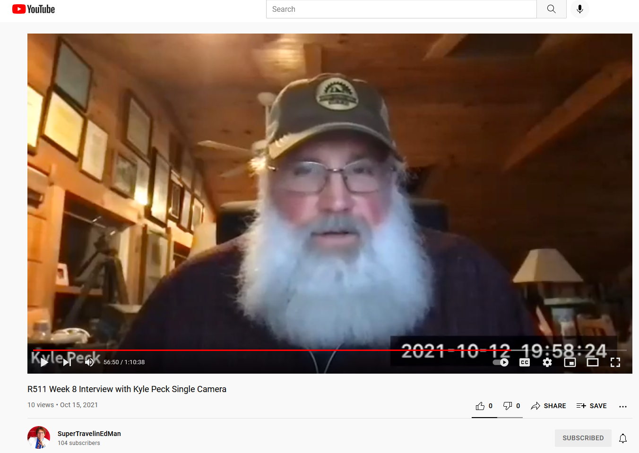
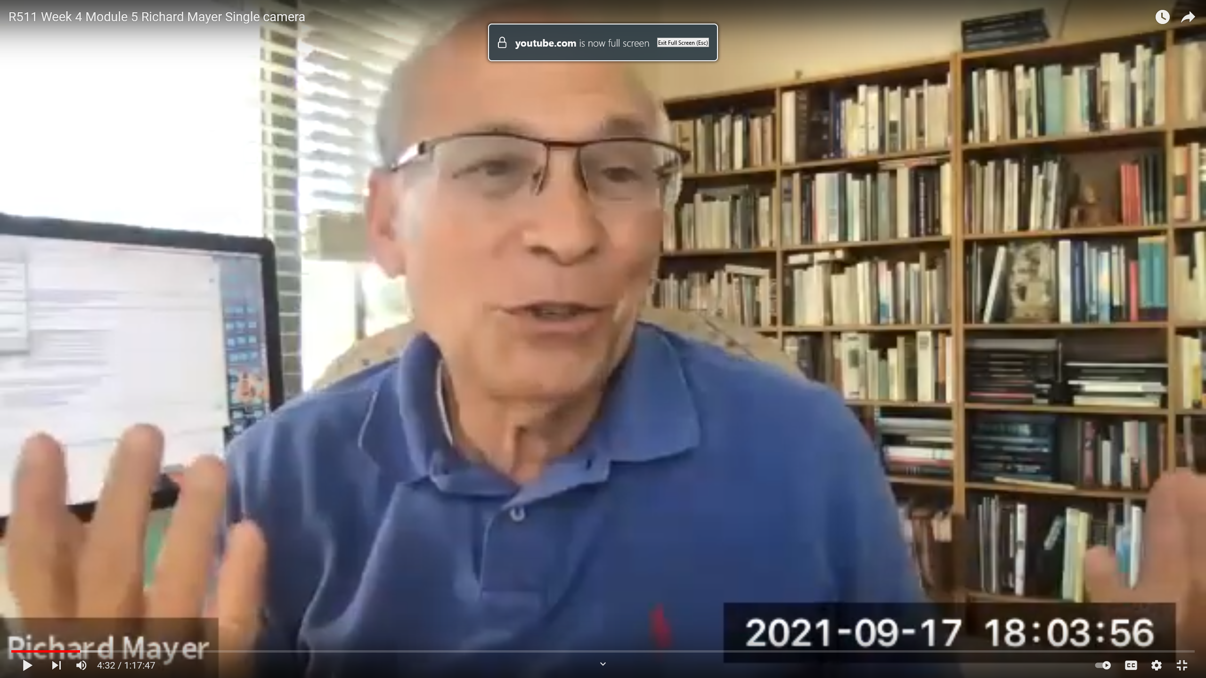
November 14, 2021, Week 13, R511, Merve Basdogan, Indiana University https://youtu.be/4PCSXArug4k October 18, 2021, Week 9, R511, Punya Mishra, ASU (1:06:19), https://youtu.be/jBFIiB11N5I October 12, 2021, Week 8, R511, Kyle Peck, Penn State, (1:22:10) (1:10:38): https://www.youtube.com/watch?v=ycKFA6x-f-Q September 29, 2021, Week 6 R511 Guest #2 Anita Vyas Baylor Med School (1:16:48),, https://youtu.be/CLMEbiGrYJs September 26, 2021, Week 6, R511, Authentic Learning with Tom Reeves (1:12:24), https://www.youtube.com/watch?v=5pSZJiW3XTw September 17, 2021, Week 4, R511, Richard Mayer (1:17:47): https://youtu.be/pVo7IRsbgkA

Slide 18
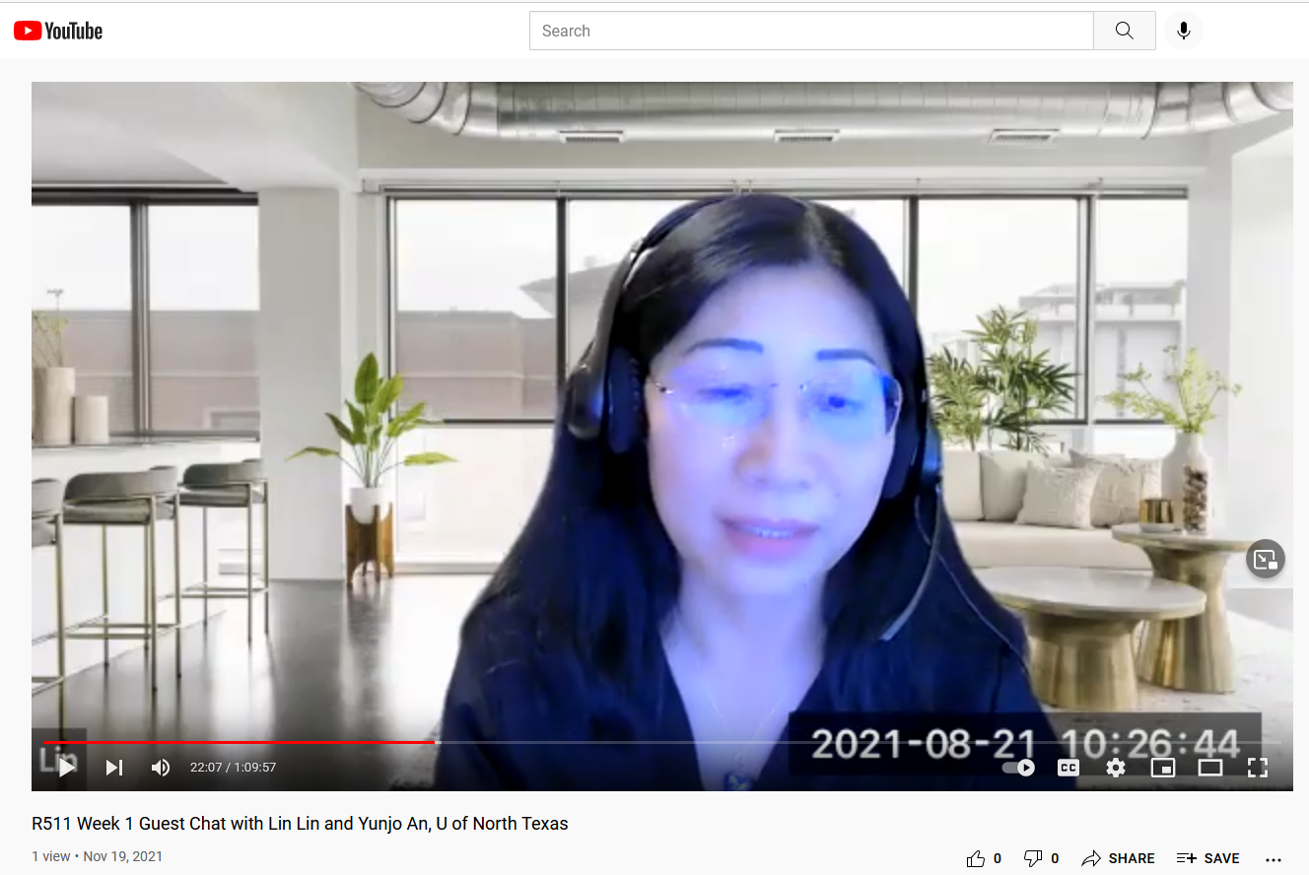
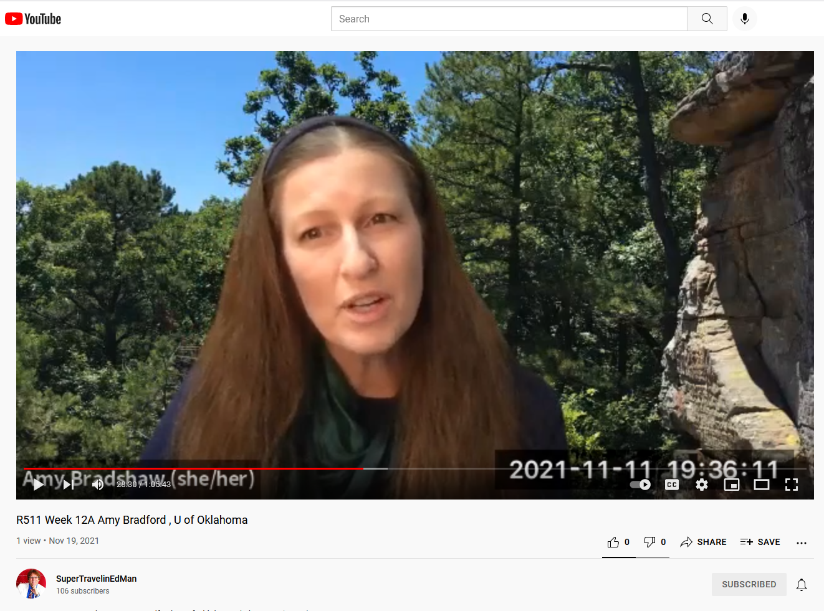
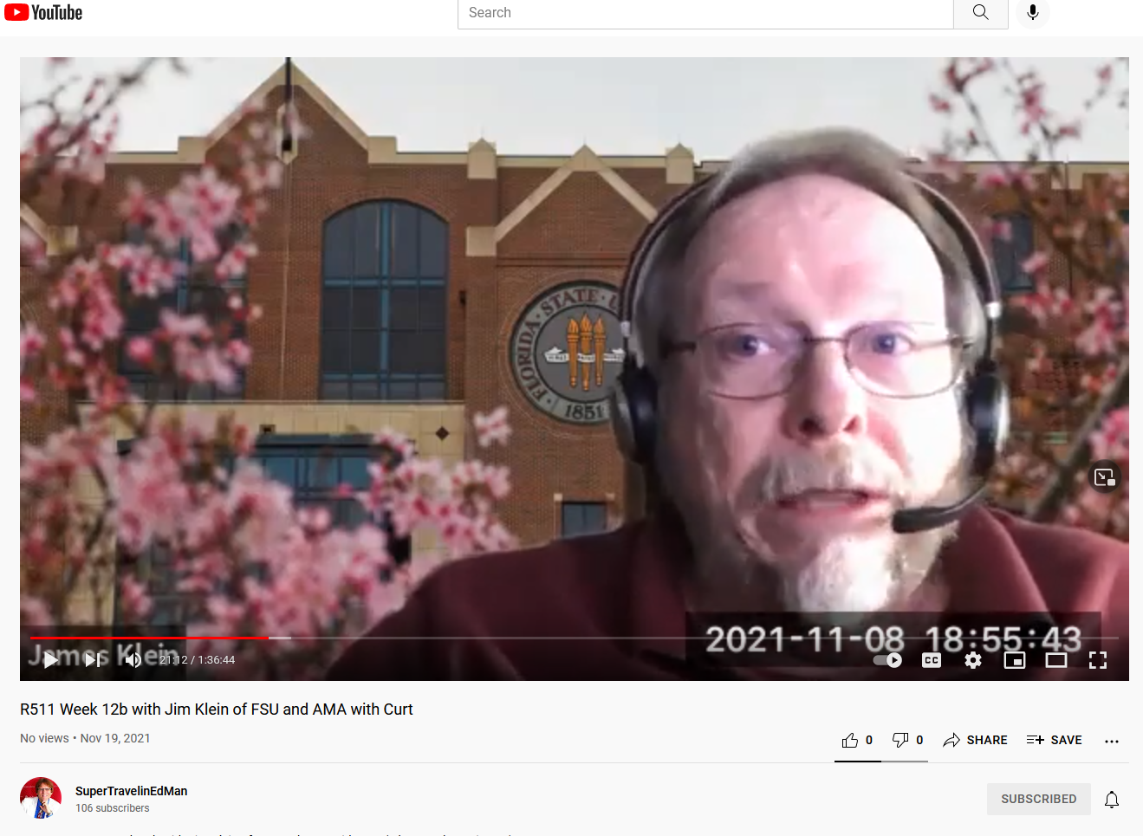
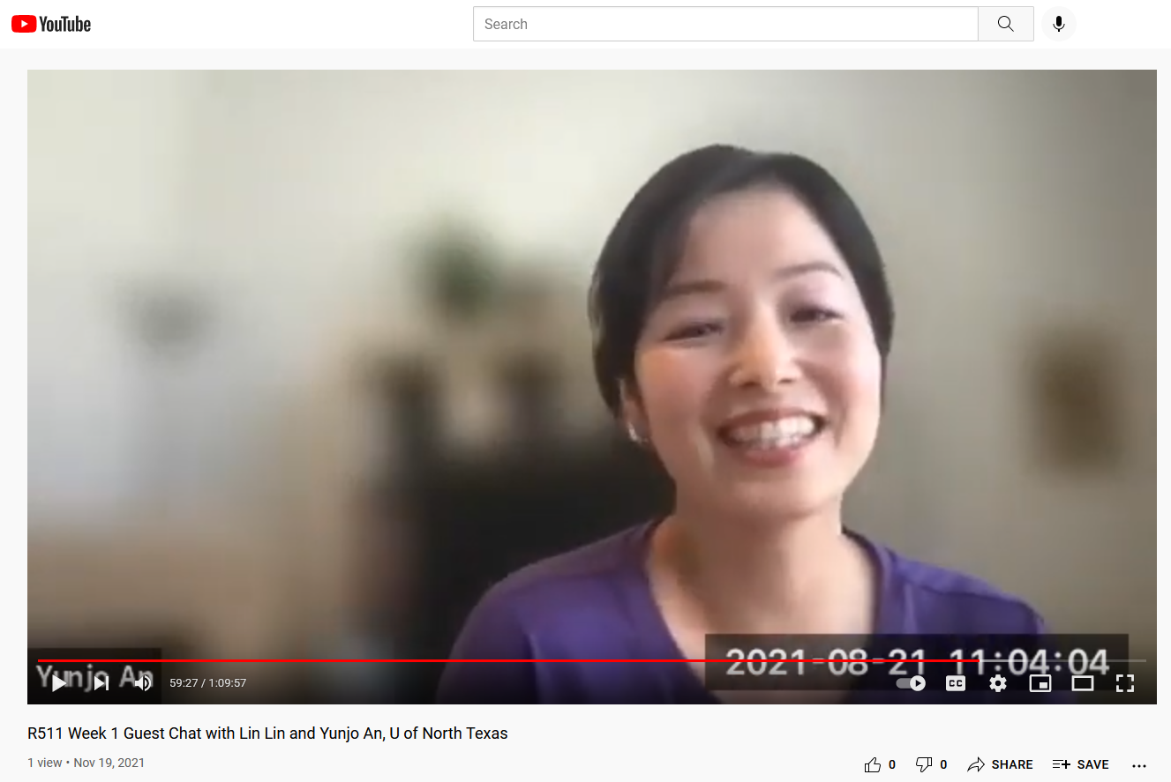
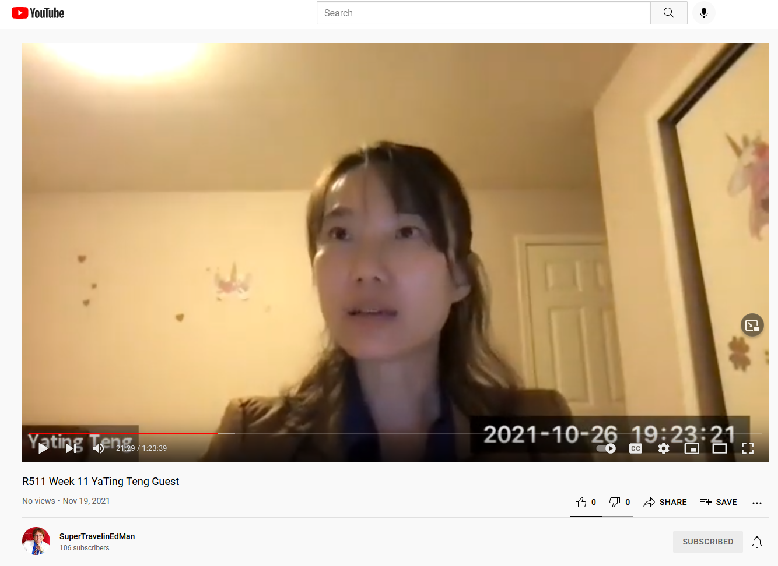
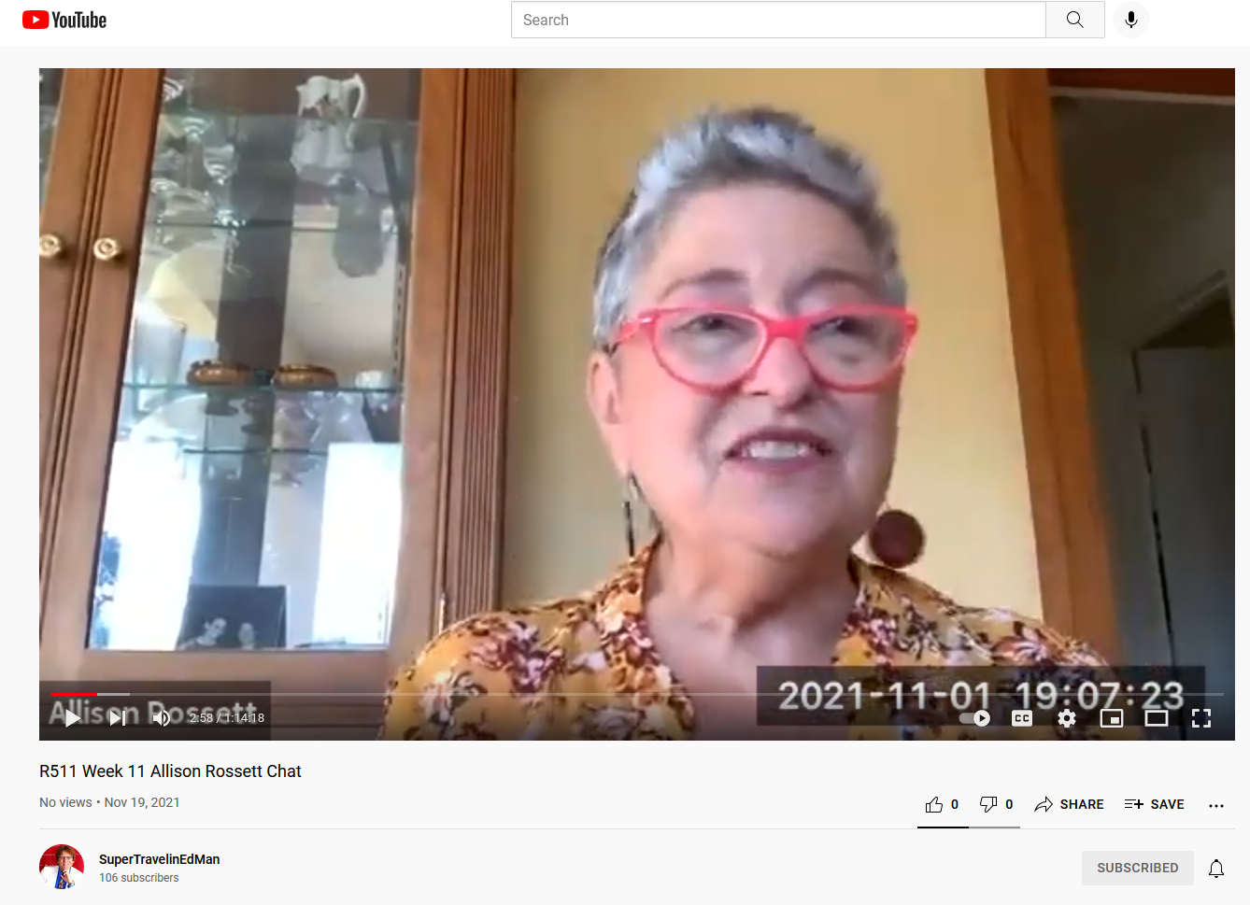
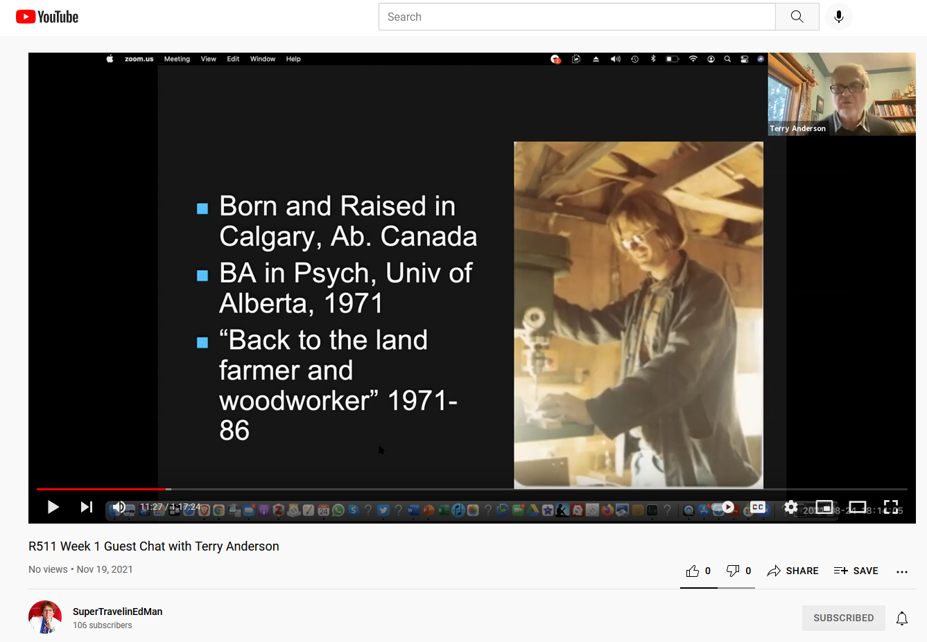
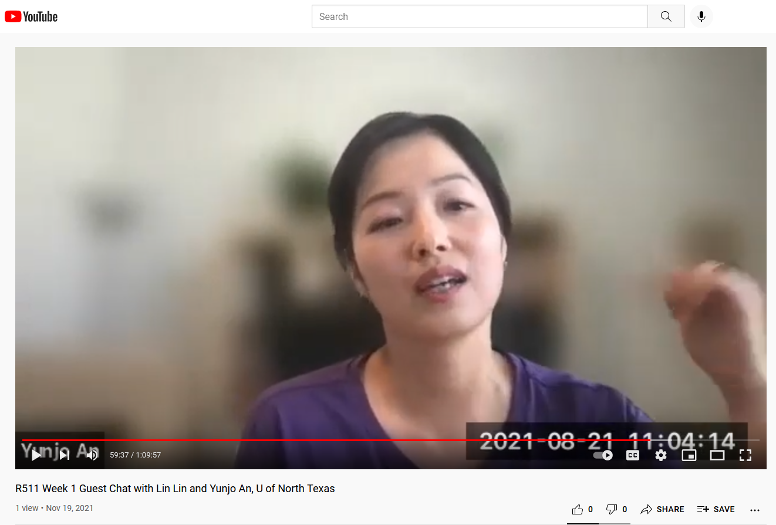
November 11, 2021, Week 12A, R511, Amy Bradford , University of Oklahoma (1:05:44) https://youtu.be/TnFE4OA7EaM November 8, 2021,Week 12b, R511, Jim Klein, Florida State University and AMA with Curt Bonk (1:08:44) https://youtu.be/IHVk0Qh74ZQ November 1, 2021, Week 11, R511, Allison Rossett, San Diego State Univ. (1:14:19) https://youtu.be/-a3PrynIi4A October 26, 2021, Week 10, R511, YaTing Teng Guest (1:23:39) https://youtu.be/_ZoWnOHhb_c August 24, 2021, Week 1B, R511, Terry Anderson, Athabasca University, Canada (1:17:24) https://youtu.be/_HuOh_woxHk August 21, 2021, R511 Week 1A, R511, Lin Lin and Yunjo An, University of North Texas (1:09:57) https://youtu.be/ZRF7Mg-5ShU

Slide 19
7. Expert Pairs
Invite two guests who can add a more complete picture. (Yunjo An and Lin Lin, University of North Texas, August 21, 2021)

Slide 20
February 22, 2022 R511 Khendum Gyabak and Anita Vyas

Slide 21
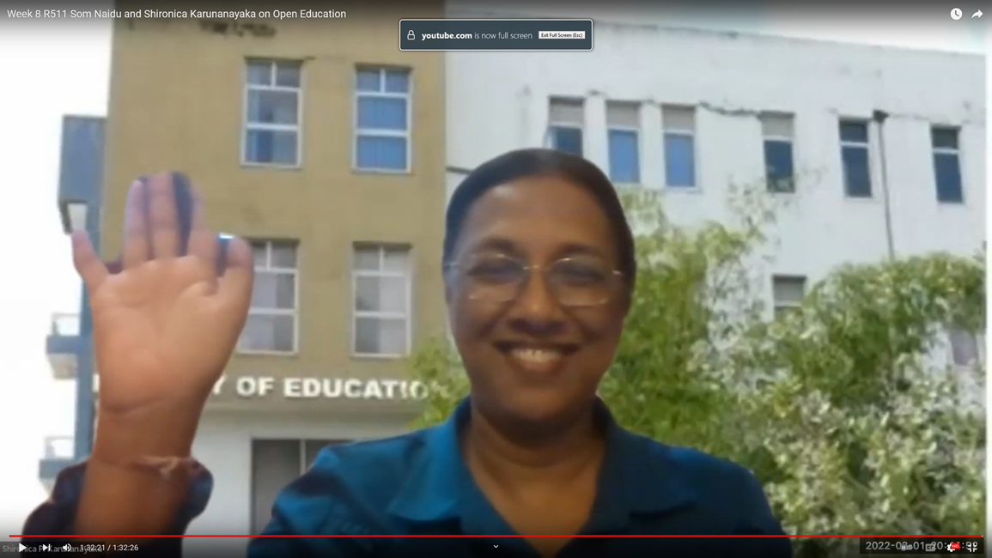
March 1, 2022 Som Naidu, Fiji and Shironica Karunanayaka, Sri Lanka

Slide 22
January 11, 2022 Bill and Sunnie Watson, Purdue University

Slide 23
8. Expert Interviews and Discussions
Students might read the biography or resume of the guest as well as available articles, books, and other resources about this person. Next, the guest might respond to questions from the class based on these resources.
August 24, 2021, Terry Anderson
September 17, 2021, Expert chat session with Richard Mayer (1:17:47): https://youtu.be/pVo7IRsbgkA

Slide 24
May 27, 2021 Dr. John Savery on PBL

Slide 25
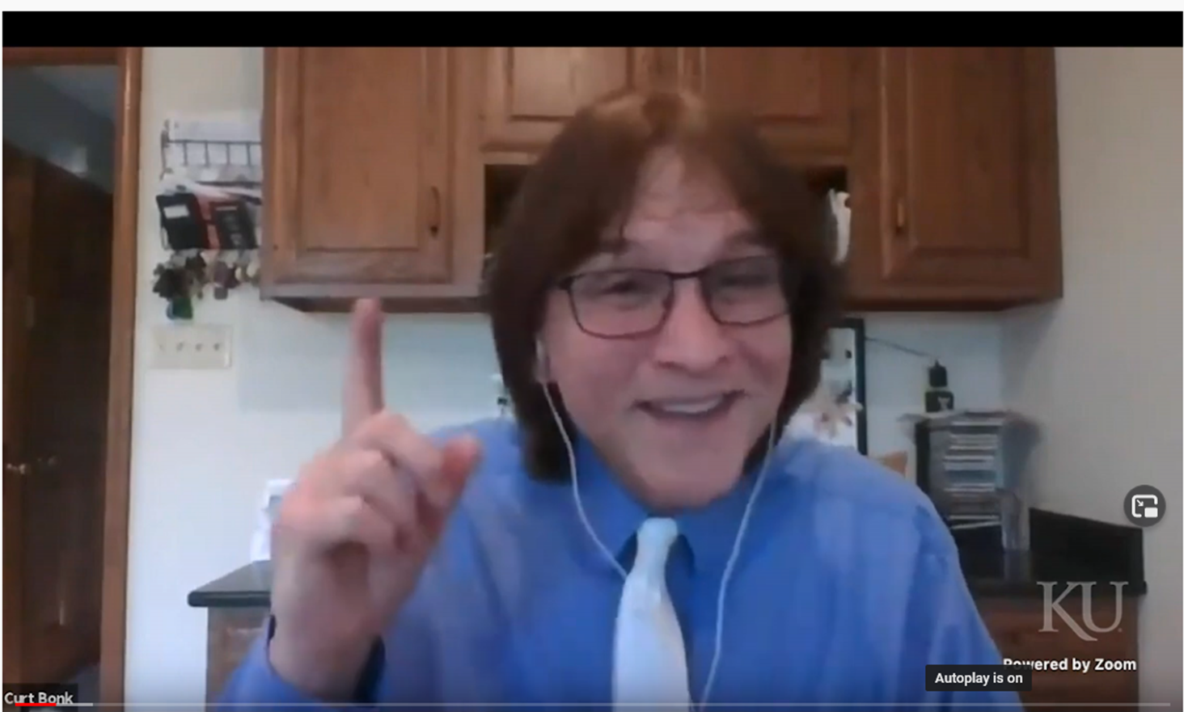
May 1, 2021 Dr. David Wiley on Open Education

Slide 26
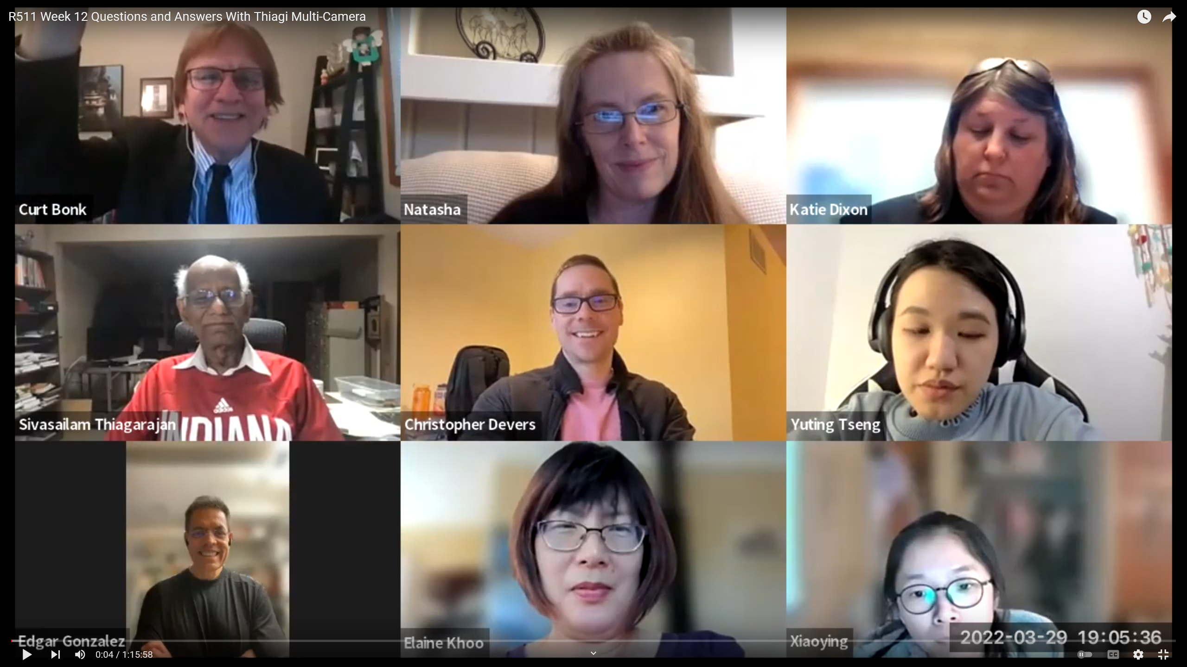
March 29, 2022 R511 Week 11 Questions and Answers With Dr. Sivasailam Thiagarajan (1 hour, 15 minutes) Single Camera View: https://youtu.be/4OGhwJSaFAo Multiple Camera View: https://youtu.be/EssDmqU030g

Slide 27
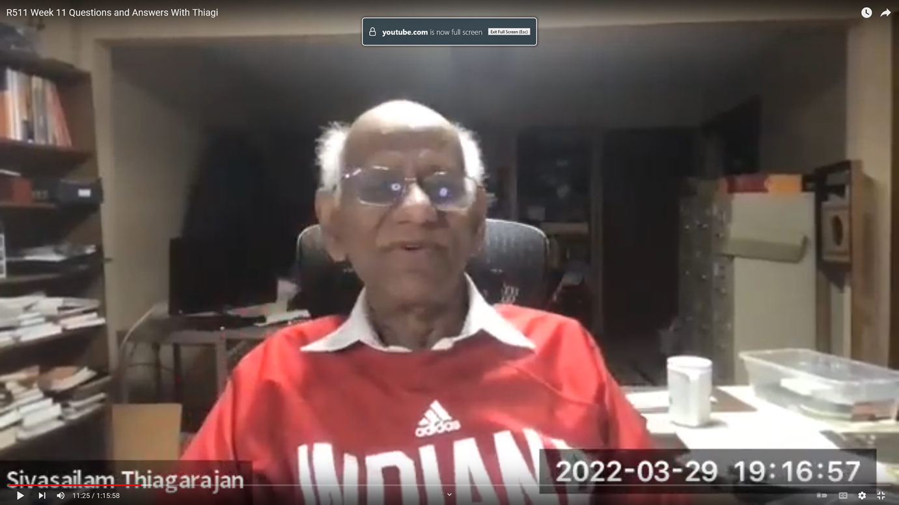
March 29, 2022 R511 Week 11 Questions and Answers With Dr. Thiagi
(1 hour, 15 minutes) Single Camera View: https://youtu.be/4OGhwJSaFAo Multiple Camera View: https://youtu.be/EssDmqU030g

Slide 28
March 29, 2022 Dr. Sivasailam Thiagarajan

Slide 29
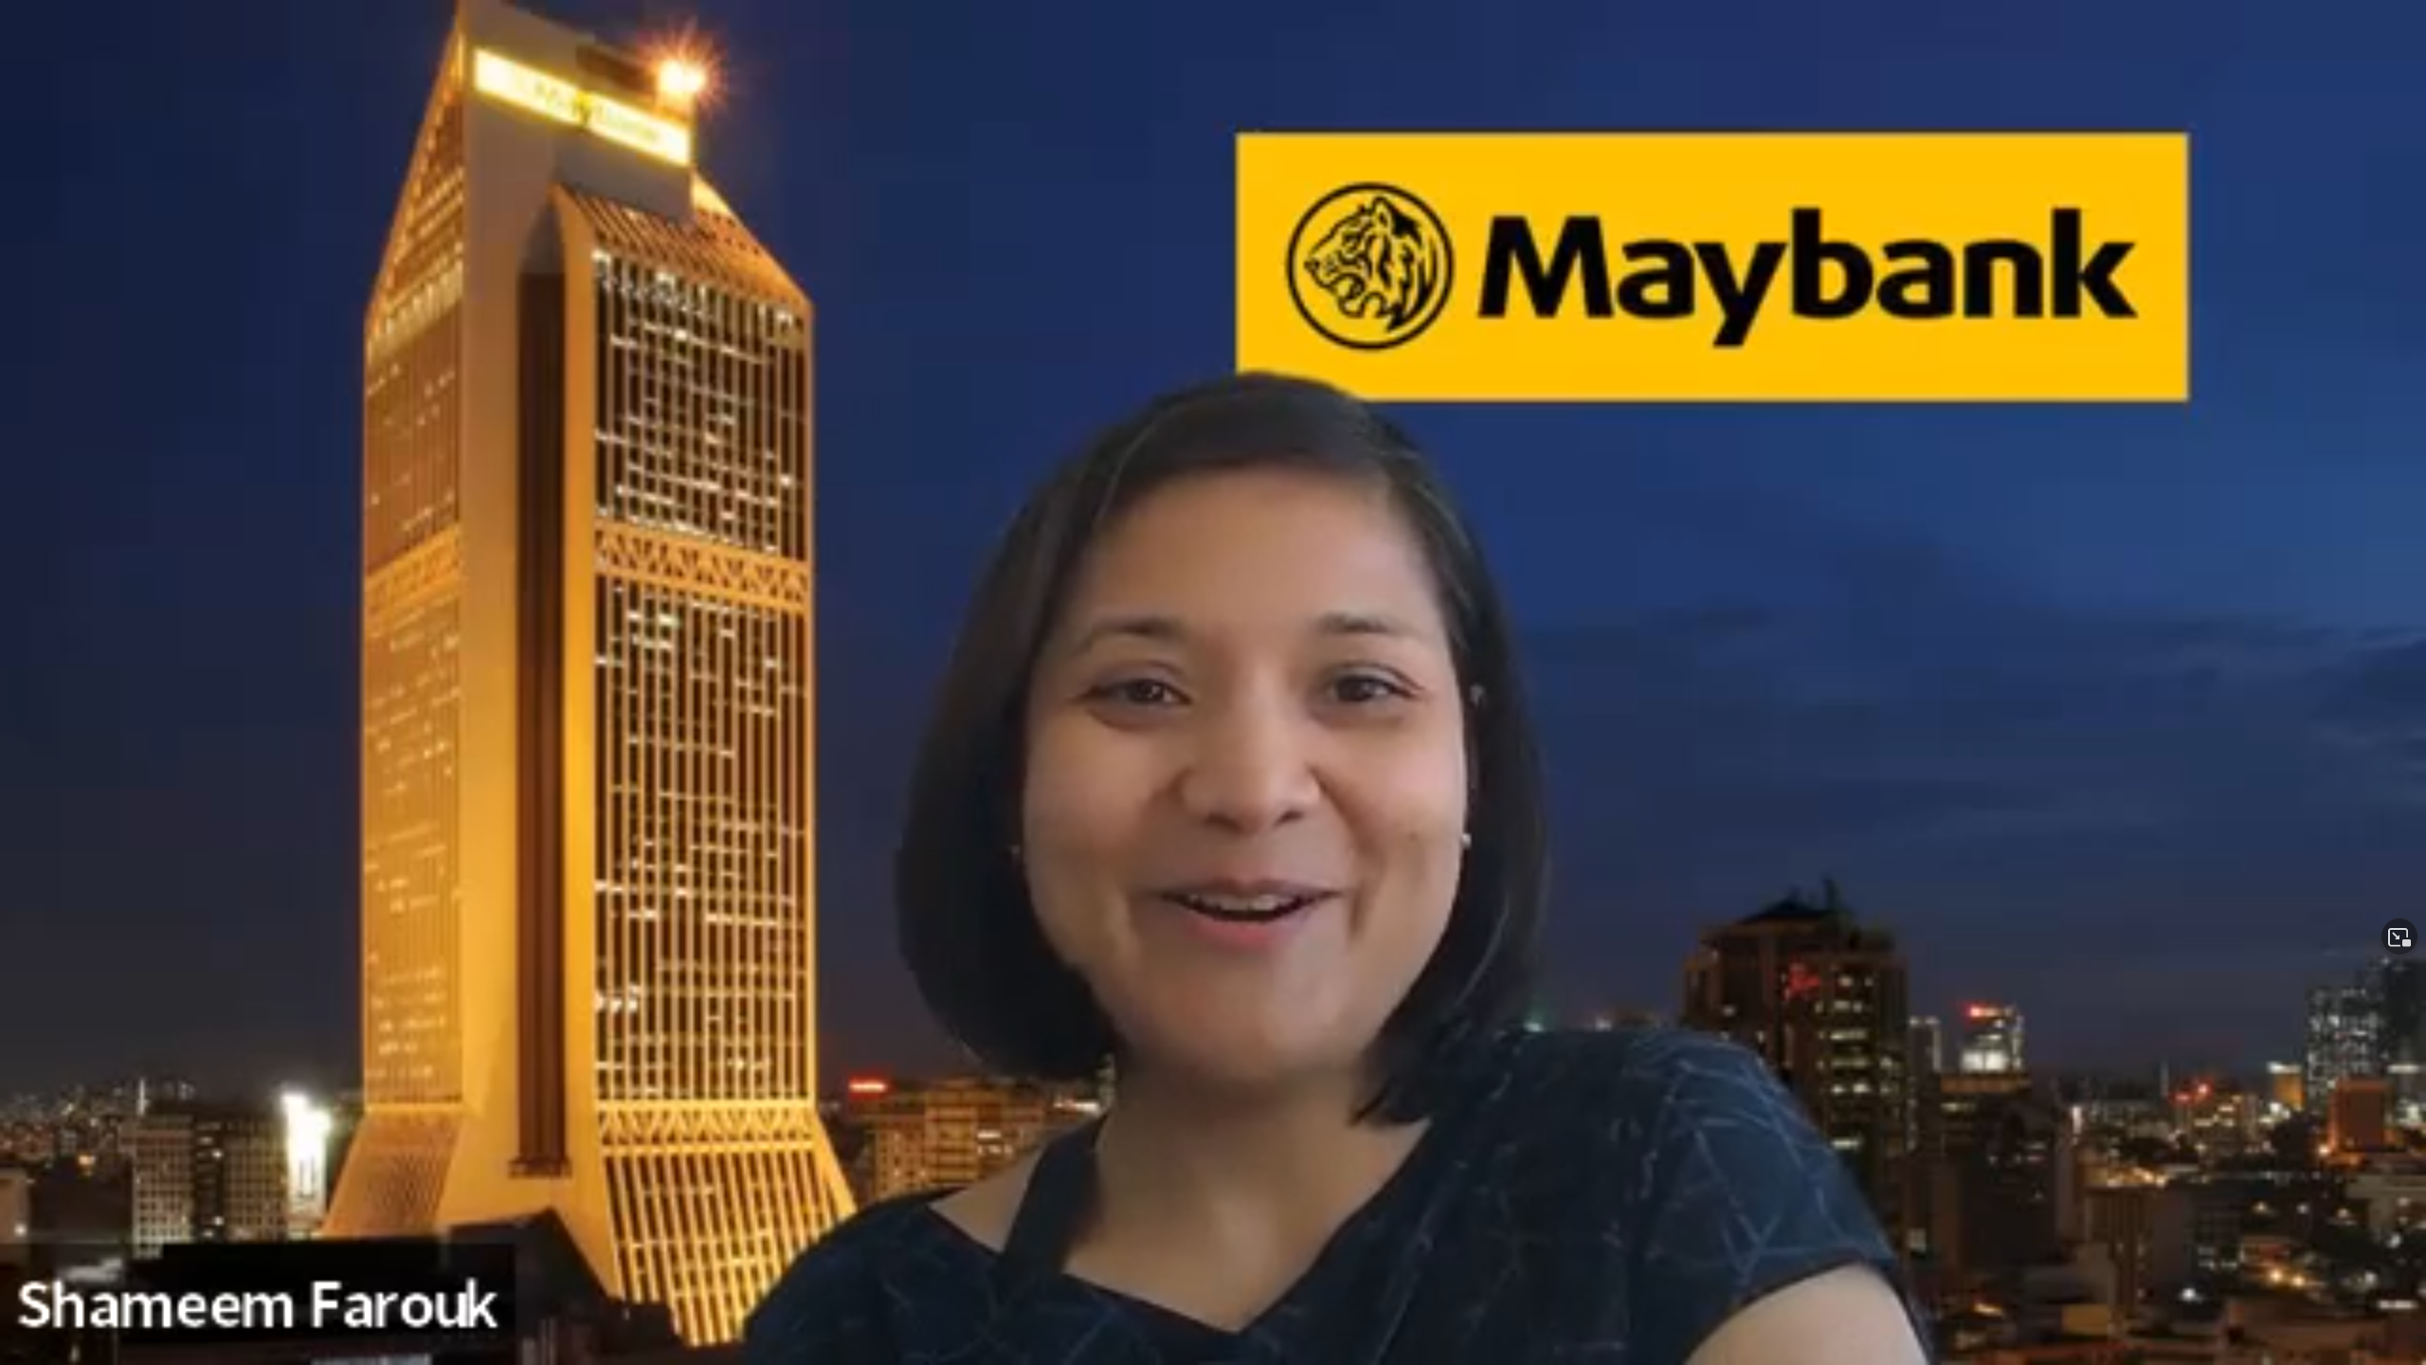
March 25, 2022 Dr. Shameem Farouk, Malaysia
https://iu.mediaspace.kaltura.com/media/t/1_zwqeanef

Slide 30
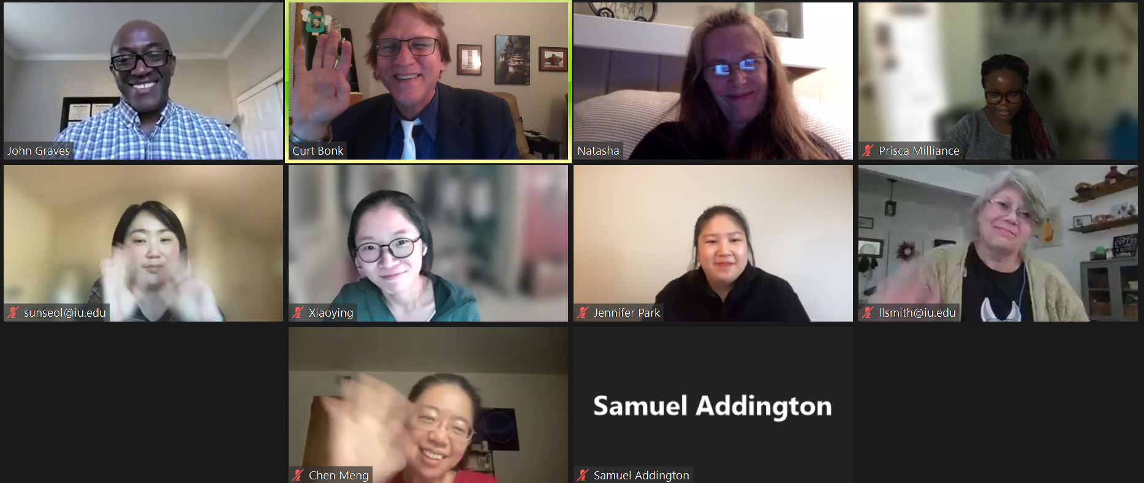
March 22, 2022 R511 Week John Aaron Graves, Ph.D., Change Management Consultant, San Francisco https://youtu.be/dBJhRXsL9Uo

Slide 31
March 22, 2022 R511 Week John Aaron Graves, Ph.D., Change Management Consultant, San Francisco https://youtu.be/dBJhRXsL9Uo

Slide 32
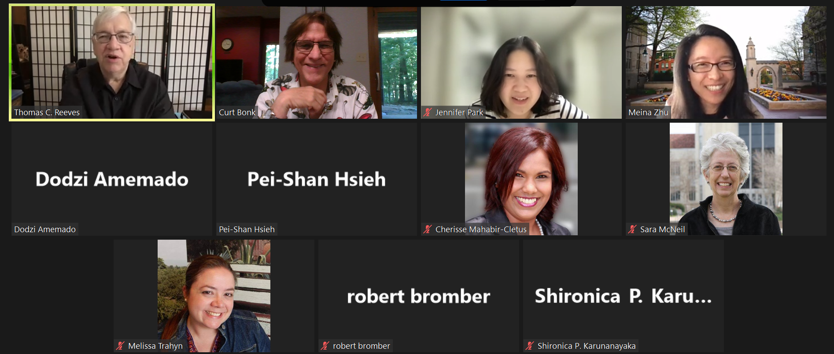
9. Expert Session Archive Reviews and Discussions
A class might watch one or more guest expert sessions from a previous semester and form discussion groups based on controversial, confusing, or complex aspects of such sessions.
September 26, 2021, Week 6 Authentic Learning with Tom Reeves (1:12:24), https://www.youtube.com/watch?v=5pSZJiW3XTw

Slide 33
10. Expert Life Stories
The guest expert might detail different stories or situations that he or she has encountered related to a certain topic of the class. Students in the class can comment on them and ask questions as needed.
(October 12, 2021, R511 Week 8 Interview with Kyle Peck Single Camera (1:10:38): https://www.youtube.com/watch?v=ycKFA6x-f-Q

Slide 34
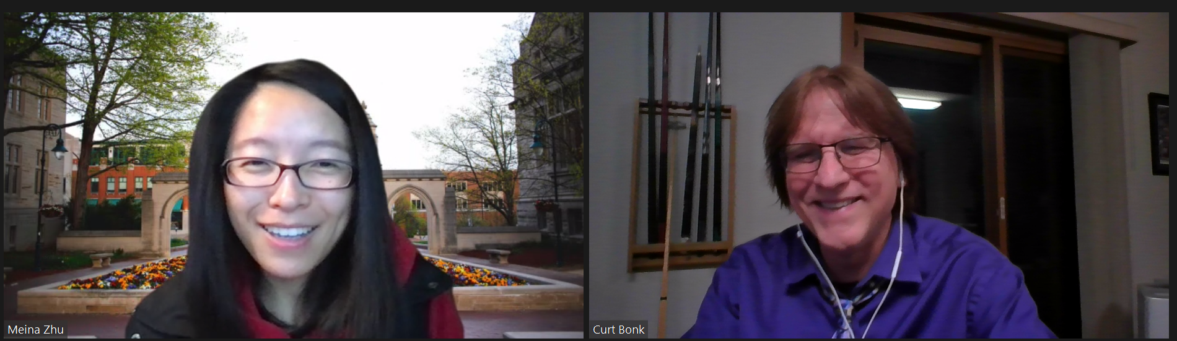
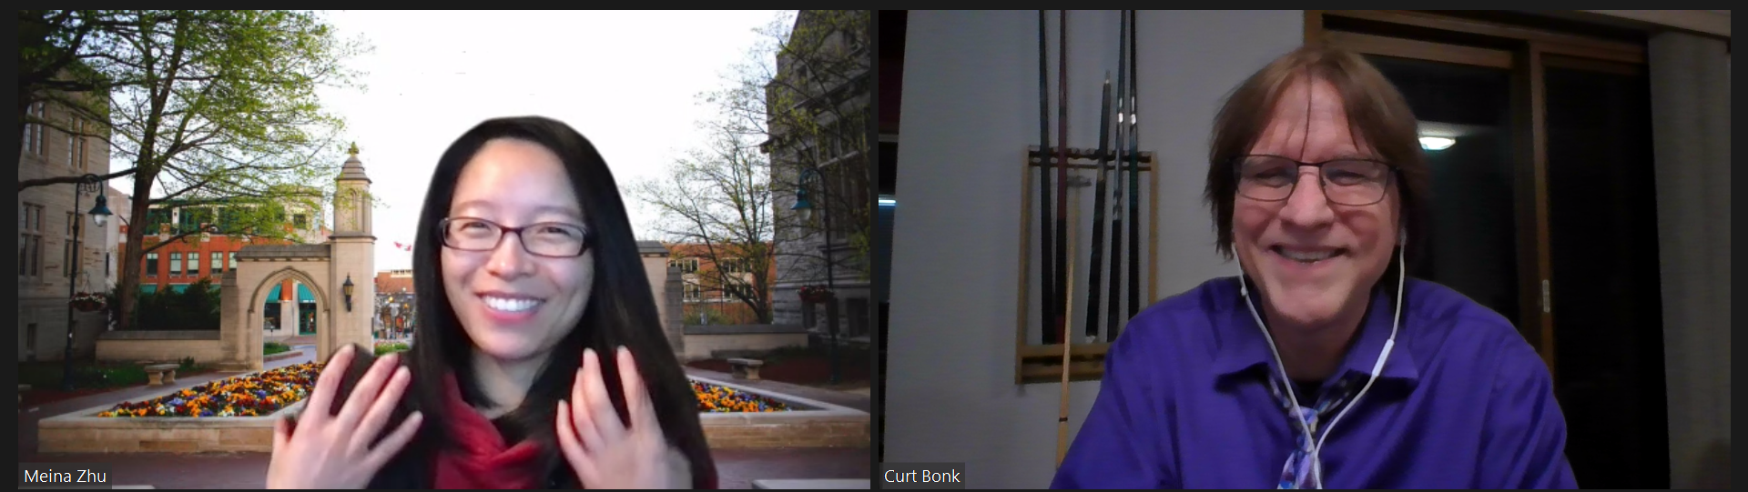
11. Expert Research Presentations
The guest expert detail one or more studies and the findings.

Slide 35
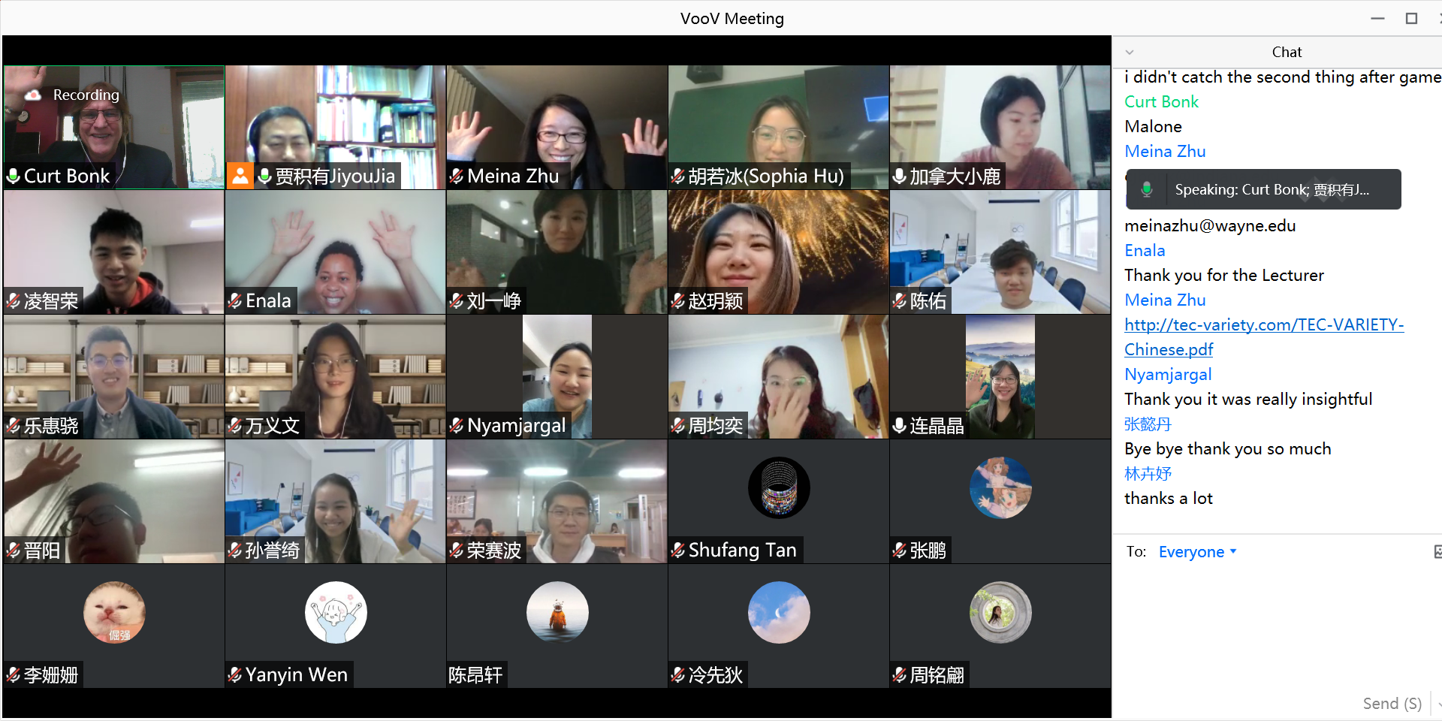
October 26, 2021 Meina Zhu and Curt Bonk, Peking University

Slide 36
March 13, 2022 Meina Zhu and Curt Bonk, Malaysia

Slide 37
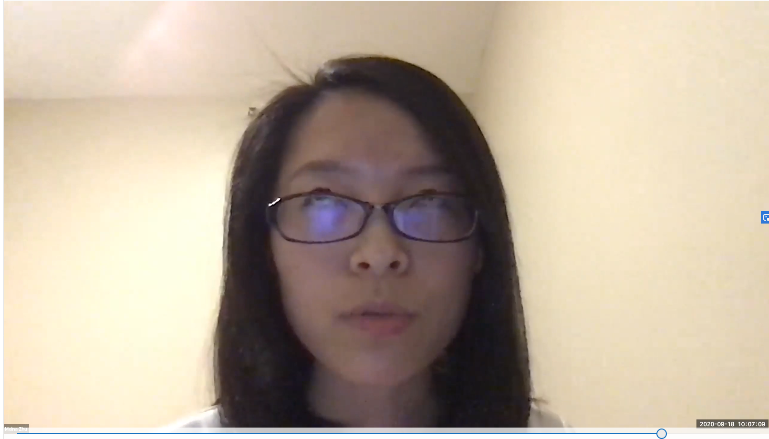
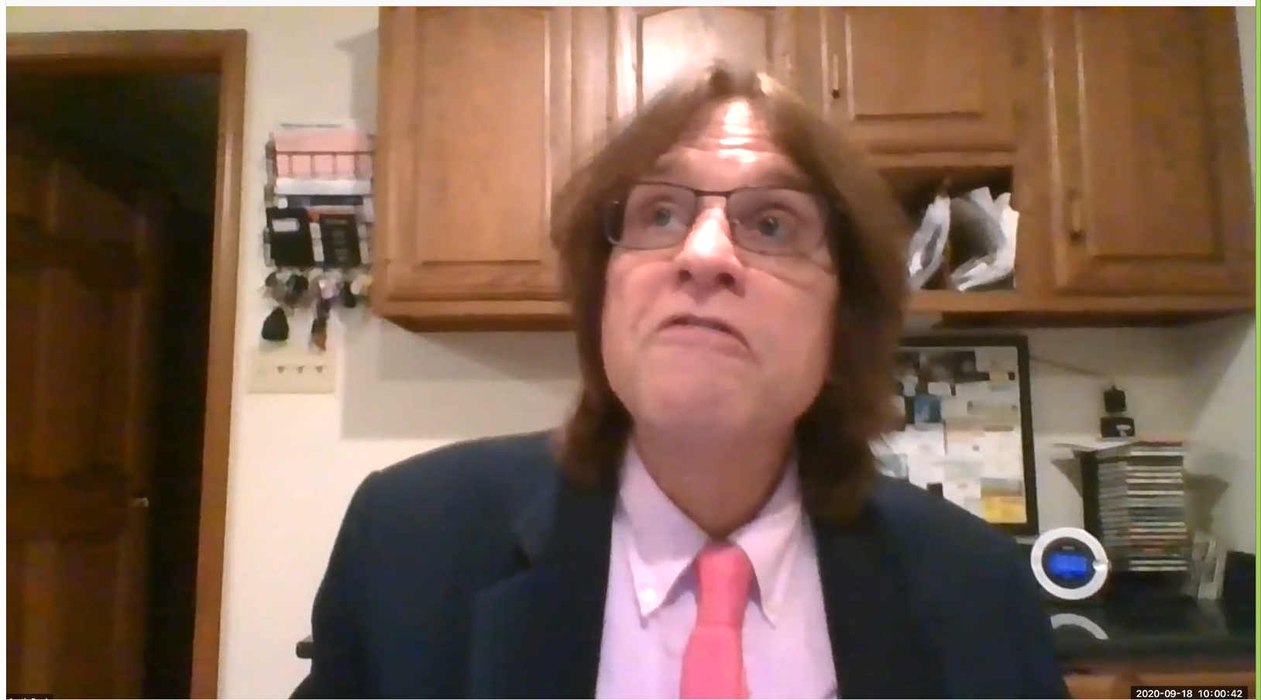
September 17, 2020 Bonk, C. J., & Zhu, M. (2020, September 17). On the Road Toward Fostering Greater Self-Directed Learning in MOOCs: Research Toward Better Design Practices. New Education Normal Webinar Series, National Institute of Education and Nanyang Technological University, Singapore. https://tinyurl.com/y2ld4d4f https://www.youtube.com/watch?v=yC4aQuYnqZk&feature=youtu.be 120 registered and 129 attended from India, Japan, China, Nigeria, Indonesia, Singapore, Malaysia, Iran, Iraq, Eswantini, USA, HK, Korea, Bhutan, Nepal

Slide 38
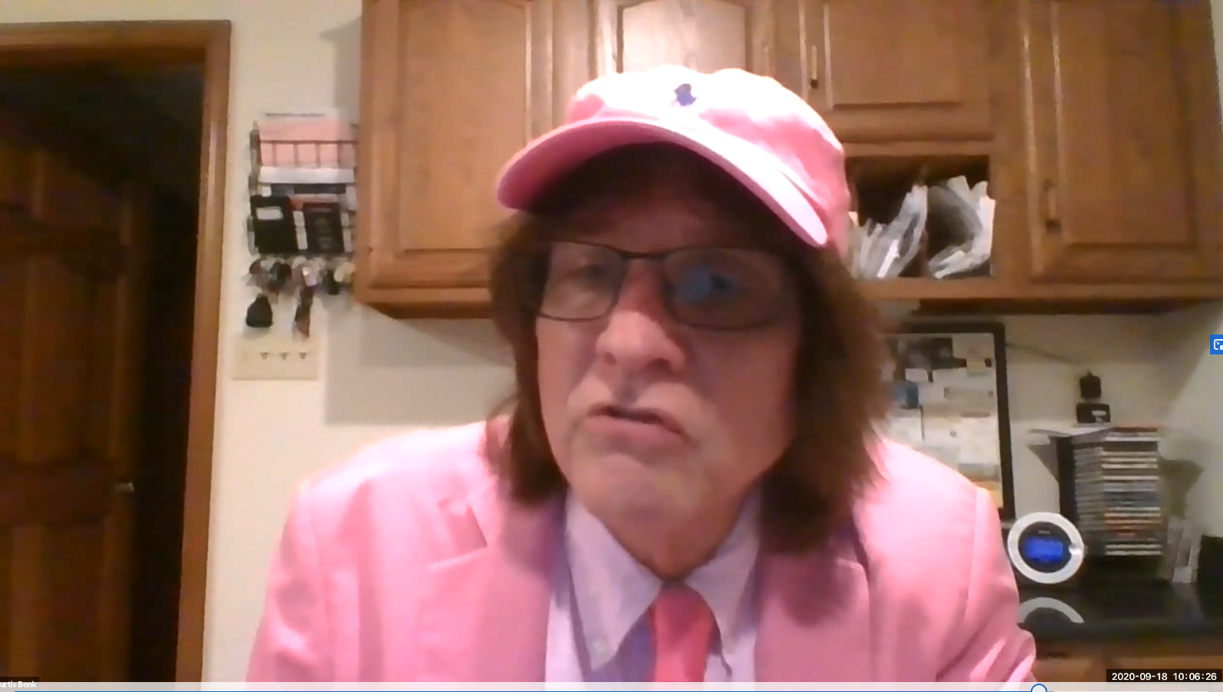
September 17, 2020 Bonk, C. J., & Zhu, M. (2020, September 17). On the Road Toward Fostering Greater Self-Directed Learning in MOOCs: Research Toward Better Design Practices. New Education Normal Webinar Series, National Institute of Education and Nanyang Technological University, Singapore. https://tinyurl.com/y2ld4d4f

Slide 39
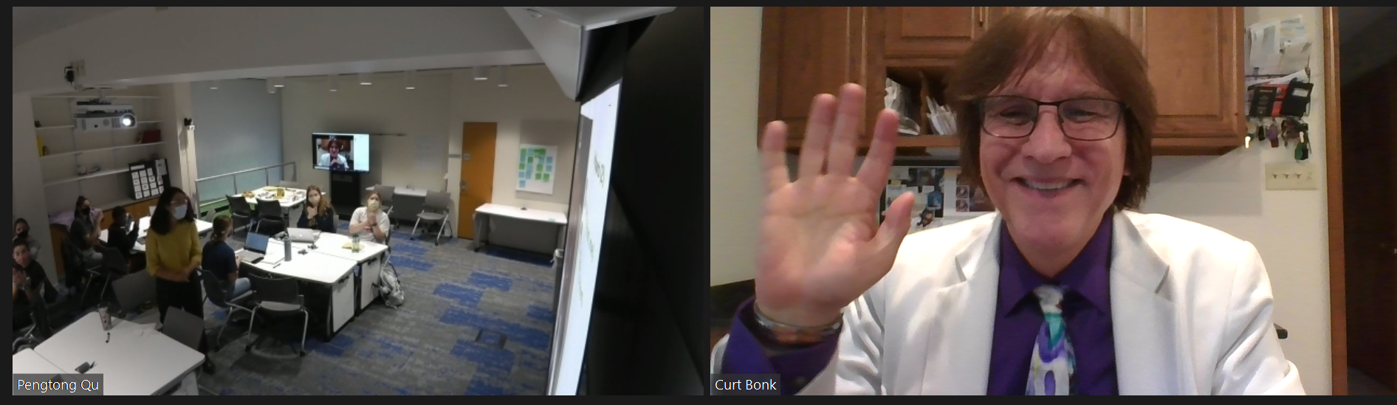
October 25, 2021 Classroom talk to Butler University

Slide 40
12. Expert Panel Presentations (March 4, 2022, IST Conference)

Slide 41
12. Expert Panel Presentations (March 4, 2022, IST Conference)

Slide 42
February 28, 2022 Ed Tech Past, Present, and Future Panel R678 with Tom Reeves, Tom Reynolds, Veronica Acosta, and Okhwa Lee https://youtu.be/BUu9vFDqixw

Slide 43
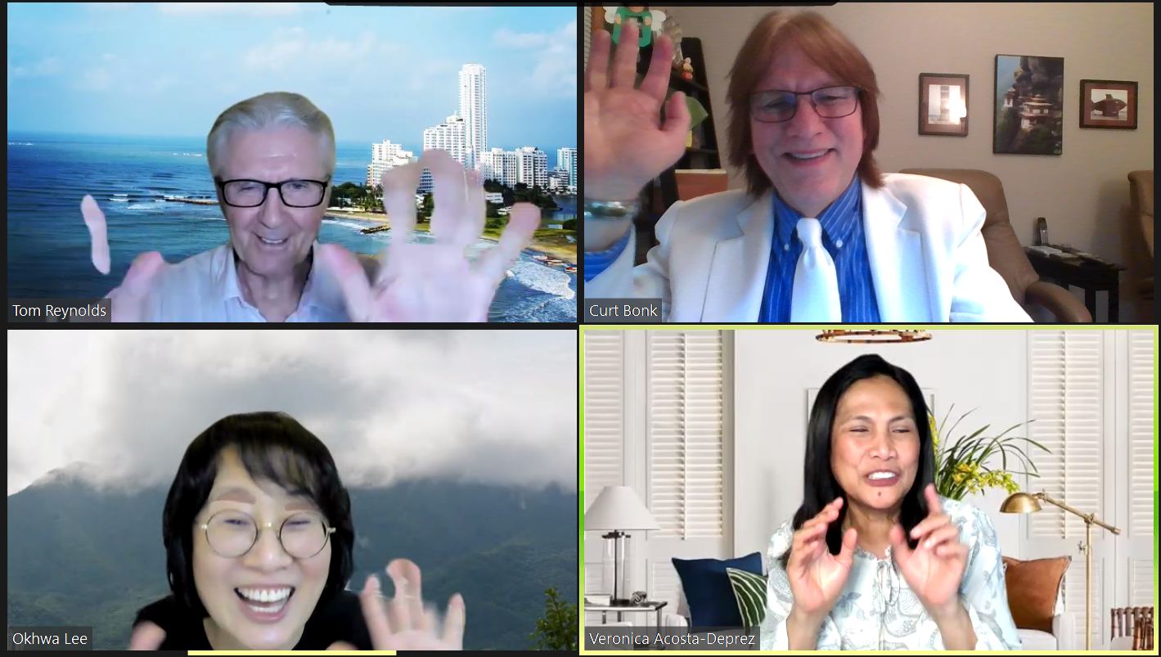
February 28, 2022 Ed Tech Past, Present, and Future Panel R678 with Tom Reeves, Tom Reynolds, Veronica Acosta, and Okhwa Lee https://youtu.be/BUu9vFDqixw

Slide 44
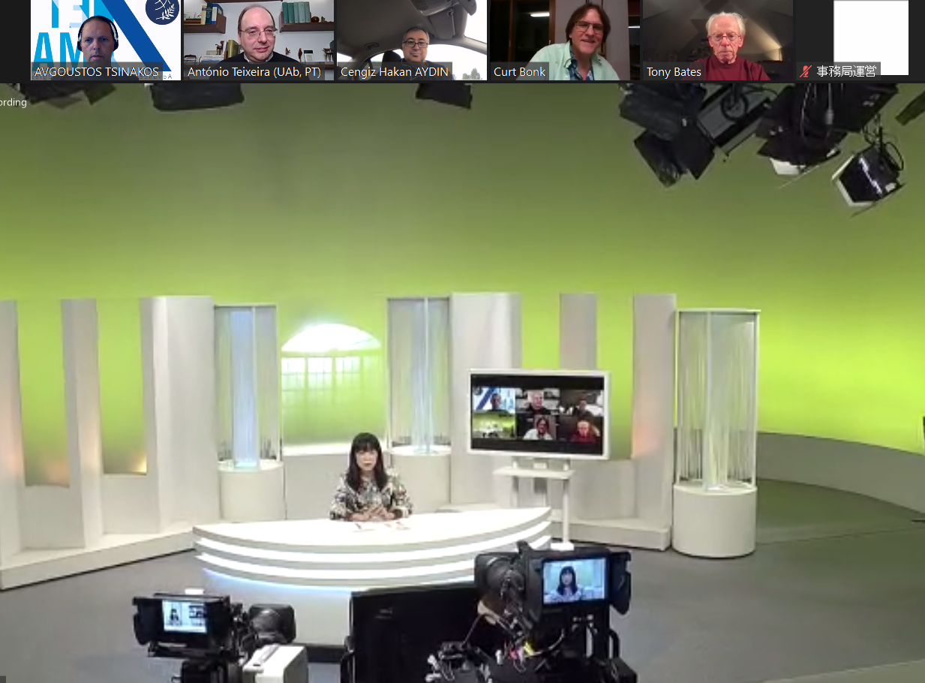
September 28, 2021 Practice for Open U of Japan, Kimiko Aiko

Slide 45
October 18, 2021 Open University of Japan, TV Show recording

Slide 46
October 18, 2021 Open University of Japan, TV Show recording

Slide 47
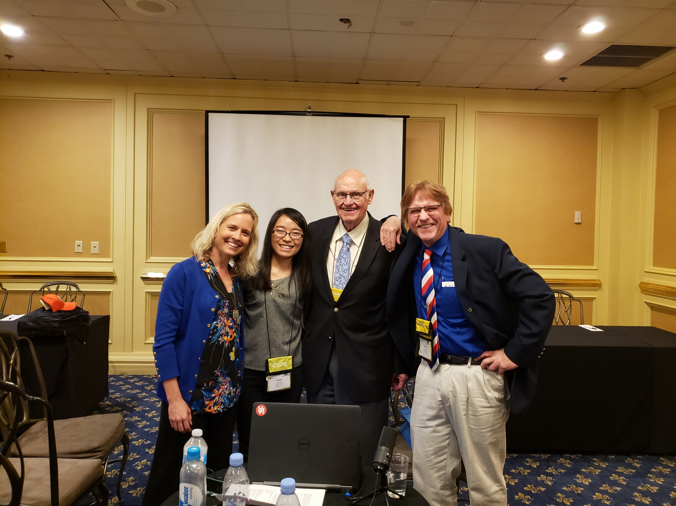
SuperTravelinEdMan https://www.youtube.com/c/Trainingshare/videos
David Merrill, AECT 2019, Las Vegas (Video = 119:36)
https://www.youtube.com/watch?v=LhrFTzigUdo

Slide 48
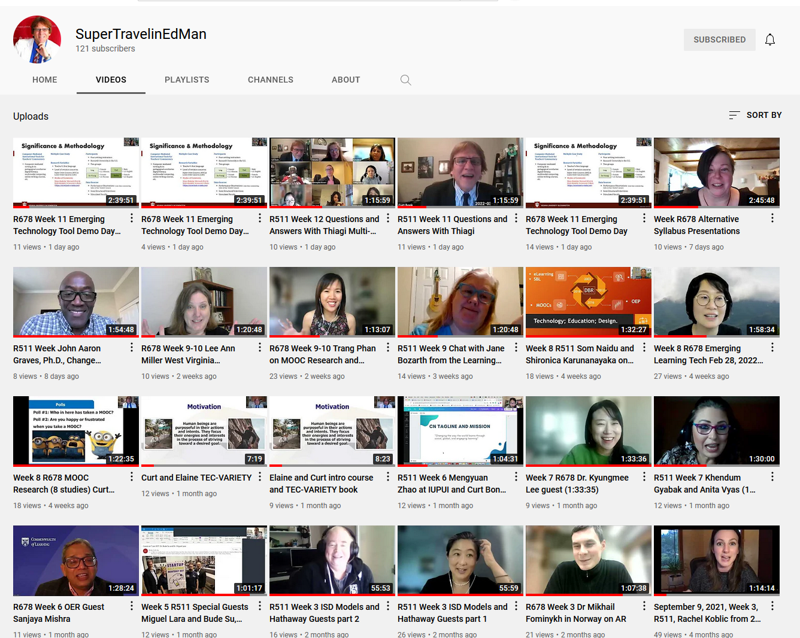
SuperTravelinEdMan https://www.youtube.com/c/Trainingshare/videos

