Slide 1


Slide 2
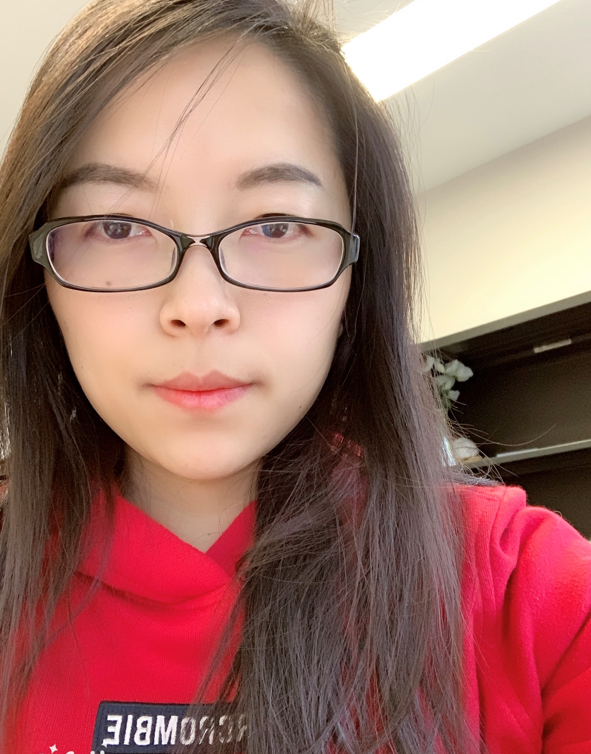
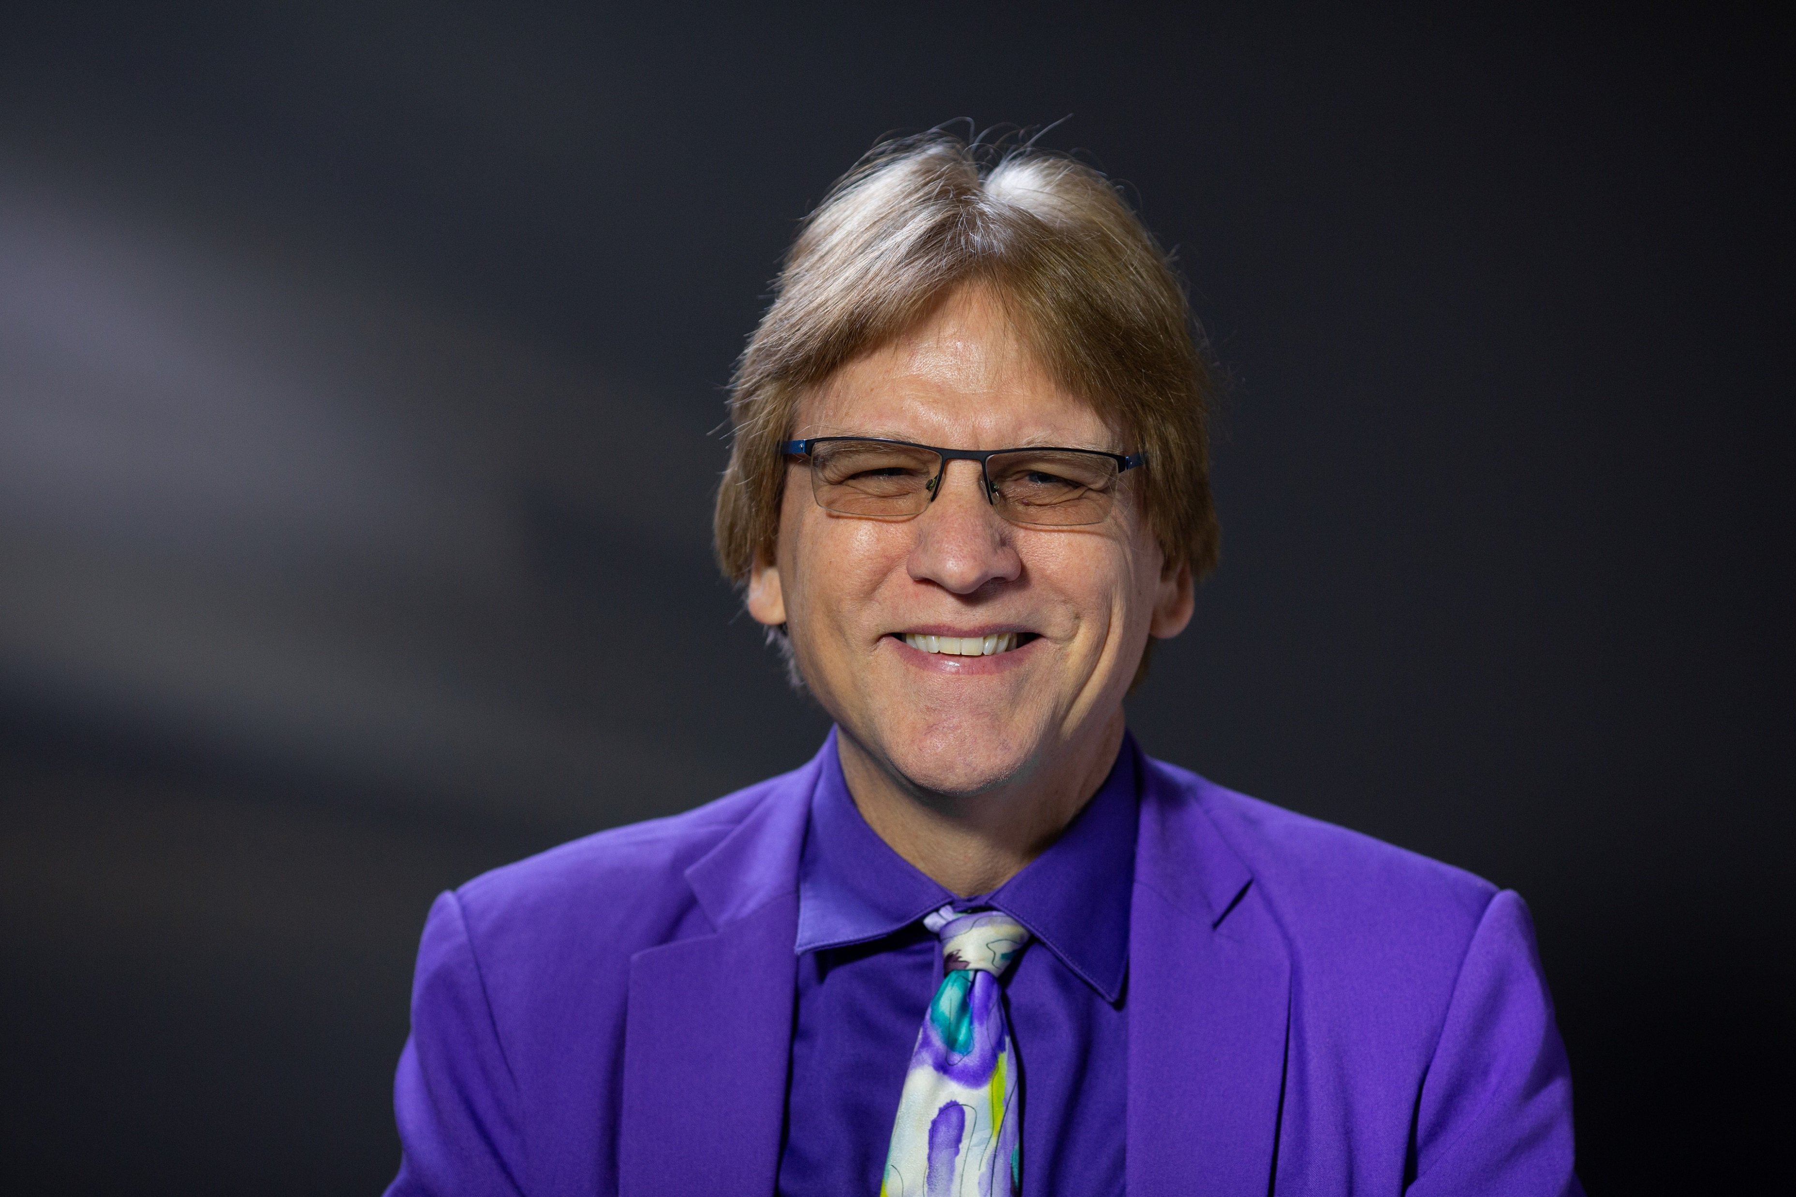
Transformative Teaching Around the World:
Stories of Cultural Impact, Technology Integration, and Innovative Pedagogy
Curtis J. Bonk and Meina Zhu, USA

Slide 3
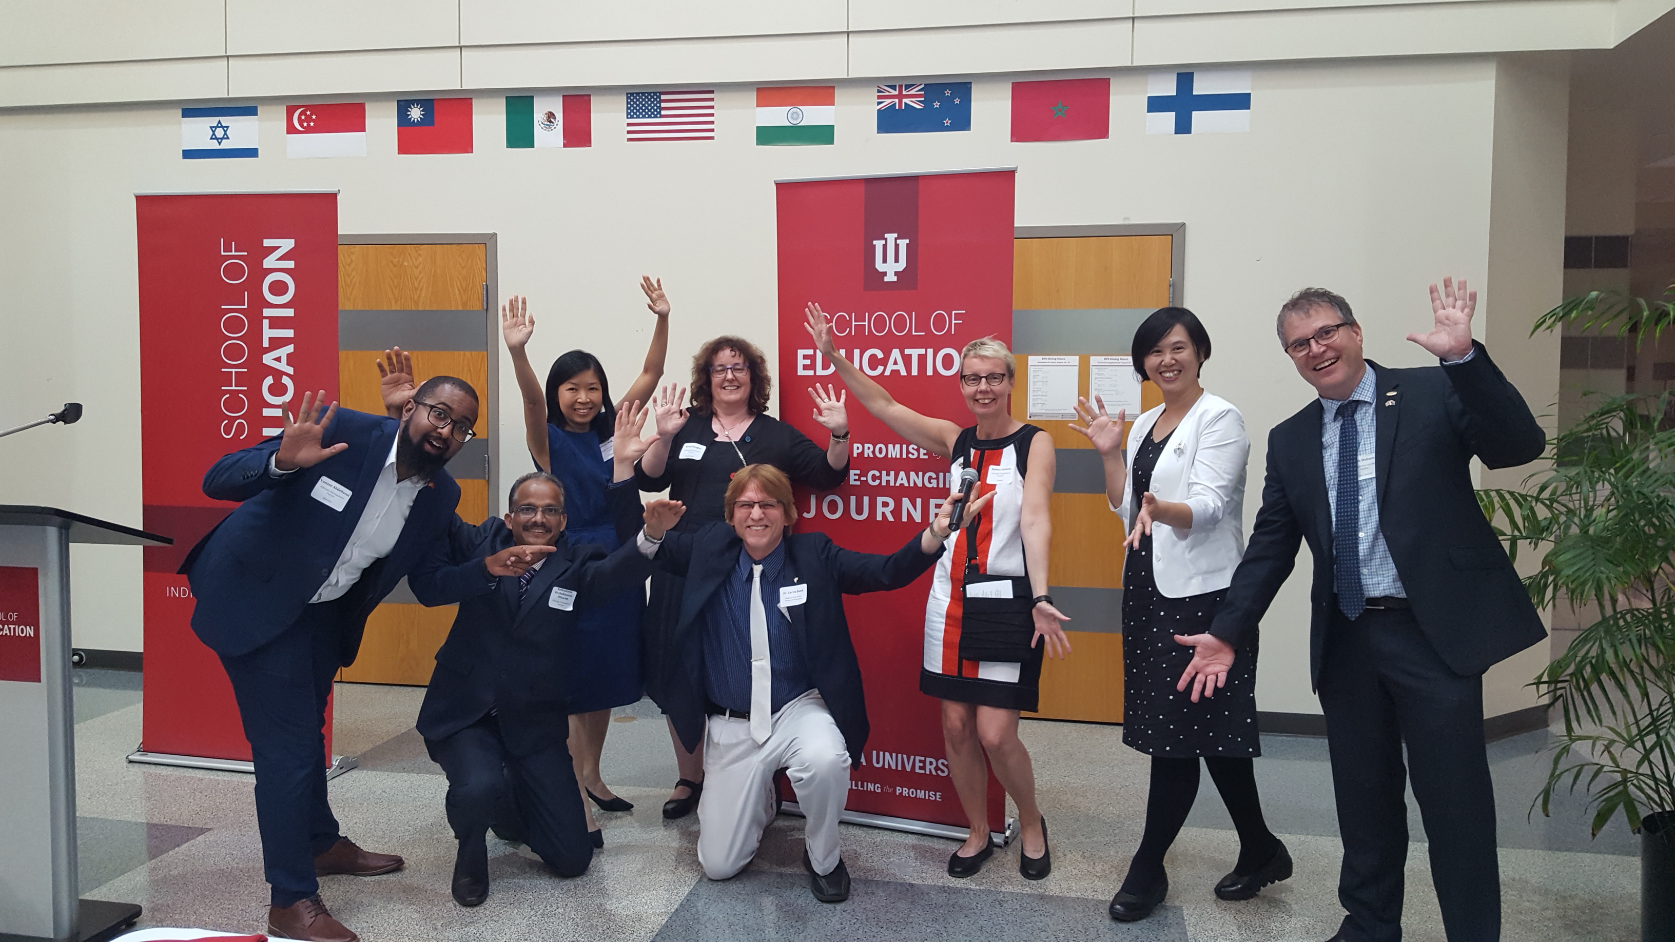
Transformative Teaching Around the World:
Stories of Cultural Impact, Technology Integration, and Innovative Pedagogy
2017 Fulbright Scholars

Slide 4
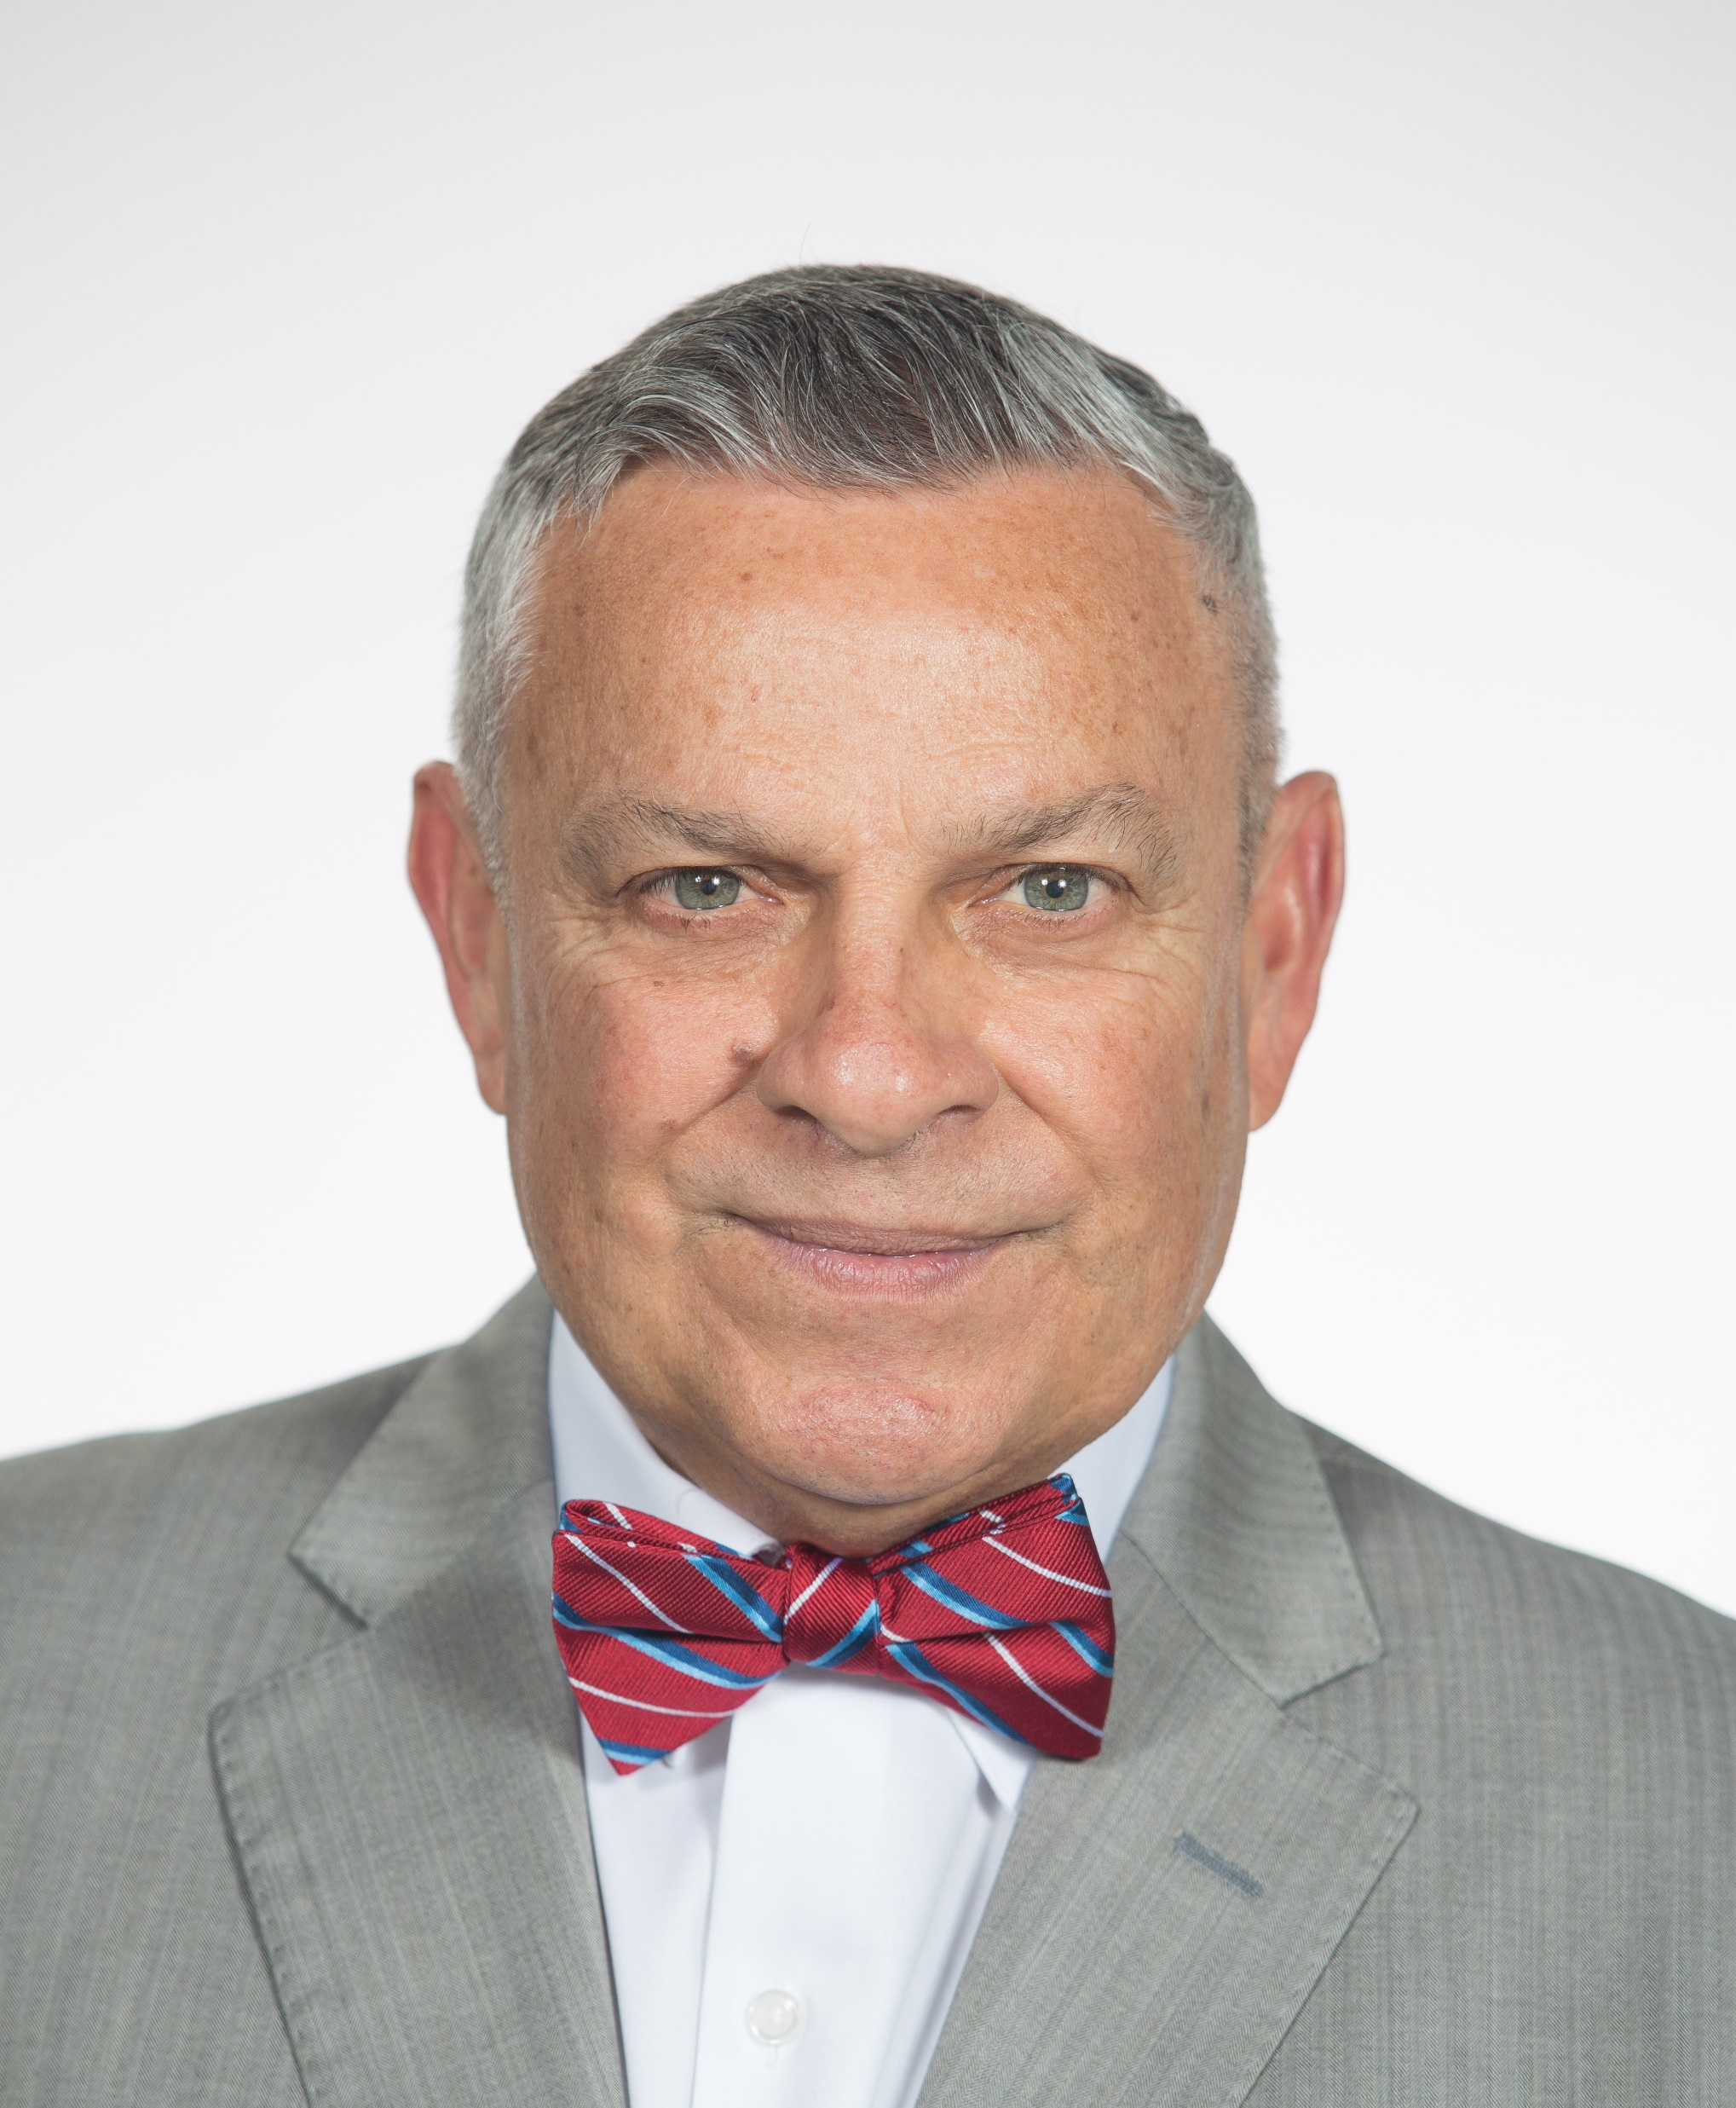
Foreword: The Power of Story
Gerardo Gonzalez, USA

Slide 5
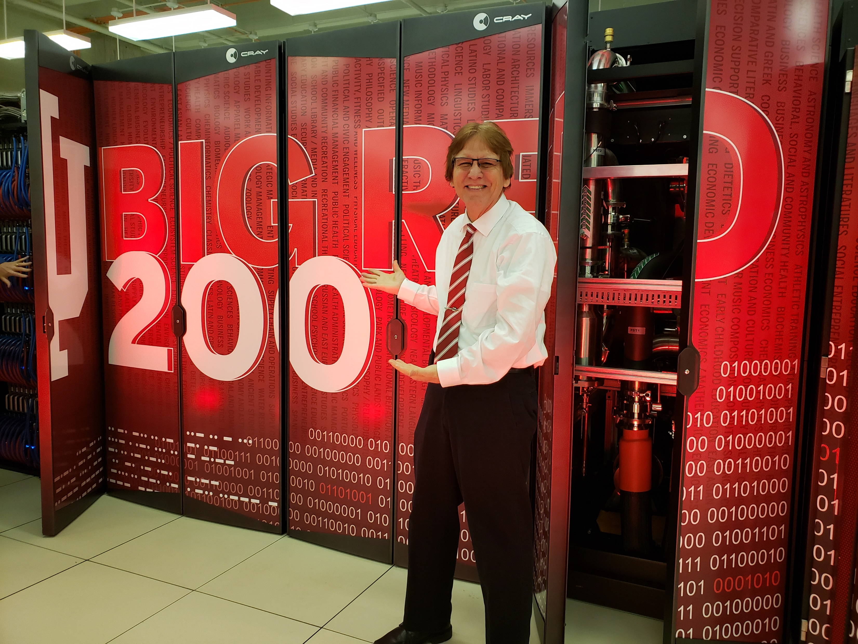
Preface: Before Making Impact
Curtis J. Bonk and Meina Zhu, USA

Slide 6
Intentions for the Book
The book chapters will inspire others to action; from the preservice teacher in his first education class or the first-year induction teachers struggling with the countless unanticipated demands to the mid-career educators wondering what to do with the rest of their lives or those wanting to make an impact when nearing the end of their professional careers.

Slide 7
Goals of Book
Help the reader appreciate the range of ways to impact learning in the 21st century;
Reflect on the ways an educational idea might be implemented in different regions or countries of the world;
Better grasp of the local and global impact of new ideas, methods, and approaches in education;
Highlight pressing issues and controversies where there presently is passionate debate;

Slide 8
Goals of Book
Gain insights into ways teachers are adopting and transforming various instructional strategies and ideas to their local context;
Appreciate teacher and student inspiration in regards to the implementation of innovative instructional ideas;
Grasp how teachers proactively react to challenging educational issues and problems;
Emotionally connect to the stories, experiences, pilot testing situations, etc., of educators attempting a creative or novel approach to instruction;
Integrate various educational reform efforts.

Slide 9
The audience for the book
This book will be of value to preservice teachers as well as newly minted in-service teachers who are searching for inspiration, ideas, and innovative pedagogy.
In effect, the audience could be anyone who stumbles upon the book and opens it. Deans of teacher education or colleges of education might use the book at faculty retreats. Educators might also use the book in special topic courses and seminars.
We are also hopeful that this book appeals to higher education administrators struggling with how to inspire innovative educational models or higher standards of achievement.

Slide 10
Preface: Before Making Impact
Dozens of stories of the change process in education.
Educational transformation toward more active and engaging learning that is occurring across the globe.
Stories from outstanding teachers in 22 countries.
Educators’ struggles and successes.
Award-winning Fulbright teachers in the DAT program.

Slide 11
Time for Making Impact
Learning Transformations
Finding Education 4.0
Finding the Holy Grail
Finding the Principles
Finding the Entry Ramp

Slide 12

Section #1: Personal Transformations

Slide 13
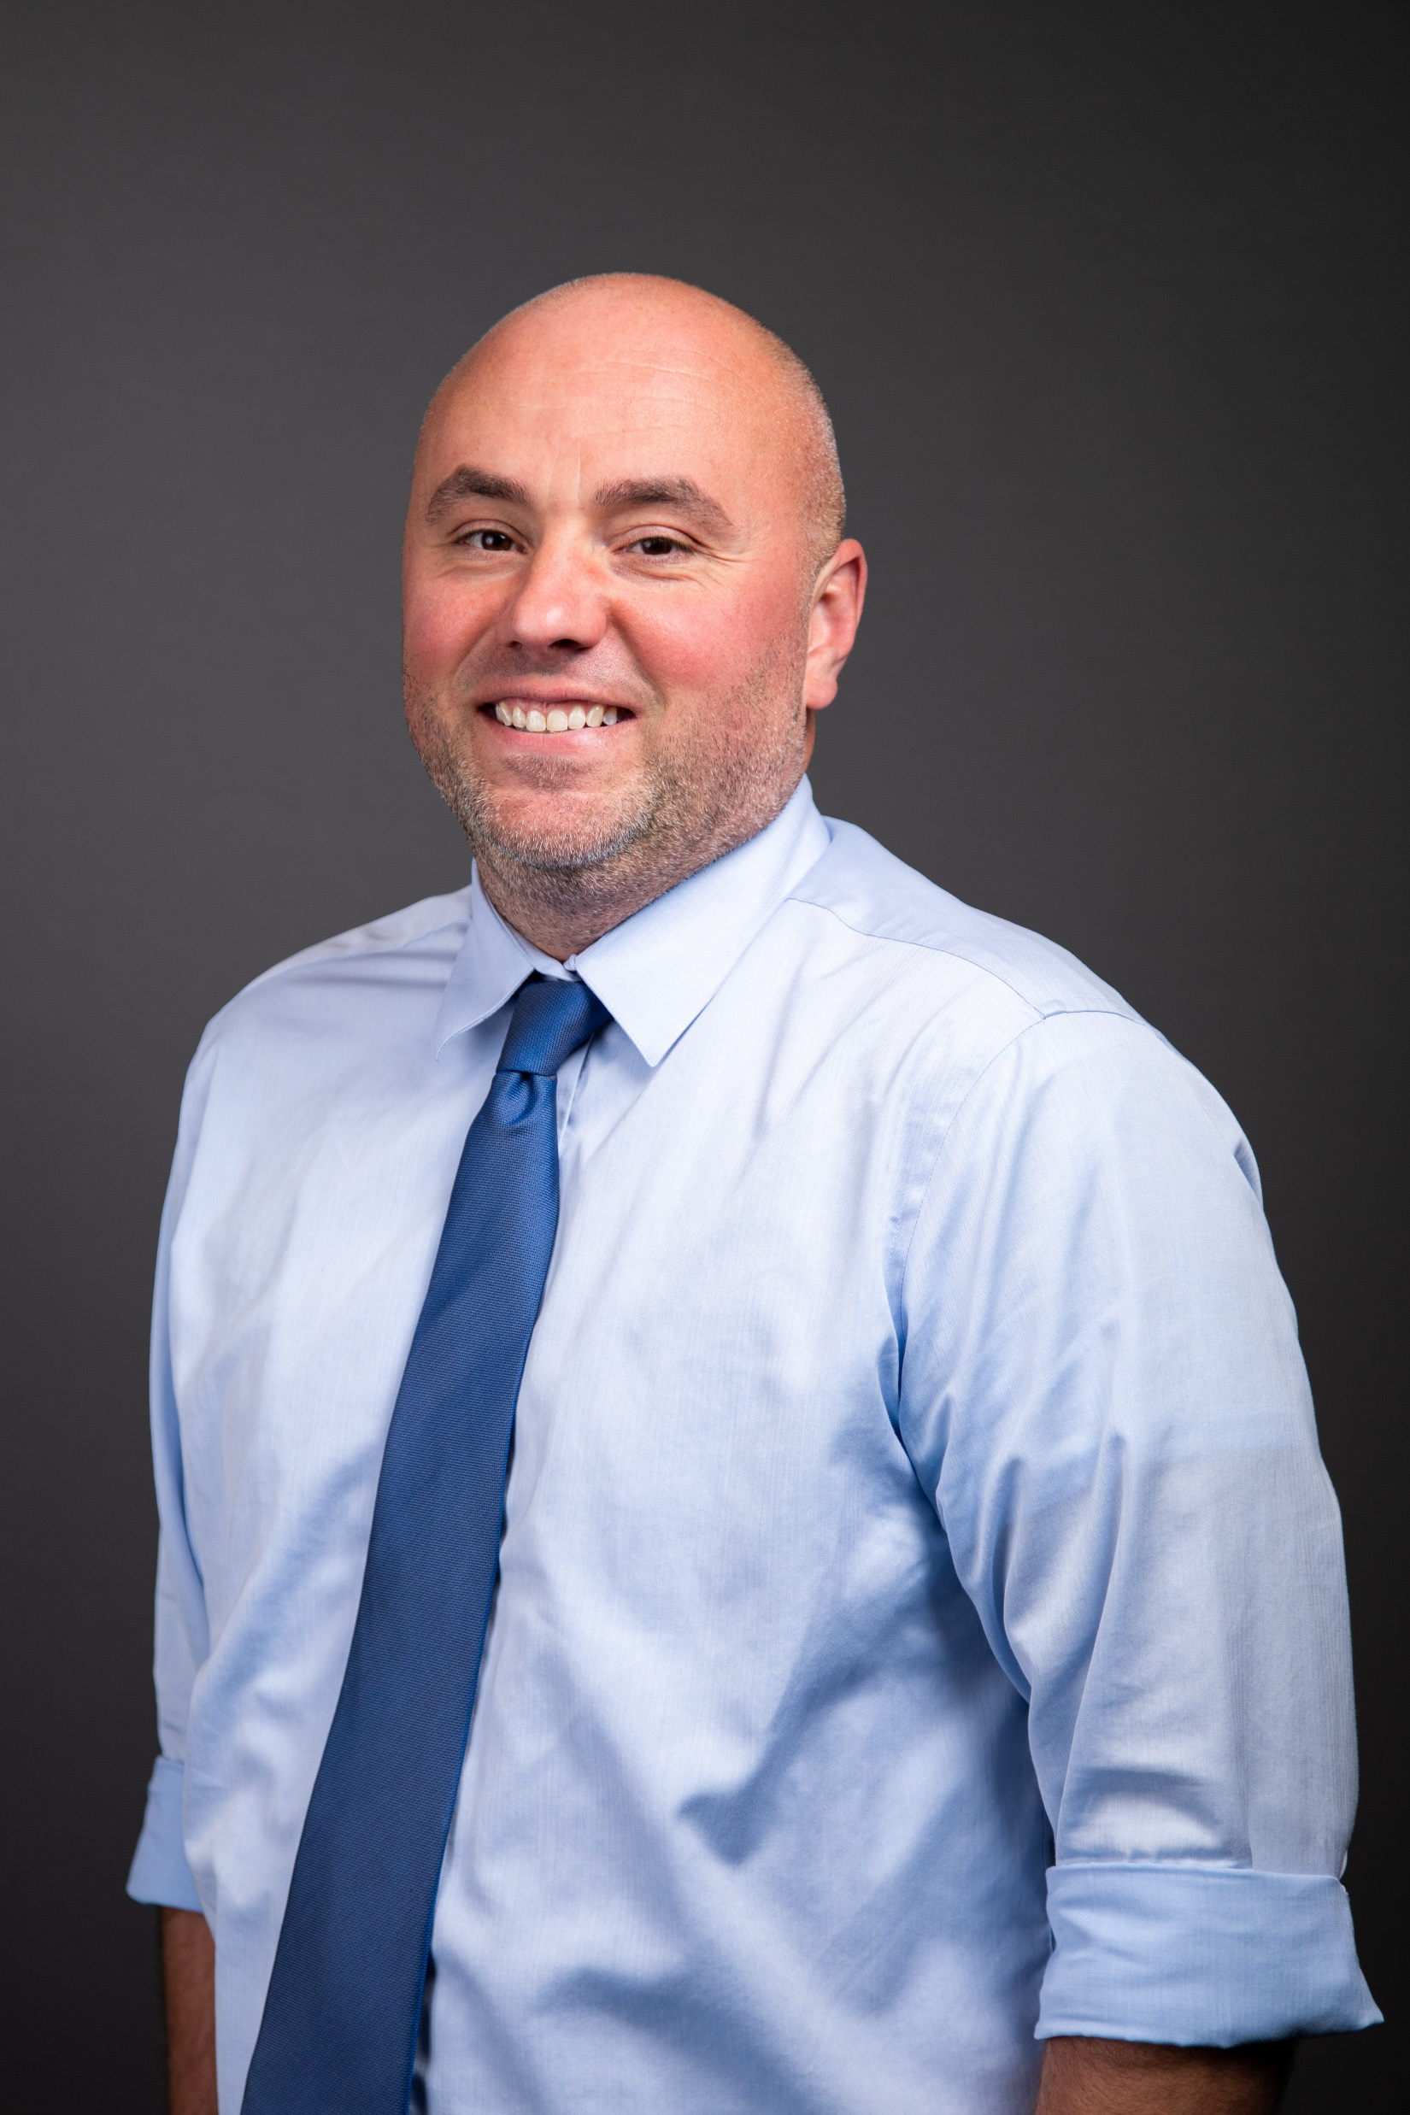
Professional Growth and Cross-Cultural Exchange:
A Glimpse into a Fulbright Program’s Life-Long Impact on Global Educators
Jacob Butler, USA

Slide 14
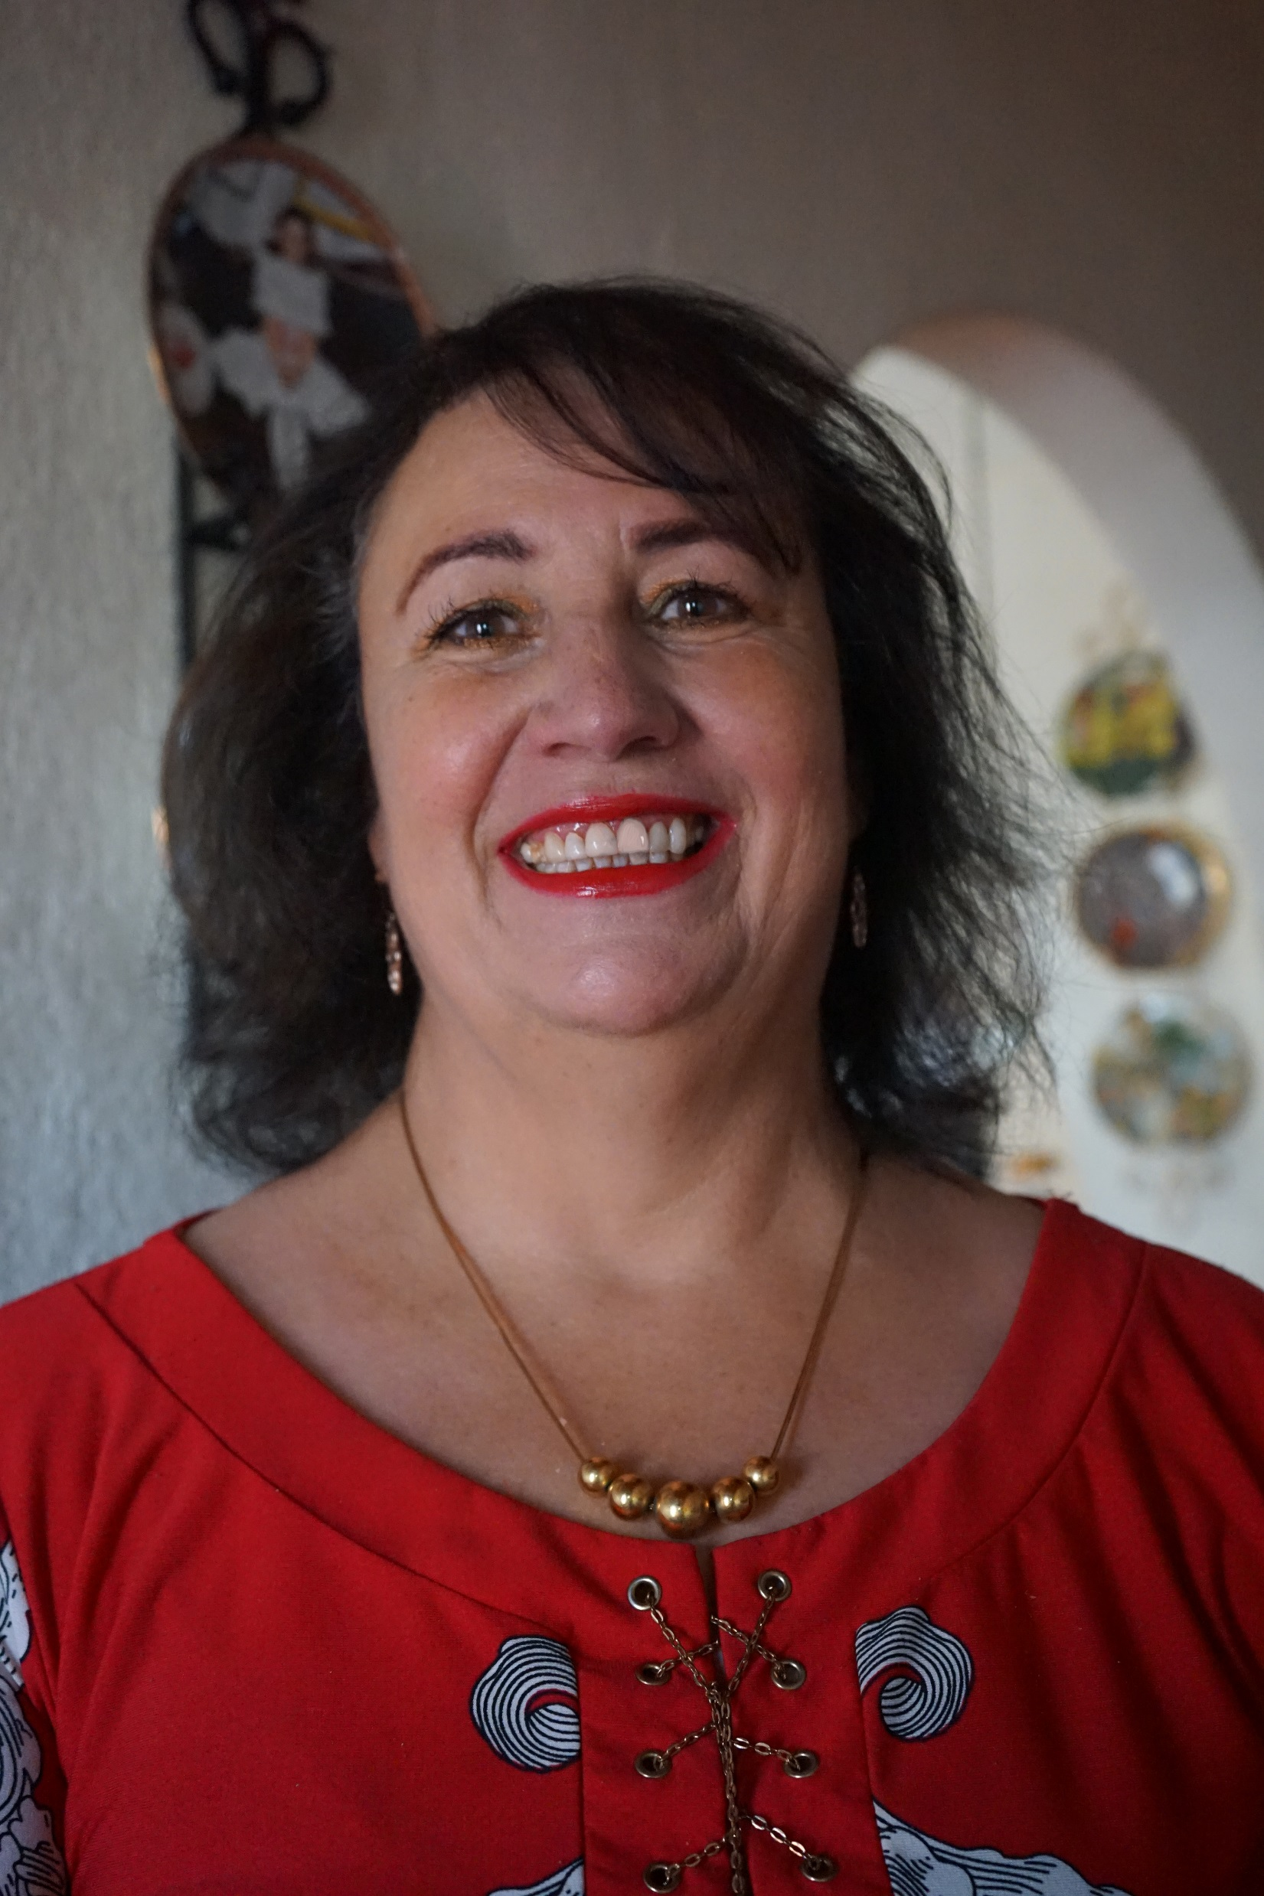
Education found me; energy kept me:
Thoughts on power, sharing, and service
Alba Rosario Marrón Canseco, Mexico

Slide 15
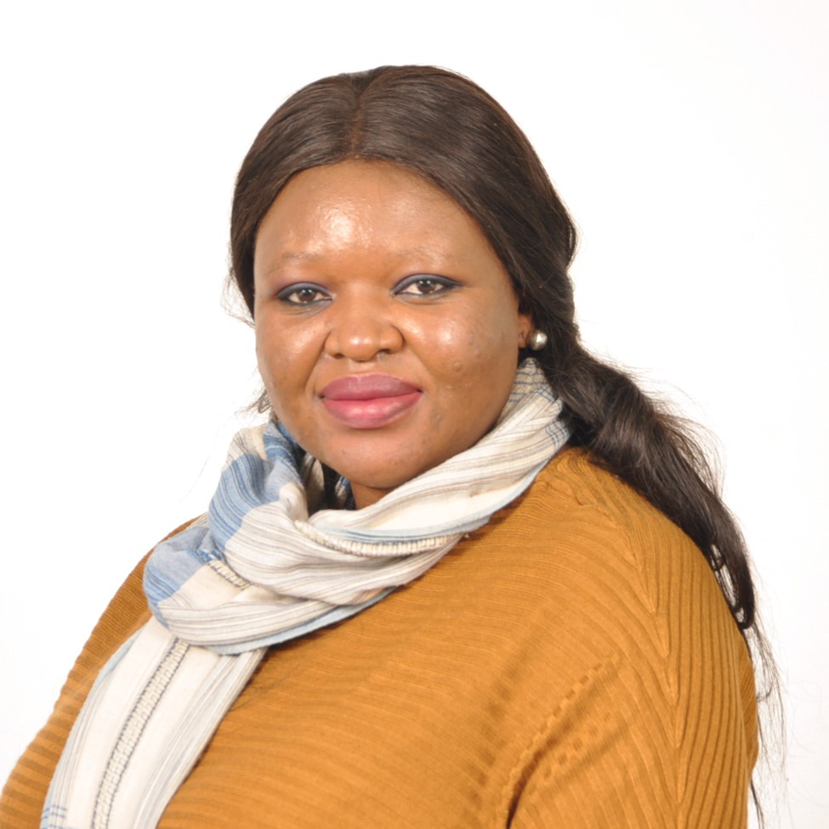
The World of Endless Possibilities- The Educator in Me
Keitumetse Thobani, Botswana

Slide 16

Questions that Matter – An Epistle to the Learner
Pratiksha Chopra, India

Slide 17
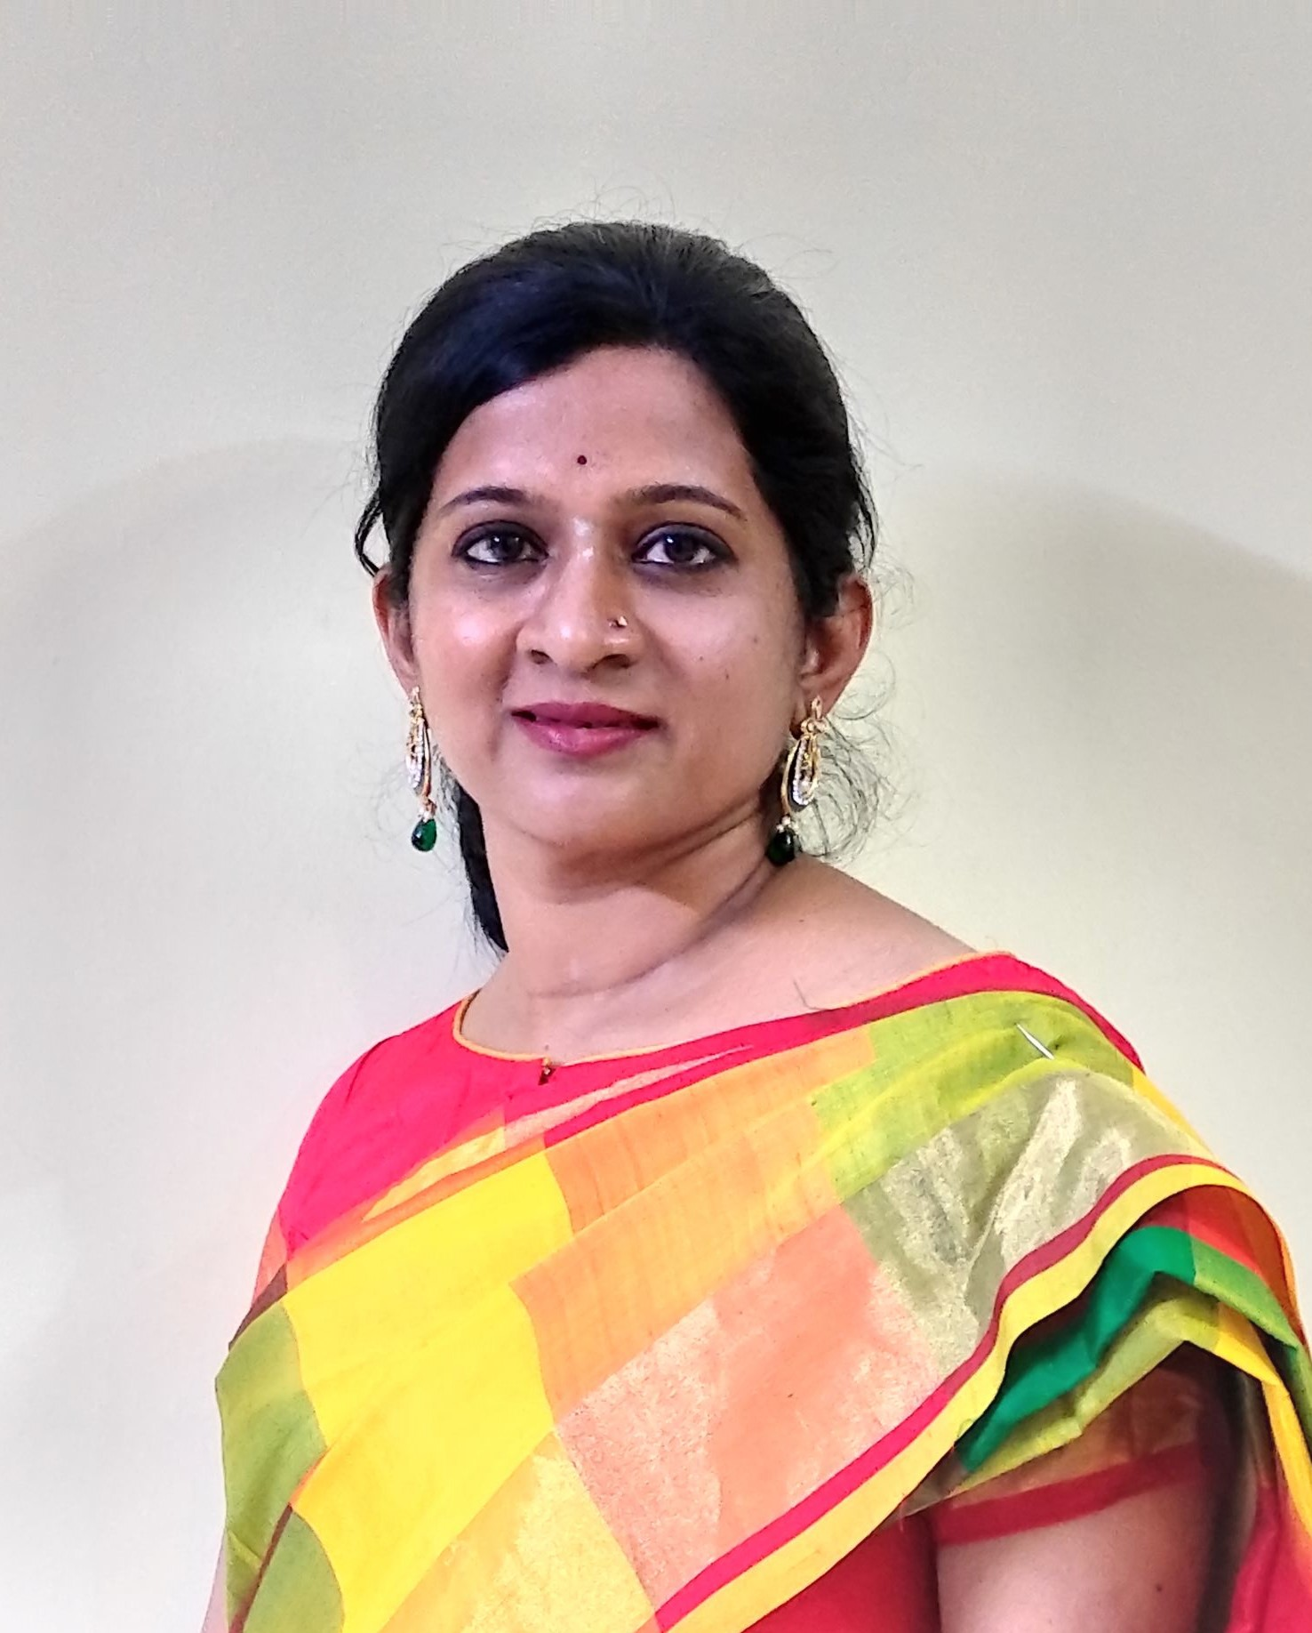
Sun on the Snow: Ad Meliora - Toward Better Things
Remya Parameswar Iyer, India

Slide 18

Section #2. Innovative Education

Slide 19
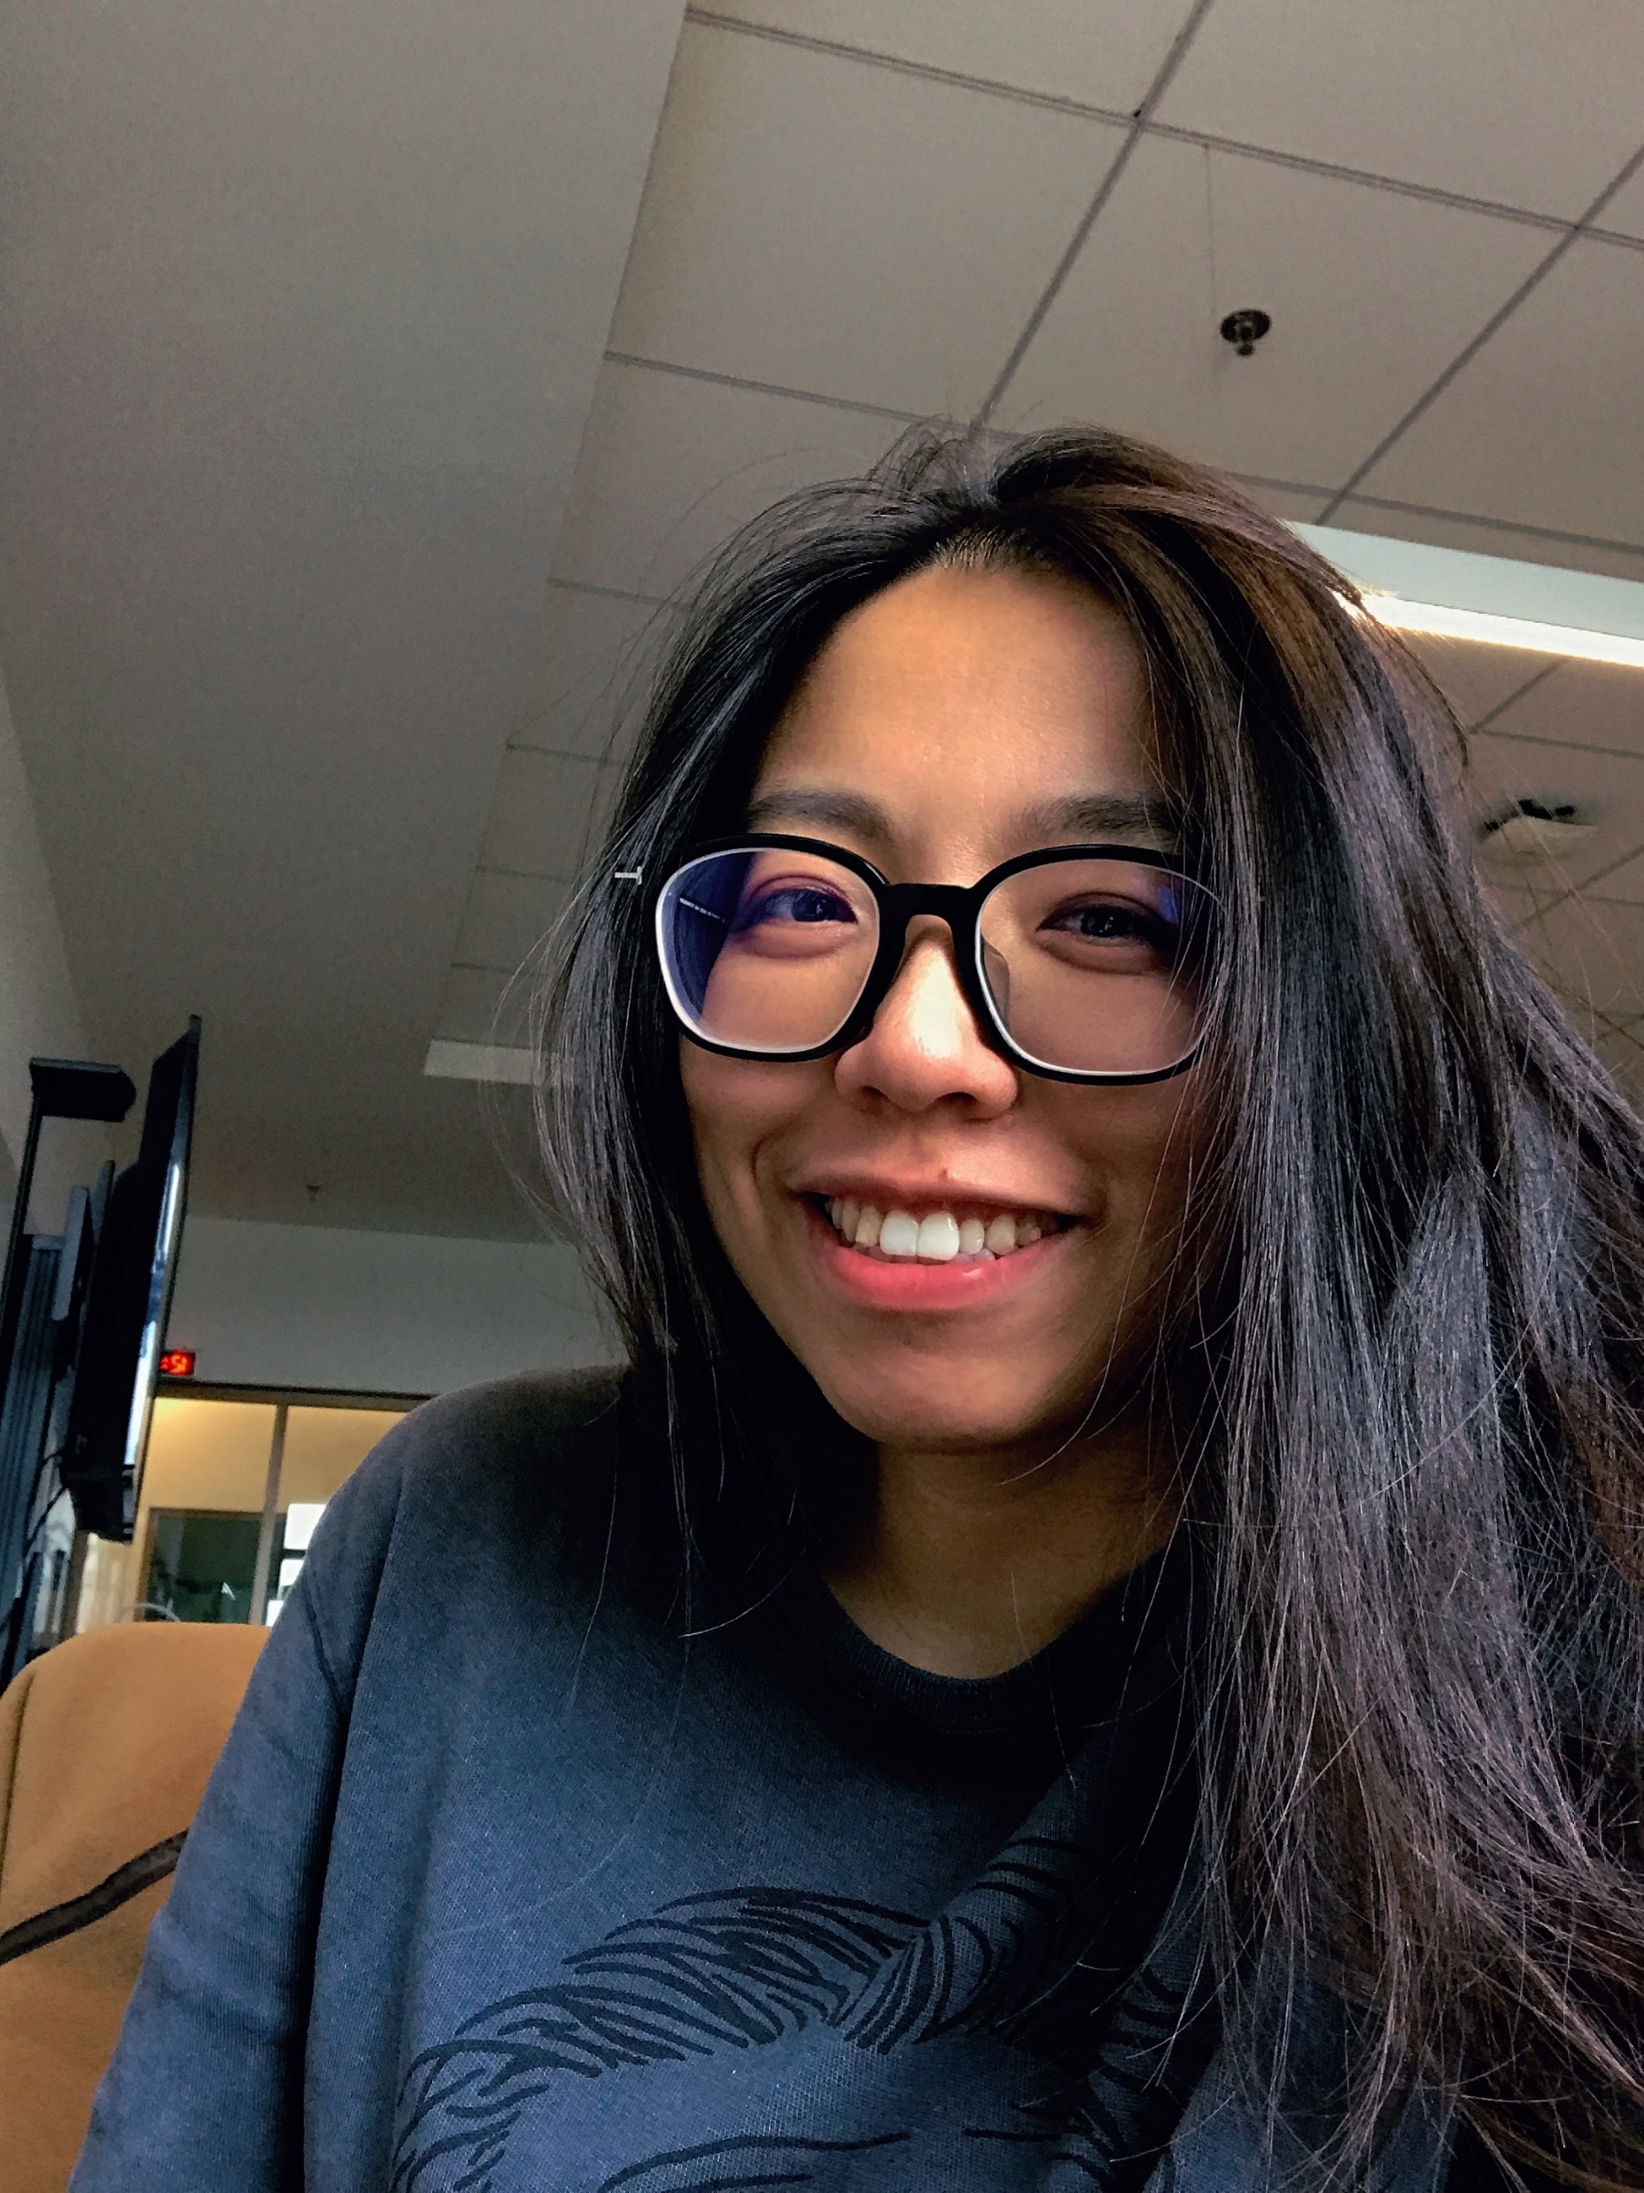
“You can't use up creativity:
The more you use, the more you have”: The story of Chris Gadbury
Shengnan (Penny) Ma, Thailand, HK, and China

Slide 20

“You Can’t Use Up Creativity—The More You Use, the More You Have”: The Story of Chris Gadbury
Shengnan (Penny) Ma
Chris Gadbury is Primary Years Programme (PYP) Art Teacher in Hong Kong, China with 16 years of teaching experience.
View our limitations as creative opportunities.
Think of the funniest, most playful, more provocative possible ways of learning something and then use sharing platforms to get feedback and improve our teaching and learning.

Slide 21
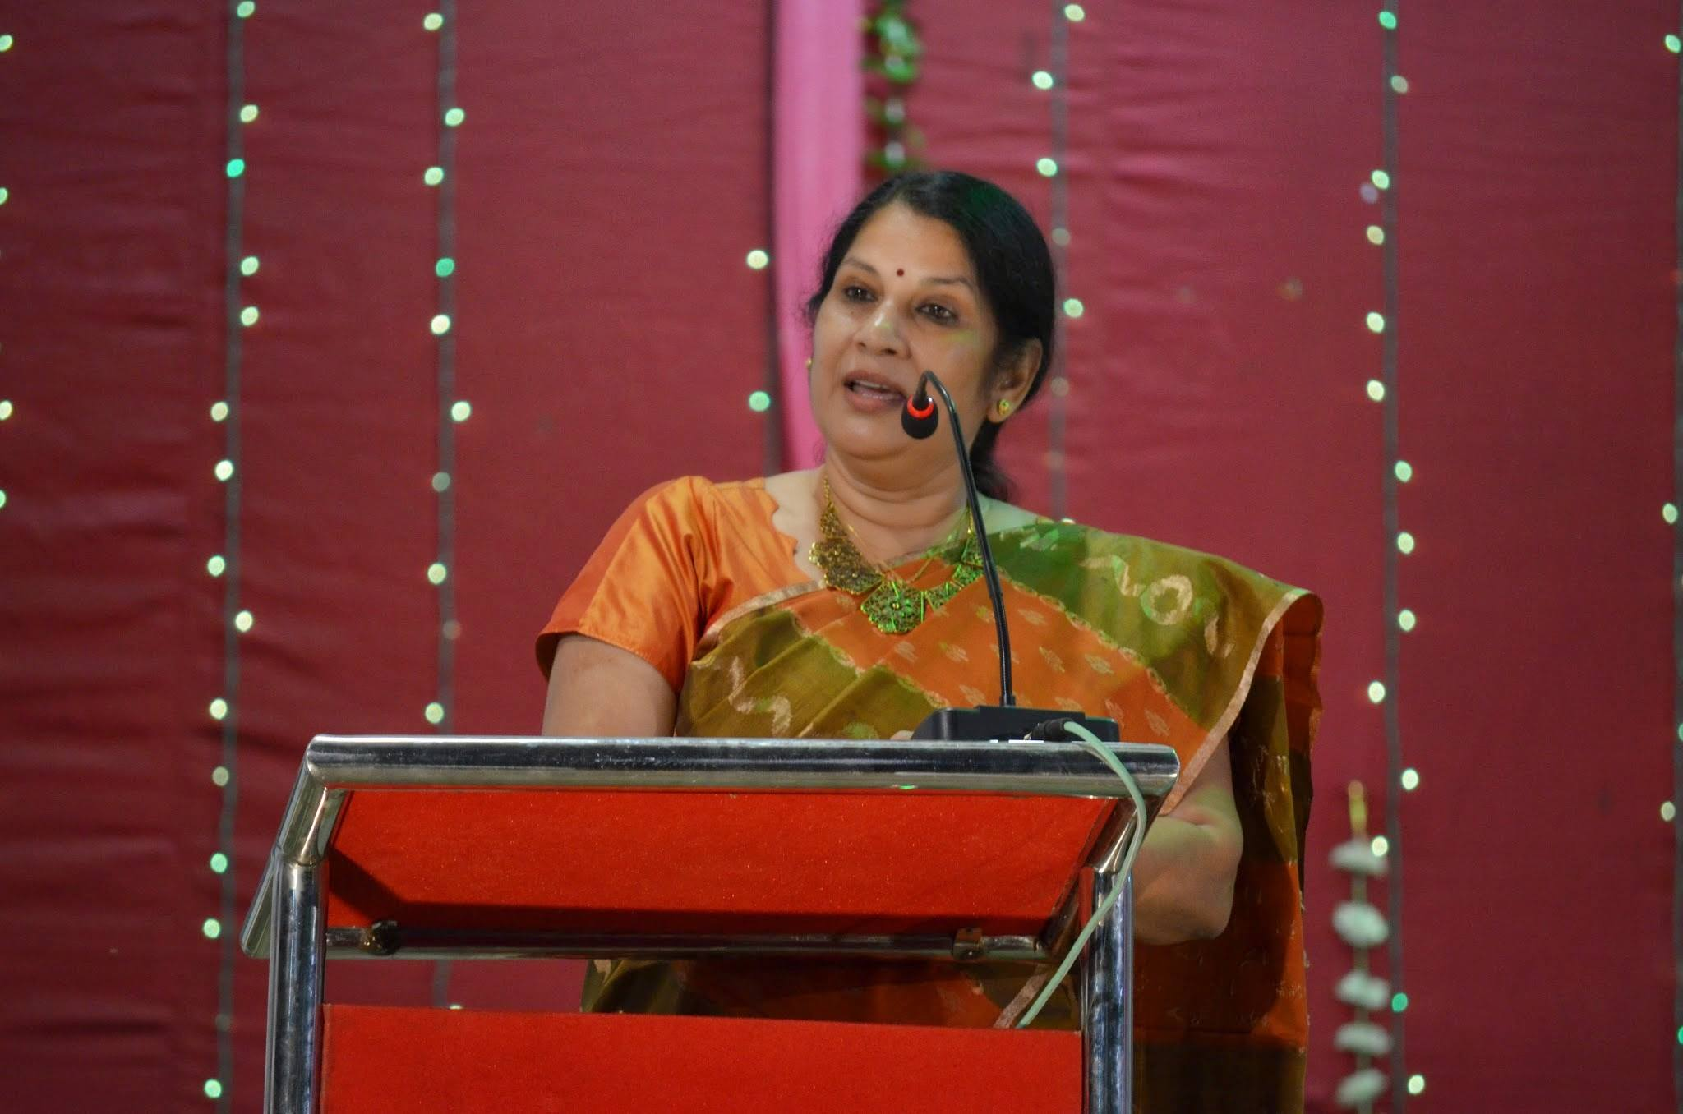
Community health and environment:
A learning project from India
Narayani Singh, India

Slide 22
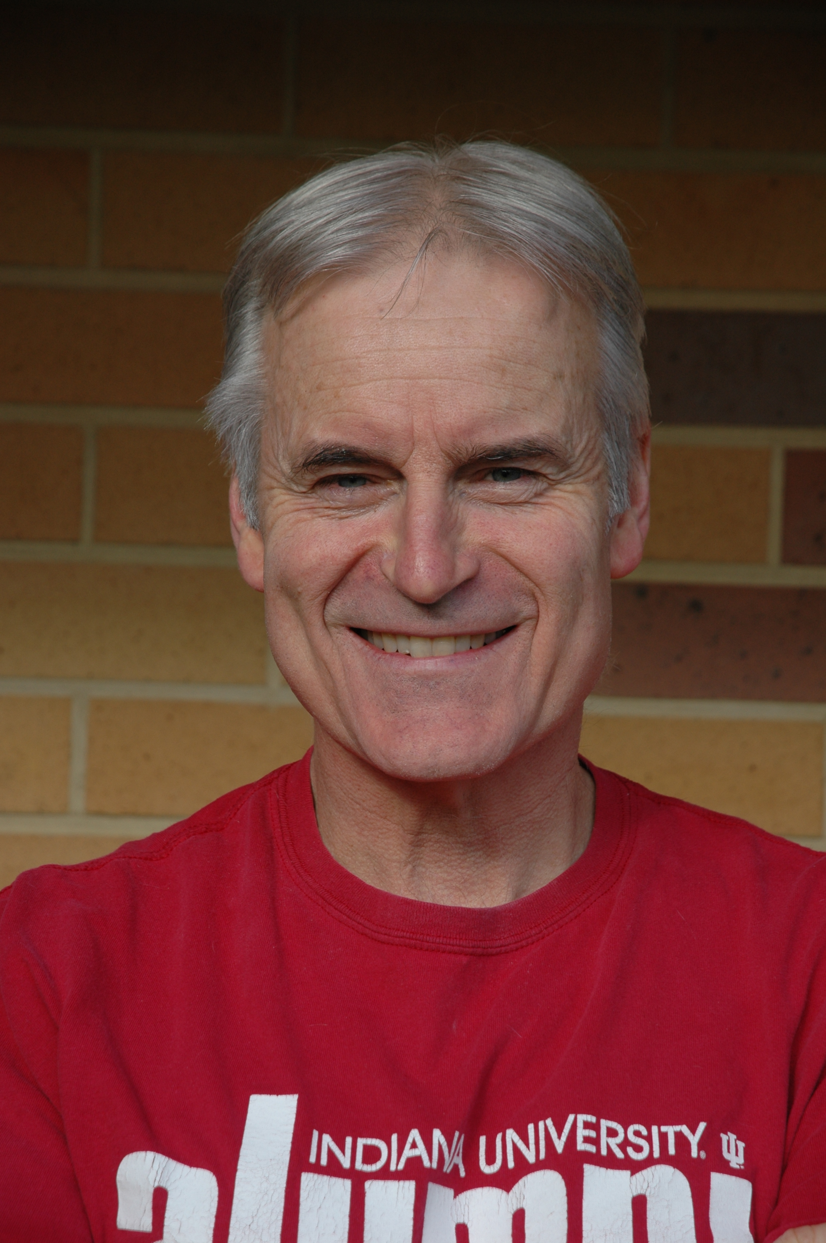
Metacognitive experiences on an urban concept farm:
Local, project-based learning in science and sustainable agriculture
Simon McMillan, New Zealand

Slide 23

Empowering teachers to become transformational leaders through reflective conversations:
A school-based inquiry and a professional development project
Mohana Ratnam, Singapore

Slide 24
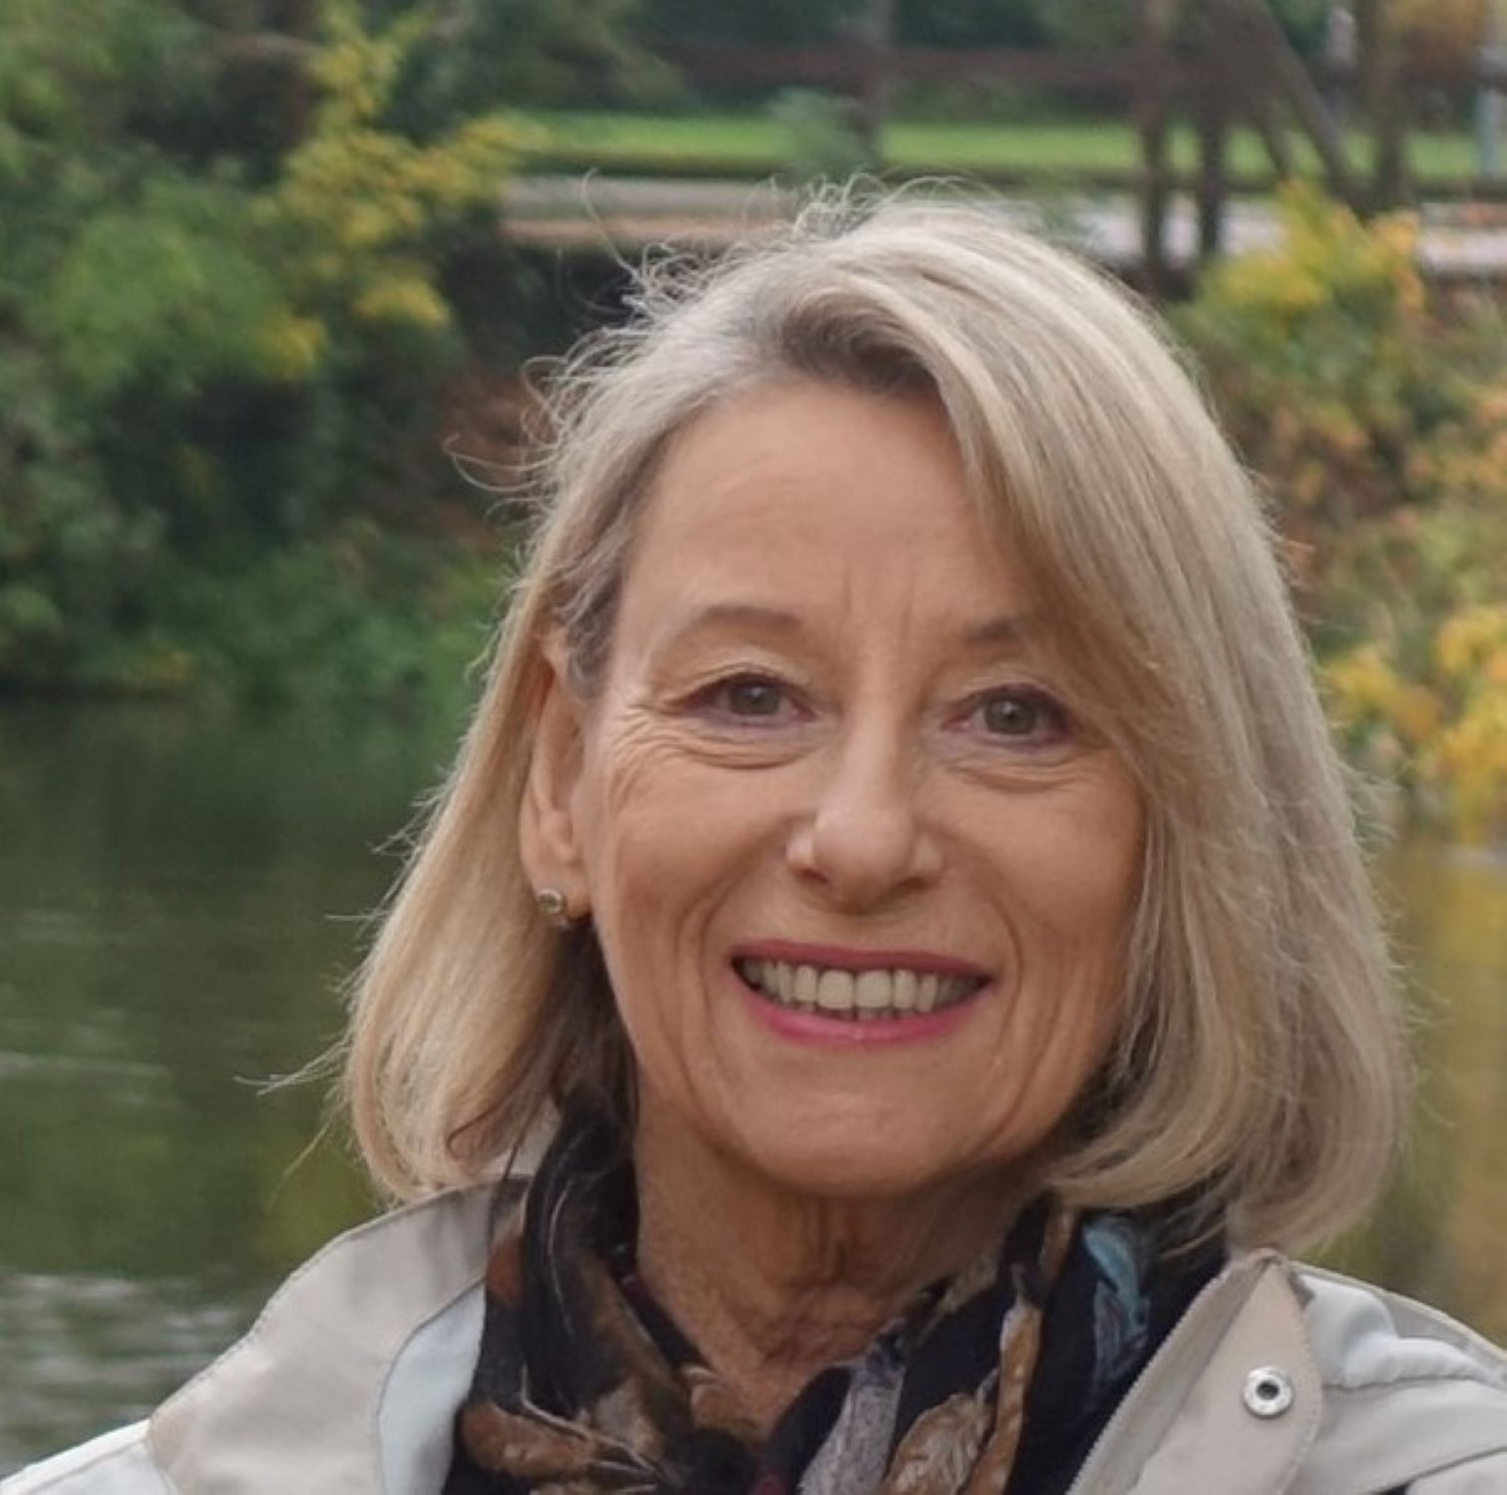
“Poipoia te kakano kia puawai” (Nuture the seed and it will blossom):
Affective spaces in education-- prison, and beyond
Lynnette Brice, New Zealand

Slide 25


Section #3. Teaching with Technology

Slide 26

Fostering student motivation and engagement through the Relevant, Appealing and Personal (RAP) pedagogical guideline: Tech stories from Singapore
Muhammad Nazir Amir, Singapore

Slide 27
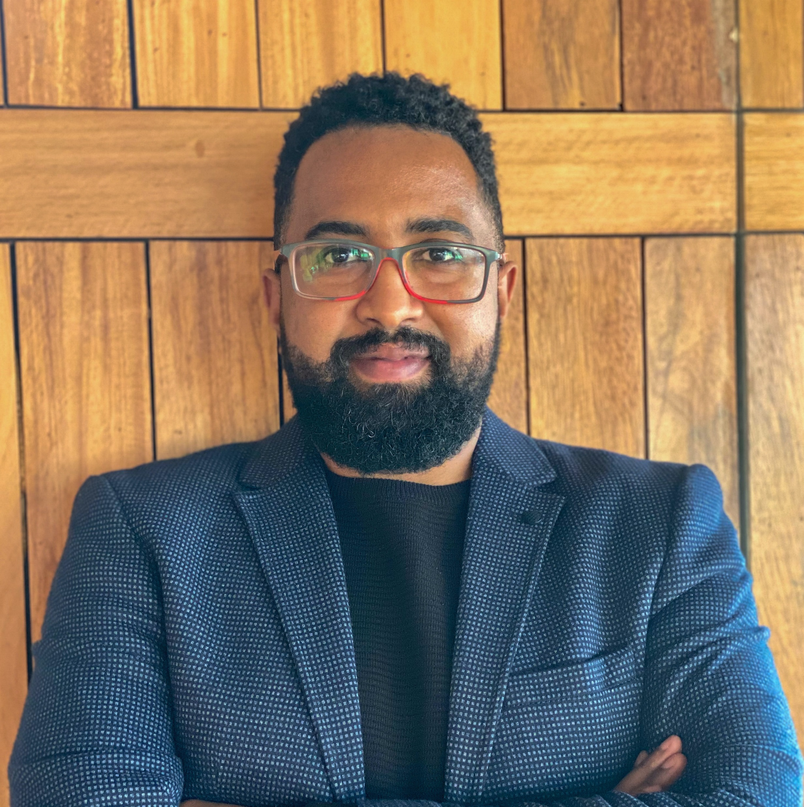
Sparking inspiration through motivation and technology integration
Yassine Abdellaoui, Morocco

Slide 28

Interactive writing instruction in Zoom
Yan/Shyvia (Elaine) Zhang, China

Slide 29

Interactive Writing Instruction in Zoom
Yan Zhang
Effective group peer review can be achieved by developing detailed peer-review tasks, scoring criteria, group discussions, and teacher feedback to peer-review tasks
The choice of the group leader is critical.

Slide 30
Interactive Writing Instruction in Zoom
Yan Zhang
The teacher’s role is to assist and scaffold while students take more control over the writing and feedback processes.
Provide training to peer review
Technology play an important role—Zoom & QQ

Slide 31

It's all about the experience:
Technology enhanced designs to generate value
Maria Solomou, Cyprus

Slide 32
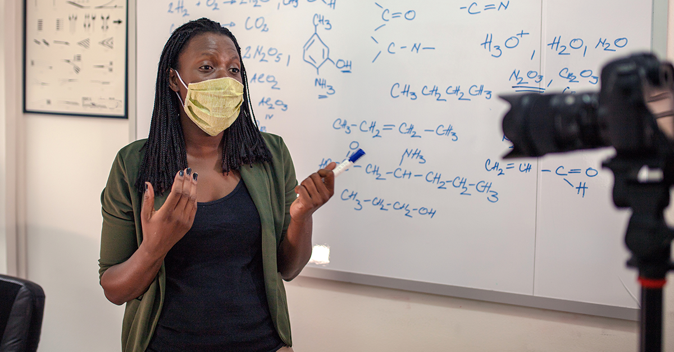
Section #4: Pandemic Practices

Slide 33

Chicken or Egg? Achieving the right balance between technology and pedagogy in online learning
Edwin Chew, Singapore

Slide 34

Actively engaging students in India during COVID-19:
A former Fulbrighter finds hope
Rathnakaran Kozhukkunnon Othayoth, India

Slide 35

Online Education in a Korean Elementary School During COVID-19:
Focusing on My Experience using Blended Learning
Jeong-Ae Lee, Korea

Slide 36

Section #5: English Education and Collaboration

Slide 37
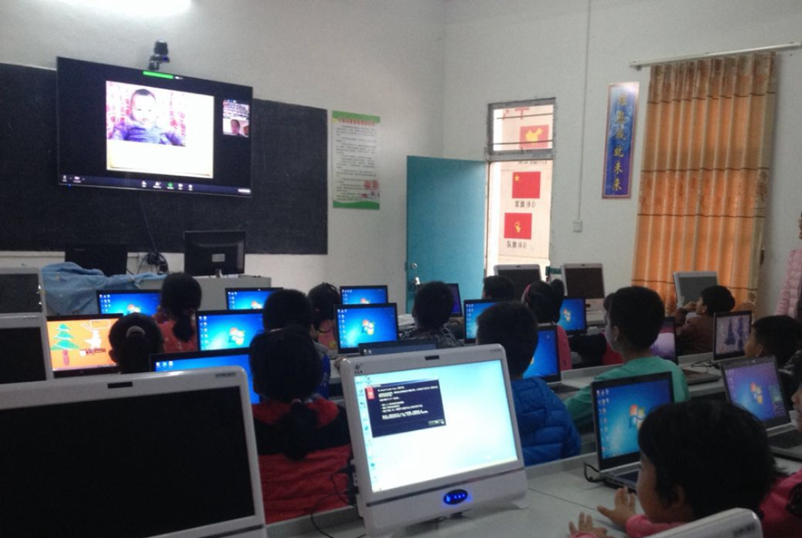
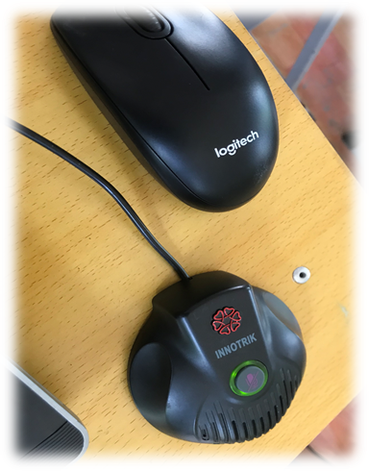

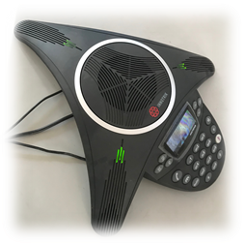
English education enabled by technology:
Story from an Online Teacher for an Under-Sourced Village School in China
Chaoran Wang, China

Slide 38
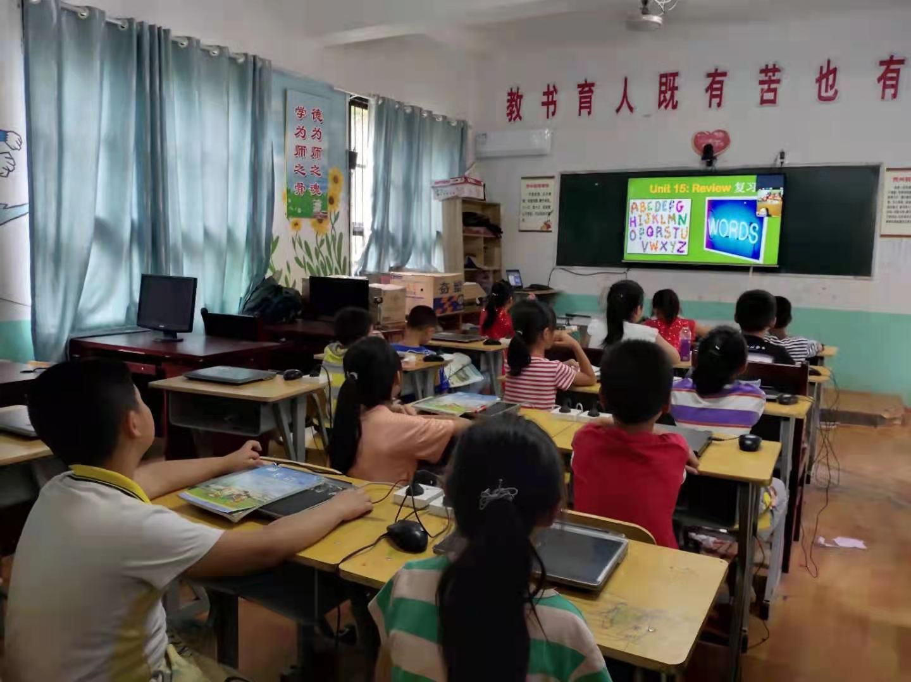
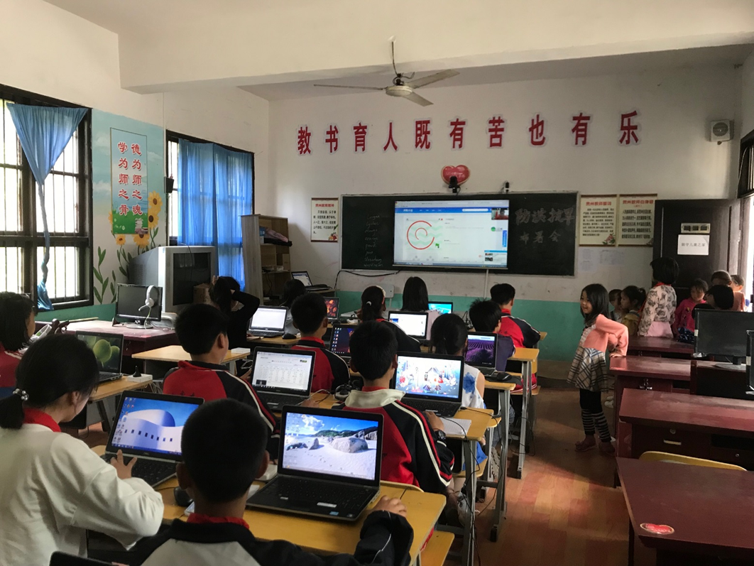
June 18, 2021
Learning is More Synchronous
I am writing to send a screenshot of the synchronous hybrid English class for rural Chinese students. I also have a short video clip (though not in high quality), if you are interested.

Slide 39

Highlighting collaborative learning in language classroom:
A story from Thailand
Apapan Sailabada, Thailand

Slide 40
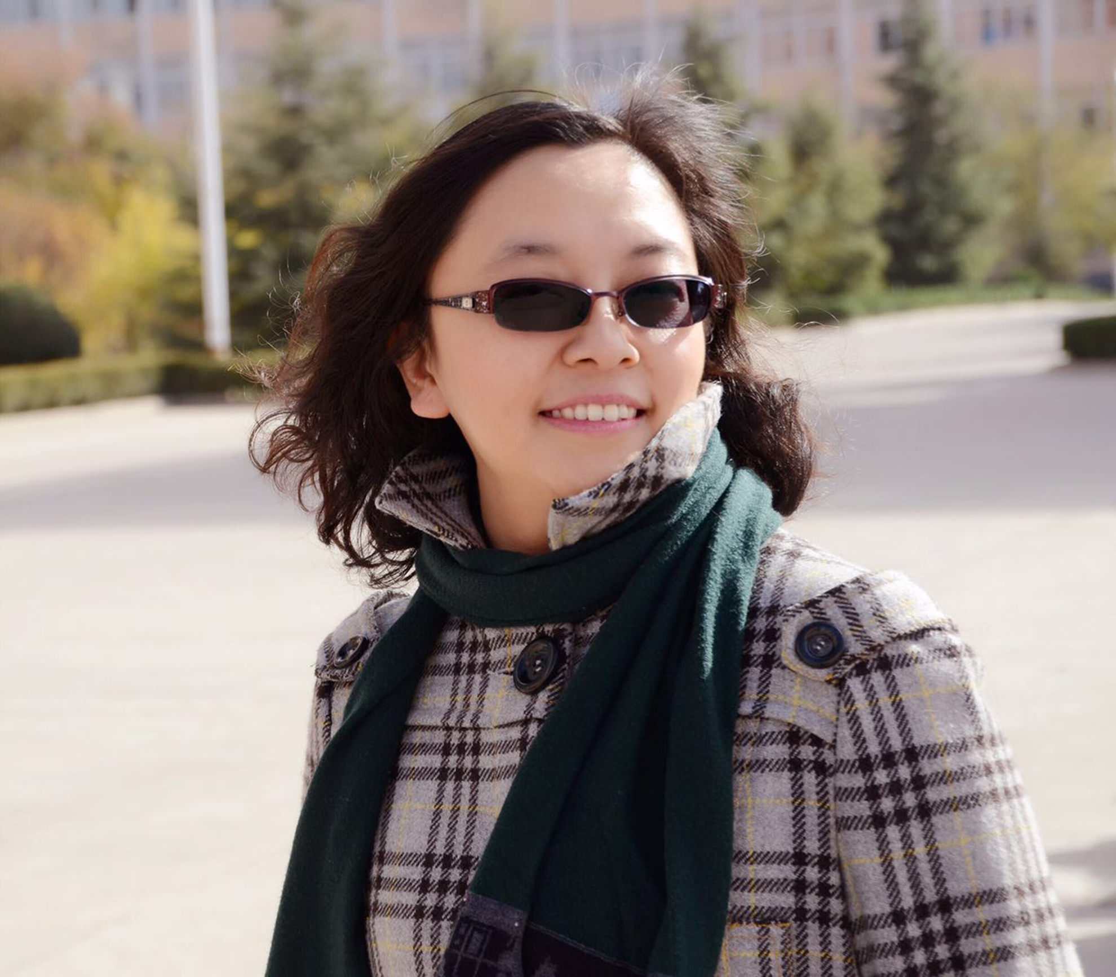
Live classes of lives:
English reading to ponder life, social phenomena, the fate of the world
Xiaoxiu (Anne) Wang, China

Slide 41
Live Classes of Lives: English Reading to Ponder Life, Social Phenomena, and the Fate of the World
Xiaoxiu (Anne) Wang
Take advantages of online teaching
Materials must be selected and arranged.
Reading tasks must be made available for students of different levels and abilities.

Slide 42

Transformative Learning?
Yes, Possibly in a Flipped Classroom
Hyun-Ju Kim, Korea

Slide 43
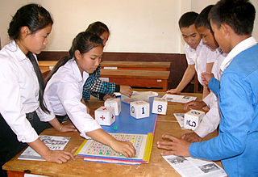
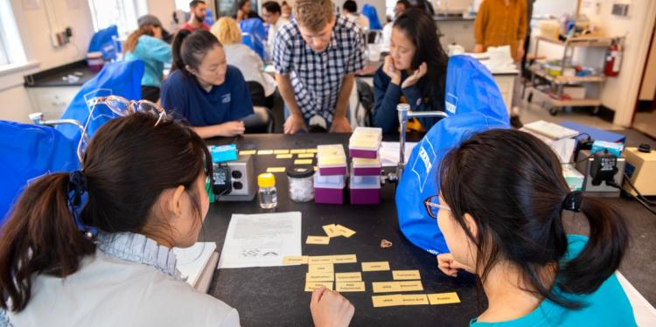
Section #6: Active Learning Strategies

Slide 44
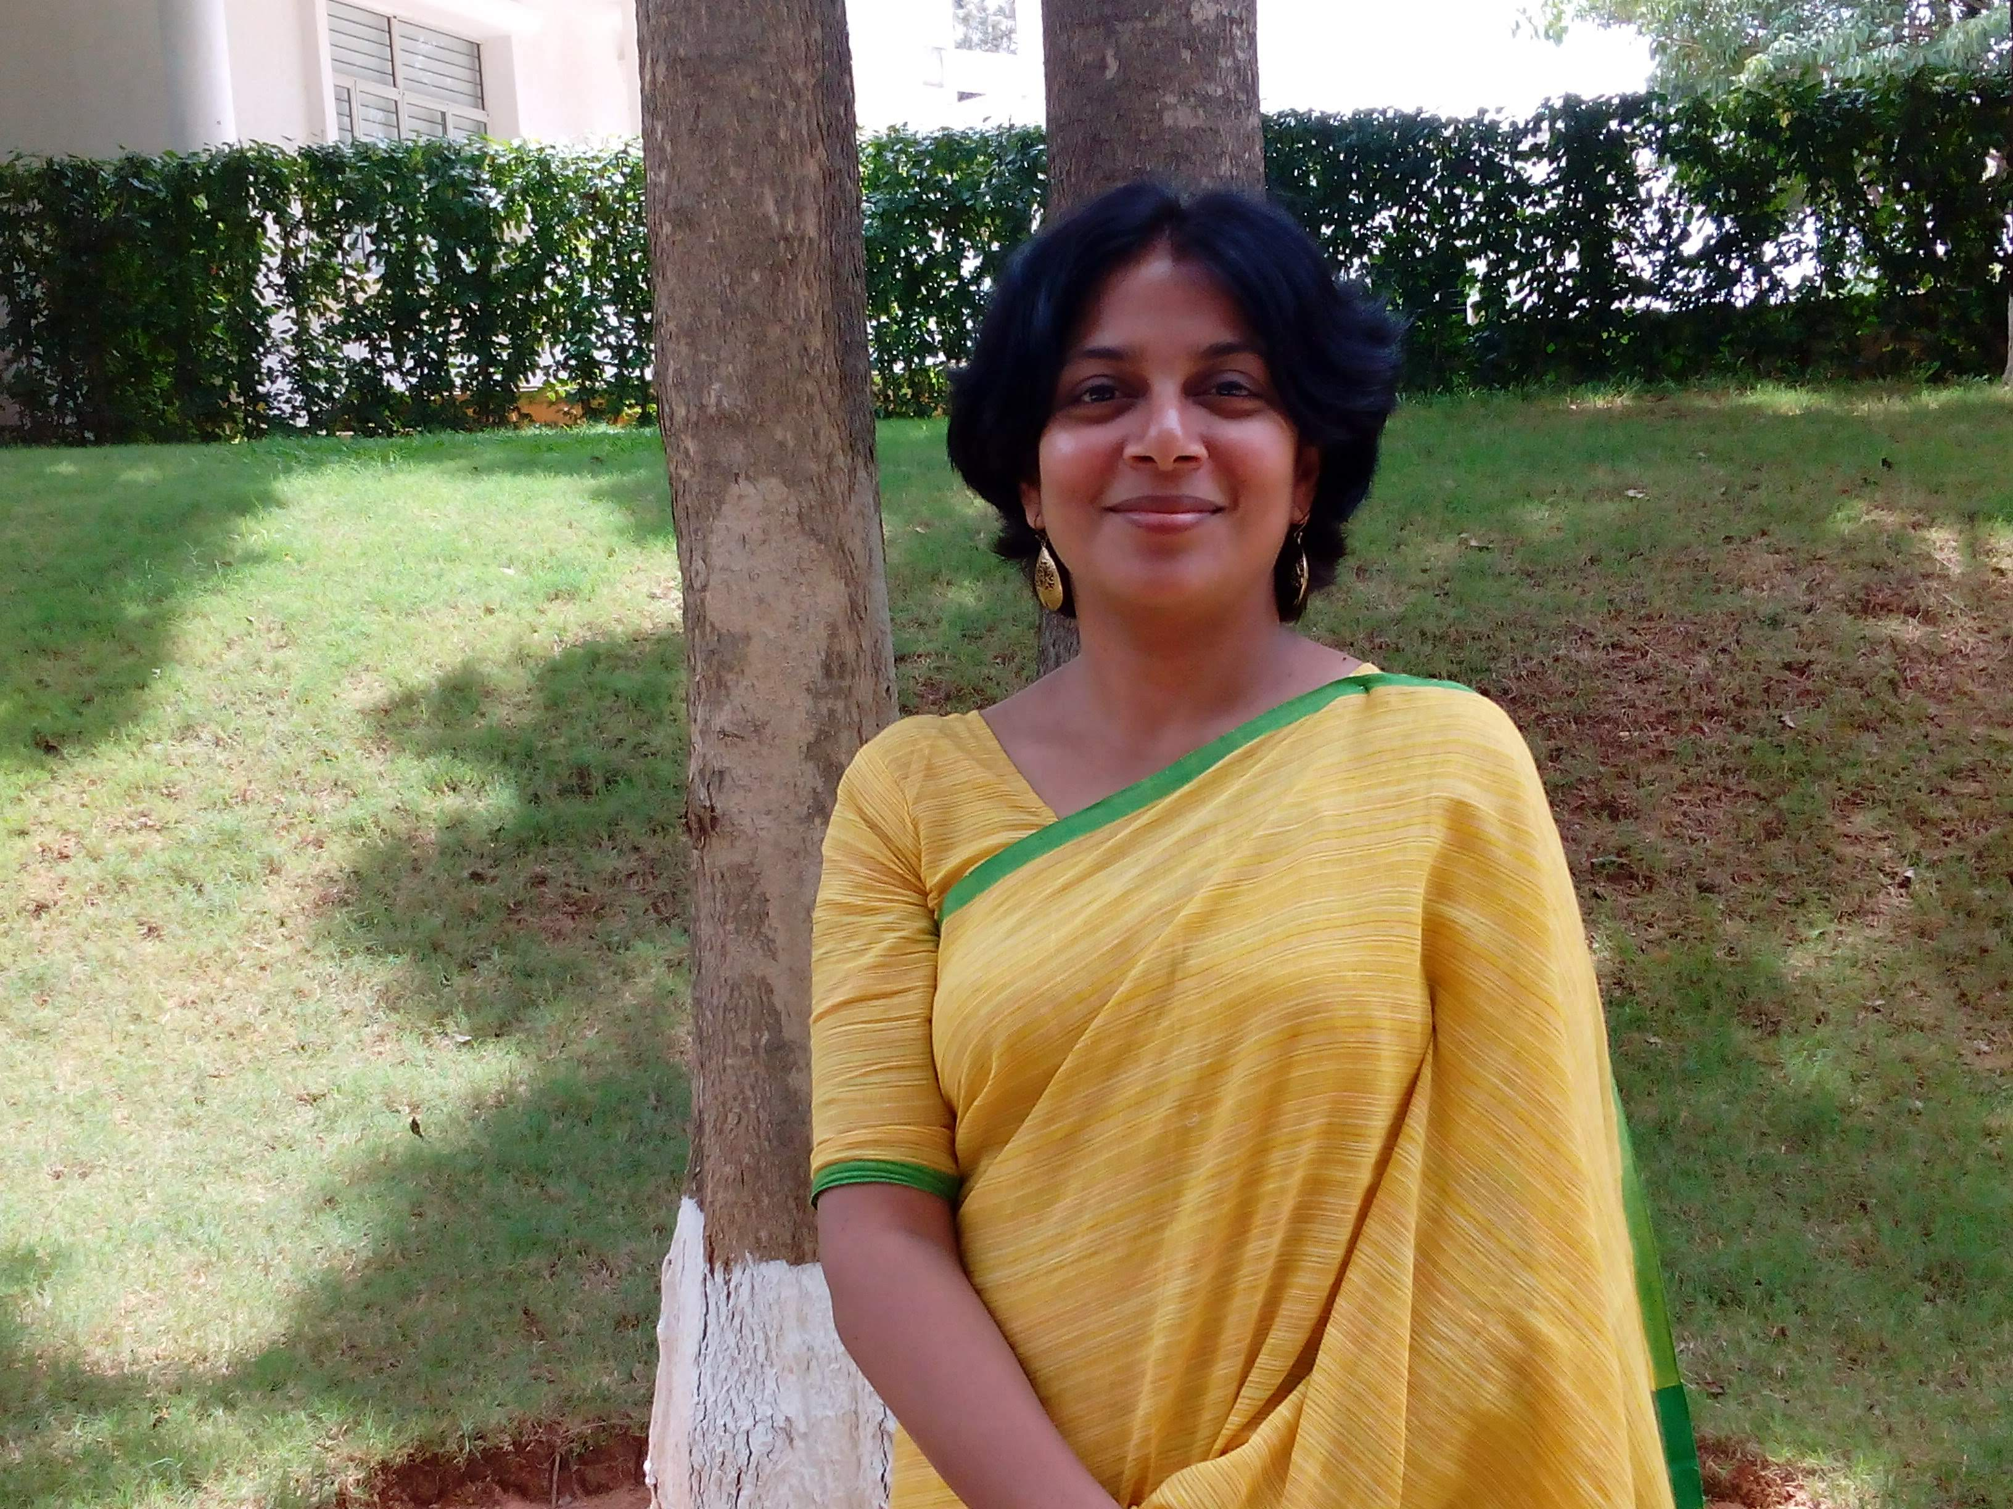
Why weren’t we taught like this?:
Introducing Creative Strategies to Indian Teachers
Marina Basu, India

Slide 45

Hooking students into science with engaging activities
Sutapa Mukund, New Zealand

Slide 46
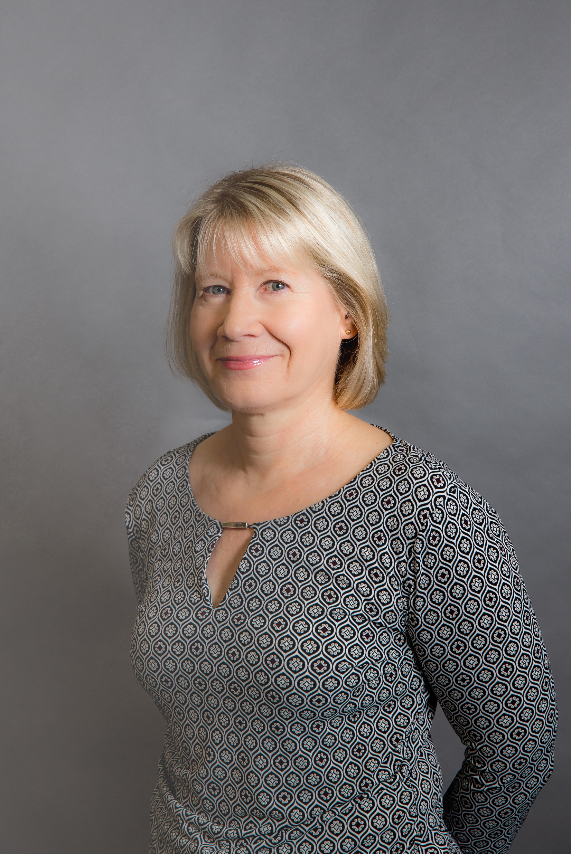
Pedagogical innovations from Finland:
Using positive phenomena for powerful learning
Tarja Mykrä, Finland

Slide 47
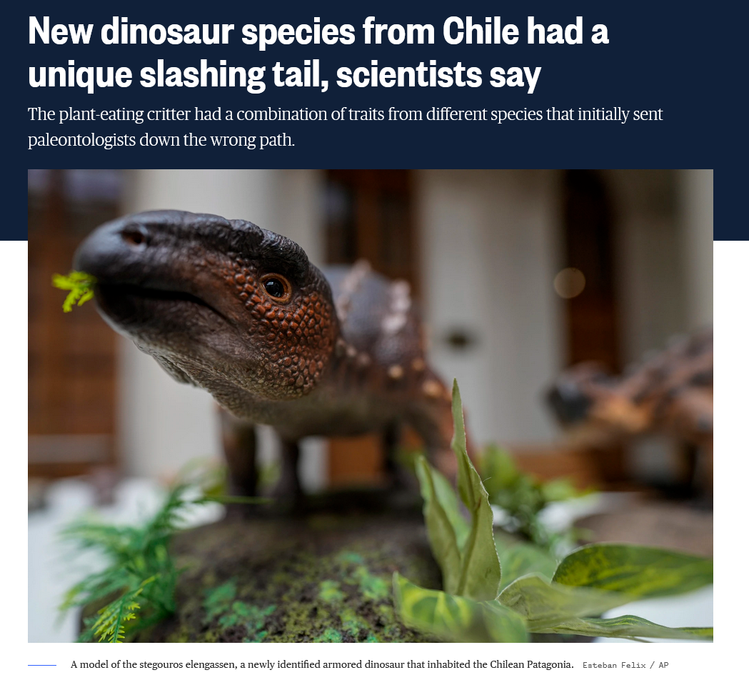
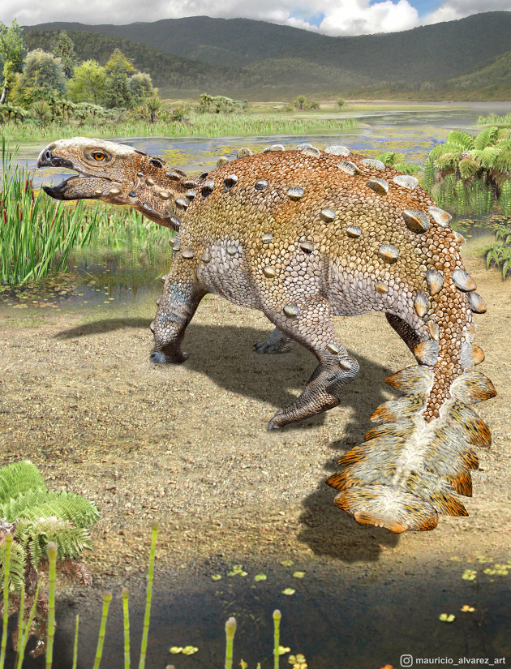
December 2, 2021
Learning is More Immediate…
Science in the News
New dinosaur species from Chile had a unique slashing tail, scientists say
NBC News, Science News https://www.nbcnews.com/science/science-news/new-dinosaur-species-chile-unique-slashing-tail-scientists-say-rcna7447

Slide 48
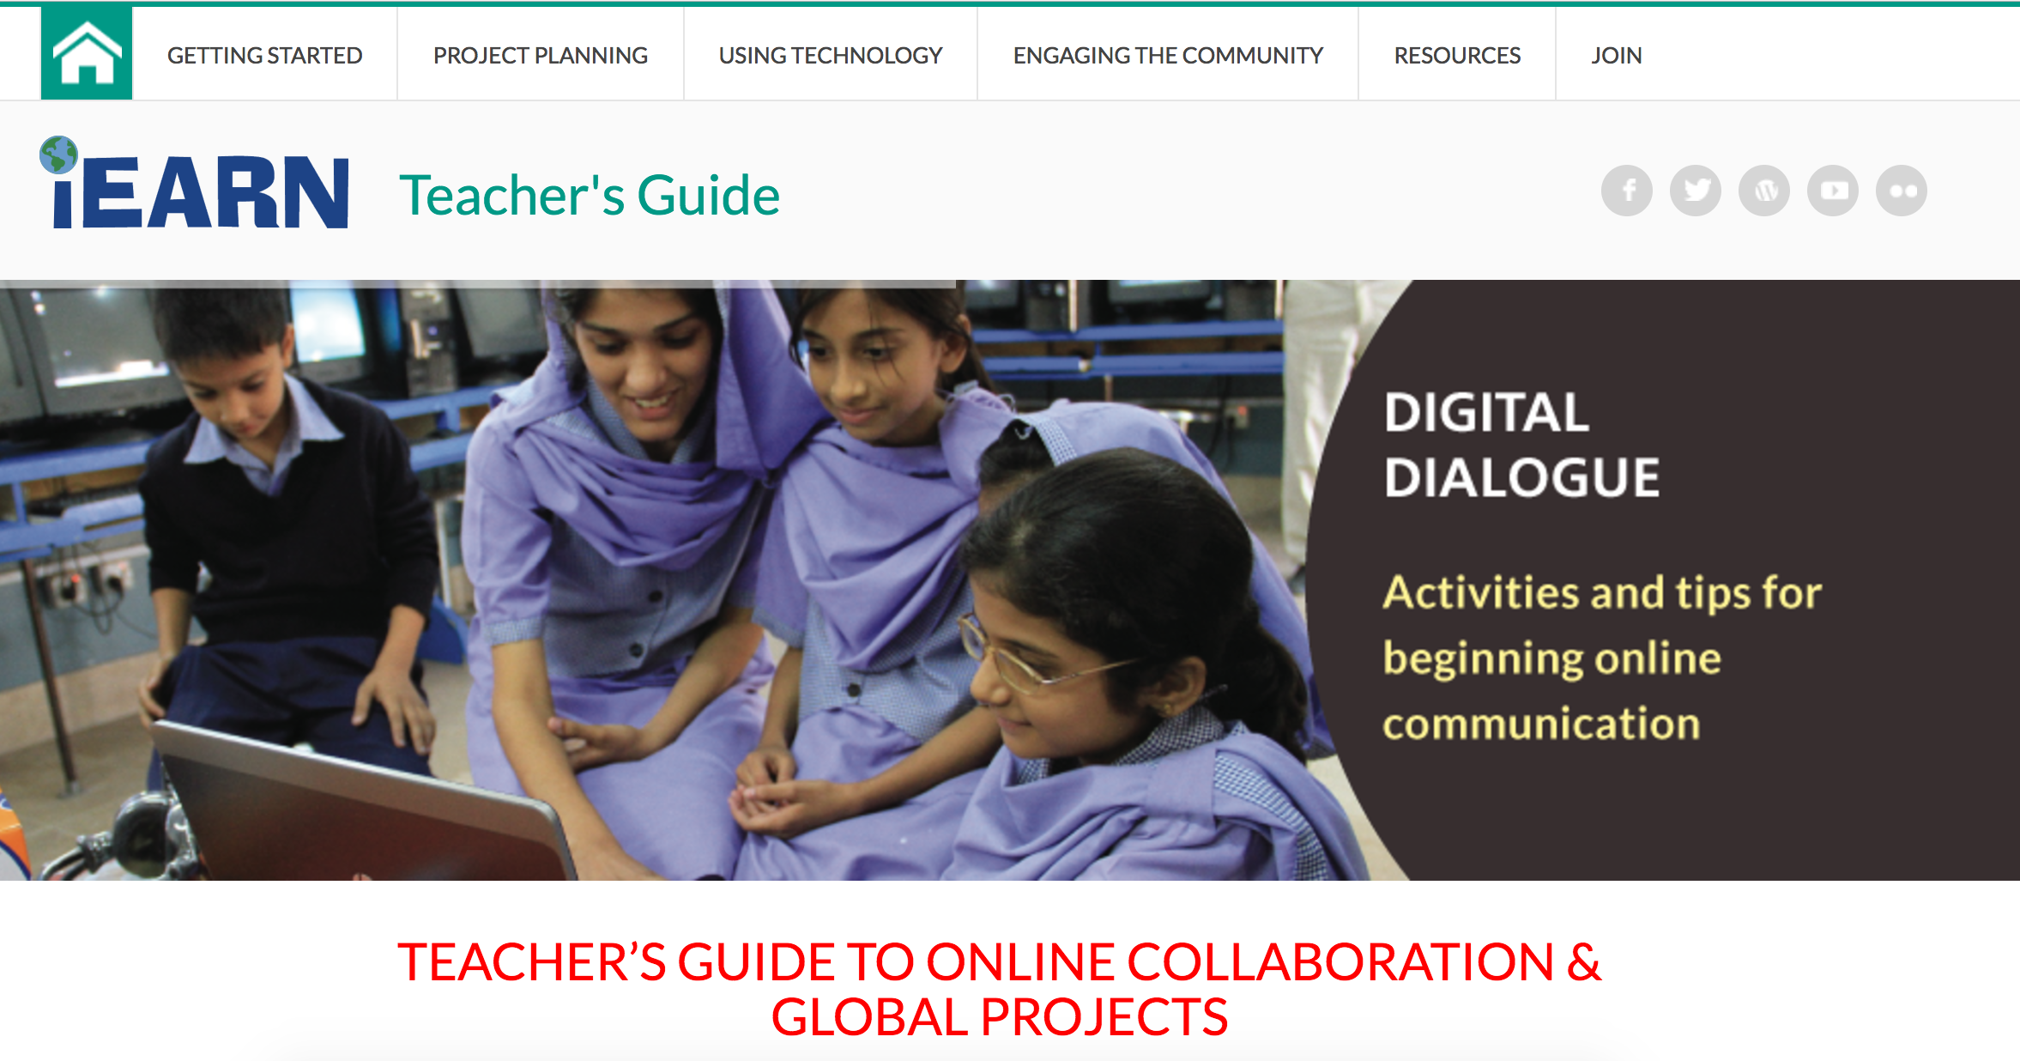
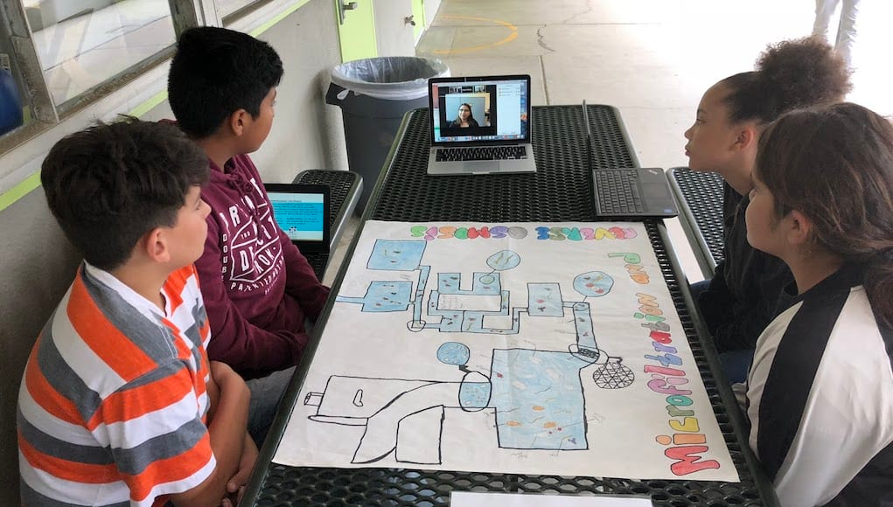
Section #7: Global Education

Slide 49
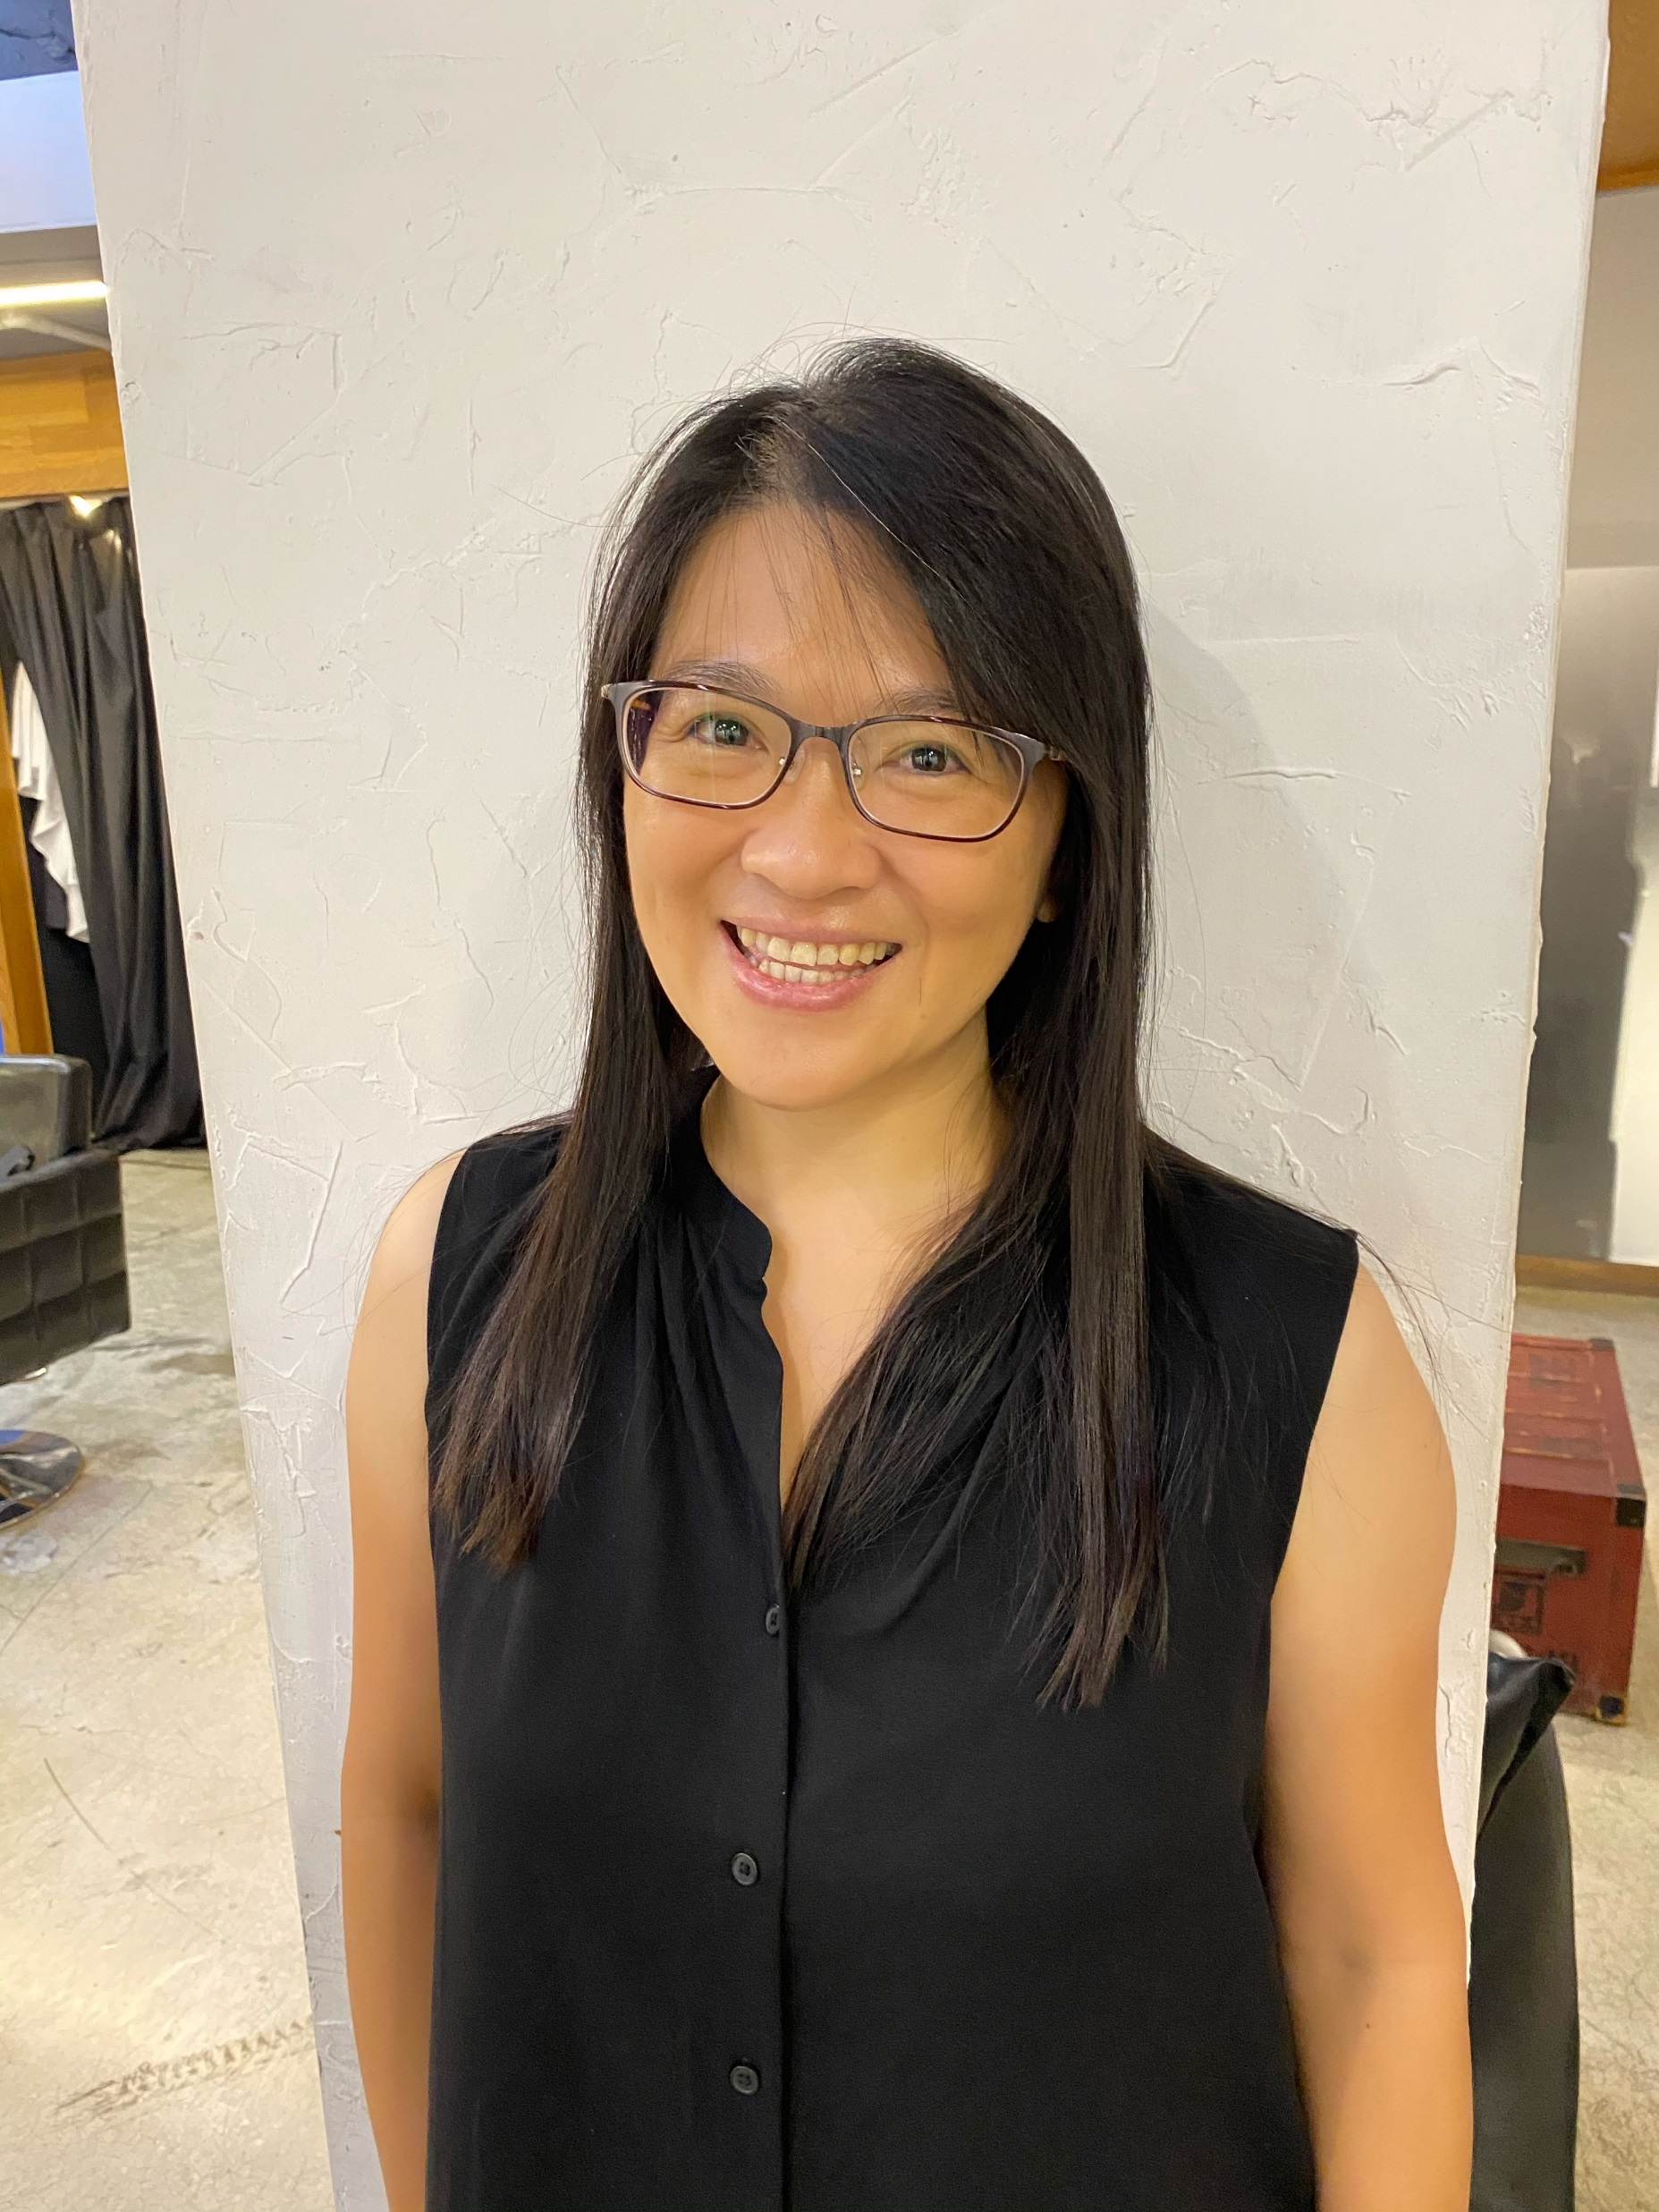
Distant Horizon, Close Friendship:
Learning through Cross-Cultural Projects and Exchanges
Sandy Tsai

Slide 50
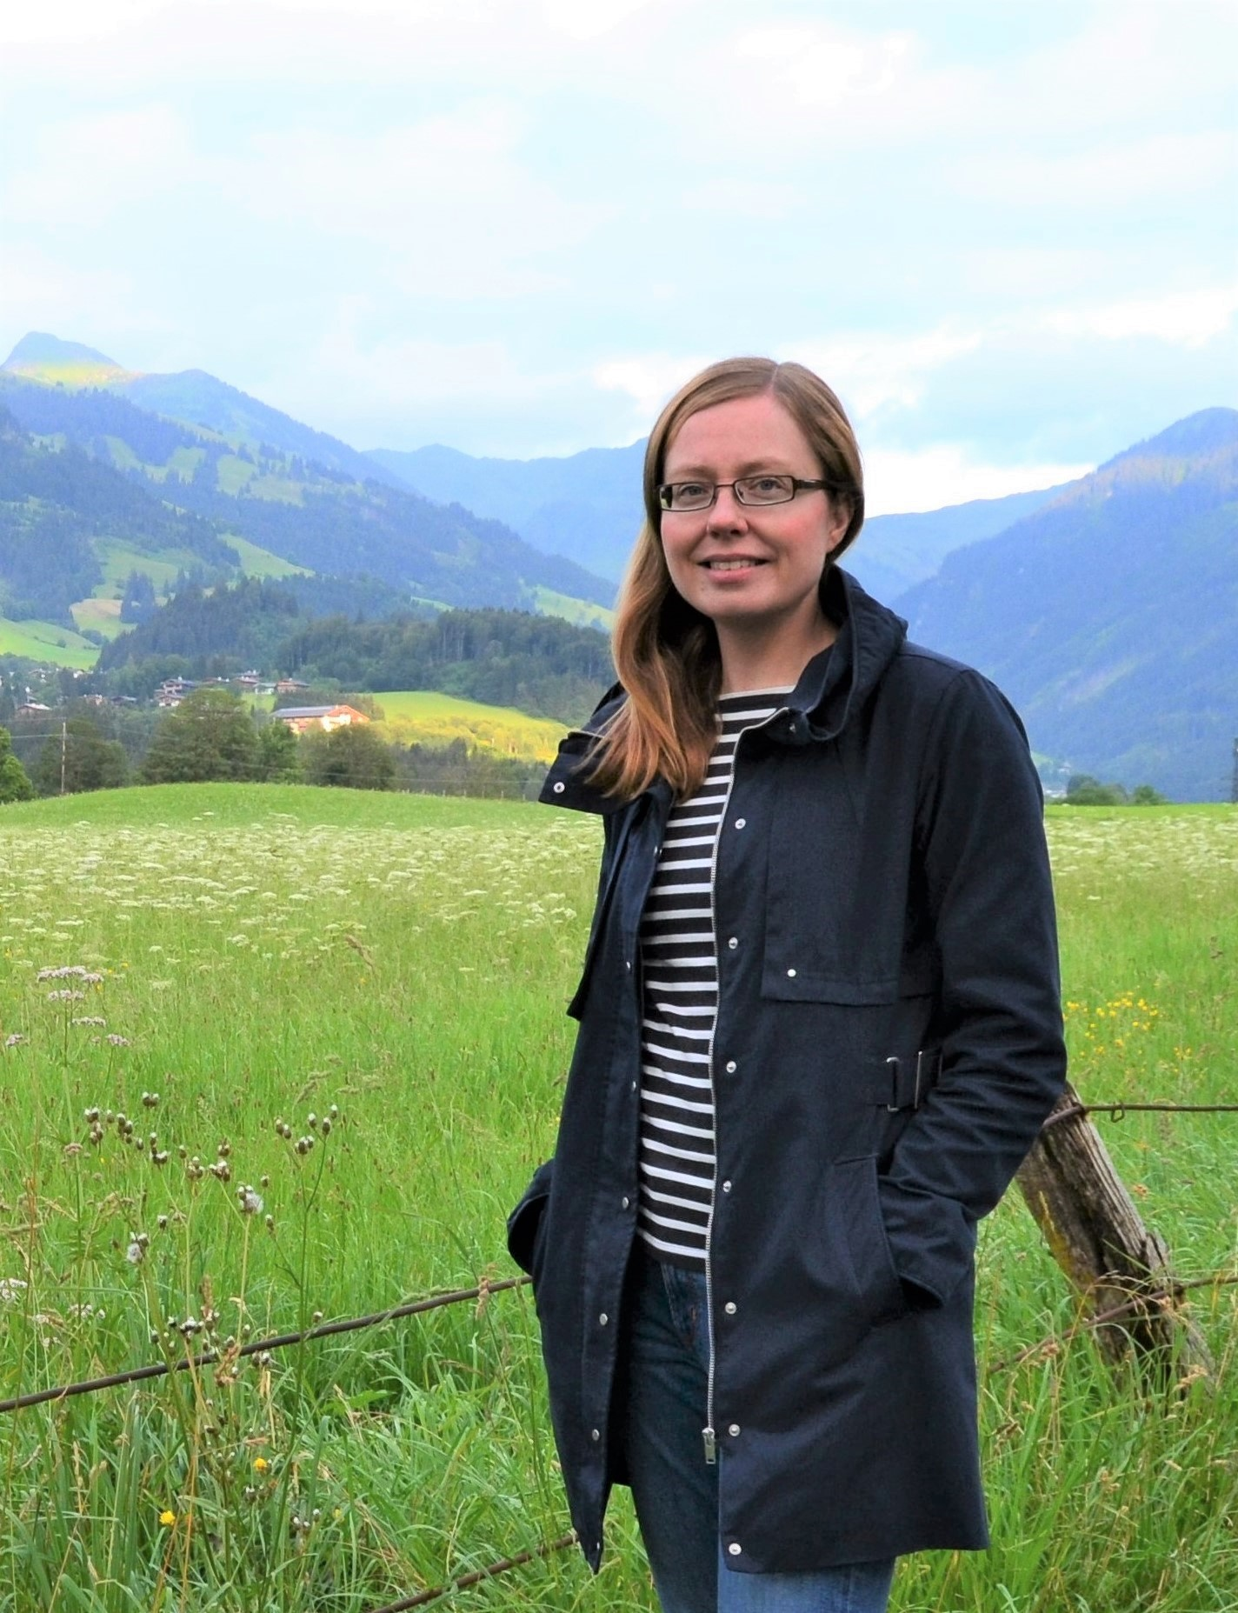
Learning through student exchange projects
Taru Pohtola, Finland

Slide 51

From Moment to Momentum:
Technology Expanded Classrooms from Mexico to France and Back
Diana Gabriela Zamudio Troncoso, Mexico

Slide 52
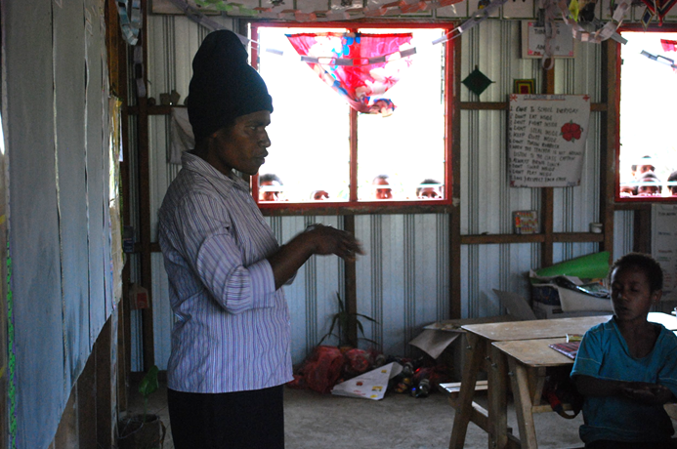
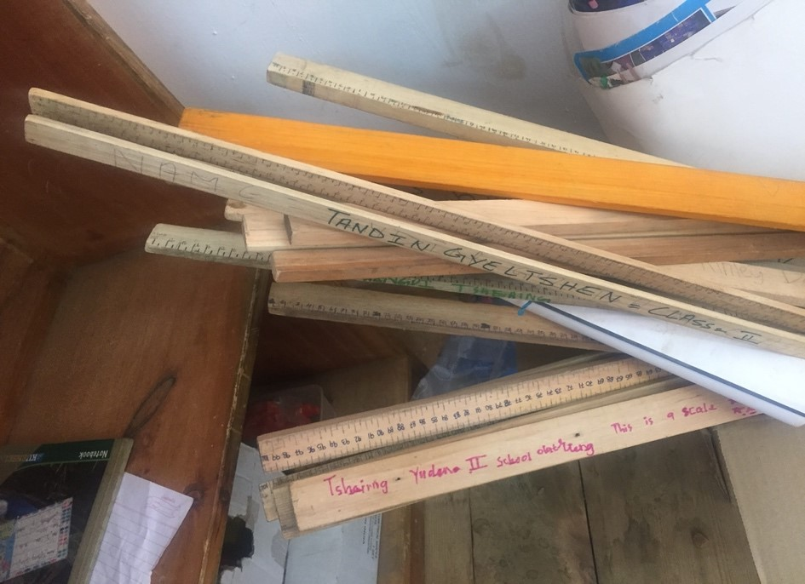
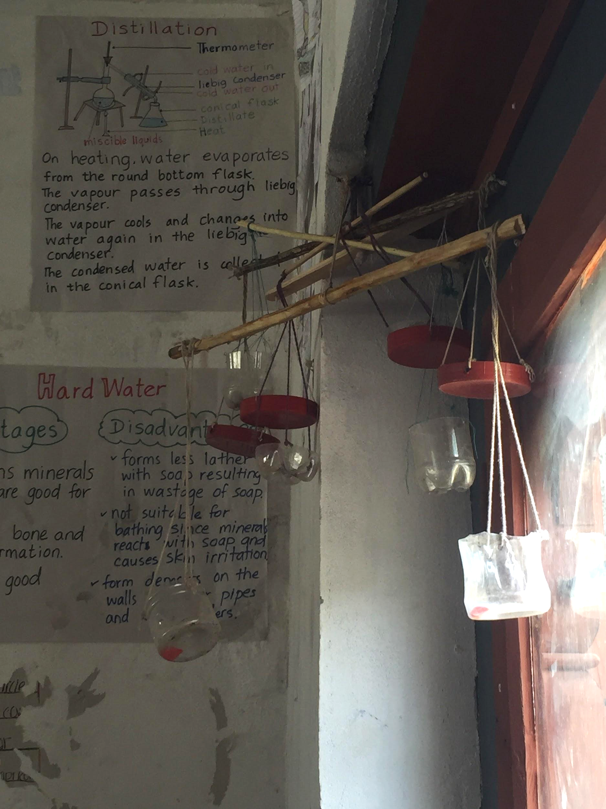
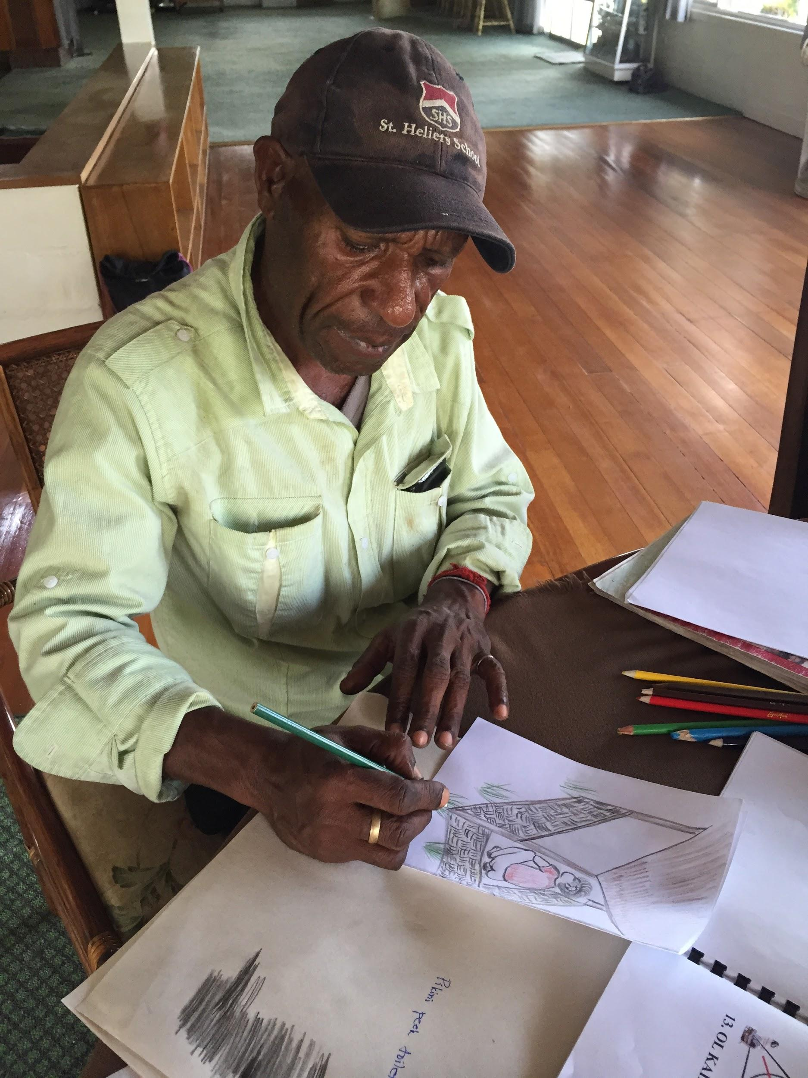
Section #8: Overcoming Challenges

Slide 53
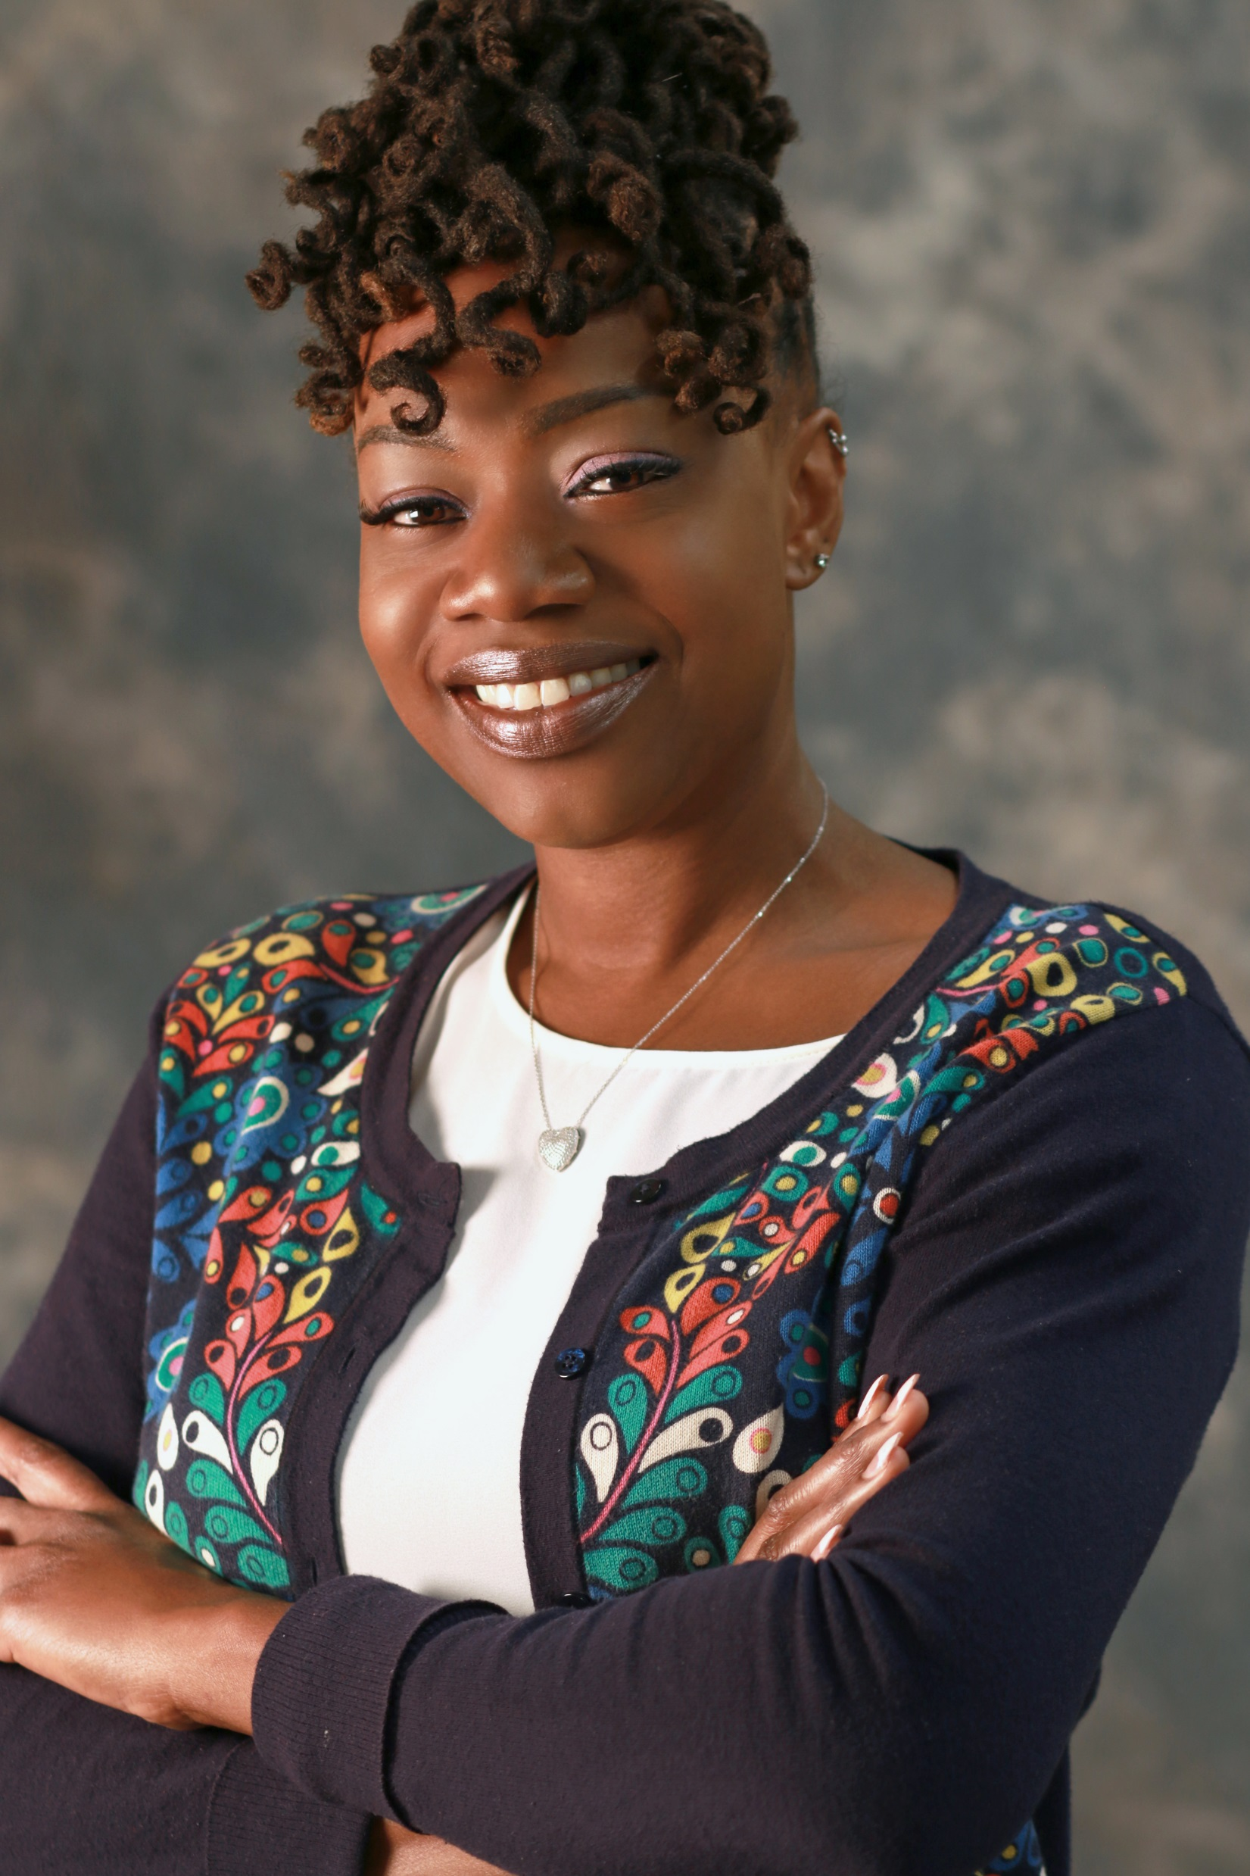
Cancer, Covid-19, and the Cultural Impact of Technology in the Classroom
Rhuperdia Crowe-Clay, USA

Slide 54
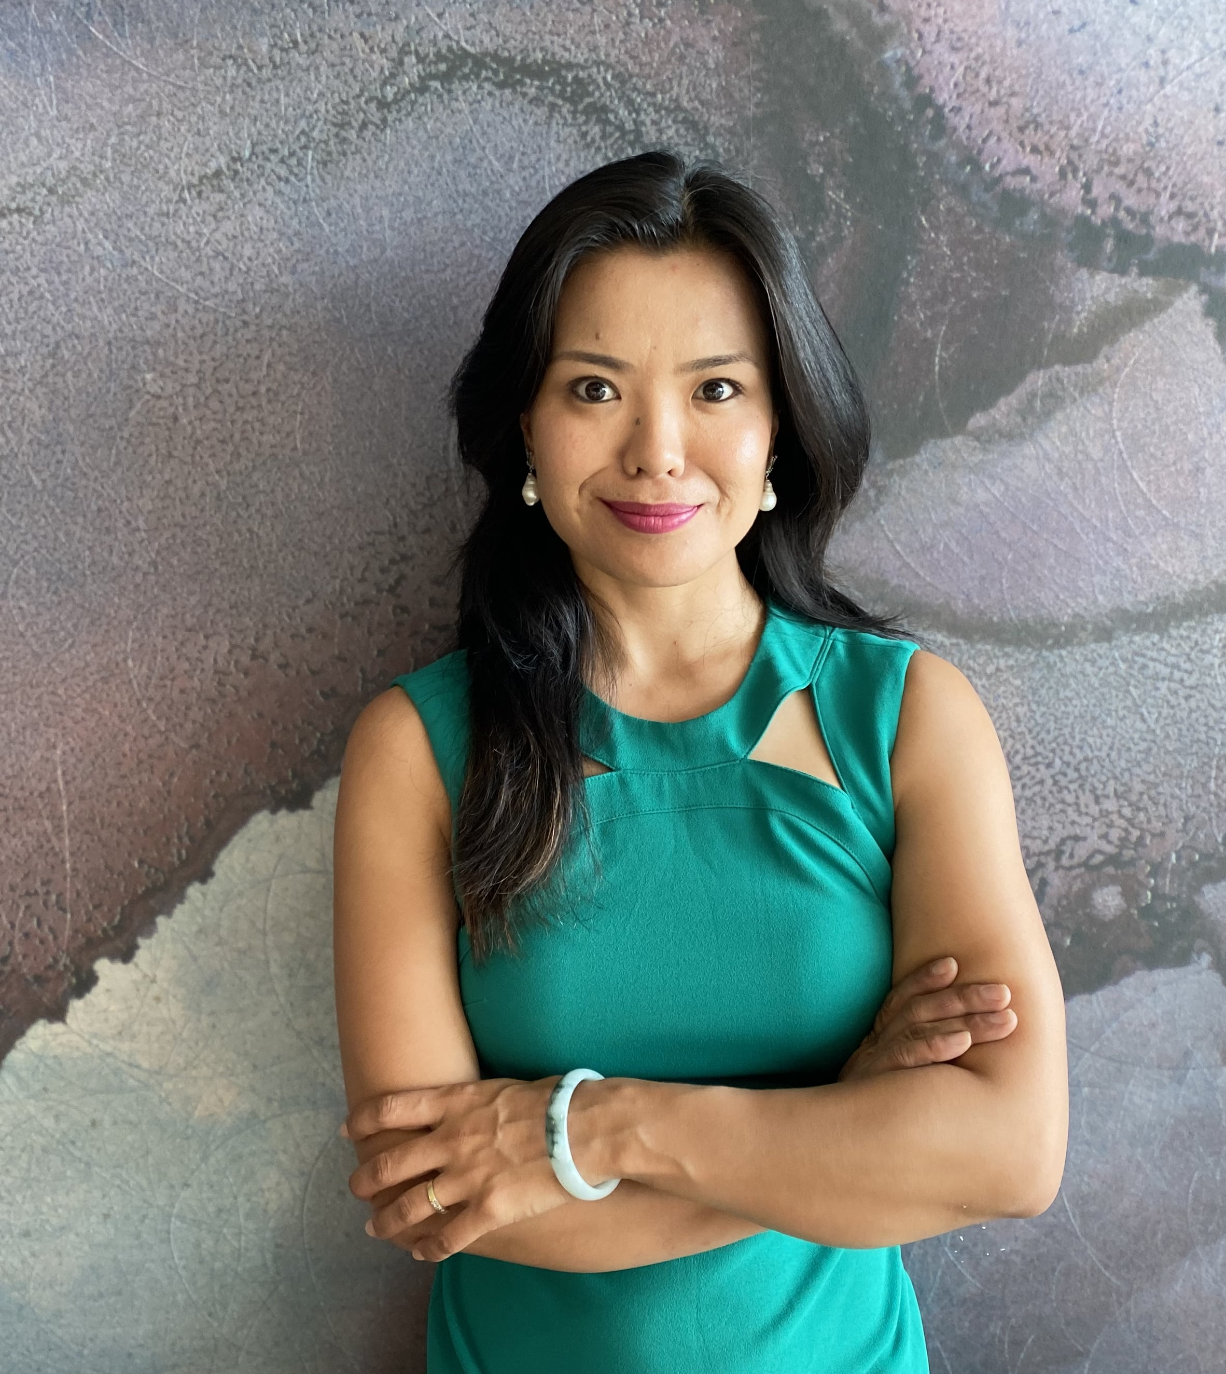
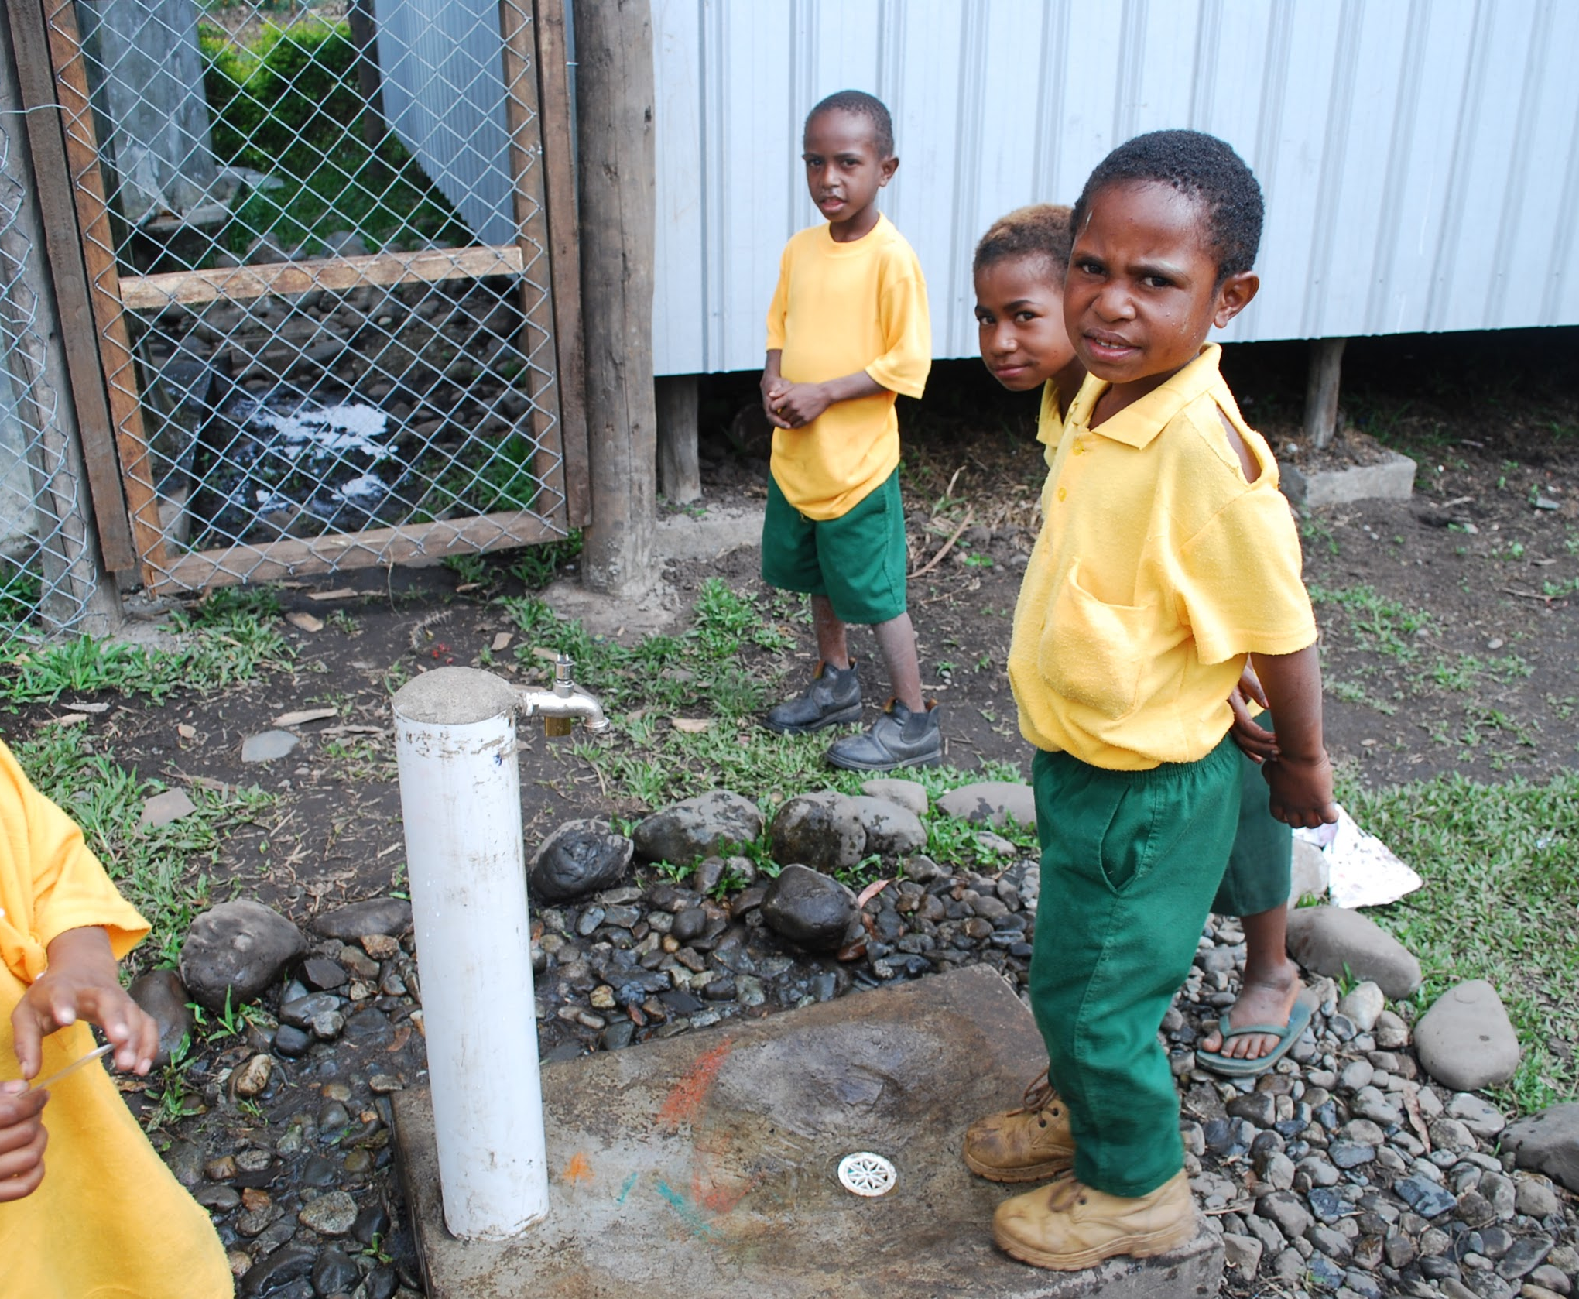
Equitable learning in inequitable classrooms:
Cases of teacher design thinking in rural schools in Bhutan and Papua New Guinea
Khendum Gyabak, Bhutan and PNG

Slide 55
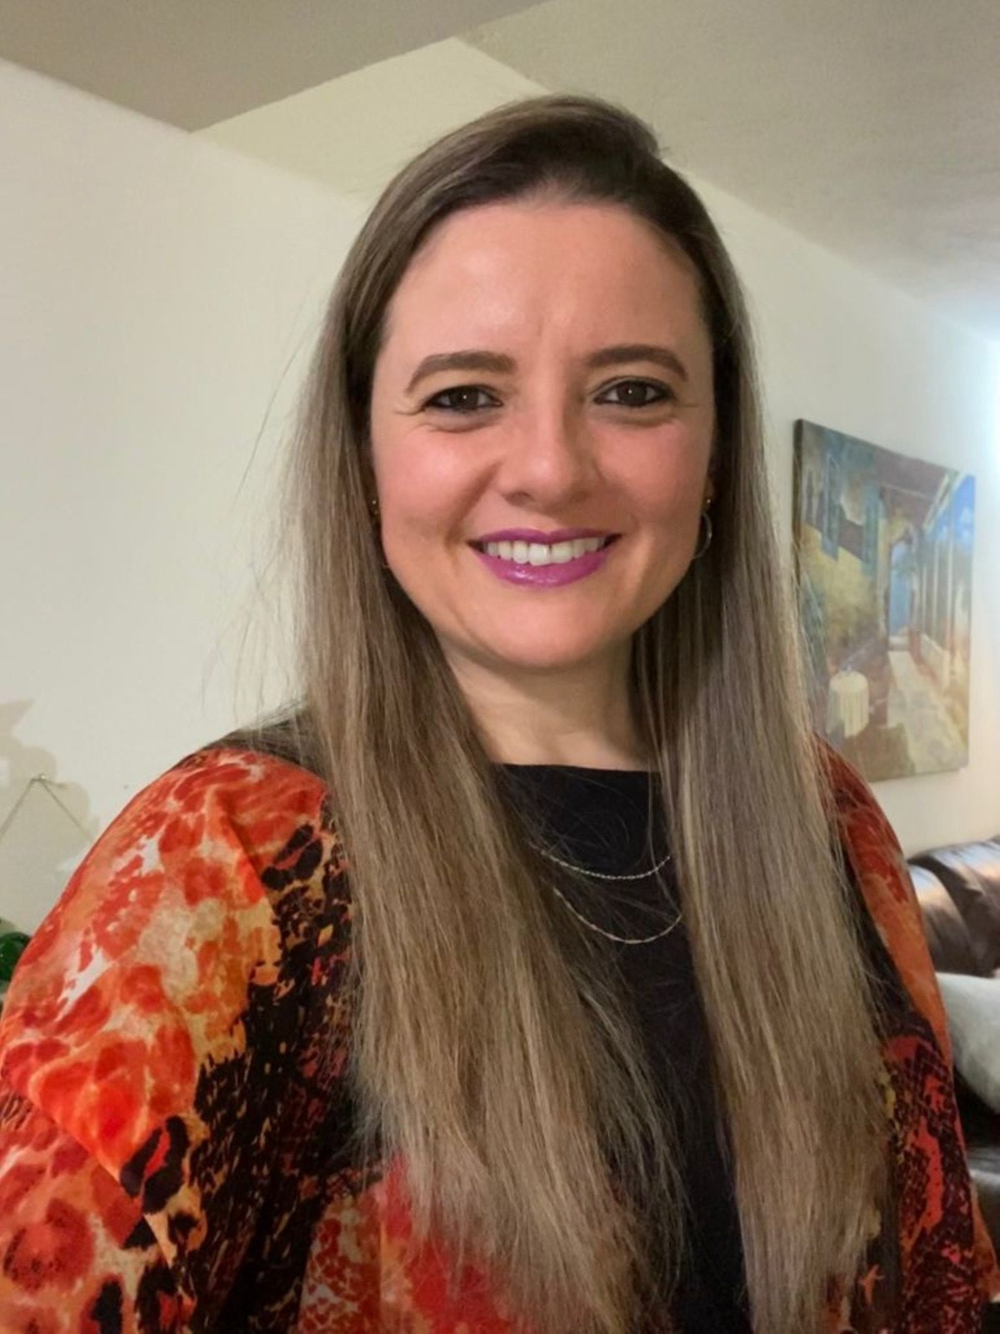
The Story Behind Jacky’s Cell Phone:
Bring the Invisible Forward
Natalia Ramirez Casalvolone, Costa Rica

Slide 56
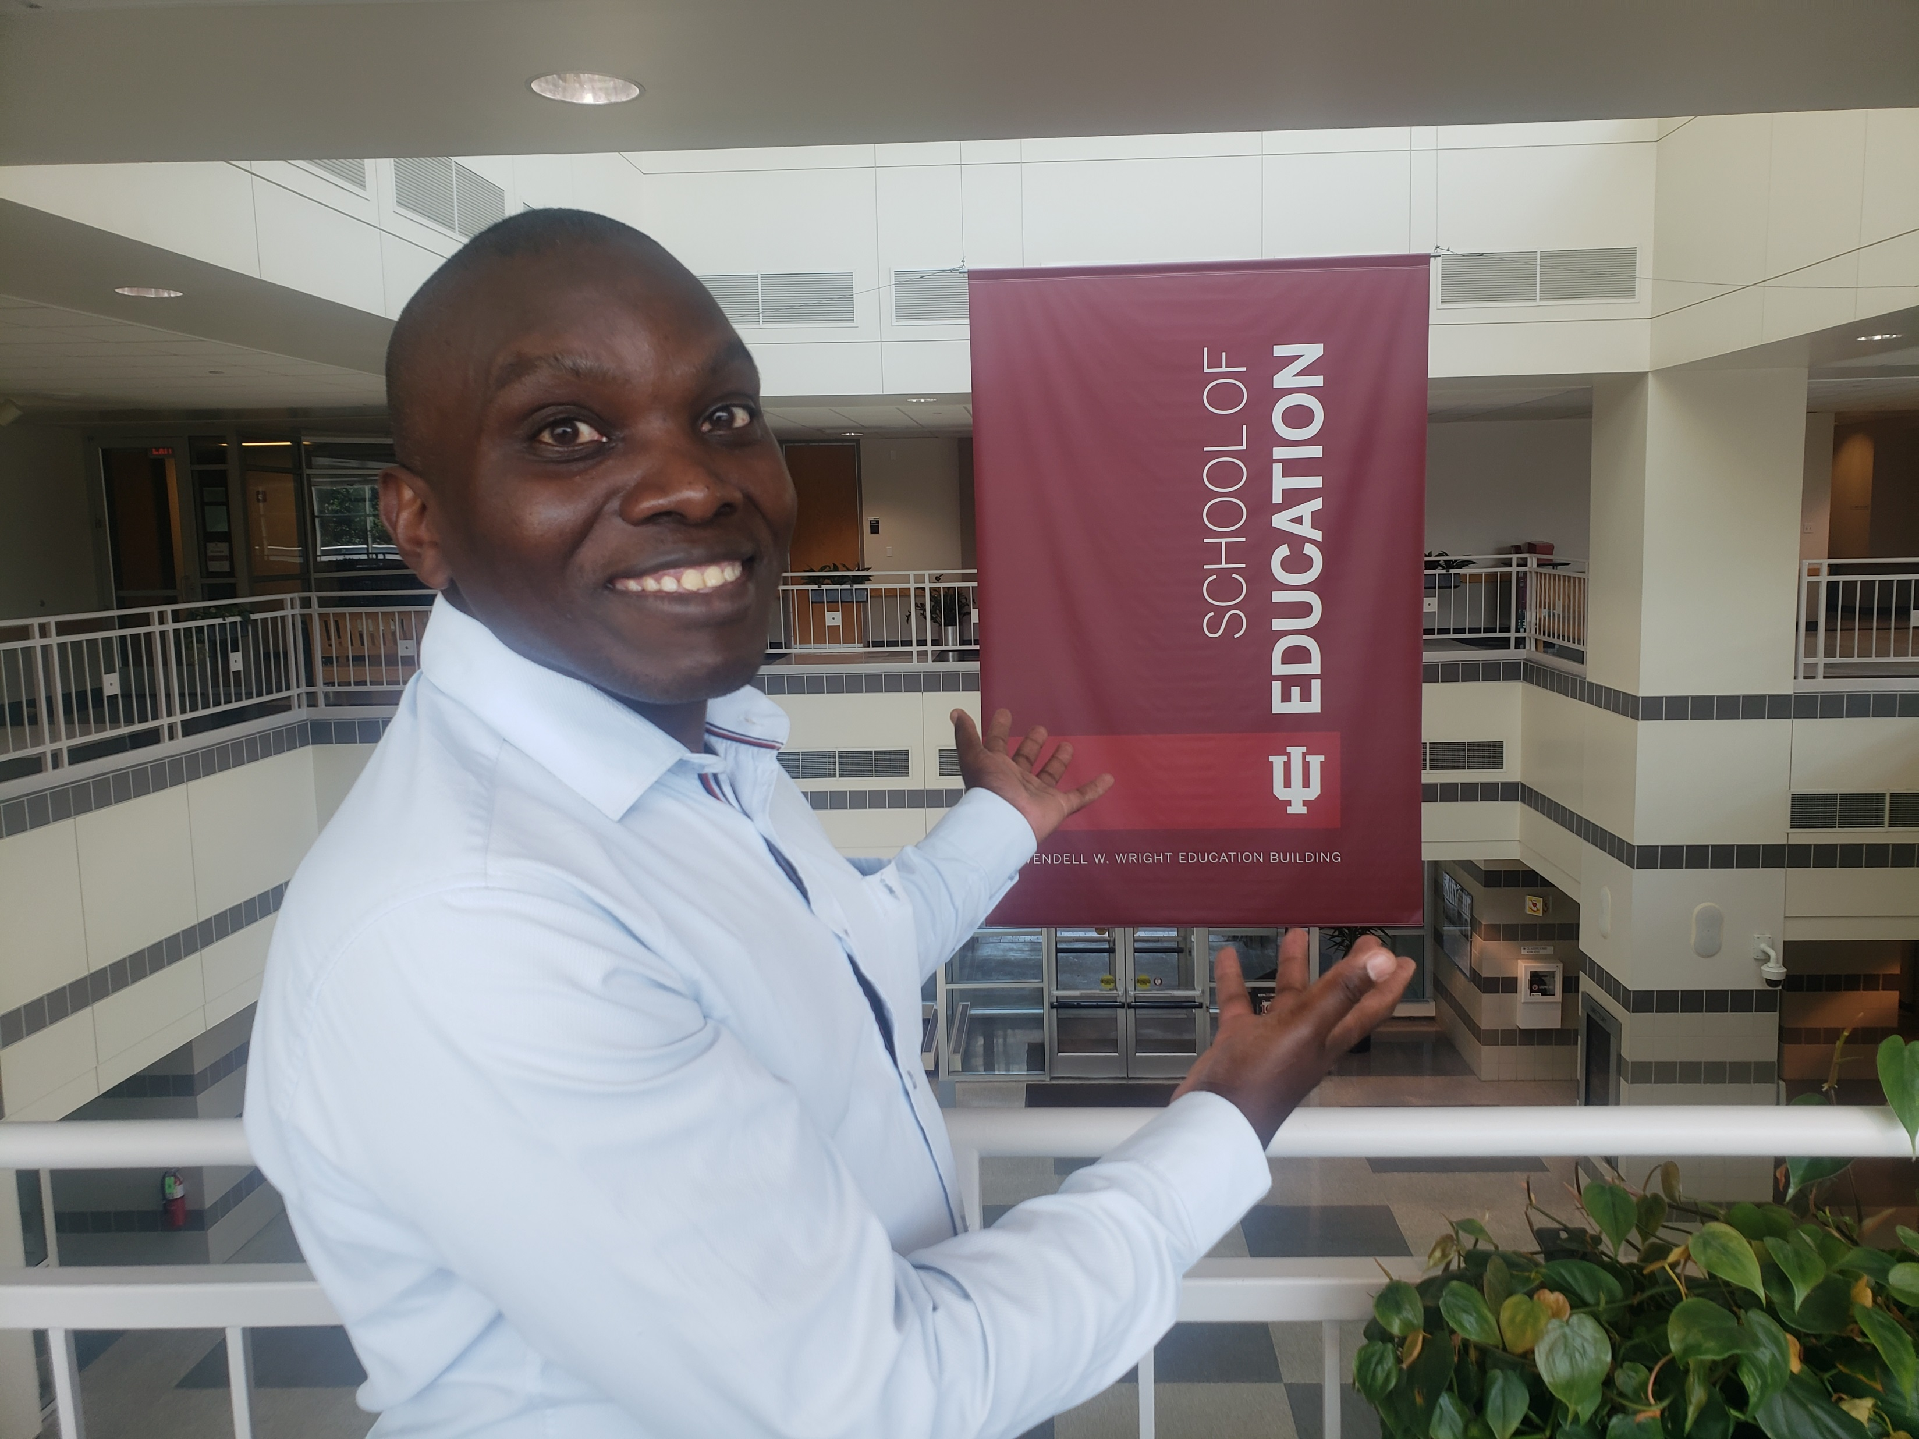
The story of keeping education wheels turning:
Motivation and collaboration when Teaching in a post-war context
Simon Pierre Munyaneza, Rwanda

Slide 57
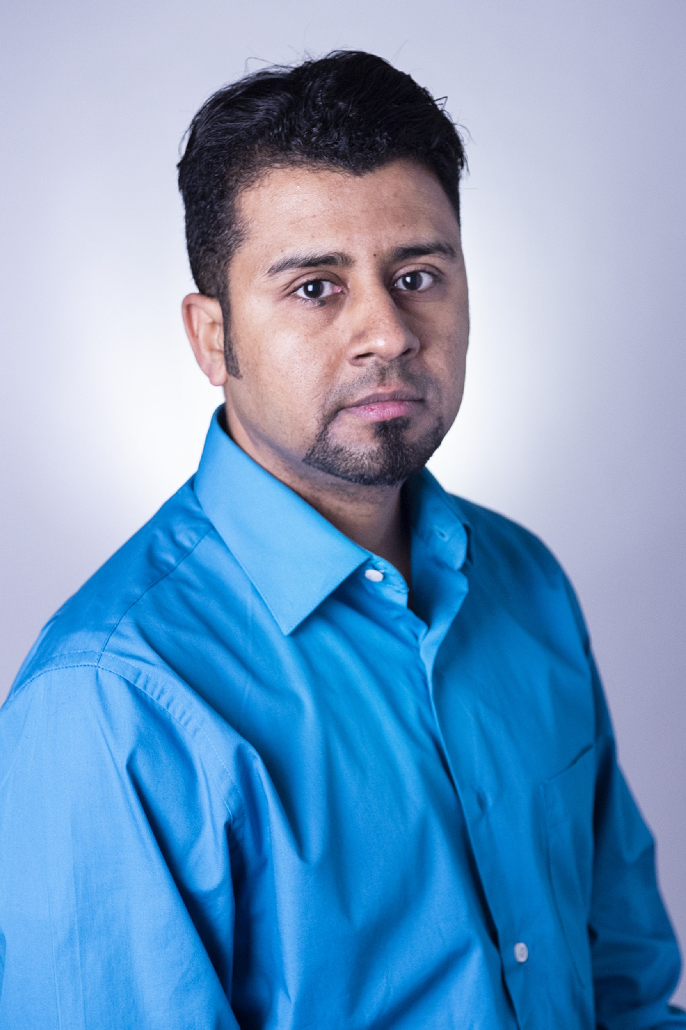
Augmenting curriculum in a war-torn country: Augmented reality online teaching
Ebrahim Bamanger, Yemen

Slide 58
Augmenting Curriculum in a War-Torn Country: Augmented Reality in Online Teaching
Ebrahim Bamanger
Using a free AR application, students can easily download it into their cell phones and follow the developed curriculum
Use Zoom for teacher tRaining
Technology can bridge the education gap.

Slide 59


After Making Impact
Meina Zhu and Curtis J. Bonk, USA

Slide 60
After Making Impact
Pondering Questions
Responding to Challenges
Lasting Impact

Slide 61
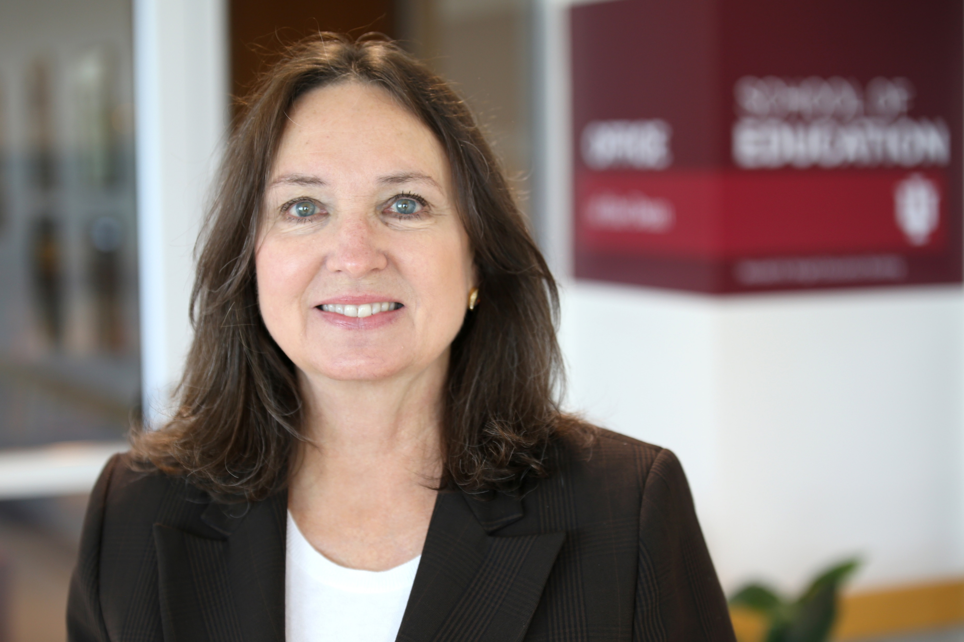
Afterword: The Power of Planning
Anastasia Morrone, USA

Slide 62
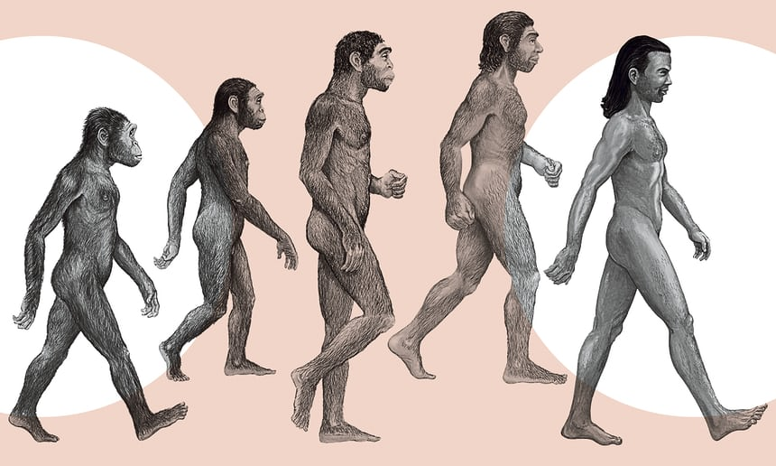



Is this an Evolution or Revolution?

Slide 63



Chat Window Sharing:
Three Words from this Session…? e.g., “I am happy!” and…
“minions are happy!”

Slide 64
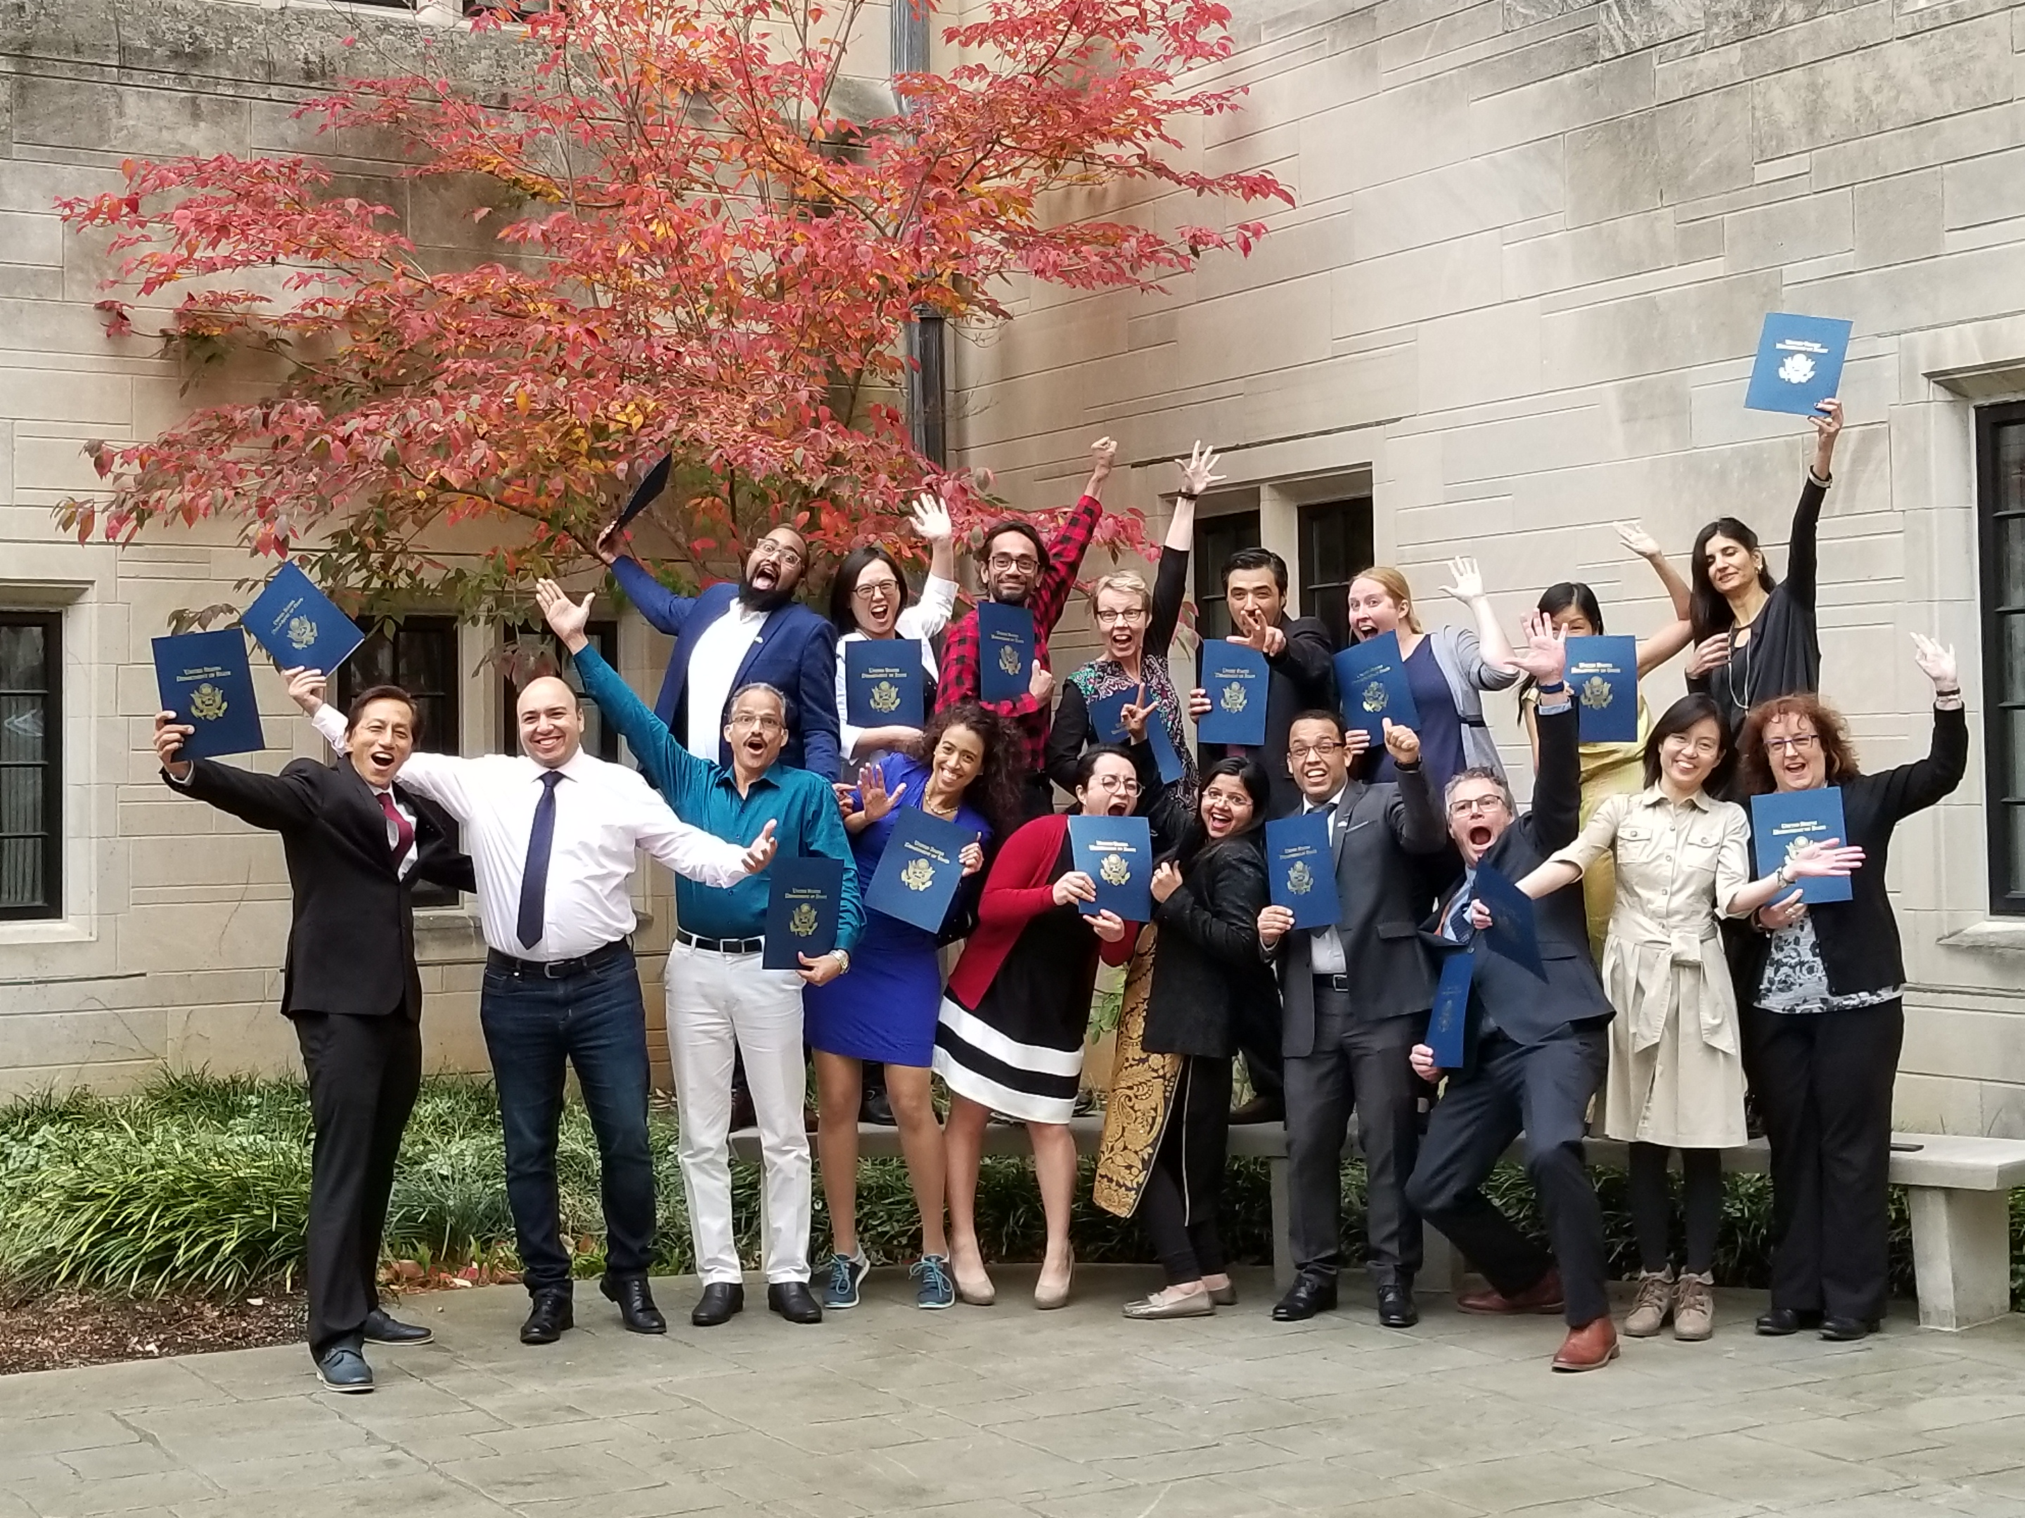
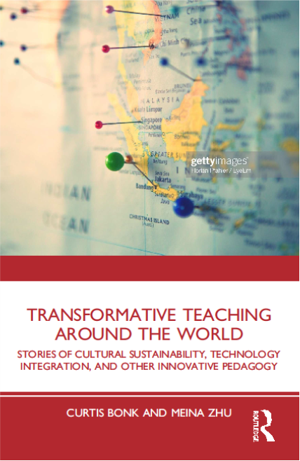
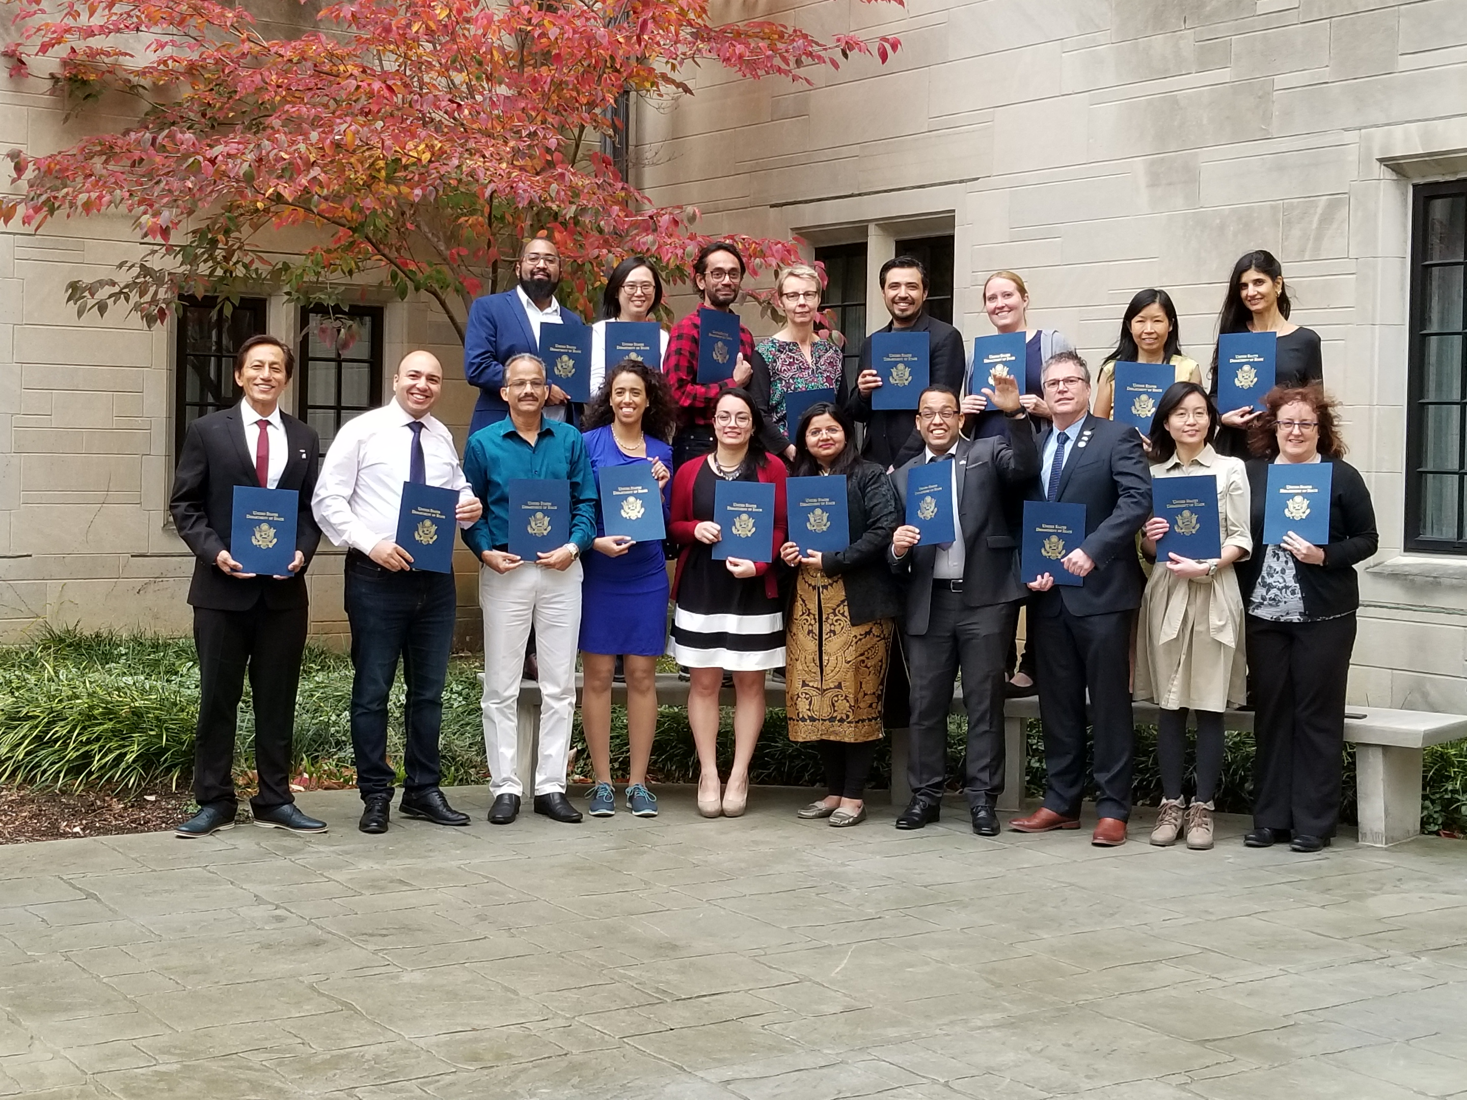
Transformative Teaching Around the World

Slide 65
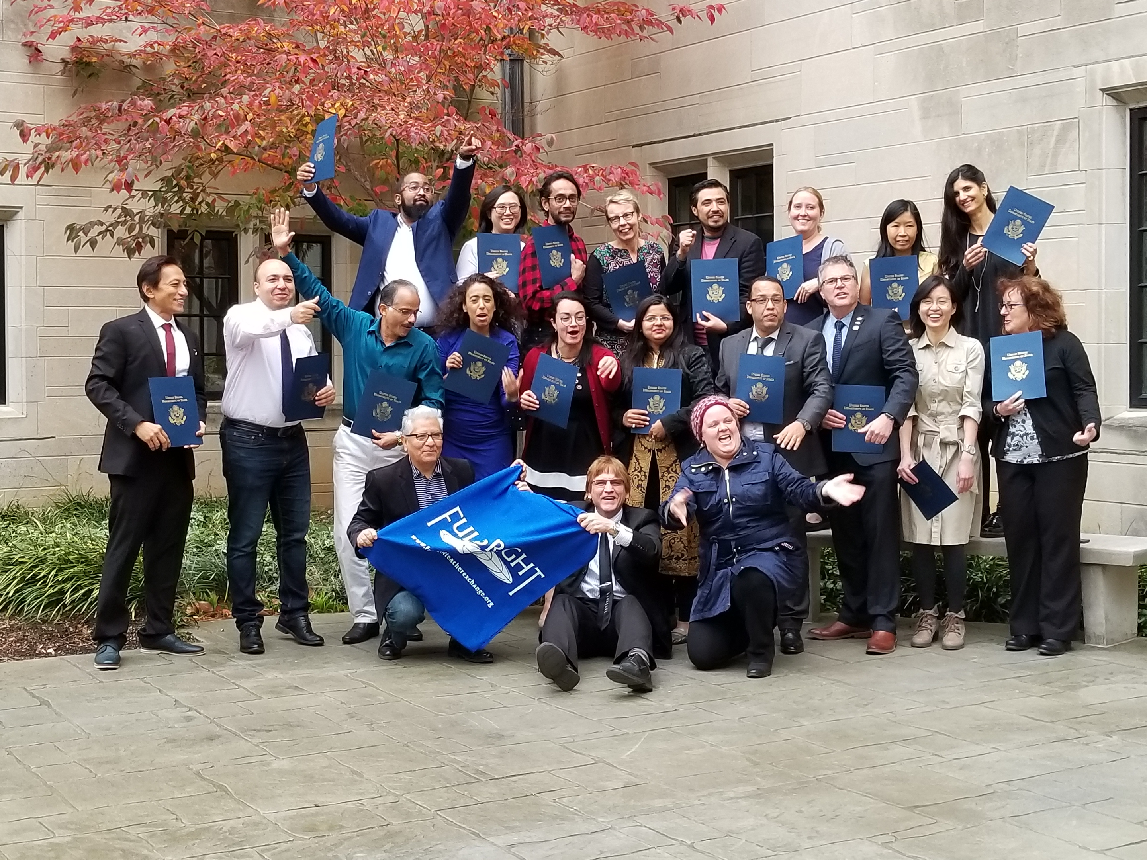
Transformative Teaching Around the World

Slide 66
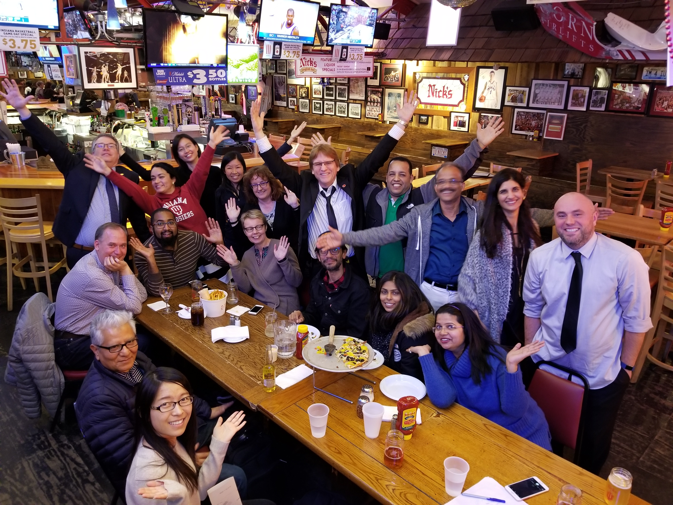
Transformative Teaching Around the World

Slide 67
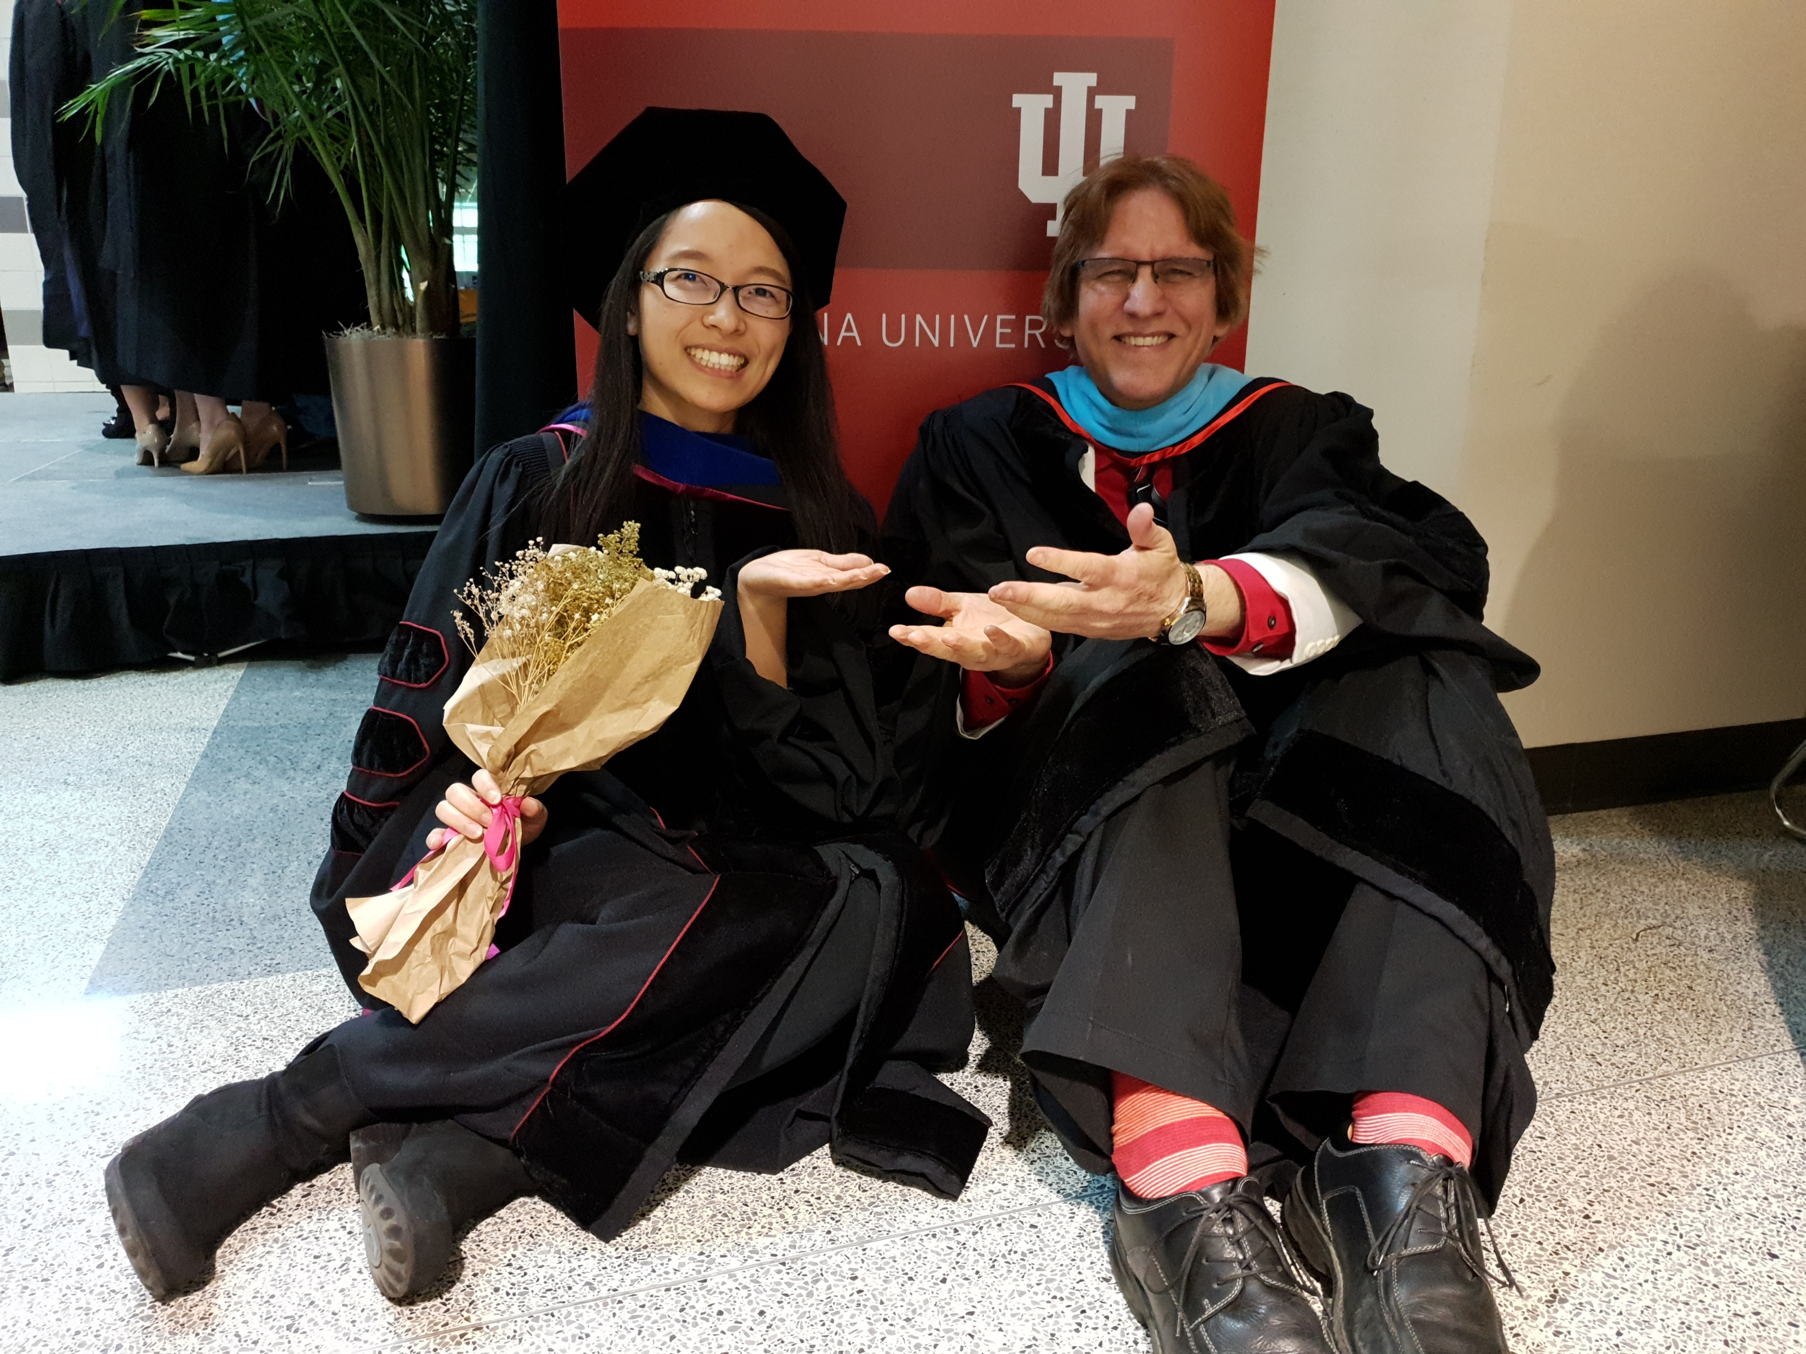
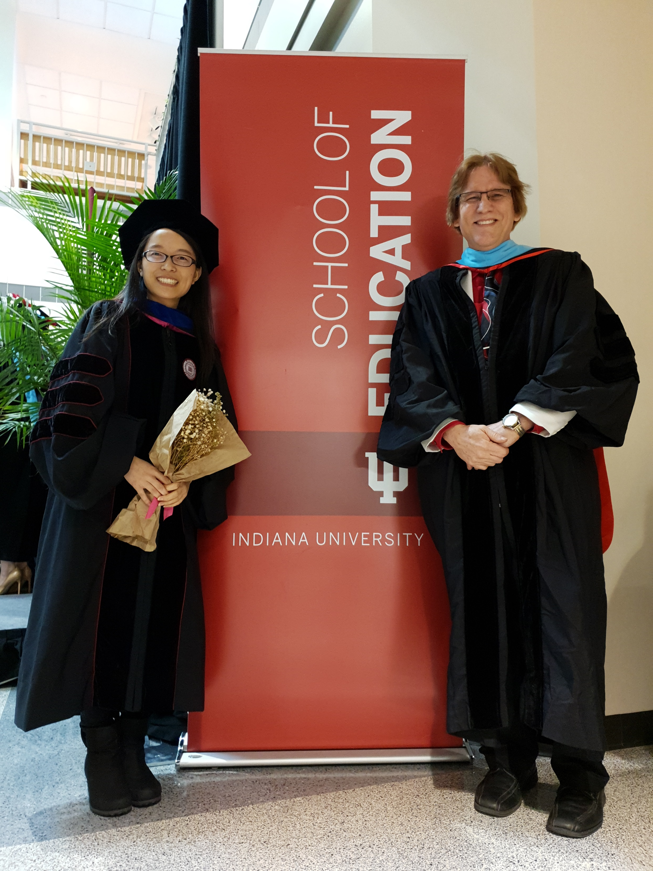
Any Questions or Comments?

Slide 68
Any Questions or Comments?
Curtis Bonk: cjbonk@Indiana.edu
Meina Zhu: meinazhuiu@gmail.com
http://www.trainingshare.com
(go to “Archived Talks)
Free book: http://tec-variety.com/

