Slide 1
Self-Direct to Learn, Self-Direct to Live: Learner Choices, Experiences, and Possibilities in a Self-Directed Learning World
Curtis J. Bonk
Indiana University
cjbonk@indiana.edu
http://curtbonk.com/
(with help from Dr. Meina Zhu, Wayne State University; meinazhu@wayne.edu)
Notes:
Background picture from
https://unsplash.com/photos/O5mmDoBqTF8

Slide 2
December 14, 2021 A Decade of MOOCs: A Review of MOOC Stats and Trends in 2021 Dhawal Shah, Class Central https://www.classcentral.com/report/moocs-stats-and-trends-2021/

Slide 3
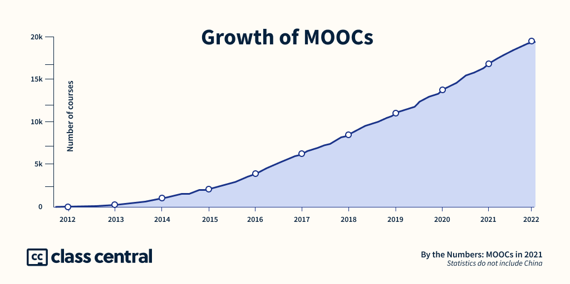
December 14, 2021 A Decade of MOOCs: A Review of MOOC Stats and Trends in 2021 Dhawal Shah, Class Central https://www.classcentral.com/report/moocs-stats-and-trends-2021/

Slide 4
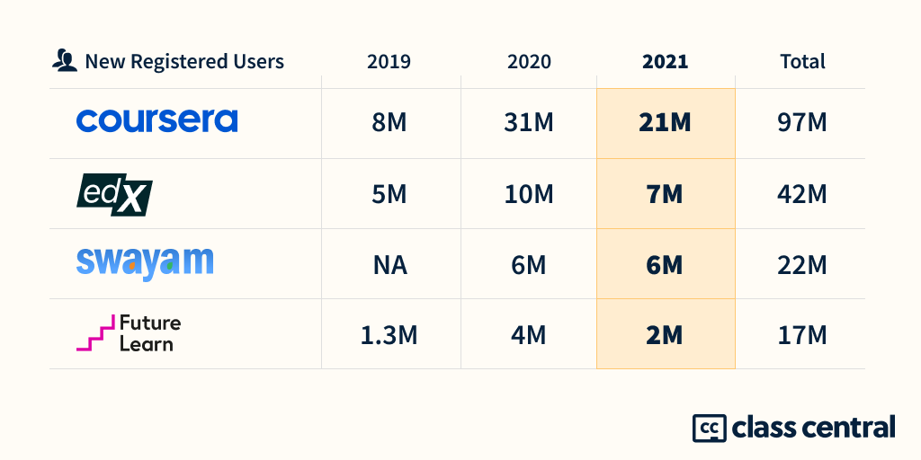
December 14, 2021 A Decade of MOOCs: A Review of MOOC Stats and Trends in 2021 Dhawal Shah, Class Central https://www.classcentral.com/report/moocs-stats-and-trends-2021/

Slide 5
MOOC books (2020) and (2015)
Notes:
Last year, I co-edited a book titled MOOCs and Open Education around the World. MOOCs stands for Massive Open Online Courses. An individual MOOC can enroll tens of thousands of students, and several MOOCs have now surpassed 1 million students in total enrollment. MOOCs are primarily offered by elite universities such as Stanford, MIT, and Harvard through enterprises such as Coursera, edX, and FutureLearn. More people enrolled in MOOCs developed at Harvard in a single year than attended Harvard in its entire 377-year history.

Slide 6
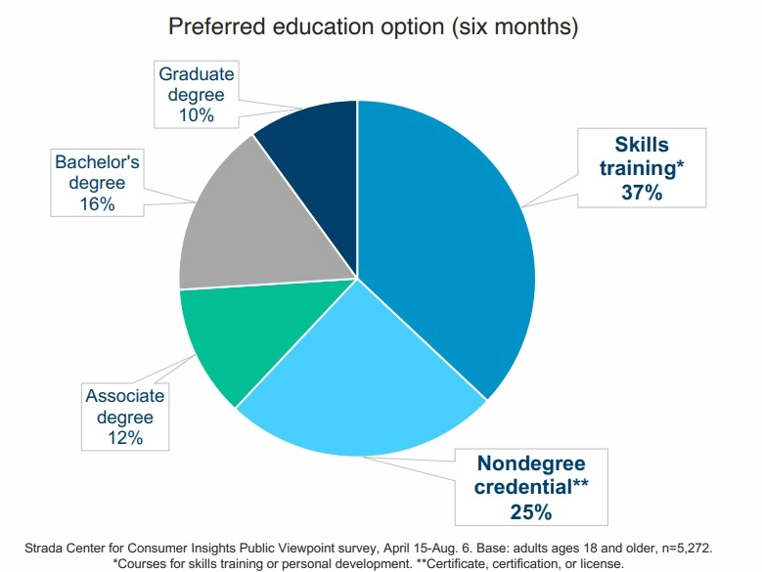
Alternative Credentials on the Rise Paul Fain, Inside Higher Ed https://www.insidehighered.com/news/2020/08/27/interest-spikes-short-term-online-credentials-will-it-be-sustained

Slide 8
October 22, 2021 Wanted: Billions of Self-Directed Learners https://www.peoplematters.in/article/training-development/the-era-of-self-directed-learning-hrs-new-role-and-strategy-24348

Slide 9
Benefits of Self-Directed Learners https://discoverpraxis.com/reasons-not-to-go-to-college/

Slide 10
Study #1. Nepali Youth Learn from MOOCs

Slide 11
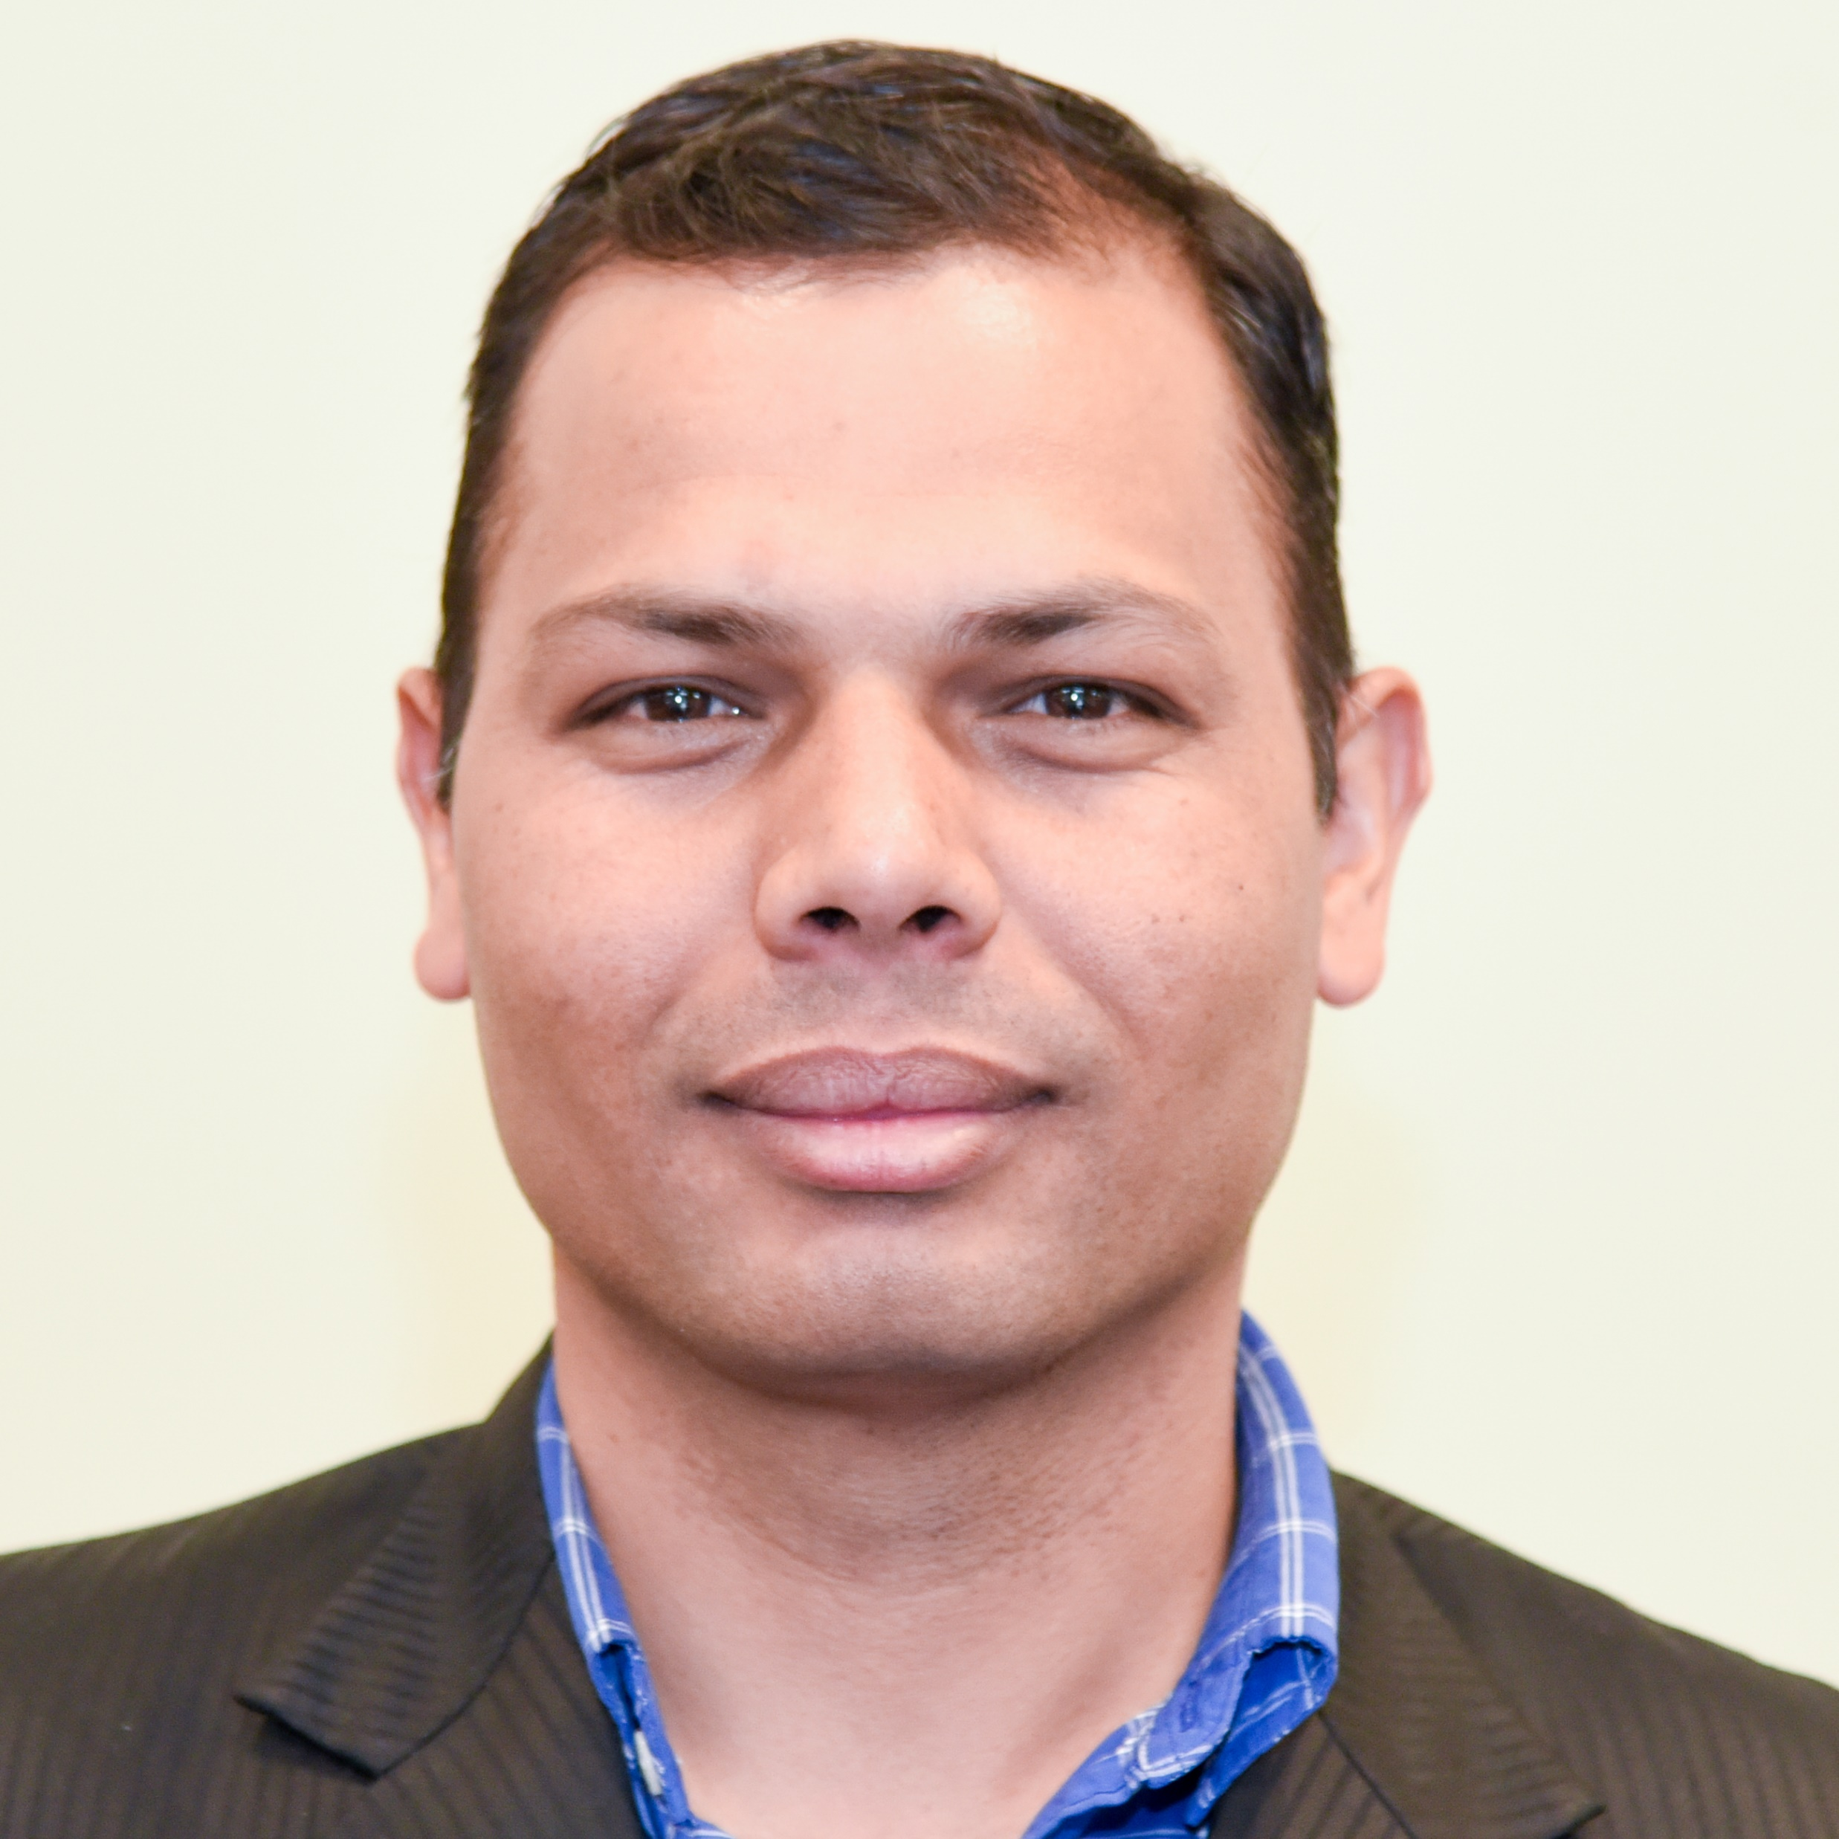
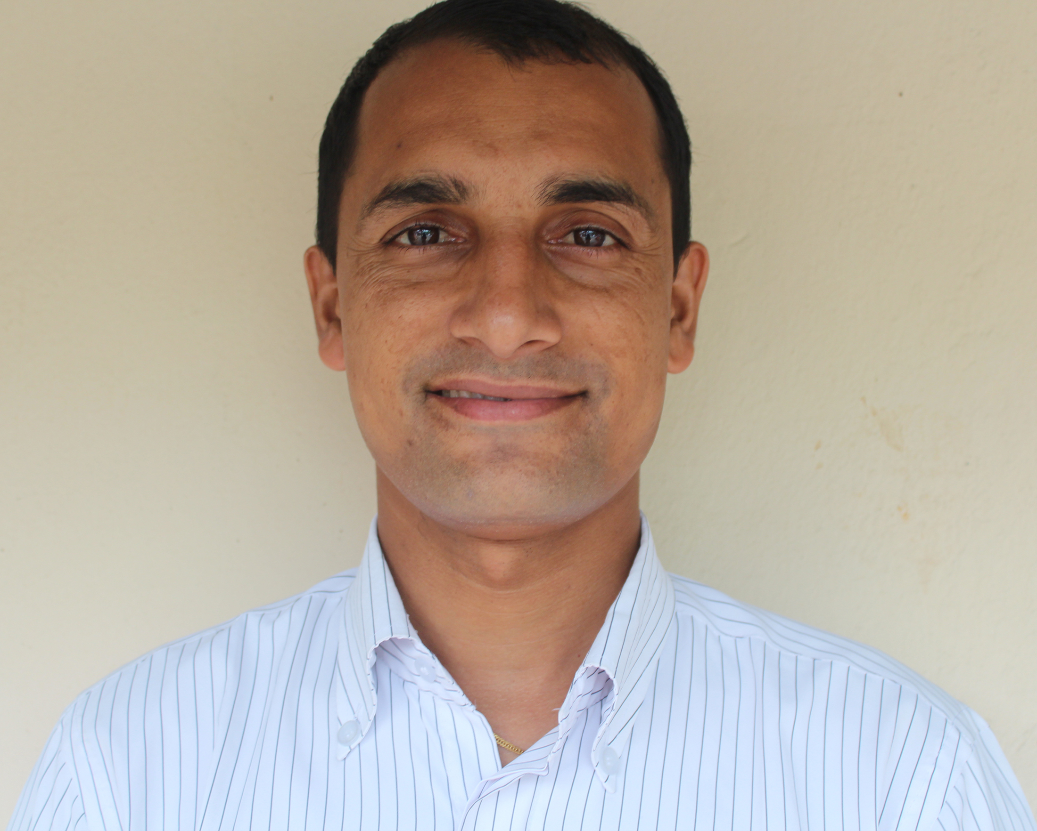
The name of the Himalayan peak is Mt. Nilgiri with 7061 Meters height.
Bishwa Raj Gautam, Program Specialist, Regional English Language Office (RELO), U.S. Embassy, Nepal.
With Baman Kumar Ghimire, Motherland Secondary School, Pokhara, Nepal

Slide 12
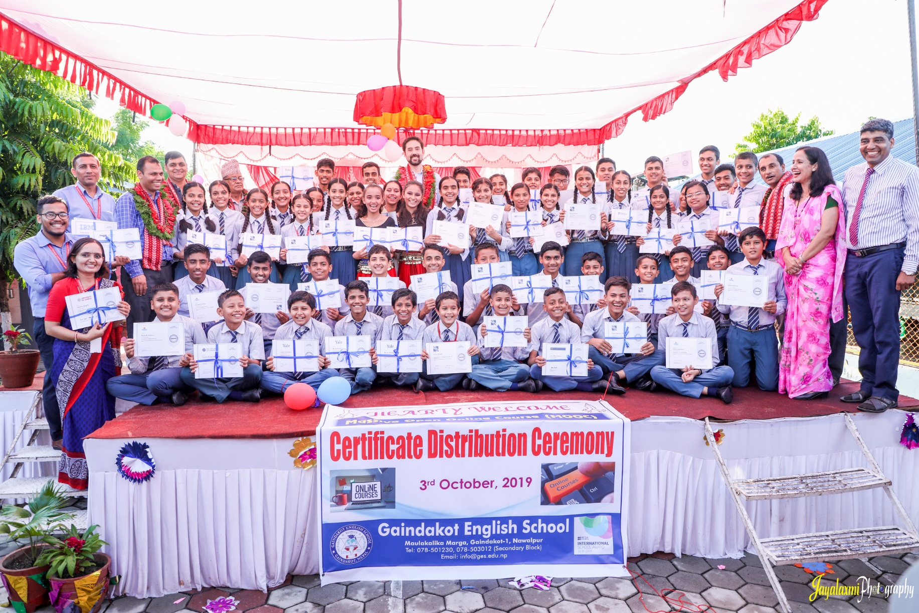
November 9, 2019 Greetings from Nepal, Baman Kumar Ghimire Teacher, Motherland Secondary School, Pokhara

Slide 13
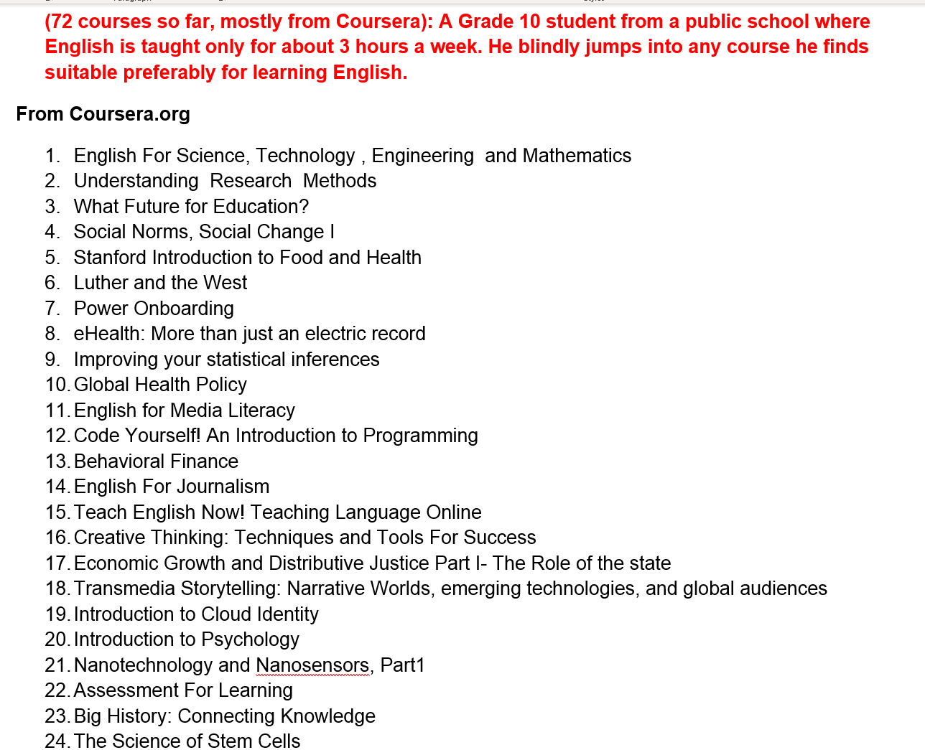
Participant #1 (boy, grade 10)

Slide 14
Participant #2 (girl, first MOOC age 10)

Slide 15
Participant #3 (teenage girl)

Slide 16
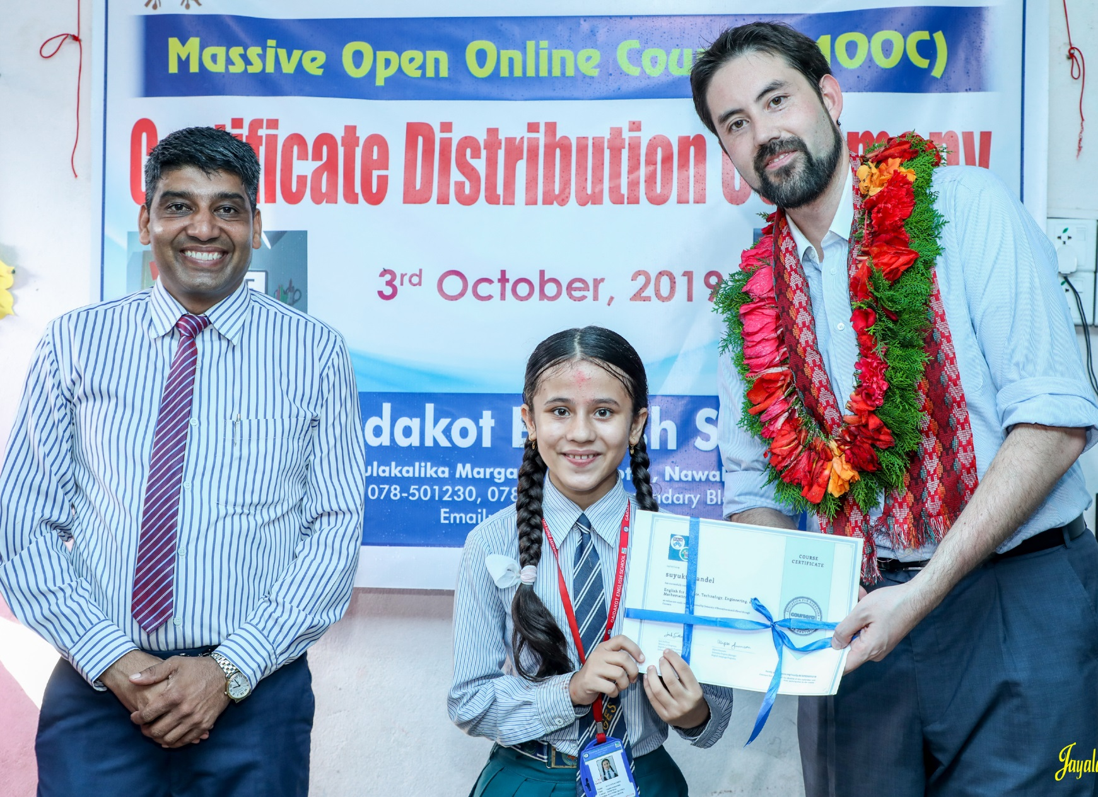
November 9, 2019 Chapter 9. Nepali High School Students in Massive Open Online Courses (MOOCs): Impressive Results and a Promising Future Baman Kumar Ghimire and Bishwa Raj Gautam Greetings from Nepal Baman Kumar Ghimire Teacher, Motherland Secondary School, Pokhara

Slide 17
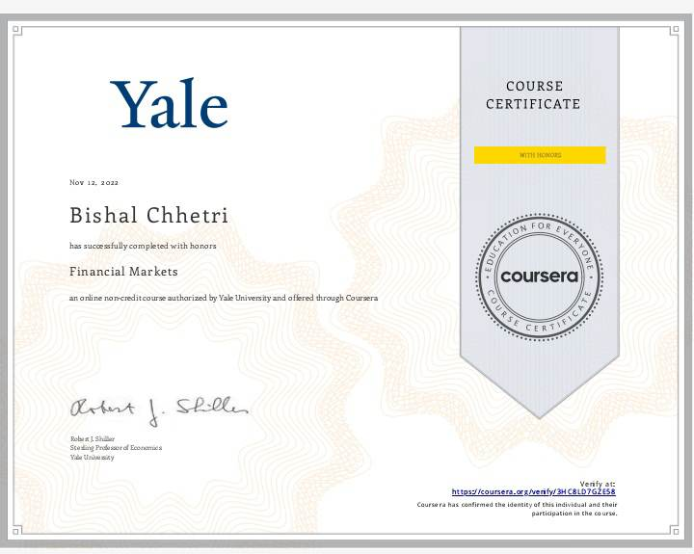
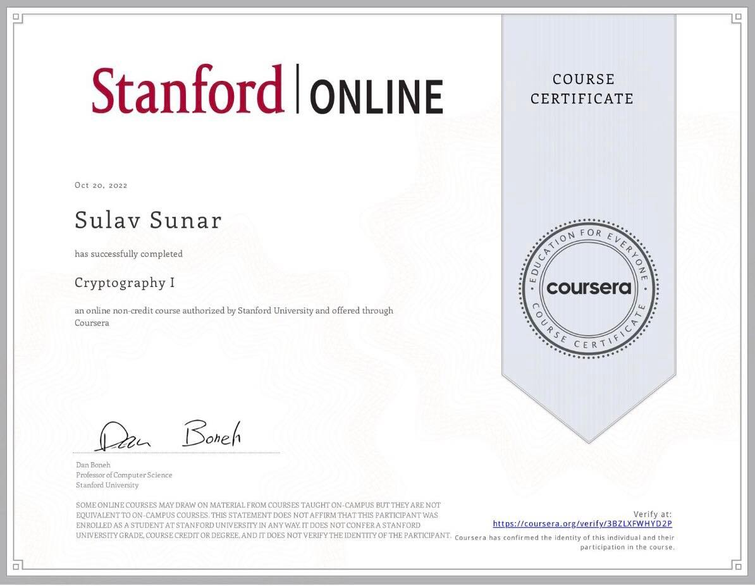
December 20, 2022 Baman Ghimire https://www.facebook.com/baman.ghimire.3

Slide 18
All Participants of the Study
Convenient sampling ​
Recruitment: contact teacher ​
Nepali students who took and completed at least one MOOC​.
Nepali teachers who used MOOCs in their teaching, and whose students took and completed MOOCs.

Slide 19
Data Collection Background
Student Interviews
Total #13
Semi-structured
7 female
6 male
Teacher Interviews
total #7
Semi-structured
4 female
3 male
Student Focus Groups
total #2
Semi-structured
total 8 students

Slide 20
Research Questions
Methods: Teacher’s Perspective
What scaffoldings and environmental cues were provided by teachers to support Nepali adolescent in enrolling and succeeding in MOOCs?
What are Nepali teachers' perspectives on using MOOCs as supplementary resources?

Slide 21
Participants
Participant | Job title | Years of using MOOCs | School Type | Number of Students Completed MOOCs
Teacher #1 | Science Teacher | 4 years | Private | 15-20
Teacher #2 | EFL Teacher | 7 years | Private | more than 20
Teacher #3 | EFL Teacher, Principal | 3 years | Private | more than 20
Teacher #4 | EFL Teacher | 1 year | Private | more than 20
Teacher #5 | EFL Teacher | 1 month | Public school; ACCESS | 2 completed
Teacher #6 | EFL Teacher | 1 month | Public school; ACCESS | 2 completes
Teacher #7 | EFL Teacher, Principal | 8-9 years | Private | more than 20

Slide 22
Identified Themes
Sources of support | parental; teacher's fading support; external support
Teacher roles | facilitators, guides, cheerleaders
Substantial gains | teachers learning from MOOCs, benefits, positive outcomes
Strategies & student initiatives | student mentors, intrinsic sources, incentives
Challenges & suggestions | engaging with courses, resources, design

Slide 23
RQ 1
Sources of support | parental; teacher's fading support; external support
“They did on their own pace but initially we guided them, initially we guided them and every week what we follow up them initially but later on they did by themselves.” (T#1, line-134-136)
“…the school has been promoting these kinds of activities, please, to let your children be with the computer. If they ask for, and it was really very difficult to convince the parents as well.” (T#3, line 390-396)

Slide 24
RQ 1
Strategies & student initiatives | student mentors, intrinsic sources, incentives
“Those students who just completed MOOC, they are really happy got excited here they are leading the group and they are sharing their experience.”(T#4, line 588-591)
“They have shown interest in coding, and they have started now they're running coding Club in school. And they mentor the junior those who did coding courses and now mentoring the juniors they're supporting the juniors.”(T#1, line 259-263)
“…they were quite interested, they showed their motivation in doing the courses, so we didn't have to push them. You know, they were like motivated internally…”(T#4, line 283-286)

Slide 25
“My life changed….(MOOCs) opened my eyes for a whole new field of learning.”
“I’m learning something not included in the regular (school).”
“Learning can never be stopped.”

Slide 26
Study #2:
Self-directed language learning in Duolingo

Slide 27
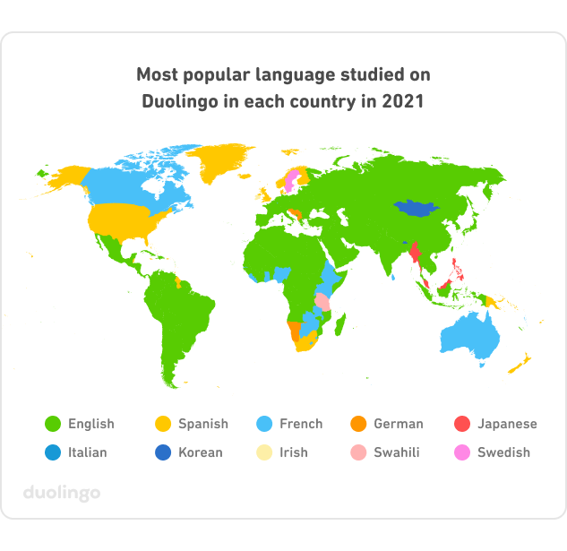
(Blanco, 2021)

Slide 28
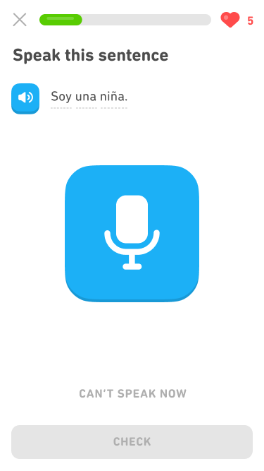
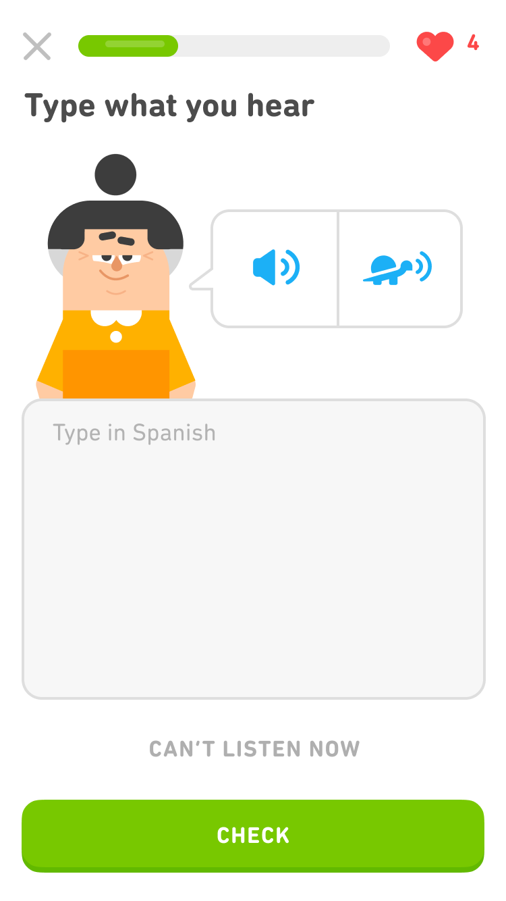
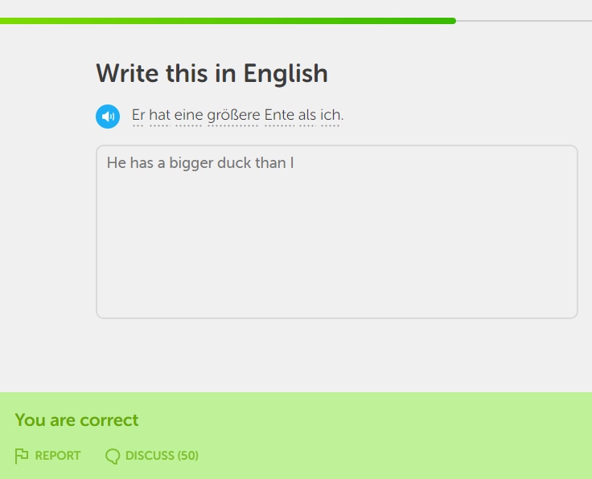
Platform Overview

Slide 29
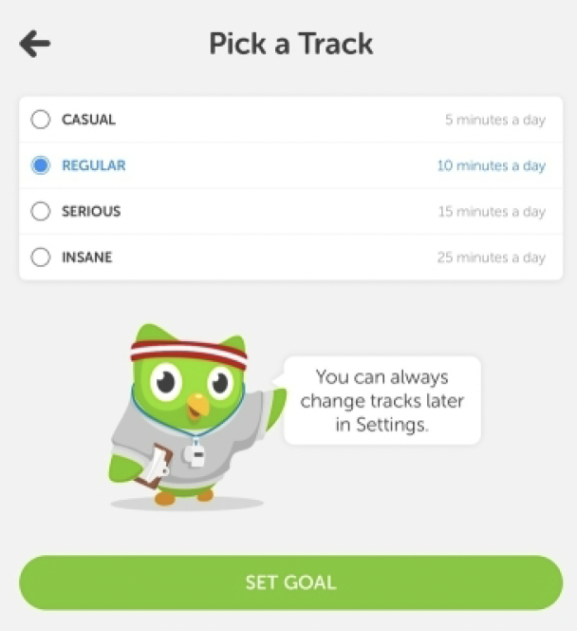
Goal Setting
Based on microlearning.
Is goal-oriented.
Range from 5 min/day to 20 min/day.
Flexibility to personalized.
Teachers may track students’ performance if use “Schools”
Notes:
Duolingo is based on the concept of microlearning, constructed with small learning units and short-term-focused learning activities that reach users through the day (Brebera, 2017). The daily study goal ranges from 5 min/day to 20 min/day, which can be easily completed on the mobile app whether when the learner is waiting in the checkout line at a grocery store or sitting on a bus to school. It provides the learner great flexibility to personalize their learning process that matches their learning goal, learning capability, time limitations, etc. More recently, the context for Duolingo use has extended to a formal classroom setting. Teachers can incorporate Duolingo into their individual lesson plan and track students’ performance through Duolingo (Gigaom: Language-learning app, 2015).

Slide 30
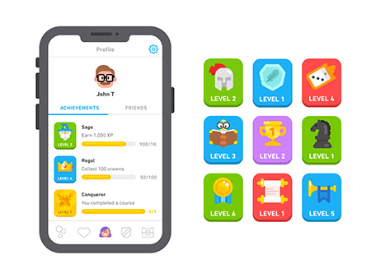
Gamification
Duolingo applies gameful learning to keep the learner motivated and consistently engaged in a positive and casual learning environment.
Its learning process is structured as a learning game that has game features, such as reward, badges, and leader-board, to allow users to learn as playing.
Notes:
Duolingo applies gameful learning to keep the learner motivated and consistently engaged in a positive and casual learning environment. Its learning process is structured as a learning game that has game features, such as reward, badges, and leader-board, to allow users to learn as playing.
. Gems and lingots are used as rewards, functioning as virtual currency that learners gain by completing lessons or skills. Leaderboards provide opportunities for learners to compete with other learners, forming social connections and interactions between online users. The level-system provides a way to track a learner’s learning process. When users learn on Duolingo, they earn experience points (XP), which determine a user’s language level. Badges are important components of Duolingo design, which display user’s achievements in the learning process (Huynh, Zuo, & Ilda, 2016).

Slide 31
Research Questions
How do Duolingo learners self-manage their learning goals, time, resources, and support?
What strategies are employed by Duolingo learners to overcome challenges and frustrations related to learning foreign languages with Duolingo?
What motivating factors underpin the decisions of learners to learn a foreign language with Duolingo?
How does the design and delivery of Duolingo foster learners to be self-directed learners?

Slide 32
Context of the Study
Learning with technology (e.g., Duolingo) in an out-of-classroom context is often challenged by the absence of instructors and lack of guidance.
Therefore, it demands a much higher level of self-directed learning (SDL) ability for the learners to be successful.
White (1995) suggests that learners need to have strong independence, autonomy, and control to self-manage learning and make their own decisions in distance language learning.

Slide 33
Garrison’s (1997) Framework of SDL
Self-management is the task control ability that is associated with external activities, such as time, resources, and goal management.
Self-monitoring is the cognitive and metacognitive process of establishing learning strategies and learning paces.
Motivation can initiate and sustain learning efforts towards cognitive goals (Garrison, 1997).

Slide 34
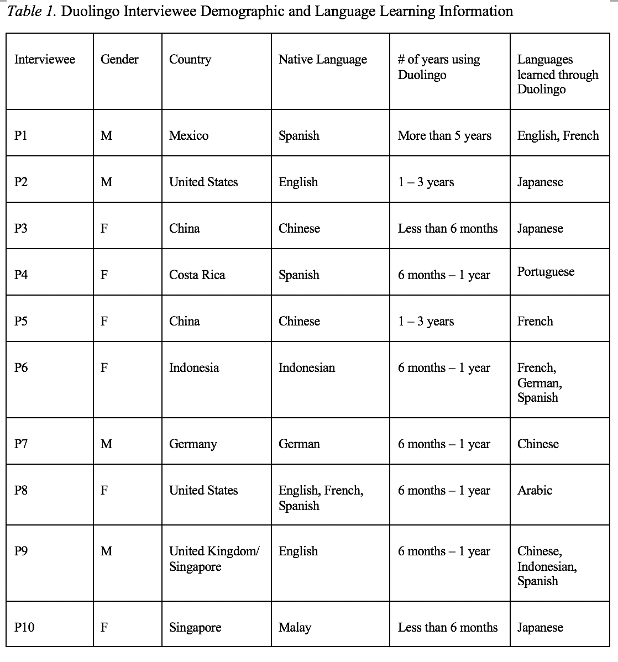
Study Design
The 10 research participants represented a wide range of age and ethnic groups.
Participants of this study were screened and identified through the previous survey that was distributed through the Duolingo forum, an online language community using Discord, as well as through postings on Facebook pages, emails, and WeChat groups. The interviewees’ demographics are listed in Table 1.

Slide 35
Goal Management
Goals specify the amount of effort required to succeed and the self-satisfaction anticipated (Schunk, 1990).
Goal setting leads to task assessment and considerations of the appropriate learning strategies from a metacognitive perspective (Ridley et al., 1992).
In MALL, timescales influence the dynamic nature of the learning ecology and so influence the learning goals.
Setting realistic and achievable goals is more likely to lead to a successful SDL.
Notes:
A goal is something that an individual is intentionally attempting to achieve, whereas goal-setting refers to establishing a goal and adjusting it as needed. (Bandura 1986, 1988; Lunenburg, 2011). Goals with specific standards can enhance learning because they specify the amount of effort required to succeed and the self-satisfaction anticipated (Schunk, 1990). Further, goal setting leads to task assessment and considerations of the appropriate learning strategies from a metacognitive perspective (Ridley et al., 1992). In MALL, timescales influence the dynamic nature of the learning ecology and so influence the learning goals. In effect, learners lose motivation when there are not enough accomplishments in a reasonable time towards the learning goals (Isbell et al., 2017). Accordingly, setting realistic and achievable goals is more likely to lead to a successful SDL.

Slide 36
Self-management
Specific goals can lead to improved performance, and learners' learning goals can be self-initiated or technology-defined.
Distractions from daily living may make time management difficult, both physically and psychologically.
A single MALL tool like Duolingo is not enough to master a language in all dimensions; as a result, they seek and manage other resources to complement their learning.
Both human and material resources can be used to complement Duolingo learning.

Slide 37
Self-management
“I think my biggest suggestion, as I mentioned a little earlier, is just don't use Duolingo as your only resource. Because particularly nowadays or for any language, there are so many other resources out there and there are certain things that each of them does better or worse than the others.”
Interviewee #2
“My opinion on that is since Duolingo is a non-human system, I think to have a human tutor at the end of a section would actually be a nice relief, a nice change of pace.”
Interviewee #9

Slide 38
Time Management
The majority of interviewees (n=8) stated that daily life activities are a constraint to their time management.
The significant obstacle is due to work demands, which have an impact on learners’ physical and emotional ability to complete their learning goals on a consistent basis.
“Because my schedule can be busy. Sometimes, especially during the exam
period in schools, I really have no time. I'm just busy completing my markings.”
Interviewee #10
Notes:
The majority of interviewees (n=8) stated that daily life activities are a constraint to their time management. The significant obstacles that interviewees face relate to time constraints for studying a language and the limited free time due to work demands, both of which have an impact on their physical and emotional ability to complete their learning goals on a consistent basis. P10, for example, stated, “Because my schedule can be busy. Sometimes, especially during the exam period in schools, I really have no time. I'm just busy completing my markings.”
Despite the fact that learners face a variety of physical and physiological challenges when it comes to time management, eight interviewees (n=8) either use technology-assisted time management or a self-developed time management system to overcome time constraints. To cope with the problem, four of them (n=4) even use a combination of technology and individual planning systems to facilitate time management. Six interviewees (n=6) reported that Duolingo notifications via phone push and emails are effective at reminding them to devote time to language learning. As P7 from Germany noted, “Because I wa

Slide 39
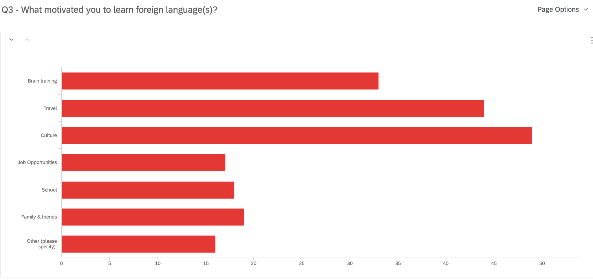
Finding: Motivation
Language learners are mostly driven by intrinsic motivators that relates to culture, travel, and brain training.
Q3. What motivated you to learn a foreign language?
Brain Training
Travel
Culture
Job Opportunities
School
Family and Friends
Other

Slide 40
Finding: Motivation
The idea is that I would really like to go to Europe someday. (P5)
So in the last month, the idea came up of going from Hamburg with the train to Moscow and then transit to the trains. And then make some stops in Siberia and then end at Beijing and enjoy the visit in China. (P7)
But for people, who are more like my mother, when she talks about it, she is just like, “oh, well, I'm learning it. I don't expect to be conversational and I'm just learning it to keep my mind sharp.” (P8)

Slide 41
Finding: Self-monitoring
Most of the learners highly rely on the technology to support monitoring, such as reinforcing micro learning habits without extra effort and maintaining learning process by receiving frequent practice reminders and notifications.
And after you have chosen the wrong one and at the end of this lesson, the system will provide you with a repeated choice to make you make a choice again. (P3)
And I don't actually see much about self-monitoring in the process. Because they have a clear structure, clear modules. Basically, you just tap in and go with it. (P5)
I think when they come to self-monitoring, it is really lacking, because there's no little test that I can take, and “okay, I have progressed to this level.” (P10)

Slide 42
Study #3 MOOCs Instructional Design to Facilitate Participants’ Self-directed Learning

Slide 43
Key Terms
Self-directed learning (SDL) (Garrison, 1997)
(1) self-management
(2) self-monitoring
(3) motivation
Notes:
Garrison’s model: 3 inter-related part.

Slide 44
Research Background
Learners need self-directed learning skills and strategies to be successful in MOOCs (Halawa, Greene, & Mitchell, 2014; Littlejohn & Milligan, 2016), as there is a lack of personalized interaction with teachers.
Self-directness of a learner might vary in different learning environments which means that the learners could be more self-directed in one learning environment than another (Hiemstra, 1994).

Slide 45
Research Purpose
The purpose is to inform instructors or instructional designers and MOOC providers of the current practices of designing MOOCs to facilitate learners’ SDL.

Slide 46
Research Design
Explanatory sequential mixed methods design (Creswell & Clark, 2017)
Pilot survey with 48 instructors
Survey
198 instructors
Review 22 MOOCs of interviewees
Interview 22 instructors
Review 22 MOOCs of interviewees
Pilot interview with 4 instructors

Slide 47
Data Collections
Survey:
Volunteer sampling (Creswell & Clark, 2017)
198 instructors responded to the survey (10% response rate)
Interview:
Homogeneous purposeful sampling (Creswell & Clark, 2017; Patton, 2002)
Maximal variation sampling (Creswell & Clark, 2017)
22 interviewees
MOOC review:
Reviewed 22 interviewees’ MOOCs

Slide 48
Pseudonym | Country | Subject area | Platform | Gender | No. of O/B | No. of M | Mode of the M
Lucas | US | Social science | edX | M | 0 | 1 | I without T
Branden | US | Education | Udacity | M | 0 | 5 or more | Self-paced
Logan | US | Literacy and Language | Coursera | M | 5 or more | 5 or more | I with T
Emma | US | Literacy and Language | Coursera | F | 2 | 1 | Self-paced
Jason | US | Science | edX | M | 1 | 1 | I with T
Jackson | US | Medicine and health | Coursera | M | 5 or more | 1 | Self-paced
Samuel | US | Education | FutureLearn | M | 4 | 3 | Self-paced
Hannah | US | Education | Blackboard | F | 5 or more | 1 | I with T
Ashley | US | Education | EdX | F | 0 | 5 or more | I with T
Andrew | UK | Art | FutureLearn | M | 0 | 3 | I with T
Emily | UK | Medicine and health | FutureLearn | F | 2 | 2 | I with T
Aiden | UK | Social science | FutureLearn | M | 0 | 1 | Self-paced
Henry | UK | Social science | FutureLearn | M | 0 | 1 | Self-paced
Joseph | UK | Medicine and health | FutureLearn | M | 1 | 1 | Self-paced
Joshua | UK | Literacy and language | FutureLearn | M | 2 | 2 | I with T
Mason | Australia | Education | Coursera | M | 5 or more | 1 | I with T
Ethan | Australia | Business | Coursera | M | 3 | 1 | I without T
Ben | Australia | Social science | edX | M | 1 | 1 | I with T
Paul | France | Computer Science | Coursera | M | 1 | 1 | I with T
Fernando | Belgium | Research methods | Blackboard | M | 5 or more | 3 | I with T
Jacob | Netherland | Science | Coursera | M | 0 | 1 | I with T
Dylan | Israel | Science | Coursera | M | 5 or more | 3 | I without T
Data Collections
Interview:

Slide 49
Study #4
MOOC Learners and SDL
Zhu, M., Bonk, C. J., & Berri, S. (2022). Fostering self-directed learning in MOOCs: Motivation, learning strategies, and instruction. Online Learning

Slide 50
Research Questions
What motivated individuals to enroll in MOOCs?
What were the learning strategies that helped learners’ SDL in MOOCs?
What were the design and instructional elements of MOOCs that facilitated learners’ SDL?

Slide 51
Study #4
MOOC Learners and SDL
Zhu, M., Bonk, C. J., & Berri, S. (2022). Fostering self-directed learning in MOOCs: Motivation, learning strategies, and instruction. Online Learning

Slide 52
RQ1. Intrinsic Motivation
Jacob, a retired management consultant from the US, expressed his motive behind enrolling in MOOCs as strictly intrinsic, “there's no reward. I'm retired. It's really just [that] I get very interested in topics. I realize holes in my knowledge and try to fill the holes.”

Slide 53
RQ1. Extrinsic Motivation
Besides educational purposes, some participants enrolled in MOOCs to help with their career development. For example, Sarah, who received her Ph.D. degree and was in between jobs at the time, selected topics such as anatomy, MatLab software, oncology, biology, and neuroscience. Sarah explained the purpose for taking these types of MOOCs was:
To acquire and improve my knowledge as a medical physicist…I consider my resume when selecting MOOC. I choose courses related to my professional field to add them to my curriculum; otherwise, there would be a period without being in contact with my profession.

Slide 54
RQ2. Learning Strategies
RQ2: What were the Learning Strategies that Helped Learners’ SDL in MOOCs?
Dan considered the progress bar to be a good indication of his progress, and it also created a healthy competition among the learners. Seeing where he was at in the course compared to the other learners gave him a push. He stated,
“All the progress bar with milestones, with a small quiz that doesn't count for the evaluation, but they're good for you to check if I'm really learning. And, for example, I like when you have these kinds of nice competition[s], right. Everyone starts a MOOC at the same time, but you see that these weeks you progress faster than other members in the MOOC.”

Slide 55
Top 10 Strategies to Facilitate SDL in MOOCs
Helping students set their own learning goals.
Building learning community.
Offering immediate feedback.
Embedding quizzes for self-assessment.
Providing progress indicators.
Providing reflection questions.
Designing short learning units.
Providing flexible timelines.
Highlighting estimated time frames.
Making available optional learning materials.

Slide 56
15 Guidelines and Strategies for Fostering and Enhancing Self-Directed Online Learning Zhu, M., & Bonk, C. J. (2022). Guidelines and strategies for fostering and enhancing self-directed online learning. Open Learning: The Journal of Open, Distance and e-Learning. DOI: https://doi.org/10.1080/02680513.2022.2141105
15 guidelines for promoting SDL in MOOCs and similar large scale open education environments:
(1) helping students set their own learning goals,
(2) encouraging learners to make plans,
(3) offering flexible timelines,
(4) highlighting estimated time frames,
(5) embedding tasks and activities to form a learning community,
(6) supplying timely and constructive feedback,
(7) embedding quizzes for self-assessment,
(8) crafting visuals showing work progress and tasks completed,
(9) providing reflection questions,
(10) designing time-sensitive learning units,
(11) making available optional learning materials and self-selection options,
(12) creating a structured learning environment, including weekly overviews,
(13) making sure that lectures are recorded with captions added,
(14) inserting application exercises for putting the course material into practice, and
(15) using gamification to support SDL.

Slide 57
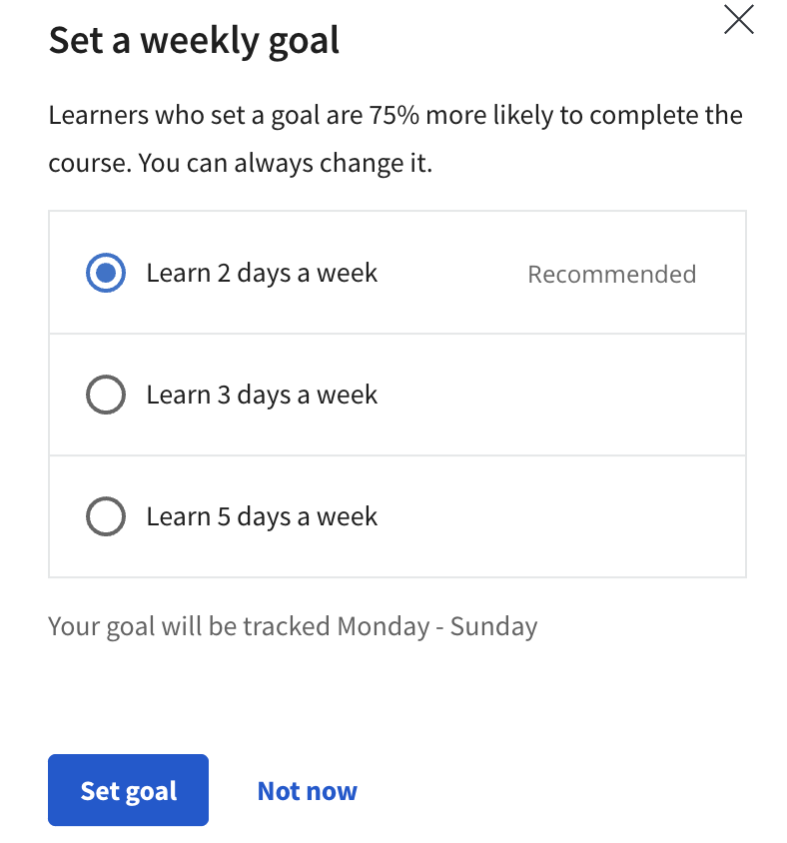
#1. Helping students set their own learning goals

Slide 58
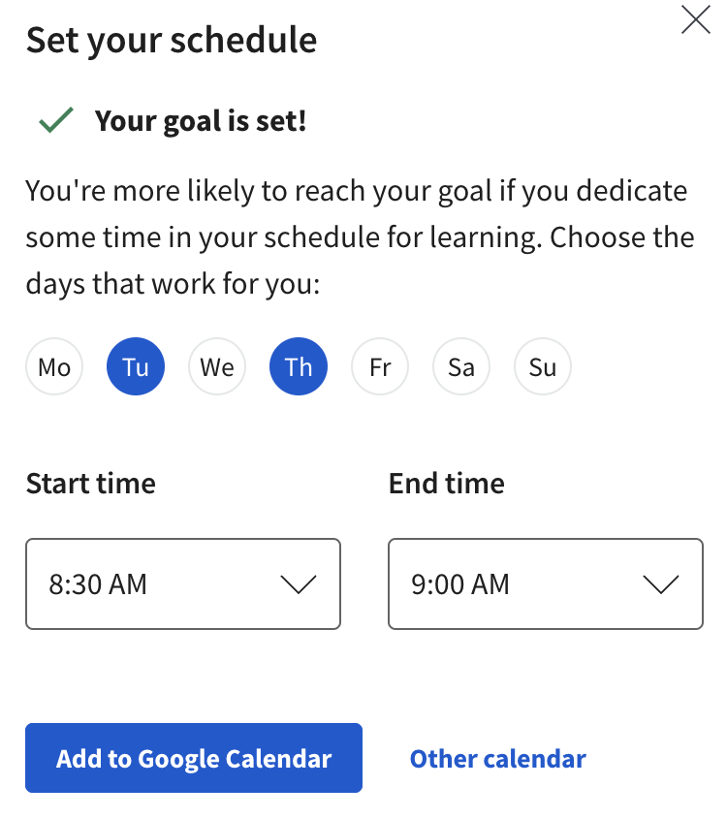
#2. Encouraging learners to make plans

Slide 59
#3. Offering flexible timelines

Slide 60
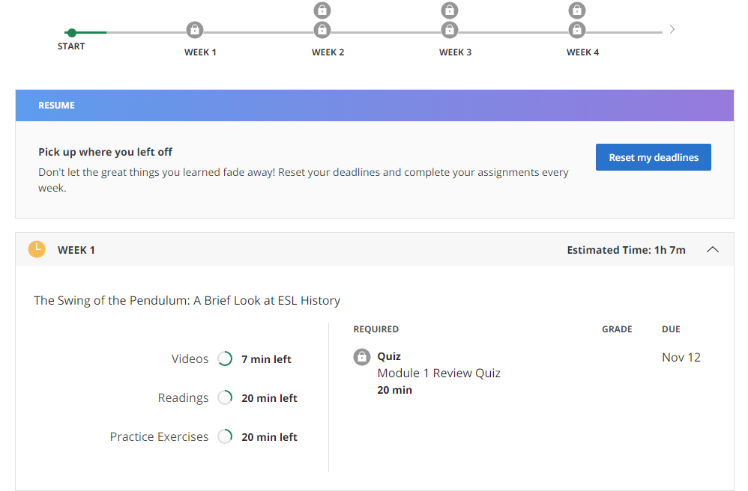
#4. Highlighting estimated time frames

Slide 61
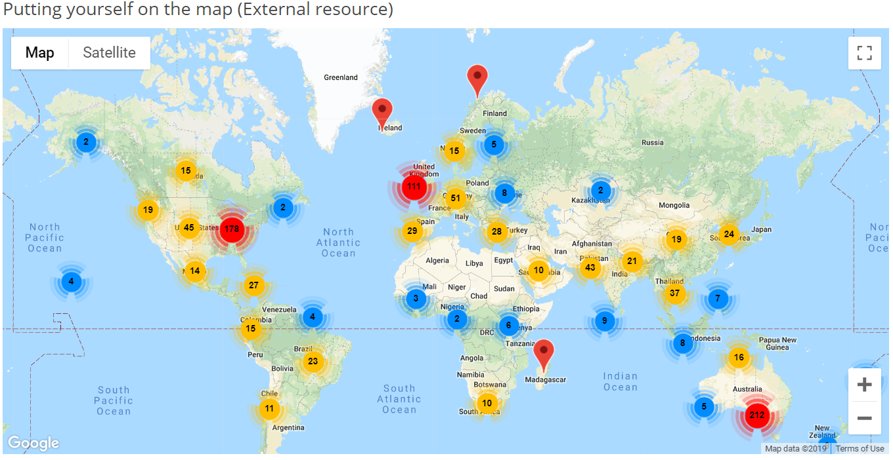
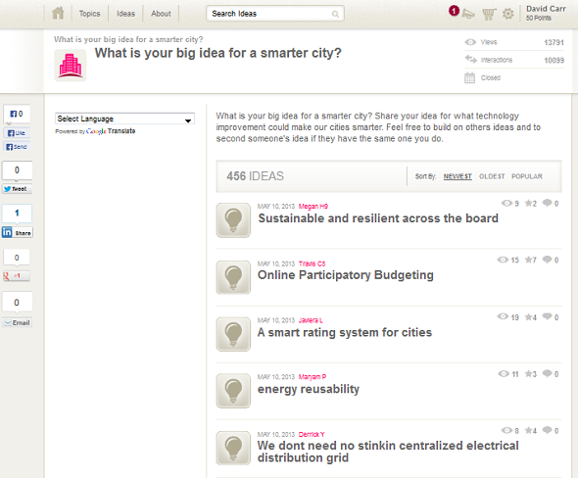
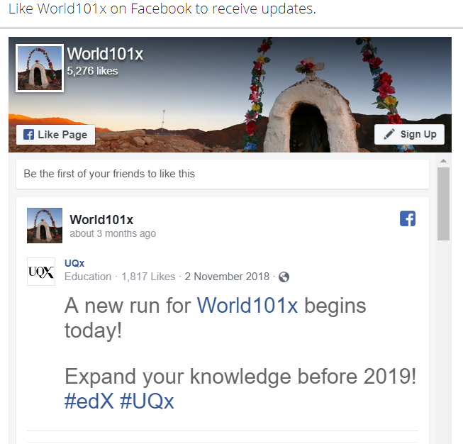
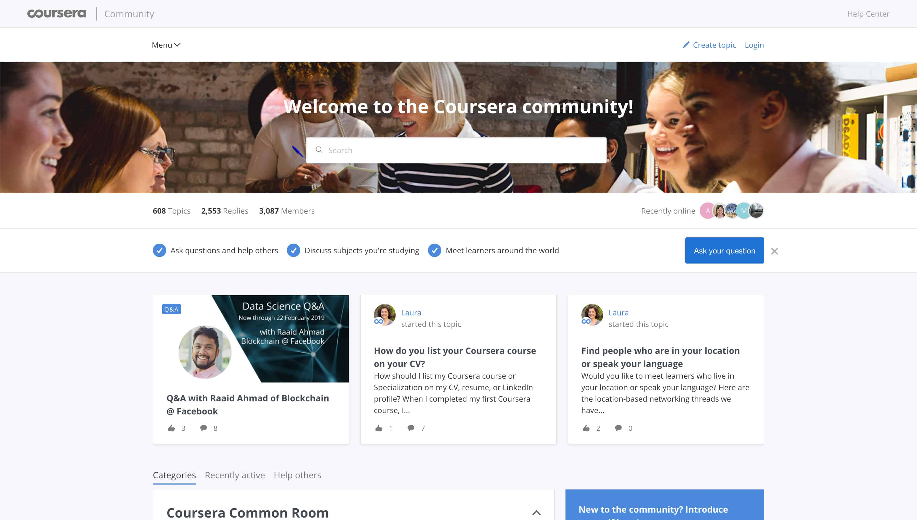
#5. Embedding tasks and activities to form a learning community

Slide 62
#6. Supplying timely and constructive feedback

Slide 63
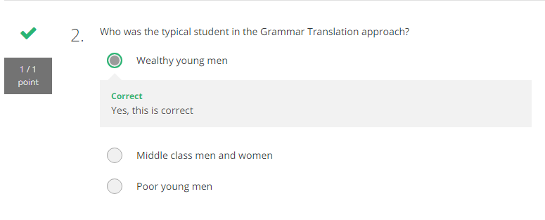
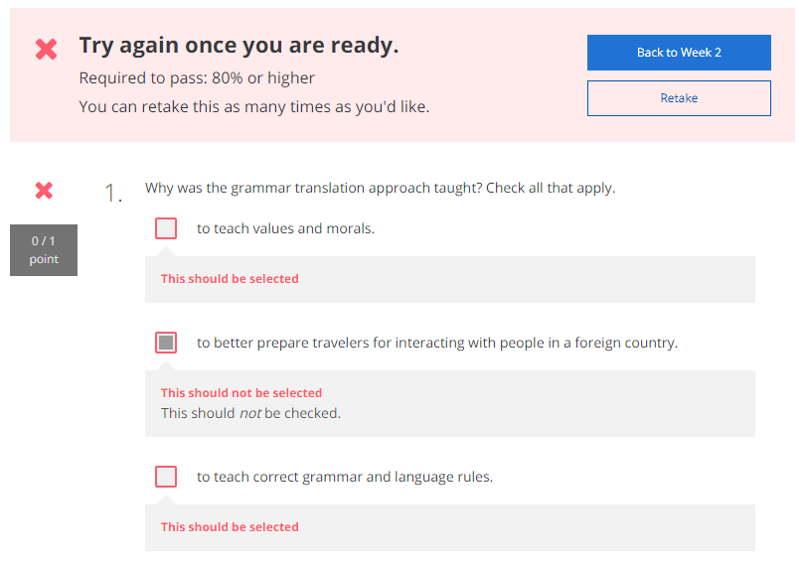
#7. Embedding quizzes for self-assessment

Slide 64
#8. Crafting visuals showing work progress and tasks completed

Slide 65
#9. Providing reflection questions

Slide 66
#10. Designing time-sensitive learning units

Slide 67
#11. Making available optional learning materials and self-selection options

Slide 68
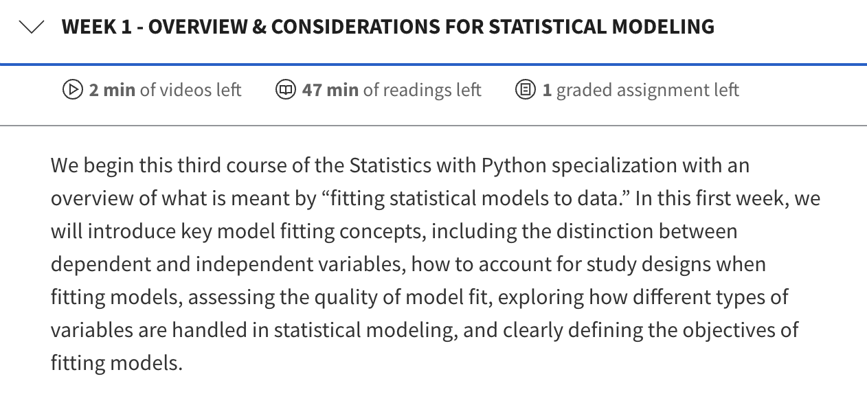
#12. Creating a structured learning environment, including weekly overviews

Slide 69
#13. Making sure that lectures are recorded with captions added

Slide 70
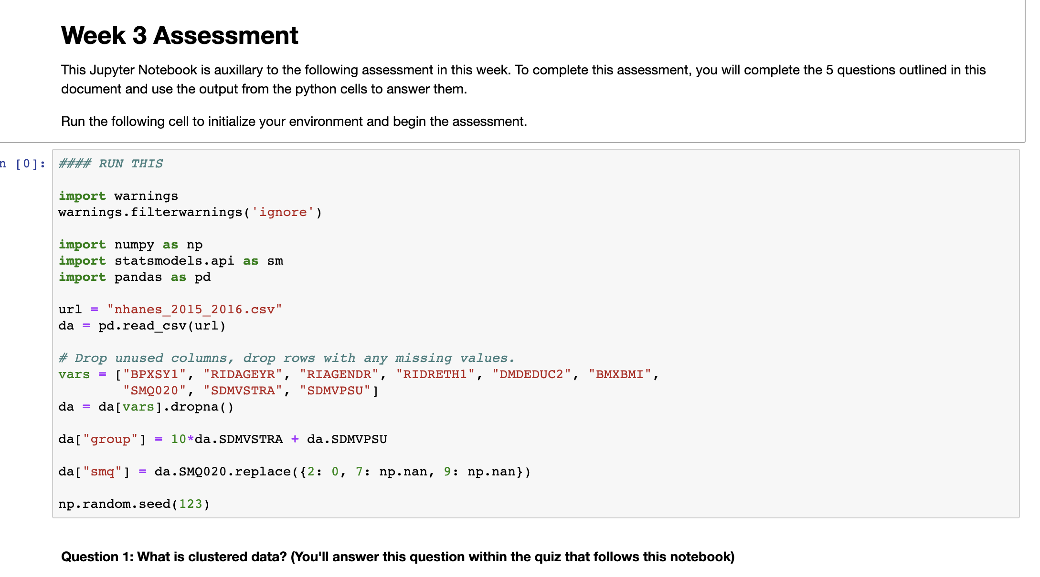
#14. Inserting application exercises for putting the course material into practice

Slide 71
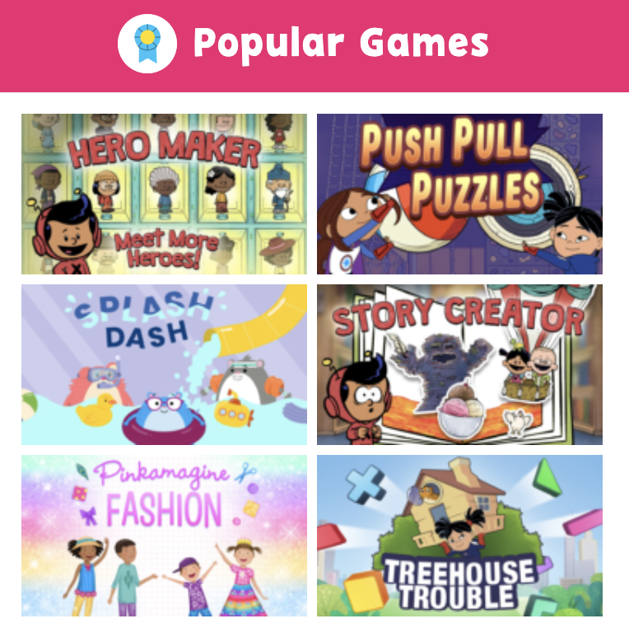
#15. Using gamification to support SDL

Slide 72
Zhu, M., & Bonk, C. J. (2022). Guidelines and strategies for fostering and enhancing self-directed online learning. Open Learning: The Journal of Open, Distance and e-Learning. DOI: https://doi.org/10.1080/02680513.2022.2141105

Slide 73
Thank You! Q&A
Curtis J. Bonk
Indiana University
cjbonk@indiana.edu
http://curtbonk.com/

