Slide 1
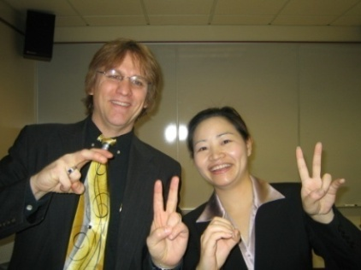
Where Are You R2D2?: Addressing Diverse Learner Needs with the Read, Reflect, Display, and Do Model
Curtis J. Bonk, Professor, Indiana University
cjbonk@indiana.edu
http://mypage.iu.edu/~cjbonk/

Slide 2
This Generation of Students

Slide 3
Learning is Resource Rich March 22, 2015 Madagascar marvel: Divers find fossils of extinct giant lemurs Daisy Carrington, for CNN, March 22, 2015 http://www.cnn.com/2015/03/19/africa/underwater-fossil-lemur-graveyard-madagascar/index.html

Slide 4
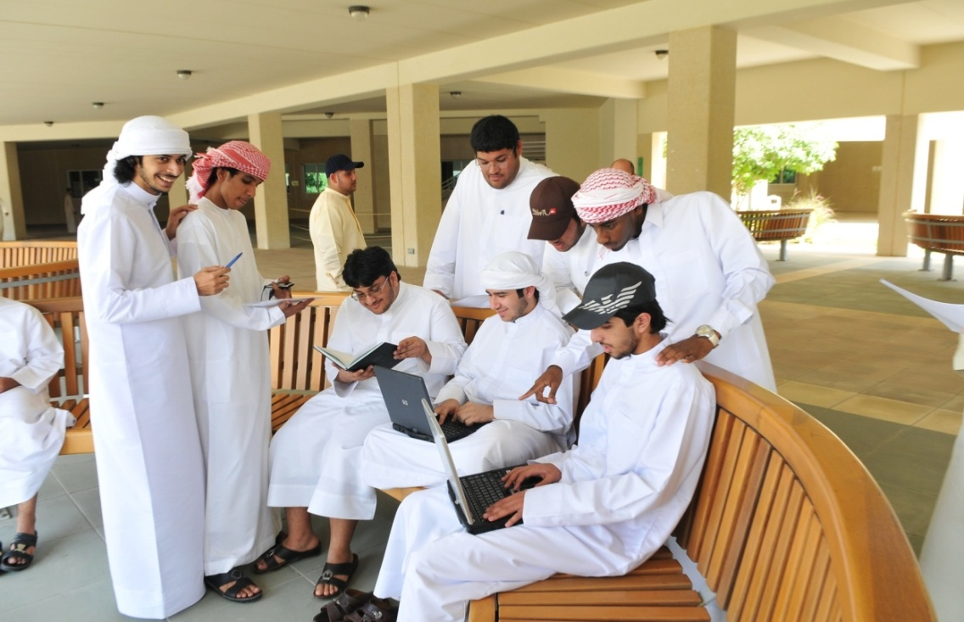
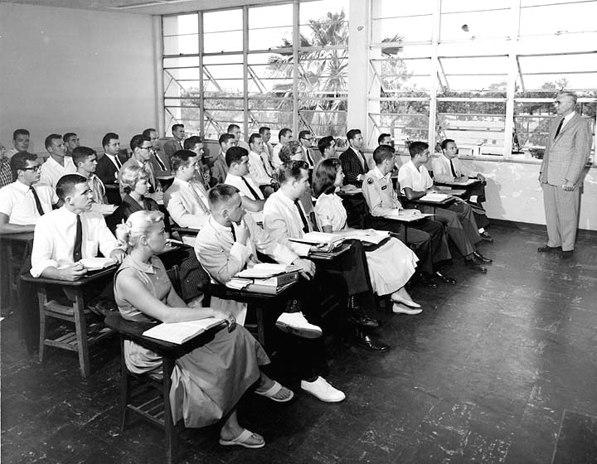
What about the Instructor in the Open World?

Slide 5
From Instructor as Credit Manager

Slide 6
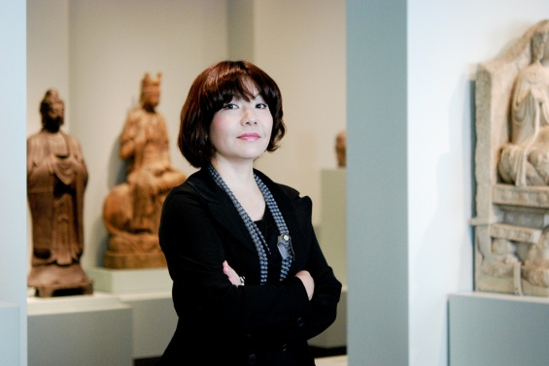
To Instructor as Curator and Concierge

Slide 7
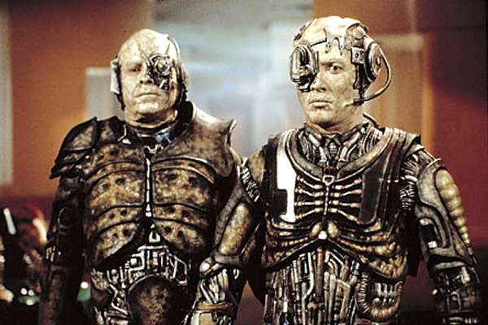
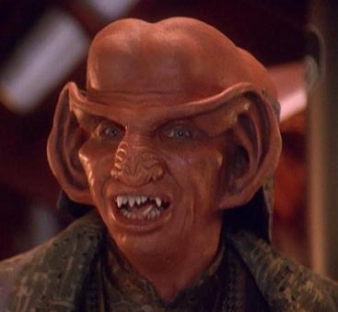
Question: How can technology address diverse learner needs?

Slide 8
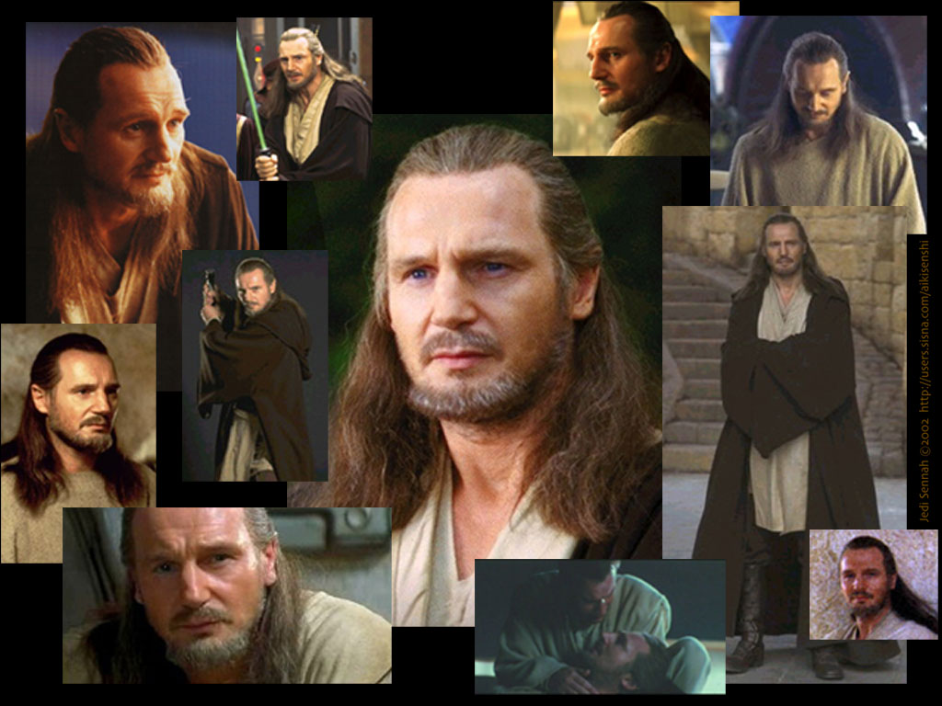
Addressing Learning Styles

Slide 9
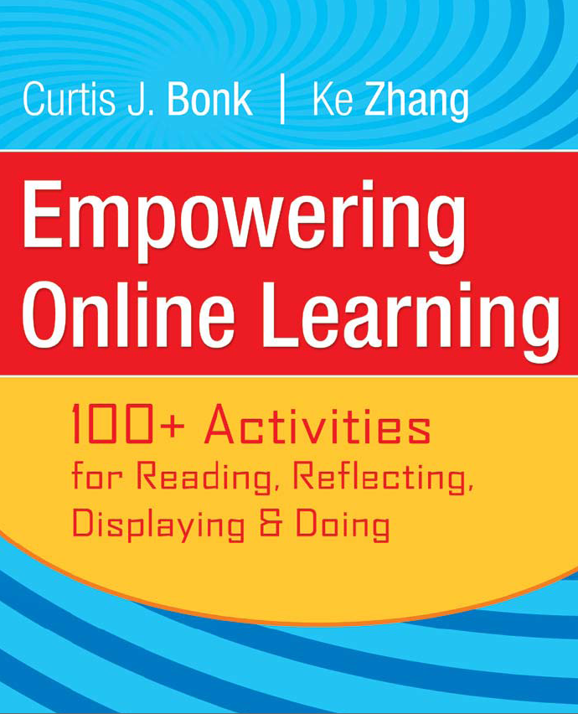
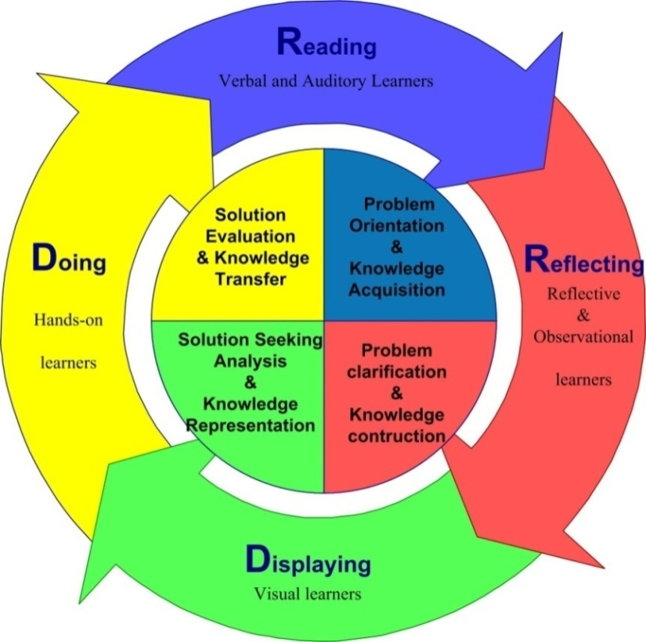
Framework #1: The R2D2 Model

Slide 10
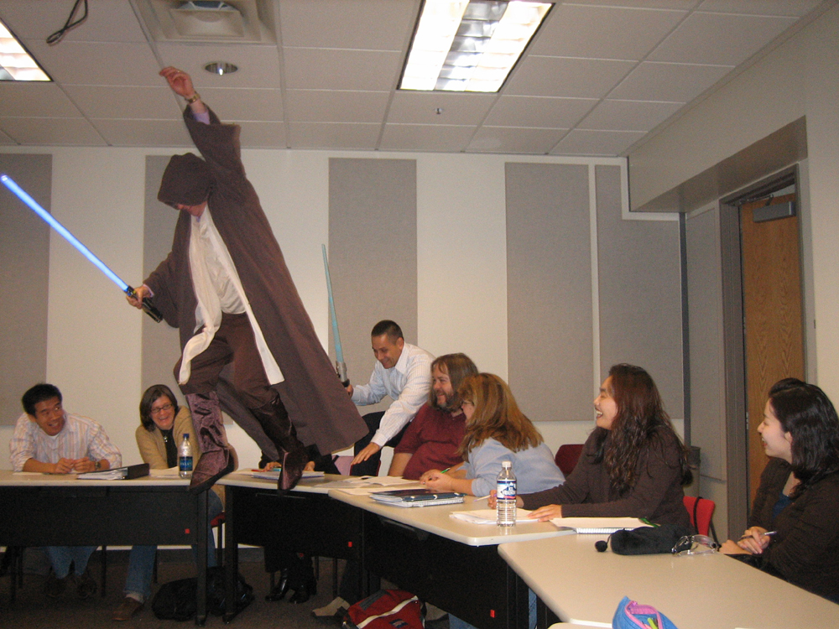

Slide 11
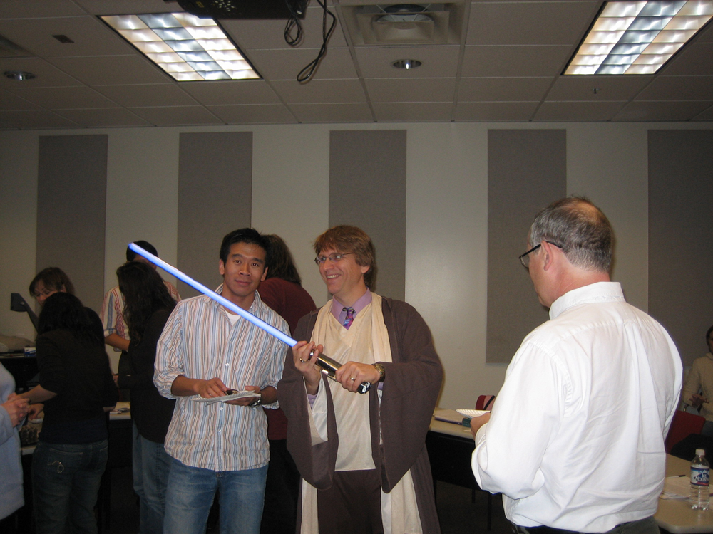

Slide 12
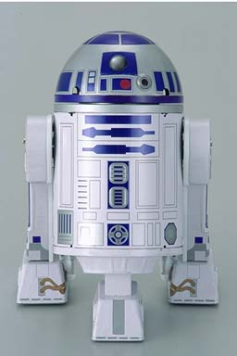
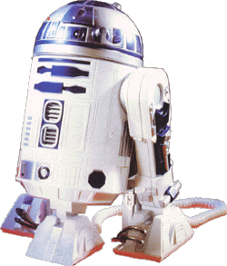
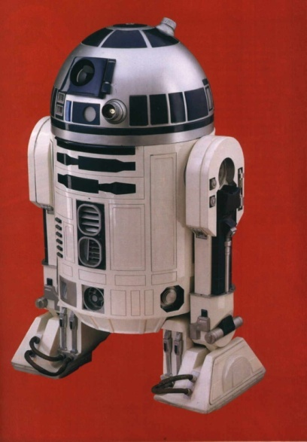
The R2D2 Method
Read (Auditory and Verbal Learners)
Reflect (Reflective Learners)
Display (Visual Learners)
Do (Tactile, Kinesthetic, Exploratory Learners)

Slide 13
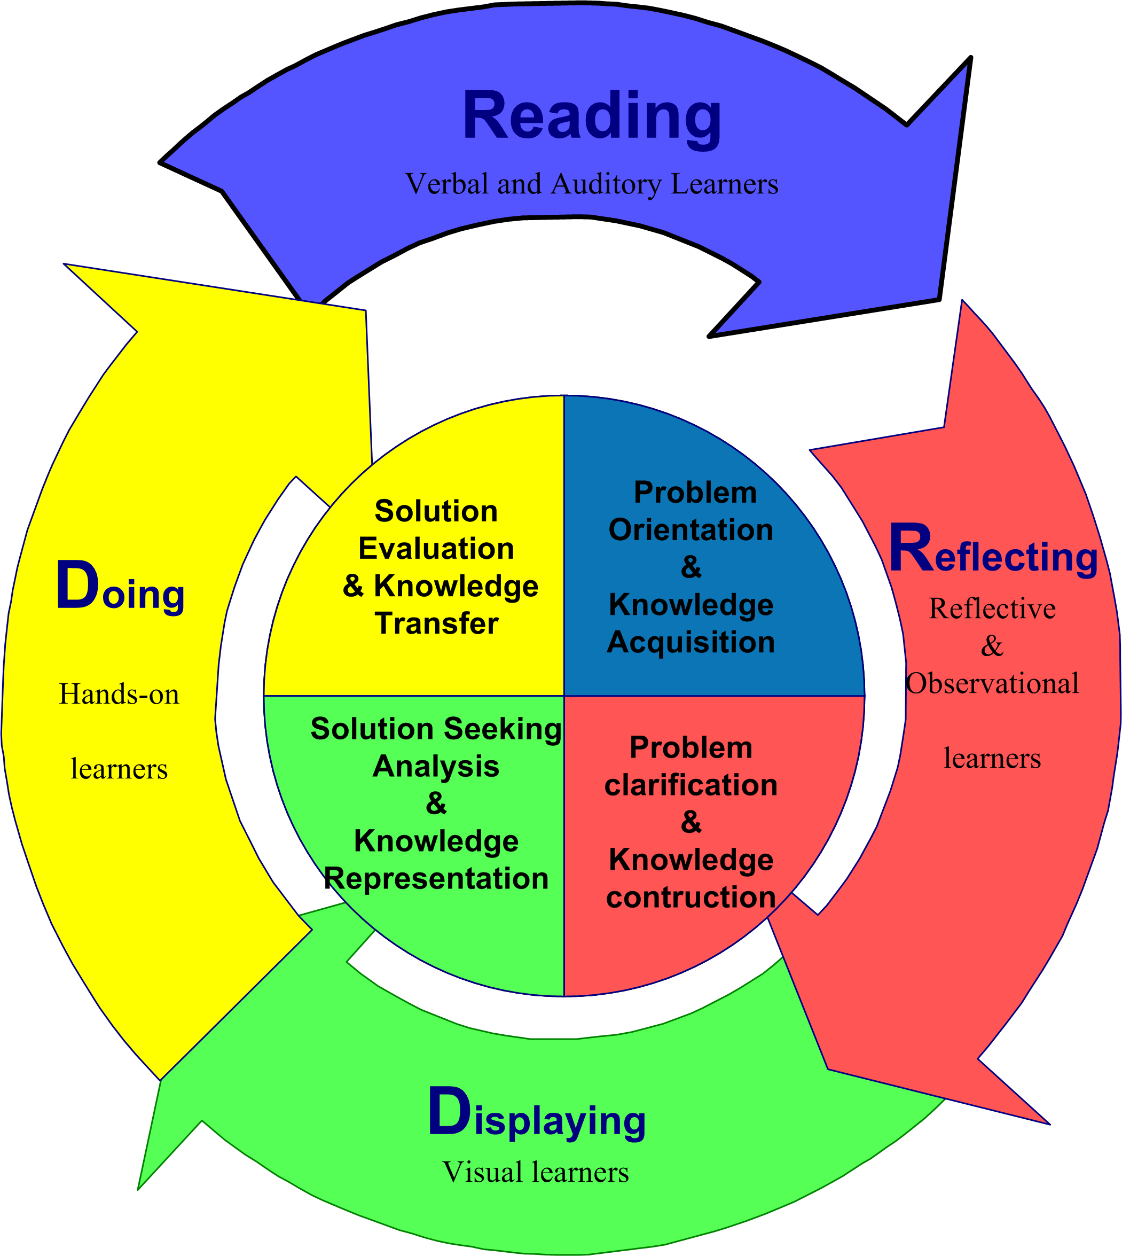
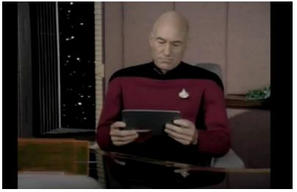
1. Auditory or Verbal Learners
Auditory and verbal learners prefer words, spoken or written explanations.

Slide 14
Read 1a. Collect and Listen to Interactive Stories (e.g., Meograph: http://www.meograph.com/)

Slide 15
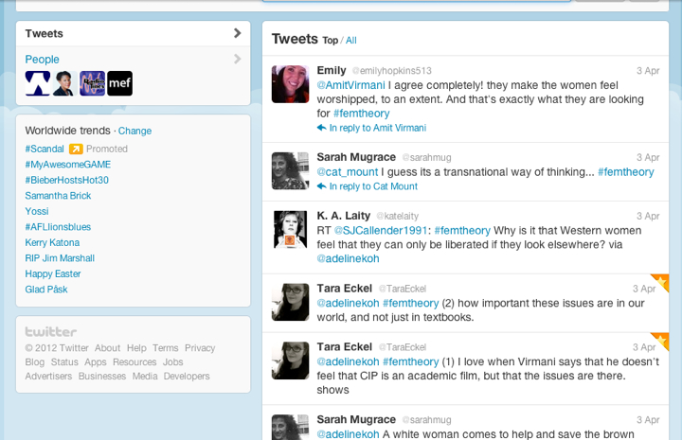
January 28, 2015 Read 1b. Twitter Fed Class Discussions Live-Tweeting Assignments: To Use or Not to Use? he Chronicle of Higher Education, Adeline Koh http://chronicle.com/blogs/profhacker/live-tweeting-assignments-to-use-or-not-to-use/58949

Slide 16
Read 1c. Grammer Checkers (e.g., Grammarly, Ginger, GrammarCheck, PaperRater, and SpellCheckPlus) http://www.grammarly.com/

Slide 17
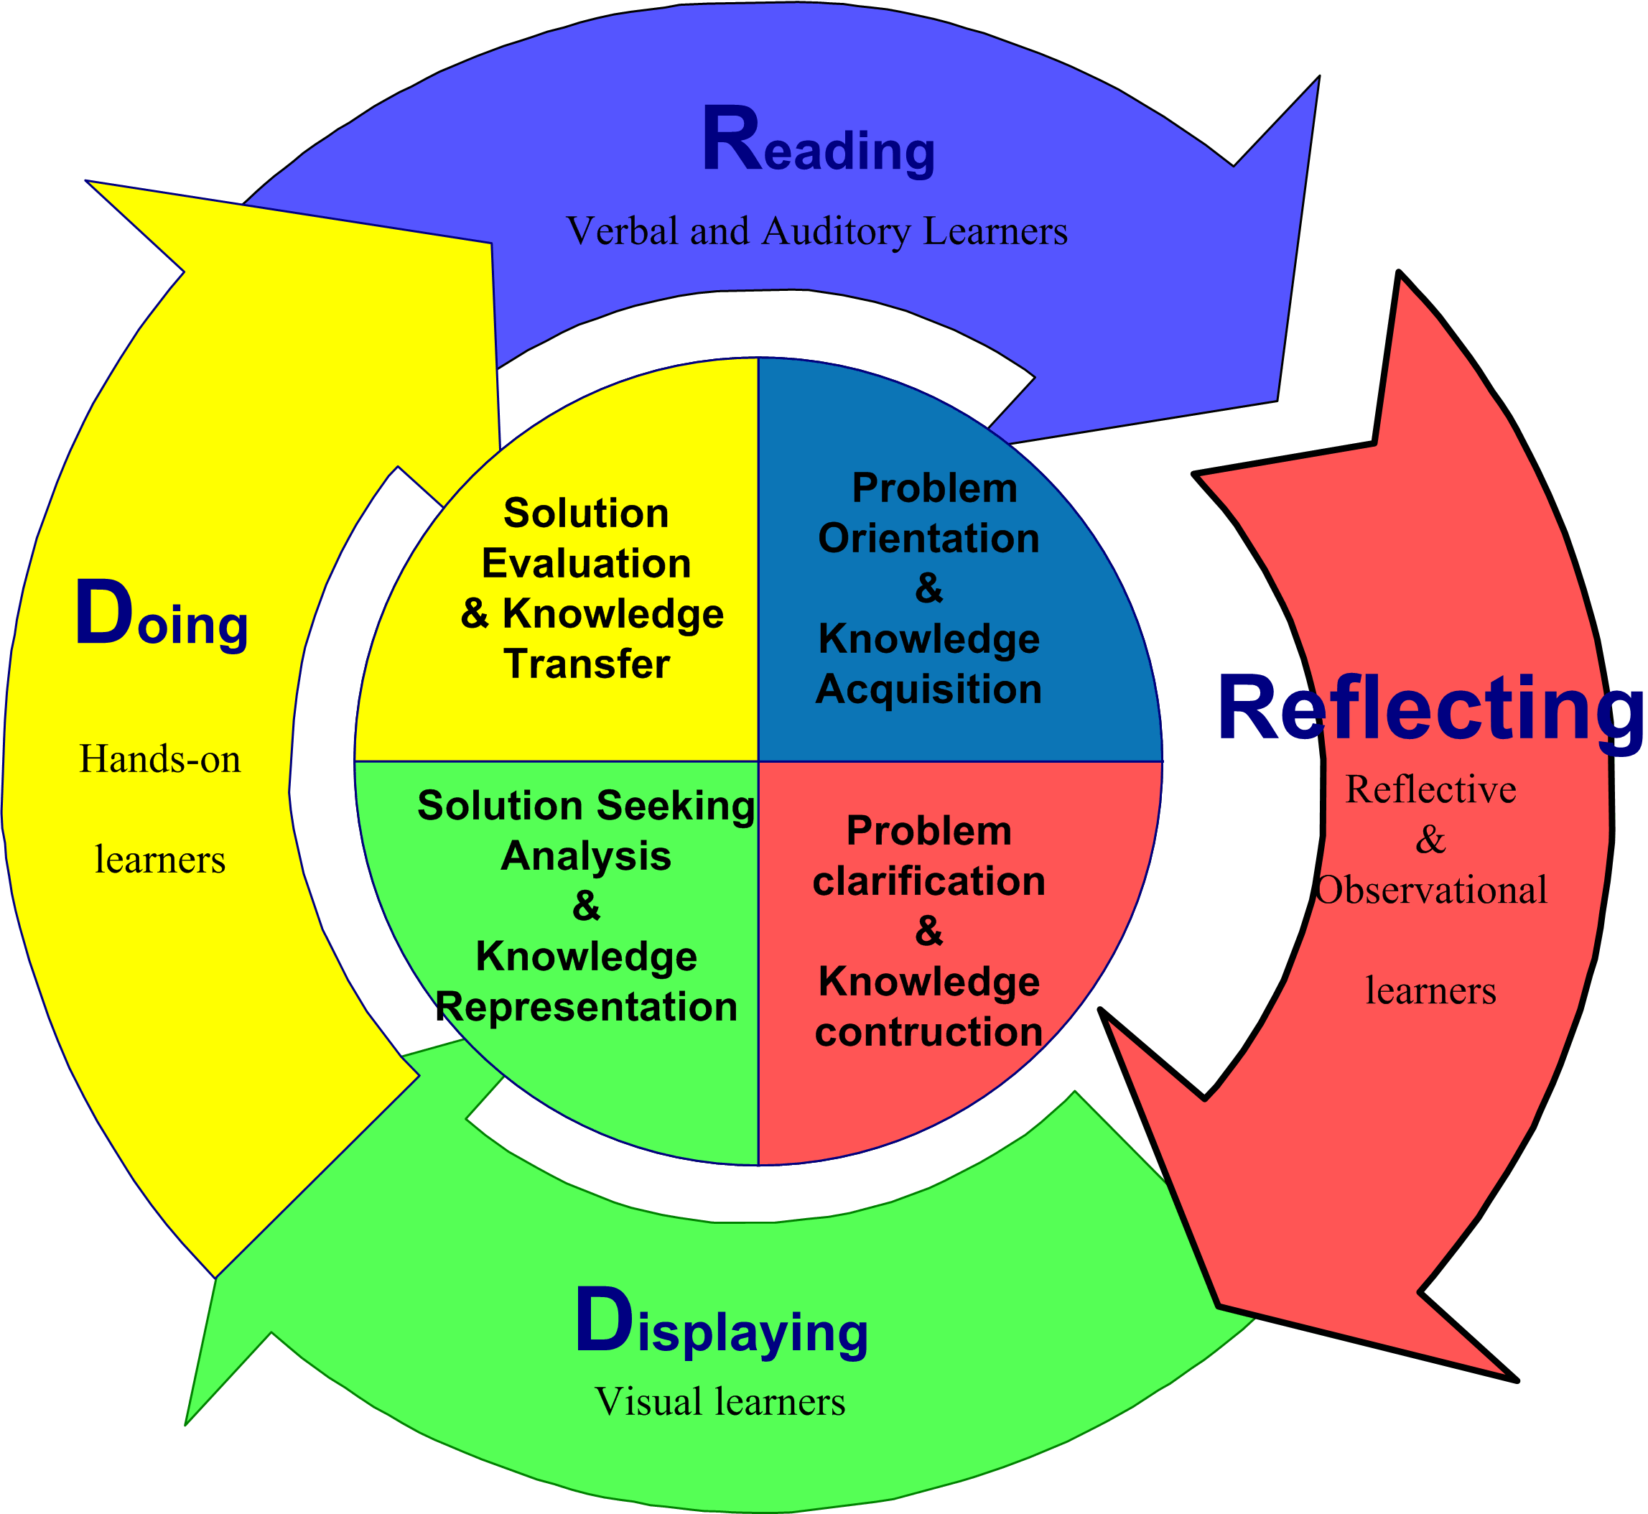
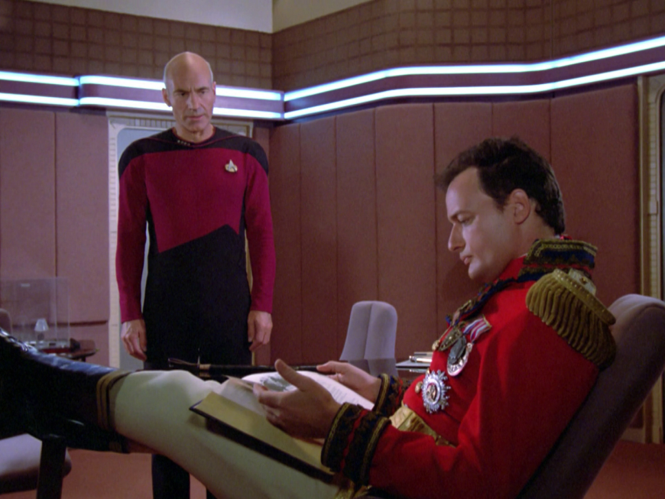
2. Reflective and Observational Learners
Reflective and observational learners prefer to reflect, observe, view, and watch learning; they make careful judgments and view things from different perspectives

Slide 18
Reflect 2a. Big Issue Reflections (Big Questions Online (BQO)), Feb 3, 3015 (e.g., Is curiosity essential for human flourishing?) https://www.bigquestionsonline.com/content/do-we-have-souls

Slide 19
Reflect 2b. Interpreting Infographics July 24, 2014 Woman in Computer Science http://graduatedegrees.online.njit.edu/mscs-resources/mscs-infographics/women-in-computer-science/

Slide 20
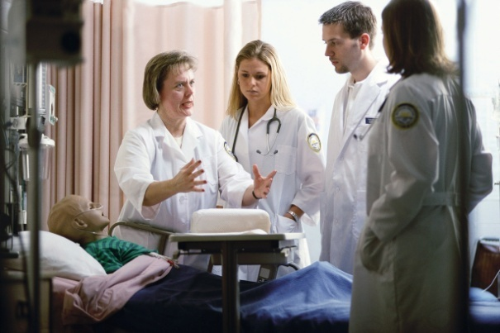
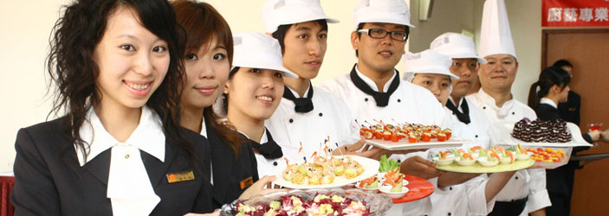
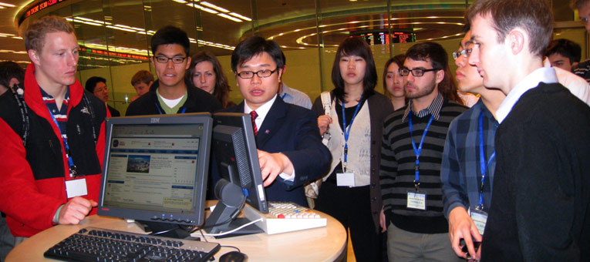
Reflect 2c. Workplace Internship, Practicum, and Field Experiences

Slide 21
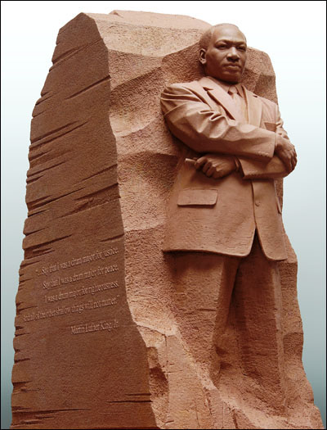
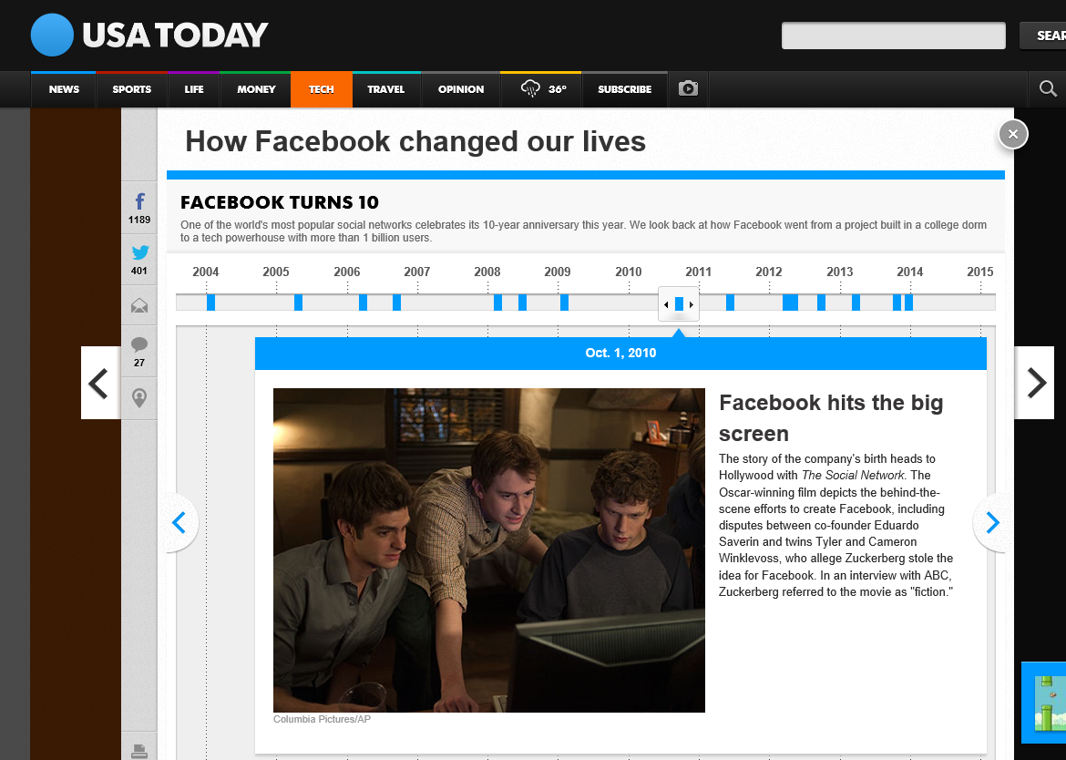
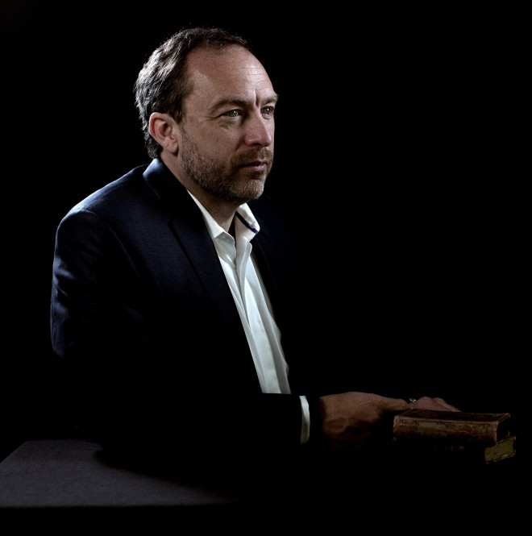
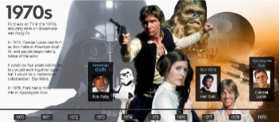
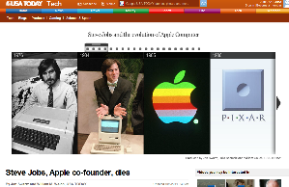
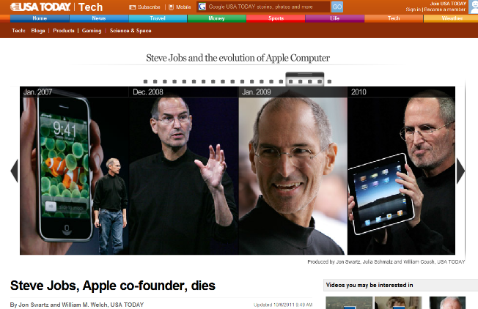
Reflect 2d. Reflect on Virtual Timelines (Dipity, xtimeline, Simile, etc.) http://www.usatoday.com/news/destinations/story/2011-08-25/Martin-Luther-King-Jr-Memorial-in-Washington-A-closer-look/50136470/1?csp=34news http://usatoday30.usatoday.com/tech/news/story/2011-09-22/steve-jobs-dies/50672498/1 http://www.cnet.com/news/steve-jobs-a-timeline/

Slide 22
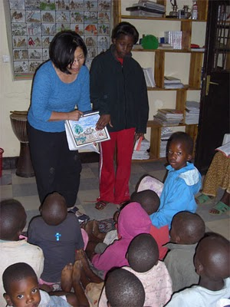
Reflect 2e. Cultural Blogs (e.g., Dr. Kim Foreman, San Fran State Univ, Come and See Africa Blog; http://comeandseeafrica.blogspot.com/)

Slide 23
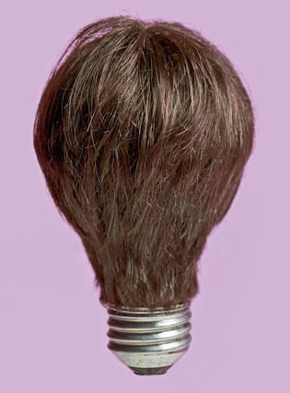
Poll #1: Any light bulbs going off in your head so far…?
Yes definitely
Maybe
No

Slide 24
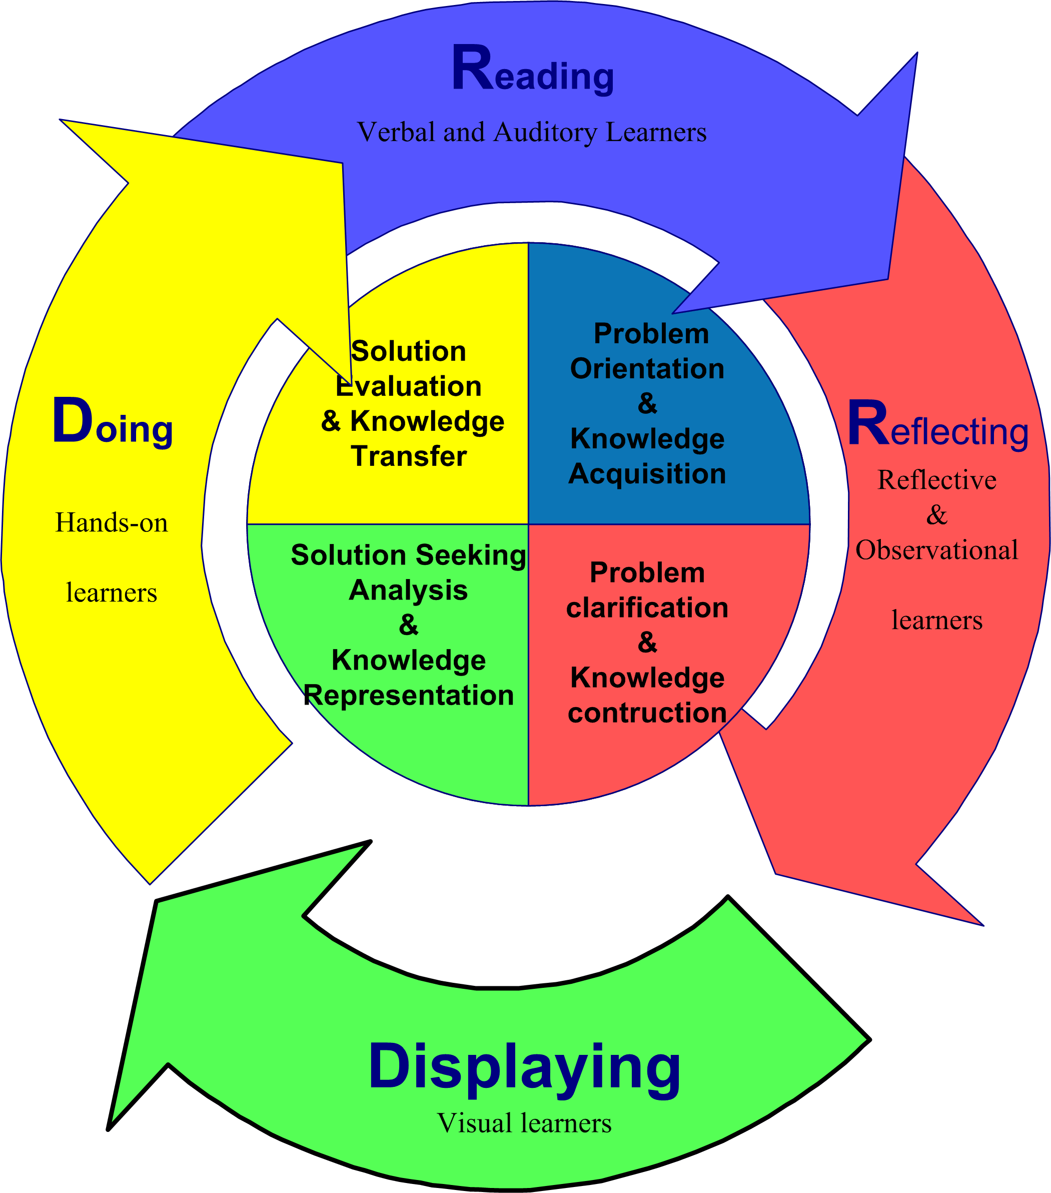
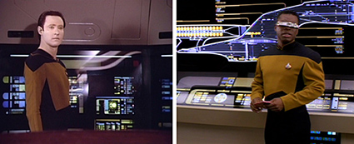
3. Visual Learners
Visual learners prefer diagrams, flowcharts, timelines, pictures, films, and demonstrations.

Slide 25
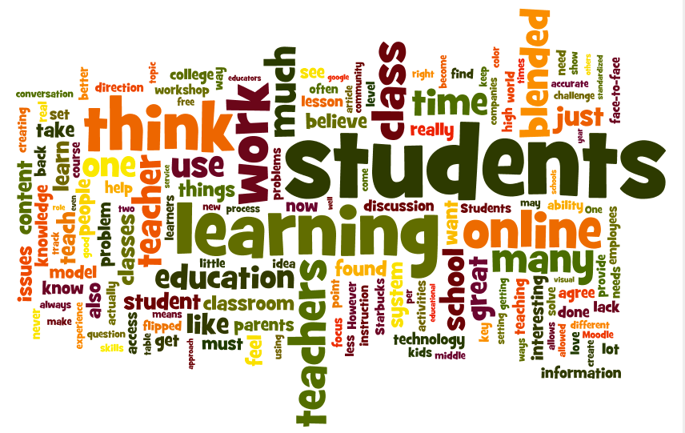
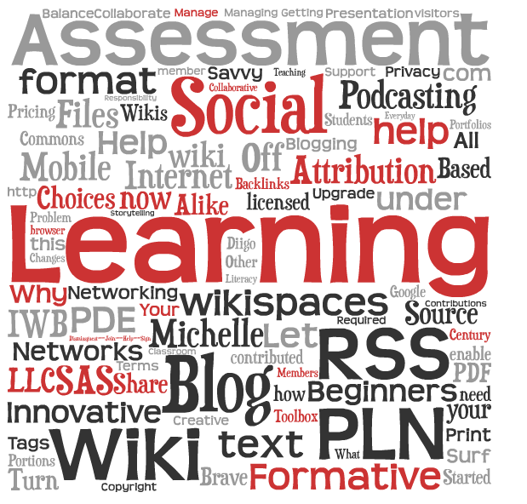
Display 3a. Virtualize Words Used (e.g., Wordle, Tagzedo, Tagul, WordSift, Word It Out) http://shellyterrell.com/2010/02/14/12-word-cloud-resources-tips-tools/

Slide 26
Display 3b. (April 28, 2015) Concept Mapping and Timeline Tools (Bubbl.us, Cmap, Gliffy, Spicynodes, or Mindomo) http://www.spicynodes.org/index.html

Slide 27
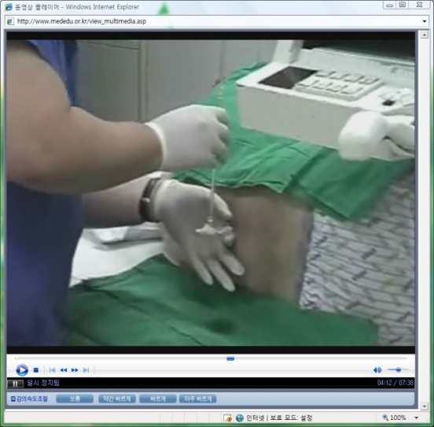
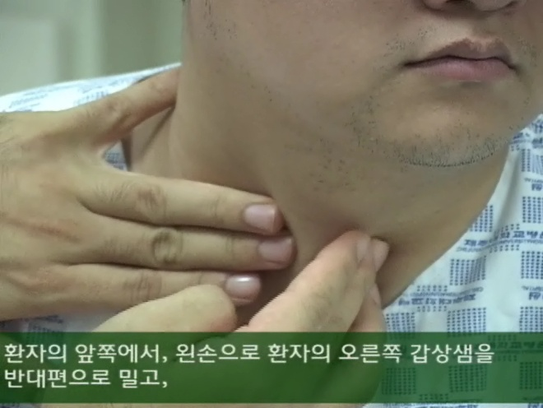
Display 3c. Videos for clinical education (Sungkyunkwan University School of Medicine, www.mededu.or.kr)

Slide 28
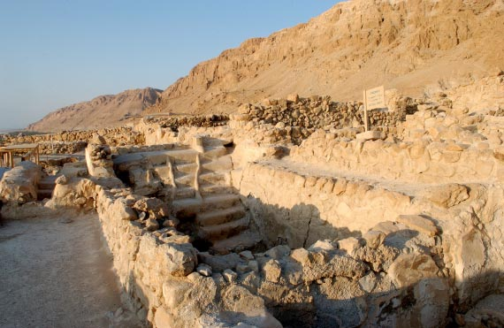
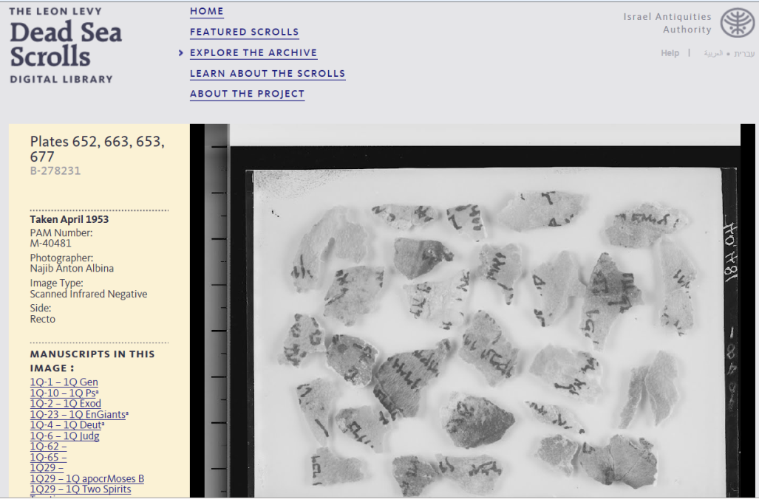
Display 3d. Unique OER (e.g., Dead Sea Scrolls) http://www.deadseascrolls.org.il/explore-the-archive http://www.deadseascrolls.org.il/explore-the-archive/search#q=site_en:'Qumran,_Cave_4' http://www.deadseascrolls.org.il/home

Slide 29
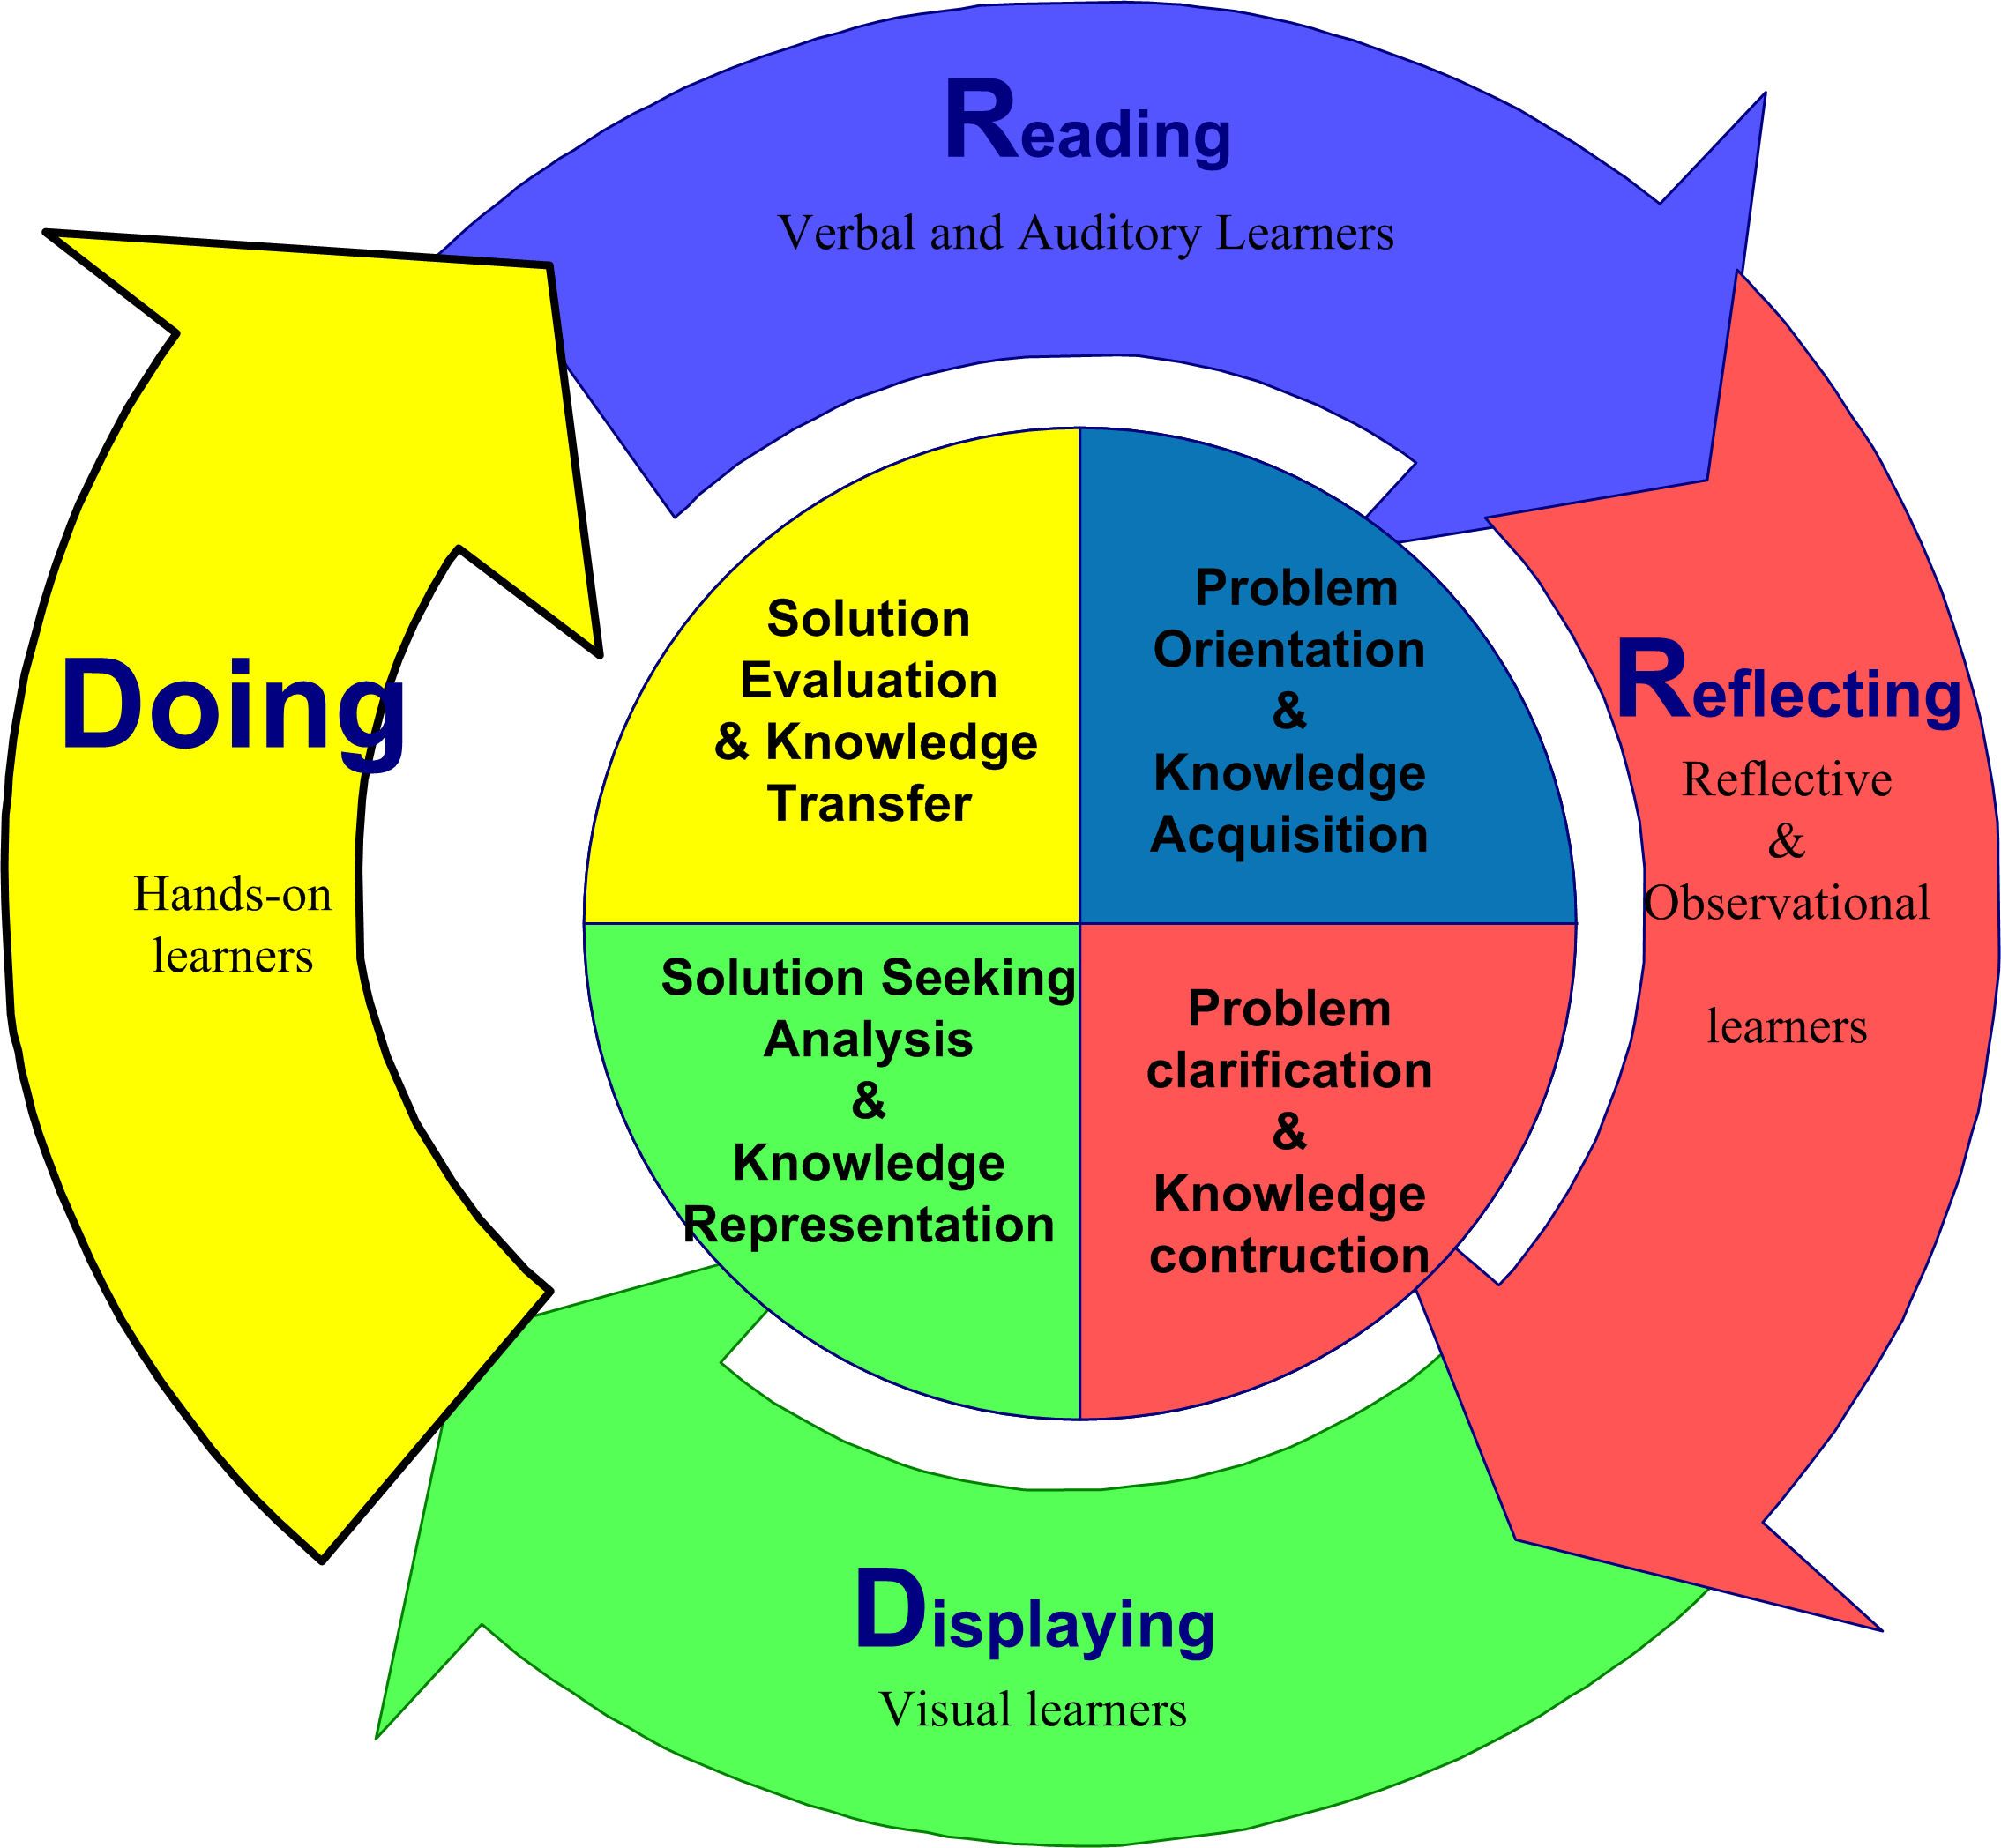
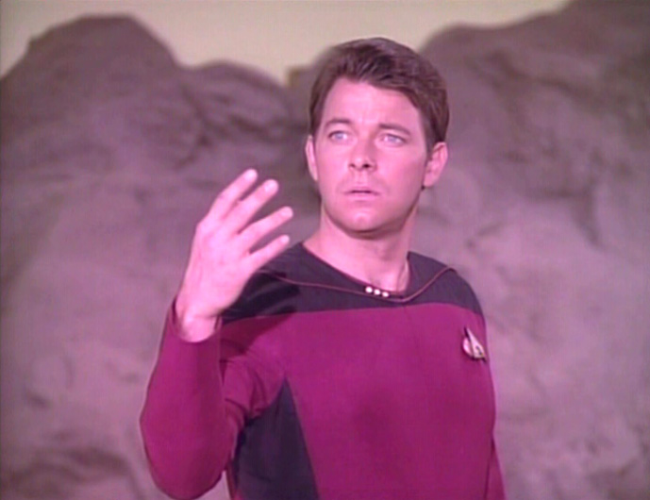
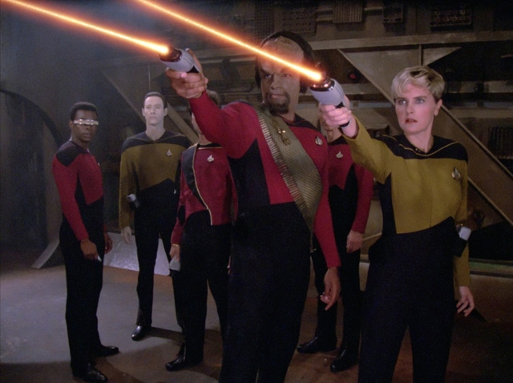
4. Tactile/Kinesthetic Learners
Tactile/kinesthetic senses can be engaged in the learning process are role play, dramatization, cooperative games, simulations, creative movement and dance, multi-sensory activities, manipulatives and hands-on projects.

Slide 30
February 8, 2015 Do 4a. Recap Discussion (e.g., Prezi from Thuy Han for R678 class Week 4) https://prezi.com/r4vkwqolkrn9/httpswebarchiveorgweb20040303191129httpwwwnetco/?utm_campaign=share&utm_medium=copy

Slide 31
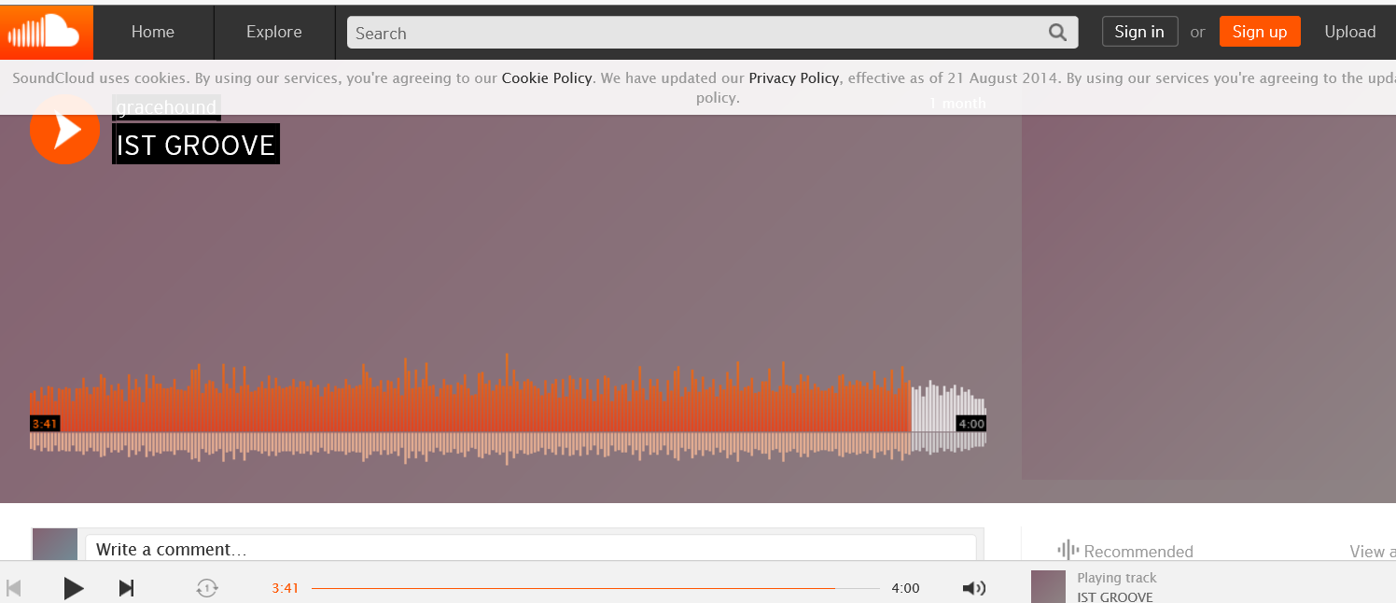
Do 4b. Student Music Recordings of Course Content April 26, 2015 IST Groove Song, Jeffrey Jenkins, R511: https://soundcloud.com/jeffjenkins25/ist-groove The World is Open , Jill Kaufman, R678: https://www.youtube.com/watch?v=ZRGV0Mg5Vmw&feature=youtu.be Daniel Halluska, P540: http://www.youtube.com/watch?v=tOL7lrGsqnw

Slide 32
Poll #2: How many ideas did you get from this talk?
0 if I am lucky.
Just 1.
2, yes, 2…just 2!
Do I hear 3? 3!!!!
4-5.
5-10.
More than 10.

Slide 33
Where are we headed? Where is Education 3.0?

