Slide 1
Publishing as a graduate student: Why? How? And What? Thursday, October 25th: 2:15-3:20 pm Muehlebach, Roosevelt, Marriott Downtown, Kansas City, MO
Ana-Paula Correia, Ph.D.
The Ohio State University
Curtis J. Bonk, Ph.D.
Indiana University
Feng-Ru Sheu, Ph.D.
Kent State University
Notes:
All
1

Slide 2
Purposes of this Session
Explore the process for getting published
Discuss the process for selecting a journal for publication
Examine writing tips and insights
Access curated resources
https://tinyurl.com/y9jnonur
Notes:
Ana

Slide 3
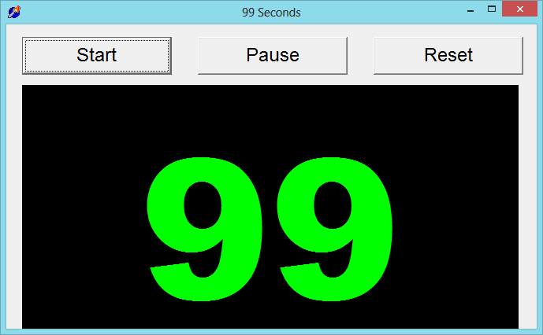
99 Seconds Activity #1
With your next chair neighbor discuss 1 to 2 writing dilemmas currently facing.
Notes:
Ana
Not sure if we want to keep all these activities as we only have 1 hour and 5 minutes and need to leave time for questions. It’s up to you….
3

Slide 4
Writing Difficulties and Challenges of a Early Career Scholar
Time
Notes:
Ana
4

Slide 5
The Process
Insights and Advice on Getting Published in Educational and Instructional Technology
Notes:
Ana

Slide 6
Put Forward your Best Work
Collaborative research projects
Literature reviews
Reflections/ conceptual pieces
Grant projects
Class projects
Notes:
Ana
6

Slide 7
Finding a Journal that Fits
What to look for?
Who will be your target readers?
Who are the authors and journals you cite the most related with your research program?
Is there a match between your work and the journal aims and scope?
What is the journal turnaround time?
What is the journal acceptance rate?
Notes:
Ana
https://www.editage.com/insights/how-to-choose-journals-for-submitting-your-paper
Who will be your target readers? Scholarly vs. non-scholarly periodicals
readership and target audience
Look for a match between your work and the journal aims and scope. – journal analysis
What is the journal’s turnaround time?
Acceptance rates? Get familiar with the journals’ acceptance rates
7

Slide 8
Finding a Journal that Fits
Where to look for?
Social Sciences Citation Index (SSCI) is a commercial citation index product of Clarivate Analytics. It was originally developed by the Institute for Scientific Information from the Science Citation Index.
European Reference Index for the Humanities and the Social Sciences (ERIH PLUS) was created and developed by European researchers under the coordination of the Standing Committee for the Humanities of the European Science Foundation.
Notes:
Ana
8

Slide 9
Where to start?
Practitioner Journals
Target practitioners
Deal with problems and issues tied directly to practice
Receive wider circulations and visibility
Refereed or nonrefereed articles
Notes:
Ana
Unlike peer reviewed articles, nonrefereed articles, where publication decisions are made by one or more editors without using a blind review process, are important because they fill an important niche in practice oriented fields like ed tech.
Peer-reviewed or refereed articles undergo a blind review. This means that neither he authors nor reviewers know each other’s identity. This process is designed to endure that a manuscript has been reviewed and accepted in an ethical and unbiased manner by experts from a specific field.
Although refereed articles are often considered the gold standard in faculty promotion and tenure deliberations, nonrefereed articles nevertheless plan an important role within most academic disciplines.
Practitioner journals are targeted toward practitioners and deal with problems and issues tied directly to practice, Thus,, an article appearing in a practitioners journal could receive wider circulations and visibility than one published in a respected academic journal that is narrowly targeted toward a more limited audience.

Slide 10
Where to start?
Peer-Reviewed Journals
Top-tier journals: are SSCI-indexed
Second-tier journals: have an established history in the field
Third-tier journals: are newer in the field
Notes:
Ana
you should publish everything you do, even if it is only acceptable for a lower tier journal. It demonstrates your commitment to finish a project and makes your work available to everyone else. Lower tier journals are also great outlets for quality undergraduate research that you have directed.

Slide 11
TOP-TIER JOURNALS
British Journal of Educational Technology
Educational Technology Research and Development
Computers & Education
Instructional Science
Notes:
Ana
Mention:
http://www.trainingshare.com/resources/distance_ed_journals_and_online_learning_books.php
More examples:
Distance EducationDistance Education; The Internet and Higher Education; Asian Journal of Technology InnovationAsian Journal of Technology Innovation ; Australasian Journal of Educational Technology
Educational Technology Research and Development
11

Slide 12
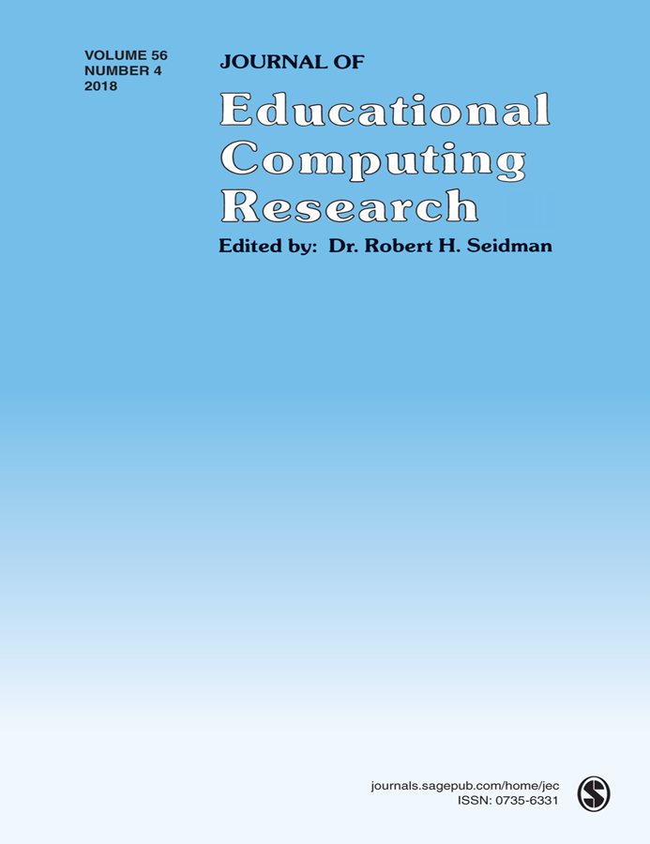
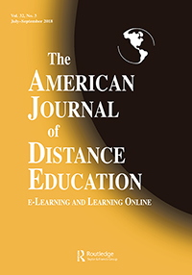
SECOND-TIER JOURNALS
Journal of Educational Computing Research
TechTrends
The American Journal of Distance Education
Notes:
Ana
Journal of Technology and Teacher EducationJournal of Technology and Teacher Education; The Quarterly Review of Distance EducationJournal of Technology and Teacher Education; The Quarterly Review of Distance Education; Science & Education
Journal of Digita Learning in Teacher Education
International Review of Research in Open and Distributed Learning
The American Journal of Distance Education
12

Slide 13
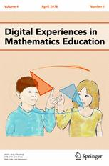
THIRD-TIER JOURNALS
International Journal of Online Pedagogy and Course Design
Contemporary Issues in Technology and Teacher Education
Digital Experiences in Mathematics Education
Notes:
Ana
International Journal of Gaming and Computer Mediated SimulationsInternational Journal of Gaming and Computer Mediated Simulations; Advances in MultimediaInternational Journal of Gaming and Computer Mediated Simulations; Advances in Multimedia; Learning: Research and Practice
International Journal of Designs for Learning

Slide 14
Academic information/ resources (Cont’d)
Tools for research
Citation/reference management
Ex. Endnote, Zotero, Refwork, Paper, etc.
Incorporate other software
Ex. Nvivo (qualitative analysis tool, Network analysis i.e.)
Writing Tutorial Services
Tutoring Services

Slide 15
Academic information/ resources (Cont’d)
Journal selection/evaluation
Impact/accreditation (*Predatory Journals)
Citation index (Web of Science, Google, etc.)
Impact factor
Ranking
Open Access vs. non-Open Access
Directory of Open Access Journals
Open Access Scholarly Publishers Association

Slide 16
Academic information/ resources (Cont’d)
Journal evaluation & legitimacy
Consult with a librarian
Visit & Examine the journal's web site.
Reach out to journal's editorial board members.
Aim and goals of journal. Read the scope of the journal.
Read their peer review policy.
Check to see what "author fees" are being requested
Research industry associations.
DOAJ= Directory of Open Access Journals
OASPA = Open Access Scholarly Publishers Association

Slide 17
Journal Impact Factor
Is the frequency of the average article in a journal has been cited in a specific period of time.
Suggested the rank or importance of a journal, the higher impact factor, the better rank
The calculation is to dividing the number of times articles were cited by the number of articles were citable. It is usually based on a two-year period.
Tools to measure journal impact factor
Journal Citation Report, https://goo.gl/yVw8si
Scimago Journal Rank (SRJ), https://www.scimagojr.com/
Notes:
Feng-Ru

Slide 18
Predatory Journals/ Publishers
Be Aware of Predatory Journals/Publishers!
The publishing venue prey on academicians for making money without following scholarly publishing standards, commonly seen in the Open Access world.
Also called “Pseudo-journals,” “fake journals,” and “sham journals.”
(Beager, 2017; Clark & Smith, 2017)
Notes:
Feng-Ru
the “Think. Check. Submit.” checklist developed by a coalition of scholarly publishing organizations
Think
Are you submitting your research to a trusted journal?
Is it the right journal for your work?

Slide 19
Predatory Journals/ Publishers
Be Aware of Predatory Journals/Publishers!
Characteristics
The journal asks for a submission fee
Promises of fast peer review and fast publication
Spam emails to attract potential authors
Small size of editorial board or not indicated clearly
Newness and the quantity: a very new journal that consists of a high quantity of articles in one issue
Inconsistencies in the scope and the content or journal title and contact address
(Beager, 2017;Prater, 2018)
Notes:
Feng-Ru
the “Think. Check. Submit.” checklist developed by a coalition of scholarly publishing organizations
Think
Are you submitting your research to a trusted journal?
Is it the right journal for your work?

Slide 20
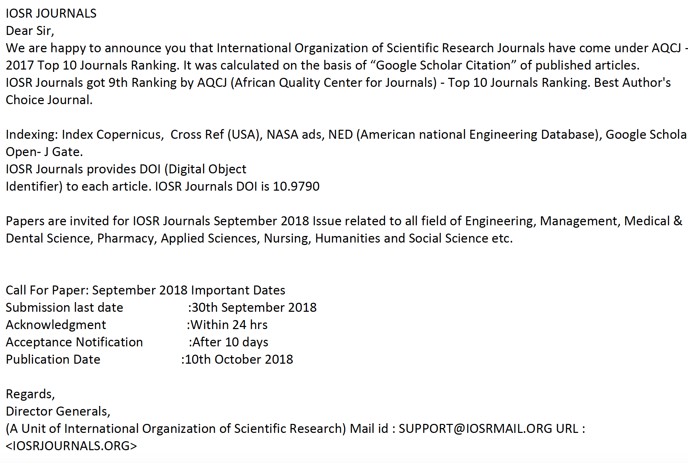
Predatory Journals/ Publishers
Examples of spam emails to attract potential authors
Notes:
Feng-Ru
the “Think. Check. Submit.” checklist developed by a coalition of scholarly publishing organizations
Think
Are you submitting your research to a trusted journal?
Is it the right journal for your work?

Slide 21
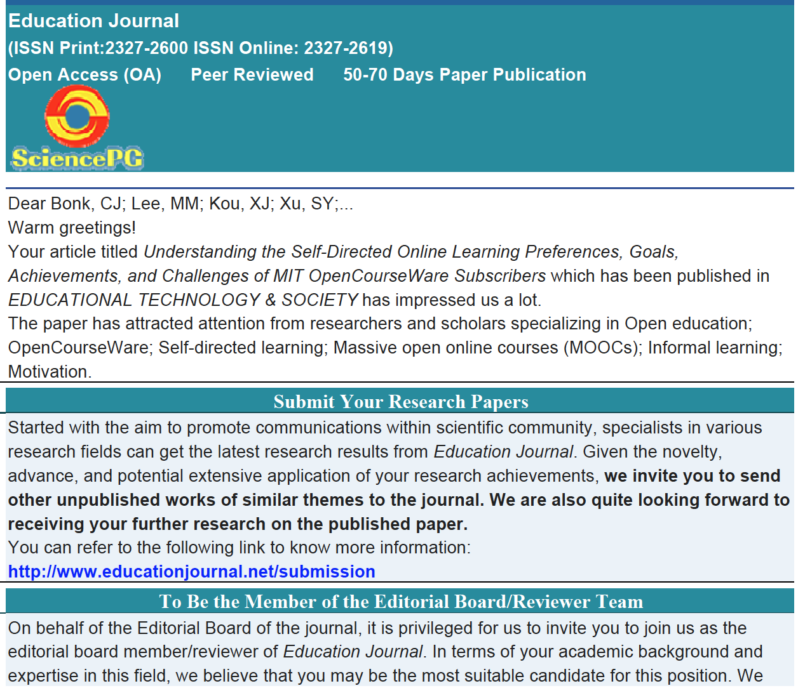
Predatory Journals/ Publishers
Examples of spam emails to attract potential authors
Notes:
Feng-Ru
the “Think. Check. Submit.” checklist developed by a coalition of scholarly publishing organizations
Think
Are you submitting your research to a trusted journal?
Is it the right journal for your work?

Slide 23
Selecting a Journal
Be Aware Predatory Journals!
Using the “Think. Check. Submit.” checklist
Developed by a initiative of scholarly publishing organizations
(think.check.submit.org, 2018)
Notes:
Feng-Ru

Slide 24
Selecting a Journal
Be Aware Predatory Journals!
Criteria to check the journal
Do you or your colleagues know the journal?
Can you easily identify and contact the publisher?
Is the journal clear about the type of peer review it uses?
Are articles indexed in services that you use?
Is it clear what fees will be charged?
Do you recognize the editorial board?
Is the Publisher a member of a recognized industry initiative?
Access the checklist in detail at http://thinkchecksubmit.org/check/
Notes:
Feng-Ru

Slide 25
Selecting a Journal
Two resources to identify the journals and publishers
The Directory of Open Access Journals (DOAJ), https://doaj.org/
Identify legitimate open access journals
Beall’s List, https://beallslist.weebly.com/
Identify predatory journals/publishers
Notes:
Feng-Ru

Slide 26
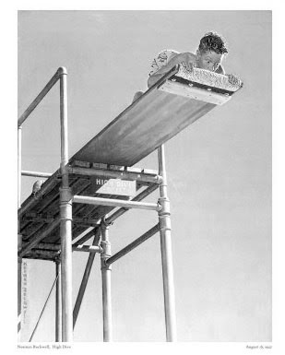
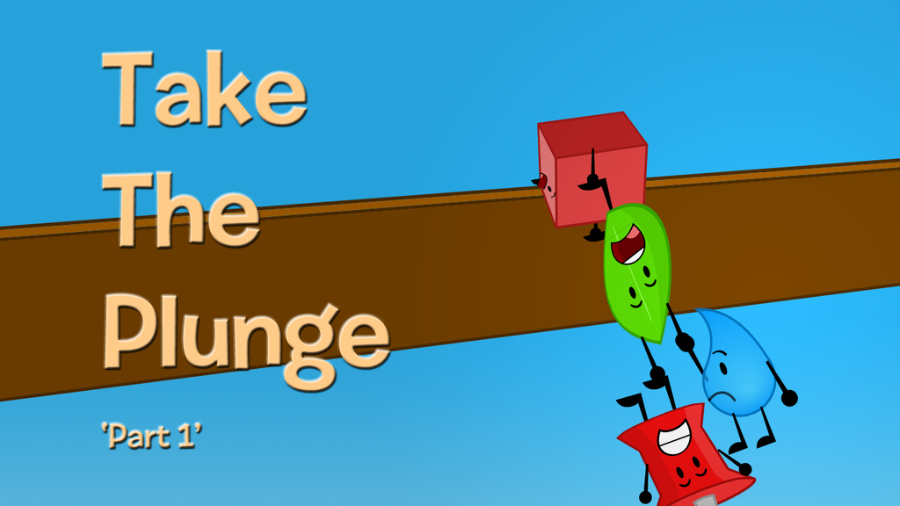
Take the Plunge…Part 1
Look for opportunities to create publishable manuscripts from your dissertation
Contribute with a chapter
Conduct an interview
Write a practical article, newsletter, or book review
Notes:
Ana
Review articles and conference proposals (learn about peer-review criteria and guidelines)
Review book proposals
Do a conference workshop
Organize a symposium
26

Slide 27
Take the Plunge…Part 2
Write a major grant proposal
Lead a special journal issue
Edit a book
Sole author a book
Get your name out there!
Notes:
Curt
27

Slide 28
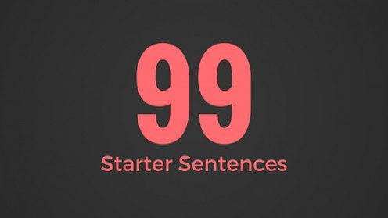
Generate Starter Text…
Author a blog
Use social media
Submit a conference proposal
Write editorials
Write book and software reviews
101
Notes:
Curt

Slide 29
99 Seconds Activity #2
Commit to 1 to 2 things that take the plunge and share them with your next chair neighbor.
Notes:
Curt
Not sure if we want to keep all these activities as we only have 1 hour and 5 minutes and need to leave time for questions. It’s up to you….
29

Slide 30
Writing Tips and Insights
Insights and Advice on Getting Published in Educational and Instructional Technology
Notes:
Curt
30

Slide 31
October 2, 2018 How to Learn to Write Like a Machine Rose Jacobs, Inside Higher Ed https://www.chronicle.com/blogs/linguafranca/2018/10/02/how-to-learn-to-write-like-a-machine/
Notes:
Curt

Slide 32
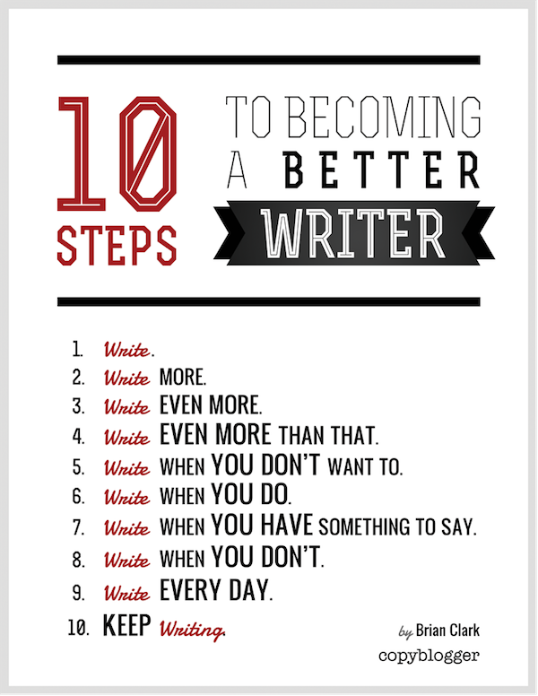
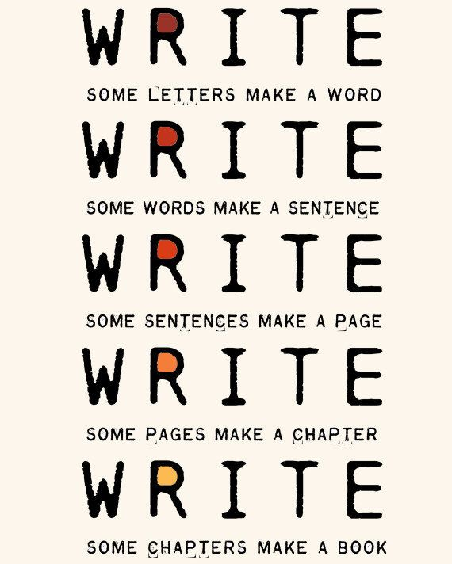
The Top 20 Writing Tips
Notes:
Curt
32

Slide 33
1. Mark Writing Days in Planner
Notes:
Curt
33

Slide 34
2. Maintain a List and Network of Potential Research and Writing Collaborators
Notes:
Curt
34

Slide 35
Sidenote: Find Good People to Work With…Life is Short—Avoid Egomaniacs and People Who Lie
Notes:
Curt
35

Slide 36
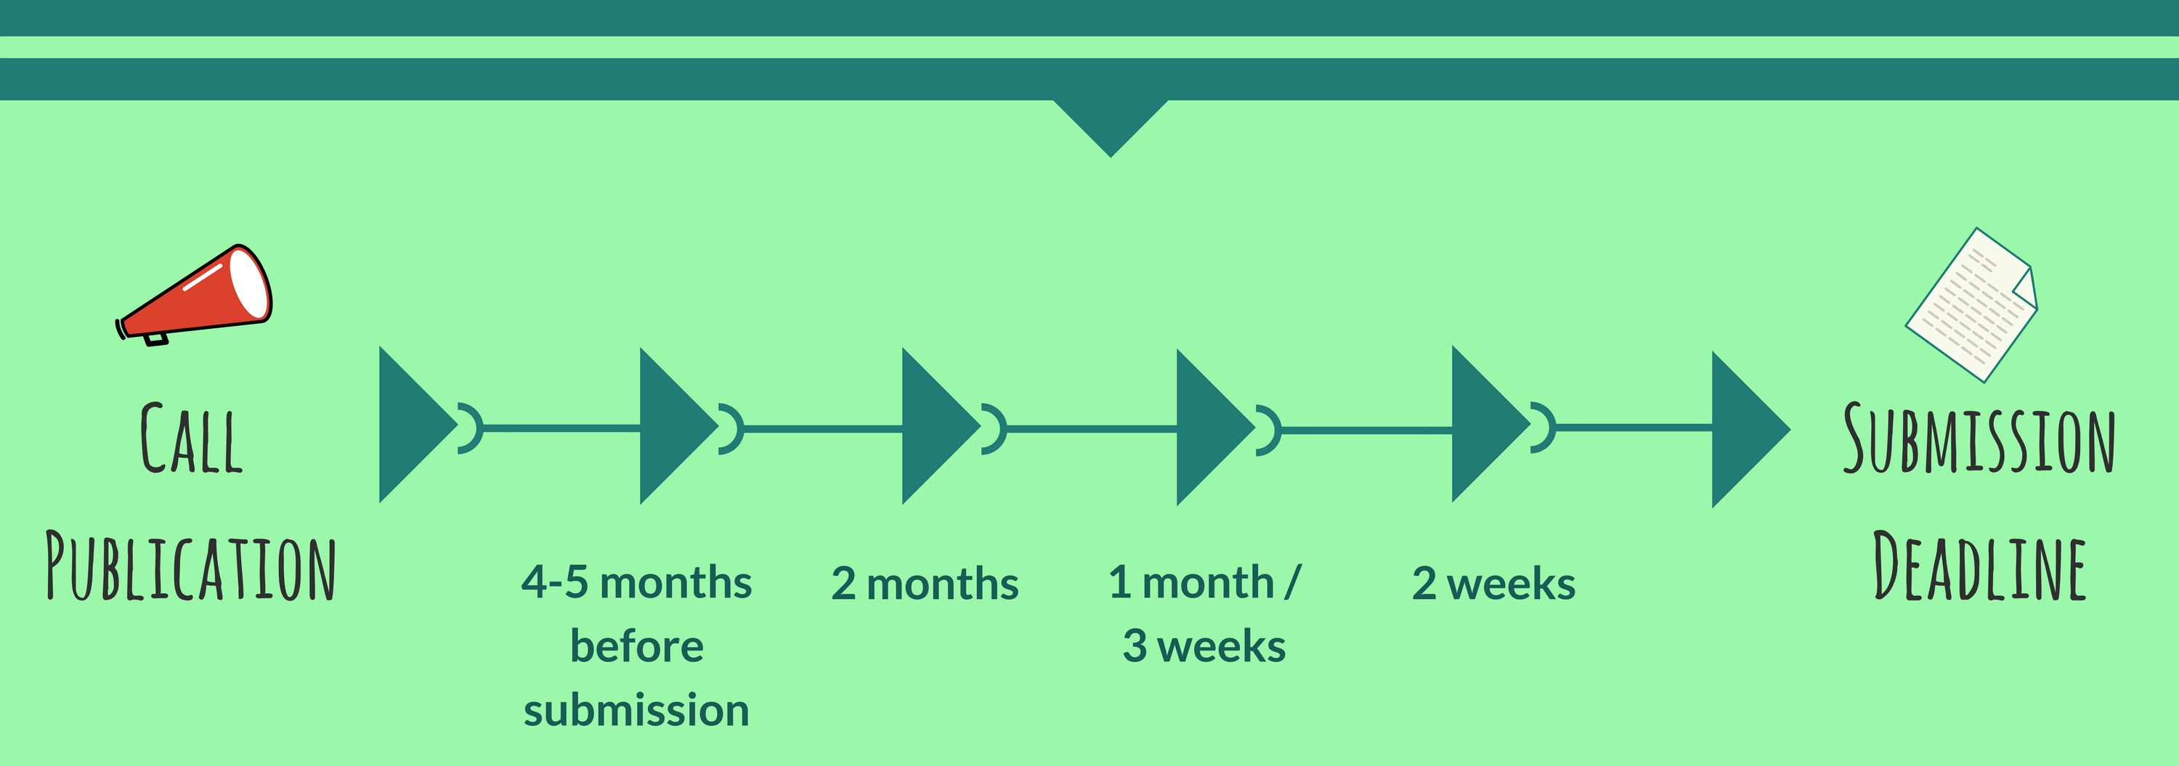
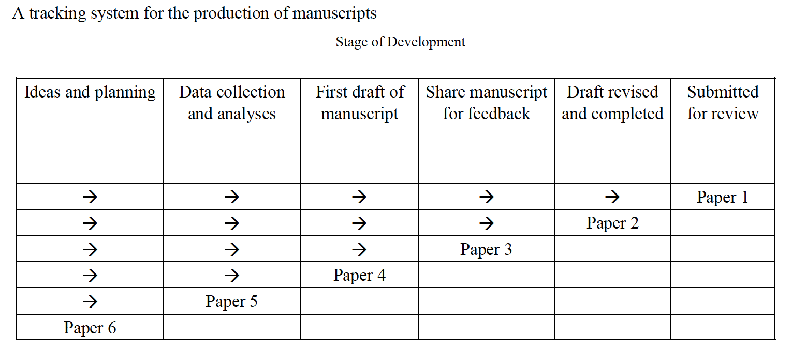
3. Draft a Timeline or Multiple Timelines with Flexible Goals
Notes:
Curt
Screenshot from Cecil’s article
36

Slide 37
October 10, 2018 Perhaps write to your future self about your goals… FutureMe.org Write a letter to the future https://www.futureme.org/
Notes:
Curt
Screenshot from Cecil’s article
37

Slide 38
4. Think Ahead About the Publishing Potential of Each Project
Notes:
Curt
38

Slide 39
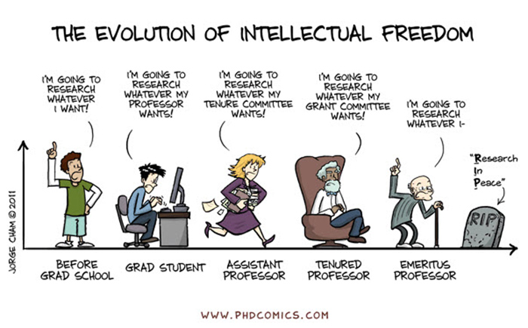
Sidenote: Don’t Just Publish for the Sake of Publishing…
Notes:
Curt
39

Slide 40
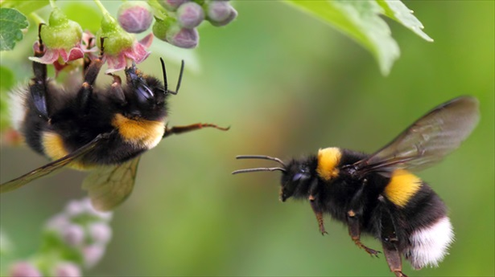
5. Be a Bumblebee and Butterfly
Notes:
Curt
40

Slide 41
6. Find, Save, and Use Starter Text (overcomes writer’s block)
Notes:
Curt
41

Slide 42
7. Always Scan the Reference Sections of Other Articles to See What Journals are Popular
Notes:
Curt
42

Slide 43
8. Avoid High Quality (i.e., SSCI) Journal Fixations
Notes:
Curt
43

Slide 44
9. Be Second or Third Author Sometimes to Spread Limited Resources
Notes:
Curt
44

Slide 45
10. If Need Summer Money, Teach Short Term or Intensive Courses
Notes:
Curt
45

Slide 46
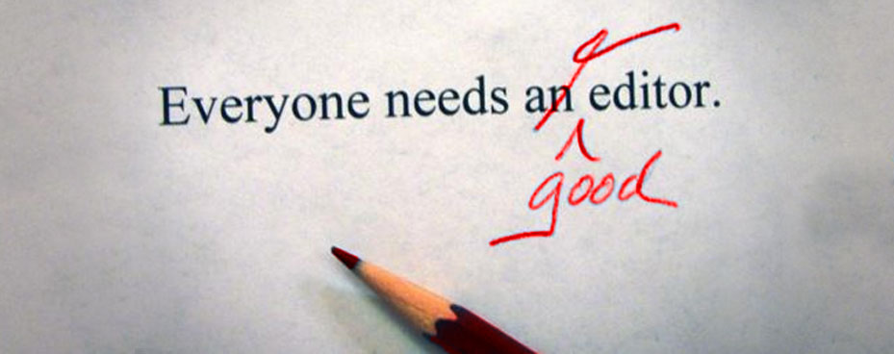
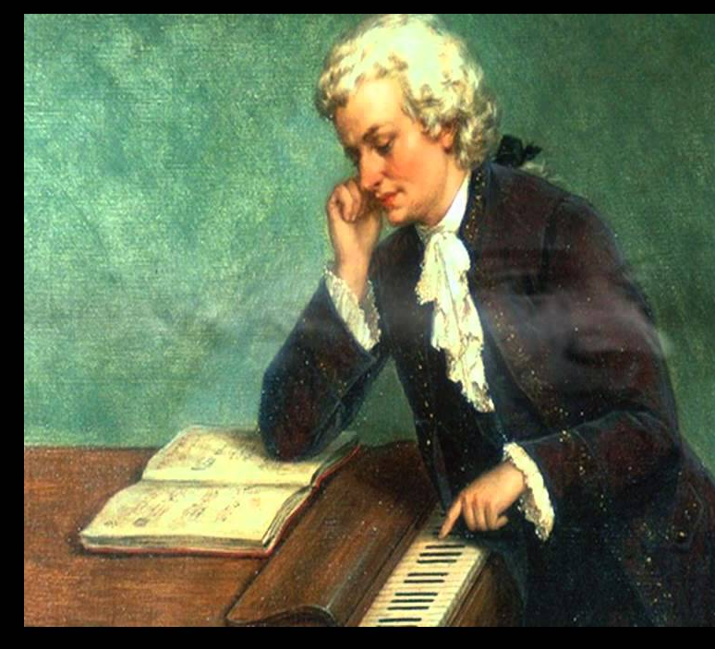
11. Edit Your Papers a Lot! (Mozartian vs. Beethovenian)
Notes:
Curt
46

Slide 47
October 1, 2018 6 Tips to Shape Up Your Writing Two-Minute Tips: Short videos to help you excel in the academic workplace Fernanda Zamudio-Suaréz, The Chronicle of Higher Education https://www.chronicle.com/article/6-Tips-to-Shape-Up-Your/244281?cid=cp221 https://www.chronicle.com/specialreport/Two-Minute-Tips/221
Writing is an exercise (write!).
Set goals based on output not input (e.g., 3 pages double-spaced).
Find a voice (don’t just focus on getting published).
Give yourself time (not deadlines).
Pick a puzzle (your writing is an answer to that puzzle).
Edit your work (over and over and over again…just like Beethoven).
Notes:
Curt

Slide 48
October 8, 2018 How to Improve Your Teaching-Philosophy Statement Two-Minute Tips: Short videos to help you excel in the academic workplace Fernanda Zamudio-Suaréz, The Chronicle of Higher Education https://www.chronicle.com/article/How-to-Improve-Your/244283 https://www.chronicle.com/specialreport/Two-Minute-Tips/221
Notes:
curt

Slide 49
October 15, 2018 How to Become a Highly Productive Writer Two-Minute Tips: Short videos to help you excel in the academic workplace Fernanda Zamudio-Suaréz, The Chronicle of Higher Education https://www.chronicle.com/article/How-to-Become-a-Highly/244351?cid=cp221 https://www.chronicle.com/specialreport/Two-Minute-Tips/221
Notes:
curt

Slide 50
12. Organize Conference Symposia Which Can Lead to Special Journal Issues and Books
Notes:
Curt
50

Slide 51
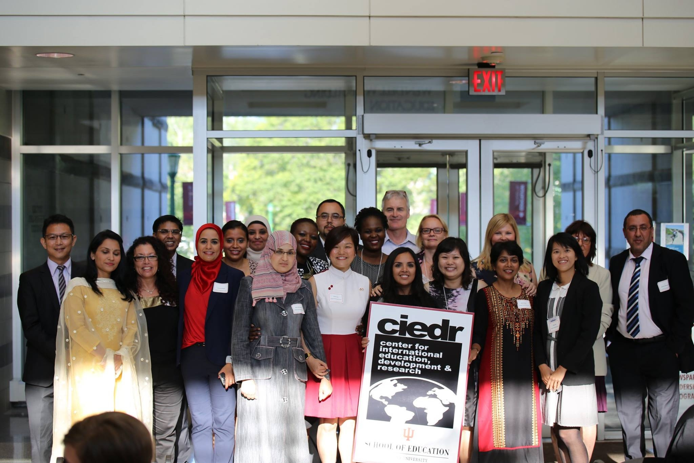
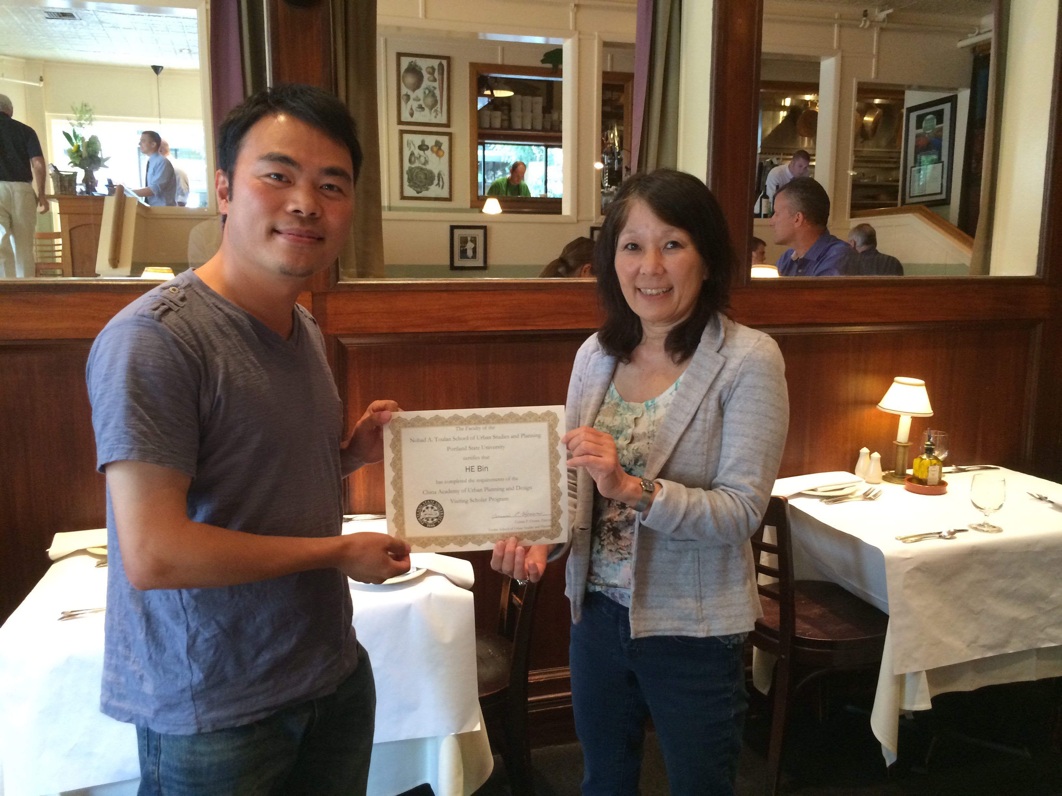
13. Sponsor Visiting Scholars to Work with You; They Often Have Writing Plans
Notes:
Curt
51

Slide 52
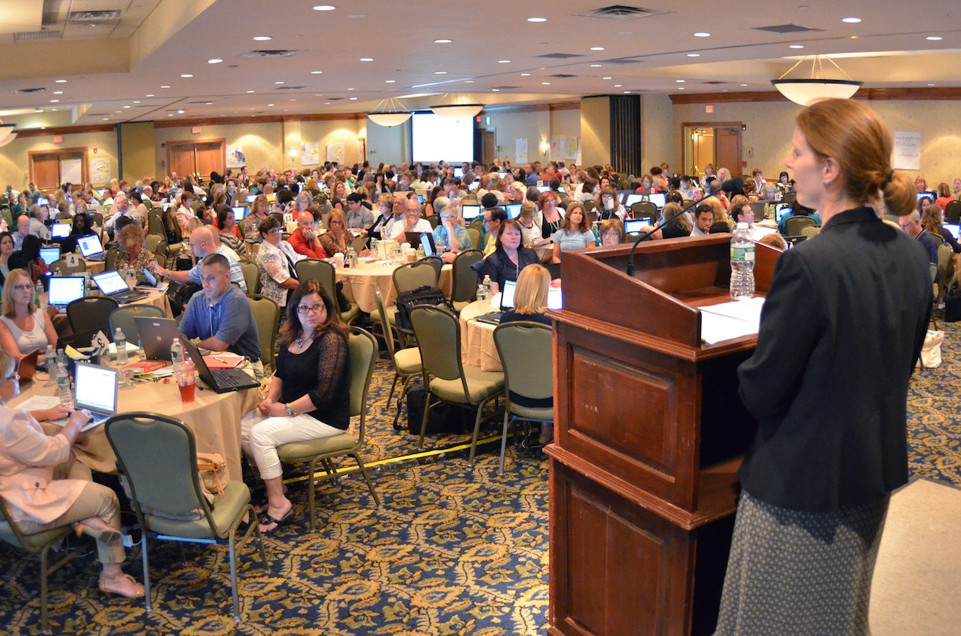
14. Try to Submit or Publish Your Paper Before the Conference
Notes:
Curt
52

Slide 53
15. Be Creative Somewhere (e.g., unique model, figure, chart, etc.)
Notes:
Curt
53

Slide 54
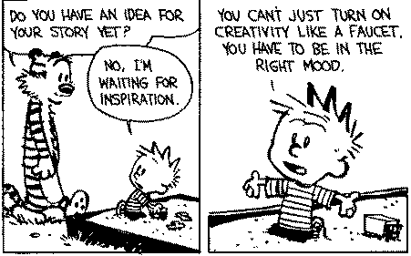
Sidenote: Modify Your Environment (Find or Create Your Personal Sandbox)
Notes:
Curt
54

Slide 55
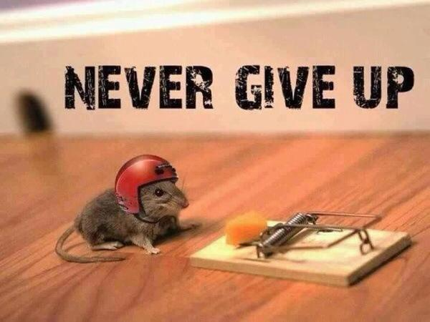
16. Try Not to Give Up: Persistence and Grit Wins the Day
Notes:
Curt
55

Slide 56
17. Be Polite and Thankful to the Journal or Book Chapter Editors
Notes:
Curt
56

Slide 57
18. Recap Reviewer Points and How You Attempted to Address Them
Notes:
Curt
57

Slide 58
October 4, 2018 A New Series on Scholarly Productivity: ‘Are You Writing?’ Rebecca Shuman, The Chronicle of Higher Education https://www.chronicle.com/article/A-New-Series-on-Scholarly/244689
Read as peer reviewer; mark up everything.
Catalog problems on a 1 to 3 difficulty scale (Level 1 takes less than 30 minutes, Level 2 takes 2 hours or less; Level 3 takes more time).
Fix the easy ones and gain momentum for the harder ones!
Take breaks as needed.
Notes:
Curt

Slide 59
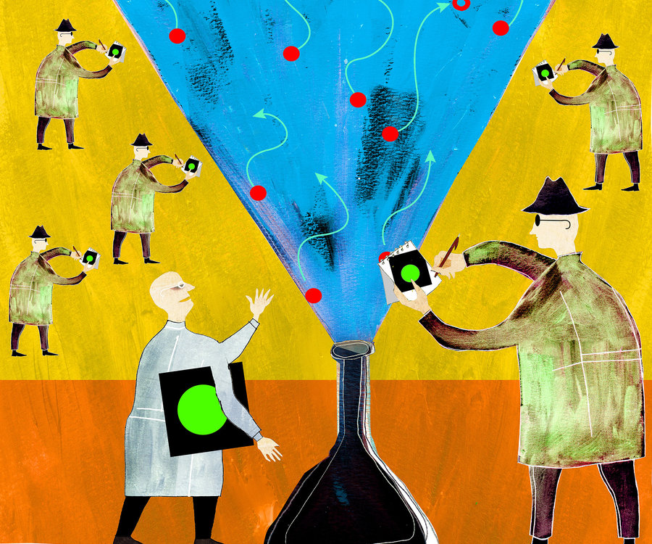
19. Share Your Publication Efforts (e.g., Twitter, Facebook, LinkedIn, email, ResearchGate, Academia.edu, etc.)
Notes:
Curt
59

Slide 60
20. Celebrate Your Writing Accomplishments with Friends
Notes:
Curt
60

Slide 61
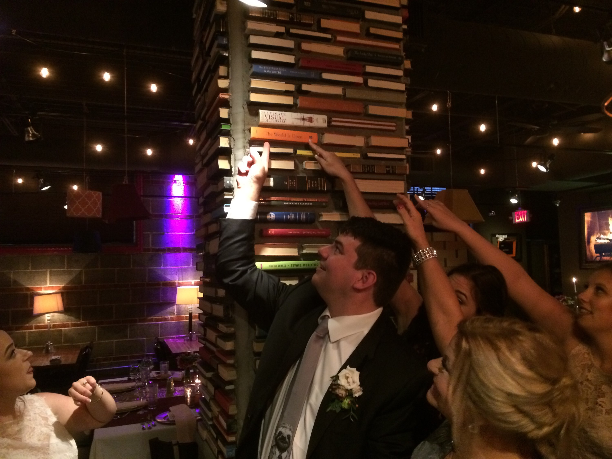
You never know where you’ll be celebrating your writing accomplishments… Perhaps right here in KC!
Notes:
Curt
61

Slide 62
Just don’t celebrate too much!
Notes:
Curt
62

Slide 63
Recap
Publishing as a graduate student: Why? How? And What?
The process for getting published
The process for selecting a journal for publication
Writing tips and insights
Curated resources
https://tinyurl.com/y9jnonur
Notes:
Ana
Encourage audience to access the resources on GoogleDoc.
63

Slide 64
Thank You!
Ana-Paula Correia, OSU | Curt Bonk, IU | Feng-Ru Sheu, Kent State U
correia.12@osu.edu | cjbonk@Indiana.edu | fsheu711@gmail.com
Follow me on Twitter: https://twitter.com/correia65 | TravelinEdMan in Twitter: https://twitter.com/travelinedman | fsheu@kent.edu
http://anapaulacorreia.com/ | http://curtbonk.com/
Notes:
All
64

