Slide 1
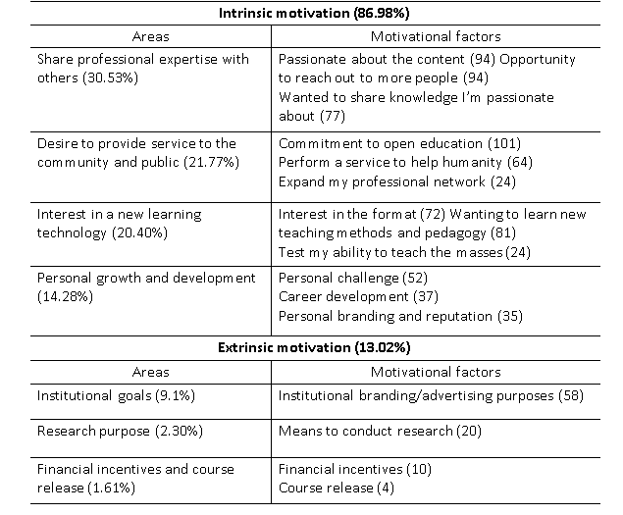
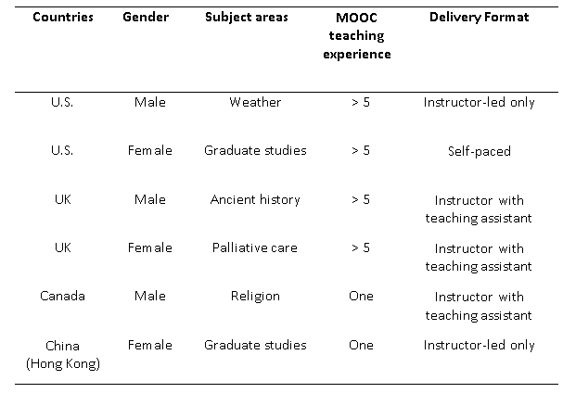
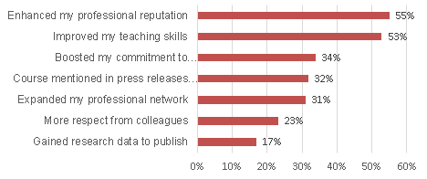
A Mixed Methods Look at MOOC Instructor Motivation and Career Development
Min Young Doo, Ying Tang, Curtis J. Bonk, and Meina Zhu
Sejong University, Indiana Univ., Wayne State University
Introduction
Results
Results-Continued
MOOCs have gained attention in higher education settings by making higher education more accessible to massive audiences on a global scale. As MOOCs proliferate, a better understanding of MOOC instructors is essential. The purpose of this study is to suggest ways to encourage instructors to teach MOOCs by investigating their motivations and frustrations when teaching MOOCs. In addition, we explore the perception of teaching MOOCs for instructors’ career development and knowledge and skills to improve their teaching of MOOCs. The research questions of this study are as follows:
(1) What motivate instructors to teach MOOCs?
(2) What aspects of teaching MOOCs influence instructors’ career development?
(3) What areas do MOOC instructors want to improve for more effective teaching in terms of professional development?
RQ1: What motivate instructors to teach MOOCs?
RQ3: What areas do MOOC instructors want to improve for more effective teaching in terms of professional development?
The participants reported that there was a stronger need to improve skills and knowledge related to online teaching (40%) such as their “On-camera presence,” “Being good/natural/engaging in front of the camera,” “Better presentation skills in front of a camera and without an audience,” and “Faster interaction with students.” The survey participants were also interested in improving skills and knowledge in designing MOOCs (26%), such as “Making course video live” and “Efficient ways to produce mixed video/online courseware content.” Finally, those who taught MOOCs for public or non-traditional students also wanted to learn how to market their courses globally, such as “Information about better accessibility of MOOC content in less developed countries” and “Understanding how to reach a wider audience.” The interview participants mentioned many skill areas in need of refinement and improvement. Among the more common concerns related to learner assessment, interaction, and feedback.
Methods
Discussion & Conclusions
This study examined the motivation as well as the career and professional development of 142 MOOC instructors using a mixed-methods approach entailing an online survey combined with six MOOC instructor interviews. Given that MOOC instructors reside globally, a Web-based survey was designed and then administered. In addition to the online survey, this study conducted interviews to investigate the three research questions in more depth.
The survey included 20 questions in three sections: (1) demographic information and MOOCs teaching experiences (eight questions), (2) motivation for teaching MOOCs (three questions), and (3) career and professional development of MOOC instructors (nine questions).
Participants: In terms of the gender of the participants, 64.43% were male and 35.57% were female instructors. Their ages varied from under 30 (2.01%), to those in their 30s (16.11%), 40s (26.17%), 50s (28.19%), 60s (18.79%), and 70 or older (8.72%). After the survey, six interview participants were selected from those who agreed to be interviewed after completing the survey. Interviewees’ demographic information is as below:
The research findings indicate that instructors’ motivation to teach MOOCs were mostly explained by their intrinsic motivation. Since intrinsic motivation can positively influence individuals’ behaviors and attitudes toward jobs, and job satisfaction, this research finding is optimistic and promising. At the same time, it also demonstrated that there was not sufficient external support from institutions or attractive extrinsic motivating factors for teaching MOOCs. As mentioned earlier, there should be sufficient support and recognition for teaching MOOCs in institutional levels. In addition, this study grouped motivation factors into seven categories based on their contents. Intrinsic motivation included four key categories: (1) interest in new learning technology, (2) service to the public and community, (3) desire to promote subject matter, (4) personal growth and development. Extrinsic motivation related to the other three categories, (5) financial incentives and course release, (6) research purpose, and (7) institutional goals. In this study, MOOC instructors’ intrinsic motivation was stronger than their extrinsic motivation for teaching MOOCs.
In terms of the instructor perspectives, a MOOC is an effective way to network with professionals or individuals who have the same academic interests. In terms of career development, this study demonstrated that half of the MOOC instructors surveyed expected to enhance their professional reputations and to improve their instructional acumen by teaching MOOCs. These MOOC instructors believed that they could bolster their reputation among those who are interested in the subject matter and use their MOOC as a means to demonstrate their expertise via the cutting-edge format of MOOCs.
The research findings of the present study indicated that MOOC instructors want to learn more about how to deliver MOOCs effectively. They also seek vigorous, but practical, ways to evaluate students’ learning progress. MOOC instructors may also be anxious about their on-camera presence and have concerns about how they visually engage with students. They recognize the vast room for personal improvement in teaching MOOCs so they could be high quality MOOC instructors.
It cannot be overemphasized that the training of instructors is vital for MOOC impact and sustainability. The research findings of this study are expected to help organizations and institutions offering MOOCs and those who are interested in teaching MOOCs understand MOOC instructors’ motivations and their career development goals and needs related to MOOCs. Of course, with a fast-expanding MOOC instructor population, much more needs to be done.
RQ2: What aspects of teaching MOOCs influence instructors’ career development?

