Slide 2
Panelists: 1. Briefly introduce yourself
Som Naidu, Pro-Vice Chancellor Flexible Learning and Director, Center for Flexible Learning, The University of the South Pacific, Fiji Islands
Shironica P. Karunanayaka, Professor in Educational Technology, Dean/Faculty of Education, The Open University of Sri Lanka
Deepak Bhartu, Open Education Design Architect, Centre for Flexible Learning, The University of the South Pacific, Laucala Campus, Suva, Fiji Islands
Martha Cleveland-Innes, Professor of Educational Innovation, Athabasca University, Alberta, Canada
Tadinada V. Prabhakar, Professor, Department of Computer Science and Engineering, Indian Institute of Technology Kanpur (IITK), India

Slide 3
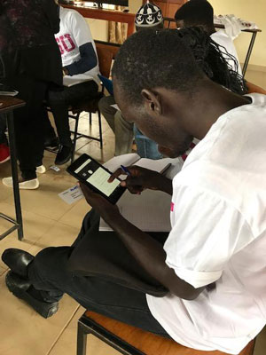
Panelists:
2. Could you please tell us about the status of MOOCs and OER in your country/education systems/institution including successful achievements and collaborations as well as the challenges?

Slide 4
Panelists:
3. What can we learn from the Global South to leverage MOOCs and OER for sustainable development?

Slide 5
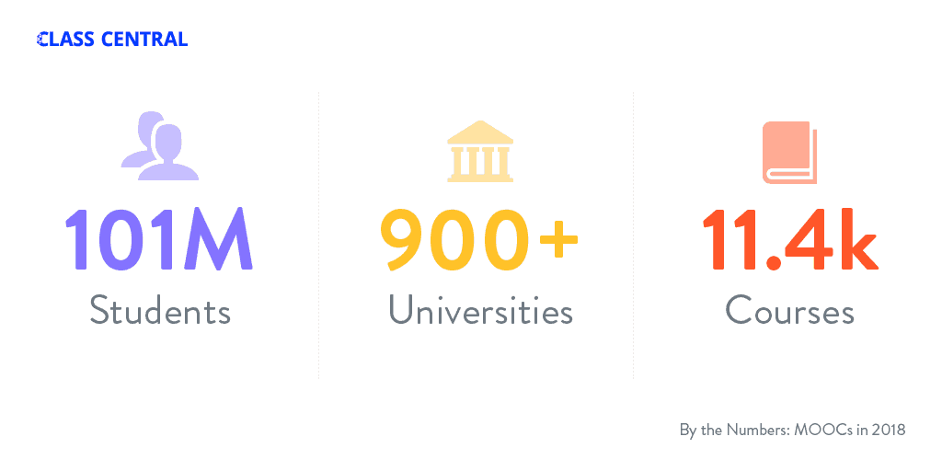
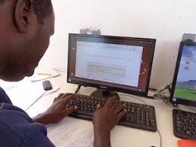
Panelists:
4. Some predict that the primary focus areas of MOOCs in 2040 will target adult learners in the workforce with opportunities for professional development and job reskilling and upskilling. Embedded in these predictions are visions of MOOCs playing a role in late adulthood hobbies, entertainment interests, and career change. What’s perhaps more striking, many of these people expect that Global South participants will be the majority of MOOC participants by 2040. Is any of this accurate? If so, what are the ramifications? Who wants to comment?

Slide 6
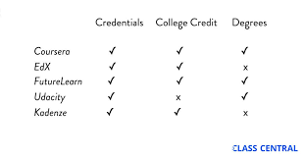
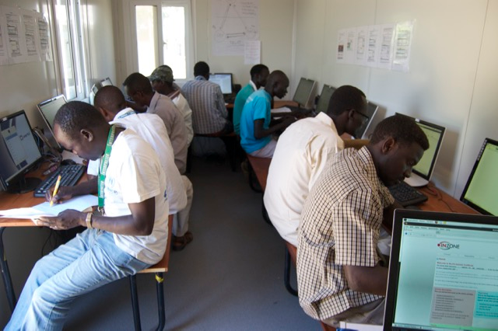
Panelists:
5. Some also predict that as part of this transformation in legitimacy and acceptance of open forms of learning and training, MOOC experiences will be increasingly reflected and expected on one’s resume. In addition, they say MOOCs will also offer free and credentialed educational experiences for all secondary school academic requirements as well as the first year or two of higher education by 2025. What are your thoughts and experiences?

Slide 7
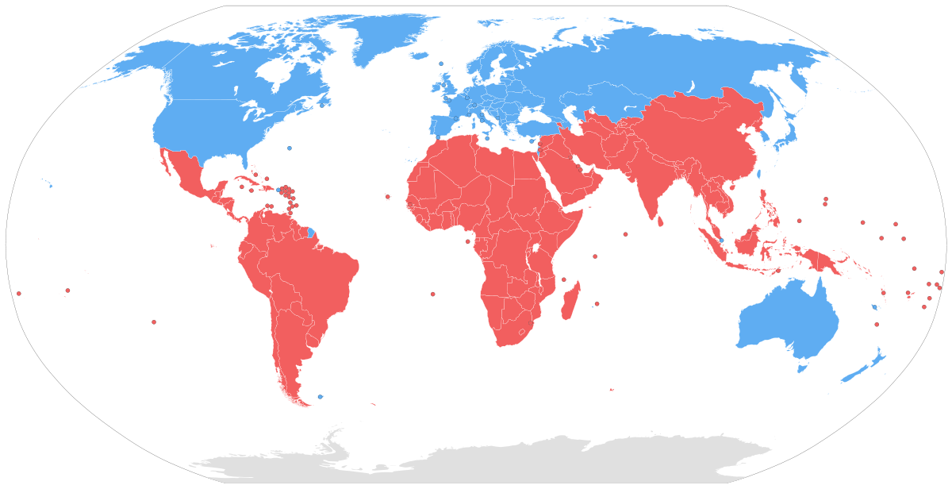
Panelists:
6. If time permits….Is there anything we haven’t discussed terms of future directions/opportunities about MOOCs and OER development and implementation in your country/institution and in the Global South in general? Any visions we have not heard or addressed?

Slide 8
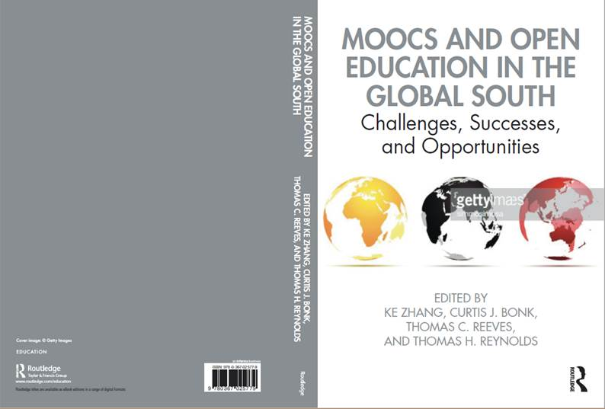
Zhang, K., Bonk, C. J., Reeves, T. C., & Reynolds, T. H. (Eds.). (in press). MOOCs and Open Education in the Global South: Challenges, Successes, Opportunities. NY: Routledge. http://moocsbook.com/

Slide 9
Questions and Comments?
Som Naidu, sommnaidu@gmail.com
Shironica P. Karunanayaka, shironica.k@gmail.com
Deepak Bhartu, deepak.bhartu@usp.ac.fj
Martha Cleveland-Innes, martic@athabascau.ca
Tadinada V. Prabhakar, TVP@cse.iitk.ac.in
Curtis J. Bonk, cjbonk@indiana.edu, IU
(Free book: http://tec-variety.com/)

