Slide 1
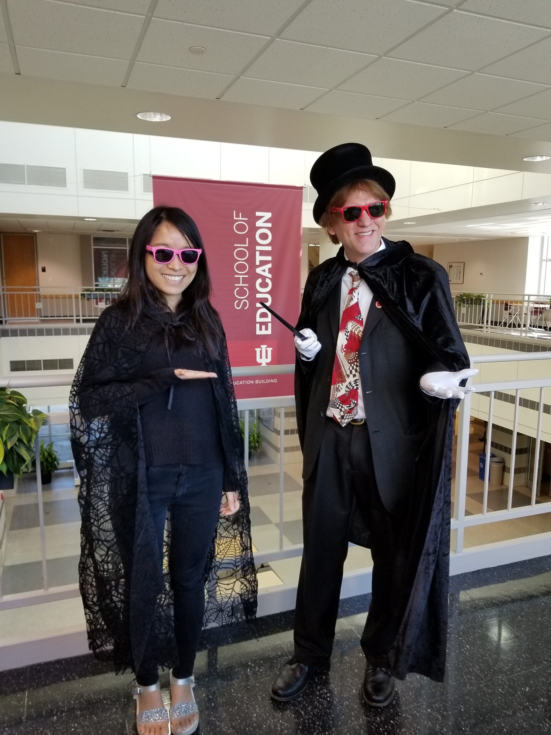
Research Insights into How Instructors Design and Deliver MOOCs to Facilitate Participant Self-monitoring
Meina Zhu
meinazhu@wayne.edu| Wayne State University
Curtis J. Bonk
cjbonk@indiana.edu| Indiana University Bloomington

Slide 2
Research Theme #1
Theme #1: Meina Zhu, Annisa Sari, Ying Tang (a visiting scholar in Hong Kong…now post-doc in Informatics), and I have spent four years developing a unique database of over 3,300 massive open online course (MOOC) instructors from around the world.
We have mined by looking at MOOC instructor motivation (why do they do this?), personalization practices, cultural sensitivity, gamification practices, instructional design challenges, pedagogical practices, how they foster learner self-directed learning, professional development (how are they trained), engagement and altruistic behaviors, etc.

Slide 3
Research Theme #2
Theme #2: Meina and Annisa are also working with Mimi Lee (an IST alum at the U of Houston) to do a systematic comprehensive review of ALL MOOC research in SCOPUS database and other journals not in SCOPUS since inception (nearly 500 studies) (2009-2019). I am supervising the project and mentoring them so they learn to publish without my name attached.

Slide 4
Outline
Research Background
Research Purpose and Questions
Research Design
Results
Discussion, Conclusion, Limitations,
and Implications

Slide 5
Key Terms

Slide 6
Key Terms
Massive Open Online Courses (MOOCs)
Coined by David Cormier from Canada when he referred to the Connectivism and Connective Knowledge course (de Freitas et al., 2015; Fini, 2009).

Slide 7
Key Terms
“Massive”
The large number of learners enrolled in a MOOC. One study revealed that the median number of learners in a MOOC was around 8,000 (Chuang & Ho, 2016) at the time of the study.

Slide 8
Key Terms
“Open”
Access to the course content. Usually, learners enroll in MOOCs with minimal requirements; once enrolled, they can obtain all course resources, interact with peers, and share their knowledge with classmates (Daniel, 2012; Kop, 2011; McAuley, Stewart, Siemens, & Cormier, 2010).

Slide 9
Key Terms
Self-directed learning (SDL) (Garrison, 1997)
(1) Self-management
(2) Self-monitoring
(3) Motivation

Slide 10
MOOCs Examples

Slide 11
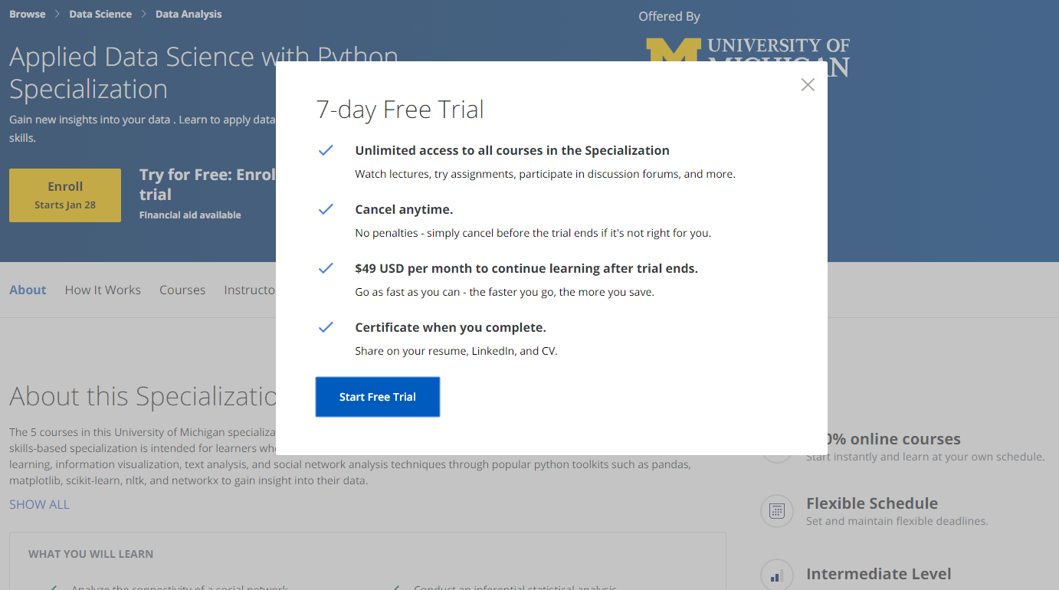
MOOC Certificate

Slide 12
MOOC Degree

Slide 13
MOOC Degree

Slide 14
EdX: From MicroMasters to Online Master’s Degrees

Slide 15
MOOC Degree

Slide 16
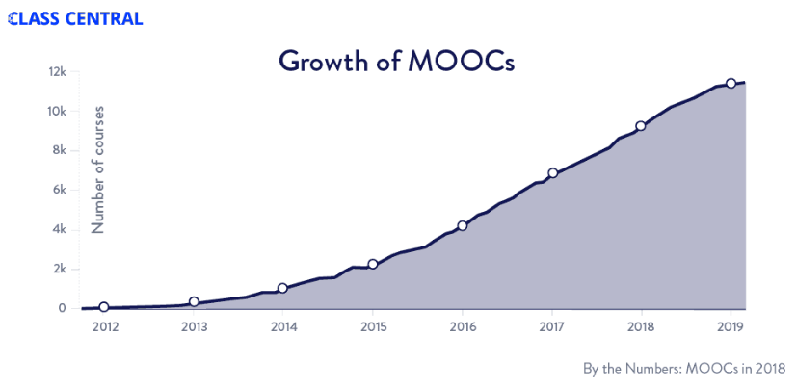
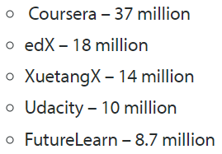
MOOCs Trends
Year of MOOC-based Degrees: A Review of MOOC Stats and Trends in 2018, Dhawal Shah, Class Central--January 6, 2019
Top five MOOC providers

Slide 17
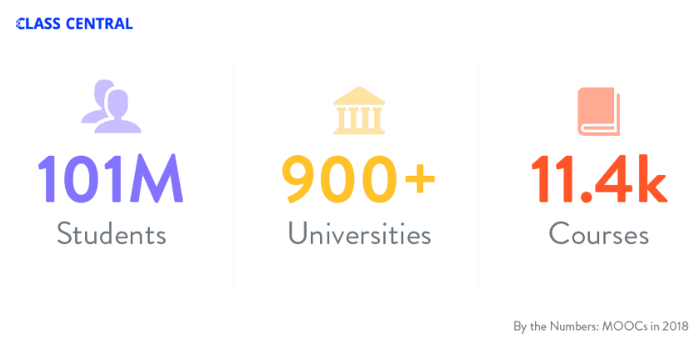
MOOCs Stats
Year of MOOC-based Degrees: A Review of MOOC Stats and Trends in 2018, Dhawal Shah, Class Central--January 6, 2019

Slide 18
Research Background

Slide 19
Research Background
Learners need self-directed learning skills and strategies to be successful in MOOCs (Kop & Fournier, 2010; Littlejohn, Hood, Milligan, & Mustain, 2016), as there is a lack of personalized interaction with teachers.
Self-monitoring, as one of the SDL skills, can improve learning performance (Chang, 2007; Coleman & Webber, 2002).
Teaching self-monitoring skills will benefit learners (e.g., Delclos & Harrington, 1991; Maag et al., 1992; Malone & Mastropieri, 1991; Schunk, 1982).

Slide 20
Research Background
However, few studies have examined instructional design and the delivery of instruction using MOOCs from instructor perspectives (Zhu, Sari, & Lee, 2018; Margaryan et al., 2015; Watson et al., 2016); especially lacking is research on instructors’ perception of student self-monitoring and how they design MOOCs to facilitate student self-monitoring.

Slide 21
Research Purpose and Questions

Slide 22
Research Purpose
This study is to inform instructors or instructional designers and MOOC providers of the current practices of designing and delivering MOOCs to facilitate student self-monitoring by finding out how the instructors who are concerned with facilitating self-monitoring skills put these considerations into MOOC design.

Slide 23
Research Questions
How do MOOC instructors design and deliver their MOOCs to facilitate students’ self-monitoring skills?
How are various technologies employed to support MOOC learners’ self-monitoring skills?

Slide 24
Research Design

Slide 25
Research Design
Explanatory sequential mixed methods design (Creswell & Plano-Clark, 2017)
Pilot survey with 48 instructors
Survey
198 instructors
Review 22 MOOCs of interviewees
Interview 22 instructors
Review 22 MOOCs of interviewees
Pilot interview with 4 instructors

Slide 26
Data Collections
Survey:
Volunteer sampling (Creswell & Plano-Clark, 2017)
198 instructors responded to the survey (18% response rate)
Interview:
Homogeneous purposeful sampling (Creswell & Plano-Clark, 2017; Patton, 2002)
Maximal variation sampling (Creswell & Plano-Clark, 2017)
22 interviewees via Zoom
Document analysis:
Reviewed 22 interviewees’ MOOCs

Slide 27
Pseudonym | Country | Subject area | Platform | Gender | No. of O/B | No. of M | Mode of the M
Lucas | US | Social science | edX | M | 0 | 1 | I without T
Branden | US | Education | Udacity | M | 0 | 5 or more | Self-paced
Logan | US | Literacy and Language | Coursera | M | 5 or more | 5 or more | I with T
Emma | US | Literacy and Language | Coursera | F | 2 | 1 | Self-paced
Jason | US | Science | edX | M | 1 | 1 | I with T
Jackson | US | Medicine and health | Coursera | M | 5 or more | 1 | Self-paced
Samuel | US | Education | FutureLearn | M | 4 | 3 | Self-paced
Hannah | US | Education | Blackboard | F | 5 or more | 1 | I with T
Ashley | US | Education | EdX | F | 0 | 5 or more | I with T
Andrew | UK | Art | FutureLearn | M | 0 | 3 | I with T
Emily | UK | Medicine and health | FutureLearn | F | 2 | 2 | I with T
Aiden | UK | Social science | FutureLearn | M | 0 | 1 | Self-paced
Henry | UK | Social science | FutureLearn | M | 0 | 1 | Self-paced
Joseph | UK | Medicine and health | FutureLearn | M | 1 | 1 | Self-paced
Joshua | UK | Literacy and language | FutureLearn | M | 2 | 2 | I with T
Mason | Australia | Education | Coursera | M | 5 or more | 1 | I with T
Ethan | Australia | Business | Coursera | M | 3 | 1 | I without T
Ben | Australia | Social science | edX | M | 1 | 1 | I with T
Paul | France | Computer science | Coursera | M | 1 | 1 | I with T
Fernando | Belgium | Research methods | Blackboard | M | 5 or more | 3 | I with T
Jacob | Netherland | Science | Coursera | M | 0 | 1 | I with T
Dylan | Israel | Science | Coursera | M | 5 or more | 3 | I without T
Data Collections
Interview:
Notes:
Can we include this table or not? It is not in our paper.

Slide 28
Data Analysis
RQs | Data Sources | Data analysis | Tools
RQ1 | Survey Interview | Descriptive statistics Content analysis (Leech & Onwuegbuzie, 2007) | SPSS NVivo
RQ2 | Survey Interview | Descriptive statistics Content analysis | SPSS NVivo
RQ3 | Interview Document analysis | Content analysis Content analysis | NVivo NVivo

Slide 29
Trustworthiness
Validity survey: Experts review, think-aloud interview, and pilot test (PCA)
Reliability survey: Pilot test and internal consistency reliability (Cronbach alpha)
Triangulation: Data sources, researchers, and methods
Member checks: Interview transcriptions
Peer debriefing: Committee and colleagues
Researcher reflexivity: Constant reflection and be forthright with our positions
Thick description: Report the context, data sources, and analyses in detail
Prolonged engagement: Immerse in instructors’ MOOCs before the interview and continue reviewing the MOOCs after the interview

Slide 30
Survey Participant Disciplines

Slide 31
Results

Slide 32
RQ1 Design and the Delivery of MOOCs to Facilitate Student Self-Monitoring Skills
Table 1 Mean Score and Standard Deviation of the Specific Self-Monitoring Skills that the Participants’ MOOC Facilitate
Items | Mean | SD
helps the student be in control of his/her learning | 4.15 | 0.55
helps the student set his/her own learning goals | 3.68 | 0.91
helps the student evaluate his/her own performance | 3.94 | 0.78
helps the student be responsible for his/her learning | 4.06 | 0.79
helps the student be able to focus on a problem | 3.87 | 0.74
helps the student be able to find out information related to learning content for him/herself | 4.02 | 0.70
helps the student have high beliefs in his/her abilities of learning | 3.73 | 0.74

Slide 33
RQ1 Strategies to Facilitate Self-monitoring
Both internal feedback and external feedback were provided to help students’ self-monitoring.
Self-monitoring |  | Strategies
Internal feedback | Cognition | MOOC instructors provided quizzes for self-assessment, tutorial on technology use, learning advice, learning aids, and instructional modeling, etc.
 | Meta-cog | MOOC instructors encouraged students to reflect and think critically by providing reflection questions and building learning community.
External feedback |  | MOOC instructors, teaching assistants, and peers were involved in providing external feedback.

Slide 34
RQ1 Strategies to Facilitate Self-monitoring
Cognition
Lucas, a social science instructor stated:
I do think frequent quizzes and somewhat lengthy quizzes are really helpful... It makes the whole thing hang together as a unit. So, I gave a little quizzes at the end of my videos.

Slide 35
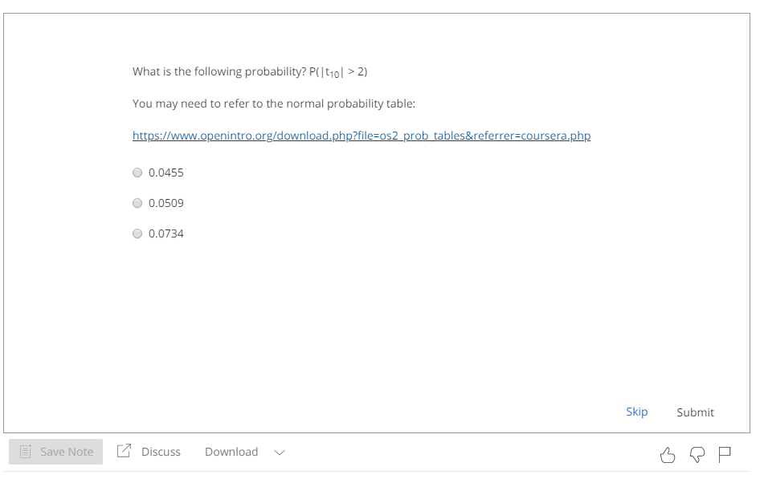
RQ1 Strategies to Facilitate Self-monitoring
Figure 1. Example of the quizzes embedded in videos used in MOOCs

Slide 36
RQ1 Strategies to Facilitate Self-monitoring
Metacognition
A science instructor from the US, Samuel, utilized weekly questions to foster self-monitoring and reflection in his MOOC. As he stated:
We do ask, kind of, a summary discussion question at the end of the week. I'll ask: “What did you learn? How do you feel about that? How would this apply to a real-world application?” So, we asked those kind[s] of reflection questions.

Slide 37
RQ1 Strategies to Facilitate Self-monitoring
External Feedback-Instructor Feedback
Joseph from the UK provided feedback through panels or lectures. As Joseph explained:
We have [a] discussion moderator, who was also in that space talking to students. So, we try to engage students on some of those points, and question some of the things that they're saying. Maybe get them to reflect.

Slide 38
RQ1 Strategies to Facilitate Self-monitoring
External Feedback-Peer Feedback
Emma, encouraged learners to provide feedback to their peers. As she observed:
We also put in peer evaluation because the interaction between students would motivate them. We give a very, very basic syllabus because we don't know what the educational background and the levels of the students. We gave them five different key points to enable them to evaluate other students on assignment.

Slide 39
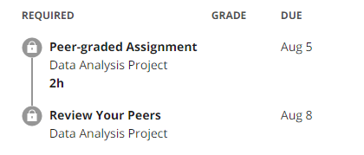
RQ1 Strategies to Facilitate Self-monitoring
Figure 2. Example of tool for peer-assessment in MOOCs

Slide 40
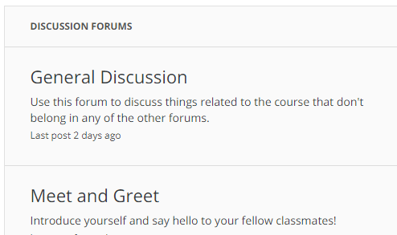
RQ1 Strategies to Facilitate Self-monitoring
Figure 3. Example from discussion forum used for building a learning community

Slide 41
RQ2 Tech Use for Self-monitoring
Synchronous communication technologies
Google Hangouts YouTube Live
Asynchronous communication technologies
Discussion forum Blog Slackbot Flickr
Feedback technologies

Slide 42
Discussion, Conclusion, Limitations, and Implications

Slide 43
Limitations
This study did not include MOOC instructors whose MOOCs were not delivered in English
Low response rate
We could not verify whether the strategies that MOOC instructors reported were effective or not

Slide 44
Discussion and Conclusion
Facilitate Self-monitoring through self-assessment: Such results concurred with the findings reported a few years ago by Kulkarni et al. (2013).
Facilitate Self-monitoring through fostering reflection: the results are in line with the implications of a study by Parker et al. (1995) and Schraw (1998).
External feedback (instructor, TAs, and peers) motivates students as well as helps learners with their self-monitoring.
Tech for Self-monitoring: These technologies included: (1) synchronous communication technologies, (2) asynchronous communication technologies, and (3) feedback tools. The results confirm with the findings of Blaschke (2012) and Junco, Heiberger, and Loken (2010) that social media can support students SDL.

Slide 45
Implications for Future Research and Practice
Future research might want to explore different forms of instructional scaffolds and supports for self-monitoring
Educators might want to design and evaluate innovative training programs for SDL in this age of massively open online teaching and learning
Designers of MOOC platforms as well as MOOC vendors might evaluate MOOC retention and completion rates resulting from the introduction of new technology tools and features for self-monitoring, self-management, and motivation

Slide 46
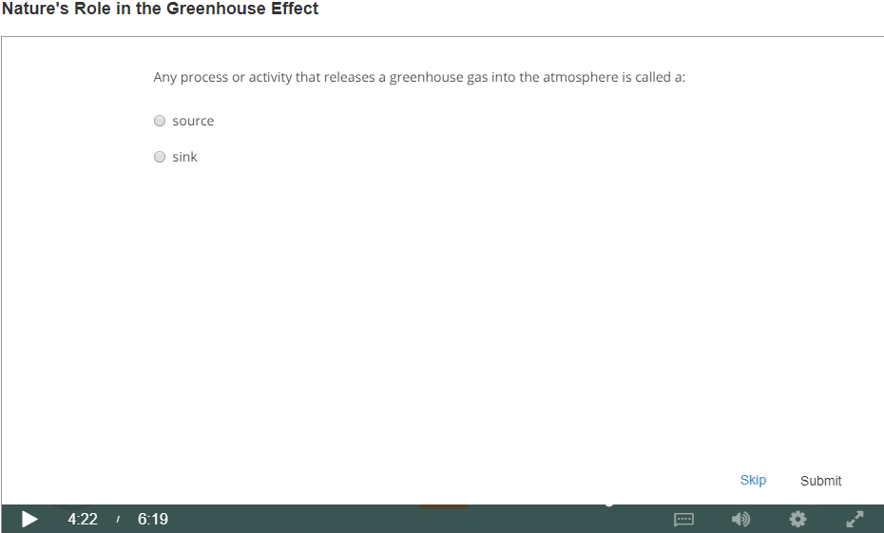
Top 10 Strategies to Facilitate SDL in MOOCs
Helping students set their own learning goals;
Building learning community;
Offering immediate feedback;
Embedding quizzes for self-assessment;
Providing progress indicators;
Providing reflection questions;
Designing short learning units;
Providing flexible timelines;
Highlighting estimated time frames;
Making available optional learning materials.

Slide 47
Follow-up study (in process)
MOOC Student Perceptions of Effective SDL Strategies
Survey (n = 314)
Interview MOOC students
Document analysis (MOOC course review)

Slide 48
Thank you!
Questions and Comments?
Meina Zhu
meinazhu@wayne.edu| Wayne State University
Curtis J. Bonk
cjbonk@indiana.edu| Indiana University Bloomington

