Slide 1
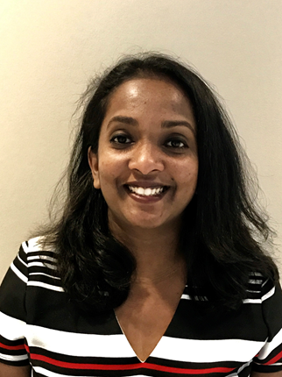
Creating Space for Academic Writing
Florence Martin, PhD
Professor in Learning, Design and Technology
University of North Carolina Charlotte
www.florencemartin.net

Slide 2
What else do I do?
Teach 2:2 courses
Program Director for Post-Masters Certificate in University and College Teaching
Program Coordinator for Learning, Design and Technology concentration in Educational Leadership
Principal Investigator of Digital Safety NSF Grant
Co-Principal Investigator of Preparing High School Teachers to Teach Programming Online NSF Grant
Associate Editor for Online Learning Journal, Special Issue Editor for Journal of Research on Technology in Education
Board Member, IBSTPI; Advisory Council Member NCVPS
University/College/Department Service
Teaching
Program Direction/Coordination
Principal Investigator
Journal Editor
External Service
Internal Service

Slide 3
Creating Space
Physical Space
Technology Space
Web Space
Schedule Space
Space - “a continuous area which is free, available, or unoccupied”.
Physical Space, Space in Schedule, Technology Space, Web Space,

Slide 4
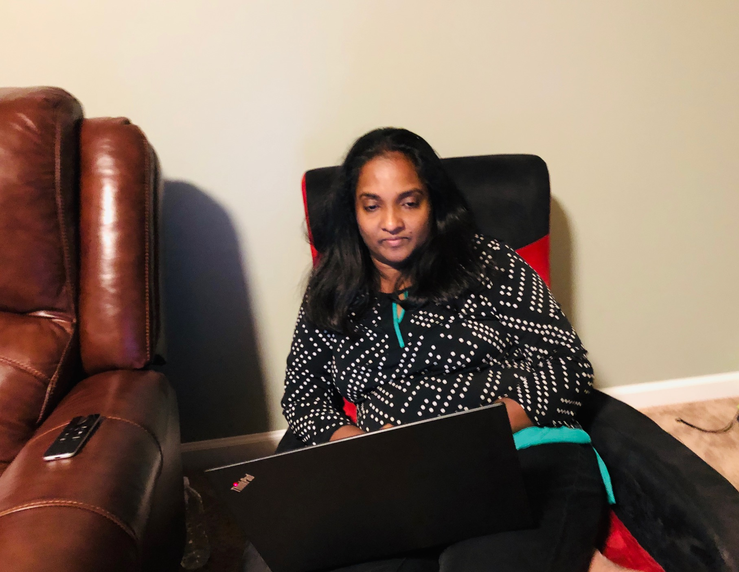
1. Physical Space
I write from anywhere

Slide 5
2. Space in Schedule
Teaching/Research/Service – 40/40/20
Research Intensive Institution – 2:2
2 days/week
Including research meetings and writing time
11 hours/this week with meetings for research
Biweekly meetings for research projects
Not setting it aside for summer

Slide 6
3. Technology Space
Use tools to increase your efficiency
Dropbox (sometimes google drive)
Mendeley
Keep track of your projects - Word
Grammarly
Otter
Zotero
MaxQDA
CMA
Online First and In press | Under Review | In progress
X X X X | X X X X | X X X X

Slide 7
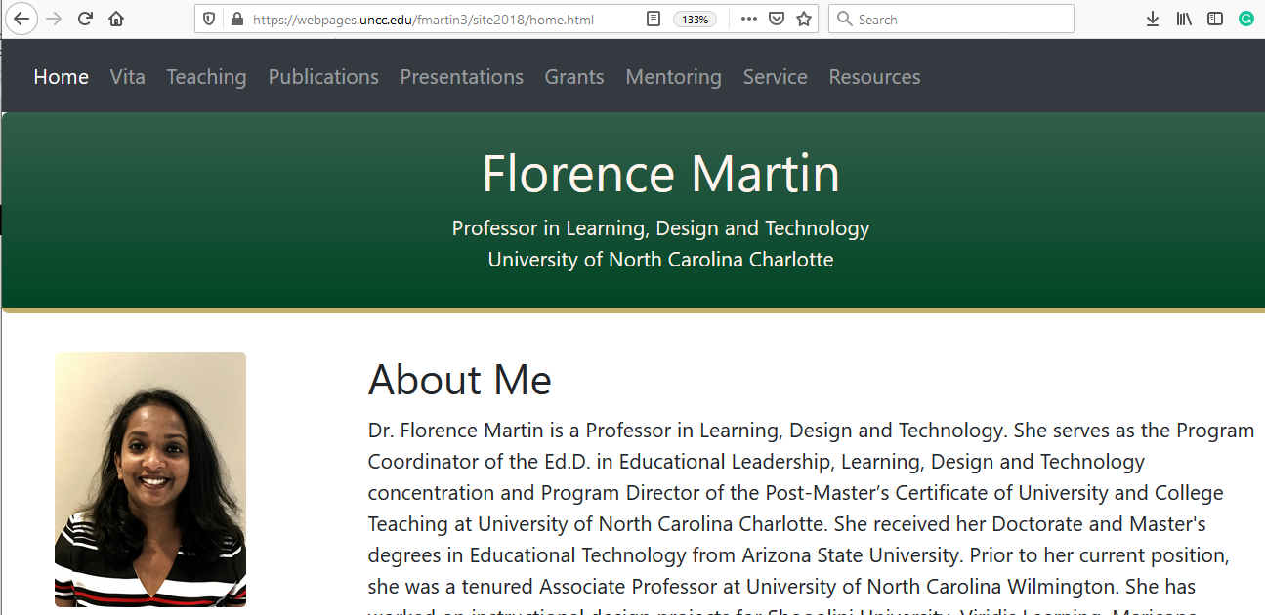
4. Web Space - Dissemination
Faculty Website
Google Scholar
Research Gate
Mendeley

Slide 8
My practices
Topic is key
Be passionate about what you write
Going deep rather than going wide
Don’t go in too many directions on research topics
Aim for high quality research
Find collaborators who have similar interests
Communicate biweekly with team
Seek funding to support your writing
Have a goal on number of publications for each year
Juggle projects
Be a life long learner

Slide 9
Good Luck

