Slide 1
Self-Direct to Learn, Self-Direct to Live: Eight MOOC Studies in an Increasingly Self-Directed Learning World
Curtis J. Bonk| cjbonk@Indiana.edu
Indiana University Bloomington
and
Meina Zhu| meinazhu@wayne.edu
Wayne State University

Slide 2
Talk Outline
MOOC News and Trends
Study #1: Systematic Review of MOOC Research
Study #2: Expanded Review of MOOC Research
Study #3: MOOC Instructor ID Considerations and Challenges
Study #4: MOOC ID for Self-directed Learning
Study #5: MOOC Instructor Personalization

Slide 3
Talk Outline
Study #6: Cultural Sensitivity in MOOCs
Study #7: MOOC Learners and SDL
Study #8: SEM and MOOC Learning

Slide 4
Polls
Poll #1: Who in here has taken a MOOC? Poll #2: Are you happy or frustrated when you take a MOOC?

Slide 5
MOOC Trends and Recent Data

Slide 6
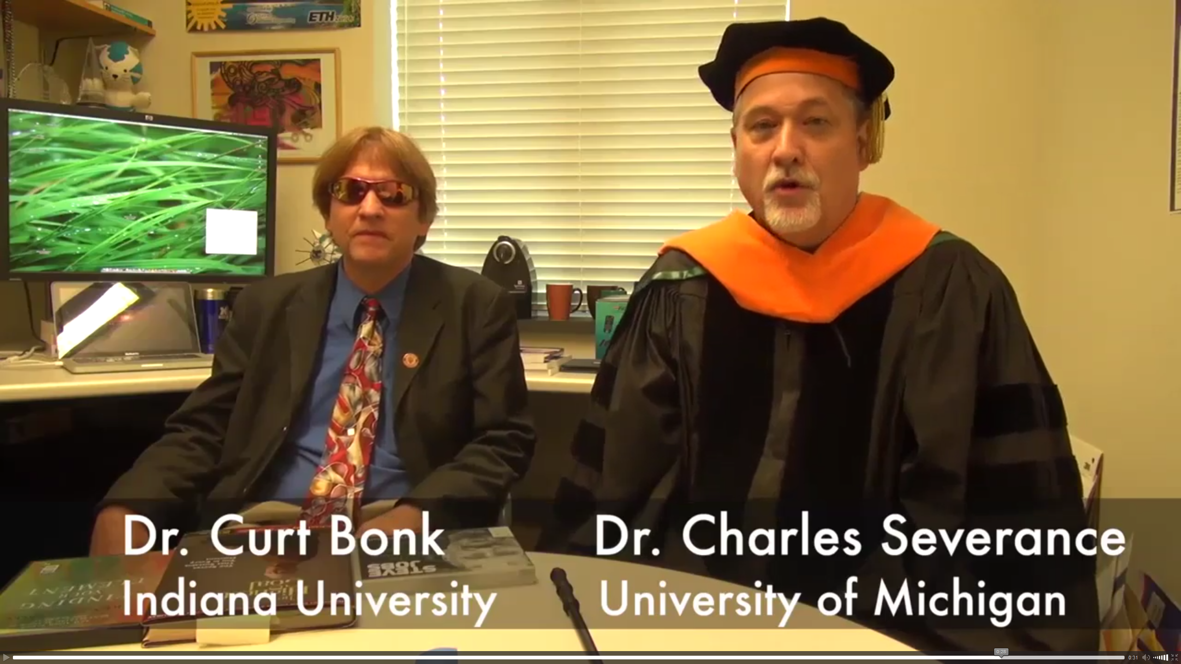
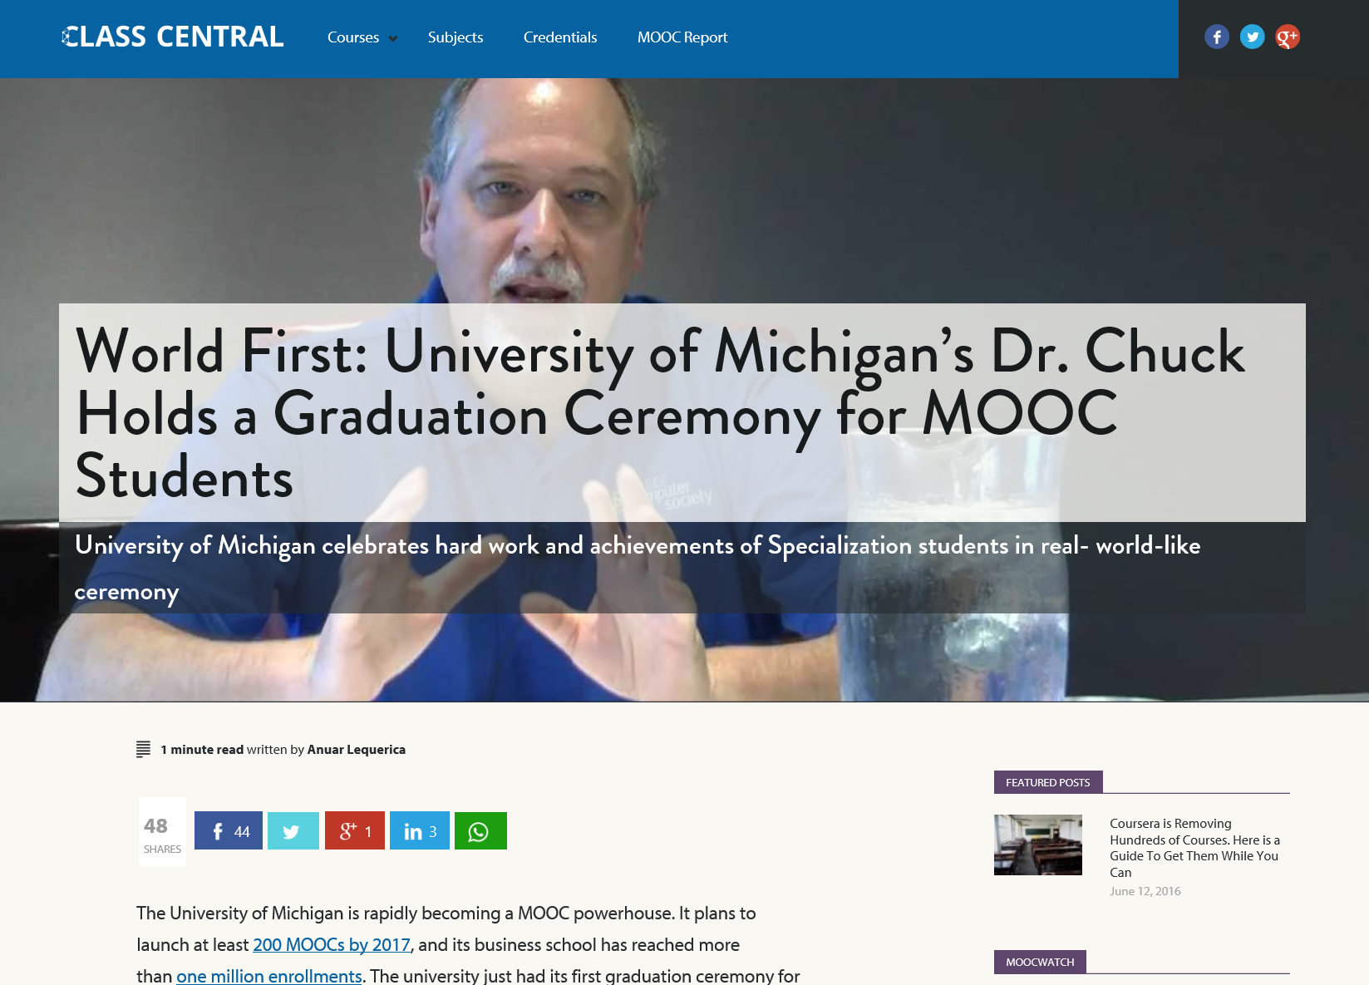
June 14, 2016 (MOOC graduation ceremonies) Chapter 15: Learning About MOOCs by Talking to Students Charles Severance, Univ. of Michigan Anuar Lequerica, Class Central https://www.class-central.com/report/dr-chuck-graduate-ceremony-python-specialization/

Slide 7
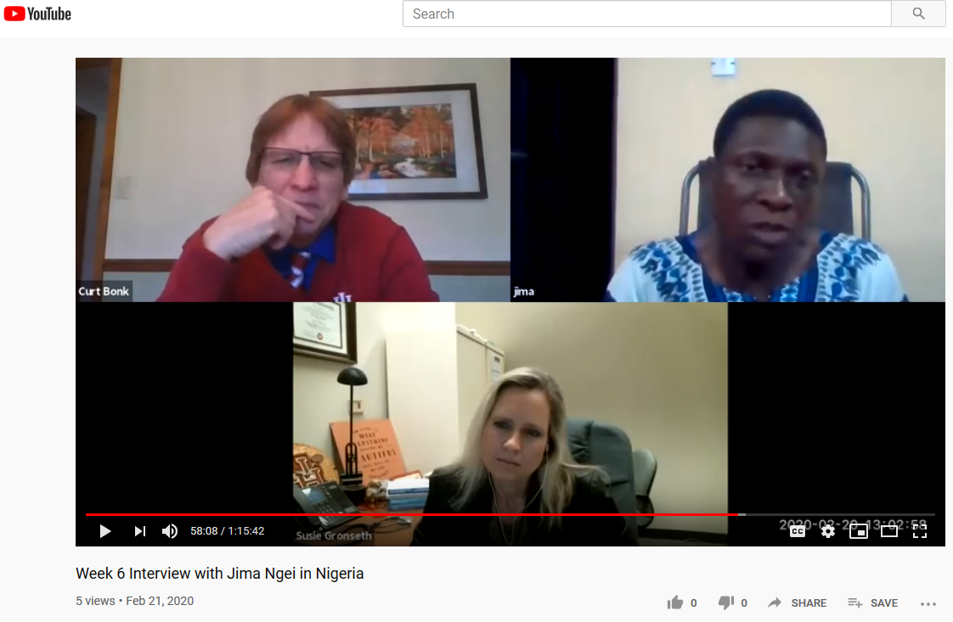
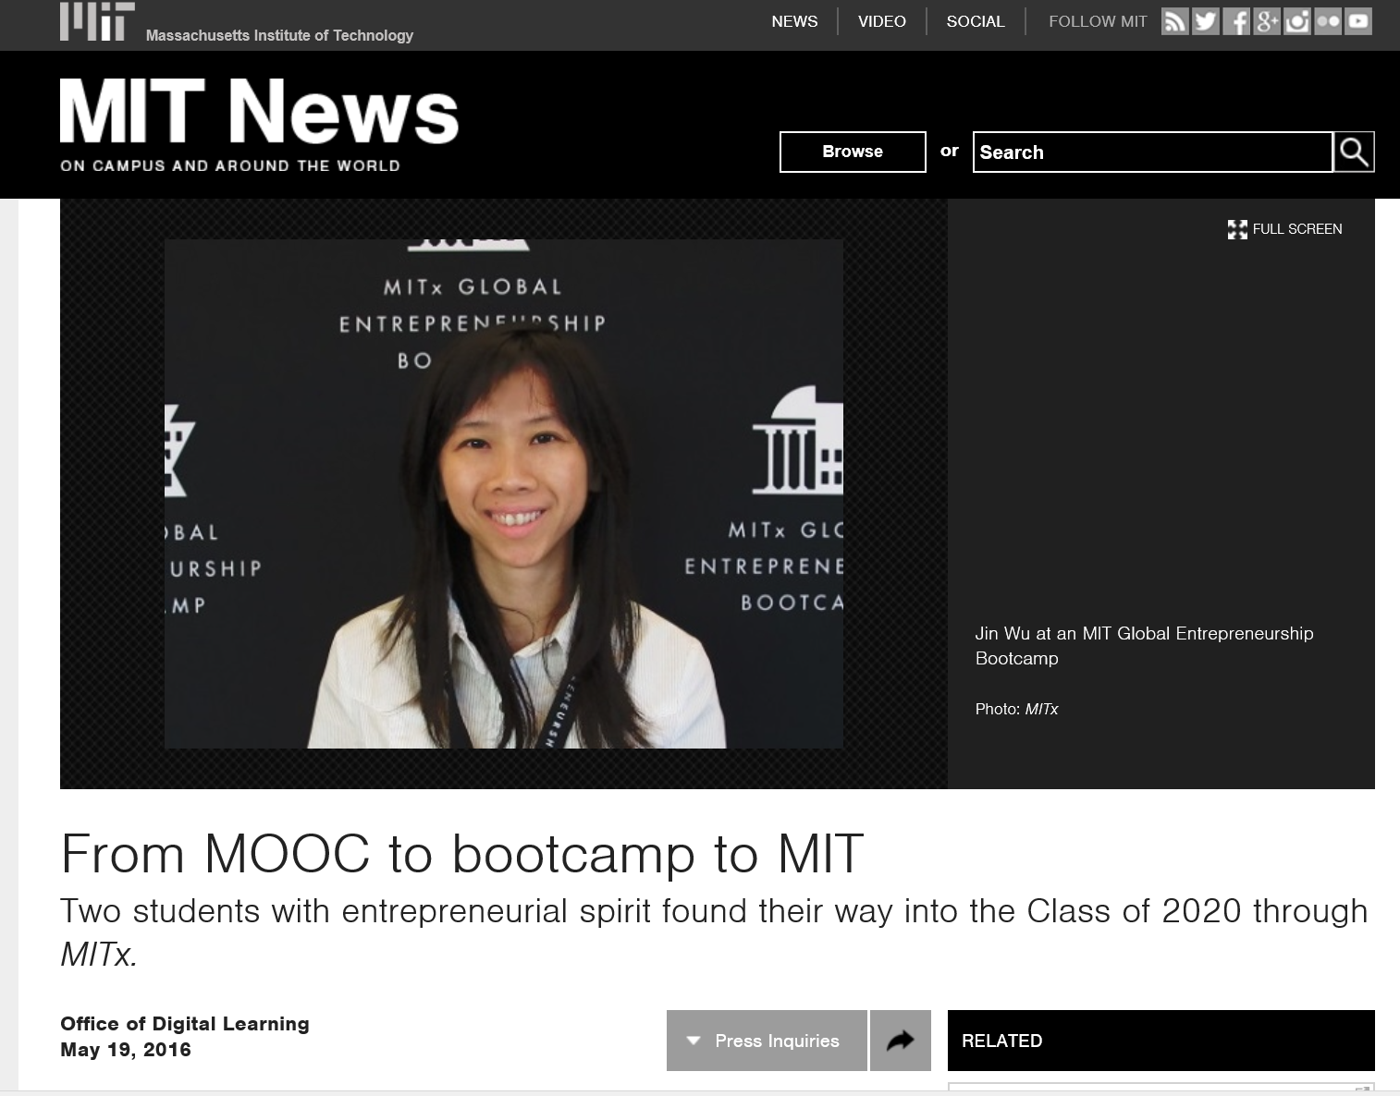
Hundred+ MOOC Clubs February 21, 2020 250 MOOCs and Counting: One Man’s Educational Journey, Chronicle of Higher Education http://chronicle.com/article/250-MOOCsCounting-One/229397/?cid=at If the MOOC movement has faded, nobody told Jima Ngei. Mr. Ngei, who lives in Port Harcourt, Nigeria, has completed and passed 250.
Jima Ngei: “I had this unrelenting fear that this miracle of free access might evaporate soon.”

Slide 8
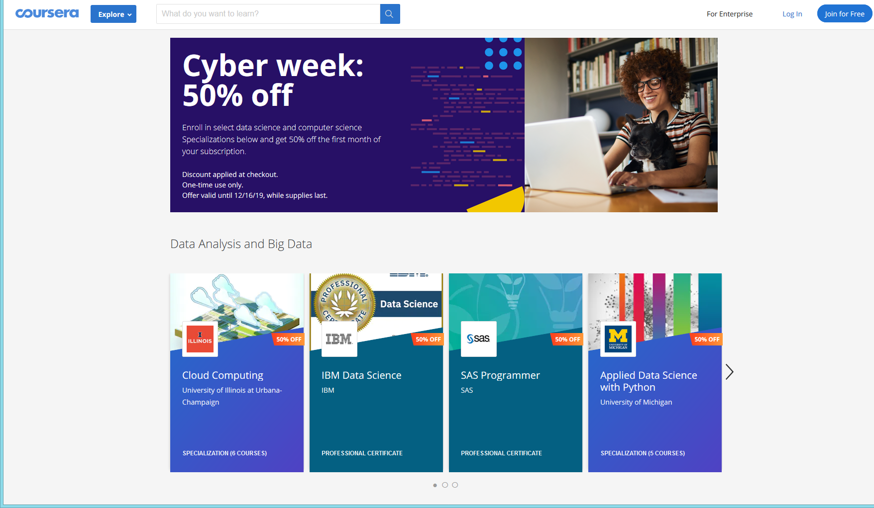
December 15, 2019 Coursera <no-reply@m.mail.coursera.org> Ends TOMORROW: 50% off top tech Specializations

Slide 9
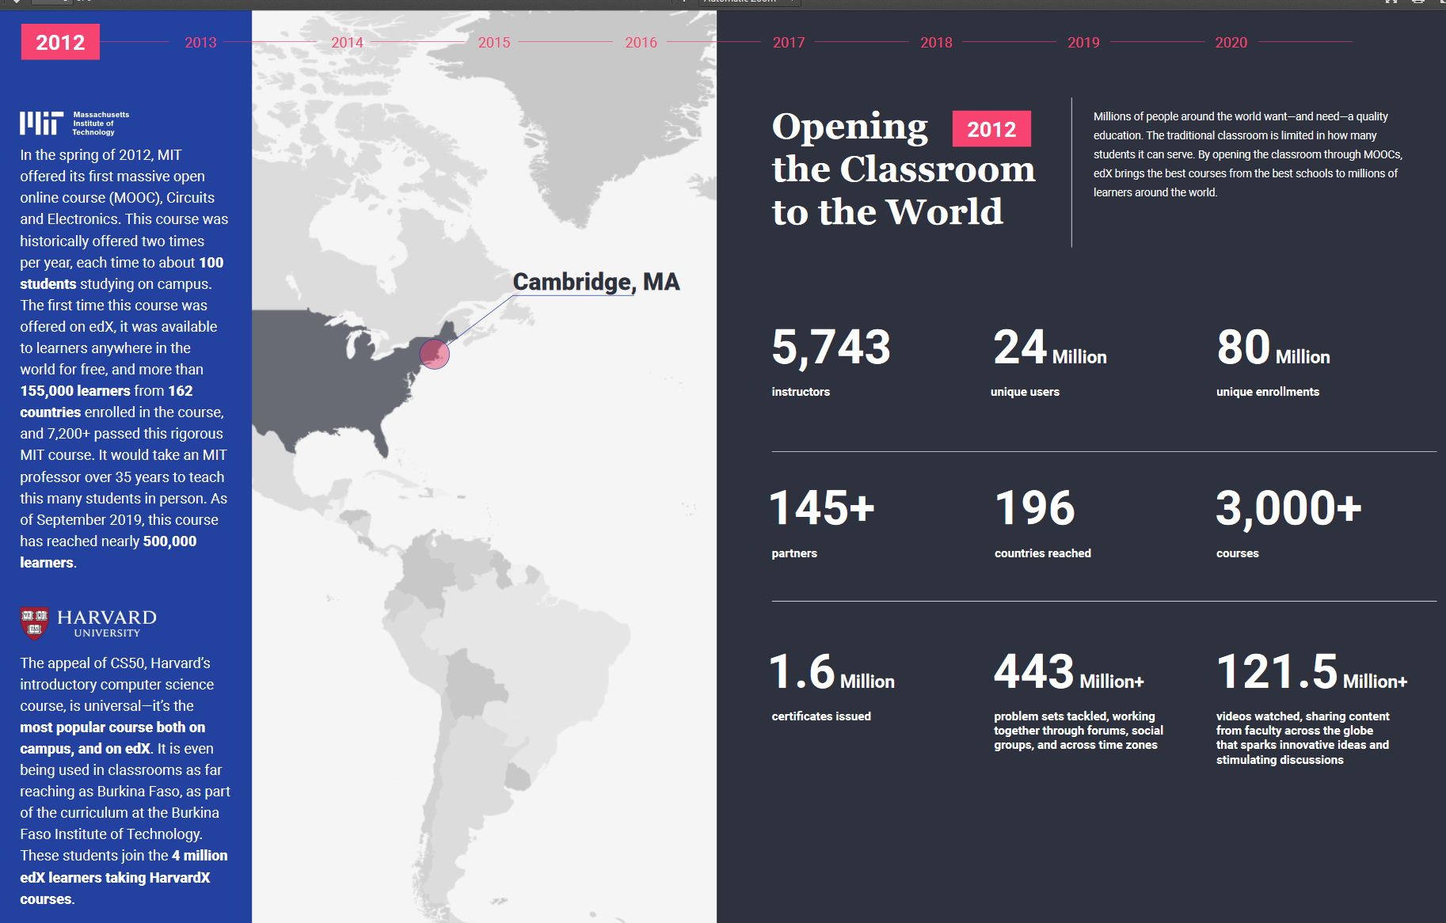
December 16, 2019 2020 Impact Report, edX https://www.edx.org/sites/default/files/2020-impact-report.pdf

Slide 10
MOOCs Stats
December 17, 2019
Online Degrees Slowdown: A Review of MOOC Stats and Trends in 2019, Dhawal Shah, Class Central
https://www.classcentral.com/report/moocs-stats-and-trends-2019/

Slide 11
MOOCs Stats
December 17, 2019
A Review of MOOC Stats and Trends in 2019
Dhawal Shah, Class Central
https://www.classcentral.com/report/moocs-stats-and-trends-2019/

Slide 12
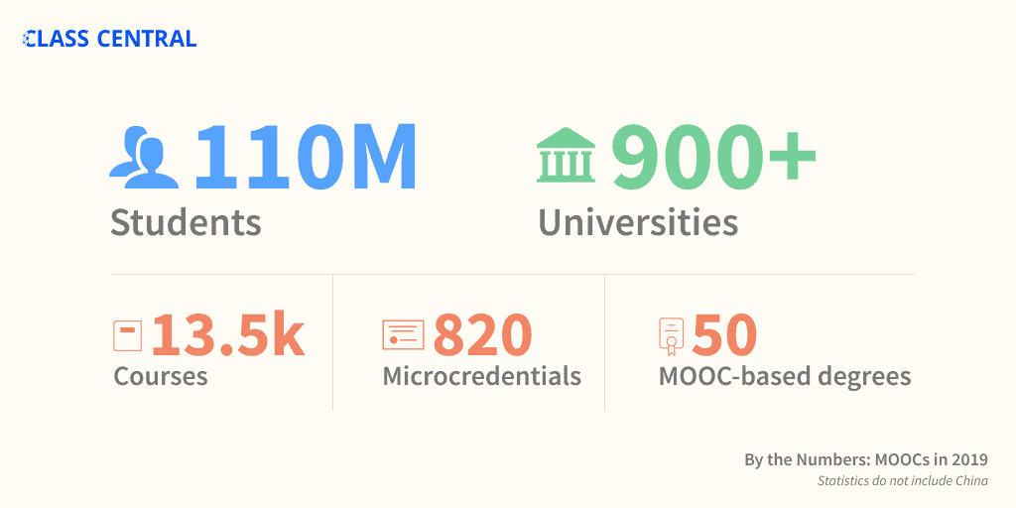
MOOCs Stats
December 17, 2019
A Review of MOOC Stats and Trends in 2019
Dhawal Shah, Class Central
https://www.classcentral.com/report/moocs-stats-and-trends-2019/

Slide 13
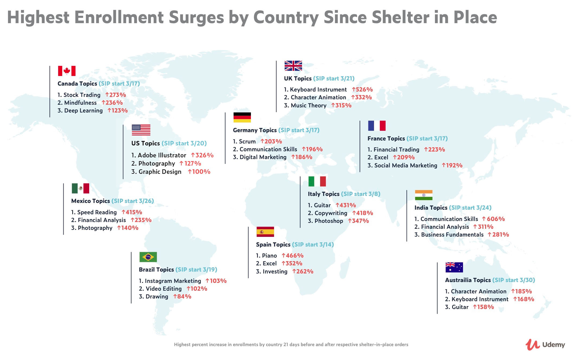
April 30, 2020 New Udemy Report Shows Surge in Global Online Ed in Response to COVID-19 People around the world are learning how to work from home and stay productive as the Future of Work arrives Businesswire: https://www.businesswire.com/news/home/20200430005243/en/

Slide 14
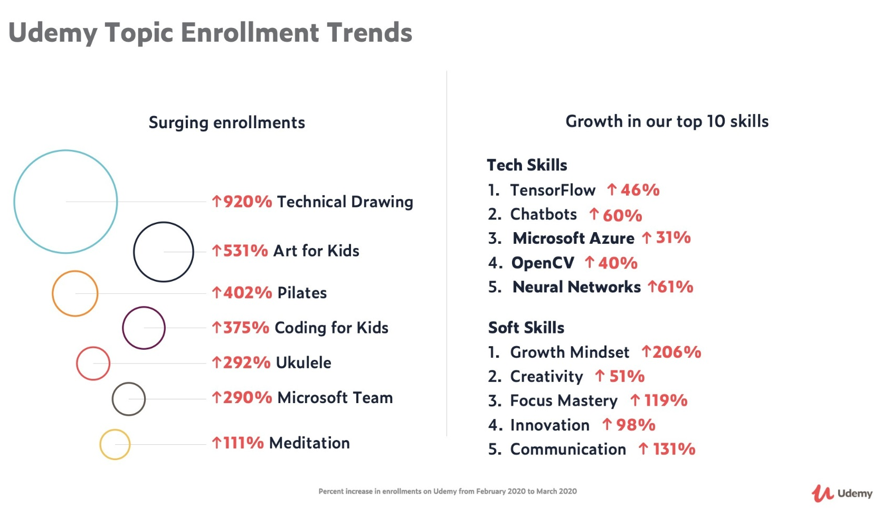
April 30, 2020 New Udemy Report Shows Surge in Global Online Education in Response to COVID-19 There has been an immense surge in enrollments in courses related to Telecommuting (21,598% increase) and Virtual Teams (1,523%), as well as Decision Making (277%), Self Discipline (237%), and Stress Management (235%).
https://www.businesswire.com/news/home/20200430005243/en/

Slide 15
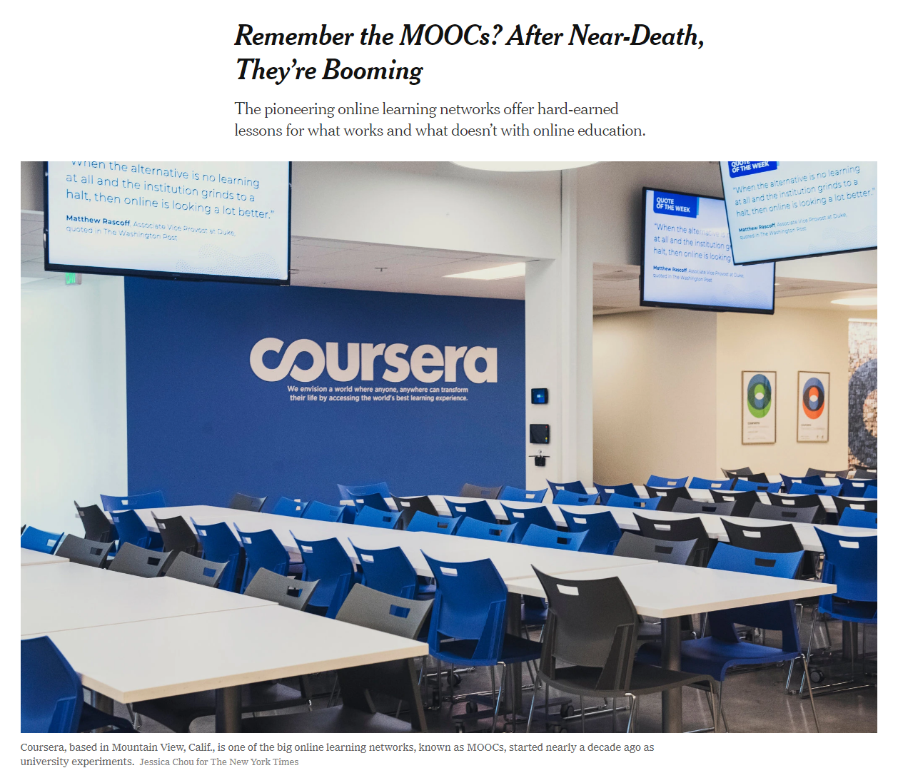
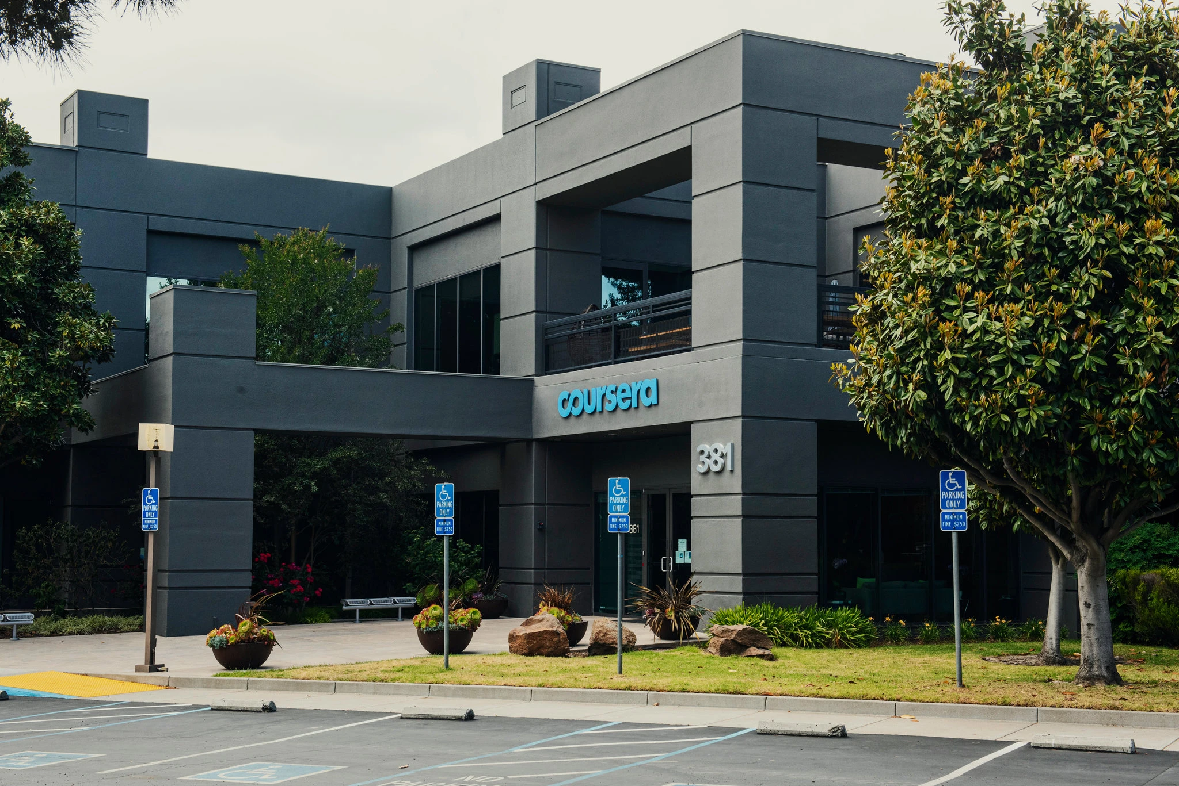
May 26, 2020 Remember the MOOCs? After Near-Death, They’re Booming Steven Lohr, The New York Times https://www.nytimes.com/2020/05/26/technology/moocs-online-learning.html
Coursera added 10 million new users from mid-March to mid-May. Credit...Jessica Chou for The New York Times

Slide 16
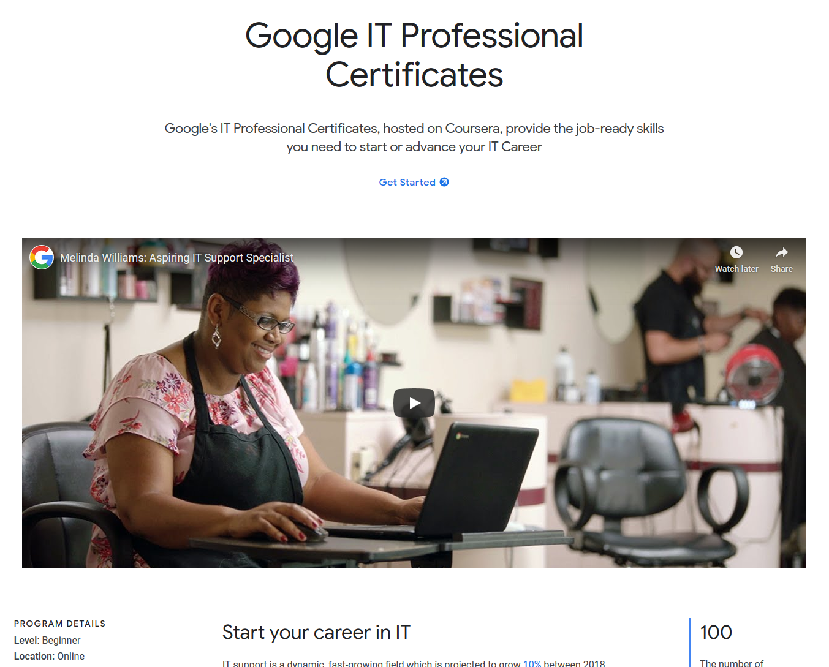
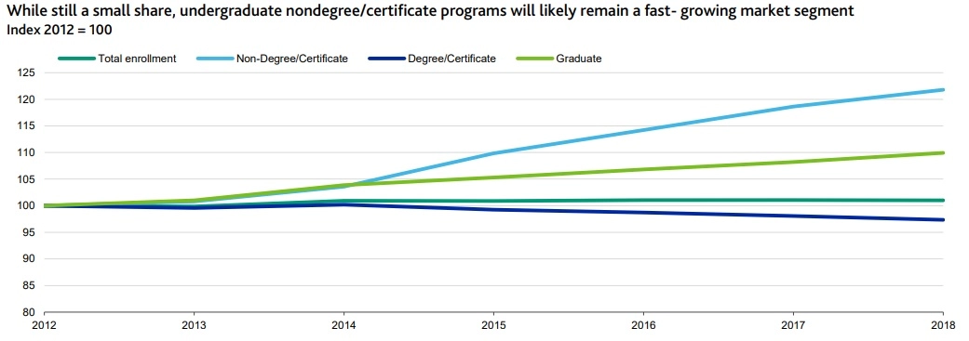
August 27, 2020 Alternative Credentials on the Rise Paul Fain, Inside Higher Ed https://www.insidehighered.com/news/2020/08/27/interest-spikes-short-term-online-credentials-will-it-be-sustained
Sources: Moody's, U.S. Department of Education

Slide 17
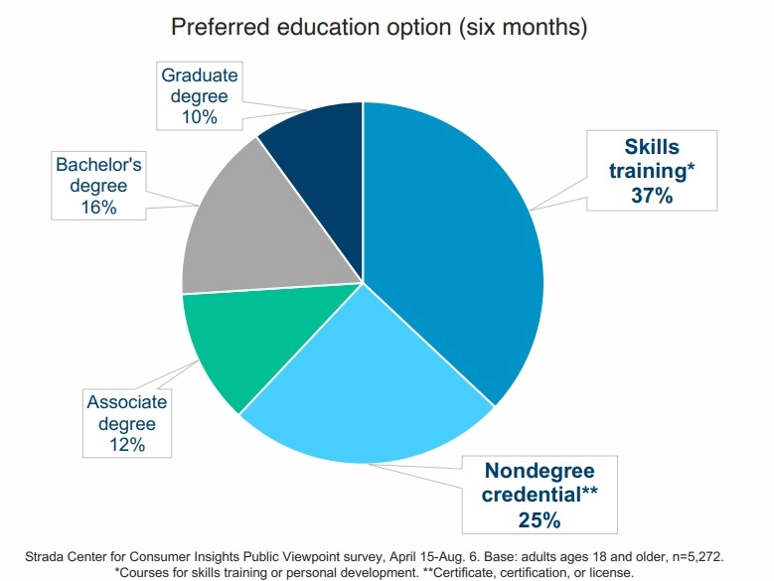
August 27, 2020 Alternative Credentials on the Rise Paul Fain, Inside Higher Ed https://www.insidehighered.com/news/2020/08/27/interest-spikes-short-term-online-credentials-will-it-be-sustained

Slide 18
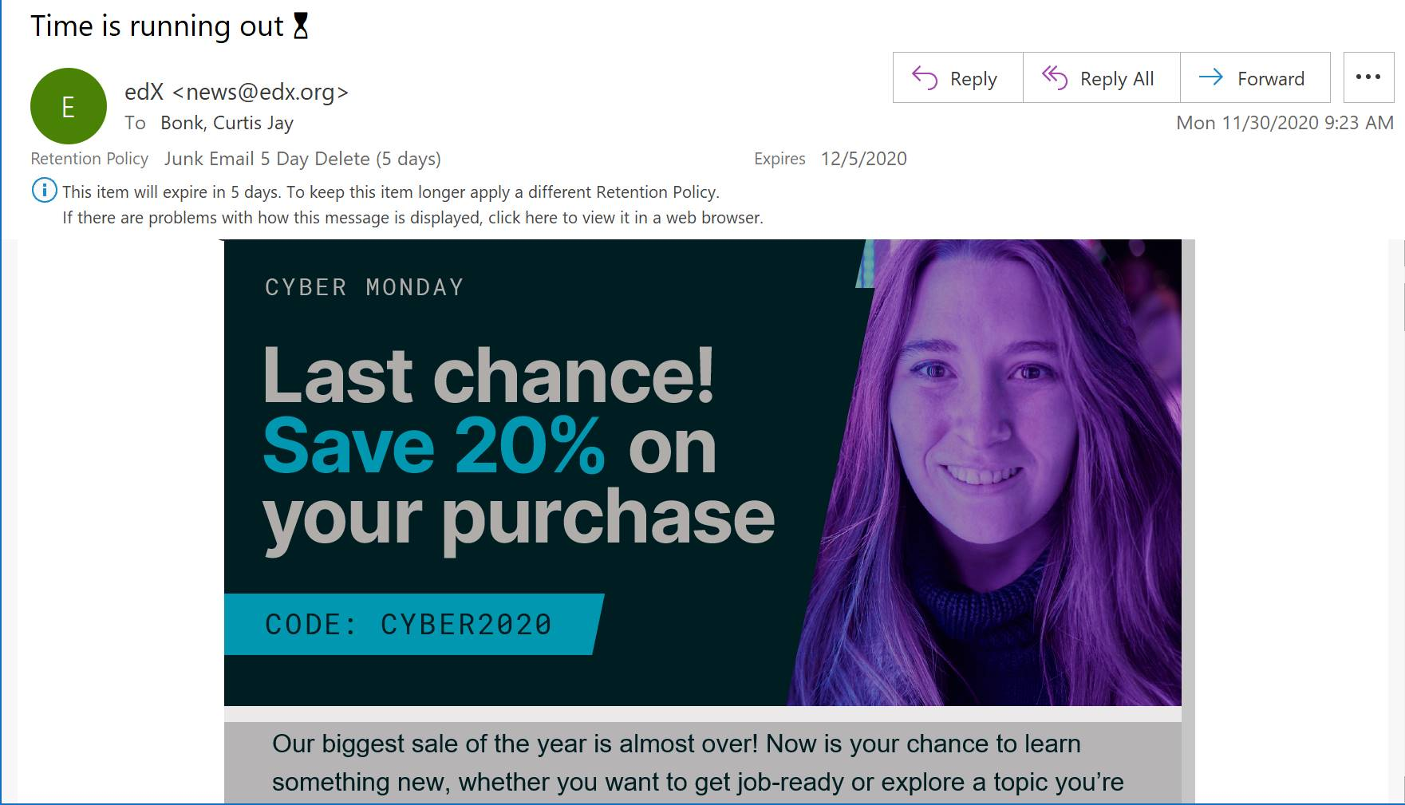
November 30, 2020 Cyber Monday

Slide 19
MOOCs Stats
December 14, 2020
The Second Year of the MOOC: A Review of MOOC Stats and Trends in 2020, Dhawal Shah, Class Central
https://www.classcentral.com/report/the-second-year-of-the-mooc/

Slide 20
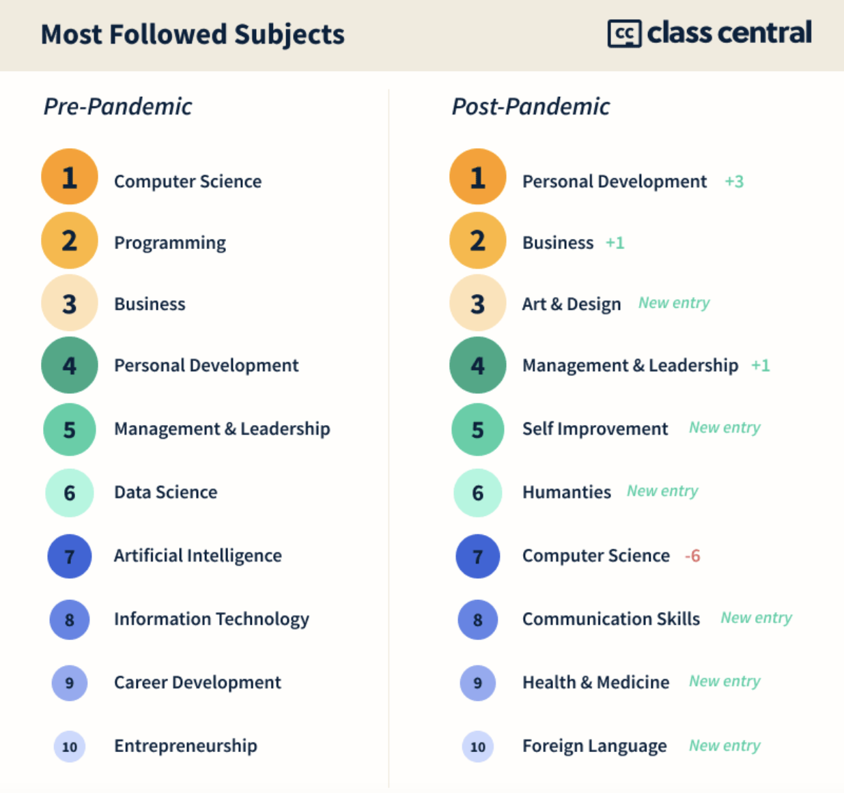
MOOCs Stats
December 14, 2020
The Second Year of the MOOC:
A Review of MOOC Stats and Trends in 2020, Dhawal Shah, Class Central
https://www.classcentral.com/report/the-second-year-of-the-mooc/

Slide 21
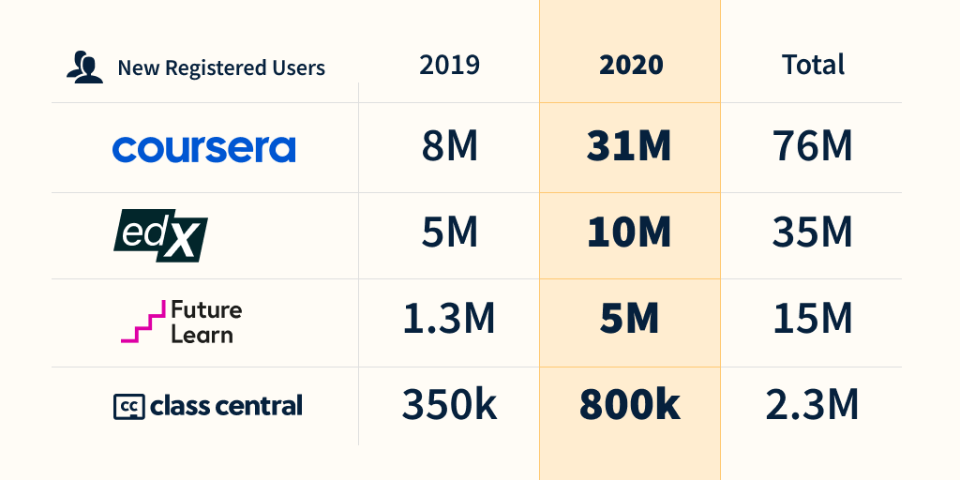
MOOCs Stats
December 14, 2020
The Second Year of the MOOC: A Review of MOOC Stats and Trends in 2020, Dhawal Shah, Class Central
https://www.classcentral.com/report/the-second-year-of-the-mooc/

Slide 22
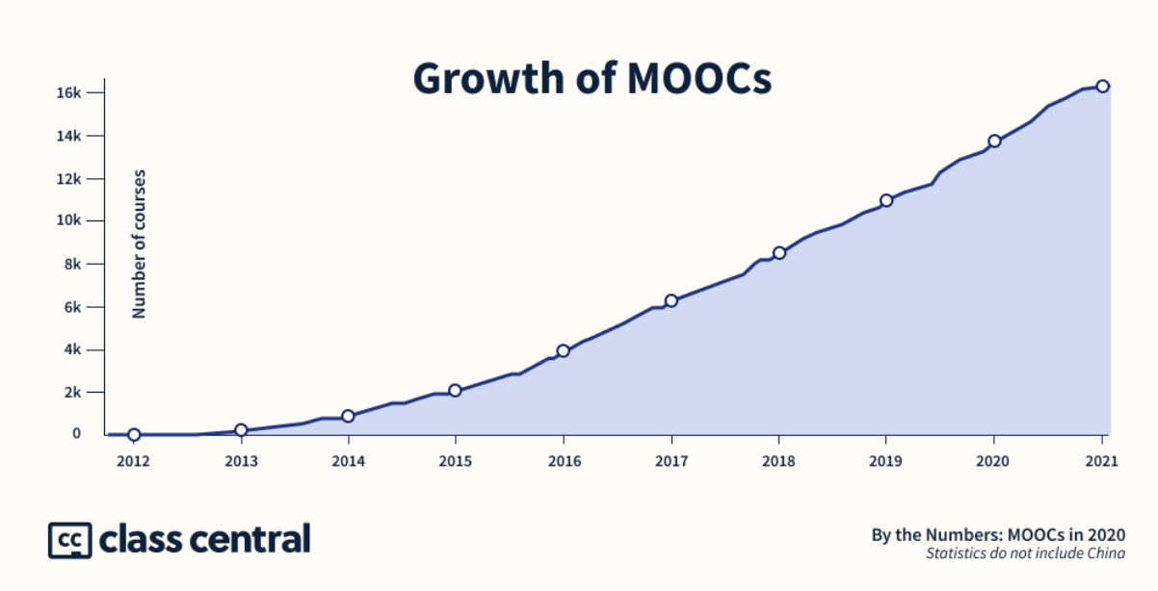
MOOCs Stats
December 14, 2020
The Second Year of the MOOC: A Review of MOOC Stats and Trends in 2020, Dhawal Shah, Class Central
https://www.classcentral.com/report/the-second-year-of-the-mooc/

Slide 23
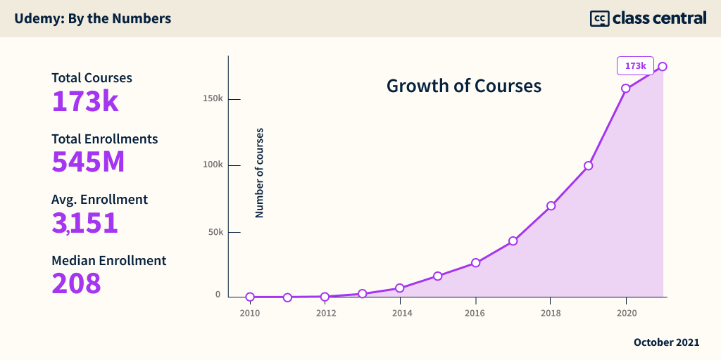
October 13, 2021 Analyzing Udemy’s IPO Filing: $430M Revenue; $30M CorpU Acquisition; Consumer Segment Stalls, Enterprise Grows. Dhawal Shah, Class Central https://www.classcentral.com/report/udemy-s1-analysis/

Slide 24
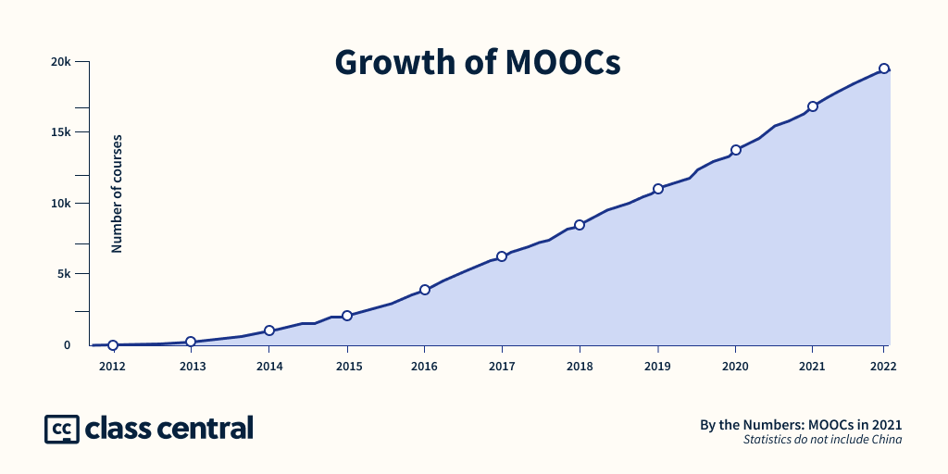
December 14, 2021 A Decade of MOOCs: A Review of MOOC Stats and Trends in 2021 Dhawal Shah, Class Central https://www.classcentral.com/report/moocs-stats-and-trends-2021/

Slide 25
December 14, 2021 A Decade of MOOCs: A Review of MOOC Stats and Trends in 2021 Dhawal Shah, Class Central https://www.classcentral.com/report/moocs-stats-and-trends-2021/

Slide 26
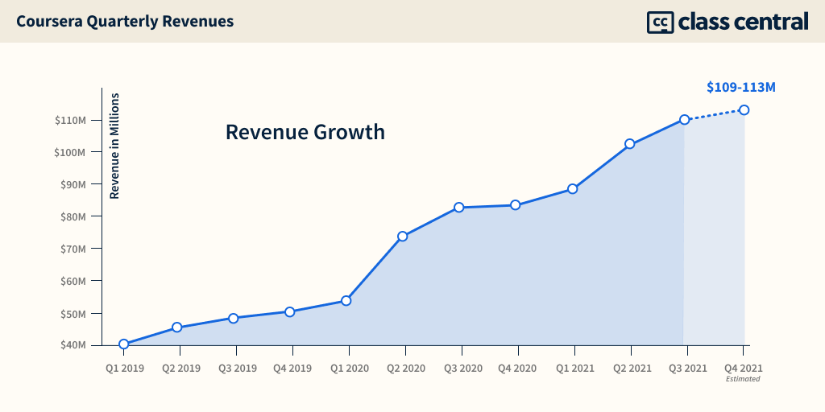
December 14, 2021 A Decade of MOOCs: A Review of MOOC Stats and Trends in 2021 Dhawal Shah, Class Central https://www.classcentral.com/report/moocs-stats-and-trends-2021/

Slide 27
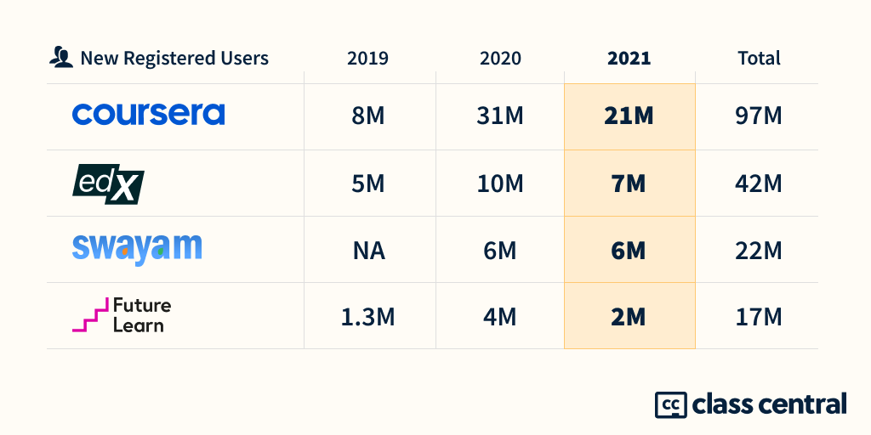
December 14, 2021 A Decade of MOOCs: A Review of MOOC Stats and Trends in 2021 Dhawal Shah, Class Central https://www.classcentral.com/report/moocs-stats-and-trends-2021/

Slide 28
Polls
Poll #1: Who in here has taken a MOOC? Poll #2: Are you happy or frustrated when you take a MOOC?

Slide 29
Weirdness #7…MOOC-based Pricing Charts December 30, 2018 MOOC-Based Degrees, Pricing Chart IBL News https://www.class-central.com/pricing-charts/mooc-based-degrees

Slide 30
Weirdness #8…MOOCs in Wedding Announcements September 26, 2018 The Future of Professional Credentialing ... in an Engagement Announcement Joshua Kim, Inside Higher Ed https://www.insidehighered.com/digital-learning/blogs/technology-and-learning/future-professional-credentialing-engagement

Slide 31
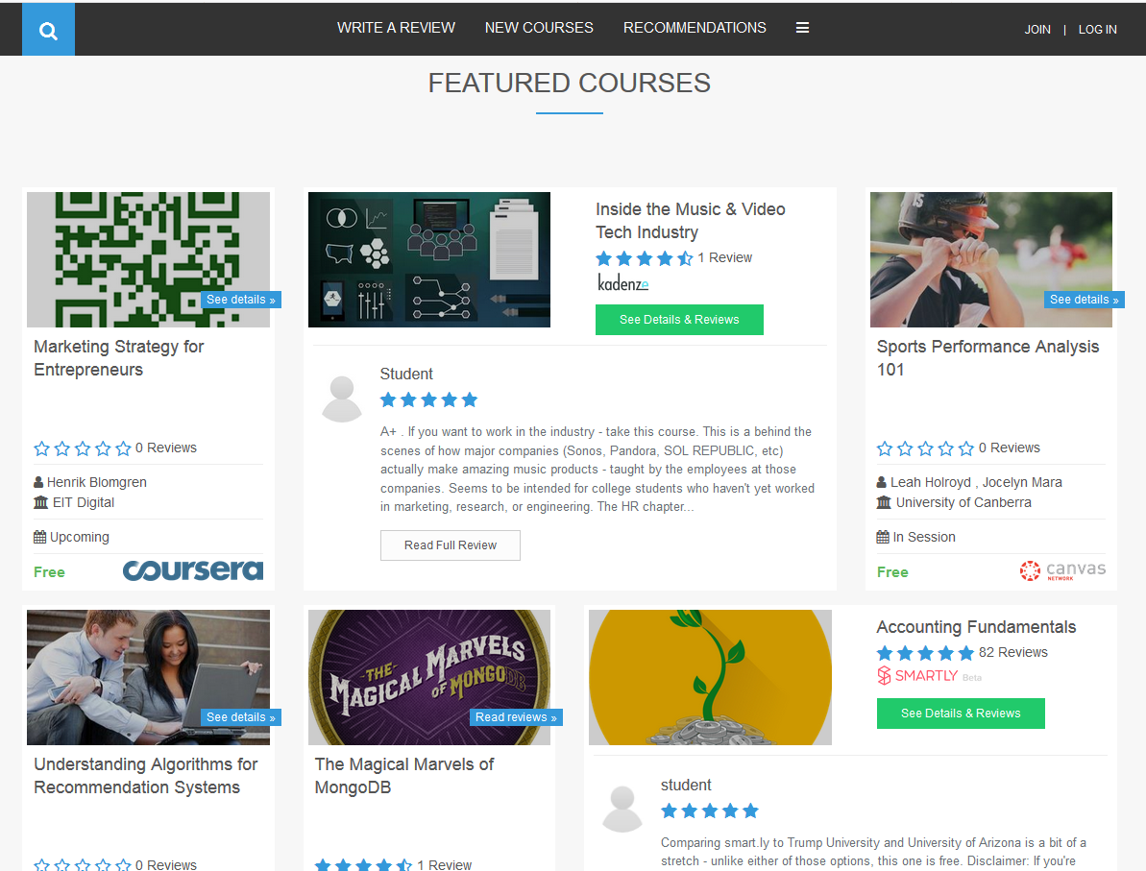
Khe Foon (Timothy) Hew (2018) Hew, K. F. (2018). Unpacking the Strategies of Ten Highly Rated MOOCs: Implications for Engaging Students in Large Online Courses. Teachers College Record, 120(1). https://www.coursetalk.com/
Hew’s (2018, p. 1) analyzed 4,565 coursetalk review comments of 10 highly rated MOOCs. He found “six key factors that can engage online [MOOC] participants and nine reasons for participant disaffection.”
Problem-centric learning supported by clear explanations.
Active learning supported by timely feedback (e.g., assignments, projects, discussion).
Course resources that cater to participants’ learning needs or preferences.
Instructor attributes (e.g., passion, enthusiasm, humor, variety of examples).
Peer interaction.
Instructor availability.

Slide 32
Quotes: Veletsianos et al. (2015-2016)
“To gain a deeper and more diverse understanding of the MOOC phenomenon, researchers need to use multiple research approaches (e.g., ethnography, phenomenology, discourse analysis) add content to them.” (p. 583)
Veletsianos, Collier, & Schneider (2015, May), Digging deeper into learners’ experiences in MOOCs: Participation in social networks outside of MOOCs, notetaking and contexts surrounding content consumption. BJET, 46(3), 570-587.
“Dependence on Particular Research Methods May Restrict our Understanding of MOOCs.”
George Veletsianos & Peter Shepherdson’s Study (2016). Systematic Analysis and Synthesis of the Empirical MOOC Literature Published in 2013-2015. IRRODL. http://www.irrodl.org/index.php/irrodl/article/view/2448/3655

Slide 33
MOOC books (2020) and (2015)
Notes:
Last year, I co-edited a book titled MOOCs and Open Education around the World. MOOCs stands for Massive Open Online Courses. An individual MOOC can enroll tens of thousands of students, and several MOOCs have now surpassed 1 million students in total enrollment. MOOCs are primarily offered by elite universities such as Stanford, MIT, and Harvard through enterprises such as Coursera, edX, and FutureLearn. More people enrolled in MOOCs developed at Harvard in a single year than attended Harvard in its entire 377-year history.

Slide 34
October 22, 2021 Wanted: Billions of Self-Directed Learners

Slide 35
October 22, 2021 Wanted: Billions of Self-Directed Learners https://www.peoplematters.in/article/training-development/the-era-of-self-directed-learning-hrs-new-role-and-strategy-24348

Slide 36
Benefits of Self-Directed Learners https://discoverpraxis.com/reasons-not-to-go-to-college/

Slide 37
Study #1 MOOCs Literature Review (2014-2016)
Zhu, M., Sari, A., & Lee, M. M. (2018). A Systematic Review of Research Methods and Topics of the Empirical MOOC Literature (2014-2016). The Internet and Higher Education, 37, 31-39.

Slide 38
Research Purposes & Questions
The purpose was to gain a deeper and more diverse understanding of the current MOOC phenomenon and identify the gap in MOOC empirical studies.
1. What are the research methods researchers employed in empirical MOOC studies?
2. What are the research topics or focuses in MOOC studies?
3. How are researchers of empirical MOOC studies geographically distributed?
4. In terms of the delivery of the MOOC, what are the countries which are attracting the most research?

Slide 39
Journals of the Articles
No. | Journal | Total
1 | International Review of Research in Open and Distance Learning (IRRODL) | 31
2 | Computers & Education | 12
3 | British Journal of Educational Technology | 9
4 | Online Learning | 7
5 | Distance Education | 5
6 | Educational Media International | 5
7 | Internet and Higher Education | 5
8 | Journal of Computer Assisted Learning | 5
9 | Computers in Human Behavior | 4
10 | Open Learning | 4
11 | Journal of Online Learning and Teaching | 3
12 | Journal of Asynchronous Learning Network | 3

Slide 40
RQ1 & RQ2
MOOC research focuses and methods
 | Quantitative | Qualitative | Mixed methods
Student-focused | 39 | 9 | 26
Design-focused | 19 | 12 | 17
Context and impact | 9 | 6 | 5
Instructor-focused | 0 | 3 | 2

Slide 41
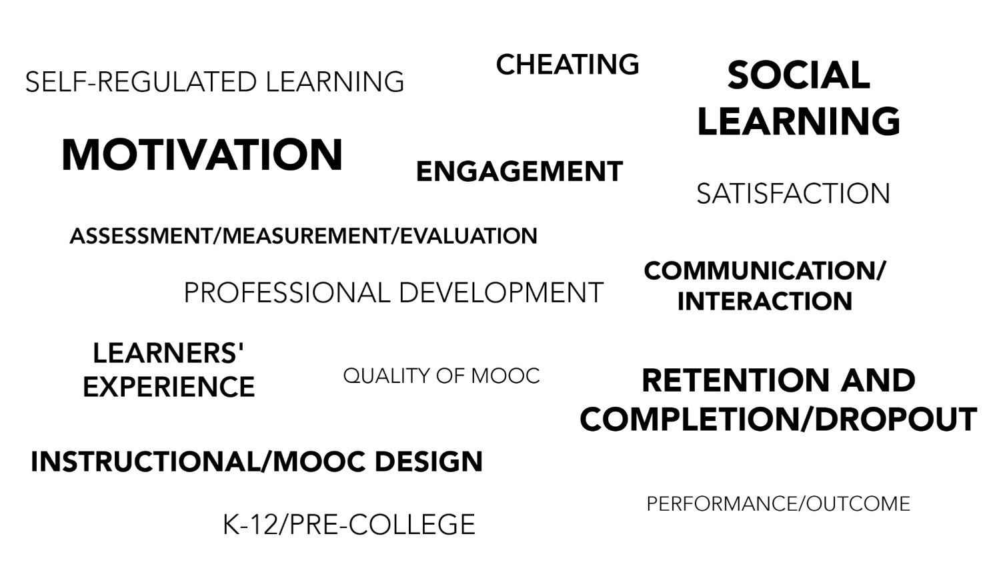
RQ2
Specific Focus of MOOC Research (2014-2016)

Slide 42
RQ3 Locations
Location of MOOC Research Team Members (2014-2016)

Slide 43
Study #2 Systematic Review of MOOC Research Expamded (2009-2019)

Slide 44
Total Number of Empirical MOOC Studies Published in Different Journals from 2009-2019
Table 1
(Note: the table only includes the top nine journals in terms of the number of empirical MOOC studies)
Journals | Number of empirical studies
International Review of Research in Open and Distributed Learning | 51
Computers & Education | 22
British Journal of Educational Technology | 15
Online Learning | 12
Distance Education | 11
Journal of Online Learning and Teaching | 11
The Internet and Higher Education | 10
Computers in Human Behavior | 10
Open Learning | 8

Slide 45
Research Methods
Figure 2. Research methods used in empirical MOOCs studies from 2013-2018 (N=321 studies)

Slide 46
Data Collection Methods
Figure 5. Data collection methods used in empirical MOOCs studies from 2013-2018 (N = 321 studies)
(Note: some studies contain more than one data collection method and this figure only includes the main data collection methods)

Slide 47
Study #3 MOOCs Design Considerations and Challenges
Zhu, M., Bonk, C. J., & Sari, A. (2018). Instructor experiences designing MOOCs in higher education: Pedagogical, resource, and logistical considerations and challenges. Online Learning, 22(4), 203-241.

Slide 48
Research Background
MOOCs can be beneficial to both learners and instructors (Hew & Cheung, 2014).
Instructional design is critical for online learning (Johnson & Aragon, 2003; Phipps & Merisotis, 1999).
Instructors are one of the five main components of MOOCs (Kop, 2011).
Few studies have examined instructional design from MOOC instructors’ perspectives (Margaryan et al., 2015; Watson et al., 2016).

Slide 49
Research Purpose
The purpose of this study is to provide suggestions for future MOOC instructors and instructional designers in higher education through exploring MOOC design considerations and challenges from the instructor’s perspective.

Slide 50
Research Questions
What are the design considerations of instructors when designing MOOCs?
What challenges do instructors perceive when designing MOOCs?
How do instructors address the challenges that they perceive related to MOOCs?

Slide 51
Research Design
Sequential mixed methods design (Creswell & Clark, 2017)
Quan
Data Collection
Quan
Data Analysis
Qual
Data Collection
Interpretation of Entire Analysis
Qual
Data Analysis

Slide 52
Data Collection
Data Collection:
Survey, interview, and course review
Participants:
143 survey participants (10% response rate)
12 interviewees

Slide 53
12 Interviewees
No. | Countries | Subject areas | Platforms
1. | The U.S. | Language and Literacy | Coursera
2. | The U.S. | Education | Coursera
3. | The U.S. | Education | Canvas
4. | The U.S. | Chemistry | Coursera
5. | UK | Medicine and Health | FutureLearn
6. | UK | Language and Literacy | FutureLearn
7. | Hong Kong (China) | Math | Coursera
8. | Mainland China | Math | Coursera
9. | Canada | Psychology | Coursera
10. | Australia | Medicine and Health | Open2Study
11. | Sweden | Computer Science | edX
12. | India | Management | edX

Slide 54
Data Analysis
RQs | Data Sources | Data analysis
RQ1 | Survey-multiple-choice questions Survey-open-ended questions Interview MOOC review | Descriptive statistics Content analysis (Elo & Kyngäs, 2008) Content analysis Content analysis
RQ2 | Survey-multiple-choice questions Survey-open-ended questions Interview | Descriptive statistics Content analysis Content analysis
RQ3 | Survey-multiple-choice questions Interview | Descriptive statistics Content analysis

Slide 55
Research Context

Slide 56
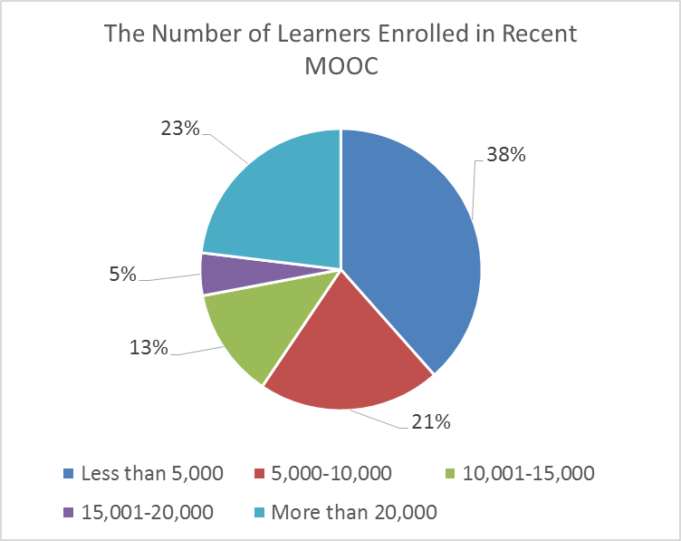
Research Context

Slide 57
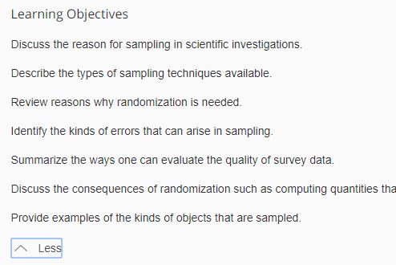
Findings RQ1
RQ #1. What are the design considerations of instructors when designing MOOCs?
Learning objectives
Assessment
Time for designing MOOC
Engaging learners
An example of learning objectives:

Slide 58
RQ1 Survey Results

Slide 59
RQ1 Interview Results
Engage learners
One instructor from US mentioned:
“I engaged people in the forum. So each week I would write a message that would be the new welcome page for the week that would say, ‘hey come to the forum and ask questions about this or come to the forum introduce yourself’... Of course, I tried to get students to feel like I was engaged with them during the videos by asking them questions and telling them to do things during the video.”

Slide 60
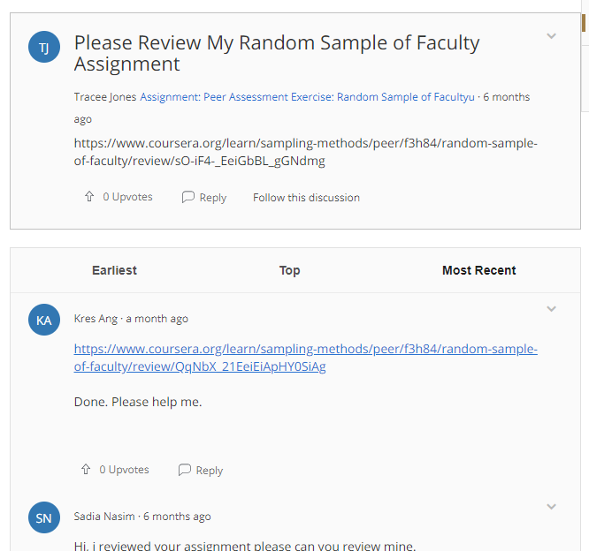
Findings RQ2
RQ #2. What challenges do instructors perceive when designing MOOCs?
Assessment methods
Engaging students’ learning
Time limitation
(Note: Above is an example of peer-assessment.)

Slide 61
RQ2 Survey Results

Slide 62
RQ2 Interview Results
Time limitation
One instructor from education subject mentioned:
“I think one of the challenges is time. It does take a lot of time to get the videos done. I did not get a course release when I was doing, and it was a side project at the same time as my regular load.”

Slide 63
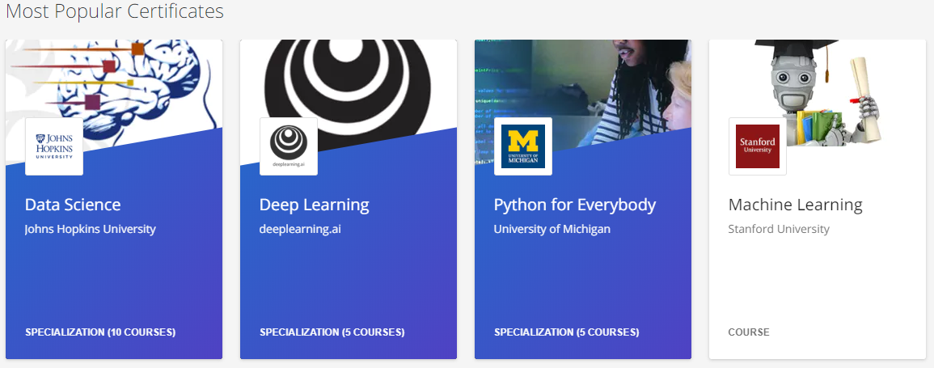
Findings RQ3
RQ #3. How do instructors address the challenges that they perceive related to MOOCs?
Explore other MOOC examples
Seek help from the platform/colleagues/institutions

Slide 64
RQ3 Survey Results

Slide 65
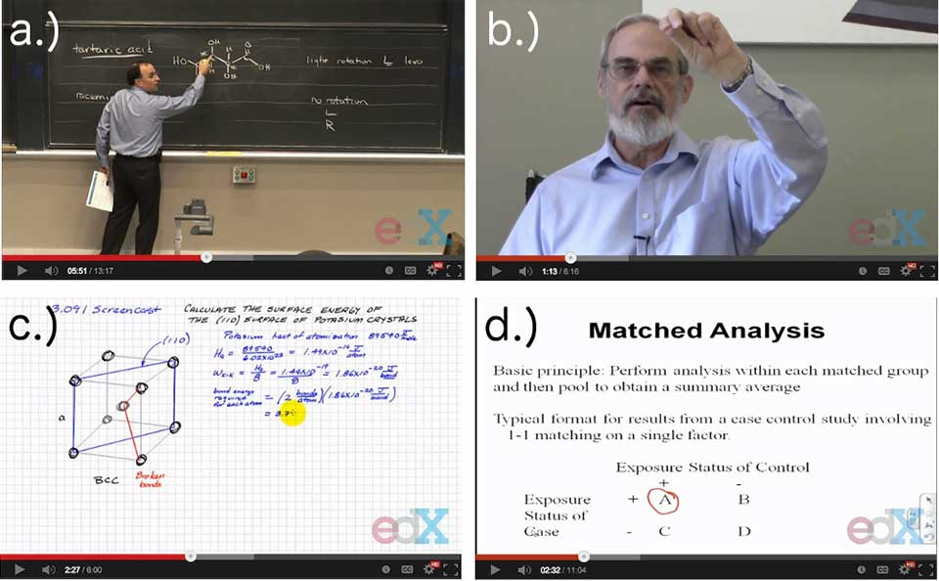
RQ3 Interview Results
Explore other MOOC examples
One MOOC instructor from the US mentioned:
“When I started making the MOOC, I could see MOOCs that other people had made. So I could see what other people did in terms of having videos with questions embedded in the videos, which I really liked.”

Slide 66
Discussion
The time limitation of creating MOOCs was the primary logistical consideration (Hew & Chung, 2014; Watson et al., 2016) and challenges.
The pedagogical factors were the primary design considerations (Watson et al., 2016) and challenges in MOOC design.
The assessment and engagement strategies are the main considerations as well as challenges.

Slide 67
Study #4 MOOCs Instructional Design to Facilitate Participants’ Self-directed Learning

Slide 68
Key Terms
Self-directed learning (SDL) (Garrison, 1997)
(1) self-management
(2) self-monitoring
(3) motivation
Notes:
Garrison’s model: 3 inter-related part.

Slide 69
Research Background
Learners need self-directed learning skills and strategies to be successful in MOOCs (Halawa, Greene, & Mitchell, 2014; Littlejohn & Milligan, 2016), as there is a lack of personalized interaction with teachers.
Self-directness of a learner might vary in different learning environments which means that the learners could be more self-directed in one learning environment than another (Hiemstra, 1994).

Slide 70
Research Background
Instructional design can greatly influence students’ interaction and engagement (Garrison & Cleveland-Innes, 2005) and success in online learning (Song, Singleton, Hill, & Koh, 2004; Swan, 2001).
However, few studies have examined instructional design and the delivery of instruction using MOOCs from instructor perspectives (Margaryan et al., 2015; Watson et al., 2016); especially lacking is research on instructors’ perception of SDL and how they design MOOCs to facilitate students’ SDL.

Slide 71
Research Purpose
The purpose is to inform instructors or instructional designers and MOOC providers of the current practices of designing MOOCs to facilitate learners’ SDL.

Slide 72
Research Questions
How do MOOC instructors perceive participant SDL skills?
How do MOOC instructors perceive their facilitation of participant SDL skills?
How do instructors design and deliver MOOCs to facilitate participant SDL skills?
a. How is technology being used by MOOC instructors to support the development of participant SDL skills?
b. What technology features or functions do MOOC instructors want to have to improve their facilitation of MOOC participant SDL skills?

Slide 73
Research Design
Explanatory sequential mixed methods design (Creswell & Clark, 2017)
Pilot survey with 48 instructors
Survey
198 instructors
Review 22 MOOCs of interviewees
Interview 22 instructors
Review 22 MOOCs of interviewees
Pilot interview with 4 instructors

Slide 74
Data Collections
Survey:
Volunteer sampling (Creswell & Clark, 2017)
198 instructors responded to the survey (10% response rate)
Interview:
Homogeneous purposeful sampling (Creswell & Clark, 2017; Patton, 2002)
Maximal variation sampling (Creswell & Clark, 2017)
22 interviewees
MOOC review:
Reviewed 22 interviewees’ MOOCs

Slide 75
Pseudonym | Country | Subject area | Platform | Gender | No. of O/B | No. of M | Mode of the M
Lucas | US | Social science | edX | M | 0 | 1 | I without T
Branden | US | Education | Udacity | M | 0 | 5 or more | Self-paced
Logan | US | Literacy and Language | Coursera | M | 5 or more | 5 or more | I with T
Emma | US | Literacy and Language | Coursera | F | 2 | 1 | Self-paced
Jason | US | Science | edX | M | 1 | 1 | I with T
Jackson | US | Medicine and health | Coursera | M | 5 or more | 1 | Self-paced
Samuel | US | Education | FutureLearn | M | 4 | 3 | Self-paced
Hannah | US | Education | Blackboard | F | 5 or more | 1 | I with T
Ashley | US | Education | EdX | F | 0 | 5 or more | I with T
Andrew | UK | Art | FutureLearn | M | 0 | 3 | I with T
Emily | UK | Medicine and health | FutureLearn | F | 2 | 2 | I with T
Aiden | UK | Social science | FutureLearn | M | 0 | 1 | Self-paced
Henry | UK | Social science | FutureLearn | M | 0 | 1 | Self-paced
Joseph | UK | Medicine and health | FutureLearn | M | 1 | 1 | Self-paced
Joshua | UK | Literacy and language | FutureLearn | M | 2 | 2 | I with T
Mason | Australia | Education | Coursera | M | 5 or more | 1 | I with T
Ethan | Australia | Business | Coursera | M | 3 | 1 | I without T
Ben | Australia | Social science | edX | M | 1 | 1 | I with T
Paul | France | Computer Science | Coursera | M | 1 | 1 | I with T
Fernando | Belgium | Research methods | Blackboard | M | 5 or more | 3 | I with T
Jacob | Netherland | Science | Coursera | M | 0 | 1 | I with T
Dylan | Israel | Science | Coursera | M | 5 or more | 3 | I without T
Data Collections
Interview:

Slide 76
Data Analysis
RQs | Data Sources | Data analysis | Tools
RQ1 | Survey Interview | Descriptive statistics Content analysis (Elo & Kyngäs, 2008) | SPSS NVivo
RQ2 | Survey Interview | Descriptive statistics Content analysis | SPSS NVivo
RQ3 | Interview Course review | Content analysis Content analysis | NVivo NVivo

Slide 77
Research Context

Slide 78
RQ1 Perceptions of SDL
A majority of the MOOC instructors thought that these skills or attributes are not static, and that SDL as a set of skills can be educated or students’ personal attributes that can be changed.

Slide 79
RQ1 Interview Results
Emma’s understanding of SDL is more related to self-management and motivation. She said:
“When I think about self-directed learning, I think about students managing their time and managing the coursework on their own, and how it fits into their schedules and their lives, how they interact with materials, what's going to keep them engaged.”

Slide 80
RQ2 Perceptions of Facilitation of SDL
Most of MOOC instructors thought that they can intentionally or unintentionally facilitate students’ SDL.

Slide 81
RQ2 Interview Results
Ashely emphasized the importance of both instructors’ facilitation and students’ SDL skills. She said:
“The participant has a lot of flexibility on how they approach the content. I mean, obviously, we have things like assignments. We have things like online forums. And there're ways that we scaffold the learning experience. But there still is a lot of choice for the learner.”

Slide 82
RQ3 Strategies to Facilitate SDL
Students’ intrinsic motivation plays an important role. However, extrinsic motivation provided by the MOOCs might help transfer extrinsic motivation to intrinsic motivation.
Motivations | Strategies
Entering motivation | MOOC instructors helped students identify the needs and goals of learning and sense of achievement.
Task motivation | MOOC instructors motivated students through instruction, learning materials, feedback, and learning community.

Slide 83
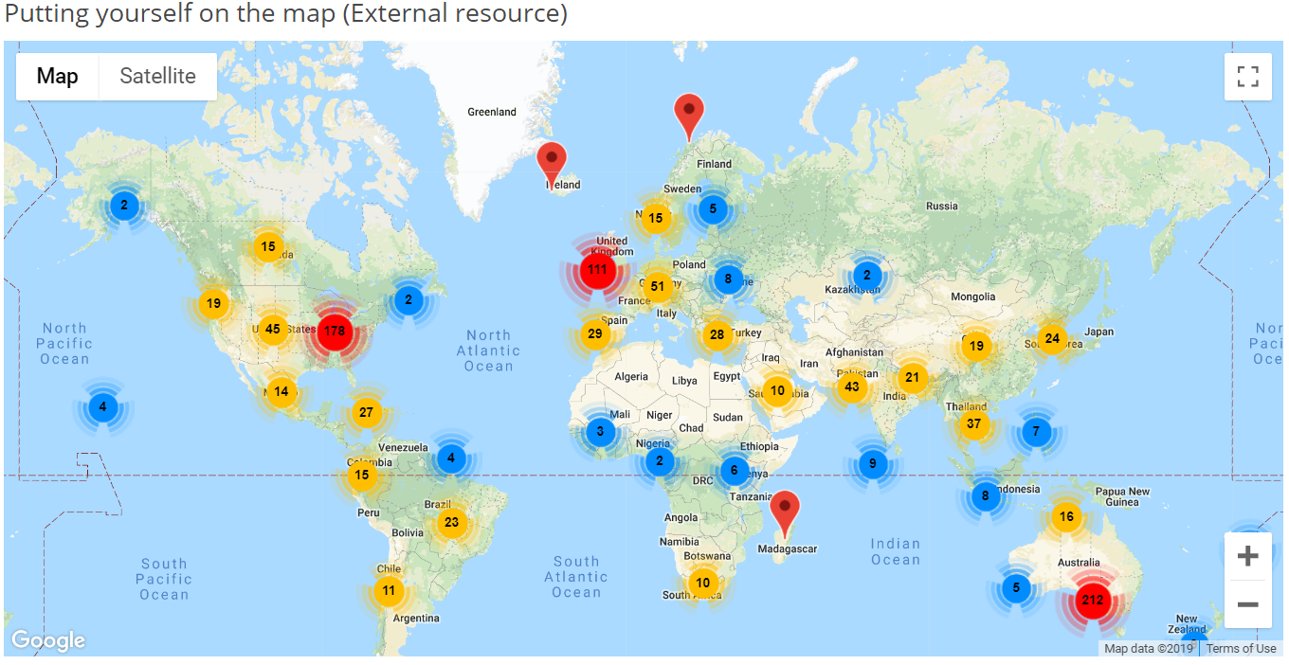
RQ3 Learning Community

Slide 84
RQ3 Strategies to Facilitate SDL
Both internal feedback and external feedback were provided to help students’ self-monitoring.
Self-monitor |  | Strategies
Internal feedback | Cognition | MOOC instructors provided quizzes for self-assessment, tutorial on technology use, learning advice, navigation of the course, progress indicators, resources, and instructional modeling, etc.
 | Meta-cog | MOOC instructors encouraged students to reflect and think critically by providing reflection questions and building learning community.
External feedback |  | MOOC instructors, teaching assistants, and peers were involved in providing external feedback.

Slide 85
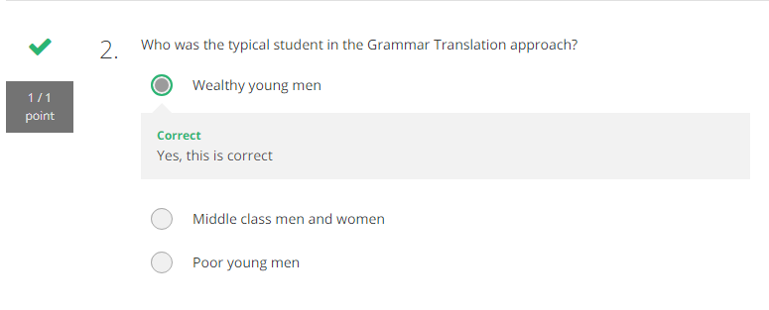
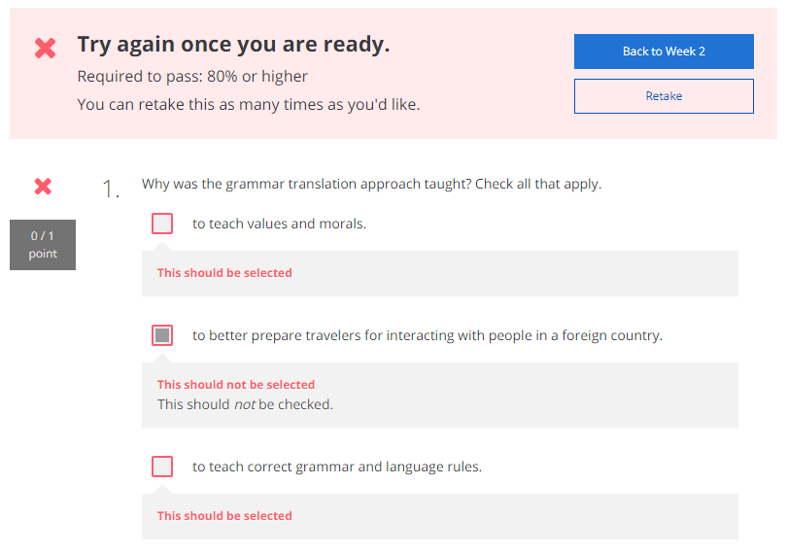
RQ3 Self-assessment (i.e., embedded quizzes)

Slide 86
RQ3 Progress Indicators

Slide 87
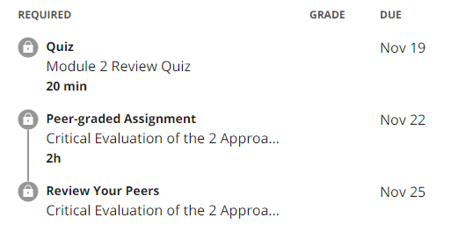
RQ3 External Feedback: Peer-assessment
(e.g., 3 peers assigned to review each assignment)

Slide 88
RQ3 Strategies to Facilitate SDL
They helped students’ self-management concerning setting learning goals, time management, resources and support management although among the three elements of SDL, MOOC instructors had less control over students’ management.
Self-management | Strategies
Enactment of learning goals | Providing discussion questions, reflections, survey, and appreciation students’ learning goals.
Time management | Providing time frame, progress indicator, short learning units, and flexible timeline.
Management of resources and support | Providing flexible learning resources, peer-assessment, accessibilities, clear expectations, and short learning units.

Slide 89
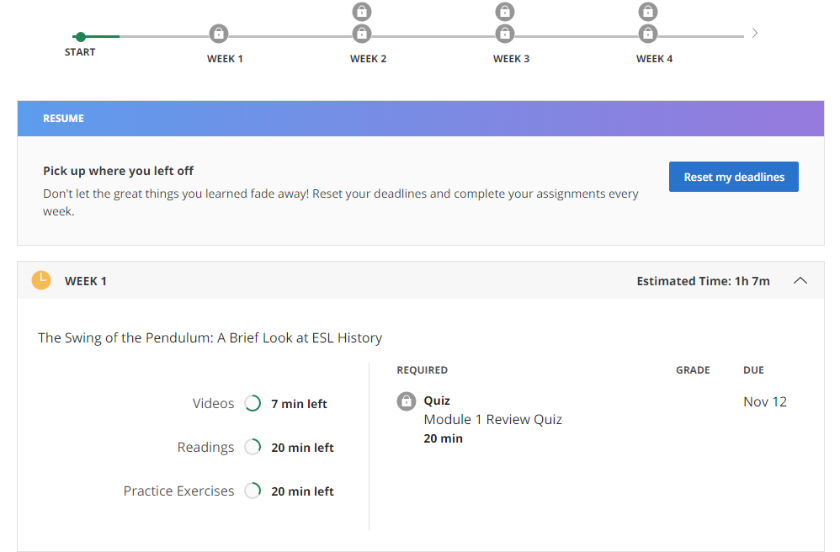
RQ3 Time Management
(e.g., time advisories and estimates)

Slide 90
RQ3-a. Tech Used for SDL
Synchronous communication technologies
Google Hangouts YouTube Live
Asynchronous communication technologies
Discussion forum Blog Slackbot Flickr
Multimedia (e.g., video and graphics)
Feedback technologies

Slide 91
Discussion
SDL can be Changed
MOOC Instructors can Facilitate SDL
Strategies to Facilitate SDL: A variety of strategies can be used to facilitate student SDL skills in terms of motivation, self-monitor, and self-management.
Tech for SDL: Tech plays a vital role in facilitating SDL skills.
Tech expectations: Adaptive learning systems, artificial intelligent systems, and learning analytics were expected to have to support SDL.

Slide 92
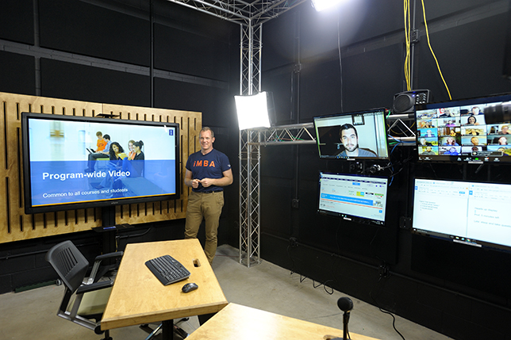
Implications
For MOOC instructors and Instructional Designers
Build learning community
Inspire intrinsic motivation
Personalize learning
For MOOC providers
Create a personalized learning environment
Provide learning analytics to support learning and teaching

Slide 93
Top 10 Strategies to Facilitate SDL in MOOCs
Helping students set their own learning goals.
Building learning community.
Offering immediate feedback.
Embedding quizzes for self-assessment.
Providing progress indicators.
Providing reflection questions.
Designing short learning units.
Providing flexible timelines.
Highlighting estimated time frames.
Making available optional learning materials.

Slide 94
Top 10 Strategies to Facilitate SDL in MOOCs
Helping students set their own learning goals.
Example:
“I have asked, at the first page of course, why they're taking the course. So that is the goal. A lot of people say, ‘I'm a teacher. And I want to do the stuff with my kids. Or I want to update my knowledge. Or I'm retired and I want to learn this.’”

Slide 95
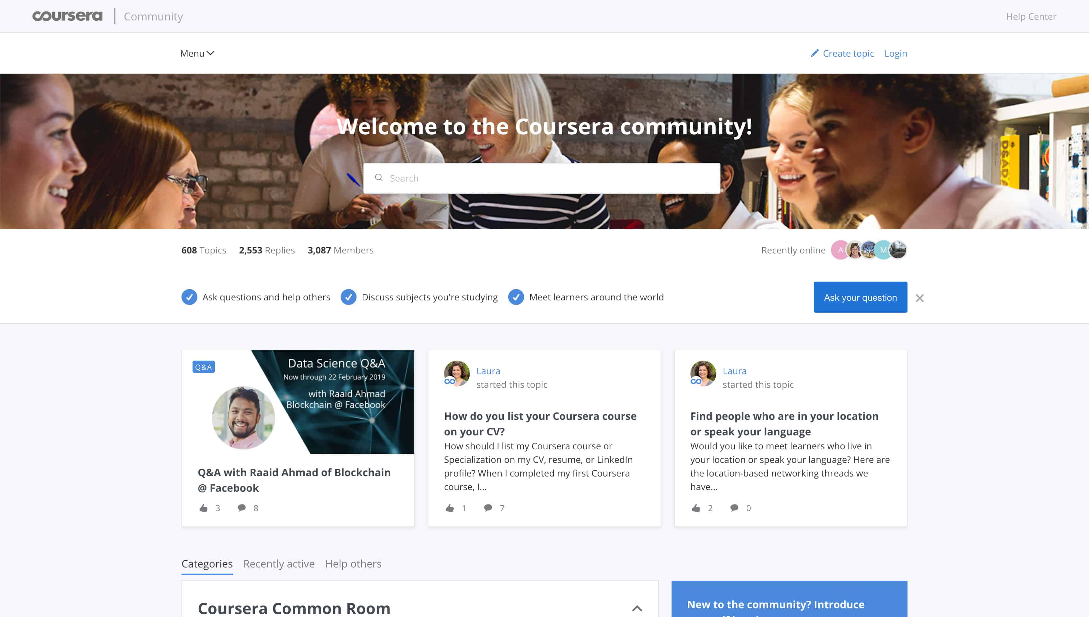
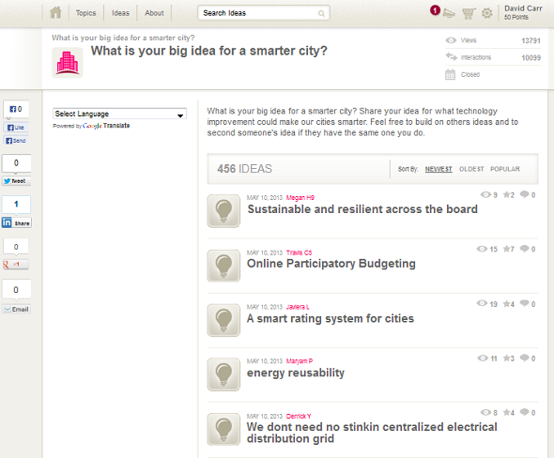
Top 10 Strategies to Facilitate SDL in MOOCs
2. Building learning community.
Joshua from the UK mentioned: We use a lot of resources that already exist. And then we use the MOOC discussion board as a place to where they, kind of, point out and say, “I've seen this. And this is useful. Well, I use this, and this is good. I created this.”

Slide 96
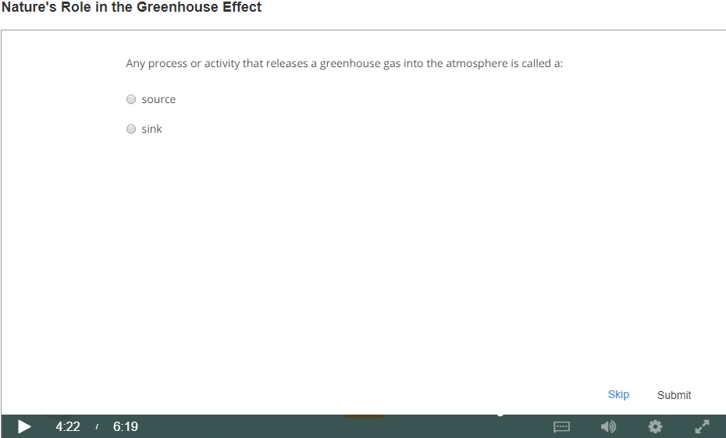
Top 10 Strategies to Facilitate SDL in MOOCs
3. Offering immediate feedback.
4. Embedding quizzes for self-assessment.

Slide 97
Top 10 Strategies to Facilitate SDL in MOOCs
5. Providing progress indicators

Slide 98
Top 10 Strategies to Facilitate SDL in MOOCs
6. Providing reflection questions.
We introduced kind of moments that video was stopped and there was a question. The student had to think of it a bit. Sometimes it was kind of a rhetorical question. There wasn't even no answer required. But it was just a pause for a while to let the student reflect. (Jacob)

Slide 99
Top 10 Strategies to Facilitate SDL in MOOCs
7. Designing short learning units.

Slide 100
Top 10 Strategies to Facilitate SDL in MOOCs
8. Providing flexible timelines.

Slide 101
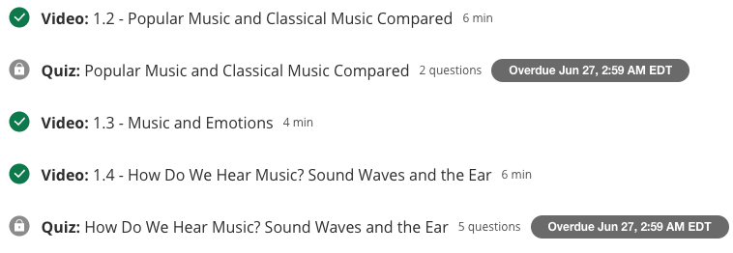
Top 10 Strategies to Facilitate SDL in MOOCs
9. Highlighting estimated time frames.

Slide 102
Top 10 Strategies to Facilitate SDL in MOOCs
10. Making available optional learning materials.

Slide 103
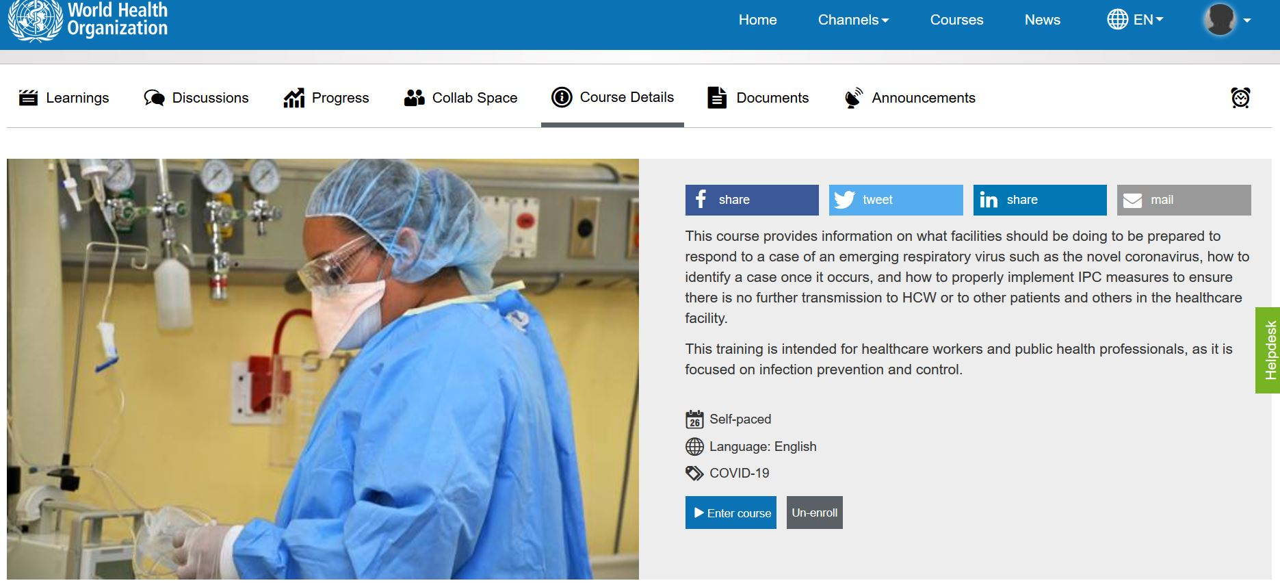
10 More Strategies to Facilitate SDL in MOOCs
MOOC: Infection Prevention and Control (IPC) for Novel Corona virus (COVID-19) from OpenWHO (English Version)
11. Structured learning environment:
Clearly stated the learning objectives.
Course details stated the expected time to complete the course.
The syllabus, number of course modules, and title of each module.

Slide 104
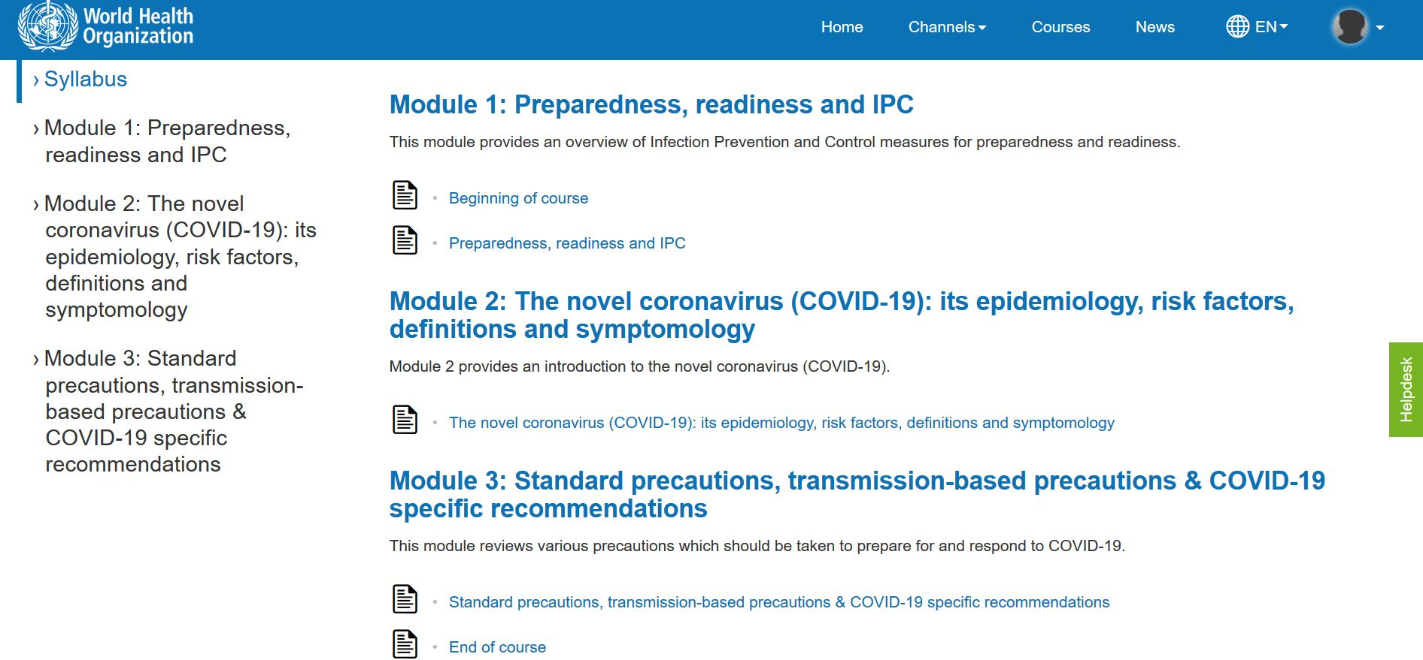
10 More Strategies to Facilitate SDL in MOOCs
11. Structure continued…
Graphic or visual organizations for essential material.
The text on screen matched the narration enforcing the redundancy principle.

Slide 105
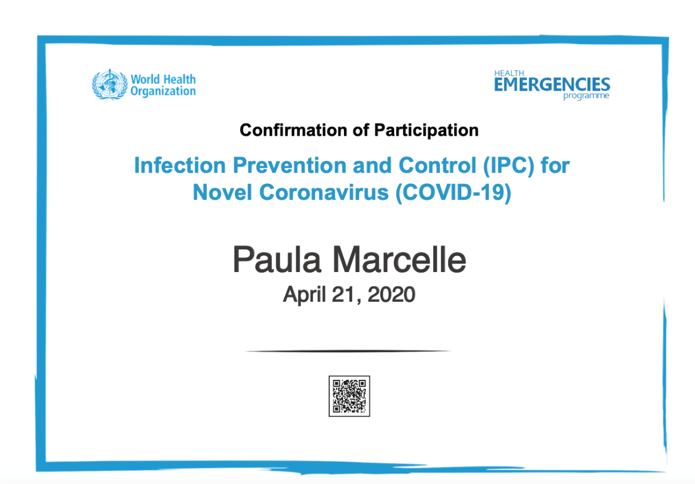
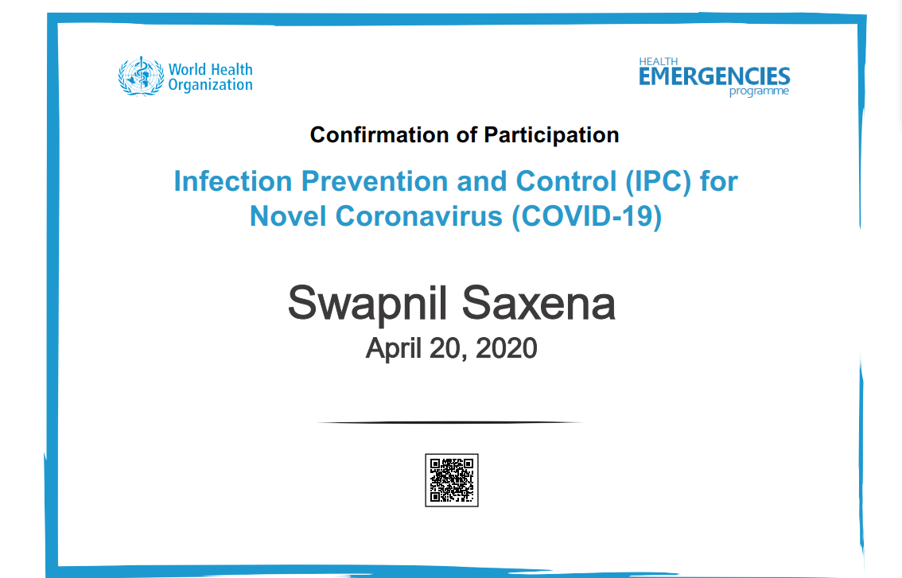
10 More Strategies to Facilitate SDL in MOOCs
12. On completion of modules participants get a certificate.
Providing External Rewards and Goals

Slide 106
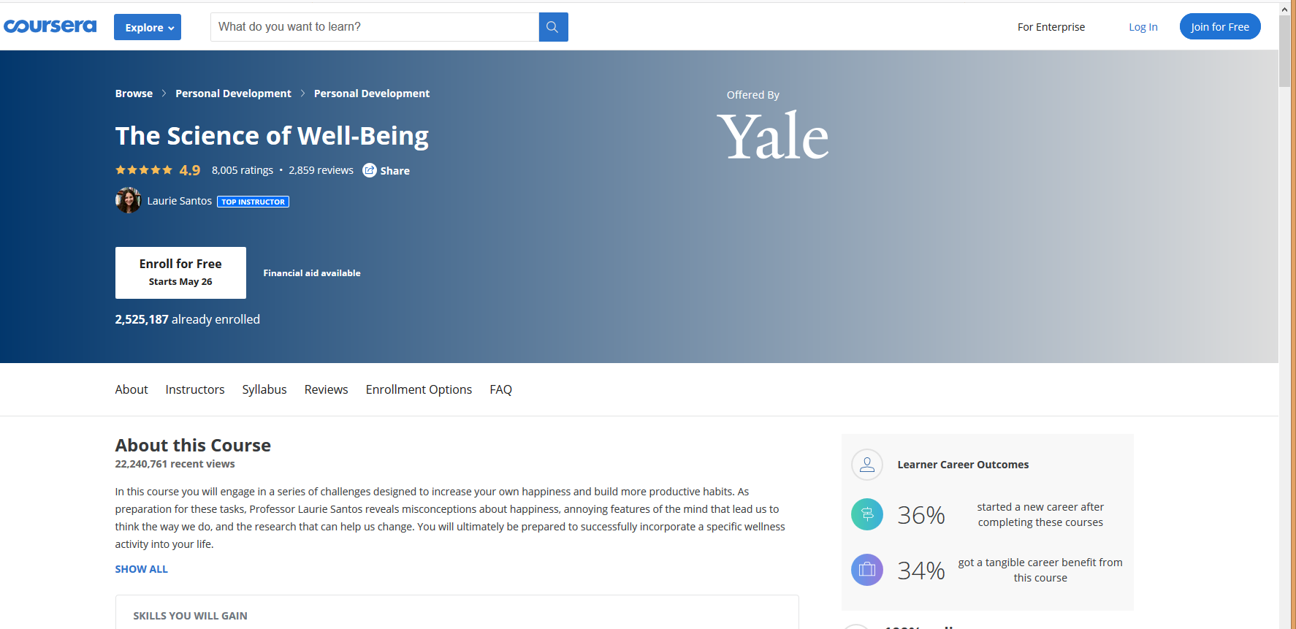
The Science of Well-Being, Yale

Slide 107
10 More Strategies to Facilitate SDL in MOOCs
13. Week overview. The course is divided into week-long segments, and each week is chunked into manageable parts. Very importantly for the participant to be able to anticipate what can get done in one sitting, the length of each video is included.

Slide 108
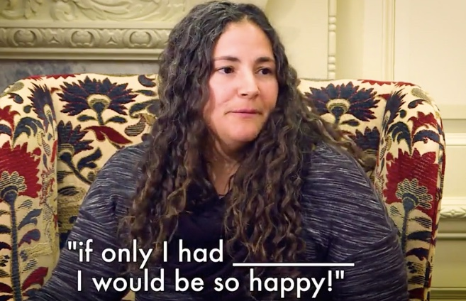
10 More Strategies to Facilitate SDL in MOOCs
14. Lecture recorded and captions added.
Caption added to video
Video of student audience

Slide 109
10 More Strategies to Facilitate SDL in MOOCs
14. Continued…Lecture video transcripts.

Slide 110
10 More Strategies to Facilitate SDL in MOOCs
15. Quick check tasks.

Slide 111
10 More Strategies to Facilitate SDL in MOOCs
16. Providing students with self-selection options.
There is the choice to watch all of the videos, read all of the materials, and submit all of the assignments, or there are choices all along the way to “cut corners” and take in only what the participant wants to.

Slide 112
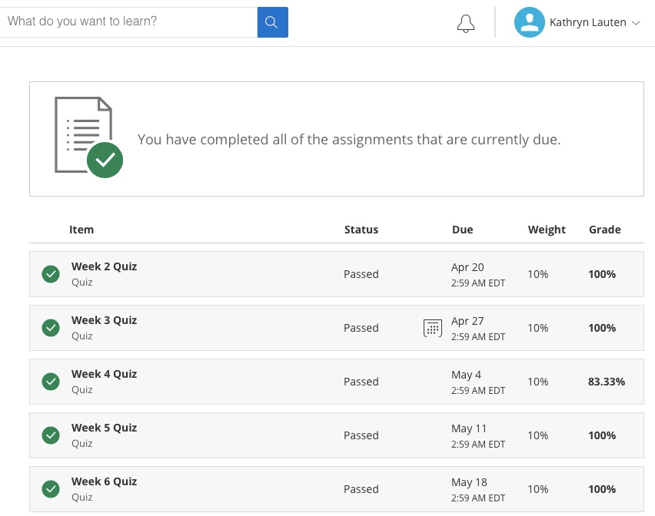
10 More Strategies to Facilitate SDL in MOOCs
17. Visuals showing tasks completed.

Slide 113
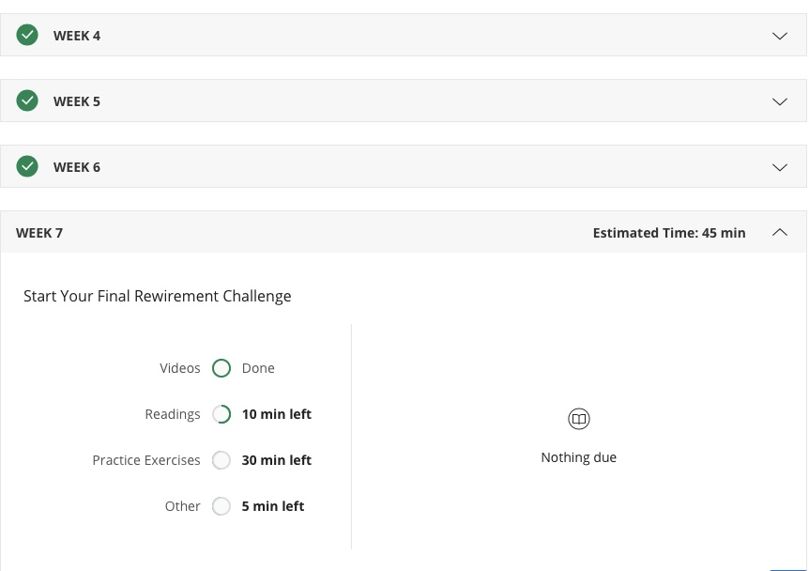
10 More Strategies to Facilitate SDL in MOOCs
18. Visuals showing work progress.

Slide 114
10 More Strategies to Facilitate SDL in MOOCs
19. Rewirements (assignments) for putting the material to practice (e.g, Random Acts of Kindness, Make A Social Connection, Let’s Get Physical, Meditate!, Sleep!, Gratitude Letter/Visit, Savoring, etc.)
Daily Gratitude Journal
Gratitude is a positive emotional state in which one recognizes and appreciates what one has received in life. Research shows that taking time to experience gratitude can make you happier and even healthier. For the next seven days, you will take 5-10 minutes each night to write down five things for which you are grateful. They can be little things or big things. But you really have to focus on them and actually write them down (Again, try to develop a tracking method works for you and utilize a note on your phone, a daily calendar, a special notebook, etc). You can just write a word or short phrase, but as you write these things down, take a moment to be mindful of the things you’re writing about (e.g., imagine the person or thing you’re writing about, etc.). This exercise should take at least five minutes. Do this each night for the whole week.

Slide 115
10 More Strategies to Facilitate SDL in MOOCs
20. Offer community support and help.

Slide 116
10 More Strategies to Facilitate SDL in MOOCs
Bonus Item: Peer-graded assignments.

Slide 117
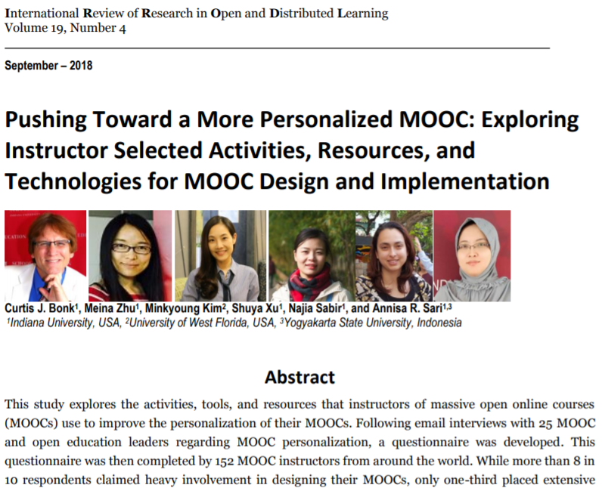
MOOC Study #5

Slide 124
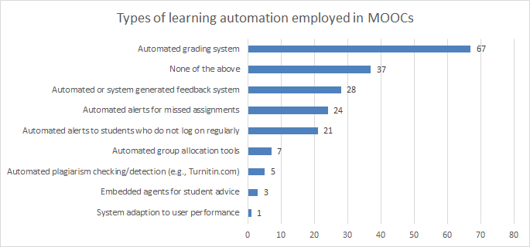

Slide 125
MOOC Study #6
Zhu, M., Sabir, N., Bonk, C. J., Sari, A., Xu., S., & Kim, M. (2021, April). Addressing learner cultural diversity in MOOC design and delivery: Strategies and practices of instructors and experts. Turkish Online Journal of Distance Education, 22(2), 1-25. https://doi.org/10.17718/tojde.906468;

Slide 126
Zhu, M., Sabir, N., Bonk, C. J., Sari, A., Xu., S., & Kim, M. (2021, April). Addressing learner cultural diversity in MOOC design and delivery: Strategies and practices of instructors and experts. Turkish Online Journal of Distance Education, 22(2), 1-25. https://doi.org/10.17718/tojde.906468;

Slide 127
Zhu, M., Sabir, N., Bonk, C. J., Sari, A., Xu., S., & Kim, M. (2021, April). Addressing learner cultural diversity in MOOC design and delivery: Strategies and practices of instructors and experts. Turkish Online Journal of Distance Education, 22(2), 1-25. https://doi.org/10.17718/tojde.906468;

Slide 128
Zhu, M., Sabir, N., Bonk, C. J., Sari, A., Xu., S., & Kim, M. (2021, April). Addressing learner cultural diversity in MOOC design and delivery: Strategies and practices of instructors and experts. Turkish Online Journal of Distance Education, 22(2), 1-25. https://doi.org/10.17718/tojde.906468;

Slide 129
Zhu, M., Sabir, N., Bonk, C. J., Sari, A., Xu., S., & Kim, M. (2021, April). Addressing learner cultural diversity in MOOC design and delivery: Strategies and practices of instructors and experts. Turkish Online Journal of Distance Education, 22(2), 1-25. https://doi.org/10.17718/tojde.906468;

Slide 130
Zhu, M., Sabir, N., Bonk, C. J., Sari, A., Xu., S., & Kim, M. (2021, April). Addressing learner cultural diversity in MOOC design and delivery: Strategies and practices of instructors and experts. Turkish Online Journal of Distance Education, 22(2), 1-25. https://doi.org/10.17718/tojde.906468;

Slide 131
Zhu, M., Sabir, N., Bonk, C. J., Sari, A., Xu., S., & Kim, M. (2021, April). Addressing learner cultural diversity in MOOC design and delivery: Strategies and practices of instructors and experts. Turkish Online Journal of Distance Education, 22(2), 1-25. https://doi.org/10.17718/tojde.906468;

Slide 135
MOOC Study #7
MOOC Learners and SDL
Zhu, M., Bonk, C. J., & Berri, S. (in press). Fostering self-directed learning in MOOCs: Motivation, learning strategies, and instruction. Online Learning

Slide 136
Research Questions
What motivated individuals to enroll in MOOCs?
What were the learning strategies that helped learners’ SDL in MOOCs?
What were the design and instructional elements of MOOCs that facilitated learners’ SDL?

Slide 137
MOOC Study #7
MOOC Learners and SDL
Zhu, M., Bonk, C. J., & Berri, S. (in press). Fostering self-directed learning in MOOCs: Motivation, learning strategies, and instruction. Online Learning

Slide 138
MOOC Study #7
MOOC Learners and SDL
Zhu, M., Bonk, C. J., & Berri, S. (in press). Fostering self-directed learning in MOOCs: Motivation, learning strategies, and instruction. Online Learning

Slide 139
RQ1. Intrinsic Motivation
Jacob, a retired management consultant from the US, expressed his motive behind enrolling in MOOCs as strictly intrinsic, “there's no reward. I'm retired. It's really just [that] I get very interested in topics. I realize holes in my knowledge and try to fill the holes.”

Slide 140
RQ1. Extrinsic Motivation
Besides educational purposes, some participants enrolled in MOOCs to help with their career development. For example, Sarah, who received her Ph.D. degree and was in between jobs at the time, selected topics such as anatomy, MatLab software, oncology, biology, and neuroscience. Sarah explained the purpose for taking these types of MOOCs was:
To acquire and improve my knowledge as a medical physicist…I consider my resume when selecting MOOC. I choose courses related to my professional field to add them to my curriculum; otherwise, there would be a period without being in contact with my profession.

Slide 141
RQ2. Learning Strategies
RQ2: What were the Learning Strategies that Helped Learners’ SDL in MOOCs?
Dan considered the progress bar to be a good indication of his progress, and it also created a healthy competition among the learners. Seeing where he was at in the course compared to the other learners gave him a push. He stated,
“All the progress bar with milestones, with a small quiz that doesn't count for the evaluation, but they're good for you to check if I'm really learning. And, for example, I like when you have these kinds of nice competition[s], right. Everyone starts a MOOC at the same time, but you see that these weeks you progress faster than other members in the MOOC.”

Slide 142
RQ2. Learning Strategies
RQ2: What were the Learning Strategies that Helped Learners’ SDL in MOOCs?
Note taking: Dan stated that his main learning strategy was notetaking: “I always have my little notebook for the MOOC that I'm working on or I'm studying. And whatever videos or whatever exercise that I was doing, I was always taking notes…”

Slide 143
RQ2. Self-monitoring
To help her self-monitoring, Melena noted how enriching her knowledge and knowing new things that she did not know before, along with doing well on the quizzes and tests, were vital indications of her progress. She explained, “Usually, there is a test after each week. Performing it, I can see in which topic I have the biggest gaps, or I got it well. Moreover, if I apply it in other areas of my life and it can also be seen then.”

Slide 144
RQ2. Self-management
Dan, the participant that enrolled in MOOCs as a learner and also taught MOOCs, described how he dedicated a certain time to work on MOOCs. For the most part, he allocated the mornings for reading and the afternoons for writing:
For me, I'm a researcher. I'm better at writing papers in that afternoon and reading in the morning… Also, I try to schedule my time for the MOOC as everyone scheduled. This is time to go to the gym or whatever.

Slide 145
RQ3. Design Elements
RQ3: What Design and Instructional Elements of MOOCs Facilitate Learners’ SDL from the Student’s Perspective?
Alina believed that having worksheets or a set of questions after each module was the most helpful strategy to evaluate her learning step by step. Being able to answer the questions after each module gave her a sense of how much knowledge she retained before starting the next module. Similarly, Sandy elaborated upon how quizzes and tests were helpful, but she wished they were more advanced and included questions and answers rather than only multiple-choice questions.

Slide 146
RQ3. Design Elements
Design Element: Clear Goals
As Dan explained: “Some tips at the opening of your MOOC saying: ‘hey guys, this is a MOOC that requires you a certain amount of hours per week. And there is a strong deadline for delivering homework and during your quizzes.’”

Slide 147
RQ3. Design Elements
Design Element: Authentic Examples
One participant, Helen, believed that authentic examples, resources, and visuals that some instructors demonstrated in their courses helped maintain her curiosity. In our interview, she explained:
When I studied the brain, the professor showed the real brain. Like, she took us to the laboratory and showed us how the brains, how they did it, they did things in the laboratory. So, I find it fascinating. I find it very interesting. Even though for the test I try to read, but for understanding and looking at the real thing, the visualization is very good.

Slide 148
RQ3. Design Elements
Design Element: Flexibility
Sandy, a former perfectionist, described her MOOC experience as life-changing. In this situation, the learner felt more comfortable directing her own learning rather than being pressured to follow a stricter schedule. When asked to describe her MOOCs experience, she explained,
“It helped me realize that I enjoy learning a lot more when I can just be a little more casual about it. I just find it a lot more enjoyable to learn. I think when I'm enjoying it more, I probably actually learn a lot more.”

Slide 149
RQ3. Design Elements
Design element- small learning units
As Joe explained:
I think what's really good is keeping it into small chunks. I'm going to say, roughly speaking, 3 to 7 minutes long because that makes it easy for you to put it down and pick it up again in small bits.

Slide 150
RQ3. Responsive Feedback
Design Element: Discussion board and feedback.
Jacob sadly acknowledged that: “I’ll ask [the professor] a question today. I'll type in a question on my computer in the forum. It may be 2 to 3 weeks before I get a reply.” Ali expressed that “it would be great to communicate with professors.” Similarly, Sarah explained that what affected her experience the most was the “lack of real-time interaction with the teacher.”

Slide 151
Study #8: Self-Directed learning in MOOCs:
Exploring the Relationships among motivation, self-monitoring, and self-management, Zhu, Bonk, & Doo, 2020, ETR&D
(SEM: Survey of 322 MOOC Learners)

Slide 152
Research Questions
H1: Motivation positively affects self-monitoring of MOOC students.
H2: Motivation positively affects self-management of MOOC students.
H3: Self-monitoring positively affects self-management of MOOC students.
H4: Self-monitoring mediates the relationship between learning motivation and self- management of MOOC instructors.

Slide 153
Study #8: Self-Directed learning in MOOCs:
Exploring the Relationships among motivation, self-monitoring, and self-management, Zhu, Bonk, & Doo, 2020, ETR&D
(SEM: Survey of 322 MOOC Learners)

Slide 154
What’s the Future?

Slide 155
Thank you! Any Questions?
Curtis Bonk: cjbonk@Indiana.edu
Meina Zhu: meinazhu@wayne.edu
Slides and Proceedings Paper at TrainingShare.com: http://www.trainingshare.com (go to “Archived Talks”)

