Slide 1
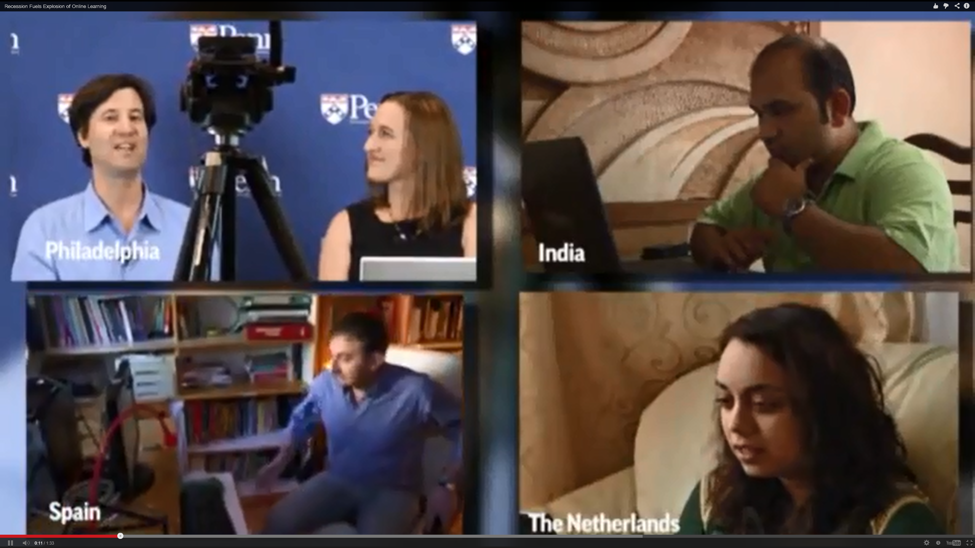
Personalizing the MOOC: Insights from Experts Around Planet Earth
Curtis J. Bonk, Indiana University
cjbonk@Indiana.edu
Thomas C. Reeves, The University of Georgia
treeves@uga.edu
Wisconsin DTL Conference, Madison, WI August 10, 2016

Slide 2
Part I. Current Trends and Recent Cycles

Slide 3
Audience Poll #1: Who in here has taken a MOOC?

Slide 4
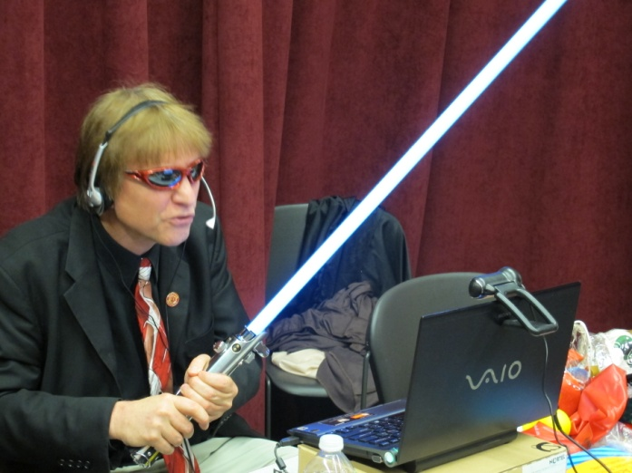
Audience Poll #2: Who has designed or taught a MOOC?

Slide 5
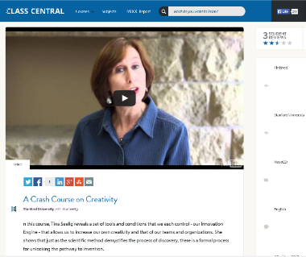
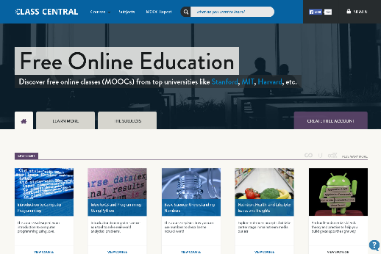
July 27, 2016 Class Central https://www.class-central.com/collection/top-free-online-courses
Now there are close to 6,000 MOOCs from 600+ universities around the world. This can be daunting to the millions of learners around the world who have never done an online course before.
That’s why we came up with a list of Top 50 MOOCs of All Time based on thousands of reviews written by Class Central users.

Slide 6
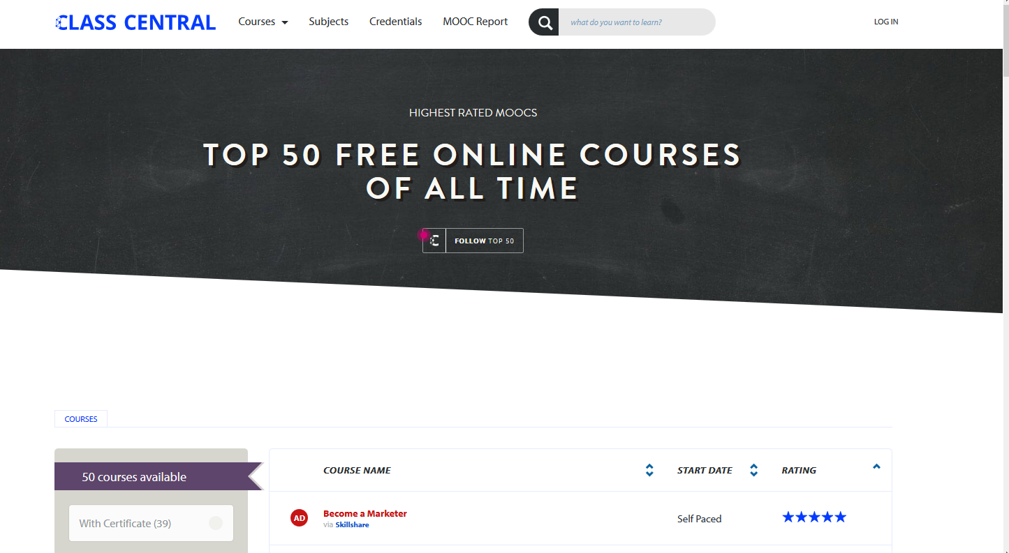
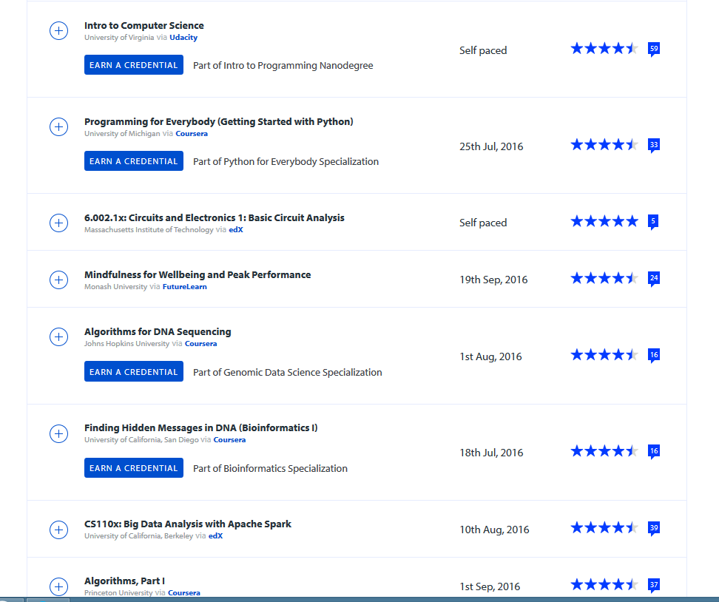
July 27, 2016 Class Central (Top 50 Free) https://www.class-central.com/collection/top-free-online-courses

Slide 7
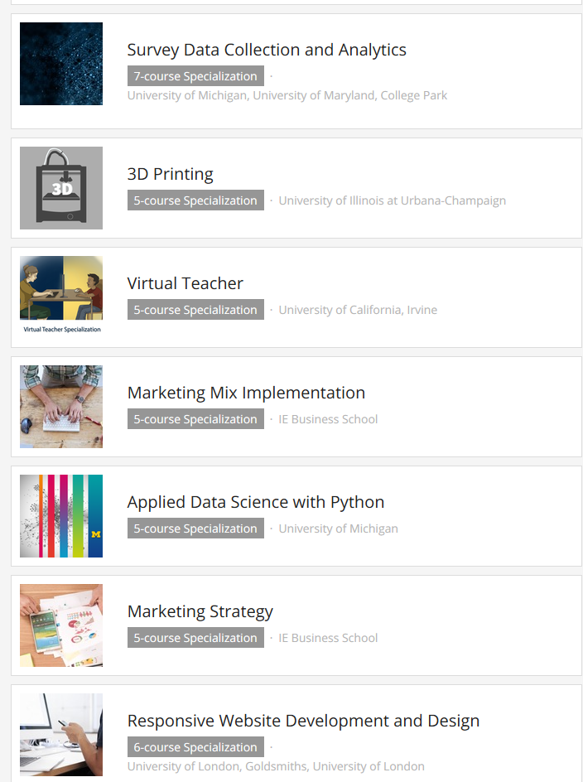
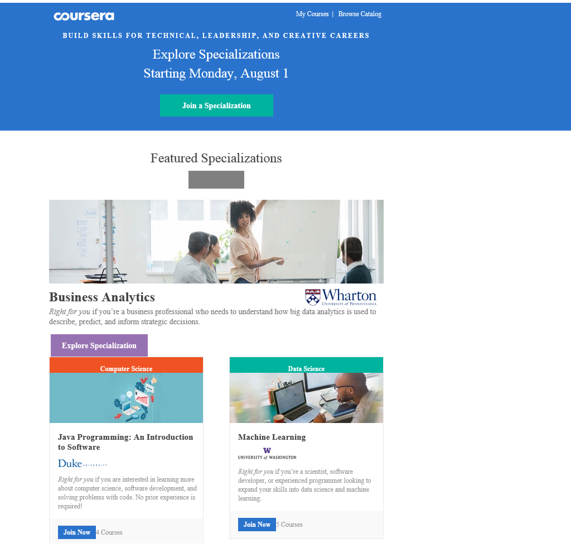
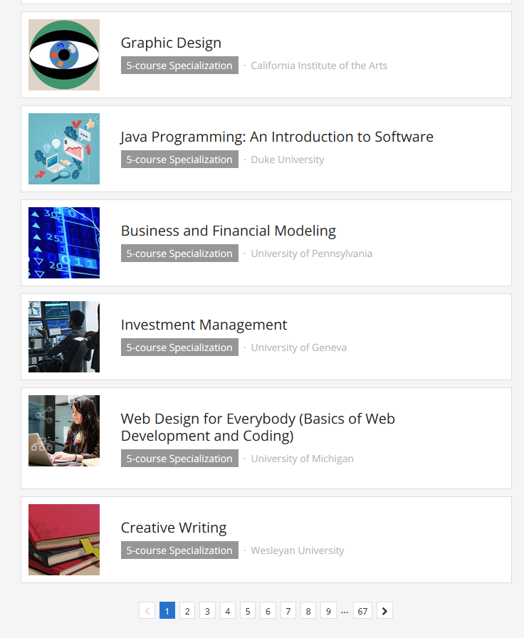
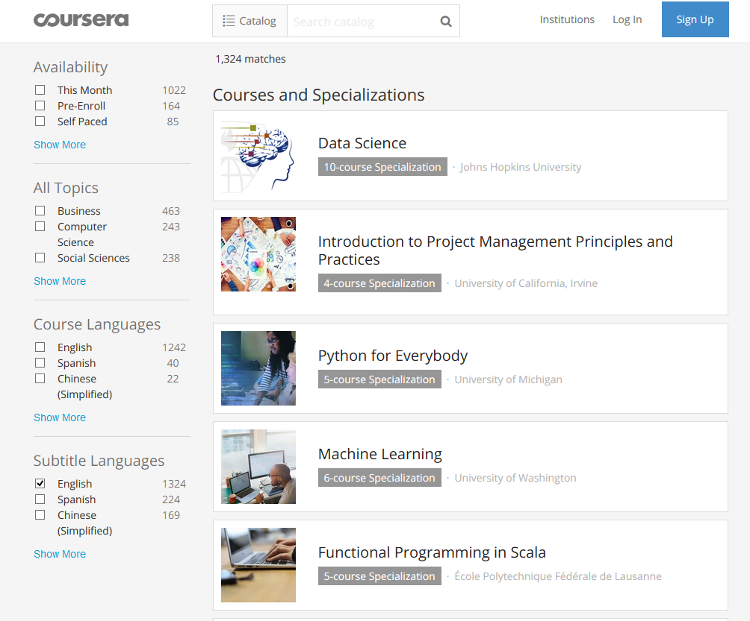
July 28, 2016 Coursera Specializations email Starting Monday August 1st: 9 Top Specializations

Slide 8
July 21, 2016 The Scope of edX Joshua Kim, Inside Higher Ed https://www.insidehighered.com/blogs/technology-and-learning/scope-edx?utm_source=Inside+Higher+Ed&utm_campaign=56cdbb1f78-DNU20160722&utm_medium=email&utm_term=0_1fcbc04421-56cdbb1f78-197362401
Here are some edX numbers that blew us away:
8.3 million (unique) learners on the edX platform.
Between 2012, when edX started, and today - there have been 27 million course enrollments.
Over 1,000 courses have been offered.
Over 2,300 faculty and staff have taught on edX.
Over 840,000 certificates earned by edX learners.
EdX has over 100 schools, institutes and organizations in the Consortium creating open online courses.

Slide 9
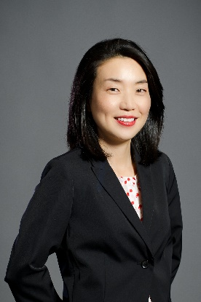
Part II. MOOCs and Open Education Around the World http://routledge-ny.com/books/details/9781138807419/

Slide 10
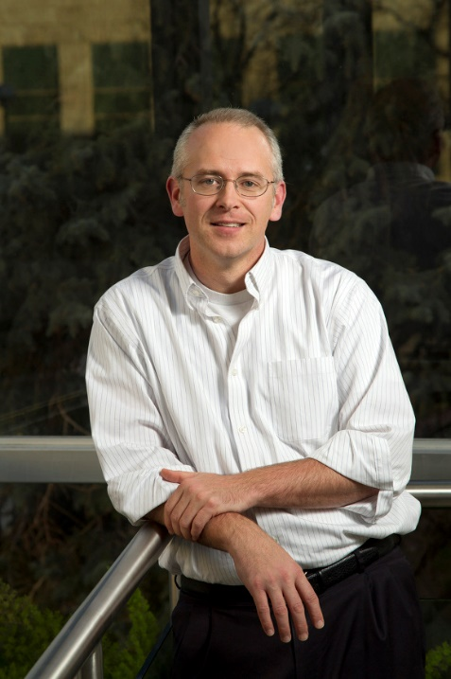
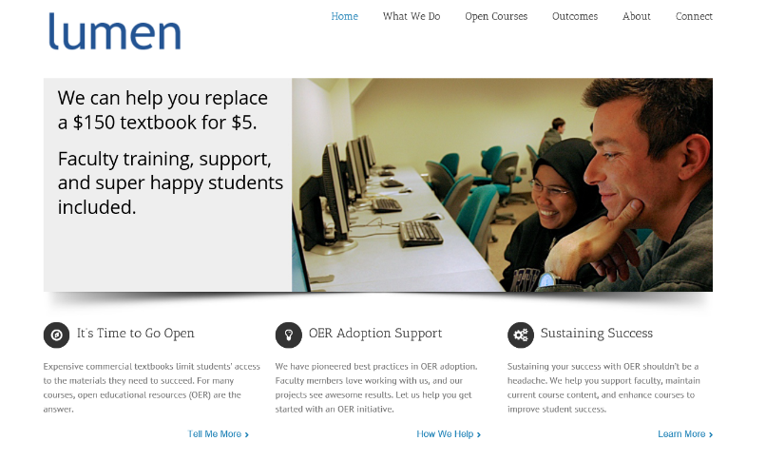
Chapter 1: The MOOC Misstep and the Open Education Infrastructure David Wiley, Co-founder and Chief Academic Officer, Lumen Learning
The Open Education Infrastructure
Open Credentials
Open Assessments
Open Educational Resources
Open Competencies

Slide 11
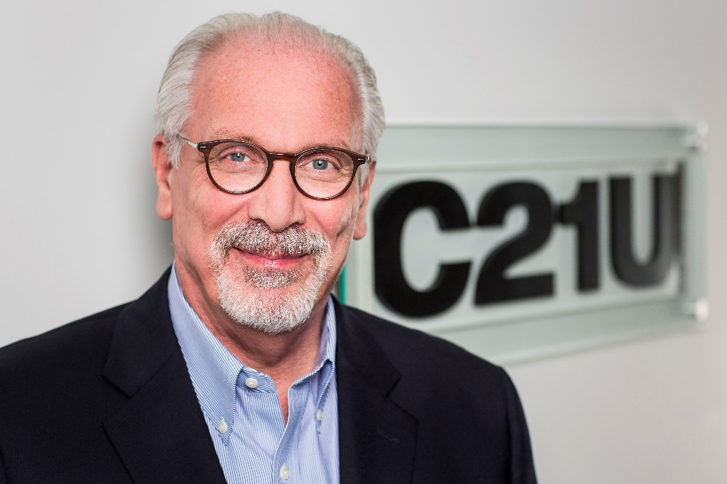
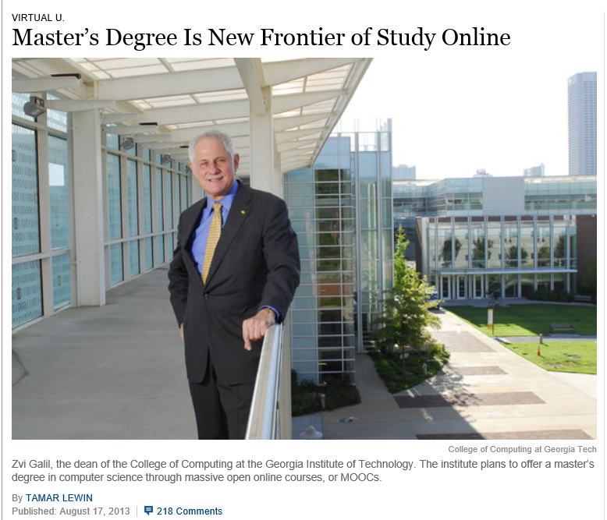
Chapter 13: Unbundling Higher Education and the Georgia Tech Online MS in Computer Science: A Chronicle Richard DeMillo

Slide 12
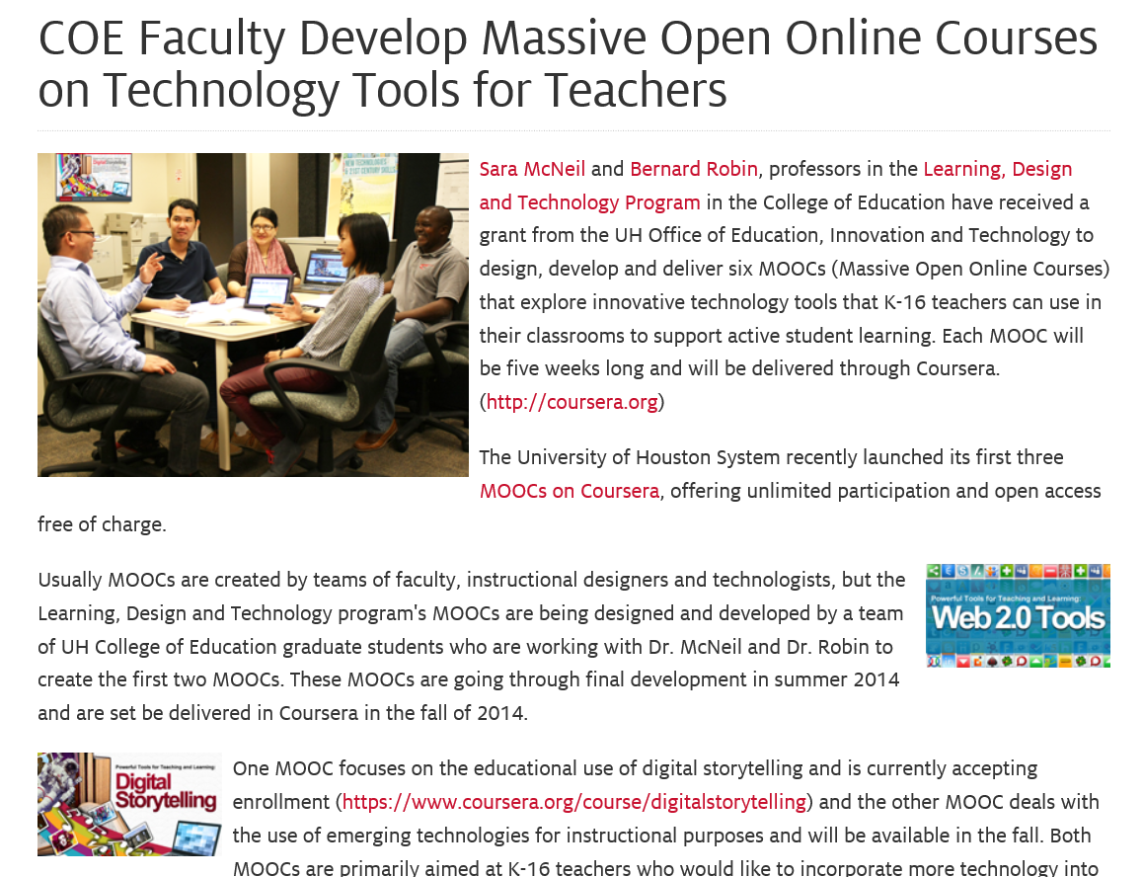
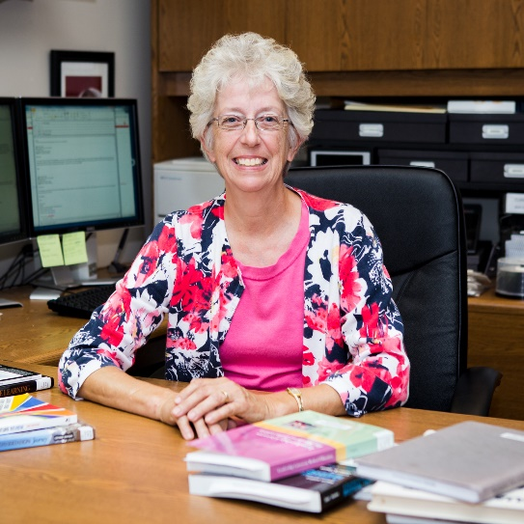
Chapter 16: Collaborative Design and Development of MOOCs for Teacher PD Bernard Robin and Sara McNeil, Univ. of Houston

Slide 13
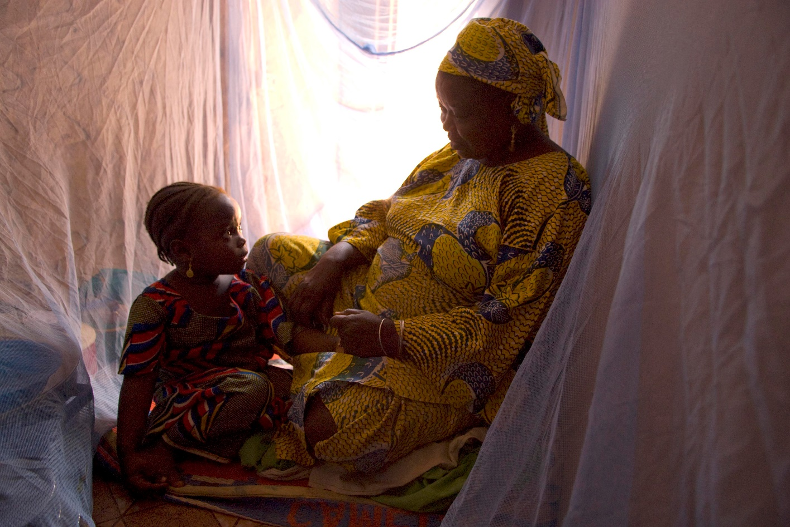
Chapter 19: Harnessing the Power of Open Learning to Share Global Prosperity and Eradicate Poverty Sheila Jagannathan, World Bank, Washington DC MOOCs on Climate Change (e.g., impacts of climate change on farmland) and Risk and Opportunity (reducing the risk of childhood mortality)

Slide 14
Part III. Ideas for Cultural Sensitivity

Slide 15
Chapter 2: USA/Georgia Tech: Karen Head
Be careful with: hand gestures (e.g., finger pointing—use at least two fingers), body movements, English dominance, political issues.
Jokes and humor can easily be misinterpreted.
Be aware of shifting political climates impacting resource access such as YouTube in China.
Many cultures do not have a linear approach (e.g., from A to B) to communication.
Using visual rhetoric (e.g., visual images) to communicate can be a minefield of problems.

Slide 16
Chapter 3: Japan/The Open U Kumiko Aiko
Make subtitles available in multiple languages based on intended audiences.
Avoid references to current events that may only be shared by a small subgroup.

Slide 17
Chapter 5: Australia Carina Bossu
To ensure inclusiveness (including cultural, ethical, and religious), one should openly license all educational materials developed for MOOCs, so as to guarantee the permissions and freedoms required for translation, adaptation, re-use, redistribution, and repackaging.

Slide 18
Chap. 6: South Africa Laura Czerniewicz
The single most important requirement is that MOOCs and MOOC resources be made available under Creative Commons licenses or other open licenses which allow for re-use and adaptation. It is essential a broadcast model be employed.
The agency for and ownership of local resources needs to be in the hands of those who best understand local conditions, and therefore they need to be able to create and adapt as they see fit.

Slide 19
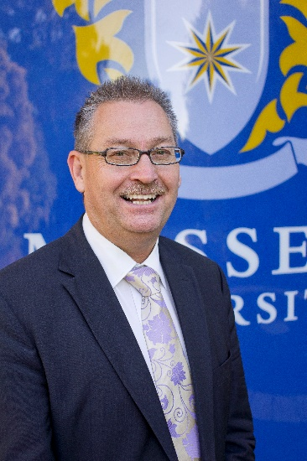
Chapter 8: New Zealand and Ireland Mark Brown
Create MOOCs on indigenous cultures and unique languages other than English (e.g., Irish).

Slide 20
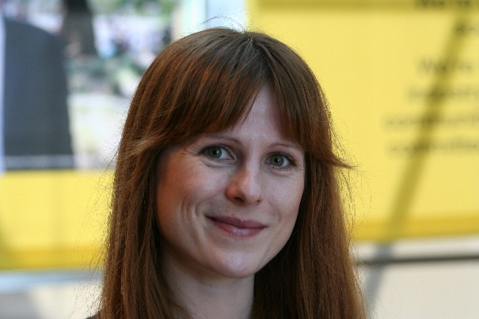
Chapter 9: Scotland U of Edinburgh Amy Woodgate
Intermittent Internet access on one’s mobile phone will not help to stream HD videos.
Simple course designs (e.g., talking heads with minimal hand gestures) helps to make content more available for international audiences. More engaging content is more difficult to convert.

Slide 21
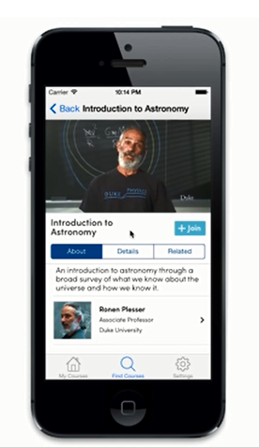
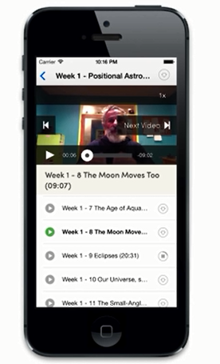
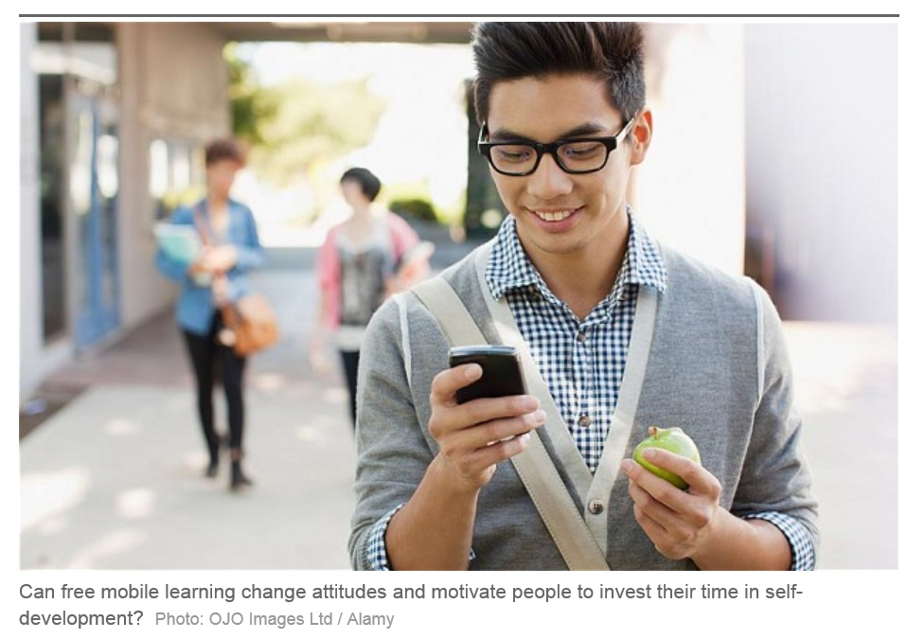
Mobile MOOCs (e.g., mobile courses on smartphone)

Slide 22
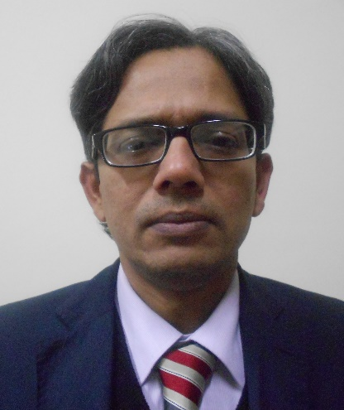
Chapter 11: India and Canada/COL Sanjaya Mishra
Be culturally sensitive to music and pictures while designing content for global audience.
Consider technology used to develop the content (does it assist reuse and remixing?).
Instead of focusing too much on the cultural sensitivity of MOOCs and raising costs, try to allow for reuse and remixing of content. Use open source technologies and content.

Slide 23
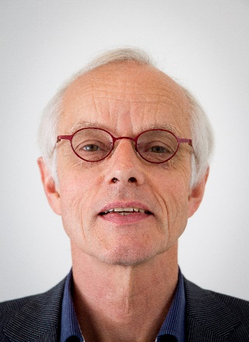
Chapter 12: Netherlands/Open U Fred Mulder and Darco Jansen
To be mindful of:
Different levels of digital literacy skills
Local resources by locals
Legal differences and barriers
Gender, age, and disability issues
Device-specific pedagogy and interface

Slide 24
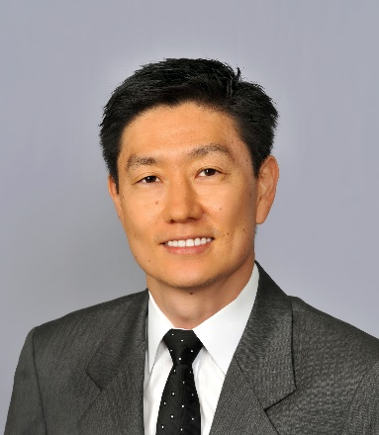
Chapter 14: USA/Stanford Paul Kim and Charlie Chung
Encourage students to download lecture videos and translate them to other languages and perhaps add captions and make available in their local cloud services.
Encourage students to create low bandwidth versions of videos for those in low bandwidth areas.
Encourage students to translate videos and add nuances and words understandable in local languages.
Encourage students to meet locally in teams to share materials and take care of “sensitive matters.”

Slide 25
Chapter 15: USA/U Michigan Chuck Severance
Avoid troublesome metaphors and examples (e.g., the baseball World Series in the USA).
Never show lecturer’s face (use audio only)—allows for complete overdubbing in the native language and avoid hand gesture problems.
Make slides as word free as possible—where possible use symbols
“Limit” to audio and “No” video OR keep the video “simple”

Slide 26
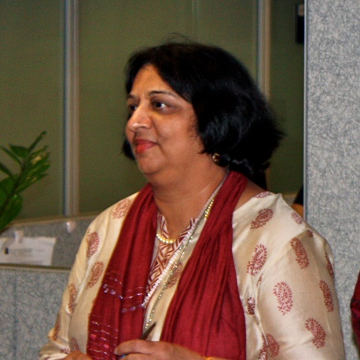
Chapter 19: DC/World Bank Institute Sheila Jagannathan
“Widen” and “increase” representations from more diverse groups and stakeholders (gender, non western, public and private, grass roots, etc.).
Make the contents more culturally sensitive/relevant.

Slide 27
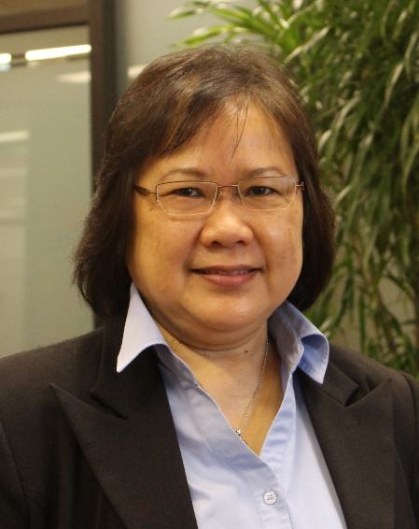
Chapter 20 Indonesia and Malaysia Zoraini Wati Abas
Do not expect Asian audience to quickly voice their opinions
Treat Asian audience as an equal
Avoid issues related to religion and politics.
Minimize distractions and negative feelings (e.g., do not show visuals or give examples of prohibited types of foods or animals)

Slide 28
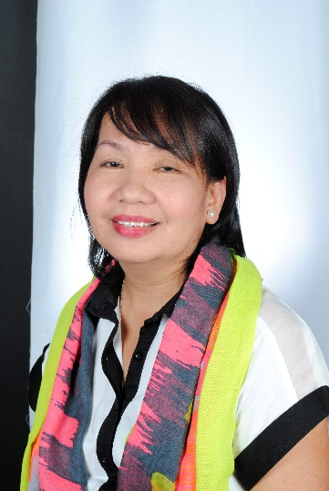
Chapter 21: U of Philippines Open U Melinda Bandalaria
Strictly avoid references to religion.
Use acceptable dress code.
Even when English is the primary or secondary language of the country, consider making MOOC content available in the major dialects of the country.

Slide 29
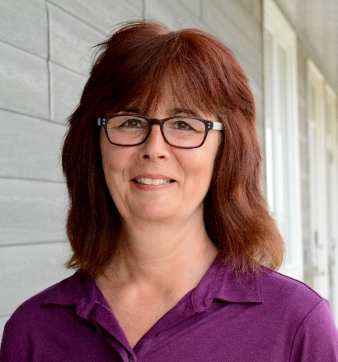
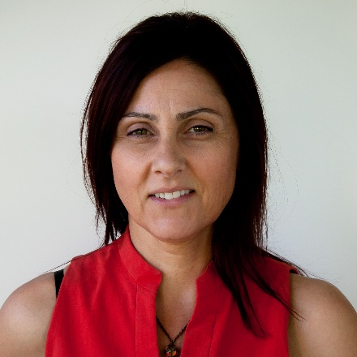
Chapter 27: Canada Helene Fournier and Rita Hop
“Personalize” the learning experience to offset the massiveness.
Need to think hard about how cultural differences might be expressed and accepted in the MOOC platform.
The road ahead hinges on personalizing learning experiences; the connectivist approach (i.e., cMOOCs) is which participants are in the driver’s seat.

Slide 30
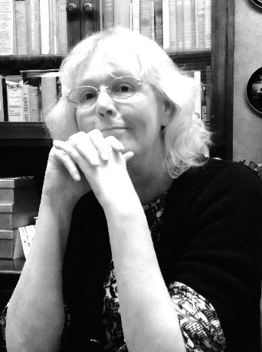
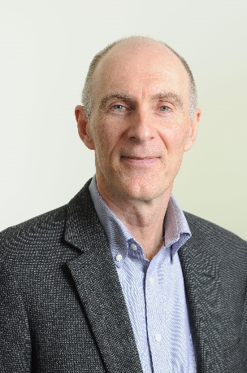
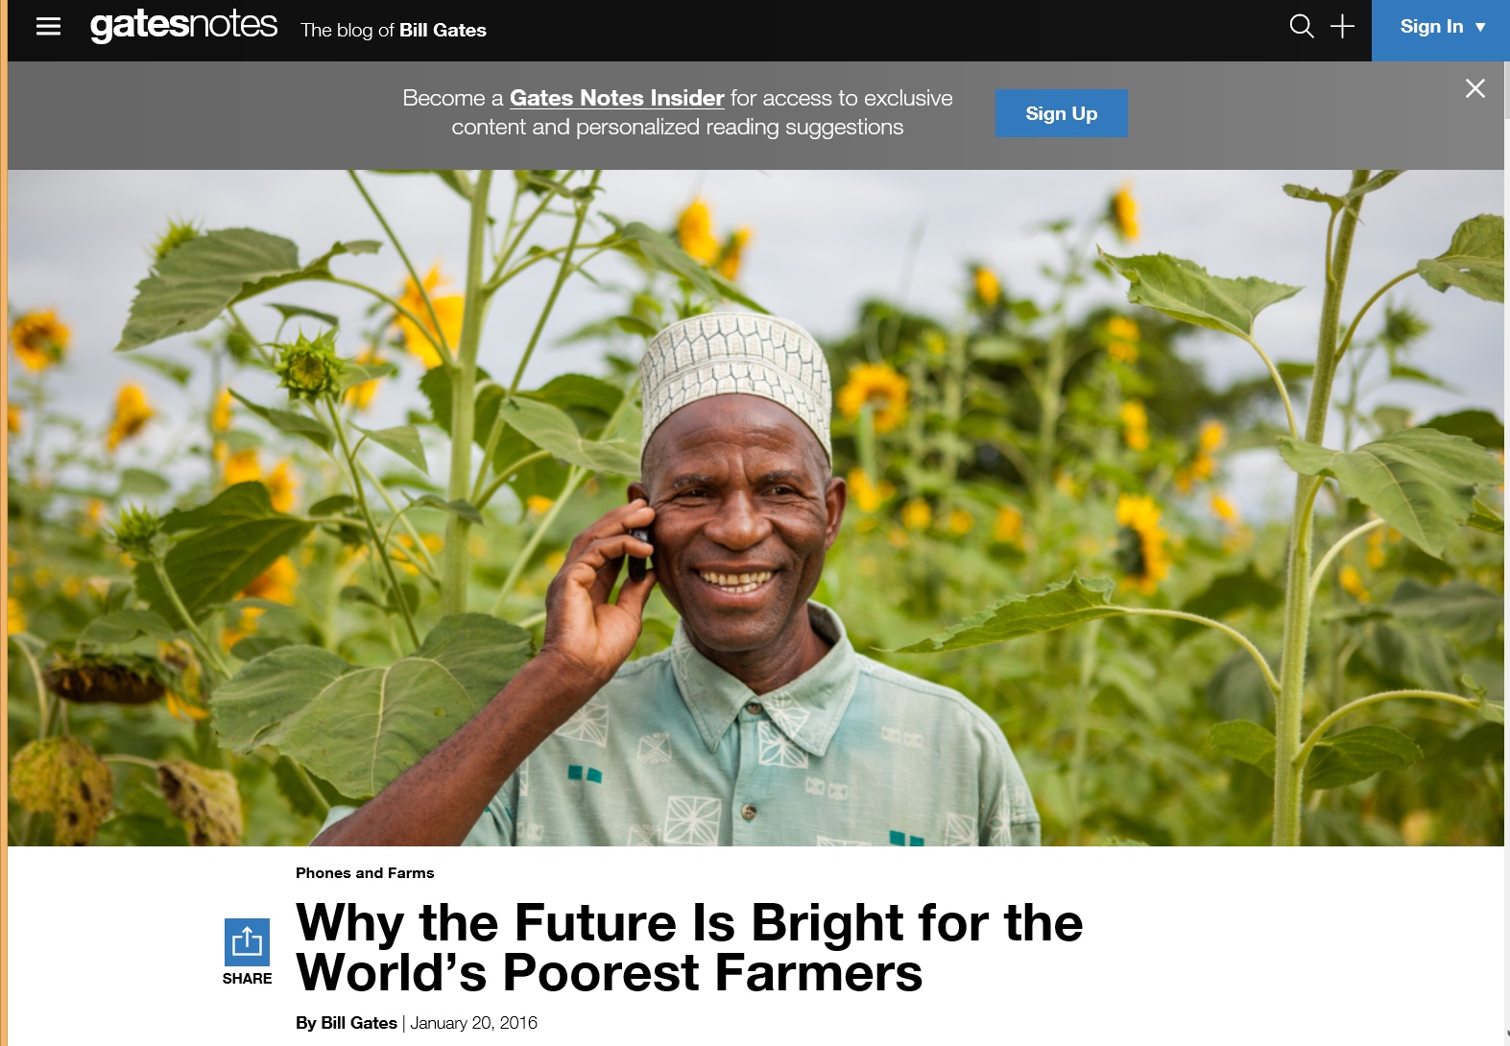
Chapter 28: UK/FutureLearn Rebecca Ferguson and Mike Sharples
Access. In many countries (e.g., in Africa, but also areas of Asia) mobile is the main means of access, so the courses need to be developed for a mobile-first experience, including pedagogy as well as interface.
Provide transcripts of videos, preferably in multiple languages and multi-language subtitles.

Slide 31
Part IV. Personalization of MOOCs

Slide 32
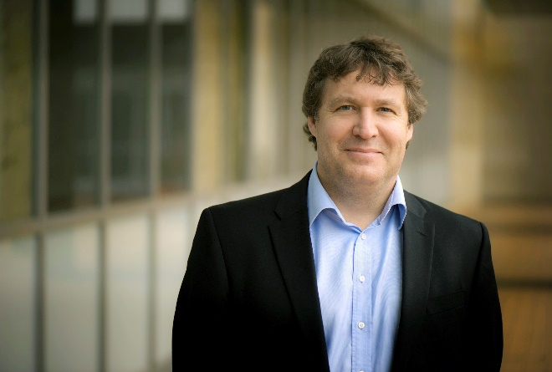
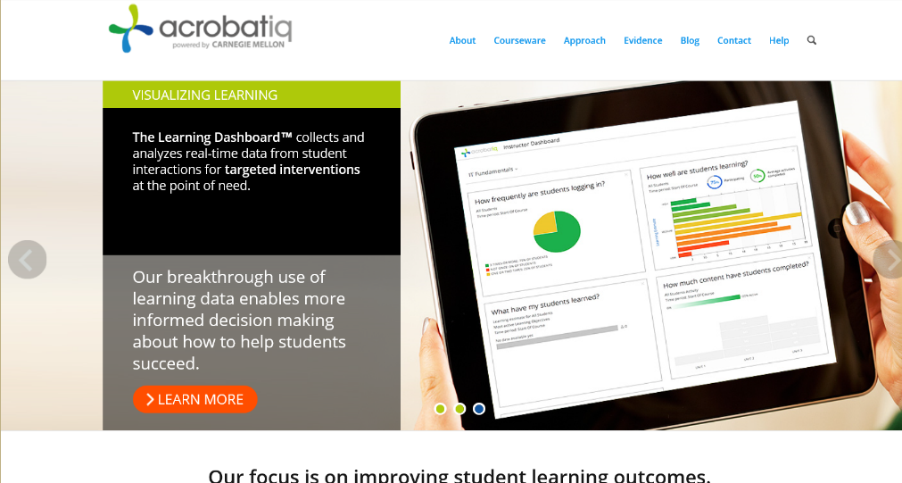
Foreword: Canada/USA George Siemens
MOOCs are adopting CMUs OLI project (adaptive learning in stats) (e.g., Candace Thille at Stanford).
Smart Sparrow (adaptive learning company connected to ASU) has started running personalization in MOOCs. One personalized/adaptive MOOC with Australian univ.

Slide 33
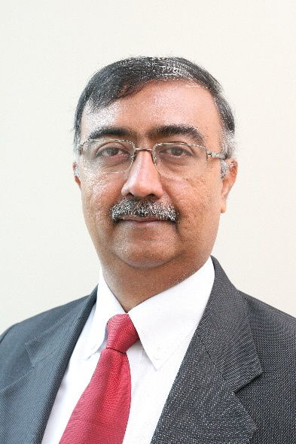
Chapter 18: Canada/COL Balaji Venkataraman
In the Mooc on mobiles for development the course team received requests from two groups of learners in Sierra Leone and Zambia for the course materials on DVD.
AgMoocs initiative (http://www.agmoocs.in/) uses MooKIT platform designed for access in low bandwidth conditions. It includes a functionality for a learner to hear the voice track on a basic mobile phone.

Slide 34
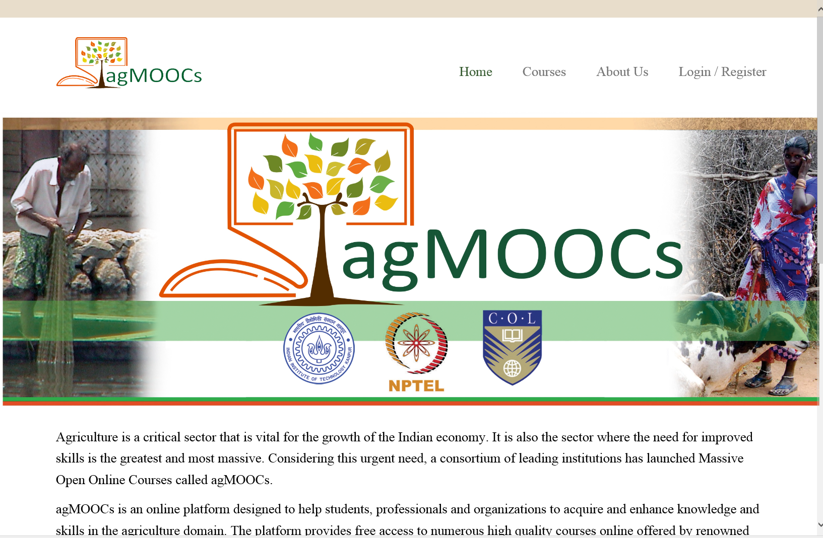
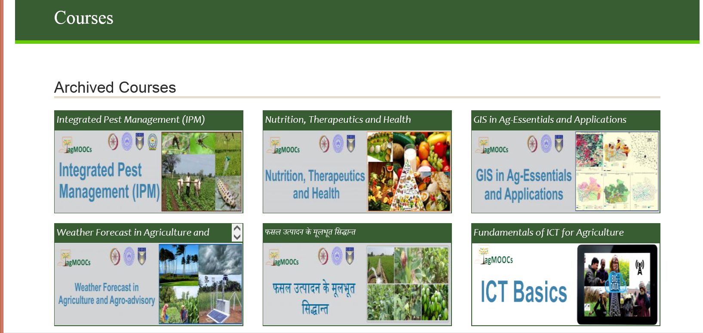
May 20, 2016 agMOOCs (India) http://www.agmoocs.in/

Slide 35
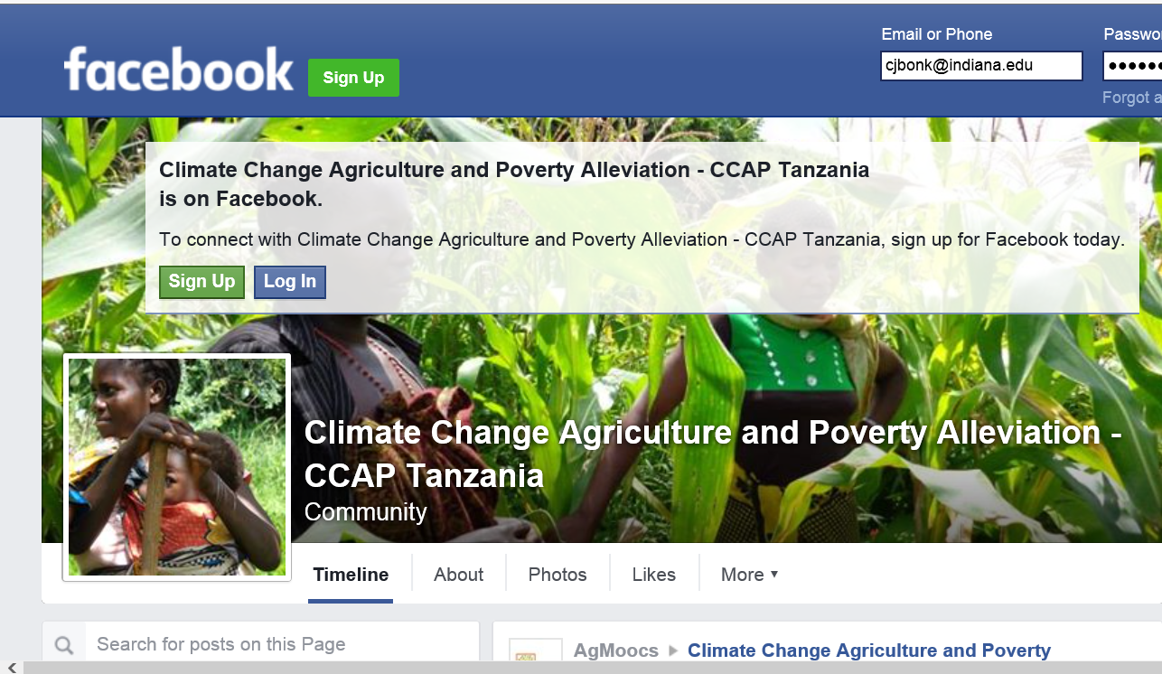
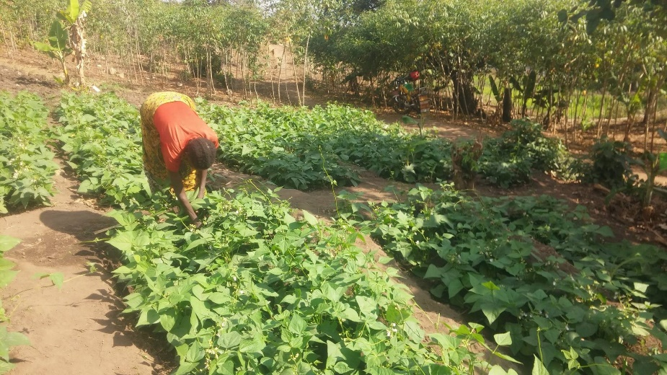
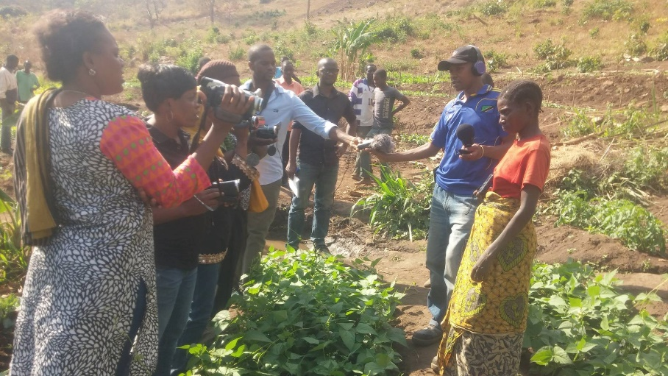
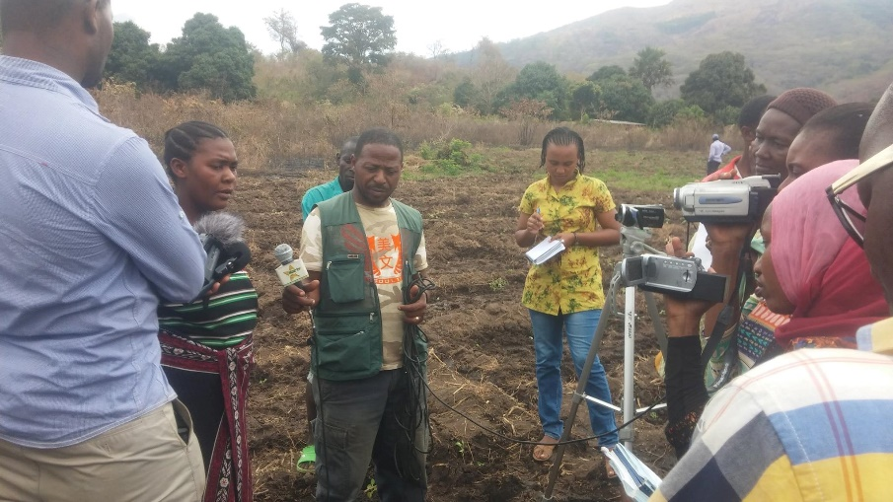
May 20, 2016 agMOOCs (India) http://www.agmoocs.in/ https://www.facebook.com/ccapatanzania/posts/1540201329627397

Slide 36
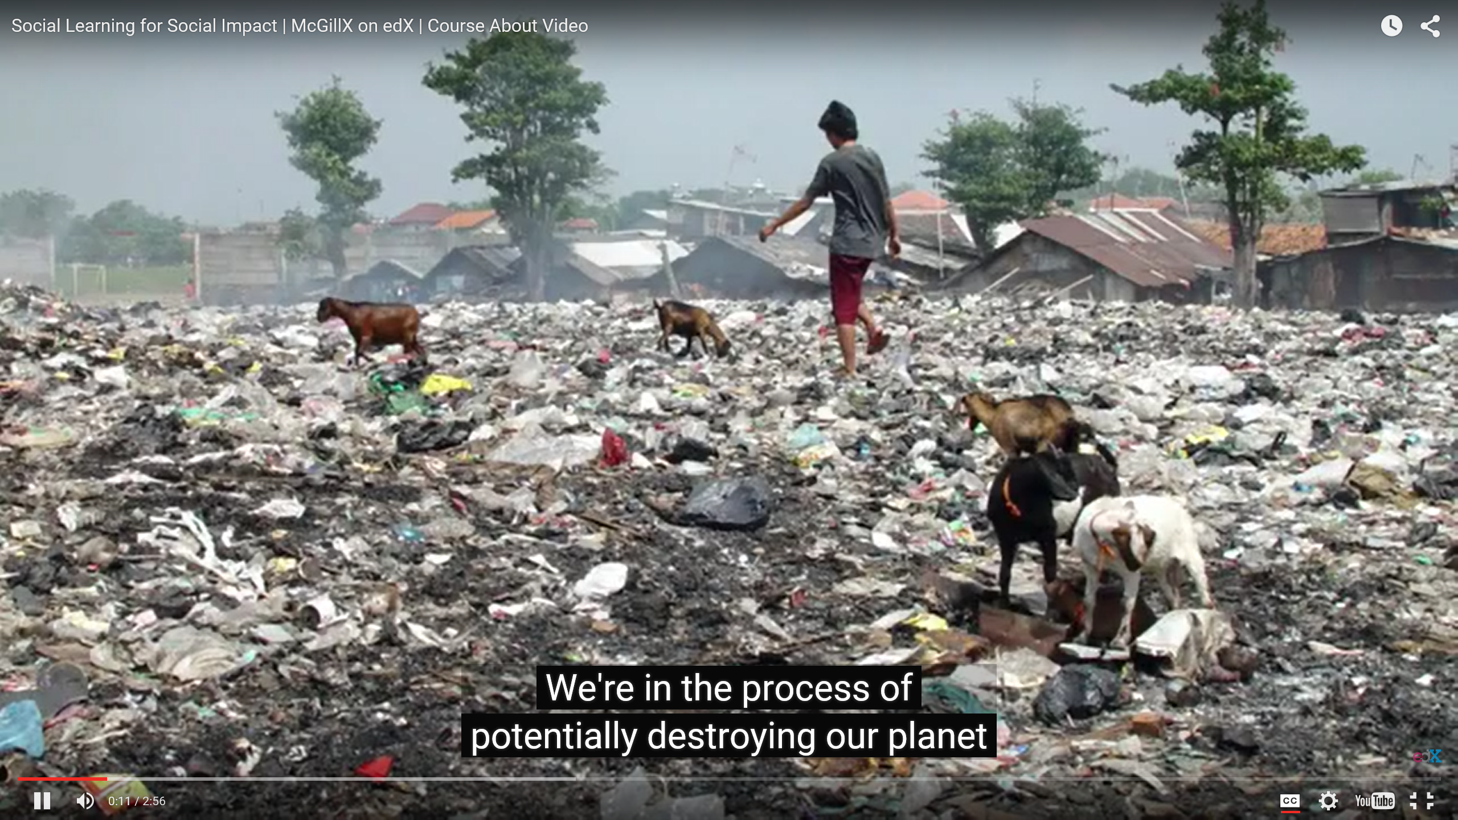
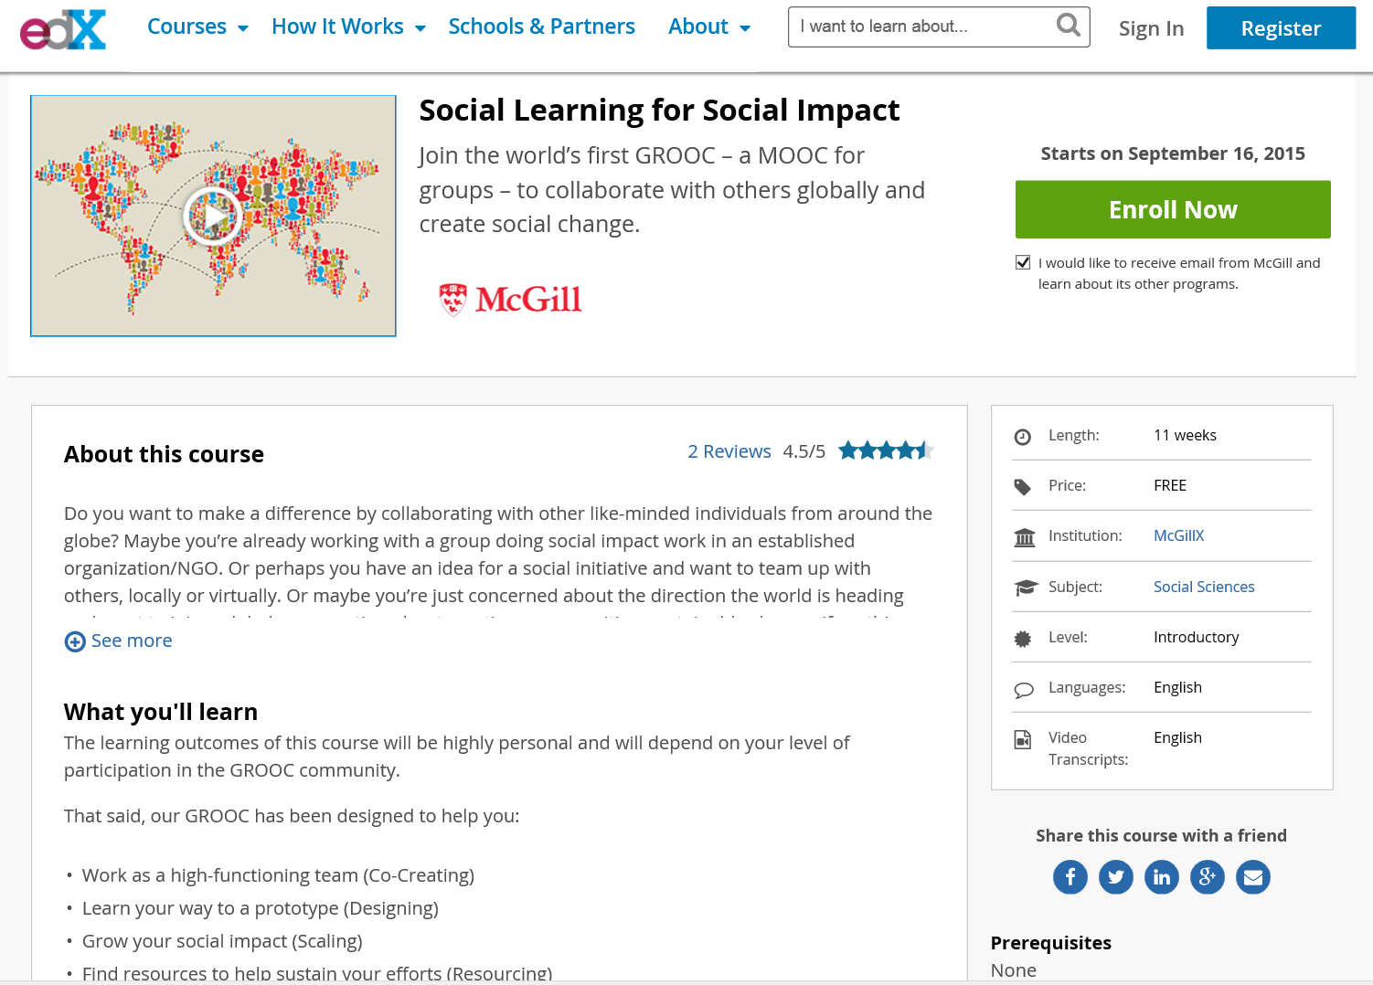
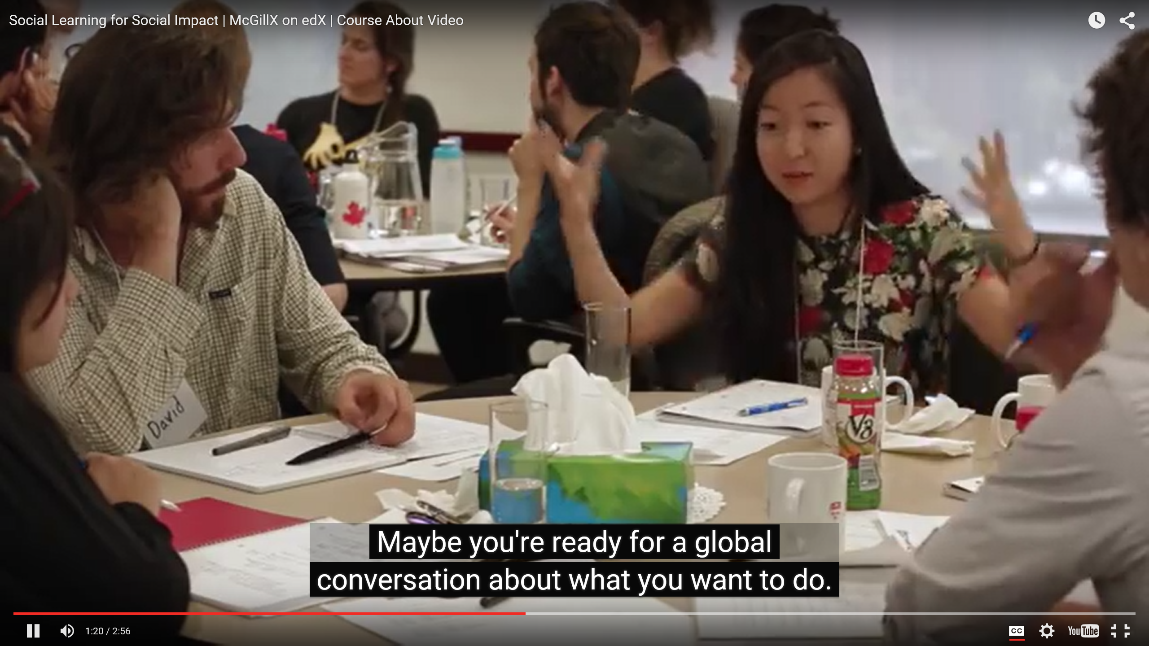
September 15, 2015 GROOCs are MOOCs for Social Impact Social Learning for Social Impact, edX Join the world’s first GROOC – a MOOC for groups – to collaborate with others globally and create social change. https://www.edx.org/course/social-learning-social-impact-mcgillx-groocx https://www.youtube.com/watch?t=36&v=WNg-5LFAMdI

Slide 37
Chapter 18: Canada/COL Balaji Venkataraman
In the Pacific COL supported the U of South Pacific with a specially constructed MOOKIT platform. Social media was integrated with it. Any interested learner can add his or her SM profile to the profile in the course. This will enable a learner to follow the discussions on the course forum in real time using just the smart phone. This bandwidth is cheaper in most Pacific island countries than bandwidth availed for laptops. This facility greatly contributed to increased course participation often overwhelming the team of instructors.

Slide 38
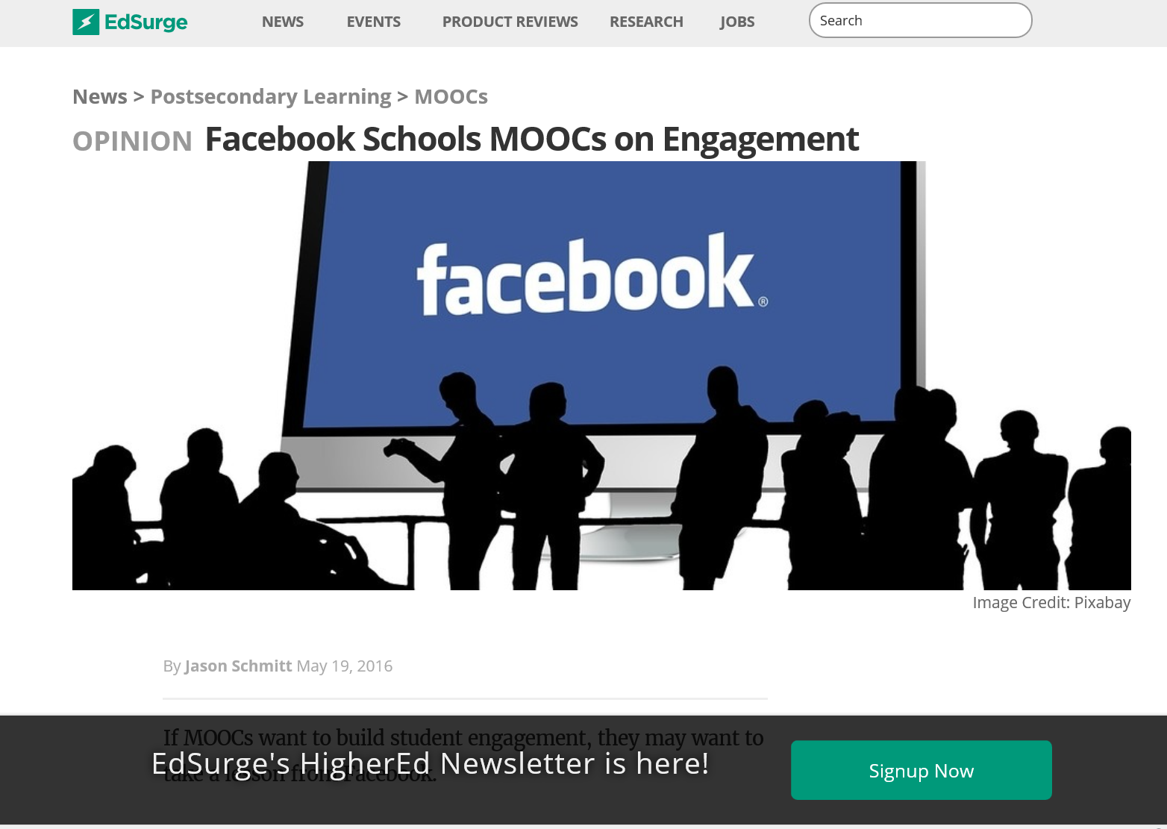
May 19, 2016 Facebook Schools MOOCs on Engagement Jason Schmitt, EdSurge https://www.edsurge.com/news/2016-05-19-facebook-schools-moocs-on-engagement

Slide 39
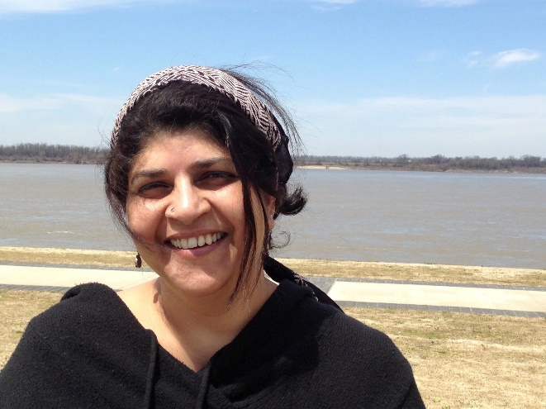
Chapter 18: DOCC/USA Radhika Gajjala
Doing a "Collaborative" course requires that we engage the context - not just talk to it.... We start by dialogue and engagement with the students - the sensitivity would emerge through interaction and skype conversations and discussion and debate.

Slide 40
Chapter 19: DC/World Bank Institute Sheila Jagannathan
We try to do badging etc. to give motivation and personal incentives such as champion or expert.
We try to customize the discussion forums with regional and very level forums, topics and moderators.
Google hangouts are also used to customize and personalize at country or institutional levels.

Slide 41
Chapter 21: Philippines Open U Melinda Bandalaria
…one feature that we have integrated into our MOOCs which I think is one effort to personalize learning is the "Multiple Paths to Learning" or the "Learning on the Go." Through this feature, the learner can choose whether to learn through the video lessons, text lessons or podcast.
In terms of gadgets to use, of course, we made sure that the courses are accessible whatever device especially mobile devices, the learner has access to.

Slide 42
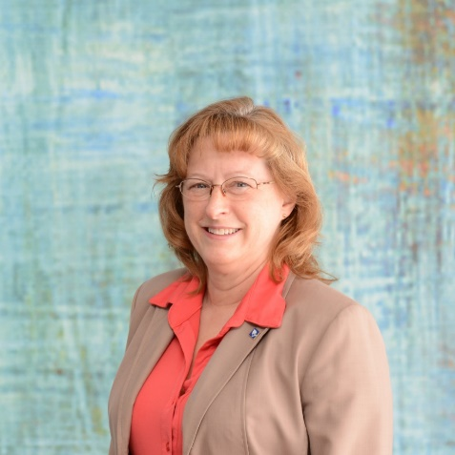
Chapter 25: USA/Illinois Vickie Cook
Personal notes within the MOOC from either other students or the instructor that the MOOC takes on a personalized emphasis…communications that do not use my name, or are generic to be reused– feel quite cold and impersonal.
Theory of “heutagogy” – basically learning that is self-determined and available in a mobile interface, I think it is important that personalization also create the desire to return to the MOOC for more.

Slide 43
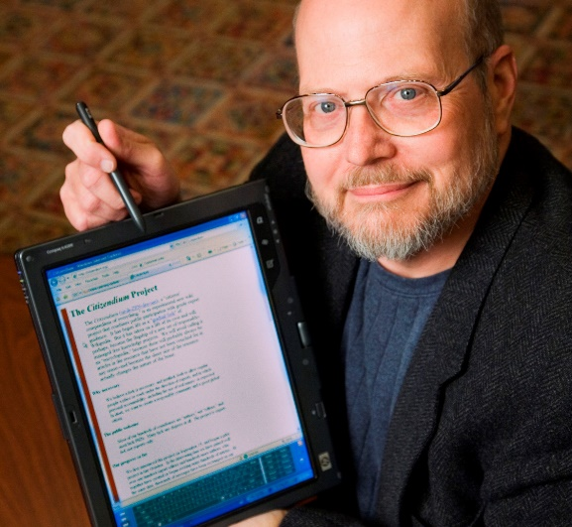
Chapter 25: USA/Illinois Ray Schroeder
Most obvious way to personalize is to include group projects, allowing students to self-select into interest areas to conduct collaborative projects that are relevant to the MOOC topic
One of the easiest and most effective ways is to build self-reflection into each module of a MOOC.
Motivated self-determined learners (such as many MOOCers are) do naturally adapt, build upon and scaffold MOOCs to meet their personal learning needs and desires.

Slide 44
Part V. MOOC Personalization Survey Results

Slide 45
Q2: 1. How many MOOCs have you taught (including any that you are currently teaching)?
Answered: 145 Skipped: 10

Slide 46
Q4: 3. How many MOOCs have you completed as a learner (including any that you are currently enrolled in)?
Answered: 145 Skipped: 10

Slide 47
Q8: 7. What is the delivery format of your most recent MOOC?
Answered: 143 Skipped: 12

Slide 48
Q9: 8. How many people signed up for your most recent MOOC?
Answered: 143 Skipped: 12

Slide 49
Q17: 16. In what ways is peer interaction encouraged in your MOOC?[Check all that apply]
Answered: 131 Skipped: 24

Slide 50
Q20: 19. How is student progress/participation monitored or tracked? [Check all that apply]
Answered: 131 Skipped: 24

Slide 51
Q21: 20. In what ways do students get feedback in the course?[Check all that apply]
Answered: 129 Skipped: 26

Slide 52
Q22: 21. Does your most recent (or current) MOOC utilize any of the following?[Check all that apply]
Answered: 122 Skipped: 33

Slide 53
Q23: 22. How do participants in your MOOC contact you if they have questions, concerns, or suggestions?[Check all that apply]
Answered: 129 Skipped: 26

Slide 54
Open-ended question 1: Can you provide one or more ways that you attempt to personalize the MOOC experience for those enrolled in the course?
Answered: 36 Skipped: 119
Replying personally to asynchronous discussion messages to explain or reference materials to students as well as to refer to peers. Retweeting and commenting on learners social media posts.
Mainly, we ran moderated peer discussion through Piazza. Students, teachers, and the moderator commented on student contributions.
To give more different case studies and examples, considering different backgrounds and interests. To have high order and low order assessments, considering the personal interest for deepening into content.
Its all about expectations and communication. From the first day of 'launching' we have moderators & academics assigned to welcome and encourage learners to ask questions and post comments for peer-to-peer feedback, etc. We also list specific times when different academics and experts will be online (various times/dates due to international reach) to have 1-2-1 and group discussions where applicable.
I adjust some of the content based on early discussion in the course to better meet the needs of the recruited cohort. Some of the material was co-created and labelled geographically.

Slide 55
Open-ended question 2: How do you use learning technology such as computer conferencing (e.g., Skype, Zoom, Google Hangouts, etc.) to personalize your MOOC?
Answered: 37 Skipped: 118
Online office hours were available through Appointlet. Had an online whiteboard to share with students' during scheduled office hours. Used Skype or Google Hangouts to video conference during online office hours.
Slack for group projects
I held virtual office hours during each of the three offerings of my course. In several had teaching associates join in. In the last offering, I used the first part of the meet-up to share current nutrition related news and studies to help keep the course more up to date (we also posted news and studies). One challenge of the course is keeping content current in subsequent offerings without reshooting videos or redoing all the PowerPoints. Used announcements, resources and the meetups to provide updates.
We didn't but I am working on another distance learning course now that is closed using Skype, Zoom and Webex. They are all good in different ways. The participants in the closed course have bonded much more as a cohort than any of the groups in the MOOC.
Google Hangouts are excellent - but they don't work in China. We also use WarpWire to allow student video presentations in private environment.

Slide 56
Open-ended question 3: How did you design your MOOC to make it easier to access for students with different backgrounds and technology access?
Answered: 34 Skipped: 121
Worked closely with university expert. Consulted with language dept. Talked with and piloted with our international students and friends from Jordan, China, Greece and Turkey.
Follow UK accessibility compliance guidelines. Main course material pitched at entry level but more complex further reading provided to allow students to 'go deeper' as well as range of case study content to facilitate more in-depth analysis.
There was scripts for everything ... videos mainly. There was also downloadable documents produced in different formats to make it easier depending on the technology they had available. The content was 'beginner' level so I think we naturally slowed down and covered the basics in a lot of detail - as well as providing links and documents with more information as different points.
Our content covered examples from different political and religious contexts, across Europe, the Americas, the Middle East and Asia, designed in turn to encourage students from diverse backgrounds to share their own political experience.

Slide 57
Open-ended question 4: In what ways, do you or your teaching assistants and moderators provide just in time support, feedback, and individualized learner attention?
Answered: 37 Skipped: 118
Tremendous amount of work here. We continuously monitor student performance and find where students are struggling. We then respond to struggle areas with forum posts and weekly updates.
We had all of our academics who developed the MOOC…assigned a different section to deliver and then moderate. So during the few days before/after the 'official launch' of our sections, we were online at various times to provide comments and feedback. We also gave learners specific dates/times that we would be online to discuss synchronously and answer questions, etc. We had resident entrepreneurs and business experts who were asked to be online over certain dates/times to provide the 'practical' view. Finally, we also have a central 'digital learning team' who support all University MOOCs.
Tremendous amount of work here. We continuously monitor student performance and find where students are struggling. We then respond to struggle areas with forum posts and weekly updates.
Constant, constant, constant attention to discussion forums.
Our computer technician checked every day for posts from students who were having technical problems and helped to correct them.

Slide 58
Open-ended question 5: If you were to redesign the course for enhanced personalization within your most recent MOOC offering, what would you do?
Answered: 37 Skipped: 118
I would encourage study groups with 'pupil teacher' techniques... champions in the 'crowd' leading smaller groups who are struggling or who would like more social and tutor presence.
Introduce Google Hangouts. Develop alternative pathways for content. Allow students more space to share own competencies and knowledge levels (perhaps wikis etc. ).
I would probably include one or two more items from non-western cultures and find an opportunity for students to share work in a different way.
I would review the latest cognitive science evidence on how best to achieve this important goal and redesign the course and its production accordingly.
I would hire some of our students and alumni to get involved - the students really loved the additional points-of-view and the interaction.
Change the videos - make them shorter and less formal. Give better instructions on use of discussion boards.

Slide 59
Personalized
MOOCs

Slide 60
Any Comments or Questions? Slides at: TrainingShare.com MOOCsBook: http://moocsbook.com/ Contact us: Curt: cjbonk@Indiana.edu Tom: treeves@uga.edu

