Slide 1
The 3Ts MOOCs Debate: Targets, Types, and Tensions AERA Conference, DC, April 11, 2016
Curtis J. Bonk, Indiana University
Mimi Miyoung Lee, University of Houston
Thomas C. Reeves, The University of Georgia
Thomas H. Reynolds, National University
Acknowledgments: This invited debate session was sponsored by the AERA Computer and Internet Applications in Education Special Interest Group (SIG) during their annual business meeting session in Washington, DC. We wish to warmly thank Shiang-Kwei Wang, New York Institute of Technology, and Justin Olmanson, University of Nebraska-Lincoln, for arranging this special event.

Slide 2
2016 State of the MOOC 2016: A Year of Massive Landscape Change For Massive Open Online Courses, Online Course Report http://www.onlinecoursereport.com/state-of-the-mooc-2016-a-year-of-massive-landscape-change-for-massive-open-online-courses/

Slide 3
State of the MOOC 2016: A Year of Massive Landscape Change For Massive Open Online Courses, Online Course Report http://www.onlinecoursereport.com/state-of-the-mooc-2016-a-year-of-massive-landscape-change-for-massive-open-online-courses/

Slide 4
State of the MOOC 2016: A Year of Massive Landscape Change For Massive Open Online Courses, Online Course Report http://www.onlinecoursereport.com/state-of-the-mooc-2016-a-year-of-massive-landscape-change-for-massive-open-online-courses/

Slide 5
State of the MOOC 2016: A Year of Massive Landscape Change For Massive Open Online Courses, Online Course Report http://www.onlinecoursereport.com/state-of-the-mooc-2016-a-year-of-massive-landscape-change-for-massive-open-online-courses/

Slide 6
State of the MOOC 2016: A Year of Massive Landscape Change For Massive Open Online Courses, Online Course Report http://www.onlinecoursereport.com/state-of-the-mooc-2016-a-year-of-massive-landscape-change-for-massive-open-online-courses/

Slide 7
State of the MOOC 2016: A Year of Massive Landscape Change For Massive Open Online Courses, Online Course Report http://www.onlinecoursereport.com/state-of-the-mooc-2016-a-year-of-massive-landscape-change-for-massive-open-online-courses/

Slide 8
Audience Poll What does it cost to create a MOOC? A. $0-$10,000 USD B. $10,000-25,000 C. $25,000-50,000 D. $50,000-100,000 E. Over $100,000

Slide 9
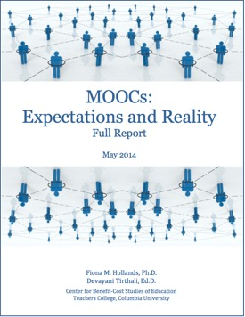
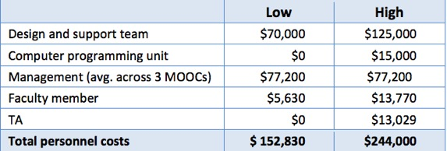
State of the MOOC 2016: A Year of Massive Landscape Change For Massive Open Online Courses, Online Course Report http://www.onlinecoursereport.com/state-of-the-mooc-2016-a-year-of-massive-landscape-change-for-massive-open-online-courses/
These are just personnel costs!

Slide 10
Debate Question #1: (1) Types of Delivery: cMOOCs vs. xMOOCs vs. pMOOCs vs pdMOOCs vs. ???

Slide 11
Bonk, C. J., Lee. M. M., Reeves, T. C., & Reynolds, T. H. (in press). The emergence and design of massive open online courses (MOOCs). In R. A. Reiser, & J. V. Demsey (Eds.), Trends and issues in instructional design and technology (4th Ed.), (pp.?). Boston, MA: Pearson Education. Available: http://www.publicationshare.com/3

Slide 12
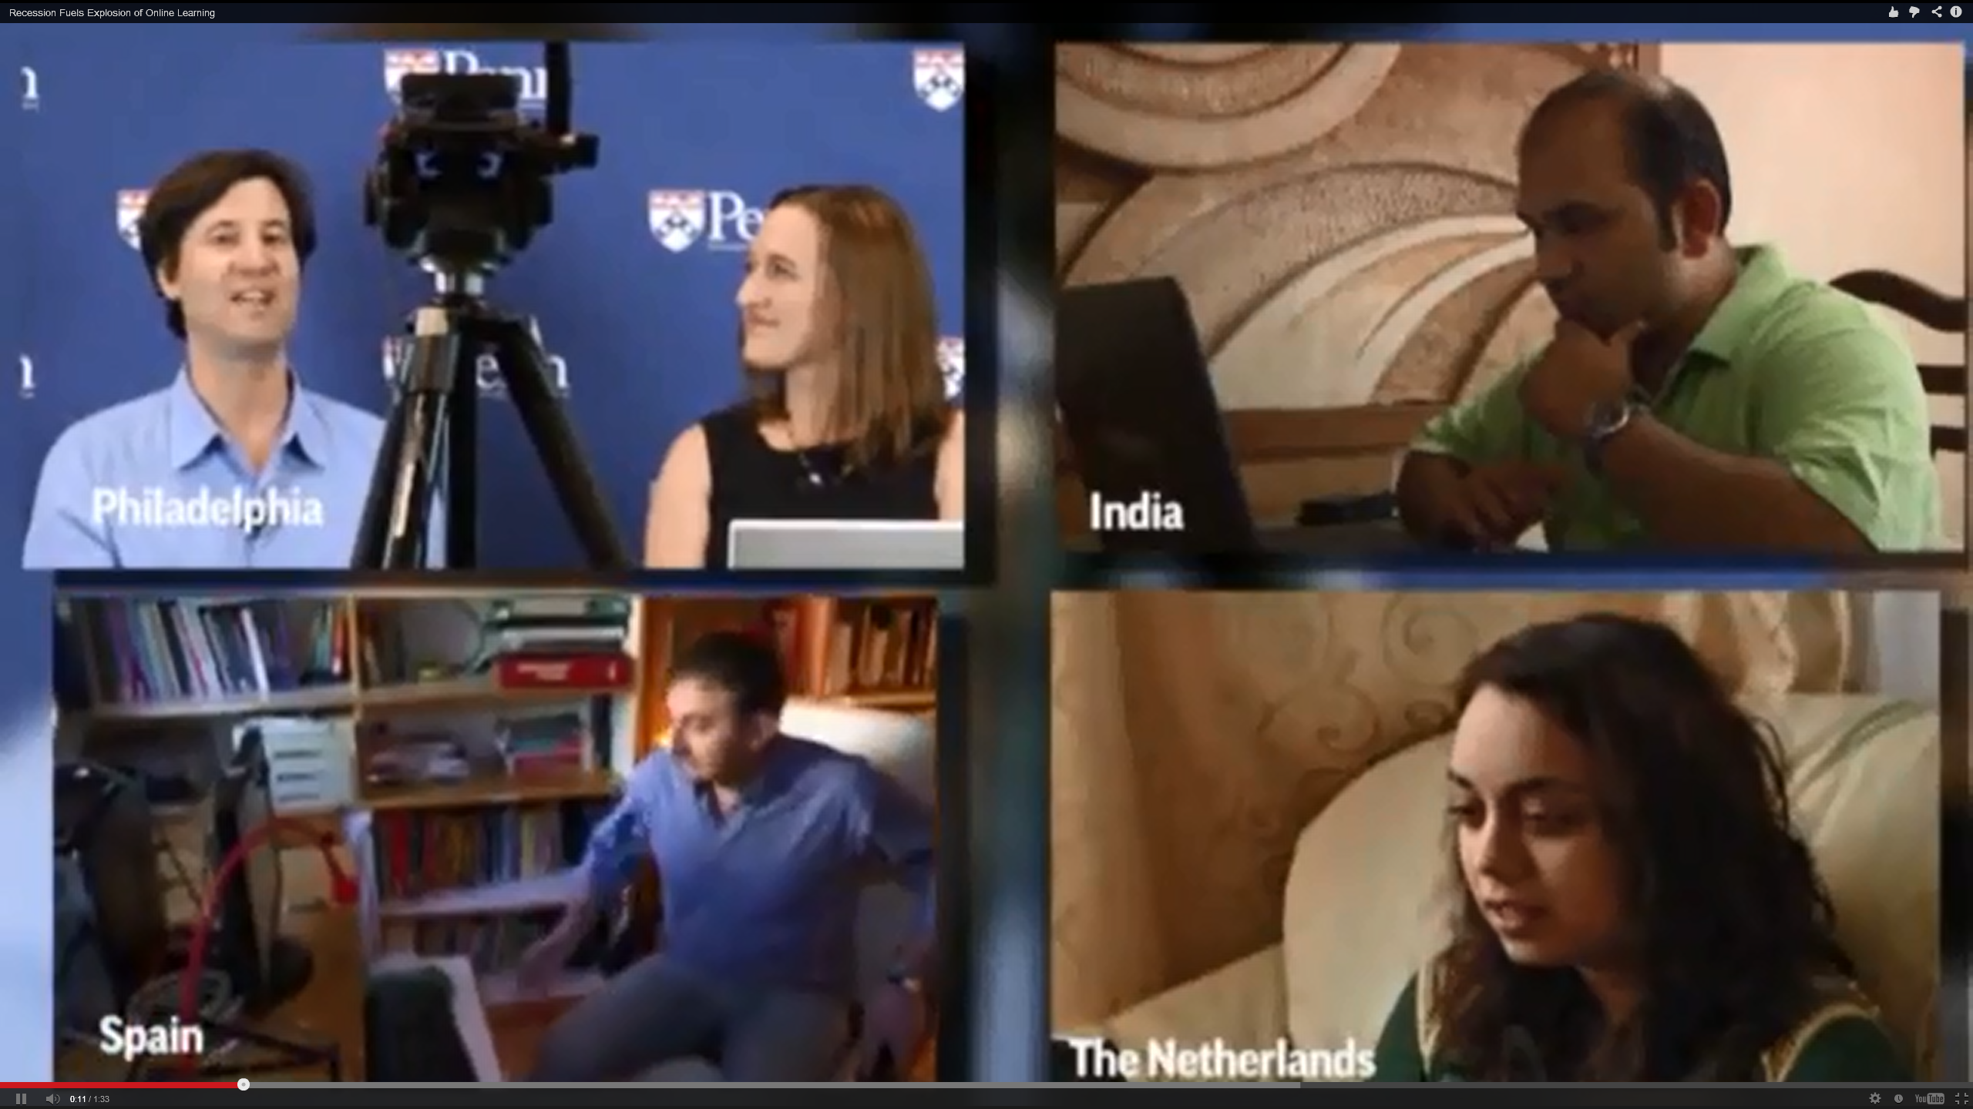
Debate Question #2: (2) Target Audience: Casual and informal lifelong learning vs. High school and college students’ supplements vs. Workplace skills gaps or other?

Slide 13
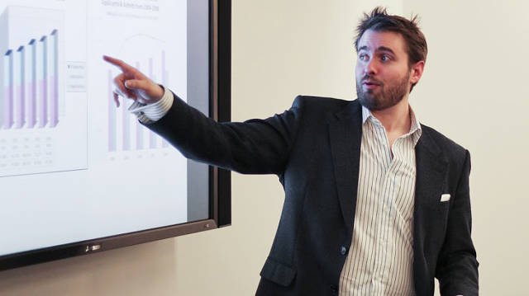
Employee to Employee Training G2g (Googler to Googler) Training Seven Ways to Corporate MOOC, Udemy blog, December 23, 2013, Shannon Hughes https://www.udemy.com/organizations/blog/2013/12/23/seven-ways-to-corporate-mooc/
Classes range from management and public speaking, to parenting and mountain climbing.

Slide 14
Debate Question #3: (3) Tense Issues: Each panelist will select a currently trending, controversial, or tense issue or two and debate it as the most pressing issue(s) facing the field.

Slide 15
June 26, 2015 In China, Where Everything is a MOOC (the “Zhongguancun MOOCs Times Building”) Education Week, Justin Reich, HarvardX Research Fellow http://blogs.edweek.org/edweek/edtechresearcher/2015/05/in_china_where_everything_is_a_mooc.html?r=284759497
The most memorable line from my recent visit to China was this: "We have 12 million K-12 teachers in China who need to receive this particular in-service training, so we started with a group of about 200,000."

Slide 16
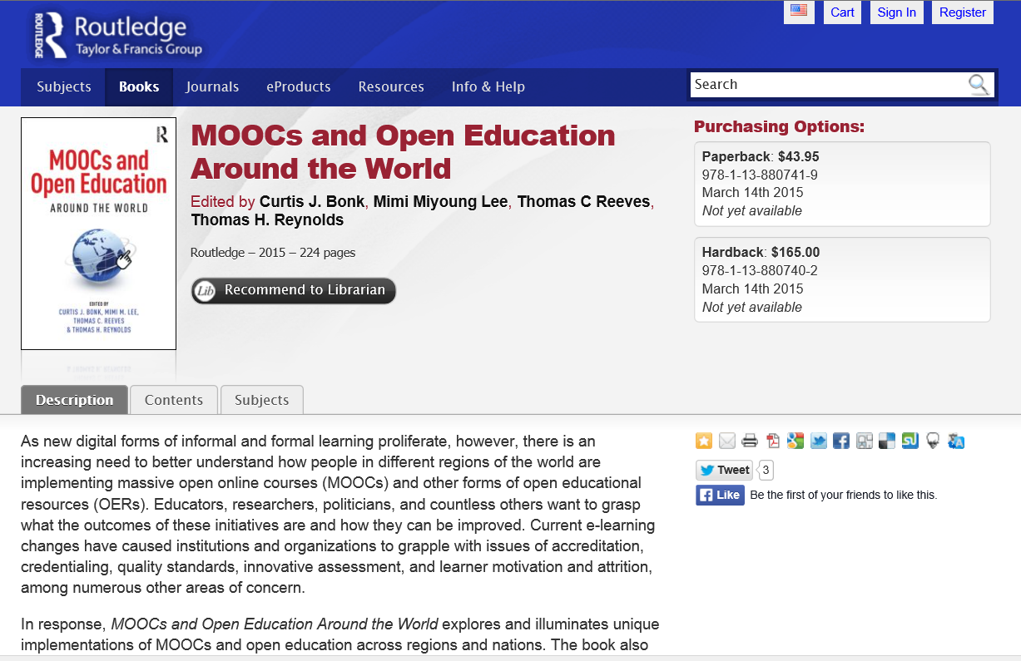
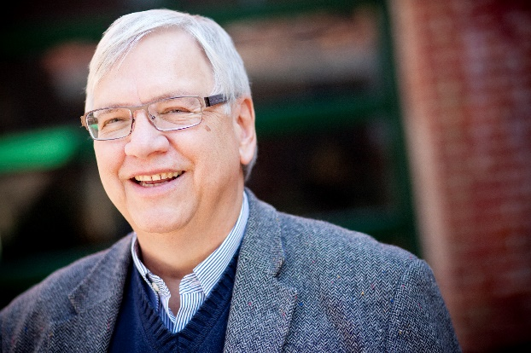
MOOCs and Open Education Around the World Routledge: http://routledge-ny.com/books/details/9781138807419/ Book Homepage: http://moocsbook.com/ Slides at: http://moocsbook.com/other.php

