Slide 1



MOOC and Open Education Around the World:
Recent News and Research Clues
Curt Bonk, Indiana University, cjbonk@indiana.edu

Slide 2
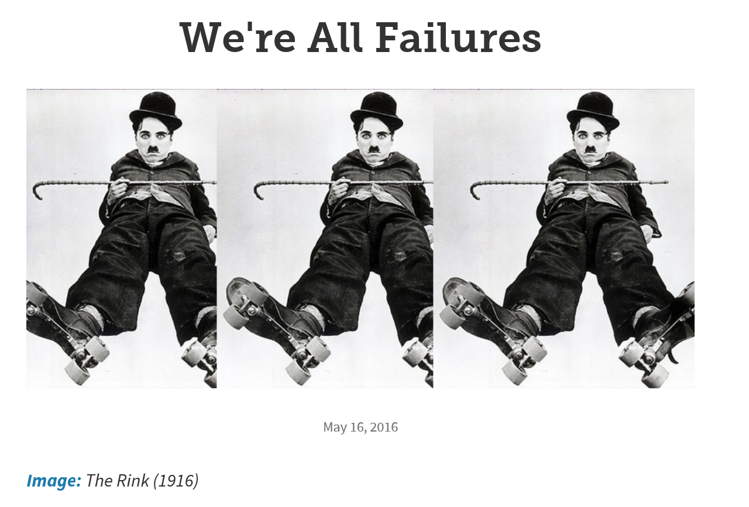
May 11, 2016
We're All Failures
The Chronicle of Higher Education https://chroniclevitae.com/news/1391-we-re-all-failures?cid=at&utm_source=at&utm_medium=en&elqTrackId=4fb9cc139bc44f8995a1fa5e537c1fd1&elq=c0dd0d45a2514289916fc3f4d5577e5f&elqaid=9077&elqat=1&elqCampaignId=3137

Slide 3
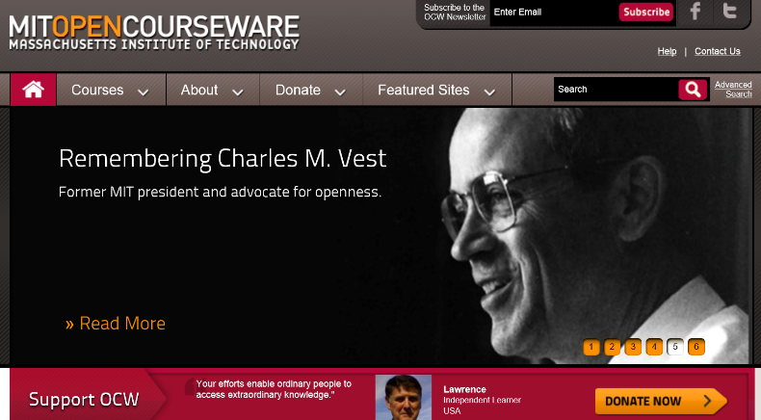
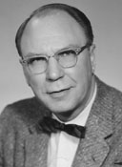
Audience Poll #1:
Has open education transformed your life?

Slide 4

Charles Wedemeyer Quote #1:
“It should be immaterial whether one has learned at the front door or the back door of the Palace of Learning. What one has learned—not where, or how, in what sequence, at what institution, or in what period of time—is the only criterion of supreme importance.”
(Charles Wedemeyer, 1981, p. 216)

Slide 5
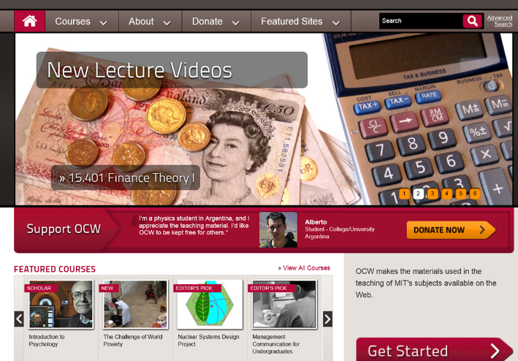

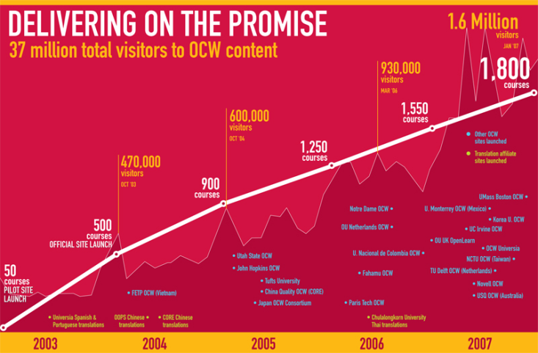
Charles Vest (April 4, 2001) http://web.mit.edu/newsoffice/2001/ocw.html
“This is about something bigger than MIT. I hope other universities will see us as educational leaders in this arena, and we very much hope that OpenCourseWare will draw other universities to do the same. We would be delighted if -- over time -- we have a world wide web of knowledge that raises the quality of learning -- and ultimately, the quality of life -- around the globe."

Slide 6
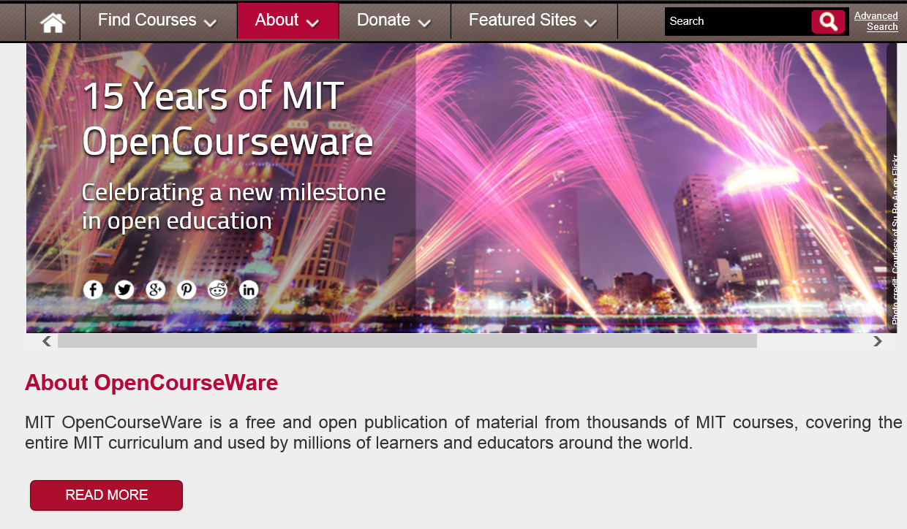
February 24, 2016
MIT OpenCourseWare http://ocw.mit.edu/about/15-years/

Slide 7


Enter the age of the MOOC…
Frank Basile, an aircraft technician, took an MITx course on circuits and electronics to increase his knowledge.
Joe Alfonso, a financial adviser from Oregon, is taking the online finance course as a "refresher."

Slide 8
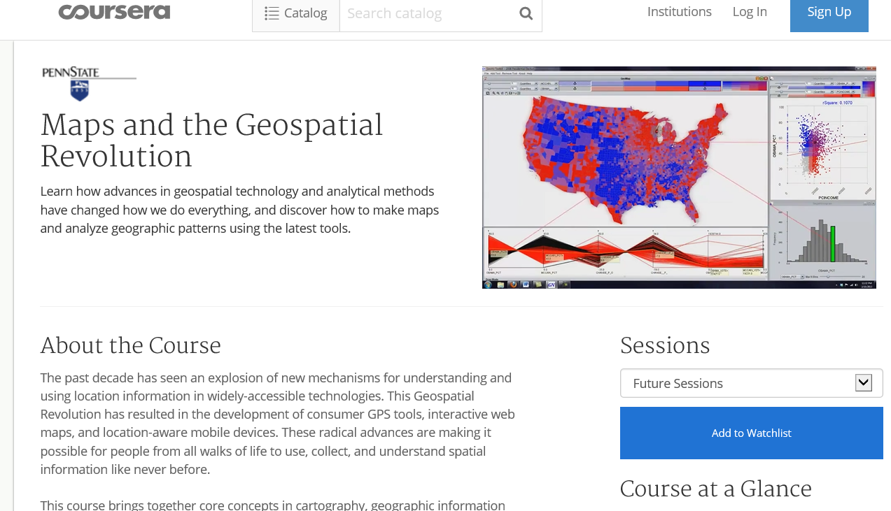
January 11, 2016
Maps and the Geospatial Revolution
Anthony C. Robinson, Penn State, Coursera http://chronicle.com/article/Mapping-a-MOOC-Reveals-Global/234795?cid=at&utm_source=at&utm_medium=en&elq=bf52c7566e1d42d6ac7d42b49e1980ea&elqCampaignId=2208&elqaid=7501&elqat=1&elqTrackId=ed3e40a9614c4a5fb84d8851653a8839

Slide 9

Audience Poll #2:
Who in here has taken a MOOC?

Slide 10
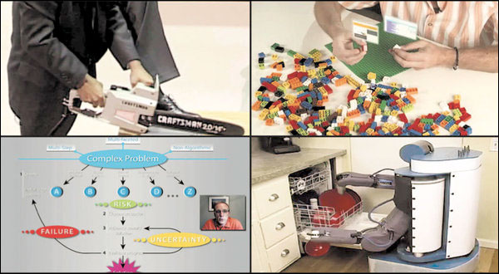

November 2, 2012
The Year of the MOOC,
New York Times, Laura Pappano, http://www.nytimes.com/2012/11/04/education/edlife/massive-open-online-courses-are-multiplying-at-a-rapid-pace.html?pagewanted=all
Clockwise, from top left: an online course in circuits and electronics with an M.I.T. professor (edX); statistics, Stanford (Udacity); machine learning, Stanford (Coursera); organic chemistry, University of Illinois, Urbana (Coursera).

Slide 11


June 19, 2013
2013 is “The Year of the Anti-MOOC”
George Siemens, UW-Madison Summit http://globalhighered.wordpress.com/european-moocs-in-global-context/

Slide 12
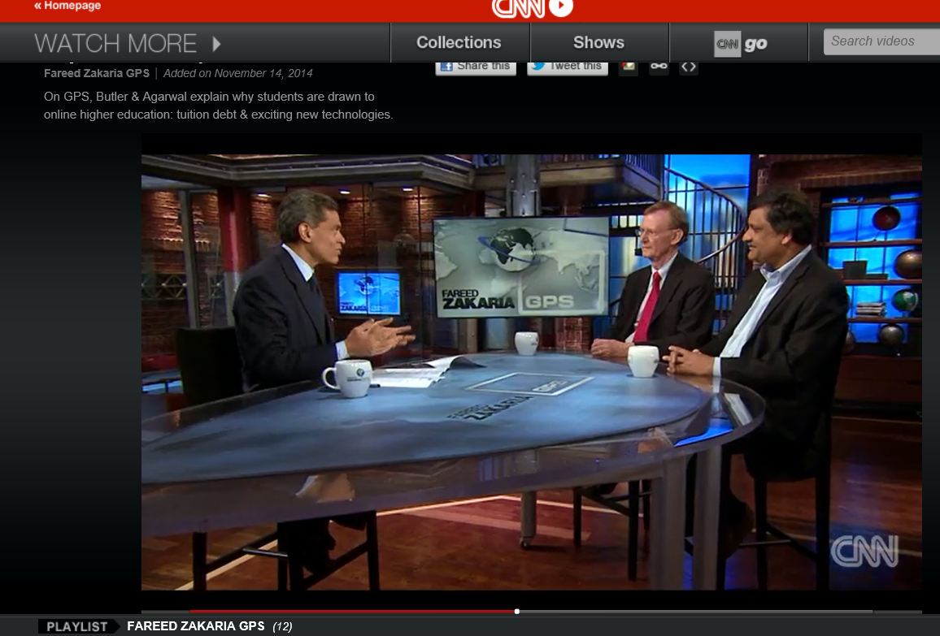
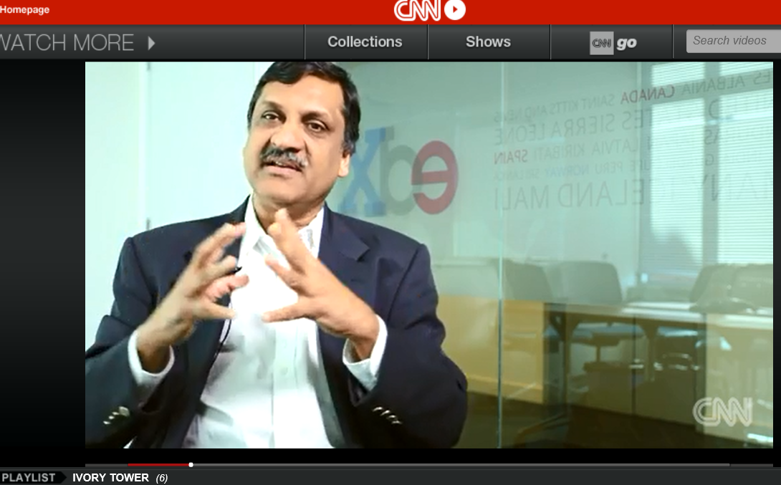
MOOCs Disruptive?
November 14, 2014 (2:25)
Why online ed disrupts the traditional model,
Fareed Zakaria GPS, CNN, On GPS, Stuart Butler & Anant Agarwal explain why students are drawn to online higher education: tuition debt & exciting new technologies http://www.cnn.com/video/data/2.0/video/bestoftv/2014/11/15/exp-gps-moocs-sot.cnn.html

Slide 13
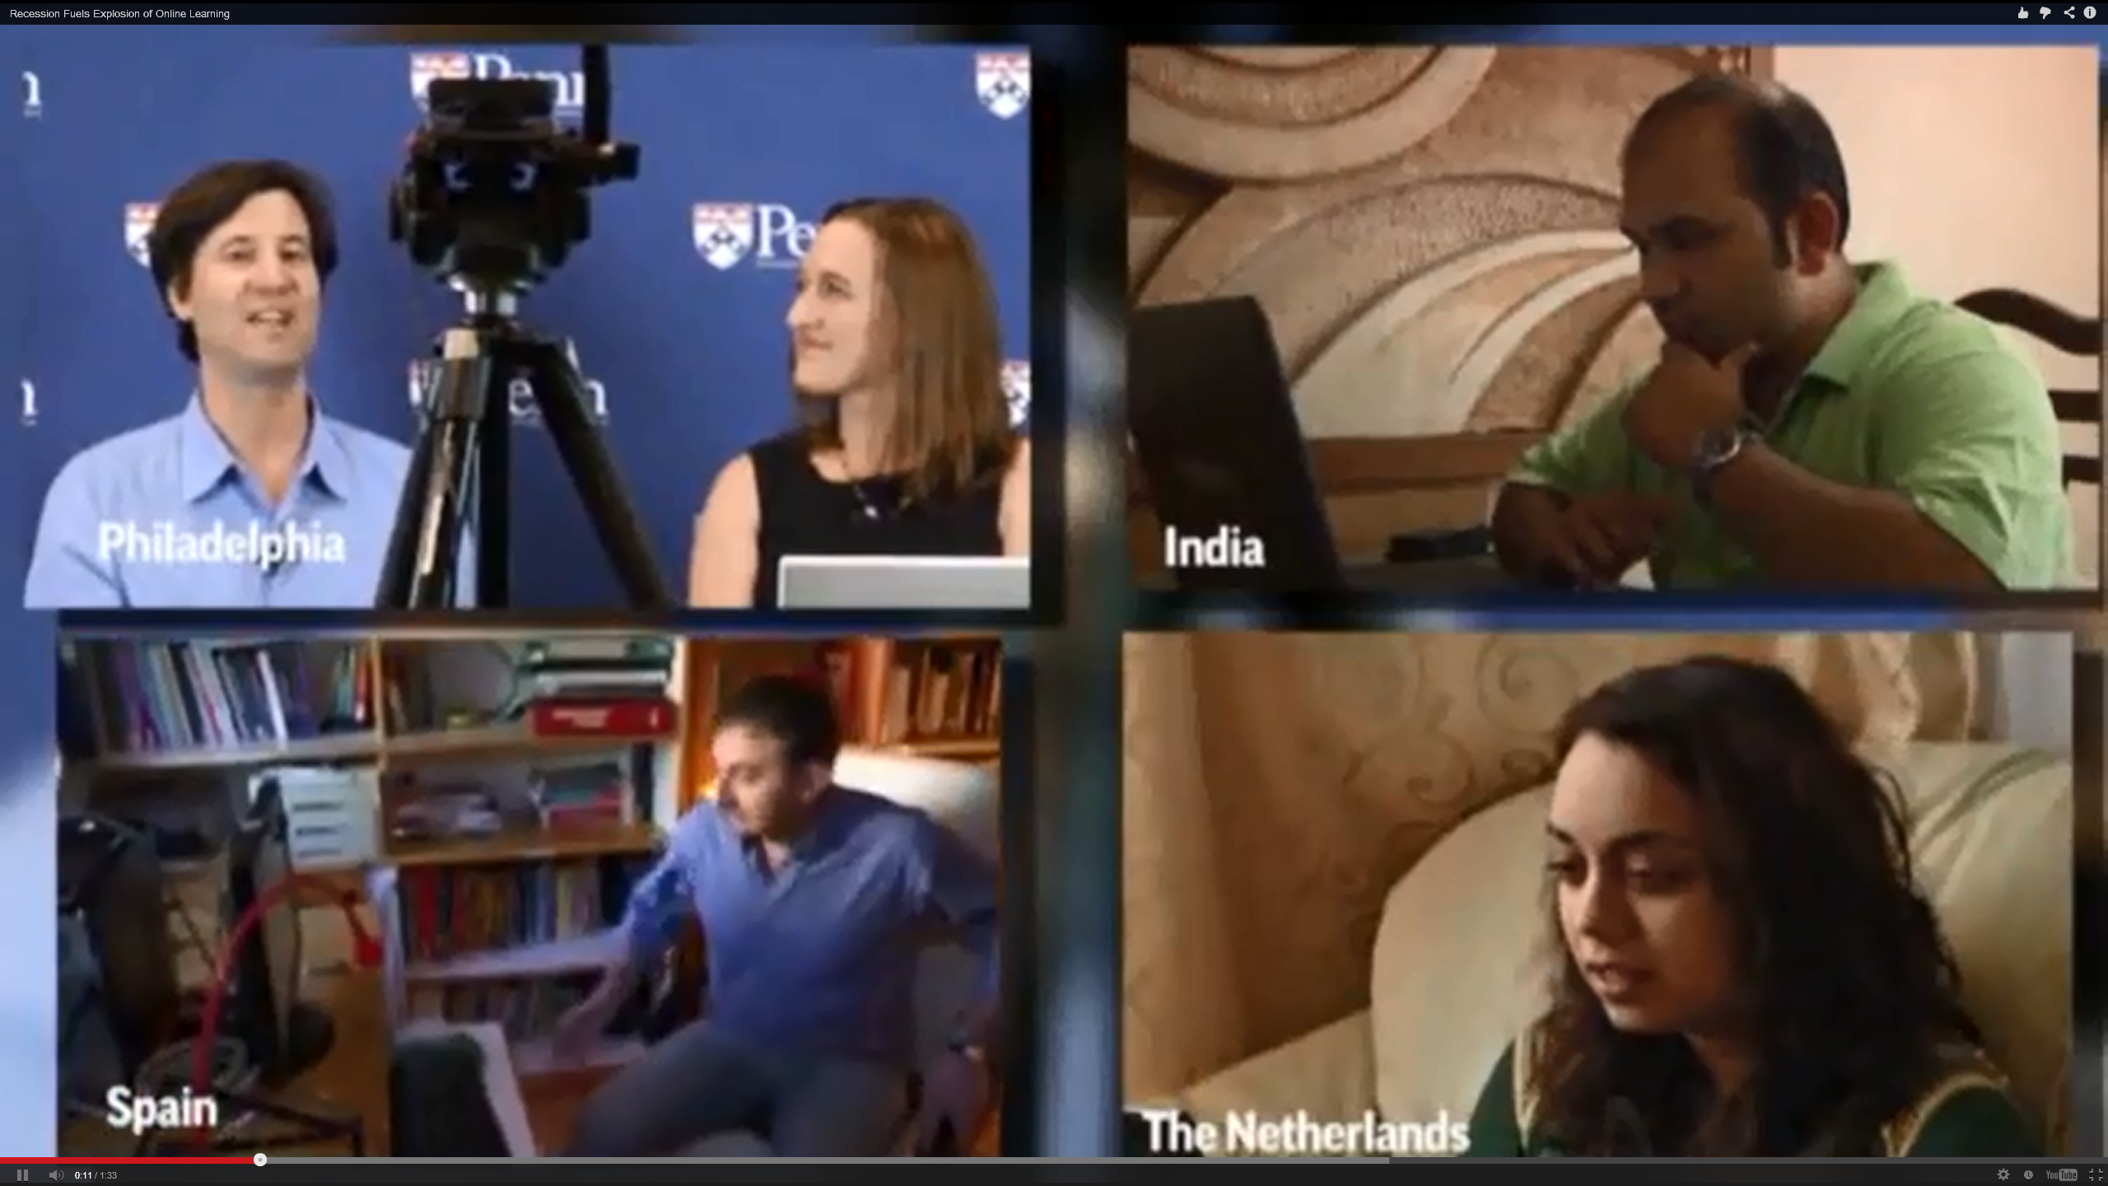

How Disruptive?
40,000+ people in a MOOC on Mythology…
Softcover ($30): http://www.parlorpress.com/invasion_of_the_moocs
Free (PDF): http://www.parlorpress.com/pdf/invasion_of_the_moocs.pdf

Slide 14

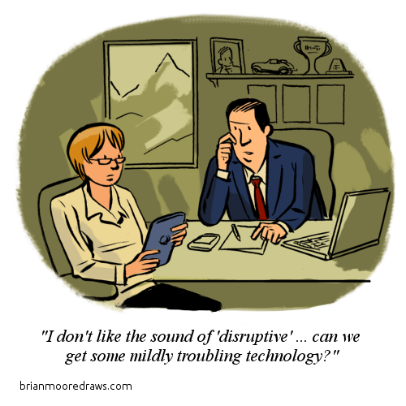

Slide 15
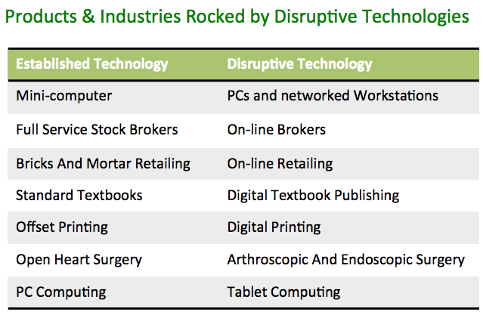
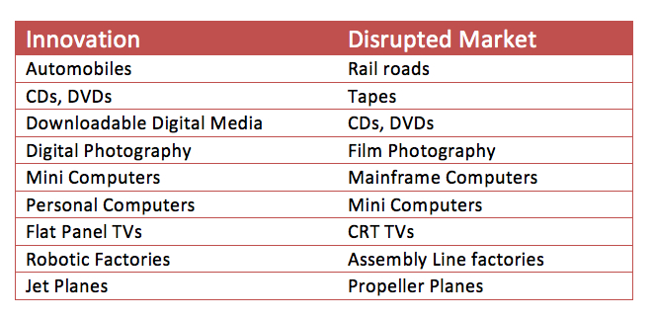

Slide 16
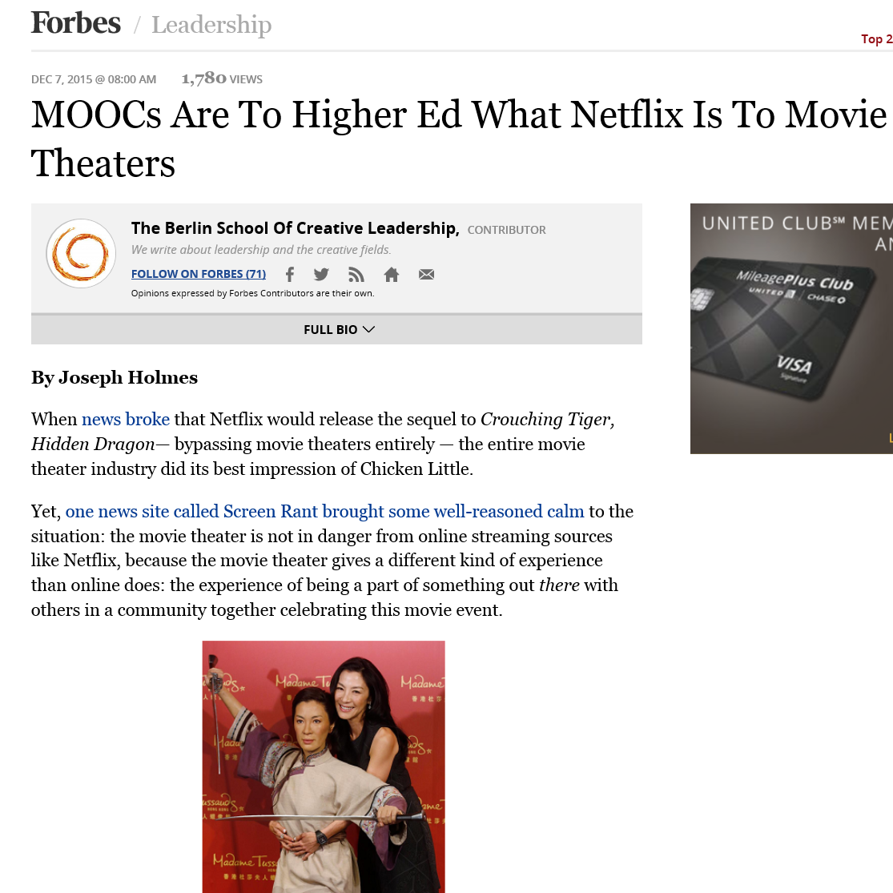
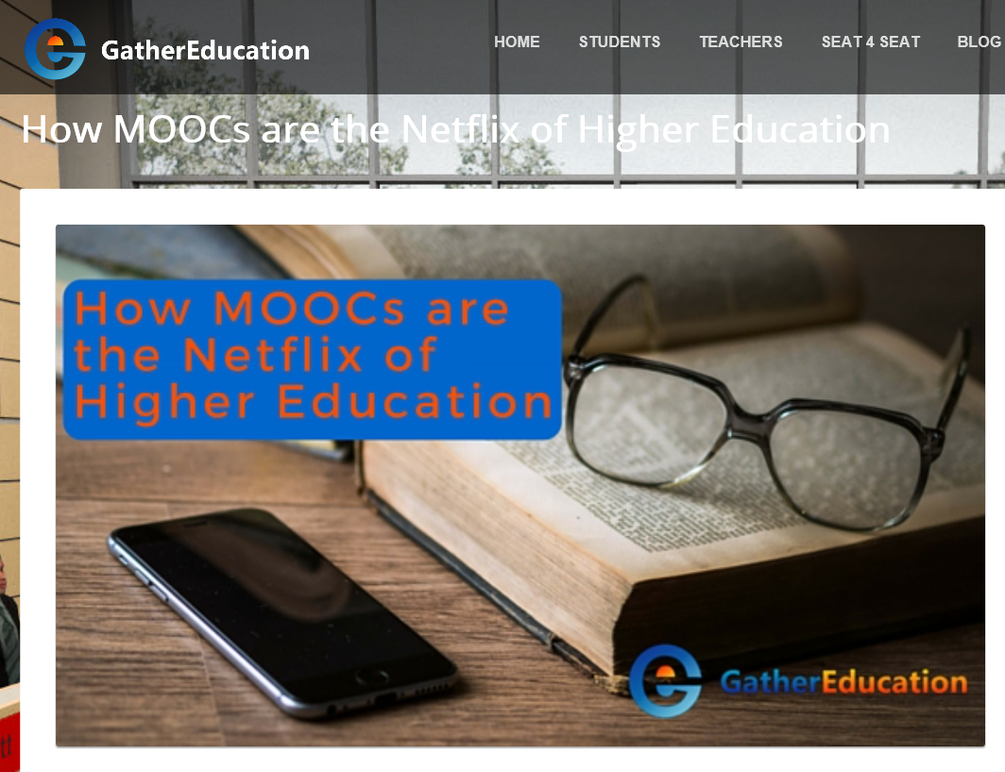
December 7, 2015
MOOCs Are To Higher Ed What Netflix Is To Movie Theaters
Forbes, Joseph Holmes http://www.forbes.com/sites/berlinschoolofcreativeleadership/2015/12/07/moocs-are-to-highered-what-netflix-is-to-movie-theaters/#76f3e4a176f7 http://www.gathereducation.com/blog/2015/how-moocs-are-the-netflix-of-higher-education/

Slide 17
August 30, 2015
Massive online courses grow; what's in it for the universities?, Kirk Pinho, Crain’s Detroit Business http://www.crainsdetroit.com/article/20150830/NEWS/308309998/massive-online-courses-grow-whats-in-it-for-the-universities
More than 3.25 million people took massive open online courses through the University of Michigan during the last three years — a figure equivalent to 76 percent of the metro Detroit population of 4.29 million.

Slide 18
August 30, 2015
Massive online courses grow; what's in it for the universities?, Kirk Pinho, Crain’s Detroit Business http://www.crainsdetroit.com/article/20150830/NEWS/308309998/massive-online-courses-grow-whats-in-it-for-the-universities
And all told, there have been between 16 million and 18 million people enrolled in MOOCs, about 2,500 of which had started or were scheduled to start as of July 2015, according to EdSurge Inc., an independent Burlingame, Calif.-based education technology information provider.
A typical MOOC enrollment level is around 25,000 students, according to research by Katy Jordan, a Ph.D. candidate focusing on technology-enhanced learning at The Open University in the United Kingdom.

Slide 19
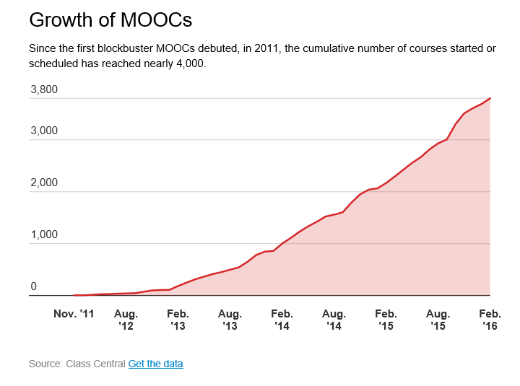
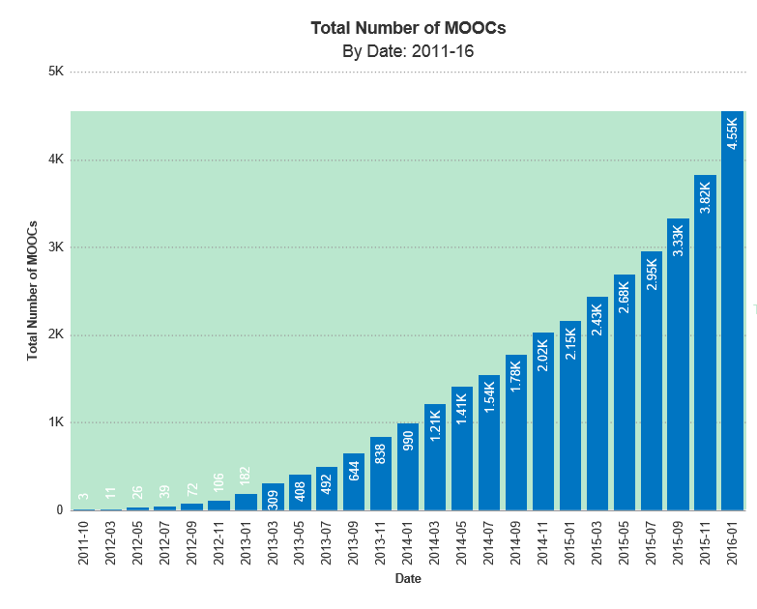
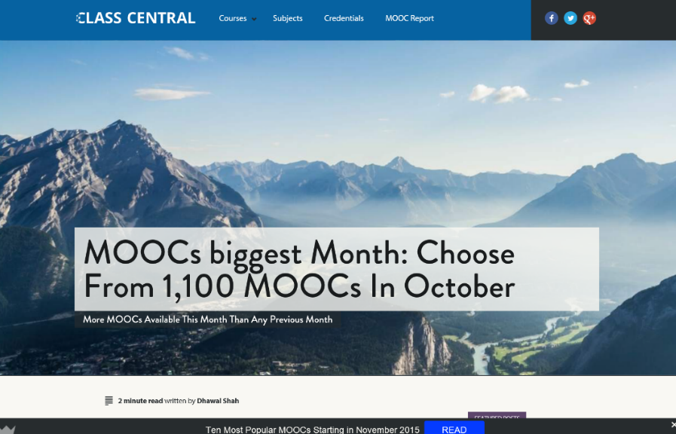
State of the MOOC 2016:
A Year of Massive Landscape Change For Massive Open Online Courses,
Online Course Report http://www.onlinecoursereport.com/state-of-the-mooc-2016-a-year-of-massive-landscape-change-for-massive-open-online-courses/ http://chronicle.com/blogs/wiredcampus/moocs-are-still-rising-at-least-in-numbers/57527

Slide 20
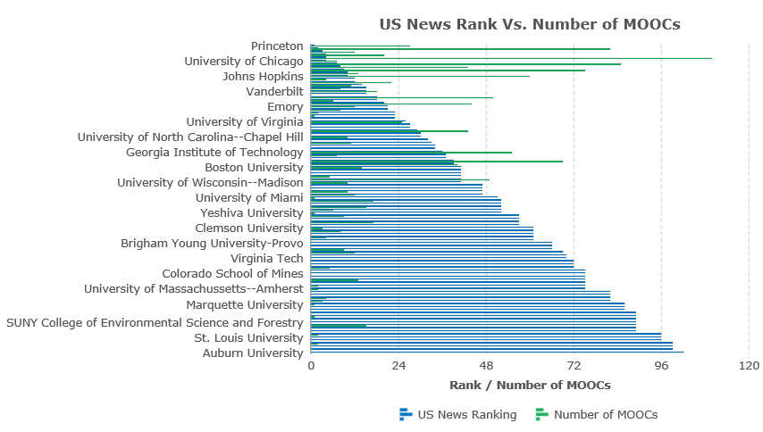
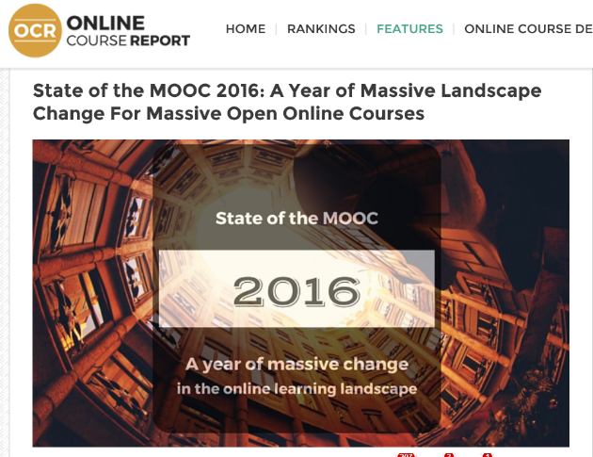
2016
State of the MOOC 2016:
A Year of Massive Landscape Change For Massive Open Online Courses, Online Course Report http://www.onlinecoursereport.com/state-of-the-mooc-2016-a-year-of-massive-landscape-change-for-massive-open-online-courses/

Slide 21
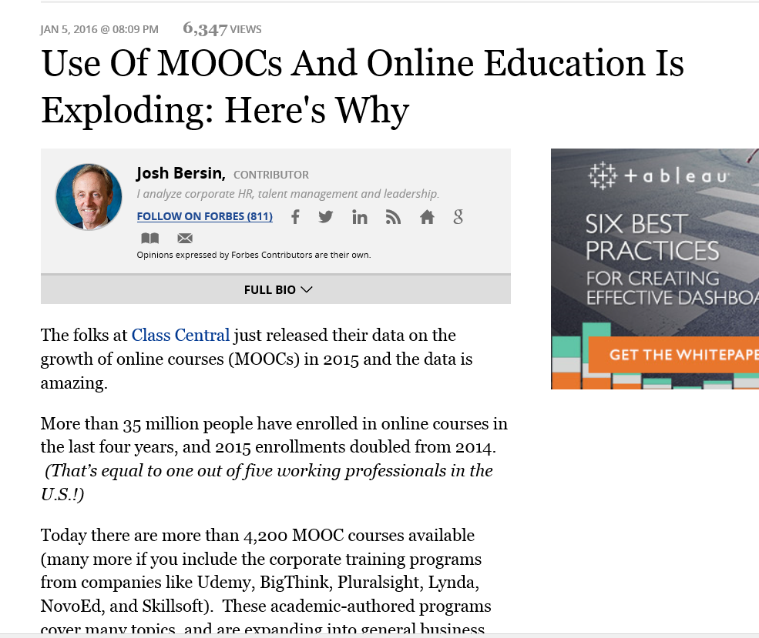
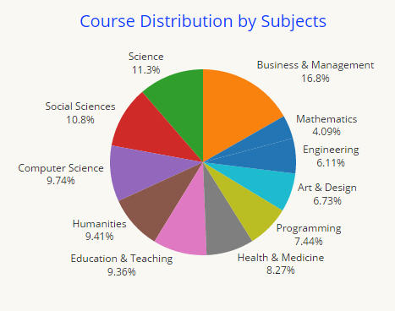
January 5, 2016
Use Of MOOCs And Online Education Is Exploding: Here's Why
Josh Bersin, Forbes http://www.forbes.com/sites/joshbersin/2016/01/05/use-of-moocs-and-online-education-is-exploding-heres-why/#290acdda7f09

Slide 22
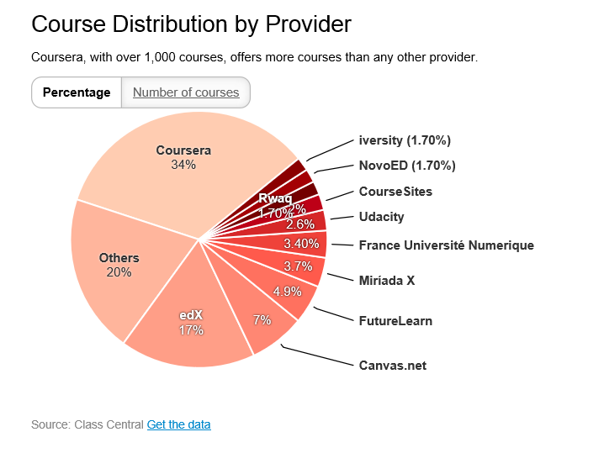
October 19, 2015
MOOCs Are Still Rising, at Least in Numbers
Ellen Wexler, Chronicle of Higher Education http://chronicle.com/blogs/wiredcampus/moocs-are-still-rising-at-least-in-numbers/57527

Slide 23
January 14, 2016
Why You Should Care That MOOCs Had a Great 2015
Bravetta Hassell, Chief Learning Officer
data collected by Class Central:
35 million: total number of students who signed up for at least one course.
1,800: number of new courses announced.
75 percent: the amount of courses available in English (was 80 percent in 2014).
2,200: courses offered for the first time.
Reportlinker estimates the MOOC market to grow by nearly $7 billion by 2020.

Slide 24
January 14, 2016
Why You Should Care That MOOCs Had a Great 2015
Bravetta Hassell, Chief Learning Officer
Self-paced courses are getting a boost…More than 800 self-paced courses exist in the MOOC market, and that number is only getting larger.
MOOC providers are realizing their value. No longer are MOOC providers offering free certificates. At Coursera, the average course is $56; at edX, it’s $53. Further, Coursera is putting up a paywall for graded assignments for some courses.

Slide 25

MOOC’ing Issue
Are we starting our research from the point of view of “here are some serious problems (students are unengaged, disenfranchised people lack access to educational opportunities)”
Or:
Are we simply going to focus on making MOOCs more effective, efficient, etc., without sufficient attention to the needs that they should be fulfilling?

Slide 26
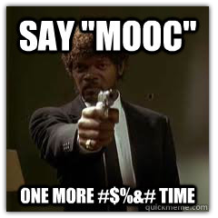
Question:
"What are the problems that MOOCs and OER are supposed to address?" or "Are MOOCs and OER "solutions" in search of problems?"
(Note: Best Answers get a MOOCs book.)

Slide 27

30+ Sample MOOC Research Topics

Slide 28
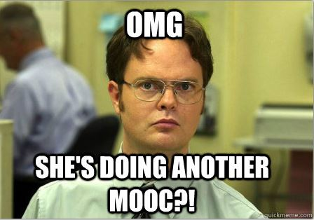
Activity:
During this talk, jot down a research idea on a card. We will share it at the end.
(Note: Best idea gets a MOOCs book.)

Slide 29
May 19, 2016
Current Issues on MOOC Research
Trang Phan, University of Houston, tphanuh16@gmail.com
The influence of MOOCs on the future of higher education (Billington & Fronmuller, 2013)
The effects of MOOCs on learning and teaching (Martin, 2012)
The educational problems MOOCs might solve (Rivard, 2013)
The blending of face-to-face classes with online MOOC classes (Bruff, Fisher, McEwen, & Smith, 2013).

Slide 30


October 25, 2014
Research Topic #1.
Faculty Awareness of the Open World
Opening the Curriculum: Open Educational Resources in U.S. Higher Education, 2014
I. Elaine Allen and Jeff Seaman http://www.onlinelearningsurvey.com/reports/openingthecurriculum2014.pdf

Slide 31
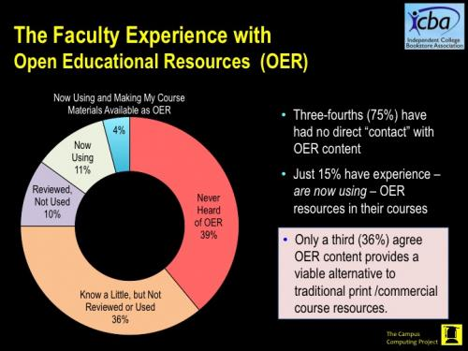
February 2016
Faculty Awareness of the Open World
Going Digital: Faculty Perspectives on Digital and OER Course Materials
Kenneth Green, The Campus Computing Project http://www.campuscomputing.net/goingdigital2016

Slide 32
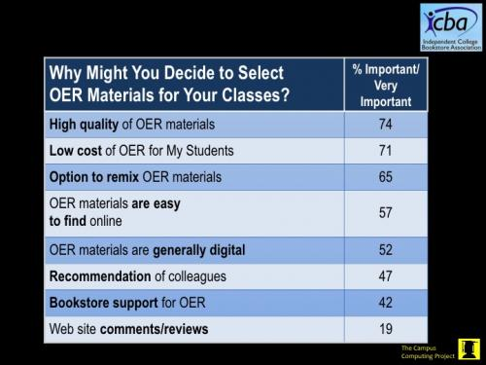
February 2016
Going Digital: Faculty Perspectives on Digital and OER Course Materials
Kenneth Green, The Campus Computing Project http://www.campuscomputing.net/goingdigital2016

Slide 33
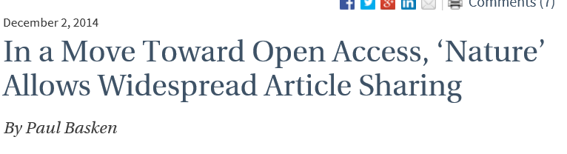

Research Topic #2. Actual Use of Open Access Resources and Materials
Nature, Openwords, etc. http://www.openwords.com/ https://www.facebook.com/Openwords

Slide 34
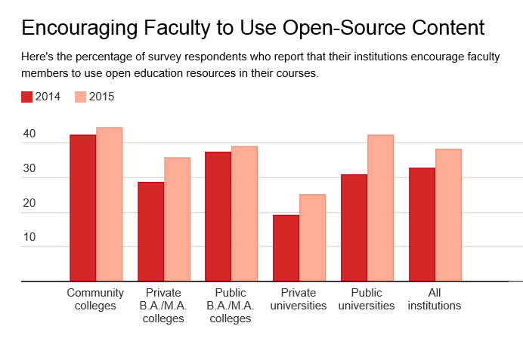
October 29, 2015
Campus Tech Leaders Report More Support for Free Educational Materials, Ellen Wexler, Chronicle of Higher Education

Slide 35
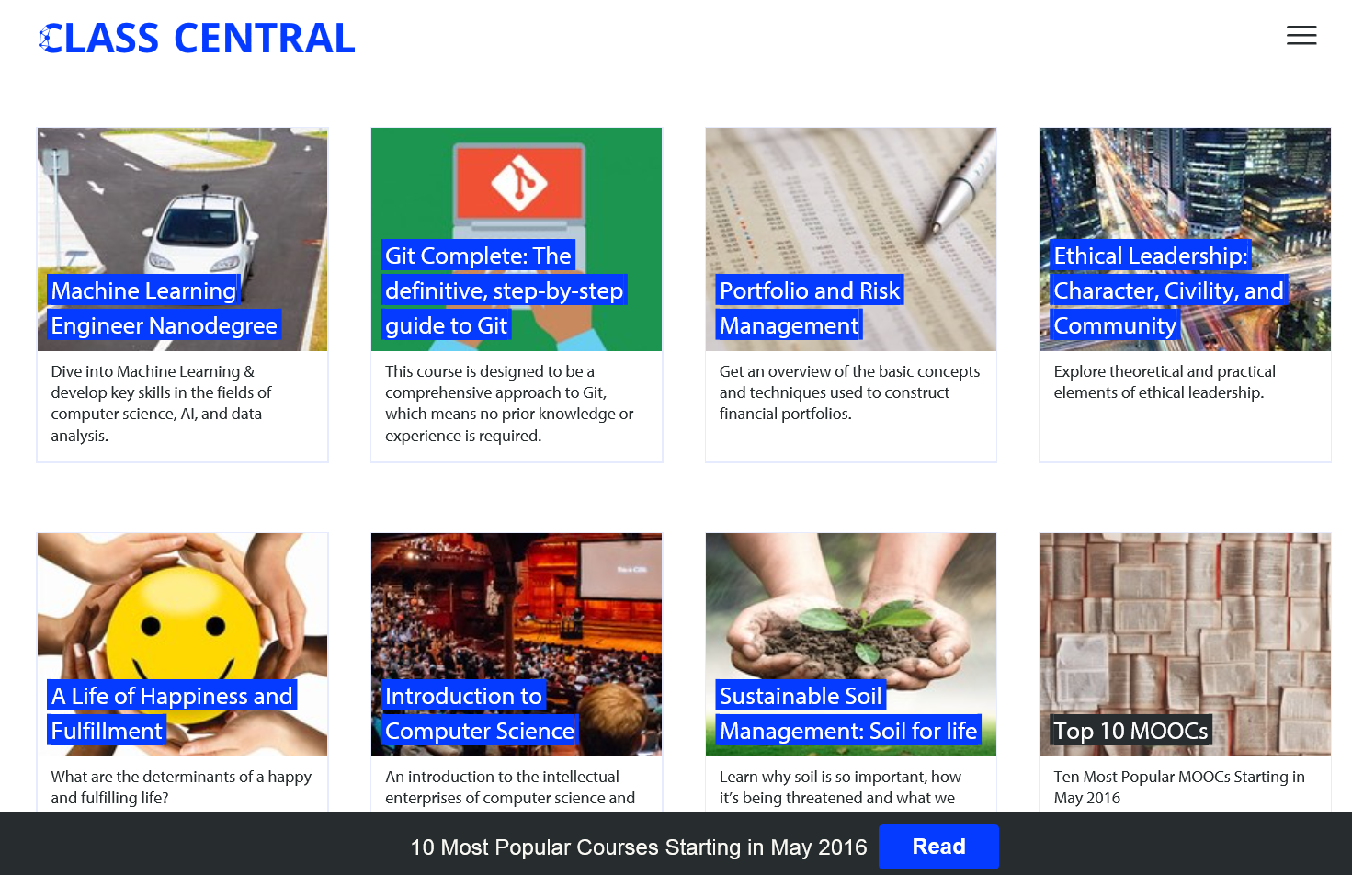
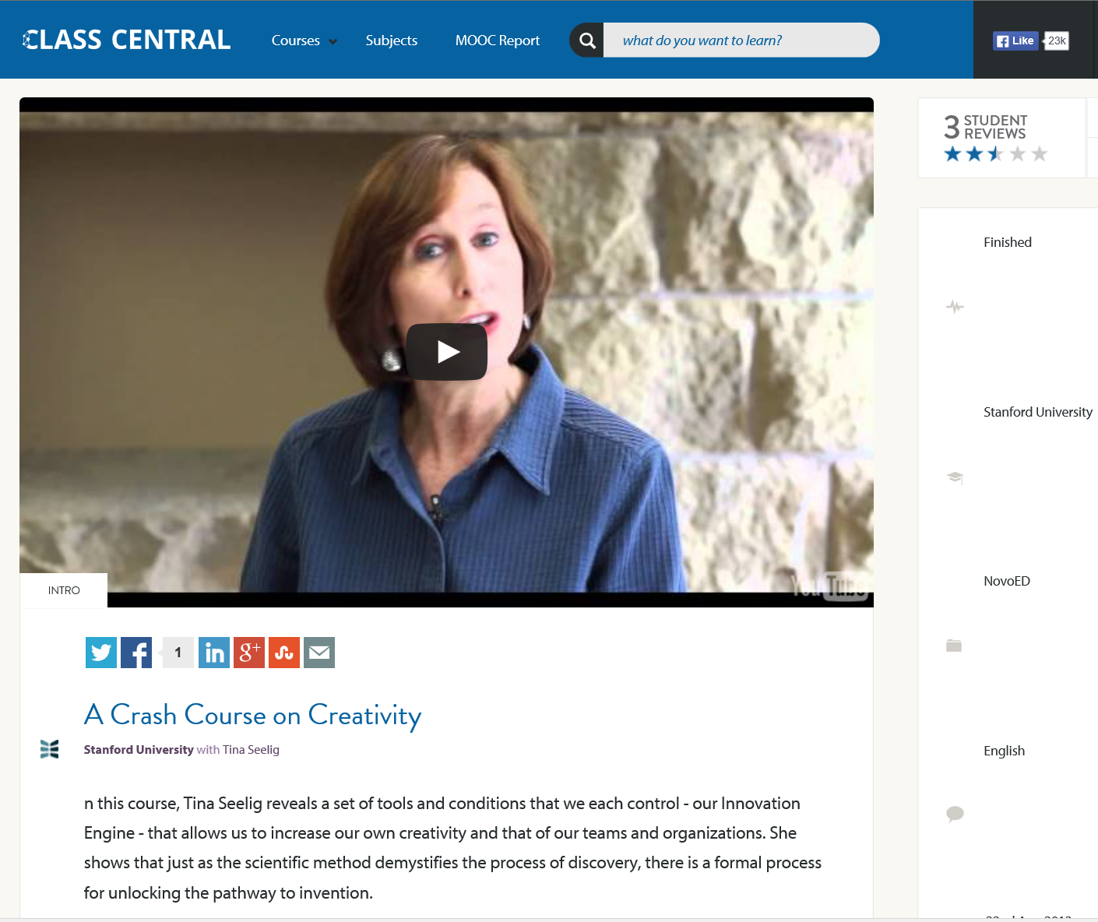
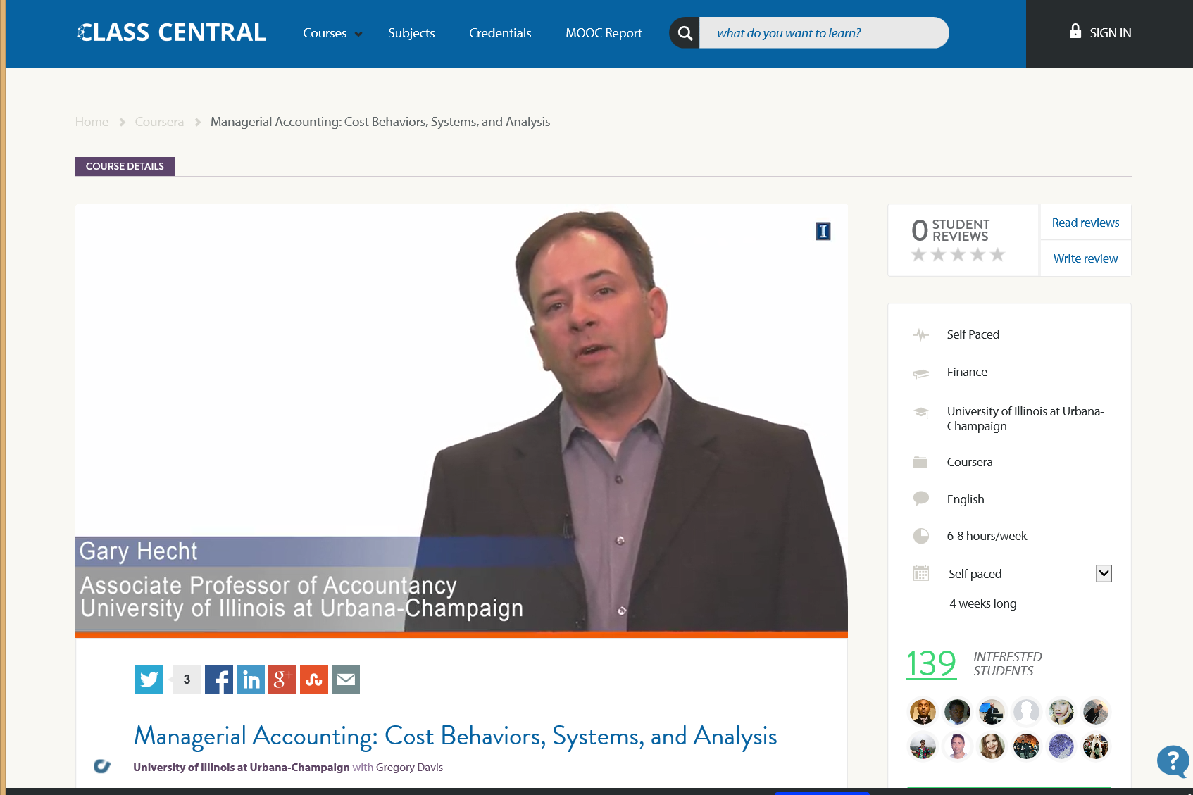
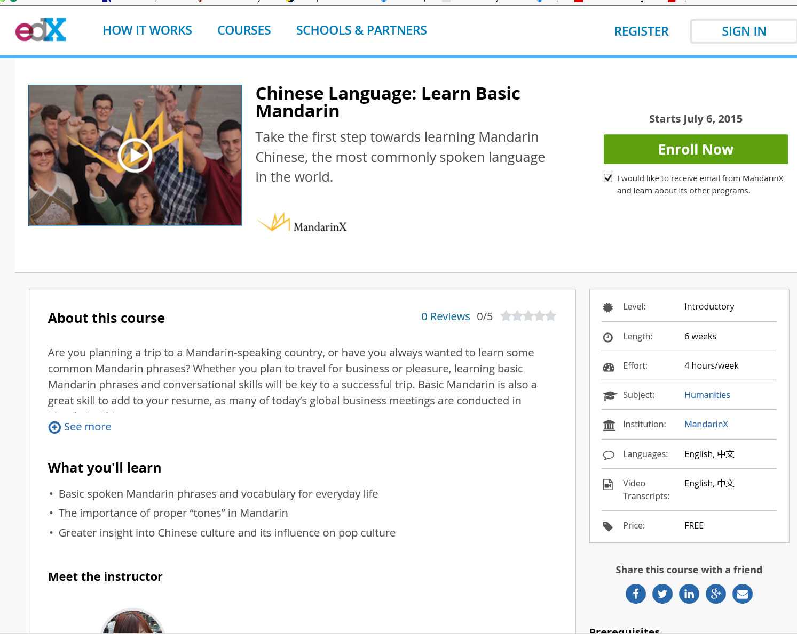
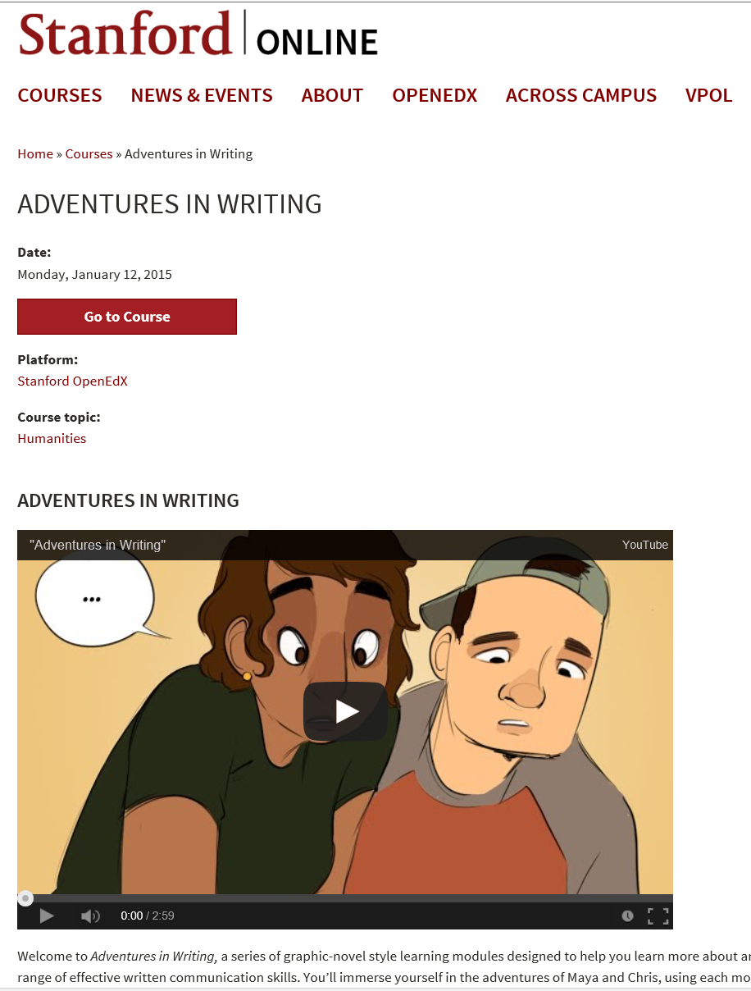
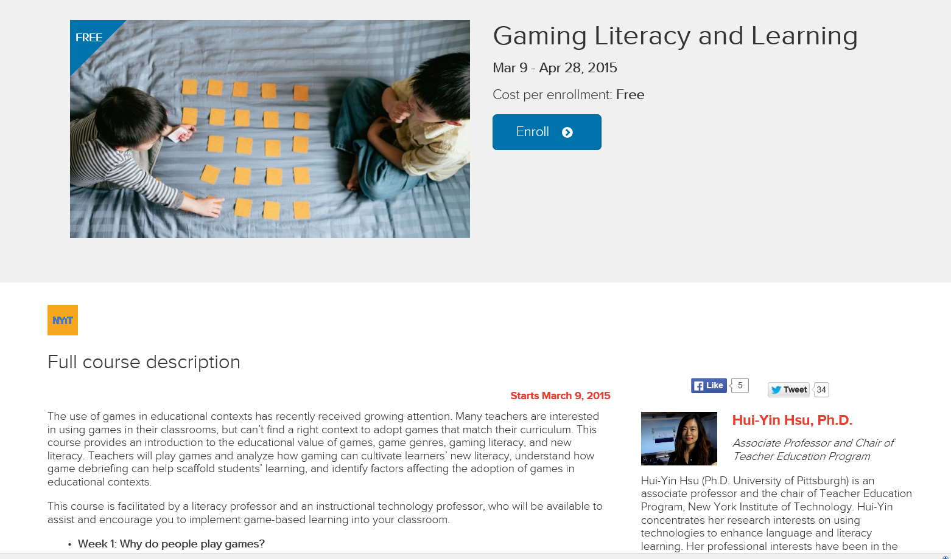
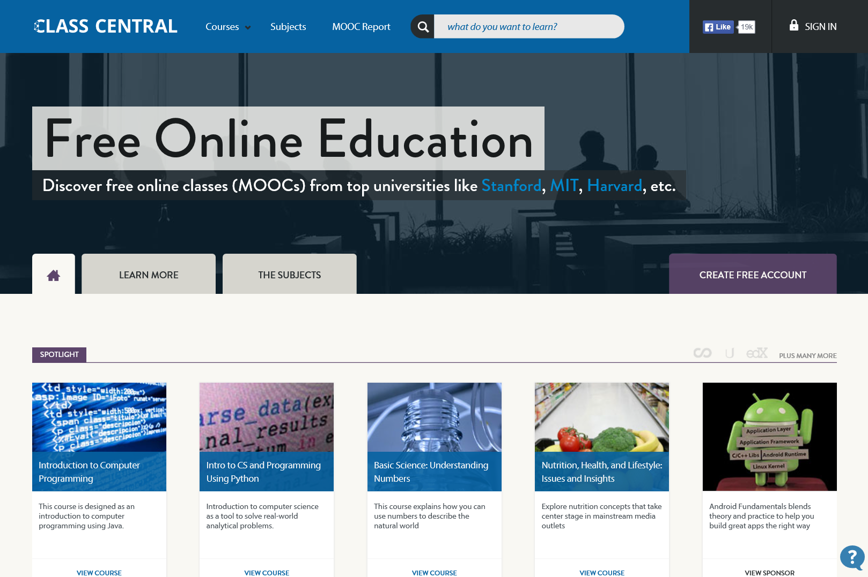
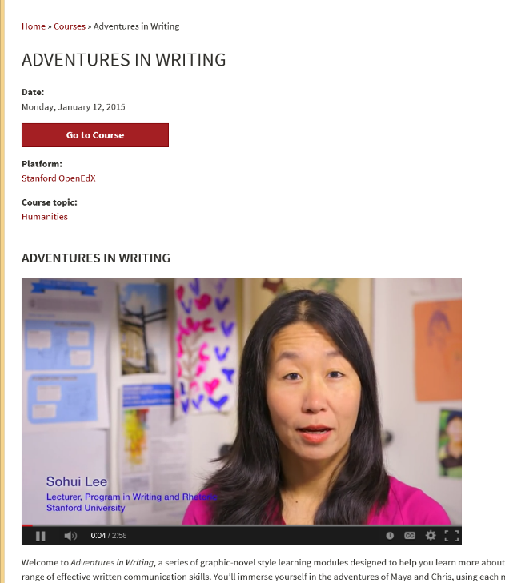
May 19, 2016
Research Topic #3. MOOC Access and Use (e.g., MOOC listings and ratings schemes)
MOOC lists: Class Central, the MOOC list https://www.mooc-list.com/ https://www.class-central.com/

Slide 36


April 23, 2015
Research Topic #4.
Cost-Benefit Analysis
Offloading Semesters or Years to MOOCs
The Catch in Arizona State’s Low-Cost Freshman Year Online: No Aid, Chronicle of Higher Education, Thomas Fisher http://chronicle.com/article/The-Catch-in-Arizona-State-s/229617/
Anant Agarwal, the head of edX, which teamed up with Arizona State U. in the new project: “Our mission is to provide education to people who need it the most.”

Slide 37
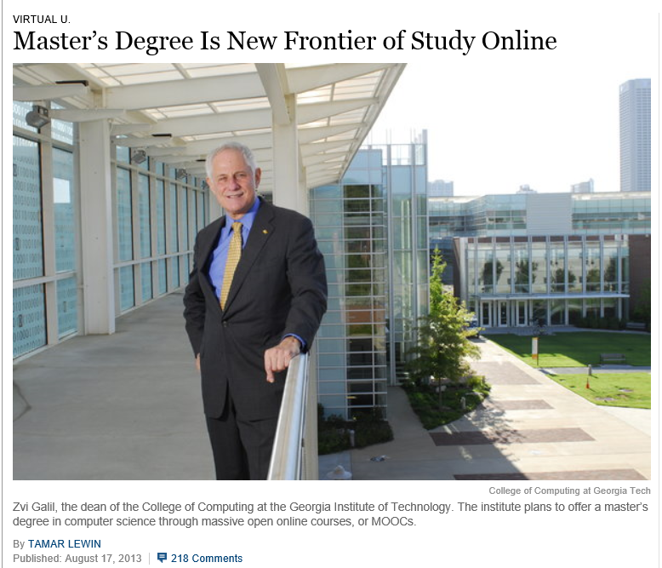
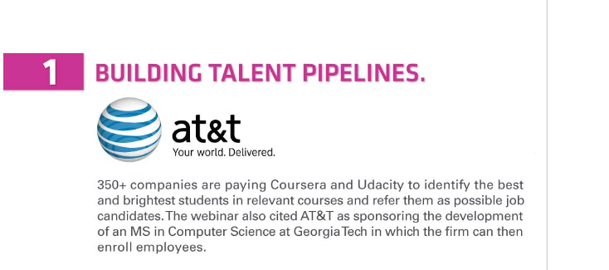

Building Talent Pipeline
Master’s Degree Is New Frontier of Study Online, August 17, 2013, The New York Times
By Tamar Lewin http://chronicle.com/article/MOOCs-May-Not-Be-So-Disruptive/140965/ http://extensionengine.com/putting-moocs-to-work-recap-infographic/#.VExR4o3wtjs

Slide 38
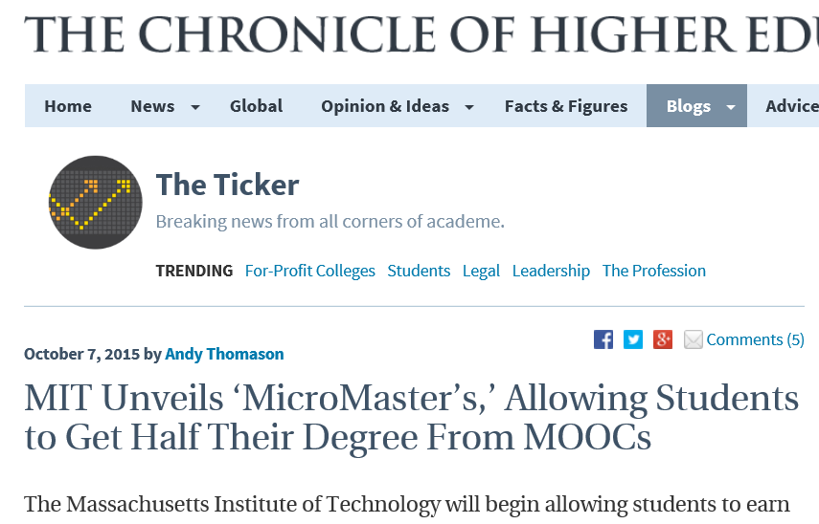
October 7, 2015
Research Topic #5.
Alternative Delivery Systems
MIT Unveils ‘MicroMaster’s,’ Allowing Students to Get Half Their Degree From MOOCs, Andy Thomason, Chronicle of Higher Education http://chronicle.com/blogs/ticker/mit-unveils-micromasters-allowing-students-to-get-half-their-degree-from-moocs/105615?cid=pm&utm_source=pm&utm_medium=en&elq=5df23adc260141d79bb6b8d5f282aa4a&elqCampaignId=1549&elqaid=6450&elqat=1&elqTrackId=5dc2477c7c354ee48373a9522da104c5

Slide 39

June 12, 2014
Research Topic #6. Economic Value of MOOCs (Assessment Issues)
Will a degree made up of Moocs ever be worth the paper it's written on?
The University of the People can now hand out degrees to its online students – but will employers take them seriously?, Louise Tickle The Guardian http://www.theguardian.com/higher-education-network/blog/2014/jun/12/moocs-viable-alternative-traditional-degree
Moocs can offer a lot, but they don't offer the feedback of a traditional degree.

Slide 40
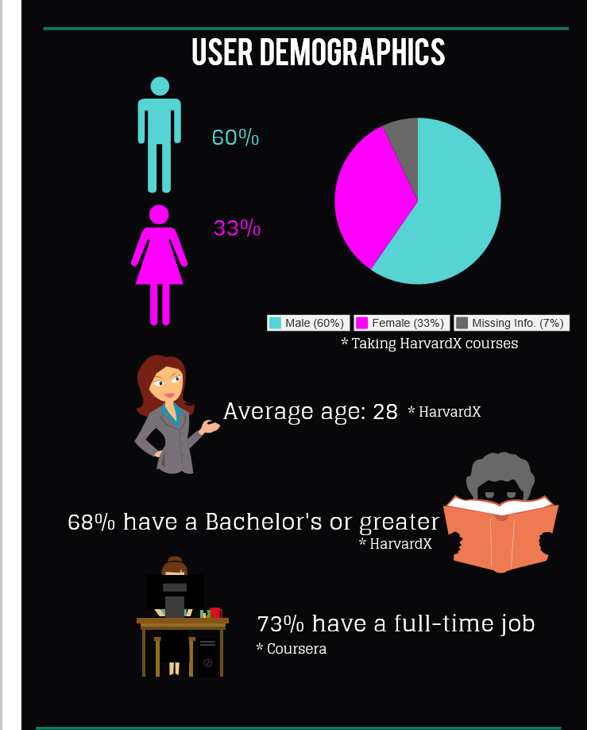

April 17, 2014
Research Topic #7.
Impact of MOOCs Across Age, Gender, and Course Type
Infographic: Global MOOC statistics eCampus News, Meris Stansbury http://www.ecampusnews.com/research/infographic-moocs-global-436/
Inforgraphic: https://magic.piktochart.com/output/1747660-moocs
Krissa Swain, of Knoxville, Tenn., is taking "Operations Management" online to help develop her management skills.

Slide 41
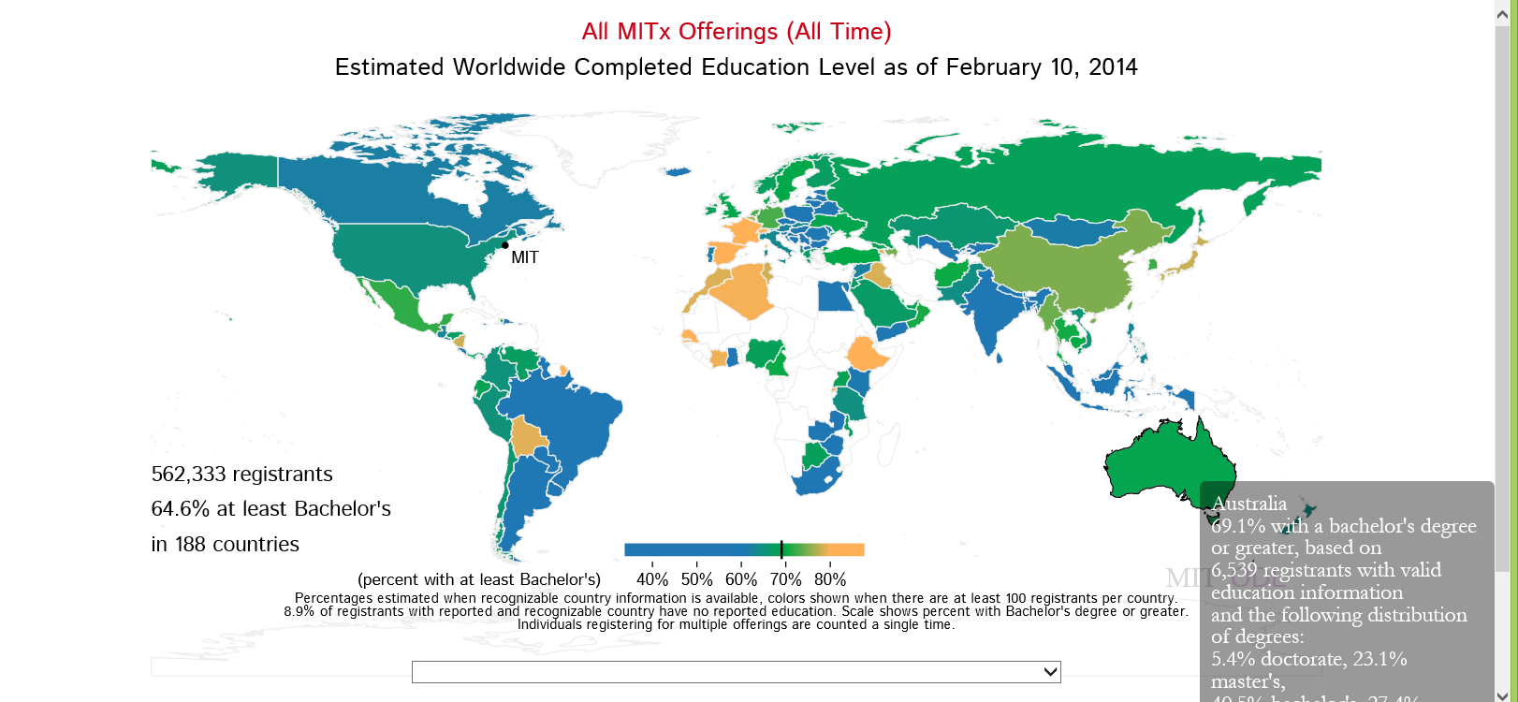
February 20, 2014
What about Education Level?
Harvard and MIT Release Visualization Tools for Trove of MOOC Data
Lawrence Biemiller, Chronicle of Higher Education http://chronicle.com/blogs/wiredcampus/harvard-and-mit-release-visualization-tools-for-trove-of-mooc-data/50631?cid=pm&utm_source=pm&utm_medium=en

Slide 42
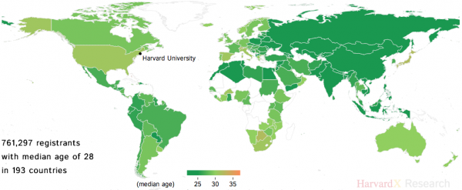
What About Age?
Data Visualization Tools
(Harvard and MIT MOOCs)
Lawrence Biemiller, February 20, 2014, Chronicle of HE http://chronicle.com/blogs/wiredcampus/harvard-and-mit-release-visualization-tools-for-trove-of-mooc-data/50631?cid=pm&utm_source=pm&utm_medium=en

Slide 43
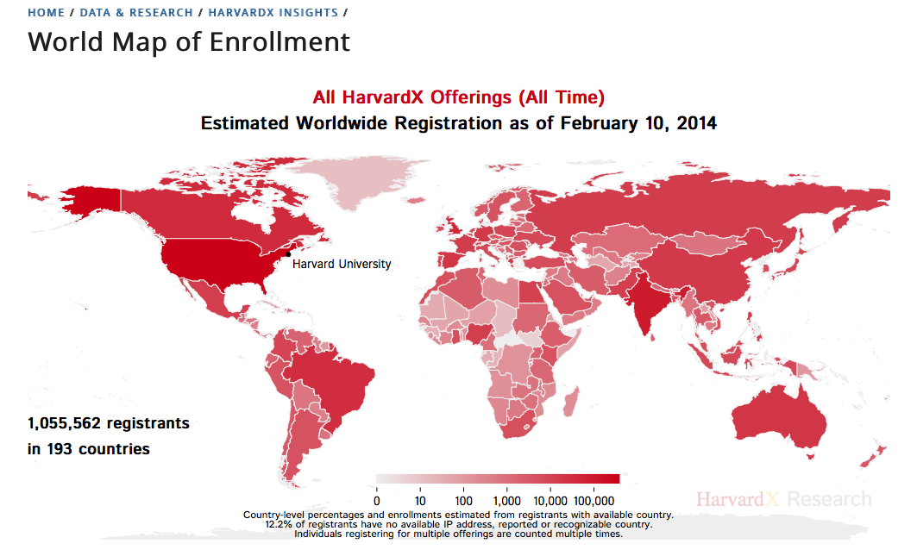
February 20, 2014
Research Topic #8.
Utility of Data Visualization Tools
Harvard and MIT Release Visualization Tools for Trove of MOOC Data
Lawrence Biemiller, Chronicle of Higher Education http://chronicle.com/blogs/wiredcampus/harvard-and-mit-release-visualization-tools-for-trove-of-mooc-data/50631?cid=pm&utm_source=pm&utm_medium=en

Slide 44
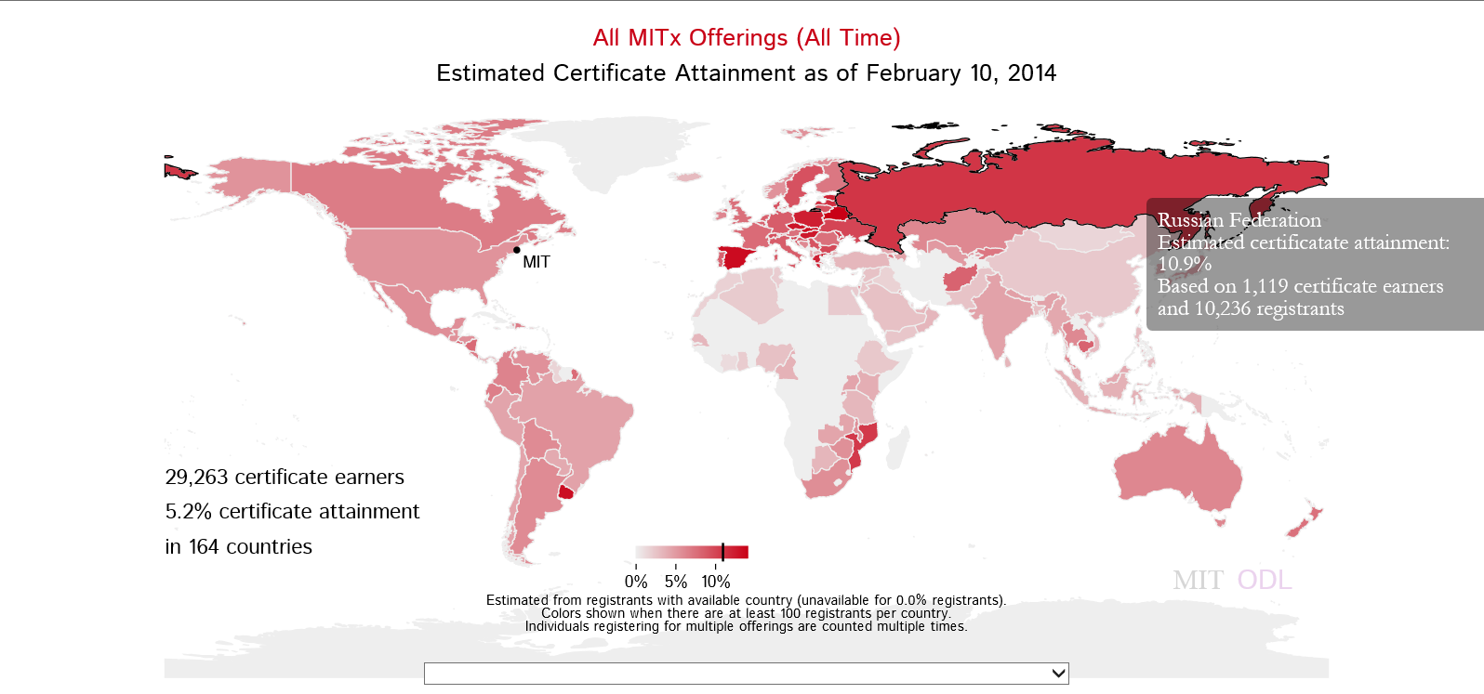
Certificate Earners
Data Visualization Tools
(Harvard and MIT MOOCs)
Lawrence Biemiller, February 20, 2014, Chronicle of HE http://chronicle.com/blogs/wiredcampus/harvard-and-mit-release-visualization-tools-for-trove-of-mooc-data/50631?cid=pm&utm_source=pm&utm_medium=en

Slide 45
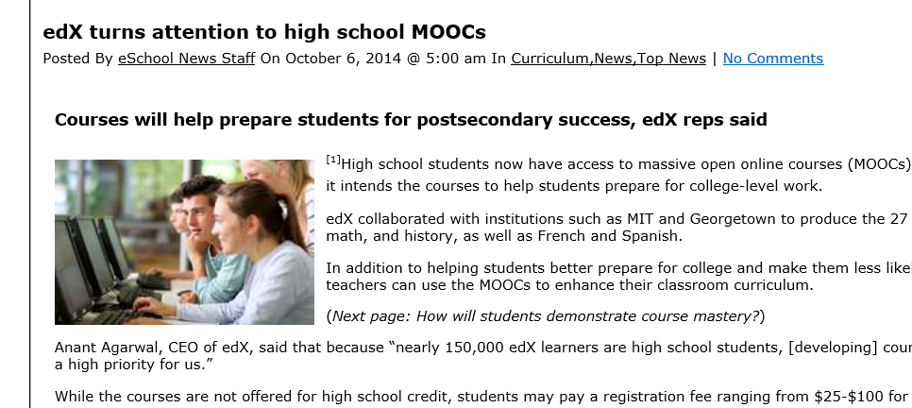
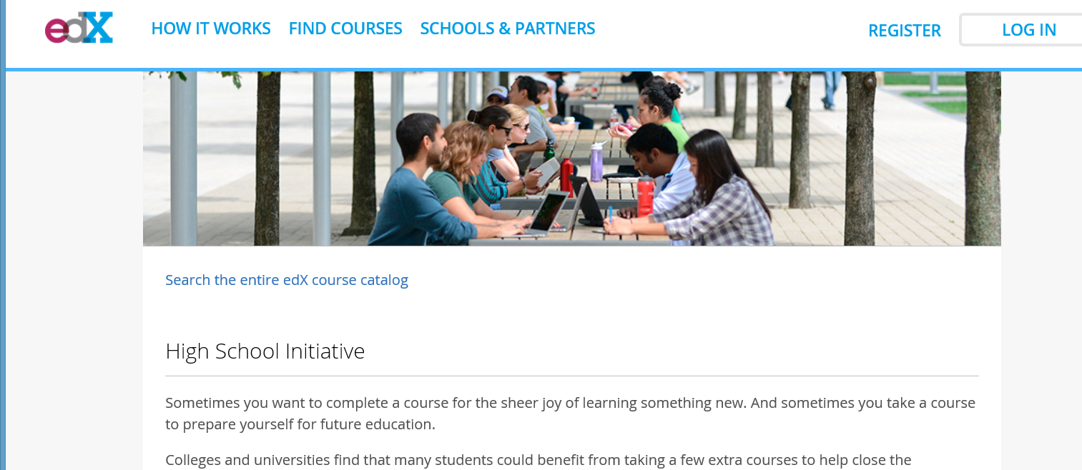
October 6, 2014
Research Topic #9.
High School Student College Prep and Advanced Placement Courses edX turns attention to high school MOOCs, eSchool News http://www.eschoolnews.com/2014/10/06/high-school-moocs-839/print/

Slide 46
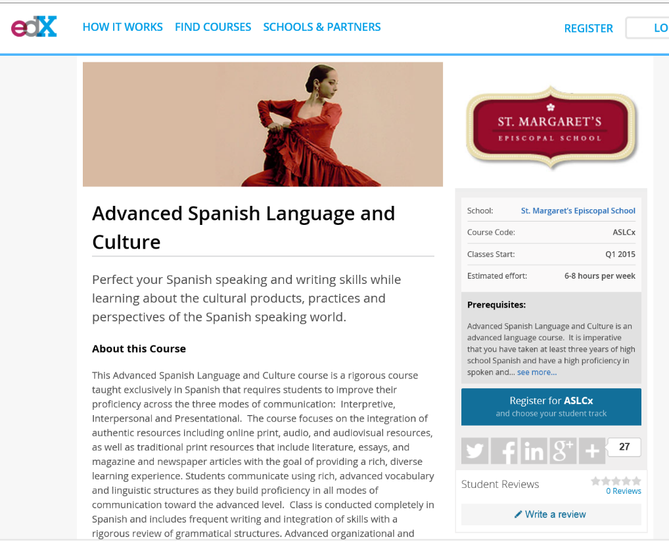
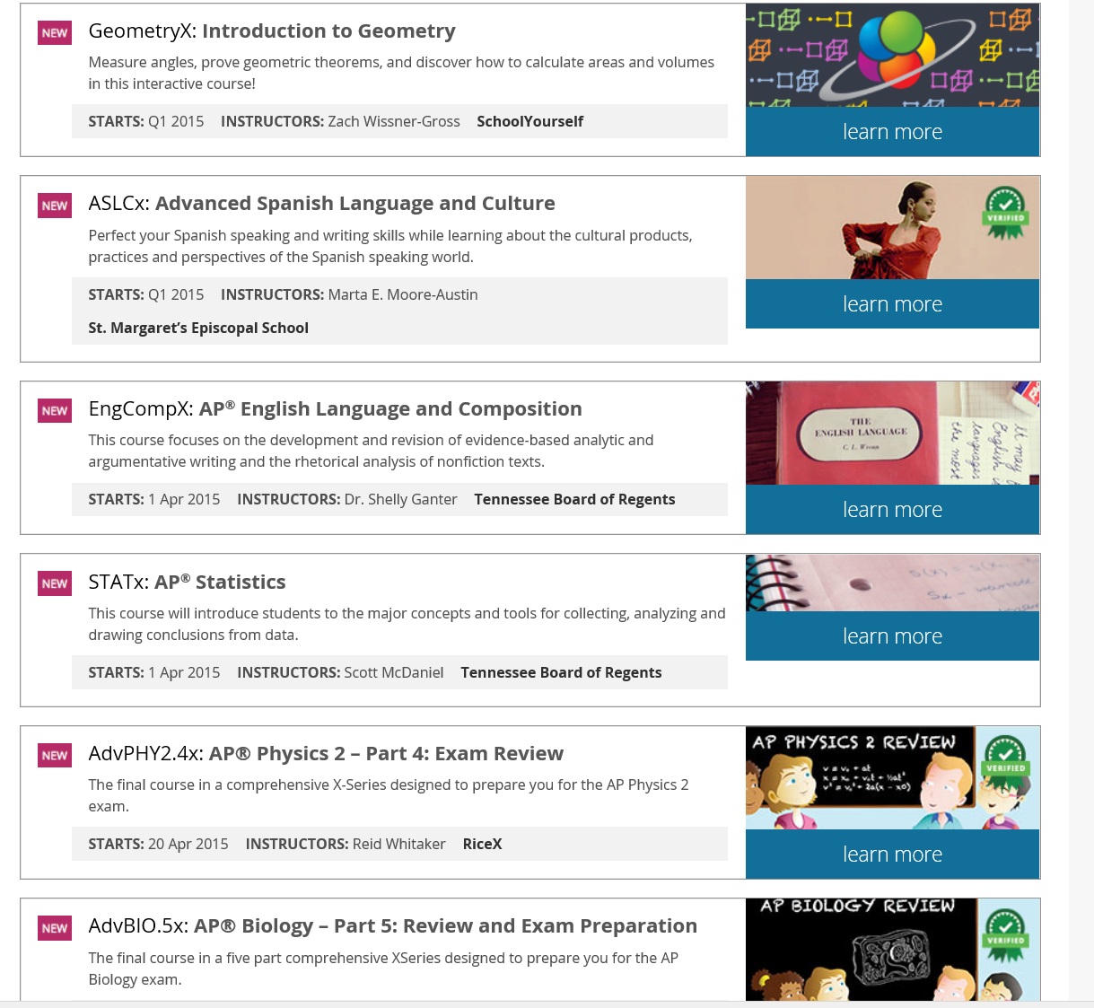
October 6, 2014
High School Initiative https://www.edx.org/high-school-initiative http://www.eschoolnews.com/2014/10/06/high-school-moocs-839/print/

Slide 47



January 11, 2016
7th grade scholarships for MOOC completion
U.S. News and World Report, eSchool News http://www.eschoolnews.com/2016/01/11/7th-grade-scholarships-for-mooc-completion/

Slide 48


Research Topic #10. Acceptability of MOOCs as Corporate Training
G2g (Googler to Googler) Training
Seven Ways to Corporate MOOC, Udemy blog, December 23, 2013, Shannon Hughes https://www.udemy.com/organizations/blog/2013/12/23/seven-ways-to-corporate-mooc/
Classes range from management and public speaking, to parenting and mountain climbing.

Slide 49


May 19, 2016
Udemy

Slide 50

May 2013
Research Topic #11.
Dropout (i.e., retention) Concerns
MOOCs @ Edinburgh 2013– Report #1

Slide 51


February 5, 2013
Bioelectricity: A Quantitative Approach,
Duke University’s First MOOC http://dukespace.lib.duke.edu/dspace/bitstream/handle/10161/6216/Duke_Bioelectricity_MOOC_Fall2012.pdf

Slide 52

Audience Poll #3:
Have you ever dropped a MOOC?
Have you ever completed a MOOC? http://elearnhero.com/moocs-completion-rates/

Slide 53


2016
State of the MOOC 2016:
A Year of Massive Landscape Change For Massive Open Online Courses, Online Course Report http://www.onlinecoursereport.com/state-of-the-mooc-2016-a-year-of-massive-landscape-change-for-massive-open-online-courses/

Slide 54

May 2013
Research Topic #12.
MOOC Motivators and Goals
MOOCs @ Edinburgh 2013– Report #1

Slide 55

February 5, 2013
Bioelectricity: A Quantitative Approach,
Duke University’s First MOOC http://dukespace.lib.duke.edu/dspace/bitstream/handle/10161/6216/Duke_Bioelectricity_MOOC_Fall2012.pdf

Slide 56










April, 2015
Learners Goals, Motivations, Achivements, Challenges, etc.
Bonk, C. J., Lee, M. M., Kou, X., Xu, S. & Sheu, F.-R. (2015). Understanding the Self-Directed Online Learning Preferences, Goals, Achievements, and Challenges of MIT OpenCourseWare Subscribers. Educational Technology and Society, 18(2), 349-368. Available: http://www.ifets.info/journals/18_2/26.pdf;
Issue TOC: http://www.ifets.info/issues.php?id=67

Slide 57

June 13, 2014
Research Topic #13.
Learner Engagement with Content
8 Things You Should Know About MOOCs
Chronicle of Higher Education, Jonah Newman and Soo Oh http://chronicle.com/article/MOOCs-EdX/146901/

Slide 58

January 11, 2016
Mapping a MOOC Reveals Global Patterns in Student Engagement
Chronicle of Higher Education, Anthony C. Robinson http://chronicle.com/article/Mapping-a-MOOC-Reveals-Global/234795?cid=at&utm_source=at&utm_medium=en&elq=bf52c7566e1d42d6ac7d42b49e1980ea&elqCampaignId=2208&elqaid=7501&elqat=1&elqTrackId=ed3e40a9614c4a5fb84d8851653a8839

Slide 59

April 21, 2014
Research Topic #14. Benefits of MOOCs for Disadvantaged and Underprivileged
The Revolution Is Not Being MOOC-ized, Students are educated, employed, and male.
Gayle Christensen and Brandon Alcorn, UPenn, New Scientist http://www.slate.com/articles/health_and_science/new_scientist/2014/03/mooc_survey_students_of_free_online_courses_are_educated_employed_and_male.html
Filipino youths go online at an Internet café in Manila on Feb. 18, 2014. Two-thirds of Coursera participants come from the developed world, according to a new report.

Slide 60

OER and MOOCs in Africa:
The AVU Experience
Griff Richards and Bakary Diallo, African Virtual University
Nairobi, Kenya
It is estimated that only 6% of Africans can access post-secondary education. The development goal is set at 12% even though North America and Europe are somewhere around 45%. The gap is huge. This is not to say that African nations are not investing in post-secondary education. For example, Nigeria has been steadily building universities during the past couple of decades.

Slide 61


September 15, 2015
Research Topic #15.
MOOCs for Social Impact
Social Learning for Social Impact, edX
Join the world’s first GROOC – a MOOC for groups – to collaborate with others globally and create social change. https://www.edx.org/course/social-learning-social-impact-mcgillx-groocx https://www.youtube.com/watch?t=36&v=WNg-5LFAMdI

Slide 62


September 15, 2015
Social Learning for Social Impact, edX
Join the world’s first GROOC – a MOOC for groups – to collaborate with others globally and create social change. https://www.edx.org/course/social-learning-social-impact-mcgillx-groocx https://www.youtube.com/watch?t=36&v=WNg-5LFAMdI

Slide 63


October 7, 2014
ALISON: Global Health Initiatives
Online Mooc courses deliver Ebola health advice, BBC News, Sean Coughlan http://www.bbc.com/news/education-29521360 http://www.advancelearning.com/why-wait-for-others-to-fight-ebola
Disinfecting a room in Monrovia, Liberia: Online courses are providing health advice to fight Ebola.

Slide 64

Activity #2: Half-Way Pt.
Which of the research ideas mentioned so far match what you have written down?

Slide 65

May 31, 2014
Research Topic #16.
Localization of Content ocMOOCs and hMOOCs
Revolutionizing online education
Professor creates courses tailored to cultural differences,
Korea JoongAng Daily, KIM BONG-MOON [bongmoon@joongang.co.kr] http://koreajoongangdaily.joins.com/news/article/article.aspx?aid=2989930&cloc=joongangdaily%7Chome%7Cnewslist1
Professor Auh Yoon-il of Kyung Hee Cyber University explains the upcoming Kyung Hee MOOC 2.0 in an interview with the Korea JoongAng Daily at Kyung Hee University on Wednesday. (“one culture” or ocMOOCs and hMOOCs)

Slide 66

2016
State of the MOOC 2016:
A Year of Massive Landscape Change For Massive Open Online Courses, Online Course Report http://www.onlinecoursereport.com/state-of-the-mooc-2016-a-year-of-massive-landscape-change-for-massive-open-online-courses/

Slide 67




Research Topic #17.
Functioning of Translation Teams
Learning from Localized OER and OCW
(e.g., Opensource Opencourseware Prototype System (OOPS), Lucifer Chu, Janitor of OOPS)

Slide 68



June 26, 2015
Research Topic #18. Cultural Differences
MOOC Madness in China!
In China, Where Everything is a MOOC, Education Week, Justin Reich, HarvardX Research Fellow http://blogs.edweek.org/edweek/edtechresearcher/2015/05/in_china_where_everything_is_a_mooc.html?r=284759497
The most memorable line from my recent visit to China was this: "We have 12 million K-12 teachers in China who need to receive this particular in-service training, so we started with a group of about 200,000."

Slide 69






January 27, 2014
Research Topic #19.
Various Geo-Political Issues
Coursera Support Center, Why is my country blocked? http://help.coursera.org/customer/portal/articles/1425714-why-is-my-country-blocked-
Online education platform Coursera blocks students in Syria and Iran, Wamba, Nina Curley http://www.wamda.com/2014/01/coursera-blocks-syria-and-iran-moocs-online-courses

Slide 70


May 27, 2015
Research Topic #20.
MOOC Participant Study Strategies
The Invisible Learners Taking MOOCs,
George Veletsianos, Inside Higher Ed https://www.insidehighered.com/blogs/higher-ed-beta/invisible-learners-taking-moocs
Rajeev Bajpai, an airline pilot based in Mumbai, took an online computer-science course to gain programming skills.

Slide 71

October 6, 2015
Research Topic #21.
MOOCs as a Learning Supplement
Using MOOCs to Fill In Your Weak Spots, Hanna Peacock, Inside Higher Ed https://www.insidehighered.com/blogs/gradhacker/using-moocs-fill-your-weak-spots?utm_source=Inside+Higher+Ed&utm_campaign=bf05053fb7-DNU20151007&utm_medium=email&utm_term=0_1fcbc04421-bf05053fb7-197362401

Slide 72



April 30, 2014
Research Topic #22. Impact of Blending FTF Sessions with Online MOOCs
New Learning Hubs Locations Hosted by The New York Public Library and Seven Other Int’l Partners, Coursera Learning Hubs https://www.coursera.org/about/programs/learningHubs http://blog.coursera.org/post/84322385012/new-learning-hubs-locations-hosted-by-the-new-york

Slide 73


Research Topic #23.
Learning for Enjoyment vs. Credentials

Slide 74


March 3, 2016
‘Trump U.’ Draws Unflattering Spotlight to the Candidate as Fraud Cases Move Forward
Chronicle of Higher Education, Corrine Ruff http://chronicle.com/article/Trump-U-Draws/235573?cid=trend_right_a

Slide 75


Learning for Enjoyment Versus Credentials and Badges
“Just play around with ideas for alternatives to printed texts and don't be afraid to create your own, even if they're amateurish…I think we need to de-emphasise formal assessment and accreditation and encourage our playful side to see what is possible. Too much informal learning wants to get itself 'badged' or validated too quickly and this means its losing its genuine amateur status.”

Slide 76



August 5, 2015
Research Topic #24. Acceptability of
Nanodegrees and Microcredentials
How Nanodegrees Are Disrupting Higher Education
John Waters, Campus Technology http://campustechnology.com/articles/2015/08/05/how-nanodegrees-are-disrupting-higher-education.aspx

Slide 77


September 14, 2015
Philanthropy University https://novoed.com/philanthropy-initiative?referral_token=NOVOED-CC

Slide 78

January 5, 2016
Use Of MOOCs And Online Education Is Exploding: Here's Why
Josh Bersin, Forbes http://www.forbes.com/sites/joshbersin/2016/01/05/use-of-moocs-and-online-education-is-exploding-heres-why/#290acdda7f09
Most of the MOOC providers now offer such credentials (there are over 100) and they include tools like Nanodegrees (Udacity), Credentials of Readiness (Harvard), XSeries (EdX), and many more. It’s not yet clear how well these credentials will be recognized by employers, but that’s where this market is going.
Most of these companies focus on technical education – software skills, IT systems, and other technical topics.

Slide 79




January 13, 2016
Degree gets you a tech job — or your money back, Marco della Cava, USA Today http://www.usatoday.com/story/tech/news/2016/01/13/degree-gets-you-tech-job-your-money-back/78703230/

Slide 80




January 20, 2016
Coursera Specializations https://www.coursera.org/browse?utm_medium=email&utm_source=marketing&utm_campaign=aUAR4L-fEeW6i-NodUB9Qw&languages=en

Slide 81

October 7, 2015
MIT Master’s Program to Use MOOCs as ‘Admissions Test’
Jeffrey R. Young, Chronicle of Higher Education http://chronicle.com/article/MIT-Master-s-Program-to-Use/233685

Slide 82

September 16, 2013
Research Topic #25. Issues of Quality
Rwandan Degree Program Aims for a 'University in a Box', Chronicle of Higher Education, Megan O’Neil http://chronicle.com/article/Rwandan-Degree-Program-Aims/141631/
Students attend an orientation session at Kepler, a new hybrid program in Kigali, Rwanda, which will use MOOCs and classroom time to help students earn competency-based associate degrees.

Slide 83

Challenges and Issues
Discern the quality of information
Evaluate the quality
Informal learning not taken seriously by their superiors
Certificates and badges may reduce sense of fun and learning enjoyment

Slide 84




Research Topic #26.
Impact of Mobile MOOCs
(e.g., mobile courses on smartphone)

Slide 85


August 31, 2015
MOOC Watch? samsung unveils Gear S2 smartwatch,
USA Today, Brett Molina http://www.usatoday.com/tech/

Slide 86


April 1, 2015
Research Topic #27.
Flipped the Classroom with MOOCs
For a Better Flip, Try MOOCs, David Raths, Campus Technology http://campustechnology.com/articles/2015/04/01/for-a-better-flip-try-moocs.aspx

Slide 87

September 22, 2015
Research Topic #28.
MOOC Benefits and Impact
Who’s Benefiting from MOOCs, and Why
Chen Zhenghao, Brandon Alcorn, Gayle Christensen, Nicholas Eriksson, Daphne Koller, Ezekiel J. Emanuel, Harvard Business Review https://hbr.org/2015/09/whos-benefiting-from-moocs-and-why

Slide 88

September 22, 2015
Who’s Benefiting from MOOCs, and Why
Chen Zhenghao, Brandon Alcorn, Gayle Christensen, Nicholas Eriksson, Daphne Koller, Ezekiel J. Emanuel, Harvard Business Review https://hbr.org/2015/09/whos-benefiting-from-moocs-and-why

Slide 89

April 20, 2015
Research Topic #29. Case Studies
250 MOOCs and Counting: One Man’s Educational Journey, Chronicle of Higher Education http://chronicle.com/article/250-MOOCsCounting-One/229397/?cid=at
If the MOOC movement has faded, nobody told Jima Ngei. Mr. Ngei, who lives in Port Harcourt, Nigeria, has completed and passed 250.
Jima Ngei: “I had this unrelenting fear that this miracle of free access might evaporate soon.”

Slide 90

May 19, 2016
From MOOC to bootcamp to MIT
MIT News http://news.mit.edu/2016/mooc-bootcamp-mit-0519

Slide 91


Various Case Studies:
Life Impact from OER and MOOCs

Slide 92

MIT Data:
Prepares to Reenter University
(41-50 year old male, Middle East)
Most interesting experience of my own was my use of MIT OCW to refresh on Calculus. I purchased the textbook and followed one of several calculus options on the site. This was quite successful in re-introducing Calculus, as a prep to re-entering college 28 years after graduation - this time to study for a Master's.

Slide 93

MIT Data:
Retiree Develops New Hobby
(70+ year old female, North America)
I'm am avid photographer and have developed skills for developing my own website for display of my photography and books I have written that include my photographs…I've had multiple careers, from science, to public administration, and information technology. The development of my art is a new and exciting experience.

Slide 94

Life Changing Example
My life has changed in a big way. I used these new skills to create a small business that supplements my income. I couldn't use this income soley to support myself, but it does pay some bills.

Slide 95

Joining a Learning Community
“My key moment came when I discovered a community of like-minded scholars from around the world. I no longer felt isolated or disconnected. This has become my most valuable support network and I am grateful.”

Slide 96



July 2015
Research Topic #30. MOOC Pedagogy
AMP: A Tool for Characterizing the Pedagogical Approaches of MOOCs
Karen Swan, Scott Day, Leonard Bogle, and Traci van Prooyen
University of Illinois Springfield
Figure 3. Ratings Metaphors

Slide 97


December 30, 2015
Research Topic #31. Research on Changes in Teaching Practices
Udemy Awards, 2015 Instructor Awards! https://teach.udemy.com/congratulations-to-udemys-outstanding-instructors-of-2015/

Slide 98



August 20, 2015
Research on Unique Pedagogy
Syracuse professor offers free ‘Star Trek’ class to the public, USA Today, Amari D. Pollard, LeMayne College http://college.usatoday.com/2015/08/20/syracuse-professor-offers-free-star-trek-class-to-the-public/ r

Slide 99



December 30, 2015
Less Experimentation, More Iteration:
A Review of MOOC Stats and Trends in 2015
Class Central Blog, Dhawal Shah https://www.class-central.com/report/moocs-stats-and-trends-2015/ https://www.class-central.com/report/ https://www.youtube.com/watch?v=LD0sNEVhNZ8

Slide 100


Chapter 14: Creating a Temporary Spontaneous Mini-Ecosystem through a MOOC
Paul Kim and Charlie Chung, Stanford University
Figure 2. Twitter thread announcing the MOOC

Slide 101

Audience Poll #4:
Would you like to research MOOCs now? What was your idea?
A. Yes…
B. No…

Slide 102



We are entering a jumping off point…
(South University of Science and Technology of China, Wednesday June 10, 2015)

Slide 103

Things are heating up! http://routledge-ny.com/books/details/9781138807419/

Slide 104







MOOCs and Open Education Around the World http://routledge-ny.com/books/details/9781138807419/

Slide 105



Want something FREE?
Introducing the “TEC-VARIETY” book…(Framework #1) http://tec-variety.com/

Slide 106


December 13, 2013
Former MIT president Charles M. Vest dies at 72
As the Institute’s leader from 1990 to 2004, he sparked a period of dynamism.
Steve Bradt, MIT News Office http://web.mit.edu/newsoffice/2013/former-mit-president-charles-m-vest-dies-at-72-1213.html

Slide 107
Charles Wedemeyer Quote #2:
”If America is on the threshold of becoming a Learning Society, non-traditional learning may be its most genuine ingredient.”
(Charles Wedemeyer, 1981, p. 219)

Slide 108



Any Comments or Questions?
Slides at: TrainingShare.com
Papers: PublicationShare.com
Free Book: http://tec-variety.com/
MOOCsBook: http://moocsbook.com/

