Slide 1
Fostering Self-Directed Learning in MOOCs: One Modest Little Study to Help Save the Planet
Curtis J. Bonk| cjbonk@Indiana.edu
Meina Zhu| meinzhu@iu.edu
Instructional Systems Technology Dept.
Indiana University Bloomington
Feb 26, 2019

Slide 2
Talk Outline
MOOC Weird Stuff
MOOC Systematic Literature Review
MOOC ID Considerations and Challenges
MOOC ID for Self-directed Learning
Others

Slide 3
Polls
Poll #1: Who in here has taken a MOOC? Poll #2: Are you happy or frustrated when you take a MOOC?

Slide 4
Some Weird Things Going On…

Slide 5
Weirdness #1…We’re Teaching the World October, 2018 Sarah Fister Gale, CLO https://magazine.clomedia.com/issue/october-2018/teaching-the-world/ https://magazine.clomedia.com/issue/october-2018/

Slide 6
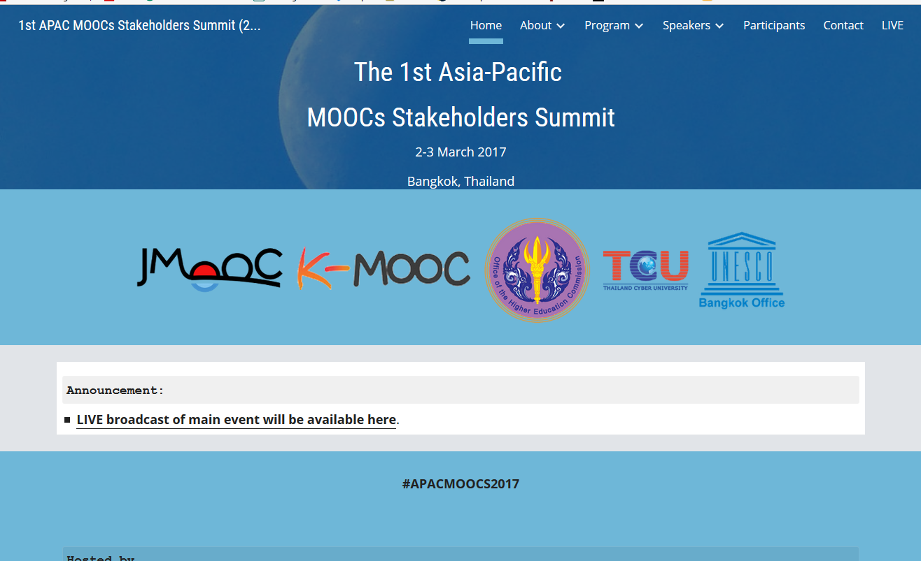
Weirdness #2: Your Friends are doing MOOCs June 15, 2017 Massive List of MOOC Providers Around The World, Class Central JMOOC, K-MOOC, and T-MOOC? https://www.class-central.com/report/mooc-providers-list/

Slide 7
Weirdness #3: Summer MOOC Discounts Email inbox: June 10, 2018 edX (Summer discounts) https://www.edx.org/course

Slide 8
Weirdness #4: Cyber Monday Discounts Email inbox: November 26, 2018 edX (Summer discounts) https://www.edx.org/course

Slide 9
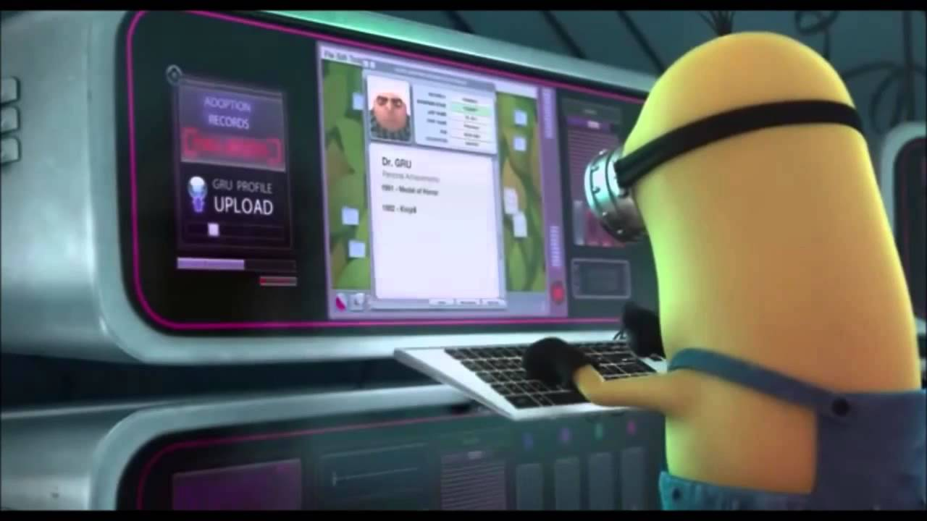
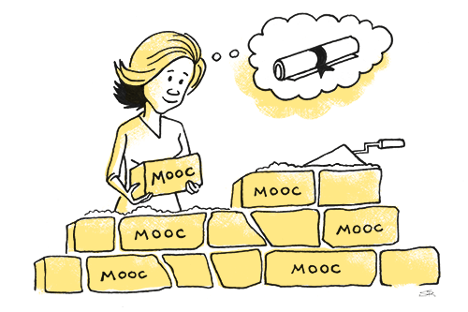
Weirdness #5…The MOOC Wave May 21, 2018 The Second ave of MOOC Hype Is Here, and It’s Online Degrees Dhawal Shah, Class Central https://www.edsurge.com/news/2018-05-21-the-second-wave-of-mooc-hype-is-here-and-it-s-online-degrees

Slide 10
September 12, 2018 Coursera's CEO on the Evolving Meaning of 'MOOC’ Dian Schaffhauser, Campus Technology https://campustechnology.com/articles/2018/09/12/courseras-ceo-on-the-evolving-meaning-of-mooc.aspx
Jeff Maggioncalda, Coursera CEO

Slide 11
October 12, 2018 Weirdness #6…Degrees Via the MOOC EdX: From MicroMasters to Online Master’s Degrees Lindsey McKenzie, Inside Higher Ed https://www.insidehighered.com/news/2018/10/12/edx-launches-nine-low-cost-online-degrees

Slide 12
Weirdness #7…MOOCs in Wedding Announcements September 26, 2018 The Future of Professional Credentialing ... in an Engagement Announcement Joshua Kim, Inside Higher Ed https://www.insidehighered.com/digital-learning/blogs/technology-and-learning/future-professional-credentialing-engagement

Slide 13
Weirdness #8…Master’s of Accountancy MOOCs? Email inbox: June 11, 2018 Coursera https://www.coursera.org/

Slide 14
Weirdness #9…Discounted MOOC-based MBAs August 7, 2017 FutureLearn and Coventry University to Roll Out 50 Online Degrees (Last year Deakin University announced a similar partnership with FutureLearn) Class Central, Dhawal Shah https://www.class-central.com/report/futurelearn-coventry-university-roll-50-online-degrees/

Slide 15
Weirdness #10…MOOC-based Pricing Charts December 30, 2018 MOOC-Based Degrees, Pricing Chart IBL News https://www.class-central.com/pricing-charts/mooc-based-degrees

Slide 16
MOOC Trends and Recent Data

Slide 17
MOOCs are not dead August 19, 2018 Cumulative Growth in Number of MOOCs, 2011-18 Almanac 2018, Chronicle of Higher Education https://www.chronicle.com/article/Top-5-MOOC-Providers-by-Number/244090?cid=cp216

Slide 18
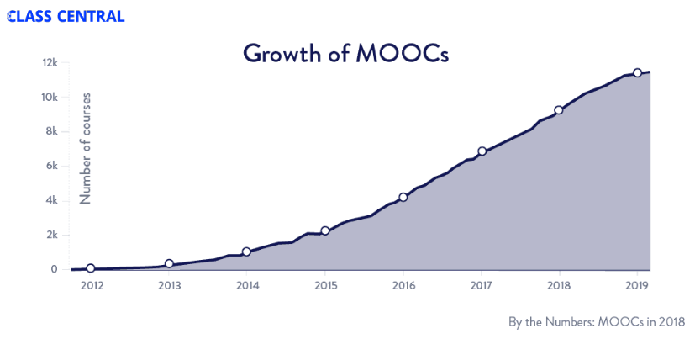
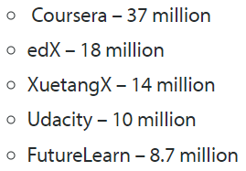
MOOCs Trends
Year of MOOC-based Degrees: A Review of MOOC Stats and Trends in 2018, Dhawal Shah, Class Central--January 6, 2019
Top five MOOC providers

Slide 19
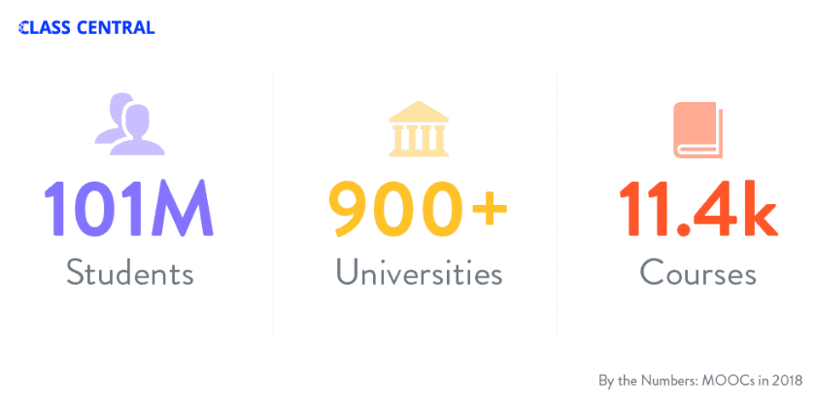
MOOCs Stats
Year of MOOC-based Degrees: A Review of MOOC Stats and Trends in 2018, Dhawal Shah, Class Central--January 6, 2019

Slide 20
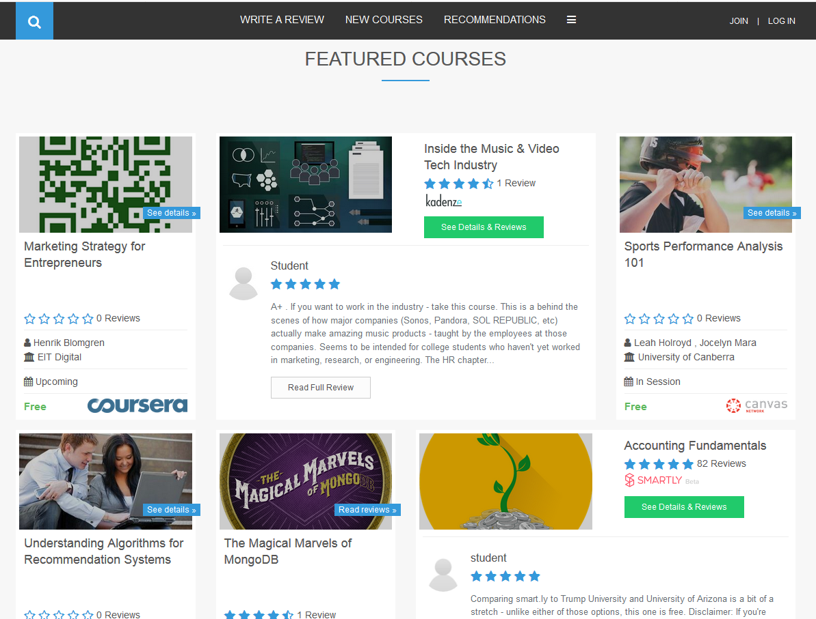
Khe Foon (Timothy) Hew (2018) Hew, K. F. (2018). Unpacking the Strategies of Ten Highly Rated MOOCs: Implications for Engaging Students in Large Online Courses. Teachers College Record, 120(1). https://www.coursetalk.com/
Hew’s (2018, p. 1) analyzed 4,565 coursetalk review comments of 10 highly rated MOOCs. He found “six key factors that can engage online [MOOC] participants and nine reasons for participant disaffection.”
Problem-centric learning supported by clear explanations.
Active learning supported by timely feedback (e.g., assignments, projects, discussion).
Course resources that cater to participants’ learning needs or preferences.
Instructor attributes (e.g., passion, enthusiasm, humor, variety of examples).
Peer interaction.
Instructor availability.

Slide 21
Quotes: Veletsianos et al. (2015-2016)
“To gain a deeper and more diverse understanding of the MOOC phenomenon, researchers need to use multiple research approaches (e.g., ethnography, phenomenology, discourse analysis) add content to them.” (p. 583)
Veletsianos, Collier, & Schneider (2015, May), Digging deeper into learners’ experiences in MOOCs: Participation in social networks outside of MOOCs, notetaking and contexts surrounding content consumption. BJET, 46(3), 570-587.
“Dependence on Particular Research Methods May Restrict our Understanding of MOOCs.”
George Veletsianos & Peter Shepherdson’s Study (2016). Systematic Analysis and Synthesis of the Empirical MOOC Literature Published in 2013-2015. IRRODL. http://www.irrodl.org/index.php/irrodl/article/view/2448/3655

Slide 22
Three Studies
Study #1
MOOC Literature Review
Study #3
MOOC Design for SDL
Study #2
MOOC Design Considerations and Challenges

Slide 23
Study #1 MOOCs Literature Review (2014-2016)
Zhu, M., Sari, A., & Lee, M. M. (2018). A Systematic Review of Research Methods and Topics of the Empirical MOOC Literature (2014-2016). The Internet and Higher Education, 37, 31-39.

Slide 24
Research Purposes & Questions
The purpose was to gain a deeper and more diverse understanding of the current MOOC phenomenon and identify the gap in MOOC empirical studies.
1. What are the research methods researchers employed in empirical MOOC studies?
2. What are the research topics or focuses in MOOC studies?
3. How are researchers of empirical MOOC studies geographically distributed?
4. In terms of the delivery of the MOOC, what are the countries which are attracting the most research?

Slide 25
Journals of the Articles
No. | Journal | Total
1 | International Review of Research in Open and Distance Learning (IRRODL) | 31
2 | Computers & Education | 12
3 | British Journal of Educational Technology | 9
4 | Online Learning | 7
5 | Distance Education | 5
6 | Educational Media International | 5
7 | Internet and Higher Education | 5
8 | Journal of Computer Assisted Learning | 5
9 | Computers in Human Behavior | 4
10 | Open Learning | 4
11 | Journal of Online Learning and Teaching | 3
12 | Journal of Asynchronous Learning Network | 3

Slide 26
RQ1 & RQ2
MOOC research focuses and methods
 | Quantitative | Qualitative | Mixed methods
Student-focused | 39 | 9 | 26
Design-focused | 19 | 12 | 17
Context and impact | 9 | 6 | 5
Instructor-focused | 0 | 3 | 2

Slide 27
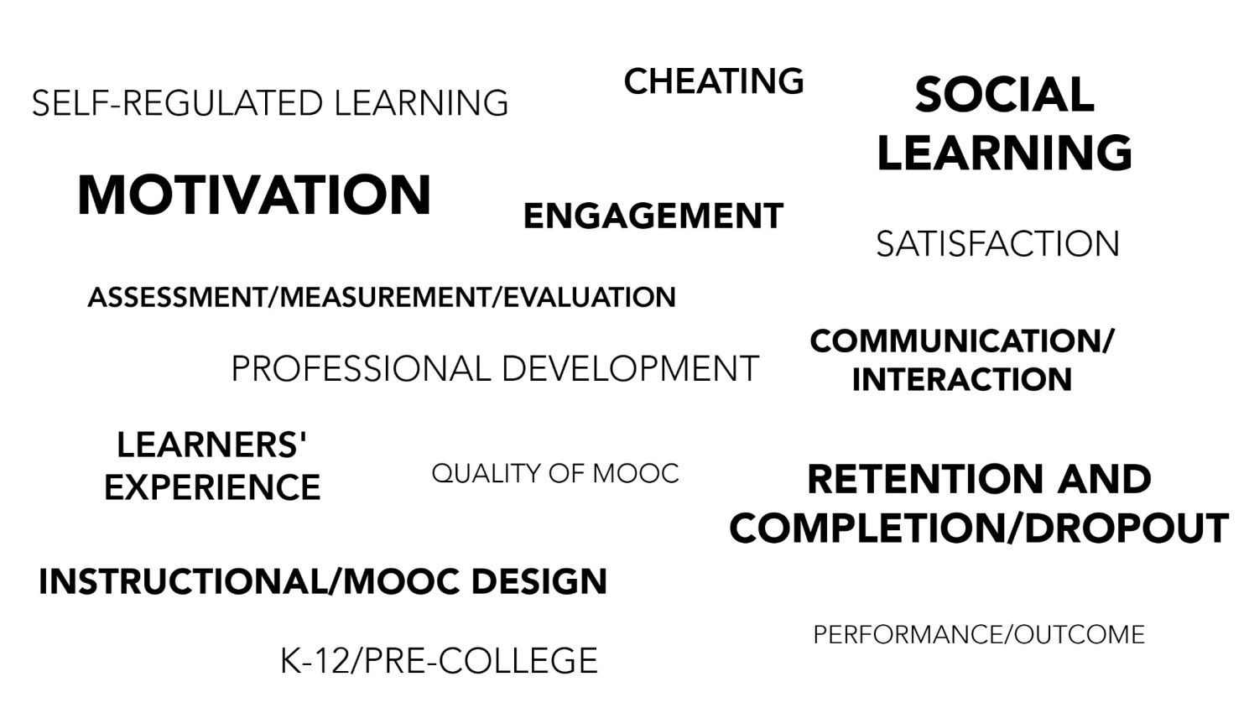
RQ2
Specific Focus of MOOC Research (2014-2016)

Slide 28
RQ3 Locations
Location of MOOC Research Team Members (2014-2016)

Slide 29
Implications
A continuous expansion of methodological approaches in MOOCs research is needed.
More empirical MOOC research focusing on instructors’ perspective might provide more comprehensive picture of MOOC phenomenon.
(Note: Data collection is continuing…)

Slide 30
The study expanded!

Slide 31
Total Number of Empirical MOOC Studies Published in Different Journals from 2013-2018
Table 1
(Note: the table only includes the top nine journals in terms of the number of empirical MOOC studies)
Journals | Number of empirical studies
International Review of Research in Open and Distributed Learning | 51
Computers & Education | 22
British Journal of Educational Technology | 15
Online Learning | 12
Distance Education | 11
Journal of Online Learning and Teaching | 11
The Internet and Higher Education | 10
Computers in Human Behavior | 10
Open Learning | 8

Slide 32
Research Methods
Figure 2. Research methods used in empirical MOOCs studies from 2013-2018 (N=321 studies)

Slide 33
Data Collection Methods
Figure 5. Data collection methods used in empirical MOOCs studies from 2013-2018 (N = 321 studies)
(Note: some studies contain more than one data collection method and this figure only includes the main data collection methods)

Slide 34
Study #2 MOOCs Design Considerations and Challenges
Zhu, M., Bonk, C. J., & Sari, A. (2018). Instructor experiences designing MOOCs in higher education: Pedagogical, resource, and logistical considerations and challenges. Online Learning, 22(4), 203-241.

Slide 35
Research Background
MOOCs can be beneficial to both learners and instructors (Hew & Cheung, 2014).
Instructional design is critical for online learning (Johnson & Aragon, 2003; Phipps & Merisotis, 1999).
Instructors are one of the five main components of MOOCs (Kop, 2011).
Few studies have examined instructional design from MOOC instructors’ perspectives (Margaryan et al., 2015; Watson et al., 2016).

Slide 36
Research Purpose
The purpose of this study is to provide suggestions for future MOOC instructors and instructional designers in higher education through exploring MOOC design considerations and challenges from the instructor’s perspective.

Slide 37
Research Questions
What are the design considerations of instructors when designing MOOCs?
What challenges do instructors perceive when designing MOOCs?
How do instructors address the challenges that they perceive related to MOOCs?

Slide 38
Research Design
Sequential mixed methods design (Creswell & Clark, 2017)
Quan
Data Collection
Quan
Data Analysis
Qual
Data Collection
Interpretation of Entire Analysis
Qual
Data Analysis

Slide 39
Data Collection
Data Collection:
Survey, interview, and course review
Participants:
143 survey participants (10% response rate)
12 interviewees

Slide 40
12 Interviewees
No. | Countries | Subject areas | Platforms
1. | The U.S. | Language and Literacy | Coursera
2. | The U.S. | Education | Coursera
3. | The U.S. | Education | Canvas
4. | The U.S. | Chemistry | Coursera
5. | UK | Medicine and Health | FutureLearn
6. | UK | Language and Literacy | FutureLearn
7. | Hong Kong (China) | Math | Coursera
8. | Mainland China | Math | Coursera
9. | Canada | Psychology | Coursera
10. | Australia | Medicine and Health | Open2Study
11. | Sweden | Computer Science | edX
12. | India | Management | edX

Slide 41
Data Analysis
RQs | Data Sources | Data analysis
RQ1 | Survey-multiple-choice questions Survey-open-ended questions Interview MOOC review | Descriptive statistics Content analysis (Elo & Kyngäs, 2008) Content analysis Content analysis
RQ2 | Survey-multiple-choice questions Survey-open-ended questions Interview | Descriptive statistics Content analysis Content analysis
RQ3 | Survey-multiple-choice questions Interview | Descriptive statistics Content analysis

Slide 42
Research Context

Slide 43
Research Context

Slide 44
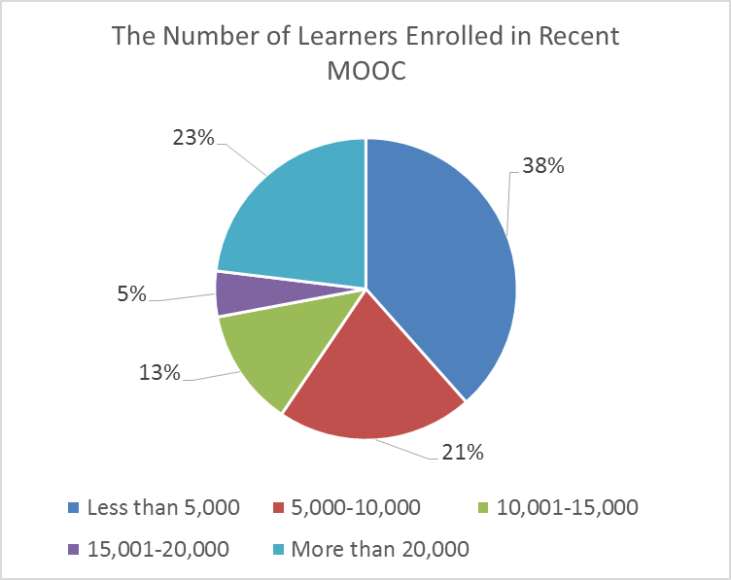
Research Context

Slide 45
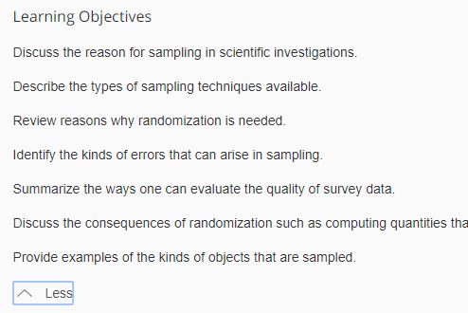
Findings RQ1
RQ #1. What are the design considerations of instructors when designing MOOCs?
Learning objectives
Assessment
Time for designing MOOC
Engaging learners
An example of learning objectives:

Slide 46
RQ1 Survey Results

Slide 47
RQ1 Interview Results
Engage learners
One instructor from US mentioned:
“I engaged people in the forum. So each week I would write a message that would be the new welcome page for the week that would say, ‘hey come to the forum and ask questions about this or come to the forum introduce yourself’... Of course, I tried to get students to feel like I was engaged with them during the videos by asking them questions and telling them to do things during the video.”

Slide 48
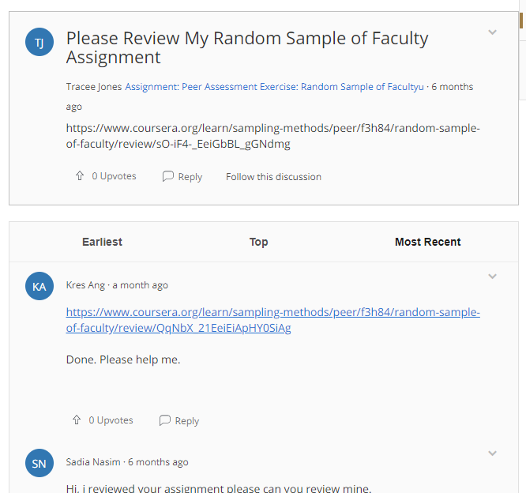
Findings RQ2
RQ #2. What challenges do instructors perceive when designing MOOCs?
Assessment methods
Engaging students’ learning
Time limitation
(Note: Above is an example of peer-assessment.)

Slide 49
RQ2 Survey Results

Slide 50
RQ2 Interview Results
Time limitation
One instructor from education subject mentioned:
“I think one of the challenges is time. It does take a lot of time to get the videos done. I did not get a course release when I was doing, and it was a side project at the same time as my regular load.”

Slide 51
Findings RQ3
RQ #3. How do instructors address the challenges that they perceive related to MOOCs?
Explore other MOOC examples
Seek help from the platform/colleagues/institutions

Slide 52
RQ3 Survey Results

Slide 53
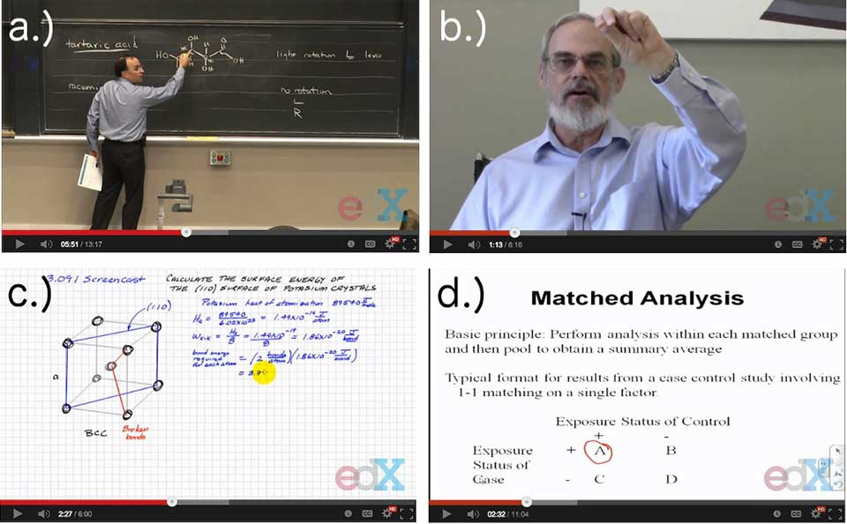
RQ3 Interview Results
Explore other MOOC examples
One MOOC instructor from the US mentioned:
“When I started making the MOOC, I could see MOOCs that other people had made. So I could see what other people did in terms of having videos with questions embedded in the videos, which I really liked.”

Slide 54
Discussion
The time limitation of creating MOOCs was the primary logistical consideration (Hew & Chung, 2014; Watson et al., 2016) and challenges.
The pedagogical factors were the primary design considerations (Watson et al., 2016) and challenges in MOOC design.
The assessment and engagement strategies are the main considerations as well as challenges.

Slide 55
Implications
For MOOC instructors
May inform them about what other instructors are most concerned with and tend to target in MOOC design as well as their efforts in addressing the possible design challenges.
For instructional designers
Guide attention to ID in the areas that MOOC instructors might need them to help in consultation.

Slide 56
Study #3 MOOCs Instructional Design to Facilitate Participants’ Self-directed Learning (Dissertation)

Slide 57
Key Terms
Self-directed learning (SDL) (Garrison, 1997)
(1) self-management
(2) self-monitoring
(3) motivation
Notes:
Garrison’s model: 3 inter-related part.

Slide 58
Research Background
Learners need self-directed learning skills and strategies to be successful in MOOCs (Halawa, Greene, & Mitchell, 2014; Littlejohn & Milligan, 2016), as there is a lack of personalized interaction with teachers.
Self-directness of a learner might vary in different learning environments which means that the learners could be more self-directed in one learning environment than another (Hiemstra, 1994).

Slide 59
Research Background
Instructional design can greatly influence students’ interaction and engagement (Garrison & Cleveland-Innes, 2005) and success in online learning (Song, Singleton, Hill, & Koh, 2004; Swan, 2001).
However, few studies have examined instructional design and the delivery of instruction using MOOCs from instructor perspectives (Margaryan et al., 2015; Watson et al., 2016); especially lacking is research on instructors’ perception of SDL and how they design MOOCs to facilitate students’ SDL.

Slide 60
Research Purpose
The purpose is to inform instructors or instructional designers and MOOC providers of the current practices of designing MOOCs to facilitate learners’ SDL.

Slide 61
Research Questions
How do MOOC instructors perceive participant SDL skills?
How do MOOC instructors perceive their facilitation of participant SDL skills?
How do instructors design and deliver MOOCs to facilitate participant SDL skills?
a. How is technology being used by MOOC instructors to support the development of participant SDL skills?
b. What technology features or functions do MOOC instructors want to have to improve their facilitation of MOOC participant SDL skills?

Slide 62
Research Design
Explanatory sequential mixed methods design (Creswell & Clark, 2017)
Pilot survey with 48 instructors
Survey
198 instructors
Review 22 MOOCs of interviewees
Interview 22 instructors
Review 22 MOOCs of interviewees
Pilot interview with 4 instructors

Slide 63
Data Collections
Survey:
Volunteer sampling (Creswell & Clark, 2017)
198 instructors responded to the survey (10% response rate)
Interview:
Homogeneous purposeful sampling (Creswell & Clark, 2017; Patton, 2002)
Maximal variation sampling (Creswell & Clark, 2017)
22 interviewees
MOOC review:
Reviewed 22 interviewees’ MOOCs

Slide 64
Pseudonym | Country | Subject area | Platform | Gender | No. of O/B | No. of M | Mode of the M
Lucas | US | Social science | edX | M | 0 | 1 | I without T
Branden | US | Education | Udacity | M | 0 | 5 or more | Self-paced
Logan | US | Literacy and Language | Coursera | M | 5 or more | 5 or more | I with T
Emma | US | Literacy and Language | Coursera | F | 2 | 1 | Self-paced
Jason | US | Science | edX | M | 1 | 1 | I with T
Jackson | US | Medicine and health | Coursera | M | 5 or more | 1 | Self-paced
Samuel | US | Education | FutureLearn | M | 4 | 3 | Self-paced
Hannah | US | Education | Blackboard | F | 5 or more | 1 | I with T
Ashley | US | Education | EdX | F | 0 | 5 or more | I with T
Andrew | UK | Art | FutureLearn | M | 0 | 3 | I with T
Emily | UK | Medicine and health | FutureLearn | F | 2 | 2 | I with T
Aiden | UK | Social science | FutureLearn | M | 0 | 1 | Self-paced
Henry | UK | Social science | FutureLearn | M | 0 | 1 | Self-paced
Joseph | UK | Medicine and health | FutureLearn | M | 1 | 1 | Self-paced
Joshua | UK | Literacy and language | FutureLearn | M | 2 | 2 | I with T
Mason | Australia | Education | Coursera | M | 5 or more | 1 | I with T
Ethan | Australia | Business | Coursera | M | 3 | 1 | I without T
Ben | Australia | Social science | edX | M | 1 | 1 | I with T
Paul | France | Computer Science | Coursera | M | 1 | 1 | I with T
Fernando | Belgium | Research methods | Blackboard | M | 5 or more | 3 | I with T
Jacob | Netherland | Science | Coursera | M | 0 | 1 | I with T
Dylan | Israel | Science | Coursera | M | 5 or more | 3 | I without T
Data Collections
Interview:

Slide 65
Data Analysis
RQs | Data Sources | Data analysis | Tools
RQ1 | Survey Interview | Descriptive statistics Content analysis (Elo & Kyngäs, 2008) | SPSS NVivo
RQ2 | Survey Interview | Descriptive statistics Content analysis | SPSS NVivo
RQ3 | Interview Course review | Content analysis Content analysis | NVivo NVivo

Slide 66
Trustworthiness
Validity survey: Experts review, think-aloud interview, and pilot test (EFA)
Reliability survey: Pilot test and internal consistency reliability (Cronbach alpha)
Triangulation: Data sources, researchers, and methods
Member checks: Interview transcriptions
Peer debriefing: Committee and colleagues
Researcher reflexivity: Constant reflection and be forthright with our positions
Thick description: Report the context, data sources, and analyses in detail
Prolonged engagement: Immerse in instructors’ MOOCs before the interview and continue reviewing the MOOCs after the interview

Slide 67
Research Context

Slide 68
RQ1 Perceptions of SDL
A majority of the MOOC instructors thought that these skills or attributes are not static, and that SDL as a set of skills can be educated or students’ personal attributes that can be changed.

Slide 69
RQ1 Interview Results
Emma’s understanding of SDL is more related to self-management and motivation. She said:
When I think about self-directed learning, I think about students managing their time and managing the coursework on their own, and how it fits into their schedules and their lives, how they interact with materials, what's going to keep them engaged.

Slide 70
RQ2 Perceptions of Facilitation of SDL
Most of MOOC instructors thought that they can intentionally or unintentionally facilitate students’ SDL.

Slide 71
RQ2 Interview Results
Ashely emphasized the importance of both instructors’ facilitation and students’ SDL skills. She said:
The participant has a lot of flexibility on how they approach the content. I mean, obviously, we have things like assignments. We have things like online forums. And there're ways that we scaffold the learning experience. But there still is a lot of choice for the learner.

Slide 72
RQ3 Strategies to Facilitate SDL
Students’ intrinsic motivation plays an important role. However, extrinsic motivation provided by the MOOCs might help transfer extrinsic motivation to intrinsic motivation.
Motivations | Strategies
Entering motivation | MOOC instructors helped students identify the needs and goals of learning and sense of achievement.
Task motivation | MOOC instructors motivated students through instruction, learning materials, feedback, and learning community.

Slide 73
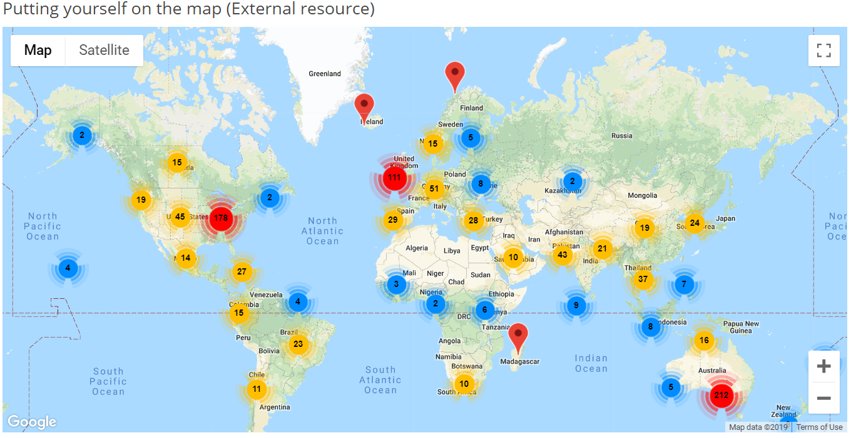
RQ3 Learning Community

Slide 74
RQ3 Strategies to Facilitate SDL
Both internal feedback and external feedback were provided to help students’ self-monitoring.
Self-monitor |  | Strategies
Internal feedback | Cognition | MOOC instructors provided quizzes for self-assessment, tutorial on technology use, learning advice, navigation of the course, progress indicators, resources, and instructional modeling, etc.
 | Meta-cog | MOOC instructors encouraged students to reflect and think critically by providing reflection questions and building learning community.
External feedback |  | MOOC instructors, teaching assistants, and peers were involved in providing external feedback.

Slide 75
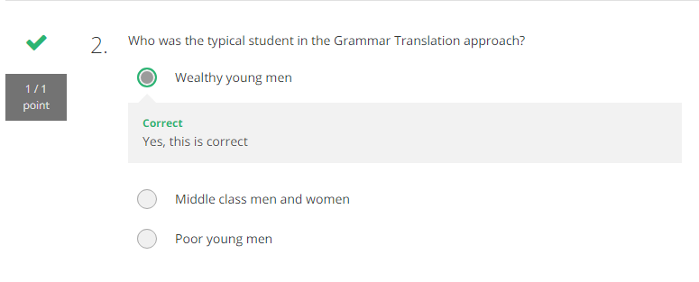
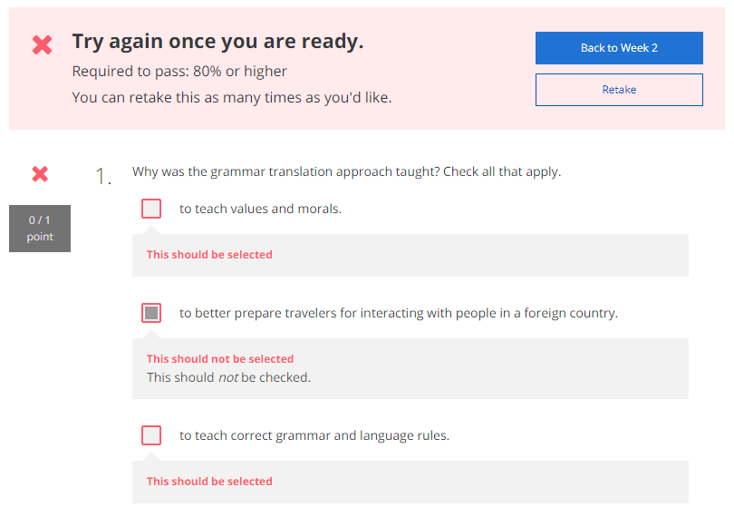
RQ3 Self-assessment

Slide 76
RQ3 Progress Indicators

Slide 77
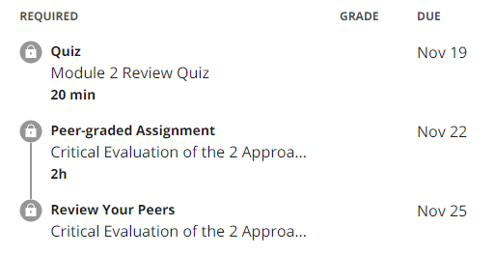
RQ3 External Feedback-Peer-assessment

Slide 78
RQ3 Strategies to Facilitate SDL
They helped students’ self-management concerning setting learning goals, time management, resources and support management although among the three elements of SDL, MOOC instructors had less control over students’ management.
Self-management | Strategies
Enactment of learning goals | Providing discussion questions, reflections, survey, and appreciation students’ learning goals.
Time management | Providing time frame, progress indicator, short learning units, and flexible timeline.
Management of resources and support | Providing flexible learning resources, peer-assessment, accessibilities, clear expectations, and short learning units.

Slide 79
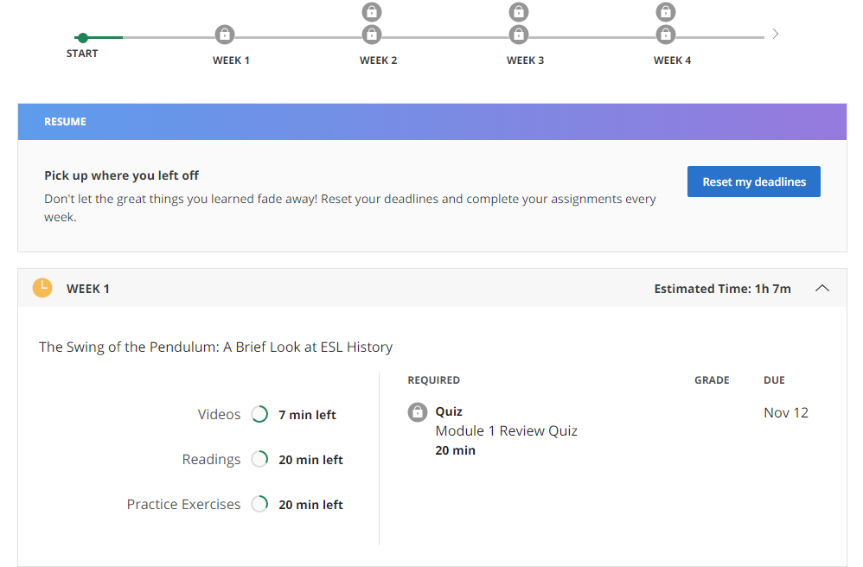
RQ3 Time Management

Slide 80
RQ3-a Tech Use for SDL
Synchronous communication technologies
Google Hangouts YouTube Live
Asynchronous communication technologies
Discussion forum Blog Slackbot Flickr
Multimedia (e.g., video and graphics)
Feedback technologies

Slide 81
RQ3-b Tech Expectations for SDL
Adaptive learning systems
Artificial intelligent systems
Learning analytics
Interactive technologies
Interaction between learners and content
Interaction among learners and other participants
Tools embedded in platforms

Slide 82
Discussion
SDL can be Changed
MOOC Instructors can Facilitate SDL
Strategies to Facilitate SDL: A variety of strategies can be used to facilitate student SDL skills in terms of motivation, self-monitor, and self-management.
Tech for SDL: Tech plays an important role in facilitating SDL skills.
Tech expectations: Adaptive learning systems, artificial intelligent systems, and learning analytics were expected to have to support SDL.

Slide 83
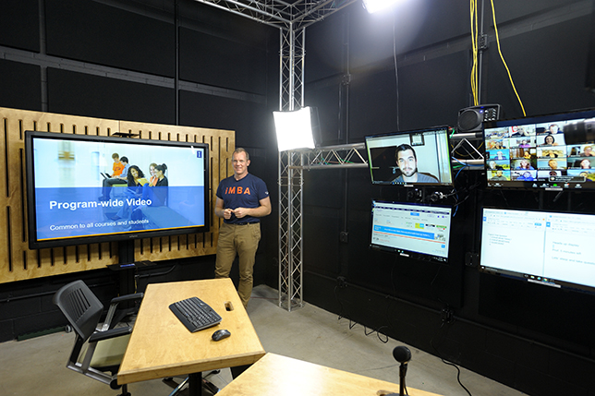
Implications
For MOOC instructors and Instructional Designers
Build learning community
Inspire intrinsic motivation
Personalize learning
For MOOC providers
Create a personalized learning environment
Provide learning analytics to support learning and teaching

Slide 84
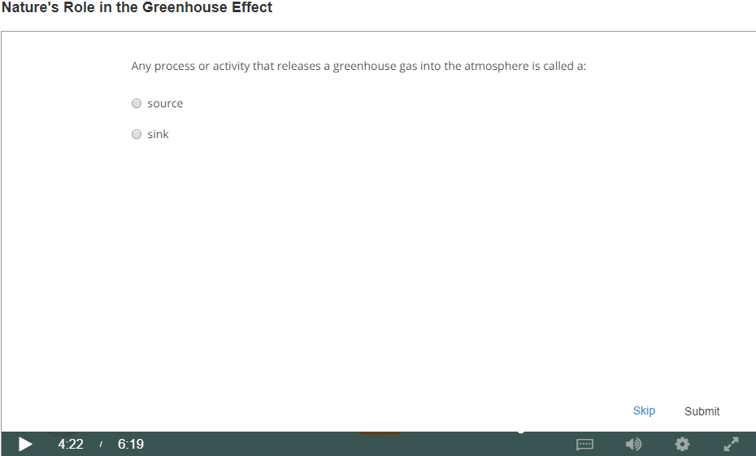
Top 10 Strategies to Facilitate SDL in MOOCs
Helping students set their own learning goals;
Building learning community;
Offering immediate feedback;
Embedding quizzes for self-assessment;
Providing progress indicators;
Providing reflection questions;
Designing short learning units;
Providing flexible timelines;
Highlighting estimated time frames;
Making available optional learning materials.

Slide 85
Other Related MOOC Studies
Sari, A. R., Bonk, C. J., & Zhu, M. (in revision). MOOC Instructor Designs and Challenges: What can be Learned from Existing MOOCs in Indonesia and Malaysia? Asia Pacific Education Review.
Zhu, M., Bonk, C. J., & Sari, A. (in review). MOOC Instructor Motivations, Innovations, and Designs: Surveys, Interviews, and Course Reviews. Canadian Journal of Learning & Tech.
Doo, M., Tang, Y., Bonk, C. J., & Zhu, M. (in review). A Mixed Methods Look at Motivation and Career Development of MOOC Instructors. Australasian Journal of Educ. Technology.
Bonk, C. J., Sabir, N., Sari, A., Zhu, M., Xu., S., & Kim, M. (in preparation). MOOC instructors’ efforts to address learner diversity in design and implementation.
Zhu, M., Sari, A. R., & Bonk, C. J. (in preparation). Systematic review of MOOC research from 2012-2019. (Intended for special issue of ETR&D)
Doo, M., Zhu, M., Bonk, C. J., & Tang, Y. (data collect). MOOC instructor engagement.
Zhu, M., & Bonk, C. J. (data collect). MOOC Student Perceptions of Effective SDL Strats.

Slide 86
Tired of MOOCs…?

Slide 87
Do we have time for another study?

Slide 88
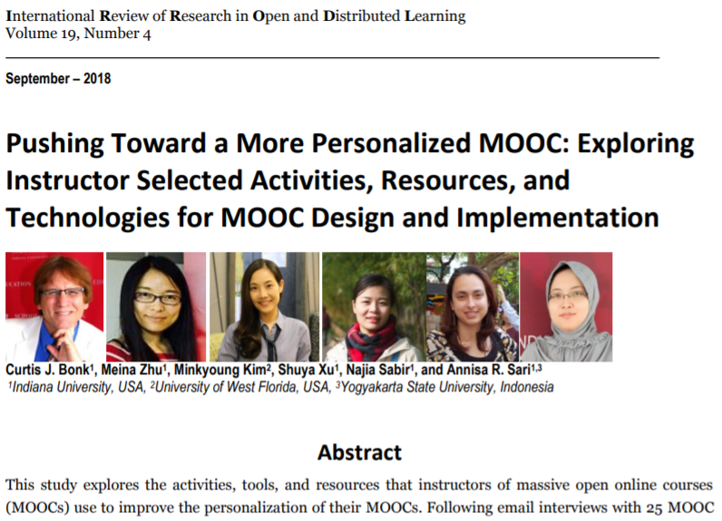
Other Related MOOC Studies

Slide 89
Figure 1. MOOC instructor departmental or primary discipline affiliations (n=150)

Slide 90
Figure 3 and 4. Effort placed on meeting unique learner needs when designing and delivering most recent MOOC (Note: on a scale of 1 (low) to 10 (high) (n=144)

Slide 91
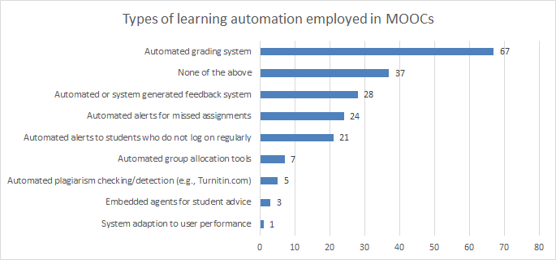
Figure 6. Number of MOOCs that offer different types of learning system automation and adaptation (n=127)

Slide 92
Figure 9: MOOC instructors (n=133) instructional practices to address cultural diversity

Slide 93
Table 1. Instructional Practices of MOOC Instructors to Address the Variety of Student Competencies and Needs (n=142)

Slide 95
Discussion, Significance, and Conclusion

Slide 96
Thank you! Any Questions?
Curtis Bonk: cjbonk@Indiana.edu
Meina Zhu: meinzhu@iu.edu
Slides and Proceedings Paper at TrainingShare.com: http://www.trainingshare.com (go to “Archived Talks”)

