Slide 1
Research Issues and Findings of MOOCs: Learning to Better Design Practices
Curtis J. Bonk| cjbonk@Indiana.edu
Indiana University Bloomington
Meina Zhu| meinazhu@wayne.edu
Wayne State University
May 27, 2020

Slide 2
March 19, 2020 Doors Open The Commonwealth of Learning https://www.col.org/resources/keeping-doors-learning-open-covid-19

Slide 3
Talk Outline
MOOC News and Trends
MOOC ID Considerations and Challenges
MOOC ID for Self-directed Learning
MOOC personalization.

Slide 4
Polls
Poll #1: Who in here has taken a MOOC? Poll #2: Are you happy or frustrated when you take a MOOC?

Slide 5
April 29, 2020 Zoom Boom Synchronous instruction is trending, but experts say a more intentional mix of live and asynchronous classwork is necessary for future remote terms. Colleen Flaherty, Inside Higher Ed https://www.insidehighered.com/news/2020/04/29/synchronous-instruction-hot-right-now-it-sustainable

Slide 6
MOOC Trends and Recent Data

Slide 7
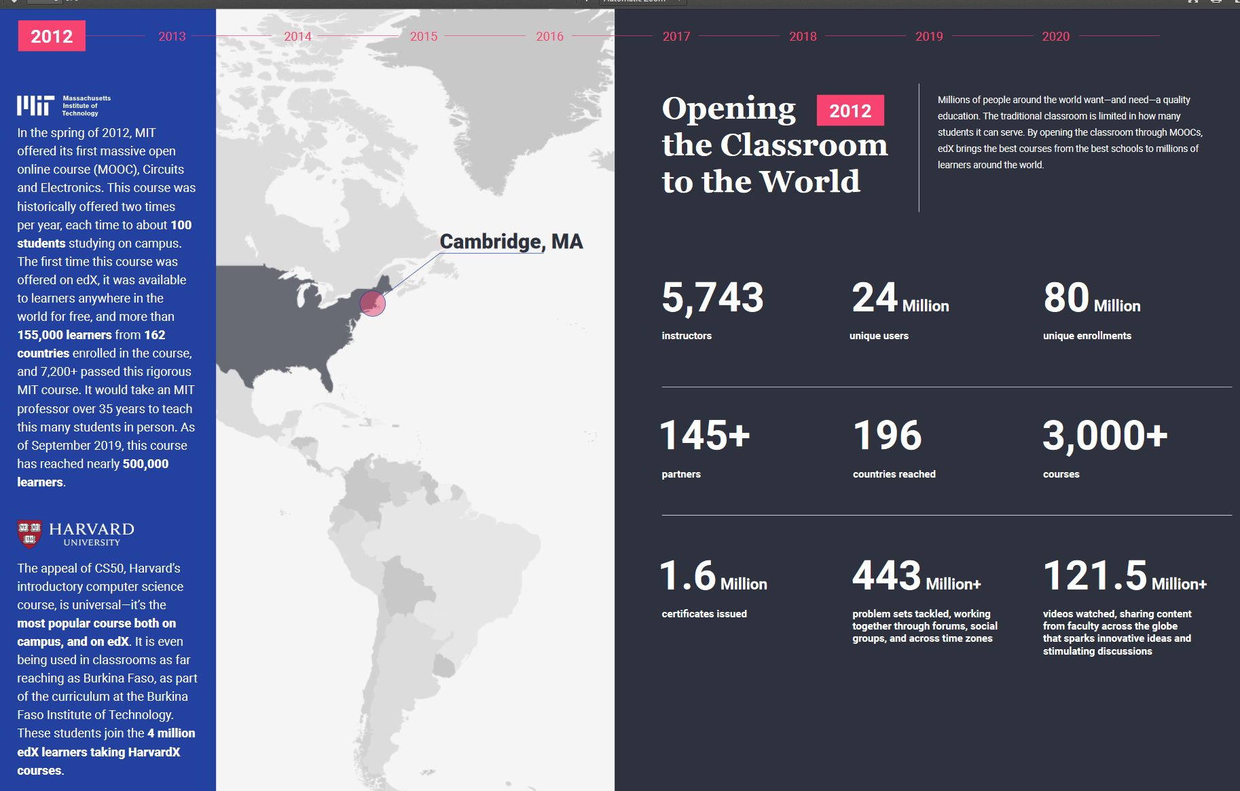
December 16, 2019 2020 Impact Report, edX https://www.edx.org/sites/default/files/2020-impact-report.pdf

Slide 8
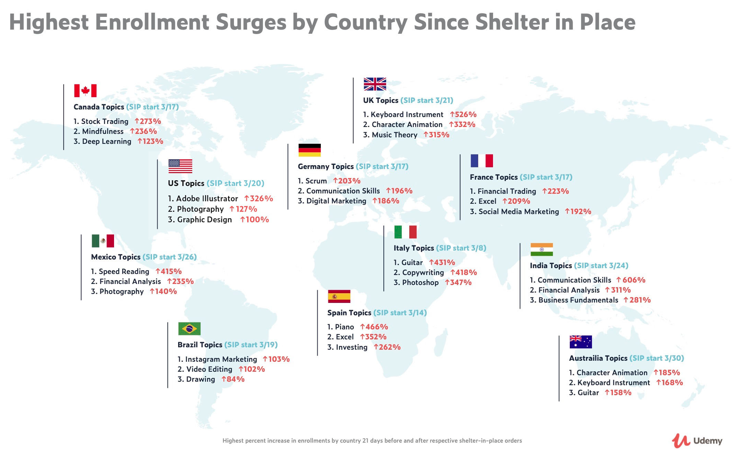
April 30, 2020 New Udemy Report Shows Surge in Global Online Ed in Response to COVID-19 People around the world are learning how to work from home and stay productive as the Future of Work arrives Businesswire: https://www.businesswire.com/news/home/20200430005243/en/

Slide 9
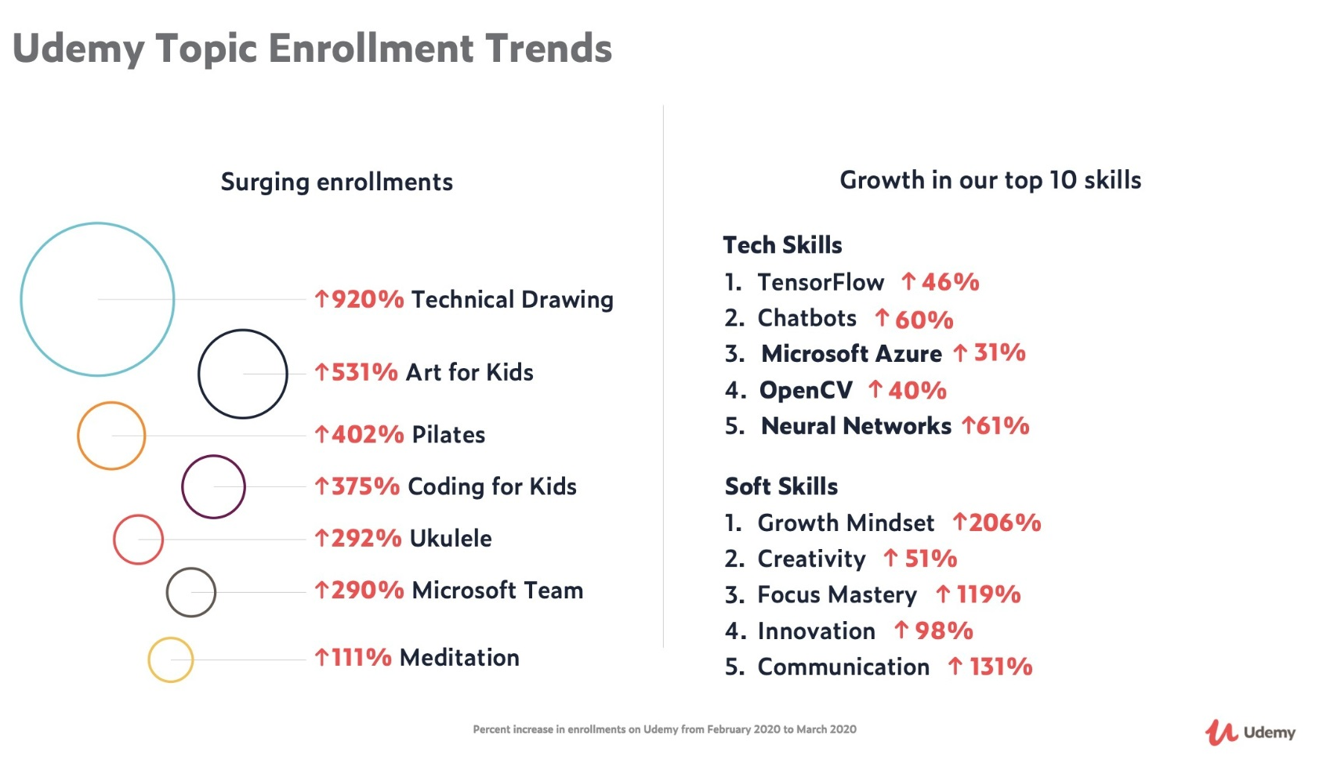
April 30, 2020 New Udemy Report Shows Surge in Global Online Education in Response to COVID-19 There has been an immense surge in enrollments in courses related to Telecommuting (21,598% increase) and Virtual Teams (1,523%), as well as Decision Making (277%), Self Discipline (237%), and Stress Management (235%).
https://www.businesswire.com/news/home/20200430005243/en/

Slide 10
April 30, 2020 New Udemy Report Shows Surge in Global Online Education in Response to COVID-19 Strong global growth in top-ranking professional skills includes Neural Networks (61% increase), Communication Skills (131%), and Growth Mindset (206%). Passion topics like Pilates (402% increase), Technical Drawing (920%), and Ukulele (292%), have surged as well. https://www.businesswire.com/news/home/20200430005243/en/
425% increase in enrollments for consumers
55% increase in course creation by instructors
80% increase in usage from businesses and governments
130% growth in enrollments in the U.S., 200% in India, 320% in Italy, and 280% in Spain.
People in India are learning Business Fundamentals (281%) and Communication Skills (606%)
Italians are taking courses on Guitar (431%), Copywriting (418%), and Photoshop (347%)
The Spanish are taking Piano (466%) and focused on Investing (262%)

Slide 11
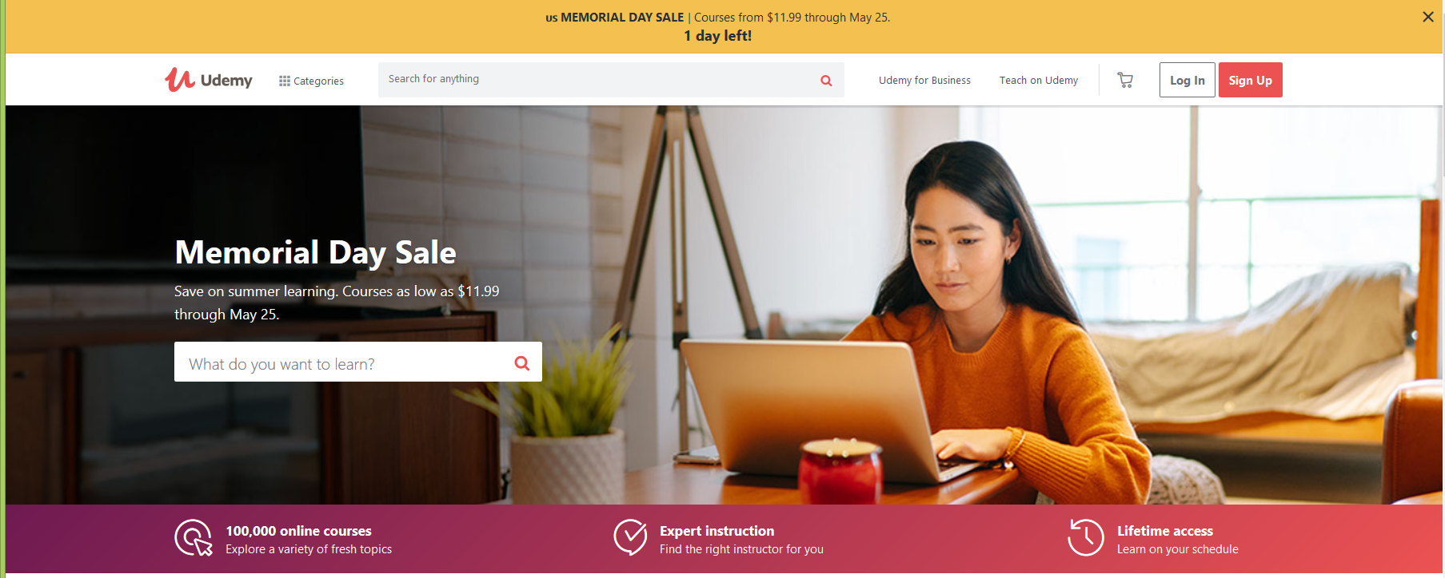
April 30, 2020 New Udemy Report Shows Surge in Global Online Education in Response to COVID-19 Businesswire https://www.businesswire.com/news/home/20200430005243/en/
Categories with the highest surge in new courses include Office Productivity (159% increase), Health and Fitness (84%), IT & Software (77%), and Personal Development (61%).

Slide 12
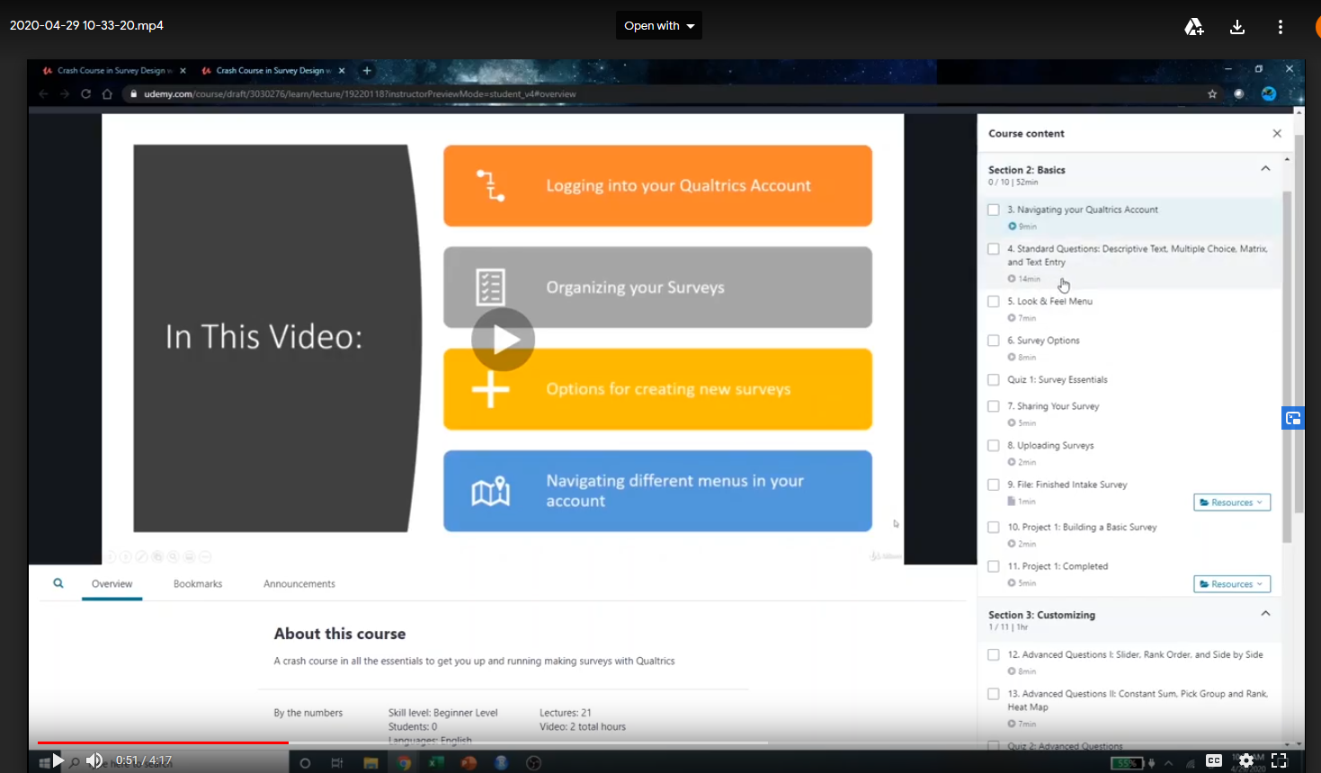
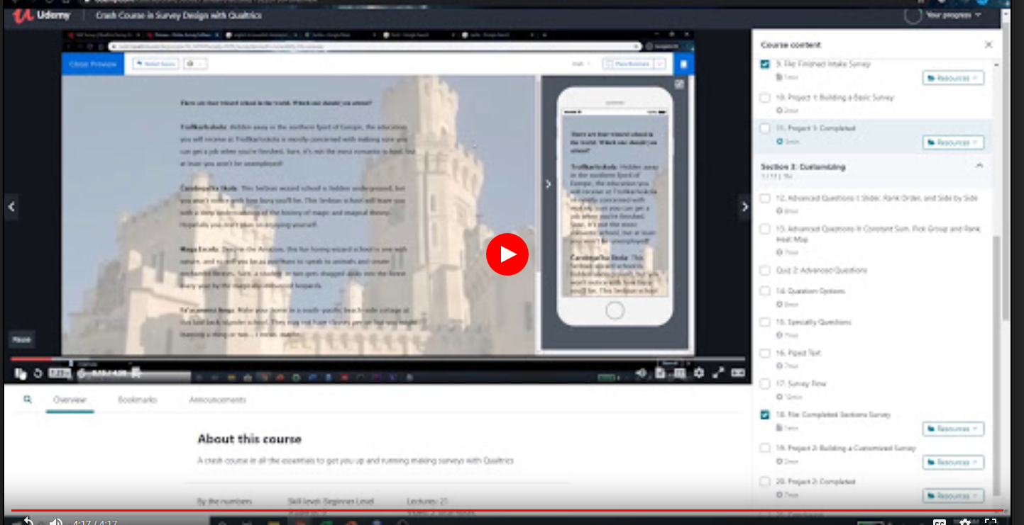
April 29, 2020 MOOC and Qualtrics Tanner Phillips, Udemy https://drive.google.com/file/d/1fkiTPUbDYiK91V-8R3odkxFytHiqQnc0/view

Slide 13
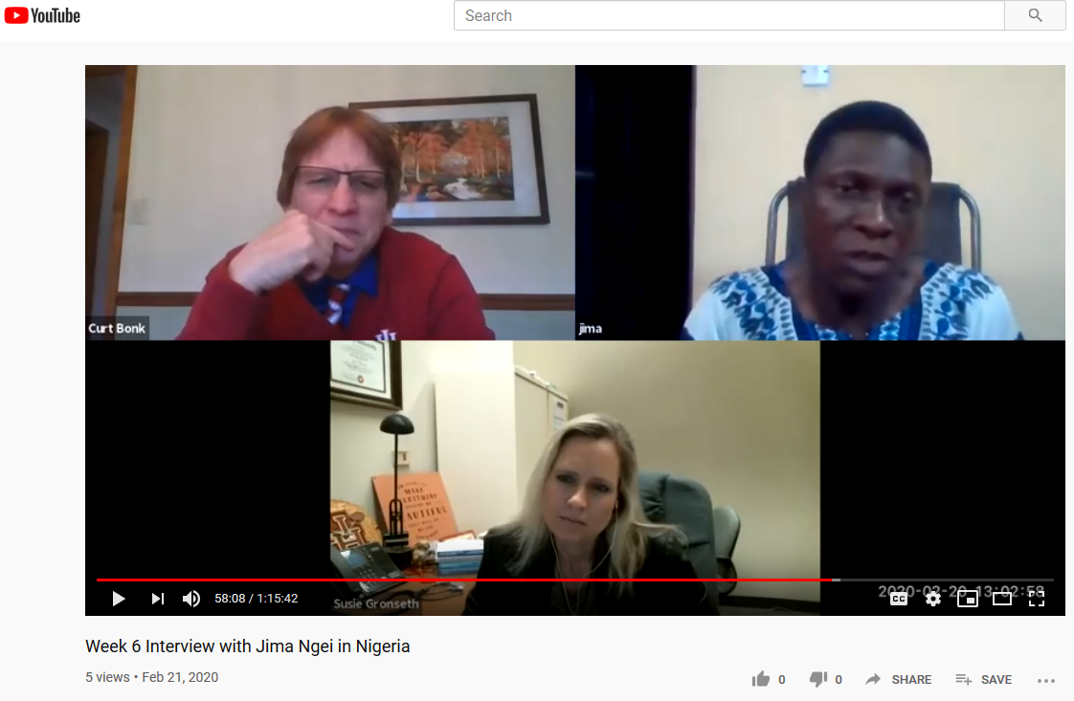
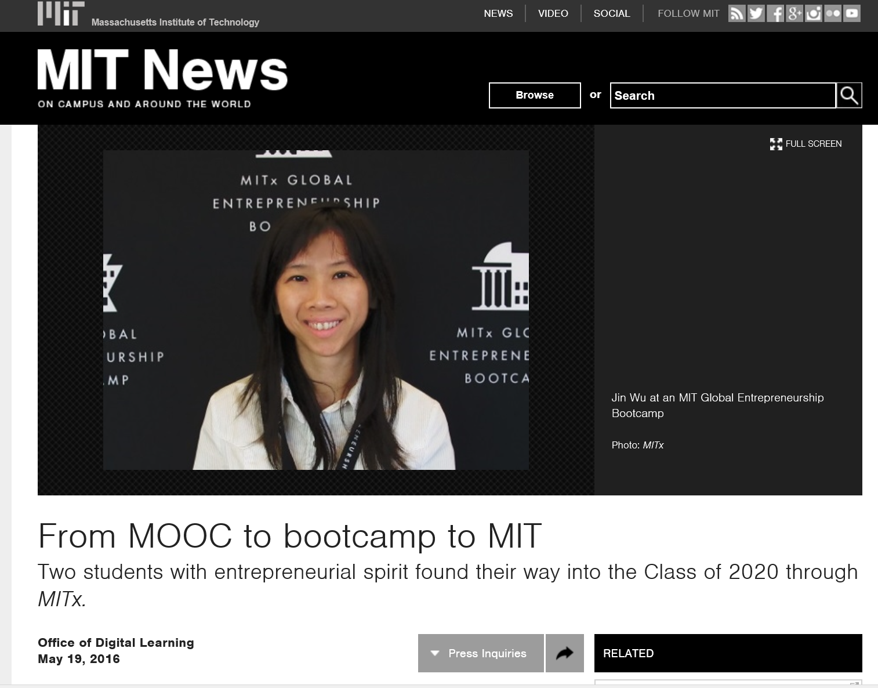
Hundred+ MOOC Clubs February 21, 2020 250 MOOCs and Counting: One Man’s Educational Journey, Chronicle of Higher Education http://chronicle.com/article/250-MOOCsCounting-One/229397/?cid=at If the MOOC movement has faded, nobody told Jima Ngei. Mr. Ngei, who lives in Port Harcourt, Nigeria, has completed and passed 250.
Jima Ngei: “I had this unrelenting fear that this miracle of free access might evaporate soon.”

Slide 14
MOOCs Stats
December 17, 2019
Online Degrees Slowdown: A Review of MOOC Stats and Trends in 2019, Dhawal Shah, Class Central
https://www.classcentral.com/report/moocs-stats-and-trends-2019/

Slide 15
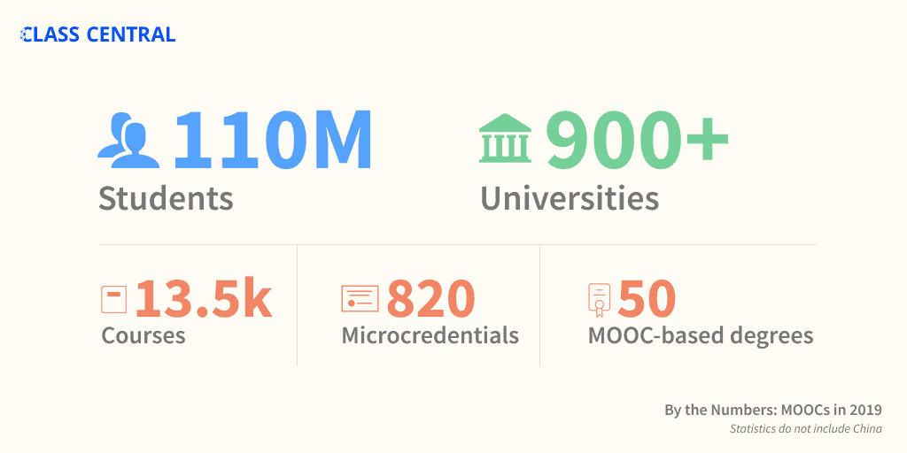
MOOCs Stats
December 17, 2019
A Review of MOOC Stats and Trends in 2019
Dhawal Shah, Class Central
https://www.classcentral.com/report/moocs-stats-and-trends-2019/

Slide 16
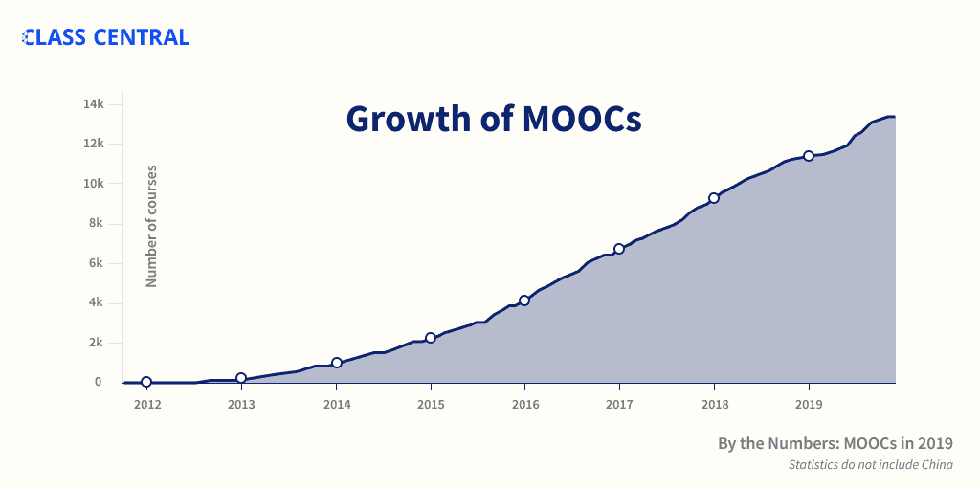
MOOCs Stats
December 17, 2019
A Review of MOOC Stats and Trends in 2019
Dhawal Shah, Class Central
https://www.classcentral.com/report/moocs-stats-and-trends-2019/

Slide 17
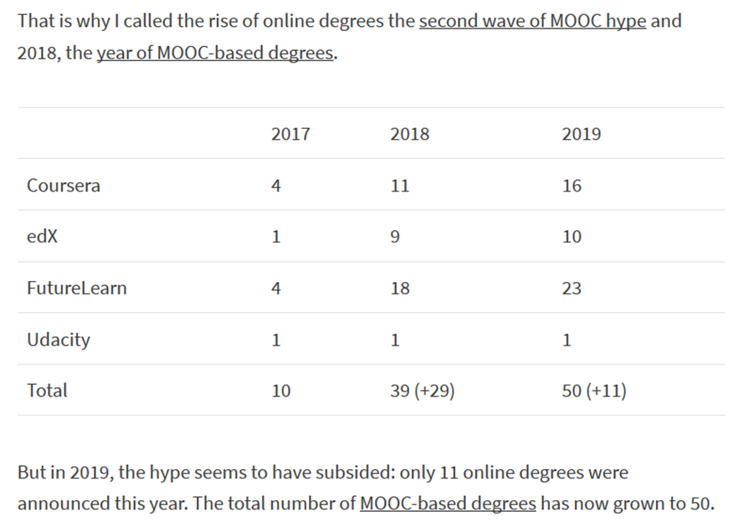
MOOCs Stats
December 17, 2019
A Review of MOOC Stats and Trends in 2019
Dhawal Shah, Class Central
https://www.classcentral.com/report/moocs-stats-and-trends-2019/

Slide 18
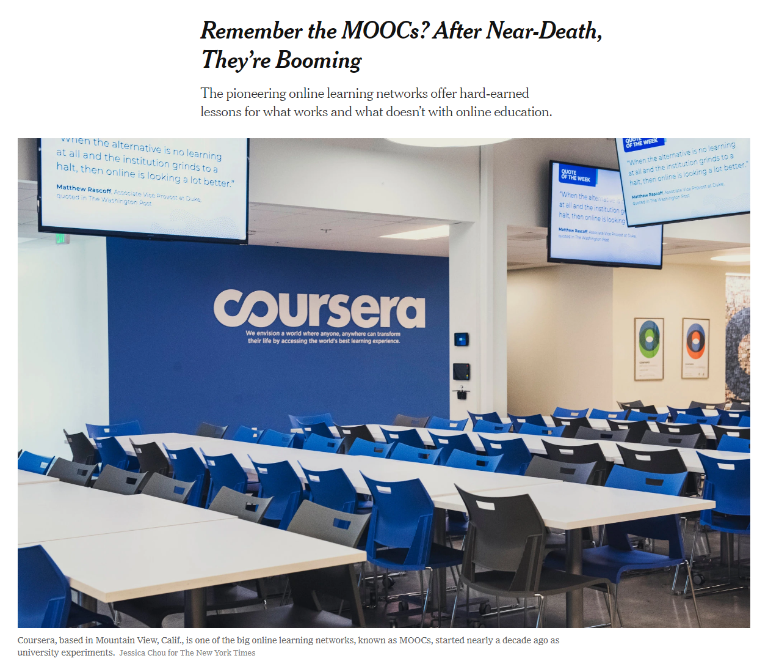
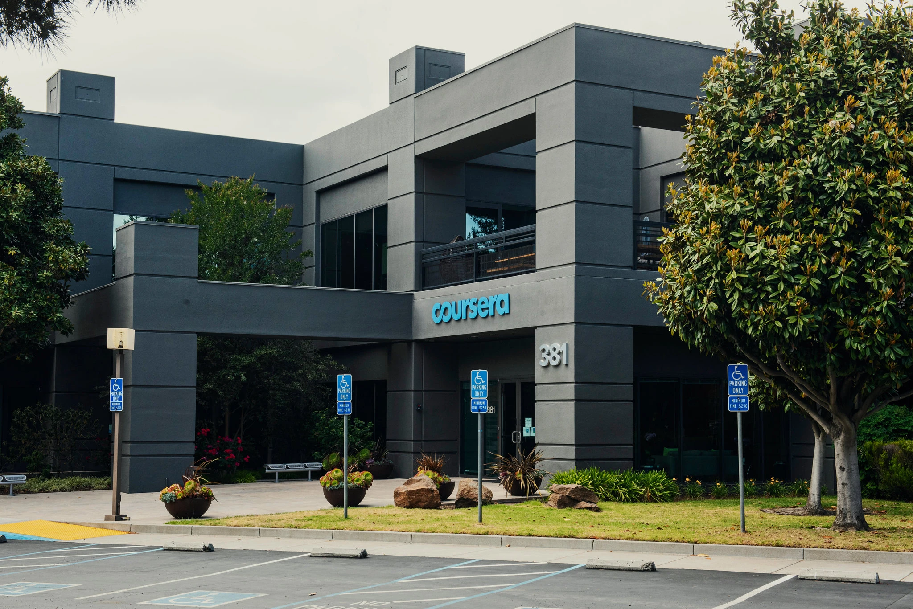
May 26, 2020 Remember the MOOCs? After Near-Death, They’re Booming Steven Lohr, The New York Times https://www.nytimes.com/2020/05/26/technology/moocs-online-learning.html
Coursera added 10 million new users from mid-March to mid-May. Credit...Jessica Chou for The New York Times

Slide 19
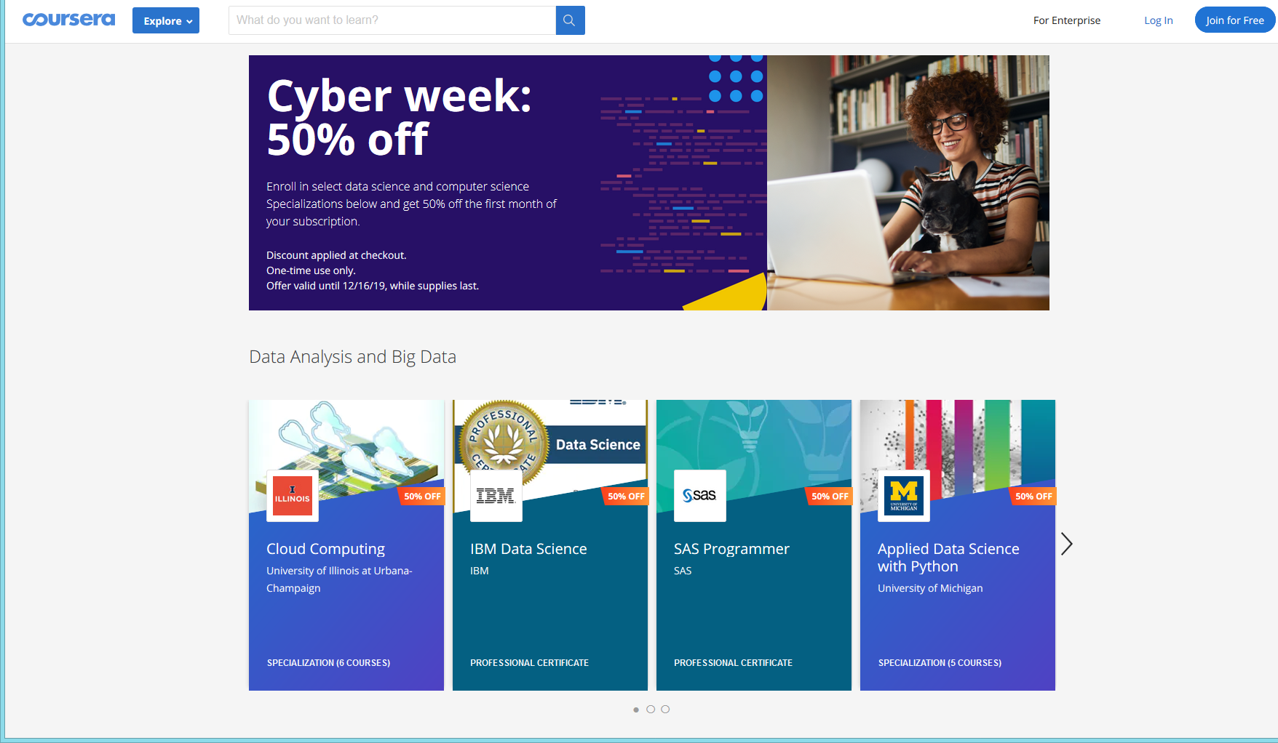
December 15, 2019 Coursera <no-reply@m.mail.coursera.org> Ends TOMORROW: 50% off top tech Specializations

Slide 20
Study #1 MOOCs Design Considerations and Challenges
Zhu, M., Bonk, C. J., & Sari, A. (2018). Instructor experiences designing MOOCs in higher education: Pedagogical, resource, and logistical considerations and challenges. Online Learning, 22(4), 203-241.

Slide 21
Research Background
MOOCs can be beneficial to both learners and instructors (Hew & Cheung, 2014).
Instructional design is critical for online learning (Johnson & Aragon, 2003; Phipps & Merisotis, 1999).
Instructors are one of the five main components of MOOCs (Kop, 2011).
Few studies have examined instructional design from MOOC instructors’ perspectives (Margaryan et al., 2015; Watson et al., 2016).

Slide 22
Research Purpose
The purpose of this study is to provide suggestions for future MOOC instructors and instructional designers in higher education through exploring MOOC design considerations and challenges from the instructor’s perspective.

Slide 23
Research Questions
What are the design considerations of instructors when designing MOOCs?
What challenges do instructors perceive when designing MOOCs?
How do instructors address the challenges that they perceive related to MOOCs?

Slide 24
Research Design
Sequential mixed methods design (Creswell & Clark, 2017)
Quan
Data Collection
Quan
Data Analysis
Qual
Data Collection
Interpretation of Entire Analysis
Qual
Data Analysis

Slide 25
Data Collection
Data Collection:
Survey, interview, and course review
Participants:
143 survey participants (10% response rate)
12 interviewees

Slide 26
12 Interviewees
No. | Countries | Subject areas | Platforms
1. | The U.S. | Language and Literacy | Coursera
2. | The U.S. | Education | Coursera
3. | The U.S. | Education | Canvas
4. | The U.S. | Chemistry | Coursera
5. | UK | Medicine and Health | FutureLearn
6. | UK | Language and Literacy | FutureLearn
7. | Hong Kong (China) | Math | Coursera
8. | Mainland China | Math | Coursera
9. | Canada | Psychology | Coursera
10. | Australia | Medicine and Health | Open2Study
11. | Sweden | Computer Science | edX
12. | India | Management | edX

Slide 27
Data Analysis
RQs | Data Sources | Data analysis
RQ1 | Survey-multiple-choice questions Survey-open-ended questions Interview MOOC review | Descriptive statistics Content analysis (Elo & Kyngäs, 2008) Content analysis Content analysis
RQ2 | Survey-multiple-choice questions Survey-open-ended questions Interview | Descriptive statistics Content analysis Content analysis
RQ3 | Survey-multiple-choice questions Interview | Descriptive statistics Content analysis

Slide 28
Research Context

Slide 29
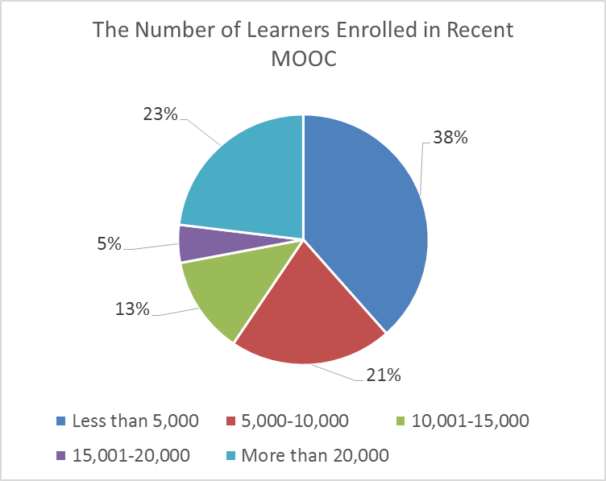
Research Context

Slide 30
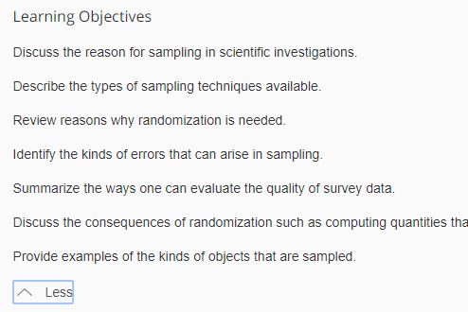
Findings RQ1
RQ #1. What are the design considerations of instructors when designing MOOCs?
Learning objectives
Assessment
Time for designing MOOC
Engaging learners
An example of learning objectives:

Slide 31
RQ1 Survey Results

Slide 32
RQ1 Interview Results
Engage learners
One instructor from US mentioned:
“I engaged people in the forum. So each week I would write a message that would be the new welcome page for the week that would say, ‘hey come to the forum and ask questions about this or come to the forum introduce yourself’... Of course, I tried to get students to feel like I was engaged with them during the videos by asking them questions and telling them to do things during the video.”

Slide 33
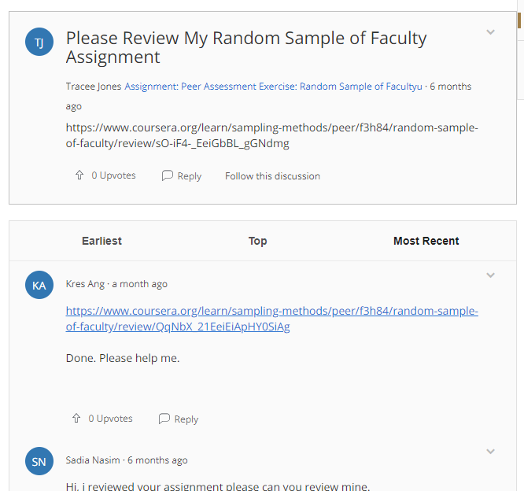
Findings RQ2
RQ #2. What challenges do instructors perceive when designing MOOCs?
Assessment methods
Engaging students’ learning
Time limitation
(Note: Above is an example of peer-assessment.)

Slide 34
RQ2 Survey Results

Slide 35
RQ2 Interview Results
Time limitation
One instructor from education subject mentioned:
“I think one of the challenges is time. It does take a lot of time to get the videos done. I did not get a course release when I was doing, and it was a side project at the same time as my regular load.”

Slide 36
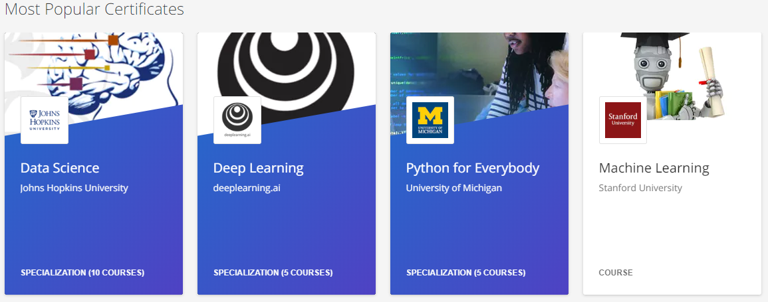
Findings RQ3
RQ #3. How do instructors address the challenges that they perceive related to MOOCs?
Explore other MOOC examples
Seek help from the platform/colleagues/institutions

Slide 37
RQ3 Survey Results

Slide 38
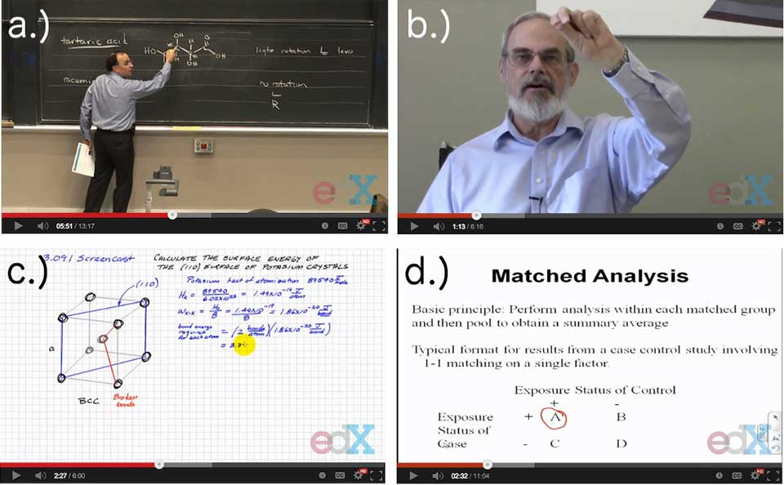
RQ3 Interview Results
Explore other MOOC examples
One MOOC instructor from the US mentioned:
“When I started making the MOOC, I could see MOOCs that other people had made. So I could see what other people did in terms of having videos with questions embedded in the videos, which I really liked.”

Slide 39
Discussion
The time limitation of creating MOOCs was the primary logistical consideration (Hew & Chung, 2014; Watson et al., 2016) and challenges.
The pedagogical factors were the primary design considerations (Watson et al., 2016) and challenges in MOOC design.
The assessment and engagement strategies are the main considerations as well as challenges.

Slide 40
Study #2 MOOCs Instructional Design to Facilitate Participants’ Self-directed Learning

Slide 41
Key Terms
Self-directed learning (SDL) (Garrison, 1997)
(1) self-management
(2) self-monitoring
(3) motivation
Notes:
Garrison’s model: 3 inter-related part.

Slide 42
Research Background
Learners need self-directed learning skills and strategies to be successful in MOOCs (Halawa, Greene, & Mitchell, 2014; Littlejohn & Milligan, 2016), as there is a lack of personalized interaction with teachers.
Self-directness of a learner might vary in different learning environments which means that the learners could be more self-directed in one learning environment than another (Hiemstra, 1994).

Slide 43
Research Background
Instructional design can greatly influence students’ interaction and engagement (Garrison & Cleveland-Innes, 2005) and success in online learning (Song, Singleton, Hill, & Koh, 2004; Swan, 2001).
However, few studies have examined instructional design and the delivery of instruction using MOOCs from instructor perspectives (Margaryan et al., 2015; Watson et al., 2016); especially lacking is research on instructors’ perception of SDL and how they design MOOCs to facilitate students’ SDL.

Slide 44
Research Purpose
The purpose is to inform instructors or instructional designers and MOOC providers of the current practices of designing MOOCs to facilitate learners’ SDL.

Slide 45
Research Questions
How do MOOC instructors perceive participant SDL skills?
How do MOOC instructors perceive their facilitation of participant SDL skills?
How do instructors design and deliver MOOCs to facilitate participant SDL skills?
a. How is technology being used by MOOC instructors to support the development of participant SDL skills?
b. What technology features or functions do MOOC instructors want to have to improve their facilitation of MOOC participant SDL skills?

Slide 46
Research Design
Explanatory sequential mixed methods design (Creswell & Clark, 2017)
Pilot survey with 48 instructors
Survey
198 instructors
Review 22 MOOCs of interviewees
Interview 22 instructors
Review 22 MOOCs of interviewees
Pilot interview with 4 instructors

Slide 47
Data Collections
Survey:
Volunteer sampling (Creswell & Clark, 2017)
198 instructors responded to the survey (10% response rate)
Interview:
Homogeneous purposeful sampling (Creswell & Clark, 2017; Patton, 2002)
Maximal variation sampling (Creswell & Clark, 2017)
22 interviewees
MOOC review:
Reviewed 22 interviewees’ MOOCs

Slide 48
Pseudonym | Country | Subject area | Platform | Gender | No. of O/B | No. of M | Mode of the M
Lucas | US | Social science | edX | M | 0 | 1 | I without T
Branden | US | Education | Udacity | M | 0 | 5 or more | Self-paced
Logan | US | Literacy and Language | Coursera | M | 5 or more | 5 or more | I with T
Emma | US | Literacy and Language | Coursera | F | 2 | 1 | Self-paced
Jason | US | Science | edX | M | 1 | 1 | I with T
Jackson | US | Medicine and health | Coursera | M | 5 or more | 1 | Self-paced
Samuel | US | Education | FutureLearn | M | 4 | 3 | Self-paced
Hannah | US | Education | Blackboard | F | 5 or more | 1 | I with T
Ashley | US | Education | EdX | F | 0 | 5 or more | I with T
Andrew | UK | Art | FutureLearn | M | 0 | 3 | I with T
Emily | UK | Medicine and health | FutureLearn | F | 2 | 2 | I with T
Aiden | UK | Social science | FutureLearn | M | 0 | 1 | Self-paced
Henry | UK | Social science | FutureLearn | M | 0 | 1 | Self-paced
Joseph | UK | Medicine and health | FutureLearn | M | 1 | 1 | Self-paced
Joshua | UK | Literacy and language | FutureLearn | M | 2 | 2 | I with T
Mason | Australia | Education | Coursera | M | 5 or more | 1 | I with T
Ethan | Australia | Business | Coursera | M | 3 | 1 | I without T
Ben | Australia | Social science | edX | M | 1 | 1 | I with T
Paul | France | Computer Science | Coursera | M | 1 | 1 | I with T
Fernando | Belgium | Research methods | Blackboard | M | 5 or more | 3 | I with T
Jacob | Netherland | Science | Coursera | M | 0 | 1 | I with T
Dylan | Israel | Science | Coursera | M | 5 or more | 3 | I without T
Data Collections
Interview:

Slide 49
Data Analysis
RQs | Data Sources | Data analysis | Tools
RQ1 | Survey Interview | Descriptive statistics Content analysis (Elo & Kyngäs, 2008) | SPSS NVivo
RQ2 | Survey Interview | Descriptive statistics Content analysis | SPSS NVivo
RQ3 | Interview Course review | Content analysis Content analysis | NVivo NVivo

Slide 50
Research Context

Slide 51
RQ1 Perceptions of SDL
A majority of the MOOC instructors thought that these skills or attributes are not static, and that SDL as a set of skills can be educated or students’ personal attributes that can be changed.

Slide 52
RQ1 Interview Results
Emma’s understanding of SDL is more related to self-management and motivation. She said:
“When I think about self-directed learning, I think about students managing their time and managing the coursework on their own, and how it fits into their schedules and their lives, how they interact with materials, what's going to keep them engaged.”

Slide 53
RQ2 Perceptions of Facilitation of SDL
Most of MOOC instructors thought that they can intentionally or unintentionally facilitate students’ SDL.

Slide 54
RQ2 Interview Results
Ashely emphasized the importance of both instructors’ facilitation and students’ SDL skills. She said:
“The participant has a lot of flexibility on how they approach the content. I mean, obviously, we have things like assignments. We have things like online forums. And there're ways that we scaffold the learning experience. But there still is a lot of choice for the learner.”

Slide 55
RQ3 Strategies to Facilitate SDL
Students’ intrinsic motivation plays an important role. However, extrinsic motivation provided by the MOOCs might help transfer extrinsic motivation to intrinsic motivation.
Motivations | Strategies
Entering motivation | MOOC instructors helped students identify the needs and goals of learning and sense of achievement.
Task motivation | MOOC instructors motivated students through instruction, learning materials, feedback, and learning community.

Slide 56
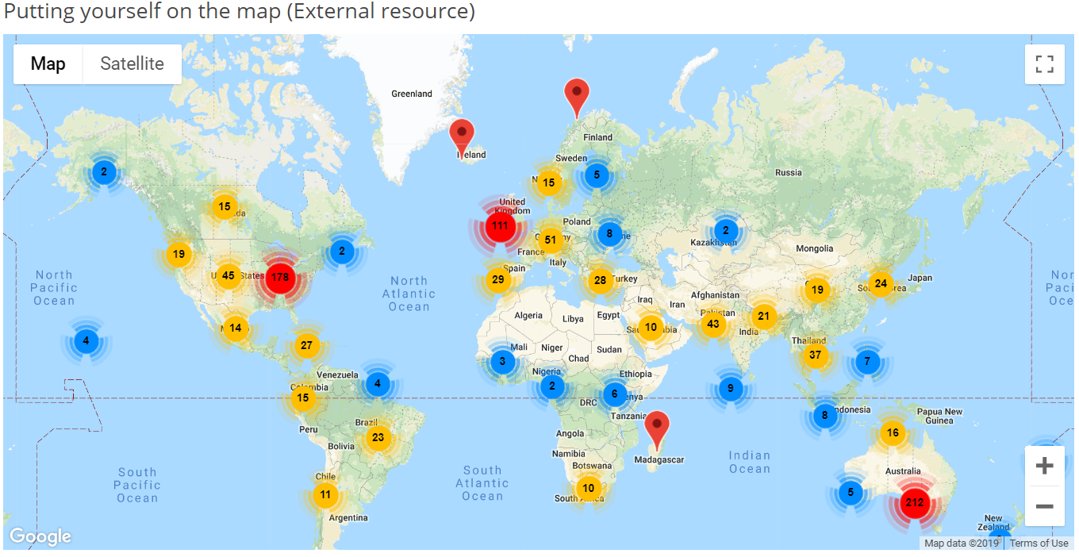
RQ3 Learning Community

Slide 57
RQ3 Strategies to Facilitate SDL
Both internal feedback and external feedback were provided to help students’ self-monitoring.
Self-monitor |  | Strategies
Internal feedback | Cognition | MOOC instructors provided quizzes for self-assessment, tutorial on technology use, learning advice, navigation of the course, progress indicators, resources, and instructional modeling, etc.
 | Meta-cog | MOOC instructors encouraged students to reflect and think critically by providing reflection questions and building learning community.
External feedback |  | MOOC instructors, teaching assistants, and peers were involved in providing external feedback.

Slide 58
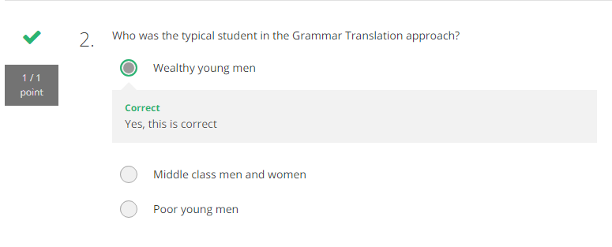
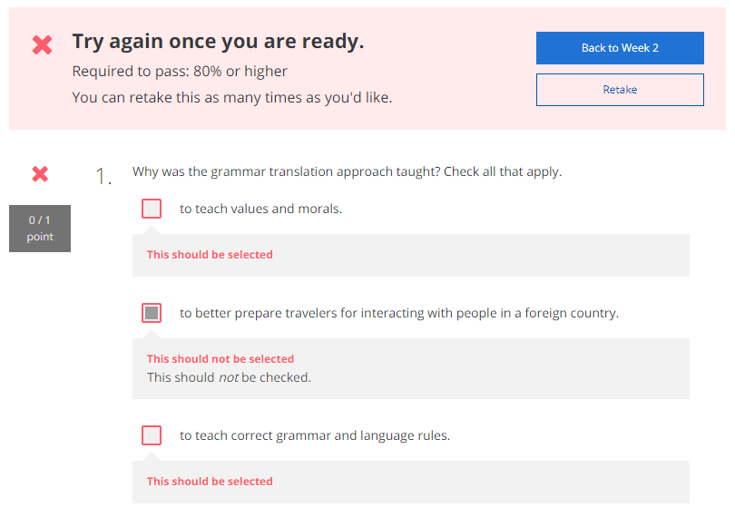
RQ3 Self-assessment (i.e., embedded quizzes)

Slide 59
RQ3 Progress Indicators

Slide 60
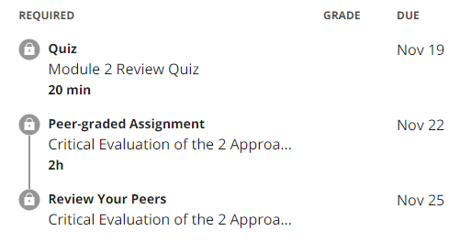
RQ3 External Feedback: Peer-assessment
(e.g., 3 peers assigned to review each assignment)

Slide 61
RQ3 Strategies to Facilitate SDL
They helped students’ self-management concerning setting learning goals, time management, resources and support management although among the three elements of SDL, MOOC instructors had less control over students’ management.
Self-management | Strategies
Enactment of learning goals | Providing discussion questions, reflections, survey, and appreciation students’ learning goals.
Time management | Providing time frame, progress indicator, short learning units, and flexible timeline.
Management of resources and support | Providing flexible learning resources, peer-assessment, accessibilities, clear expectations, and short learning units.

Slide 62
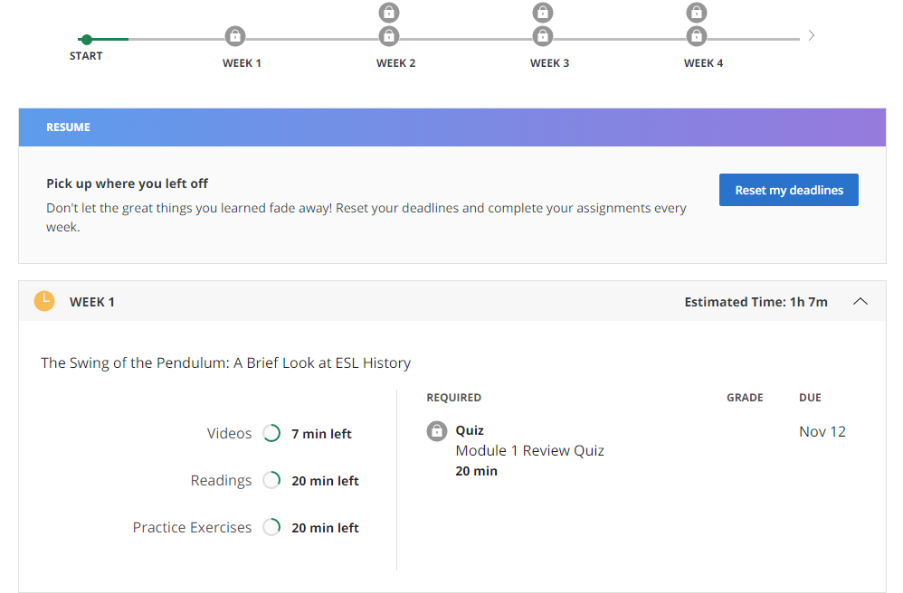
RQ3 Time Management
(e.g., time advisories and estimates)

Slide 63
RQ3-a. Tech Used for SDL
Synchronous communication technologies
Google Hangouts YouTube Live
Asynchronous communication technologies
Discussion forum Blog Slackbot Flickr
Multimedia (e.g., video and graphics)
Feedback technologies

Slide 64
Discussion
SDL can be Changed
MOOC Instructors can Facilitate SDL
Strategies to Facilitate SDL: A variety of strategies can be used to facilitate student SDL skills in terms of motivation, self-monitor, and self-management.
Tech for SDL: Tech plays a vital role in facilitating SDL skills.
Tech expectations: Adaptive learning systems, artificial intelligent systems, and learning analytics were expected to have to support SDL.

Slide 65
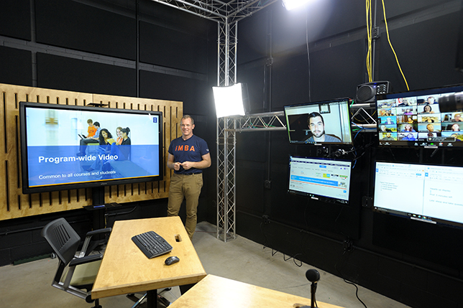
Implications
For MOOC instructors and Instructional Designers
Build learning community
Inspire intrinsic motivation
Personalize learning
For MOOC providers
Create a personalized learning environment
Provide learning analytics to support learning and teaching

Slide 66
Top 10 Strategies to Facilitate SDL in MOOCs
Helping students set their own learning goals.
Building learning community.
Offering immediate feedback.
Embedding quizzes for self-assessment.
Providing progress indicators.
Providing reflection questions.
Designing short learning units.
Providing flexible timelines.
Highlighting estimated time frames.
Making available optional learning materials.

Slide 67
Top 10 Strategies to Facilitate SDL in MOOCs
Helping students set their own learning goals.
Example:
“I have asked, at the first page of course, why they're taking the course. So that is the goal. A lot of people say, ‘I'm a teacher. And I want to do the stuff with my kids. Or I want to update my knowledge. Or I'm retired and I want to learn this.’”

Slide 68
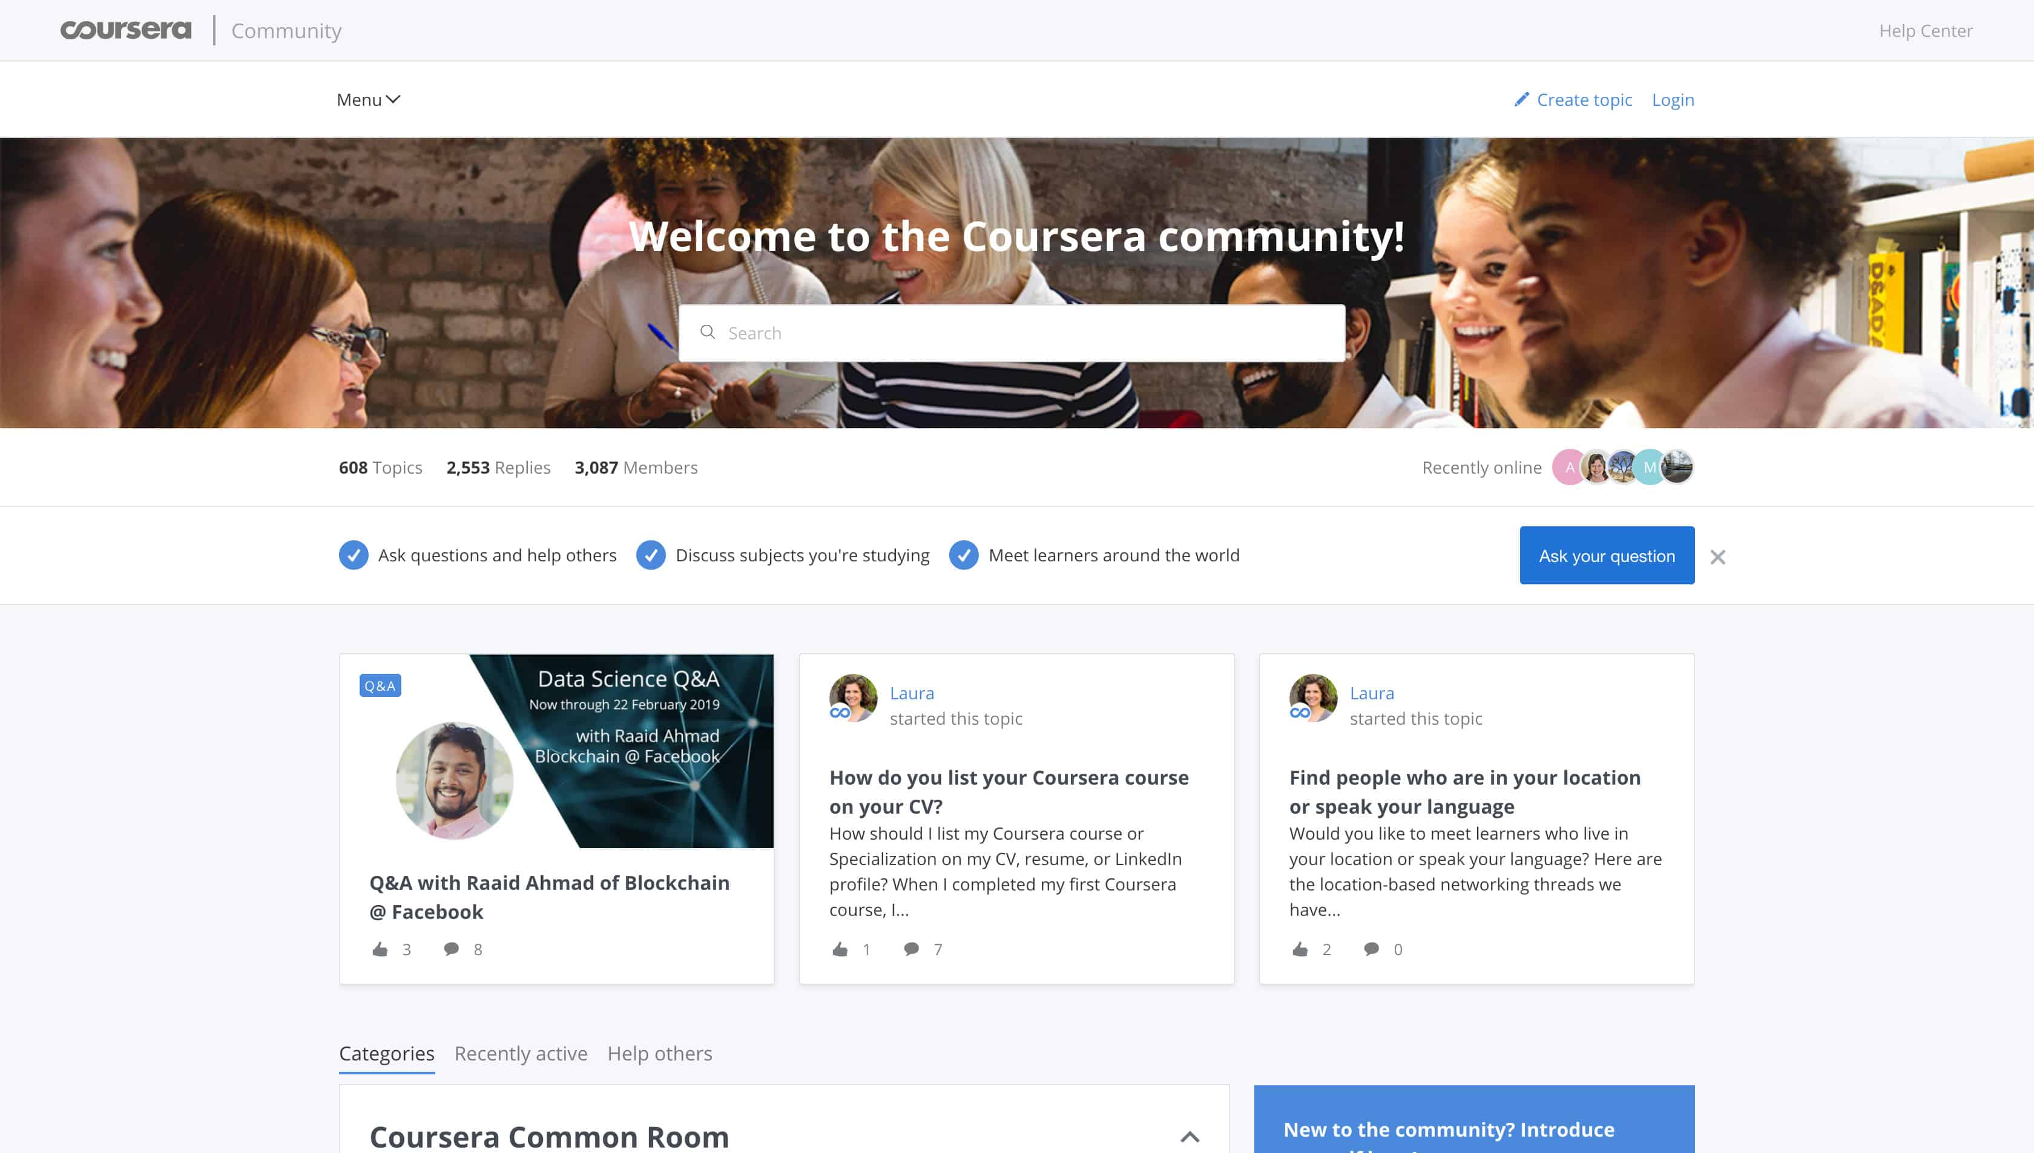
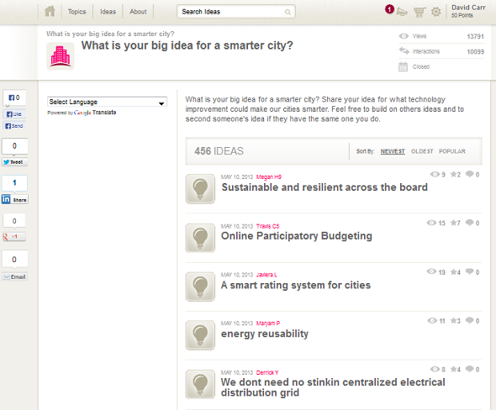
Top 10 Strategies to Facilitate SDL in MOOCs
2. Building learning community.
Joshua from the UK mentioned: We use a lot of resources that already exist. And then we use the MOOC discussion board as a place to where they, kind of, point out and say, “I've seen this. And this is useful. Well, I use this, and this is good. I created this.”

Slide 69
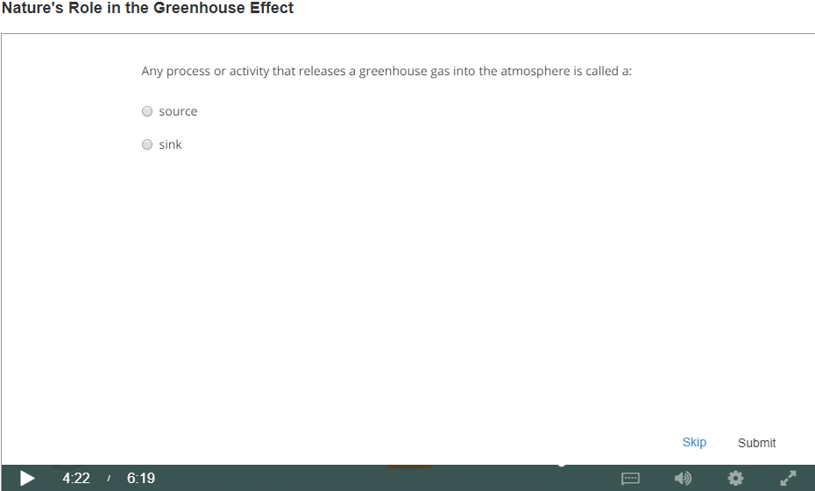
Top 10 Strategies to Facilitate SDL in MOOCs
3. Offering immediate feedback.
4. Embedding quizzes for self-assessment.

Slide 70
Top 10 Strategies to Facilitate SDL in MOOCs
5. Providing progress indicators

Slide 71
Top 10 Strategies to Facilitate SDL in MOOCs
6. Providing reflection questions.
We introduced kind of moments that video was stopped and there was a question. The student had to think of it a bit. Sometimes it was kind of a rhetorical question. There wasn't even no answer required. But it was just a pause for a while to let the student reflect. (Jacob)

Slide 72
Top 10 Strategies to Facilitate SDL in MOOCs
7. Designing short learning units.

Slide 73
Top 10 Strategies to Facilitate SDL in MOOCs
8. Providing flexible timelines.

Slide 74
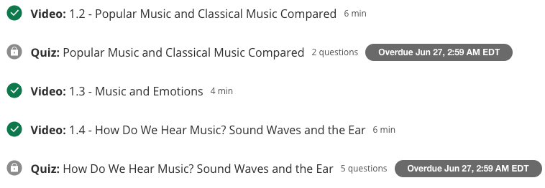
Top 10 Strategies to Facilitate SDL in MOOCs
9. Highlighting estimated time frames.

Slide 75
Top 10 Strategies to Facilitate SDL in MOOCs
10. Making available optional learning materials.

Slide 76
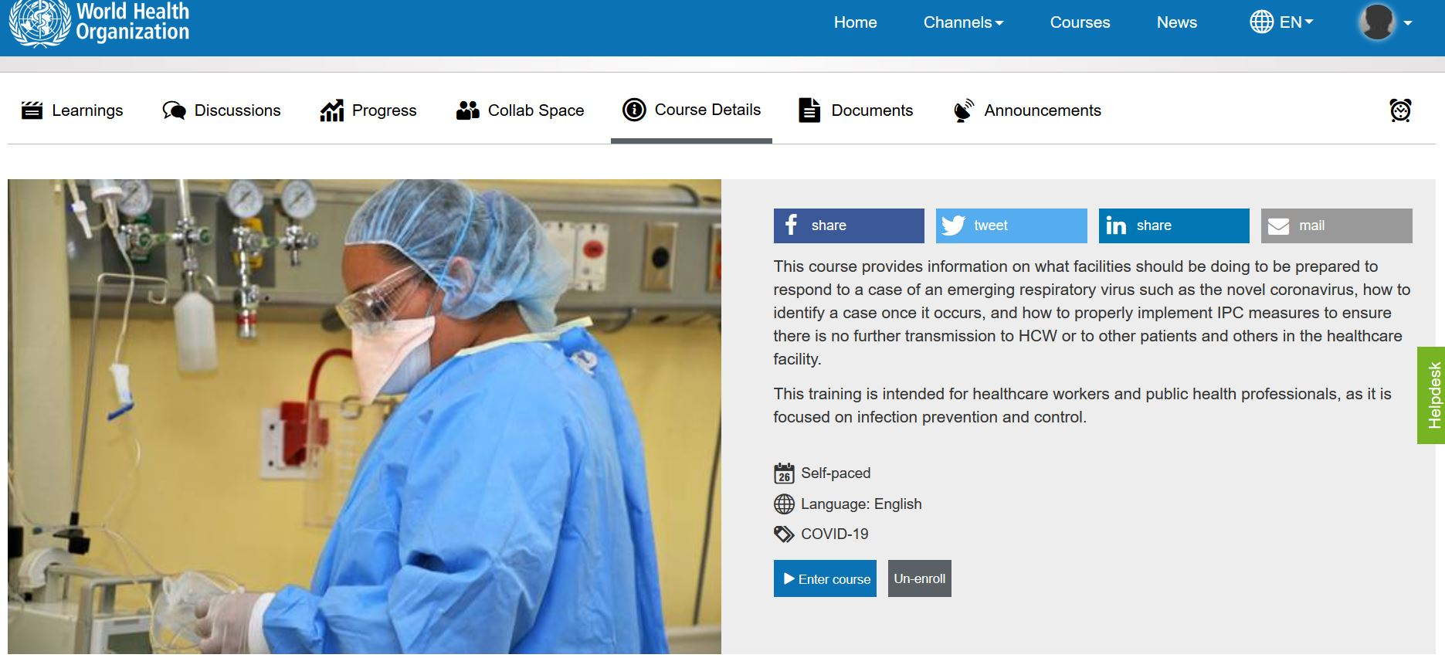
10 More Strategies to Facilitate SDL in MOOCs
MOOC: Infection Prevention and Control (IPC) for Novel Corona virus (COVID-19) from OpenWHO (English Version)
11. Structured learning environment:
Clearly stated the learning objectives.
Course details stated the expected time to complete the course.
The syllabus, number of course modules, and title of each module.

Slide 77
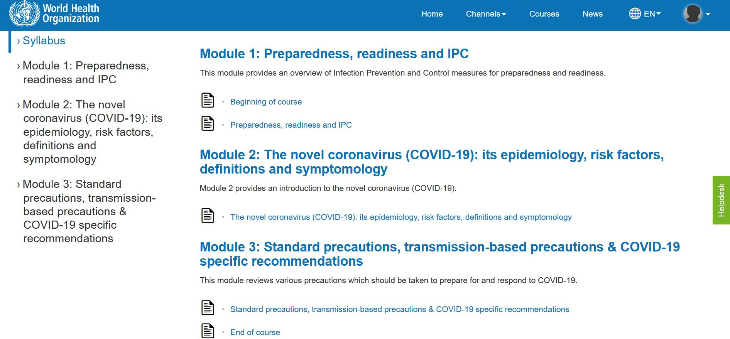
10 More Strategies to Facilitate SDL in MOOCs
11. Structure continued…
Graphic or visual organizations for essential material.
The text on screen matched the narration enforcing the redundancy principle.

Slide 78
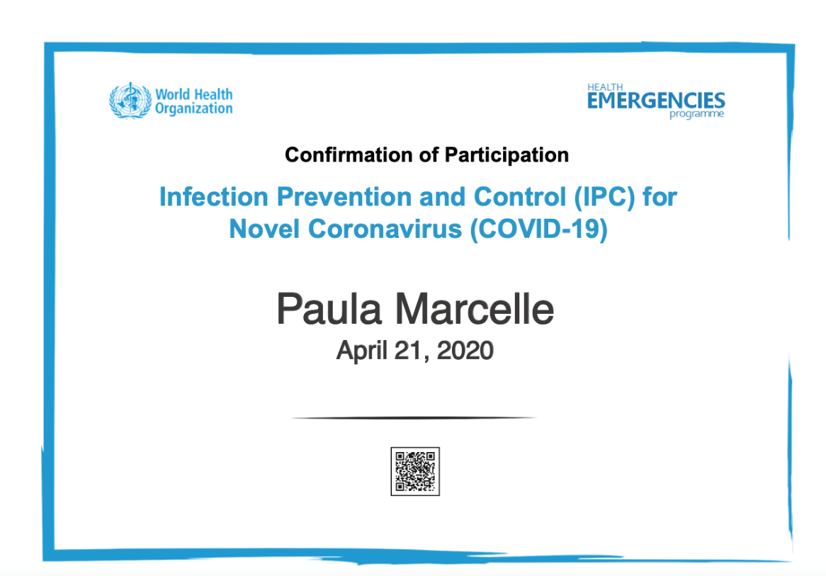
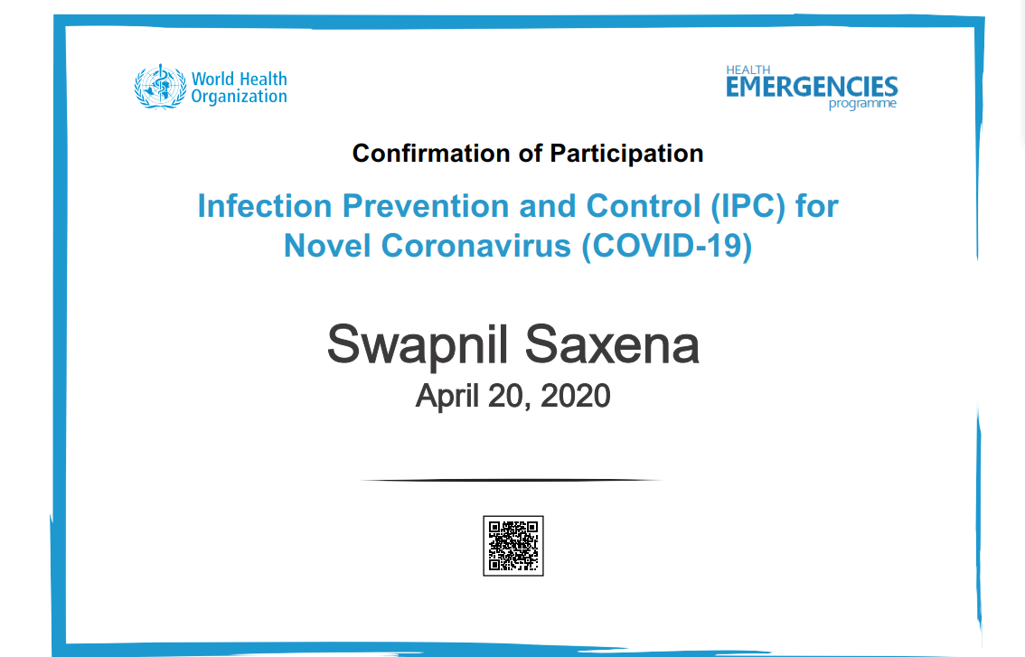
10 More Strategies to Facilitate SDL in MOOCs
12. On completion of modules participants get a certificate.
Providing External Rewards and Goals

Slide 79
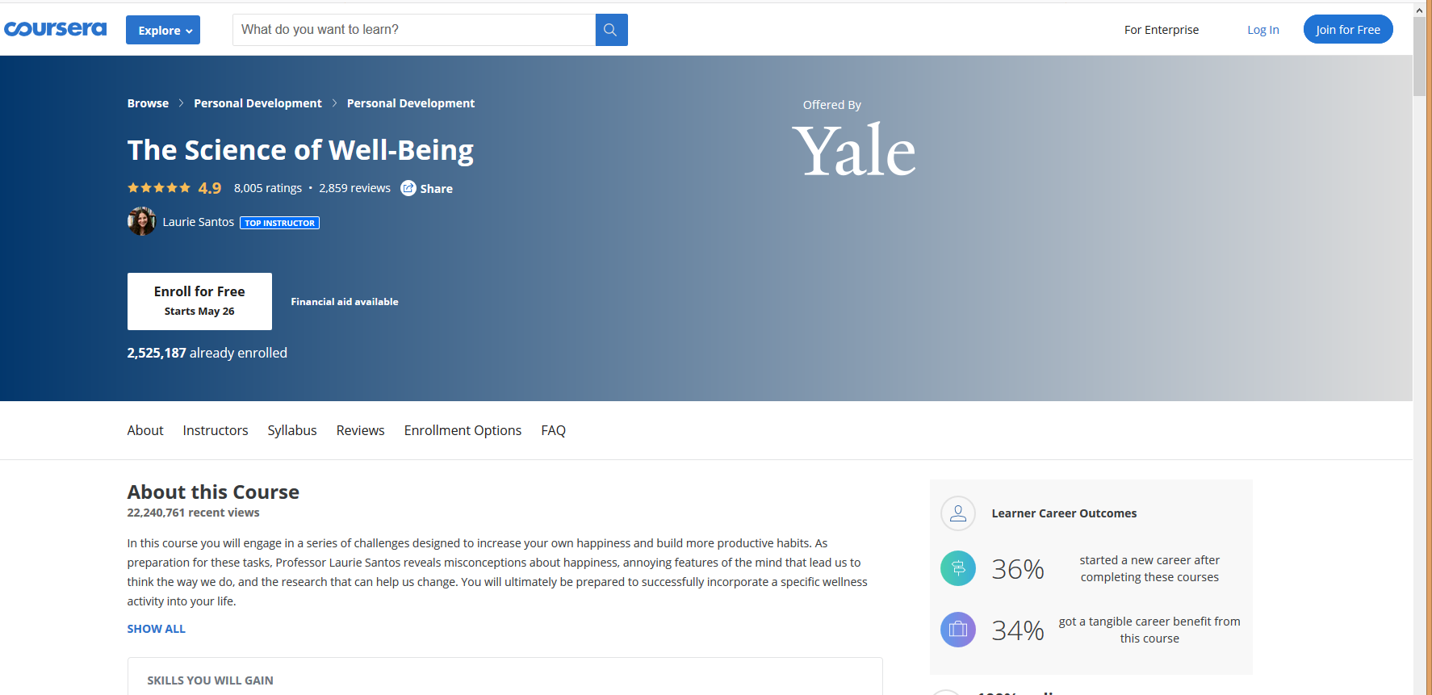
The Science of Well-Being, Yale

Slide 80
10 More Strategies to Facilitate SDL in MOOCs
13. Week overview. The course is divided into week-long segments, and each week is chunked into manageable parts. Very importantly for the participant to be able to anticipate what can get done in one sitting, the length of each video is included.

Slide 81
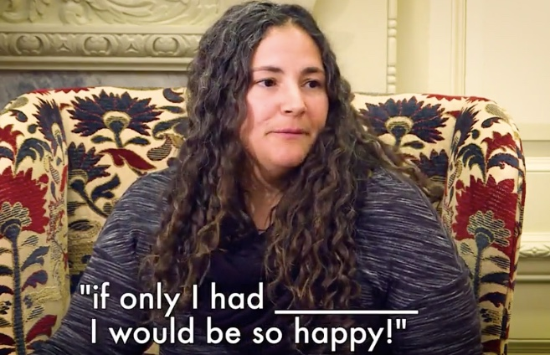
10 More Strategies to Facilitate SDL in MOOCs
14. Lecture recorded and captions added.
Caption added to video
Video of student audience

Slide 82
10 More Strategies to Facilitate SDL in MOOCs
14. Continued…Lecture video transcripts.

Slide 83
10 More Strategies to Facilitate SDL in MOOCs
15. Quick check tasks.

Slide 84
10 More Strategies to Facilitate SDL in MOOCs
16. Providing students with self-selection options.
There is the choice to watch all of the videos, read all of the materials, and submit all of the assignments, or there are choices all along the way to “cut corners” and take in only what the participant wants to.

Slide 85
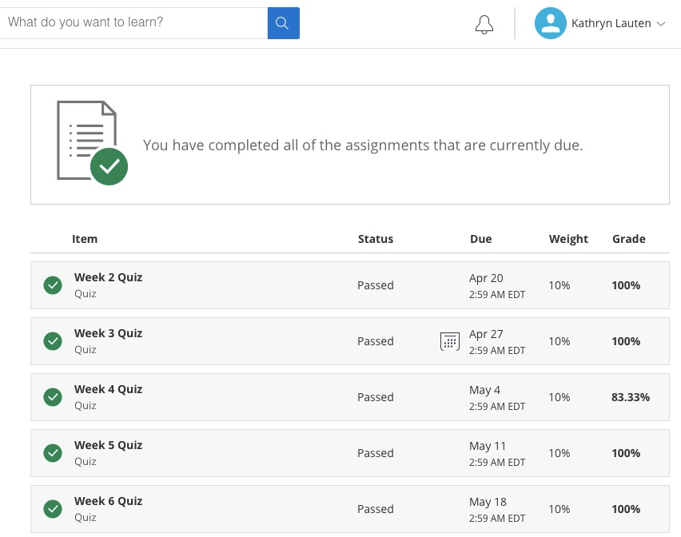
10 More Strategies to Facilitate SDL in MOOCs
17. Visuals showing tasks completed.

Slide 86
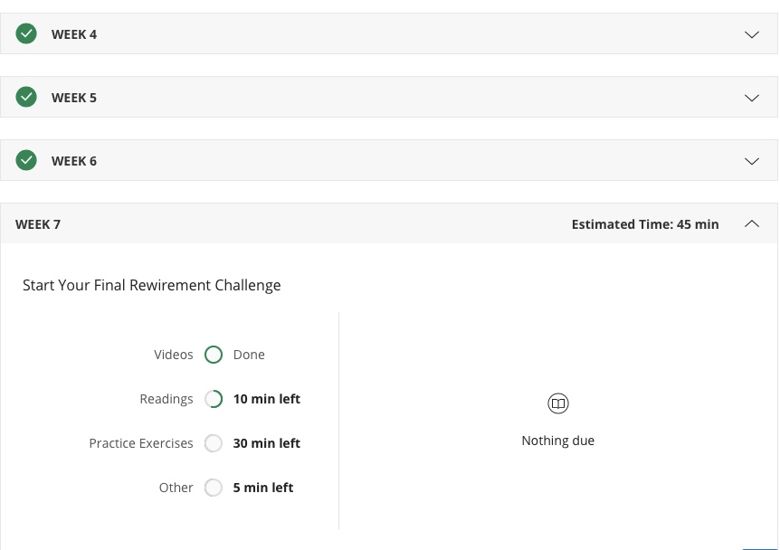
10 More Strategies to Facilitate SDL in MOOCs
18. Visuals showing work progress.

Slide 87
10 More Strategies to Facilitate SDL in MOOCs
19. Rewirements (assignments) for putting the material to practice (e.g, Random Acts of Kindness, Make A Social Connection, Let’s Get Physical, Meditate!, Sleep!, Gratitude Letter/Visit, Savoring, etc.)
Daily Gratitude Journal
Gratitude is a positive emotional state in which one recognizes and appreciates what one has received in life. Research shows that taking time to experience gratitude can make you happier and even healthier. For the next seven days, you will take 5-10 minutes each night to write down five things for which you are grateful. They can be little things or big things. But you really have to focus on them and actually write them down (Again, try to develop a tracking method works for you and utilize a note on your phone, a daily calendar, a special notebook, etc). You can just write a word or short phrase, but as you write these things down, take a moment to be mindful of the things you’re writing about (e.g., imagine the person or thing you’re writing about, etc.). This exercise should take at least five minutes. Do this each night for the whole week.

Slide 88
10 More Strategies to Facilitate SDL in MOOCs
20. Offer community support and help.

Slide 89
10 More Strategies to Facilitate SDL in MOOCs
Bonus Item: Peer-graded assignments.

Slide 90
Do we have time for another study?

Slide 91
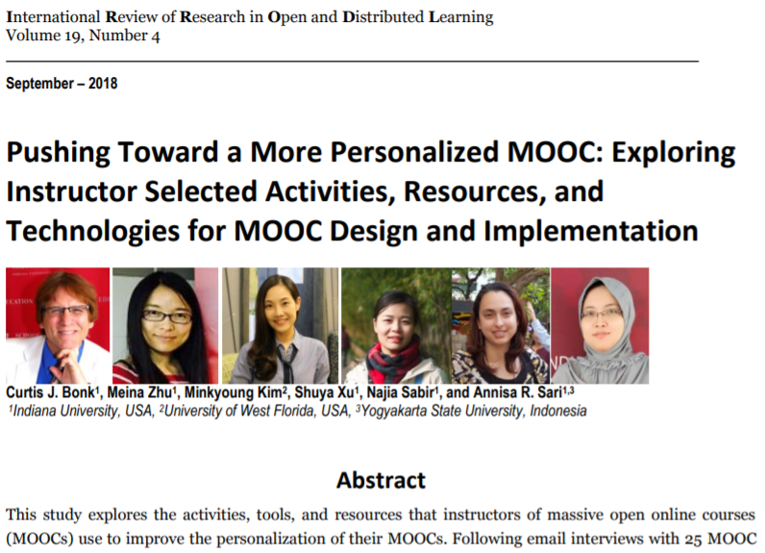
MOOC Study #3

Slide 92
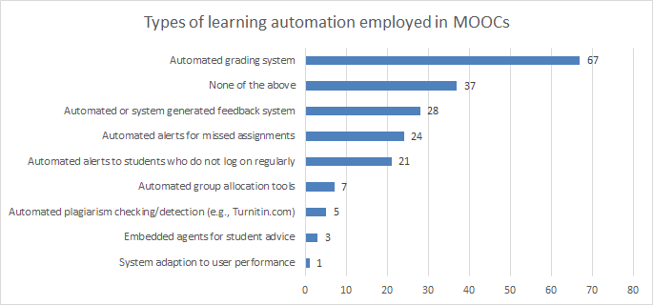
Figure 1. Number of MOOCs that offer different types of learning system automation and adaptation (n=127)

Slide 93
Figure 2: MOOC instructors (n=133) instructional practices to address cultural diversity

Slide 94
Table 1. Instructional Practices of MOOC Instructors to Address the Variety of Student Competencies and Needs (n=142)

Slide 95
What’s the Future?

Slide 96
Thank you! Any Questions?
Curtis Bonk: cjbonk@Indiana.edu
Meina Zhu: meinazhu@wayne.edu
Slides and Proceedings Paper at TrainingShare.com: http://www.trainingshare.com (go to “Archived Talks”)

