Slide 1
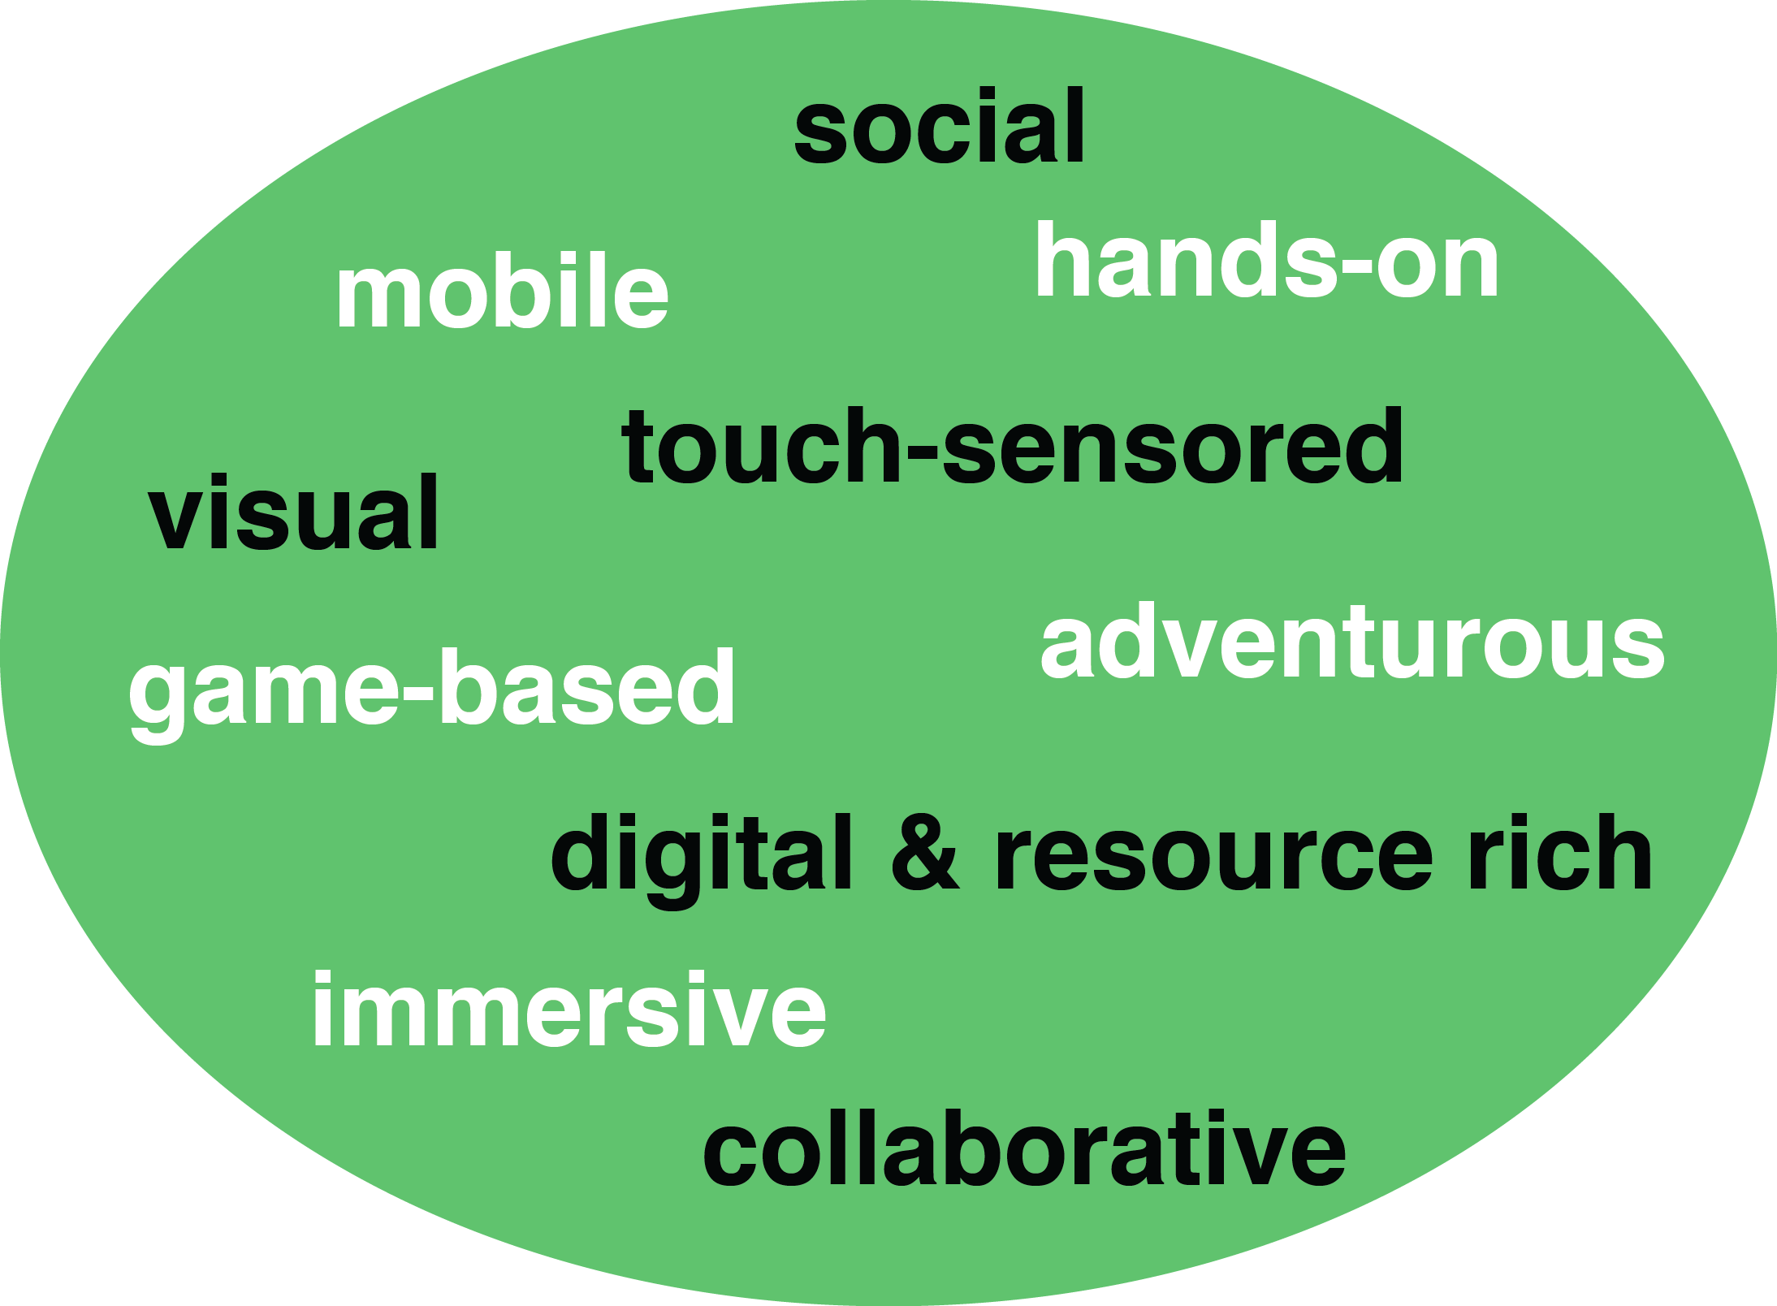
How Learning is Changing: Mega Trend #1. Learner Engagement

Slide 2
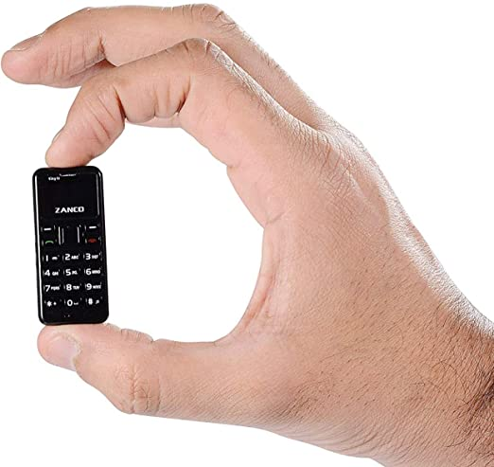
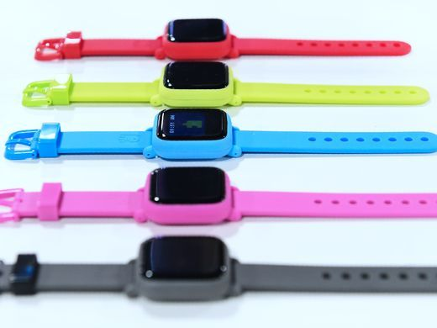
March 2021 Learning is More Mobile Best small phone 2021: The top tiny, compact smartphone choices James Rogerson, TechRadar https://www.techradar.com/best/best-small-phone
The Octopus watch from Joy, an icon-based watch for kids to have good habits is on display during CES.

Slide 3
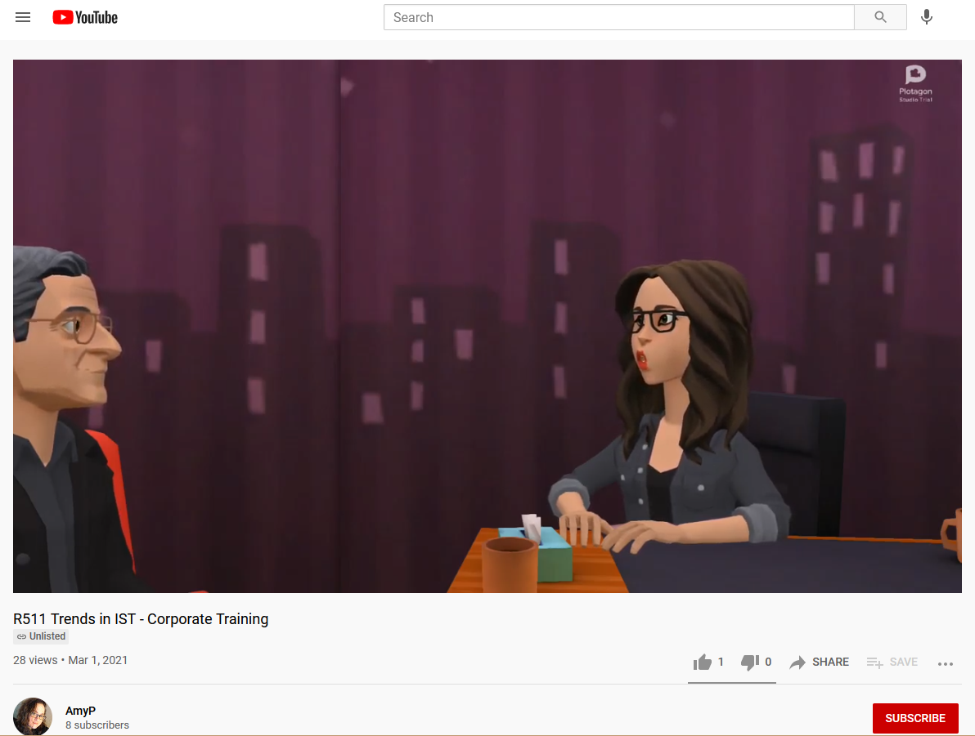
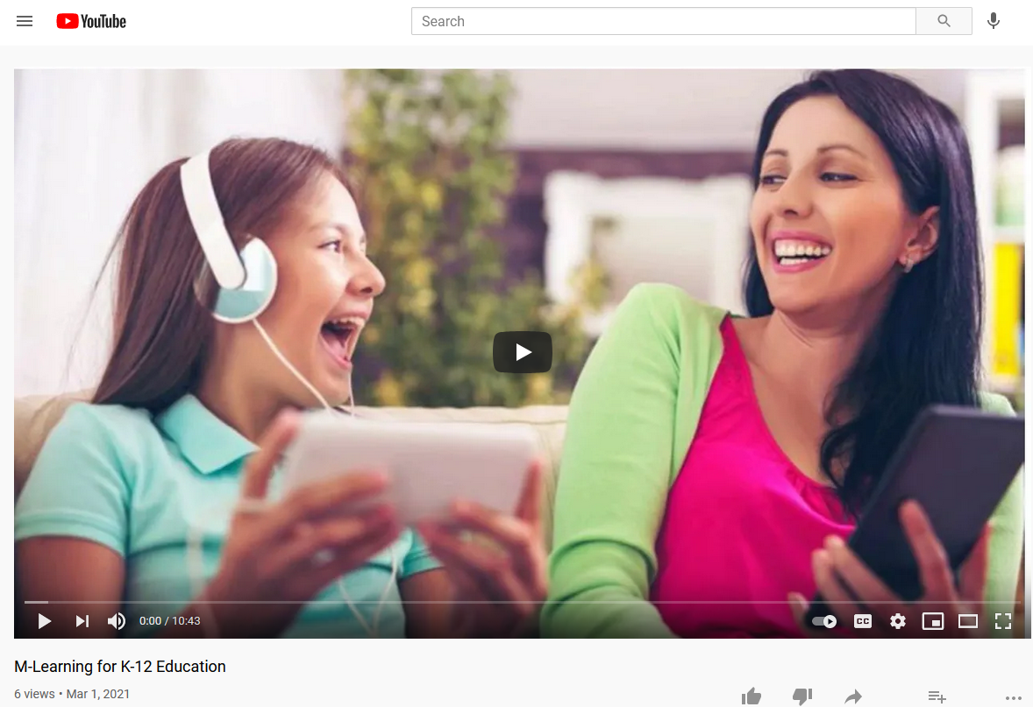
March 1, 2021 Learning is Hands-on Student Designed Videos M-Learning for K-12 Education Terri and Terri https://www.youtube.com/watch?app=desktop&v=4gv_mc7D6vo Amy Papst: https://www.youtube.com/watch?v=jJcaqGoSspE&feature=youtu.be Qi Li, Gangnam: http://www.youtube.com/watch?v=7Q429lqxZaU&feature=youtu.be Miguel Lara (Web 2.0 FREEDOM): http://www.youtube.com/watch?v=8cmCFWi9lW8 Kimberly Vincent-Layton: https://www.youtube.com/watch?v=4Ic39_rYLII&feature=youtu.be

Slide 4
July 2, 2021 Learning is Hands-on Teaching coding and design can lead to tech literacy Jean Sharp, eCampus News https://www.eschoolnews.com/2021/07/02/teaching-coding-and-design-can-lead-to-tech-literacy/?ps=999999999-0013000000j08pF-0033000000q5TNf&esmc=202252
Encouraging technology creators means engaging students in project-based technology courses that introduce them to coding, design, gaming, and animation. And as students complete projects such as developing an app, creating a 3D video game, or designing a collection, they gain relevant, hands-on experience using industry-standard tools professionals use. Students apply creativity, problem-solving, and critical thinking skills–competencies that are important in preparing students for the future and are applicable to any career, whether it’s in technology or not.

Slide 5
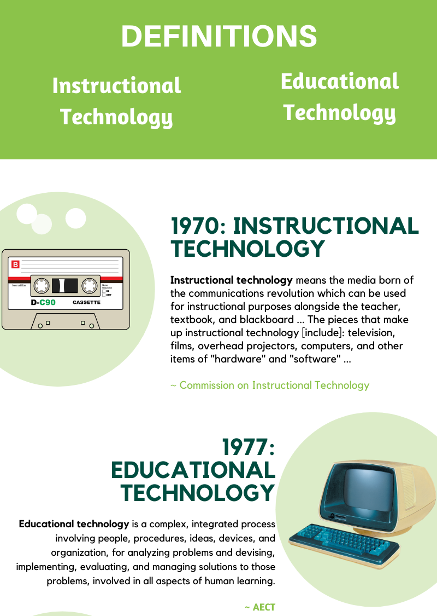
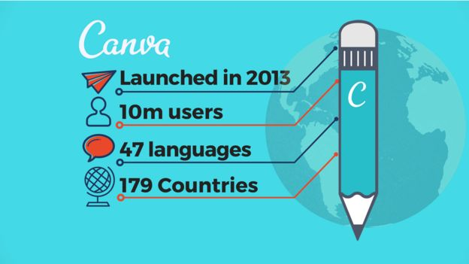
June 27, 2020 Learning is Hands-on Design Products (students created infographics, brochures, timelines) Canva is an online design program that does not require much design skills. You can design professional looking brochures, infographics, PPTs, flyers, and syllabus for free.

Slide 6
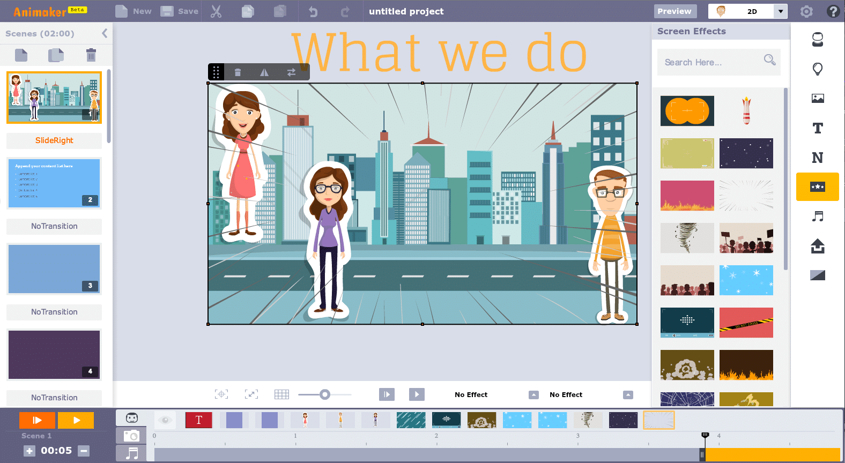
Learning is Hands-on Video, Podcast Show, Documentary, Website, Animation, Song, etc. https://app.animaker.com/animo/2h5b0Hz2gxURJ5x4/?shareid=view%7C2h5b0Hz2gxURJ5x4

Slide 7
May 11, 2020 Learning is More Game-based What is smileUP & How to use it? SMILE, Paul Kim at Stanford https://www.youtube.com/watch?v=pblU8sSALWo

Slide 8
October 15, 2021 Learning is More Digitally Rich How much for that textbook? Five ways students can save on course books, Craig Harris, USA Today https://www.usatoday.com/story/money/personalfinance/2021/10/15/school-textbooks-beat-high-cost-course-books/8424088002/

Slide 9
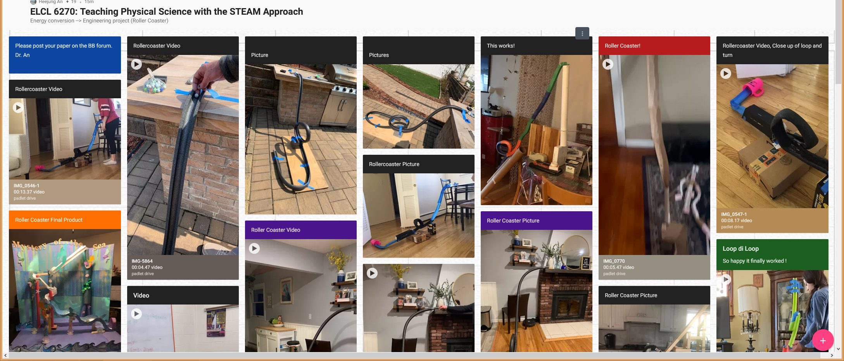
March 21, 2021 Learning is More Digitally Rich ELCL 6270: Teaching Physical Science with the STEAM Approach Heejung An: ANH2@wpunj.edu, William Paterson University https://padlet.com/anh21/4haa7swcscf1r77s

Slide 10
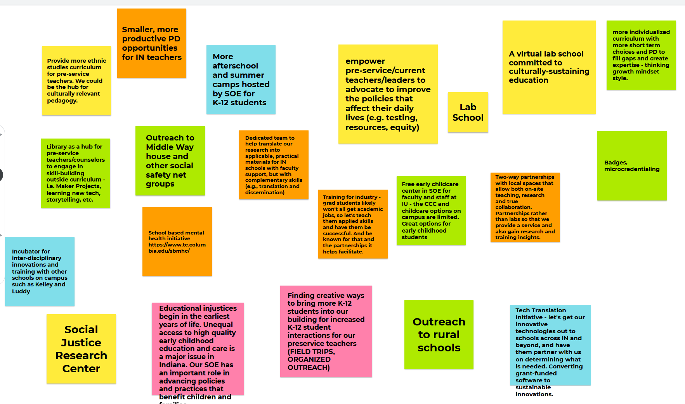
April 11, 2021 Learning is More Collaborative Brainstorming in Jamboard or Miro https://jamboard.google.com/

Slide 11
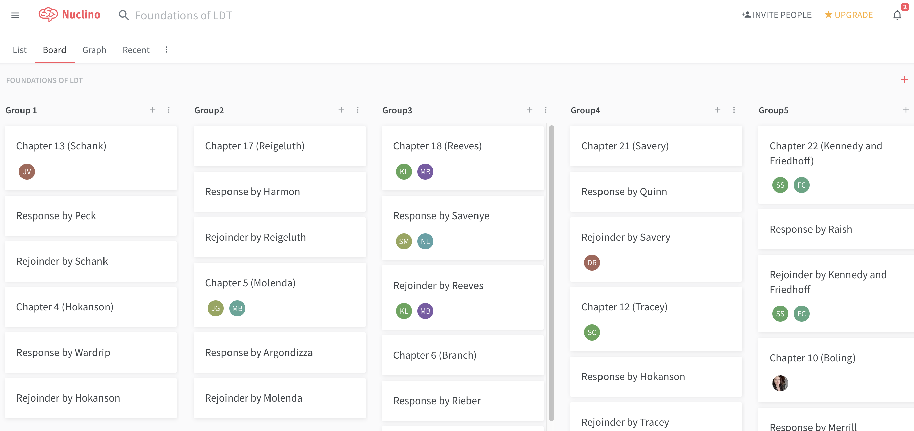
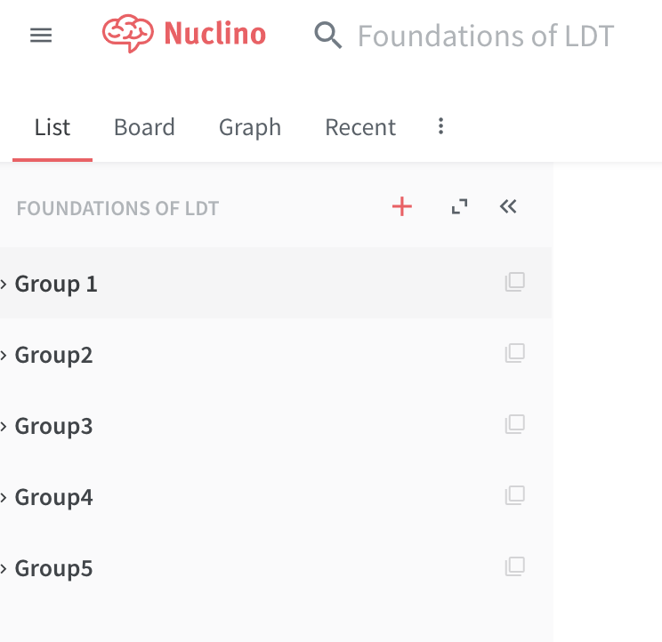
Fall 2019, R511 Learning is More Collaborative Team Article Debates Nuclino (like a wiki…may delete by mistake, trial version, limited) https://www.nuclino.com/

Slide 12
July 23, 2021 Learning is More Collaborative Kritik is a peer-grading platform Authentic peer-to-peer interaction for a New Era of Education. Carine Marette https://www.linkedin.com/in/carinemarette/ https://www.kritik.io/, Carine@kritik.io

Slide 13
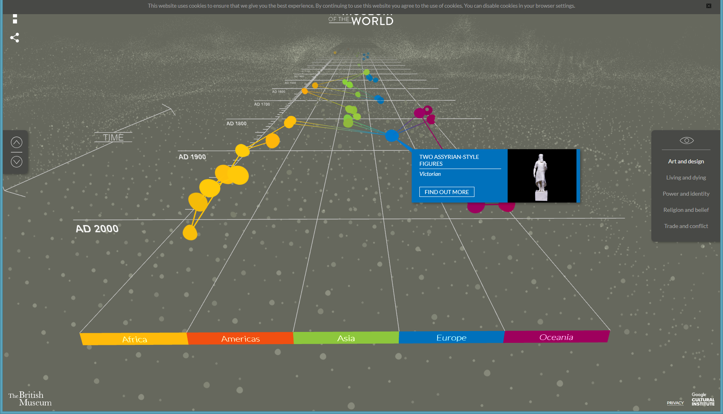
October 20, 2020 Learning is More Visual The British Museum https://britishmuseum.withgoogle.com/

Slide 14
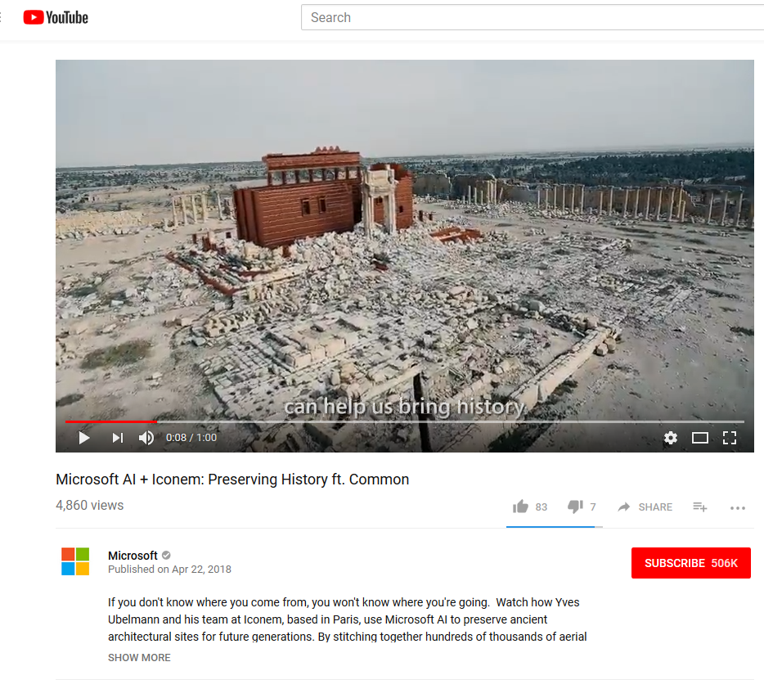
April 22, 2018 Learning is More Visual Microsoft AI Commercial ft. Common Video 1:00: Microsoft AI Commercial ft: https://www.youtube.com/watch?v=9tucY7Jhhs4 / (Feb 11, 2018) Video 1:48: Microsoft AI: Amplifying Human Ingenuity: https://www.youtube.com/watch?v=NDmu7Z5NPXo Video 1:00: Microsoft AI: Empowering Innovators ft. Common: https://www.youtube.com/watch?v=Z5OWdqfAYfw (April 22, 2018) Video: 1:00 Microsoft AI + Iconem: Preserving History ft. Common: https://www.youtube.com/watch?v=ZDZjaIhzMSM (April 22, 2018) Video: 0:44: Microsoft AI + The Yield: Taking the guesswork out of farming ft. Common: https://www.youtube.com/watch?v=7rzufxlGH4o (April 22, 2018)

Slide 15
April 15, 2021 Learning is More Visual Google Earth's New 3D Time-Lapse Feature Shows How Humans Are Affecting the Planet Sam Rutherford, Gizmodo https://gizmodo.com/google-earths-new-3d-time-lapse-feature-shows-how-human-1846685339

Slide 16
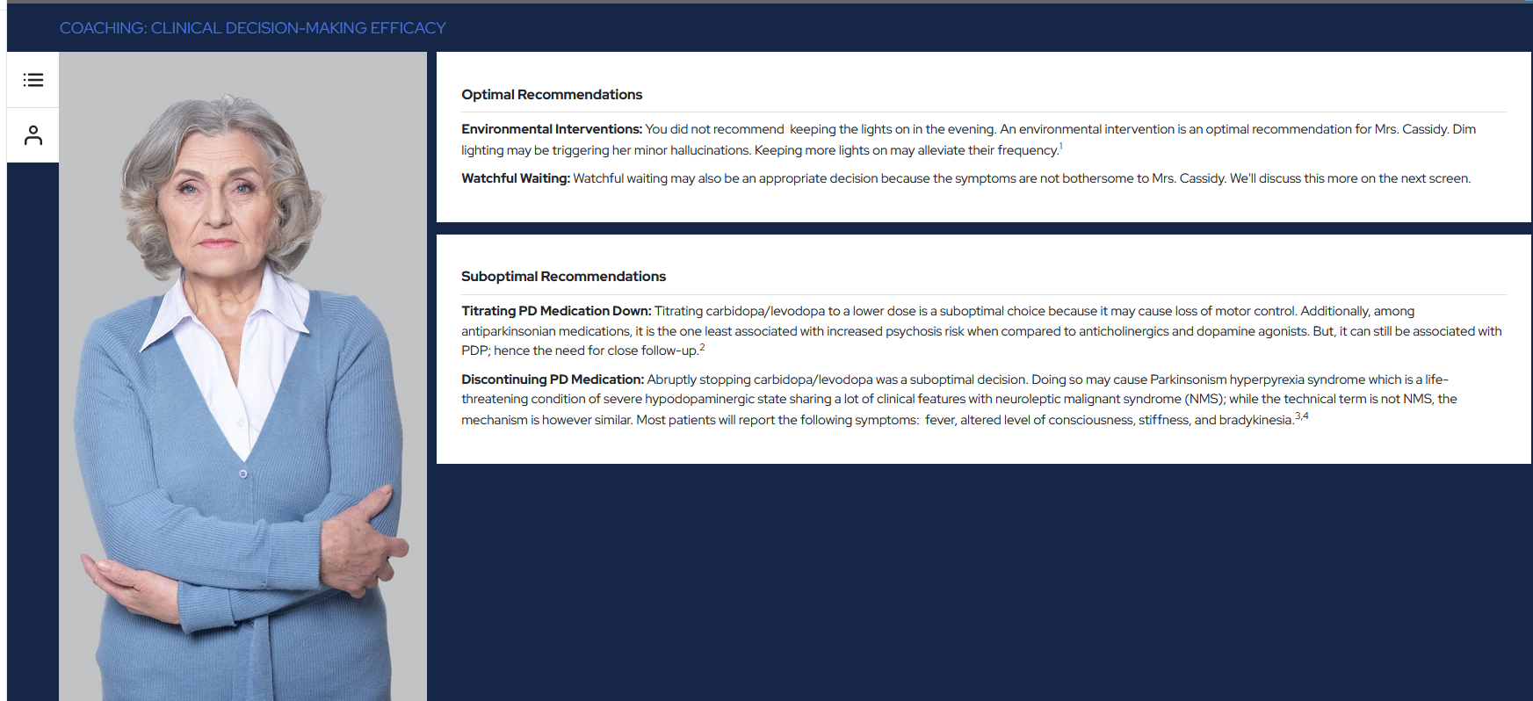
December 30, 2021 Learning is More Immersive Simulation from Kira King healthcare providers on Parkinson Disease Psychosis https://reachmd.com/programs/cme/navigating-complex-patients-in-parkinsons-disease-psychosis/13182/

Slide 17
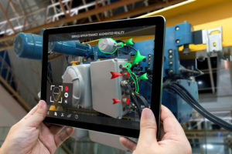
November 23, 2020 Learning is More Immersive Can AR be the antidote to virtual classroom shortcomings? Parker McDonnough, eSchool News https://www.eschoolnews.com/2020/11/23/can-ar-be-the-antidote-to-virtual-classroom-shortcomings/2/ https://www.zdnet.com/article/view-pyramids-of-ancient-egypt-via-this-360-degree-vr-capture/ AR brings learning to life and allows students to experience education during distance learning. With AR, students can walk through Stonehenge, tour the Egyptian pyramids, go on a virtual field trip of the Louvre Museum, or explore the cavities of the human heart – all from the comfort of their homes. Students can even take a journey to outer space or visit UNESCO world heritage sites….explore Mount Rushmore or the muscular system in AR.

Slide 18
January/February 2022 Virtual Reality Comes of Age in K-12 https://districtadministration.com/digital-edition/da-digital-edition-2022-0102.pdf?oly_enc_id=4802E2479378B9Y#page=10

Slide 19
July 17, 2017 Learning is More Immersive Learning Chemistry in Virtual Reality, Sarah Hardman, New Learning Times https://newlearningtimes.com/cms/article/4519/learning-chemistry-in-virtual-reality 1:38 video: https://vialogues.com/vialogues/play/38337/ All: http://curtbonk.com/chemistry-vr.html 01.-.41: http://curtbonk.com/chemistry-vr-1.html .41-1:16: http://curtbonk.com/chemistry-vr-2.html 1:16-1:36: http://curtbonk.com/chemistry-vr-3.html

Slide 20
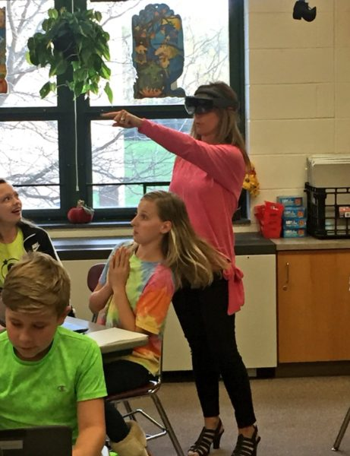
May 1, 2018 Learning is More Immersive 3 ways districts can use AR and AI Justin Anglio, eSchool News https://www.eschoolnews.com/2018/05/01/3-amazing-ways-our-district-is-using-ar-and-vr/
When a teacher glances around her classroom, Lumilo allows her to see real-time analytics (in the form of icons) floating directly above each student’s head. The teacher can glance directly at a student or “click” on a student’s icon to see more detailed information about where and how that student might be struggling.

Slide 21
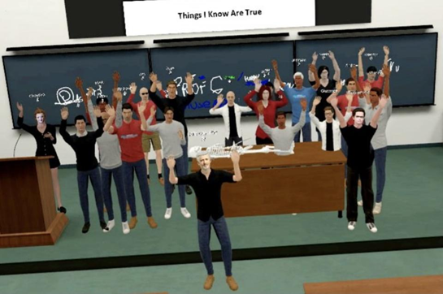
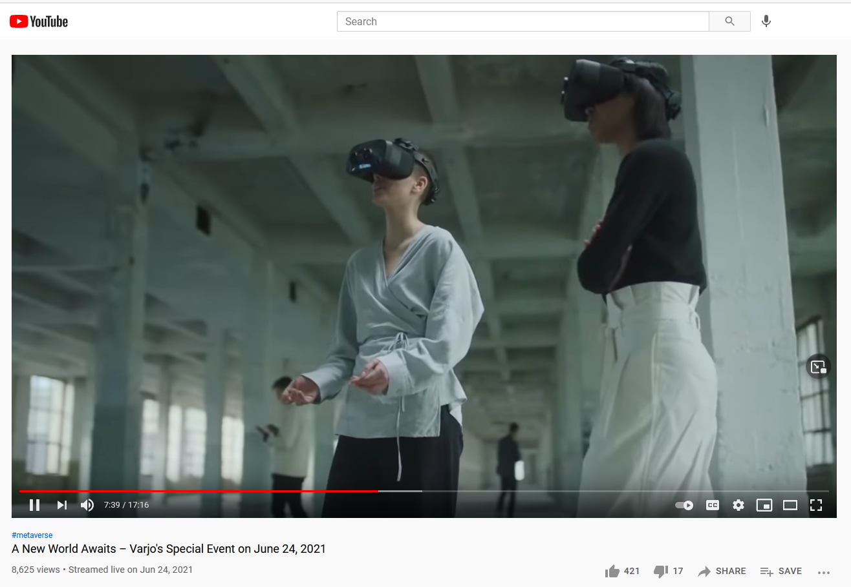
June 24, 2021 Learning is More Immersive This Week In XR: VR Ad Excitement, Tencent Invests $50M In Ultraleap, The Linkedin Of VR Charlie Fink, Forbes https://apple.news/A0dVCTuPtQsu0VdrQccHb6A
A New World Awaits – Varjo's Special Event on June 24, 2021
Metaverse explained (22:50): https://www.youtube.com/watch?v=MHDFNr0MNek
http://curtbonk.com/vr3.html
Mixed Reality Hand Tracking with Varjo XR-1 and Ultraleap (solar system/Earth):
Video (1:20): http://curtbonk.com/vr1.html

Slide 22
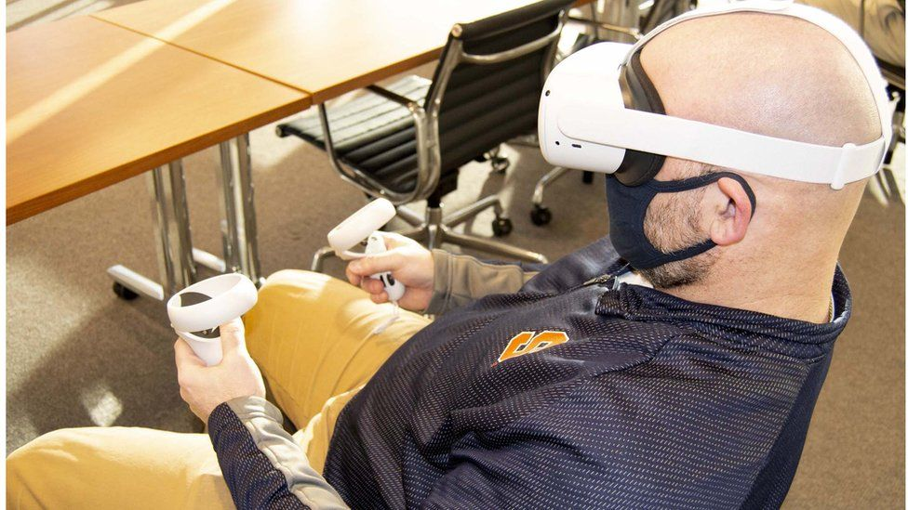
August 20, 2021 Learning is More Immersive How virtual reality can help to recruit and train staff By Bernd Debusmann Jr, BBC https://www.bbc.com/news/business-57805093
Companies with workers in remote locations can benefit from VR says Tom Symonds

Slide 23
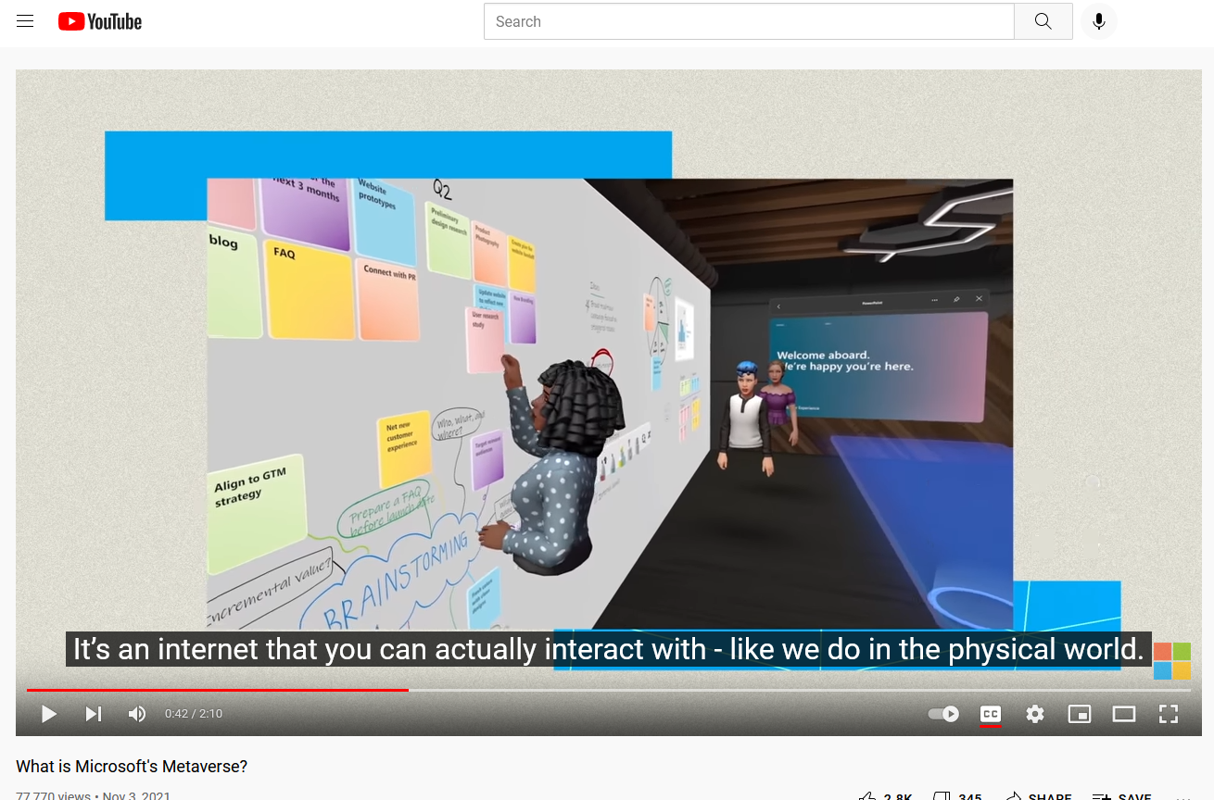
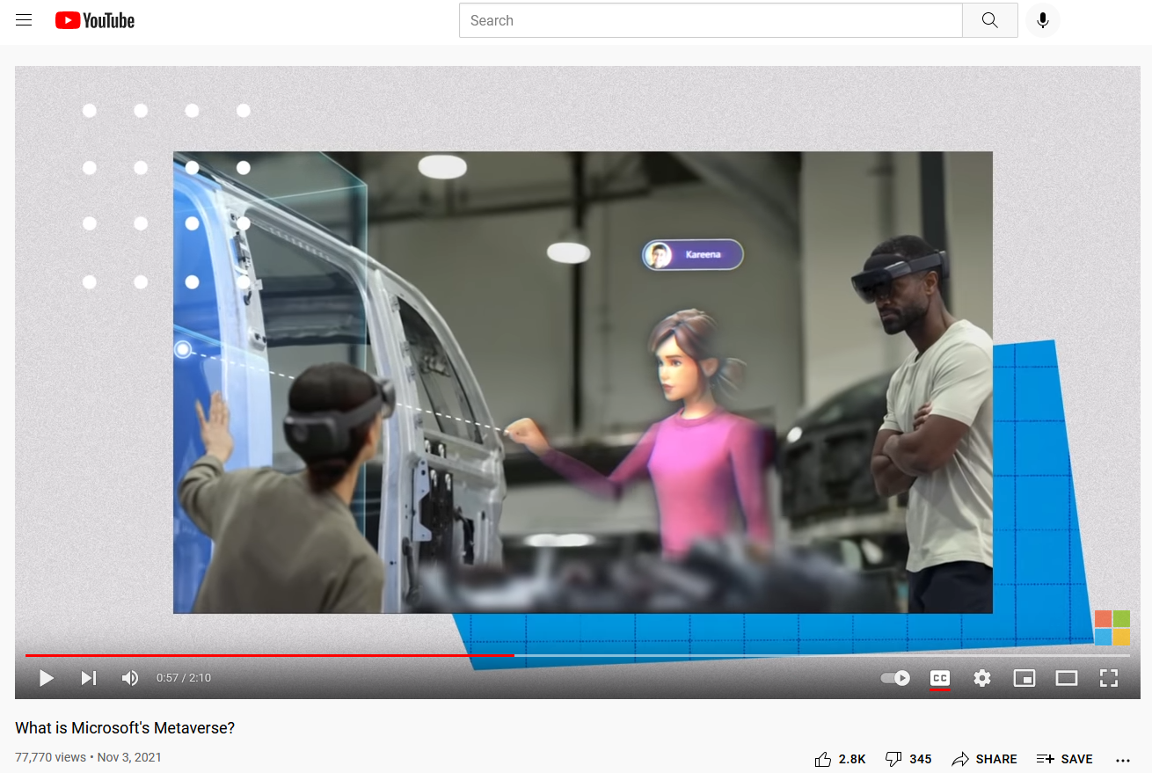
November 3, 2021 What is Microsoft's Metaverse? The metaverse is here, and in our increasingly digital world, we continue to focus on bringing humanity to every digital interaction. That’s why we announced Mesh for Microsoft Teams at Ignite 2021, our gateway to the metaverse and a way to make online meetings more personal, engaging and fun. You can think of the metaverse as a new version – or a new vision – of the internet, one where people gather to communicate, collaborate, and share with a personal virtual presence on any device. Read the article here: https://news.microsoft.com/innovation... Learn more: https://www.microsoft.com/en-us/mesh Video (2:10): https://www.microsoft.com/en-us/mesh

Slide 24
April 23, 2021 From Minecraft to Zoom calls, we’ve all spent much of the pandemic on our screens. But are we ready for the metaverse?, Mike Snider, USA Today http://curtbonk.com/metaverse.html MetaHuman Creator: High-Fidelity Digital Humans Made Easy | Unreal Engine https://www.youtube.com/watch?v=S3F1vZYpH8c https://www.usatoday.com/in-depth/tech/2021/04/21/minecraft-roblox-fortnite-nft-creating-metaverse/7000381002

Slide 25
Poll #3: Any light bulbs going off in you head so far?
Yes definitely…many of them…pop…pop…pop!
Yes, several times.
Yes maybe!
Not yet (but hopefully soon…)
Nope. Darn it my brain is not working today.
There’s no hope with this idiot presenting.

