Slide 1
MOOC Instructor Experiences and Pedagogical Choices: Some Instructional Design Considerations and Challenges
Meina Zhu, Curtis J. Bonk, and Annisa Sari
IST Department, Indiana University
March 2, 2018

Slide 3
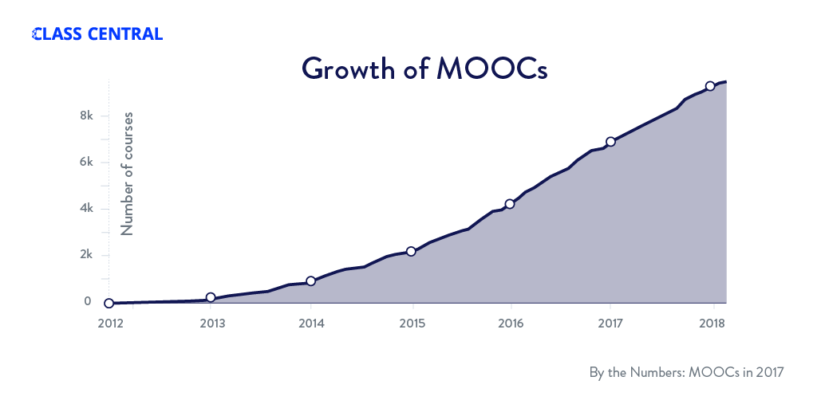
January 18, 2018 By The Numbers: MOOCS in 2017 Dhawal Shah, Class Central
Notes:
https://www.class-central.com/report/mooc-stats-2017/

Slide 4
February 14, 2018 MOOCs: Fewer New Students, but More Are Paying Doug Lederman, Inside Higher Ed
Notes:
https://www.insidehighered.com/digital-learning/article/2018/02/14/moocs-are-enrolling-fewer-new-students-more-are-paying-courses

Slide 5
January 22, 2018 A Product at Every Price: A Review of MOOC Stats and Trends in 2017 Dhawal Shah, Class Central
Notes:
https://www.class-central.com/report/moocs-stats-and-trends-2017/

Slide 6
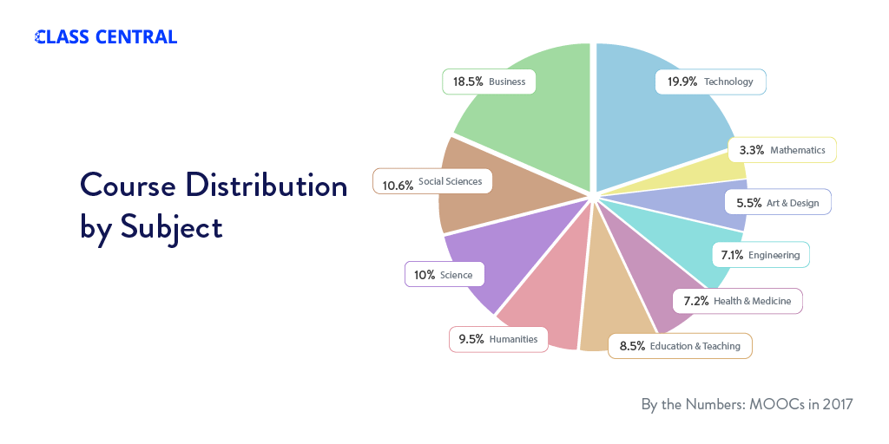
January 22, 2018 A Product at Every Price: A Review of MOOC Stats and Trends in 2017 Dhawal Shah, Class Central
Notes:
https://www.class-central.com/report/moocs-stats-and-trends-2017/

Slide 7
Research Background
MOOCs can be beneficial to both learners and instructors (Hew & Cheung, 2014)
Instructional design is critical for online learning (Johnson & Aragon, 2003; Phipps & Merisotis, 1999), including MOOC
Instructors are one of the five main components of MOOCs; the other four are learners, topic, material, and context (Kop, 2011 )
Few studies have examined instructional design from MOOC instructors’ perspectives (Margaryan et al., 2015; Ross, Sinclair, Knox, Bayne, & Macleod, 2014; Watson et al., 2016)

Slide 8
Research Background Zhu, M., Sari, A., & Lee, M. M. (2018). A Systematic Review of Research Methods and Topics of the Empirical MOOC Literature (2014-2016). The Internet and Higher Education.
Research methods used in each research topic (out of 146 studies)
 | Quantitative | Qualitative | Mixed methods
Student-focused | 39 | 9 | 26
Design-focused | 19 | 12 | 17
Context and impact | 9 | 6 | 5
Instructor-focused | 0 | 3 | 2
Notes:
Zhu, M., Sari, A., & Lee, M. M. (2018). A Systematic Review of Research Methods and Topics of the Empirical MOOC Literature (2014-2016). The Internet and Higher Education.

Slide 9
Research Purposes & Questions
Research Questions:
What are the design considerations of instructors when designing MOOCs?
What challenges do instructors perceive when designing MOOCs?
How do instructors address the challenges that they perceive related to MOOCs?

Slide 10
Research Methods-Design
Sequential mixed methods design (Creswell & Clark, 2007)

Slide 11
Research Methods (Zhu, Bonk, & Sari, in review)
Data Collection:
survey, interview, and course review
Participants:
143 survey participants (10% response rate) and 12 interviewees

Slide 12
Research Methods
MOOC instructors interviewed
No. | Countries | Subject areas | Platforms
1. | The U.S. | Language and Literacy | Coursera
2. | The U.S. | Education | Coursera
3. | The U.S. | Education | Canvas
4. | The U.S. | Chemistry | Coursera
5. | UK | Public health | FutureLearn
6. | UK | Language and Literacy | FutureLearn
7. | Hong Kong | Math | Coursera
8. | Mainland China | Math | Coursera
9. | Canada | Psychology | Coursera
10. | Australia | Public Health | Open2Study
11. | Sweden | Computer Science | edX
12. | India | Management | edX

Slide 13
Data Analysis
RQs | Data Sources | Data analysis
RQ1 | Survey-multiple-choice questions Survey-open-ended questions Interview MOOC review | Descriptive statistics Content analysis (Elo & Kyngäs, 2008) Content analysis Content Analysis
RQ2 | Survey-multiple-choice questions Survey-open-ended questions Interview | Descriptive statistics Content analysis Content analysis
RQ3 | Survey-multiple-choice questions Interview | Descriptive statistics Content analysis

Slide 14
Analytical Framework
Alario-Hoyos, Pérez-Sanagustín, Cormier, and Kloos’ (2014) MOOC design considerations
Design considerations | Example (Alario-Hoyos et al, 2014)
Resources | Technology resources and human resources
Pedagogy | Motivate students, participatory learning, and collaborative community etc.
Logistics | Time required while planning MOOCs and peer assessment

Slide 15
Demographic Information

Slide 16
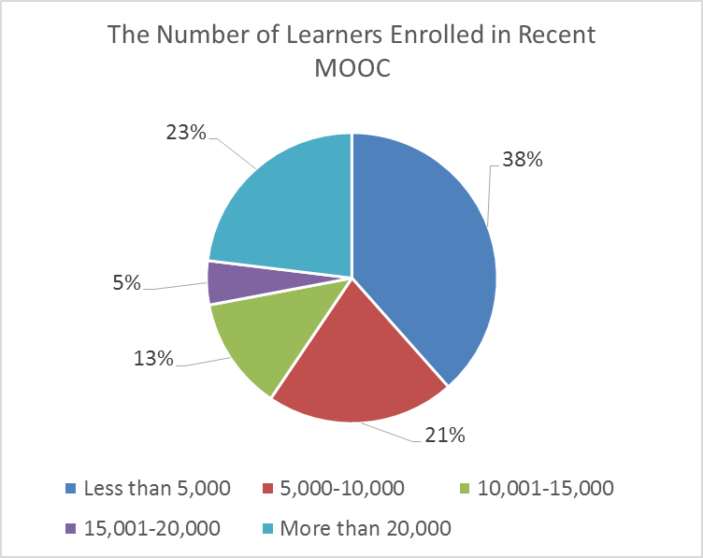
Demographic Information

Slide 17
Demographic Information

Slide 18
Demographic Information

Slide 19
Demographic Information

Slide 20
Demographic Information

Slide 21
Findings
RQ #1. What are the design considerations of instructors when designing MOOCs?
Learning objectives
Assessment
Time for designing MOOC
Engaging learners

Slide 22
Findings
Engaging learners
One instructor from the UK mentioned:
“When we were designing, we tried to have a hook for each week, a reason for learners to come back each week. So, we built that into our learning design. So what's going to be the big thing that makes you want to join the course in Week One.”

Slide 23
Findings
RQ #1-1. How do MOOC instructors design the course to encourage interaction among learners?
Asynchronous discussion forums
Pair-based types of tasks
Social media

Slide 24
Findings

Slide 25
Findings
RQ #1-2. How do MOOC instructors design the course to encourage interaction between instructor and learners?
Online discussion forums
Platform messages
Social media connections

Slide 26
Findings

Slide 27
Findings

Slide 28
Findings

Slide 29
Findings
RQ #2. What challenges do instructors perceive when designing MOOCs?
Assessment methods
Engaging students’ learning
Time limitation

Slide 30
Findings
Time limitation
One instructor mentioned:
“I think one of the challenges is time. It does take a lot of time to get the videos done. I did not get a course release when I was doing, and it was a side project at the same time as my regular load. I think it gets to be concentration and balance about what's going on.”

Slide 31
Findings
RQ #3. How do instructors address the challenges that they perceive related to MOOCs?
Explore other MOOC examples
Seek help from the platform/Colleagues/institutions

Slide 32
Findings
Team work
Teamwork. It was amazing to have such support on the development side. There was never a time where I wrote a script for a MOOC. It was like: “OK. Let's go with this.” There was always a discussion…We think examples to clarify that for visual learners or learners who respond better to auditory cues. So the challenges were never greater than the team here.

Slide 33
Discussion and Conclusions
The pedagogical factors were the primary design considerations and challenges in MOOC design (Watson, S. L., Loizzo, J., Watson, W. R., Mueller, C., Lim, J., & Ertmer, P. A., 2016).
The assessment and engagement strategies are the main considerations as well as challenges (Hew & Chung, 2014).
The time limitation of creating MOOCs was the primary logistical consideration (Hew & Chung, 2014; Watson et al., 2016).

Slide 34
Limitations
Limited to MOOCs which are mainly delivered in English
Volunteer bias
Only review 12 MOOC Courses

Slide 35
Implications
For MOOC instructors:
May inform them about what other instructors are most concerned with and tend to target in MOOC design as well as their efforts in addressing the possible design challenges.
For instructional designers:
May help them in the consulting process.

Slide 36
Future Studies
Assessment design
Engaging activity design
Course design that supports self-directed learning
Further observations and analyses are needed to better understand how MOOC instructor design and deliver their MOOCs to encourage online interaction and learner success.

Slide 37
Thank you! Questions and Comments…
Meina Zhu, IU, meinzhu@umail.iu.edu
Curtis J. Bonk, IU, cjbonk@indiana.edu
Annisa Sari, IU, annisa@uny.ac.id

