Slide 1
Exploring Instructors’ perspectives on the use of gamification in MOOCs
Yunjo An, University of North Texas
Curtis J. Bonk, Indiana University Bloomington
Lin Lin, University of North Texas
Meina Zhu, Wayne State University

Slide 2
Introduction
Challenges of Massive Open Online Courses (MOOC)
Low retention rates
Low completion rates
Engaging learners in a system with inherent feedback and interaction limitations between the instructor and the large number of participants
Gamification as a way to increase interactions and engagement in MOOCs

Slide 3
Literature review
Studies have proposed gamification as one way to alleviate the problem of low engagement and low completion rates of MOOCs.
Chang & Wei (2016)
Antonaci, Klemke, Kreijns, & Specht (2018)
Klemke, Eradze, & Antonaci (2018)
Romero-Rodríguez et al. (2019)

Slide 4
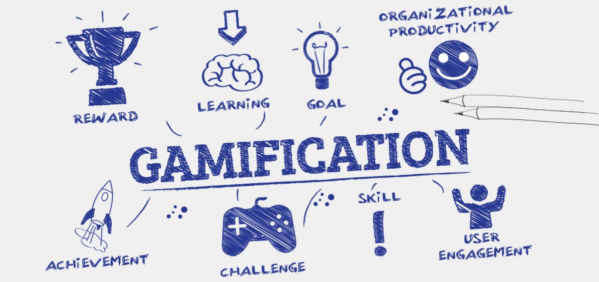
Literature review
Previous research shows that applying gamification strategies in MOOCs could increase student engagement and course completion rates.

Slide 5
Purpose of The study
The present study explored instructors’ perceptions, interests, self-efficacy, perceived barriers, and support needs regarding the use of gamification in MOOCs.
How do MOOC instructors perceive the potential of gamification?
What are the perceived barriers to gamifying MOOCs?
What types of supports and resources do MOOC instructors need to gamify their MOOCs?

Slide 6
methods
This study used a sequential mixed-methods design (Creswell & Plano-Clark, 2017).
Data collection
Online survey – 107 participants
Follow-up interviews – 11 participants
Reviews of the MOOCs of the interviewees
Data analysis
Descriptive statistics
Mann-Whitney U tests
Thematic analysis methods

Slide 7
Results: Part 1
Interest: 73% showed interest in gamification.
Perceptions of gamification
Quantitative data – Means mostly between 5.00 and 6.50.
Qualitative data - Three major groupings: (1) very positive, (2) positive but unsure, and (3) skeptical.
Majority of participants believed that gamification has the potential for education overall, and, for MOOCs, specifically.
A few participants were admittedly more skeptical about gamification and did not want to gamify their MOOCs

Slide 8
Results: Part 2
Age:
Younger participants (Mdn = 5.50) had higher self-efficacy than older MOOC instructor participants (Mdn = 3.00) in terms of gamifying their MOOCs (U = 1011.5, p = .033).
Younger participants (Mdn = 5.50) were more positive than older participants (Mdn = 5.00) about the potential of gamification to increase the learner-instructor interaction (U = 1029.5, p = .043).
Younger participants (Mdn = 7.00) were more positive than older participants (Mdn = 6.00) about the potential of gamification to increase the course completion rate (U = 1006.5, p = .030).

Slide 9
Results: Part 3
Prior experience:
MOOC instructor participants who had prior experience with gamification (Mdn = 8.00) had higher interest in gamifying their MOOCs than those without prior experience (Mdn = 5.00) (U = 756.0, p = .008).
Participants with prior experience (Mdn = 7.00) also had higher self-efficacy than those without prior experience (Mdn = 3.00) (U = 193.0, p = .000).

Slide 10
Results: Part 4
Purposes of gamification
Most MOOC instructor participants (73%) showed interest in gamification and indicated that they would consider in their future MOOCs.
Wanted to gamify their MOOCs to increase social interactions (91.6%) and student retention (85%).
More than half of them would gamify their MOOCs to enhance student learning (52.3%).

Slide 11
Results: Part 5
Perceived barriers.
Lack of time.
Limited knowledge and experience.
Lack of funding.
Lack of fit between gamification and course content.
Concerns regarding students’ perceptions or acceptance.
Concerns regarding negative effects of gamification.

Slide 12
Results: Part 6
Support needs:
Time and funding
Expert guidance
Examples
MOOC platforms
IT/media support

Slide 13
Discussion
Helping MOOC instructors develop an accurate understanding of gamification and its potential might be the first step needed in the effort of gamifying MOOCs.
Age and prior experience appeared to be critical factors relating to MOOC instructors’ perceptions of gamification.
Although younger instructors are generally more familiar to publish and engage in scholarly activities which count toward tenure and promotion.
Positive experience with gamification or concrete examples of successfully gamified MOOCs can have positive influence on MOOC instructors’ perceptions and attitudes toward gamification.

Slide 14
Discussion
Given the challenges related to low engagement, high dropout rates, and low completion rates in MOOCs, it is wise to use gamification to facilitate social interactions and community building.
Previous research on gamification in MOOCs has focused on identifying gamification mechanics suitable for MOOCs. Future research should focus more on developing guidelines for MOOC instructors.

Slide 15
Limitations
Many MOOC providers, e.g., xuetangX in China, not included.
Instructors whose MOOCs in English were included.
The survey and interview participants in this study were volunteers.
Response rate of survey was 7.5%, low but still acceptable for an survey (Cho & LaRose, 1999).
The survey instrument related to MOOC gamification was developed for this specific study.

Slide 16
Future Research
Focus more on developing guidelines for gamifying MOOCs for difference conditions.
Provide detailed descriptions of the course context and gamification strategies to help other researchers and MOOC instructors understand what strategies work in different conditions and content areas.
Focus on MOOCs in other languages to capture insights of adopting gamification in MOOCs worldwide.

Slide 17
Study significance
Study offers a better understanding of instructors’ interests, self-efficacy, perceptions, perceived barriers, concerns, and support needs regarding the gamification in MOOCs.
Provides useful insights and recs into what to consider when gamifying MOOCs as well as how to support MOOC instructors or instructional designers in gamifying MOOCs.

