Slide 1
From Incubation to Celebration and All the Disappointments in Between: Navigating the Road to Publishing and Collaborative Writing Success Wed, Oct 23, 1:00 to 1:50 pm Convention Center, Conference Rm 15
Curtis J. Bonk, Indiana University
Elizabeth M. Dalton, Univ. of Rhode Island
Susie L. Gronseth, University of Houston
Mimi Miyoung Lee, University of Houston
Thomas C. Reeves, University of Georgia
Thomas H. Reynolds, National University
Ke Zhang, Wayne State University

Slide 2
Session Presenter Bios
Susie Gronseth is Clinical Associate Professor in the Learning, Design, and Technology program at the University of Houston (UH). She may be contacted at slgronse@Central.UH.EDU.
Elizabeth (Betsy) Dalton is adjunct professor for the Communicative Disorders Department at the University of Rhode Island. She may be contacted at elizabethmdalton@gmail.com.
Ke Zhang is Professor in the Learning Design and Technology Program at Wayne State University in the USA. Inquiries are welcome by email to ke.zhang@wayne.edu.
Curtis J. Bonk is Professor at Indiana University teaching psychology and technology courses. He can be contacted at cjbonk@indiana.edu and his homepage is at http://curtbonk.com/.
Thomas C. Reeves is Professor Emeritus of Learning, Design, and Technology at The University of Georgia. He can be reached at treeves@uga.edu and his homepage can be found at http://www.evaluateitnow.com/.
Thomas H. Reynolds is a Professor of Teacher Education at National University in La Jolla, California. He can be contacted at treynold@nu.edu.
Mimi Miyoung Lee is Professor in the Department of Curriculum and Instruction at the University of Houston (UH). She may be contacted at mlee7@uh.edu.

Slide 3
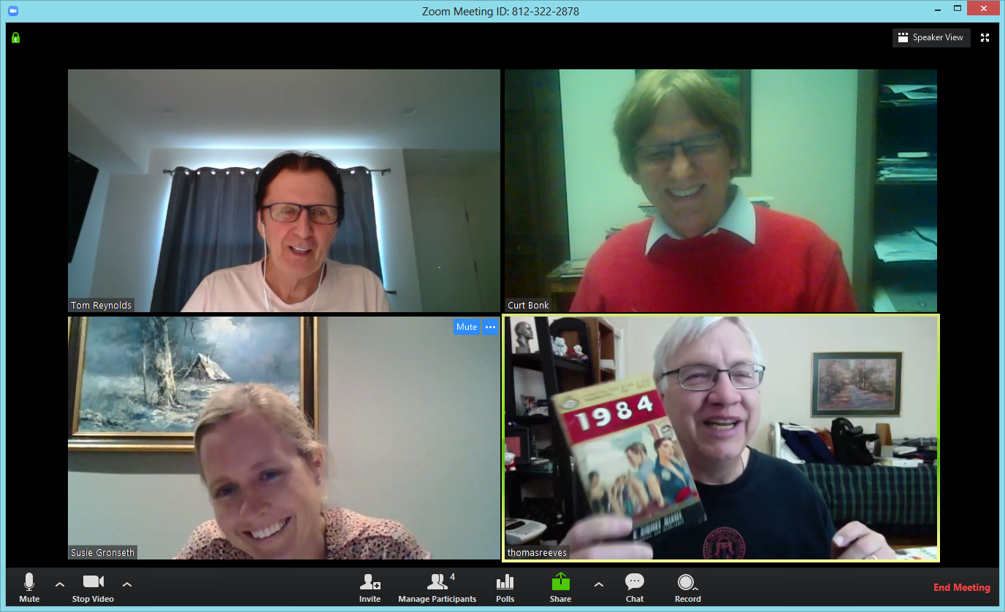
Free Book Anyone? We will give a book away for the best question asked

Slide 4
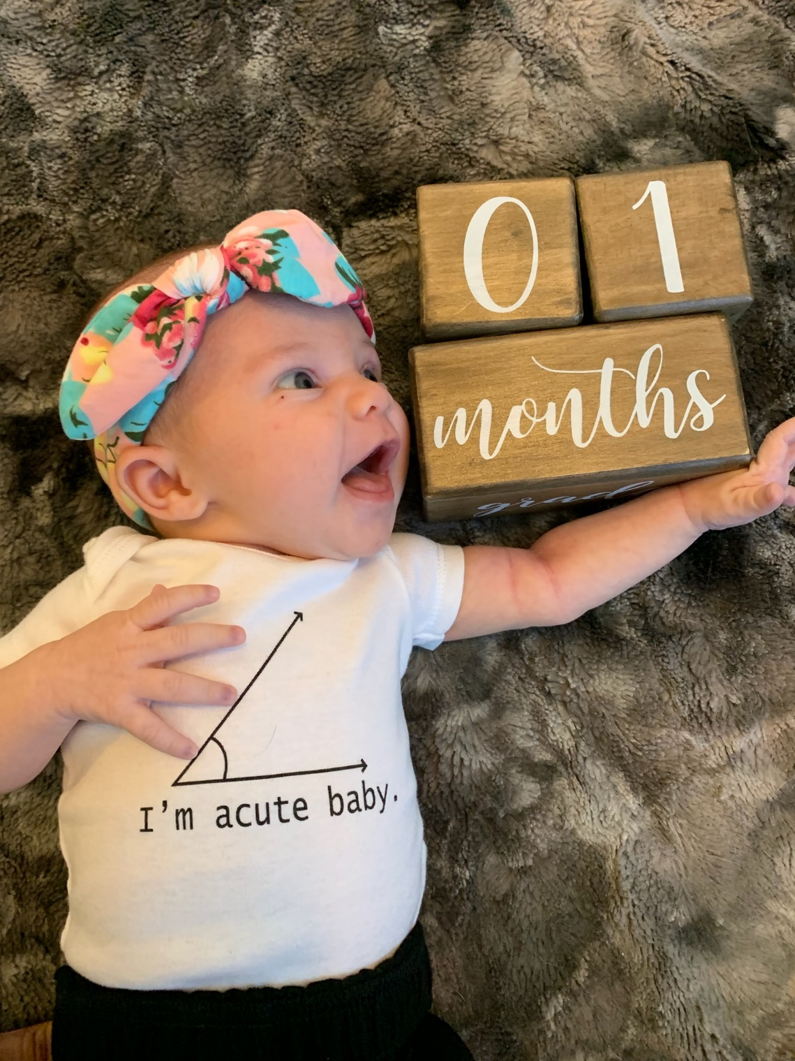
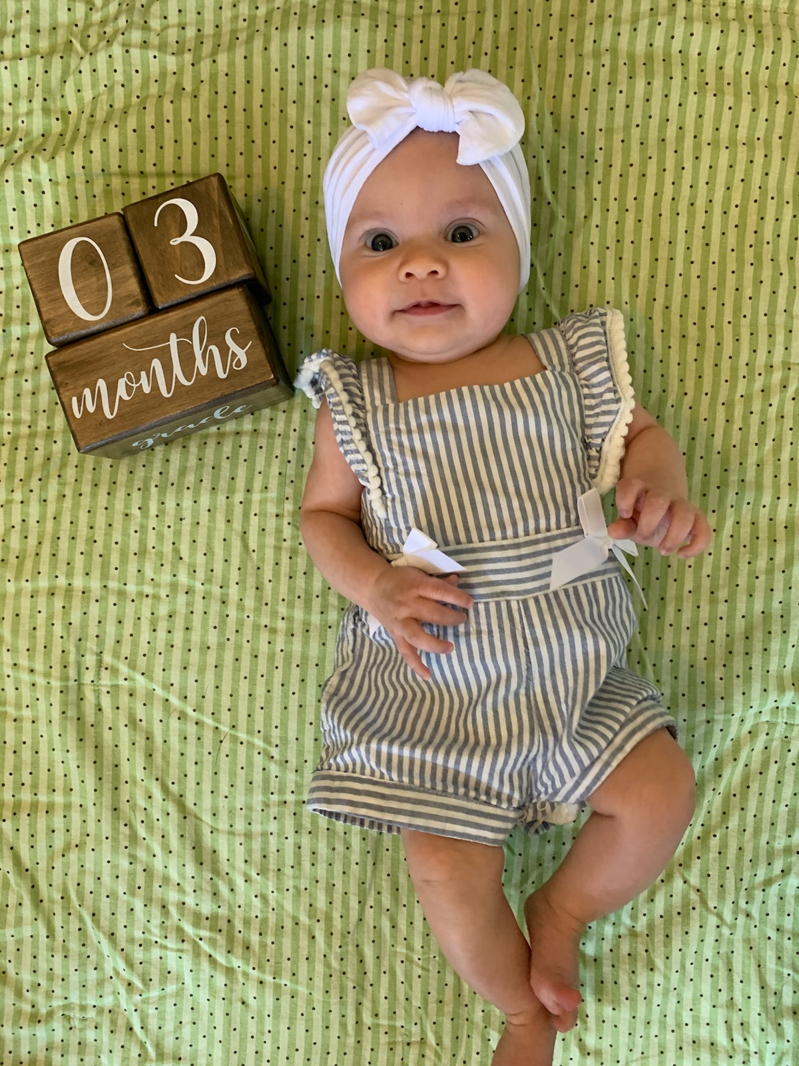
1. Giving Birth…to an Idea How do you birth a new idea?

Slide 5
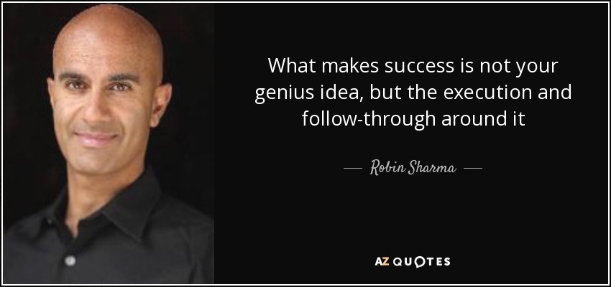
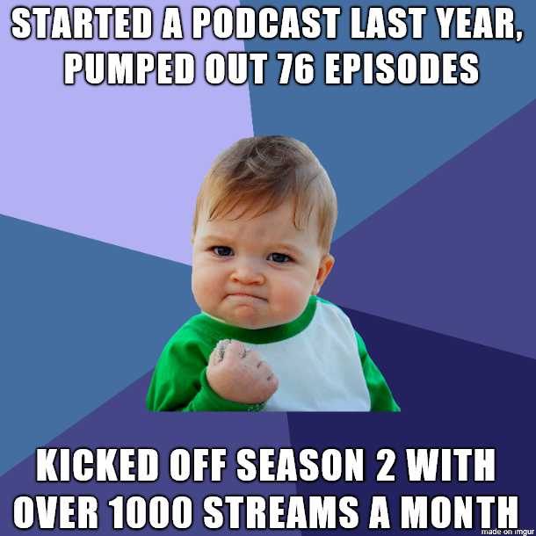
2. Idea Follow Through How do you decide which idea you are going to follow up on (from amongst many good ideas)?

Slide 6
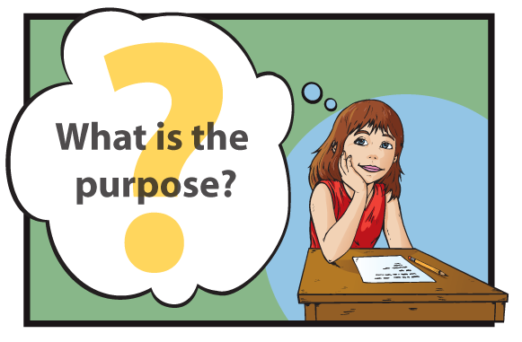
3. What’s the Purpose Why I want to write this piece? For tenure review? For sharing the message widely? As a vehicle to work together with certain colleagues? As an opportunity to build new collaborations?

Slide 7
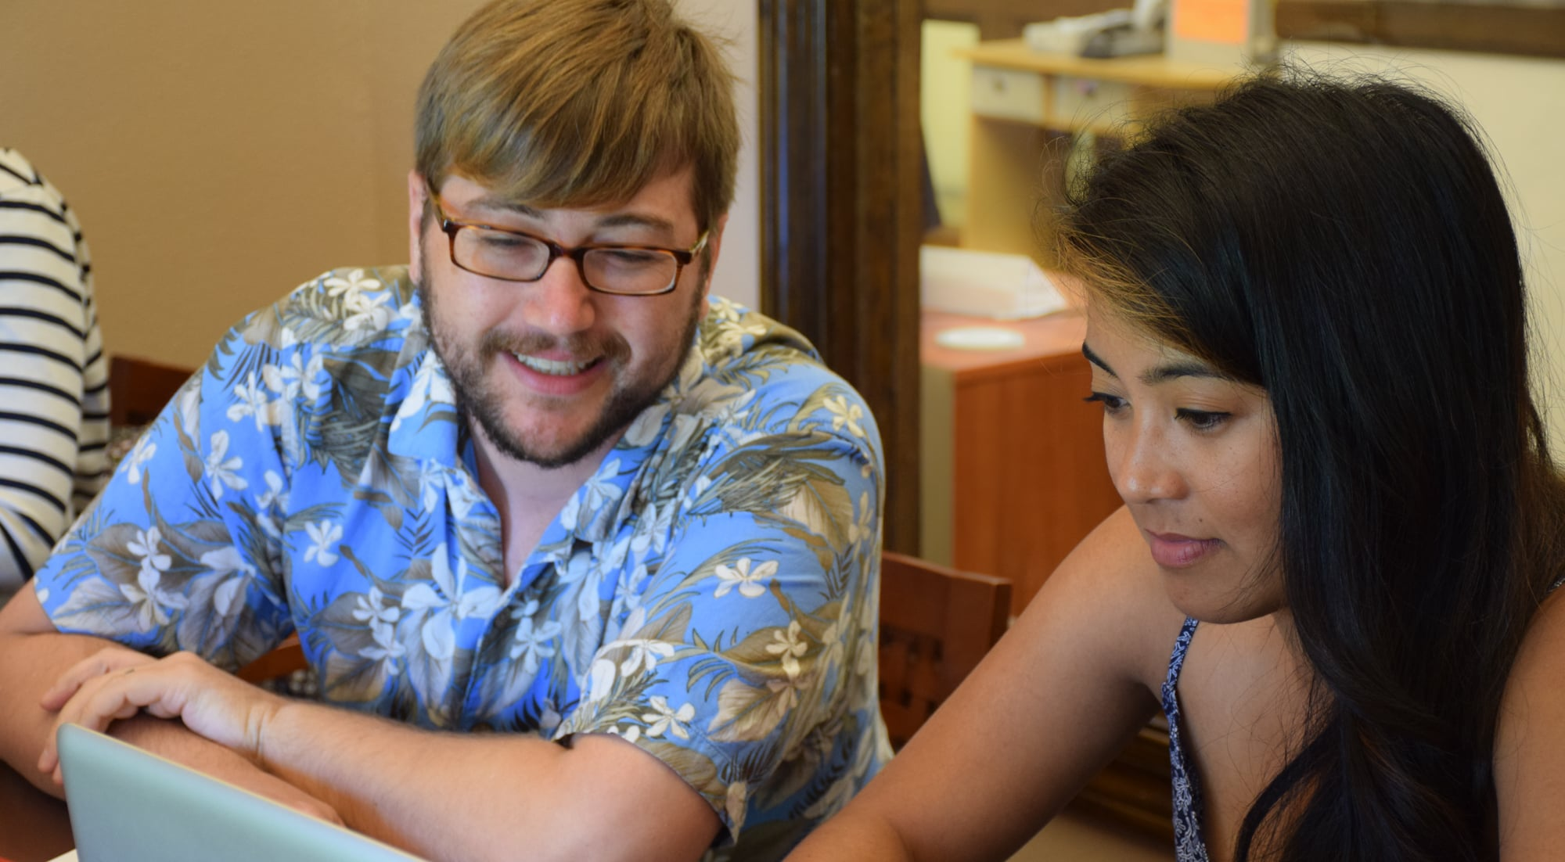
4. Graduate Student Considerations How can publishing different pieces of work help graduate students to move ahead in their programs? (Consider the 3-paper/research study dissertations, other alternate formats)

Slide 8
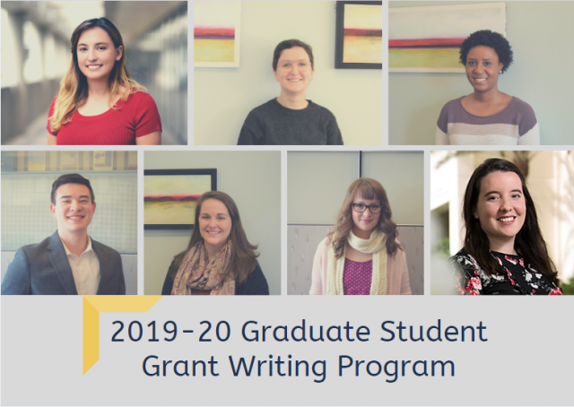
5. Graduate Student Recommendations What suggestions do you have to enable graduate students to be highly productive? How to convert class papers, conference presentations, and article ideas into accepted manuscripts?

Slide 9
6. Time to Jump? When or how do you decide to jump? What factors do you weigh? How important is “timeliness” to the development and publication of an article, book chapter, etc. Must we write about the “next best idea” or do we have more professional control of what we want to write about?

Slide 10
7. Rejection and Resilience How do you deal with rejection, disappointments, and failures?

Slide 11
8. Just Say No How do you respond “no” to book chapter, special issue invitations, etc. in a polite and collegial way? (When in doubt, explain your rationale.)

Slide 12
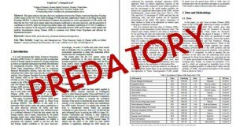
9. Predators, Scams, and Other People’s Projects What are predatory journals and outlets? How do you know and how do you respond?

Slide 13
Educational Technology Research

Slide 14
1066

Slide 15
1066
Number of educational research journals ranked by

Slide 16
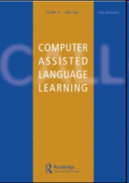
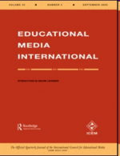
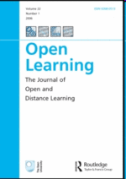
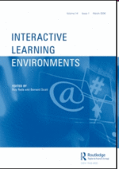
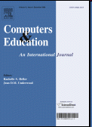
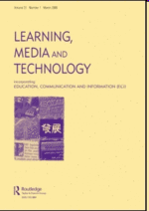
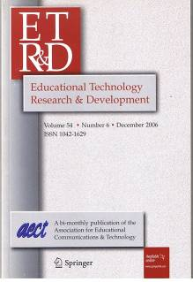
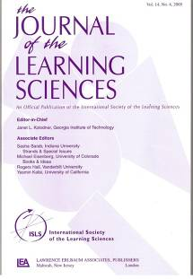
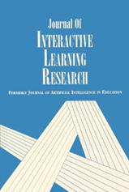

Slide 17
10. Celebrations and Parties How do you celebrate? Do you have any stories or pictures of celebrating writing success, acceptance, or publication?

Slide 18
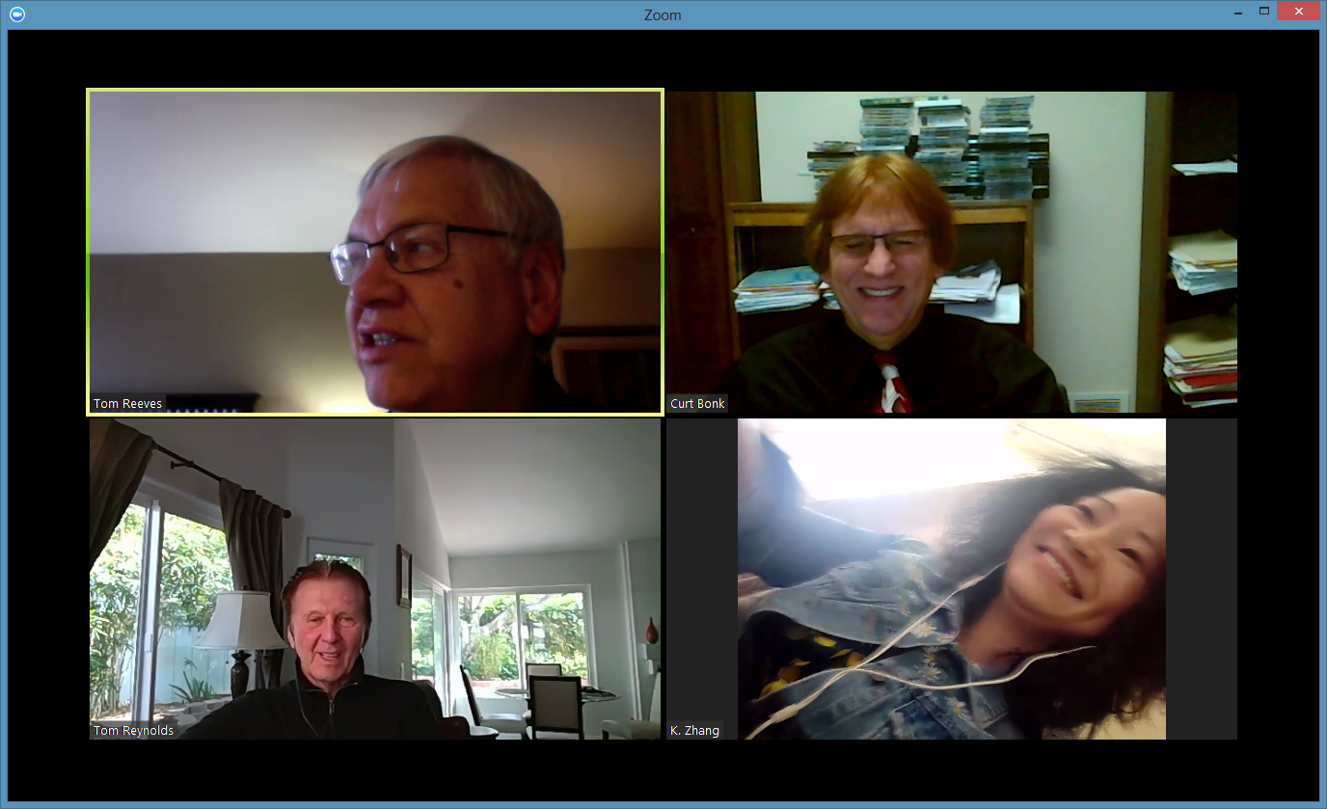
10. Celebrations and Parties

Slide 19
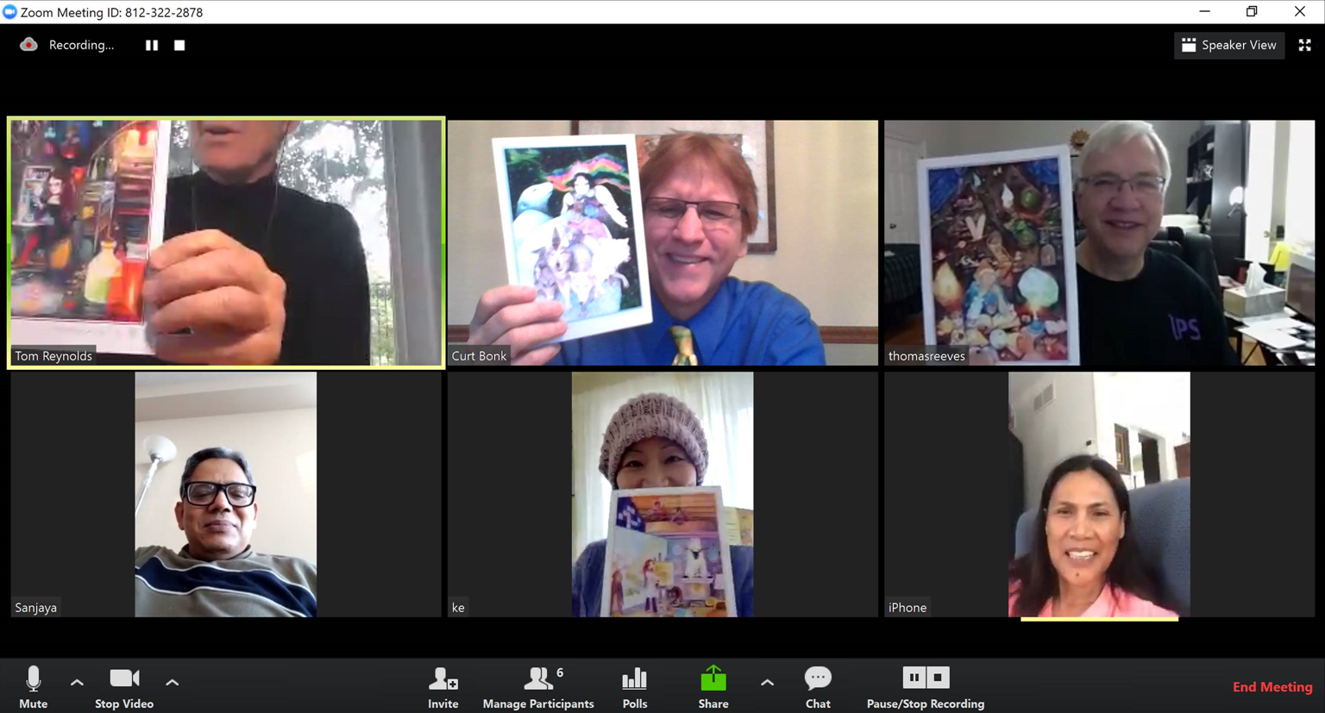
10. Celebrations and Parties

Slide 20
Comments and Questions…?
Curtis J. Bonk, Indiana University, cjbonk@indiana.edu
Elizabeth M. Dalton, Univ. of Rhode Island, elizabethmdalton@gmail.com
Susie L. Gronseth, University of Houston, slgronse@Central.UH.EDU
Mimi Miyoung Lee, University of Houston, mlee@Central.UH.EDU
Thomas C. Reeves, University of Georgia, treeves@uga.edu
Thomas H. Reynolds, National University, mnoflwrs@hotmail.com
Ke Zhang, Wayne State University, ke.zhang@wayne.edu

