Slide 1
The G³ of Writing and Publishing Tips: Gentle Guidelines, Great Stories, and Gigantic Scholarly Gains
Curtis J. Bonk, Ph.D., Indiana University
cjbonk@indiana.edu
Meina Zhu, Ph.D., Wayne State University meinazhu@wayne.edu
Notes:
All
1

Slide 2
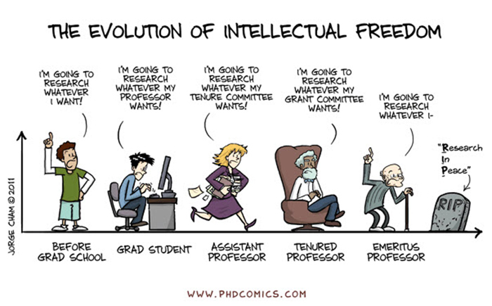
Sidenote: Don’t Just Publish for the Sake of Publishing…
Notes:
Curt
2

Slide 3
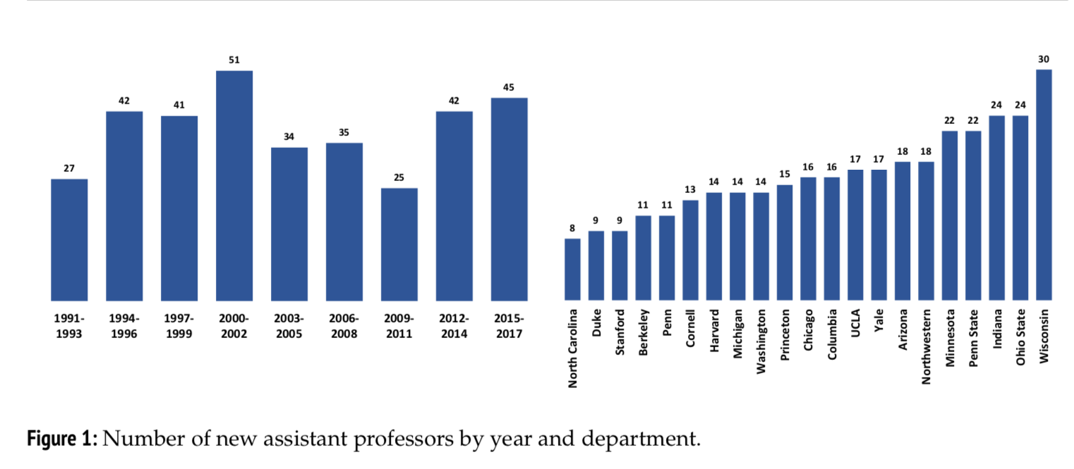
March 27, 2019 One Discipline's Soaring Publishing Expectations Colleen Flaherty, Inside Higher Ed https://www.insidehighered.com/news/2019/03/27/sociologys-publishing-expectations-have-doubled-recent-decades

Slide 4
March 27, 2019 One Discipline's Soaring Publishing Expectations Colleen Flaherty, Inside Higher Ed https://www.insidehighered.com/news/2019/03/27/sociologys-publishing-expectations-have-doubled-recent-decades

Slide 5
March 27, 2019 One Discipline's Soaring Publishing Expectations Colleen Flaherty, Inside Higher Ed https://www.insidehighered.com/news/2019/03/27/sociologys-publishing-expectations-have-doubled-recent-decades
“What does that look like, exactly? In 2017, new assistant professors at the 21 departments included in the study had published 4.8 peer-reviewed articles, on average, on their start date. About 25 years ago, the number was 2.5.”

Slide 6
March 27, 2019 One Discipline's Soaring Publishing Expectations Colleen Flaherty, Inside Higher Ed https://www.insidehighered.com/news/2019/03/27/sociologys-publishing-expectations-have-doubled-recent-decades
“Newly promoted associated professors in article-centric subfields in the 2010s also published almost twice as many peer-reviewed articles as their counterparts two decades earlier. And even in book-centric subfields, the number of peer-reviewed articles has risen.”

Slide 7
March 27, 2019 One Discipline's Soaring Publishing Expectations Colleen Flaherty, Inside Higher Ed https://www.insidehighered.com/news/2019/03/27/sociologys-publishing-expectations-have-doubled-recent-decades
Echoing the “why” piece of his study, Warren said that his findings have potential “human consequences,” in that “it's stressful and may push otherwise qualified people out of the field.”
Expectation creep also has “implications both for the quality of scholarship -- which may go down as demands for quantity increase -- and for the topics that sociologists may choose to study,” he said.

Slide 8
Purposes of this Session
Part I: The Process
a. Exploring the process for getting published
b. Selecting a journal for publication
c. Academic information resources
d. Predatory journal issues
e. Taking the plunge
Part II: Writing Tips and Insights
a. Examining 20+ writing tips
b. Making commitments to future writing
Notes:
Ana

Slide 9
February 15, 2019 The Hardest Part of Writing Is Restarting Rebecca Schuman, The Chronicle of Higher Education https://www.chronicle.com/article/The-Hardest-Part-of-Writing-Is/245720?cid=cp242

Slide 10
December 12, 2018 Don’t Spend Your Holiday Break Writing Rebecca Schuman, The Chronicle of Higher Education https://www.chronicle.com/article/Don-t-Spend-Your-Holiday/245292

Slide 11
March 31, 2019 Step Away From the Delete Button Rebecca Schuman, The Chronicle of Higher Education https://www.chronicle.com/article/Step-Away-From-the-Delete/246013?cid=cp242

Slide 12
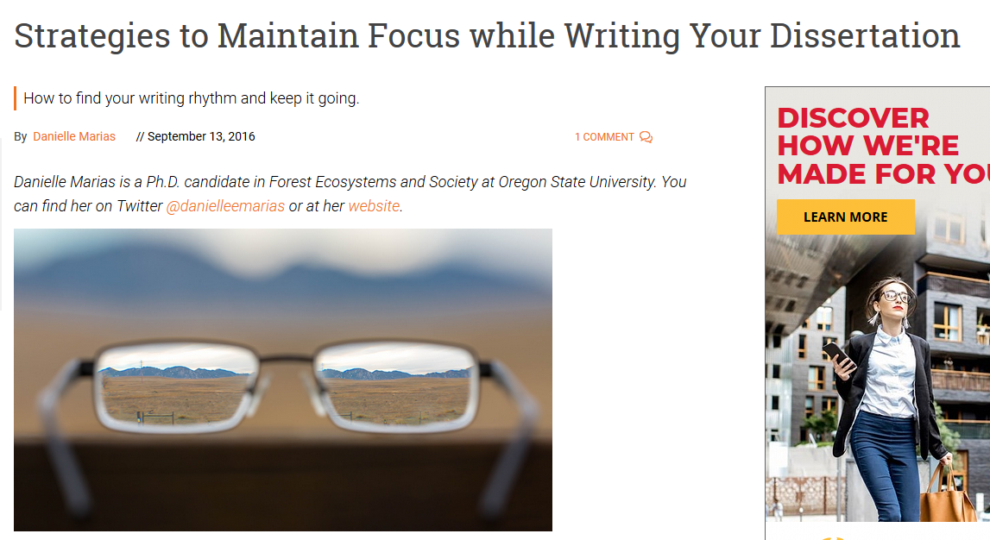
September 13, 2016 Strategies to Maintain Focus while Writing Your Dissertation GradHacker, Inside Higher Ed https://www.insidehighered.com/blogs/gradhacker/strategies-maintain-focus-while-writing-your-dissertation

Slide 13
September 13, 2016 Strategies to Maintain Focus while Writing Your Dissertation GradHacker, Inside Higher Ed https://www.insidehighered.com/blogs/gradhacker/strategies-maintain-focus-while-writing-your-dissertation
Freewriting 15 minutes per day…don’t worry about grammar and word usage.
“Only writing produces text”—words on paper overcomes anxiety and procast.
Meditation and mindfulness…for 5 minutes.
Intentions journal….visualize goals and create checklists.
Identifying our most productive times of day for writing using heat mapping.
Write first….clean house after.
Email and smartphone—turn off and abstain.
Schedule meetings in the morning/afternoon (protect some portion of day)
“Park on a downhill slope”…so you can pick up where you left off.
Gain momentum…by focusing on one thing at a time.

Slide 14
January 24, 2020 Advice for Writing -- and Finishing -- Your Dissertation Bertin M. Louis Jr. , The Chronicle of Higher Education https://www.insidehighered.com/advice/2020/01/24/tips-writing-and-completing-your-dissertation-opinion

Slide 15
December 10, 2019 Rewarding Your Writing Leslie Leonard, Inside Higher Ed https://www.insidehighered.com/blogs/gradhacker/rewarding-your-writing

Slide 16
October 3, 2019 Crucial Co-Writing Considerations Jordan McNeill, Inside Higher Ed https://www.insidehighered.com/blogs/gradhacker/crucial-co-writing-considerations

Slide 17
October 3, 2019 Crucial Co-Writing Considerations Jordan McNeill, Inside Higher Ed https://www.insidehighered.com/blogs/gradhacker/crucial-co-writing-considerations
Clarify authorship order ahead of time.
Have an honest conversation about the strengths of each team member--draft, revise, proofread, and format your manuscript.
Be clear on division of labor.
Nonwriting tasks are important too—taking notes, submission guidelines, and keep track of deadlines.
Set up digital collaboration norms and platforms—archiving, tracking, commenting, etc.
Respond to feedback professionally.
Build in time for feedback and revision.
Singular voice throughout paper—assign one member of team to read for writing style and flow.

Slide 18
May 2, 2017 A GradHacker Writing Round-Up GradHacker, Inside Higher Ed https://www.insidehighered.com/blogs/gradhacker/gradhacker-writing-round

Slide 19
May 19, 2020 Why It’s Important to Write a Proposal for an Academic Book Rachel Toor, The Chronicle of Higher Education https://www.chronicle.com/article/Why-It-s-Important-to-Write/248810

Slide 20
Part I: The Process
Insights and Advice on Getting Published in Higher Education
Notes:
Ana

Slide 21
Writing Difficulties and Challenges of a Early Career Scholar
Time
Writing habits
Resources
Local/Global Support
Starter text
Reputation
Connections
Journal awareness
Energy/Stamina
Service/Teaching duties
Notes:
Ana
21

Slide 22
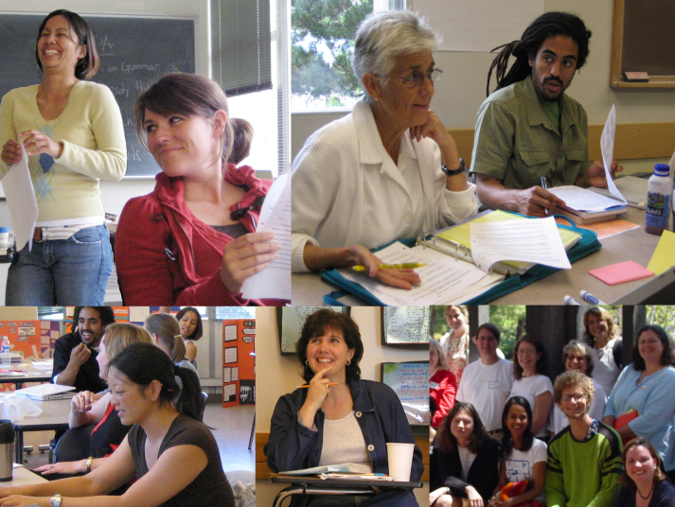
Put Forward your Best Work
Collaborative research projects
Literature reviews
Reflections/ conceptual pieces
Grant projects
Class projects
Notes:
Ana
22

Slide 23
Finding a Journal that Fits
What to look for?
Who will be your target readers?
Who are the authors and journals you cite the most related with your research program?
Is there a match between your work and the journal aims and scope?
What is the journal turnaround time?
What is the journal acceptance rate?
Do you know the editor(s)?
Notes:
Ana
https://www.editage.com/insights/how-to-choose-journals-for-submitting-your-paper
Who will be your target readers? Scholarly vs. non-scholarly periodicals
readership and target audience
Look for a match between your work and the journal aims and scope. – journal analysis
What is the journal’s turnaround time?
Acceptance rates? Get familiar with the journals’ acceptance rates
23

Slide 24
Where to start?
Peer-Reviewed Journals
Top-tier journals: are SSCI-indexed
Second-tier journals: have an established history in the field
Third-tier journals: often are newer to the field
Notes:
Ana
you should publish everything you do, even if it is only acceptable for a lower tier journal. It demonstrates your commitment to finish a project and makes your work available to everyone else. Lower tier journals are also great outlets for quality undergraduate research that you have directed.

Slide 25
Where to start?
Practitioner Journals
Target practitioners
Deal with problems and issues tied directly to practice
Receive wider circulations and visibility
Refereed or nonrefereed articles
Notes:
Ana
Unlike peer reviewed articles, nonrefereed articles, where publication decisions are made by one or more editors without using a blind review process, are important because they fill an important niche in practice oriented fields like ed tech.
Peer-reviewed or refereed articles undergo a blind review. This means that neither he authors nor reviewers know each other’s identity. This process is designed to endure that a manuscript has been reviewed and accepted in an ethical and unbiased manner by experts from a specific field.
Although refereed articles are often considered the gold standard in faculty promotion and tenure deliberations, nonrefereed articles nevertheless plan an important role within most academic disciplines.
Practitioner journals are targeted toward practitioners and deal with problems and issues tied directly to practice, Thus,, an article appearing in a practitioners journal could receive wider circulations and visibility than one published in a respected academic journal that is narrowly targeted toward a more limited audience.

Slide 26
TOP-TIER JOURNALS
British Journal of Educational Technology
Educational Technology Research and Development
The Internet and Higher Education
Instructional Science
Notes:
Ana
Mention:
http://www.trainingshare.com/resources/distance_ed_journals_and_online_learning_books.php
More examples:
Distance EducationDistance Education; The Internet and Higher Education; Asian Journal of Technology InnovationAsian Journal of Technology Innovation ; Australasian Journal of Educational Technology
Educational Technology Research and Development
26

Slide 27
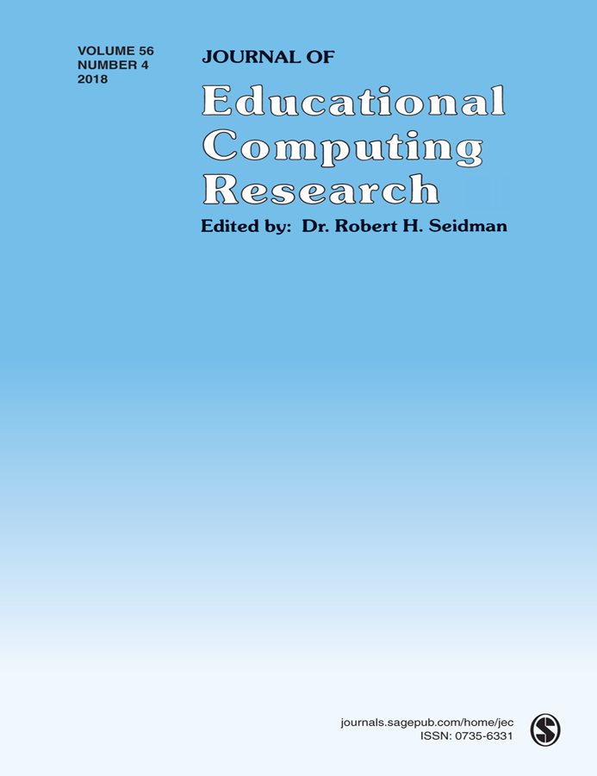
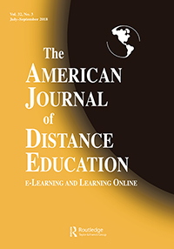
SECOND-TIER JOURNALS
Journal of Educational Computing Research
TechTrends
The American Journal of Distance Education
Notes:
Ana
Journal of Technology and Teacher EducationJournal of Technology and Teacher Education; The Quarterly Review of Distance EducationJournal of Technology and Teacher Education; The Quarterly Review of Distance Education; Science & Education
Journal of Digita Learning in Teacher Education
International Review of Research in Open and Distributed Learning
The American Journal of Distance Education
27

Slide 28
THIRD-TIER JOURNALS (often new journals)
International Journal of Online Pedagogy and Course Design
Contemporary Issues in Technology and Teacher Education
Interactive Technology and Smart Education
Notes:
Ana
International Journal of Gaming and Computer Mediated SimulationsInternational Journal of Gaming and Computer Mediated Simulations; Advances in MultimediaInternational Journal of Gaming and Computer Mediated Simulations; Advances in Multimedia; Learning: Research and Practice
International Journal of Designs for Learning

Slide 29
Resource and Idea Suggestions
Subscribe to news feeds (not too many)
Save links and images to interesting articles
Review saved documents for themes monthly
Share those links in Facebook, Twitter, etc., for peer reactions
Write to people interviewed in articles

Slide 30
Academic information/ resources (Cont’d)
(Feng-Ru Sheu, Kent State University, 2018)
Journal selection/evaluation
Impact/accreditation (*Predatory Journals)
Citation index (Web of Science, Google Scholar, etc.)
Impact factor
Ranking
Open Access vs. non-Open Access
Directory of Open Access Journals
Open Access Scholarly Publishers Association

Slide 31
Predatory (fake) Journals/ Publishers (Feng-Ru Sheu, Kent State University, 2018)
Be Aware of Predatory Journals/Publishers!
The publishing venue prey on academicians for making money without following scholarly publishing standards, commonly seen in the Open Access world.
Also called “Pseudo-journals,” “fake journals,” and “sham journals.”
(Beager, 2017; Clark & Smith, 2017)
Notes:
Feng-Ru
the “Think. Check. Submit.” checklist developed by a coalition of scholarly publishing organizations
Think
Are you submitting your research to a trusted journal?
Is it the right journal for your work?

Slide 32
Predatory Journals/ Publishers
(Feng-Ru Sheu, Kent State University, 2018)
Be Aware of Predatory Journals/Publishers!
Characteristics
The journal asks for a submission fee
Promises of fast peer review and fast publication
Spam emails to attract potential authors
Small size of editorial board or not indicated clearly
Newness and the quantity: a very new journal that consists of a high quantity of articles in one issue
Inconsistencies in the scope and the content or journal title and contact address
(Beager, 2017; Prater, 2018)
Notes:
Feng-Ru
the “Think. Check. Submit.” checklist developed by a coalition of scholarly publishing organizations
Think
Are you submitting your research to a trusted journal?
Is it the right journal for your work?

Slide 33
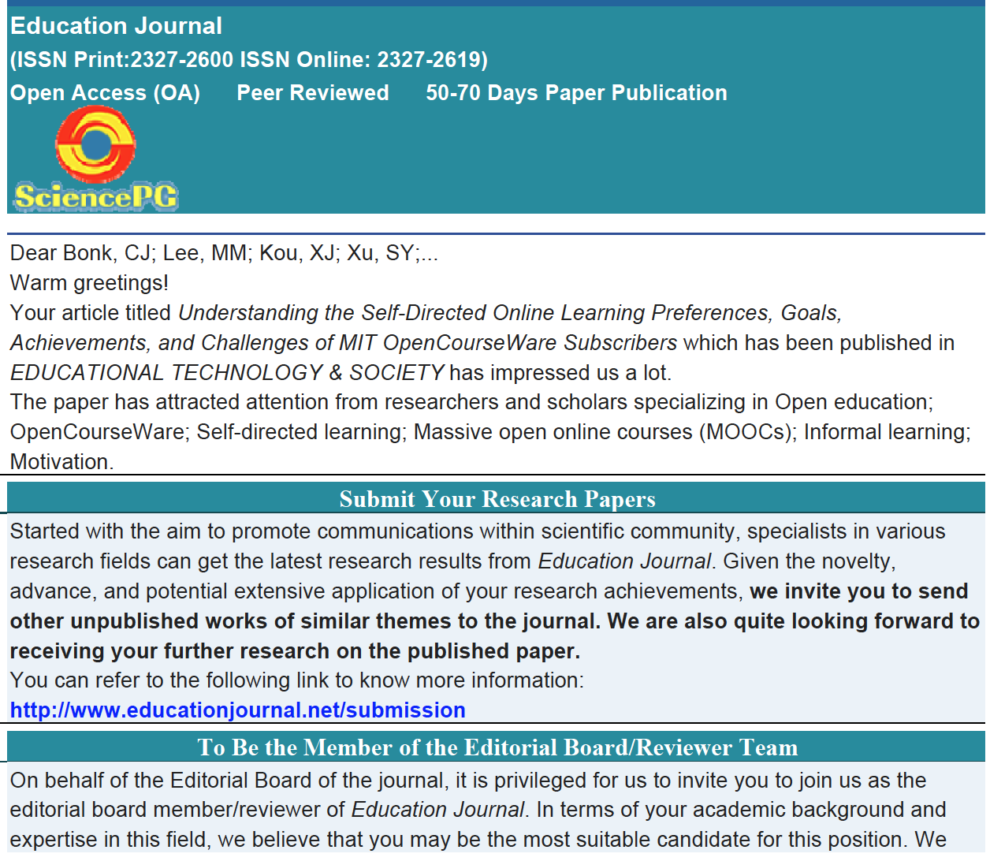
Predatory Journals/ Publishers
(Feng-Ru Sheu, Kent State University, 2018)
Examples of spam emails to attract potential authors
Notes:
Feng-Ru
the “Think. Check. Submit.” checklist developed by a coalition of scholarly publishing organizations
Think
Are you submitting your research to a trusted journal?
Is it the right journal for your work?

Slide 34
Selecting a Journal (Feng-Ru Sheu, Kent State University, 2018)
Be Aware Predatory Journals!
Using the “Think. Check. Submit.” checklist
Developed by a initiative of scholarly publishing organizations
(think.check.submit.org, 2018)
Notes:
Feng-Ru

Slide 35
Selecting a Journal (Feng-Ru Sheu, Kent State University, 2018)
Be Aware Predatory Journals!
Criteria to check the journal
Do you or your colleagues know the journal?
Can you easily identify and contact the publisher?
Is the journal clear about the type of peer review it uses?
Are articles indexed in services that you use?
Is it clear what fees will be charged?
Do you recognize the editorial board?
Is the Publisher a member of a recognized industry initiative?
Access the checklist in detail at http://thinkchecksubmit.org/check/
Notes:
Feng-Ru

Slide 36
Selecting a Journal (Feng-Ru Sheu, Kent State University, 2018)
Two resources to identify the journals and publishers
The Directory of Open Access Journals (DOAJ): https://doaj.org/
Identify legitimate and high quality open access, peer-reviewed journals
Beall’s List of Predatory Journals and Publishers: https://beallslist.weebly.com/
Identify predatory journals/publishers
Notes:
Feng-Ru

Slide 37
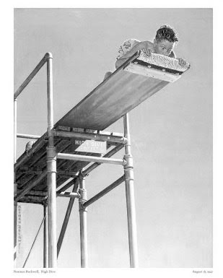
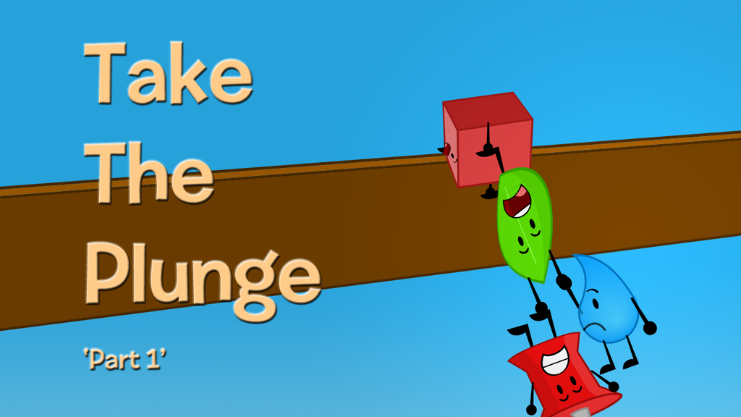
Take the Plunge…Part 1
Look for opportunities to create publishable manuscripts from your dissertation
Contribute with a chapter
Conduct an interview
Write a practical article, newsletter, or book review
Notes:
Ana
Review articles and conference proposals (learn about peer-review criteria and guidelines)
Review book proposals
Do a conference workshop
Organize a symposium
37

Slide 38
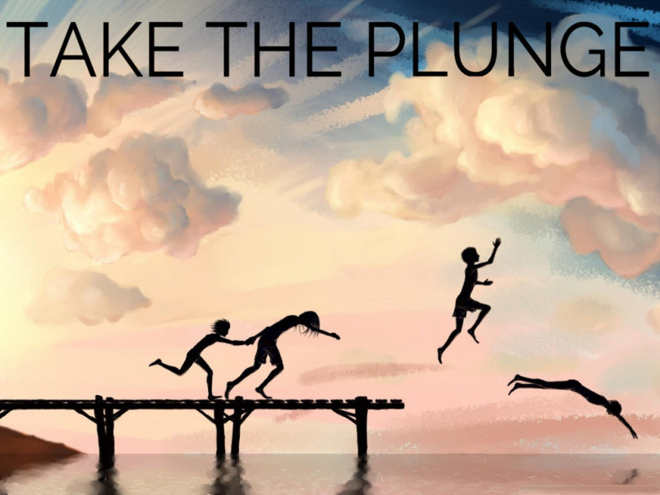
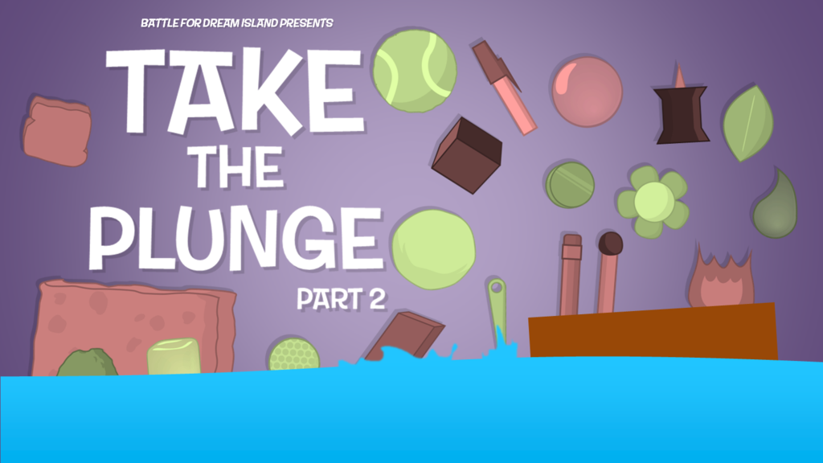
Take the Plunge…Part 2
Write a major grant proposal
Lead a special journal issue
Edit a book
Sole author a book
Get your name out there!
Notes:
Curt
38

Slide 39
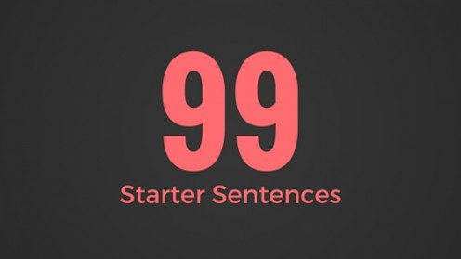
Generate Starter Text…
Author a blog
Use social media
Submit a conference proposal
Write editorials
Write book and software reviews
101
Notes:
Curt

Slide 40
Writing Tips and Insights
Insights and Advice on Getting Published from a New Faculty’s Perspective
Notes:
40

Slide 41
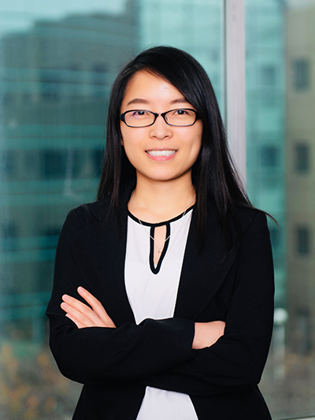
Meina Zhu: An Early Career Perspective
1. Goals 2. Strategic Plans 3. Reflection 4. Collaborators 5. Professional Development
Notes:
41

Slide 42
1. Writing Goals
Notes:
https://images.app.goo.gl/MKuUp4qKm1YVWaVy6
42

Slide 43
2. Strategic Plans
Notes:
43

Slide 44
3. Reflection on Writing
Notes:
https://images.app.goo.gl/GaBmk1XemmM54JxR7
44

Slide 45
4. Writing Collaborators
Notes:
Curt
45

Slide 46
5. Professional Development
Notes:
https://images.app.goo.gl/TQVEw8DGimxmRLGr9
46

Slide 47
Curt Bonk: Reflections on a Hot Streak
1. Persistence and grit.
2. Sense of now.
3. One at a time.
4. Assemble best team for you. Find comfort.
5. Intense and Relaxed Planning.
6. Explore Possible Journals and Commit.
7. Everyone has clear role.
8. Set bold and audacious goals.
9. Recheck list. Recheck goals.
10. Revel in good luck. Do not sulk if bad luck.
Notes:
47

Slide 48
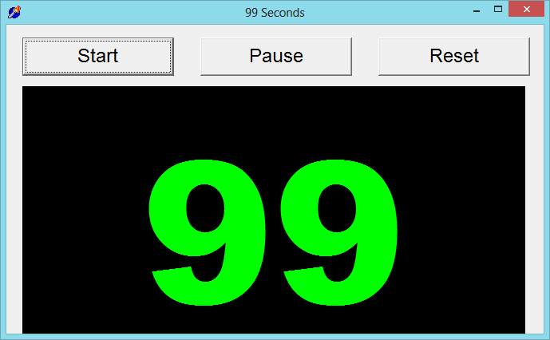
99 Seconds Activity #1
Commit to 1 to 2 things…than take the plunge and share them with your next chair neighbor.
Notes:
Curt
Not sure if we want to keep all these activities as we only have 1 hour and 5 minutes and need to leave time for questions. It’s up to you….
48

Slide 49
99 Seconds Activity #1
With your next chair neighbor discuss 1 to 2 writing dilemmas currently facing.
Notes:
Ana
Not sure if we want to keep all these activities as we only have 1 hour and 5 minutes and need to leave time for questions. It’s up to you….
49

Slide 50
Part II: Writing Tips and Insights
Insights and Advice on Getting Published Higher Education from An Experienced Faculty Member Perspective
Notes:
Curt
50

Slide 51
October 2, 2018 How to Learn to Write Like a Machine Rose Jacobs, Inside Higher Ed https://www.chronicle.com/blogs/linguafranca/2018/10/02/how-to-learn-to-write-like-a-machine/
Notes:
Curt

Slide 52
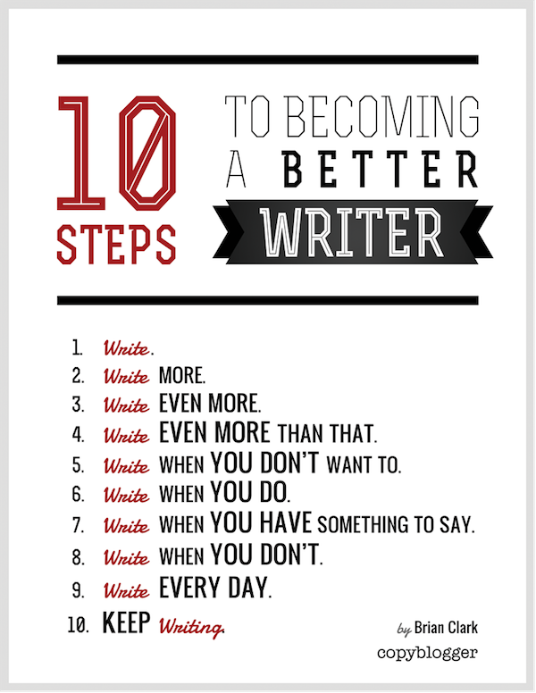
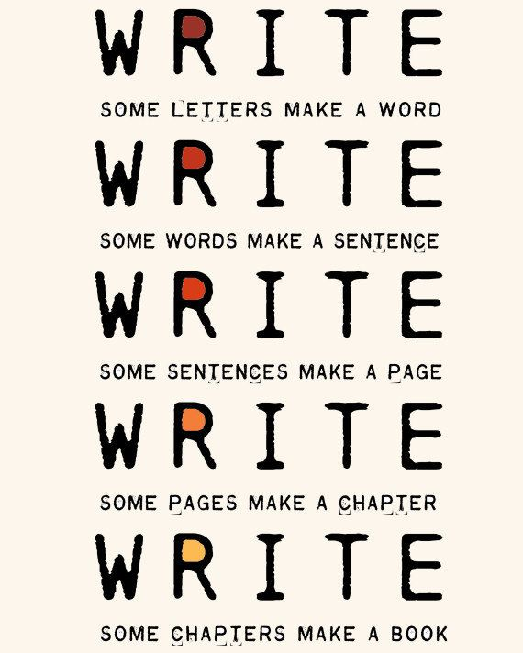
The Top 20 Writing Tips
Notes:
Curt
52

Slide 53
1. Mark Writing Days in Planner
Notes:
Curt
53

Slide 54
2. Maintain a List and Network of Potential Research and Writing Collaborators
Notes:
Curt
54

Slide 55
Sidenote: Find Good People to Work With…Life is Short—Avoid Egomaniacs and People Who Lie
Notes:
Curt
55

Slide 56
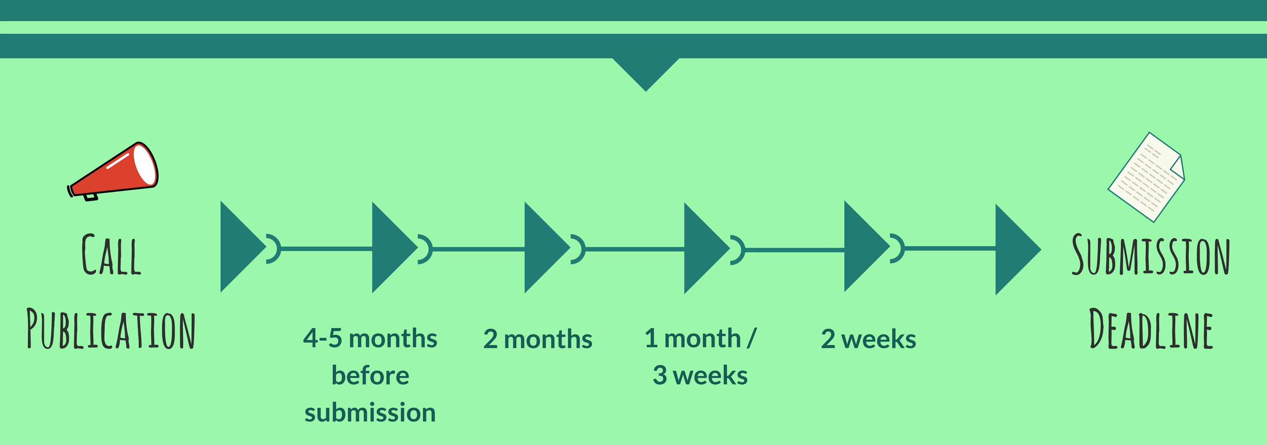
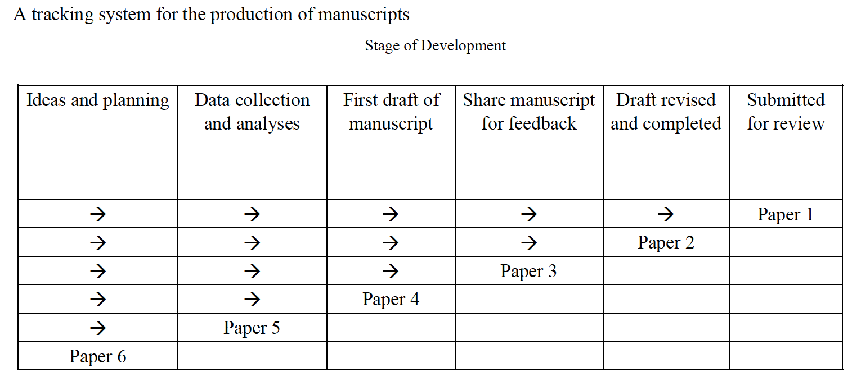
3. Draft a Timeline or Multiple Timelines with Flexible Goals
Notes:
Curt
Screenshot from Cecil’s article
56

Slide 57
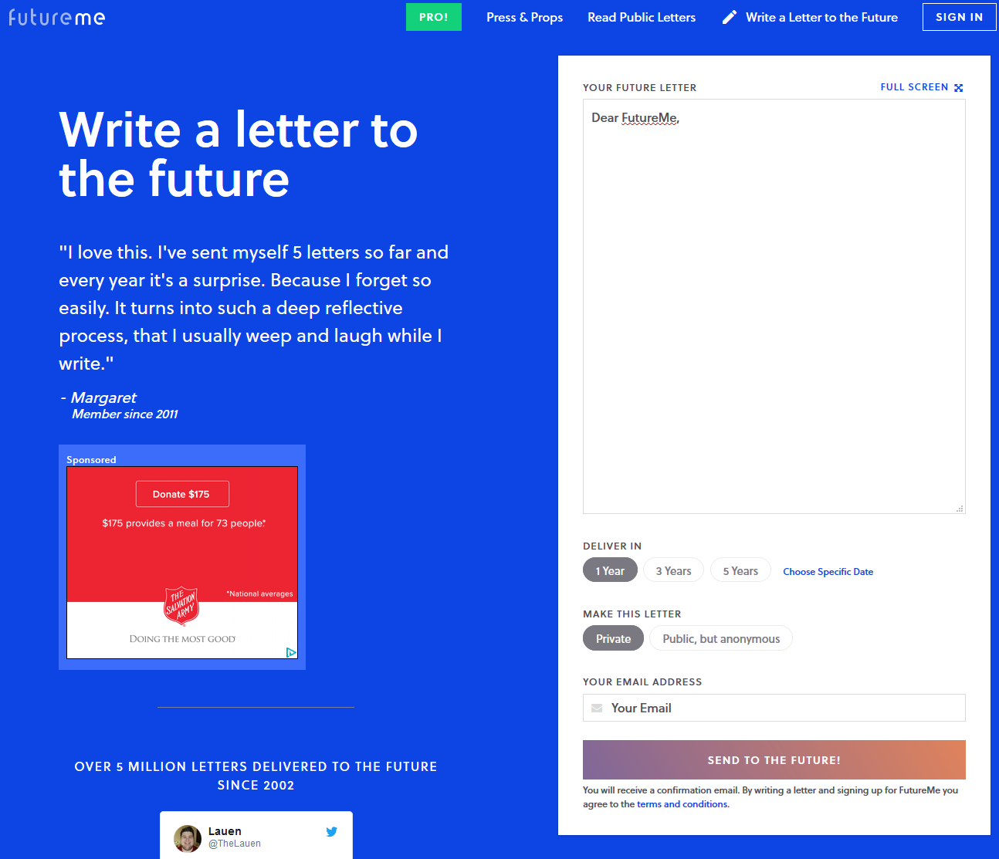
October 10, 2018 Perhaps write to your future self about your goals… FutureMe.org Write a letter to the future https://www.futureme.org/
Notes:
Curt
Screenshot from Cecil’s article
57

Slide 58
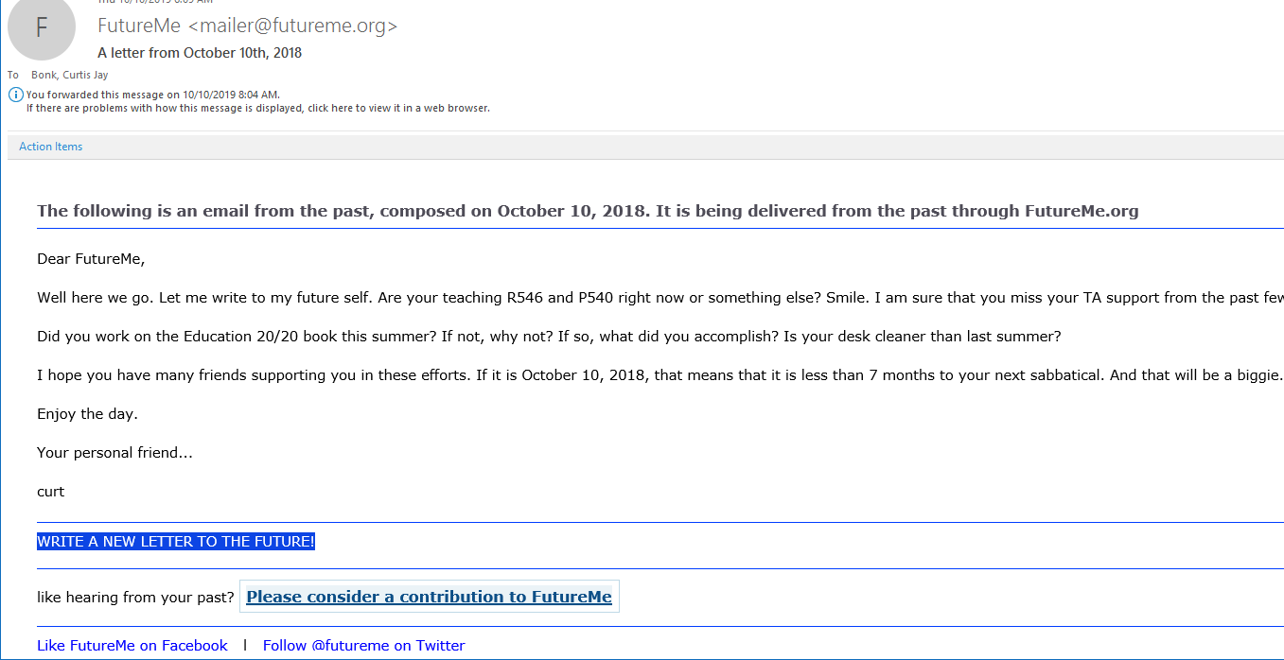
October 10, 2019 The following is an email from the past, composed on October 10, 2018. It is being delivered from the past through FutureMe.org FutureMe mailer@futureme.org

Slide 59
4. Think Ahead About the Publishing Potential of Each Project
Notes:
Curt
59

Slide 60
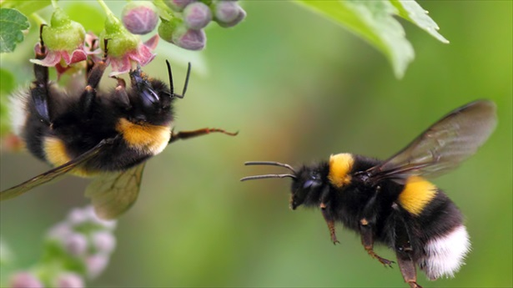
5. Be a Bumblebee and Butterfly
Notes:
Curt
60

Slide 61
6. Find, Save, and Use Starter Text (overcomes writer’s block)
Notes:
Curt
61

Slide 62
7. Always Scan the Reference Sections of Other Articles to See What Journals are Popular
Notes:
Curt
62

Slide 63
8. Avoid High Quality (i.e., SSCI) Journal Fixations
Notes:
Curt
63

Slide 64
9. Be Second or Third Author Sometimes to Spread Limited Resources
Notes:
Curt
64

Slide 65
10. If Need Summer Money, Teach Short Term or Intensive Courses
Notes:
Curt
65

Slide 66
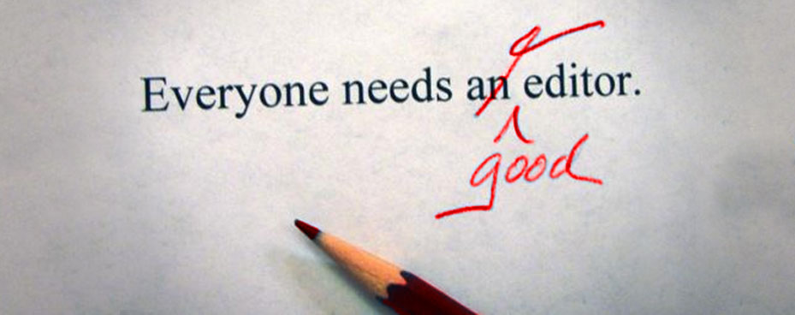
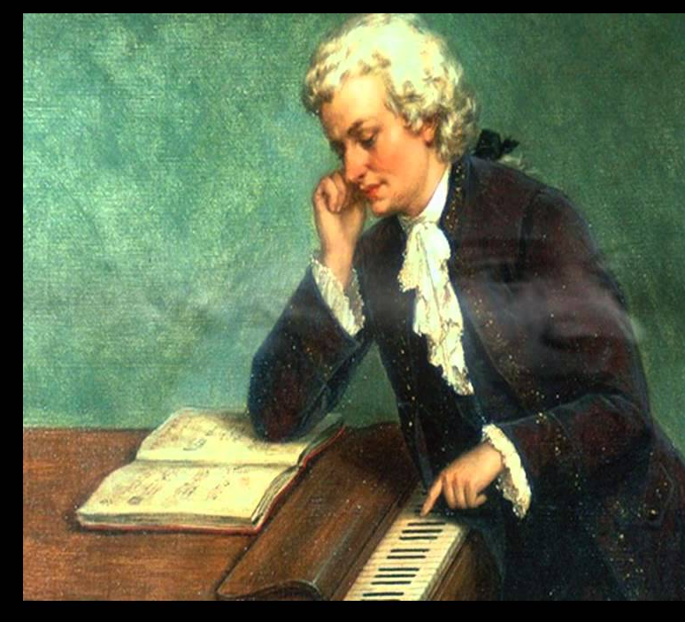
11. Edit Your Papers a Lot! (Mozartian vs. Beethovenian)
Notes:
Curt
66

Slide 67
October 1, 2018 6 Tips to Shape Up Your Writing Two-Minute Tips: Short videos to help you excel in the academic workplace Fernanda Zamudio-Suaréz, The Chronicle of Higher Education https://www.chronicle.com/article/6-Tips-to-Shape-Up-Your/244281?cid=cp221 https://www.chronicle.com/specialreport/Two-Minute-Tips/221
Writing is an exercise (write!).
Set goals based on output not input (e.g., 3 pages double-spaced).
Find a voice (don’t just focus on getting published).
Give yourself time (not deadlines).
Pick a puzzle (your writing is an answer to that puzzle).
Edit your work (over and over and over again…just like Beethoven).
Notes:
Curt

Slide 68
October 8, 2018 How to Improve Your Teaching-Philosophy Statement Two-Minute Tips: Short videos to help you excel in the academic workplace Fernanda Zamudio-Suaréz, The Chronicle of Higher Education https://www.chronicle.com/article/How-to-Improve-Your/244283 https://www.chronicle.com/specialreport/Two-Minute-Tips/221
Notes:
curt

Slide 69
October 15, 2018 How to Become a Highly Productive Writer Two-Minute Tips: Short videos to help you excel in the academic workplace Fernanda Zamudio-Suaréz, The Chronicle of Higher Education https://www.chronicle.com/article/How-to-Become-a-Highly/244351?cid=cp221 https://www.chronicle.com/specialreport/Two-Minute-Tips/221
Notes:
curt

Slide 70
12. Organize Conference Symposia Which Can Lead to Special Journal Issues and Books
Notes:
Curt
70

Slide 71
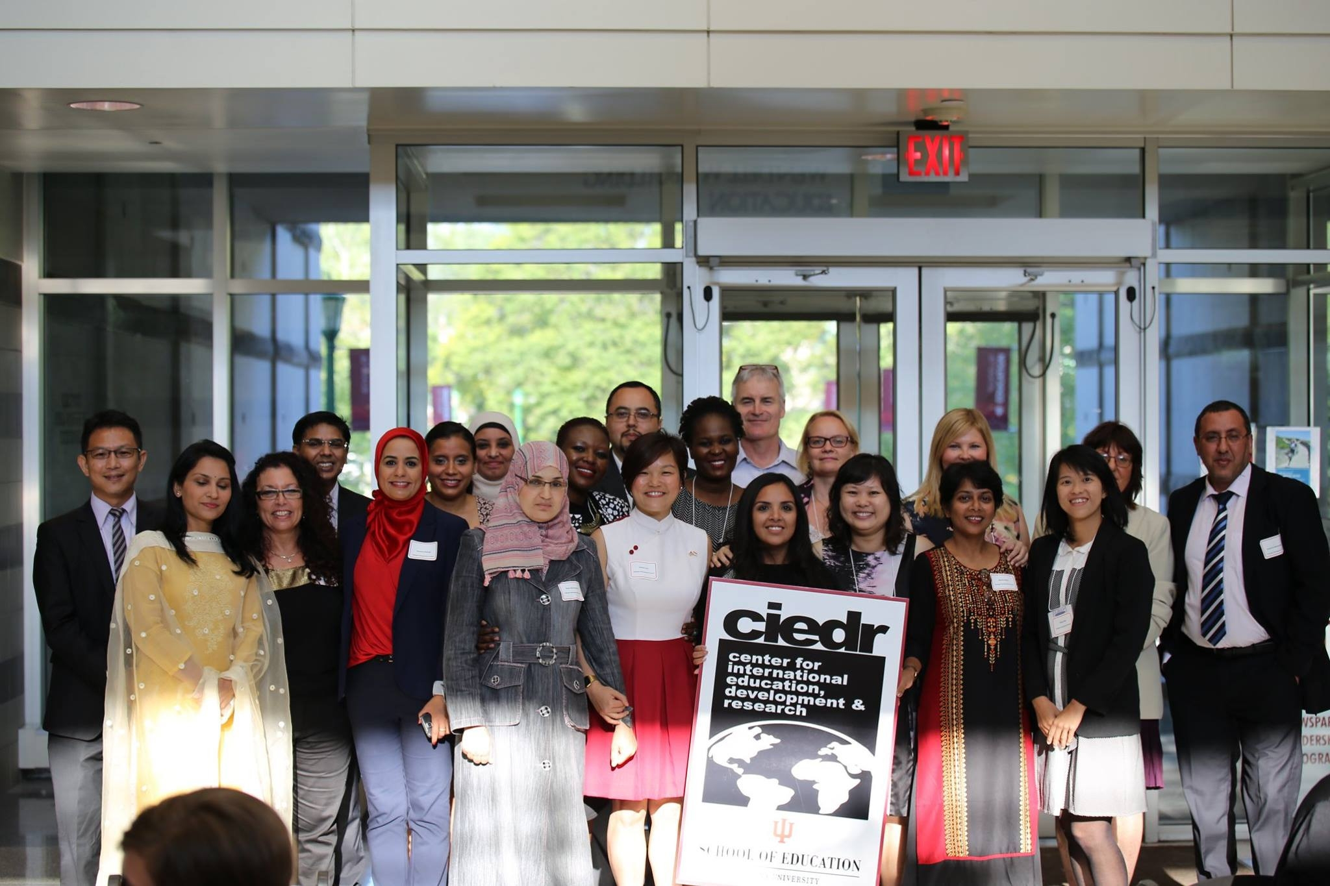
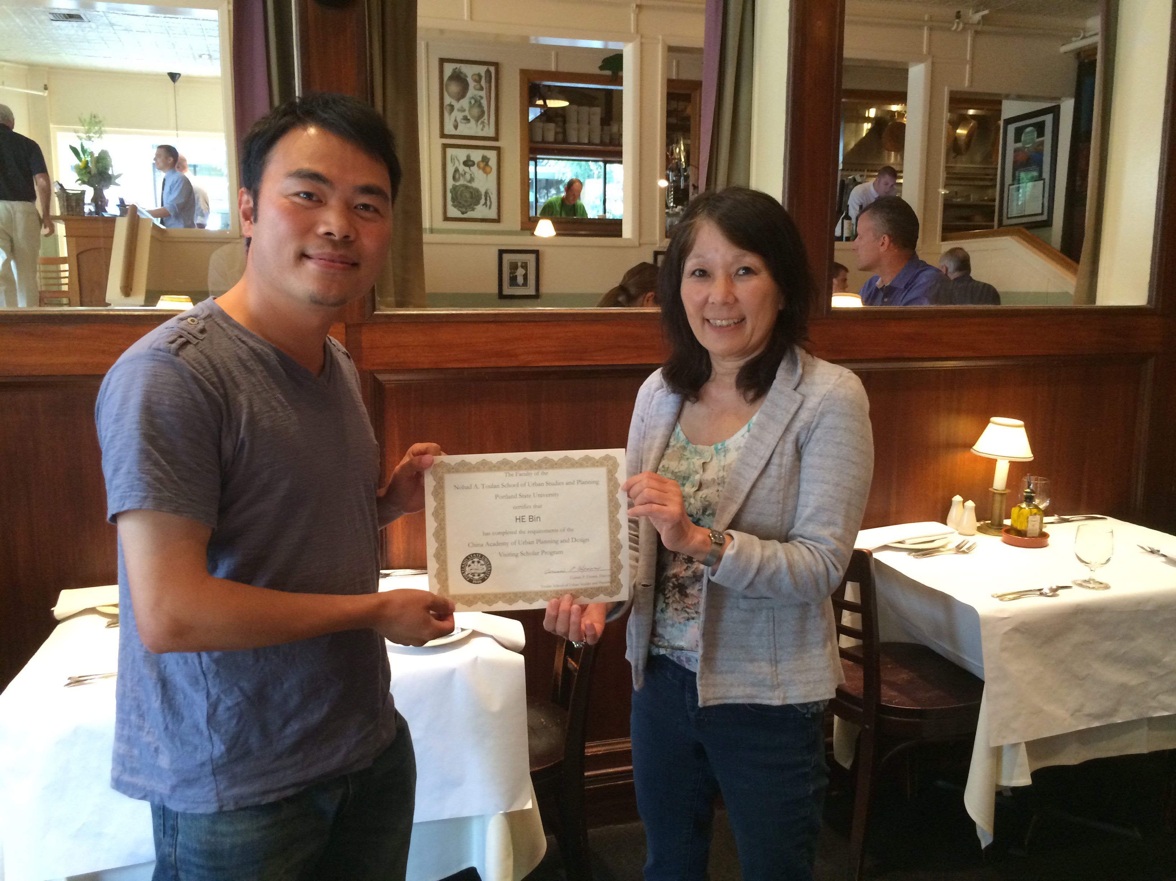
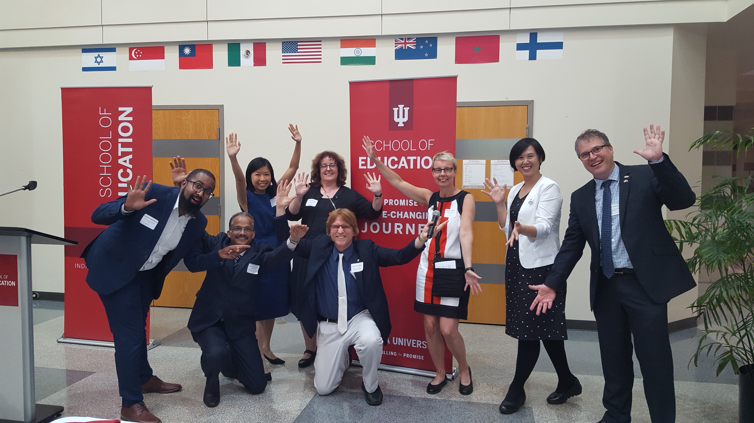
13. Sponsor Visiting Scholars to Work with You; They Often Have Writing Plans
Notes:
Curt
71

Slide 72
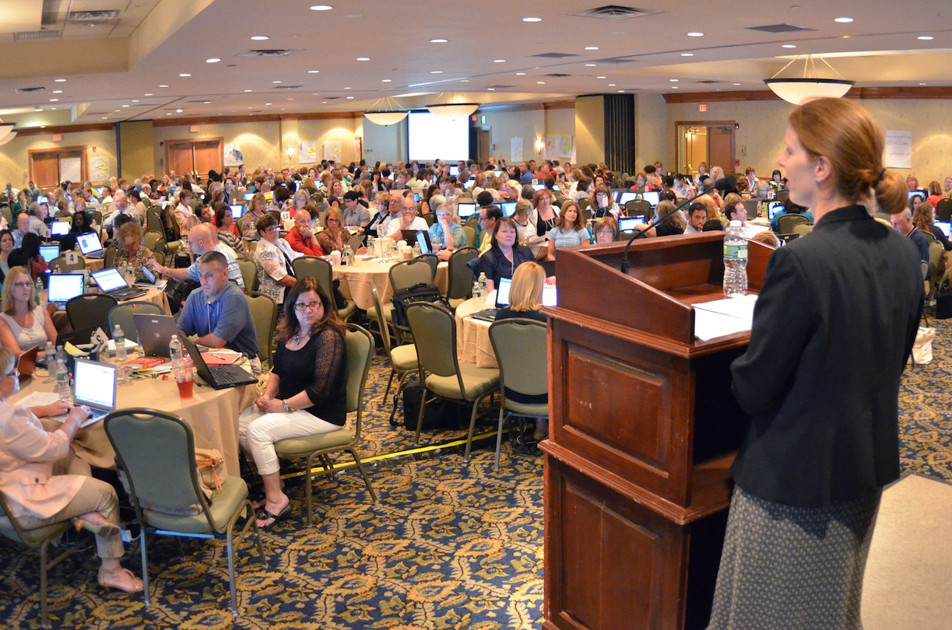
14. Try to Submit or Publish Your Paper Before the Conference
Notes:
Curt
72

Slide 73
15. Be Creative Somewhere (e.g., unique model, figure, chart, etc.)
Notes:
Curt
73

Slide 74
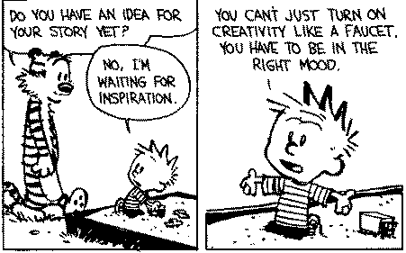
Sidenote: Modify Your Environment (Find or Create Your Personal Sandbox)
Notes:
Curt
74

Slide 75
But not too much!
Notes:
Curt
75

Slide 76
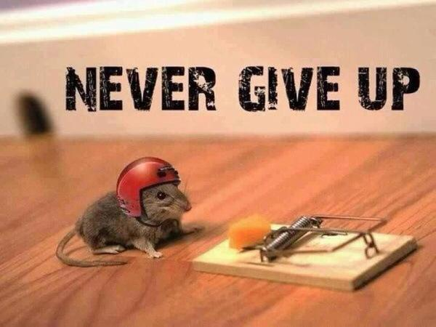
16. Try Not to Give Up: Persistence and Grit Wins the Day
Notes:
Curt
76

Slide 77
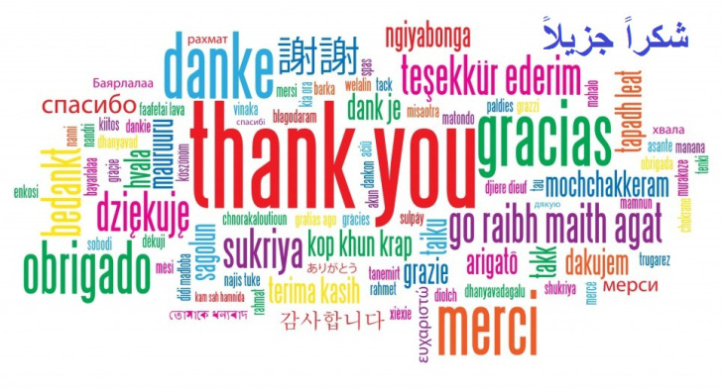
17. Be Polite and Thankful to the Journal or Book Chapter Editors
Notes:
Curt
77

Slide 78
18. Recap Reviewer Points and How You Attempted to Address Them
Notes:
Curt
78

Slide 79
February 12, 2019 From Dreaded to Amazing Cathy N. Davidson, Inside Higher Ed https://www.insidehighered.com/advice/2019/02/12/how-use-reviewers-revise-and-resubmit-comments-most-effectively-opinion

Slide 80
February 12, 2019 From Dreaded to Amazing Cathy N. Davidson, Inside Higher Ed https://www.insidehighered.com/advice/2019/02/12/how-use-reviewers-revise-and-resubmit-comments-most-effectively-opinion

Slide 81
February 12, 2019 From Dreaded to Amazing Cathy N. Davidson, Inside Higher Ed https://www.insidehighered.com/advice/2019/02/12/how-use-reviewers-revise-and-resubmit-comments-most-effectively-opinion

Slide 82
March 24, 2019 Tackling Revisions Alexandra Gold, Inside Higher Ed https://www.insidehighered.com/blogs/gradhacker/tackling-revisions

Slide 83
October 4, 2018 A New Series on Scholarly Productivity: ‘Are You Writing?’ Rebecca Shuman, The Chronicle of Higher Education https://www.chronicle.com/article/A-New-Series-on-Scholarly/244689
Read as peer reviewer; mark up everything.
Catalog problems on a 1 to 3 difficulty scale (Level 1 takes less than 30 minutes, Level 2 takes 2 hours or less; Level 3 takes more time).
Fix the easy ones and gain momentum for the harder ones!
Take breaks as needed.
Notes:
Curt

Slide 84
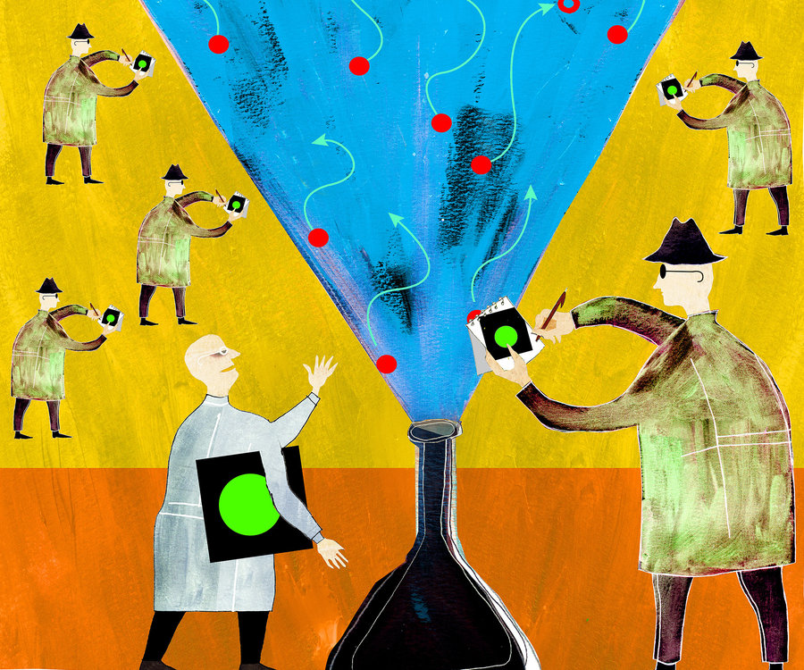
19. Share Your Publication Efforts (e.g., Twitter, Facebook, LinkedIn, email, ResearchGate, Academia.edu, etc.)
Notes:
Curt
84

Slide 85
20. Celebrate Your Writing Accomplishments with Friends
Notes:
Curt
85

Slide 86
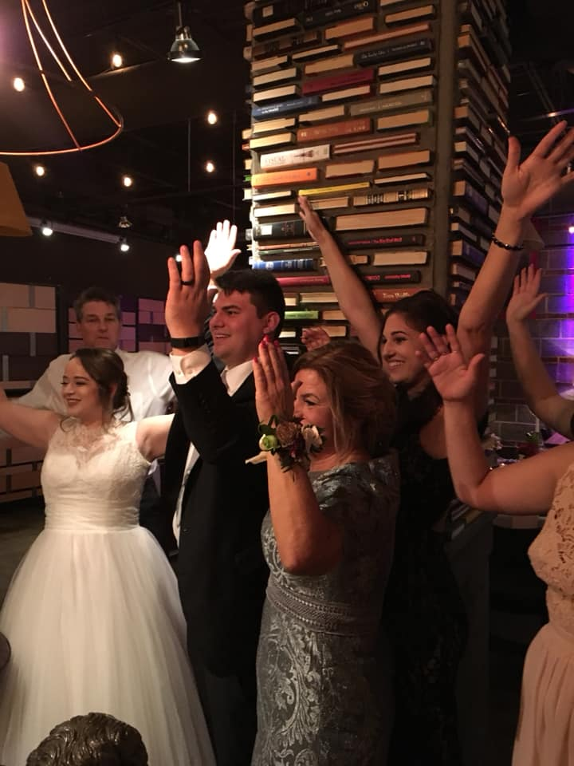
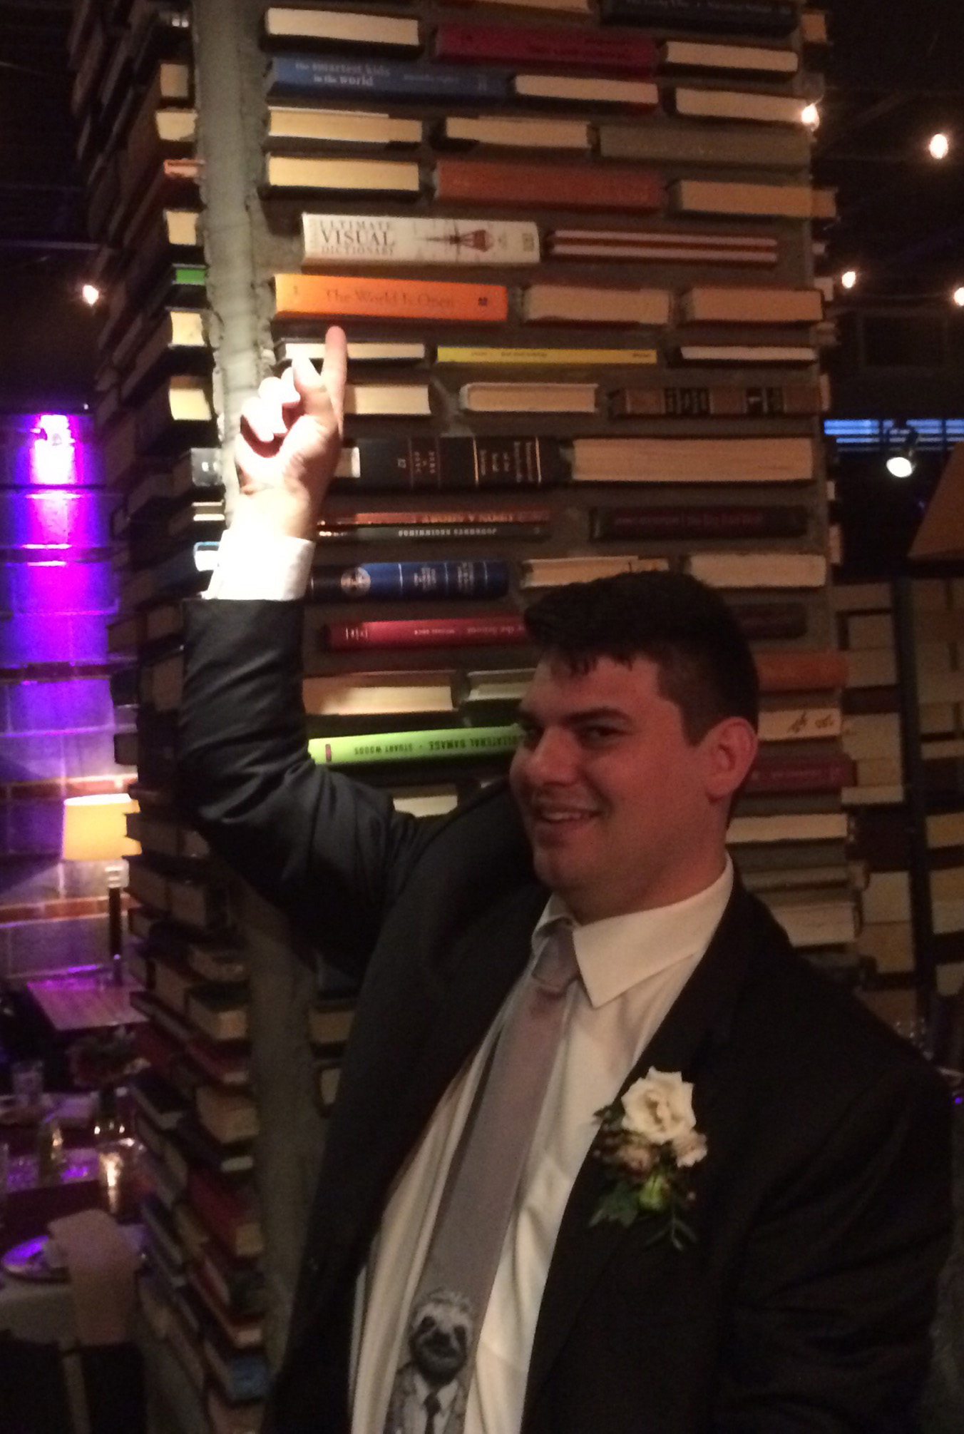
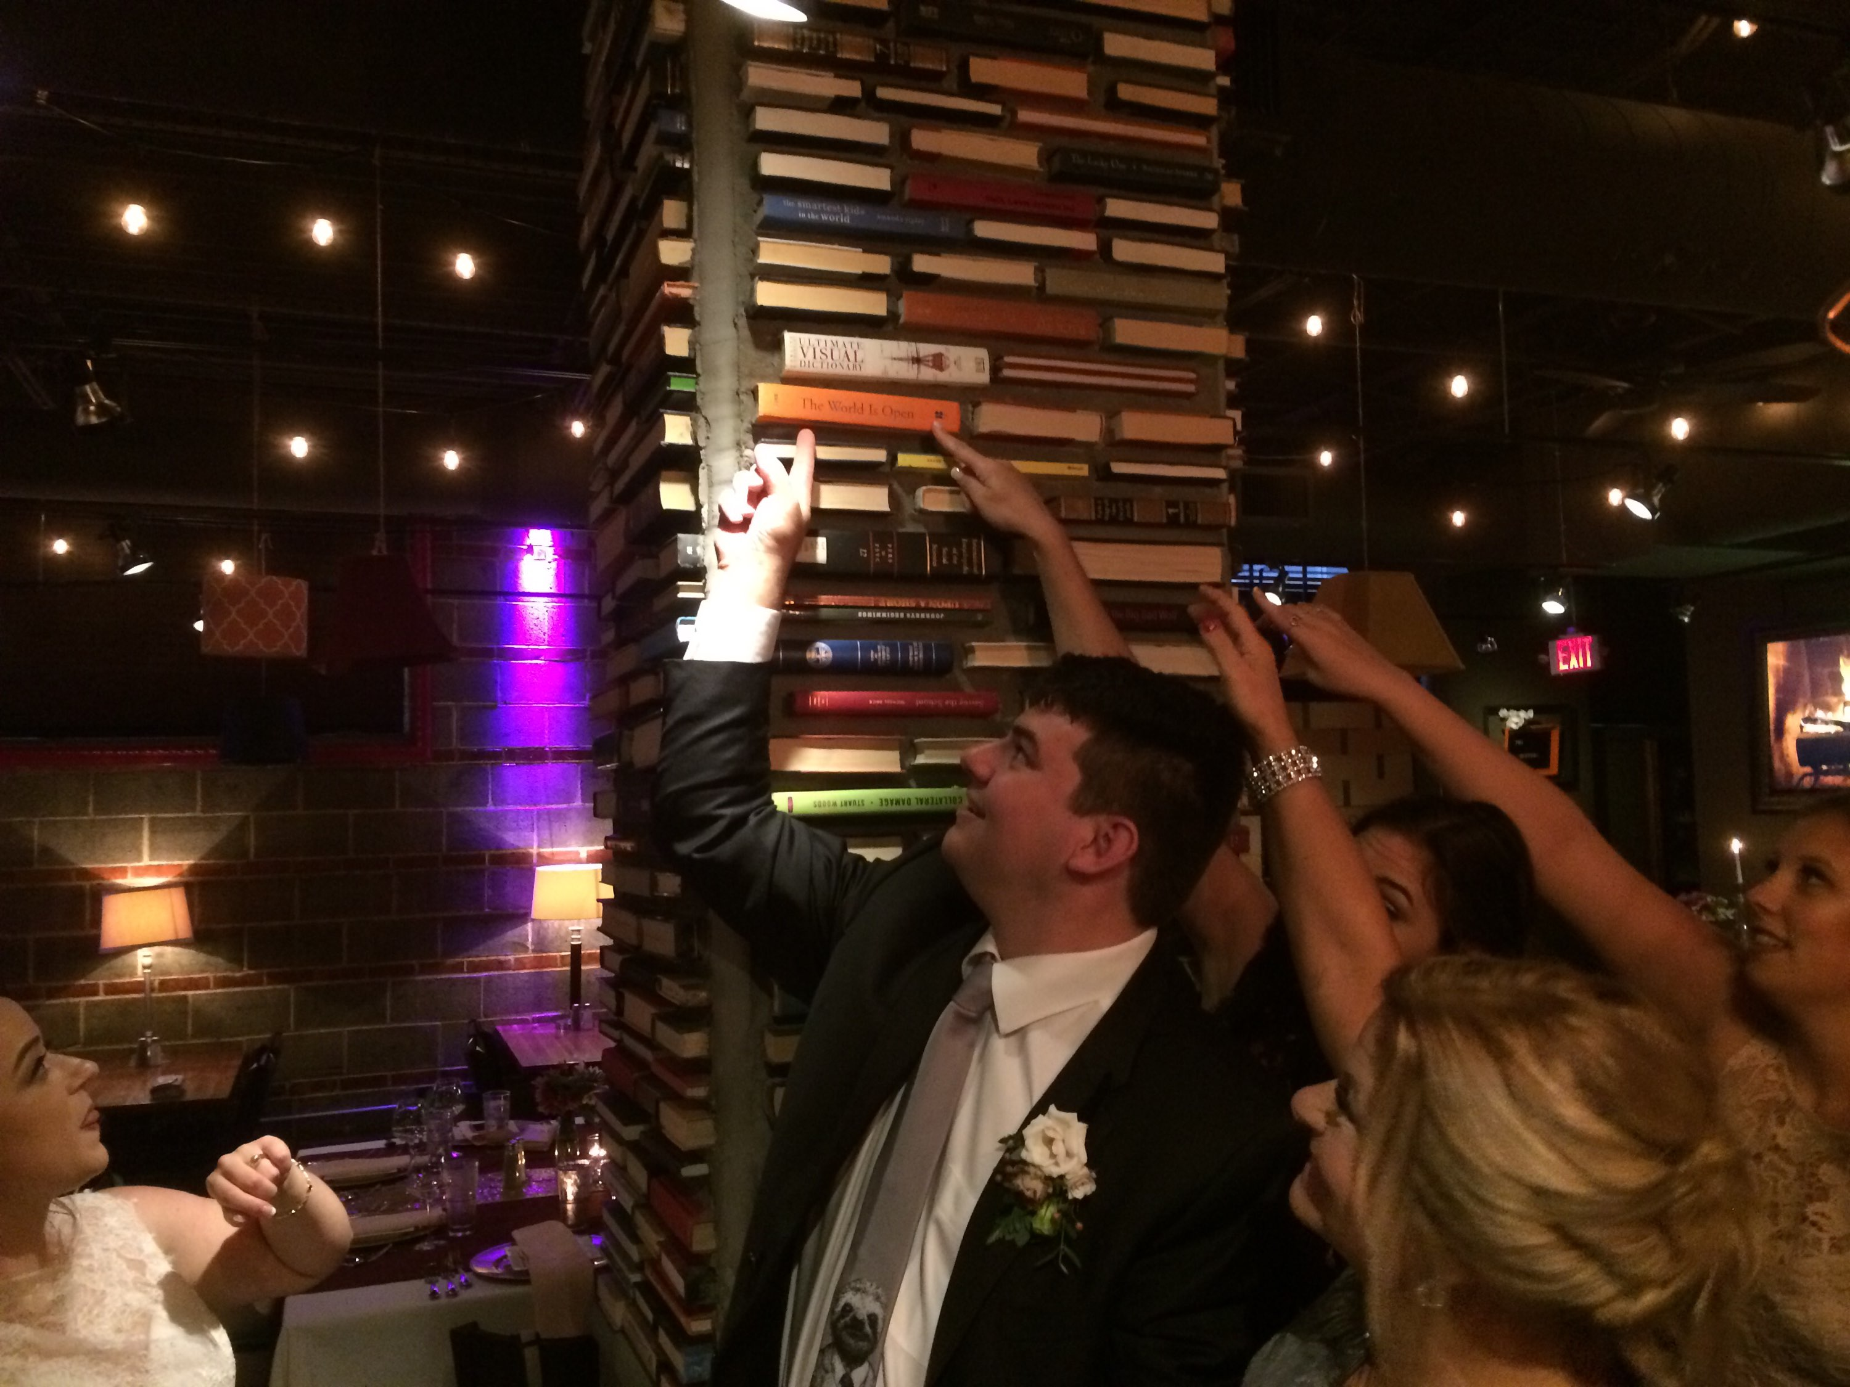
You never know where you’ll be celebrating your writing accomplishments… Even at a wedding of your nephew!
Notes:
Curt
86

Slide 87
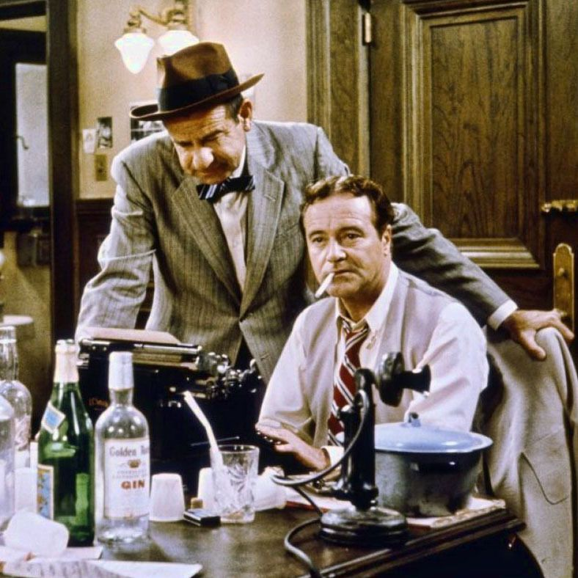
Just don’t celebrate too much!
Notes:
Curt
87

Slide 88
Bonus #1. Be Careful Committing to Other People’s Projects (OPP)
Notes:
Curt
88

Slide 89
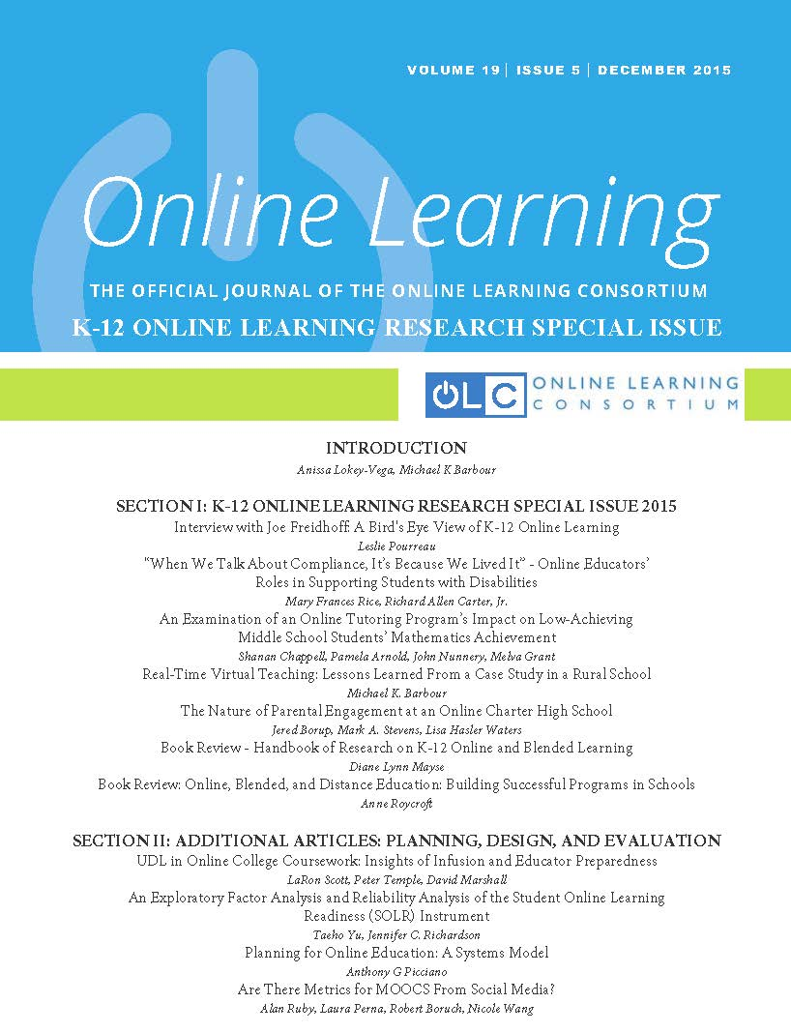
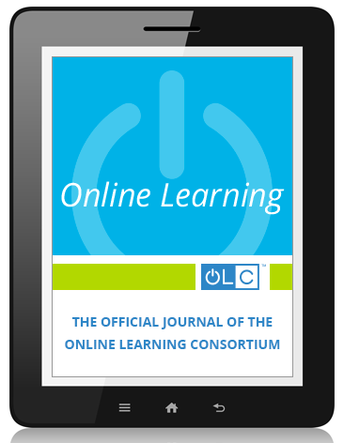
Bonus #2. Look for Special Issues that You Might Contribute To
Notes:
Curt
89

Slide 90
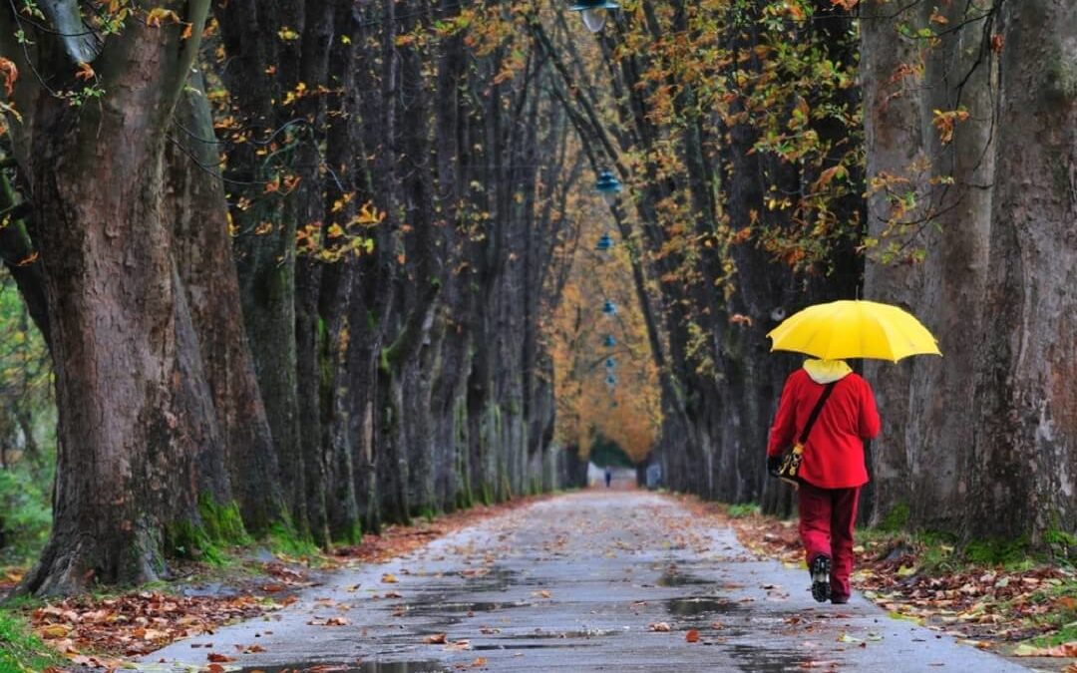
Bonus #3. Save Research Articles for a Rainy Day (file folders on different topics)
Notes:
Curt
90

Slide 91
Bonus #4. Treat Graduate Students as Colleagues (hec, treat everyone as a colleague)
Notes:
Curt
91

Slide 92
Bonus #5. Find a Mentor and Ask Senior People for Advice
Notes:
Curt
92

Slide 93
Bonus #6. Form a Writing Group
Notes:
Curt
93

Slide 94
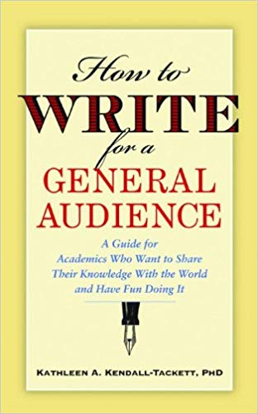
Bonus #7. Write for the General Public
Notes:
Curt
94

Slide 95
Bonus #8. Keep a Notebook of What Thinking
Notes:
Curt
95

Slide 96
Bonus #9. Engage in Free Writing
Notes:
Curt
96

Slide 97
Bonus #10. Read Everyday!

Slide 98
Time to Recap…
The process for getting published
The process for selecting a journal for publication
Writing tips and insights
Curated resources
You commitments to future writing
Notes:
Ana
Encourage audience to access the resources on GoogleDoc.
98

Slide 99
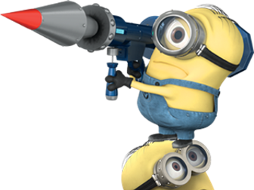
Concerns?
Comments?
Commitments?
Curt Bonk, IU, Email: cjbonk@Indiana.edu
Meina Zhu, WSU, Email: meinazhu@wayne.edu
Slides: http://www.trainingshare.com/workshop.php
Notes:
All
99

