Slide 1
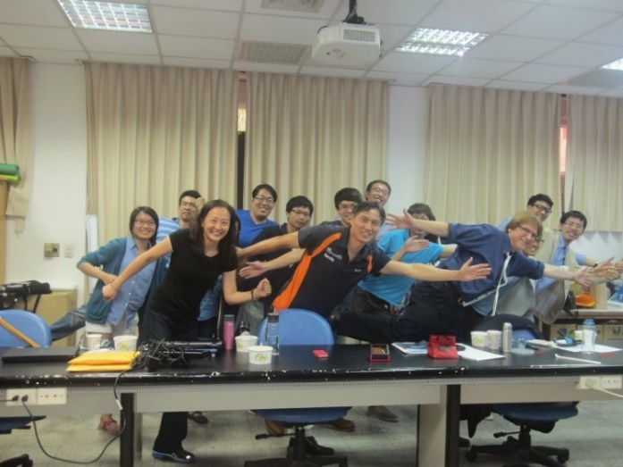
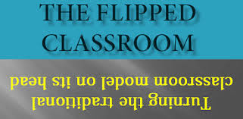
Are You Flipping Out or Flipping In?: The How’s, Why’s, and What’s of the Flipped Classroom Model
Curtis J. Bonk, Professor
Indiana University
cjbonk@indiana.edu
http://mypage.iu.edu/~cjbonk/

Slide 2
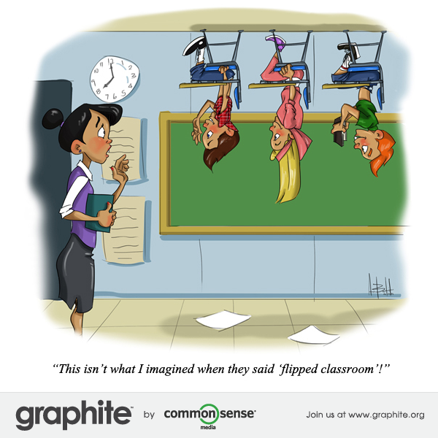
What is Flipped Classroom?

Slide 3
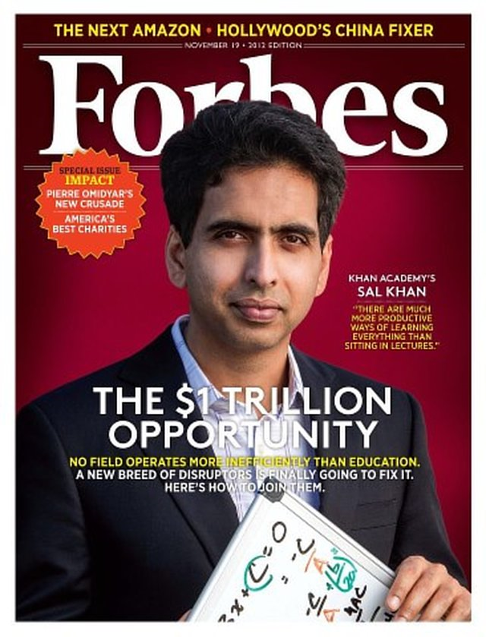
Learning is More Flipped One Man, One Computer, 10 Million Students: How Khan Academy Is Reinventing Education, Forbes, November 19, 2013, Michael Noer http://www.forbes.com/sites/michaelnoer/2012/11/02/one-man-one-computer-10-million-students-how-khan-academy-is-reinventing-education/ The One World Schoolhouse (Twelve, Oct. 2, 2012)

Slide 4
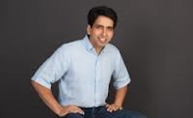
Salmon Khan (2012). The One World Schoolhouse
“The old classroom model simply doesn’t fit our changing needs. It’s a fundamentally passive way of learning, while the world requires more and more active processing of information.”

Slide 5
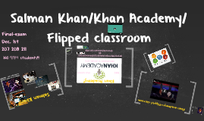
Salmon Khan (2012). The One World Schoolhouse
He explains that if students have consumed learning content before class, "teachers can then carve out face time with individual students who are struggling; they can move away from rote lecturing and into the higher tasks of mentoring, inspiring, and providing perspective."

Slide 6
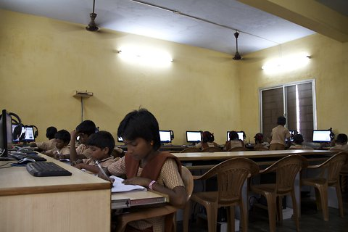
Reusable Khan Lacking Teachers and Textbooks, India’s Schools Turn to Khan Academy to Survive, NY Times, Anupama Chandrasekaran, Oct. 15, 2012 http://india.blogs.nytimes.com/2012/10/15/lacking-teachers-and-textbooks-indias-schools-turn-to-khan-academy-to-survive/
Students at Sree Karpagavalli Vidhyalaya school in Chennai, Tamil Nadu, watching Khan Academy math videos.

Slide 7
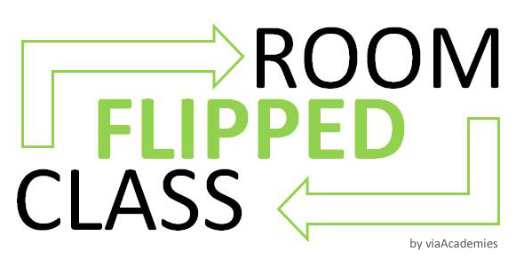
The Flipped Classroom

Slide 8
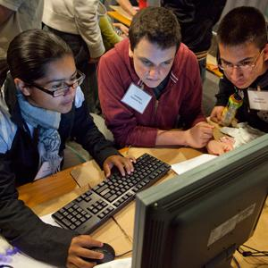
March 12, 2014 The Flipped Learning Network http://www.flippedlearning.org/definition

Slide 9
2013 and 2014 10 Pros And Cons Of A Flipped Classroom, Mike Acedo, TeachThought The Teacher’s Guide To Flipped Classrooms, Edudemic http://www.teachthought.com/learning/blended-flipped-learning/10-pros-cons-flipped-classroom/ http://www.edudemic.com/guides/flipped-classrooms-guide/
Pros:
Greater student control
Work at own pace
Learner-centered--engaged
Collaborative projects
Enhanced discussion
Increase access to content
Can share content ideas
Learning efficiencies
Pedagogical opportunities
Personalized attention

Slide 10
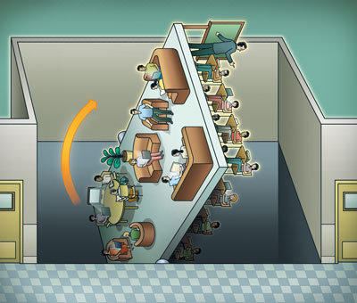
What is Flipped Classroom?
A model of learning that rearranges how time is spent both in and out of class to shift the ownership of learning from the educators to the students (The NMC horizon report, 2014).
The Flipped Classroom inverts teaching methods, delivering instruction online outside of class and moving homework into the classroom.
Students watch online lectures at home at their own pace, communicating with peers and teachers via online discussion.
Source: Demski, J. (2013), Illustration by Peter Hoey

Slide 11
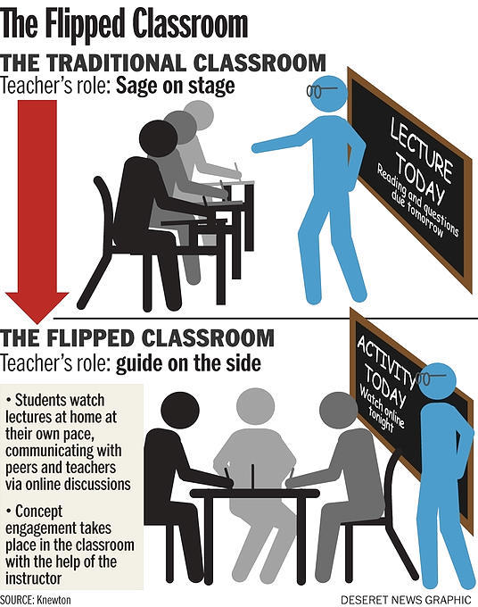
LiveTiles https://www.livetiles.nyc/education-flipped-classroom-vs-traditional-classroom/

Slide 12
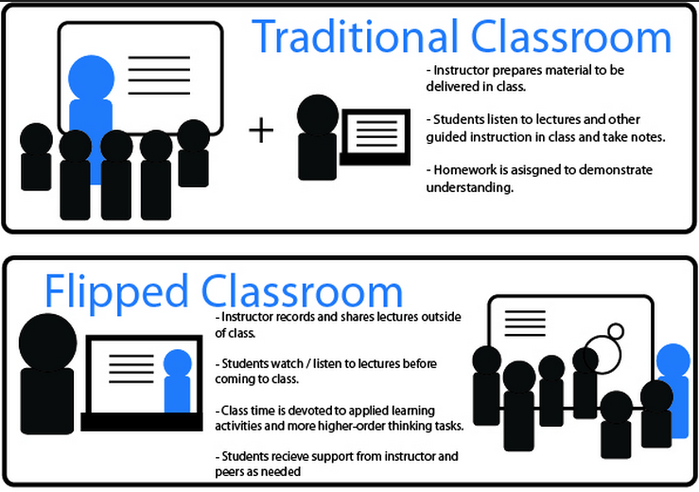
June 2, 2014 University of Wollongong Moodle Lab Wendy Meyers http://www.uowblogs.com/moodlelab/tag/flipped-classroom/

Slide 13
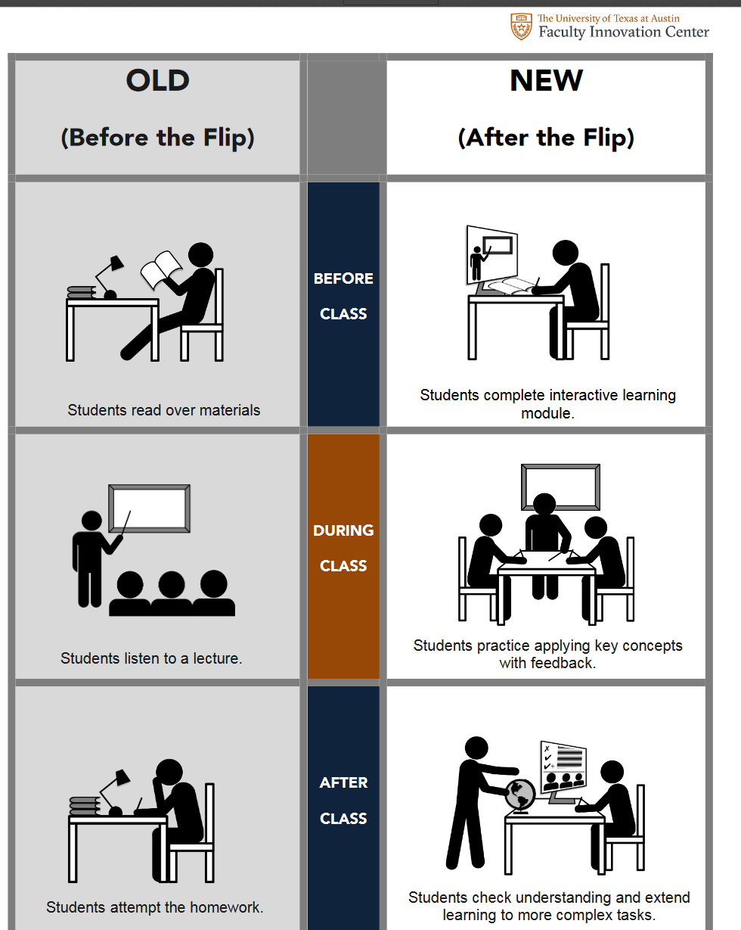
2016-2017 "Flipping" a class University of Texas at Austin https://facultyinnovate.utexas.edu/teaching/strategies/flipping (video: .57) https://facultyinnovate.utexas.edu/sites/default/files/what-is-flipped_comparison-table-120516.pdf

Slide 14
December 21, 2012 Flipping the Classroom: Explained https://www.youtube.com/watch?v=iQWvc6qhTds (video: 1:48)

Slide 15
September 28, 2015 The Flipped Classroom Model https://www.youtube.com/watch?v=qdKzSq_t8k8 (video: 3:00)

Slide 16
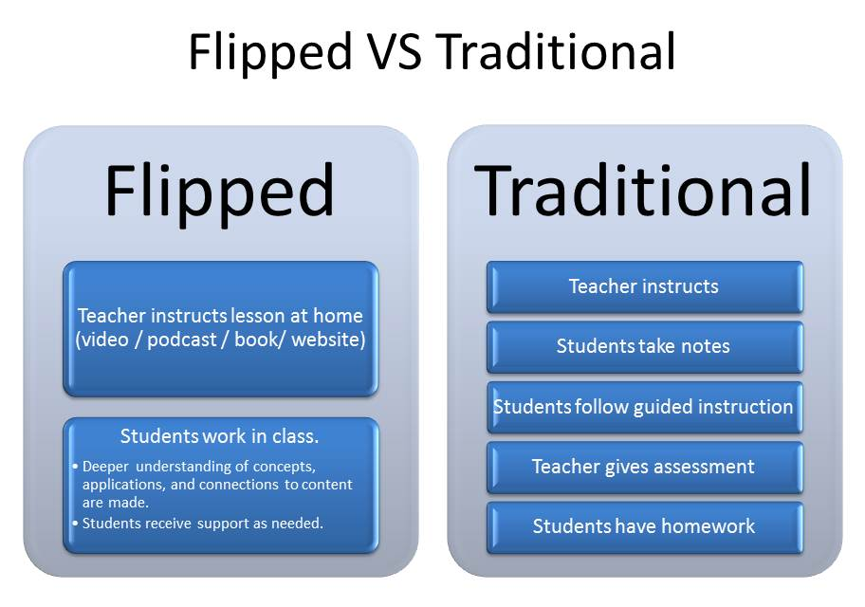
Freddie Diaz-Batista, Flipped Learning February 14, 2014, E-learning Blog http://freddiediazbatista.com/main/

Slide 17
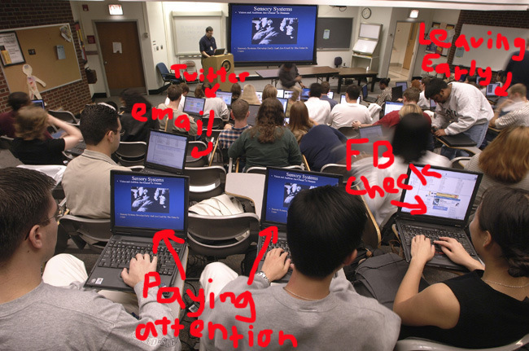
Digital distraction in the classroom July 11, 2012 by Stephanie Chasteen, The Active Class http://theactiveclass.com/category/uncategorized/

Slide 18
Digital distraction in the classroom July 11, 2012 by Stephanie Chasteen, The Active Class http://theactiveclass.com/category/uncategorized/

Slide 19
Teacher’s role
Traditional Classroom
Flipped Classroom
SAGE in the stage
GUIDE on the side
Source: Jeremy F. Strayer, Ohio State University, Flipped Class Conference 2011 (KNEWTON)

Slide 20
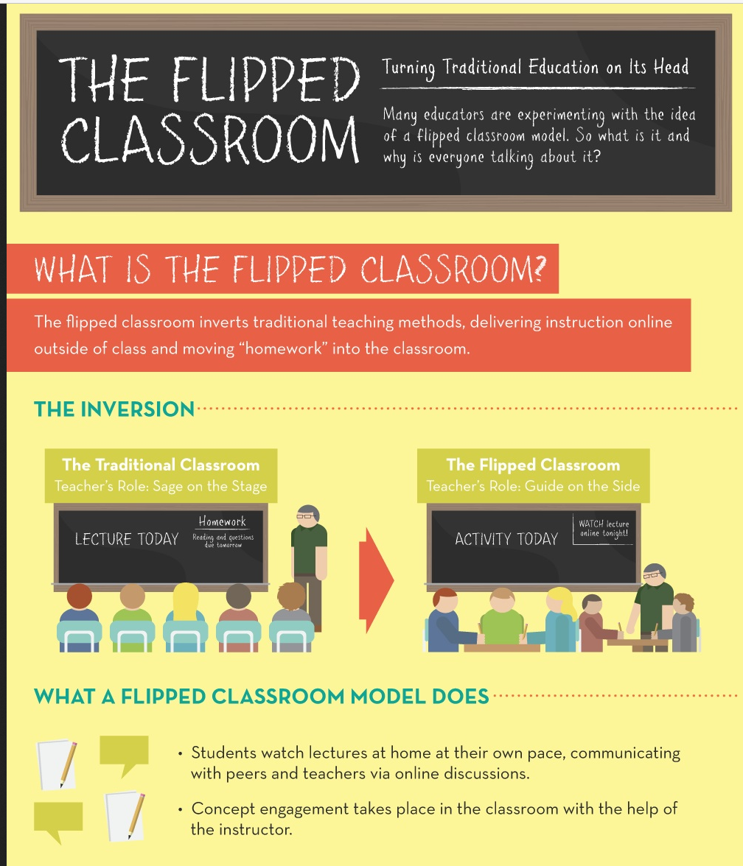
The Teacher’s Guide To Flipped Classrooms, Edudemic http://www.edudemic.com/guides/flipped-classrooms-guide/

Slide 21
Flattened Classrooms and Learning Studios Adjusting the Prescription: The School of Medicine overhauls its century-old educational approach. Maura Singleton, February 2011, University of Virginia http://uvamagazine.org/articles/adjusting_the_prescription/

Slide 22
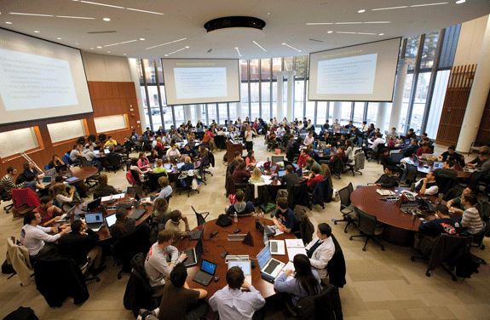
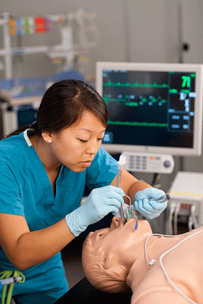
Flattened Classrooms and Learning Studios Adjusting the Prescription: The School of Medicine overhauls its century-old educational approach. Maura Singleton, February 2011, University of Virginia http://uvamagazine.org/articles/adjusting_the_prescription/
The Learning Studio: First-year medical students work in teams in the learning studio, a radical departure from the lecture hall. “One of the goals of this whole model—of having students do a lot of the learning themselves rather than passively listening—is that they need to be lifelong learners,” says Randolph Canterbury, senior associate dean for education. (called the “flattened classroom”)

Slide 23
April 30, 2014 Flipped learning skepticism: Can students really learn on their own?, Robert Talbert, Chronicle of Higher Education http://chronicle.com/blognetwork/castingoutnines/2014/04/30/flipped-learning-skepticism-can-students-really-learn-on-their-own/
“Unfortunately this is a common misconception about the flipped classroom: That it’s “learning on your own” without any guidance or support from an instructor… A misconception about the flipped classroom itself, that it is a pedagogy of abandonment, where students are loaded up with books and videos but then left to fend for themselves.”

Slide 24
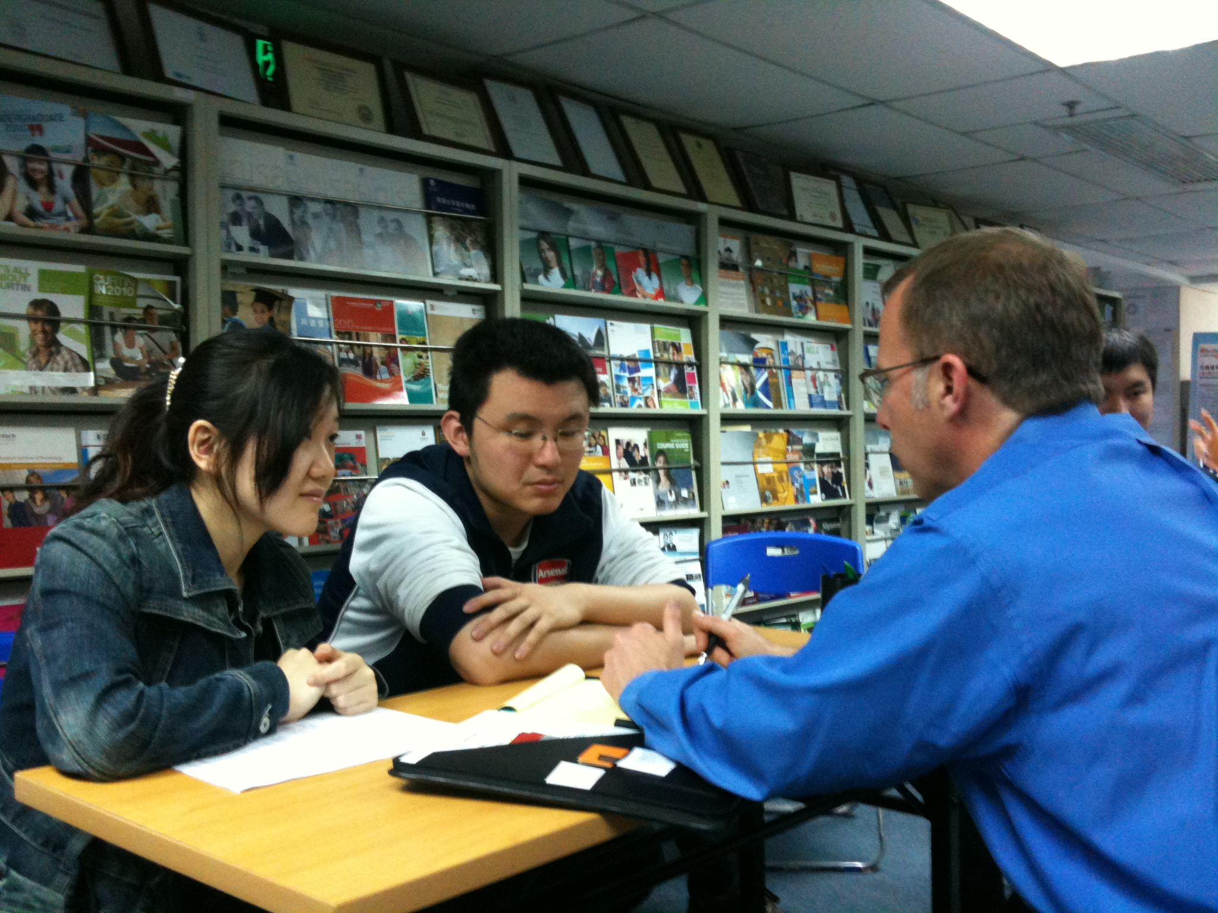
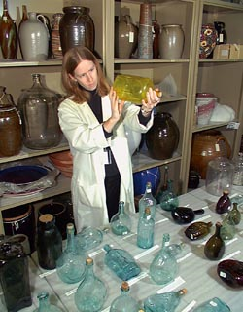
Instructor Role Changes

Slide 25
March 12, 2014 The Flipped Learning Network http://www.flippedlearning.org/definition April 1, 2014 Toward a common definition of “flipped learning”, Robert Talbert, Chronicle of HE http://chronicle.com/blognetwork/castingoutnines/2014/04/01/toward-a-common-definition-of-flipped-learning/
Four pillars:
Flexible environment (various modes of learning)
Learning culture (student-centered inquiry)
Intentional content (direct instruction b4 class)
Professional educator (reflective and accessible; collaborates and perfects one’s craft)

Slide 26
Flexible Environment

Slide 27
Learning Culture

Slide 28
Audience Polling Q#1: How get learners to do the work before class?
Model it
Points awarded
Test on it, email back 2-3 answers
Make it an expected part of the community
What else?

Slide 29
Audience Polling Q#2: How else motivate to flip?
Grade their prework
Inspire
Share the purpose, rationale, objectives
Use it
Bring back former students for testimonials
Build on it (not a one-off activity)

Slide 30
6 Expert Tips for Flipping
Use existing technology to ease faculty and students into a flipped mindset.
Be up front with your expectations.
Step aside and allow students to learn from each other.
Assess students' understanding of pre-class assignments to make the best use of class time.
Set a specific target for the flip.
Build assessments that complement the flipped model.
Source: Jennifer Demski, Campus Technology, 23 January 2013

Slide 31
May 13, 2014 Exploring the Fringe: Flipping, Microcredentials, and MOOCs Jeff Cobb and Celisa Steele, Tagoras http://www.tagoras.com/2014/05/13/flipped-learning-microcredentials-moocs/
May Require:
More time and effort to prepare.
Resource investments.
Prepared learners.
A different instructional philosophy.
Active participation.

Slide 32
May 13, 2014 Exploring the Fringe: Flipping, Microcredentials, and MOOCs Jeff Cobb and Celisa Steele, Tagoras http://www.tagoras.com/2014/05/13/flipped-learning-microcredentials-moocs/
Class time spent:
Problem solving activities;
Case studies;
Facilitated discussion;
Other.

Slide 33
Freddie Diaz-Batista, Flipped Learning, February 14, 2014, E-learning Blog http://freddiediazbatista.com/main/
“One of the big mistakes we made when we pioneered this model is that we focused too much on video. We now like to use the term “learning object” when we talk about the flipped classroom. A learning object can include videos, but it also can be resources such as online simulations, books, and periodicals.”

Slide 34
May 13, 2014 Exploring the Fringe: Flipping, Microcredentials, and MOOCs Jeff Cobb and Celisa Steele, Tagoras http://www.tagoras.com/2014/05/13/flipped-learning-microcredentials-moocs/
Flipped Content Includes:
Video captured from conferences.
Webinar recordings.
Brief audio or video interviews.
Screen recordings.
Various publications.

Slide 35
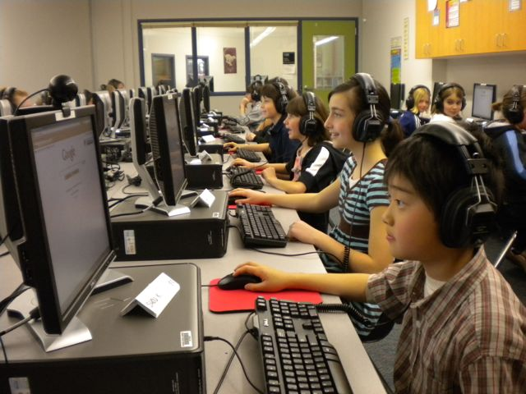
The Flipped Classroom Enables Personalized Learning Microsoft Educator Network http://www.pil-network.com/HotTopics/personalizedlearning/flipped-classroom-enables-personalized-learning#comments
Aaron Sams and John Bergmann’s book Flip Your Class: Reach Every Student in Every Class Every Day; “15 Reasons To Flip Your Classroom” speak to personalized learning:
Helps struggling students
Increases instructor-learner interaction
Allows for different learning rates or speeds

Slide 36
Teaching for Tomorrow: Flipped Learning (2:52) https://www.youtube.com/watch?v=4a7NbUIr_iQ The Flipped Classroom (2:14) https://www.youtube.com/watch?v=2H4RkudFzlc

Slide 37
Flipped-Learning Toolkit: 5 Steps for Formative Assessment Edutopia, GLEF https://www.edutopia.org/blog/five-steps-formative-assessment-jon-bergmann (1:40) https://www.edutopia.org/blog/flipping-the-non-flippable-classes-jon-bergmann (2:51) https://www.edutopia.org/blogs/tag/flipped-classroom

Slide 38
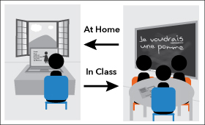
Why is flipping significant?
Students can watch, rewind, and fast-forward.
Stop and reflect.
Devote class time to application of concepts.
Better opportunity to detect errors in thinking.
Encourage social interaction and peer support.

Slide 39
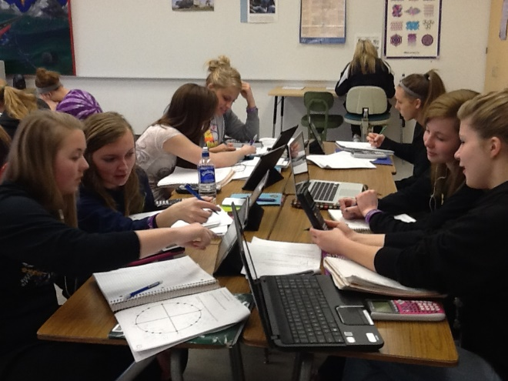
Digital distraction in the classroom July 11, 2012 by Stephanie Chasteen, The Active Class http://theactiveclass.com/category/uncategorized/
“I no longer go to work to ‘perform’ five times a day; instead, I look forward to going [to class] and interacting with my students all day,” says high school teacher Jonathan Bergmann…In the flipped class, instructors create video podcasts for students to watch — either of lectures, or solving a problem, or demonstrations — and post those for the students to watch at home.

Slide 40
Flipping the Class, Penn State (3:23 video) https://sites.google.com/site/flippingclass/

Slide 41
Flipping The Large Enrollment Psychology Classroom - NC State (Video: 3:45) https://www.youtube.com/watch?v=QTDQaaVWEzI

Slide 42
Ohio State Chemistry Flips the Classroom (Video: 1:10) https://www.youtube.com/watch?v=6FA_hCmfsp8

Slide 43
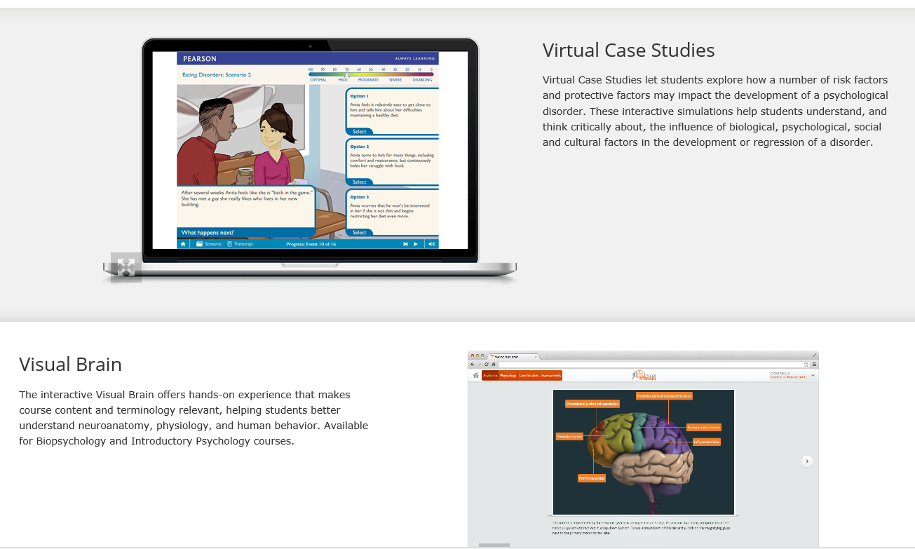
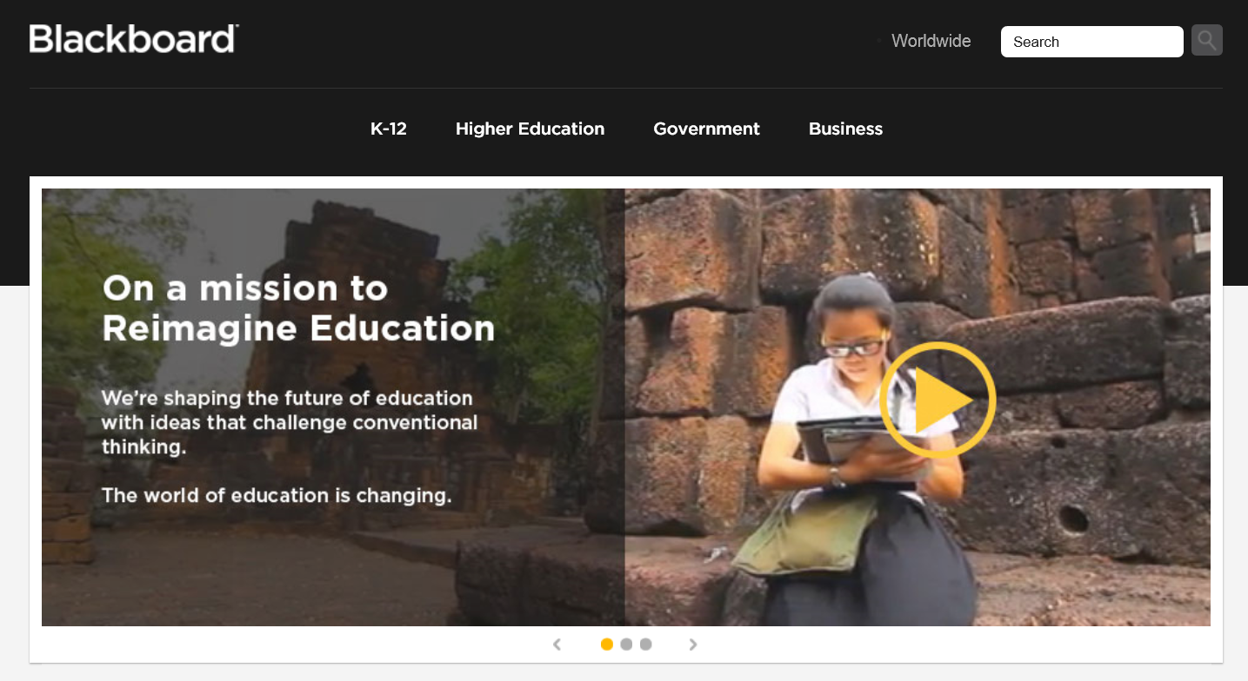
May 21, 2014 MyPyschLab from Pearson

Slide 44
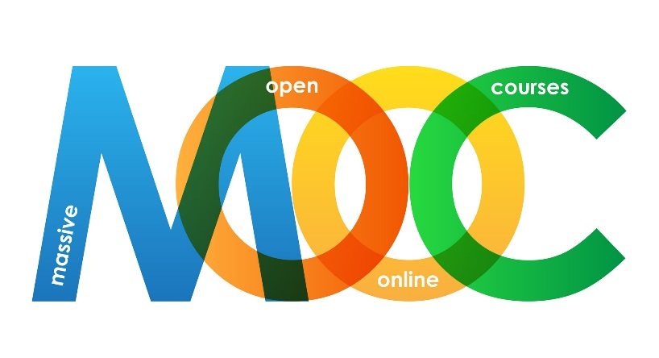
Flipping Via MOOCs! Happening in College Too! The Washington Post, Nick Anderson, March 11, 2013 http://www.washingtonpost.com/local/education/more-classroom-flipping-in-colleges/2013/03/11/0c425758-8a7f-11e2-98d9-3012c1cd8d1e_story.html

Slide 45
Flipped Classroom Research

Slide 46
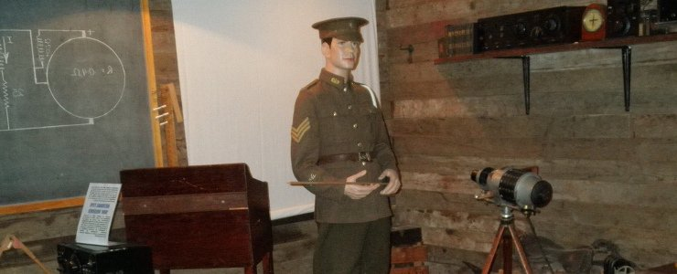
February 5, 2014 Lessons Learned from 1,125 Flipped Classrooms It's been 40 years since the Army first experimented with competency-based learning, Peter D. Lenn https://www.edsurge.com/n/2014-02-05-lessons-learned-from-1-125-flipped-classrooms
The solution they decided to test was what we now call the “flipped classroom”. After initial successes, the Army opened 1125 learning centers in every combat arms battalion worldwide. They also converted Advanced Individual Training schools to the flipped model. The result was the army was able to train over 500,000 soldiers for highly technical jobs with 85% reaching A-level competence in 40% less time than the prior conventional courses.

Slide 47
February 12, 2014 DODDS-Europe teachers find success with 'flipped classroom' approach Stars and Stripes, Jennifer H. Swan KAISERSLAUTERN, Germany http://www.stripes.com/news/dodds-europe-teachers-find-success-with-flipped-classroom-approach-1.266254
Tried PBL and Cooperative Learning but students not coming to class prepared.
After the first year of flipping math…
Traditional Approach: 77 D’s and F’s out of 265 students (2010-2011).
Flipped: 29 D’s and F’s (2011-2012.)

Slide 48
Influences on cooperation, innovation and task orientation
Strayer, J. F. (2012). How learning in an inverted classroom influences cooperation, innovation and task orientation. Learning Environments Research, 15(2), 171-193.
Compares learning environments of an inverted introductory statistics and traditional introductory statistics classes at the same university.
Less satisfied with the structure of flipped classroom than the traditional one,
More comfortable and open to cooperative learning and innovative teaching techniques.
The stability and connectedness of classroom learning communities higher.

Slide 49
How to embed inquiry and design projects
Warter-Perez, N., & Dong, J. (2012). Flipping the classroom: How to embed inquiry and design projects into a digital engineering lecture. In Proceedings of the 2012 ASEE PSW Section Conference.
Faculty at California State University flipped one introduction to Digital Engineering course with the goal:
Increasing quality of learning for collaborative PBL.
Address the prevalence of passive learning in engineering classroom and limited professor-student interaction in the large-scale classroom.
Findings: Flipped was effective in general, especially:
Improving understanding of course materials
Developing design skills.

Slide 50
Inverted classroom model in engineering statistics
Papadapoulos, C., & Roman, A. S. (2010). Implementing an inverted classroom model in engineering statistics: Initial results. American Society for Engineering Statistics.
Flipped engineering statistics. Findings:
Students more cooperative each other
Progressed faster thru learning materials;
Greater depth of understanding.
The student test scores higher than those in the traditional learning environment.

Slide 51
May 21, 2014 Missouri State U Improves Learning Outcomes With Flipped Course, Leila Meyer http://campustechnology.com/Articles/2014/05/21/Missouri-State-U-Improves-Learning-Outcomes-with-Flipped-Classroom.aspx?p=1 .
Introductory Psychology (changed fall 2012).
Old Version = 30 percent improvement.
Flipped Class = 76 percent improvement
DFW rate from 24 percent to 18 percent
“and this is a much more rigorous course now" said Hudson. "When you think about it in terms of dollars and retention, that's pretty significant."

Slide 52
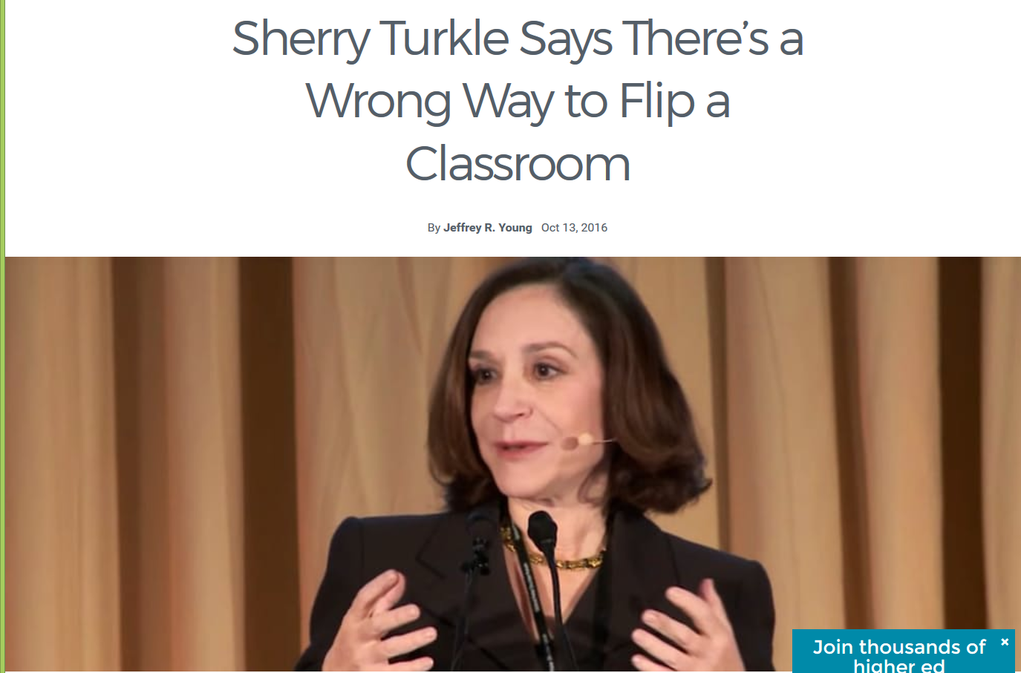
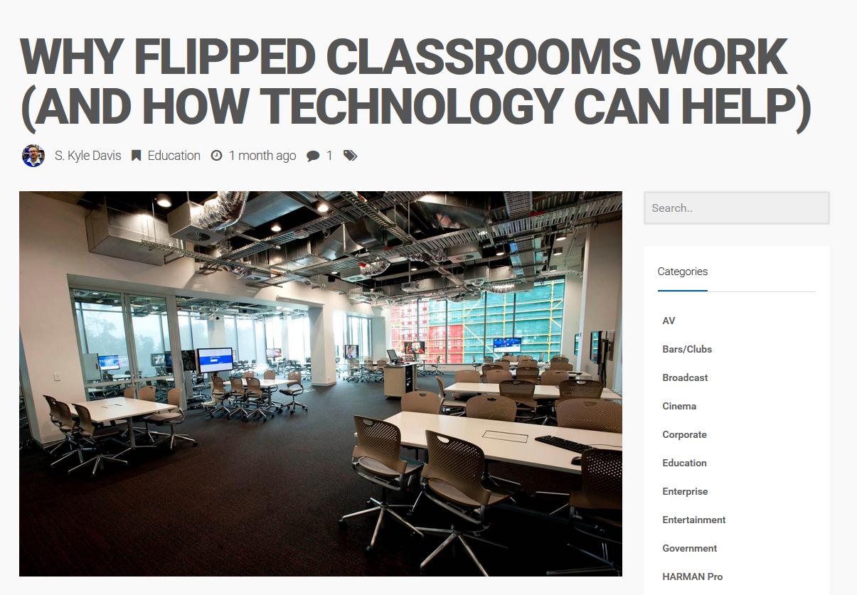
October 13, 2016 Sherry Turkle Says There’s a Wrong Way to Flip a Classroom Jeffrey Young, EdSurge https://www.edsurge.com/news/2016-10-13-sherry-turkle-says-there-s-a-wrong-way-to-flip-a-classroom

Slide 53
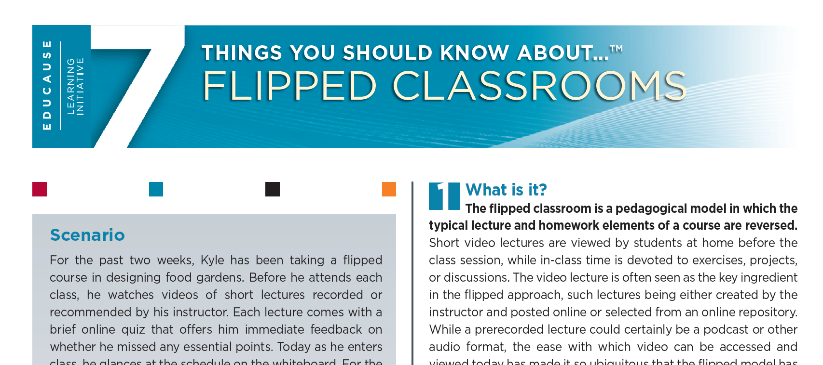
EDUCAUSE 7 Things You Should Know About… Flipped Classrooms https://net.educause.edu/ir/library/pdf/ELI7081.pdf

Slide 54
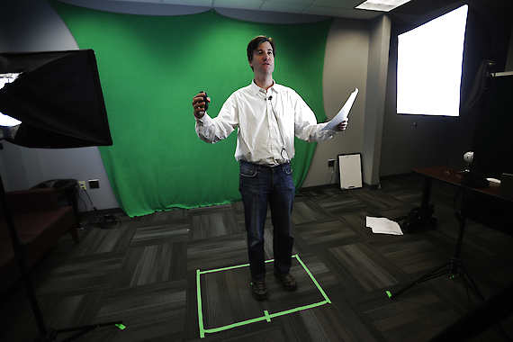
How to Create…? I Flip, You Flip, We All Flip: Setting Up a Flipped Classroom (Video: 24:09) https://www.youtube.com/watch?v=ZRvmjjeZ9CA

Slide 55
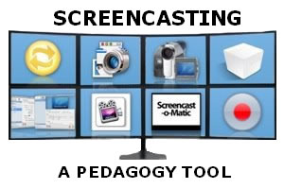
How to Create…? Creating videos for flipped learning, eSchool News http://www.eschoolnews.com/2013/09/09/educators-video-flipped-008/2/?ast=123&astc=11015 Joe Zisk: http://teacheronline.us/screencapture/
Screencasting software for iPads includes:
Replay Note ($4.99), Explain Everything ($2.99), Screenchomp (free), and ShowMe (free).
Screencasting software for a laptop or desktop includes:
Jing (free), Snagit ($29.95), Screencast-o-matic (free), Camtasia Studio ($179), Camtasia for Mac ($75 for a single educator license), and aTube Catcher (free).

Slide 56
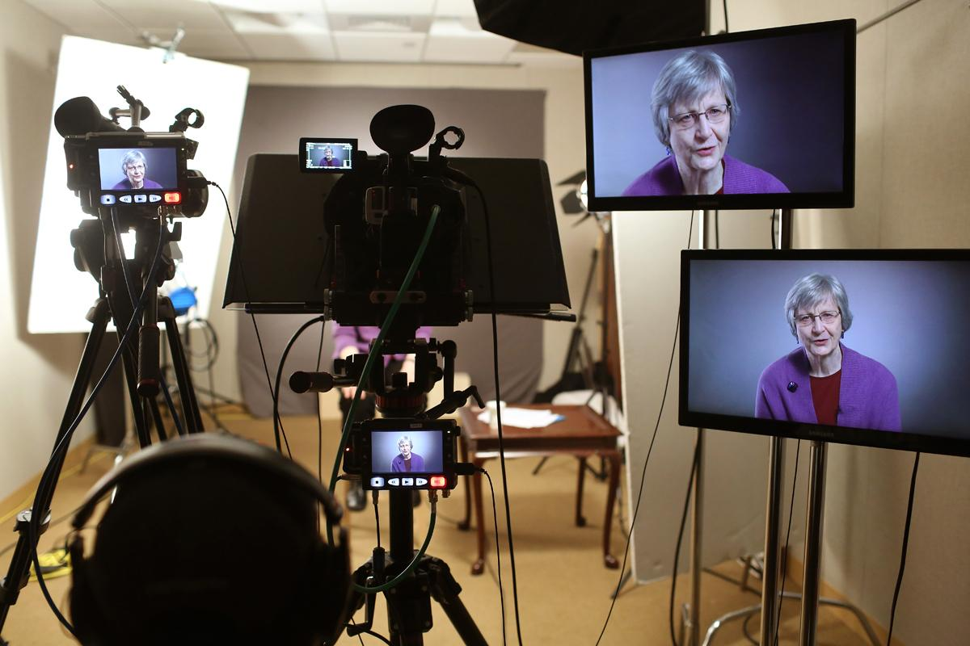
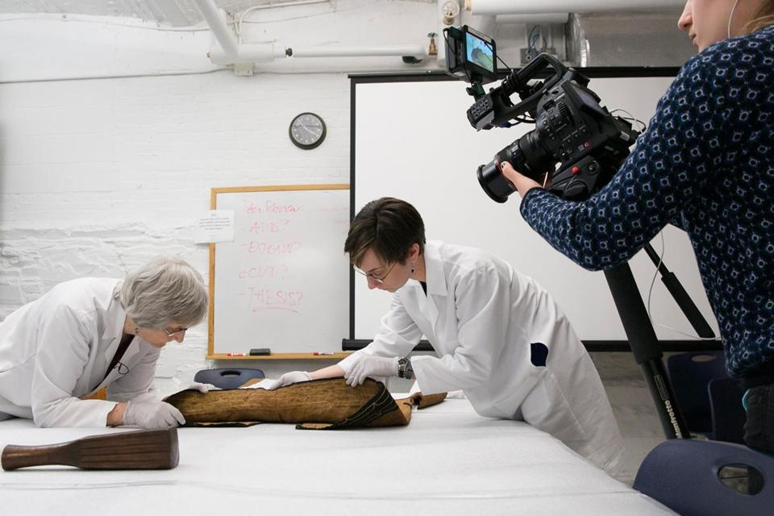
May 18, 2014 Harvard goes all in for online courses The stress is on production values, props, and, yes, scholarship The Boston Globe, Marcella Bombardieri https://www.bostonglobe.com/metro/2014/05/17/behind-harvard-explosion-online-classes-flurry-lights-camera-action/BybPhkyfX59D9a7icmHz5M/story.html
Laurel Thatcher Ulrich, a Harvard historian, was filmed in the HarvardX studio for her class, “Tangible Things.”

Slide 57
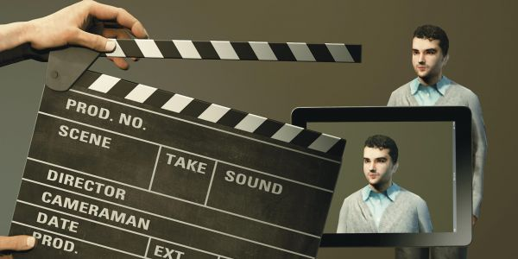
April 21, 2014 (6:52 video) Multimedia Assignments: Not Just for Film Majors Anymore (student and instructor produced videos) Chronicle of Higher Education, Danny Ledonne http://chronicle.com/article/Multimedia-Assignments-Not/145939/?cid=at&utm_source=at&utm_medium=en

Slide 58
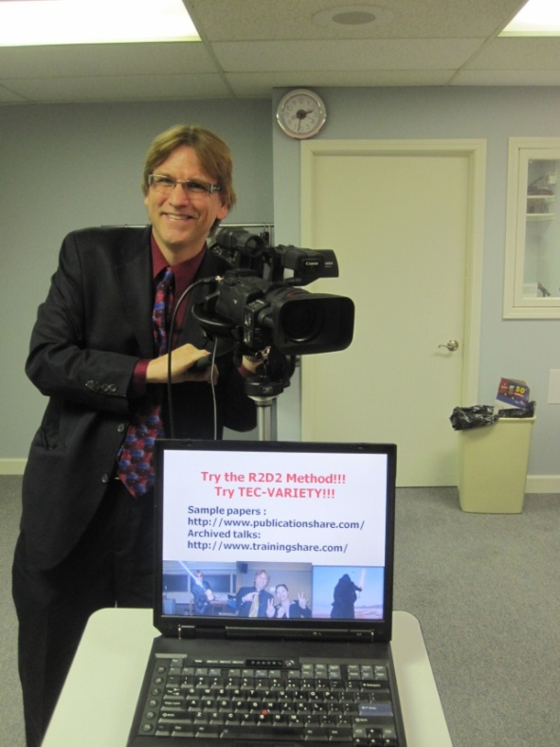
Part 2: The Rise of Shared Online Video, the Fall of Traditional Learning
Dr. Curtis J. Bonk, cjbonk@indiana.edu Professor, Indiana University

Slide 59
How long is an ideal YouTube video? (Lin, Bonk, et al., 2010)

Slide 60
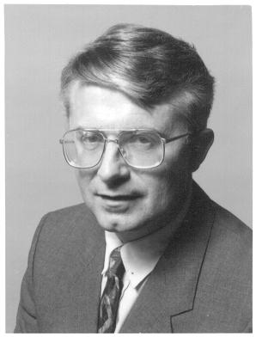
Why Use Video?
David Ausubel (1978) argued that knowledge was hierarchically organized.
New learning concepts and ideas to be subsumed under or anchored within prior learning experiences (i.e., meaningful info must be related to what already know).
Advance Organizers: Per Ausubel, we must provide a context, richer, deeper learning.

Slide 61
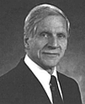
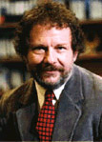
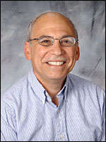
Why Use Video?
4. Dual coding theory (learning information verbally and visually is more richly stored): Alan Paivio.
5. Anchored instruction and macrocontexts: John Bransford and colleagues.
6. Multimedia theory: Richard Mayer.

Slide 62
Anchored Instruction through Short Online Videos

Slide 63
Short Educational Videos: CNN, BBC, TED, TED-Ed, ForaTV BBC One-Minute World News (August 31, 2015) http://www.bbc.com/news/business-34105708

Slide 64
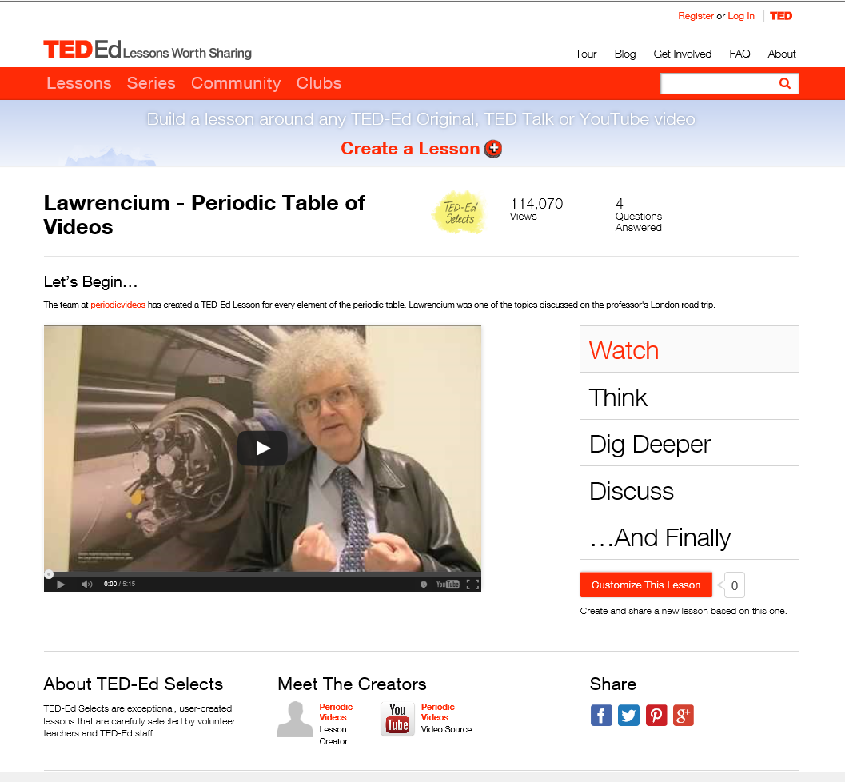
Videos with Test Questions (e.g., TEDEd) (Lessons about every single element on the periodic table) http://ed.ted.com/periodic-videos?utm_source=TED-Ed+Subscribers&utm_campaign=92b1054add-2013_09_219_19_2013&utm_medium=email&utm_term=0_1aaccced48-92b1054add-46761201

Slide 65
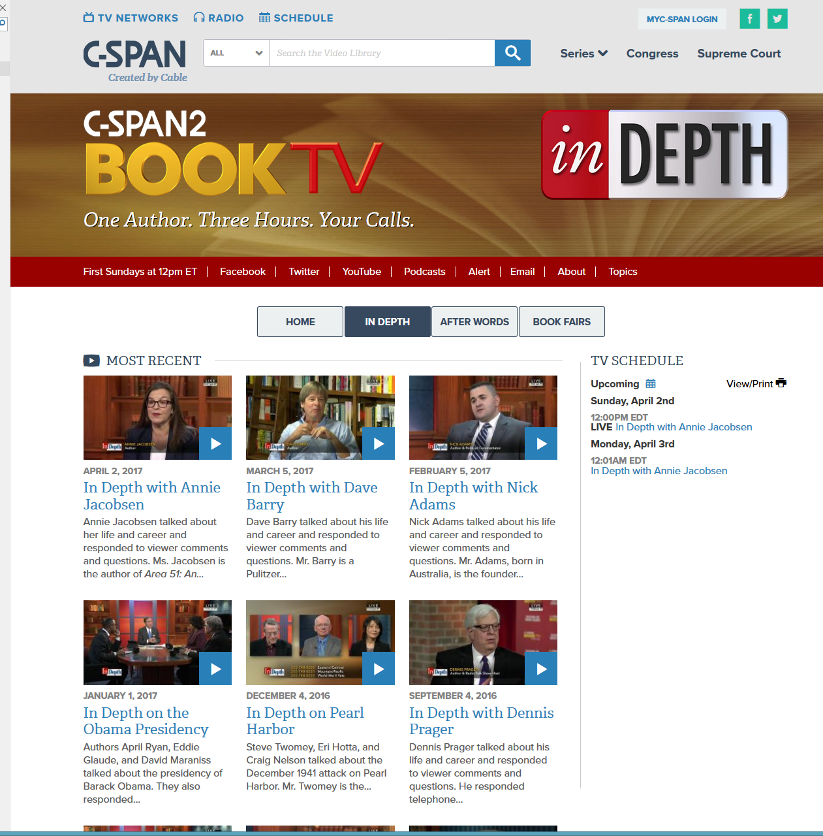
April 2, 2017 BookTV on C-Span2 (author interviews) https://www.c-span.org/series/?inDepth

Slide 66
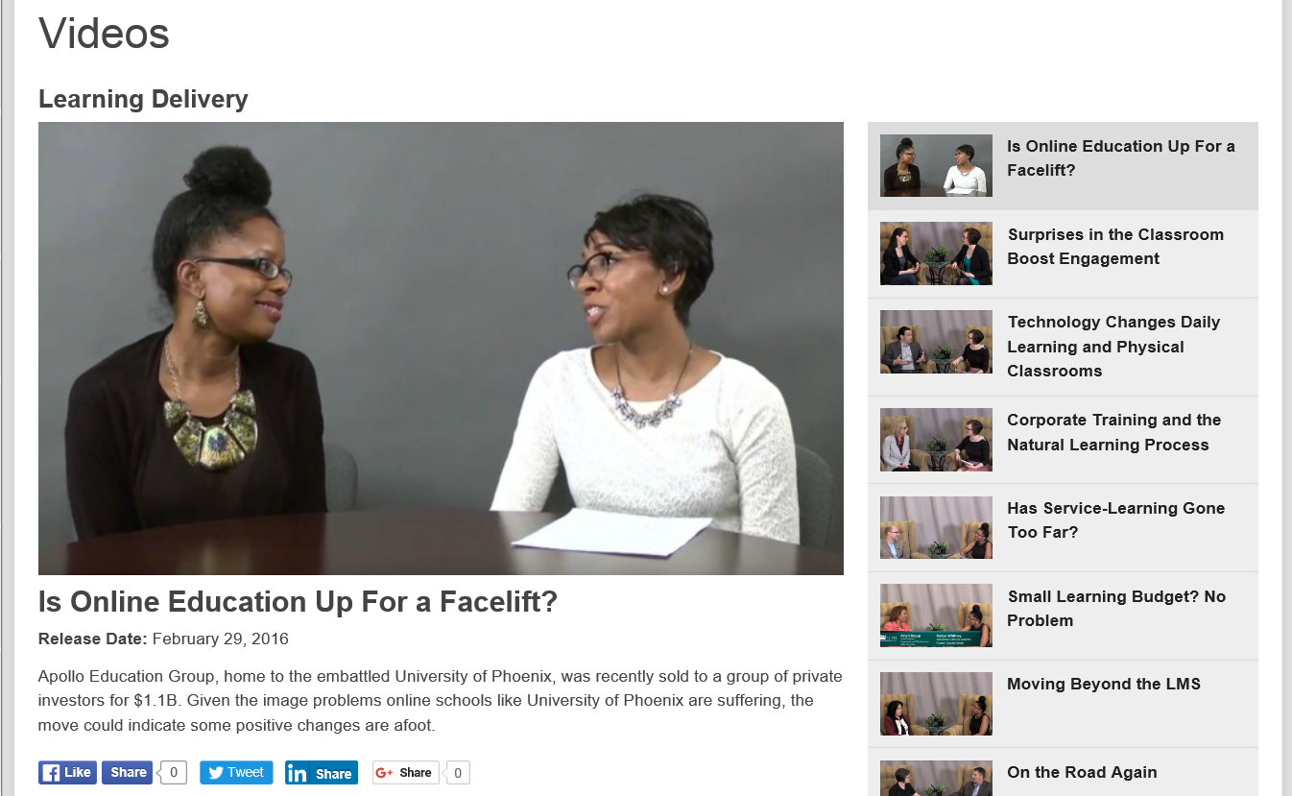
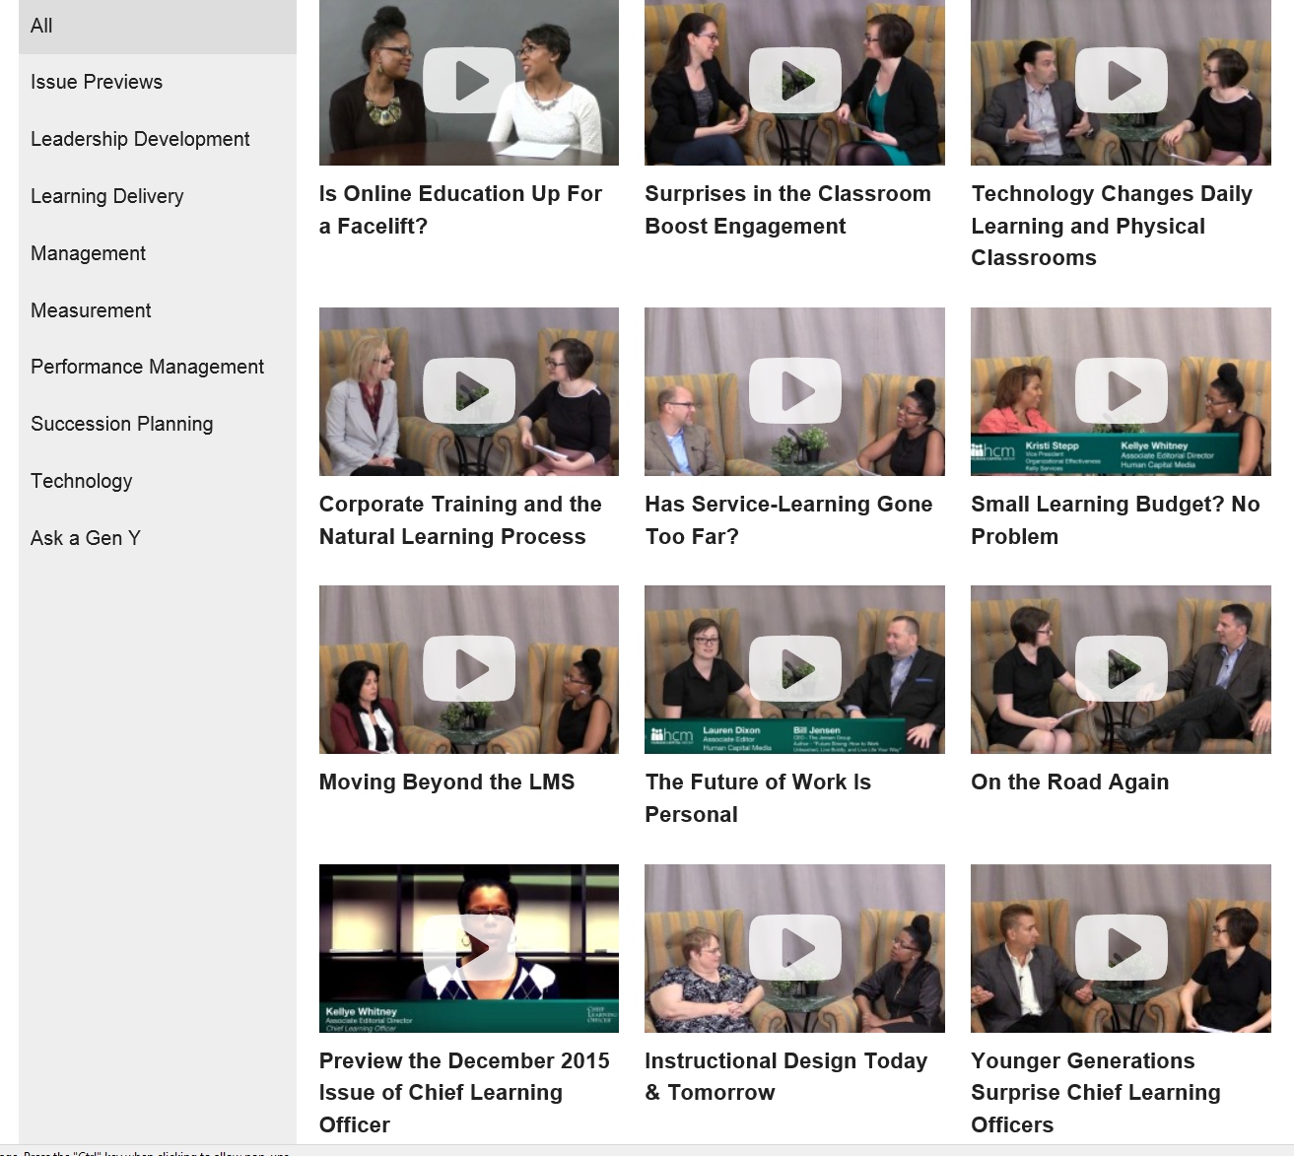
March 7, 2016 Brief Info Videos, Chief Learning Officer http://www.clomedia.com/media/videos/play/306?utm_source=MyEmma&utm_medium=Email&utm_campaign=CLO%20Today&utm_source=newsletter&utm_medium=email&utm_content=Is%20Online%20Education%20Up%20For%20a%20Facelift%3F&utm_campaign=CLO_Today_101615

Slide 67
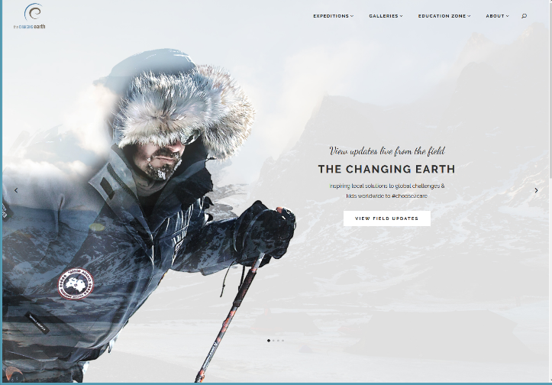
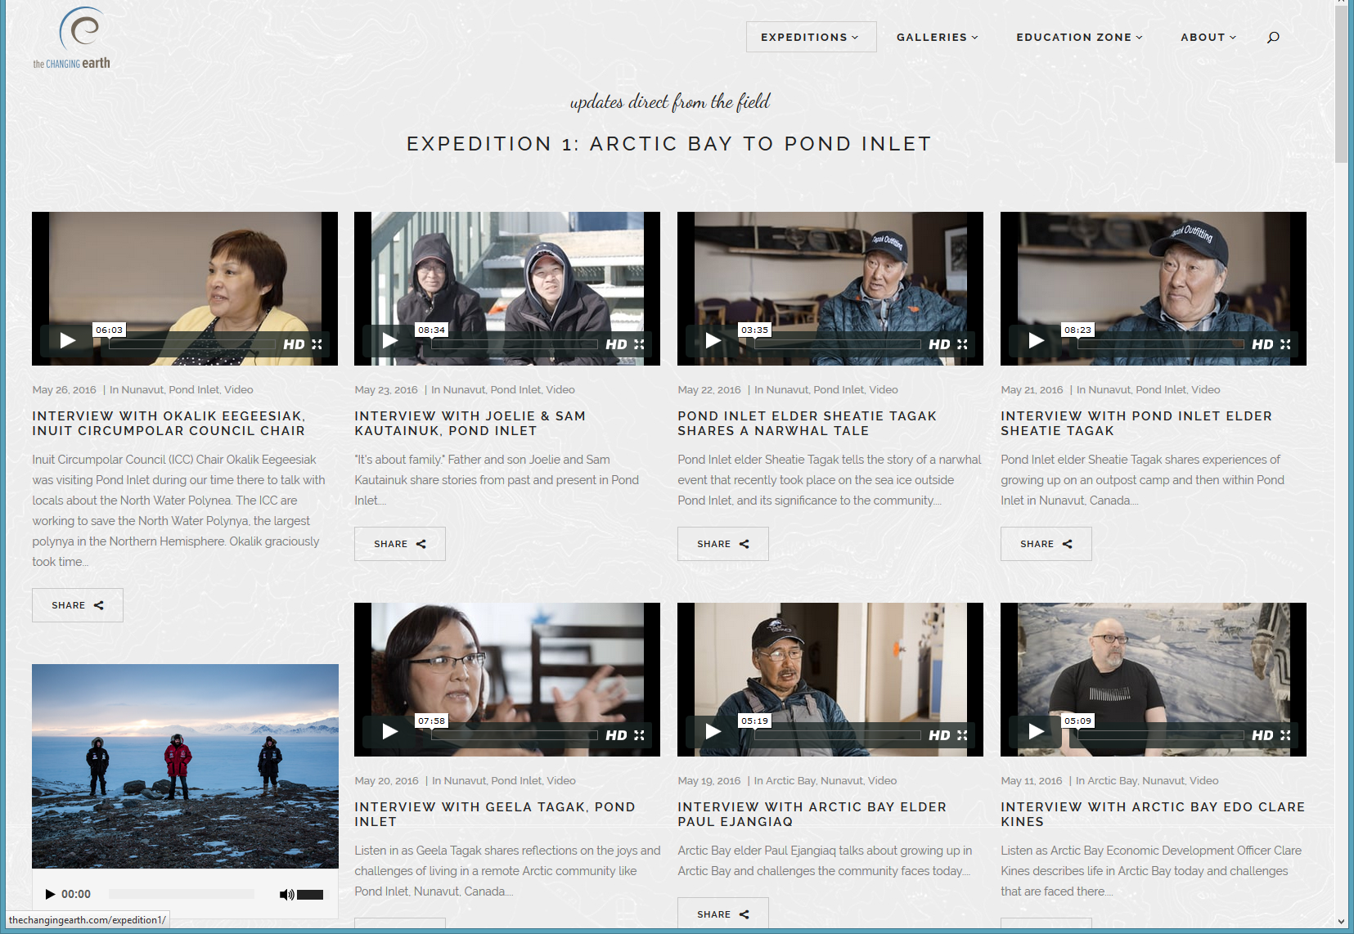
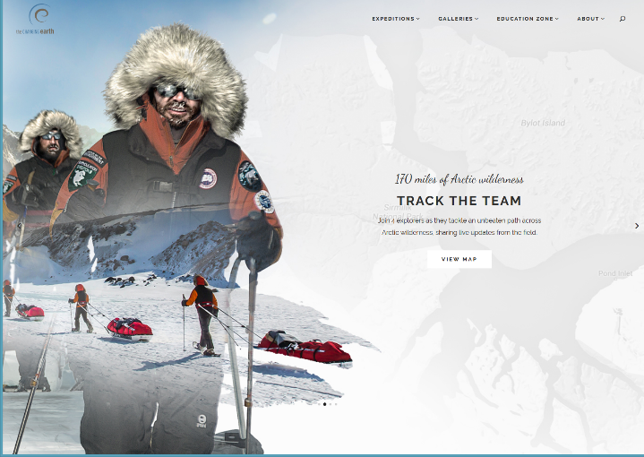
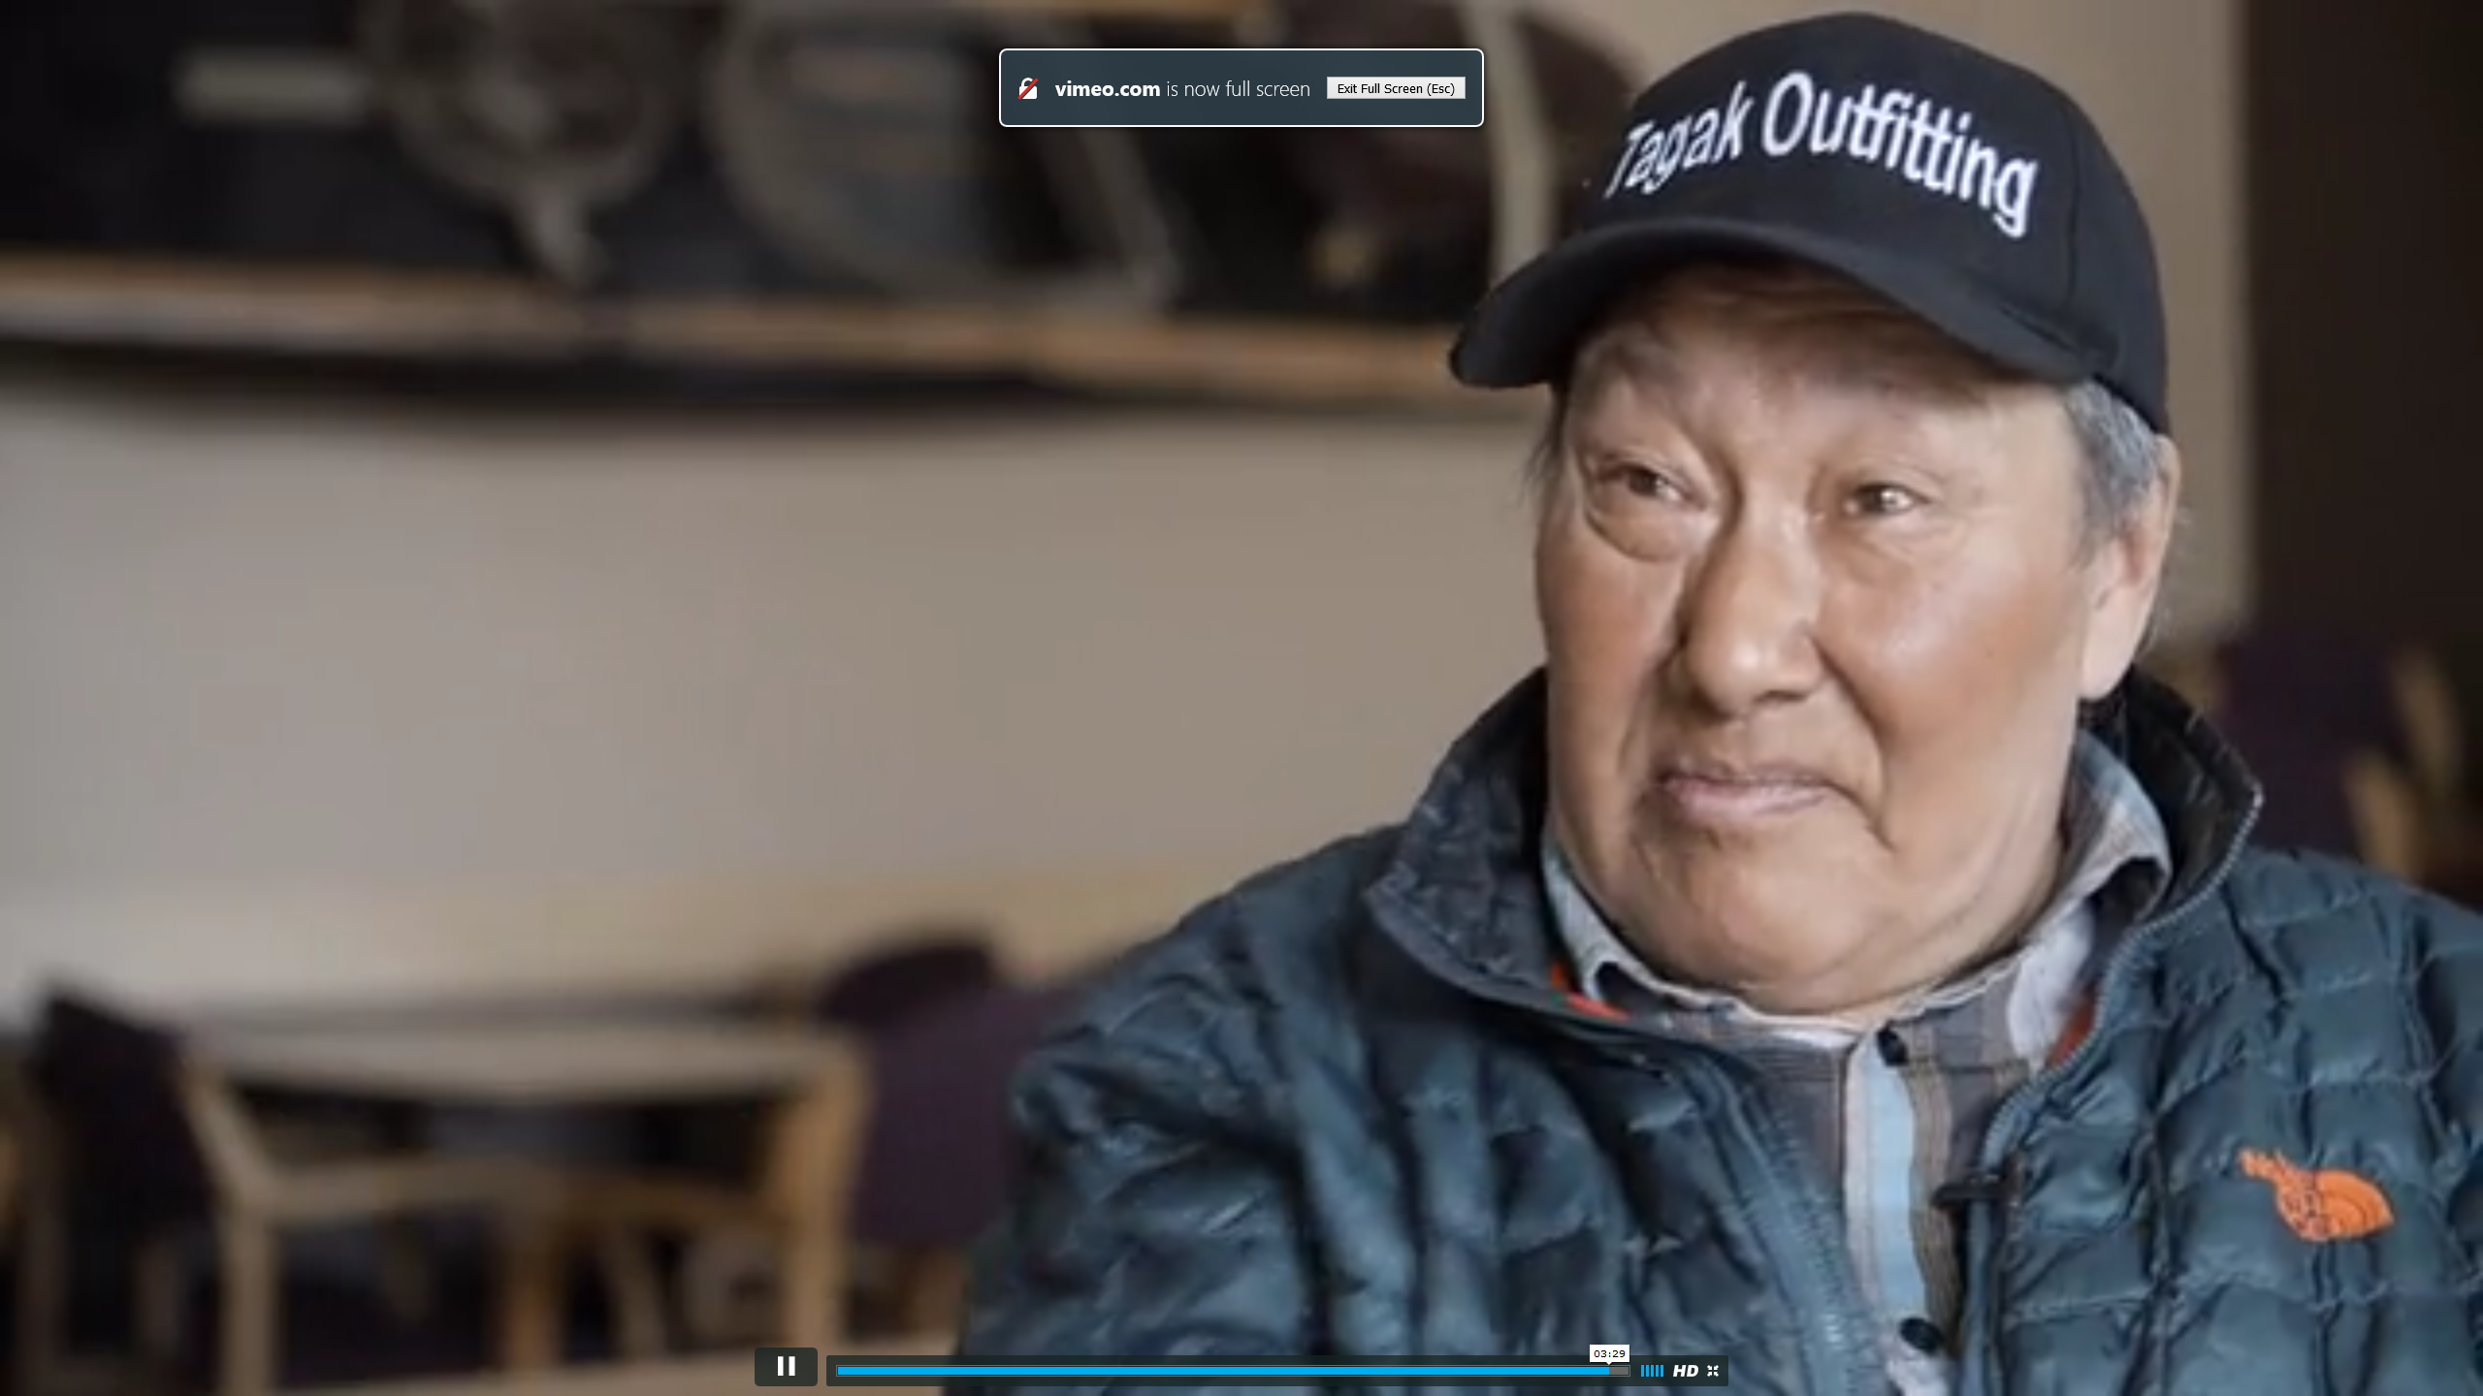
January 20, 2017 The Changing Earth (Aaron Doering) http://thechangingearth.com/

Slide 68
April 2, 2017 Weekly 1 minute Video Updates (e.g., Pinkcasts from Daniel Pink ) http://www.danpink.com/pinkcast/

Slide 69
Which of these video sharing sites do you use?
BBC News Video and Audio
CNN.com Video
MSNBC.com
Google Video, Yahoo Video
Current TV
Fora TV
MIT World
YouTube, YouTube Edu
TeacherTube
Link TV, Explore, Global Pulse, Latin Pulse
Howcast, Big Think, WonderHowTo, Explo.TV, NASA TV, ClipChef, TV Lesson, BookTV, Edutopia videos, MonkeySee, doFlick, the Research Channel, iVideosong

Slide 70
There’s so much video that…

Slide 71
Big Think (April 2, 2017) (short topical video interviews and blogs posts from famous people) http://bigthink.com/ https://www.youtube.com/watch?v=TAYhj-gekqw http://bigthink.com/laurie-vazquez/the-sooner-you-expose-a-baby-to-a-second-language-the-smarter-theyll-be

Slide 72
Big Think (April 1, 2017) (short topical video interviews and blogs posts from famous people) http://bigthink.com/ http://bigthink.com/david-ryan-polgar/38-of-american-jobs-could-be-replaced-by-robots-according-to-pwc-report http://bigthink.com/paul-ratner/elon-musk-creates-new-company-to-merge-human-brains-with-computers

Slide 73
January 20, 2016 Embedded Videos Why the Future Is Bright for the World’s Poorest Farmers, Gates Notes, the blog of Bill Gates https://www.gatesnotes.com/Development/The-Future-of-Farming?WT.mc_id=01_20_2016_20_FutureofFarming_BG-LI_&WT.tsrc=BGLI

Slide 74
Link TV (April 2, 2017) (Television without Borders) https://www.linktv.org/

Slide 75
March 10, 2016 Watch SXSWedu Live, Connie Yowell http://sxswedu.com/live?utm_campaign=Edu+2016&utm_source=hs_email&utm_medium=email&utm_content=27144469&_hsenc=p2ANqtz--ag6U7VJGlpYaciareNq6mryKvA63kCR5O3U8JVQkfAYp7yiTnncHnxw7_PmMpcjioI9V7z1-01hvyCrDPVEAR-x6HwQ&_hsmi=27144469

Slide 76
February 16, 2017 Woolly Mammoth Could Be ‘De-Extinct’ In 2 Years, Scientist Says Hillary Hansan, CNN (video: 3:22) http://www.huffingtonpost.com/entry/woolly-mammoth-elephant_us_58a62fa7e4b037d17d264477?gn4kyqd2ystpousor& http://www.huffingtonpost.com/entry/woolly-mammoth-elephant_us_58a62fa7e4b037d17d264477

Slide 77
August 1, 2017 Going All In on Personalized Learning Paul Fain, Inside Higher Ed https://www.insidehighered.com/news/2017/08/01/national-u-experiment-combines-multiple-pieces-personalized-learning March 20, 2017 National University Precision Education Initiative (3:04) https://www.youtube.com/watch?v=qfUbVfD5VVs

Slide 78
March 29, 2017 Every industrial robot takes up to 6 jobs, study finds Steve Goldstein, MarketWatch http://www.marketwatch.com/story/over-6-million-jobs-at-risk-from-robots-new-study-finds-2017-03-29 Video: 1:46 http://curtbonk.com/futureandroids.html Video: .49-1:12: http://curtbonk.com/futureandroids2.html Video: .01 to .49: http://curtbonk.com/futureandroids3.html Video.01-.25: http://curtbonk.com/futureandroids4.html

Slide 79
August 3, 2017 See the exquisite fossil that revealed the colors of a giant armored nodosaur Ben Gaurino, The Washington Post https://www.washingtonpost.com/news/speaking-of-science/wp/2017/08/03/see-the-exquisite-fossil-that-revealed-the-colors-of-a-giant-armored-nodosaur/?utm_term=.d5e8dc6c978f Video (2:33): http://curtbonk.com/dinosours.html Video: 01-.20: http://curtbonk.com/dinosours2.html Video: .47 to 2:26: http://curtbonk.com/dinosours3.html

Slide 80
Discuss Videos (e.g., Grockit Answers and Vialogues; https://vialogues.com/)

Slide 81
Collaborative Video Annotations and Discussions (Craig Howard, IU) http://scholarworks.iu.edu/journals/index.php/ijdl/article/view/853/912

Slide 82
Next Steps for you…? And Next Steps for me…

Slide 83
Want to Repeat this Talk on Flipping Bonk in HD: https://www.youtube.com/watch?v=g4p2FAdoMfU (20:16) Bonk in Regular: https://www.youtube.com/watch?v=V2LeFfywSPM (20:16)
Ask students to watch weekly lectures.
Reflect on key concepts.
Instructors helps moderate it.

Slide 84
Slides at: TrainingShare.com Papers: PublicationShare.com Free book: http://tec-variety.com/ cjbonk@indiana.edu Questions, Comments, Share Ideas (Will Work, might work, won’t work)

