Slide 1
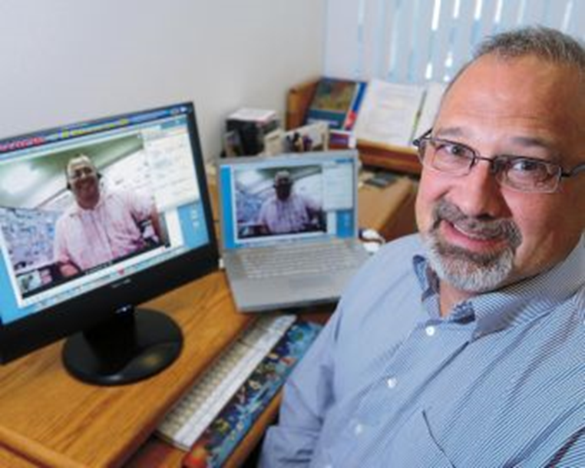
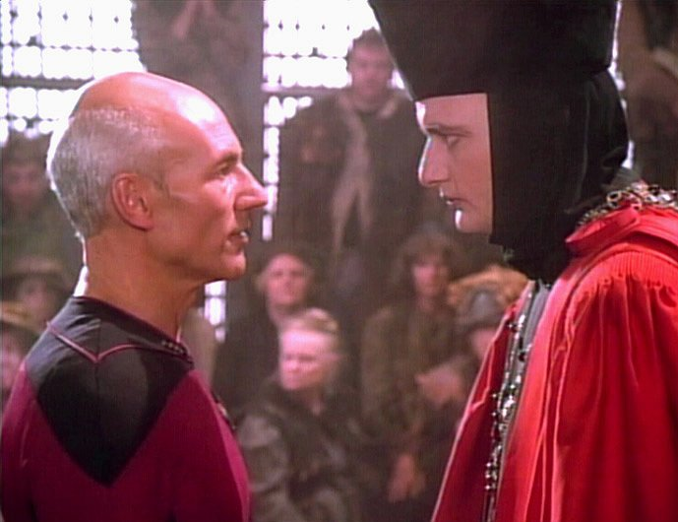
Through the Words of Experts: Cases of Expanded Classrooms Using Conferencing Technology
Dr. Curtis J. Bonk, cjbonk@indiana.edu Professor, Indiana University

Slide 2
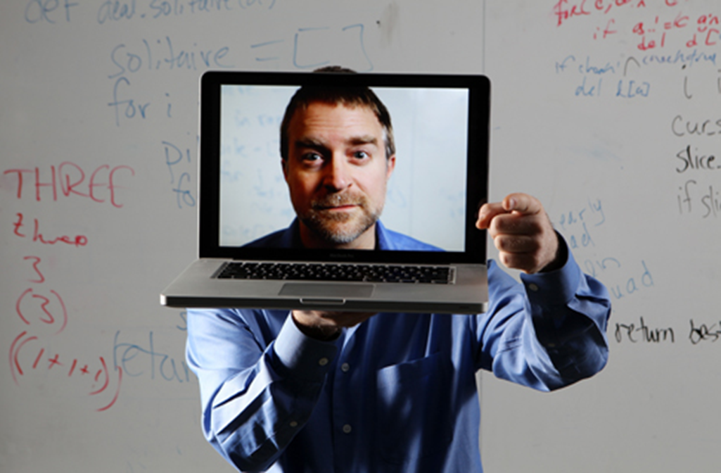
Ten Lessons Learned…

Slide 3
Lesson #1. Combining Asynchronous and Synchronous Events (e.g., guest was David Merrill, 2007)

Slide 4
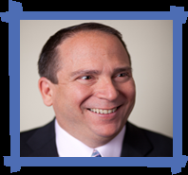
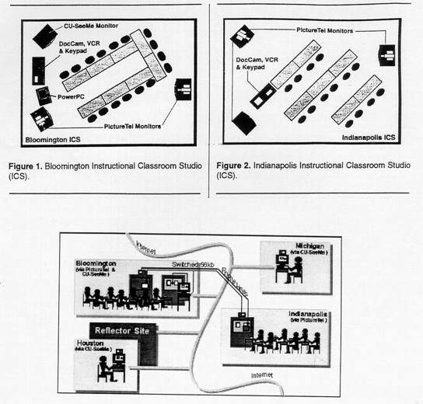
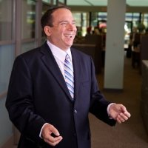
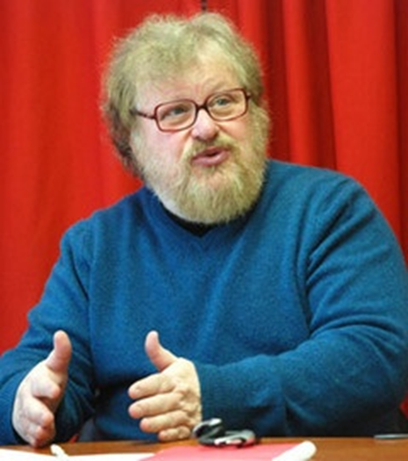
Synchronous + Asynchronous (e.g., Elliot Soloway and David Palumbo, 1995)
Notes:
94
4

Slide 5
Lesson #2. Test the System (e.g., Guest No Video)

Slide 6
March 2015 Combine Synchronous Presentation and Chat in Adobe Connect (Ana-Paul Correia, Iowa State University) https://connect.iu.edu/p259wpiabg9/

Slide 7
If Plan, No Instructor Required (Guest Session Run by Assistant)

Slide 8
Lesson #3. Guest Starts Semester Michael Horn and Curt Bonk, R685, August 20, 2012

Slide 9
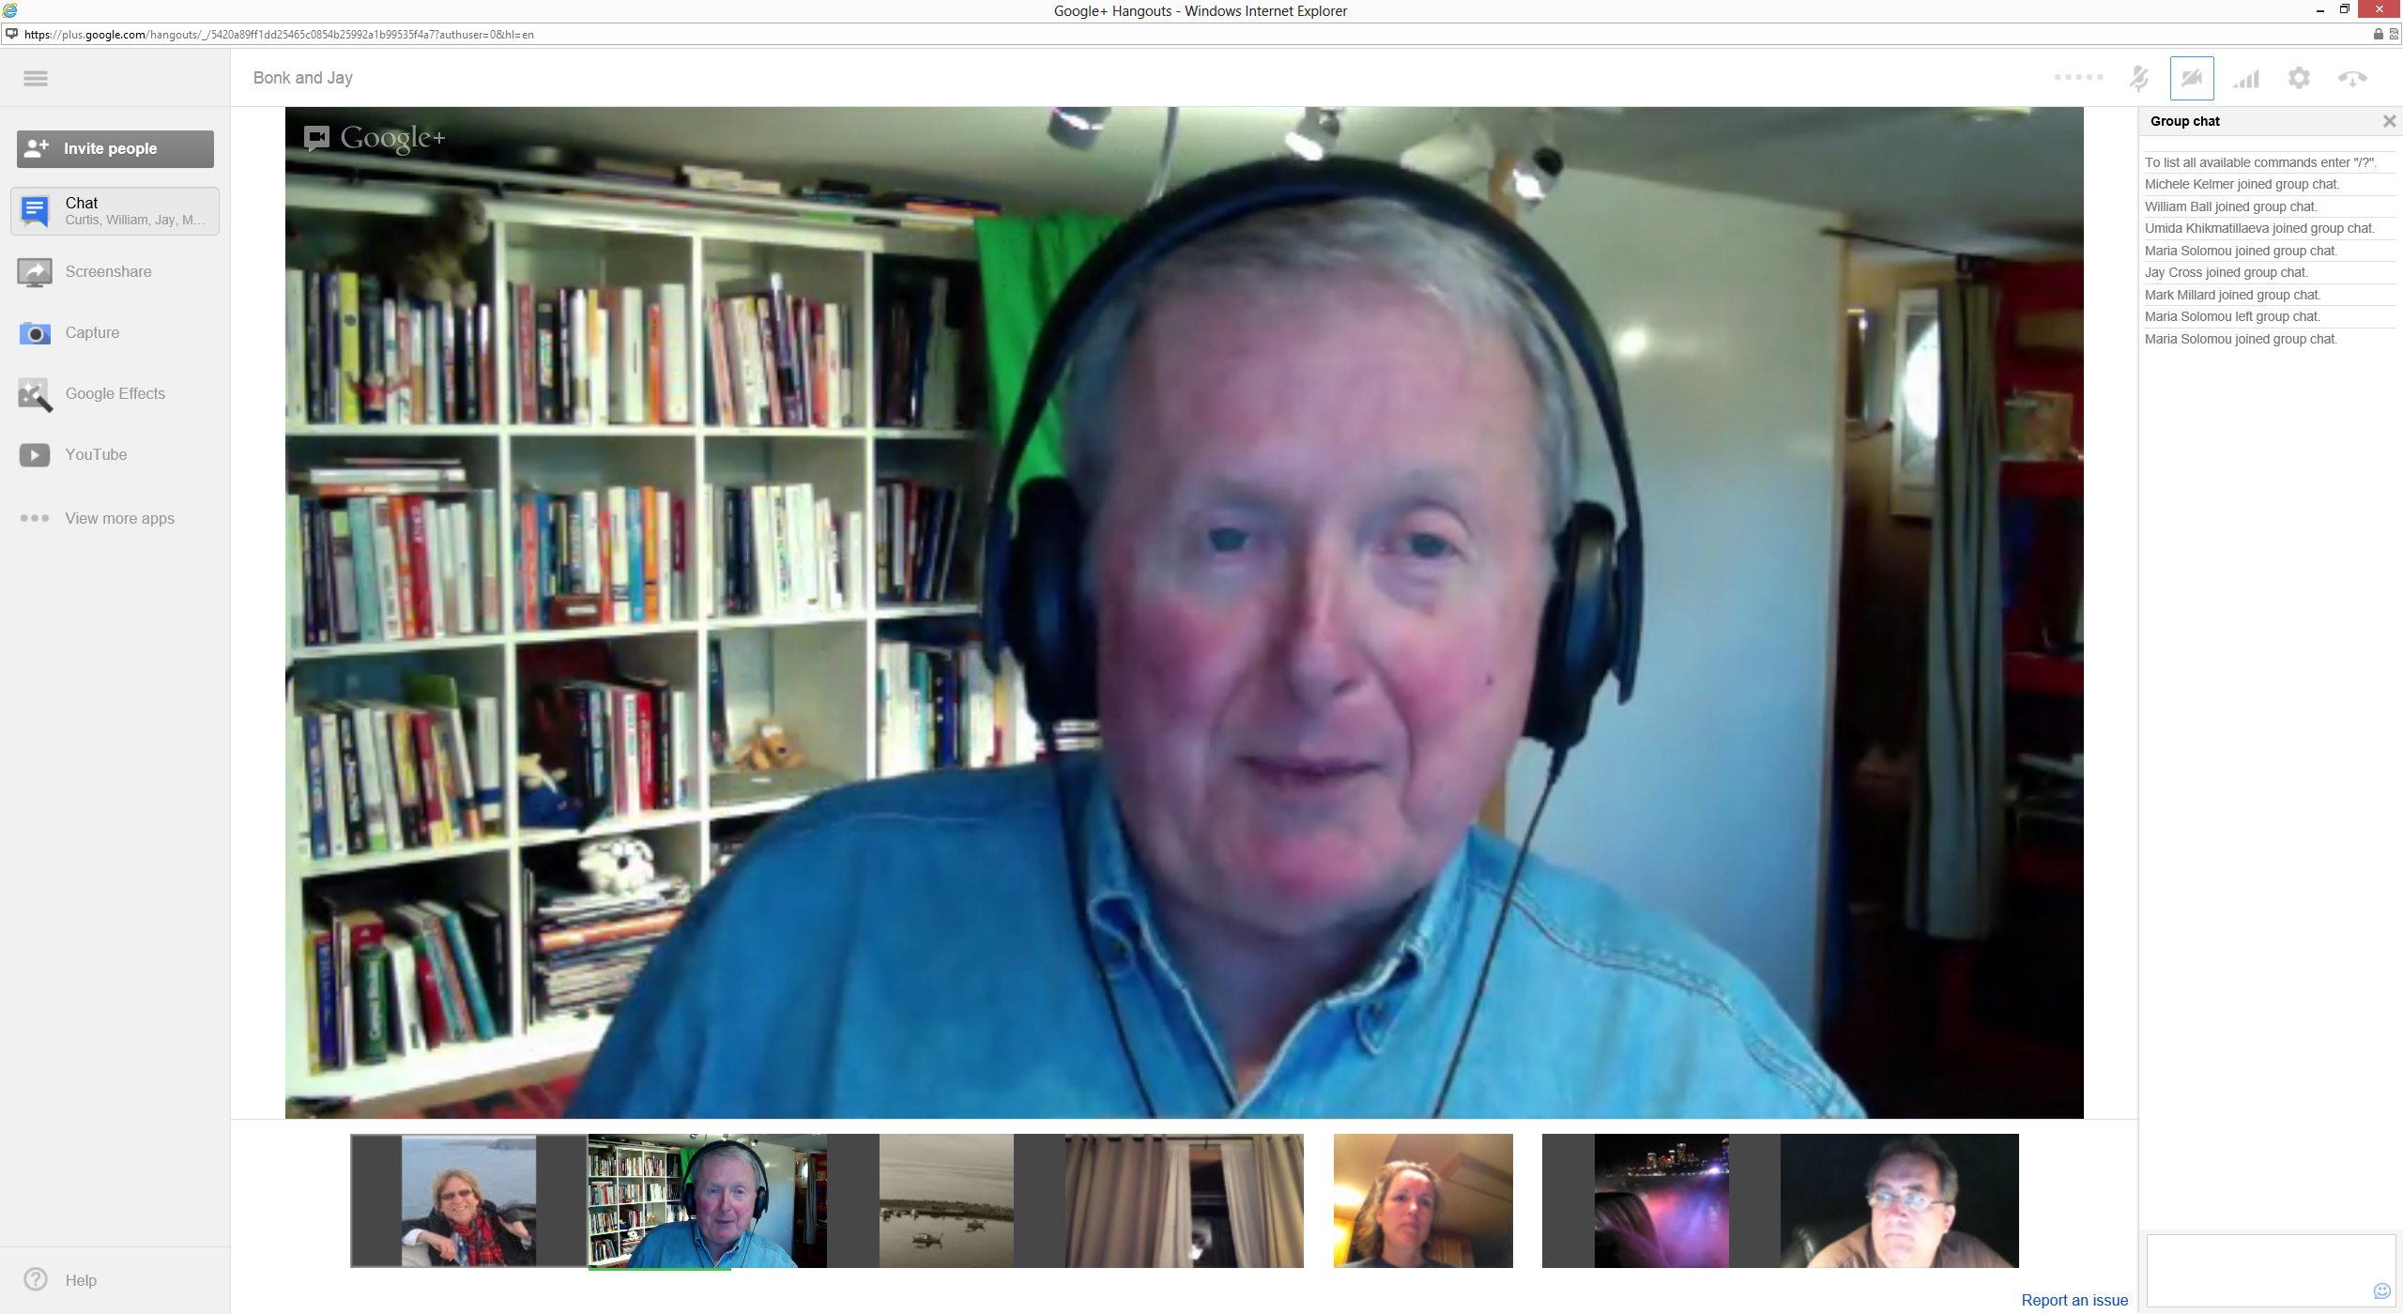
Lesson #4. Combine Synchronous Systems Jay Cross, Berkeley (https://connect.iu.edu/p4bytsoronh/)

Slide 10
Lesson #5. Be Willing to Reciprocate

Slide 11
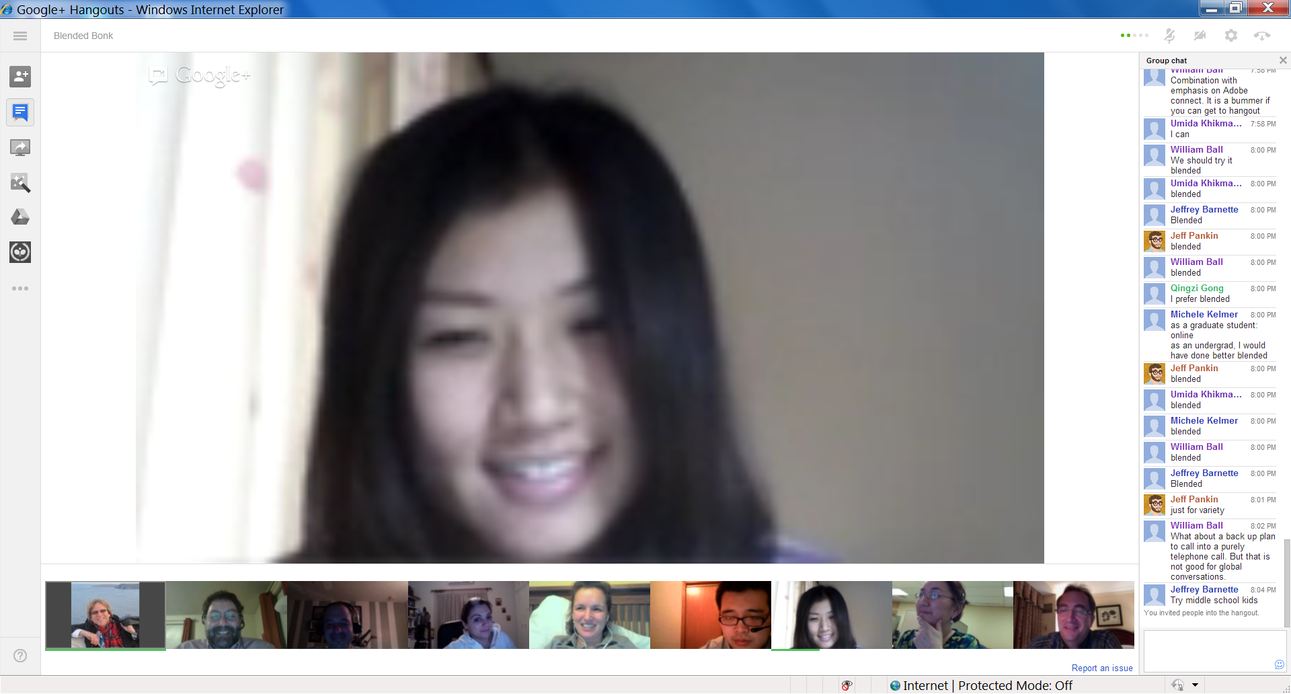
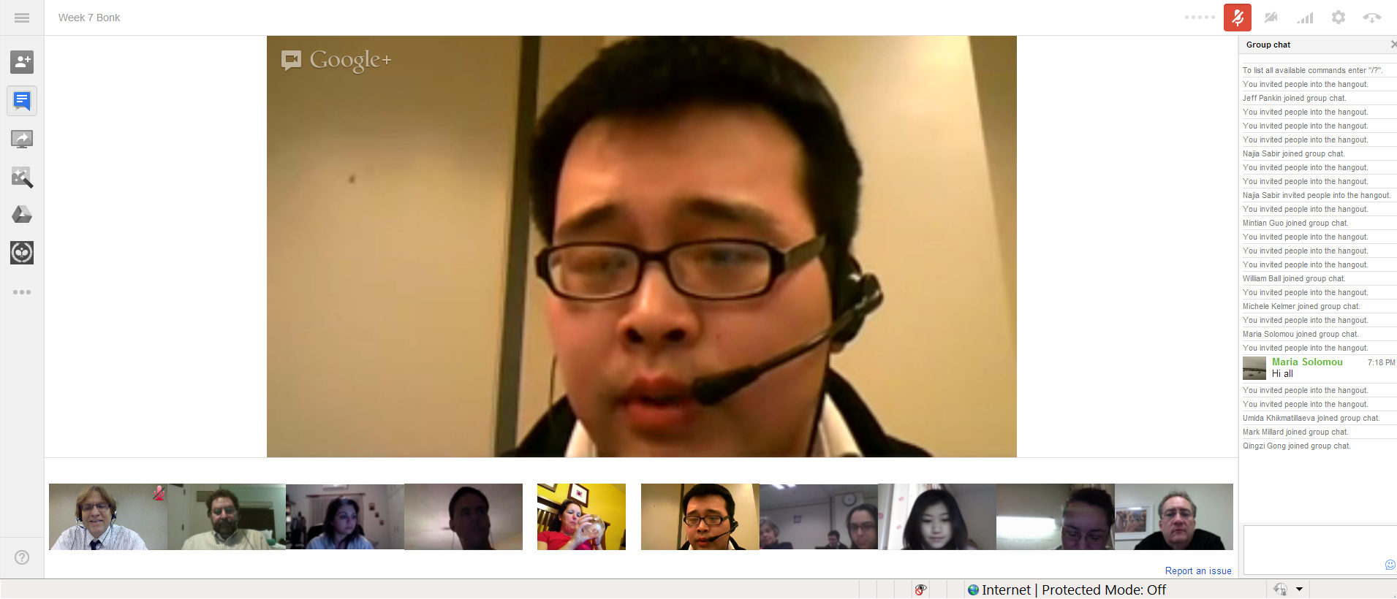
Lesson #6: Experiment with Technology Collaboration and Discussion in Google Hangouts (1/29/2013)

Slide 12
Lesson #7: Solicit Student Recommendations Expert Interviews (Rich Culatta, Acting Director, Office of Educational Technology)

Slide 13
Lesson #8: Don’t Give Up! Serious Gaming Institute, Coventry, UK Sara de Freitas and Jim Hensman, U of Coventry, UK (https://connect.iu.edu/p2ie1yx6z6x/)

Slide 14
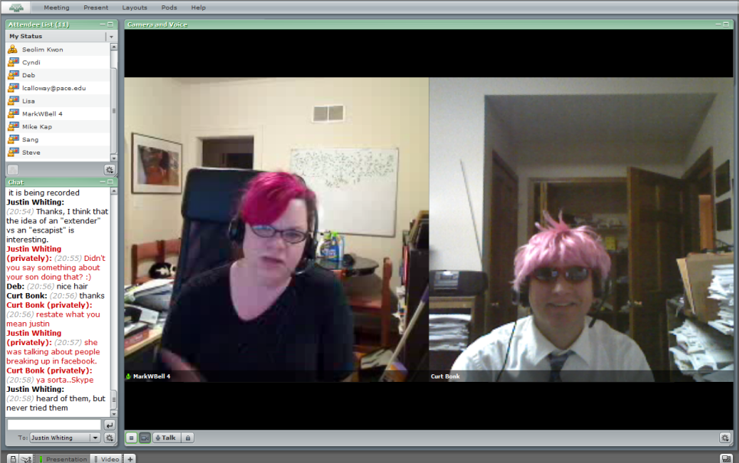
Lesson #9: Make a List of Those You Know Intellagirl Sarah Smith-Robbins and Mark Bell (Second Life for Dummies)

Slide 15
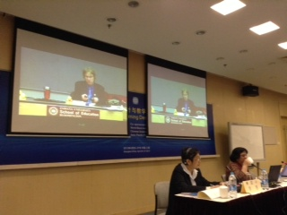
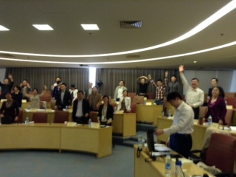
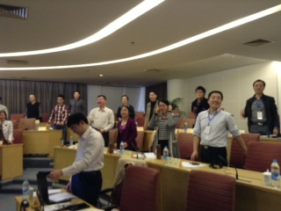
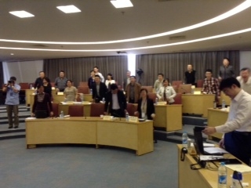
Lesson #10: Be Cognizant of Time Zones (and invite audience guest members) Videoconference, Shanghai, China, April 28, 2013

Slide 16
May 28, 2015 World Bank Institute workshop to Zhengzhou city, China

Slide 17
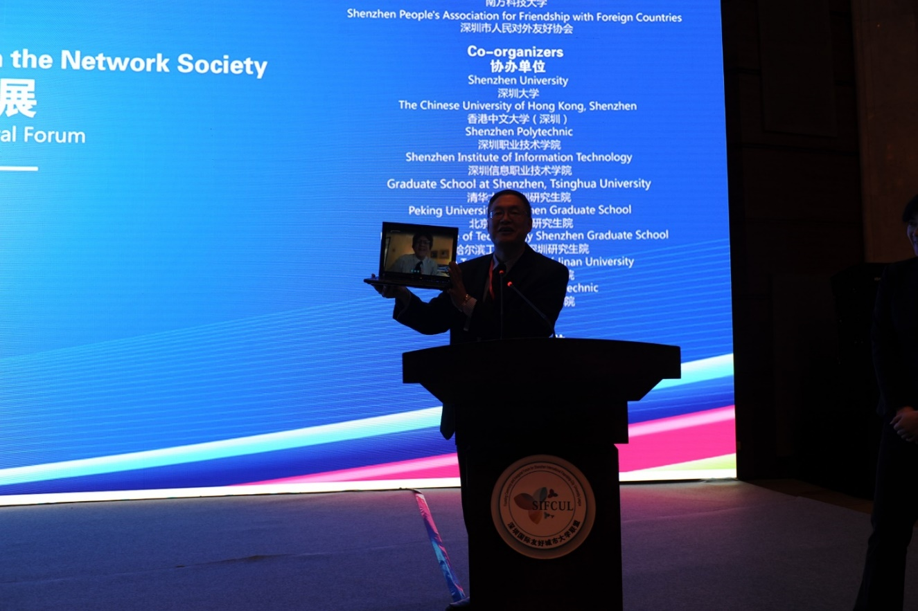
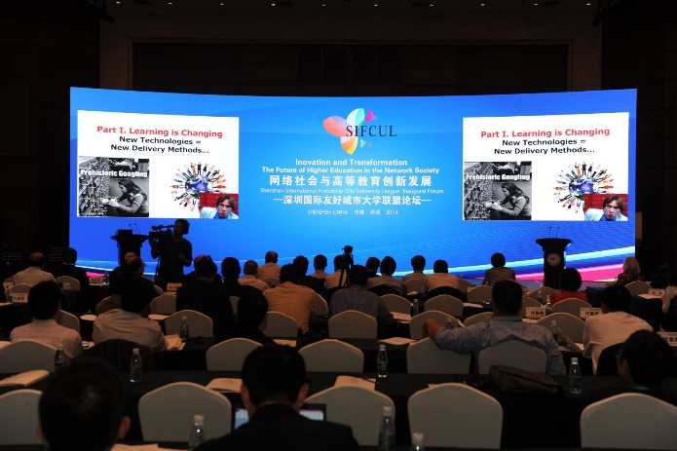
November 2014 Short Cameo Appearances Can Work Shenzhen, China Guest Speaker (cameo appearance via Skype from Madrid hotel room)

Slide 18
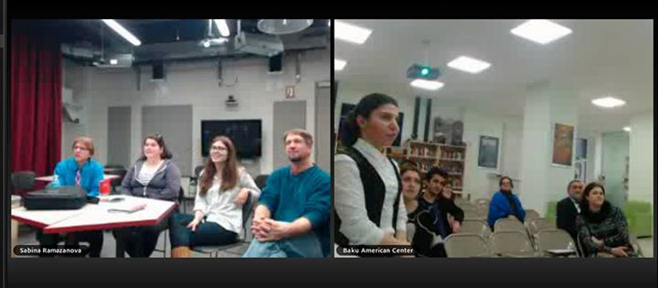
Q&A Web Conferencing (Feb/May 2015) Sync Chat in Adobe Connect with students in Azerbaijan about language learning (Adobe Connect, Jabber, iMeet, GoToMeeting, etc.) https://connect.iu.edu/p259wpiabg9/

Slide 19
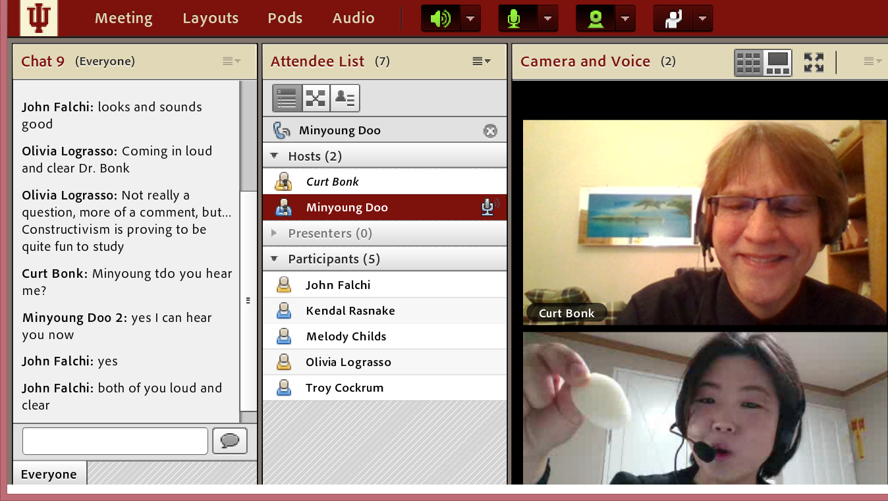
Ten Pedagogical Ideas…

Slide 20
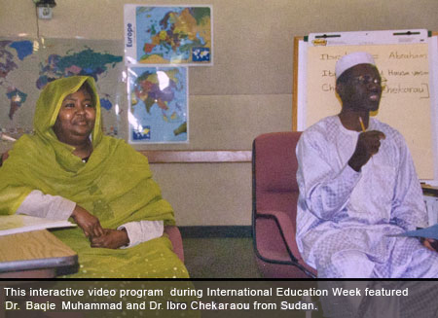
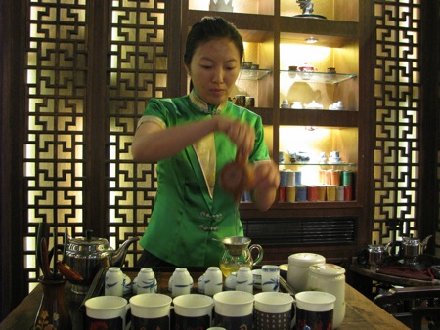
1. Expert Presentations with Audience Questioning and Commenting
The guest expert makes a formal or semi-formal presentation of ideas, activities, cultural norms and practices, or research to the class.

Slide 21
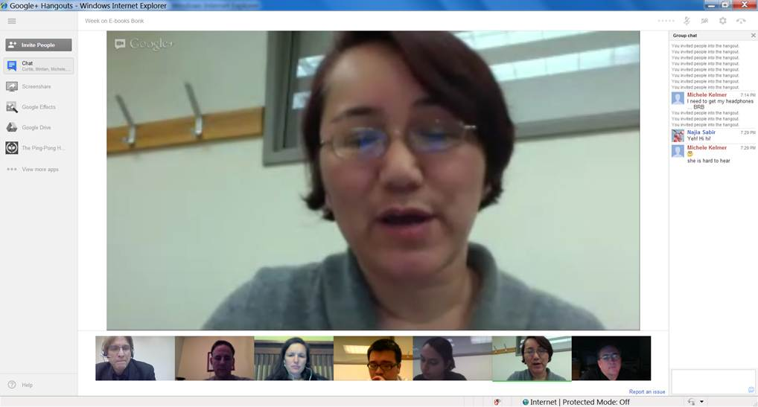
2. Responding to Book or Article Quotes
The learners come to the synchronous session with quotes from those articles or resources for the guest expert to respond to.

Slide 22
3. Responding to Publication Visuals
Students find visuals from the culture or country of the guest to respond to; alternatively, they might find charts, tables, figures, and graphs from articles, books, or presentations of the guest expert.

Slide 23
4. Expert Interviews and Discussions
Students might read the biography or resume of the guest as well as available articles, books, and other resources about this person. Next, the guest might respond to questions from the class based on these resources.

Slide 24
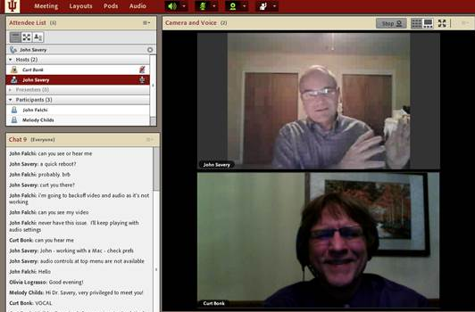
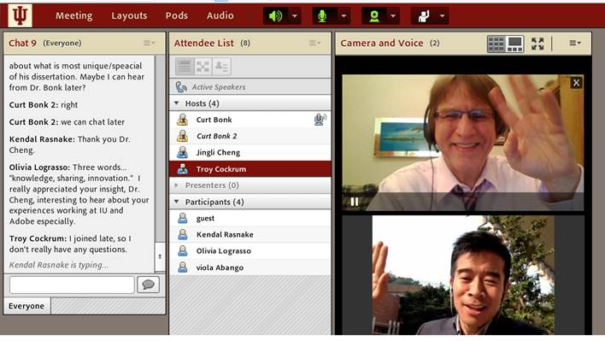
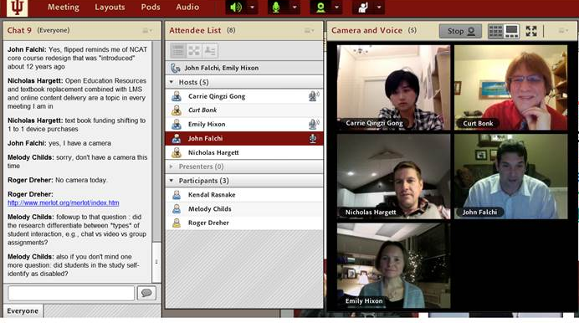
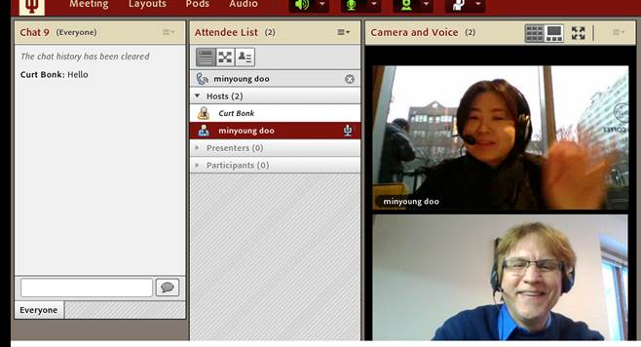
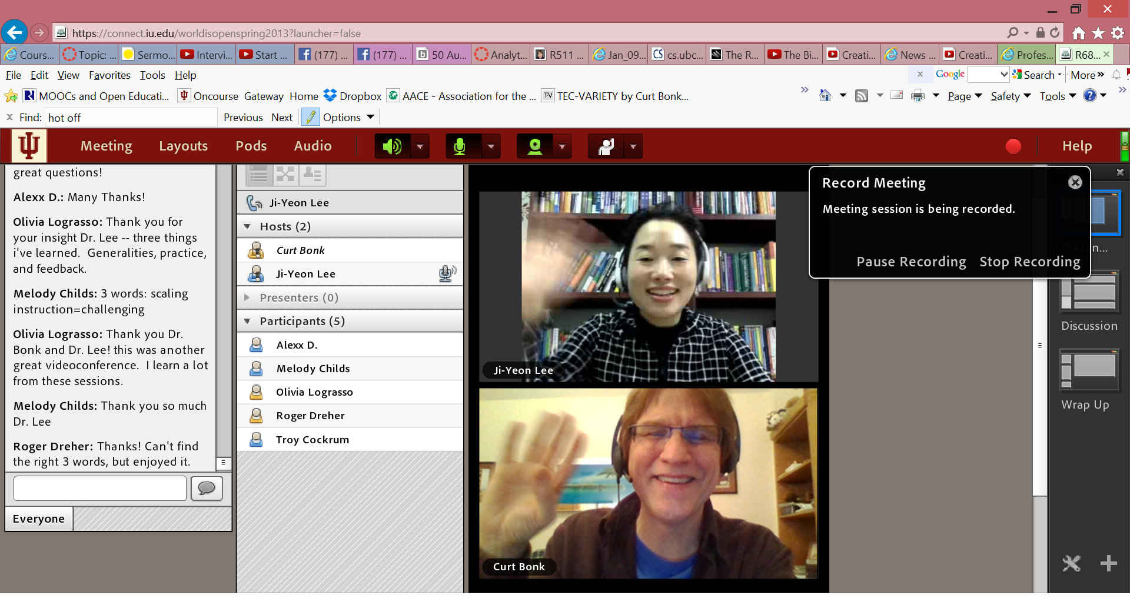
R511 Guest Chats (in Adobe Connect) (e.g., Emily Hixon, January 20, 2015) https://connect.iu.edu/p259wpiabg9/

Slide 25
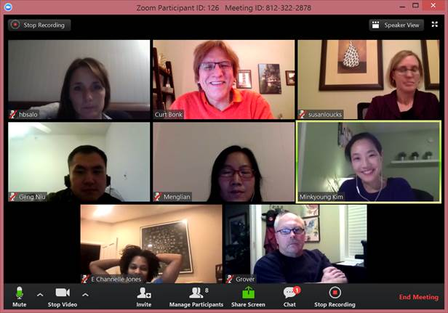
January 12, 2016 (Zoom) Discuss Course Requirements R511 Chat with Minkyoung Kim

Slide 26
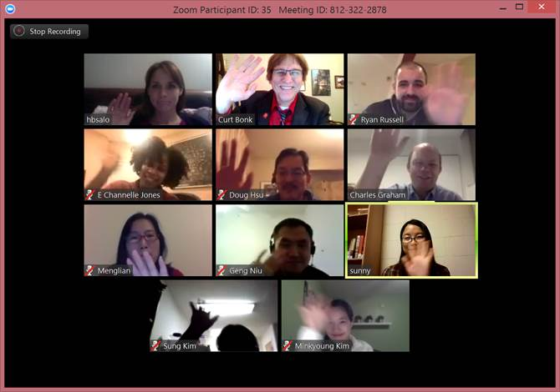
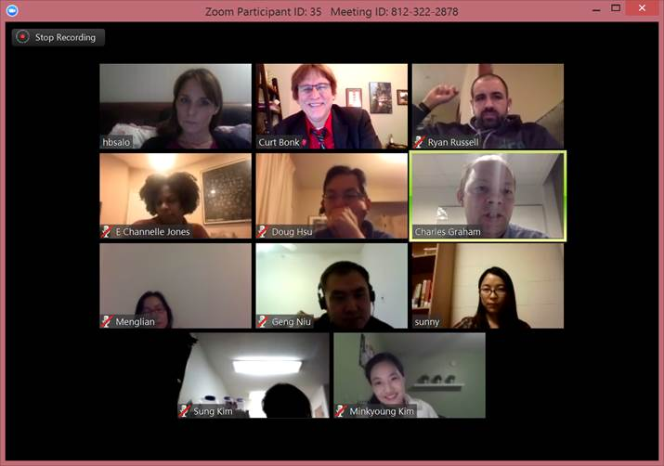
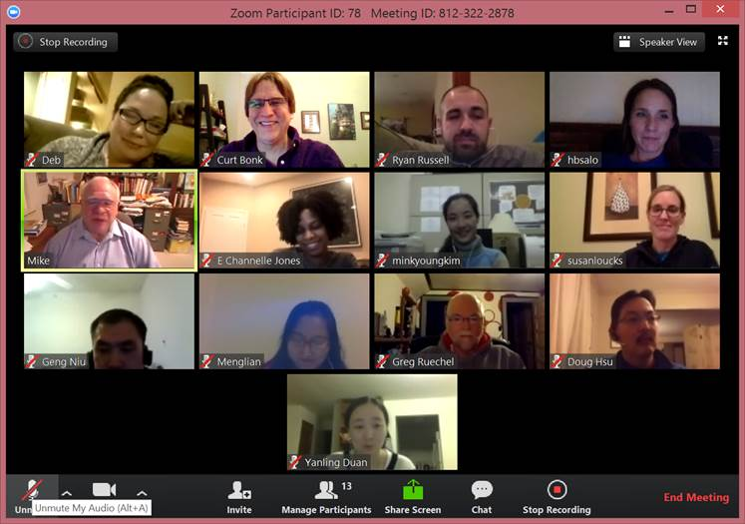
January 20 and 26, 2016 (Zoom) Guest Expert Chat R511 Chat with Mike Molenda, IU R511 Chat Charles Graham, BYU

Slide 27
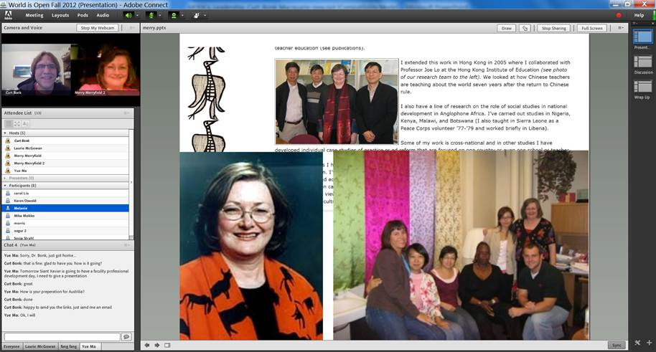
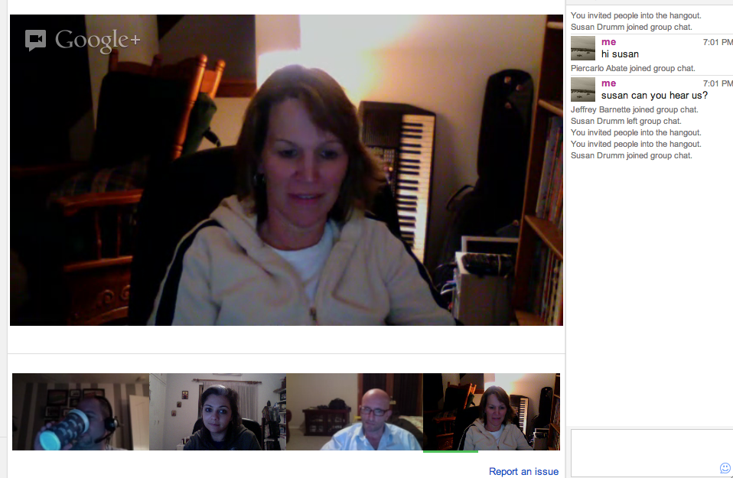
5. Expert Life Stories
The guest expert might detail different stories or situations that he or she has encountered related to a certain topic of the class. Students in the class can comment on them and ask questions as needed.

Slide 28
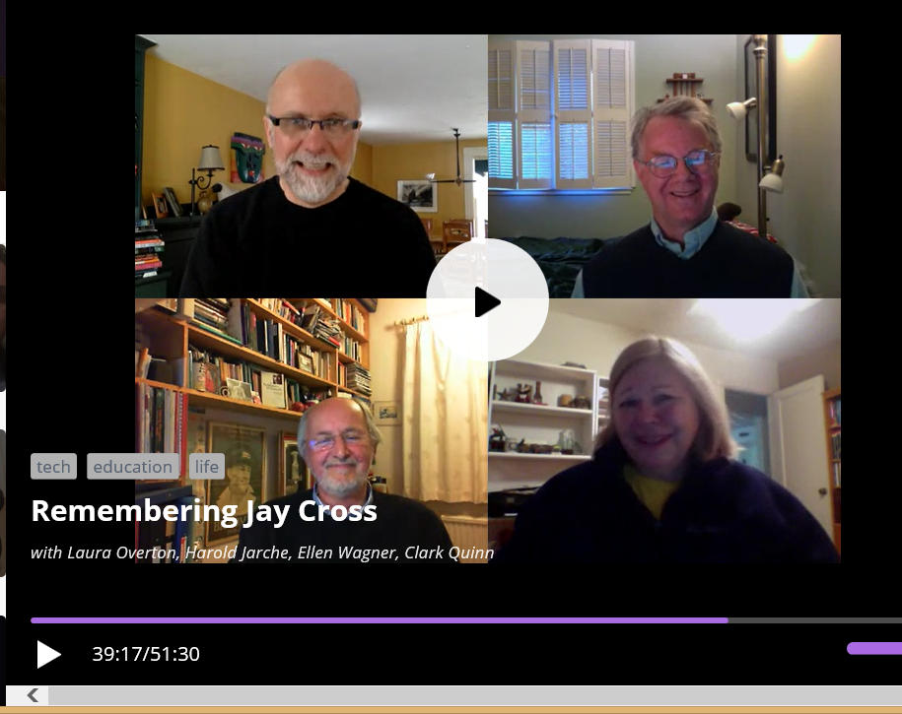
December 16, 2015 (Blab) Remembering Jay Cross (eLearning Guild members in Blab) https://blab.im/elearning-guild-remembering-jay-cross

Slide 29
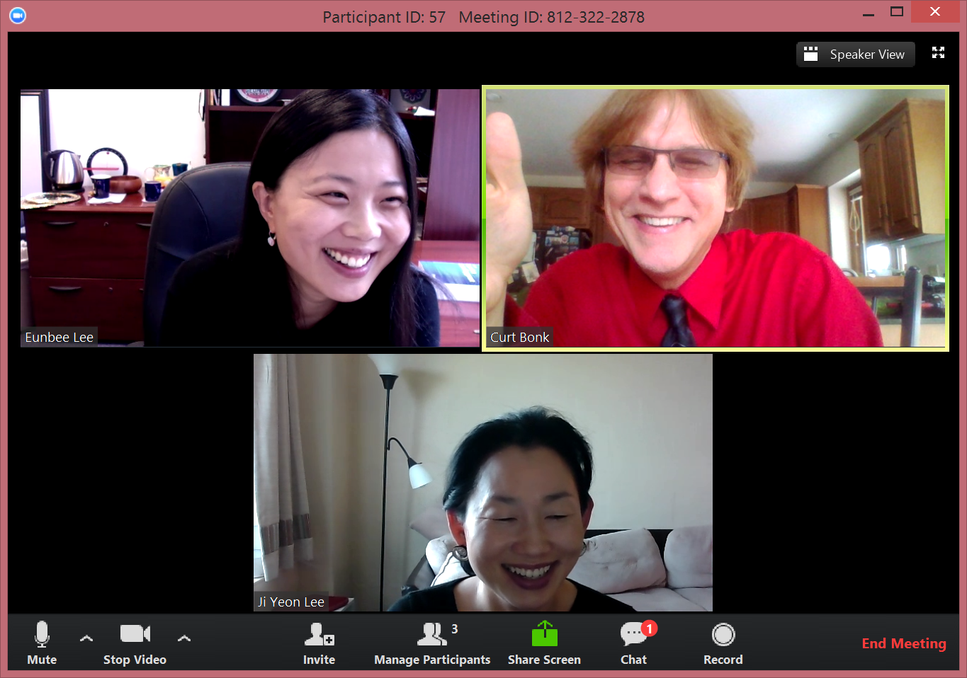
Fall 2015 (Zoom) 6. Brainstorm Ideas Research Team Meeting

Slide 30
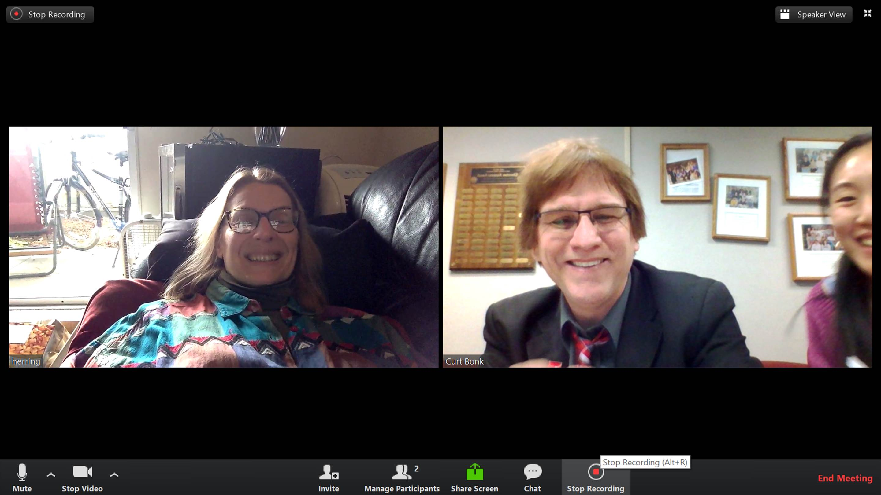
January 21, 2016 Research Meetings Dissertation proposal meeting

Slide 31
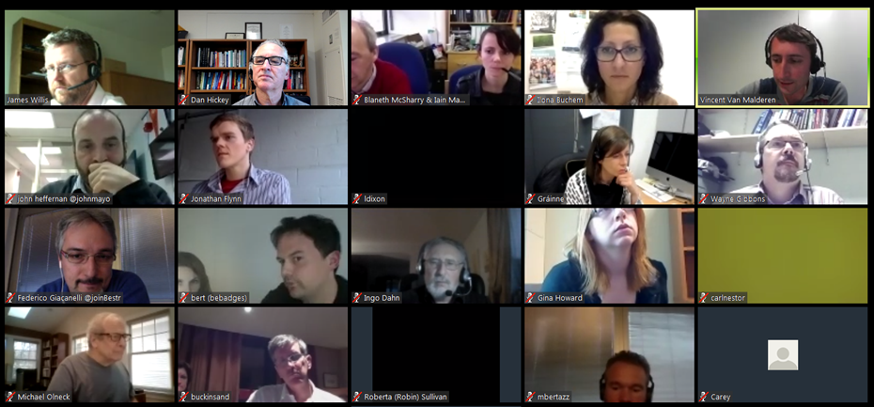
November 17, 2015 7. Collect Diverse Ideas and Feedback Zoom (International Open Badges Extravaganza) European Meeting (with Dr. Dan Hickey, IU)

Slide 32
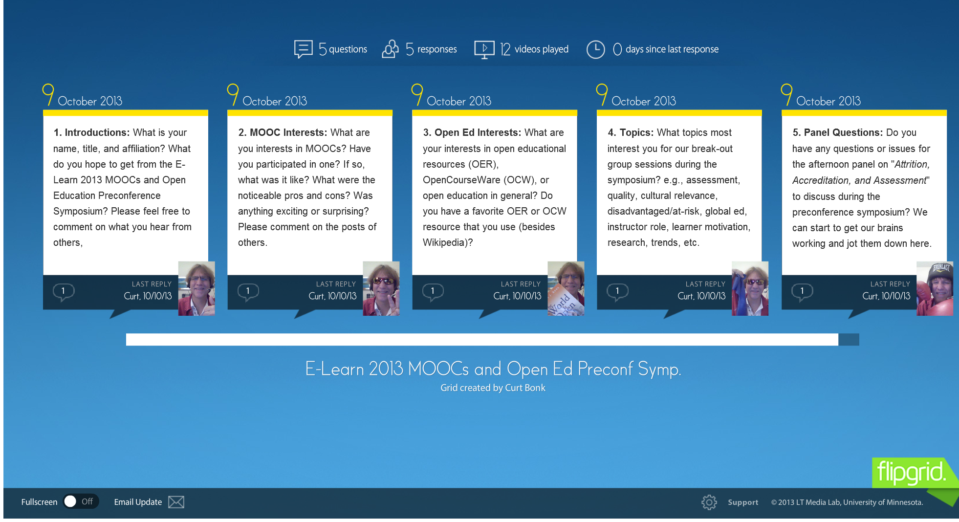
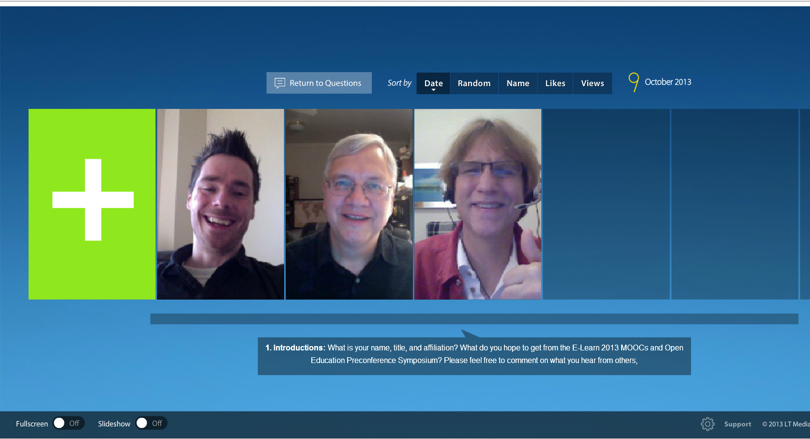
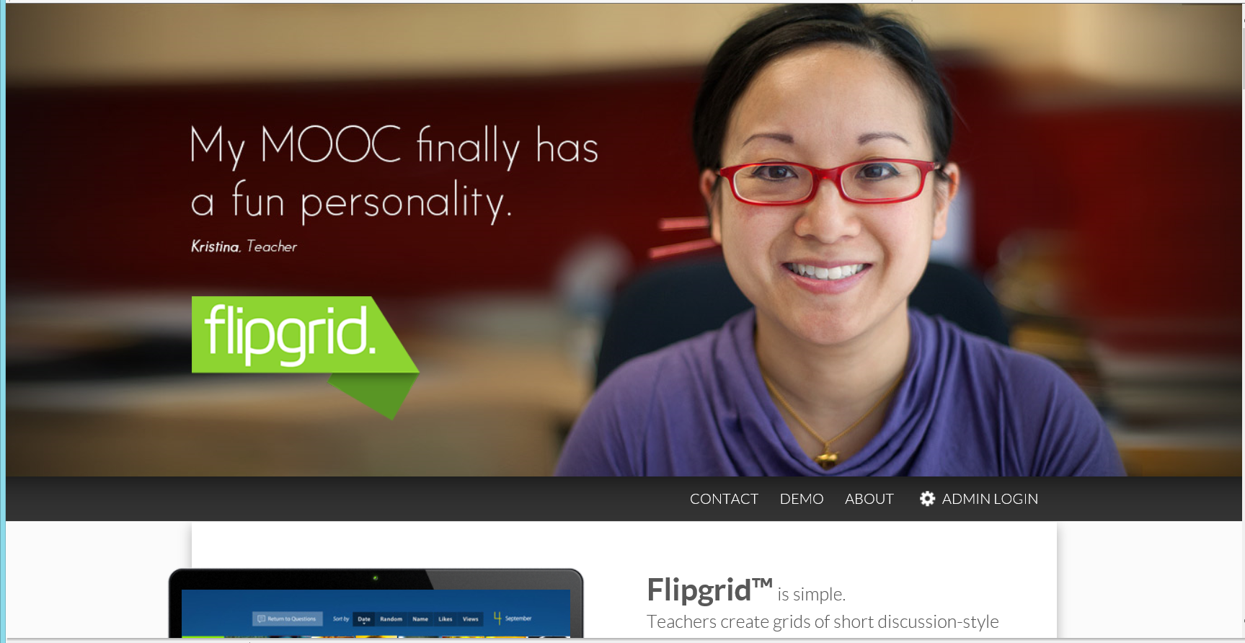
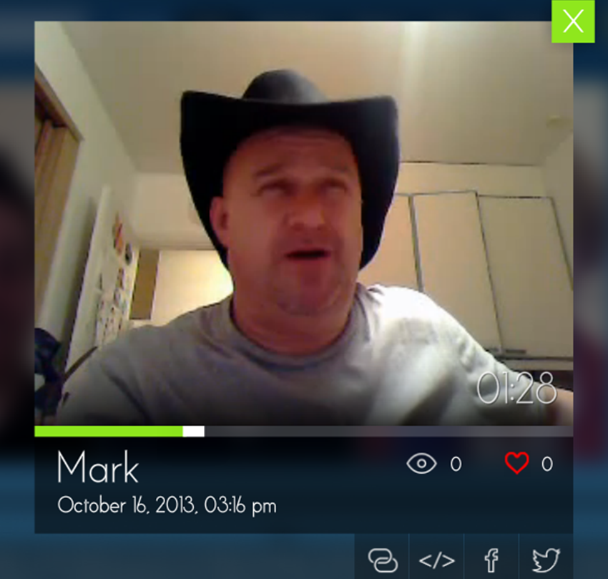
8. Threaded Video Discussions around Questions e.g., Flipgrid http://flipgrid.com/#429f88c5)

Slide 33
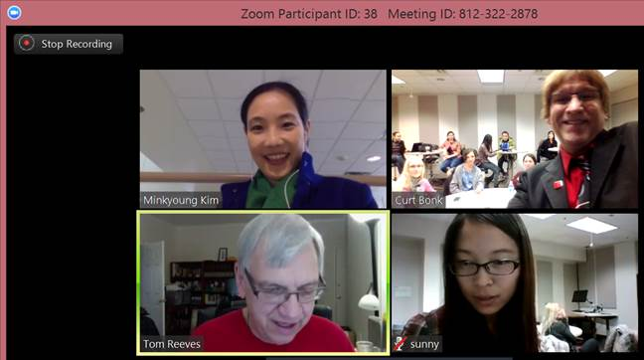
January 26, 2016 9. Demo Web Conferencing Tom Reeves, Guest Appearance Zoom

Slide 34
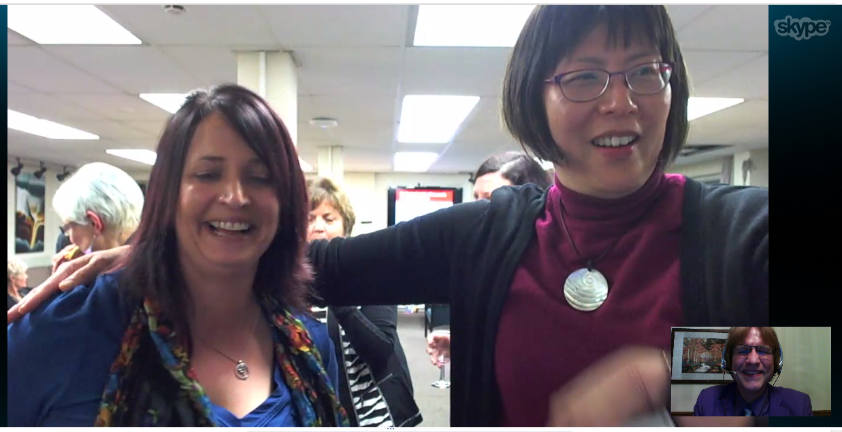
July 31, 2014 10. Celebrate Events Book Launching via Skype University of Waikato, New Zealand

Slide 35
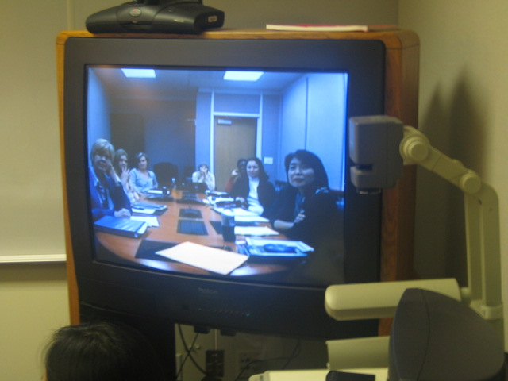
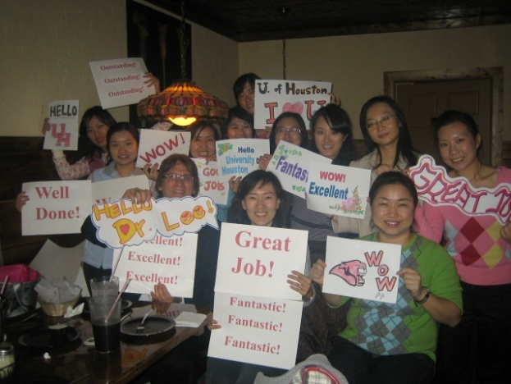
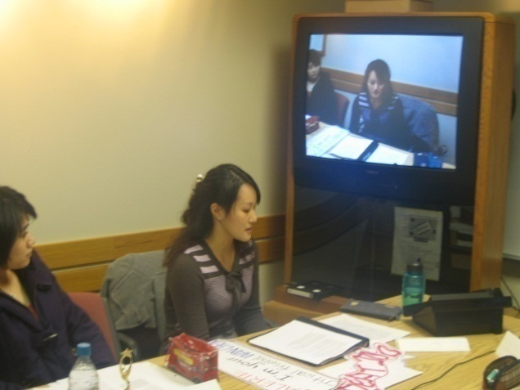
Cross-Institutional Wikibook Project (e.g., IU and the University of Houston)

Slide 36
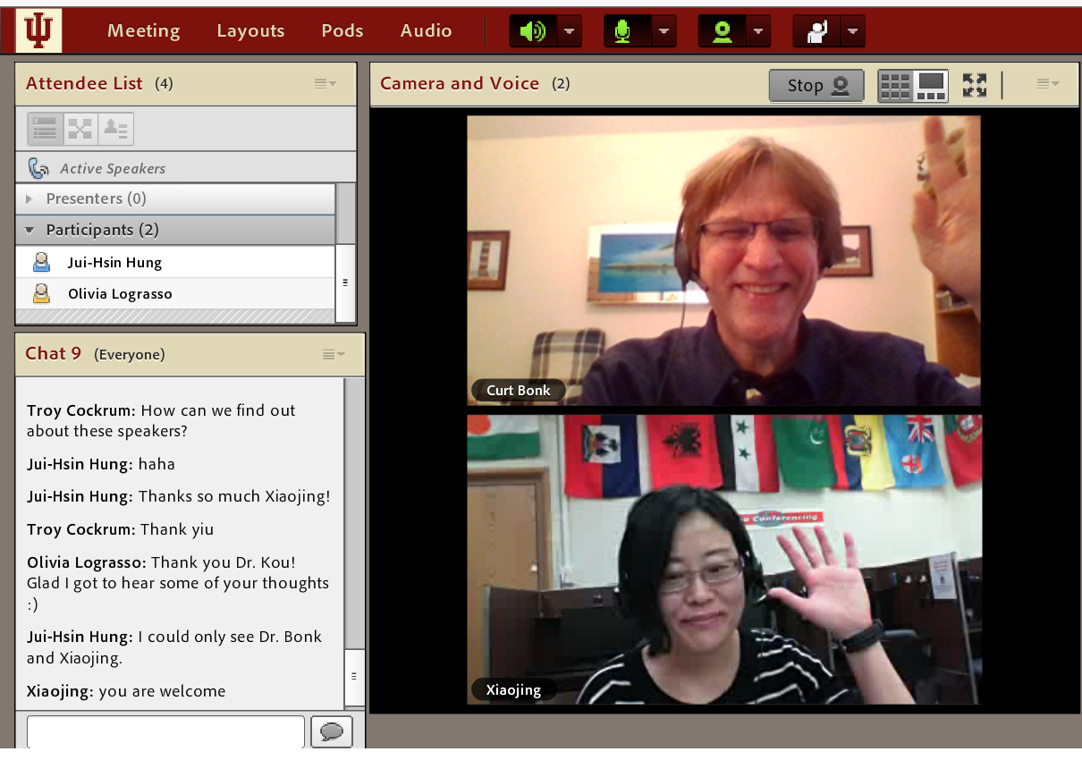
Questions? Slides at: TrainingShare.com Papers: PublicationShare.com Book: http://worldisopen.com/ Email: curt@worldisopen.com

