Slide 1
A Mixed Method Study of Instructor Design and Delivery of MOOCs for Participant Self-directed Learning
Meina Zhu
Curtis J. Bonk
Annisa Sari
Indiana University
School of Education, IST INDIANA UNIVERSITY BLOOMINGTON

Slide 2
Rethinking the MOOC Phenomenon…

Slide 3
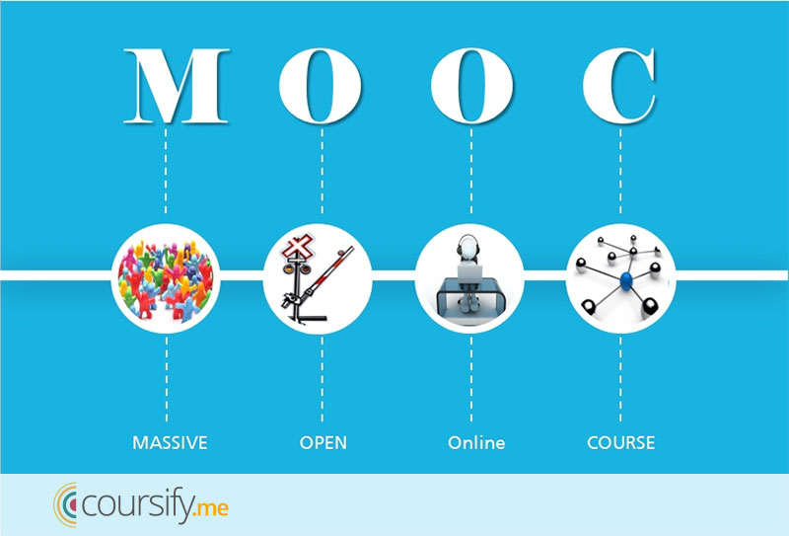

Slide 4
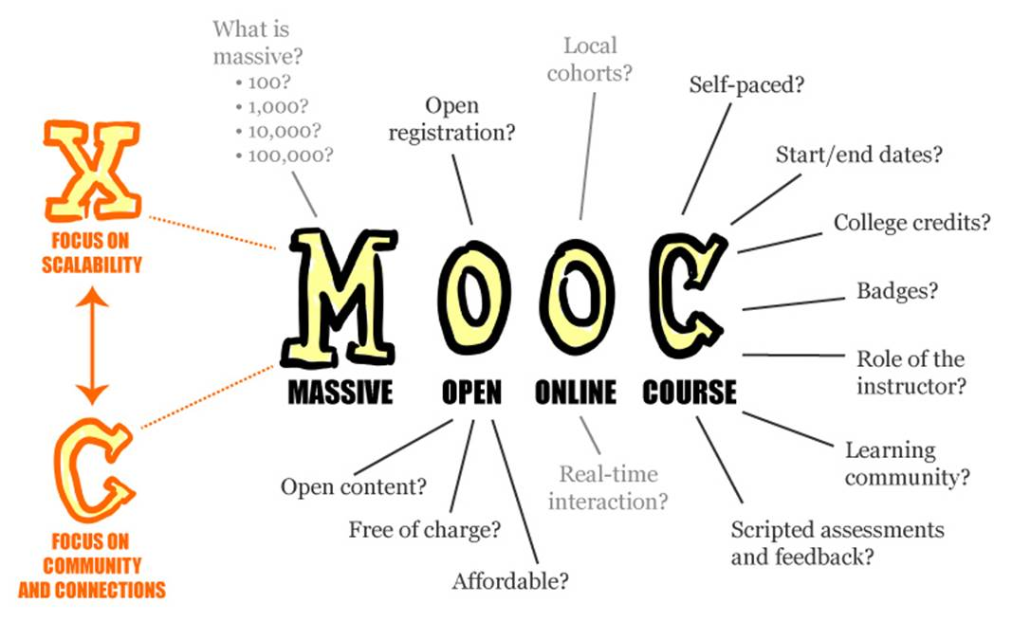

Slide 5
September 12, 2018 Coursera's CEO on the Evolving Meaning of 'MOOC’ Dian Schaffhauser, Campus Technology https://campustechnology.com/articles/2018/09/12/courseras-ceo-on-the-evolving-meaning-of-mooc.aspx
Jeff Maggioncalda, Coursera CEO

Slide 6
September 2016 MOOCs, Graduate Skills Gaps, and Employability: A Qualitative Systematic Review of the Literature David Santandreu Calonge and Mariam Aman Shah, IRRODL, 17(5), 67-90. http://www.irrodl.org/index.php/irrodl/article/view/2675/3881
“MOOCs have had a significant role in helping the traditional and the “new traditional” graduates to quickly up-skill before employment or to quickly “come on board” in their new job. MOOCs have provided flexible, on-demand, collaborative, and just-in-time learning opportunities through which to obtain relevant and applicable skills.” (p. 78)

Slide 7
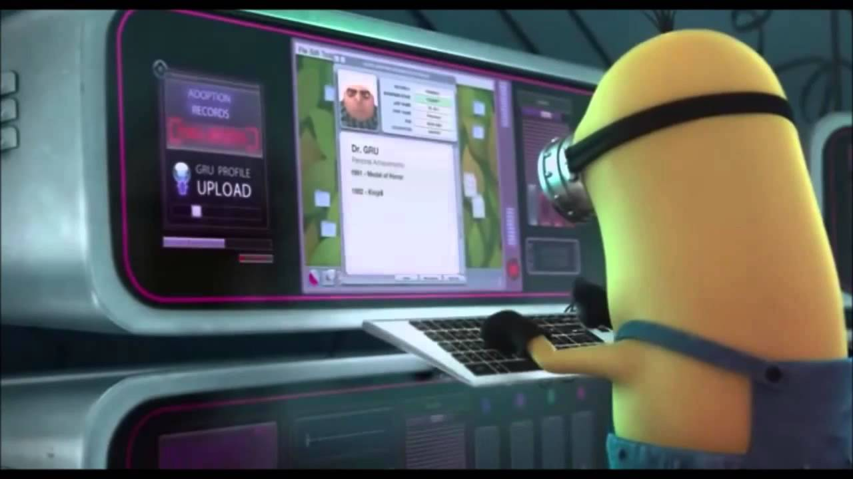
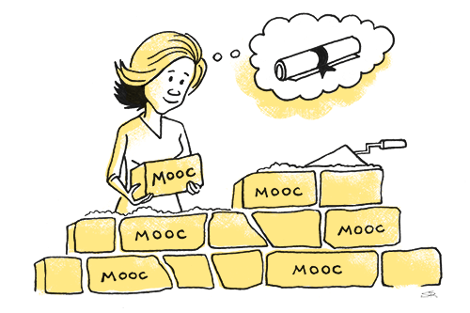
May 21, 2018 The Second Wave of MOOC Hype Is Here, and It’s Online Degrees Dhawal Shah, Class Central https://www.edsurge.com/news/2018-05-21-the-second-wave-of-mooc-hype-is-here-and-it-s-online-degrees

Slide 8
Email inbox: June 10, 2018 edX https://www.edx.org/course

Slide 9
Email inbox: June 10, 2018 edX https://www.edx.org/course

Slide 10
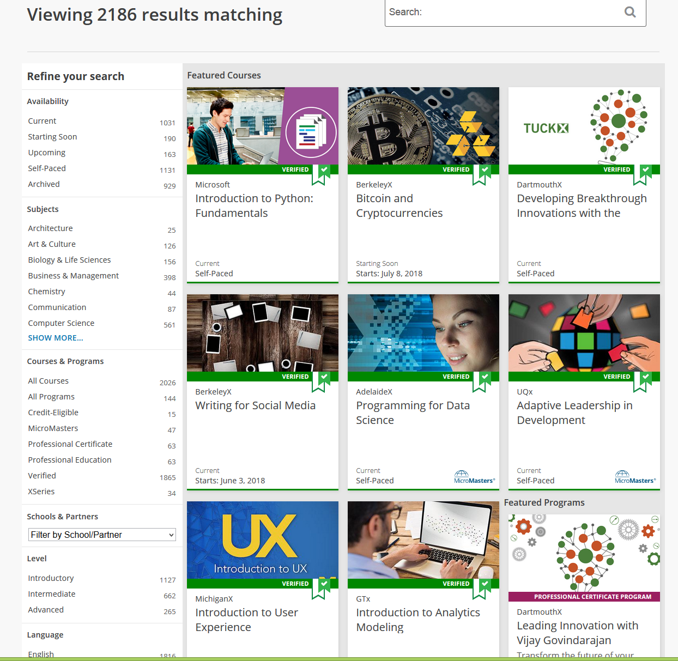
June 10, 2018 edX https://www.edx.org/course

Slide 11
Email inbox: June 11, 2018 Coursera https://www.coursera.org/

Slide 12
Email inbox: June 11, 2018 Coursera https://www.coursera.org/

Slide 13
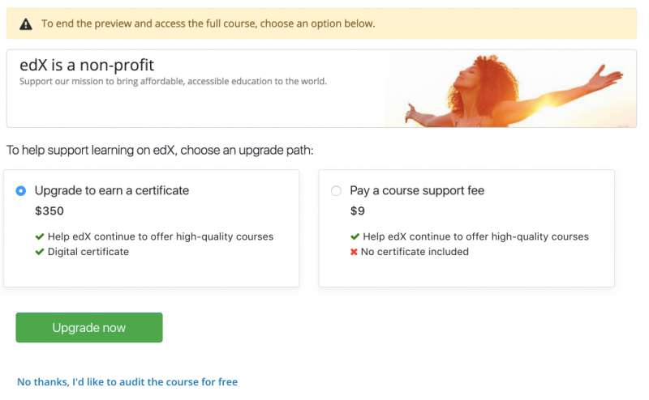
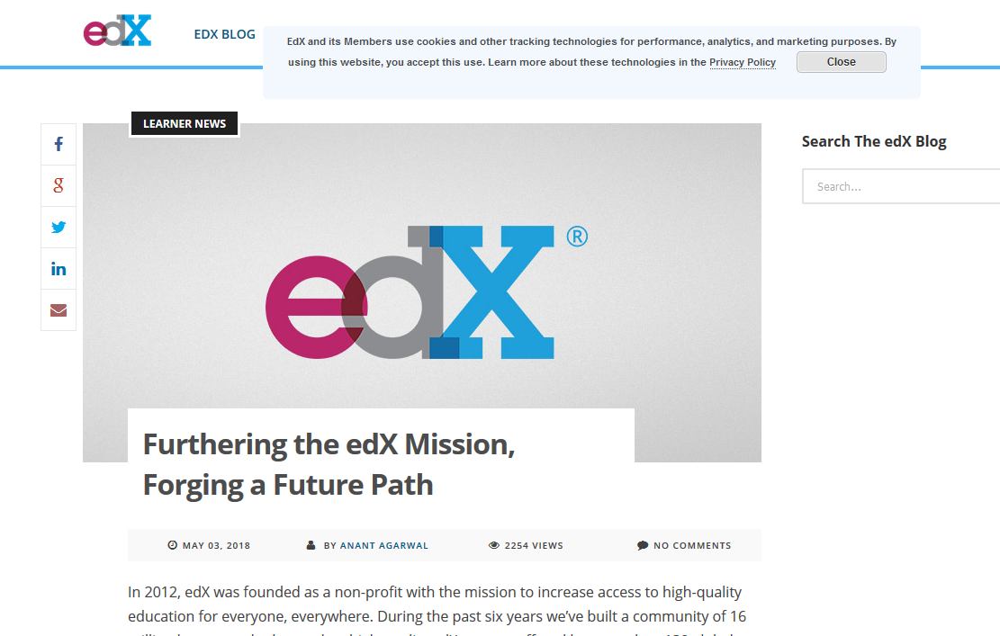
June 14, 2018 Free MOOCs Face the Music Lindsay McKenzie, Inside Higher Ed https://www.insidehighered.com/news/2018/06/14/edx-introduces-support-fee-free-online-courses

Slide 14
September 26, 2018 The Future of Professional Credentialing ... in an Engagement Announcement Joshua Kim, Inside Higher Ed https://www.insidehighered.com/digital-learning/blogs/technology-and-learning/future-professional-credentialing-engagement

Slide 15
October 3, 2018 The EV1 and the MOOC Joshua Kim, Inside Higher Ed https://www.insidehighered.com/digital-learning/blogs/technology-and-learning/ev1-electric-car-and-mooc

Slide 16
October, 2018 Teaching the World Sarah Fister Gale, CLO https://magazine.clomedia.com/issue/october-2018/teaching-the-world/ https://magazine.clomedia.com/issue/october-2018/

Slide 17
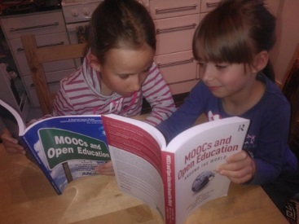
“MOOCs and Open Education Around the World” Edited by Curt Bonk, Mimi Lee, Tom Reeves, and Tom Reynolds (Published 2015 in English, 2016 in Korean, and 2018 in Chinese) Book Endorsement: “I am truly astonished by the creative energy that the MOOC has unleashed in recent years. This book is a wonderful collection of some of the very best thinking in this very young field.” Sebastian Thrun, CEO and cofounder of Udacity, Stanford Professor, and developer of Google Glass and self-driving cars, and instructor to 160,000+ students in a MOOC on AI Bonk, C. J., Lee, M. M., Reeves, T. C., & Reynolds, T. H. (Eds.). (2015). MOOCs and Open Education Around the World. NY: Routledge. (Note: translated to Korean (2016), Academy Press, Paju, Korea; and translated to Chinese (2018). East China Normal University, Shanghai, China. Homepage: http://moocsbook.com/

Slide 18
MOOC Trends and Recent Data

Slide 19
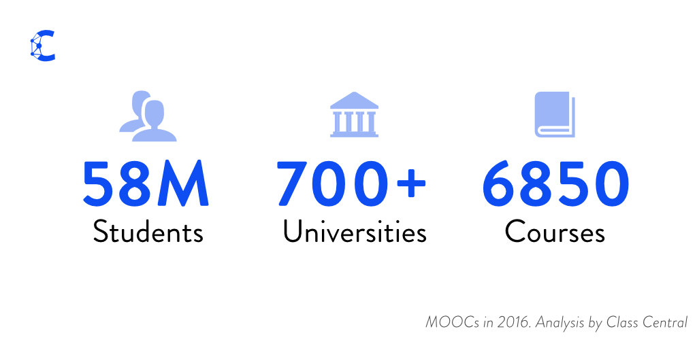
December 25, 2016 A Review of MOOCs Stats and Trends in 2016, Dhawal Shah, Class Central https://www.class-central.com/report/mooc-stats-2016/

Slide 20
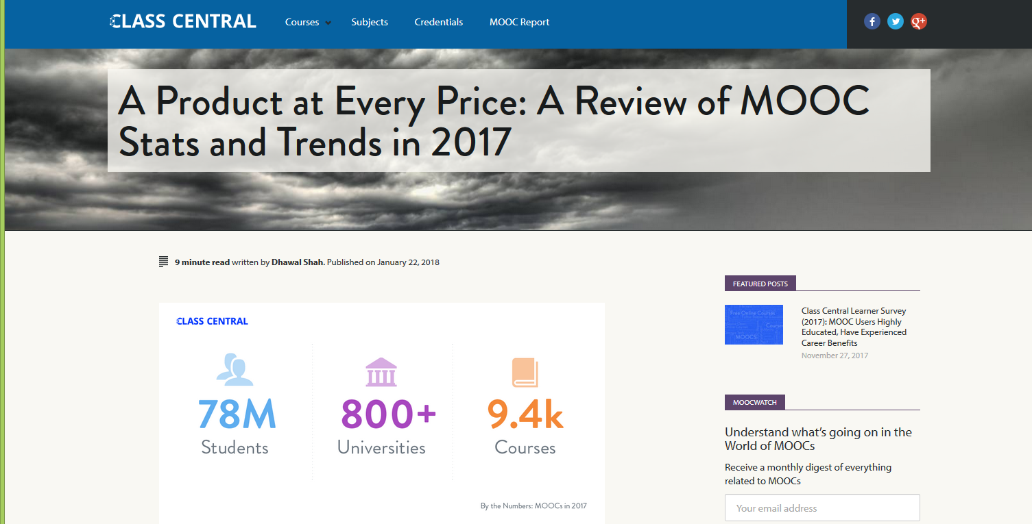
January 22, 2018 A Review of MOOCs Stats and Trends in 2017, Dhawal Shah, Class Central https://www.class-central.com/report/moocs-stats-and-trends-2017/

Slide 21
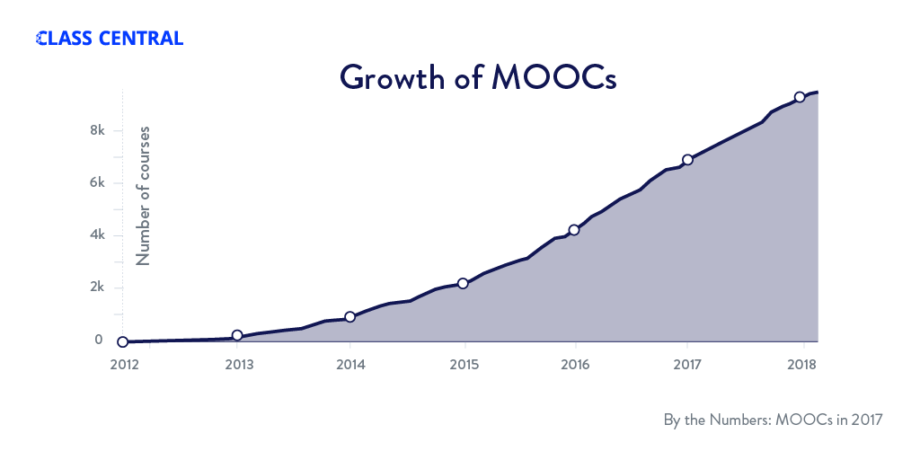
January 22, 2018 A Review of MOOCs Stats and Trends in 2017, Dhawal Shah, Class Central https://www.class-central.com/report/moocs-stats-and-trends-2017/

Slide 22
August 19, 2018 Top 5 MOOC Providers by Number of Registered Users, 2018 Almanac 2018, Chronicle of Higher Education https://www.chronicle.com/article/Top-5-MOOC-Providers-by-Number/244090?cid=cp216

Slide 23
August 19, 2018 Top 5 MOOC Providers by Number of Registered Users, 2018 Almanac 2018, Chronicle of Higher Education https://www.chronicle.com/article/Top-5-MOOC-Providers-by-Number/244090?cid=cp216

Slide 24
Subject areas (January 22, 2018)

Slide 25
August 19, 2018 Top 5 MOOC Providers by Number of Registered Users, 2018 Almanac 2018, Chronicle of Higher Education https://www.chronicle.com/article/Top-5-MOOC-Providers-by-Number/244090?cid=cp216

Slide 26
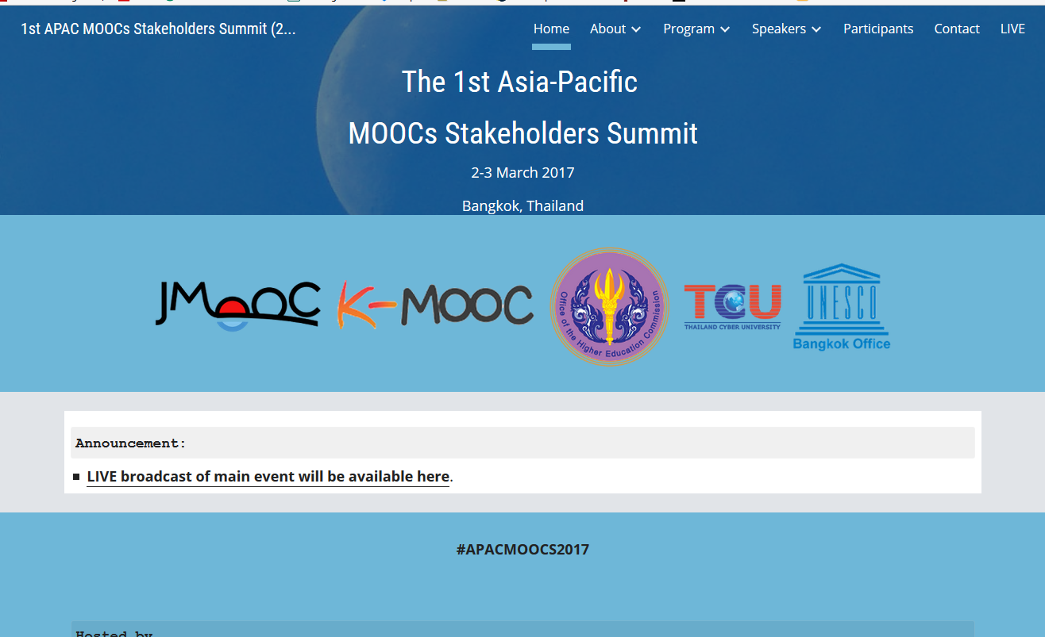
June 15, 2017 Massive List of MOOC Providers Around The World, Class Central JMOOC, K-MOOC, and T-MOOC? https://www.class-central.com/report/mooc-providers-list/

Slide 27
MOOC Research Gaps and Summaries

Slide 28
2015 Instructional quality of Massive Open Online Courses (MOOCs). Margaryan, Bianco, & Littlejohn, Computers & Education, 80, 77-83. http://www.sciencedirect.com/science/article/pii/S036013151400178X
“As MOOCs proliferate, drawing in increasing numbers of faculty and learners worldwide, the issue of their instructional quality becomes increasingly pressing.” (p. 82)

Slide 29
August 2017 A Contemporary Review of Research Methods Adopted to Understand Students’ and Instructors’ Use of Massive Open Online Courses (MOOCs) Ruiqi Deng and Pierre Benckendorff

Slide 30
August 2017 A Contemporary Review of Research Methods Adopted to Understand Students’ and Instructors’ Use of Massive Open Online Courses (MOOCs) Ruiqi Deng and Pierre Benckendorff, International Journal of Information and Education Technology, 7(8), 601-607.
“There are a number of research avenues which could be explored based upon the findings of this study. First, additional research strategies should be considered to understand students’ and instructors’ experience in using MOOCs.” (p. 605)

Slide 31
August 2017 A Contemporary Review of Research Methods Adopted to Understand Students’ and Instructors’ Use of Massive Open Online Courses (MOOCs) Ruiqi Deng and Pierre Benckendorff, International Journal of Information and Education Technology, 7(8), 601-607.
“Second, triangulation of a wider range of research methods and data source should be undertaken. Beyond triangulation of surveys and interviews or log files, MOOC scholars are encouraged to combine other research methods to triangulate findings, such as diary studies and focus groups.” (p. 605)

Slide 32
Quotes: Veletsianos et al. (2015-2016)
“To gain a deeper and more diverse understanding of the MOOC phenomenon, researchers need to use multiple research approaches (e.g., ethnography, phenomenology, discourse analysis) add content to them.” (p. 583.)
Veletsianos, Collier, & Schneider (2015, May), Digging deeper into learners’ experiences in MOOCs: Participation in social networks outside of MOOCs, notetaking and contexts surrounding content consumption. BJET, 46(3), 570-587.
“Dependence on Particular Research Methods May Restrict our Understanding of MOOCs.”
George Veletsianos & Peter Shepherdson’s Study (2016). Systematic Analysis and Synthesis of the Empirical MOOC Literature Published in 2013-2015. IRRODL. http://www.irrodl.org/index.php/irrodl/article/view/2448/3655

Slide 33
Systematic Review of Research Methods in MOOCs (2014-2016) (Zhu, M., Sari, A., & Lee, M. M., 2018)

Slide 34
Systematic Review of Research Methods in MOOCs (2014-2016) (Zhu, M., Sari, A., & Lee, M. M., 2018)
 | Quantitative | Qualitative | Mixed methods
Student-focused | 39 | 9 | 26
Design-focused | 19 | 12 | 17
Context and impact | 9 | 6 | 5
Instructor-focused | 0 | 3 | 2

Slide 35
Systematic Review of Research Methods in MOOCs (2014-2016) (Zhu, M., Sari, A., & Lee, M. M., 2018)
No. | Journal | Total
1 | International Review of Research in Open and Distance Learning (IRRODL) | 31
2 | Computers & Education | 12
3 | British Journal of Educational Technology | 9
4 | Online Learning | 7
5 | Distance Education | 5
6 | Educational Media International | 5
7 | Internet and Higher Education | 5
8 | Journal of Computer Assisted Learning | 5
9 | Computers in Human Behavior | 4
10 | Open Learning | 4
11 | Journal of Online Learning and Teaching | 3
12 | Journal of Asynchronous Learning Network | 3

Slide 36
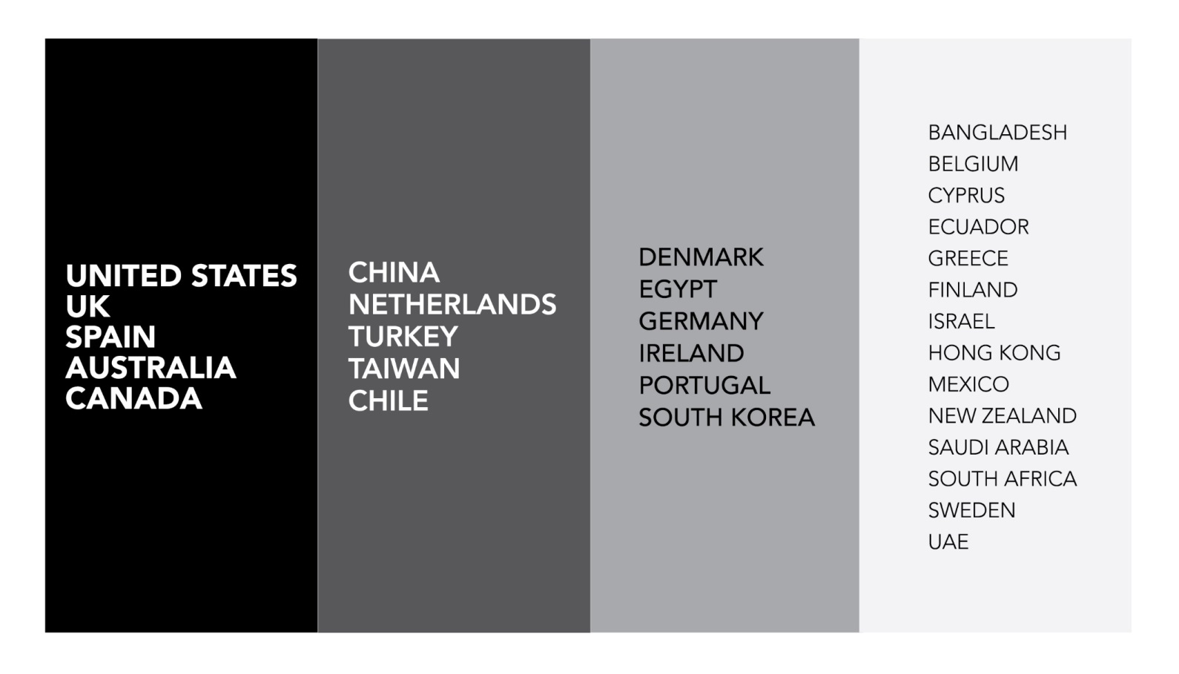
Systematic Review of Research Methods in MOOCs (2014-2016) (Zhu, M., Sari, A., & Lee, M. M., 2018)
Location of MOOC Research Team Members (2014-2016)

Slide 37
Systematic Review of Research Methods and Topics in MOOCs: Comparing 2014-2016 and 2016-2017 (Zhu, M., Sari, A., & Bonk, C. J., 2018)
Figure 7. Countries of MOOC delivery in which the research was conducted (2014 – 2017) (n=197) (Note: this figure only includes the main countries)

Slide 38
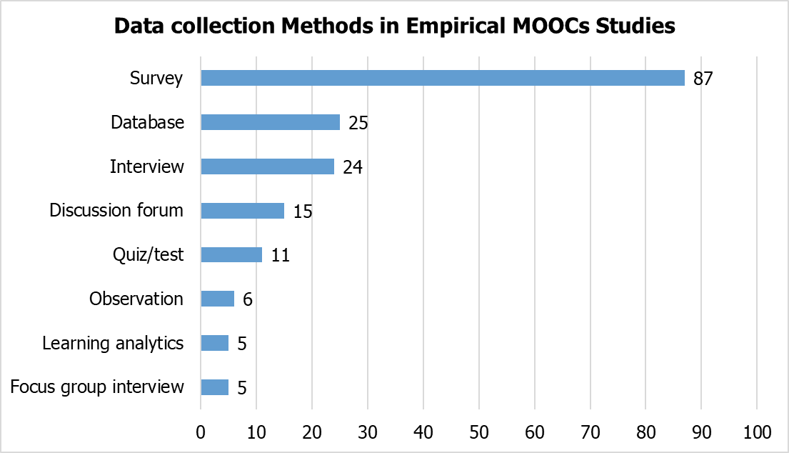
Systematic Review of Research Methods in MOOCs (2014-2016) (Zhu, M., Sari, A., & Lee, M. M., 2018)
RQ1: What are the research methods researchers employed in empirical MOOC studies?

Slide 39
Implications and Final Comments “Given the number of participants that MOOCs attract, this study has the potential to provide marked insight into an emerging phenomenon that has immense global, local, and societal ramifications. With such wide impact potential, our research team continues to expand the database of MOOC instructors and courses that we have collected. The goal as we move forward is to determine more about the psychological, instructional, and technological issues, challenges, and opportunities of MOOCs and other emerging types of open online courses and educational experiences.”

Slide 40
Self-Directed Learning Framework…

Slide 41
Research Background
Self-directed learning (SDL) is considered essential to adult education (Garrison, 1997; Merriam, 2001)
In addition, researchers consider SDL as an essential element in MOOC environments (Bonk et al., 2015; Kop & Fournier, 2010; Terras & Ramsay, 2015)
Learners expect the instructor to act as a facilitator to provide support for the development of the appropriate SDL skills (Kell & Deursen, 2002; Lunyk-Child et al., 2001)

Slide 42
Question: Are you self-directed when you take your MOOCs?

Slide 43
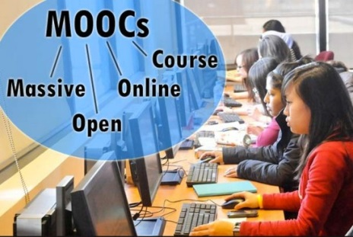
Theory Framework
Garrison’s (1997) three dimensions model is one of the popular models, which categorized SDL into three overlapping dimensions:
self-management (task control);
self-monitoring (cognitive responsibility);
motivating (entering and task).

Slide 44
Research Focus and Purpose

Slide 45
Research Background
However, there is a lack of studies that examine instructional design challenges in creating a MOOC or the issues that emerge during the actual delivery of that MOOC from the perspective of MOOC instructors (Margaryan, Bianco, & Littlejohn, 2015; Ross, Sinclair, Knox, Bayne, & Macleod, 2014; Watson et al., 2016); especially lacking is research on instructor perceptions related to the facilitation of SDL and how they design and deliver MOOCs to facilitate students’ SDL.

Slide 46
Research Purpose
This study examined instructors’ perceptions of SDL and the design and deliver of MOOCs to facilitate learners’ SDL. The purpose is to find out MOOC instructors’ perceptions of SDL and how MOOC instructors put considerations related to facilitating SDL skills into MOOC designs and delivery.

Slide 47
Research Questions
How do MOOC instructors perceive participants’ SDL skills?
How do MOOC instructors perceive their facilitation of participants’ SDL skills?
How do instructors design and deliver MOOCs to facilitate participant SDL skills?

Slide 48
Research Design

Slide 49
Research Methods-Design
Sequential mixed methods design (Creswell & Clark, 2007)

Slide 50
Research Methods-Data collection
Data Collection:
(1) surveys, (2) interviews, and (3) course reviews.
Participants:
48 survey participants (10% response rate)
4 interviewees

Slide 51
Research Methods-Data collection
MOOC instructors interviewed
No. | Countries | Subject areas | Platforms
1. | The UK | Computer Science | Kadenze
2. | The UK | Literacy | FutureLearn
3. | The U.S. | Finance | Coursera
4. | Canada | Geography | Coursera

Slide 52
Research Methods-Data analysis
RQs | Data Sources | Data analysis
RQ1 | Survey Interview MOOC review | Descriptive statistics Content analysis (Elo & Kyngäs, 2008)
RQ2 | Survey Interview MOOC review | Descriptive statistics Content analysis
RQ3 | Interview MOOC review | Content analysis

Slide 53
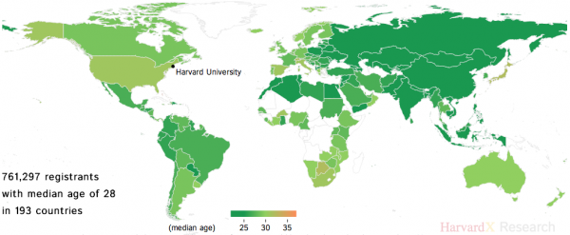
Demographic Information

Slide 54
Study Results

Slide 55
Prior Online or Blended Experience

Slide 56
Prior MOOC Experience

Slide 57
MOOC Delivery Format

Slide 58
RQ1:MOOC instructors’ perceptions of self-directed learning

Slide 59
RQ1:MOOC instructors’ perceptions of self-directed learning
One instructor from the UK shared one example of students who have high SDL.
I guess to me it gets really exciting to look at how a number of those students have done projects that really go beyond the simple examples that I showed in lecture, and beyond the simple things up they were asked to do in the assignments. You know they've taken them into the real world… One student who, during the presidential election made a presidential debate voiced motion classifier, that you could run. And it would tell you whether candidates were being angry or not. It was just like really fun stuff that people did.

Slide 60
RQ1:MOOC instructors’ perceptions of self-directed learning
Another instructor from the UK mentioned the his students with high SDL skills:
We had several students who said this is the 10th or 15th MOOC I have taken. Within a body of students who a very much learning junkies, who are enjoy doing all kinds of different MOOCs. One of them told us I just like all kinds of different things. But you have to be quite disciplined.

Slide 61
RQ1:MOOC instructors’ perceptions of self-directed learning
One instructor from Canada mentioned the he has elder students with high SDL skills:
We have a very number of sort of sixty plus, retired people taking the course. They're pretty motivated.

Slide 62
RQ2: MOOC instructors’ perceptions of their role in facilitating SDL skills

Slide 63
RQ2: MOOC instructors’ perceptions of their role in facilitating SDL skills
One instructor from the UK stated:
I mean instructors can absolutely help, and, furthermore, I think the architecture of the MOOC itself that really helped. I think is common practice now, for instance, is to chop up video isn't a ten-minute chunk so that it's really easy for students to watch a little bit at a time, to watch it on the go, also you know [you will] be able to return to a subject that they maybe didn't understand or the first time…
Similarly, having things like suggested deadlines where it's something that's used as a piece of a way to motivate students to do the next thing, even though there's not any real consequences if they're not doing it.

Slide 64
RQ2: MOOC instructors’ perceptions of their role in facilitating SDL skills
Another instructor from the UK stated that his responsibility with SDL is limited, but he can help in certain ways:
I think my responsibility with SDL was quite limited. My main responsibility is to provide good material... We also fell a mission of showcase that we are in the cutting-edge. We were very modern. We wanted students to realize that and engage with that. Those are the kind of general experiences of responsibility.

Slide 65
RQ2: MOOC instructors’ perceptions of their role in facilitating SDL skills
On the other side, the instructor from the Canada rely more on students motivation in SDL:
I tried. But I also think it's probably their [students] responsibility to be motivated. So I just make myself available and encourage you know people to complete the course if they get stuck on something to ask questions or to move on. Yeah. It's meant to be interesting and fun and you know. There's no life or death decision that hinges on whether you complete this or not. It's there you know up to you. If you're not interested in it anymore, you might stop right.

Slide 66
RQ3: How do instructors design and deliver MOOCs to facilitate participant SDL skills?
The top five SDL skills that their MOOCs facilitated included:
(1) motivates students to learn new information (M=4.38);
(2) helps the student critically evaluate new ideas (M=4.06);
(3) helps the student be in control of his/her learning (M=4.06);
(4) helps the student to be able to find out information related to learning content for him/herself (M=3.94);
(5) helps the student embrace a learning challenge (M=3.92).
However, it seems that their MOOC designs have limited influence on students’ management skills (e.g., managing time and learning resources) (M=3.38) and setting strict time frames for learning (M=3.25).

Slide 67
MOOC Instructor Perceptions of the Importance of Different SDL Skills for MOOC Participants
SDL skills | Avg.
Q17. motivates students to learn new information | 4.38
Q20. helps the student critically evaluate new ideas | 4.06
Q24. helps the student be in control of his/her learning | 4.06
Q29. helps the student be able to find out information related to learning content for him/herself | 3.94
Q19. helps the student embrace a learning challenge | 3.92
Q18. helps the student develop a need to learn | 3.90
Q16. helps the student to be confident in his/her ability to search out information | 3.88
Q27. helps the student be responsible for his/her learning | 3.88
Q26. helps the student evaluate his/her own performance | 3.83
Q22. helps the student seek the deeper reasons for the facts | 3.77
Q11. helps the student to be self-disciplined | 3.73
Q12. helps the student to be organized | 3.71
Q21. helps the student learn from his/her mistakes | 3.71
Q28. helps the student be able to focus on a problem | 3.71
Q23. helps the student be willing to seek different ways to solve difficult problems | 3.69
Q30. helps the student have high beliefs in his/her abilities of learning | 3.65
Q15. helps the student to prioritize his/her study (e.g., determine the order in which the studies are to be done) | 3.60
Q25. helps the student set his/her own learning goals | 3.52
Q14. helps the student to have good management skills (e.g., managing time and learning resources) | 3.38
Q13. helps the student to set strict time frames for learning | 3.25

Slide 68
RQ3: How do instructors design and deliver MOOCs to facilitate participant SDL skills?
An interview with one instructor from Canada revealed a more behaviorally-based tactic that some MOOC instructors use to facilitate students’ SDL skills.
He argued that “I think our quizzes at the end are helpful. And I think…we have reading lists and I update the reading lists for the course on a regular basis.” He added that they “direct people to that” and send reminders through the forum and emails.

Slide 69
RQ3: How do instructors design and deliver MOOCs to facilitate participant SDL skills?
One instructor from Canada mentioned he sent students message to remind students:
You lose people at the front and so one of the things that I've started to try to do is, because I know who those people are is to sort of send messages out saying “hey, if you haven't started yet just sign up again blah blah blah” and get people started. I figure once we get people started we can keep them in the course like we have a good track record of keeping people in the course.

Slide 70
RQ3: How do instructors design and deliver MOOCs to facilitate participant SDL skills?
One instructor from the UK mentioned she encouraged student reflection:
One of the things that I tried to do was to give people opportunities for different types of engagement with explicit opportunities for reflection built-in. So, for instance. You know for the second or third assignment, part one is you're asked to go through a set of exercises on your own following from examples in lecture. At the end you're asked some questions about which parts of this were hard, what challenges did you encounter, how would you approach solving those challenges, how successful were you.

Slide 71
RQ3: How do instructors design and deliver MOOCs to facilitate participant SDL skills?
One instructor from the US mentioned she tried to combine the content with student personal life:
one of the things that we really tried to put in was opportunities for people to take what they were learning and to reflect back how it impacted their own lives. So, we asked people about activities the case studies and things always go back to you...then we say, in your own situation what would you do? So, in that sense I think that helps people to think about not only what's the right answer to a quiz question, perhaps but also how does what I'm learning affect me and how does that what I want to still learn more about. We made this really personal and applicable to them.

Slide 72
RQ3: How do instructors design and deliver MOOCs to facilitate participant SDL skills?
One instructor from the US mentioned she used interactive interview to engage students in MOOC:
And then we also have these little one-minute like on the street interviews to also try to help students engage with like what's happening. To me so it wasn't all talking heads because that just we didn't think that was going to be helpful for the self-directed learning at all. So, we did try to really think about how could we get people involved.

Slide 73
Discussion, Significance, and Conclusion

Slide 74
Discussion of Results
Instructors considered SDL as a skill that can be educated.
Most of them felt that MOOC instructors can intentionally create learning environments that foster the development of SDL skills as Kell and Deursen (2002) suggested.
In terms of their design and delivery practices to facilitate SDL via the MOOC, it seems that the impact is mainly on learner self-monitoring and motivation. However, the impact on students’ self-management skills seems limited.

Slide 75
Significance & Conclusion
This study offers insights into MOOC design for SDL.
The findings might offer implications for instructors or instructional designers concerning the design of MOOCs for self-directed learners.
Additionally, the results also provide guidance for MOOC learners on the SDL strategies that they need to be successful.

Slide 76
Limitations and Future Directions

Slide 77
Limitations…
No student perspective or voice
Small sample (48 surveyed; 4 interviewed)
Self-report survey data
No direct observations

Slide 78
Future Research Might Explore…
Student perceive their SDL in MOOC.
Support needed from learners in terms of SDL in MOOCs.
MOOC instructional professional development and instructor teaching skill changes from designing MOOCs.

Slide 79
Any Questions?

Slide 80
Curtis J. Bonk, IU, cjbonk@indiana.edu
Meina Zhu, IU, meinzhu@iu.edu
Annisa Sari, IU, annisa@uny.ac.id
Slides and Paper: http://www.trainingshare.com

