Slide 1
Education 20/20: Toward a Vision of Blended Learning Ideas and Beyond
Curtis J. Bonk, Professor, Indiana University
cjbonk@indiana.edu
http://mypage.iu.edu/~cjbonk/

Slide 2
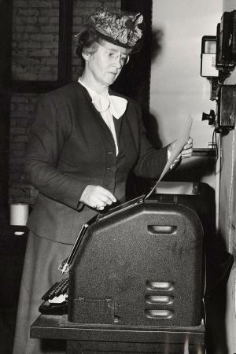
Fall 2014, On Wisconsin MOOC, Meet MORC (Massive Open Radio Course) WHA, UW Madison, College of the Air,1933, Vocational Training dedicated to Agriculture, and later Home Economics and Typing
Mimeograph machine.

Slide 3
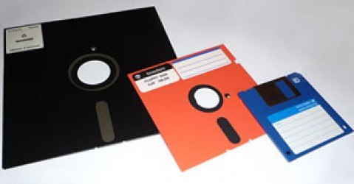
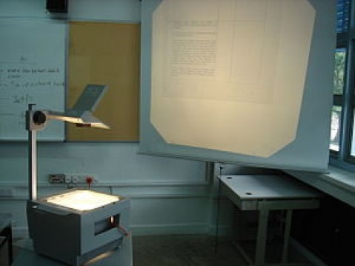
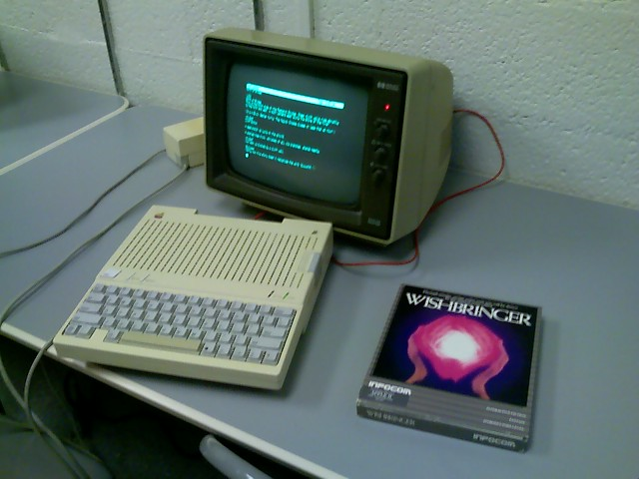
May 10, 2013 10 ed-tech tools of the 70s, 80s, and 90s eSchool News, Meris Stansbury http://www.eschoolnews.com/2013/05/10/10-ed-tech-tools-of-the-70s-80s-and-90s/print/

Slide 4
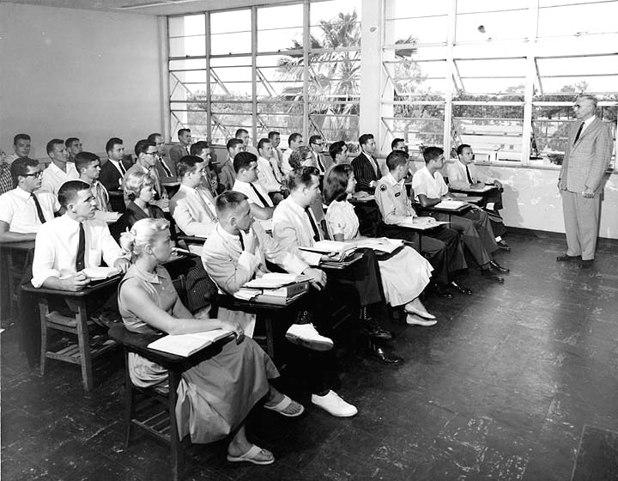
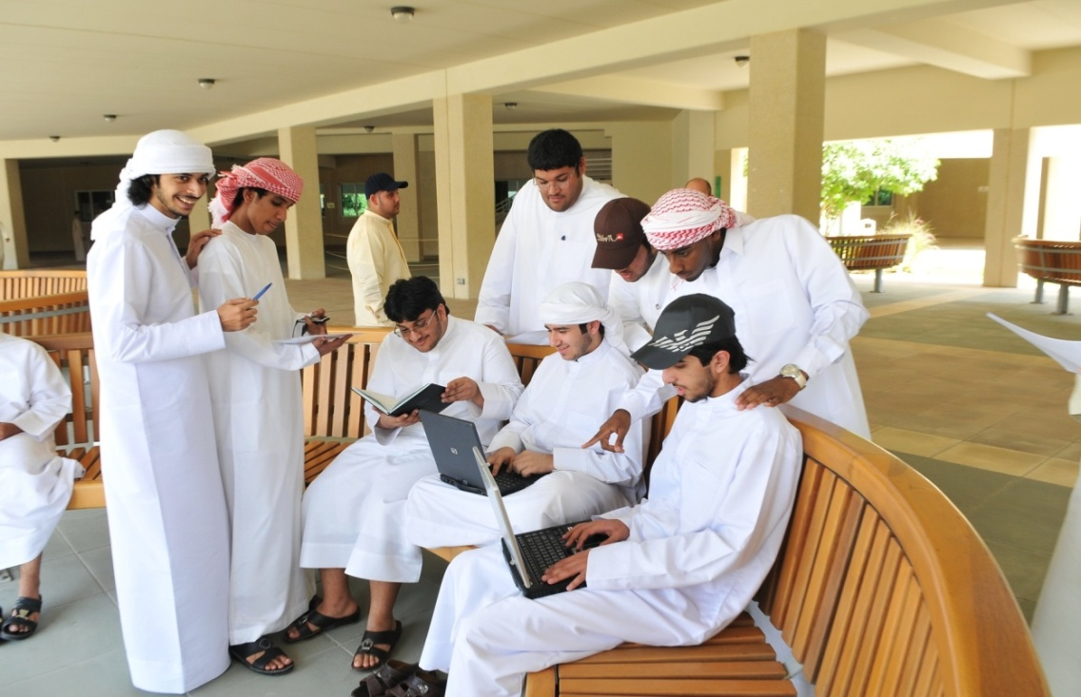
This is a new age of learning and instruction…!

Slide 5
Education 20/20

Slide 6
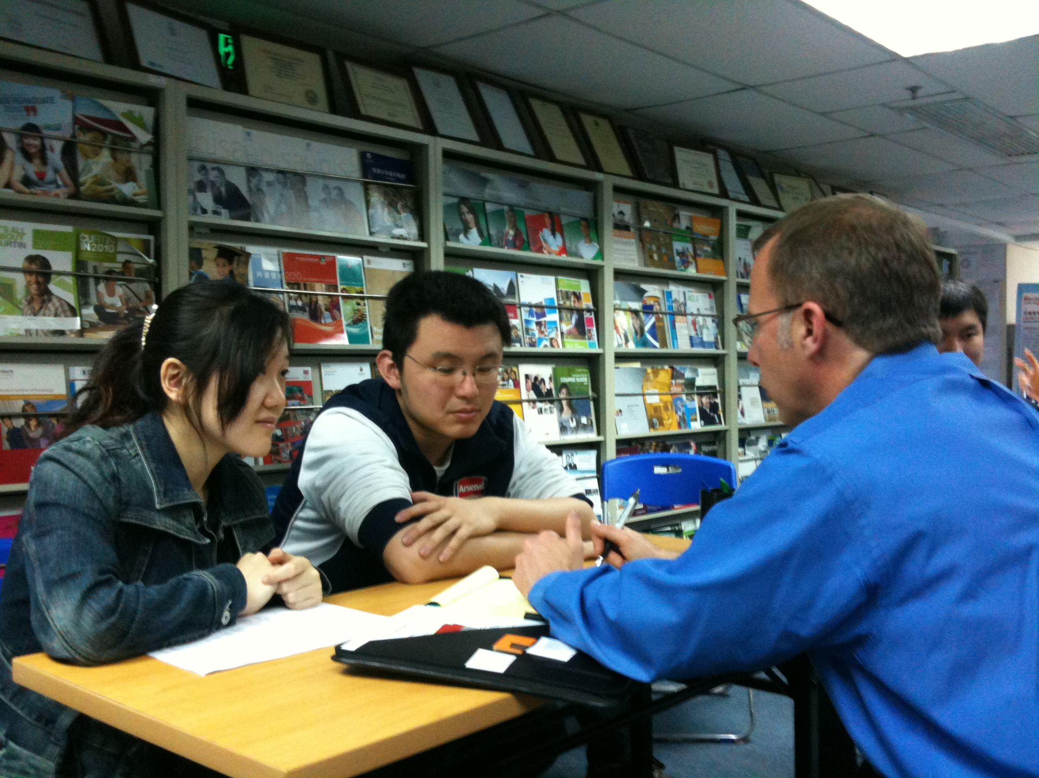
1. Instructor as Counselor

Slide 7
2. Instructor as Consultant

Slide 8
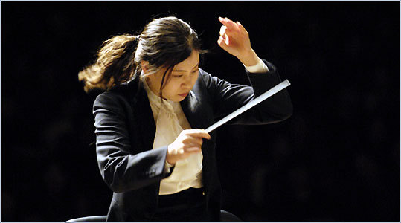
3. Instructor as Conductor

Slide 9
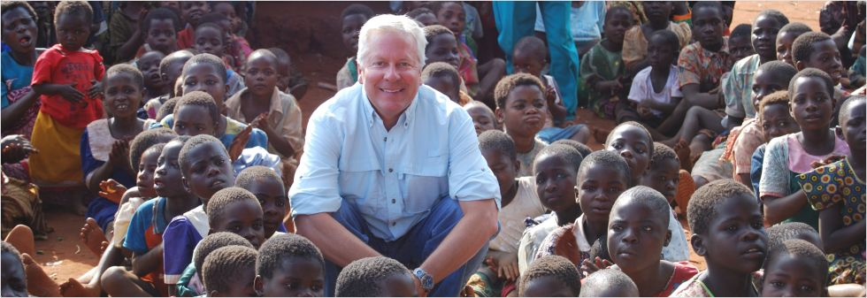
4. Instructor as Course Ambassador

Slide 10
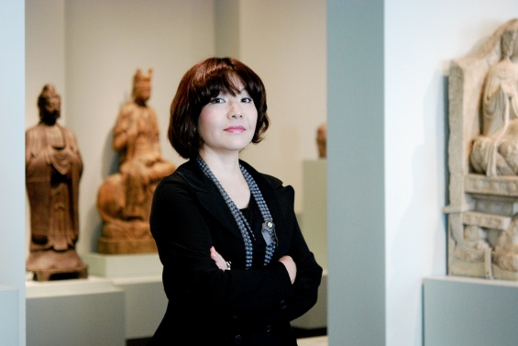
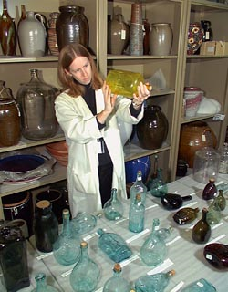
5. Instructor as Curator

Slide 11
6. Instructor as Concierge

Slide 13
20 New Roles of the Instructor
Course Ambassador
Captain
Consumer Advocate
Curator
Counselor
Cook
Change Catalyst
Concierge
Conductor
Comedian
Camping Trip Guide
Coach
Consultant
Course Expedition Leader
Collaborator
Community Organizer
Chemist
Care Giver
Cultivator
Colleague

Slide 14
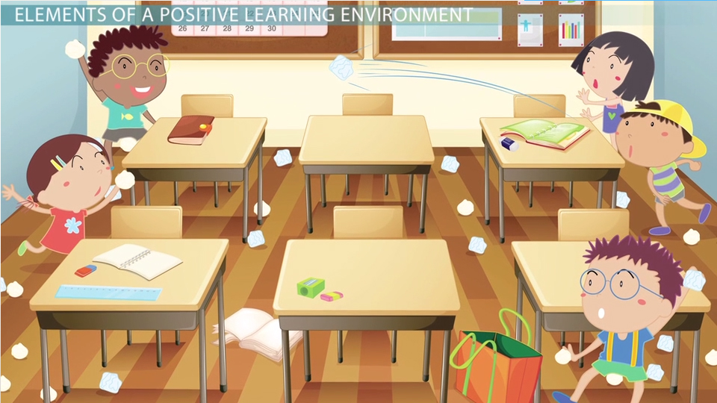
The Creation of Effective Learning Environments http://study.com/academy/lesson/learning-environment-in-the-classroom-definition-impact-importance.html

Slide 15
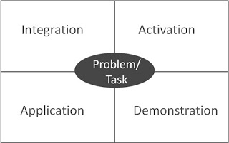
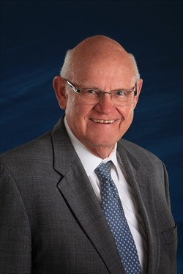
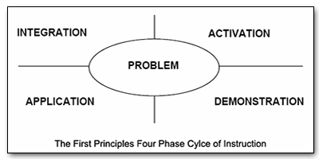
Merrill’s First Principles of Teaching/Instruction http://travelinedman.blogspot.com/2011/05/bonks-last-principles-of-instruction.html

Slide 16
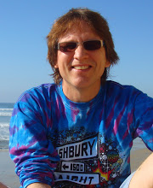
Bonk's Last Principles of Teaching/Instruction http://travelinedman.blogspot.com/2011/05/bonks-last-principles-of-instruction.html

Slide 17
2. The Principle of Convenience http://travelinedman.blogspot.com/2011/05/bonks-last-principles-of-instruction.html

Slide 18
5. The Principle of High Expectations http://travelinedman.blogspot.com/2011/05/bonks-last-principles-of-instruction.html

Slide 19
6. The Principle of Choice and Options http://travelinedman.blogspot.com/2011/05/bonks-last-principles-of-instruction.html

Slide 20
8. The Principle of Support and Feedback http://travelinedman.blogspot.com/2011/05/bonks-last-principles-of-instruction.html

Slide 21
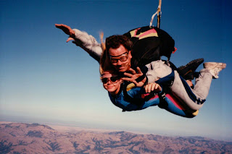
9. The Principle of Spontaneity http://travelinedman.blogspot.com/2011/05/bonks-last-principles-of-instruction.html

Slide 22
11. The Principle of Sharing http://travelinedman.blogspot.com/2011/05/bonks-last-principles-of-instruction.html

Slide 23
14. The Principle of Relevance and Meaningfulness http://travelinedman.blogspot.com/2011/05/bonks-last-principles-of-instruction.html

Slide 24
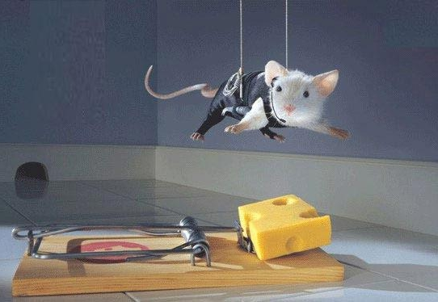
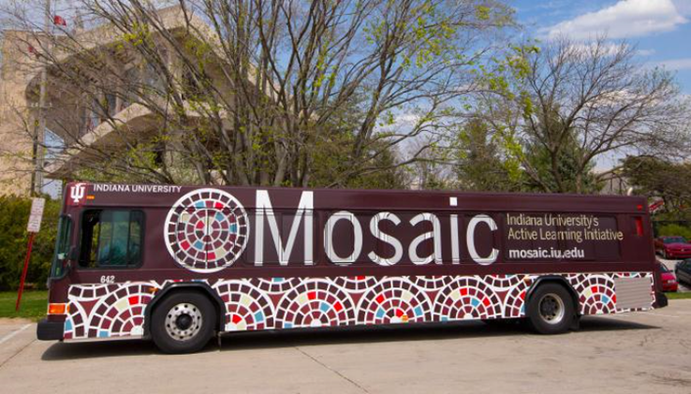
15. The Principle of Trial and Error (i.e., it is ok to fail) http://travelinedman.blogspot.com/2011/05/bonks-last-principles-of-instruction.html

Slide 25
16. The Principle of Expanded Resources http://travelinedman.blogspot.com/2011/05/bonks-last-principles-of-instruction.html

Slide 26
17. The Principle of Human Connectedness http://travelinedman.blogspot.com/2011/05/bonks-last-principles-of-instruction.html

Slide 28
Bonk's 20 "Last" Principles of Instruction (LAST = Learning Activation System Template) http://travelinedman.blogspot.com/2011/05/bonks-last-principles-of-instruction.html
Choice and Options
Support and Feedback
Flexibility
Nontraditional Learning
Spontaneity
Passion and Inspiration
Convenience
Organization
Relevance and Meaningfulness
Collegiality
Sharing
Trial and Error (i.e., it is ok to fail)
Cheerfulness and Optimism
Expanded Resources
Purpose and Vision
High Expectations
#20 ???
Human Connectedness
Empowerment and Autonomy
Cognitive Apprenticeship

Slide 29
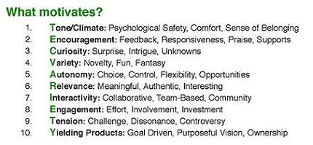
TEC-VARIETY Recap

Slide 30
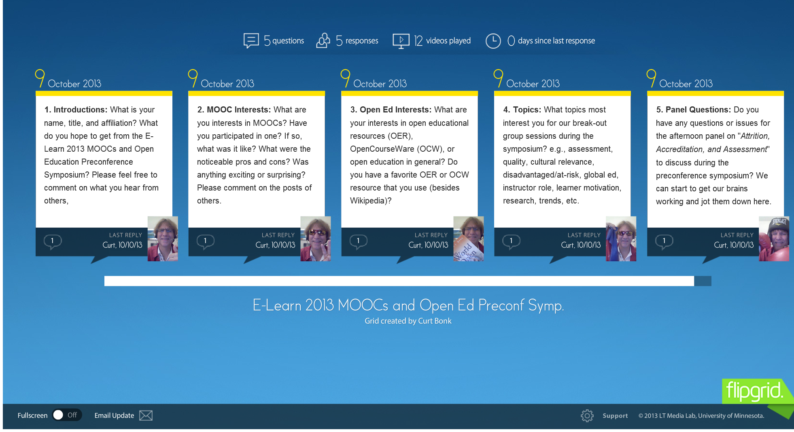
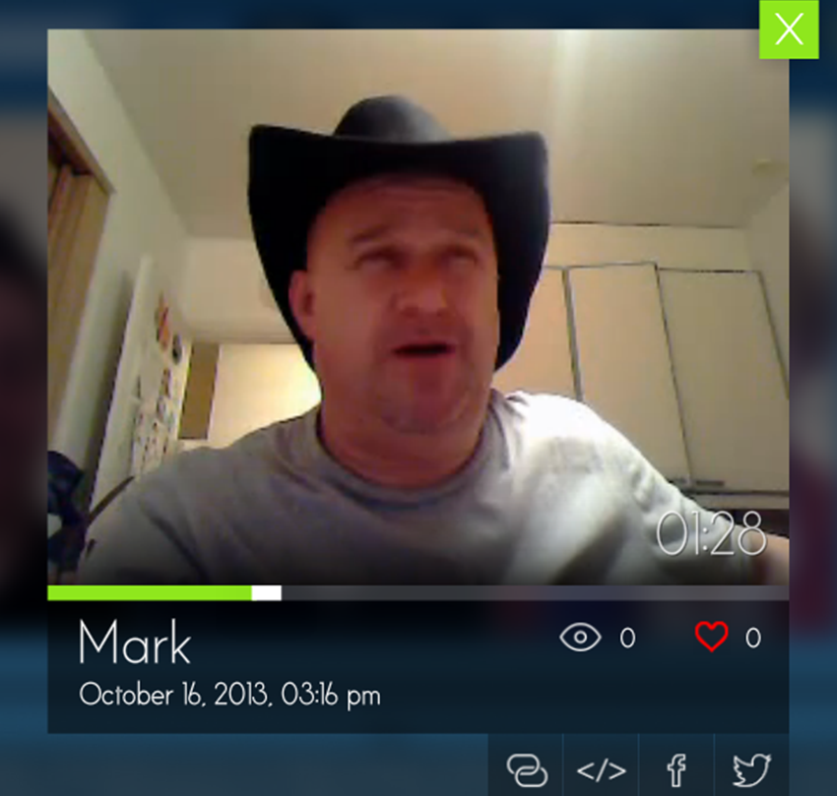
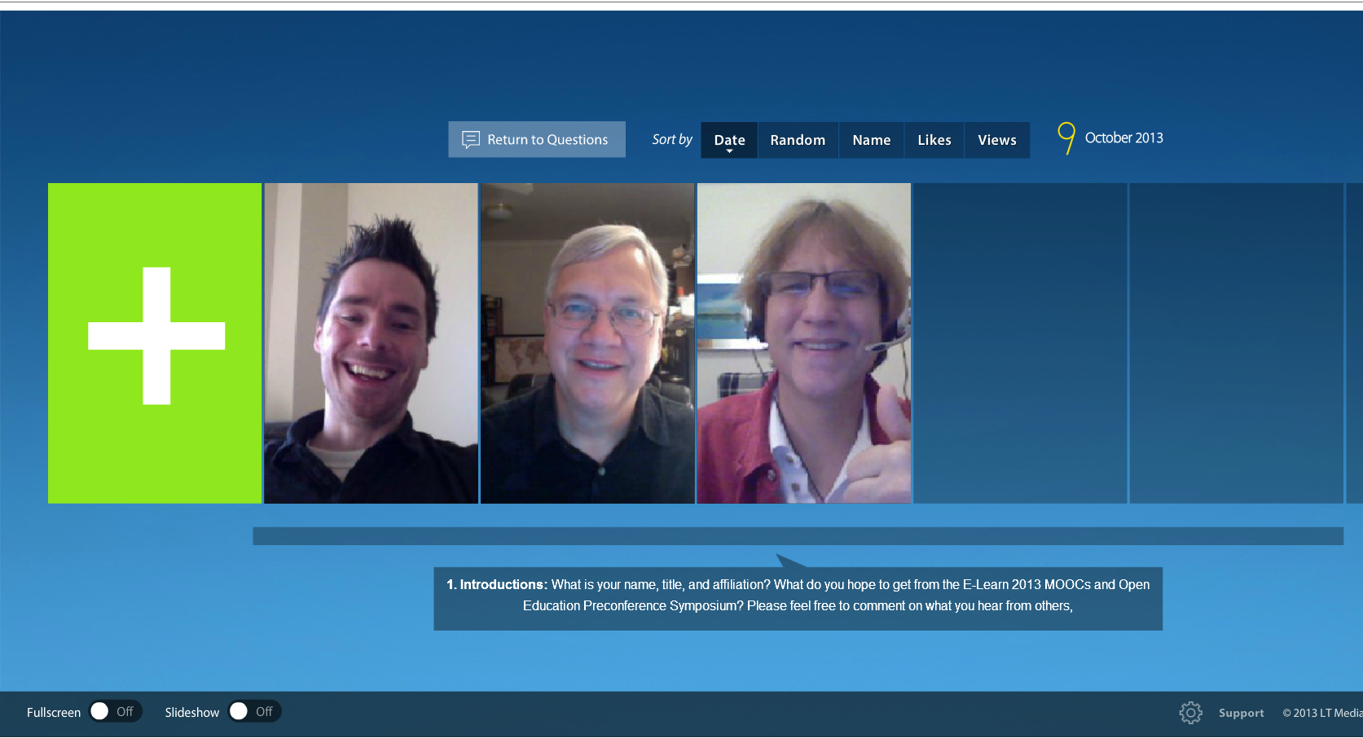
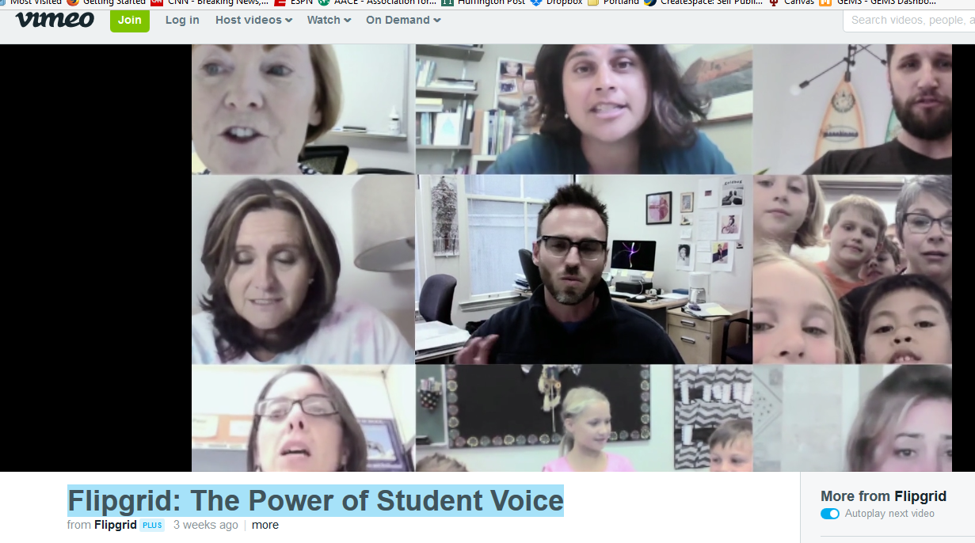
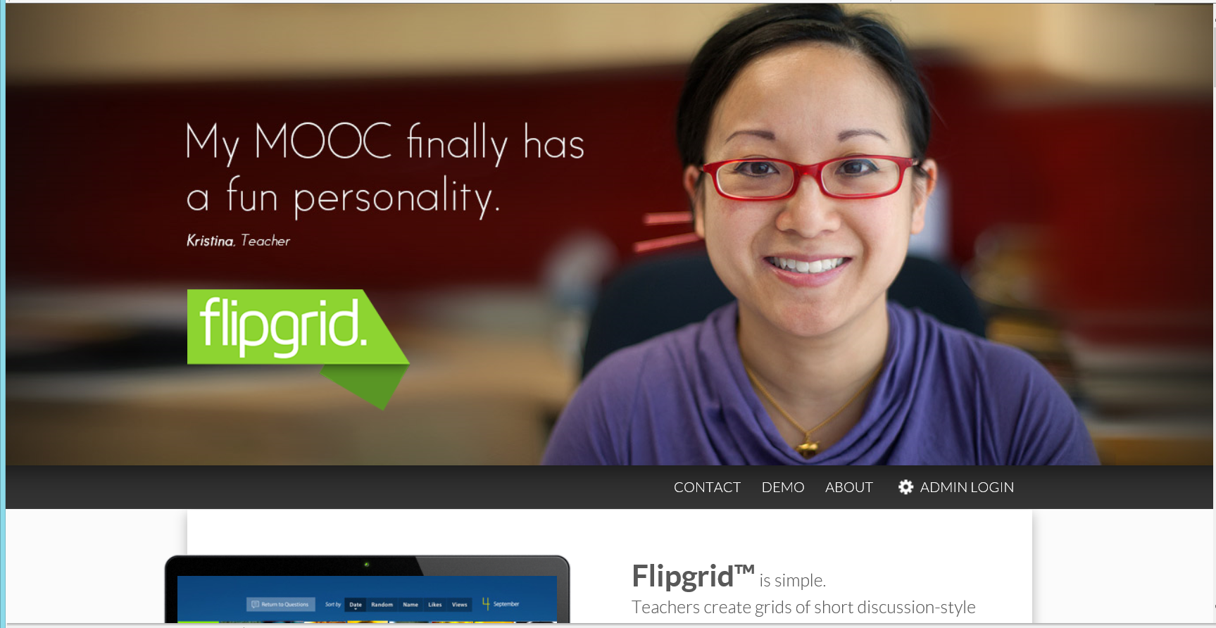
November 10, 2016 1. Tone/Climate: A. Threaded Video Discussions and Questions (e.g., Flipgrid) http://flipgrid.com/#429f88c5 Flipgrid: The Power of Student Voice https://vimeo.com/188210645

Slide 31
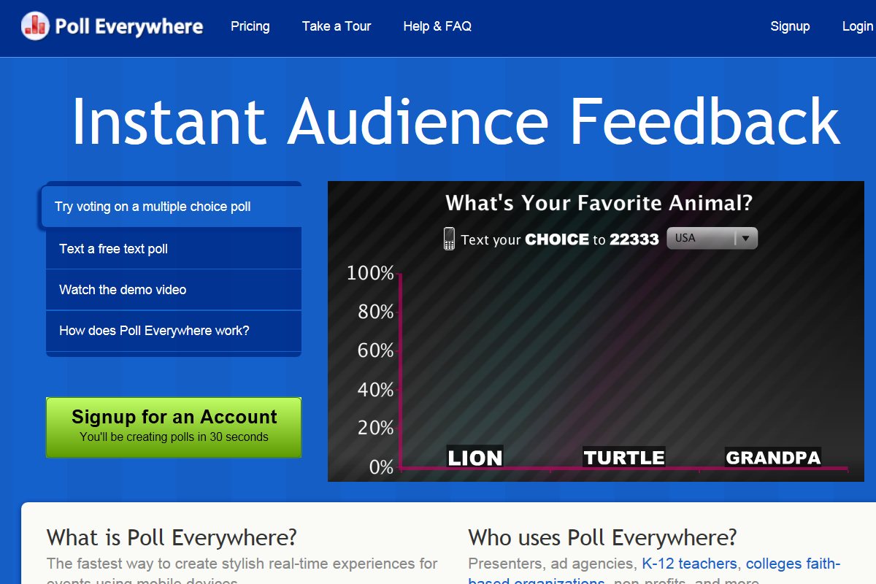
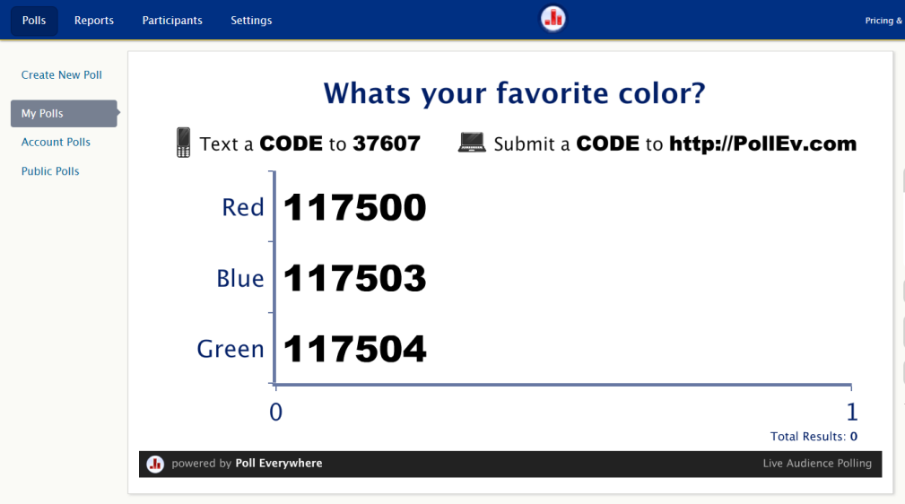
2. Encouragement, Feedback: A. Blog and Website Polling (e.g., Poll Everywhere, BlogPolls, BlogPoll, MicroPoll) http://www.polleverywhere.com/

Slide 32
2. Encouragement, Feedback: B. Voice/Audio Feedback Vocaroo: http://vocaroo.com/ http://vocaroo.com/delete/s0x8moQAYAiu/a37bbc9408bb8c95 (Recorded by Curt Bonk for the Open University of China)

Slide 33
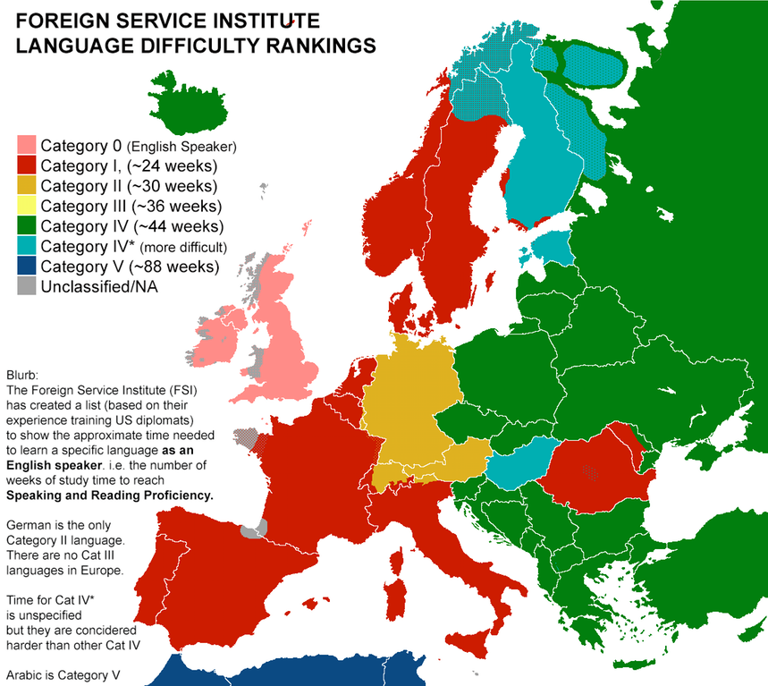
November 29, 2017 3. Curiosity, Surprise, Intrigue, Unknowns: A. Summary and Comparison Maps A Map Showing How Much Time It Takes to Learn Foreign Languages: From Easiest to Hardest, Open Culture http://www.openculture.com/2017/11/a-map-showing-how-much-time-it-takes-to-learn-foreign-languages-from-easiest-to-hardest.html

Slide 34
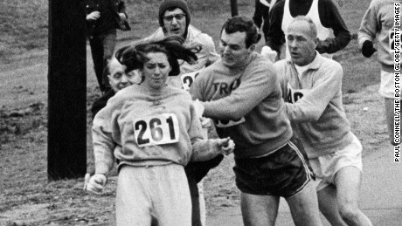
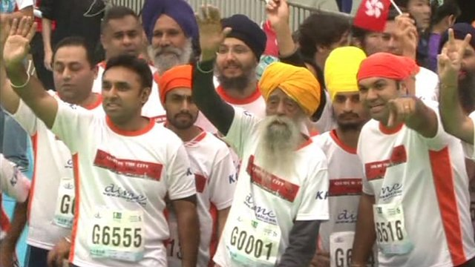
April 17, 2017 3. Curiosity, Intrigue, Unknowns: B. 1st woman to officially run Boston Marathon does it again, 50 years later Emanuella Grinberg, CNN, USA Today http://www.cnn.com/2017/04/17/us/boston-marathon-kathrine-switzer-trnd/index.html July 16, 2017 Julia Hawkins Sets 100-Meter Dash Record for Women 100 Years or Older, Joseph Zucker, CNN http://bleacherreport.com/articles/2721985-julia-hawkins-sets-100-meter-dash-record-for-women-100-years-or-older?utm_source=cnn.com&utm_medium=referral&utm_campaign=editorial

Slide 35
4. Variety, Novelty, Fun, Fantasy: A. Random Lists (Random.org—clocks, coins, playing cards, dice, integers, passwords, jazz scales, lists, sequences, etc.)

Slide 36
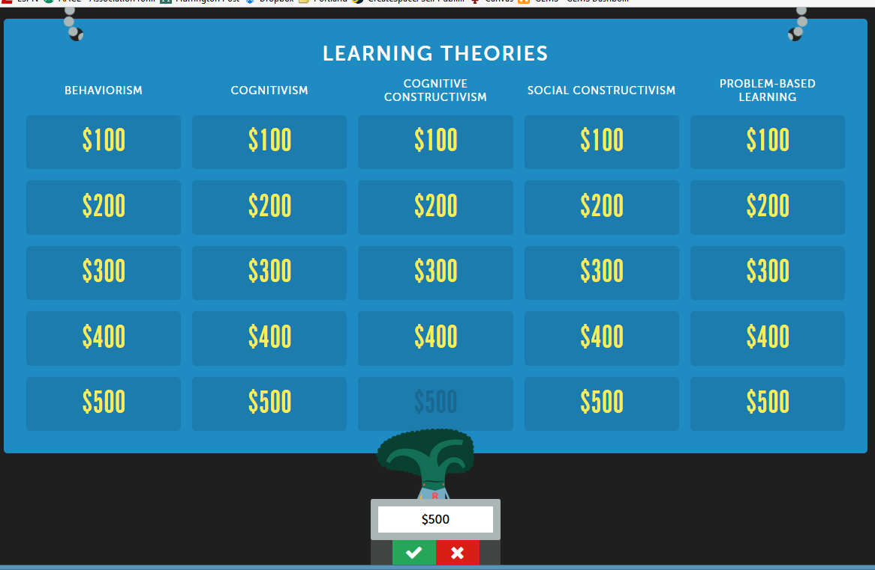
October 5, 2016 4. Variety, Novelty, Fun, Fantasy: B. Online Test/Quiz Review Games (e.g., Jeopardy Rocks) https://www.jeopardy.rocks/r511merve/

Slide 37
April 3, 2017 4. Variety, Novelty, Fun, Fantasy: C. Kahoot! https://getkahoot.com/ July 31, 2017 I’m in ‘Kahoots’ with Technology in the Classroom Cassandra OSullivan Sachar, Faculty Focus https://www.facultyfocus.com/articles/teaching-with-technology-articles/im-kahoots-technology-classroom/

Slide 38
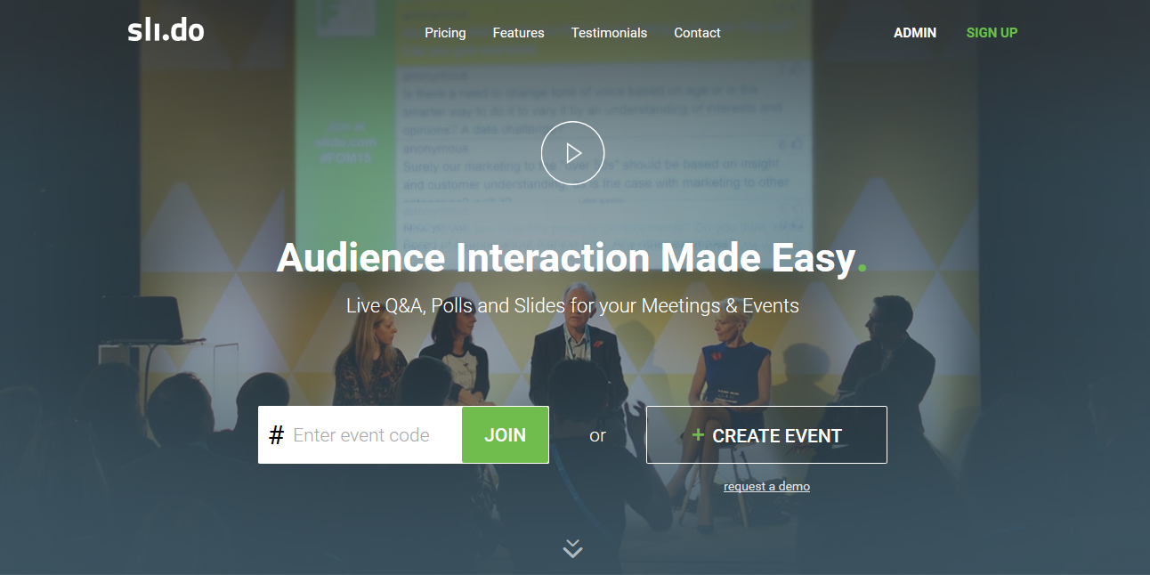
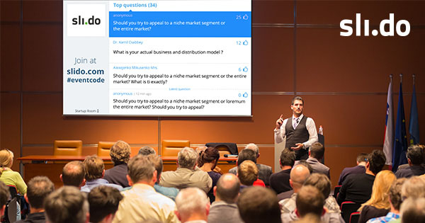
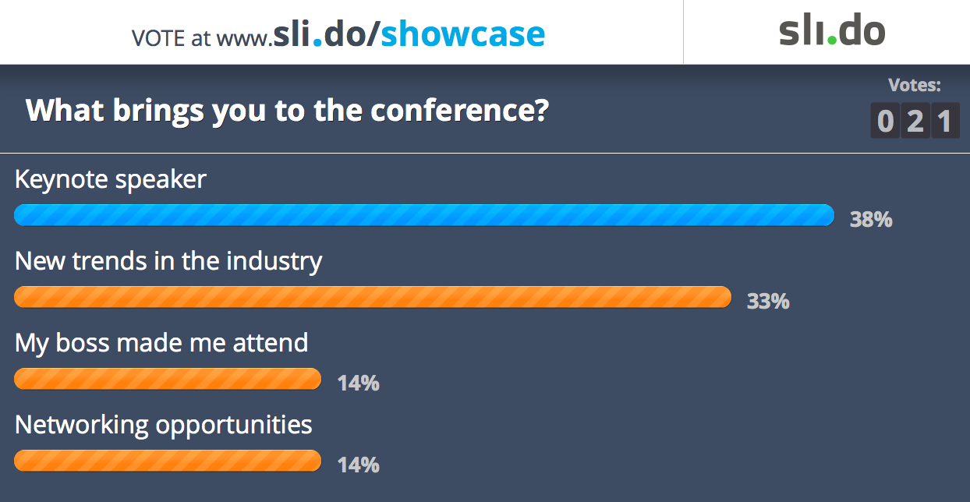
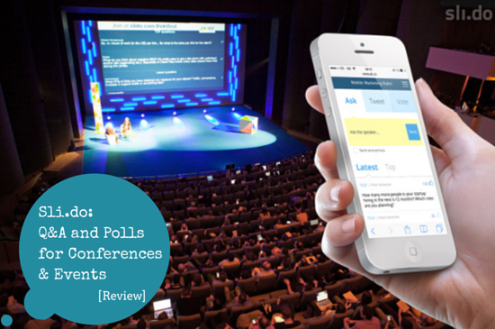
April 3, 2017 4. Variety, Novelty, Fun, Fantasy: D. Sli.do https://www.sli.do/

Slide 39
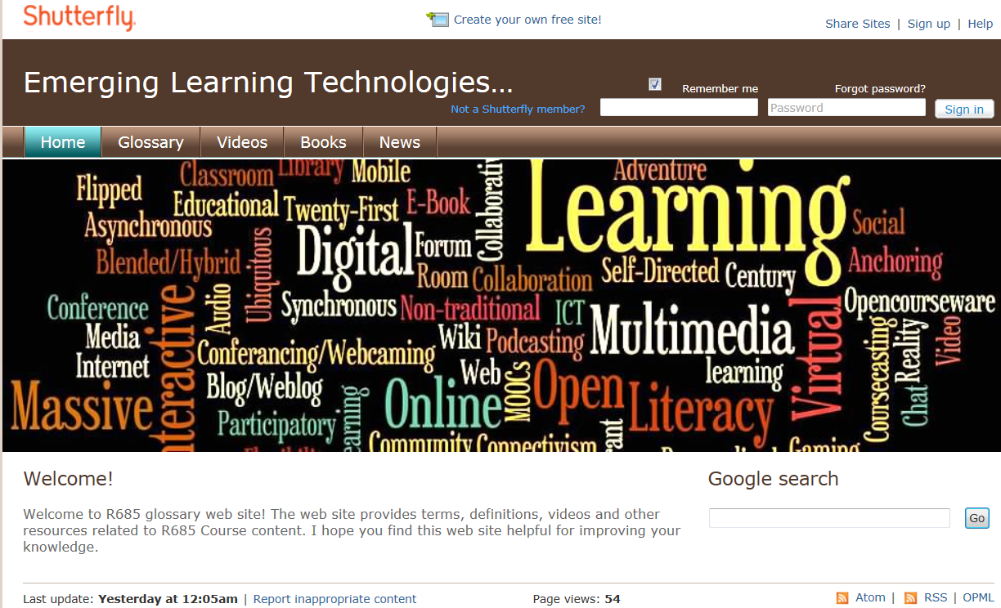
5. Autonomy, Choice: A. Design Multimedia Glossaries P540 Final Assignment: Nate Wynne, Supersized Personal Course Glossary http://natewynne1982.wix.com/p540courseglossary Ozgur Ozdemir, December 2012 http://r685glossary.shutterfly.com / Umida Khikmatillaeva, Dec. 2011, P540 http://learningplanet.shutterfly.com/

Slide 40
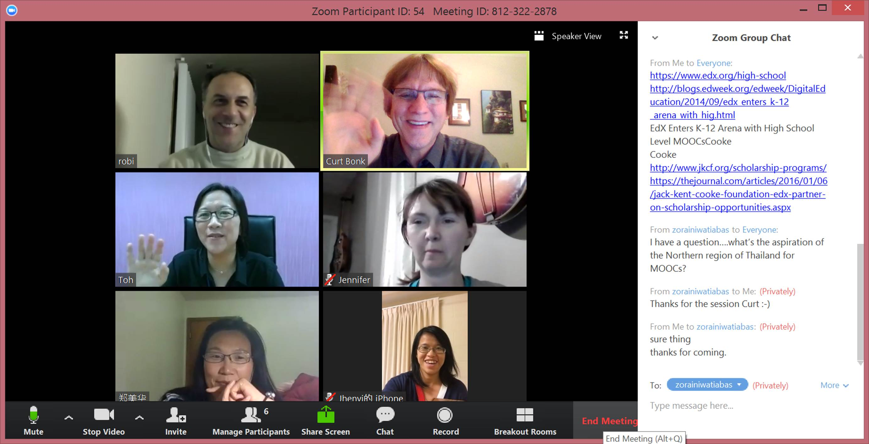
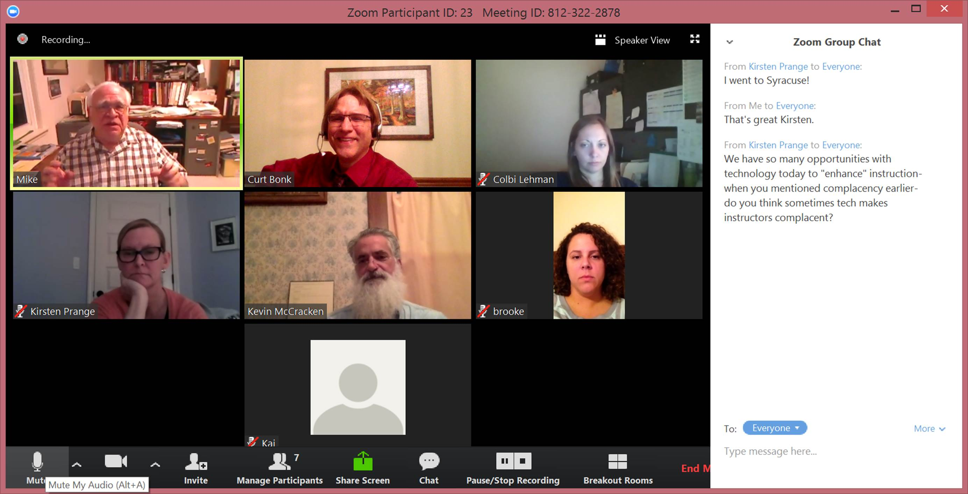
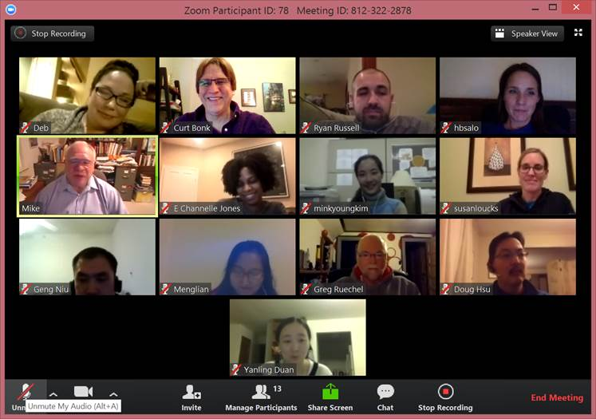
Jan. 20, Oct. 13, & Nov. 2016 (Zoom) 6. Relevance, Meaningfulness: A. Weekly Guest Expert Chats R511 Chat with Mike Molenda, IU

Slide 41
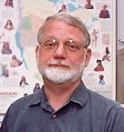
6. Relevance, Meaningfulness: B. Case-Based Learning: Instructor Cases (e.g., Mark Braun, IU)

Slide 42
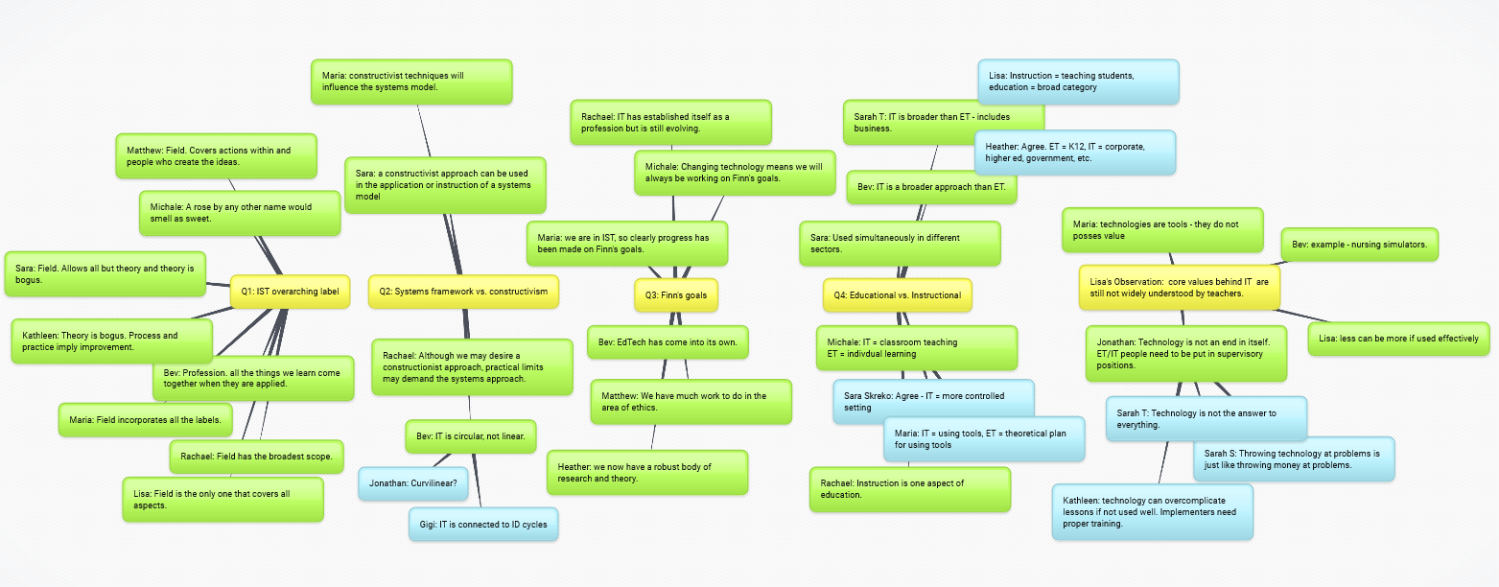
September 3, 2017 6. Relevance, Meaningfulness: C. Mindmap Recaps of Online Discussions Mindmap of Week 2 of R511 https://bubbl.us/Mjg2MzMxOC84MjYzNjczL2UyODQzMzQ0NTQ2YzQwZDlmNDE3ZWE3OWYwMmJmYTI3-X

Slide 43
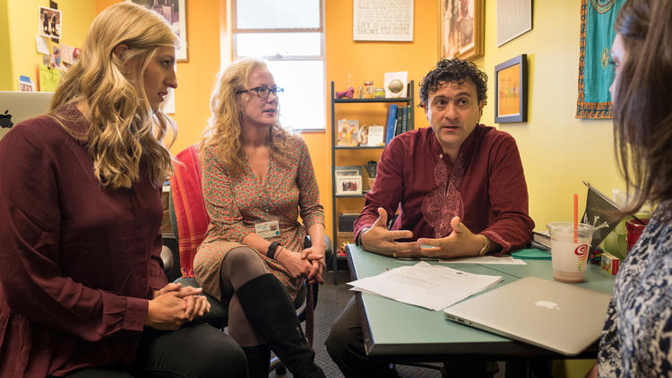
September 20, 2016 6. Relevance, Meaningfulness: D. Editing Wikipedia Pages College students take to Wikipedia to rewrite the wrongs of Internet science, Rosanna Xia, LA Times http://www.latimes.com/local/lanow/la-me-wikipedia-science-classes-adv-snap-story.html
Samantha Erickson, left, of the Wiki Education Foundation; Tina Brock, a dean of the School of Pharmacy at UC San Francisco; and professor Amin Azzam discuss implementing the integration of Wikipeida pages on medical topics with students' work. (David Butow / For The Times)

Slide 44
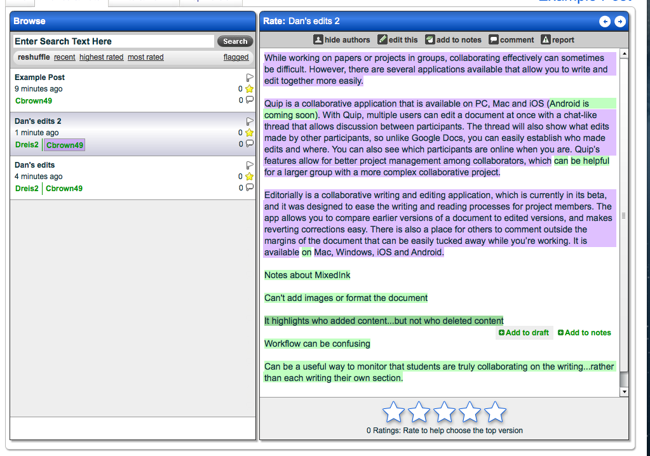
7. Interactive, Collaborative: A. Negotiate Meanings Online (e.g., PiratePad: http://meetingwords.com/) http://blogs.elon.edu/technology/6-collaborative-writing-applications-for-group-projects-or-papers/ MeetingWords, Google Docs, NowComment, MixedInk

Slide 45
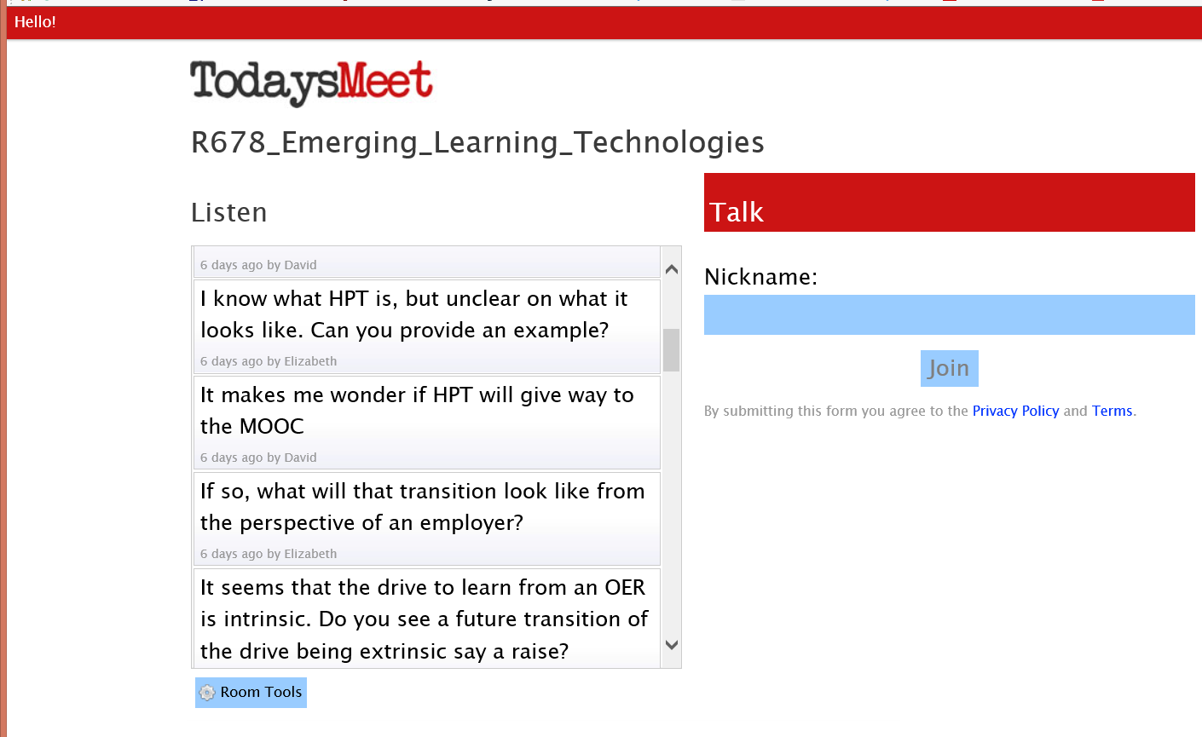
7. Interactive, Collaborative: B. Backchannel Chat (TodaysMeet) https://todaysmeet.com/ R678_Emerging_Learning_Technologies https://todaysmeet.com/R678_Emerging_Learning_Technologies

Slide 46
7. Interactive, Collaborative: C. Guest Speaker Quotes (Rey Junco, February 25, 2013)

Slide 47
8. Engagement, Involvement: A. Interactive Labs and Simulations http://phet.colorado.edu/en/simulation/energy-skate-park

Slide 48
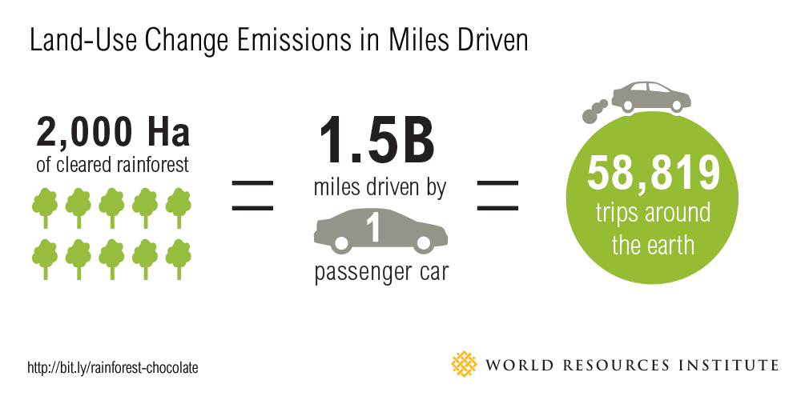
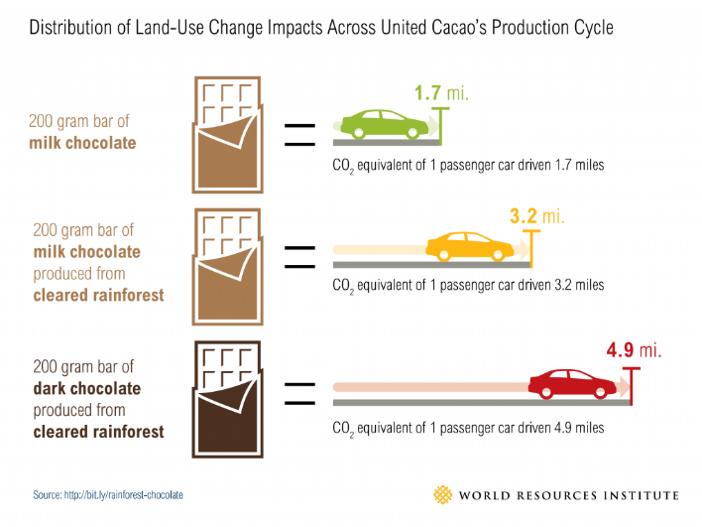
8. Engagement, Involvement: B. Interpreting Infographics August 5, 2015 How much rainforest in that chocolate bar? Global Forest Watch, Nancy Harris, Octavia Payne and Sarah Mann http://blog.globalforestwatch.org/2015/08/how-much-rainforest-is-in-that-chocolate-bar/

Slide 49
December 13, 2016 9. Tension, Challenge, Controversy, etc.: A. Controversial Issue Debates Librarians for Instructional Technology, Latrice Booker, R511, Fall 2016 http://bookerlr2000.wixsite.com/librariansforit/cognitivism R511 Midterm Video How to Create an Authentic Environment in a Content-Driven School?, R511, Nick and Nik https://www.youtube.com/watch?v=Bcr3_aZT_xQ&feature=youtu.be

Slide 50
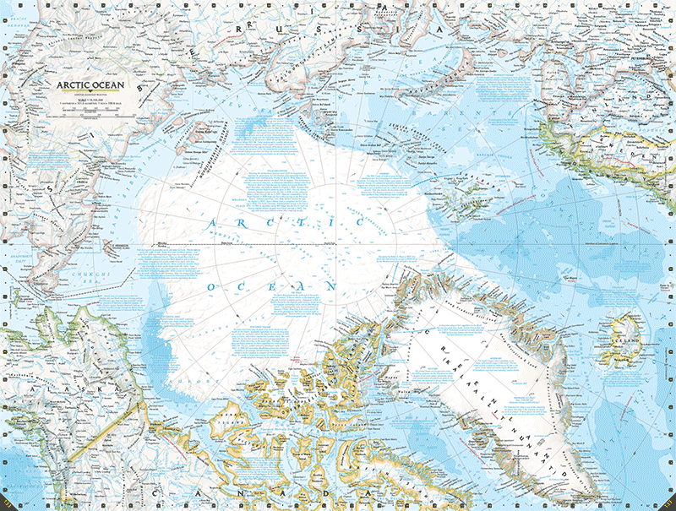
9. Tension, Challenge, Controversy, etc.: B. Yes, Mr. President, We Remade Our Atlas to Reflect Shrinking Ice Christine Dell'Amore, National Geographic, August 3, 3015 http://news.nationalgeographic.com/2015/08/150803-arctic-ice-obama-climate-nation-science/?utm_content=buffer8a394&utm_medium=social&utm_source=twitter.com&utm_campaign=buffer

Slide 51
10. Yields Products, Goals: A. Student Created Recap Videos Piercarlo Abate: http://www.youtube.com/watch?v=_-TURzHO0aU Qi Li, Gangnam: http://www.youtube.com/watch?v=7Q429lqxZaU&feature=youtu.be Miguel Lara (Web 2.0 FREEDOM): http://www.youtube.com/watch?v=8cmCFWi9lW8 Kendal Rasnake (Is IT Right For You?): https://www.youtube.com/watch?v=MJ3GUDICIGw Kimberly Vincent-Layton: https://www.youtube.com/watch?v=4Ic39_rYLII&feature=youtu.be

Slide 52
March 12, 2016 10. Yields Products, Goals: B. Student Generated Timelines, Taxonomies, and Concept Maps R678 John Falchi, Timeglider, An Abbreviated History of Distance Education http://timeglider.com/t/50843d8903a48008?min_zoom=1&max_zoom=100

Slide 53
December 12, 2017 Yields Products, Goals: C. Student Website Development R511 Student Final Projects, Lisa Milsom and Michale Siverio: https://msiverio.wixsite.com/r511

Slide 54
What about Model #1: R2D2?

Slide 55
More in this free book…! http://tec-variety.com/

Slide 56
Things are heating up…

Slide 57
Education 20/20 is coming within reach!

Slide 58
We are entering a jumping off point… (South University of Science and Technology of China, Wednesday June 10, 2015)

Slide 59
Remember for Education 20/20 to make an impact: “I cannot do this alone.” “I cannot do this alone.” “I cannot do this alone.” “I cannot do this alone.”

Slide 60
Any Questions or Comments? Slides at: TrainingShare.com Papers: PublicationShare.com Free book: http://tec-variety.com/ Email: cjbonk@Indiana.edu

