Slide 1
Education 20/20 Meets Education 3.0: Visions of Our Changing Learning World!
Curtis J. Bonk, Professor, Indiana University
cjbonk@indiana.edu
http://curtbonk.com/

Slide 3
April 30, 2017 Remember Education 1.0? Those Jobs Are Gone Steve Kolowich, The Chronicle of Higher Education http://www.chronicle.com/article/Who-s-UpWho-s-Down-in/239964

Slide 4
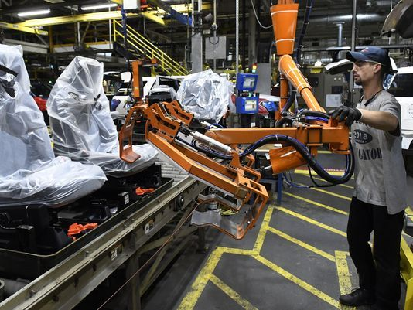
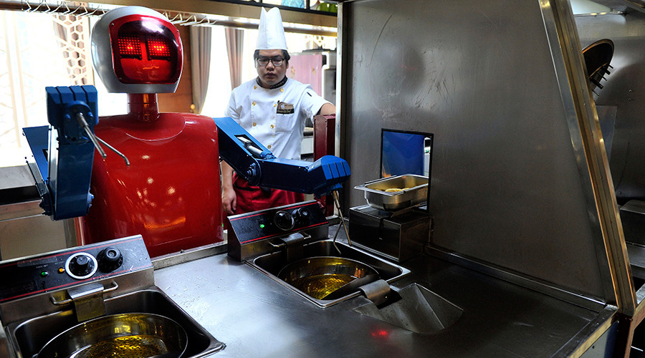
November 28, 2017 Automation could kill 73 million U.S. jobs by 2030 Paul Davidson, USA Today https://www.usatoday.com/story/money/2017/11/29/automation-could-kill-73-million-u-s-jobs-2030/899878001/ Video (1:20): http://curtbonk.com/automation.html Video (1:20): http://curtbonk.com/automation2.html

Slide 5
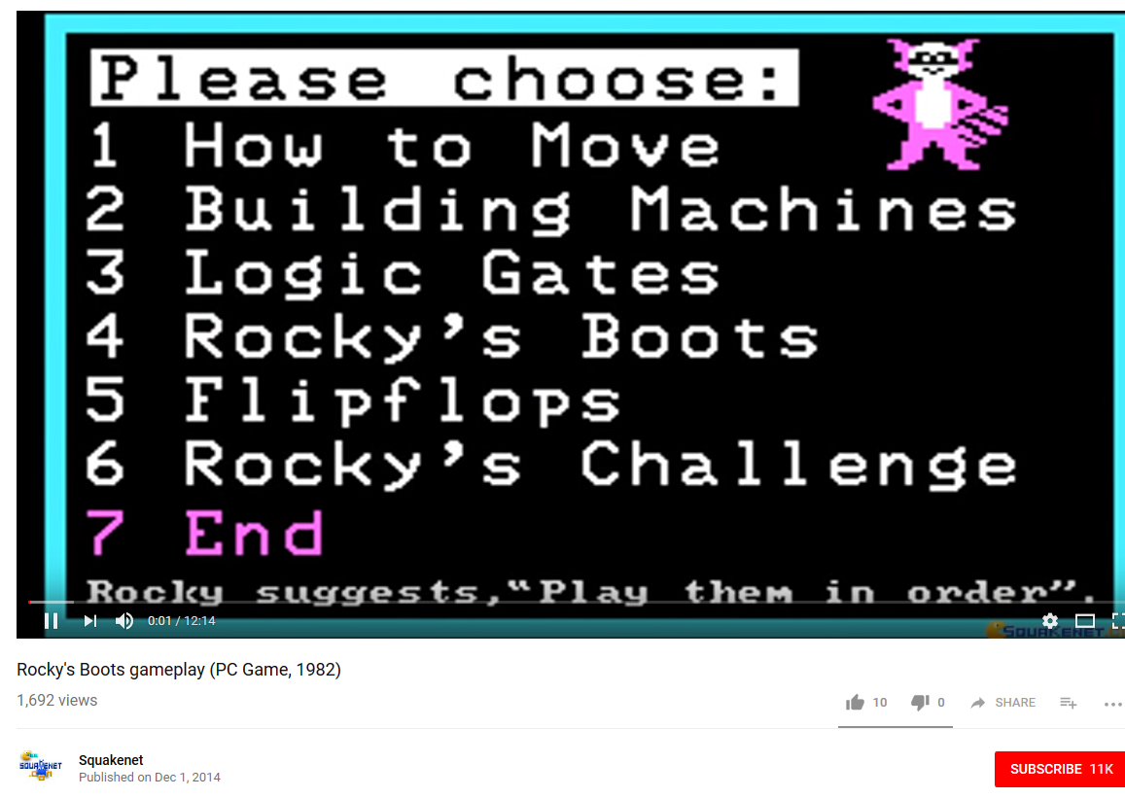
September 26, 2018 Remember Education 2.0? The rise and fall of the company behind ‘Reader Rabbit’ and all your favorite educational games Abigail Cain, The Outline https://theoutline.com/post/6293/reader-rabbit-history-the-learning-company-zoombinis-carmen-sandiego?zd=1&zi=qmbuobk7 https://www.youtube.com/watch?v=a-NLh58bIIk

Slide 6
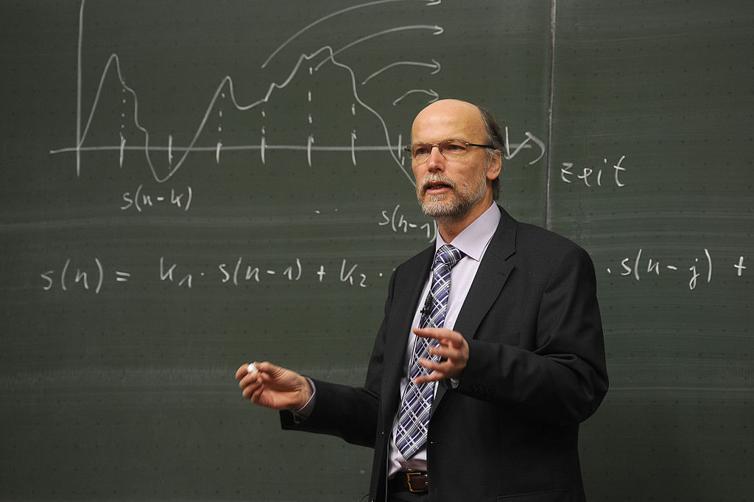
Time for Education 3.0… Time for Education 20/20
“In Education 3.0, classrooms would move away from lectures, such as this one, to having class time be spent on discussions and projects, using digital technology.”
(Per Wikipedia: https://en.wikipedia.org/wiki/Education_3.0

Slide 7
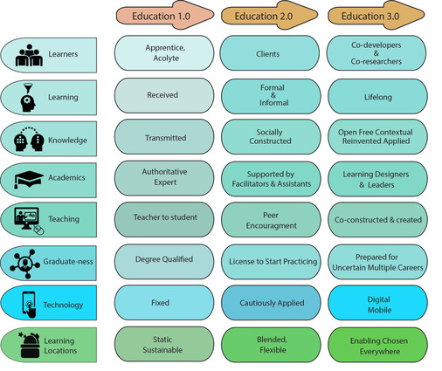
September 18, 2017 Education 1.0 to 3.0 Gilly Salmon, University of Liverpool, UK http://www.gillysalmon.com/learningfutures.html

Slide 8
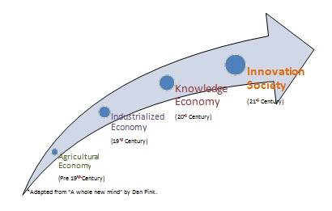
Now What is Education 4.0? “Innovation-producing education. Learn more in: Development of Individual Agency within a Collaborative, Creative Learning Community” http://www.igi-global.com/dictionary/education-40/41755 https://thinc.in.th/engadmission/education4.html (Chula Engineering)

Slide 9
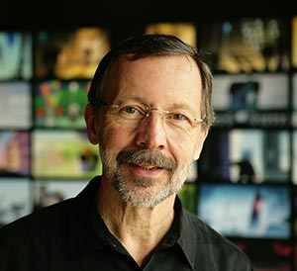
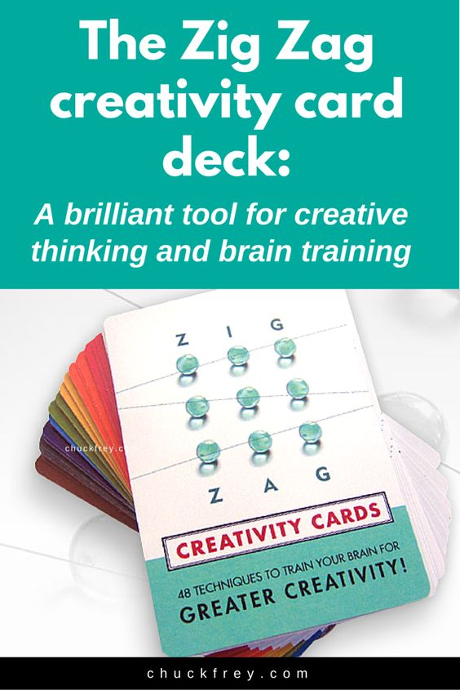
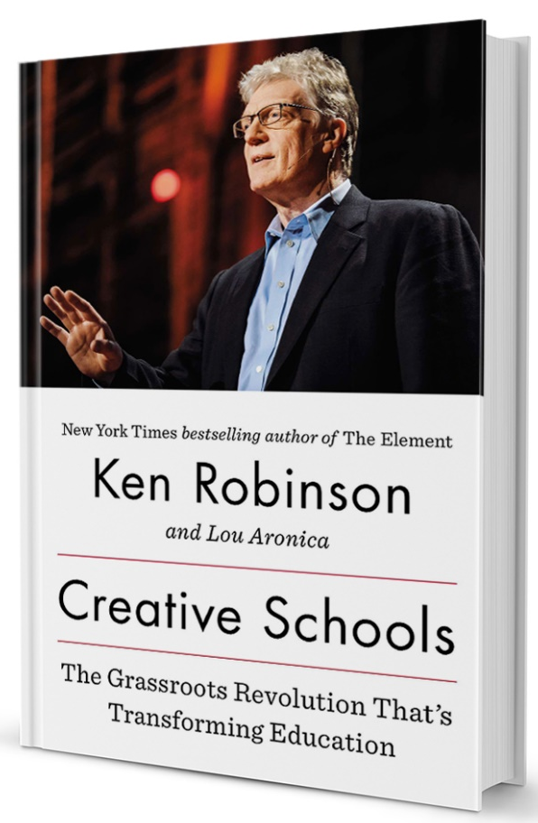
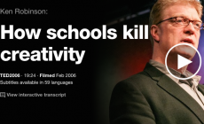

Slide 10
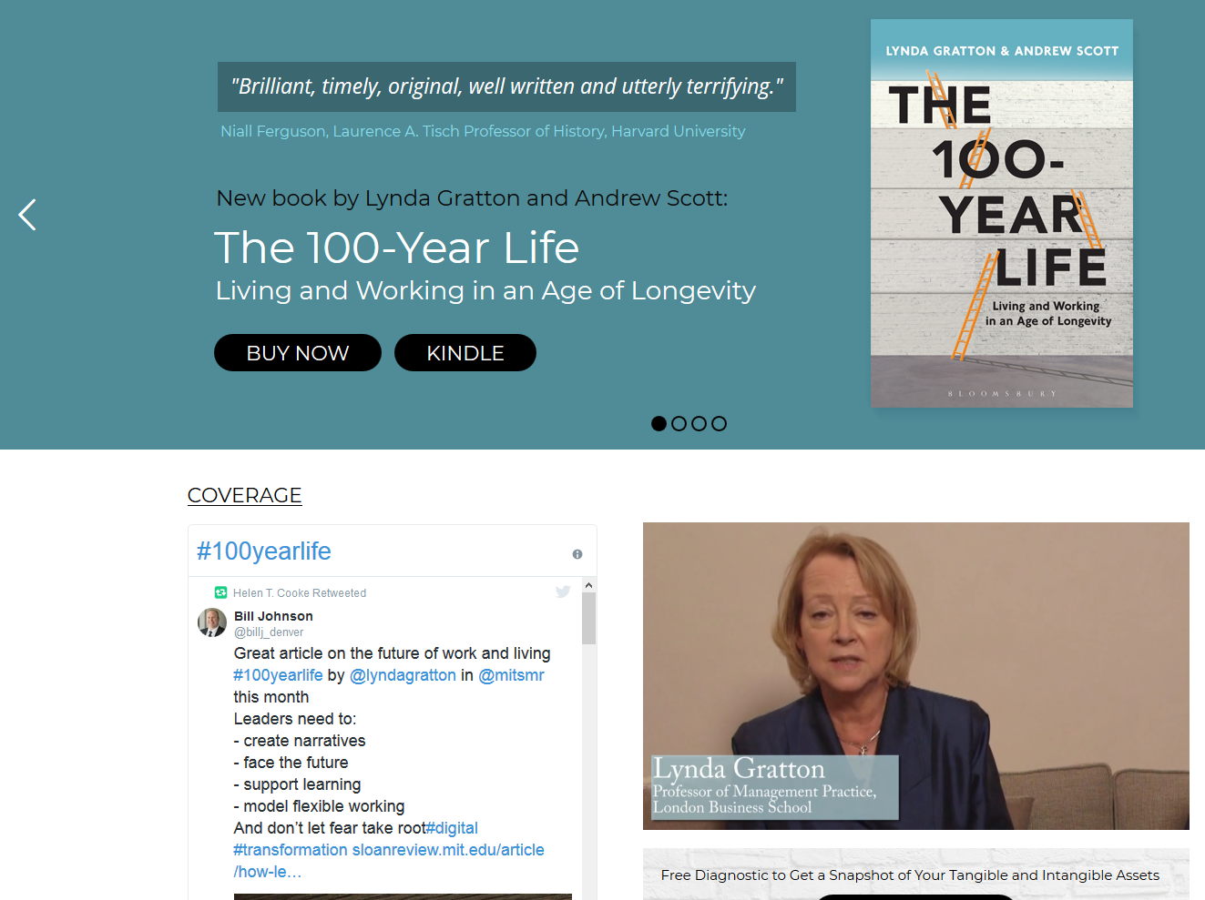
July 24, 2018 The 100-Year Life: Living and Working in an Age of Longevity Lynda Gratton and Andrew Scott http://www.100yearlife.com/ https://www.amazon.com/100-Year-Life-Living-Working-Longevity/dp/1543624634

Slide 11
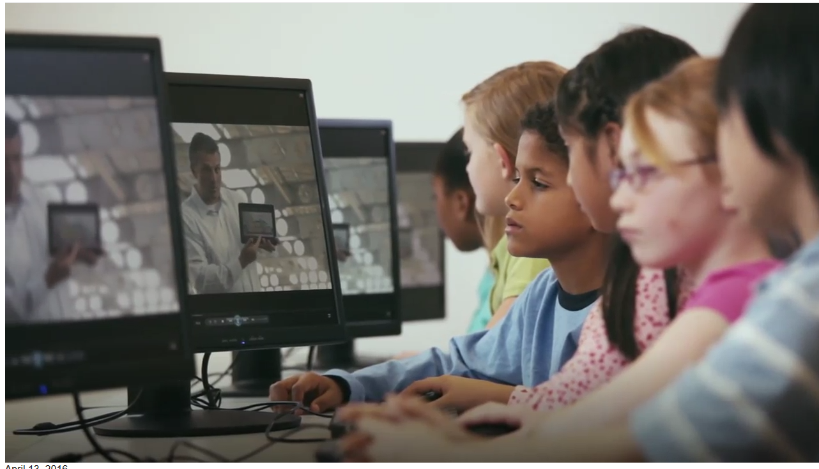
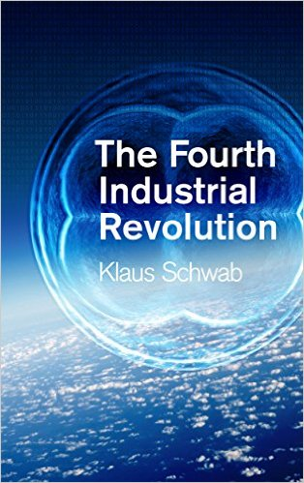
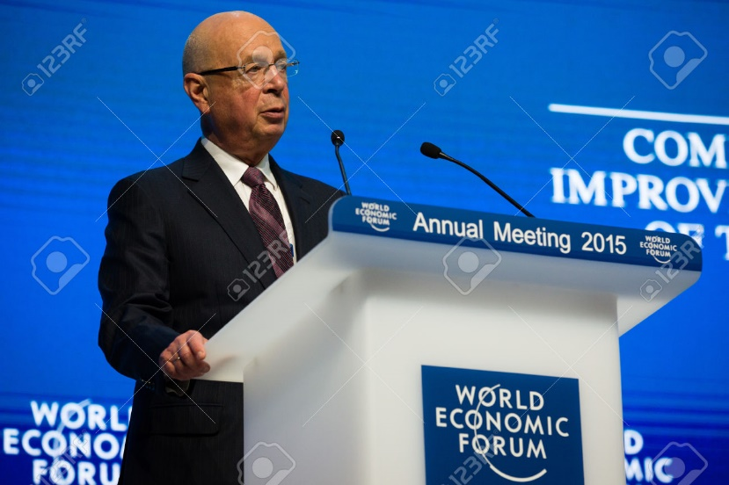
January 14, 2016 The Fourth Industrial Revolution: What it means, how to respond Klaus Schwab, Founder and Executive Chairman, World Economic Forum https://www.weforum.org/agenda/2016/01/the-fourth-industrial-revolution-what-it-means-and-how-to-respond/ (Ubiquitous, mobile supercomputing, artificially-intelligent robots, self-driving cars. neuro-technological brain enhancements, genetic editing, etc.) http://www.trainingshare.com/fourth-industrial-evolution-video-clip-short.php

Slide 13
July 11, 2017 The Rise of the Phigital Learner Going ‘phigital?’ 4 things schools need to know about Generation Z, Todd Kominiak, TrustEd http://trustedk12.com/phigital-digital-learning/ May 15, 2017 3 must know’s about the rising “phigital” student-and why their impact is enormous, Meris Stansbury, eCamous News https://www.ecampusnews.com/campus-administration/education-gen-z-phigital-student/

Slide 14
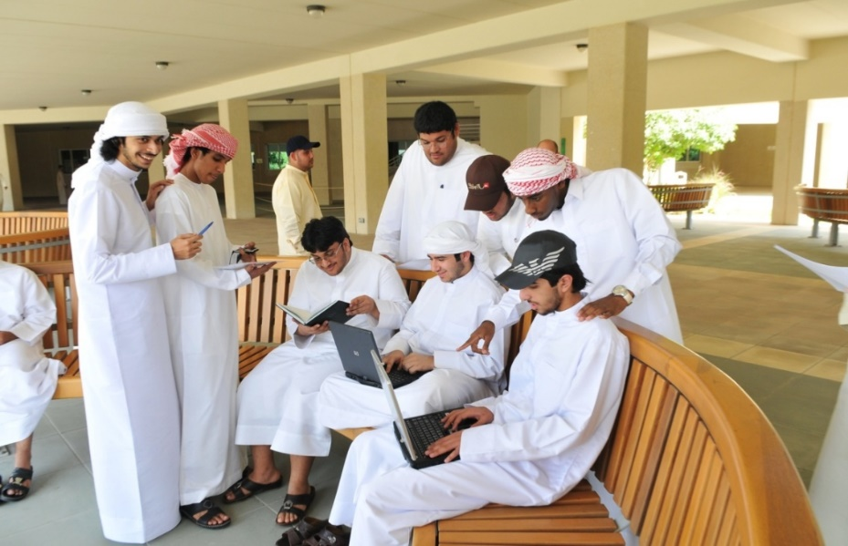
Clearly… Learning is Changing! Education 20/20

Slide 15
20 New Roles of the Instructor
Course Ambassador
Captain
Consumer Advocate
Curator
Counselor
Cook
Change Catalyst
Concierge
Conductor
Comedian
Camping Trip Guide
Coach
Consultant
Course Expedition Leader
Collaborator
Community Organizer
Chemist
Care Giver
Cultivator
Colleague

Slide 16
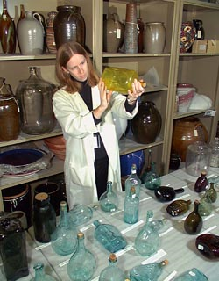
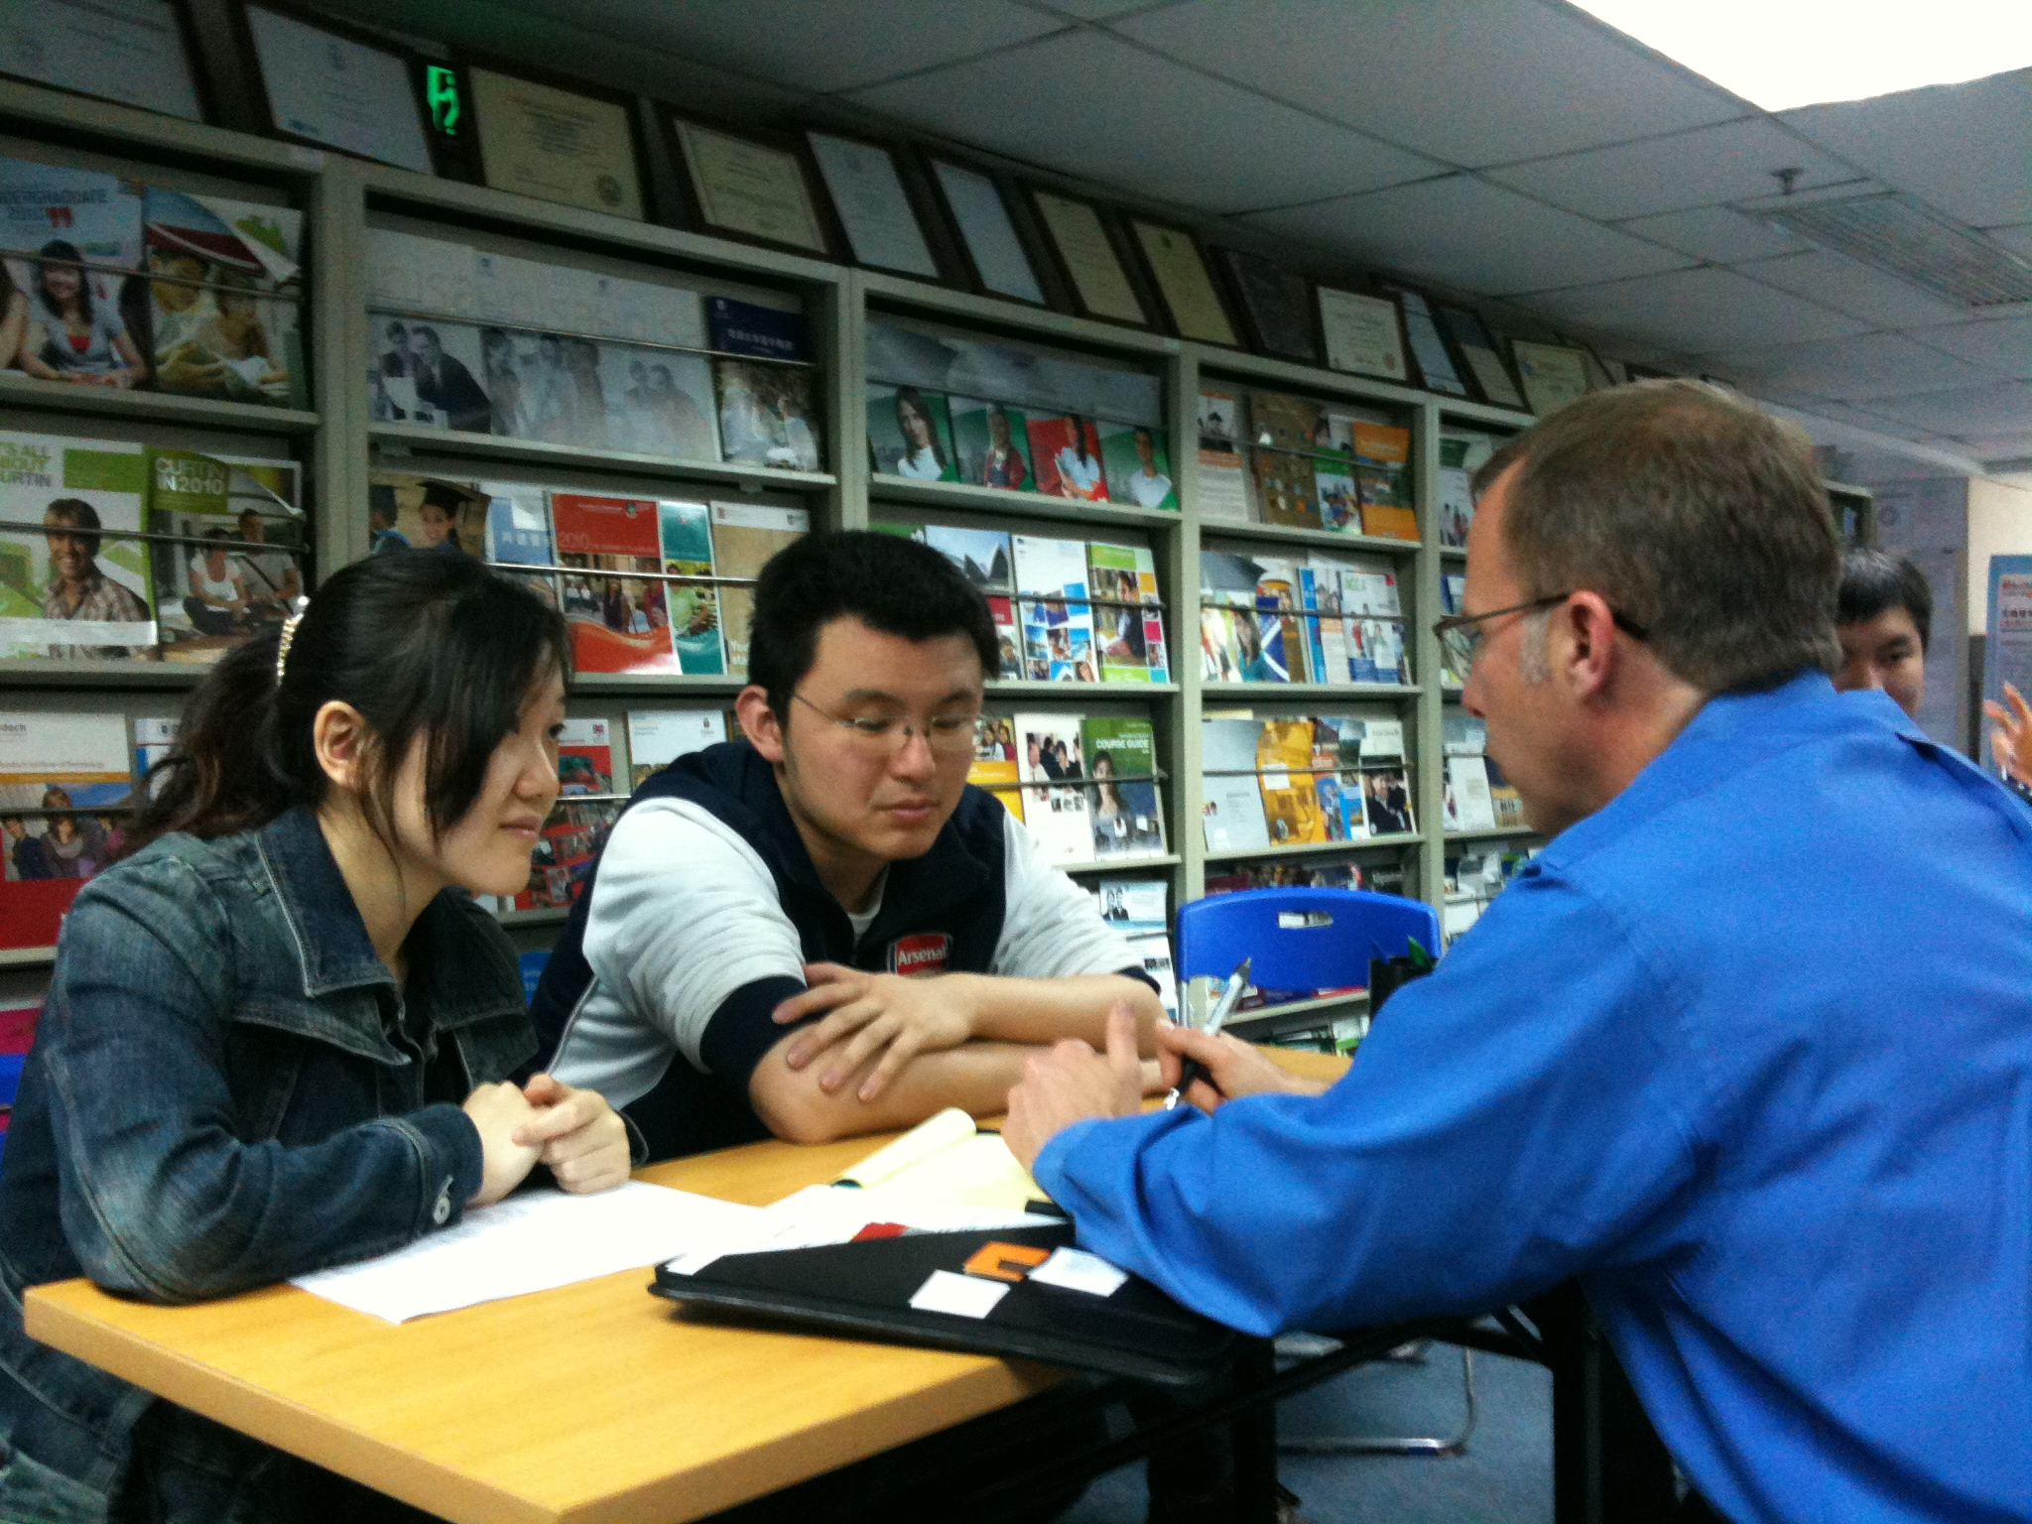

Slide 17
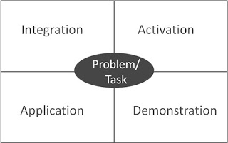
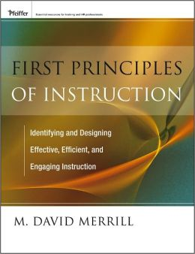
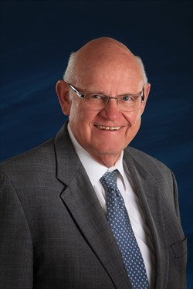
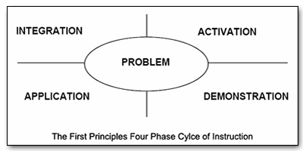
Merrill’s First Principles of Teaching/Instruction http://travelinedman.blogspot.com/2011/05/bonks-last-principles-of-instruction.html

Slide 18
Bonk's Last Principles of Teaching/Instruction (Education 4.0?) http://travelinedman.blogspot.com/2011/05/bonks-last-principles-of-instruction.html http://www.applicadthai.com/articles/education-4-0/

Slide 19
Bonk's 20 "Last" Principles of Instruction (LAST = Learning Activation System Template) http://travelinedman.blogspot.com/2011/05/bonks-last-principles-of-instruction.html
Choice and Options
Support and Feedback
Flexibility
Nontraditional Learning
Spontaneity
Passion and Inspiration
Convenience
Organization
Relevance and Meaningfulness
Collegiality
Sharing
Trial and Error (i.e., it is ok to fail)
Cheerfulness and Optimism
Expanded Resources
Purpose and Vision
High Expectations
#20 ???
Human Connectedness
Empowerment and Autonomy
Cognitive Apprenticeship

Slide 20
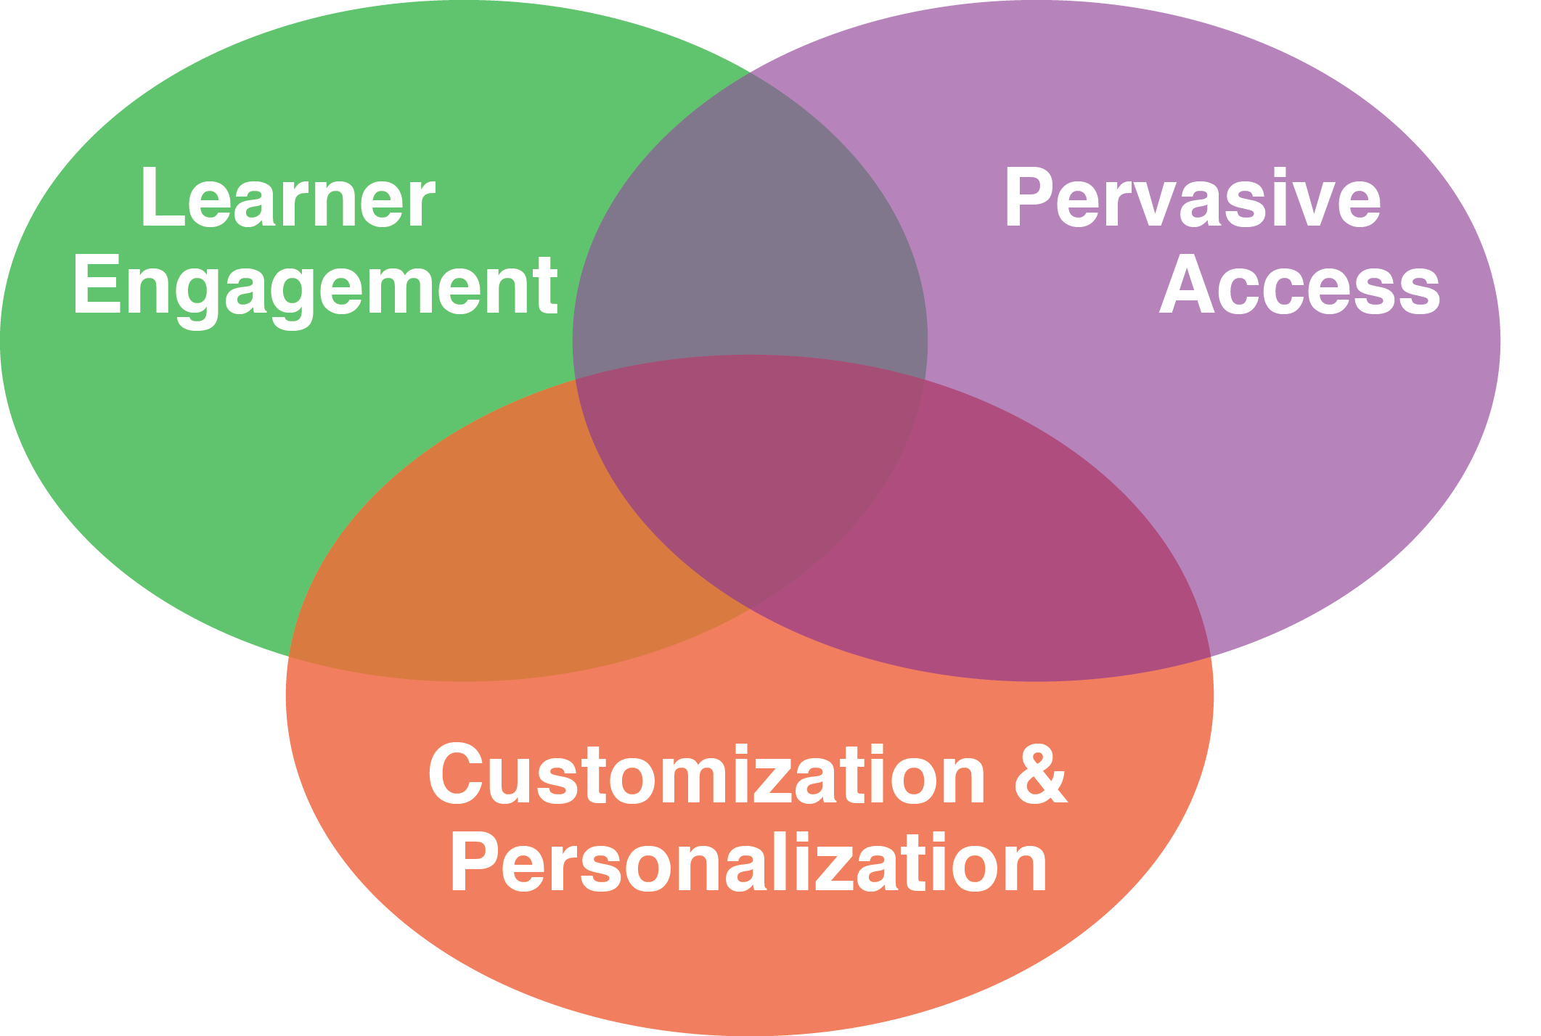
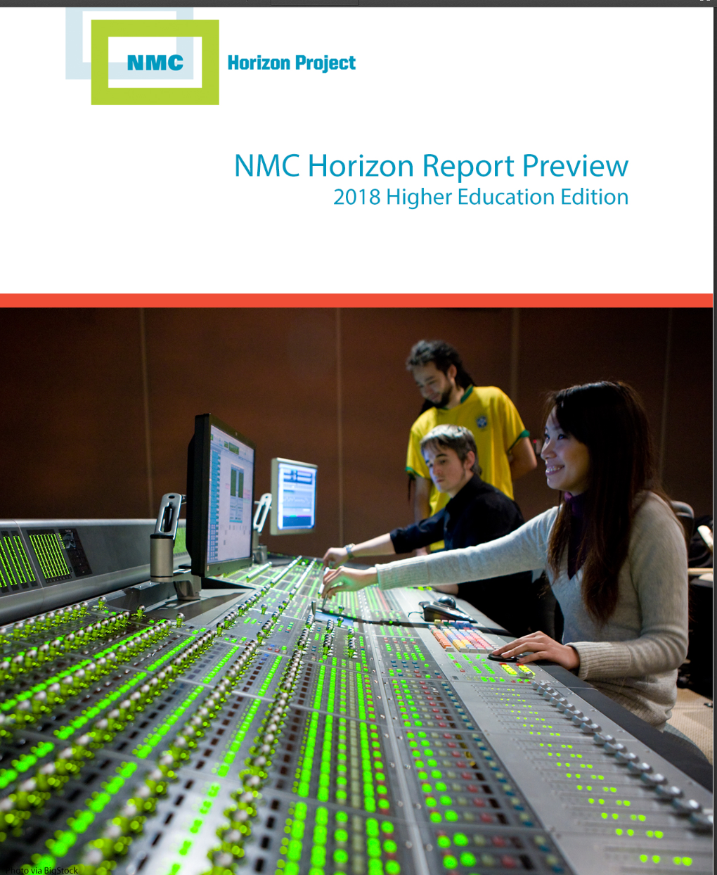
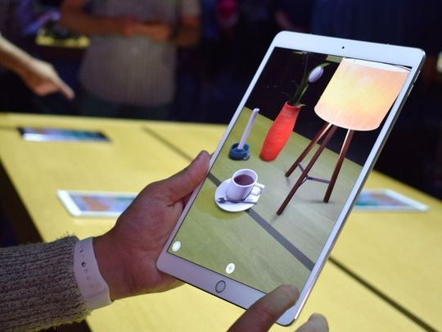
30+ Ways Learning is Changing: The Mega Trends

Slide 21
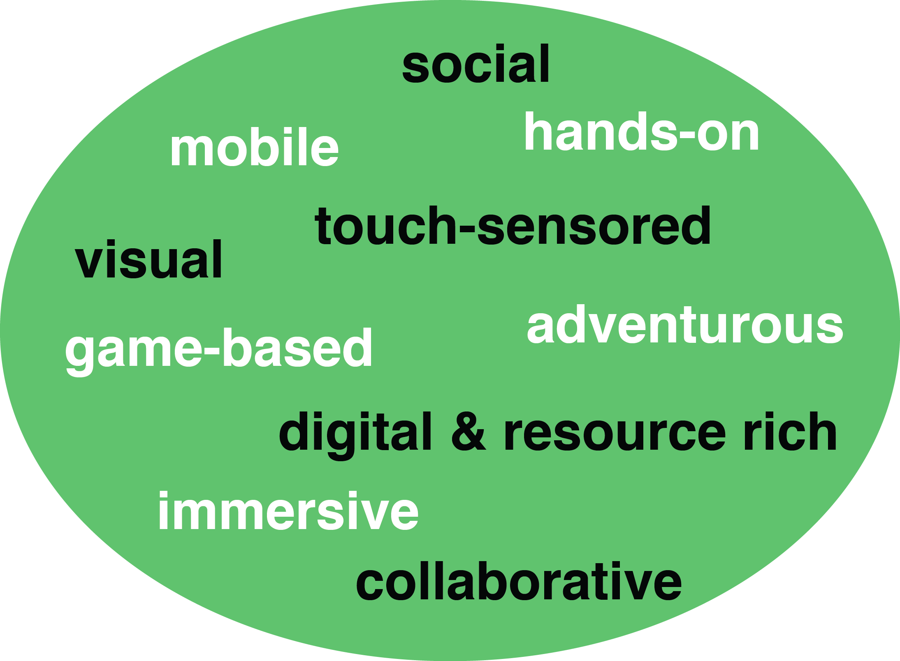
How Learning is Changing: Mega Trend #1. Learner Engagement

Slide 22
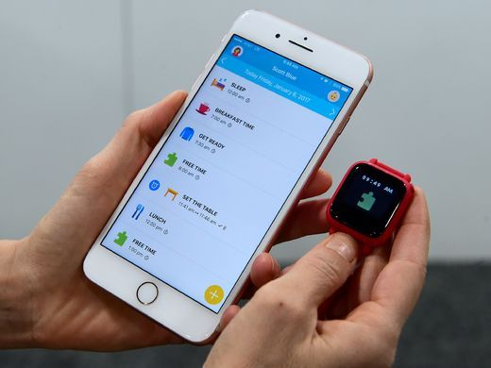
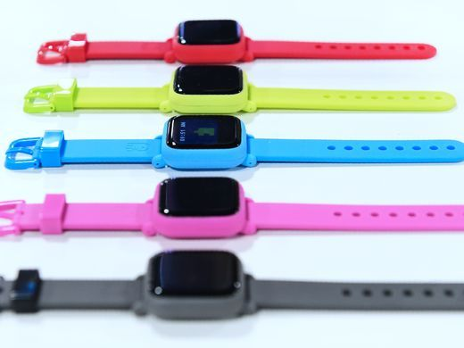
January 3, 2018 Learning is More Mobile CES 2018: Your guide to the biggest consumer electronics show USA Today https://www.usatoday.com/story/tech/news/2018/01/03/ces-2018-your-guide-biggest-consumer-electronics-show/1000778001/
The Octopus watch from Joy, an icon-based watch for kids to have good habits is on display during CES.

Slide 23
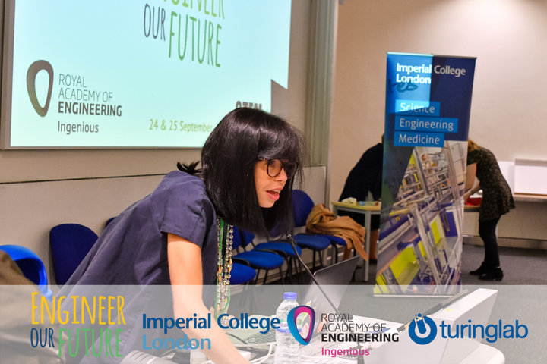
July 24, 2018 Learning is More Digital and Resource Rich This Physicist Wants Female Scientists To Get Noticed. So She Wrote 270 Wikipedia Profiles. Jenna Amatulli, Huffington Post https://www.huffingtonpost.com/entry/scientist-pens-270-wikipedia-pages-in-a-year-so-female-scientists-get-noticed_us_5b574eeee4b0b15aba92c0d5

Slide 24
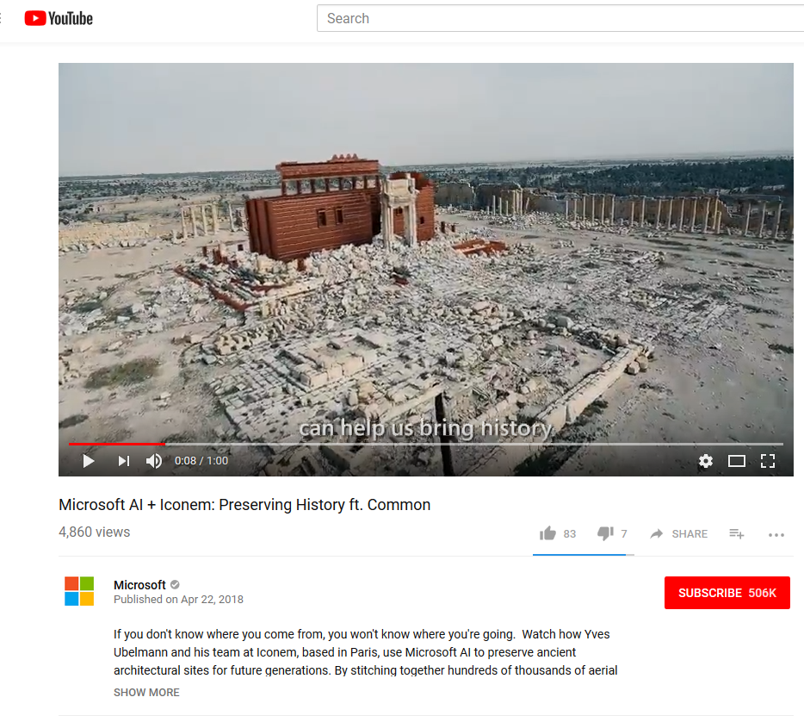
April 22, 2018 Learning is More Visual Microsoft AI Commercial ft. Common Video 1:00: Microsoft AI Commercial ft: https://www.youtube.com/watch?v=9tucY7Jhhs4 / (Feb 11, 2018) Video 1:48: Microsoft AI: Amplifying Human Ingenuity: https://www.youtube.com/watch?v=NDmu7Z5NPXo Video 1:00: Microsoft AI: Empowering Innovators ft. Common: https://www.youtube.com/watch?v=Z5OWdqfAYfw (April 22, 2018) Video: 1:00 Microsoft AI + Iconem: Preserving History ft. Common: https://www.youtube.com/watch?v=ZDZjaIhzMSM (April 22, 2018) Video: 0:44: Microsoft AI + The Yield: Taking the guesswork out of farming ft. Common: https://www.youtube.com/watch?v=7rzufxlGH4o (April 22, 2018)

Slide 25
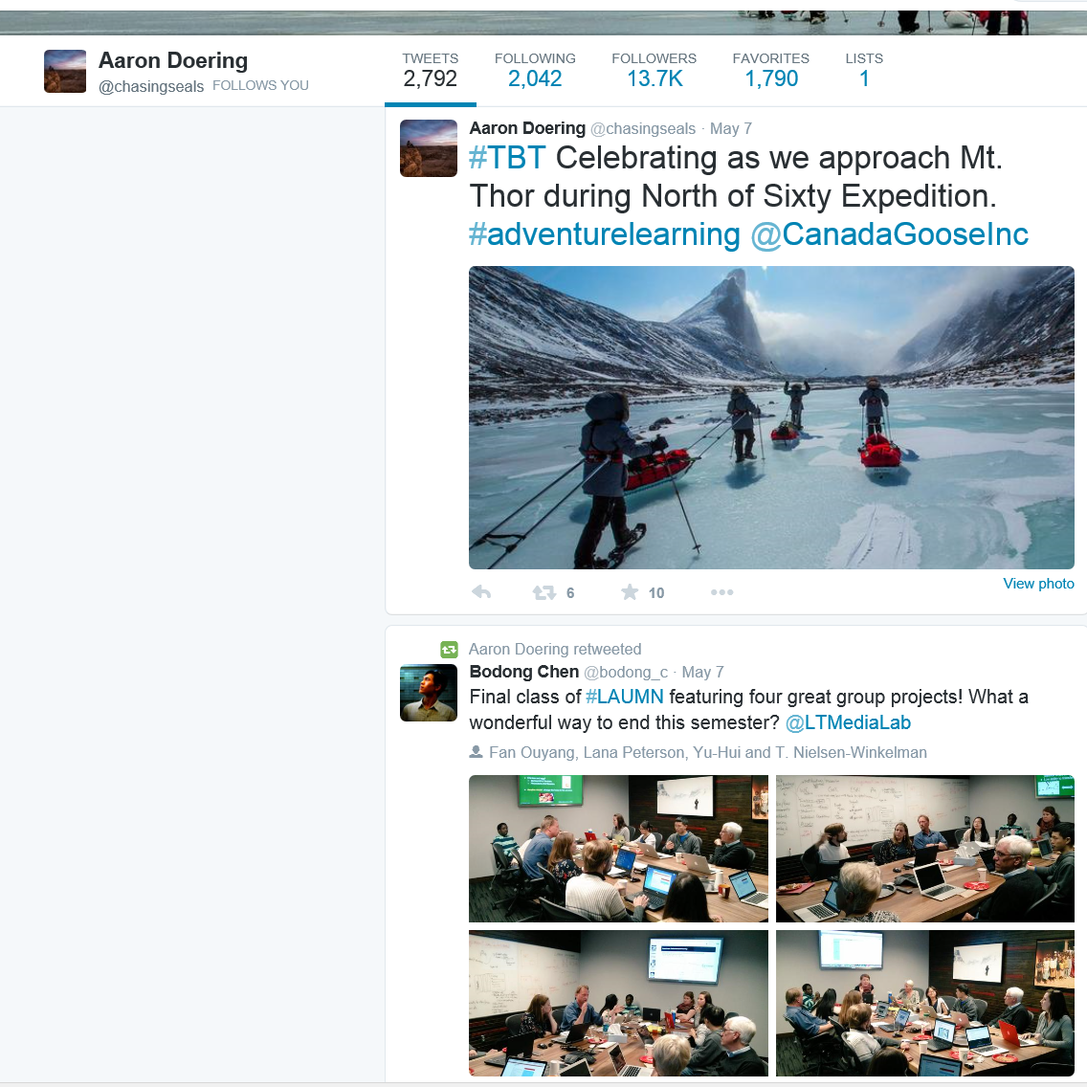
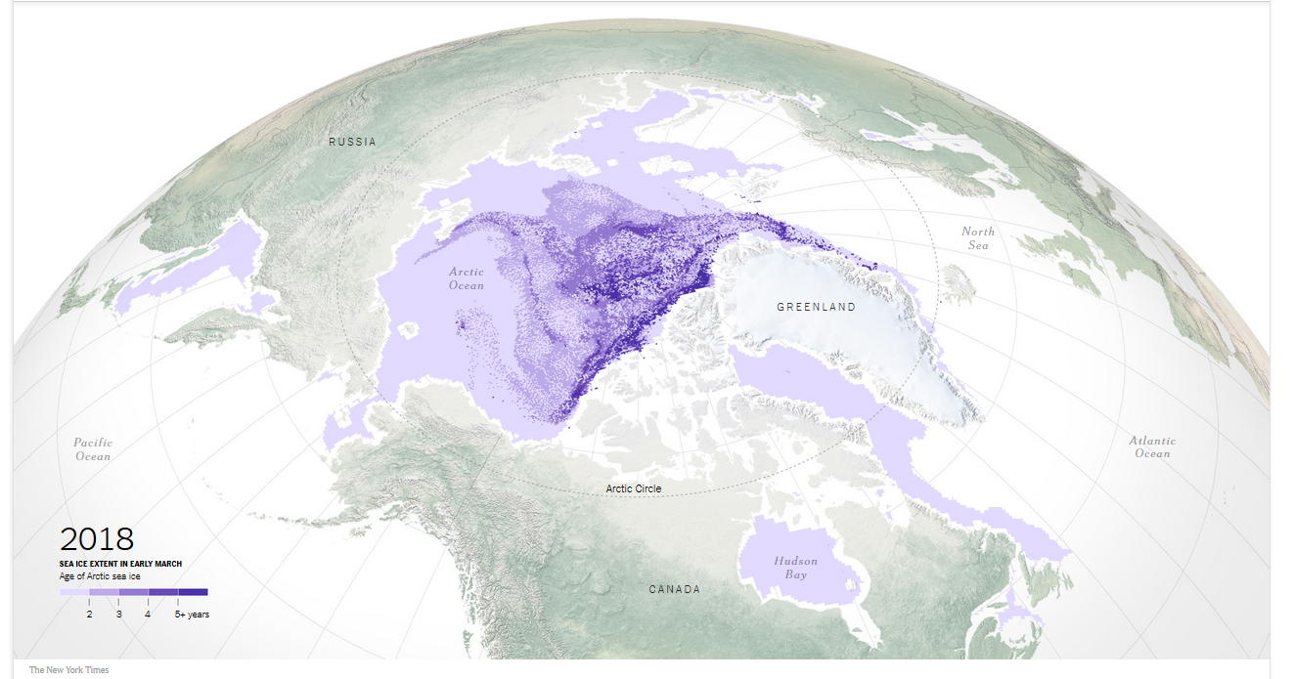
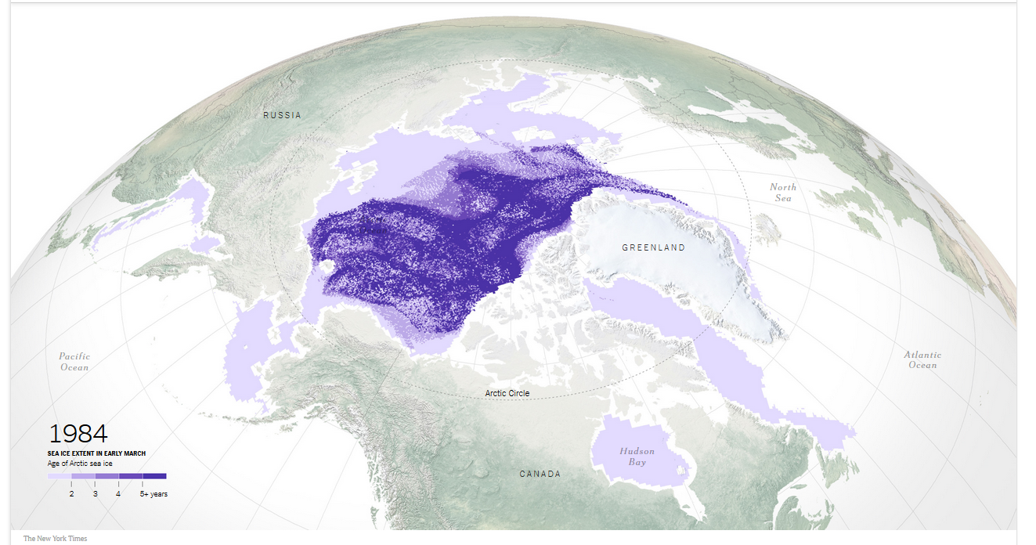
May 14, 2018 (Engagement) Learning is More Adventurous Aaron Doering, Chasing Seals, TEDx http://chasingseals.com/ https://twitter.com/chasingseals https://www.nytimes.com/interactive/2018/05/14/climate/arctic-sea-ice.html

Slide 26
July 29, 2018 Learning is More Collaborative Why Silicon Valley is teaming up with San Quentin to train young people to code Jessica Guynn and Megan Diskin, USA TODAY https://www.usatoday.com/story/tech/2018/07/25/california-youth-learning-code-prison-help-san-quentin-inmates/810122002/ Video (1:46): http://curtbonk.com/san-quentin.html

Slide 27
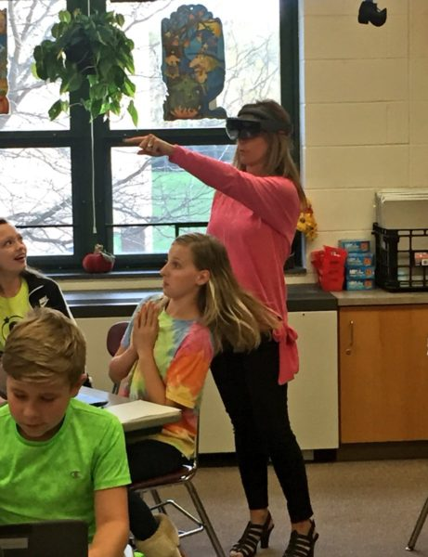
May 1, 2018 Learning is More Immersive 3 ways districts can use AR and AI Justin Anglio, eSchool News https://www.eschoolnews.com/2018/05/01/3-amazing-ways-our-district-is-using-ar-and-vr/ Video #1: 1:09: http://curtbonk.com/hololens.html
When a teacher glances around her classroom, Lumilo allows her to see real-time analytics (in the form of icons) floating directly above each student’s head. The teacher can glance directly at a student or “click” on a student’s icon to see more detailed information about where and how that student might be struggling.

Slide 28
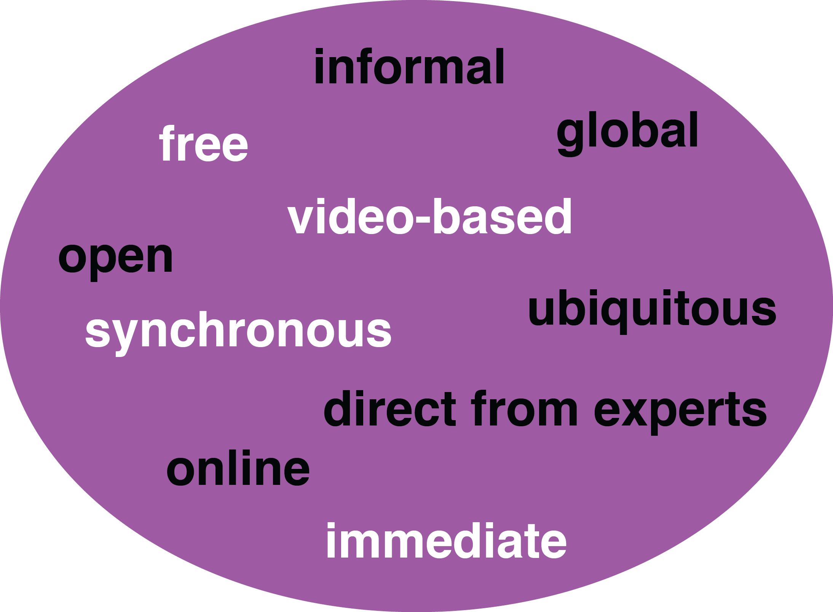
How Learning is Changing: Mega Trend #2. Pervasive Access

Slide 29
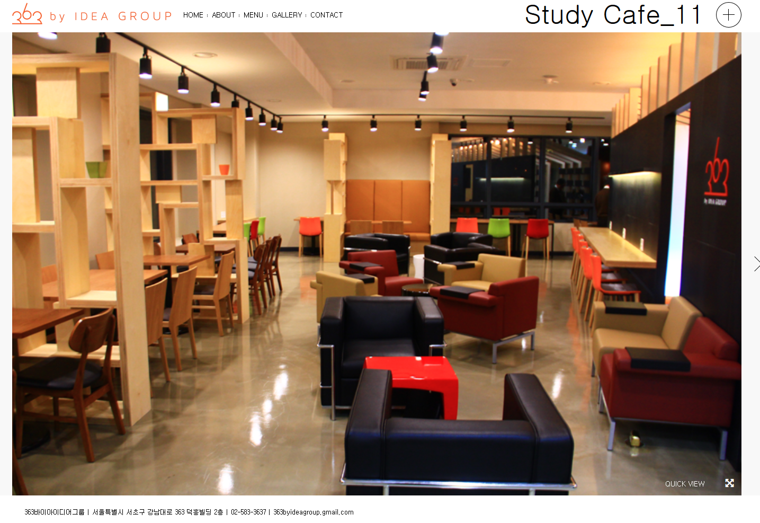
August 1, 2016 (Access) Learning is More Ubiquitous 363 by Idea Group; Study Café Meeting Place; Idea Space (Seoul, Korea) http://363.co.kr/wp/?page_id=244 http://363.co.kr/wp/?bw_gallery=study-cafe_11

Slide 30
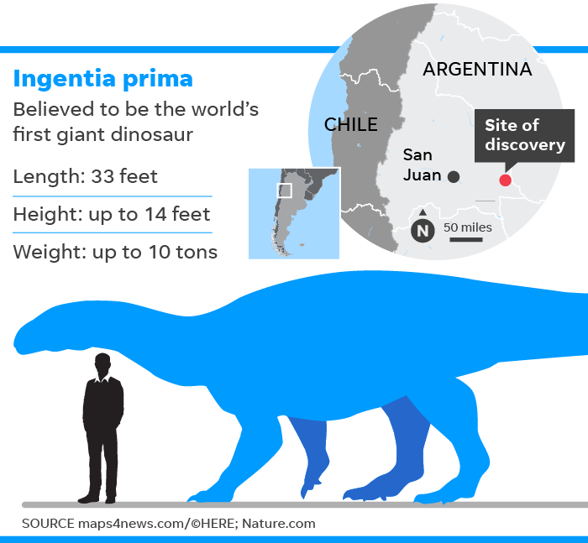
July 11, 2018 Learning is More Immediate… Fossil of first giant dinosaur, dubbed Ingentia prima, found in Argentina Brett Molina, USA Today https://www.usatoday.com/story/news/nation-now/2018/07/11/fossil-first-giant-dinosaur-discovered-argentina/774493002/ 15 second: http://curtbonk.com/ghostbusters15.html 27 second: http://curtbonk.com/ghostbusters27.html

Slide 31
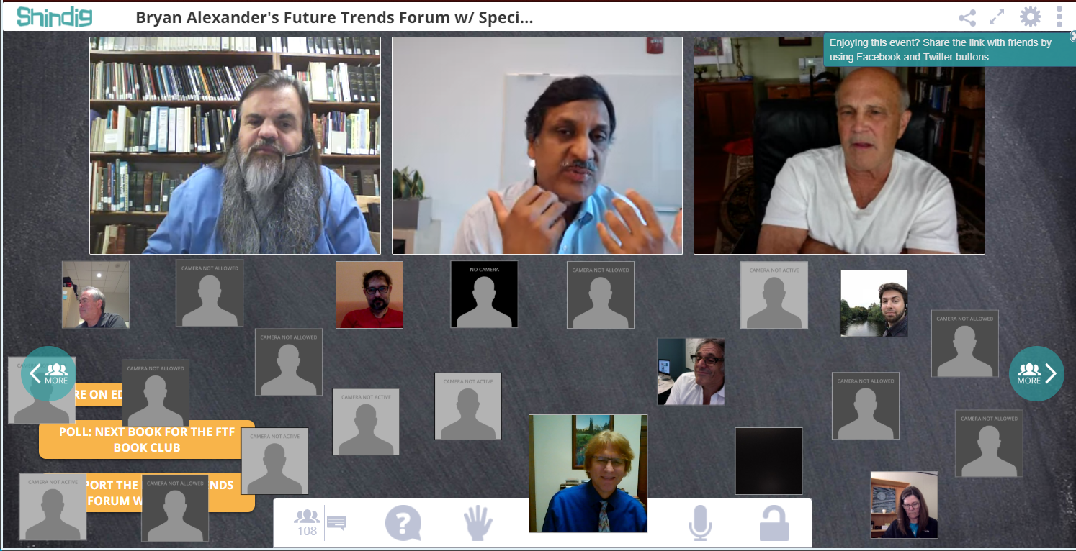
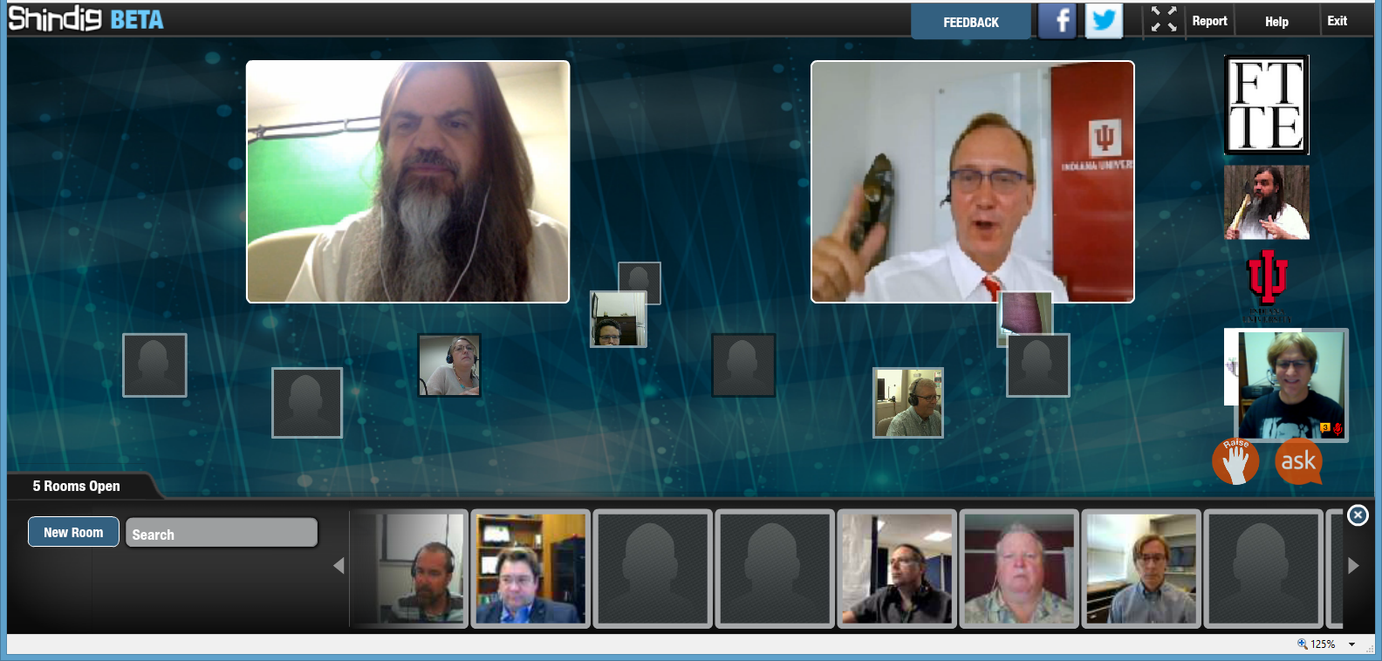
October 4, 2018 (Engagement) Learning is More Synchronous Shindig, Future Trends Forum, Bryan Alexander Anant Agarwal, CEO and founder of edX https://bryanalexander.org/the-future-trends-forum/ http://www.shindig.com/ http://events.shindig.com/event/ftf-anniversary https://shindig.com/client/client/?event=ftf-agarwal

Slide 32
March 21, 2018 (Engagement) Learning is More Global Chatterbox The overall winner in the competition was Chatterbox, an online language school powered by refugees https://wearechatterbox.org/

Slide 33
June 7, 2018 Learning is More Free and Open Open Educational Resouces The Chronicle of Higher Education http://images.results.chronicle.com/Web/TheChronicleofHigherEducation/%7B0cbd562d-5eee-4c74-88e4-4894148213e1%7D_2018_OpenEducationResources_Infographic_v4.pdf

Slide 34
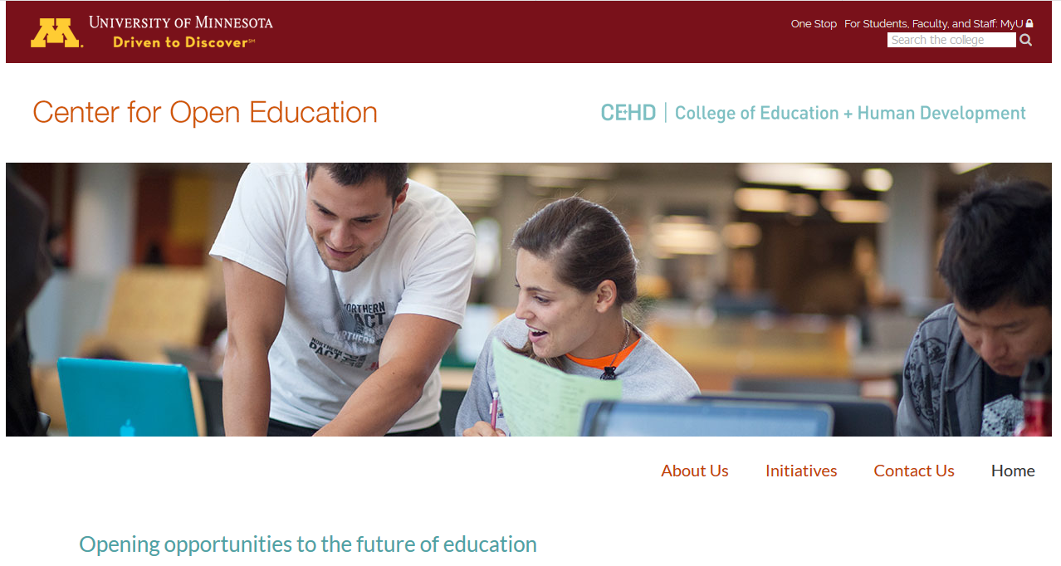
March 19, 2018 Learning is More Free and Open Open Textbook Network Center for Open Education, University of Minnesota http://research.cehd.umn.edu/otn/

Slide 35
August 2, 2018 Learning is More Free and Open OpenStax Infographic https://cpb-us-e1.wpmucdn.com/news-network.rice.edu/dist/c/2/files/2018/07/infographic-2018_final-21jjdwm.pdf

Slide 36
July 29, 2018 Learning is More Online Can a Huge Online College Solve California’s Work-Force Problems? Karin Fischer, The Chronicle of Higher Education https://www.chronicle.com/article/Can-a-Huge-Online-College/244054 http://curtbonk.com/link
The new college is being created to help California’s adults improve their job prospects in growing fields like IT support.

Slide 37
August 9, 2017 Learning is More Free and Open and Online Modern State Education Alliance https://modernstates.org/

Slide 38
March 21, 2018 Learning is More Direct from Experts TeachMeNow TeachMeNow is a gig-economy platform for teachers. This marketplace connects teachers, experts, and mentors to students. The technology combines scheduling, payments and live virtual sessions that can connect on any device allows tens of thousands of teachers to create their own online businesses, with some earning over $100,000 last year. In addition, schools and companies including Microsoft use TeachMeNow software to create their own-branded online learning communities. https://teachmenow.com/

Slide 39
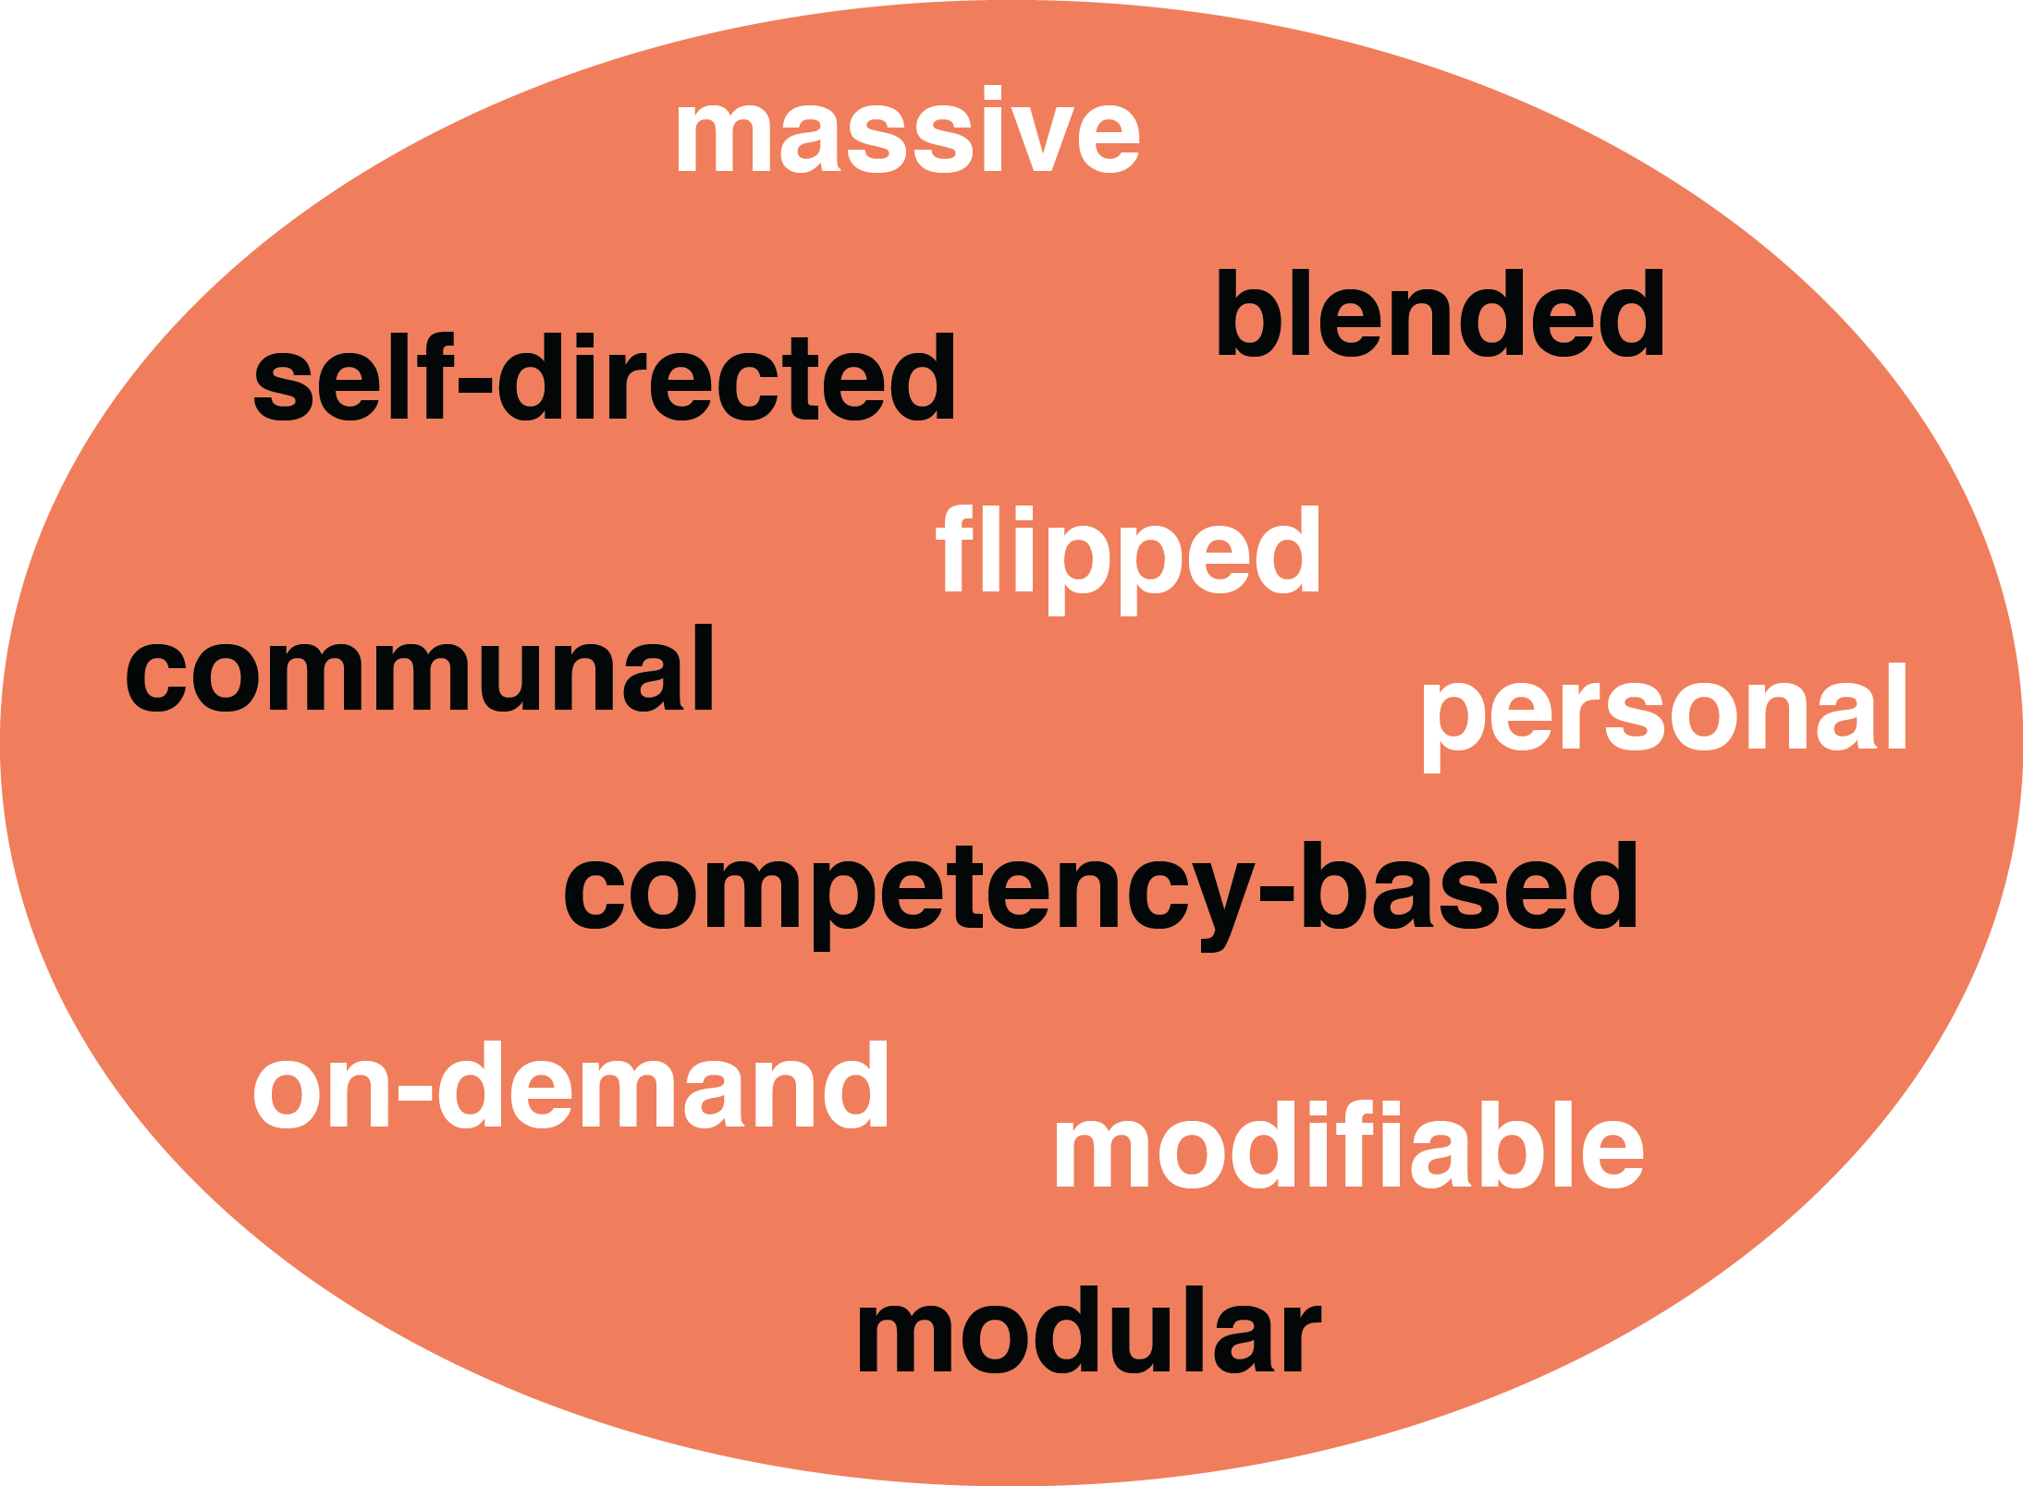
How Learning is Changing: Mega Trend #3. Customization

Slide 40
March 2, 2018 Learning is More Modifiable The Architecture of Ideal Learning Environments Emelina Minero, Edutopia The Future of Collaboration Spaces Encompasses Video Interactive, Mobile, Julie Johnston, IU, Campus Technology https://campustechnology.com/articles/2016/09/07/the-future-of-collaboration-spaces-encompasses-video-interactive-mobile.aspx http://www.miamiherald.com/news/local/education/article143434384.html https://www.edutopia.org/article/architecture-ideal-learning-environments

Slide 41
January 2, 2018 Learning is More Personalized 5G to AR: Here are 7 technologies to watch in 2018, Edward C. Baig, USA Today https://www.usatoday.com/story/tech/news/2018/01/02/artificial-intelligence-end-world-overblown-fears/985813001/ (e.g., Augmented hearing)

Slide 42
October 14, 2017 Learning is More Customized China wants to bring artificial intelligence to its classrooms to boost its education system How the take off of AI-enabled education will affect the interaction between China’s 14 million teachers and 188 million pupils Meng Jing, South China Morning Post https://www.scmp.com/tech/science-research/article/2115271/china-wants-bring-artificial-intelligence-its-classrooms-boost Video 1:33: http://curtbonk.com/chinese-ai.html

Slide 43
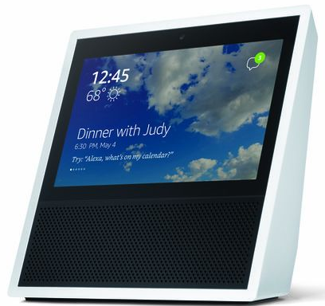
August 2, 2018 Learning is More Technology Assisted Hey, Alexa, Should We Bring Virtual Assistants to Campus? These Colleges Gave Them a Shot Lindsey Ellis, The Chronicle of Higher Education https://www.chronicle.com/article/Hey-Alexa-Should-We-Bring/244129 24 seconds: http://curtbonk.com/jetsons24.html 44 Seconds: http://curtbonk.com/jetsons44.html

Slide 44
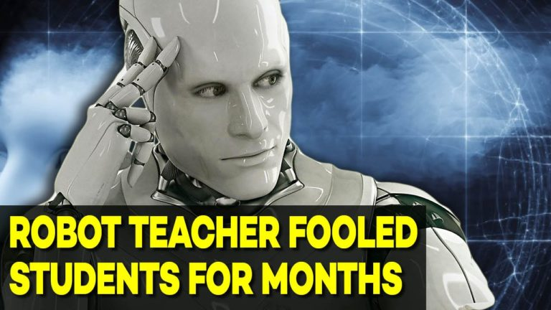
May 9, 2018 Learning is More Intelligently Assisted Google Duplex Demo from Google IO 2018 Video (4:11): https://www.youtube.com/watch?v=bd1mEm2Fy08 Video (2:05): http://curtbonk.com/google40-245.html Entire video (4:11): http://curtbonk.com/google2018.html Jill Watson, Round Three, Georgia Tech course prepares for third semester with virtual teaching assistants, Jason Maderer, Georgia Tech News Center http://www.news.gatech.edu/2017/01/09/jill-watson-round-three

Slide 45
April 14, 2018 Learning is More On Demand Google’s astounding new search tool will answer any question by reading thousands of books Anne Quito, Quartz https://qz.com/1252664/talk-to-books-at-ted-2018-ray-kurzweil-unveils-googles-astounding-new-search-tool-will-answer-any-question-by-reading-thousands-of-books/ Allows you and me to ask questions which trigger a semantic search of the 120,000 books that Google has digitized (typically in under 6 seconds).

Slide 46
October 12, 2018 Learning is More Massive and Modular EdX: From MicroMasters to Online Master’s Degrees Lindsey McKenzie, Inside Higher Ed https://www.insidehighered.com/news/2018/10/12/edx-launches-nine-low-cost-online-degrees

Slide 47
30+ Ways Learning is Changing: Recapping the Three Mega Trends: Engagement, Access, and Customization

Slide 49
August 1, 2018 1. Independent Studies Via MOOCs MOOC: AI A-Z: Learning How to Build an AI Online Course and Machine Learning Mengyuan Zhao https://www.udemy.com/artificial-intelligence-az/ https://www.coursera.org/learn/machine-learning

Slide 50
October 12, 2018 2. OER-Based Courses The Chronicle of Higher Education Launching OER Degree Pathways: An Early Snapshot of Achieving the Dream’s OER Degree Initiative and Emerging Lessons https://www.achievingthedream.org/sites/default/files/initiatives/launching_oer_degree_pathways.pdf Griffiths, R., Gardner, S., Lundh, P., Shear, L., Ball, A., Mislevy, J., Wang, S., Desrochers, D., Staisloff, R. (2018). Participant Experiences and Financial Impacts: Findings from Year 2 of Achieving the Dream’s OER Degree Initiative. Menlo Park, CA: SRI International.
Saving money with open-ed resources.
A large-scale effort to encourage the use of open-education resources has helped students save money and bolstered their learning, according to a report, released today, on the findings from the second year of Achieving the Dream’s OER Degree Initiative. The study found that:
Students saved between $66 and $121 per course.
Over 60 percent of students reported that the overall quality of their learning experience in an OER course was higher in comparison to a typical, non-OER course.
The number of OER courses at participating institutions jumped from 13 in 2016 to 385 in the spring of 2018; the number of students enrolled in OER courses went from 3,404 in 2016 to 37,398 in 2017.

Slide 51
September 22, 2017 3. Binge Learning Experiences What Online Education Can Learn from Netflix Henry Kronk, E-learning Inside News https://theumlaut.com/binge-learning-is-online-education-s-killer-app-84da18f8ae76

Slide 52
March 6, 2018 4. Rise of Super E-Mentors and Coaches By connecting Chinese pupils with North American teachers, Beijing-based platform is building cultural bridges, one online English class at a time. Most Innovative Companies, Fast Company Interview with VIPKid CEO CEO Cindy Mi https://www.fastcompany.com/company/vipkid

Slide 53
February 27, 2017 5. Web Conferencing Walls Global Learning Partner or PBL Team Selection Walls http://www.thelivingmoon.com/43ancients/02files/Library_Alexandria.html

Slide 54
September 26, 2018 6. Interactive Agents and Tutors Pushing the Boundaries of Learning With AI Lindsay McKenzie, Inside Higher Ed https://www.insidehighered.com/digital-learning/article/2018/09/26/academics-push-expand-use-ai-higher-ed-teaching-and-learning https://www.ibm.com/blogs/research/2018/08/mandarin-language-ai/ https://www.youtube.com/watch?time_continue=4&v=7EuSTu1iR2A 1:17: http://curtbonk.com/mandarin.html

Slide 55
January 30, 2017 7. Professor Einstein PDA’s http://www.usatoday.com/story/tech/2017/01/30/robotic-barista-now-serving-really-fast/95888780/
Professor Einstein, an educational Wi-Fi connected robot is on display at the Hanson Robot display during the opening day of Consumer Electronics Show 2017. (Photo: Robert Hanashiro, USA TODAY) http://www.usatoday.com/story/tech/2017/01/30/robotic-barista-now-serving-really-fast/95888780/

Slide 56
February 27, 2017 8. Robot Collaborators/Partners http://www.thelivingmoon.com/43ancients/02files/Library_Alexandria.html

Slide 57
9. Café Classroom and Café Connectedness Starbucks Your Classroom! Oskar Cymerman, Teaching Channel https://www.teachingchannel.org/blog/2016/07/29/starbucks-your-classroom/
Sterile, industrial-era rows aren’t very attractive or motivating. …I believe the “Starbucks” environment will promote that freedom and movement…Freedom is the key ingredient to social-emotional well-being and deeper learning. Rows and columns constrict. They hold and stifle.

Slide 58
10. Instructional Designer Morphs into Learning Environment Engineer

Slide 59
The Education 20/20 is coming within reach!

Slide 60
Remember… “I cannot do this alone.” Slides at: TrainingShare.com Papers: PublicationShare.com Free book: http://tec-variety.com/ Email: cjbonk@indiana.edu

