Slide 1
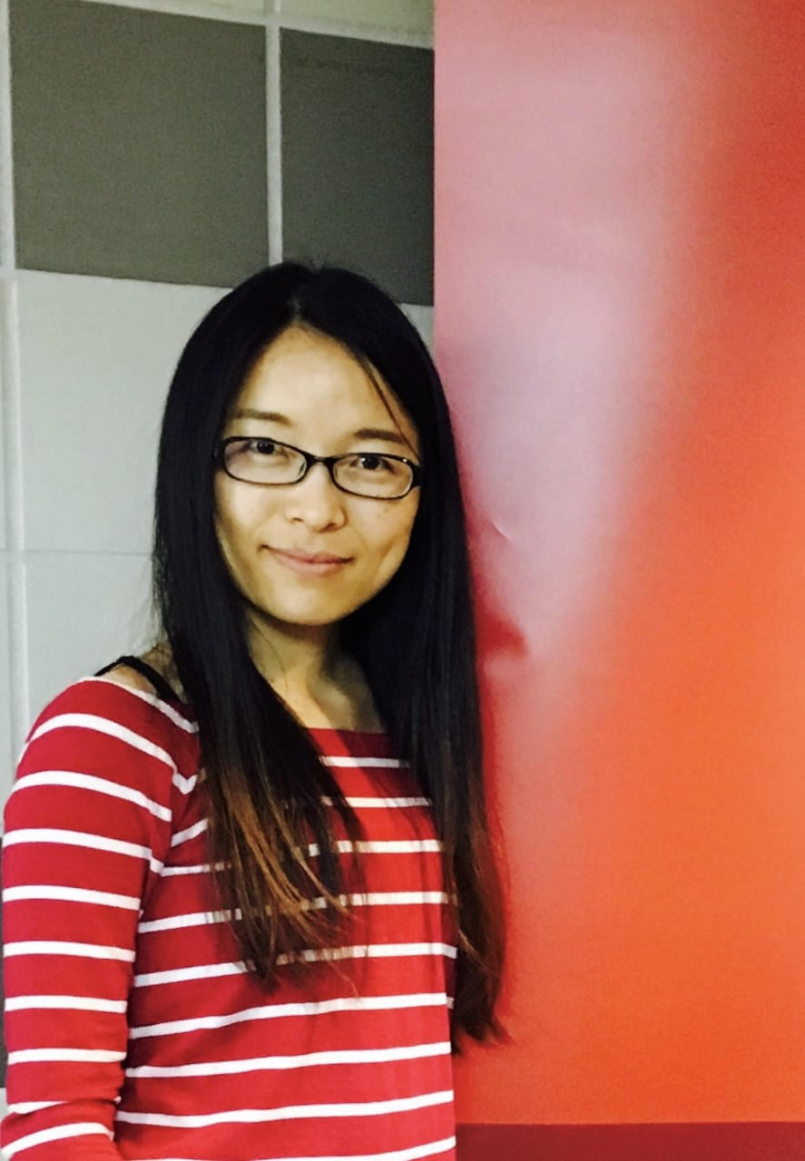
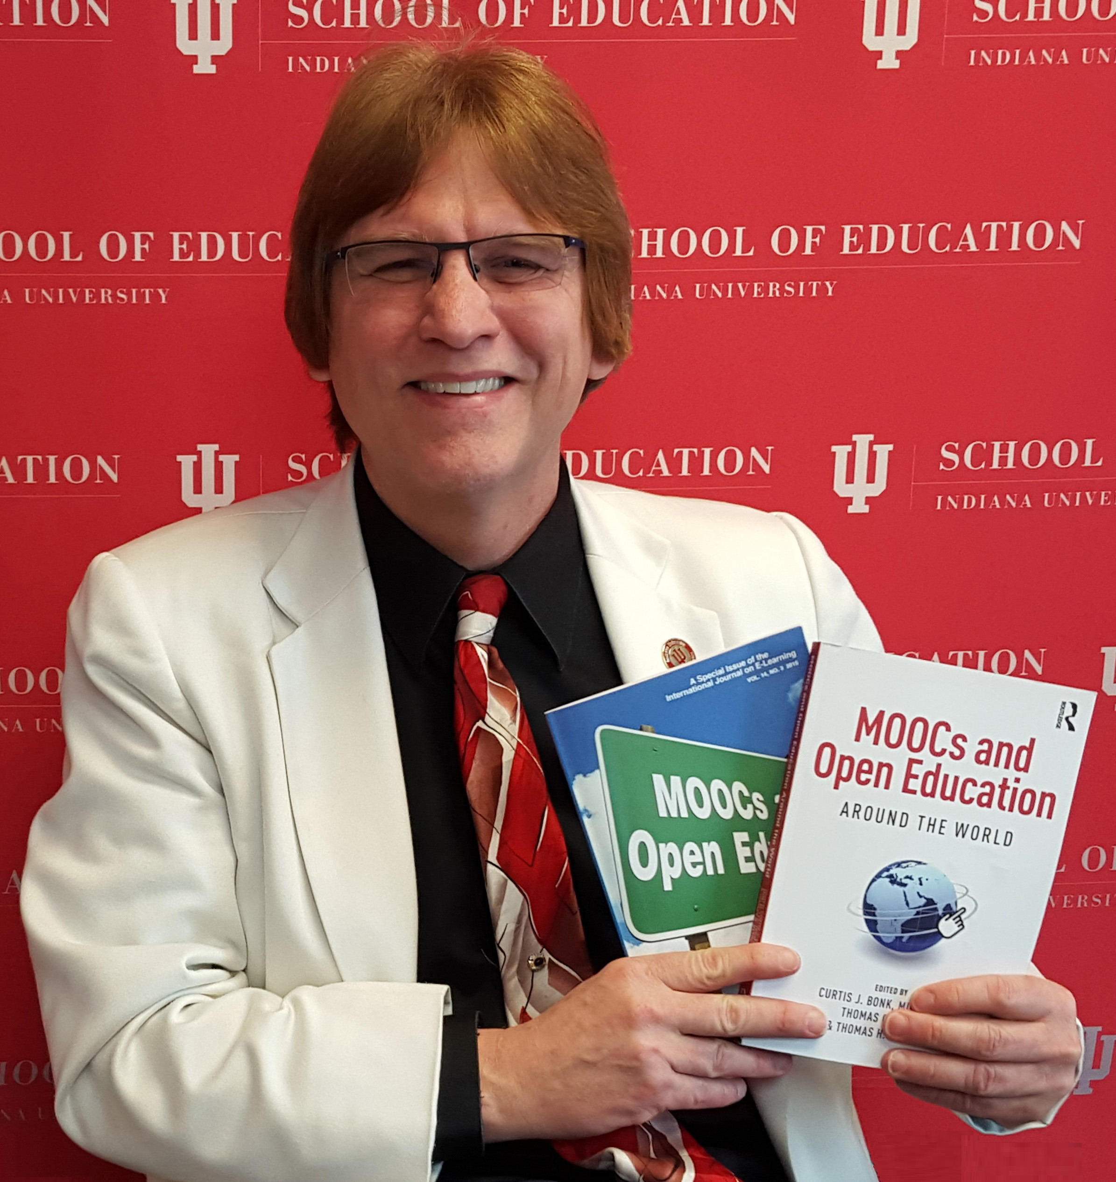
The G³ of Writing and Publishing Tips: Gentle Guidelines, Great Stories, and Gigantic Scholarly Gains
Curtis J. Bonk, Ph.D., Indiana University
cjbonk@indiana.edu
Meina Zhu, Ph.D., Wayne State University meinazhu@wayne.edu
Notes:
All
1

Slide 2
February 15, 2019 The Hardest Part of Writing Is Restarting Rebecca Schuman, The Chronicle of Higher Education https://www.chronicle.com/article/The-Hardest-Part-of-Writing-Is/245720?cid=cp242

Slide 3
March 31, 2019 Step Away From the Delete Button Rebecca Schuman, The Chronicle of Higher Education https://www.chronicle.com/article/Step-Away-From-the-Delete/246013?cid=cp242

Slide 4
March 31, 2019 Step Away From the Delete Button Rebecca Schuman, The Chronicle of Higher Education https://www.chronicle.com/article/Step-Away-From-the-Delete/246013?cid=cp242
Ideas will be no good on first pass.
There are no shortcuts…even a small subsection of a manuscript takes time.
You will need multiple versions of almost all your sentences to lead to polished prose.
It takes intellectual and artistic stamina to come up with ideas are good enough for academic journals.
Don’t let messy, gibberish words taunt and haunt you.

Slide 5
March 31, 2019 Step Away From the Delete Button Rebecca Schuman, The Chronicle of Higher Education https://www.chronicle.com/article/Step-Away-From-the-Delete/246013?cid=cp242
Write for 25 minutes 1-3 times a day for a week with deleting a single word.
Bracket some messages to yourself of sections that will need attention later (to calm your inner delete button).
Uncertain and unliked text make a difference color.
After you break the habit of deleting, you can delete judiciously.
Trust your research and your ideas. Avoid setting standards at ridiculously high levels.

Slide 6
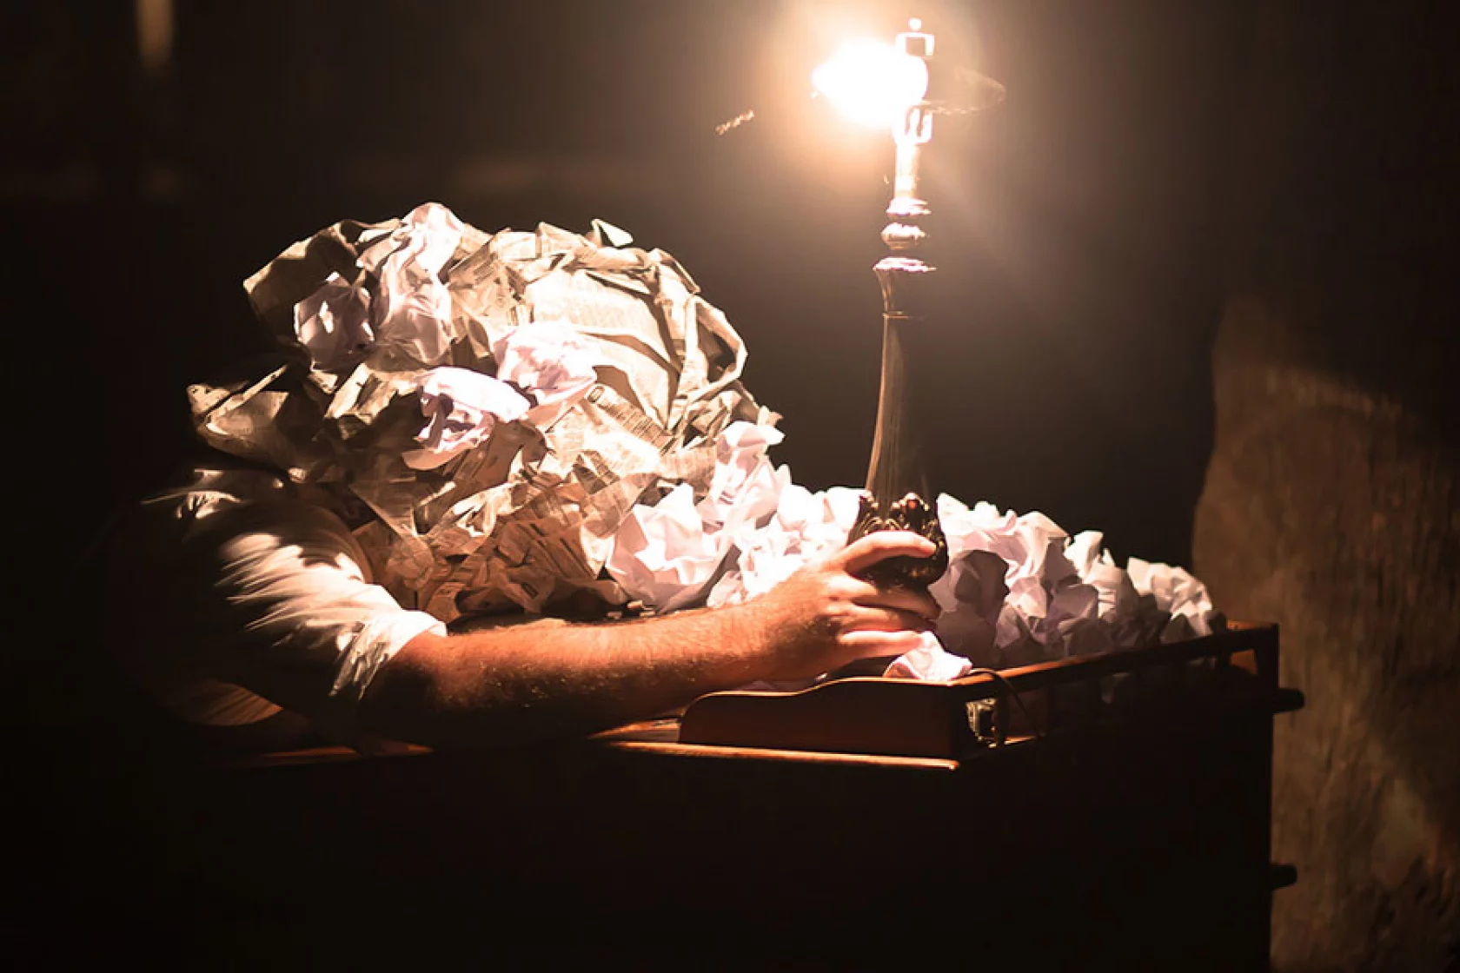
November 17, 2014 The Habits of Highly Productive Writers Rachel Tour, The Chronicle of Higher Education https://www.chronicle.com/article/the-habits-of-highly-productive-writers/?cid2=gen_login_refresh&cid=gen_sign_in
You have time only if you make it a priority. Productive writers don’t allow themselves the indulgence of easy excuses. When they start to have feelings of self-doubt—I can’t do this, it’s too hard, I’ll never write another good sentence—they tell themselves to stop feeling sorry for themselves and just do the work.
They know there are no shortcuts, magic bullets, special exercises, or incantations.

Slide 7
November 17, 2014 The Habits of Highly Productive Writers Rachel Tour, The Chronicle of Higher Education https://www.chronicle.com/article/the-habits-of-highly-productive-writers/?cid2=gen_login_refresh&cid=gen_sign_in
They believe in themselves and their work. Perhaps it’s confidence, perhaps it’s Quixote-like delusion, but to be a prolific writer you have to believe that what you’re doing matters. If you second-guess at every step, you’ll soon be going backward. A writer I know likes to say that over the years he has “trained” his family not to expect him to show up for certain things, because they know his work comes first. You have to be willing to risk seeming narcissistic and arrogant, even if you don’t like to think of yourself that way. The work takes priority.

Slide 8
June 7, 2018 6 Ways to Beat Writer’s Block Rachel Tour, The Chronicle of Higher Education https://www.chronicle.com/article/6-ways-to-beat-writers-block/
Work up a sweat. ...
Take a quick trip. ...
Just keep at it. ...
Heed Anne Lamott's clarion call…”write a shitty draft first.”
Try the “compost” method…a pile of crap can lead to something worth cultivating
Remind yourself that even the best writers get stuck.

Slide 9
December 11, 2020 How to Find a Writing Routine that Works Manya Whitaker, The Chronicle of Higher Education https://www.chronicle.com/article/how-to-find-a-writing-routine-that-works
Always work on at least 2 projects.
Review potential publishers and options.
Set a reasonable writing timeline.
Make a writing schedule and plan.
Have a project-based writing schedule.
Expand notion of when “writing.”
Set time writing goals, not word goals.
Write what motivates you that day.
Establish flexible schedules.
Read more and edit as you go.

Slide 10
December 10, 2019 Rewarding Your Writing Leslie Leonard, Inside Higher Ed https://www.insidehighered.com/blogs/gradhacker/rewarding-your-writing

Slide 11
December 10, 2019 Rewarding Your Writing Leslie Leonard, Inside Higher Ed https://www.insidehighered.com/blogs/gradhacker/rewarding-your-writing
Track your writing. Have realistic expectations of output.
Find ways to mark days you have met your writing goals (e.g., stickers).
Writing should be enjoyable, a reward in and of itself.
Rewards are many: sleeping in, a fancy cup of coffee, new clothes, movie tickets, spa day, etc.
Have drawings for random rewards for meeting goals.

Slide 12
December 10, 2019 Rewarding Your Writing Leslie Leonard, Inside Higher Ed https://www.insidehighered.com/blogs/gradhacker/rewarding-your-writing
Let your rough drafts be rough.
Just write. List your goals. Get something down.
Use goofy fonts, nonsense words, rhymes, etc. (count these towards your writing goals and reward them). Allow any writing to count toward your goals.
Make the experience enjoyable with treats or fancy clothes, etc.
Find brief moments to write (e.g., waiting for a bus or a plane).

Slide 13
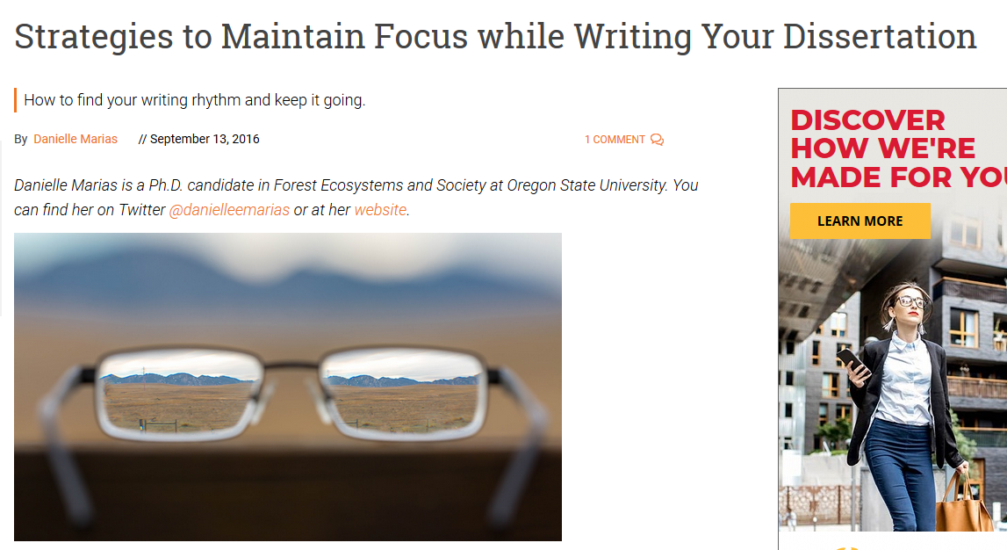
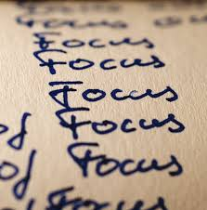
September 13, 2016 Strategies to Maintain Focus while Writing Your Dissertation GradHacker, Inside Higher Ed https://www.insidehighered.com/blogs/gradhacker/strategies-maintain-focus-while-writing-your-dissertation

Slide 14
September 13, 2016 Strategies to Maintain Focus while Writing Your Dissertation GradHacker, Inside Higher Ed https://www.insidehighered.com/blogs/gradhacker/strategies-maintain-focus-while-writing-your-dissertation
Freewriting 15 minutes per day…don’t worry about grammar and word usage.
“Only writing produces text”—words on paper overcomes anxiety and procast.
Meditation and mindfulness…for 5 minutes.
Intentions journal….visualize goals and create checklists.
Identifying our most productive times of day for writing using heat mapping.
Write first….clean house after.
Email and smartphone—turn off and abstain.
Schedule meetings in the morning/afternoon (protect some portion of day)
“Park on a downhill slope”…so you can pick up where you left off.
Gain momentum…by focusing on one thing at a time.

Slide 15
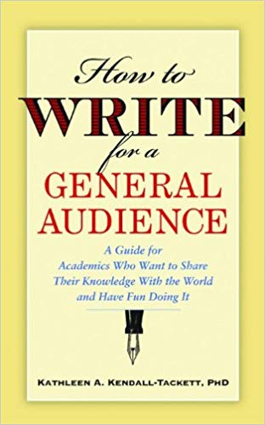
January 19, 2021 Writing for Diverse Audience: Prewriting
Ask questions about audience
Ask more questions about audience
Restate what you interpreted as the audience
Read, read, and read some more
Scan sample publications
Look to the popular press and news

Slide 16
January 19, 2021 Writing for Diverse Audience: Writing Drafts
Ask at least two others to read and comment.
Read what you wrote out loud.
Print it and look at it (digital versions can be misleading).
Simplify wording.
Revise and revise and revise some more.
Use a thesaurus.

Slide 17
January 19, 2021 Writing for Diverse Audience
Be careful on forms of humor and types of jokes.
Avoid political, religious, economic, etc. commentary.
Be careful with metaphors, idioms, and proverbs (e.g., make hay when the sunshines) and domain specific lingo (e.g., “he has a sweet stroke” in baseball).

Slide 18
Finding a Journal that Fits
What to look for?
Who will be your target readers?
Who are the authors and journals you cite the most related with your research program?
Is there a match between your work and the journal aims and scope?
What is the journal turnaround time?
What is the journal acceptance rate?
Do you know the editor(s)?
Notes:
Ana
https://www.editage.com/insights/how-to-choose-journals-for-submitting-your-paper
Who will be your target readers? Scholarly vs. non-scholarly periodicals
readership and target audience
Look for a match between your work and the journal aims and scope. – journal analysis
What is the journal’s turnaround time?
Acceptance rates? Get familiar with the journals’ acceptance rates
18

Slide 19
Resource and Idea Suggestions
Subscribe to news feeds (not too many)
Save links and images to interesting articles
Review saved documents for themes monthly
Share those links in Facebook, Twitter, etc., for peer reactions
Write to people interviewed in articles

Slide 20
Predatory (fake) Journals/ Publishers (Feng-Ru Sheu, Kent State University, 2018)
Be Aware of Predatory Journals/Publishers!
The publishing venue prey on academicians for making money without following scholarly publishing standards, commonly seen in the Open Access world.
Also called “Pseudo-journals,” “fake journals,” and “sham journals.”
(Beager, 2017; Clark & Smith, 2017)
Notes:
Feng-Ru
the “Think. Check. Submit.” checklist developed by a coalition of scholarly publishing organizations
Think
Are you submitting your research to a trusted journal?
Is it the right journal for your work?

Slide 21
Predatory Journals/ Publishers
(Feng-Ru Sheu, Kent State University, 2018)
Be Aware of Predatory Journals/Publishers!
Characteristics
The journal asks for a submission fee
Promises of fast peer review and fast publication
Spam emails to attract potential authors
Small size of editorial board or not indicated clearly
Newness and the quantity: a very new journal that consists of a high quantity of articles in one issue
Inconsistencies in the scope and the content or journal title and contact address
(Beager, 2017; Prater, 2018)
Notes:
Feng-Ru
the “Think. Check. Submit.” checklist developed by a coalition of scholarly publishing organizations
Think
Are you submitting your research to a trusted journal?
Is it the right journal for your work?

Slide 22
Writing Difficulties and Challenges of a Early Career Scholar
Time
Writing habits
Resources
Local/Global Support
Starter text
Reputation
Connections
Journal awareness
Energy/Stamina
Service/Teaching duties
Notes:
Ana
22

Slide 23
Writing Tips and Insights
Insights and Advice on Getting Published from a New Faculty’s Perspective
Notes:
23

Slide 24
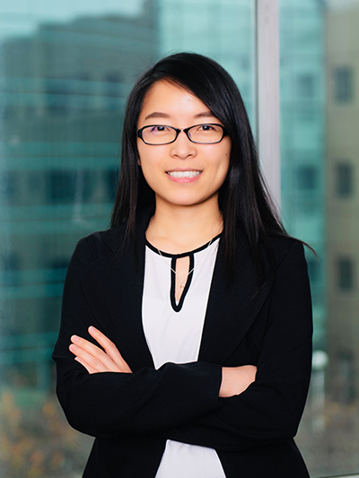
Meina Zhu: An Early Career Perspective
1. Goals 2. Strategic Plans 3. Reflection 4. Collaborators 5. Professional Development
6. Research focus
Notes:
24

Slide 25
1. Writing Goals
Notes:
https://images.app.goo.gl/MKuUp4qKm1YVWaVy6
25

Slide 26
2. Strategic Plans
Notes:
26

Slide 27
3. Reflection on Writing
Notes:
https://images.app.goo.gl/GaBmk1XemmM54JxR7
27

Slide 28
4. Writing Collaborators
Notes:
Curt
28

Slide 29
October 3, 2019 Crucial Co-Writing Considerations Jordan McNeill, Inside Higher Ed https://www.insidehighered.com/blogs/gradhacker/crucial-co-writing-considerations
Clarify authorship order ahead of time.
Have an honest conversation about the strengths of each team member--draft, revise, proofread, and format your manuscript.
Be clear on division of labor.
Nonwriting tasks are important too—taking notes, submission guidelines, and keep track of deadlines.
Set up digital collaboration norms and platforms—archiving, tracking, commenting, etc.
Respond to feedback professionally.
Build in time for feedback and revision.
Singular voice throughout paper—assign one member of team to read for writing style and flow.

Slide 30
Meina Research Collaboration-Why?
Improve quality of research
Extend research relationships and networks
Foster interdisciplinary and transdisciplinary research
Share expertise and knowledge transfer
Enhance scientific and publishing productivity
Accelerate dissemination of findings for community benefit
Notes:
Retrieved from https://www.google.com/search?q=collaboration&tbm=isch&ved=2ahUKEwj8ivazkeDsAhUI0awKHcTRALsQ2-cCegQIABAA&oq=collaboration&gs_lcp=CgNpbWcQAzIFCAAQsQMyAggAMgIIADICCAAyAggAMgIIADICCAAyAggAMgIIADICCAA6BAgjECc6BAgAEEM6BwgAELEDEEM6CAgAELEDEIMBULmxDliCvQ5gzL4OaABwAHgAgAFPiAHKBpIBAjEzmAEAoAEBqgELZ3dzLXdpei1pbWfAAQE&sclient=img&ei=iQeeX7yiDYiiswXEo4PYCw&bih=881&biw=1965&tbs=il%3Acl&hl=en#imgrc=TBP9Sue5H-FIAM

Slide 31
Meina… Research Collaboration-How?
Identify the skills that you can offer
Identify how the collaboration will meet your needs
Find collaborators
Introduce yourself
Set expectations at the beginning of the collaboration
Leverage tools for collaborations
Keep communicating
Do not be discouraged
Notes:
Retrieved from https://www.google.com/search?q=collaboration&tbm=isch&ved=2ahUKEwj8ivazkeDsAhUI0awKHcTRALsQ2-cCegQIABAA&oq=collaboration&gs_lcp=CgNpbWcQAzIFCAAQsQMyAggAMgIIADICCAAyAggAMgIIADICCAAyAggAMgIIADICCAA6BAgjECc6BAgAEEM6BwgAELEDEEM6CAgAELEDEIMBULmxDliCvQ5gzL4OaABwAHgAgAFPiAHKBpIBAjEzmAEAoAEBqgELZ3dzLXdpei1pbWfAAQE&sclient=img&ei=iQeeX7yiDYiiswXEo4PYCw&bih=881&biw=1965&tbs=il%3Acl&hl=en#imgrc=1C1gKEYxDs39-M&imgdii=FLQg6a_t9CpumM

Slide 32
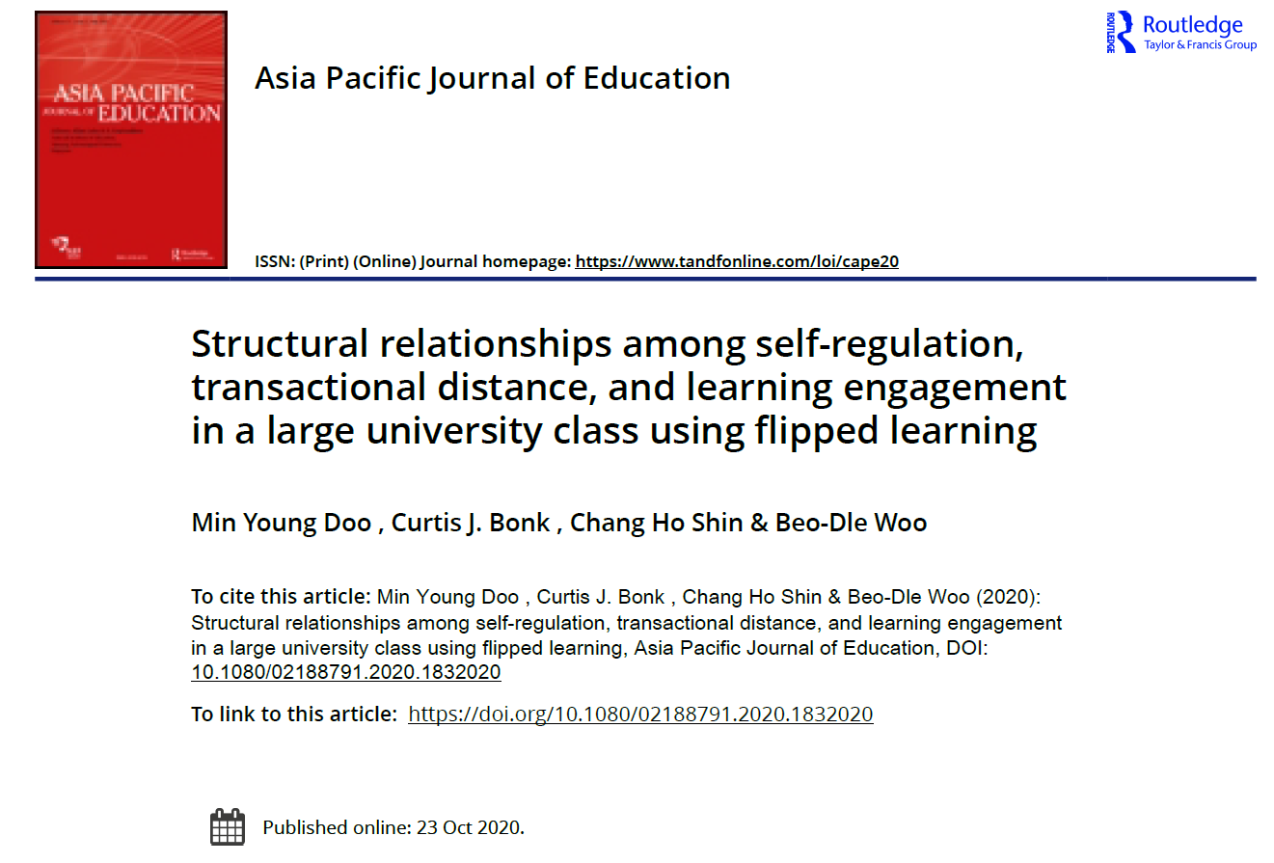
5. Sometimes you have to contact the editor…

Slide 33
6. Sometimes you have to send to an easier journal…

Slide 34
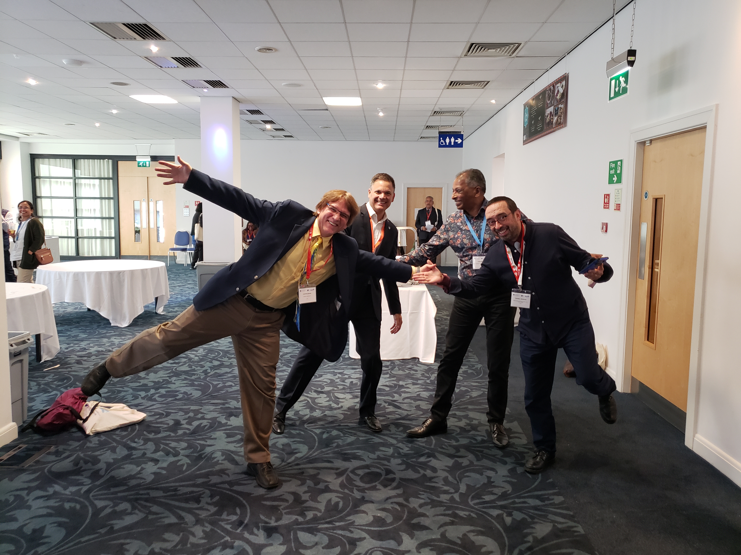
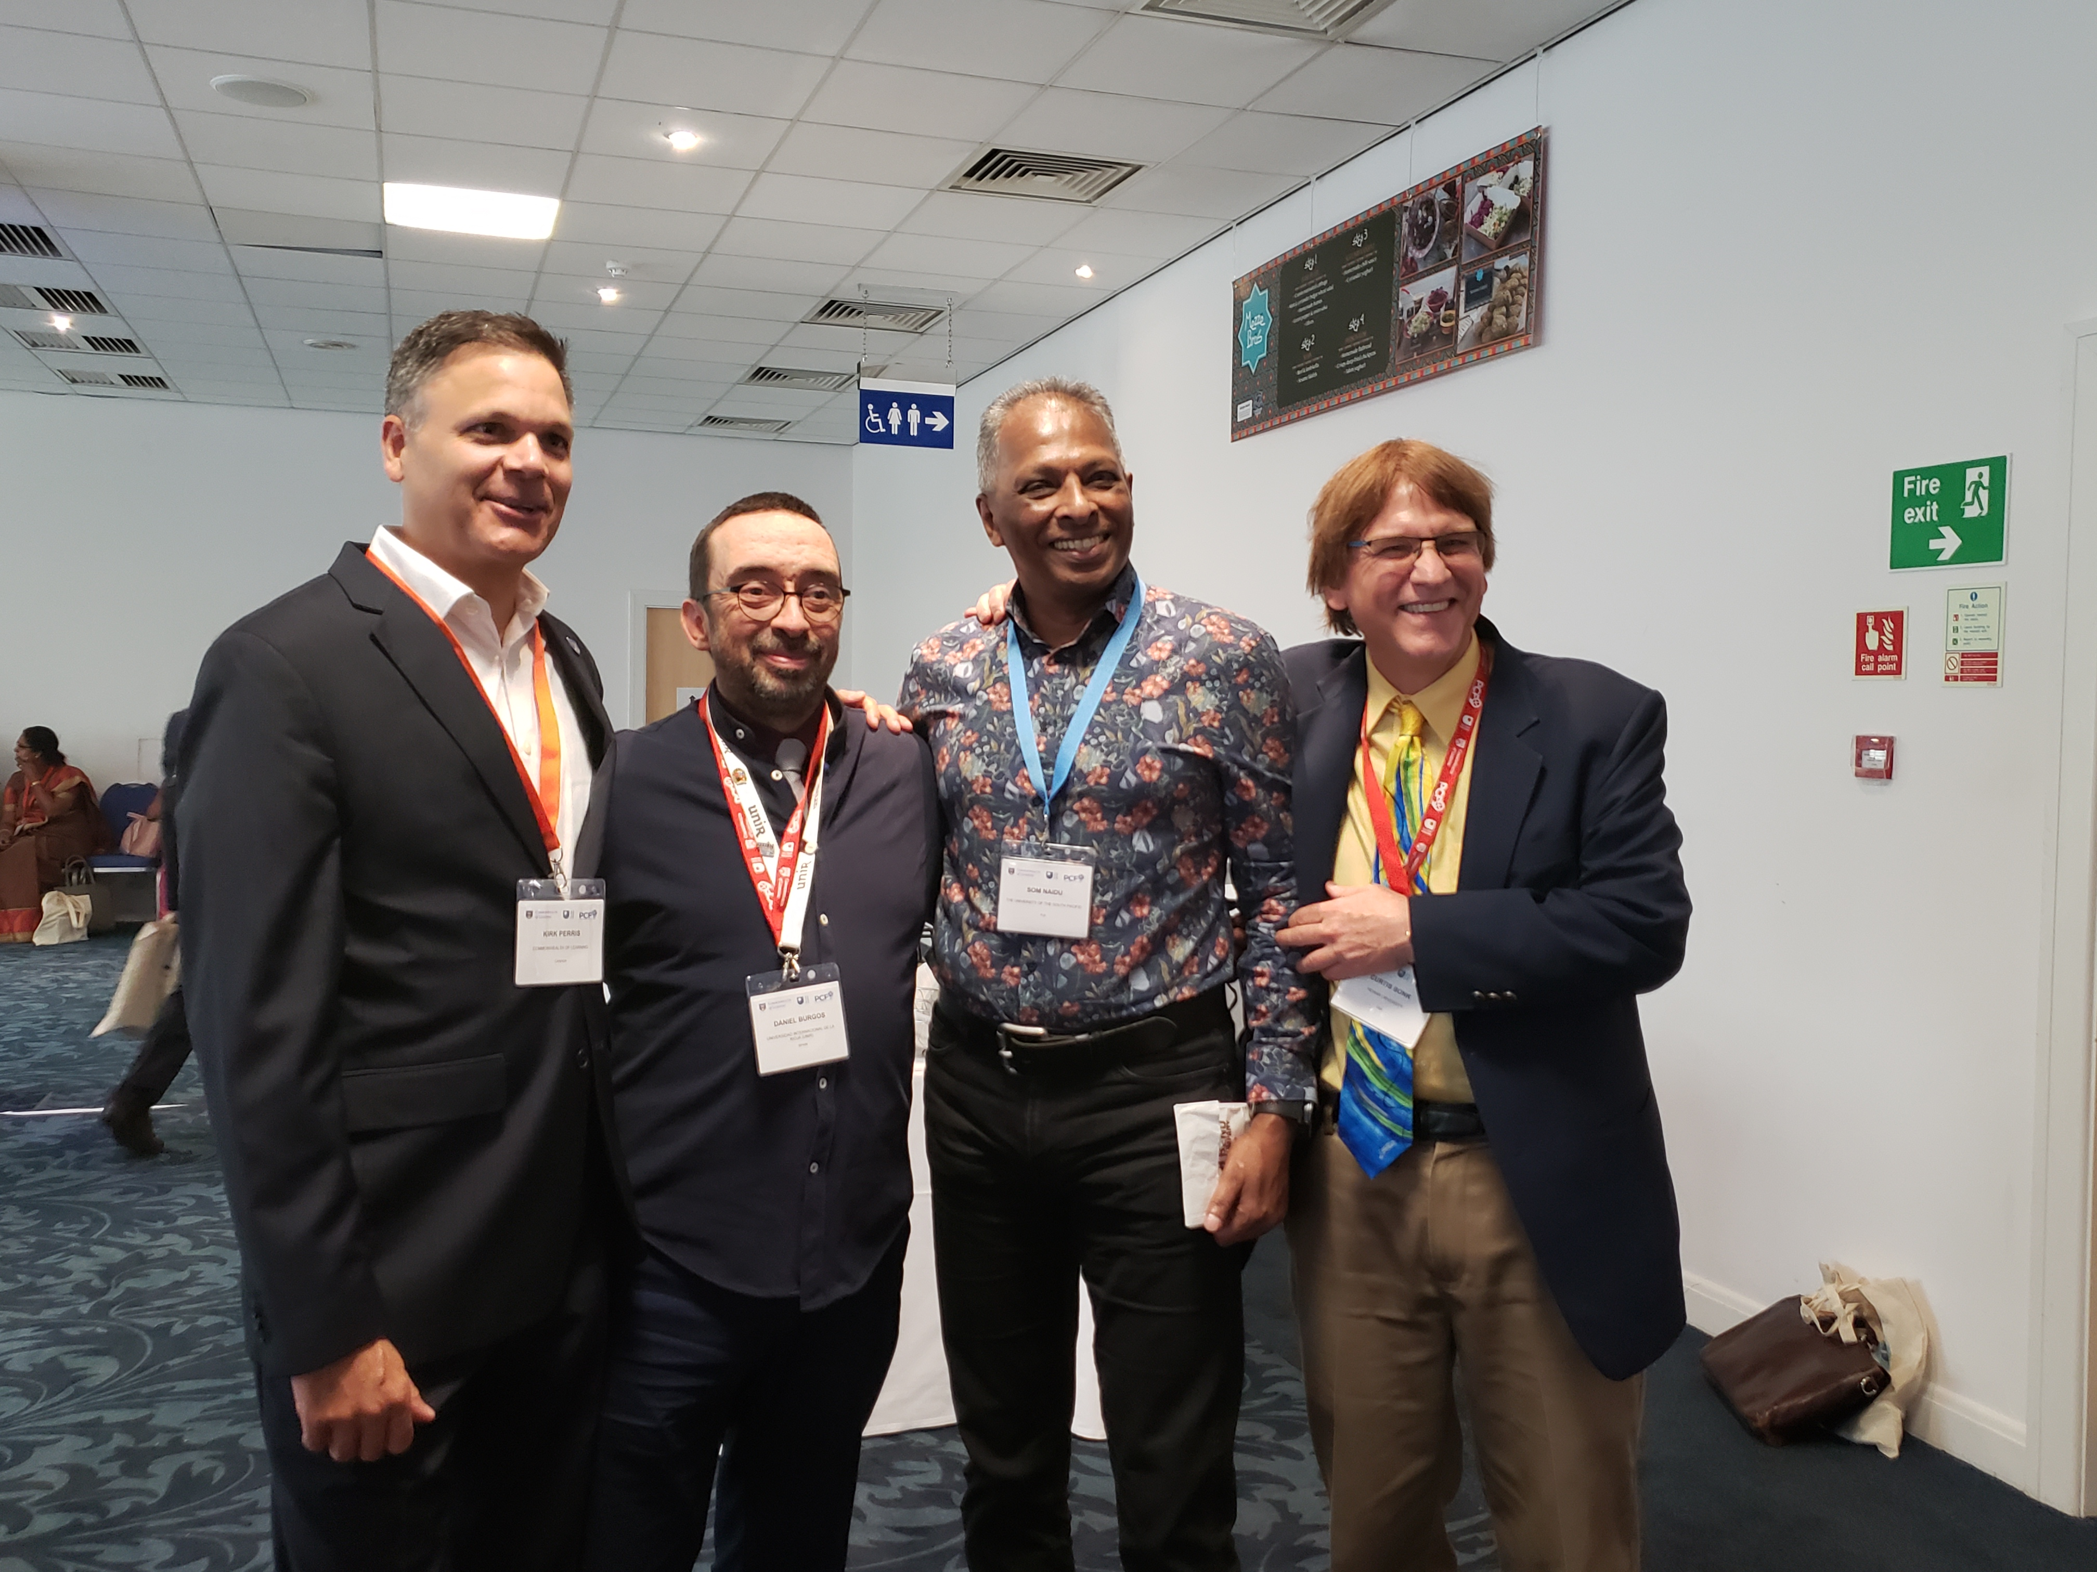
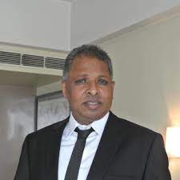
7. Sometimes you’re invited…

Slide 35
8. Mark the Level of Difficulty A New Series on Scholarly Productivity: ‘Are You Writing?’ Rebecca Shuman, The Chronicle of Higher Education https://www.chronicle.com/article/A-New-Series-on-Scholarly/244689
Read as peer reviewer; mark up everything.
Catalog problems on a 1 to 3 difficulty scale (Level 1 takes less than 30 minutes, Level 2 takes 2 hours or less; Level 3 takes more time).
Fix the easy ones and gain momentum for the harder ones!
Take breaks as needed.
Notes:
Curt

Slide 36
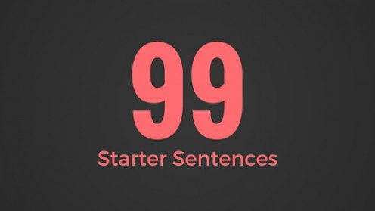
9. Generate Starter Text…
Author a blog
Use social media
Submit a conference proposal
Write editorials
Write book and software reviews
101
Notes:
Curt

Slide 37
March 31, 2019 10. Step Away From the Delete Button Rebecca Schuman, The Chronicle of Higher Education https://www.chronicle.com/article/Step-Away-From-the-Delete/246013?cid=cp242

Slide 38
Sometimes There’s a Hot Streak:
Notes:
https://letslearnenglish.com/asking-for-and-giving-directions/
38

Slide 39
Curt Bonk: Reflections on the Hot Streak
1. Persistence and grit.
2. Sense of now.
3. One at a time.
4. Assemble best team for you. Find comfort.
5. Intense and Relaxed Planning.
6. Explore Possible Journals and Commit.
7. Everyone has clear role.
8. Set bold and audacious goals.
9. Recheck list. Recheck goals.
10. Revel in good luck. Do not sulk if bad luck.
Notes:
39

Slide 40
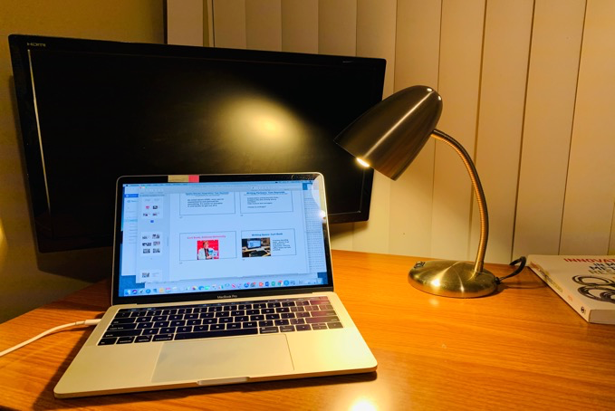
Writing Space #1: Meina Zhu, Wayne State University
My room is my writing space when it is dark outside.

Slide 41
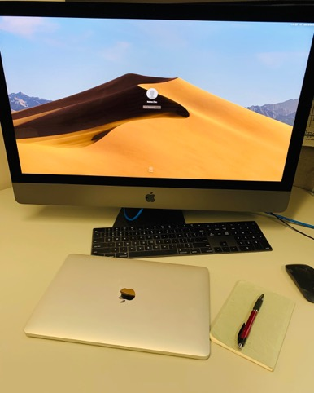
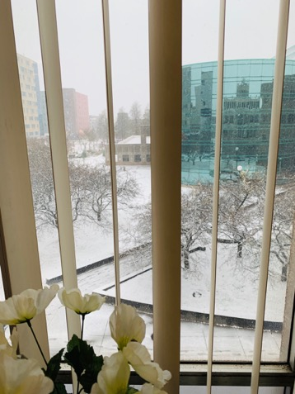
Writing Space #2: Meina Zhu
My office is my favorite place for writing during day time: perfect temperature, big screen, and great view.

Slide 42
Writing Tools: Meina Zhu
My collaborative tools are:
Google Drive
One Drive
Mendeley

Slide 43
Plans and Goals: Meina Zhu
Five year plans
One year plan
Two months plan
Weekly plan
Daily to do

Slide 44
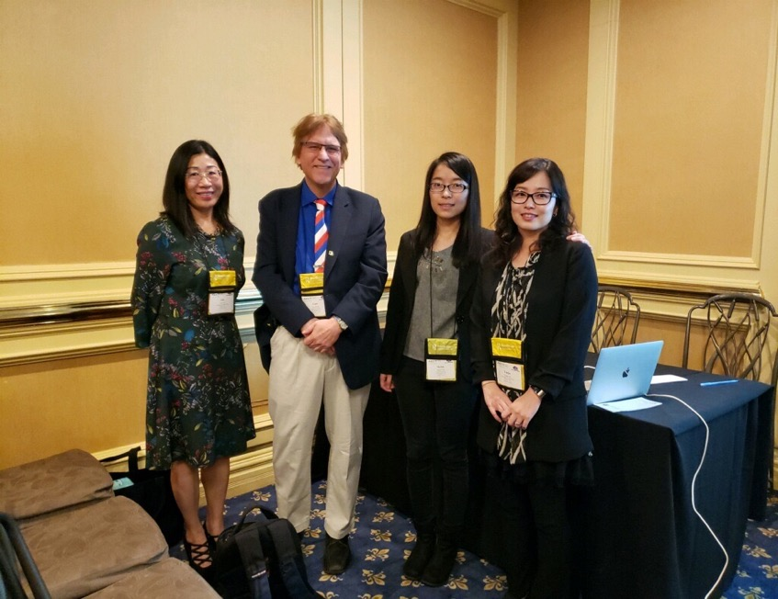
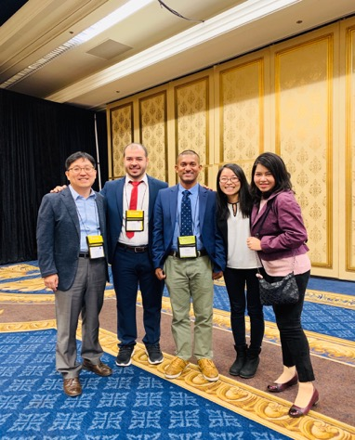
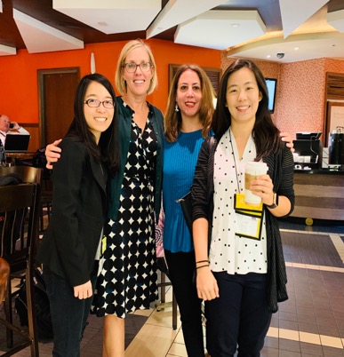
Writing Partners and Mentors: Meina Zhu

Slide 45
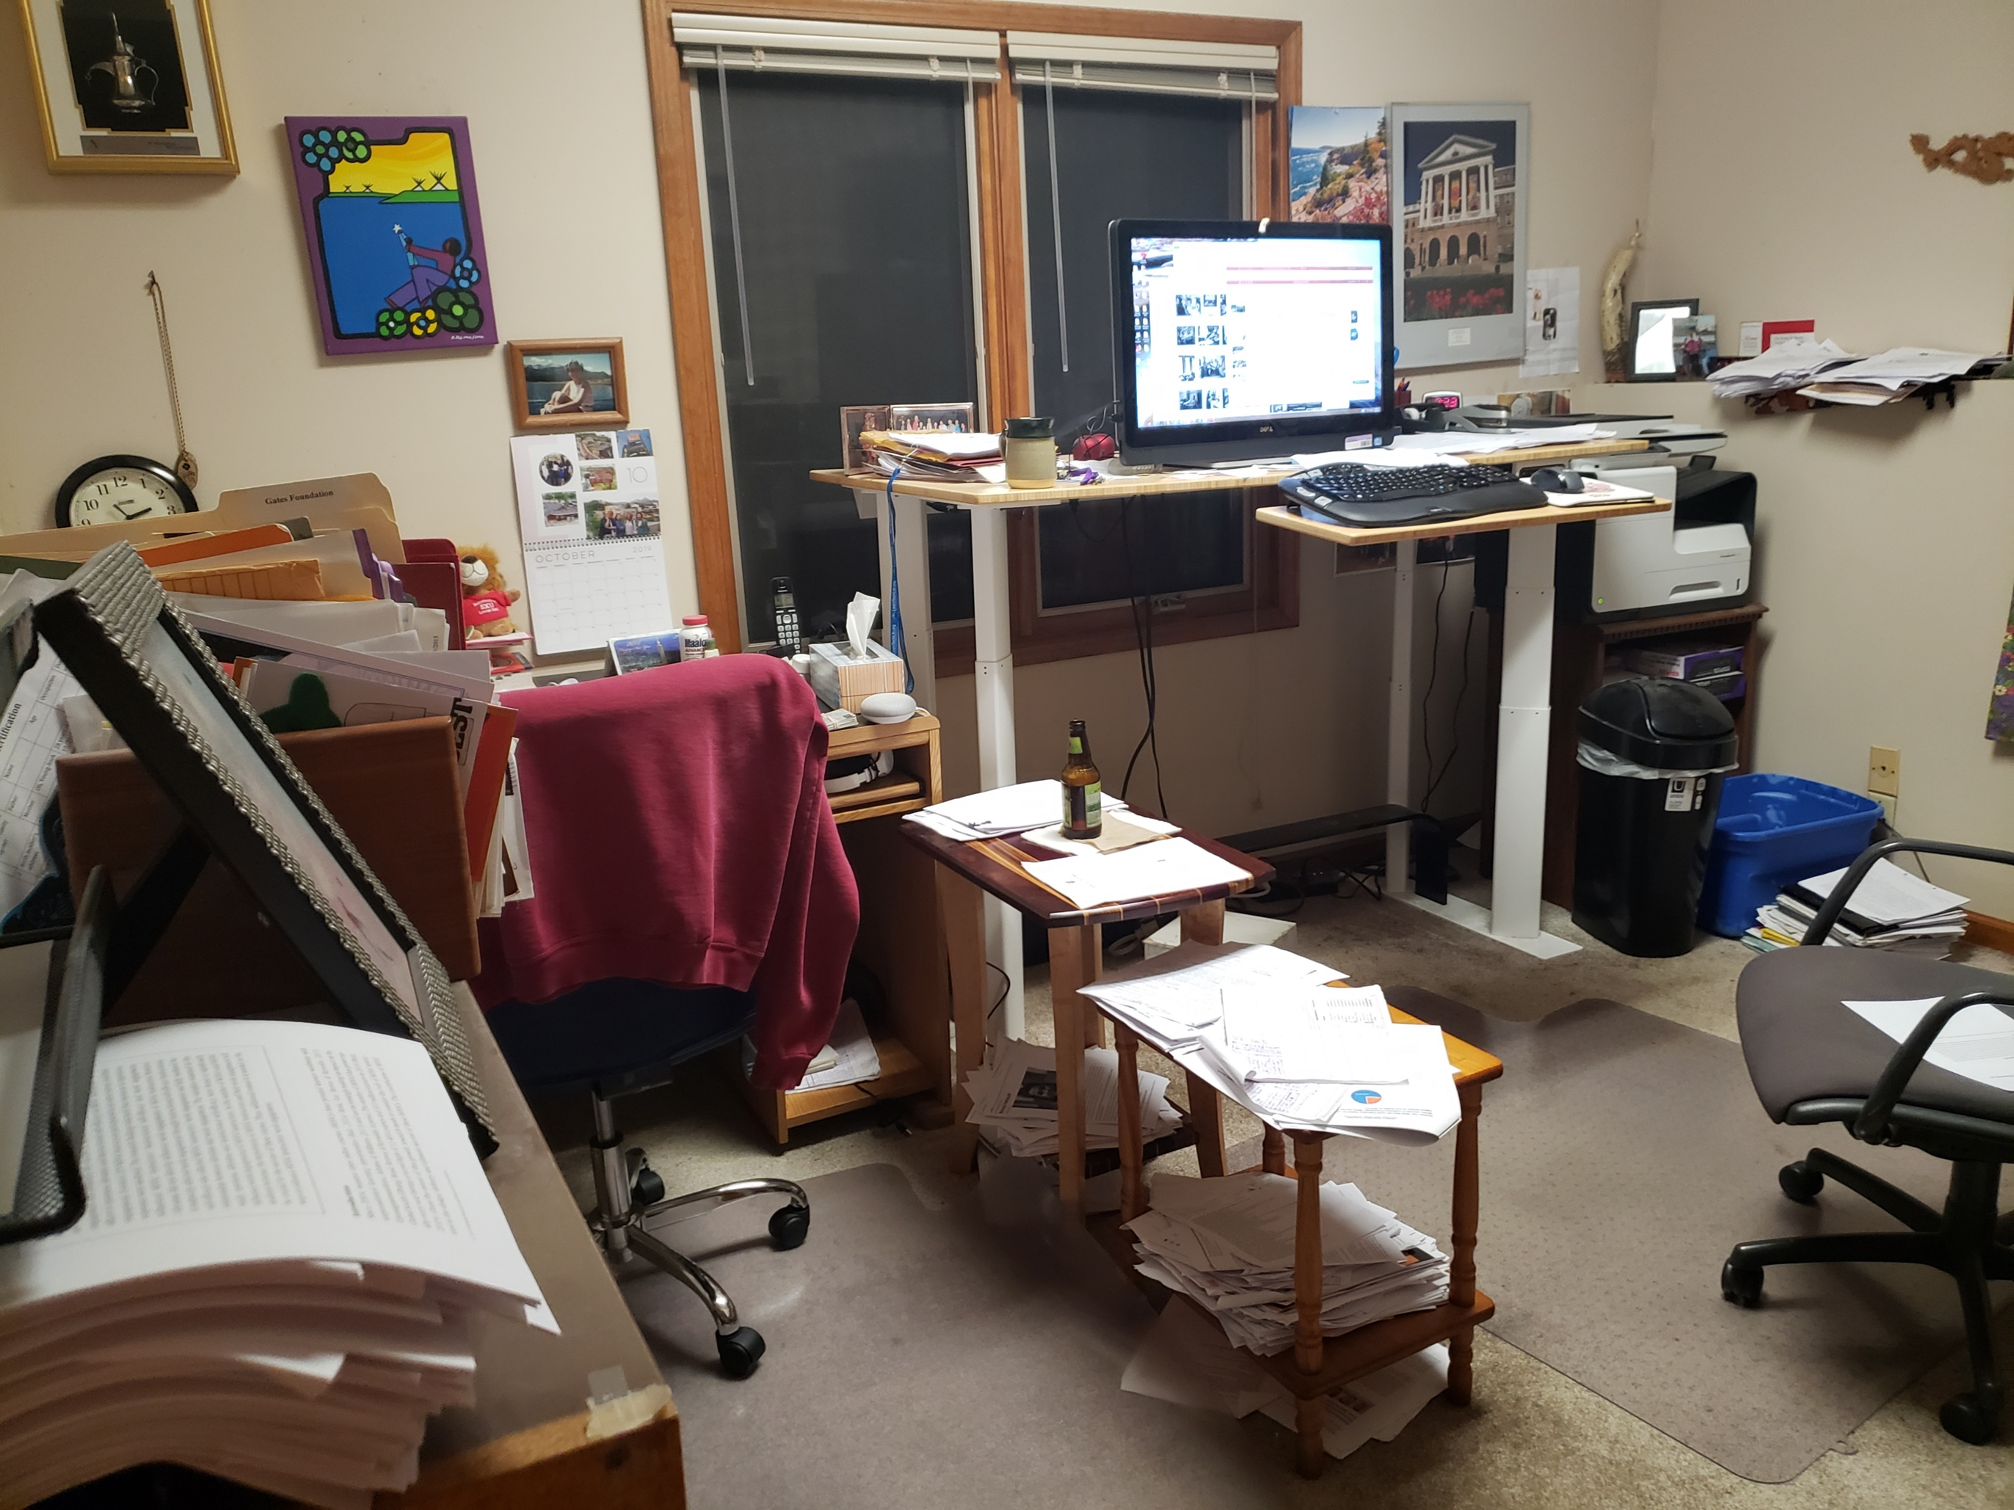
Writing Space: Curt Bonk
My office. I save interesting articles to later reference in papers and books.

Slide 46
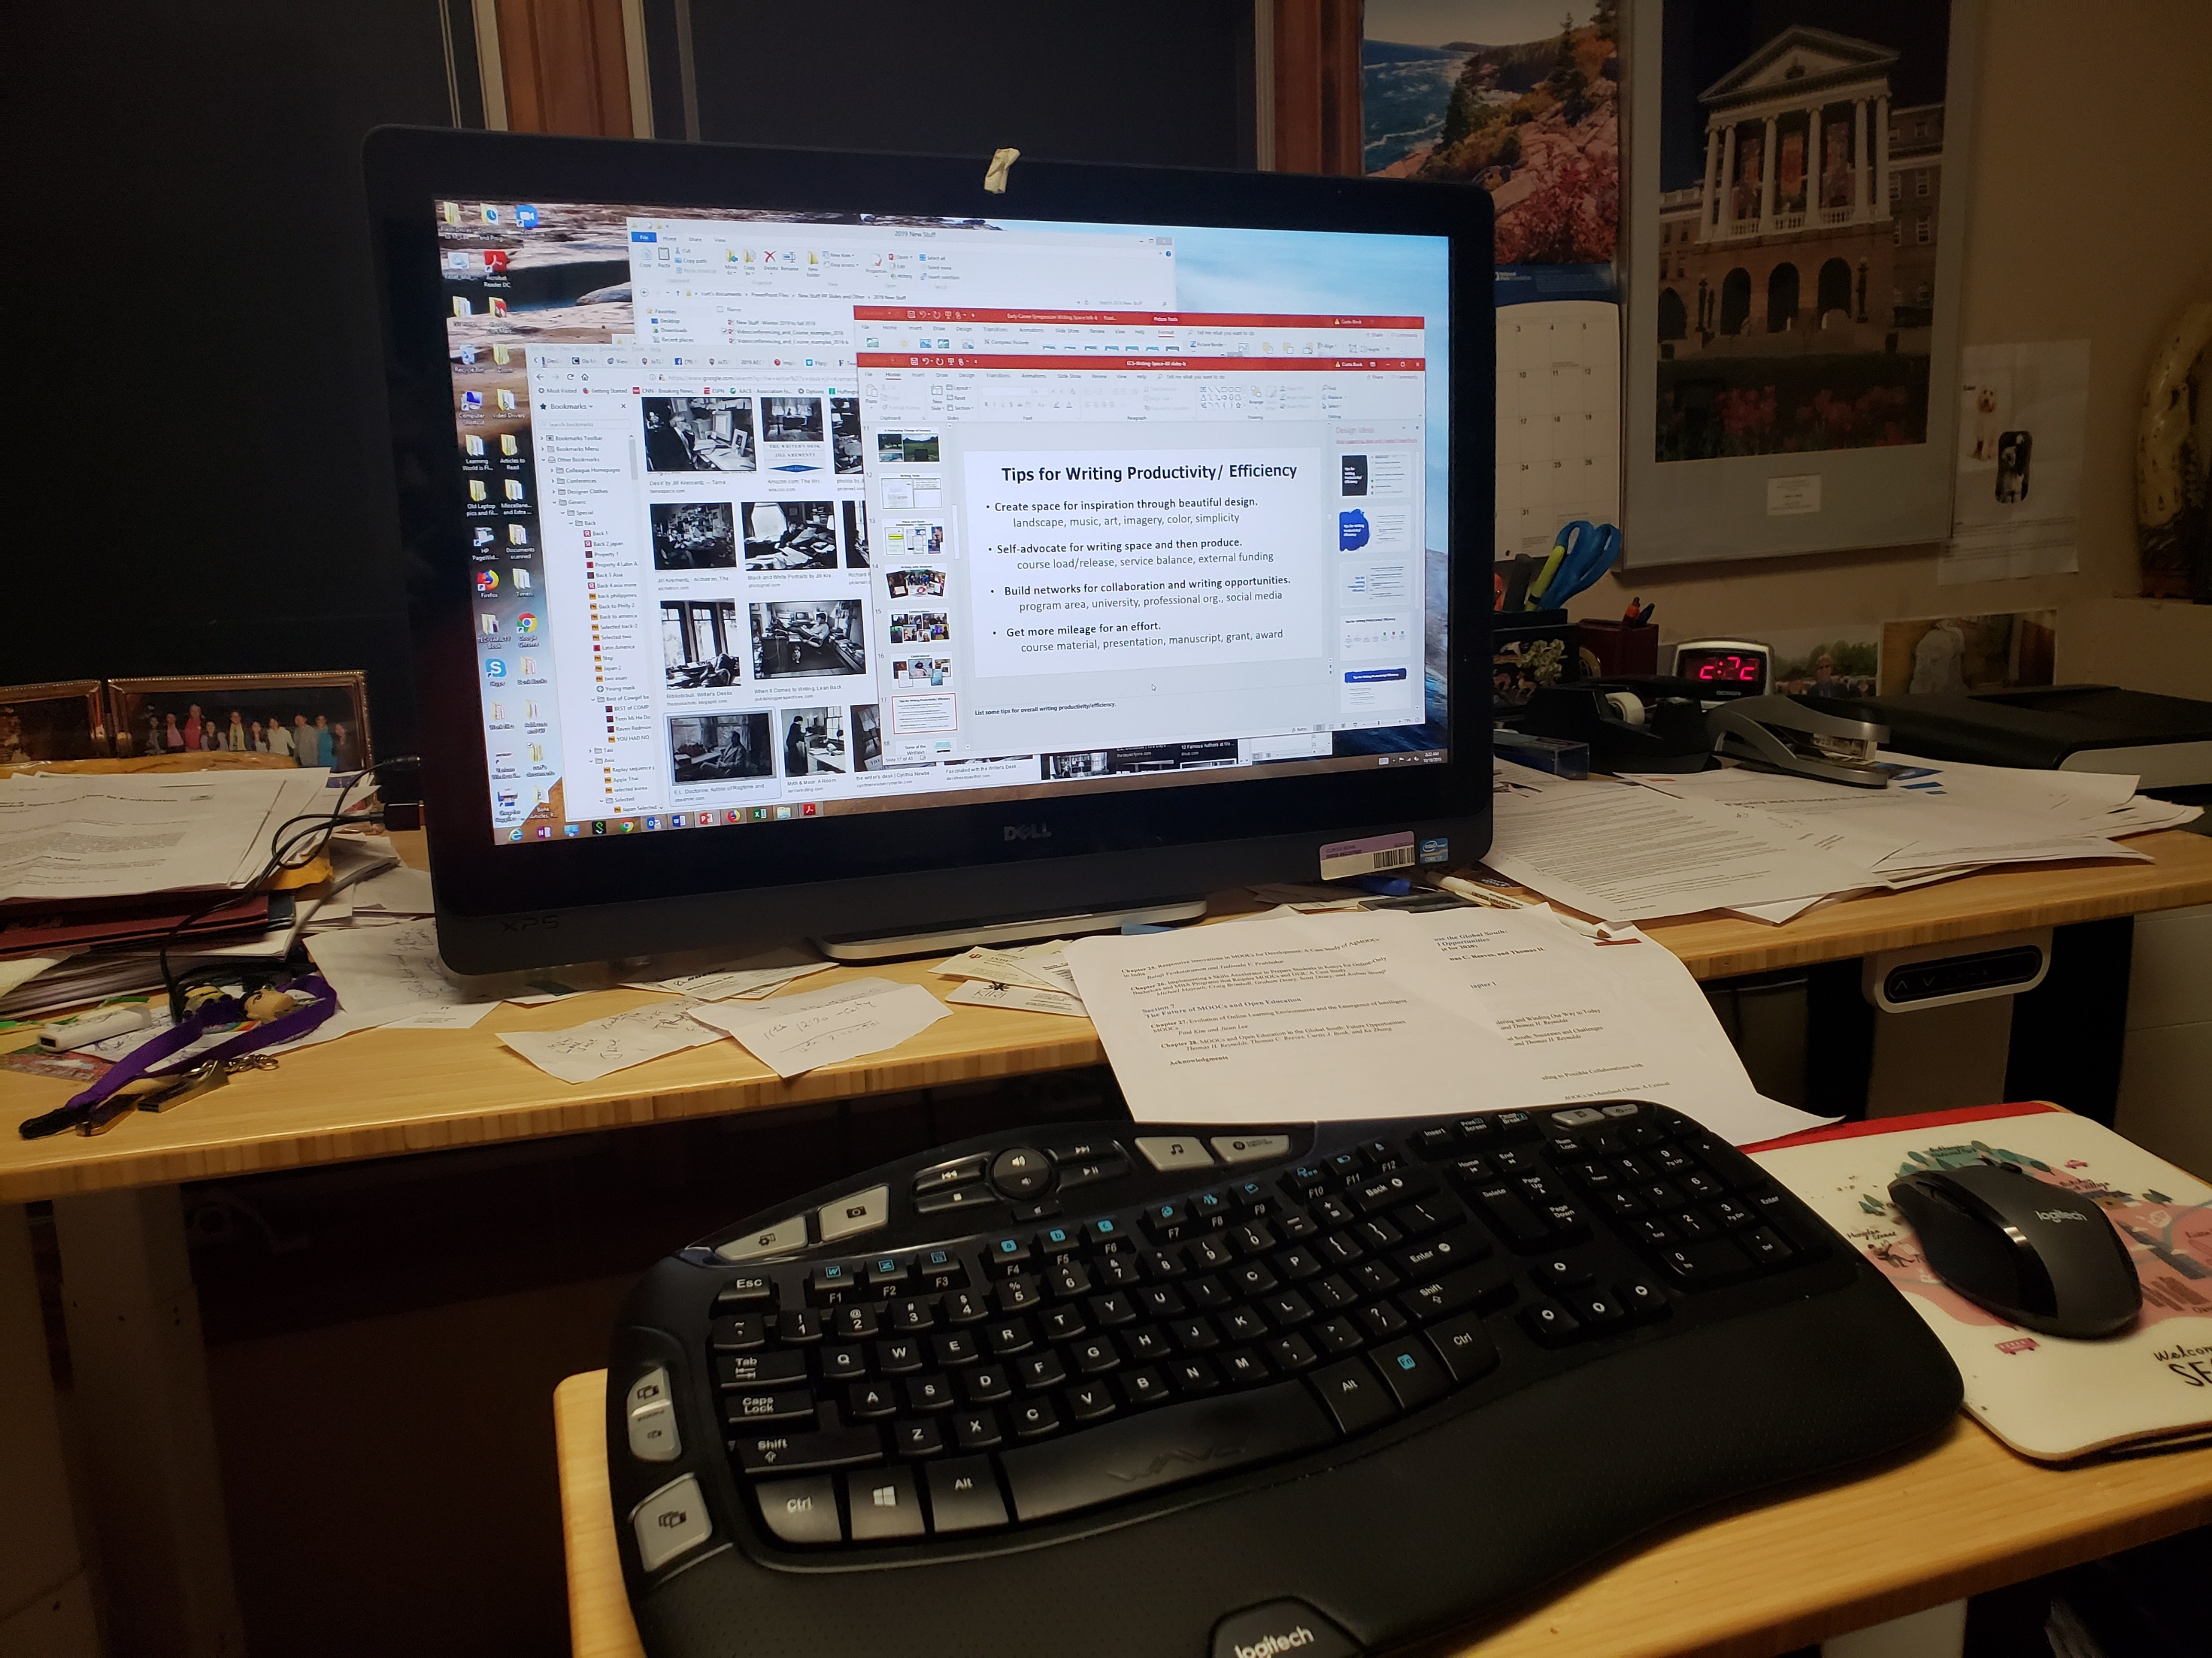
Writing Space Curt Bonk, Indiana University
I having standing desk…power it up and down via hydraulics. And my office looks out into a forest.

Slide 47
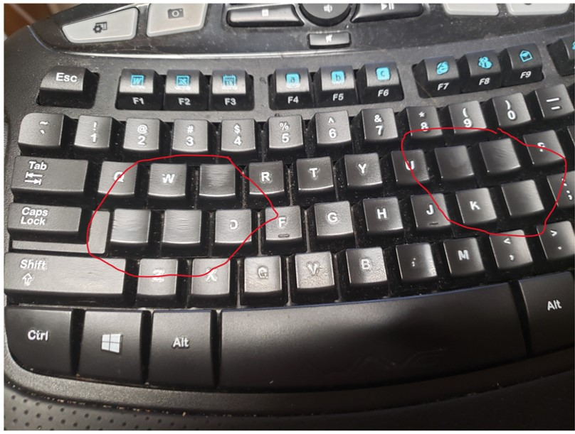
Writing Space
One of my biggest challenges is my tendency to burn through keyboards!

Slide 48
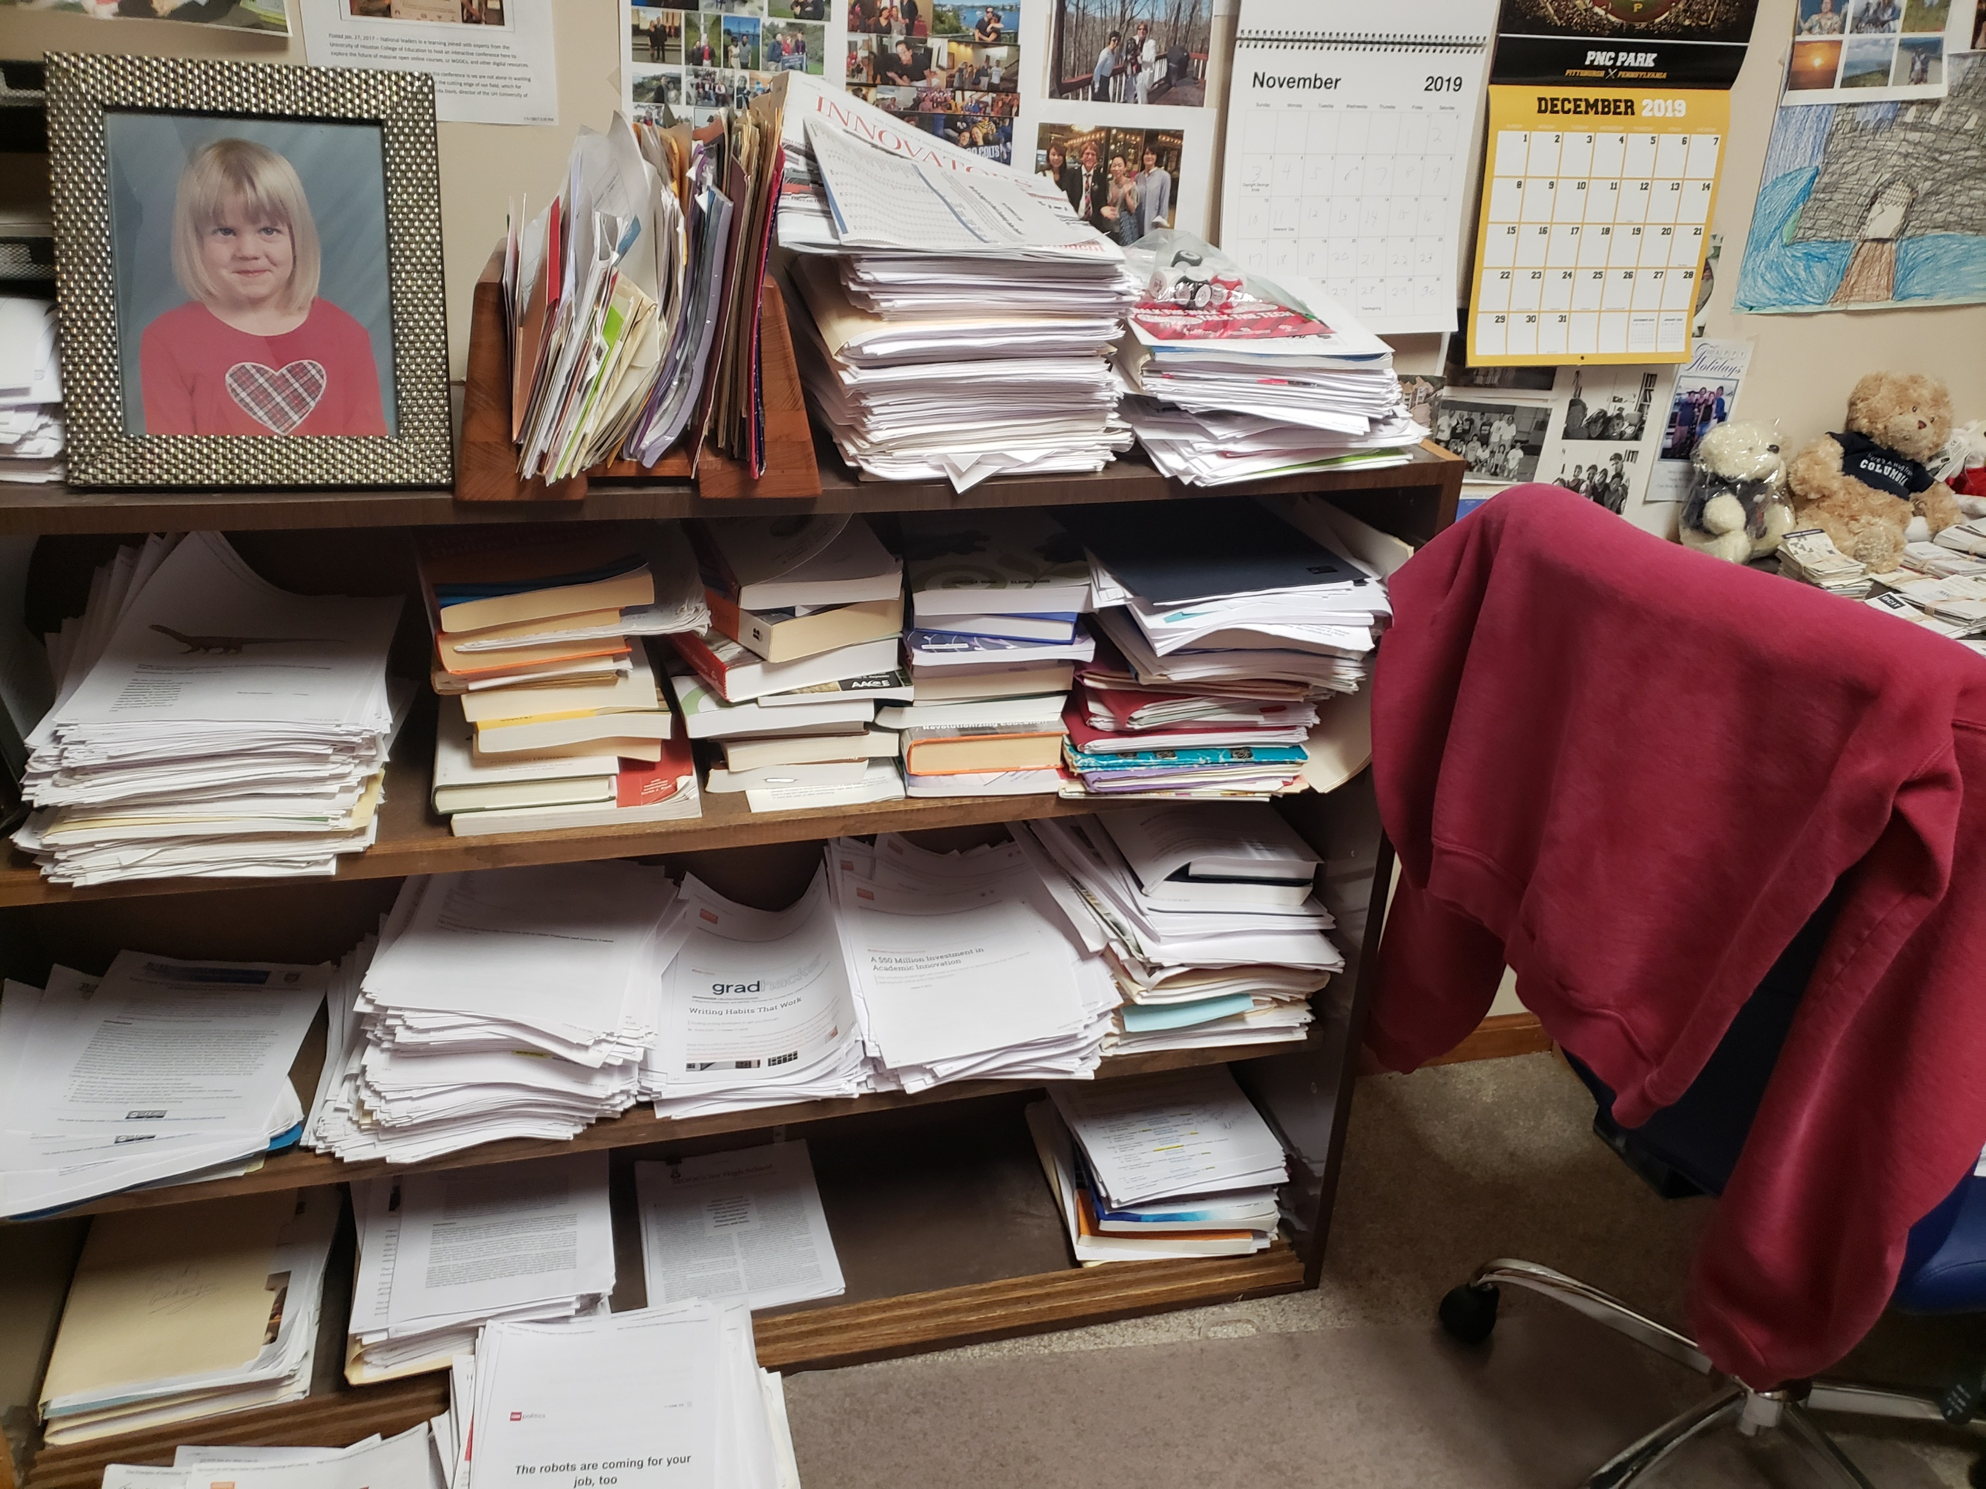
My Writing Space
Paper…I love paper….and my daughter Nicki.

Slide 49
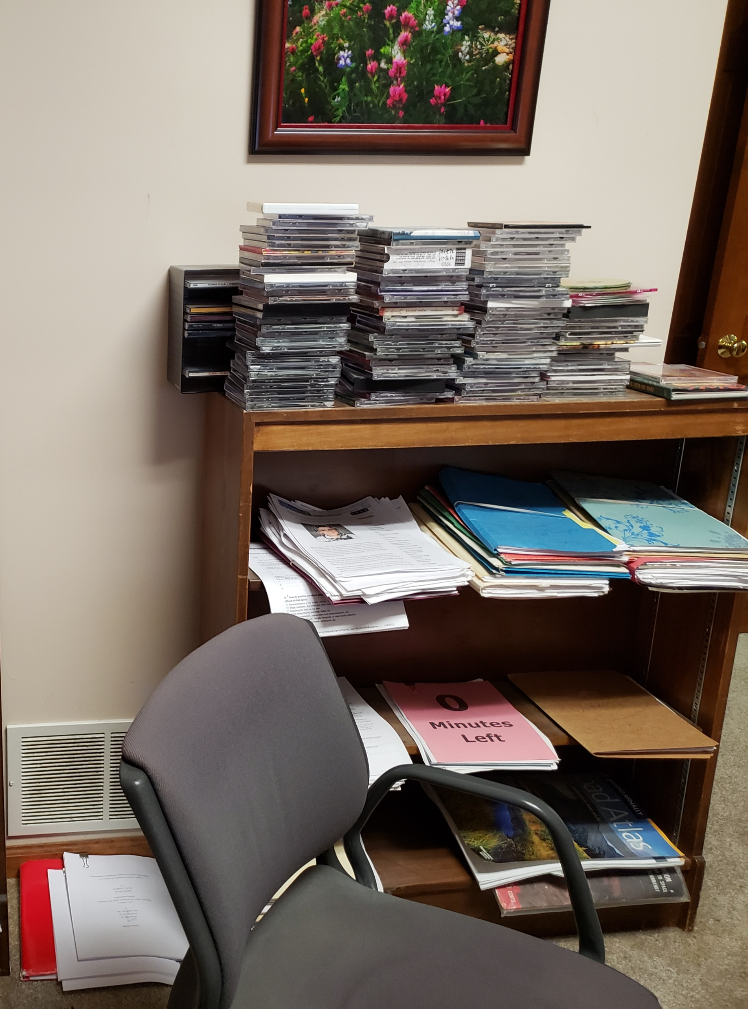
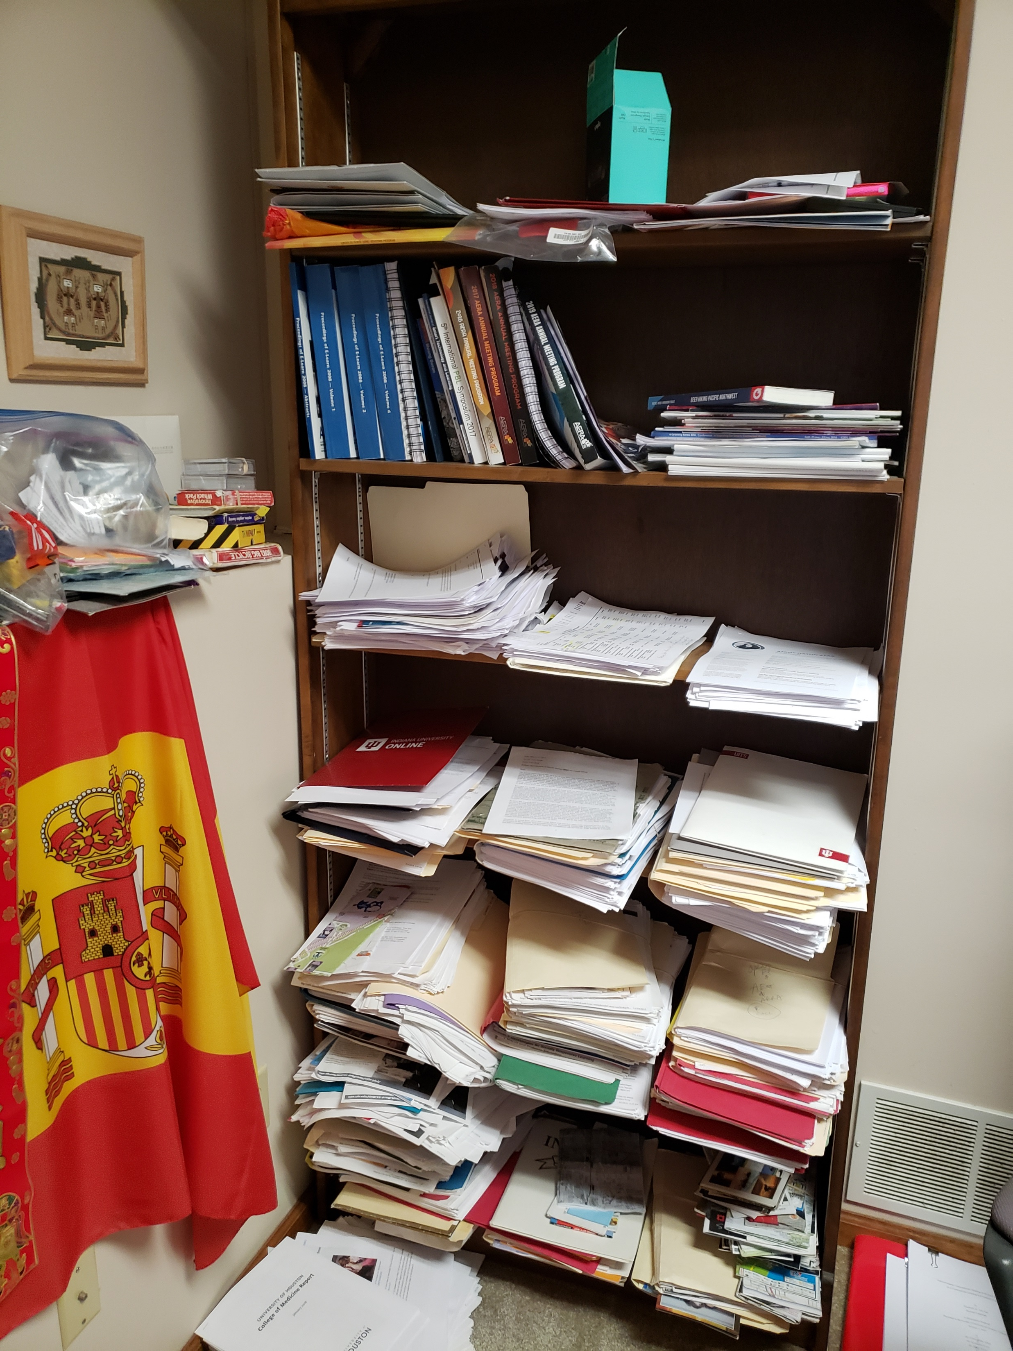
Writing Space: Curt Bonk

Slide 50
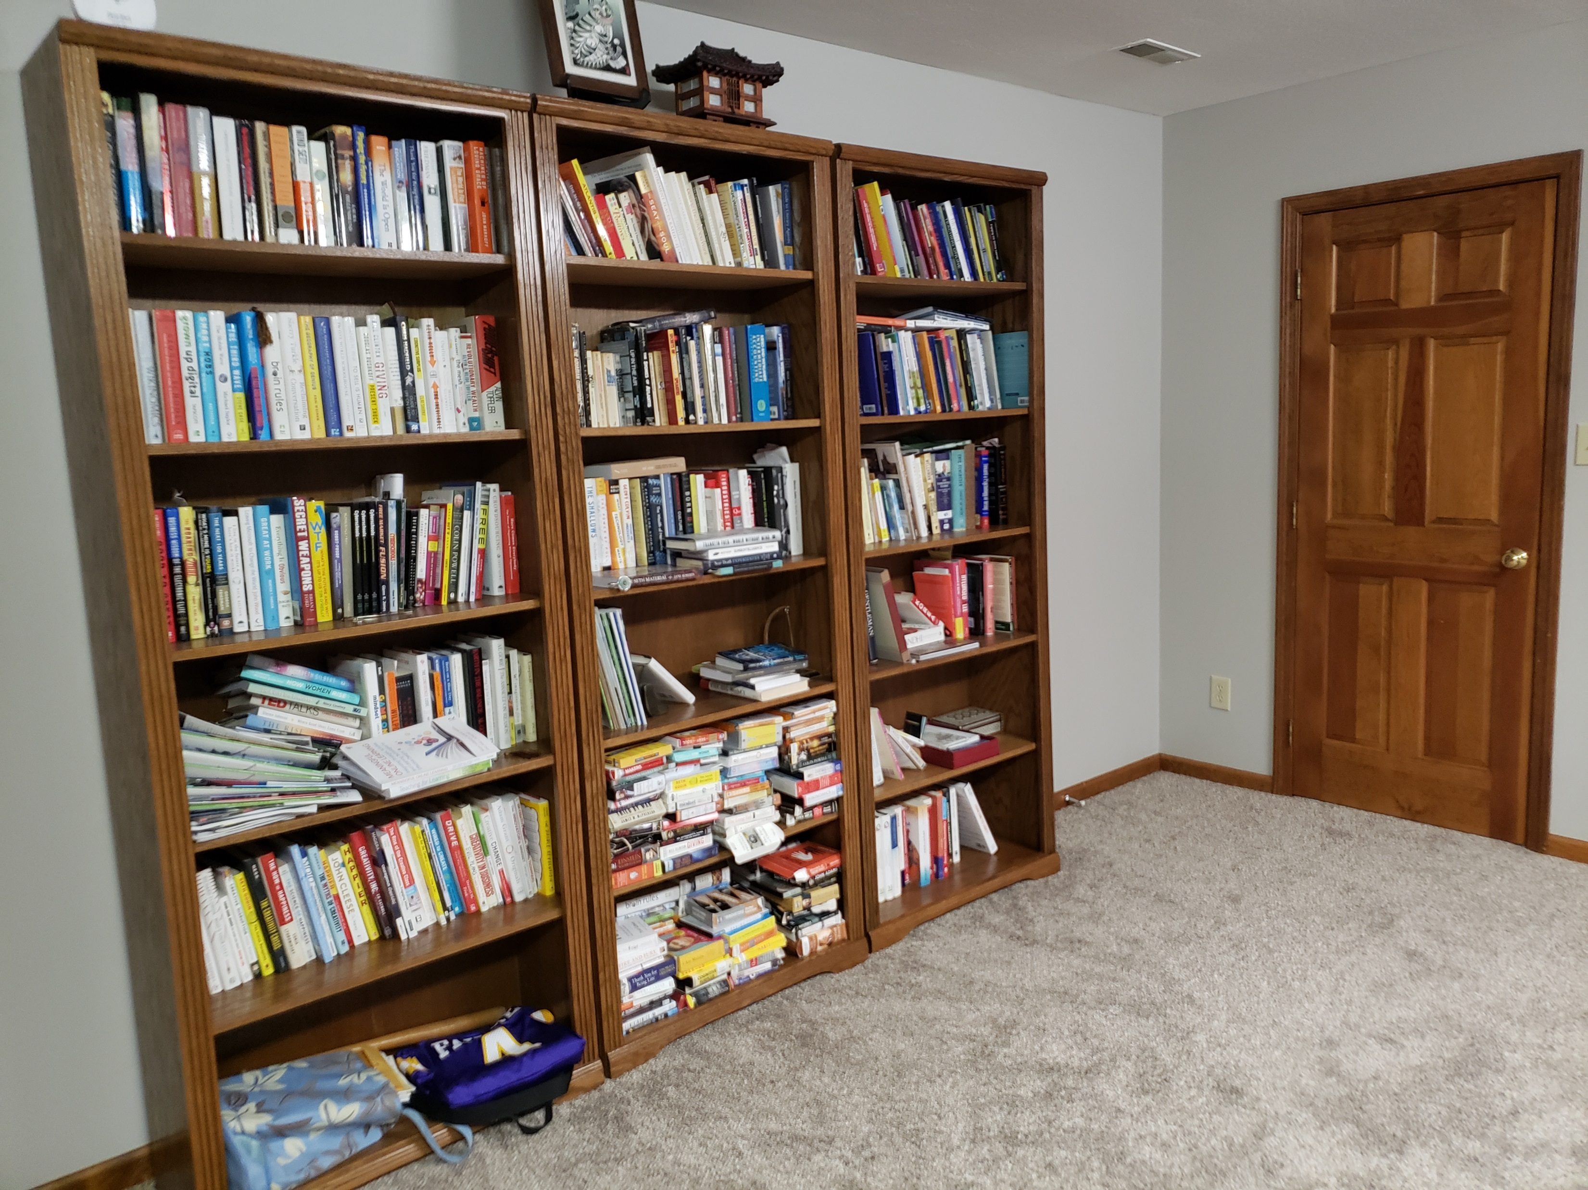
Writing Space: Curt Bonk

Slide 51
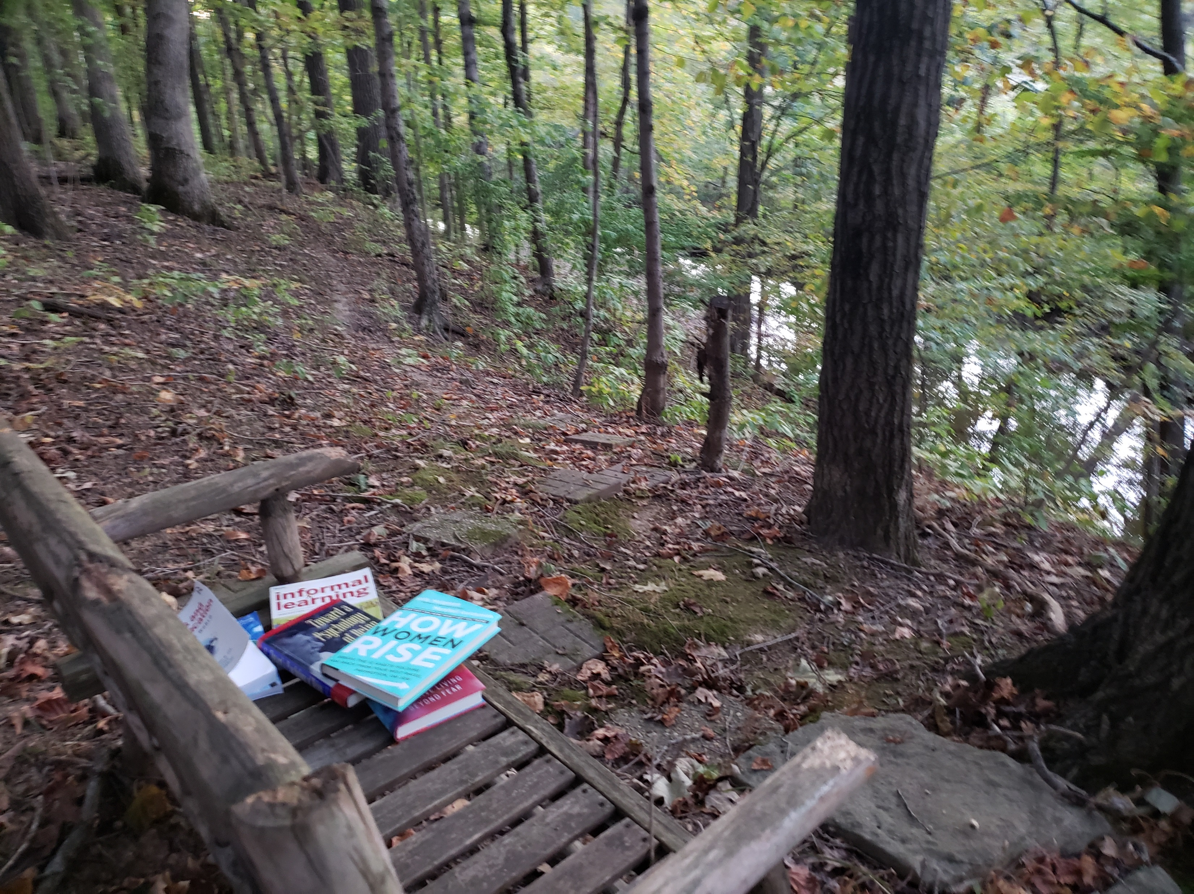
Writing Space: Curt Bonk

Slide 52
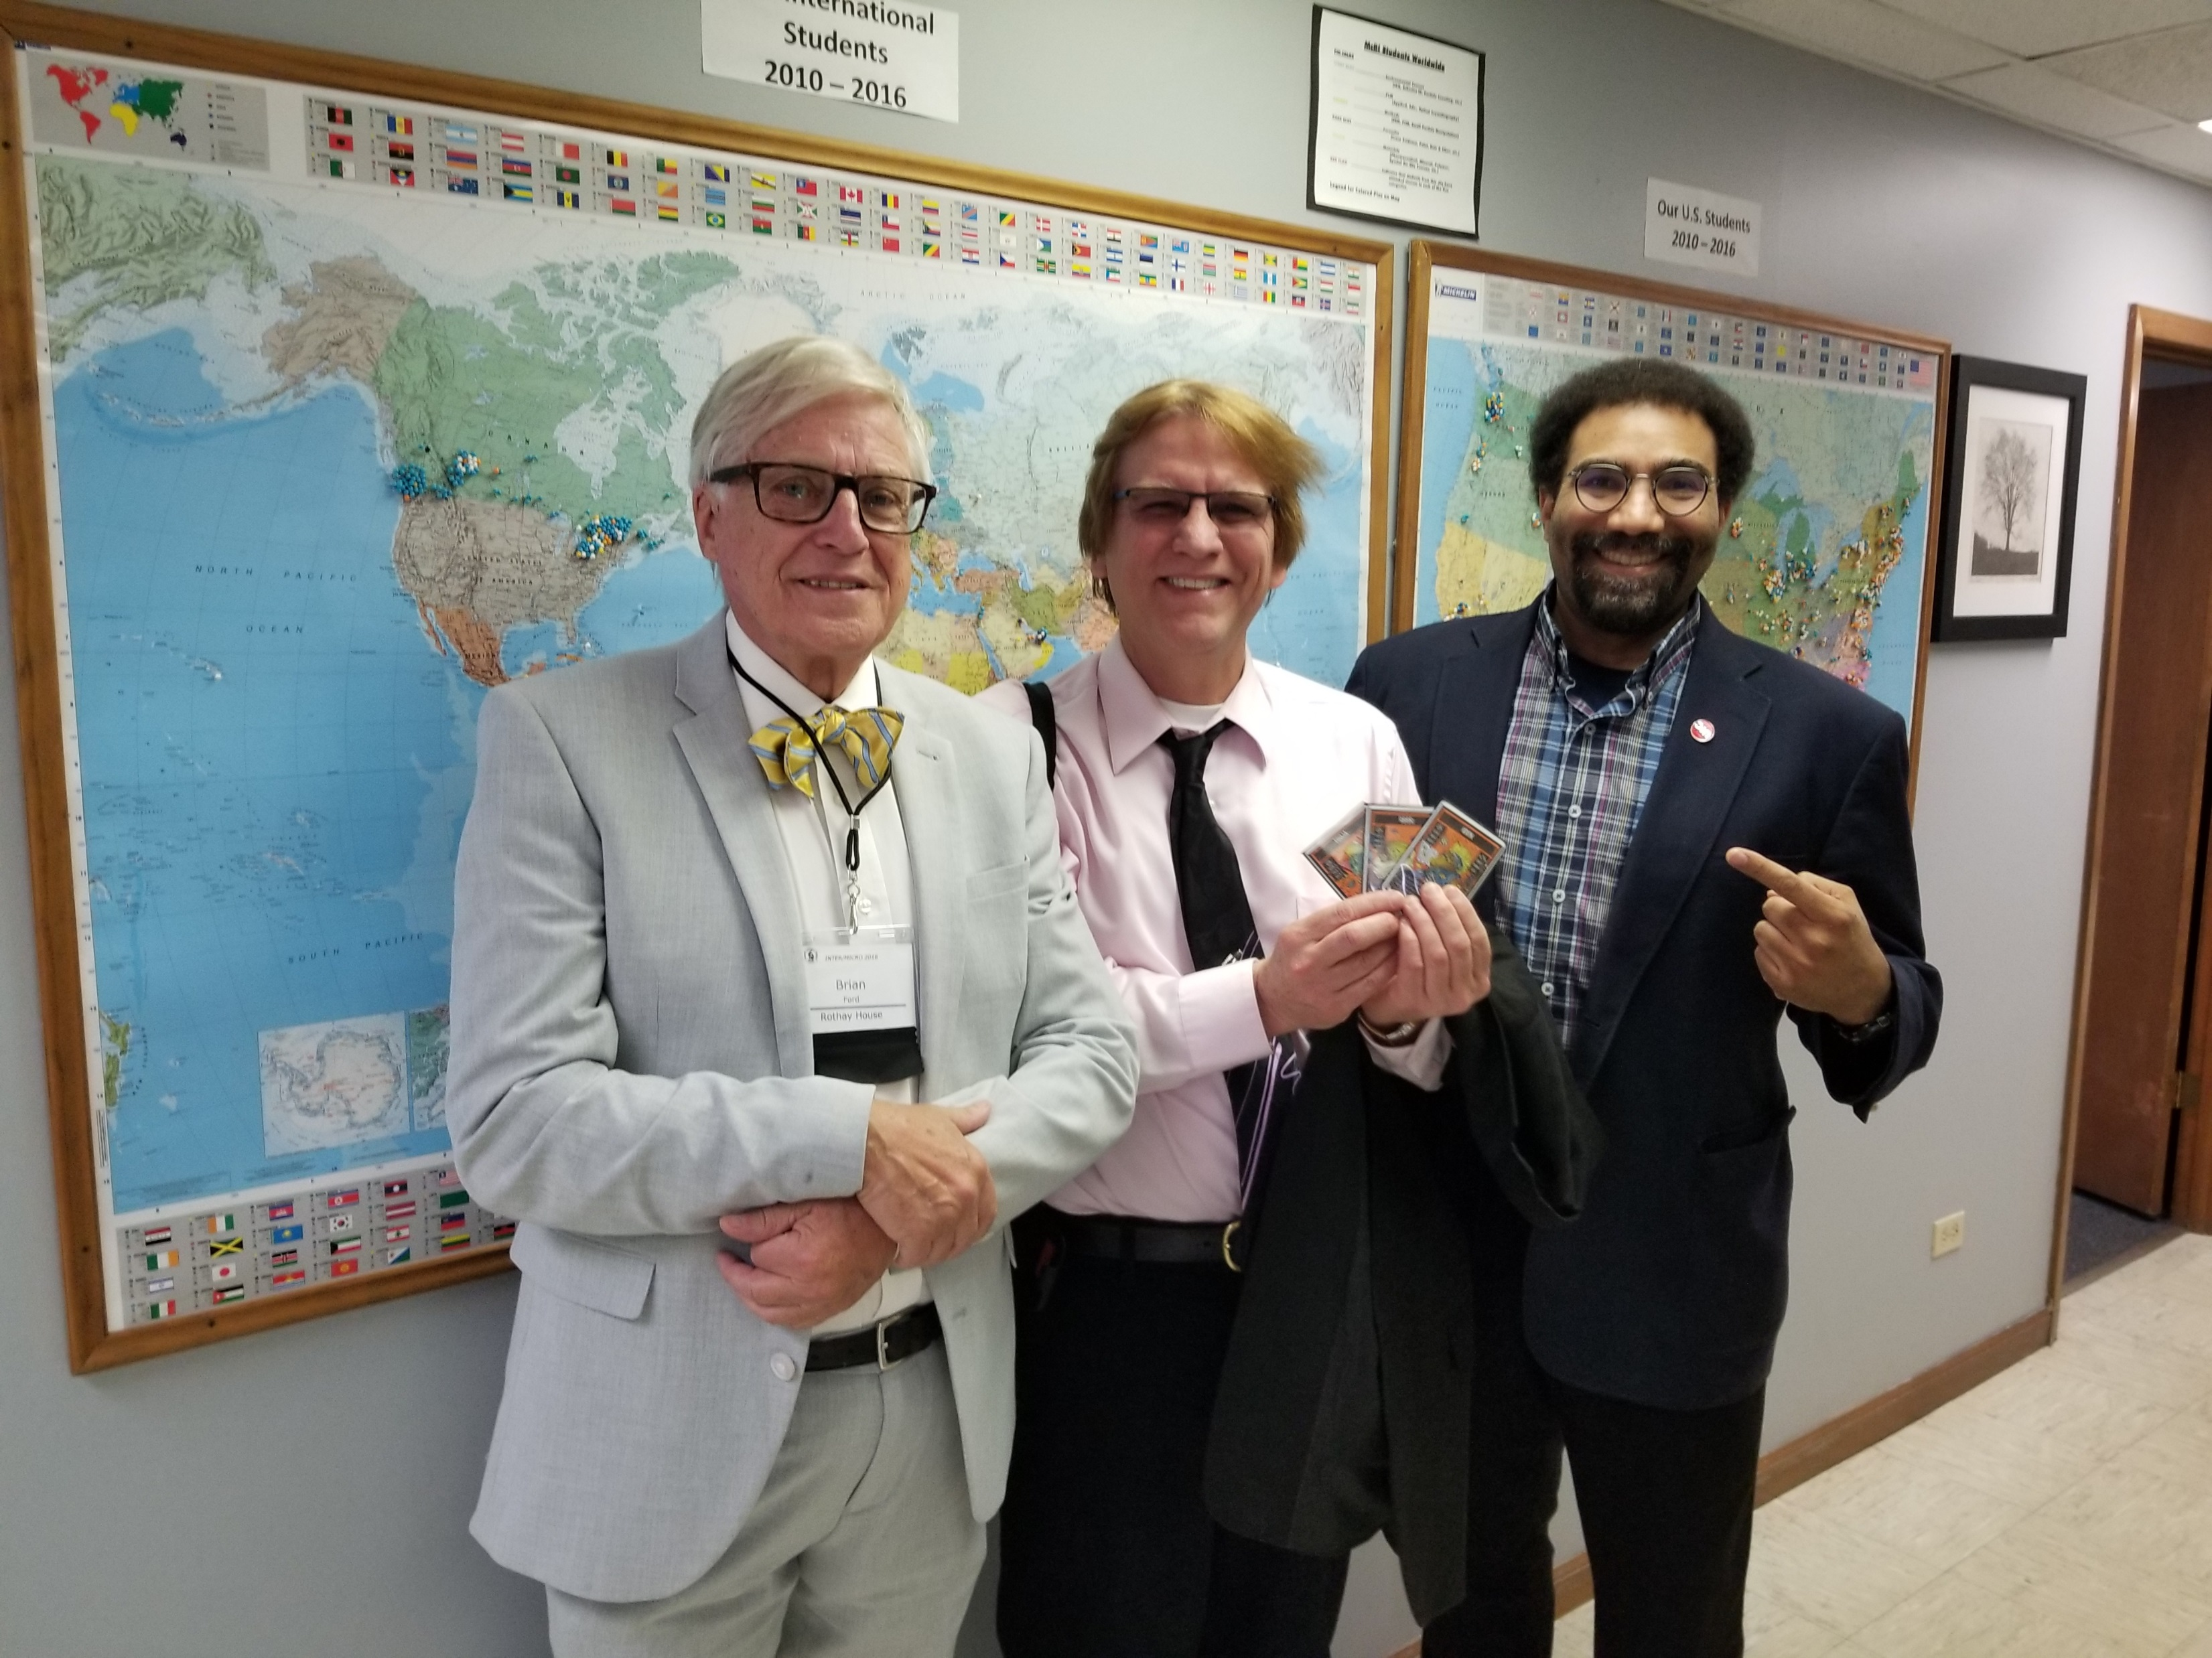
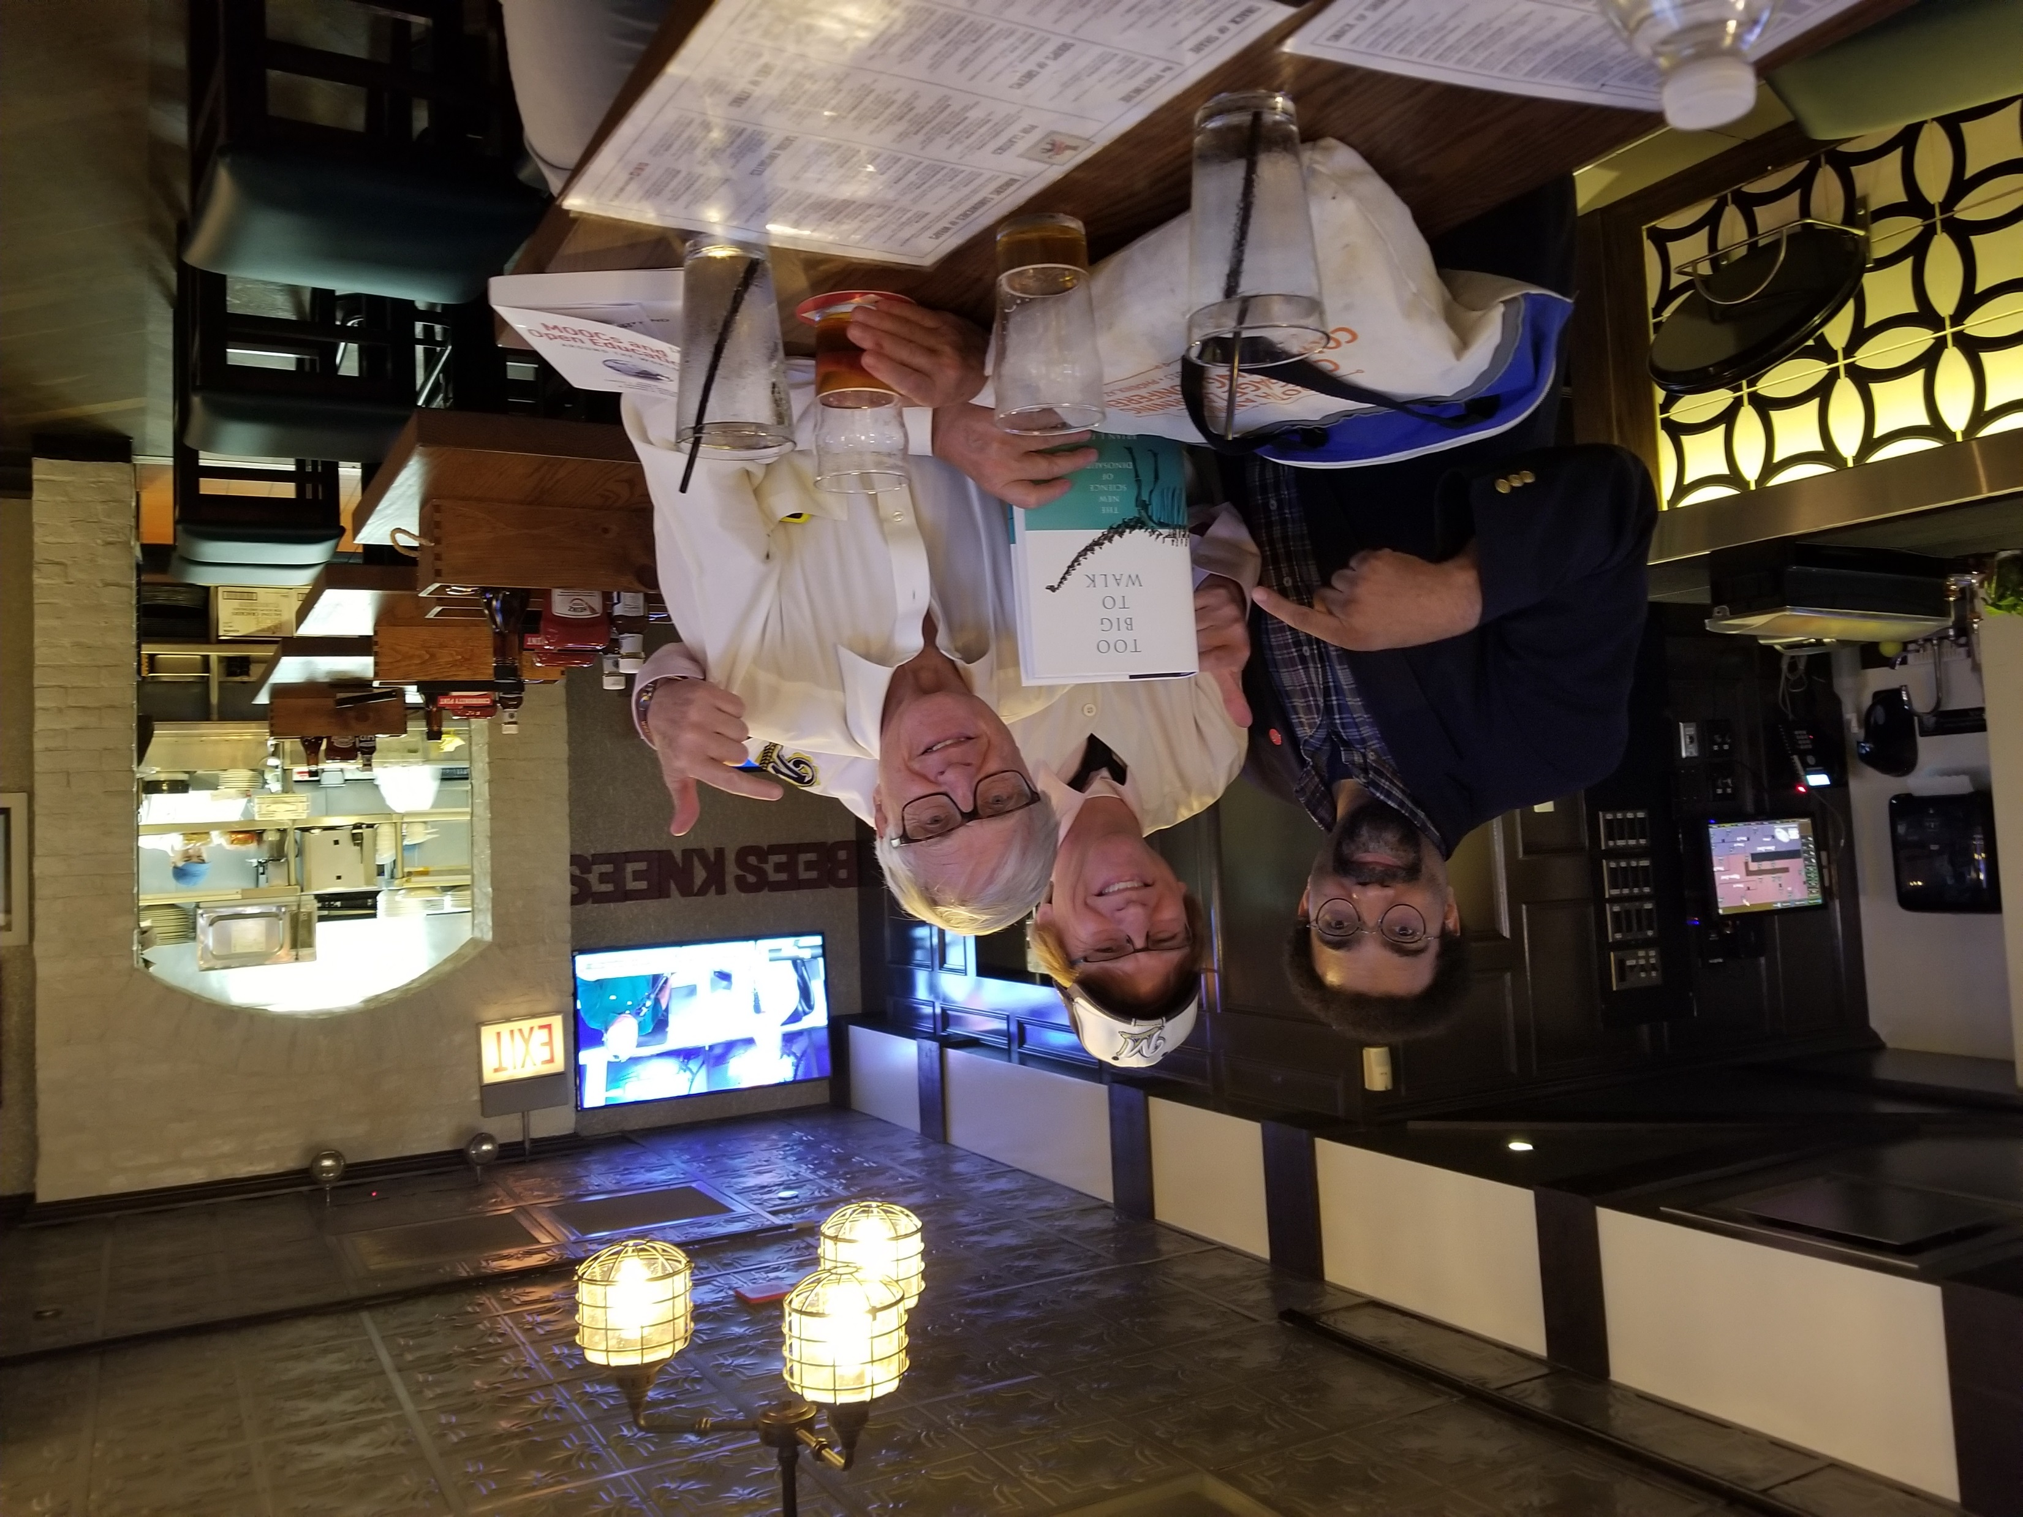
Choose Mentors and Colleagues Wisely

Slide 53
Plans and Goals: Curt Bonk How do you schedule your writing? How far in advance do you plan your writing? How do you prioritize your writing? How do you visualize your writing? Do you use a timeline or a planner? Do you have advice for developing a writing plan?
Plan: I save days for writing in my paper planner.
Focus: I say no to things that don’t fit my writing plans.
Track: I note projects in process and completed in my daily Dalia Lama quote of the day.
Monitor: I look at articles I have in review, in revision, and in press in my CV all the time.
Be Responsive: I respond to co-writer requests.
Goals: Put writing plans in annual report.

Slide 54
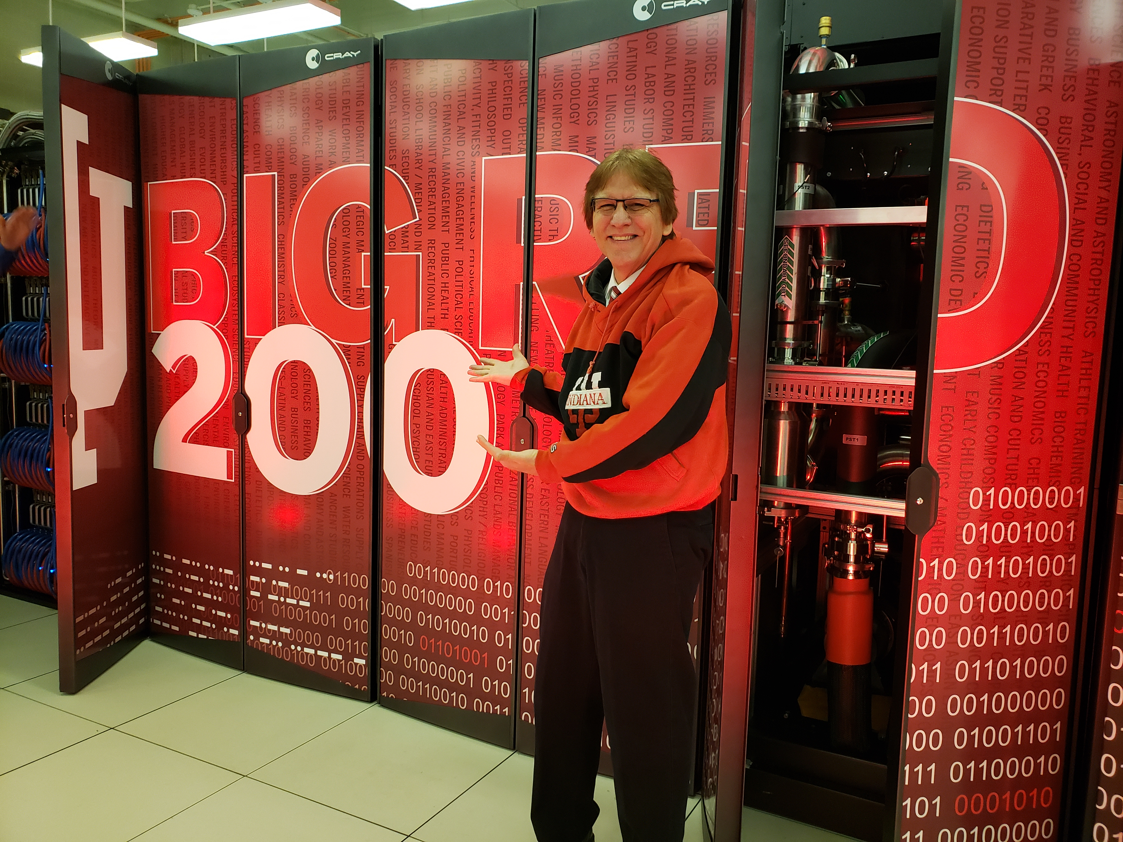
Writing Tips: Curt Bonk Anything special that you do?
My top 10 key writing tips:
Create a “Work” file on your desktop.
Save screen shots, dates, and URLs of articles.
Create “Articles to read” folder on your desktop.
Listen to audiobooks for writing ideas.
Watch movies & look for educational issues and ideas.
Always save documents at least twice.
Send draft of document to yourself on email…restart anywhere.
Ask friends to read second or third draft.
Save articles published by year.
Keep drafts of articles in special files.

Slide 55
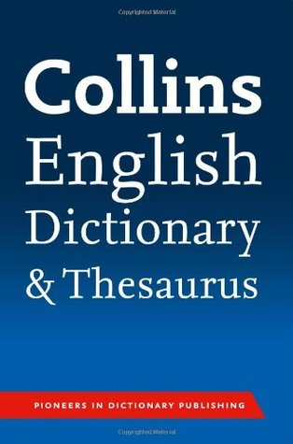
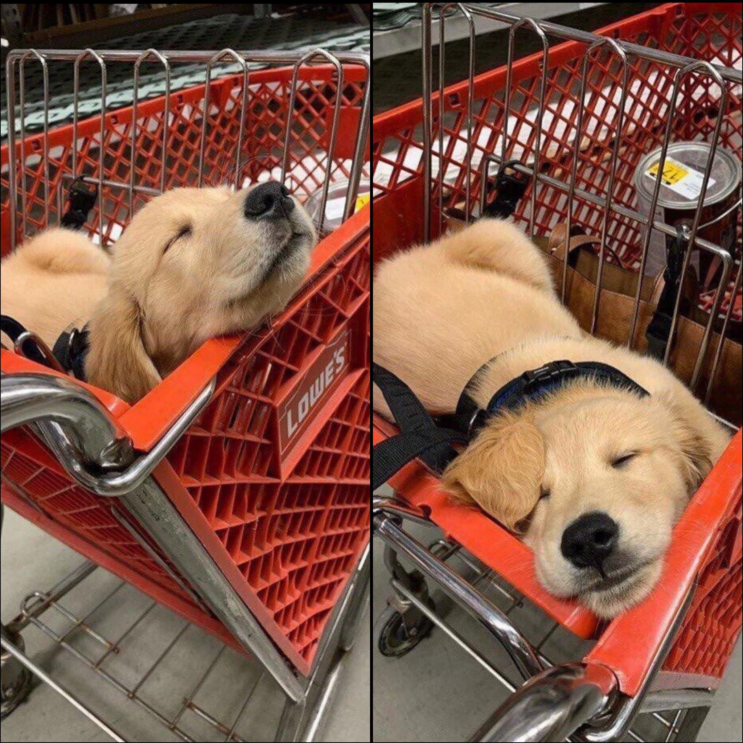
10 More Writing Tips: Curt Bonk Anything special that you do?
My top 20 key writing tips:
11. The Collins thesaurus.
12. Look for historical info online (e.g., Wikipedia and other).
13. Relocate to another room to edit document (i.e., kitchen table).
14. Sometimes sit. Sometimes stand.
15. Print out articles that you read parts of online.
16. Review paper piles on my pool table before you write.
17. Find info and URLs in previous talk slides.
18. Almost be more optimistic than pessimistic.
19. Work when your friends and family are sleeping.
20. Wherever you are is your writing space.

Slide 56
Writing Tools: Curt Bonk What particular writing tools do you use? How have they changed over time? What about tools for collaboration?
My top 10 key writing tools:
Keyboard—buy special letter keys
Microsoft Word
Google Search (I hate Bing)
Email. And forward email to self.
TravelinEdMan blog
Dropbox
Zoom (or Skype for team meetings)
Blue pens and lots of paper
My monster syllabus (R678)
FutureMe: Write a letter to yourself in the future: https://www.futureme.org/

Slide 57
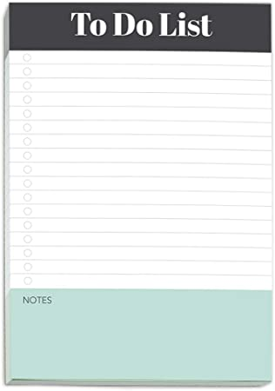
Habits/Rituals/Inspiration: Writing How do approach your writing tasks? Any rituals that you use and recommend for inspiration? Anything that really works for you?
Save writing ideas on slips of paper and look back at them.
Talk about your ideas.
Save starter text.
Clear email and to-do list.
Create checklist of plans.

Slide 58
Finding a Journal that Fits
What to look for?
Who will be your target readers?
Who are the authors and journals you cite the most related with your research program?
Is there a match between your work and the journal aims and scope?
What is the journal turnaround time?
What is the journal acceptance rate?
Do you know the editor(s)?
Notes:
Ana
https://www.editage.com/insights/how-to-choose-journals-for-submitting-your-paper
Who will be your target readers? Scholarly vs. non-scholarly periodicals
readership and target audience
Look for a match between your work and the journal aims and scope. – journal analysis
What is the journal’s turnaround time?
Acceptance rates? Get familiar with the journals’ acceptance rates
58

Slide 59
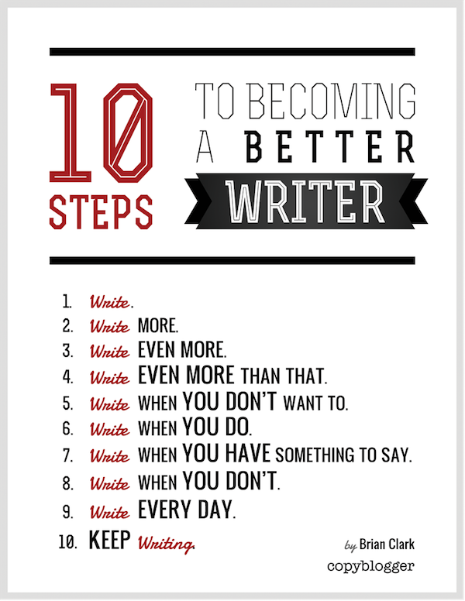
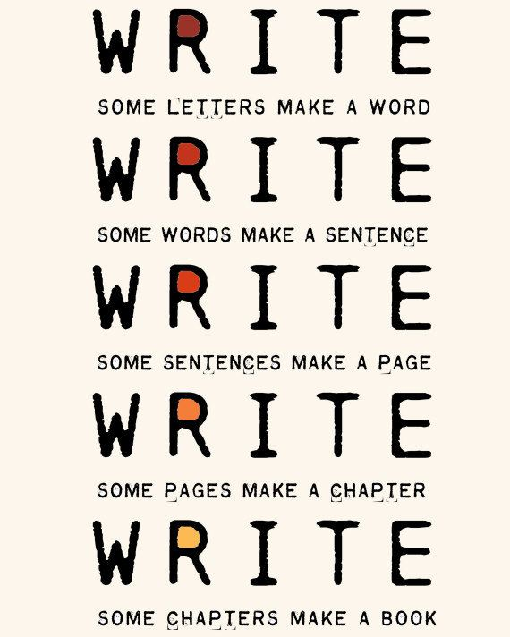
The Top 15 Writing Tips
Notes:
Curt
59

Slide 60
1. Mark Writing Days in Planner
Notes:
Curt
60

Slide 61
2. Maintain a List and Network of Potential Research and Writing Collaborators
Notes:
Curt
61

Slide 62
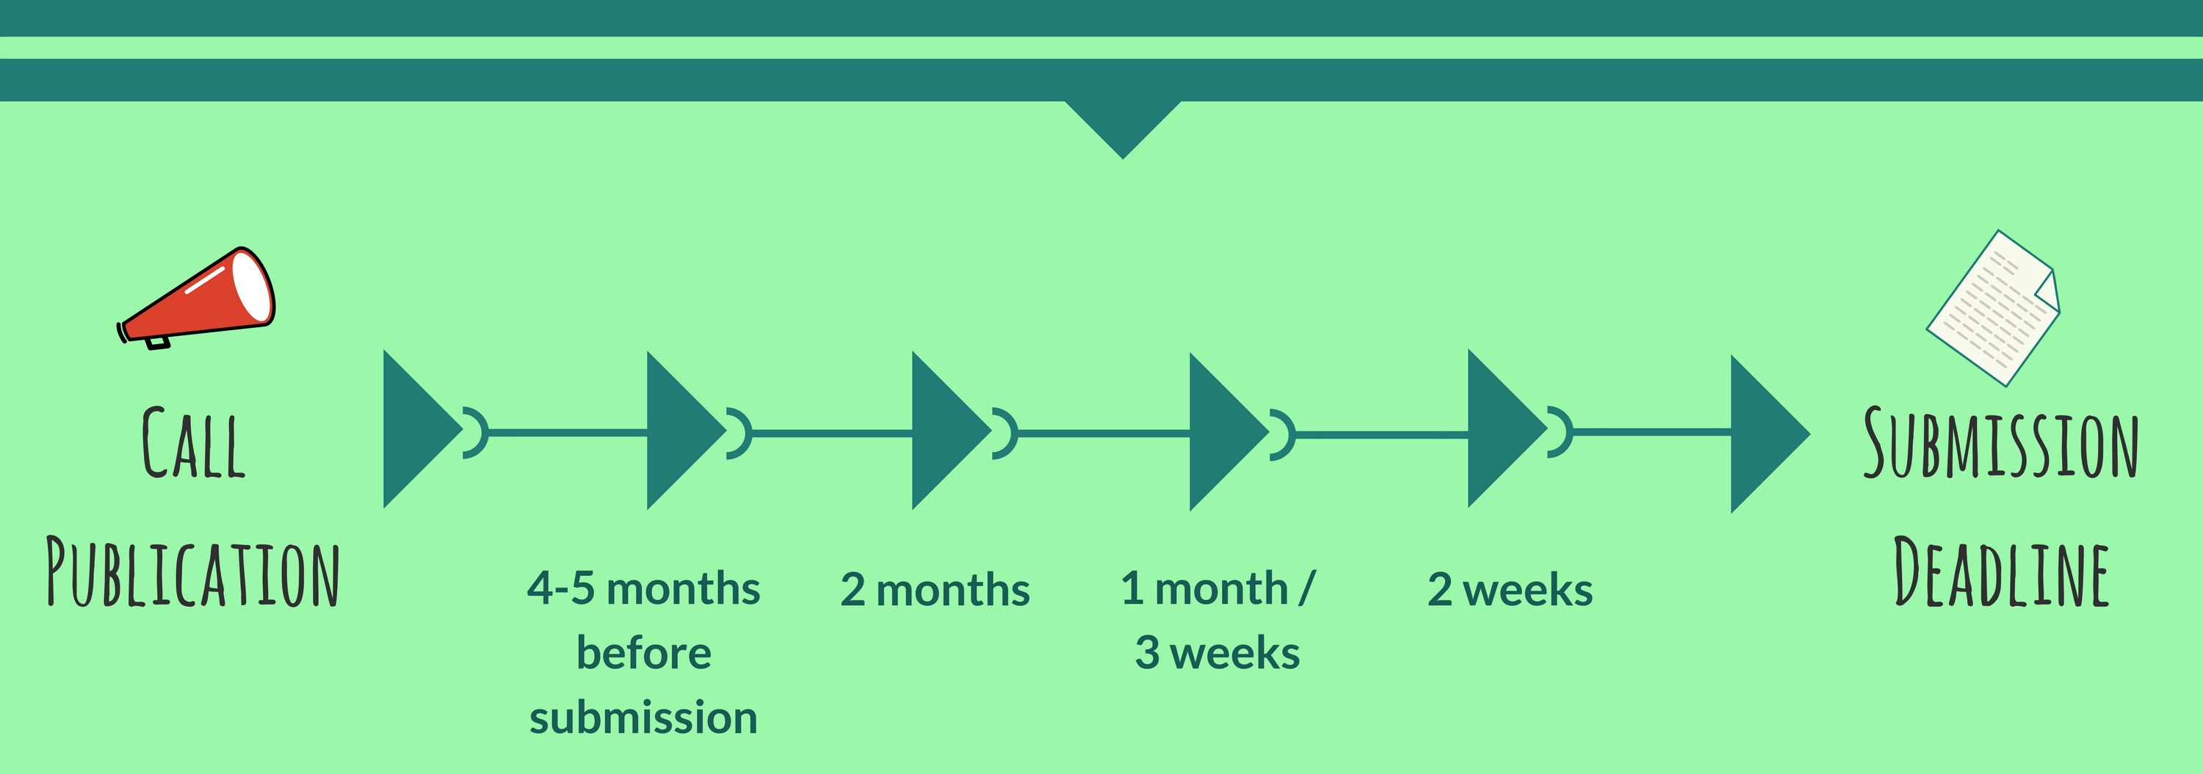
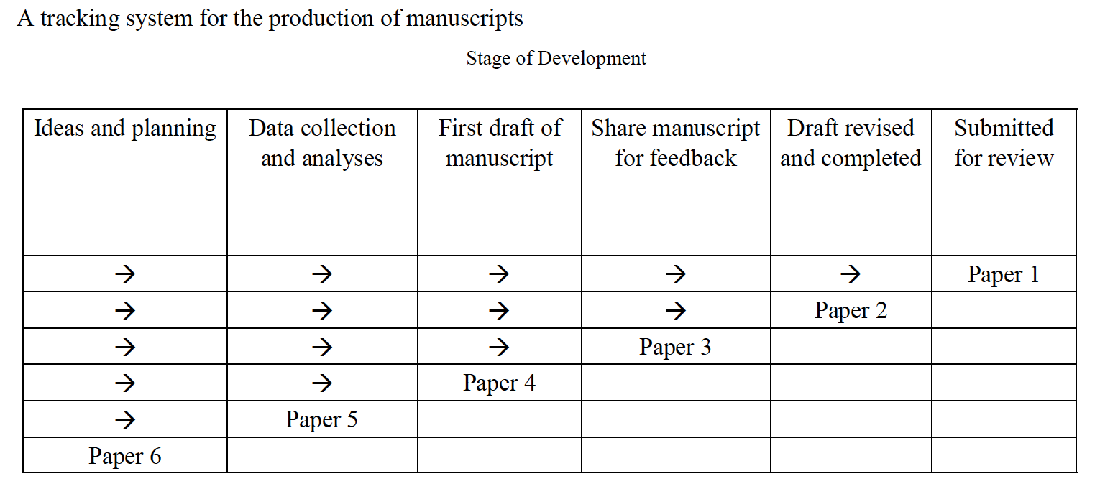
3. Draft a Timeline or Multiple Timelines with Flexible Goals
Notes:
Curt
Screenshot from Cecil’s article
62

Slide 63
4. Think Ahead About the Publishing Potential of Each Project
Notes:
Curt
63

Slide 64
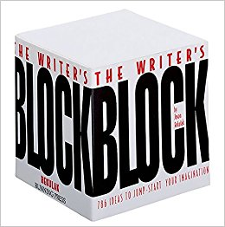
5. Find, Save, and Use Starter Text (overcomes writer’s block)
Notes:
Curt
64

Slide 65
6. Always Scan the Reference Sections of Other Articles to See What Journals are Popular
Notes:
Curt
65

Slide 66
7. Avoid High Quality (i.e., SSCI) Journal Fixations
Notes:
Curt
66

Slide 67
8. Be Second or Third Author Sometimes to Spread Limited Resources
Notes:
Curt
67

Slide 68
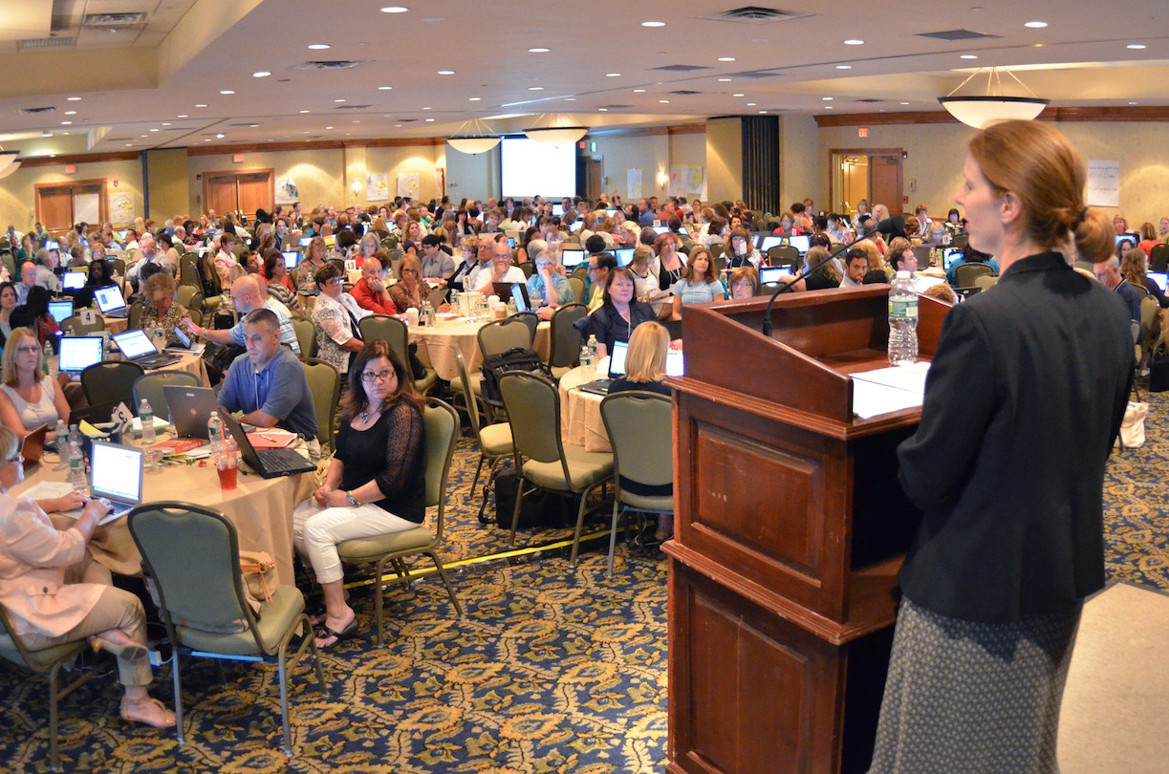
9. Try to Submit or Publish Your Paper Before the Conference
Notes:
Curt
68

Slide 69
10. Be Creative Somewhere (e.g., unique model, figure, chart, etc.)
Notes:
Curt
69

Slide 70
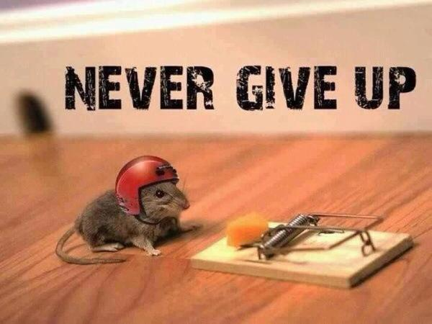
11. Try Not to Give Up: Persistence and Grit Wins the Day
Notes:
Curt
70

Slide 71
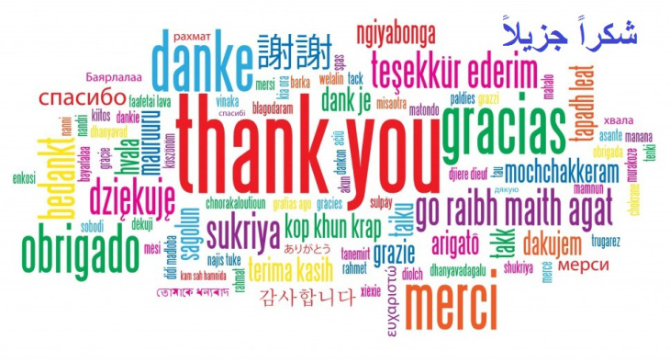
12. Be Polite and Thankful to the Journal or Book Chapter Editors
Notes:
Curt
71

Slide 72
13. Recap Reviewer Points and How You Attempted to Address Them
Notes:
Curt
72

Slide 73
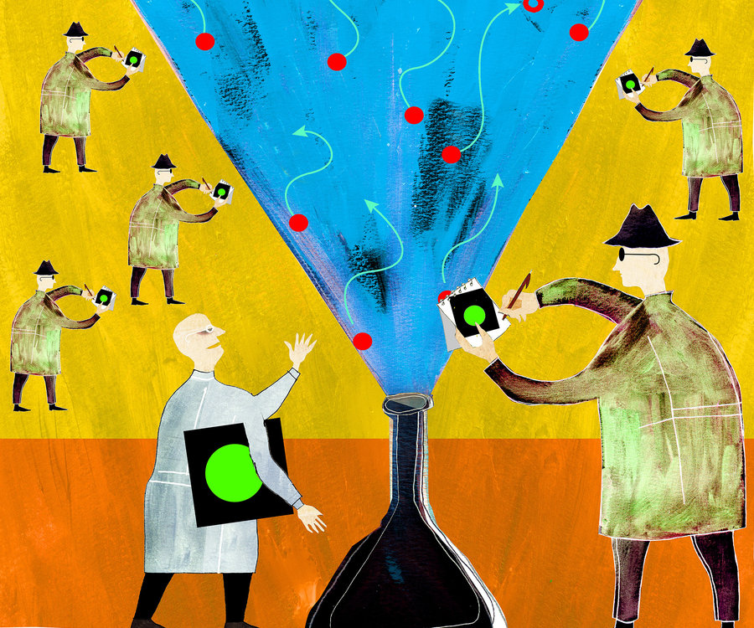
14. Share Your Publication Efforts (e.g., Twitter, Facebook, LinkedIn, email, ResearchGate, Academia.edu, etc.)
Notes:
Curt
73

Slide 74
15. Celebrate Your Writing Accomplishments with Friends
Notes:
Curt
74

Slide 75
January 20, 2020 10 Ways to Make Sure Your Writing Happens Christine Tulley, Inside Higher Ed https://www.insidehighered.com/advice/2020/01/20/advice-using-writing-day-most-productively-opinion

Slide 76
January 20, 2020 10 Ways to Make Sure Your Writing Happens Christine Tulley, Inside Higher Ed https://www.insidehighered.com/advice/2020/01/20/advice-using-writing-day-most-productively-opinion
Question: Should you write 1 hour per day or toggle in and out and writing in extremely short bursts?
Binge writing results in:
Procrastination
Distraction
Dreading to sit that long

Slide 77
January 20, 2020 10 Ways to Make Sure Your Writing Happens Christine Tulley, Inside Higher Ed https://www.insidehighered.com/advice/2020/01/20/advice-using-writing-day-most-productively-opinion
Prior to the writing day:
1. Identify a beginning and an end of the writing time for the writing day. Block the start and stop time (e.g., 9 am to 3 pm).

Slide 78
January 20, 2020 10 Ways to Make Sure Your Writing Happens Christine Tulley, Inside Higher Ed https://www.insidehighered.com/advice/2020/01/20/advice-using-writing-day-most-productively-opinion
Prior to the writing day:
2. Briefly revisit a writing day project at least two other times during the week for five or 10 minutes. Re-outline the TOC or remind yourself of the big picture. Put your thesis on a wal and fine-tune it or have coffee with a colleague.

Slide 79
January 20, 2020 10 Ways to Make Sure Your Writing Happens Christine Tulley, Inside Higher Ed https://www.insidehighered.com/advice/2020/01/20/advice-using-writing-day-most-productively-opinion
Prior to the writing day:
3. Map out your writing the night before. Carve it up into writing chunks. Tackle big problems first can be helpful (e.g., combining or reworking sections).

Slide 80
January 20, 2020 10 Ways to Make Sure Your Writing Happens Christine Tulley, Inside Higher Ed https://www.insidehighered.com/advice/2020/01/20/advice-using-writing-day-most-productively-opinion
On your writing day:
4. Ease into writing. Review your writing plan or map and reread notes for 15-30 minutes (perhaps with a timer). Remind yourself what you care about this project.

Slide 81
January 20, 2020 10 Ways to Make Sure Your Writing Happens Christine Tulley, Inside Higher Ed https://www.insidehighered.com/advice/2020/01/20/advice-using-writing-day-most-productively-opinion
On your writing day:
5. Remember that no writing is sometimes writing. Add stretching or snack breaks. Such times you are often working out your writing in your brain.

Slide 82
January 20, 2020 10 Ways to Make Sure Your Writing Happens Christine Tulley, Inside Higher Ed https://www.insidehighered.com/advice/2020/01/20/advice-using-writing-day-most-productively-opinion
On your writing day:
6. Read and write at the same time. Perhaps set timer to 15 minutes to power read.

Slide 83
January 20, 2020 10 Ways to Make Sure Your Writing Happens Christine Tulley, Inside Higher Ed https://www.insidehighered.com/advice/2020/01/20/advice-using-writing-day-most-productively-opinion
On your writing day:
7. Save busy work for the end. Bracket things where citations or names are needed. Check for repeated words and other redundancies and misspellings. Find synonyms and lexical transitions (another, equally important, first, second, etc., again, further, last, finally, as well as, next, likewise, etc.).

Slide 84
January 20, 2020 10 Ways to Make Sure Your Writing Happens Christine Tulley, Inside Higher Ed https://www.insidehighered.com/advice/2020/01/20/advice-using-writing-day-most-productively-opinion
On your writing day:
8. “Close” the project. Map out or get ready for your next writing session. Save your documents and email yourself a copy and/or upload to Google Drive.

Slide 85
January 20, 2020 10 Ways to Make Sure Your Writing Happens Christine Tulley, Inside Higher Ed https://www.insidehighered.com/advice/2020/01/20/advice-using-writing-day-most-productively-opinion
Developing the writing day (and writing year) system:
9. Find a way to “click in” to your writing on your writing day. Establish writing day rituals or habits so your mind kicks in when you get your fruits and veggies or kombucha and you arrive at your writing space.

Slide 86
January 20, 2020 10 Ways to Make Sure Your Writing Happens Christine Tulley, Inside Higher Ed https://www.insidehighered.com/advice/2020/01/20/advice-using-writing-day-most-productively-opinion
Developing the writing day (and writing year) system:
10. Systematize where writing projects are tracked and recorded. Have a master chart for all of your projects and weekly maps for particularly writing sessions. Perhaps try some sort of project management.

Slide 87
February 18, 2021 What Do Professors Do During a Writing Session? Christine Tulley, Inside Higher Ed https://www.insidehighered.com/advice/2021/02/18/how-get-started-scholarly-writing-stay-motivated-and-move-toward-finished-product

Slide 88
February 18, 2021 What Do Professors Do During a Writing Session? Christine Tulley, Inside Higher Ed https://www.insidehighered.com/advice/2021/02/18/how-get-started-scholarly-writing-stay-motivated-and-move-toward-finished-product
Easing in period:
Notes on post-its
Brackets in draft
Trello board
Read writing from previous session and start where left off
Highlight sections for more intense work
Review reviewer and co-author comments

Slide 89
February 18, 2021 What Do Professors Do During a Writing Session? Christine Tulley, Inside Higher Ed https://www.insidehighered.com/advice/2021/02/18/how-get-started-scholarly-writing-stay-motivated-and-move-toward-finished-product
How move the piece:
Word count goals such as 750 words/day, write 2 pages, or revise 5 pages
Use pomodoro technique
Set a timer
Have specific goals like “rewrite methodology
Use goal setting tools like Prolifiko
Build deadlines for writing
Participate in a writing group or share revisions each Monday in Google Doc

Slide 90
February 18, 2021 What Do Professors Do During a Writing Session? Christine Tulley, Inside Higher Ed https://www.insidehighered.com/advice/2021/02/18/how-get-started-scholarly-writing-stay-motivated-and-move-toward-finished-product
What if do not feel like writing:
Tell yourself you will only write for 5 minutes
Reward yourself such as with social media
Save small task for low-motivation occasions
Take a picture of ideas on a whiteboard
Buy standing or cycling desks
Walk around campus
Have a free pass for no writing once per month
Leave document open all day and write in short bursts
Hire a writing coach or use writing accountability services

Slide 91
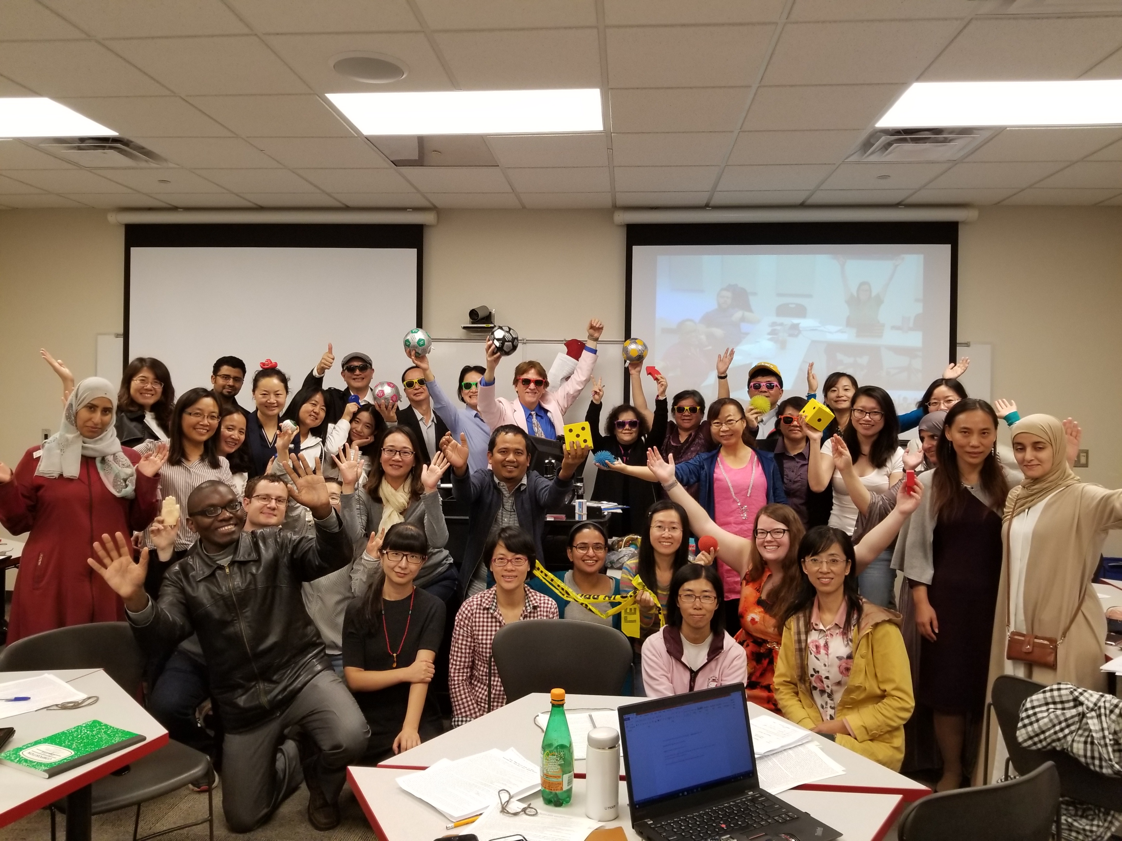
Do What Brings you Joy and Happiness What brings creativity, happiness, and joy to your writing?

Slide 92
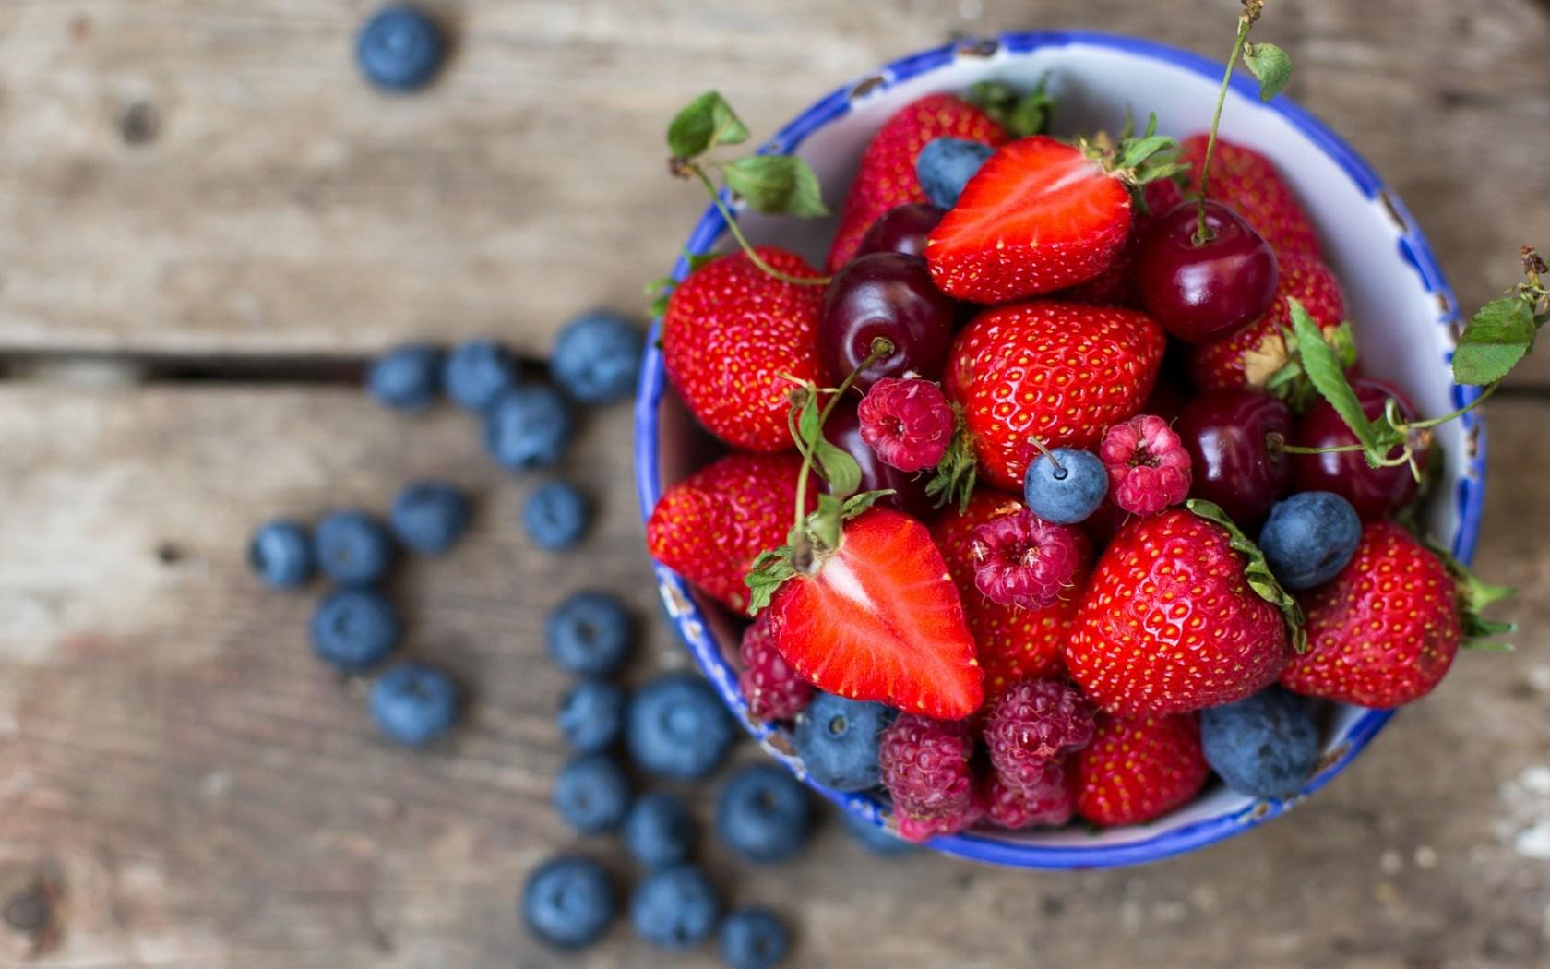
Habits/Rituals/Inspiration: Food How do approach your writing tasks? Any rituals that you use and recommend for inspiration? Anything that really works for you?
Start with a vitamin or health drink.
Grab plate of berries and celery.
Then perhaps tea or coffee.
End with a health drink.
Dilly bars are good after dinner.

Slide 93
How to decide on who to write with?
Notes:
Curt
93

Slide 94
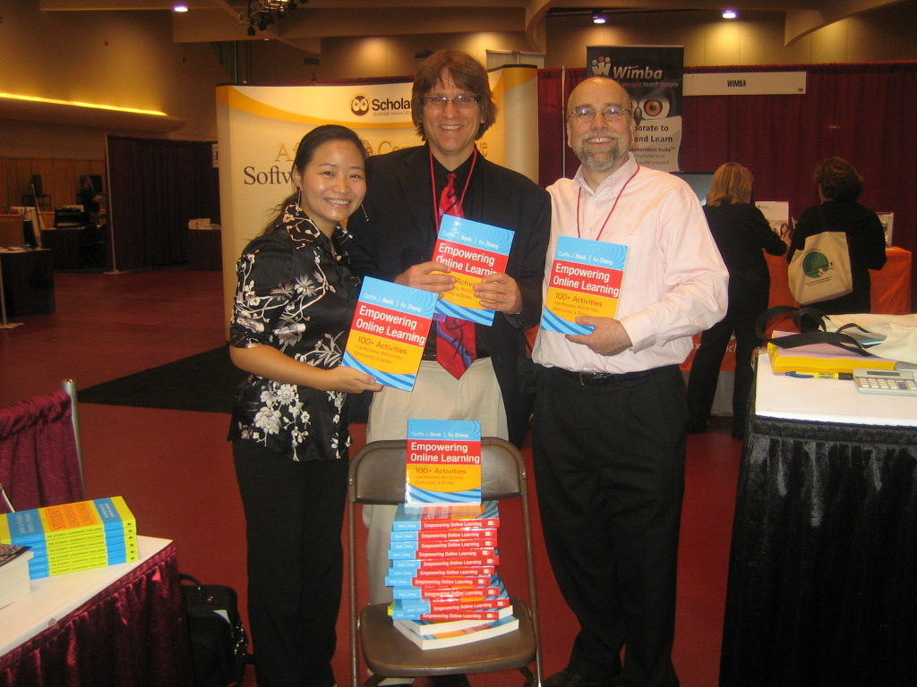
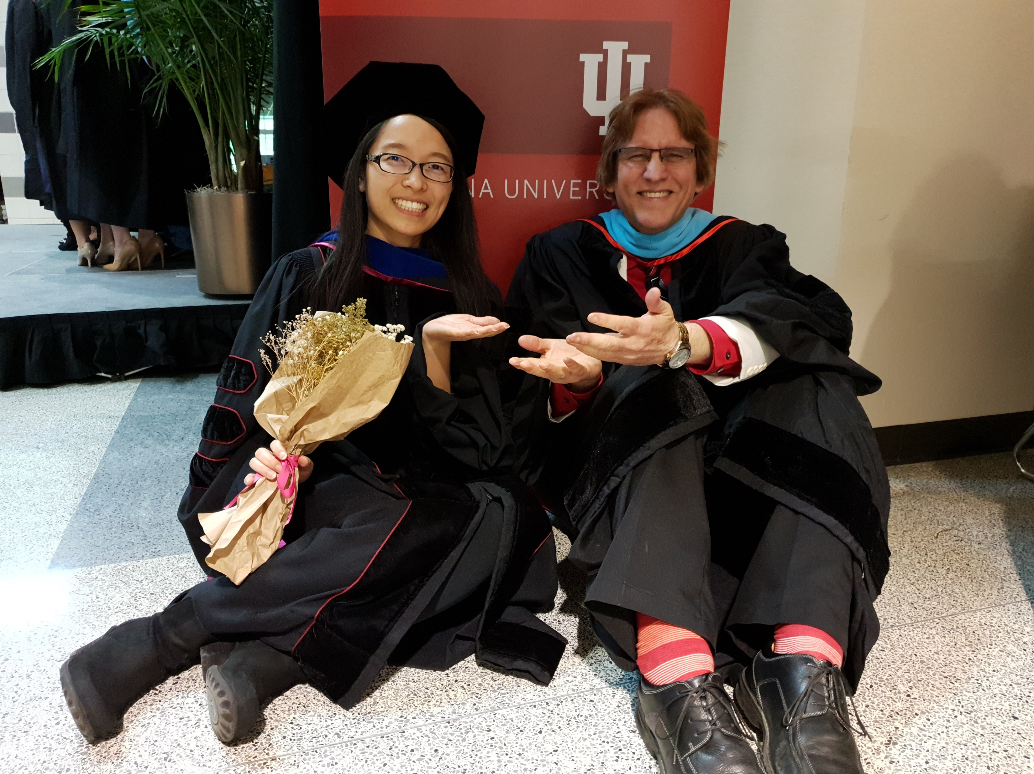
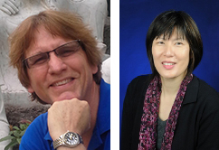
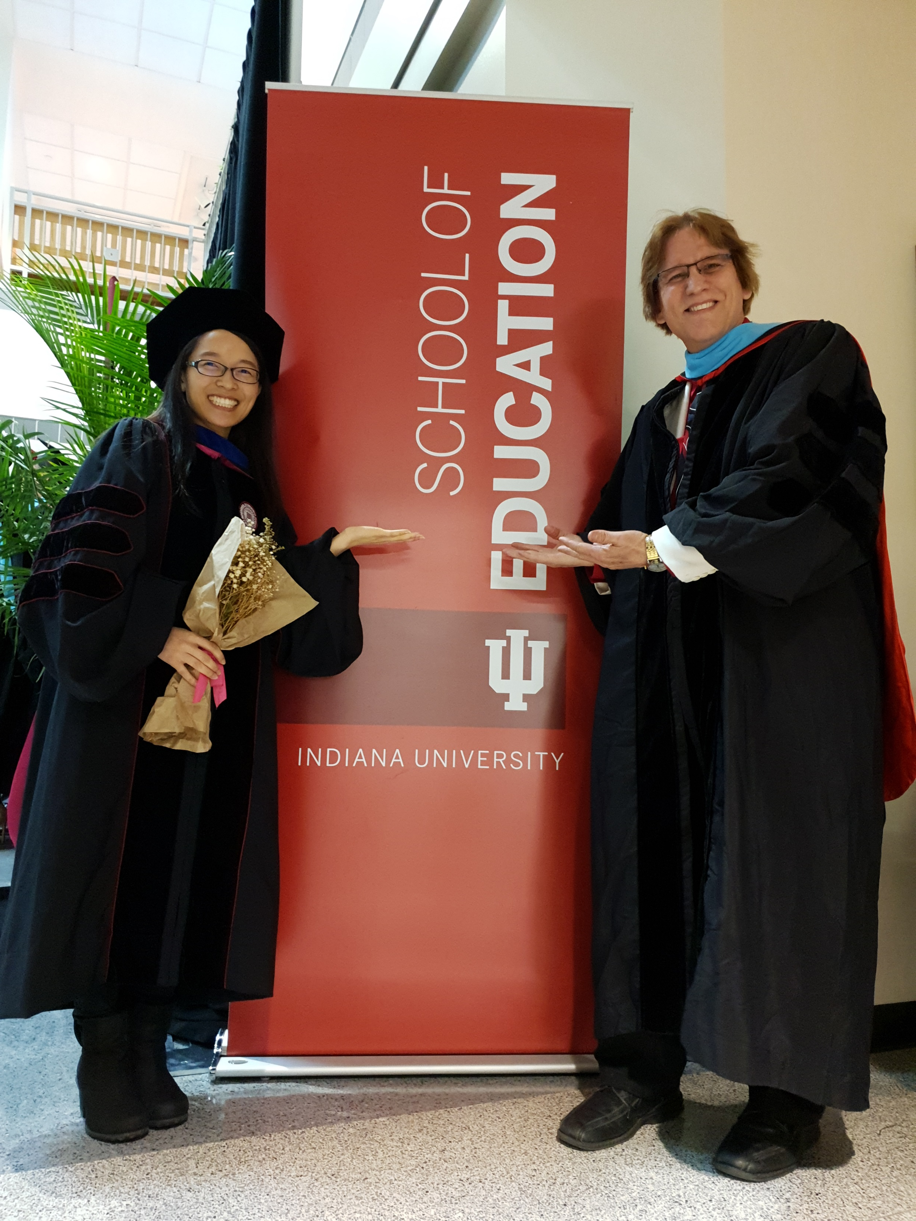
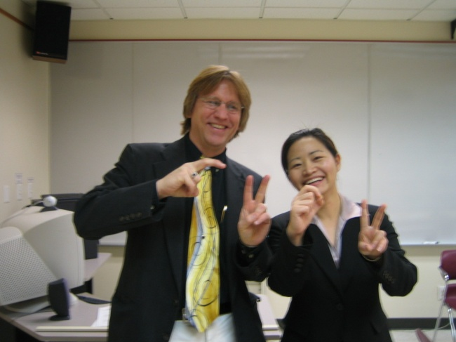
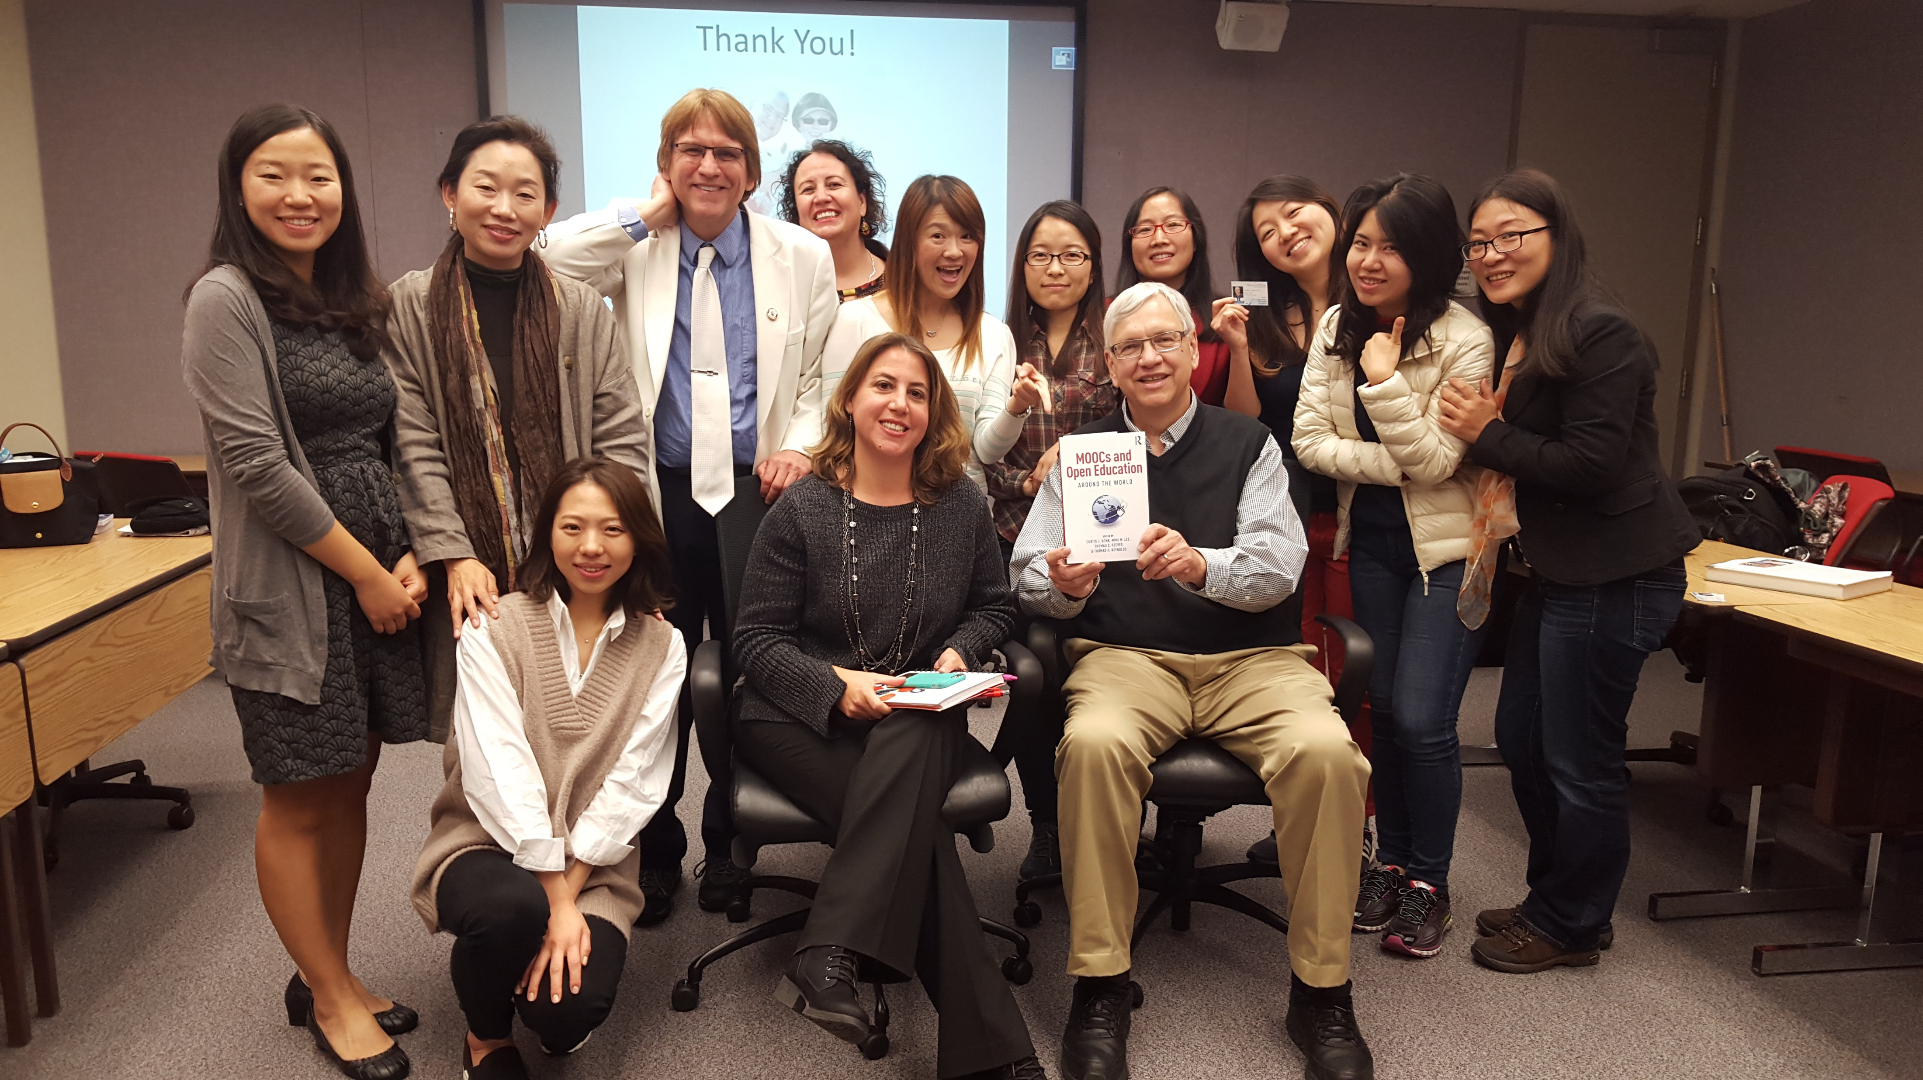
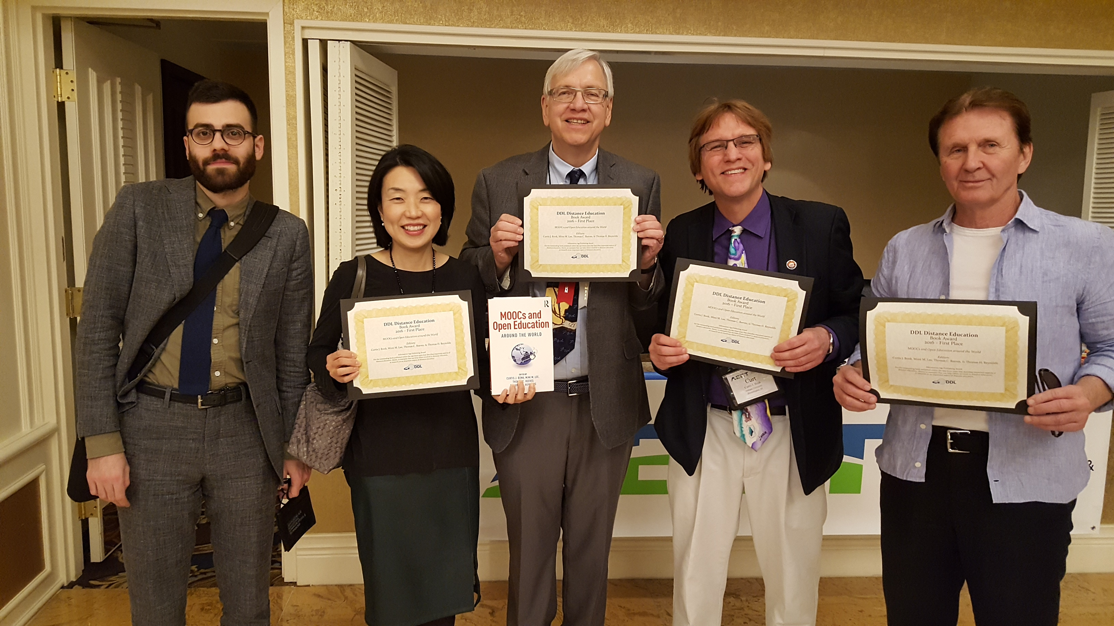
Writing Partners: Life is short: Find kind people who are prompt, positive, and productive and you can trust. How do you determine your collaborative writing partners? And negotiate tasks?

Slide 95
Concerns?
Comments?
Commitments?
Curt Bonk, IU, Email: cjbonk@Indiana.edu
Meina Zhu, WSU, Email: meinazhu@wayne.edu
Slides: http://www.trainingshare.com
Notes:
All
95

