Slide 1
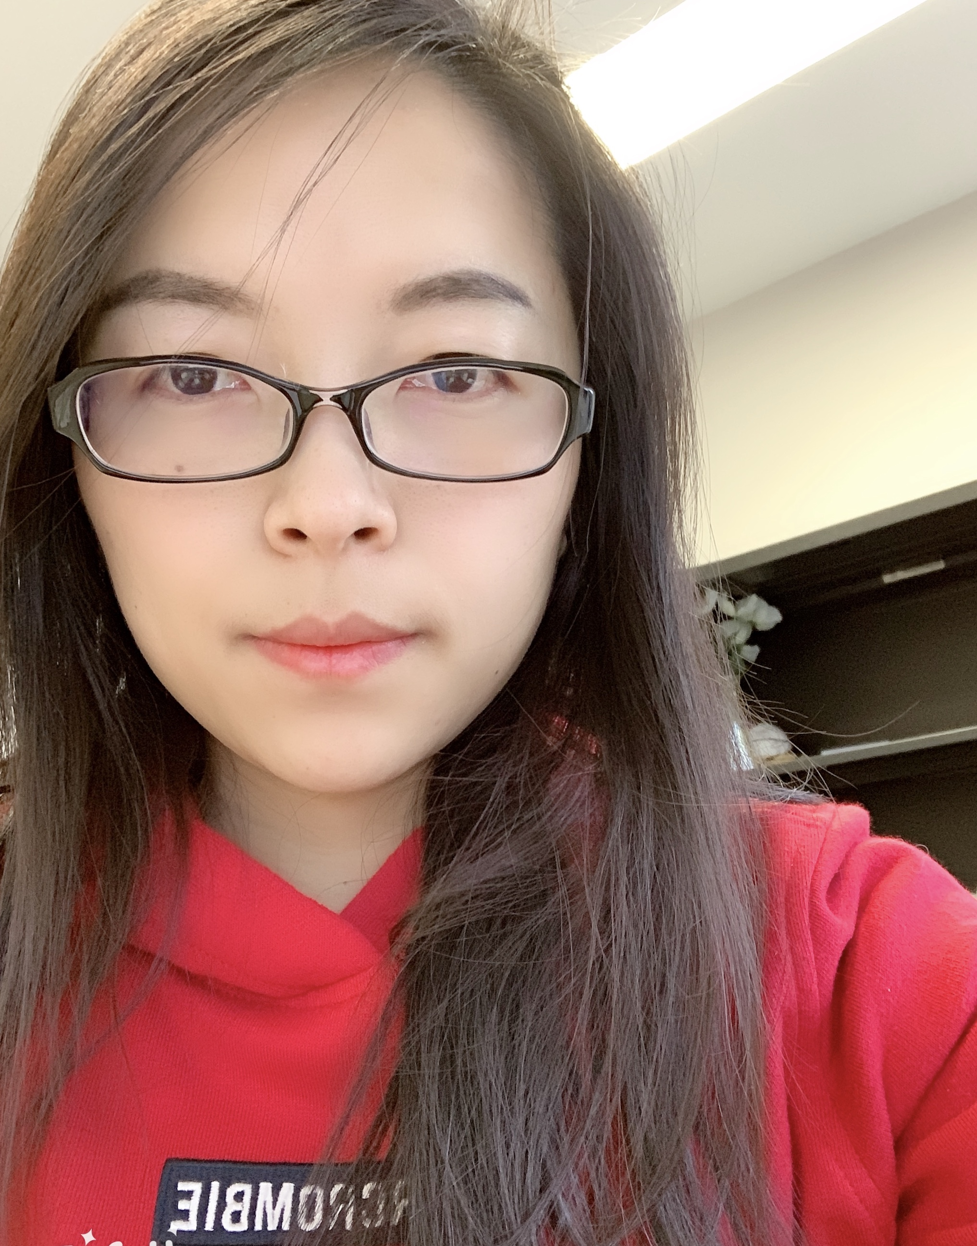
The G³ of Writing and Publishing Tips: Gentle Guidelines, Great Stories, and Gigantic Scholarly Gains
Curtis J. Bonk, Ph.D., Indiana University
cjbonk@indiana.edu
Meina Zhu, Ph.D., Wayne State University meinazhu@wayne.edu
Notes:
All
1

Slide 2
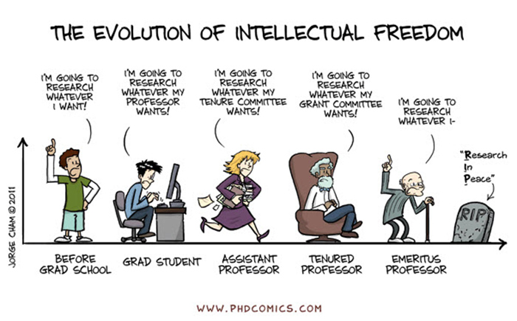
Sidenote: Don’t Just Publish for the Sake of Publishing…
Notes:
Curt
2

Slide 3
February 15, 2019 The Hardest Part of Writing Is Restarting Rebecca Schuman, The Chronicle of Higher Education https://www.chronicle.com/article/The-Hardest-Part-of-Writing-Is/245720?cid=cp242

Slide 4
March 31, 2019 Step Away From the Delete Button Rebecca Schuman, The Chronicle of Higher Education https://www.chronicle.com/article/Step-Away-From-the-Delete/246013?cid=cp242

Slide 5
June 7, 2018 6 Ways to Beat Writer’s Block Rachel Tour, The Chronicle of Higher Education https://www.chronicle.com/article/6-ways-to-beat-writers-block/
Work up a sweat. ...
Take a quick trip. ...
Just keep at it. ...
Heed Anne Lamott's clarion call…”write a shitty draft first.”
Try the “compost” method…a pile of crap can lead to something worth cultivating
Remind yourself that even the best writers get stuck.

Slide 6
December 11, 2020 How to Find a Writing Routine that Works Manya Whitaker, The Chronicle of Higher Education https://www.chronicle.com/article/how-to-find-a-writing-routine-that-works
Always work on at least 2 projects.
Review potential publishers and options.
Set a reasonable writing timeline.
Make a writing schedule and plan.
Have a project-based writing schedule.
Expand notion of when “writing.”
Set time writing goals, not word goals.
Write what motivates you that day.
Establish flexible schedules.
Read more and edit as you go.

Slide 7
March 31, 2019 Step Away From the Delete Button Rebecca Schuman, The Chronicle of Higher Education https://www.chronicle.com/article/Step-Away-From-the-Delete/246013?cid=cp242
Ideas will be no good on first pass.
There are no shortcuts…even a small subsection of a manuscript takes time.
You will need multiple versions of almost all your sentences to lead to polished prose.
It takes intellectual and artistic stamina to come up with ideas are good enough for academic journals.
Don’t let messy, gibberish words taunt and haunt you.

Slide 8
March 31, 2019 Step Away From the Delete Button Rebecca Schuman, The Chronicle of Higher Education https://www.chronicle.com/article/Step-Away-From-the-Delete/246013?cid=cp242
Write for 25 minutes 1-3 times a day for a week with deleting a single word.
Bracket some messages to yourself of sections that will need attention later (to calm your inner delete button).
Uncertain and unliked text make a difference color.
After you break the habit of deleting, you can delete judiciously.
Trust your research and your ideas. Avoid setting standards at ridiculously high levels.

Slide 9
December 10, 2019 Rewarding Your Writing Leslie Leonard, Inside Higher Ed https://www.insidehighered.com/blogs/gradhacker/rewarding-your-writing
Track your writing. Have realistic expectations of output.
Find ways to mark days you have met your writing goals (e.g., stickers).
Writing should be enjoyable, a reward in and of itself.
Rewards are many: sleeping in, a fancy cup of coffee, new clothes, movie tickets, spa day, etc.
Have drawings for random rewards for meeting goals.

Slide 10
December 10, 2019 Rewarding Your Writing Leslie Leonard, Inside Higher Ed https://www.insidehighered.com/blogs/gradhacker/rewarding-your-writing
Let your rough drafts be rough.
Just write. List your goals. Get something down.
Use goofy fonts, nonsense words, rhymes, etc. (count these towards your writing goals and reward them). Allow any writing to count toward your goals.
Make the experience enjoyable with treats or fancy clothes, etc.
Find brief moments to write (e.g., waiting for a bus or a plane).

Slide 11
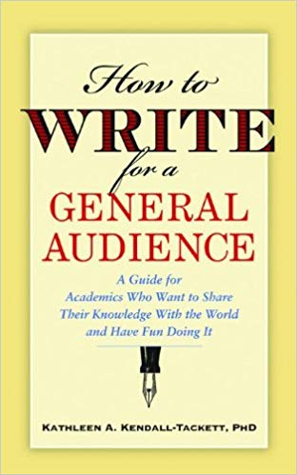
January 19, 2021 Writing for Diverse Audience: Prewriting
Ask questions about audience
Ask more questions about audience
Restate what you interpreted as the audience
Read, read, and read some more
Scan sample publications
Look to the popular press and news

Slide 12
January 19, 2021 Writing for Diverse Audience: Writing Drafts
Ask at least two others to read and comment.
Read what you wrote out loud.
Print it and look at it (digital versions can be misleading).
Simplify wording.
Revise and revise and revise some more.
Use a thesaurus.

Slide 13
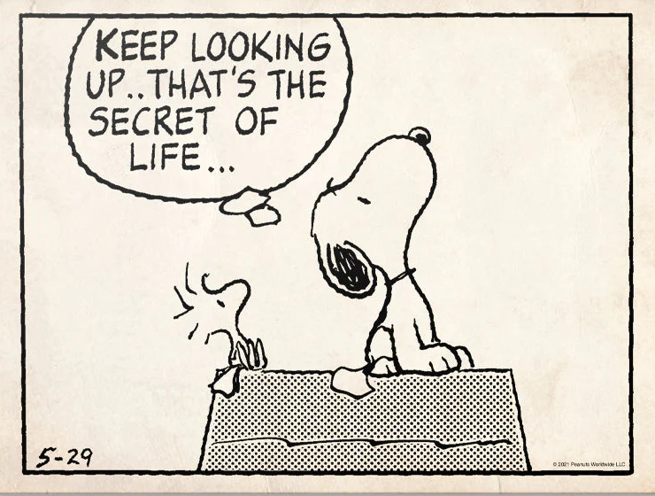
Part #2. The Publication Process and Considerations
Notes:
Curt
13

Slide 14
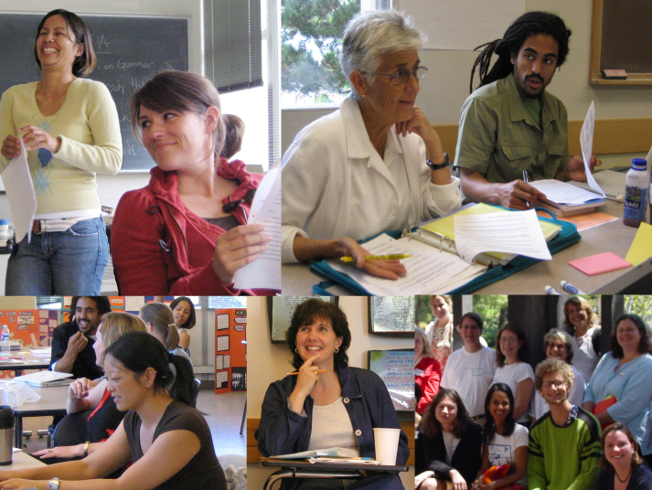
Put Forward your Best Work
Collaborative research projects
Literature reviews
Reflections/ conceptual pieces
Grant projects
Class projects
Notes:
Ana
14

Slide 15
Finding a Journal that Fits
What to look for?
Who will be your target readers?
Who are the authors and journals you cite the most related with your research program?
Is there a match between your work and the journal aims and scope?
What is the journal turnaround time?
What is the journal acceptance rate?
Do you know the editor(s)?
Notes:
Ana
https://www.editage.com/insights/how-to-choose-journals-for-submitting-your-paper
Who will be your target readers? Scholarly vs. non-scholarly periodicals
readership and target audience
Look for a match between your work and the journal aims and scope. – journal analysis
What is the journal’s turnaround time?
Acceptance rates? Get familiar with the journals’ acceptance rates
15

Slide 16
Where to start?
Peer-Reviewed Journals
Top-tier journals: are SSCI-indexed
Second-tier journals: have an established history in the field
Third-tier journals: often are newer to the field
Notes:
Ana
you should publish everything you do, even if it is only acceptable for a lower tier journal. It demonstrates your commitment to finish a project and makes your work available to everyone else. Lower tier journals are also great outlets for quality undergraduate research that you have directed.

Slide 17
TOP-TIER JOURNALS
British Journal of Educational Technology
Educational Technology Research and Development
The Internet and Higher Education
Instructional Science
Notes:
Ana
Mention:
http://www.trainingshare.com/resources/distance_ed_journals_and_online_learning_books.php
More examples:
Distance EducationDistance Education; The Internet and Higher Education; Asian Journal of Technology InnovationAsian Journal of Technology Innovation ; Australasian Journal of Educational Technology
Educational Technology Research and Development
17

Slide 18
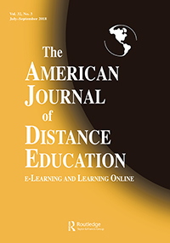
SECOND-TIER JOURNALS
Journal of Educational Computing Research
TechTrends
The American Journal of Distance Education
Notes:
Ana
Journal of Technology and Teacher EducationJournal of Technology and Teacher Education; The Quarterly Review of Distance EducationJournal of Technology and Teacher Education; The Quarterly Review of Distance Education; Science & Education
Journal of Digita Learning in Teacher Education
International Review of Research in Open and Distributed Learning
The American Journal of Distance Education
18

Slide 19
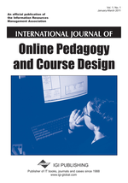
THIRD-TIER JOURNALS (often new journals)
International Journal of Online Pedagogy and Course Design
Contemporary Issues in Technology and Teacher Education
Interactive Technology and Smart Education
Notes:
Ana
International Journal of Gaming and Computer Mediated SimulationsInternational Journal of Gaming and Computer Mediated Simulations; Advances in MultimediaInternational Journal of Gaming and Computer Mediated Simulations; Advances in Multimedia; Learning: Research and Practice
International Journal of Designs for Learning

Slide 20
Resource and Idea Suggestions
Subscribe to news feeds (not too many)
Save links and images to interesting articles
Review saved documents for themes monthly
Share those links in Facebook, Twitter, etc., for peer reactions
Write to people interviewed in articles

Slide 21
Academic Information/ Resources (Cont’d)
(Feng-Ru Sheu, Kent State University, 2018)
Journal selection/evaluation
Impact/accreditation (*Predatory Journals)
Citation index (Web of Science, Google Scholar, etc.)
Impact factor
Ranking
Open Access vs. non-Open Access
Directory of Open Access Journals
Open Access Scholarly Publishers Association

Slide 22
Selecting a Journal (Feng-Ru Sheu, Kent State University, 2018)
Be Aware Predatory Journals!
Criteria to check the journal
Do you or your colleagues know the journal?
Can you easily identify and contact the publisher?
Is the journal clear about the type of peer review it uses?
Are articles indexed in services that you use?
Is it clear what fees will be charged?
Do you recognize the editorial board?
Is the Publisher a member of a recognized industry initiative?
Access the checklist in detail at http://thinkchecksubmit.org/check/
Notes:
Feng-Ru

Slide 23
Selecting a Journal (Feng-Ru Sheu, Kent State University, 2018)
Two resources to identify the journals and publishers
The Directory of Open Access Journals (DOAJ): https://doaj.org/
Identify legitimate and high quality open access, peer-reviewed journals
Beall’s List of Predatory Journals and Publishers: https://beallslist.weebly.com/
Identify predatory journals/publishers
Notes:
Feng-Ru

Slide 24
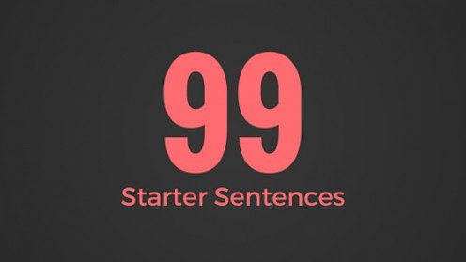
Generate Starter Text…
Author a blog
Use social media
Submit a conference proposal
Write editorials
Write book and software reviews
101
Notes:
Curt

Slide 25
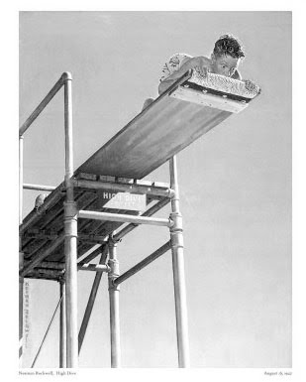
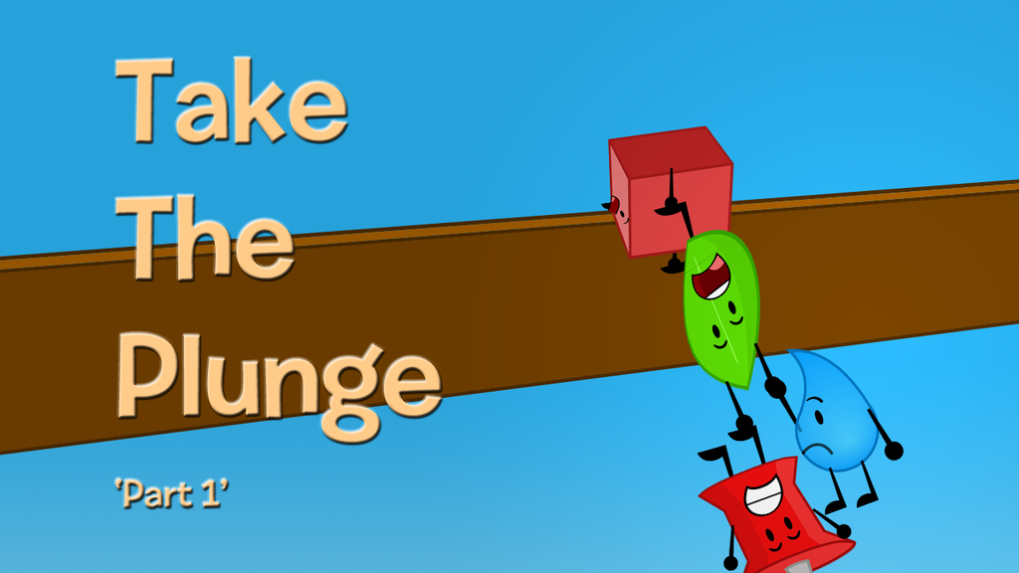
Take the Plunge…Part 1
Look for opportunities to create publishable manuscripts from your dissertation
Contribute with a chapter
Conduct an interview
Write a practical article, newsletter, or book review
Notes:
Ana
Review articles and conference proposals (learn about peer-review criteria and guidelines)
Review book proposals
Do a conference workshop
Organize a symposium
25

Slide 26
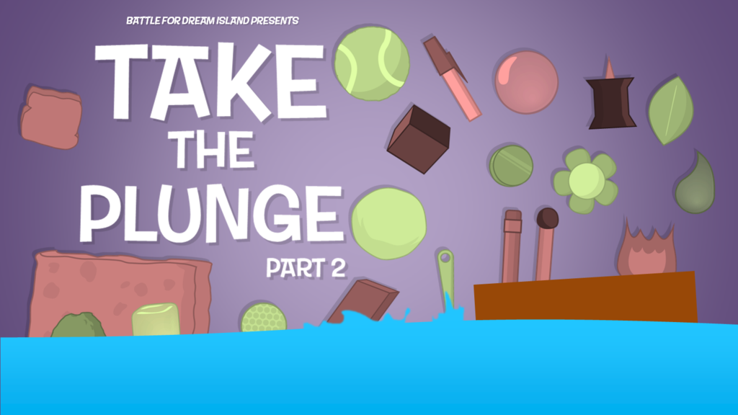
Take the Plunge…Part 2
Write a major grant proposal
Lead a special journal issue
Edit a book
Sole author a book
Get your name out there!
Notes:
Curt
26

Slide 27
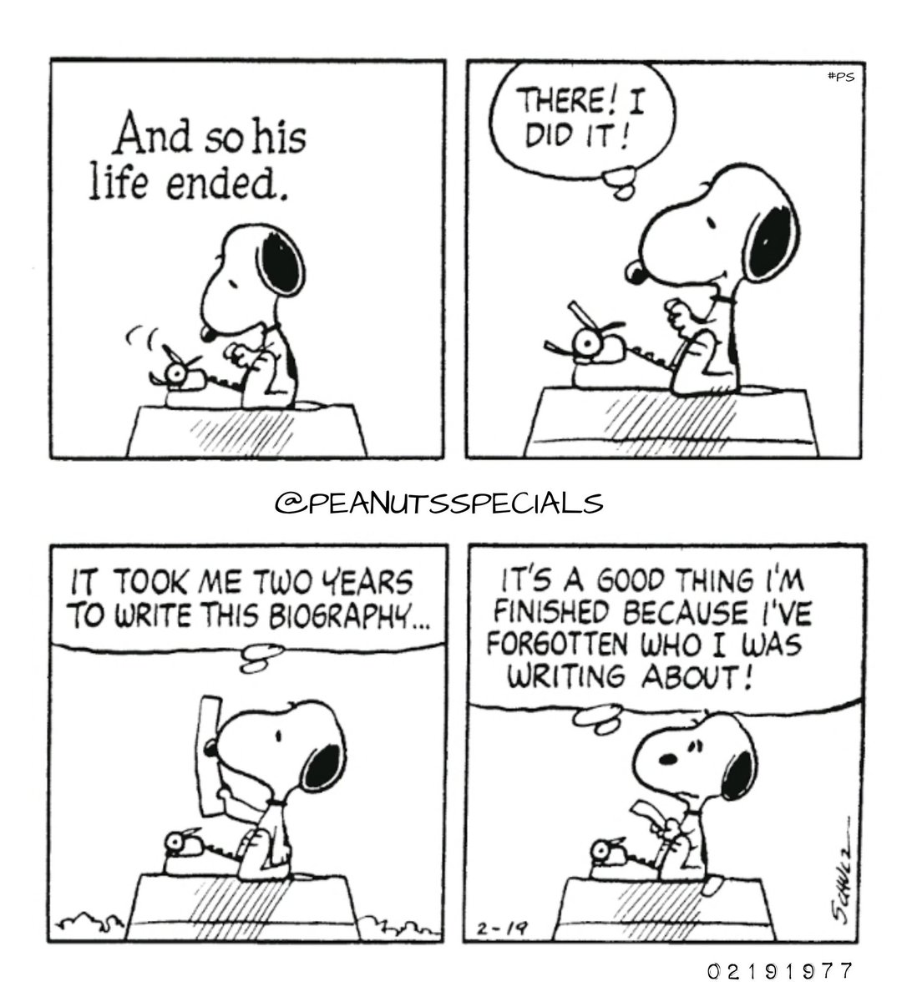
Part #3. Time Out for Early Career Writing Advice
Notes:
Curt
27

Slide 28
Writing Tips and Insights
Insights and Advice on Getting Published from a New Faculty’s Perspective
Notes:
28

Slide 29
Writing Difficulties and Challenges of a Early Career Scholar
Time
Writing habits
Resources
Local/Global Support
Starter text
Reputation
Connections
Journal awareness
Energy/Stamina
Service/Teaching duties
Notes:
Ana
29

Slide 30
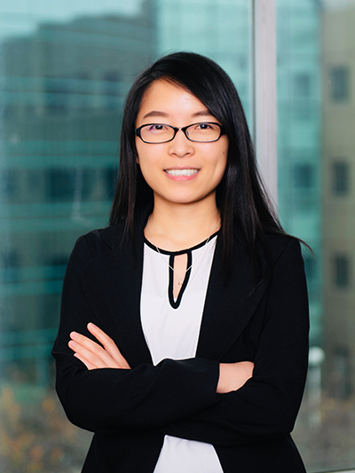
Meina Zhu: An Early Career Perspective
1. Goals 2. Strategic Plans 3. Reflection 4. Collaborators 5. Professional Development
6. Research focus
Notes:
30

Slide 31
1. Writing Goals
Notes:
https://images.app.goo.gl/MKuUp4qKm1YVWaVy6
31

Slide 32
2. Strategic Plans
Notes:
32

Slide 33
3. Reflection on Writing
Notes:
https://images.app.goo.gl/GaBmk1XemmM54JxR7
33

Slide 34
Ten Journal Published In (from easiest to most difficult experience)
Open Praxis
Contemporary Educational Technology
TechTrends
Turkish Online Journal of Distance Education
Online Learning
Distance Education
Educational Technology Research and Development
Education and Information Technologies
Journal of Computing in Higher Education
British Journal of Educational Technology

Slide 35
4. Writing Collaborators
Notes:
Curt
35

Slide 36
Writing Collaboration Advice
Build and maintain relationship
Respect diverse culture background and perspectives
Provide clear guidelines and instructions to book authors at the beginning
Respect different book chapter authors agenda

Slide 37
October 3, 2019 Crucial Co-Writing Considerations Jordan McNeill, Inside Higher Ed https://www.insidehighered.com/blogs/gradhacker/crucial-co-writing-considerations
Clarify authorship order ahead of time.
Have an honest conversation about the strengths of each team member--draft, revise, proofread, and format your manuscript.
Be clear on division of labor.
Nonwriting tasks are important too—taking notes, submission guidelines, and keep track of deadlines.
Set up digital collaboration norms and platforms—archiving, tracking, commenting, etc.
Respond to feedback professionally.
Build in time for feedback and revision.
Singular voice throughout paper—assign one member of team to read for writing style and flow.

Slide 38
Meina Research Collaboration-Why?
Improve quality of research.
Extend research relationships and networks.
Foster interdisciplinary and transdisciplinary research.
Share expertise and knowledge transfer.
Enhance scientific and publishing productivity.
Accelerate dissemination of findings for community benefit.
Notes:
Retrieved from https://www.google.com/search?q=collaboration&tbm=isch&ved=2ahUKEwj8ivazkeDsAhUI0awKHcTRALsQ2-cCegQIABAA&oq=collaboration&gs_lcp=CgNpbWcQAzIFCAAQsQMyAggAMgIIADICCAAyAggAMgIIADICCAAyAggAMgIIADICCAA6BAgjECc6BAgAEEM6BwgAELEDEEM6CAgAELEDEIMBULmxDliCvQ5gzL4OaABwAHgAgAFPiAHKBpIBAjEzmAEAoAEBqgELZ3dzLXdpei1pbWfAAQE&sclient=img&ei=iQeeX7yiDYiiswXEo4PYCw&bih=881&biw=1965&tbs=il%3Acl&hl=en#imgrc=TBP9Sue5H-FIAM

Slide 39
Meina… Research Collaboration-How?
Identify the skills that you can offer
Identify how the collaboration will meet your needs
Find collaborators
Introduce yourself
Set expectations at the beginning of the collaboration
Leverage tools for collaborations
Keep communicating
Do not be discouraged
Notes:
Retrieved from https://www.google.com/search?q=collaboration&tbm=isch&ved=2ahUKEwj8ivazkeDsAhUI0awKHcTRALsQ2-cCegQIABAA&oq=collaboration&gs_lcp=CgNpbWcQAzIFCAAQsQMyAggAMgIIADICCAAyAggAMgIIADICCAAyAggAMgIIADICCAA6BAgjECc6BAgAEEM6BwgAELEDEEM6CAgAELEDEIMBULmxDliCvQ5gzL4OaABwAHgAgAFPiAHKBpIBAjEzmAEAoAEBqgELZ3dzLXdpei1pbWfAAQE&sclient=img&ei=iQeeX7yiDYiiswXEo4PYCw&bih=881&biw=1965&tbs=il%3Acl&hl=en#imgrc=1C1gKEYxDs39-M&imgdii=FLQg6a_t9CpumM

Slide 40
5. Professional Development
Notes:
https://images.app.goo.gl/TQVEw8DGimxmRLGr9
40

Slide 41
6. Research Directions
Notes:
https://letslearnenglish.com/asking-for-and-giving-directions/
41

Slide 42
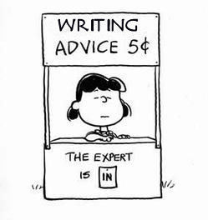
Part #4. Time Out for Senior Revising and Publishing Advice
Notes:
Curt
42

Slide 43
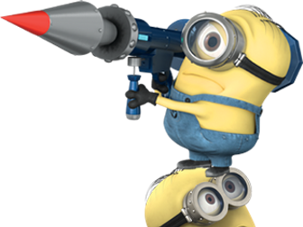
June 23, 2022 All writing and revision involves both Surface Level and Depth of Thought

Slide 44
Mark the Level of Difficulty A New Series on Scholarly Productivity: ‘Are You Writing?’ (Oct, 4, 2018) Rebecca Shuman, The Chronicle of Higher Education https://www.chronicle.com/article/A-New-Series-on-Scholarly/244689
Read as peer reviewer; mark up everything.
Catalog problems on a 1 to 3 difficulty scale (Level 1 takes less than 30 minutes, Level 2 takes 2 hours or less; Level 3 takes more time).
Fix the easy ones and gain momentum for the harder ones!
Take breaks as needed.
Notes:
Curt

Slide 45
February 12, 2019 From Dreaded to Amazing Cathy N. Davidson, Inside Higher Ed https://www.insidehighered.com/advice/2019/02/12/how-use-reviewers-revise-and-resubmit-comments-most-effectively-opinion

Slide 46
February 12, 2019 From Dreaded to Amazing Cathy N. Davidson, Inside Higher Ed https://www.insidehighered.com/advice/2019/02/12/how-use-reviewers-revise-and-resubmit-comments-most-effectively-opinion
Revise and Resubmit Steps:
Print out reader/reviewer reports.
Make 4 categories.
Make each category its own sheet of paper.
Keep clean copy of the manuscript.
Make online copy; use different fonts and colors or type size or margins.

Slide 47
February 12, 2019 From Dreaded to Amazing Cathy N. Davidson, Inside Higher Ed https://www.insidehighered.com/advice/2019/02/12/how-use-reviewers-revise-and-resubmit-comments-most-effectively-opinion
Revise and Resubmit Steps:
Make revisions by hand and online.
Keep a physical copy of the revisions.
No. 1 Praise. I list any complimentary comments according to Reader A, Reader B or both. I put in page numbers if they are available.
Don’t touch anything the readers love (i.e., don’t revise the good stuff).

Slide 48
February 12, 2019 From Dreaded to Amazing Cathy N. Davidson, Inside Higher Ed https://www.insidehighered.com/advice/2019/02/12/how-use-reviewers-revise-and-resubmit-comments-most-effectively-opinion
Revise and Resubmit Steps:
No. 2. Fix typos, factual errors, run-on sentences, clarity points, etc. List them according to Reader A, Reader B, etc.
Do small, easy fixable things and check off on sheet No. 2. This is a great psychological warmup.

Slide 49
February 12, 2019 From Dreaded to Amazing Cathy N. Davidson, Inside Higher Ed https://www.insidehighered.com/advice/2019/02/12/how-use-reviewers-revise-and-resubmit-comments-most-effectively-opinion
Revise and Resubmit Steps:
No. 3. Attack the large, conceptual, and structural revisions. Make the revision and then show a friend the before and after and get his or her feedback. Get feedback when feel stuck.

Slide 50
Curt Bonk and Meina Zhu: Reflections on the Hot Streak 10 General Factors
1. Persistence and grit.
2. Sense of now. Focus on the moment.
3. Do things one at a time.
4. Assemble best team for you. There are many smart and kind people out there to partner with.
5. Everyone has clear role.
6. Create comfort with the people and your writing space.
7. Intense and relaxed planning.
8. Explore possible journals and commit.
9. Set bold and audacious goals.
10. Revel in good luck. Do not sulk if bad luck.
Notes:
50

Slide 51
Curt Bonk and Meina Zhu: Reflections on the Hot Streak 10 Specific Factors
1. Plan your schedule—long view of 3-5 years!
2. Calendar view—6 monthly calendars!
3. Planner view—look at weeks, months, and years.
4. Notes in pocket view.
5. Timeline views.
6. Do move a month ahead without reflecting back.
7. Constantly track progress.
8. Discuss progress with others.
9. Be willing to say “yes.” Be very willing to say “no.”
10. Recheck list. Recheck goals.
Notes:
51

Slide 52
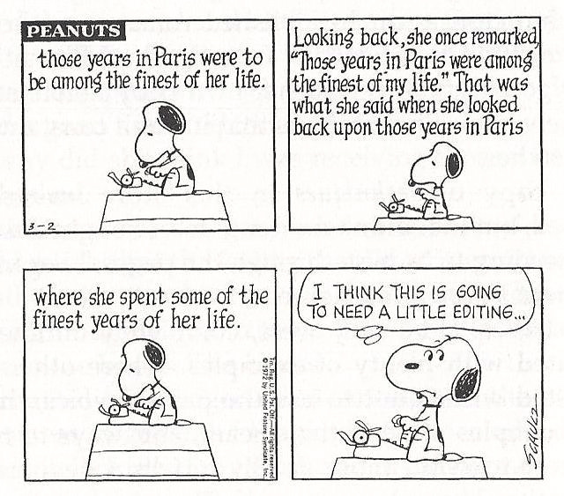
Part #5. Time Out for Some Writing Space Advice
Notes:
Curt
52

Slide 53
Writing Space #1: Meina Zhu, Wayne State University
My room is my writing space when it is dark outside.

Slide 54
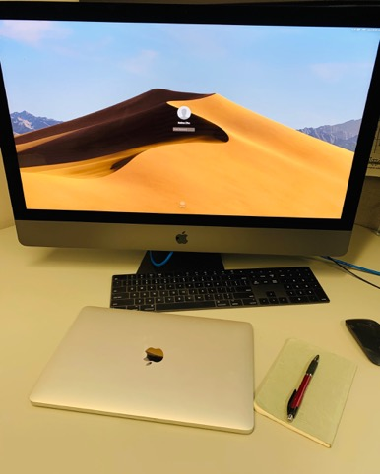
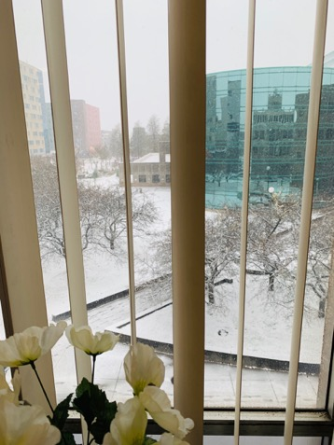
Writing Space #2: Meina Zhu
My office is my favorite place for writing during day time: perfect temperature, big screen, and great view.

Slide 55
Writing Tools: Meina Zhu
My collaborative tools are:
Google Drive
One Drive
Mendeley

Slide 56
Plans and Goals: Meina Zhu
Five year plans
One year plan
Two months plan
Weekly plan
Daily to do

Slide 57
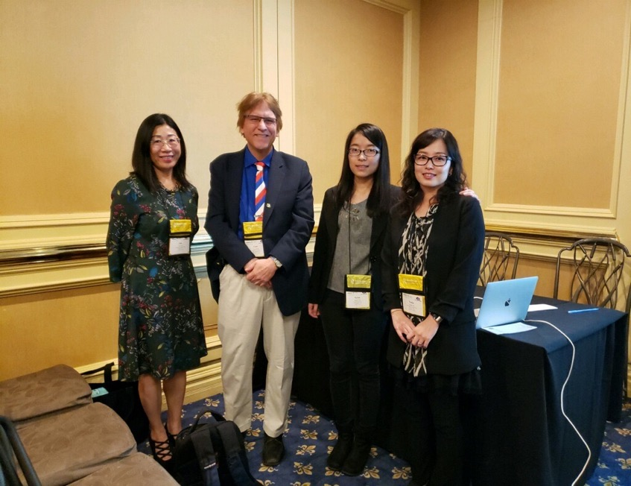
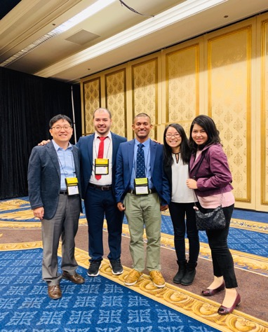
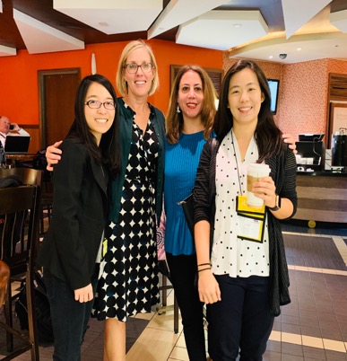
Writing Partners and Mentors: Meina Zhu

Slide 58
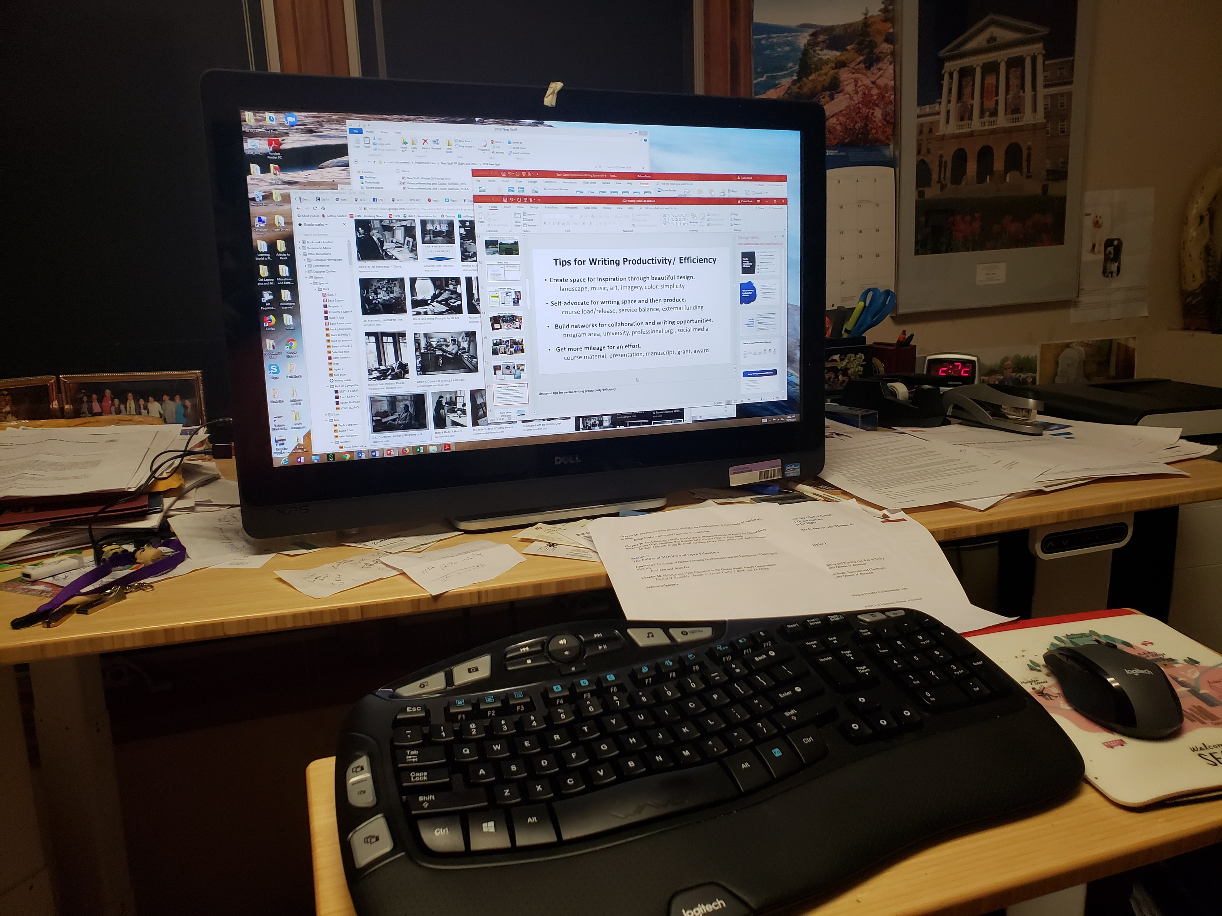
Writing Space Curt Bonk, Indiana University
I having standing desk…power it up and down via hydraulics. And my office looks out into a forest.

Slide 59
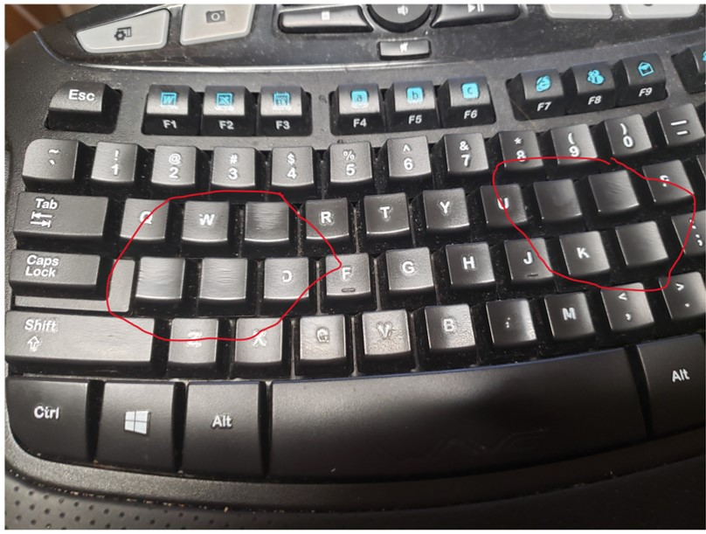
Writing Space
One of my biggest challenges is my tendency to burn through keyboards!

Slide 60
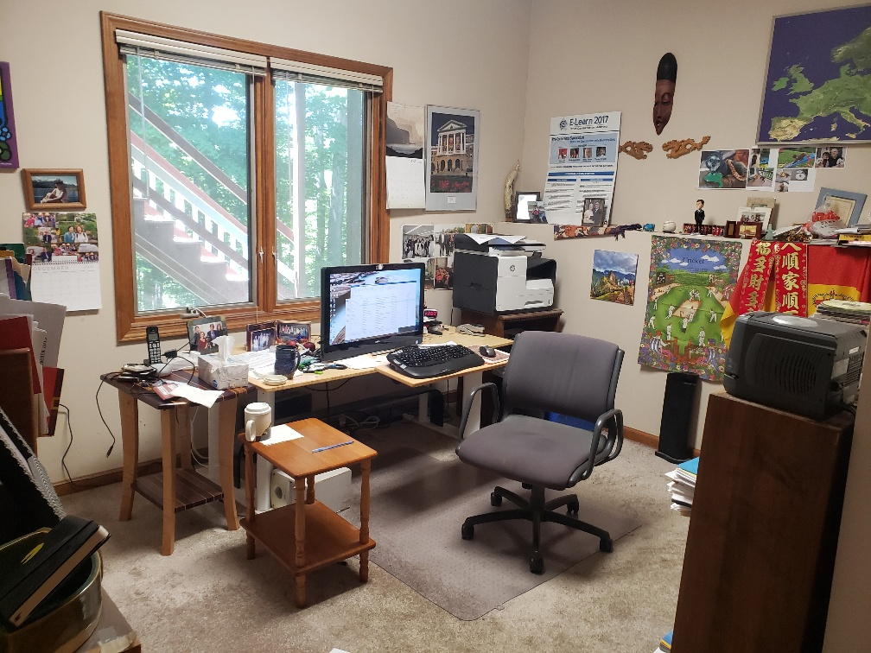
Writing Space: Curt Bonk After Cleaning

Slide 61
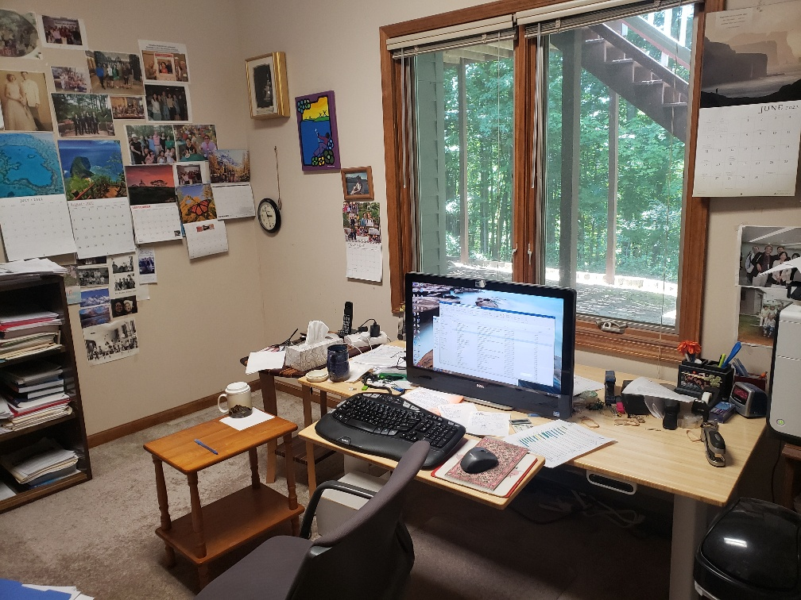
Writing Space: Curt Bonk

Slide 62
Plans and Goals: Curt Bonk How do you schedule your writing? How far in advance do you plan your writing? How do you prioritize your writing? How do you visualize your writing? Do you use a timeline or a planner? Do you have advice for developing a writing plan?
Plan: I save days for writing in my paper planner.
Focus: I say no to things that don’t fit my writing plans.
Track: I note projects in process and completed in my daily Dalia Lama quote of the day.
Monitor: I look at articles I have in review, in revision, and in press in my CV all the time.
Be Responsive: I respond to co-writer requests.
Goals: Put writing plans in annual report.

Slide 63
Writing Tips: Curt Bonk Anything special that you do?
My top 10 key writing tips:
Create a “Work” file on your desktop.
Save screen shots, dates, and URLs of articles.
Create “Articles to read” folder on your desktop.
Listen to audiobooks for writing ideas.
Watch movies & look for educational issues and ideas.
Always save documents at least twice.
Send draft of document to yourself on email…restart anywhere.
Ask friends to read second or third draft.
Save articles published by year.
Keep drafts of articles in special files.

Slide 64
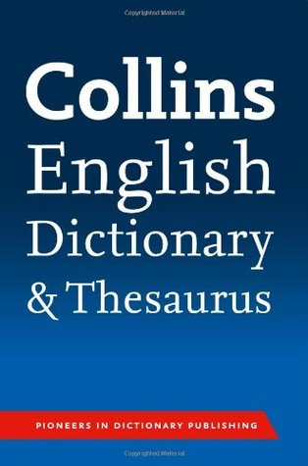
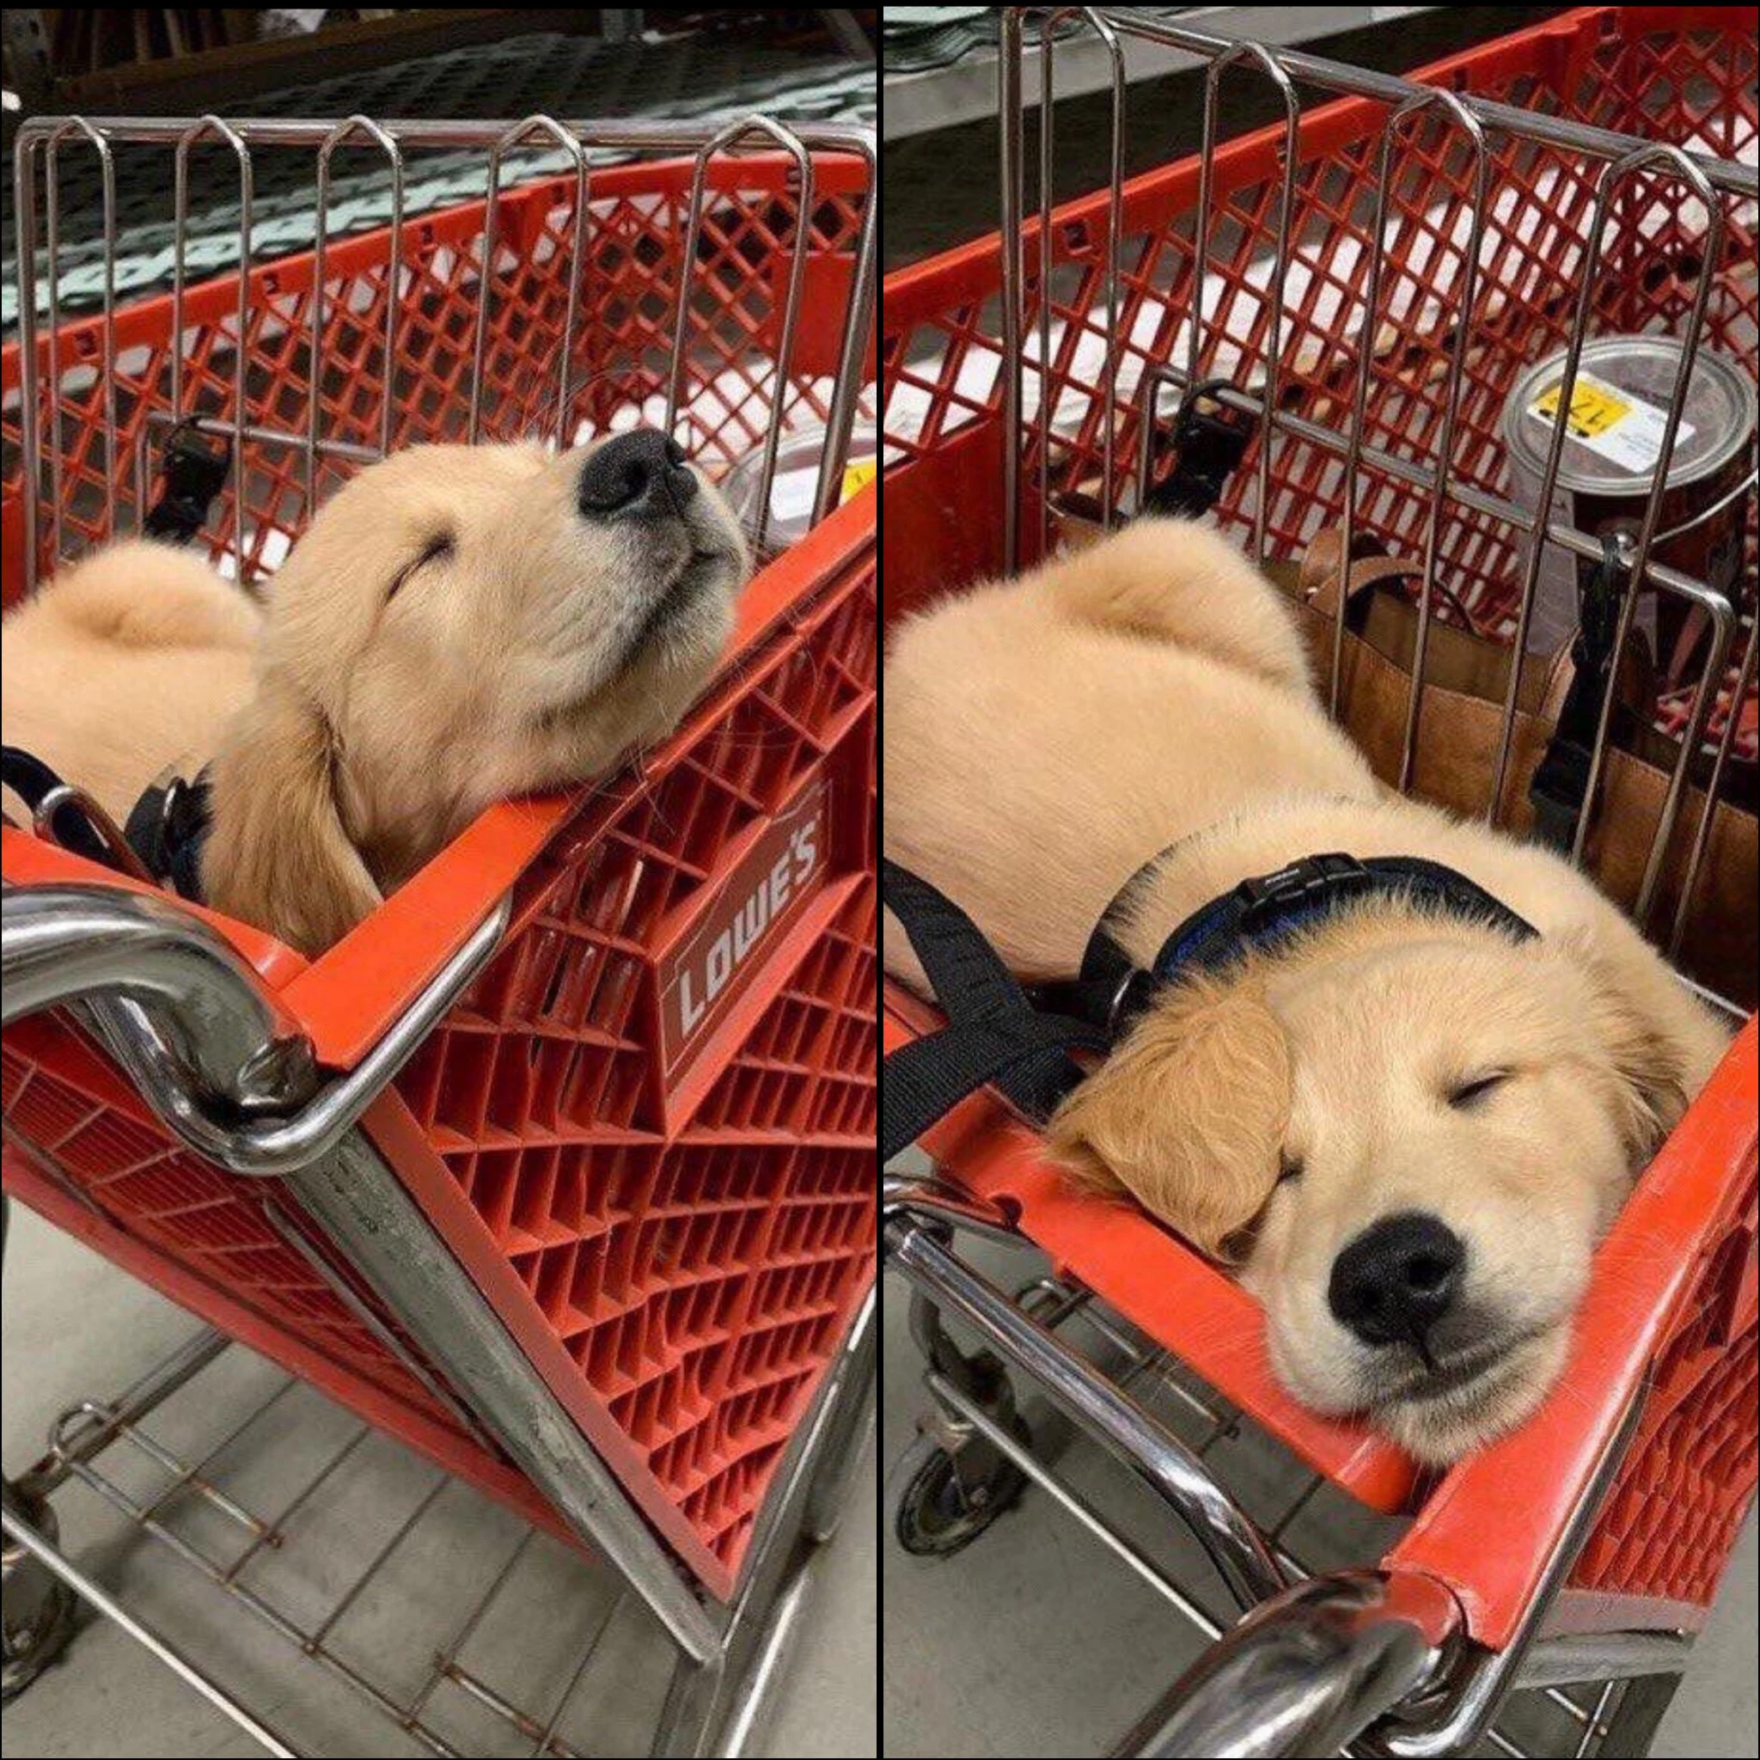
10 More Writing Tips: Curt Bonk Anything special that you do?
My top 20 key writing tips:
11. The Collins thesaurus.
12. Look for historical info online (e.g., Wikipedia and other).
13. Relocate to another room to edit document (i.e., kitchen table).
14. Sometimes sit. Sometimes stand.
15. Print out articles that you read parts of online.
16. Review paper piles on my pool table before you write.
17. Find info and URLs in previous talk slides.
18. Almost be more optimistic than pessimistic.
19. Work when your friends and family are sleeping.
20. Wherever you are is your writing space.

Slide 65
Writing Tools: Curt Bonk What particular writing tools do you use? How have they changed over time? What about tools for collaboration?
My top 10 key writing tools:
Keyboard—buy special letter keys
Microsoft Word
Google Search (I hate Bing)
Email. And forward email to self.
TravelinEdMan blog
Dropbox
Zoom (or Skype for team meetings)
Blue pens and lots of paper
My monster syllabus (R678)
FutureMe: Write a letter to yourself in the future: https://www.futureme.org/

Slide 66
Habits/Rituals/Inspiration: Writing How do approach your writing tasks? Any rituals that you use and recommend for inspiration? Anything that really works for you?
Save writing ideas on slips of paper and look back at them.
Talk about your ideas.
Save starter text.
Clear email and to-do list.
Create checklist of plans.

Slide 67
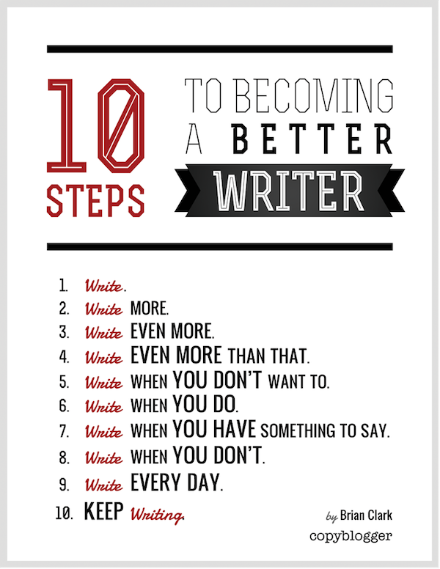
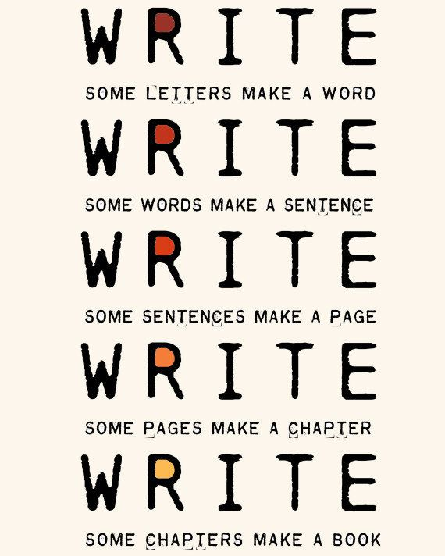
The Top 20 Writing Tips
Notes:
Curt
67

Slide 68
1. Mark Writing Days in Planner
Notes:
Curt
68

Slide 69
2. Maintain a List and Network of Potential Research and Writing Collaborators
Notes:
Curt
69

Slide 70
Sidenote: Find Good People to Work With…Life is Short—Avoid Egomaniacs and People Who Lie
Notes:
Curt
70

Slide 71
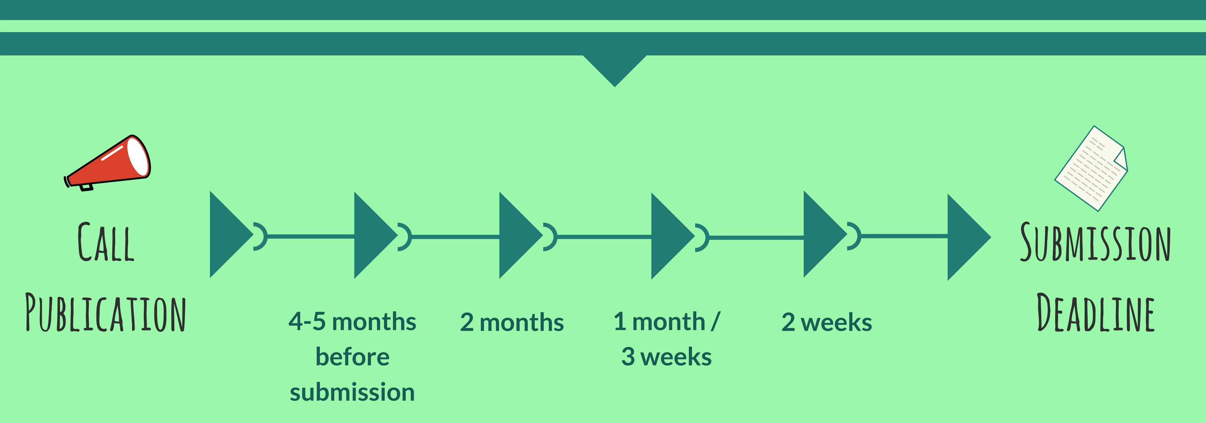
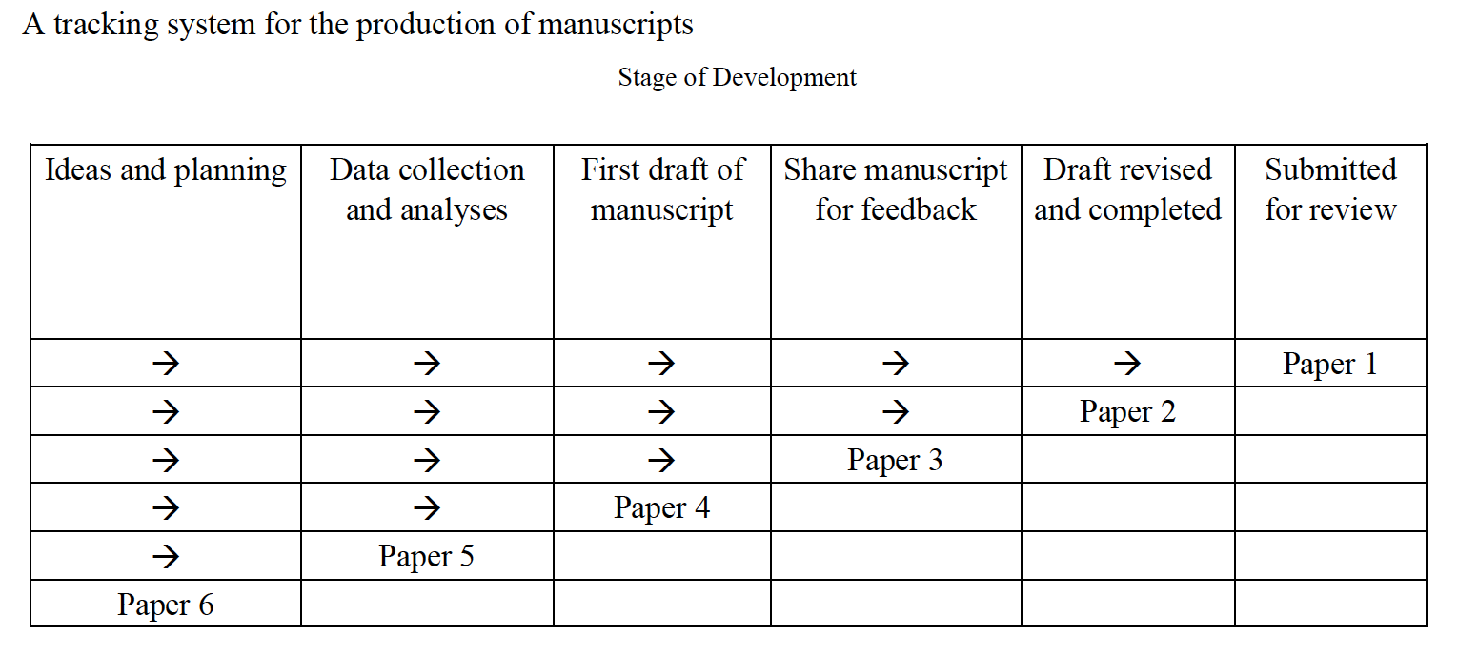
3. Draft a Timeline or Multiple Timelines with Flexible Goals
Notes:
Curt
Screenshot from Cecil’s article
71

Slide 72
4. Think Ahead About the Publishing Potential of Each Project
Notes:
Curt
72

Slide 73
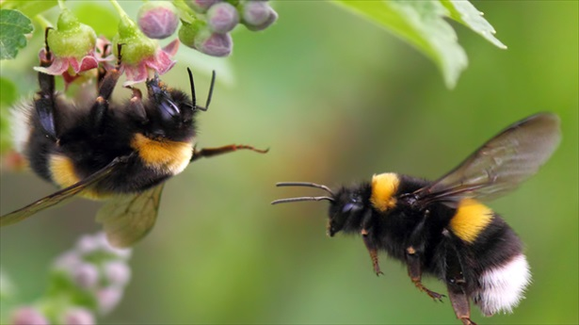
5. Be a Bumblebee and Butterfly
Notes:
Curt
73

Slide 74
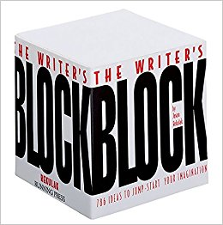
6. Find, Save, and Use Starter Text (overcomes writer’s block)
Notes:
Curt
74

Slide 75
7. Always Scan the Reference Sections of Other Articles to See What Journals are Popular
Notes:
Curt
75

Slide 76
8. Avoid High Quality (i.e., SSCI) Journal Fixations
Notes:
Curt
76

Slide 77
9. Be Second or Third Author Sometimes to Spread Limited Resources
Notes:
Curt
77

Slide 78
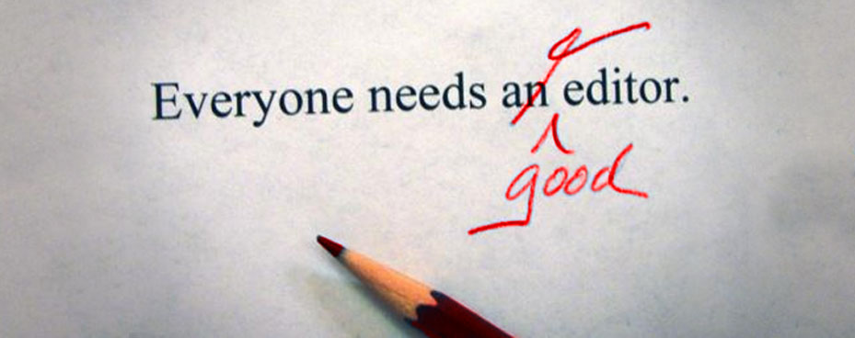
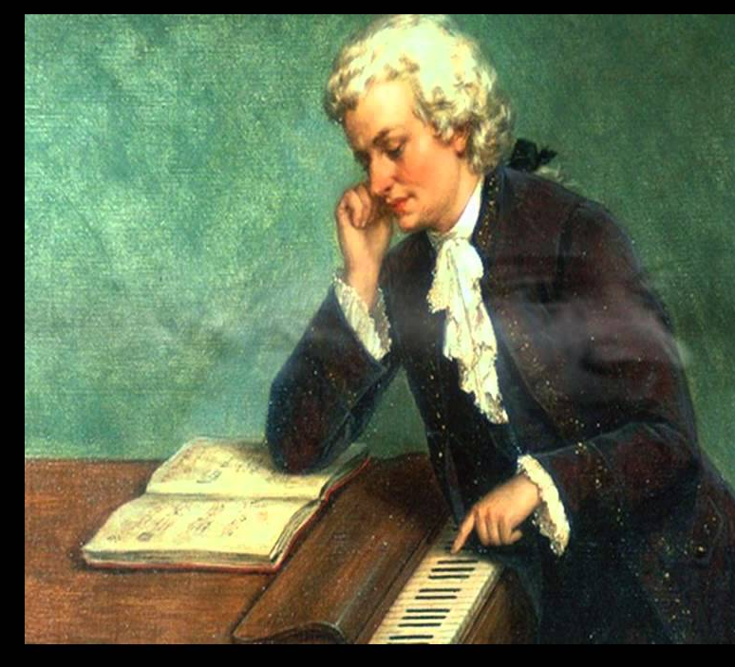
11. Edit Your Papers a Lot! (Mozartian vs. Beethovenian)
Notes:
Curt
78

Slide 79
12. Organize Conference Symposia Which Can Lead to Special Journal Issues and Books
Notes:
Curt
79

Slide 80
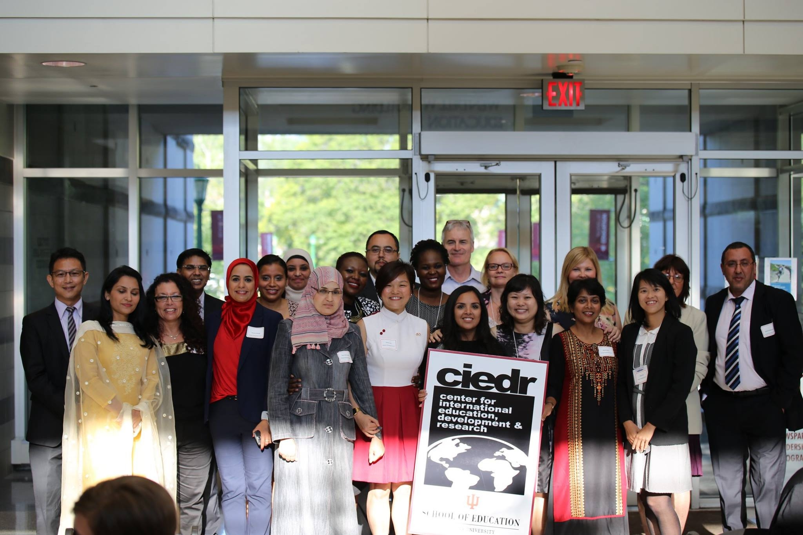
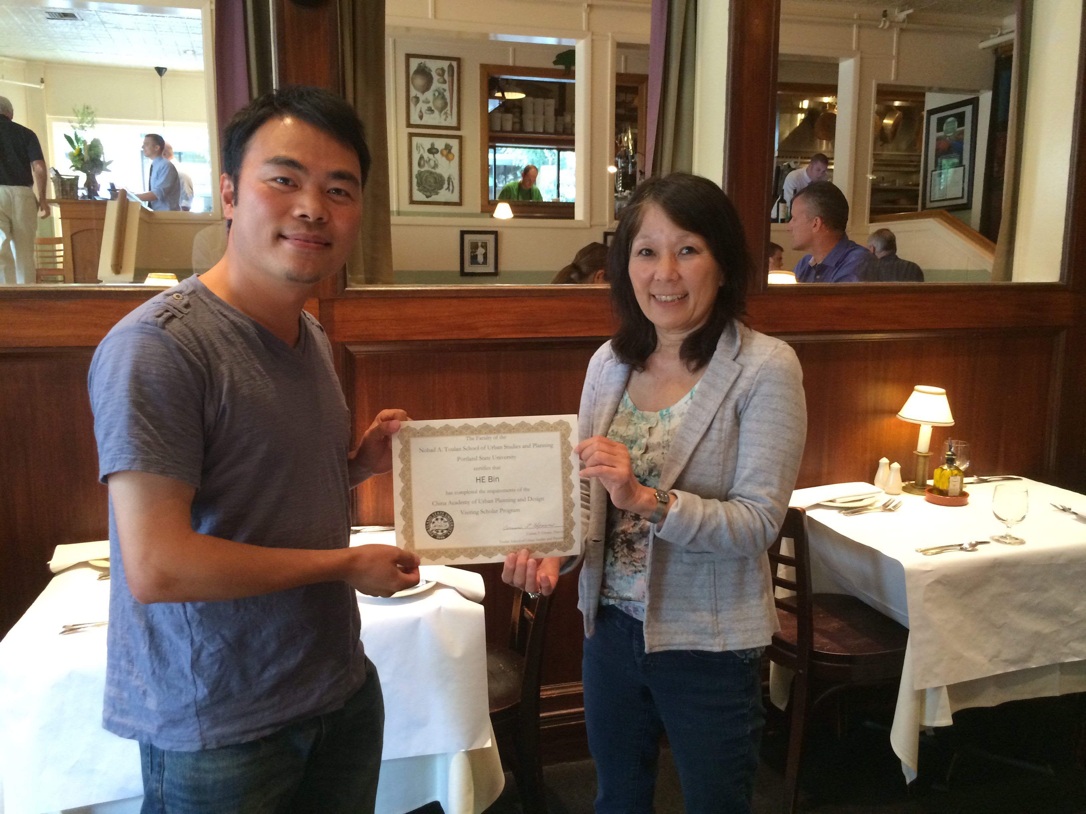
13. Sponsor Visiting Scholars to Work with You; They Often Have Writing Plans
Notes:
Curt
80

Slide 81
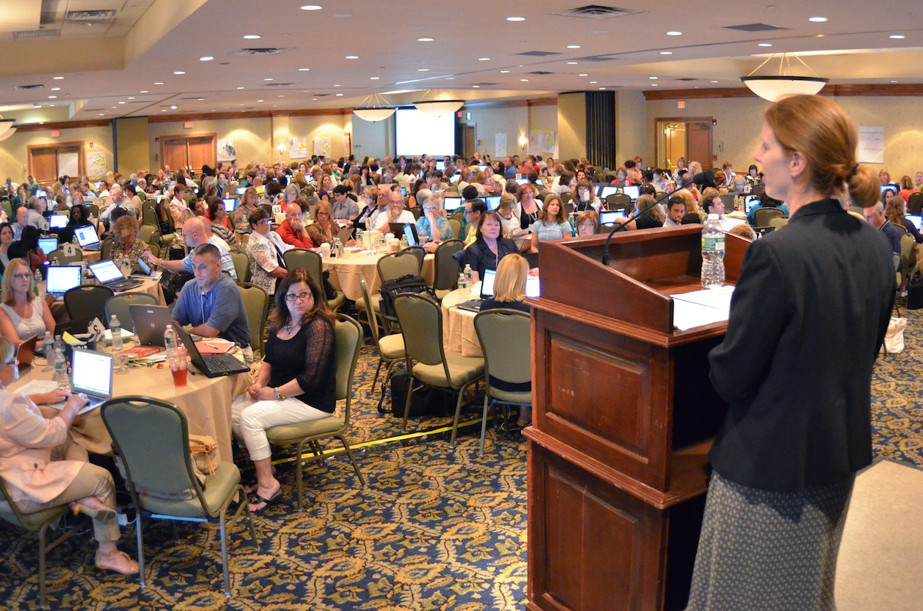
14. Try to Submit or Publish Your Paper Before the Conference
Notes:
Curt
81

Slide 82
15. Be Creative Somewhere (e.g., unique model, figure, chart, etc.)
Notes:
Curt
82

Slide 83
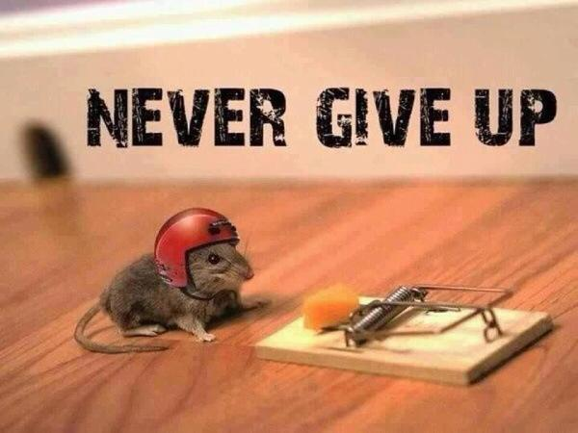
16. Try Not to Give Up: Persistence and Grit Wins the Day
Notes:
Curt
83

Slide 84
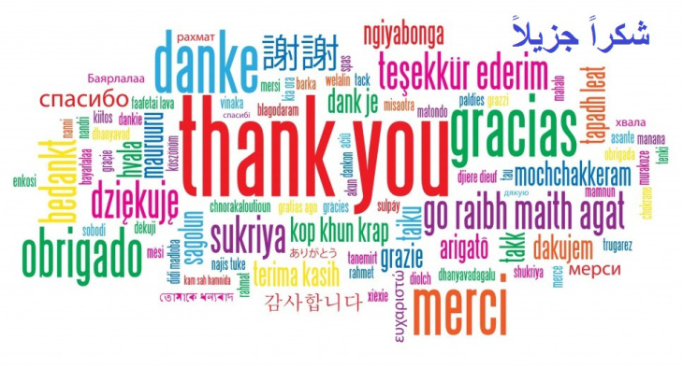
17. Be Polite and Thankful to the Journal or Book Chapter Editors
Notes:
Curt
84

Slide 85
18. Recap Reviewer Points and How You Attempted to Address Them
Notes:
Curt
85

Slide 86
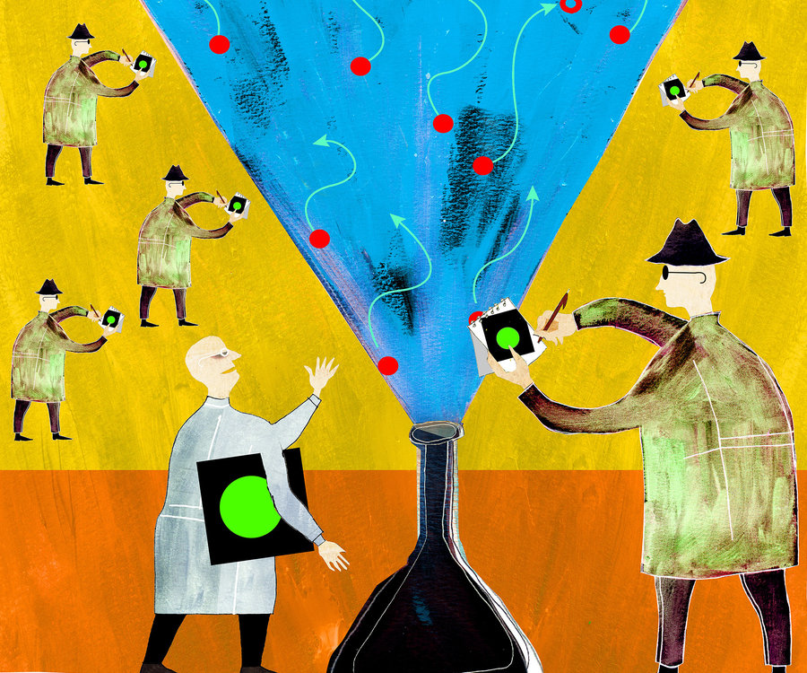
19. Share Your Publication Efforts (e.g., Twitter, Facebook, LinkedIn, email, ResearchGate, Academia.edu, etc.)
Notes:
Curt
86

Slide 87
20. Celebrate Your Writing Accomplishments with Friends
Notes:
Curt
87

Slide 88
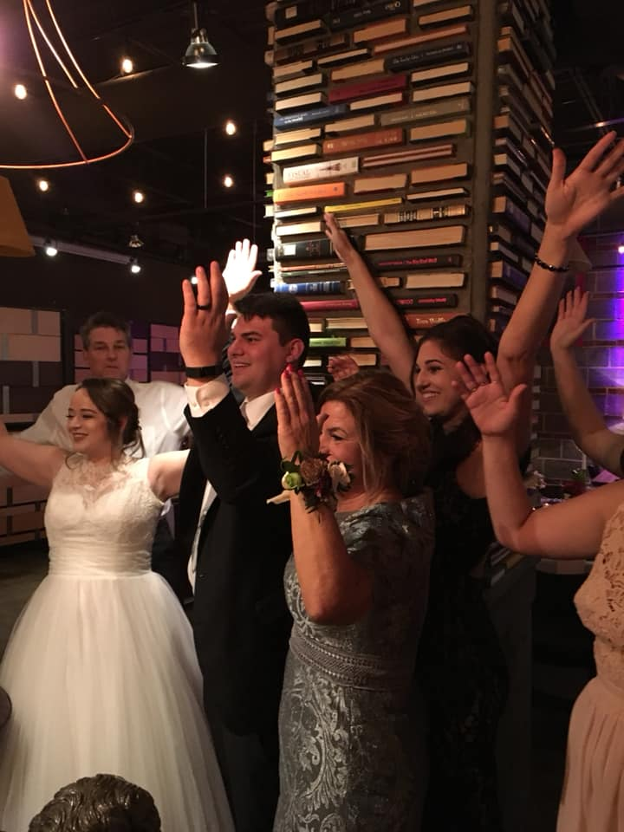
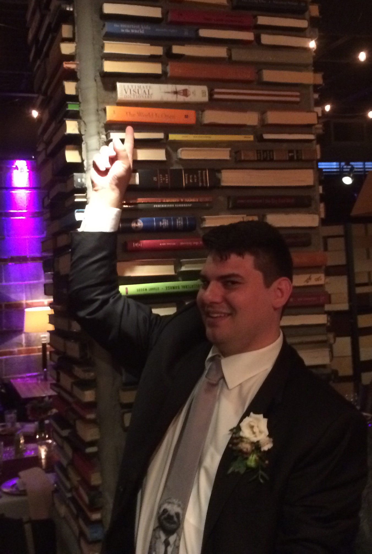
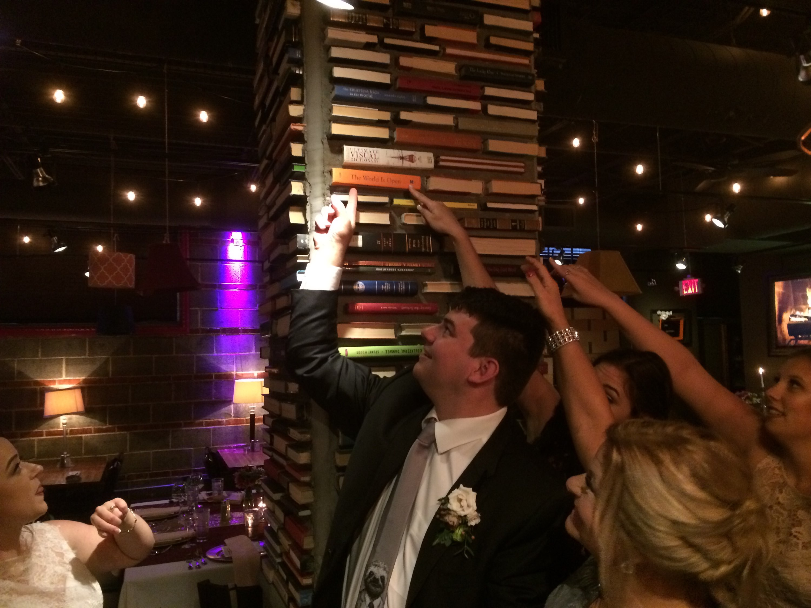
You never know where you’ll be celebrating your writing accomplishments… Even at a wedding of your nephew!
Notes:
Curt
88

Slide 89
What will you do…?

Slide 90
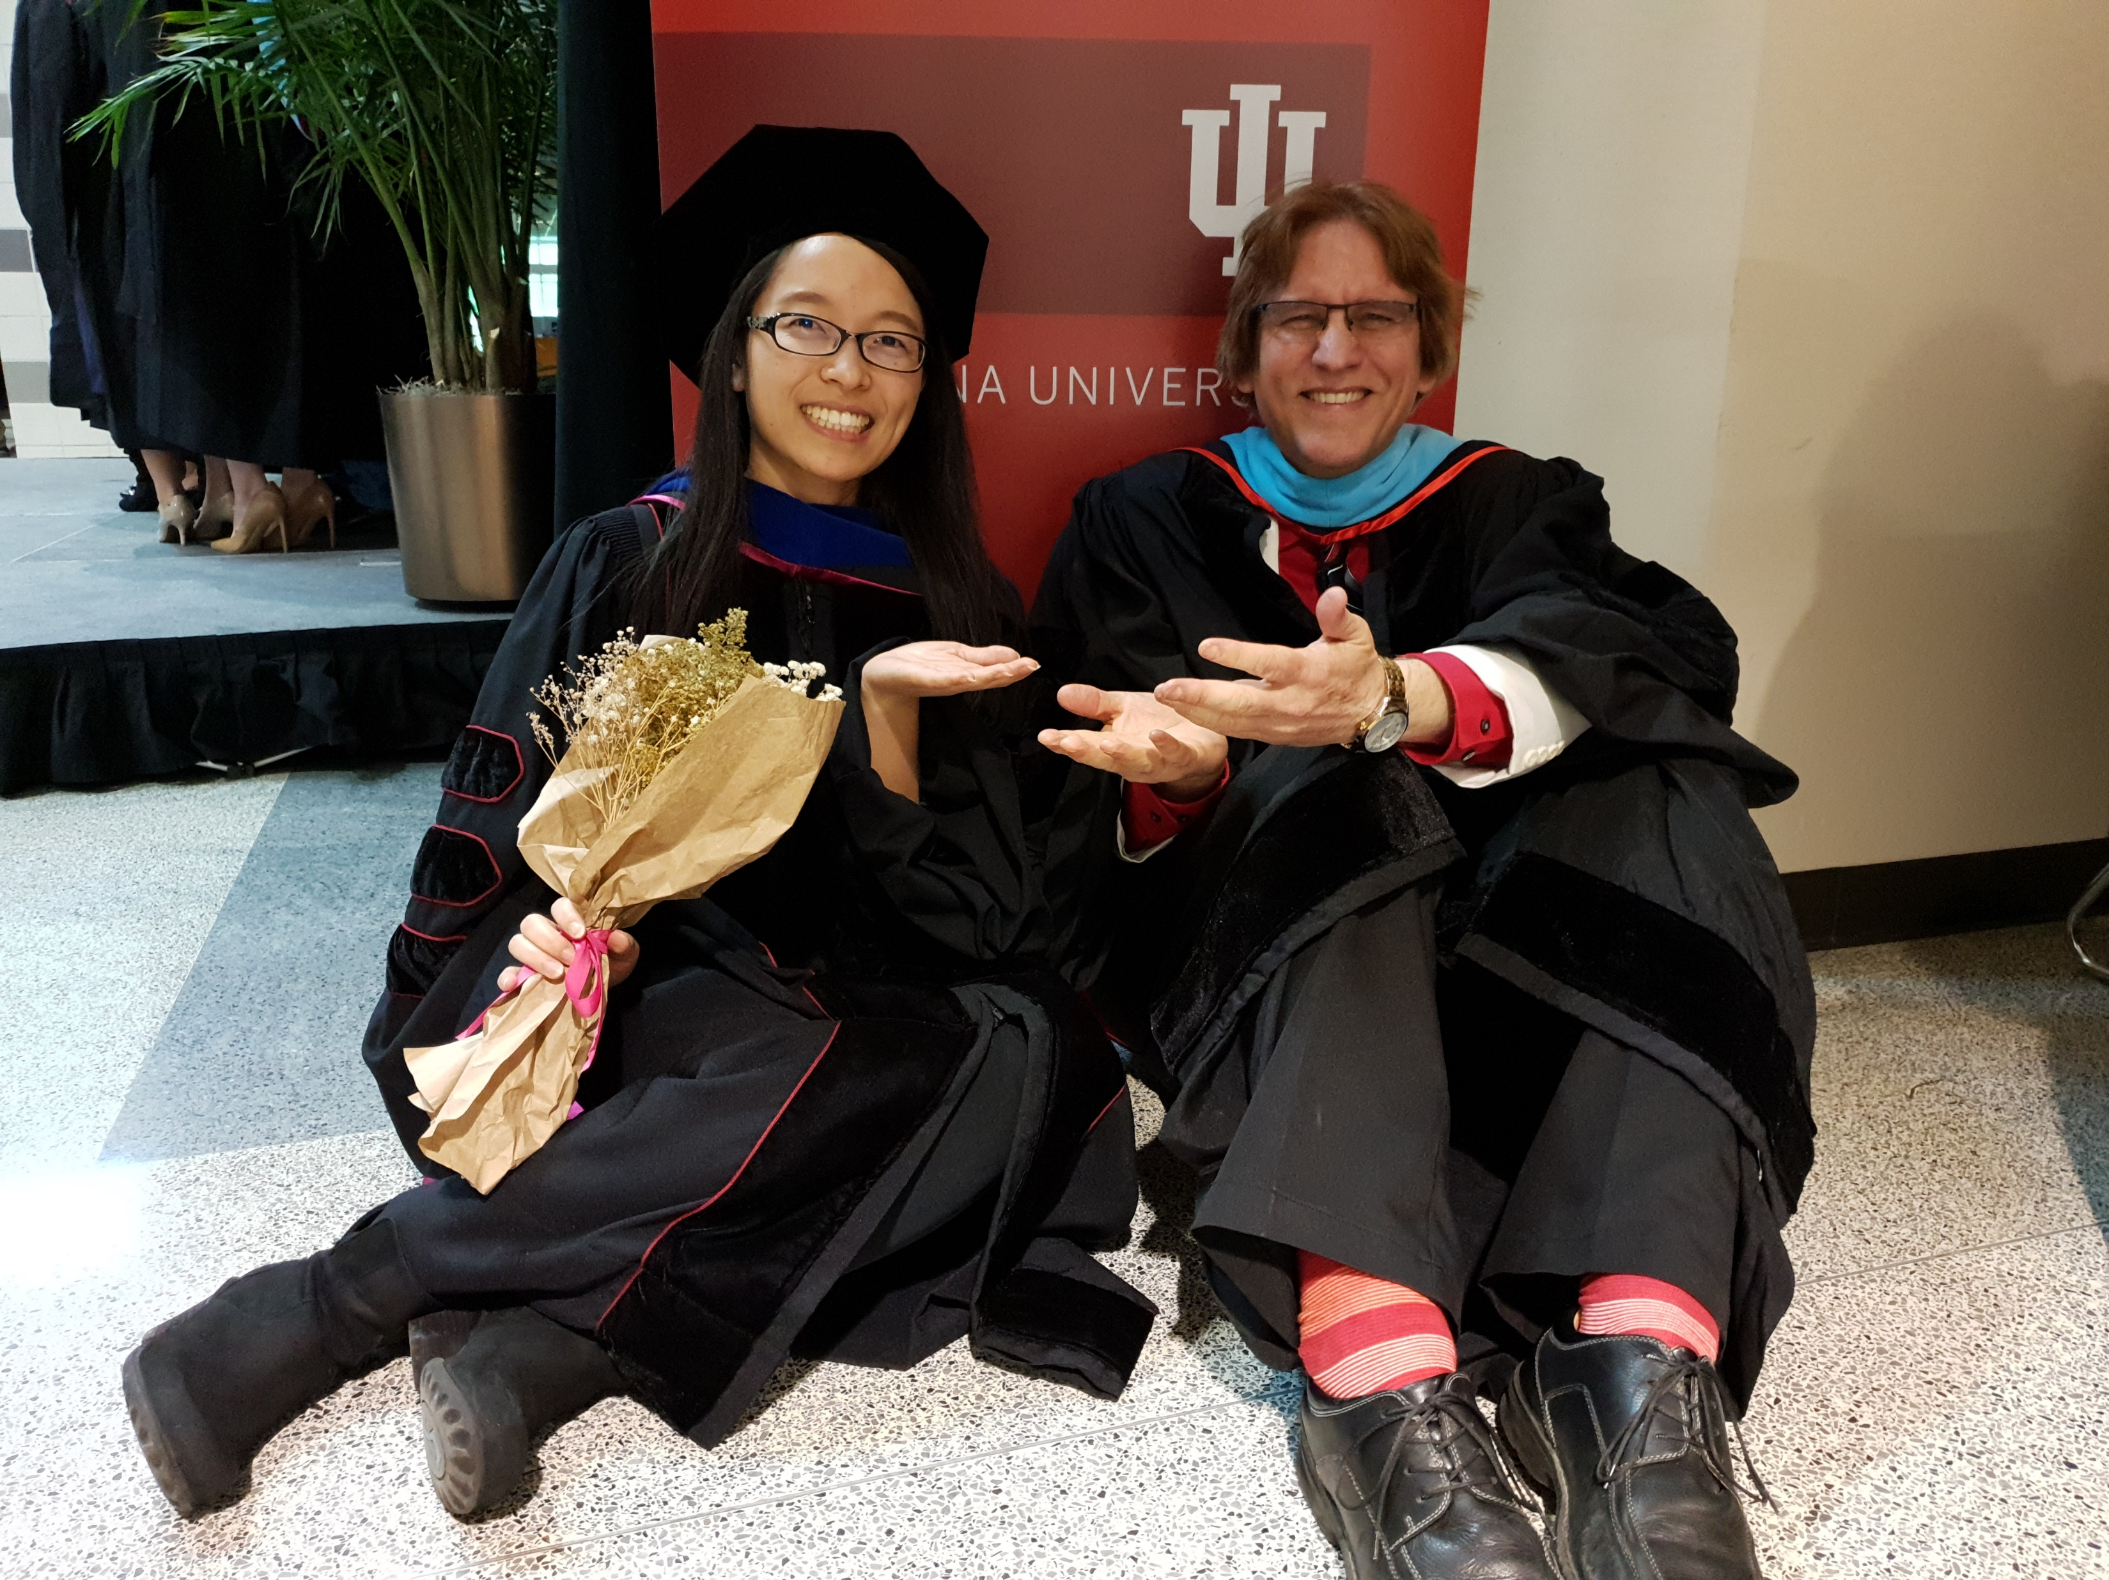
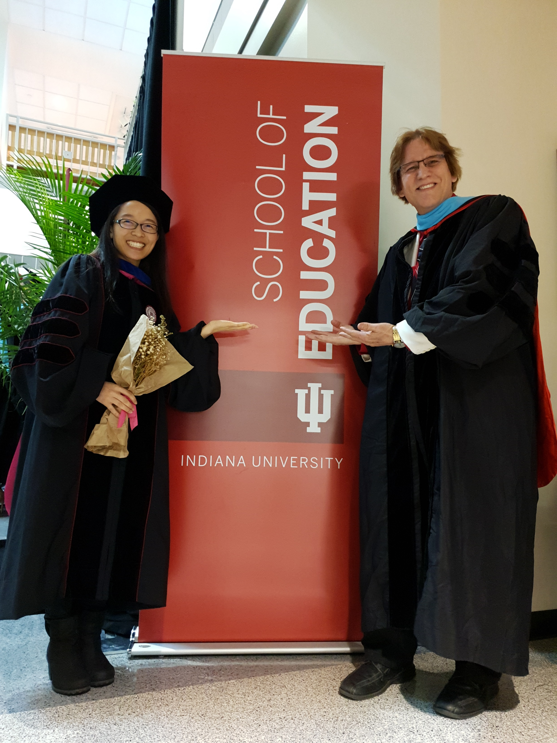
Concerns?
Comments?
Commitments?
Curt Bonk, IU, Email: cjbonk@Indiana.edu
Meina Zhu, WSU, Email: meinazhu@wayne.edu
Slides: http://www.trainingshare.com
Notes:
All
90

