Slide 1
Engage Number One: TEC-VARIETY: A Model for Motivating and Retaining Online Learners
Curtis J. Bonk, Professor, Indiana University
cjbonk@indiana.edu
http://mypage.iu.edu/~cjbonk/

Slide 2
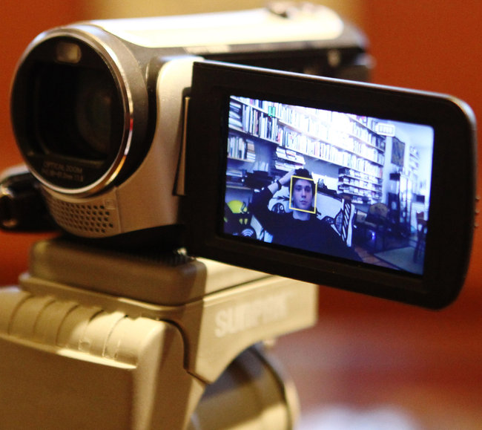
Learning is More Self-Directed Online Learning Polyglots http://www.nytimes.com/2012/03/11/nyregion/a-teenage-master-of-languages-finds-online-fellowship.html?_r=1&pagewanted=all
Timothy posts videos of himself speaking several languages on YouTube.

Slide 3
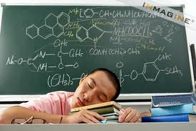
Motivation and Engagement

Slide 4
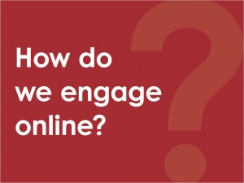
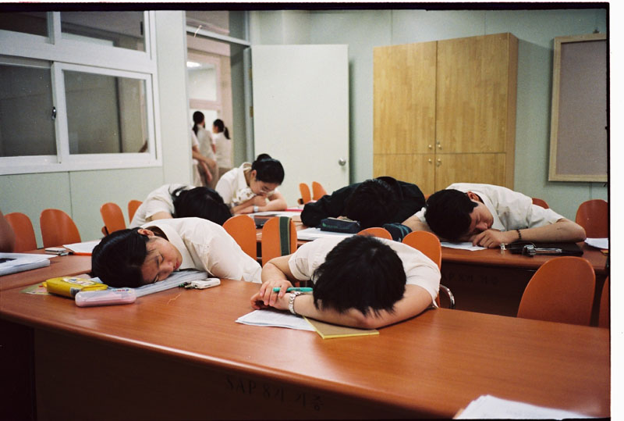

Slide 5
What did Jean-Luc Picard say?

Slide 6
That’s right, Engage!

Slide 7
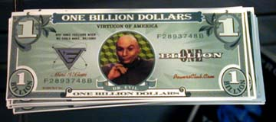
Poll #1: Million Dollar Question: What words come to mind when I say that I want to motivate learners?

Slide 8
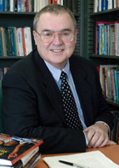
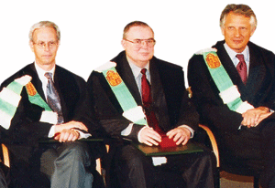
Motivation Research Highlights (Jere Brophy, Michigan State University)
1. Supportive, appropriate challenge, meaningful, moderation/optimal.
2. Teach goal setting and self-reinforcement.
3. Offer rewards for good/improved performance.
4. Novelty, variety, choice, adaptable to interests.
5. Game-like, fun, fantasy, curiosity, suspense, active.
6. Higher levels, divergence, dissonance, peer interaction.
7. Allow to create finished products.
8. Provide immediate feedback, advance organizers.
9. Show intensity, enthusiasm, interest, minimize anxiety.
10. Make content personal, concrete, familiar.

Slide 9
Intrinsic Motivation
“…innate propensity to engage one’s interests and exercise one’s capabilities, and, in doing so, to seek out and master optimal challenges
(i.e., it emerges from needs, inner strivings, and personal curiosity for growth)
See: Deci, E. L., & Ryan, R. M. (1985). Intrinsic motivation and self-determination in human behavior. NY: Plenum Press.

Slide 10
Framework: TEC-VARIETY for Online Motivation and Retention
Tone/Climate: Psych Safety, Comfort, Belonging
Encouragement, Feedback: Responsive, Supports
Curiosity: Fun, Fantasy, Control
…
Variety: Novelty, Intrigue, Unknowns
Autonomy: Choice: Flexibility, Opportunities
Relevance: Meaningful, Authentic, Interesting
Interactive: Collaborative, Team-Based, Community
Engagement: Effort, Involvement, Excitement
Tension: Challenge, Dissonance, Controversy
Yields Products: Goal Driven, Products, Success, Ownership

Slide 11
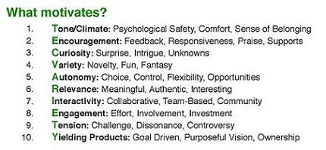
Education 3.0? Introducing the free “TEC-VARIETY” Framework… http://tec-variety.com/ http://tec-variety.com/TEC-VARIETY-Chinese.pdf

Slide 12
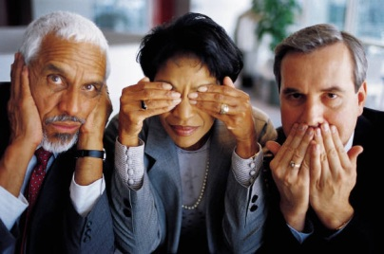
Low Risk
High Risk
1. Risk
Easy to Embed
Extensive Planning
2. Time
Free or Inexpensive
Enterprise Licenses
3. Cost
Instructor-Focus
Student-Focus
4. Student-Centered
Low
High

Slide 13
Examples of TEC-VARIETY

Slide 14
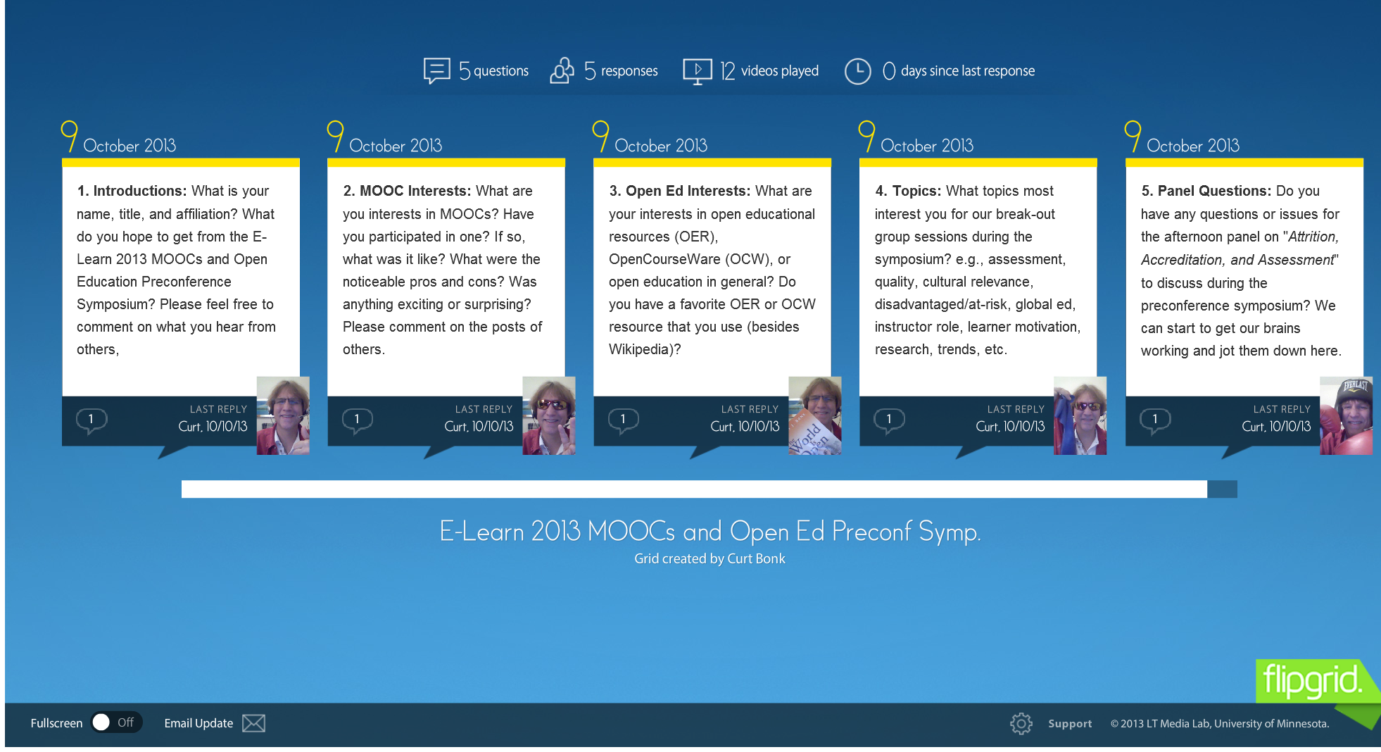
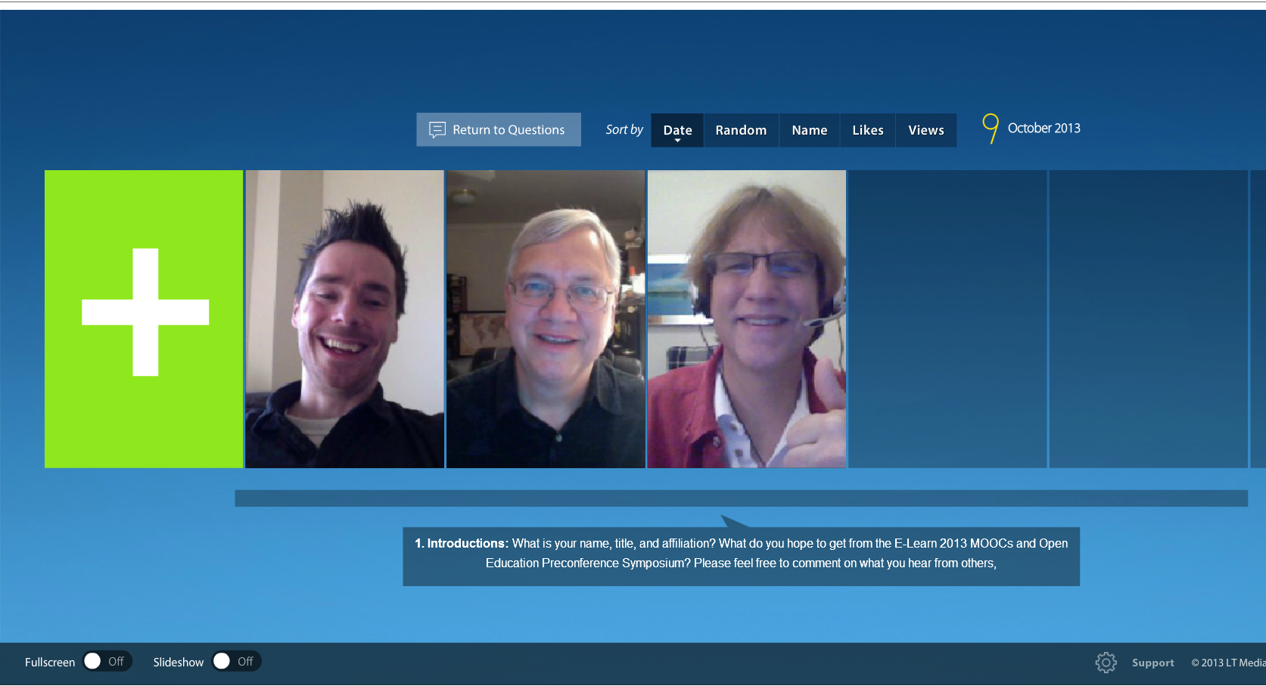
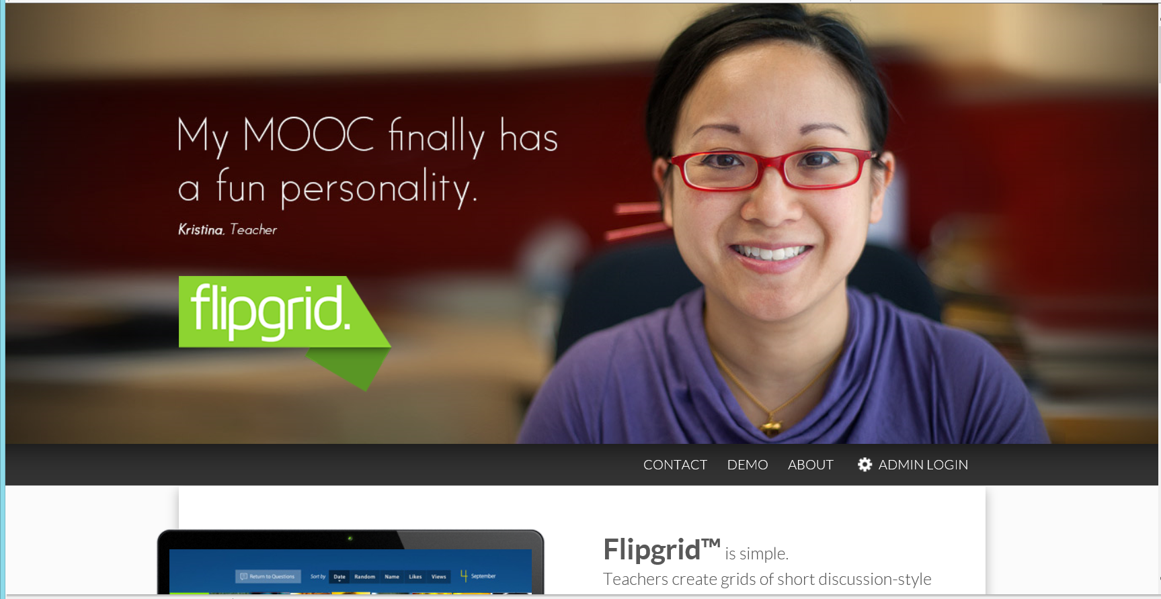
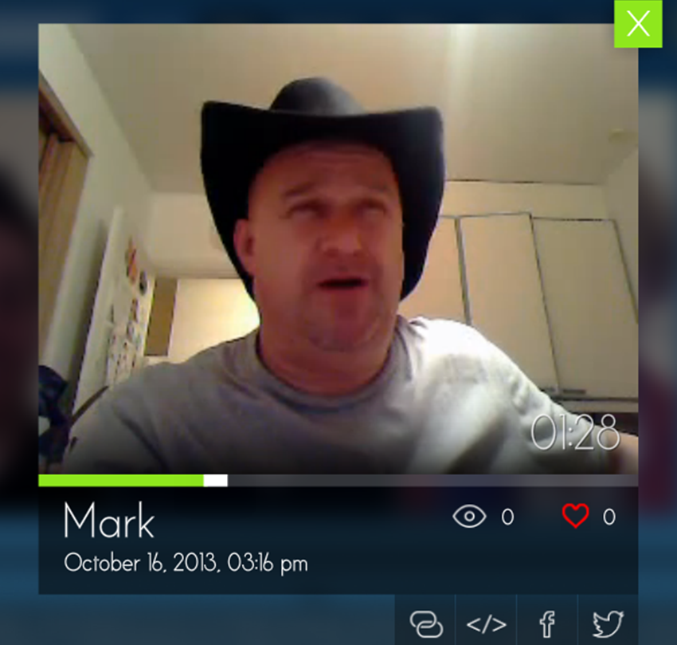
1. Tone/Climate: A. Threaded Video Discussions, e.g., Flipgrid http://flipgrid.com/#429f88c5)

Slide 15
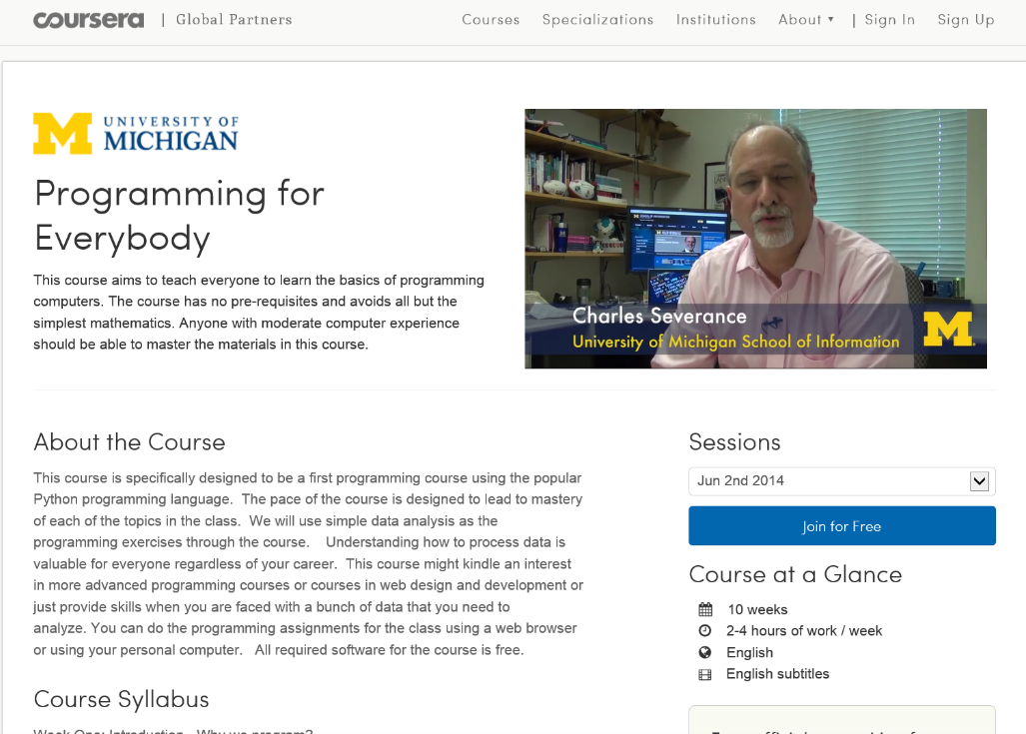
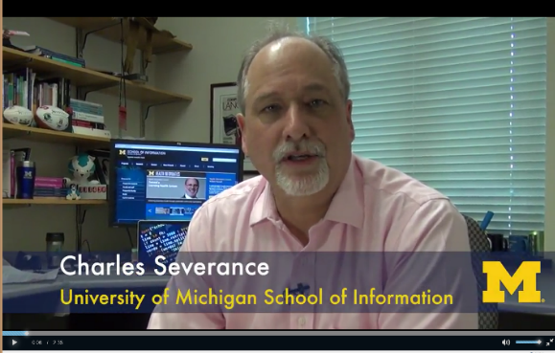
1. Tone/Climate: B. Video Introductions (Office Hours in Other Countries) Chuck Severance, U Michigan/Coursera) in Barcelona http://www.youtube.com/watch?v=JzNHvmSv8TI Chuck Severance, University of Michigan https://www.coursera.org/course/pythonlearn

Slide 16
2. Encouragement, Feedback, etc.: A. Demonstrations and Tutorials Emerging technology specialist, IU UITS, Nitocris Perez, May 29, 2014 http://inside.iub.edu/features/videos/2014-05-29-inub-vid-cib.shtml

Slide 17
2. Encouragement, Feedback, etc.: B. Voice/Audio Feedback Vocaroo: http://vocaroo.com/ http://vocaroo.com/i/s1KQTNmlB3Na (Recorded by Curt Bonk for the Open University of China)

Slide 18
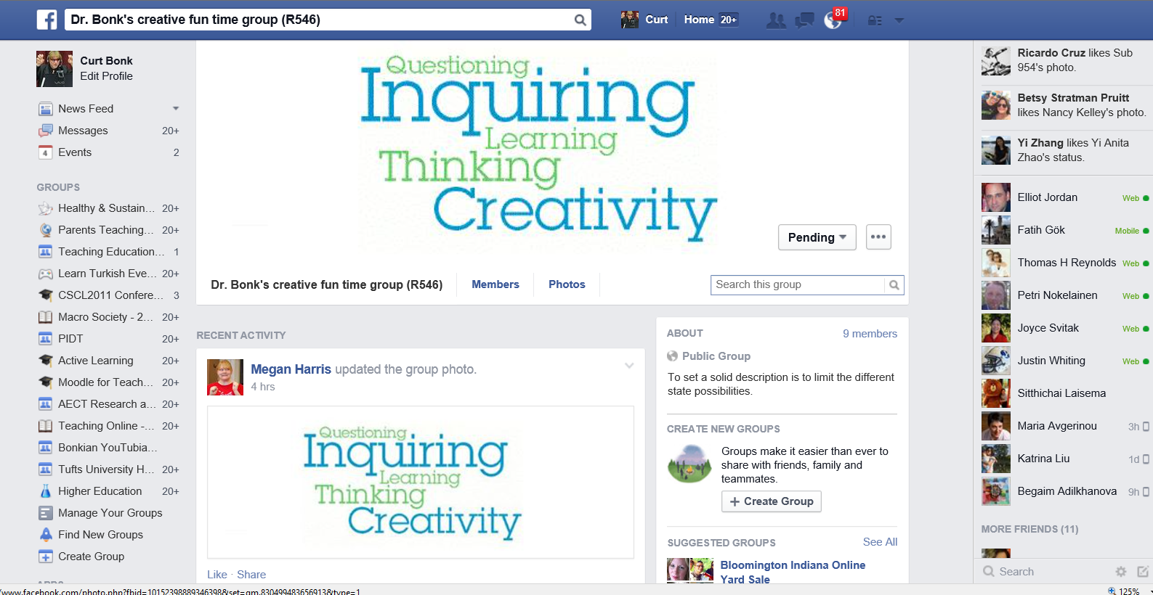
October 4, 2014 2. Encouragement, Feedback, etc.: C. Class Facebook Group Dr. Bonk's creative fun time group (R546) https://www.facebook.com/groups/830496290323899/

Slide 19
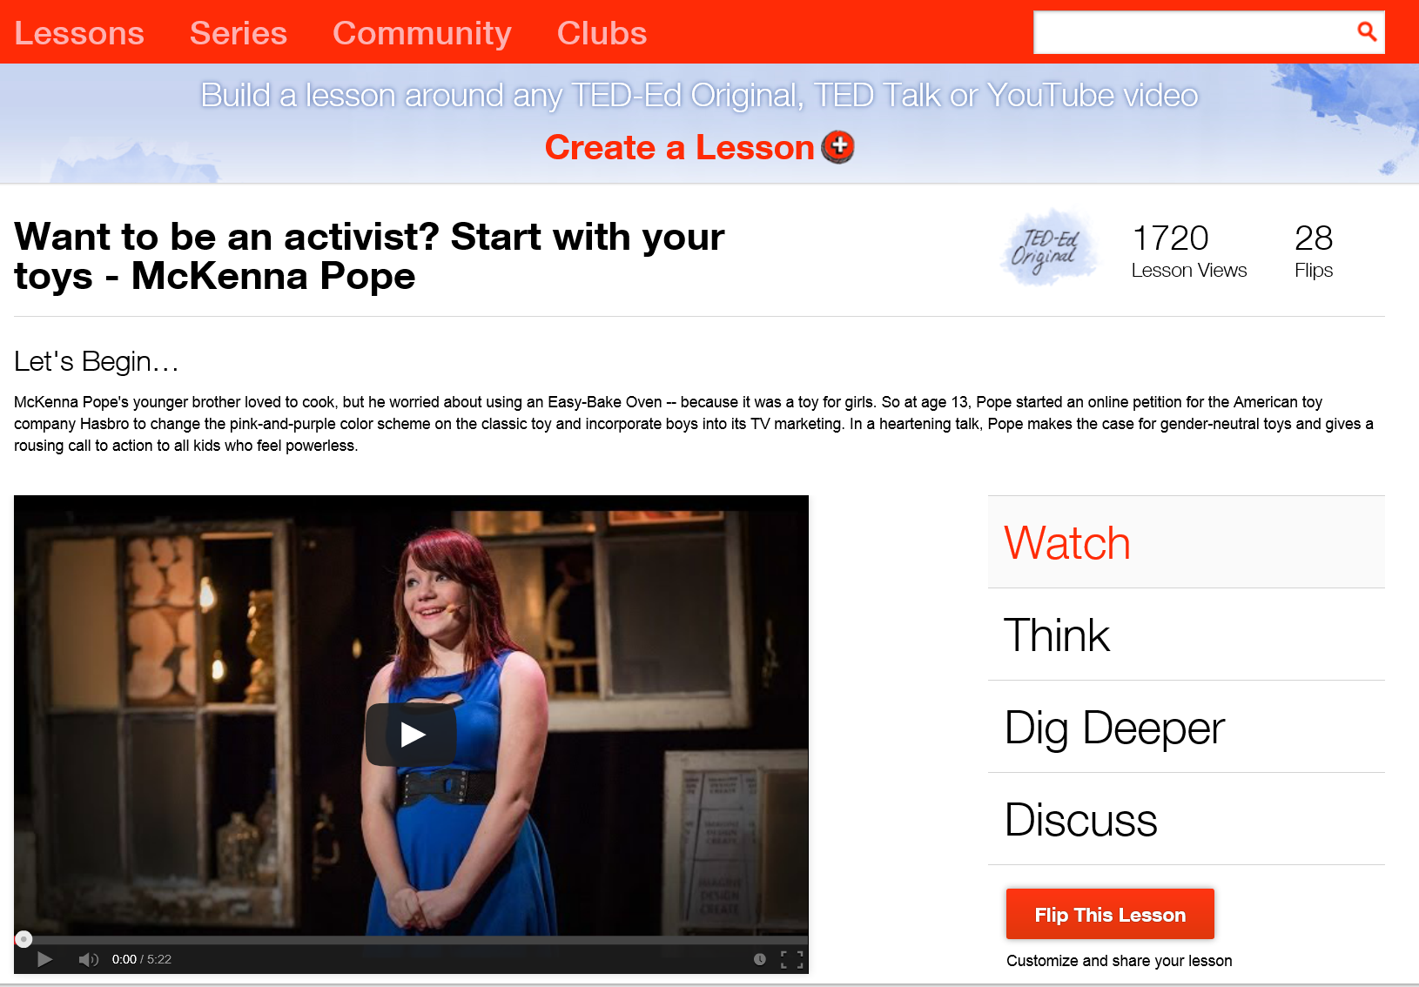
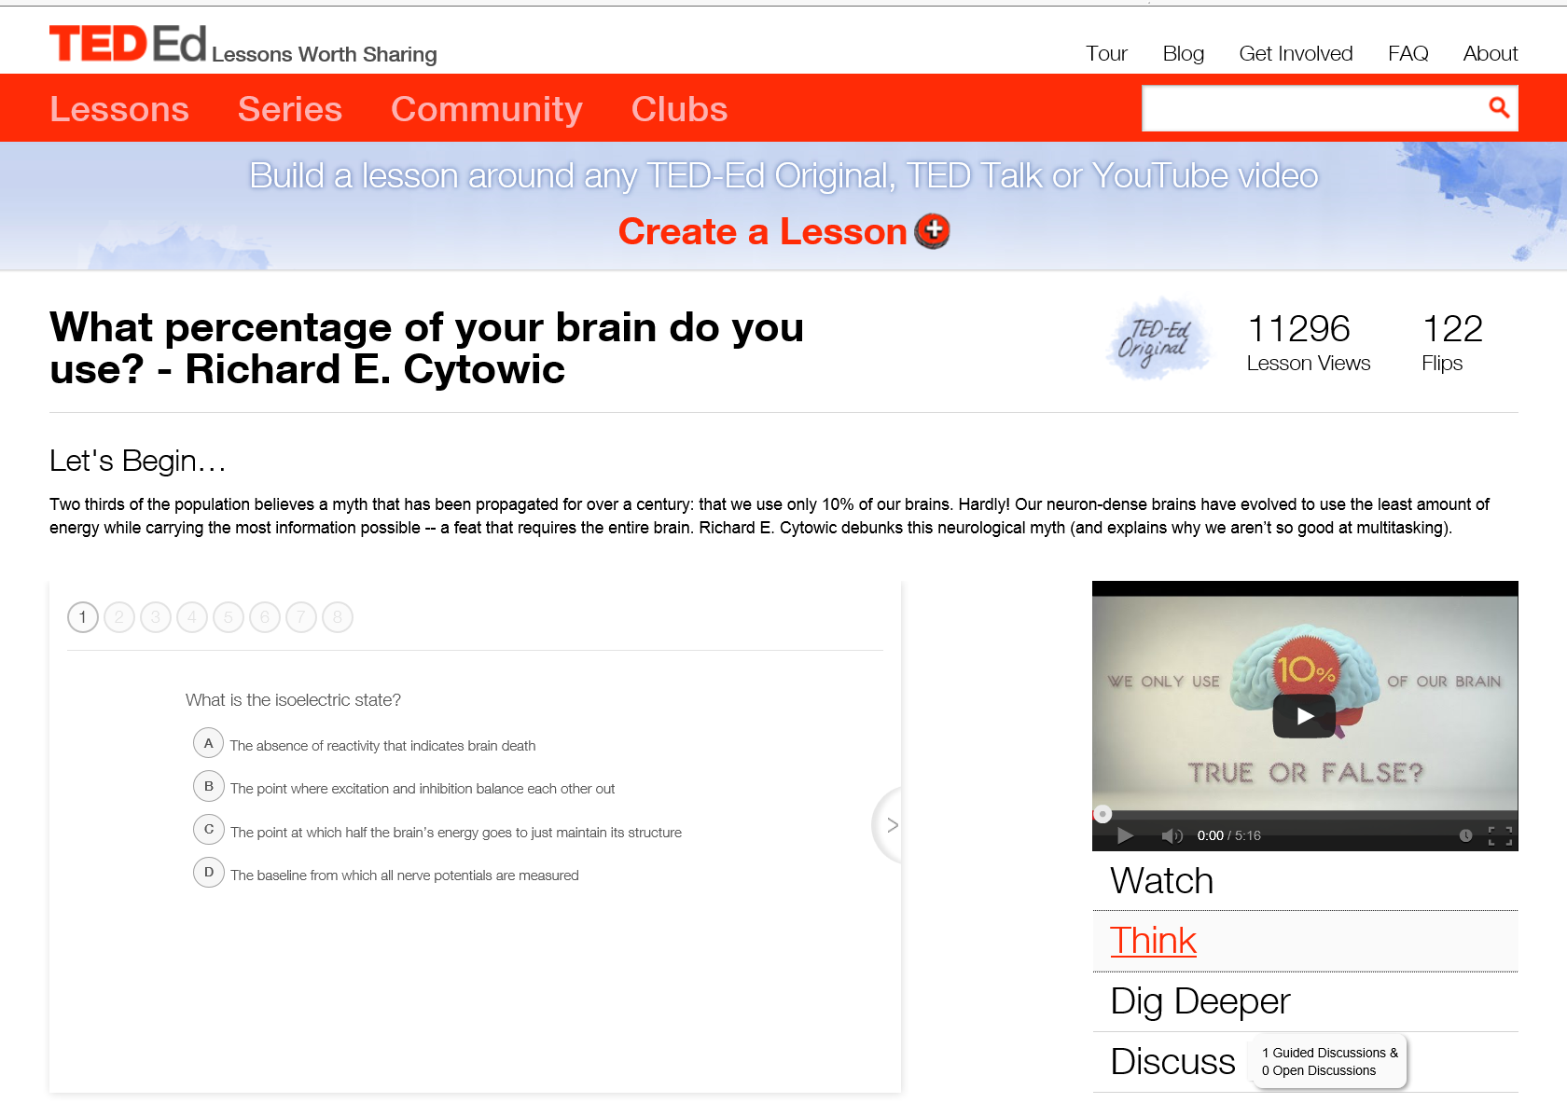
2. Encouragement, Feedback, etc.: D. Videos and Online Quizzes (e.g., Want to be an activist? Start with your toys - McKenna Pope , TEDEd) http://ed.ted.com/lessons/want-to-be-an-activist-start-with-your-toys-mckenna-pope#watch

Slide 20
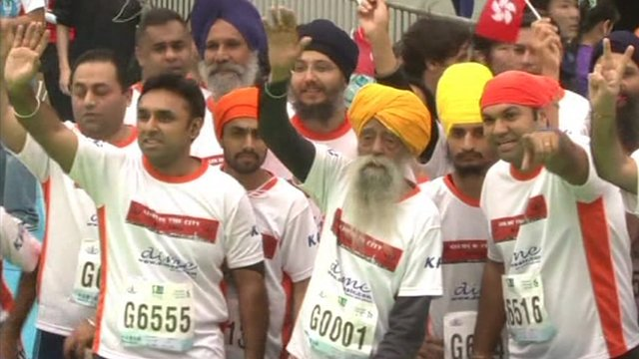
May 25, 2015 3. Curiosity, Fun: A. Something in the News (e.g., Chinese universities move up in world rankings, China Daily) http://www.cnn.com/2014/12/17/health/healthy-aging/index.html?hpt=hp_t2 http://espn.go.com/sports/endurance/story/_/id/8979487/fauja-singh-101-caps-career-10k-hong-kong http://www.chinadaily.com.cn/china/2015-05/25/content_20805854.htm

Slide 21
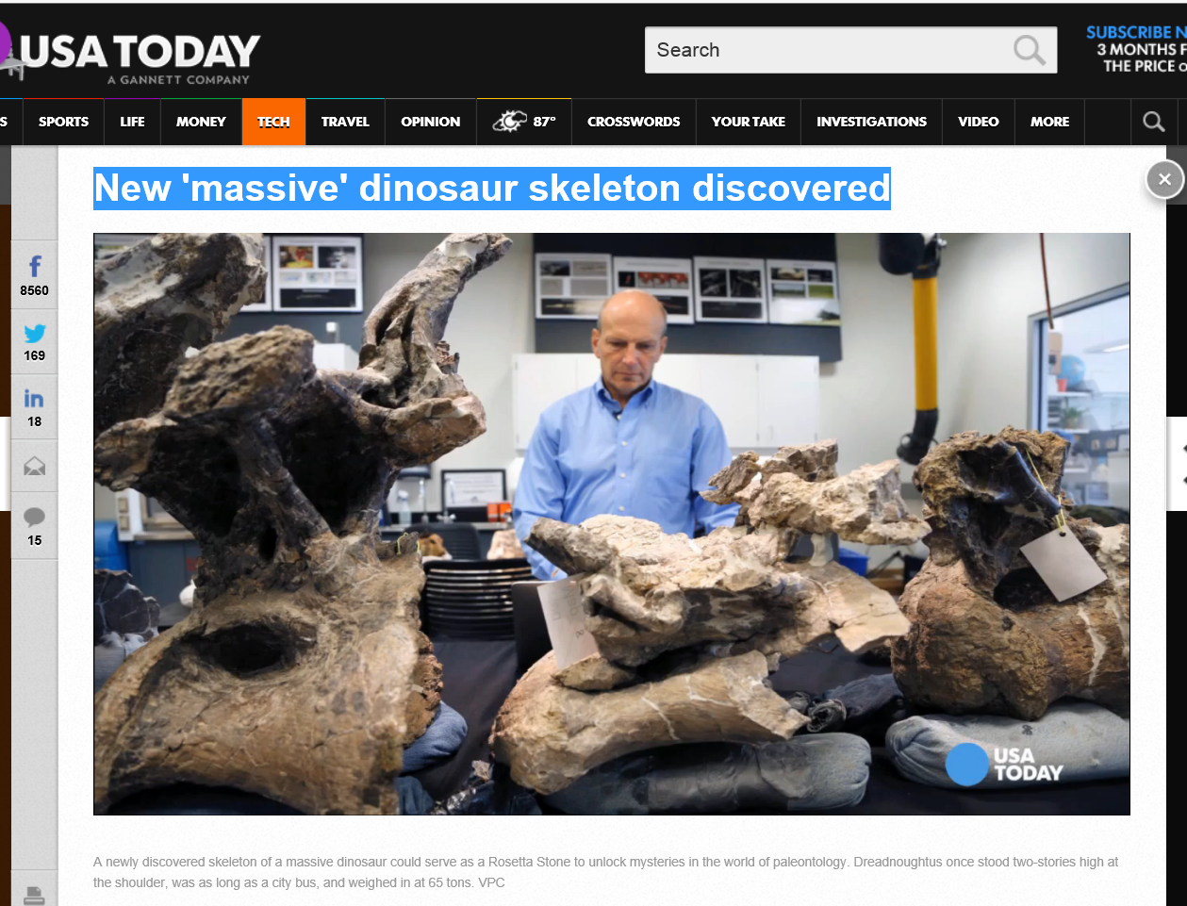
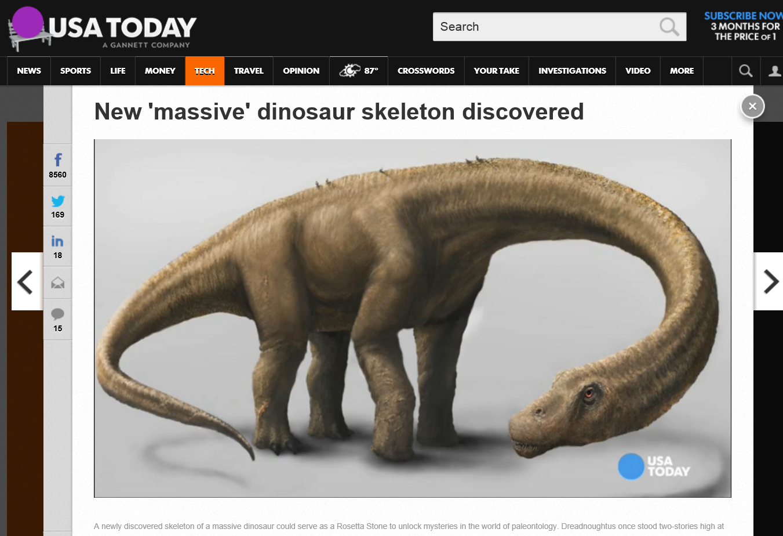
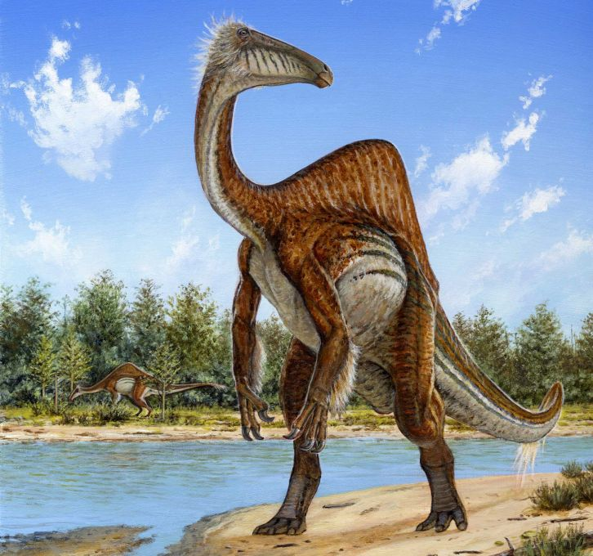
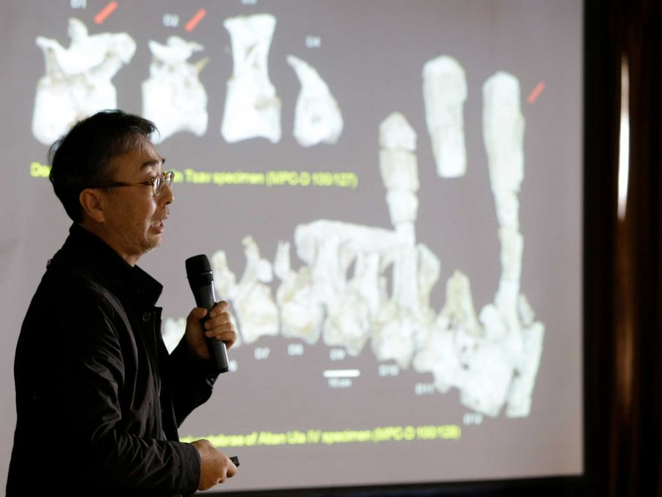
3. Curiosity, Fun: B. Something in the News New 'massive' dinosaur skeleton discovered, USA Today, September 5, 2014 (Dreadnoughtus) http://www.usatoday.com/story/tech/2014/09/04/dinosaur-skeleton-discovered/15031803/ October 23, 2014: Goofy dinosaur blends Barney and Jar Jar Binks, SF Gate http://www.sfgate.com/news/science/article/Goofy-dinosaur-blends-Barney-and-Jar-Jar-Binks-5840093.php Incredible 50-foot 'dragon' dinosaur unearthed by Chinese farmers January 20, 2015: Naomi Ng, for CNN http://www.cnn.com/2015/01/30/asia/china-dragon-dinosaur/index.html

Slide 22
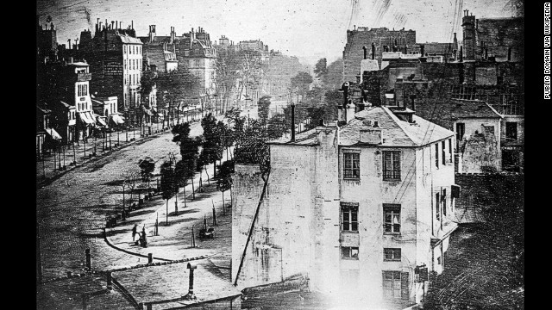
3. Curiosity, Fun: C. Something in the News (e.g., This may be the oldest surviving Photo of a human, November 7, 2014, CNN, Brandon Griggs; But this image, taken in Paris, France, in 1838) http://www.cnn.com/2014/11/06/living/oldest-photograph-human-daguerre/index.html?hpt=hp_t4 kong

Slide 23
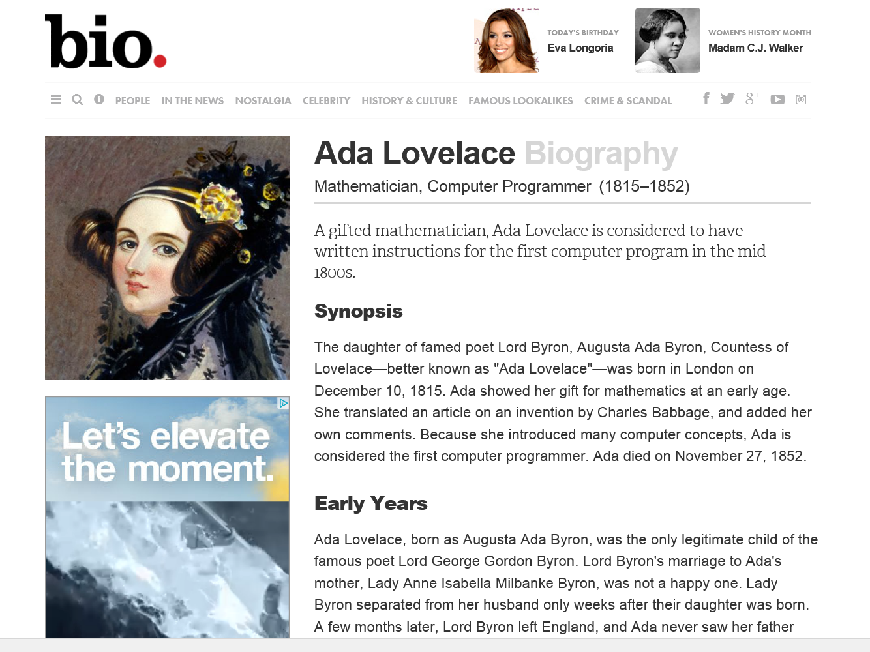
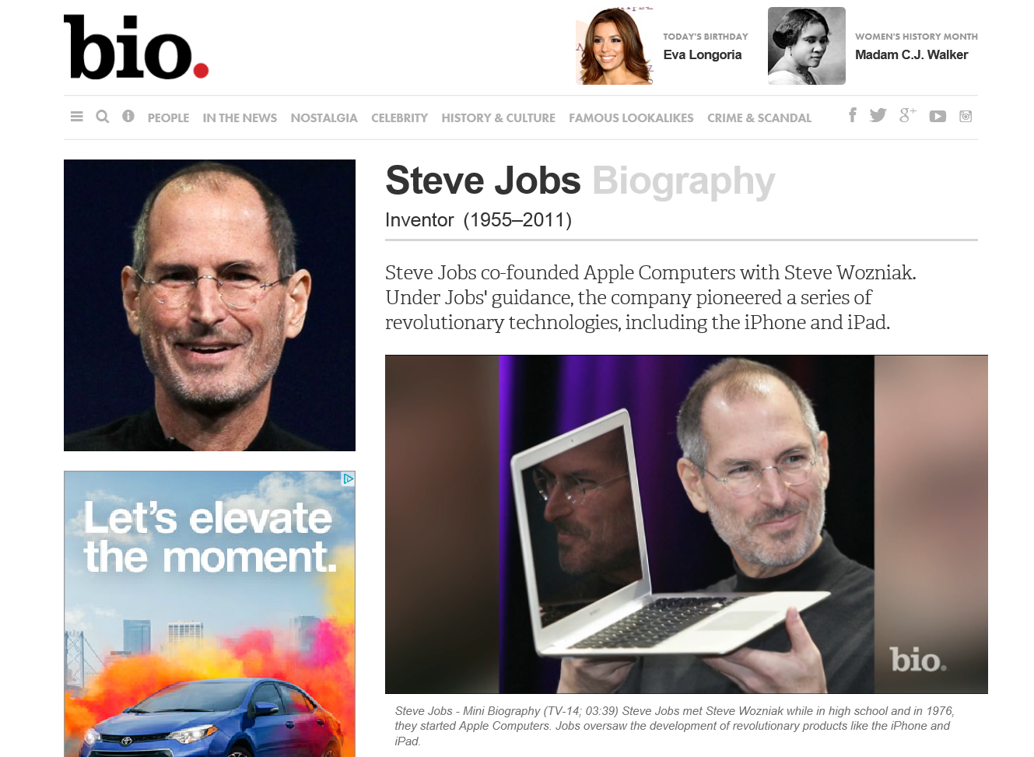
3. Curiosity, Fun: D. Tracking the Life of a Computer Scientist (bio.com) http://www.biography.com/people/steve-jobs-9354805 http://www.biography.com/people/ada-lovelace-20825323

Slide 24
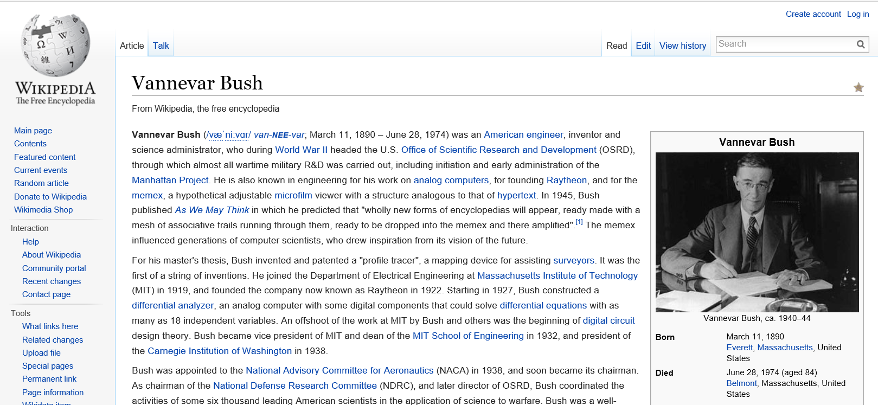
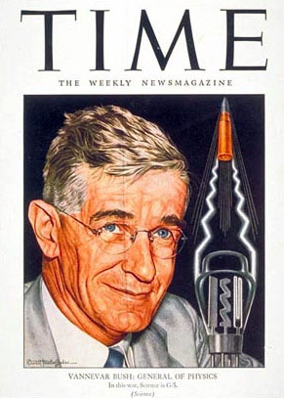
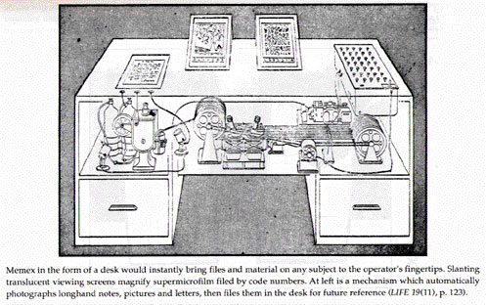
3. Curiosity, Fun: E. Tracking the Life of a Computer Scientist (Wikipedia) http://en.wikipedia.org/wiki/Vannevar_Bush

Slide 25
Poll #2: Which of these ideas might you use?
Threaded video discussions (e.g., Flipgrid)
Video introductions (instructor or student)
Demonstrations and tutorials (Jing, Screenr, etc.)
Voice/Audio feedback (Vocaroo)
Online practice tests
Something in the news
Tracking life of scientist

Slide 26
4. Variety, Novelty, Fun: A. Teach from Vietnam to the World BBC News Asia, August 14, 2013 Even though he is now very elderly Vinh Bao (age 96) still teaches music, using his computer to coach pupils across the globe. http://www.bbc.com/news/world-asia-23497559

Slide 27
4. Variety, Novelty, Fun, Fantasy: B. Random Lists (Random.org—clocks, coins, playing cards, dice, integers, passwords, jazz scales, lists, sequences, etc.)

Slide 28
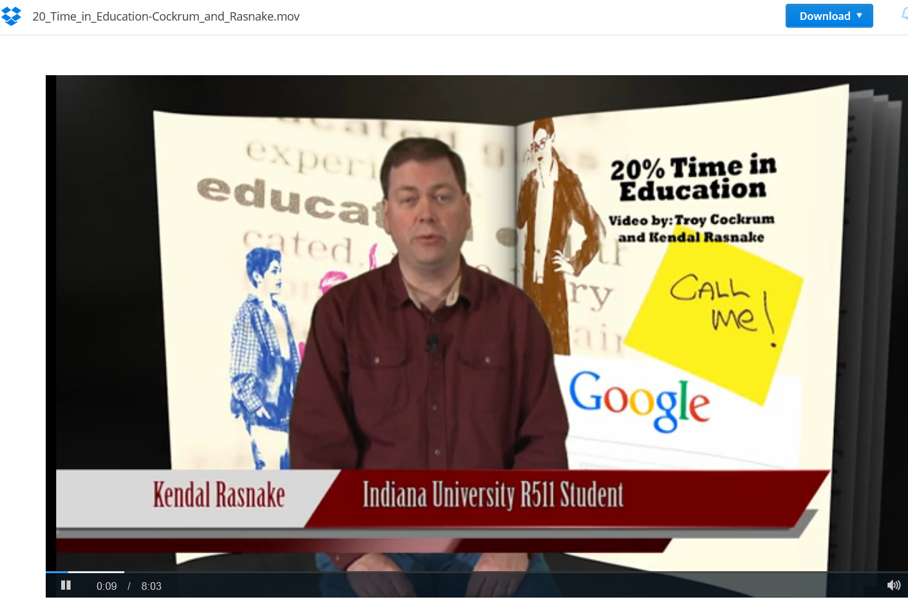
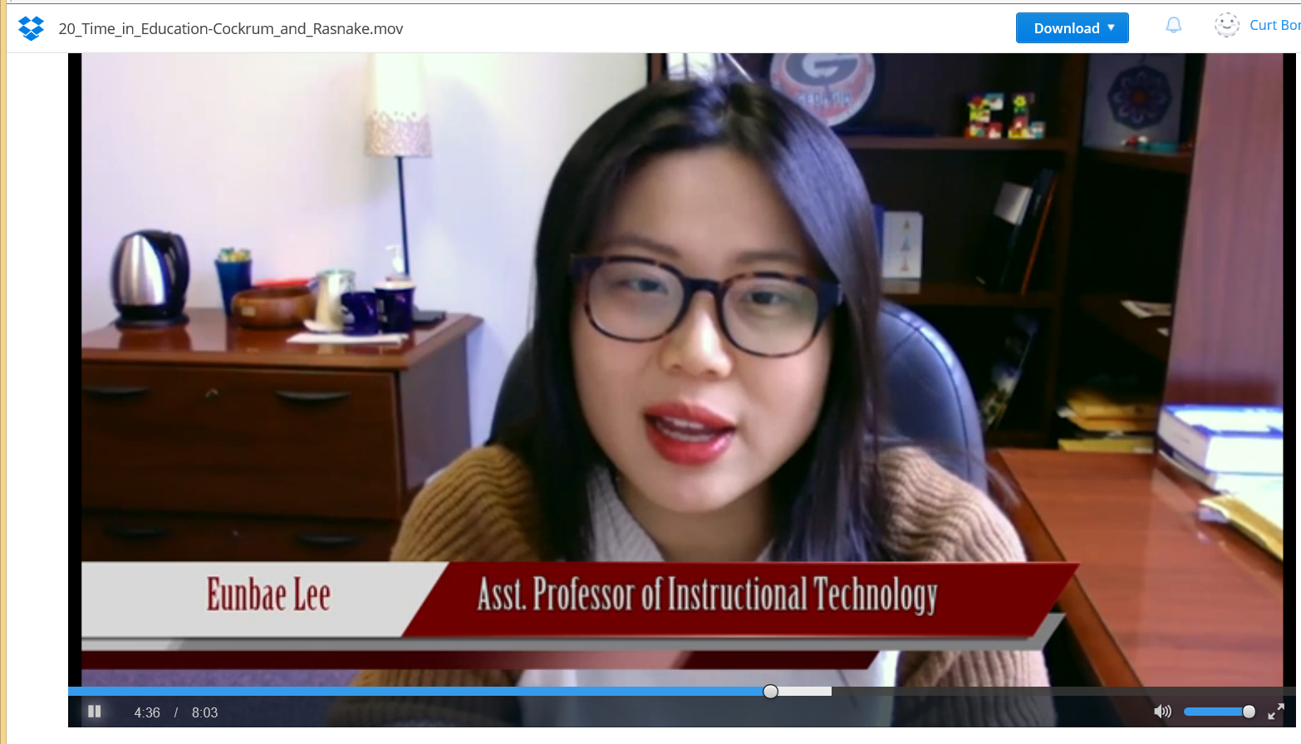
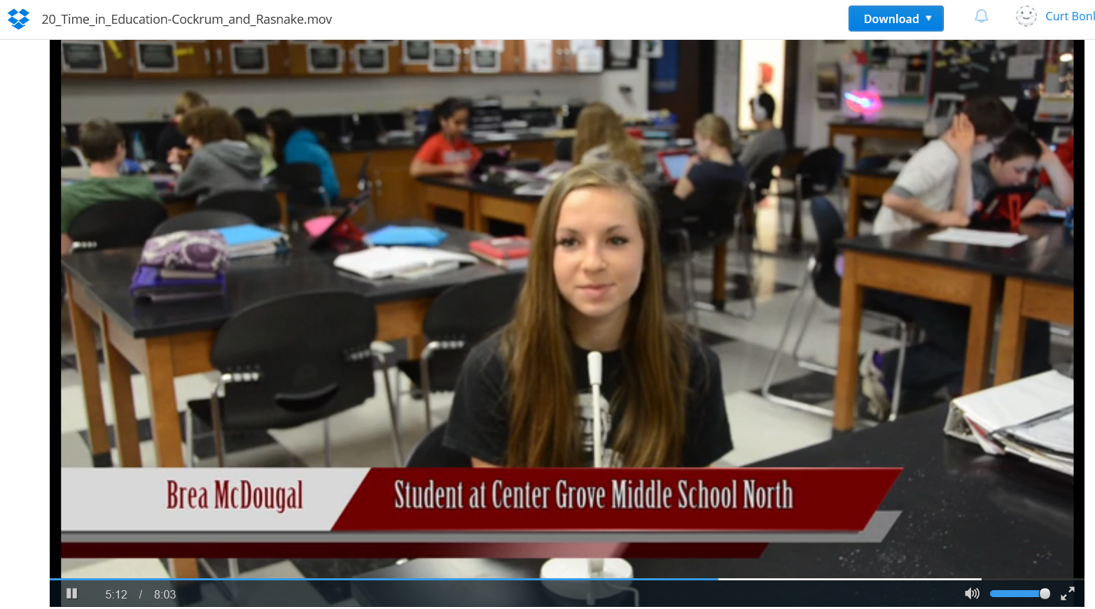
March 13, 2015 5. Autonomy, Choice: A. 20% Time in Education Kendal Rasnake & Troy Cockrum, IU https://www.dropbox.com/s/tcsr5oae2lcgwuk/20_Time_in_Education-Cockrum_and_Rasnake.mov?n=57312573

Slide 29
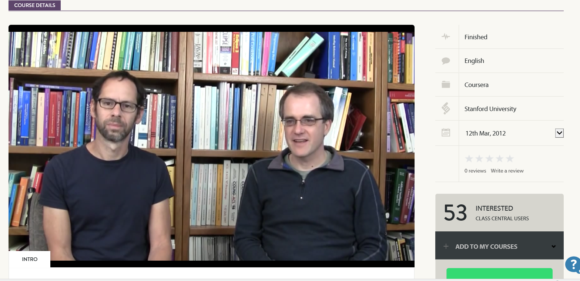
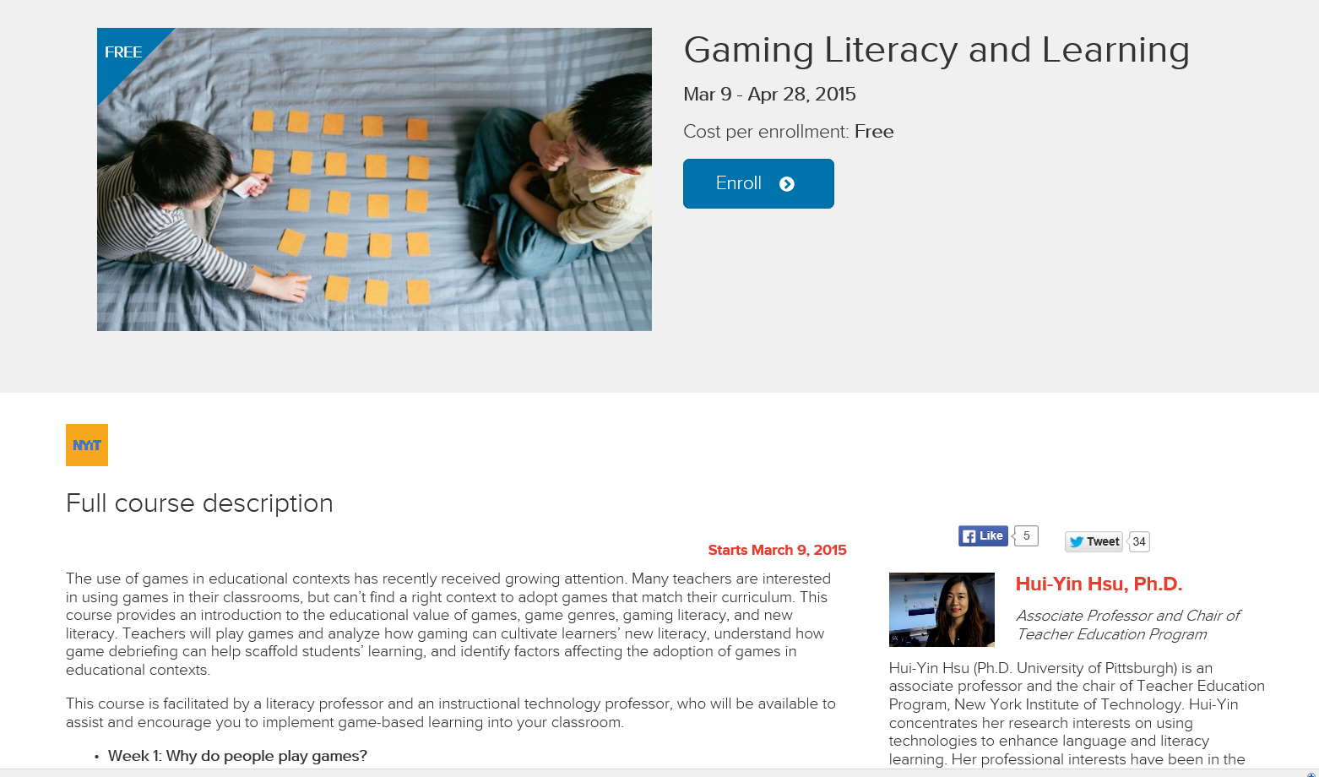
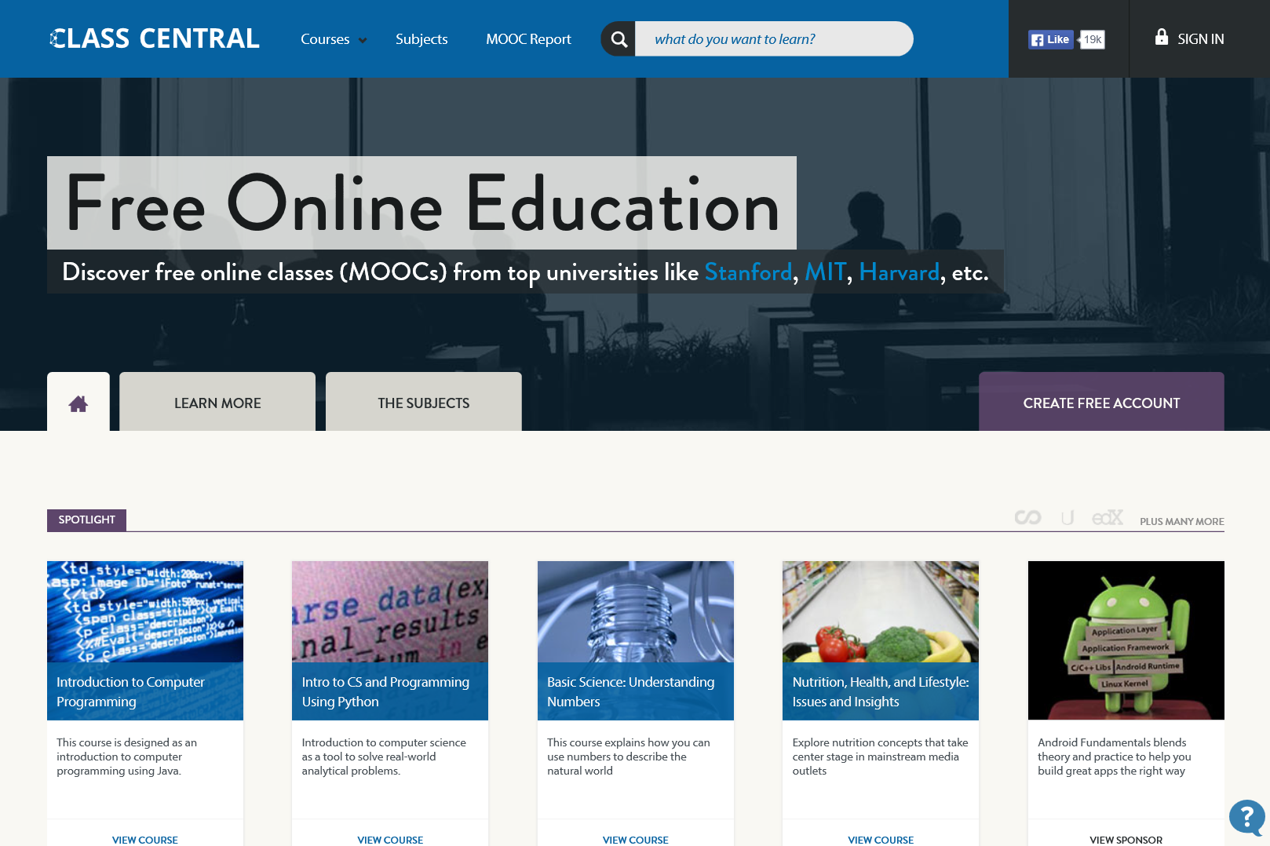
5. Autonomy, Choice: B. Enroll in a MOOC and Reflect (e.g., see Class Central)

Slide 30
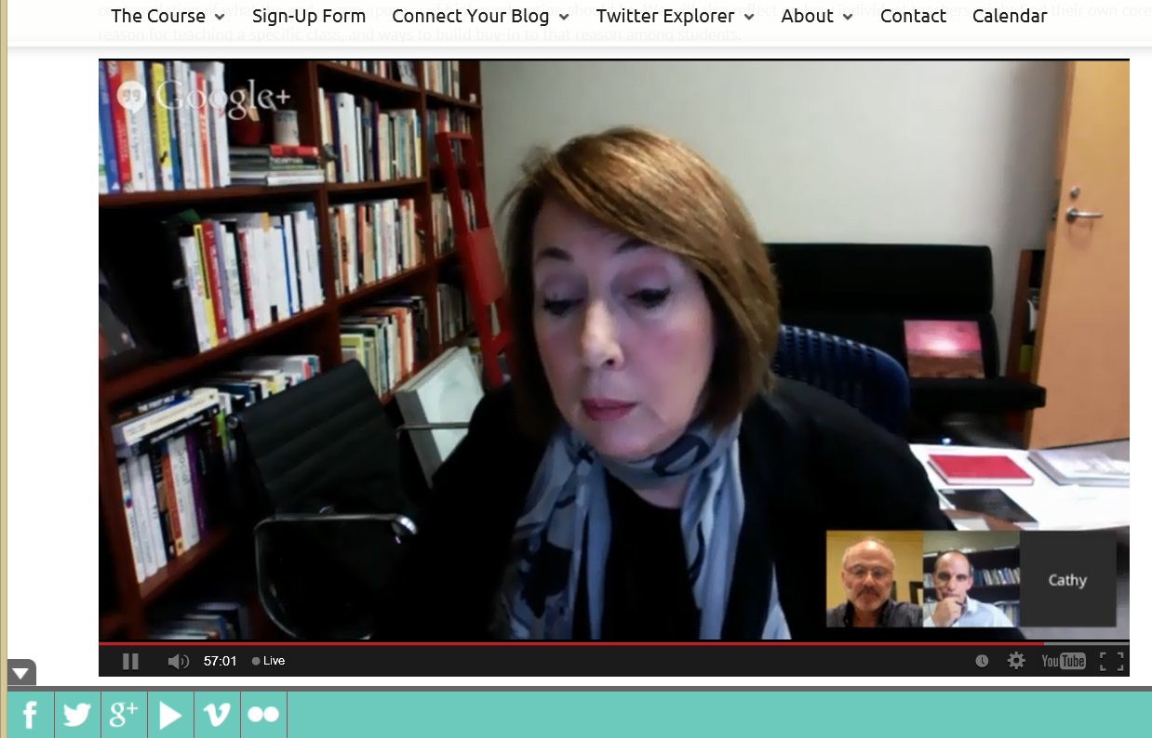
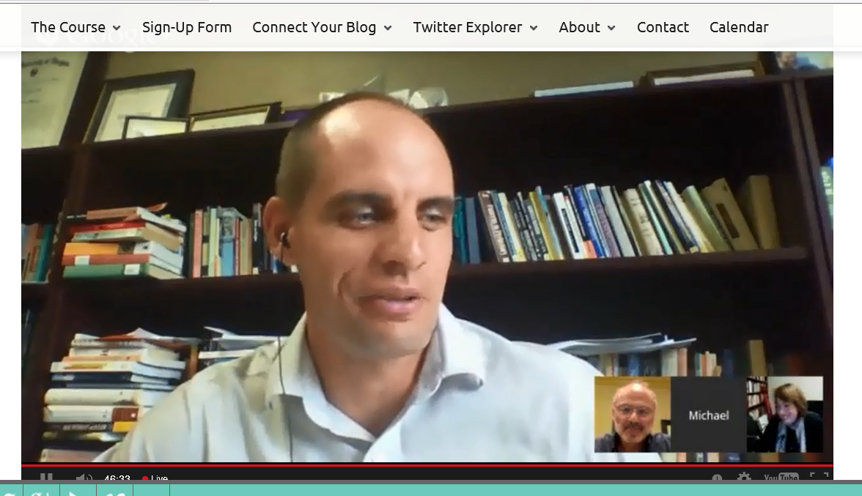
5. Autonomy, Choice: C. Attend Webinar (pick weeks and reflecti) Cathy Davidson, The End of Higher Education http://connectedcourses.net/thecourse/why-we-need-a-why/

Slide 31
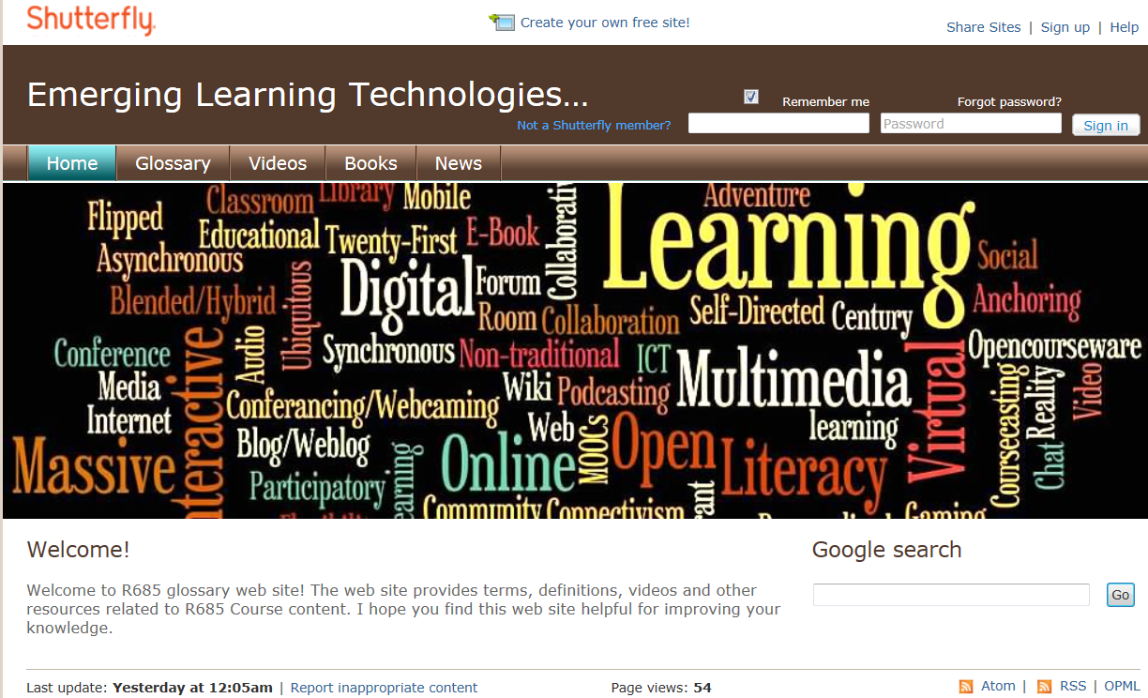
5. Autonomy, Choice: D. Design Multimedia Glossaries Ozgur Ozdemir, December 2012 http://r685glossary.shutterfly.com / Umida Khikmatillaeva, Dec. 2011, P540 http://learningplanet.shutterfly.com/

Slide 32
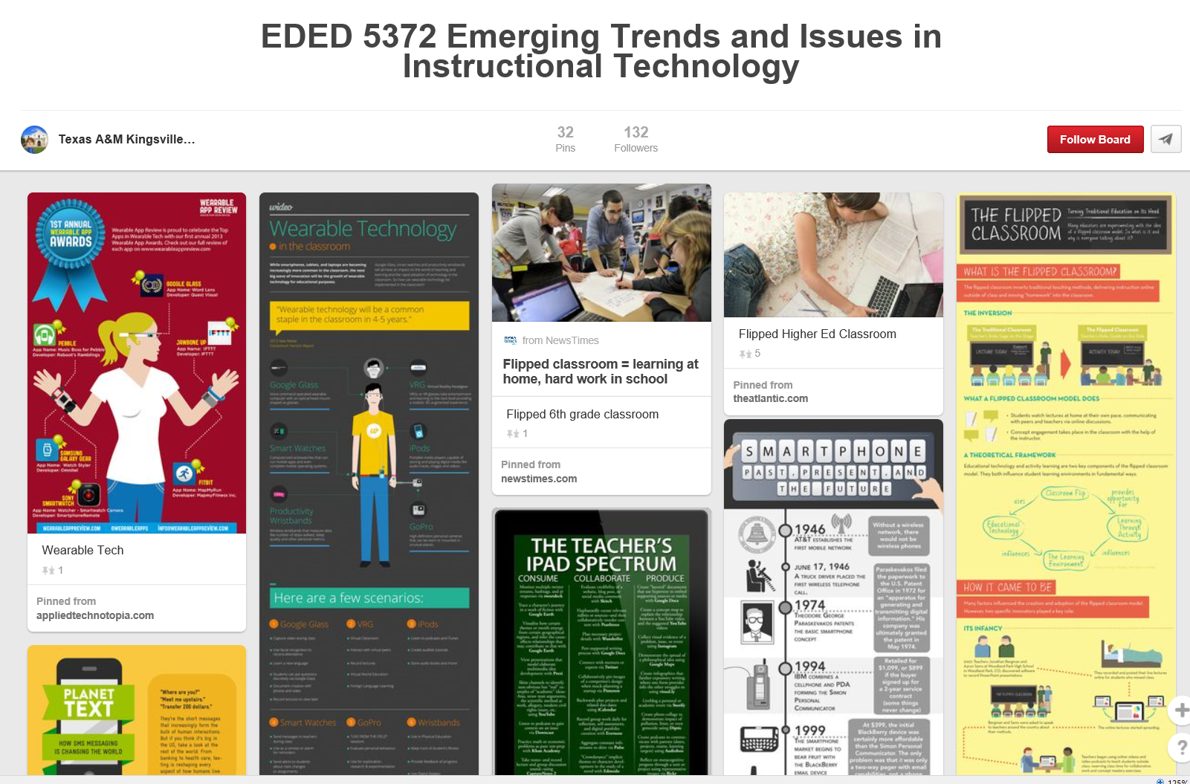
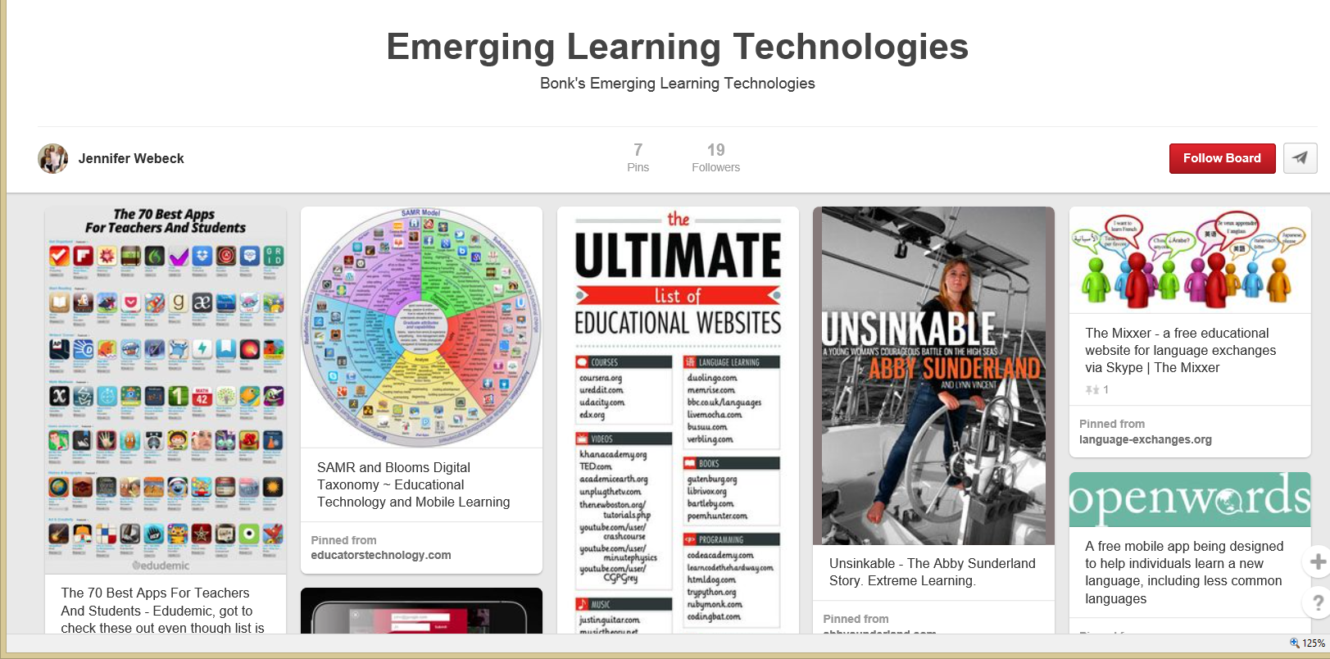
5. Autonomy, Choice: E. Design Article Database in Pinterest, Jenny Webeck https://www.pinterest.com/jennifertwebeck/emerging-learning-technologies/

Slide 33
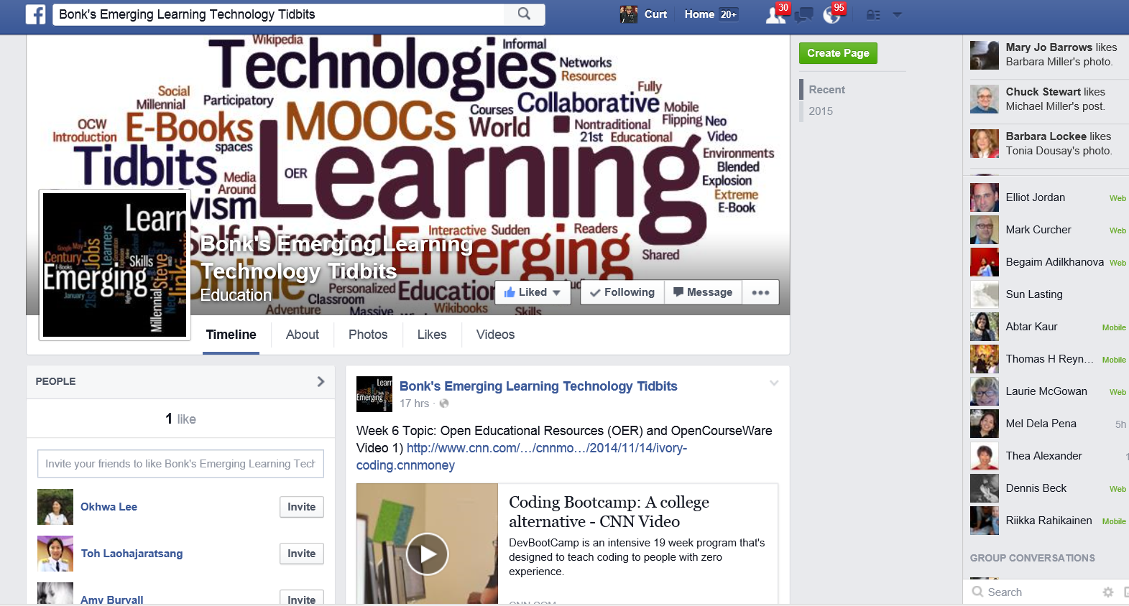
5. Autonomy, Choice: F. Design Article Database in Facebook, Jenny Webeck https://www.facebook.com/JennyBELTT/timeline

Slide 34
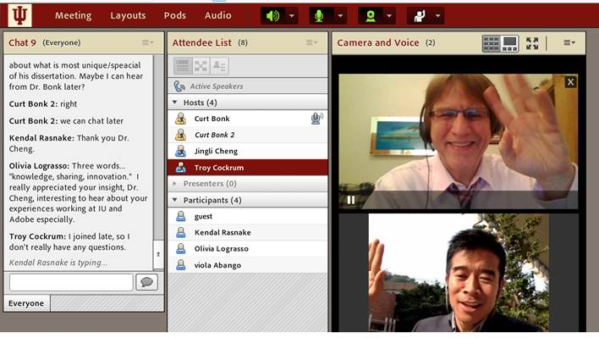
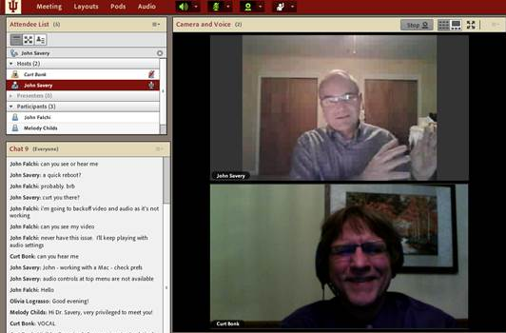
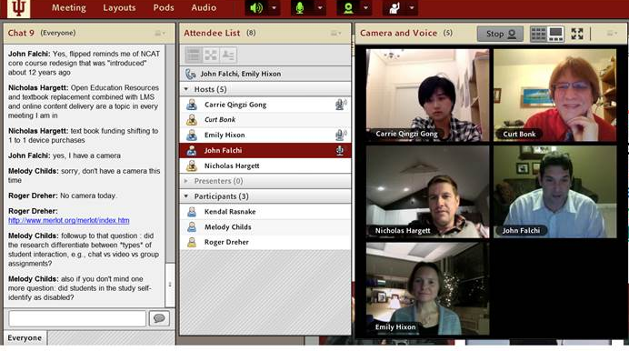
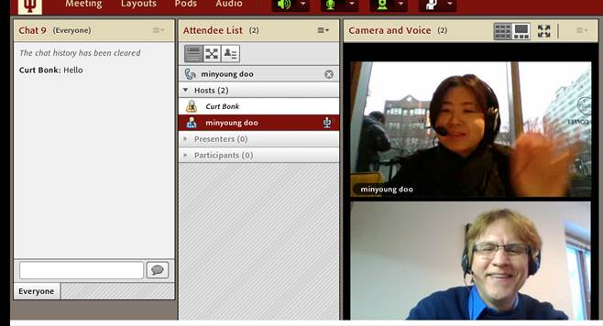
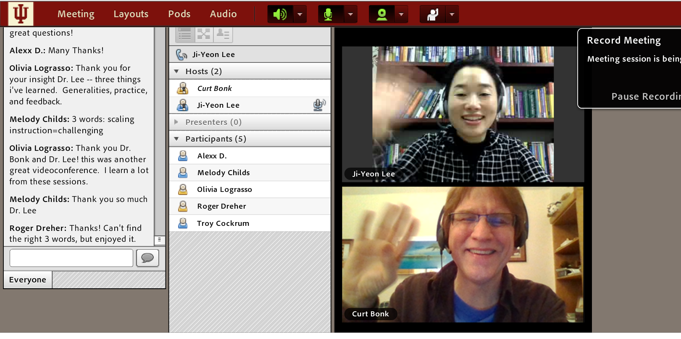
6. Relevance, Meaningfulness: A. Guest Chats (e.g., Emily Hixon, January 20, 2015) https://connect.iu.edu/p259wpiabg9/

Slide 35
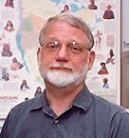
6. Relevance, Meaningfulness: B. Case-Based Learning: Instructor Cases (e.g., Mark Braun, IU)

Slide 36
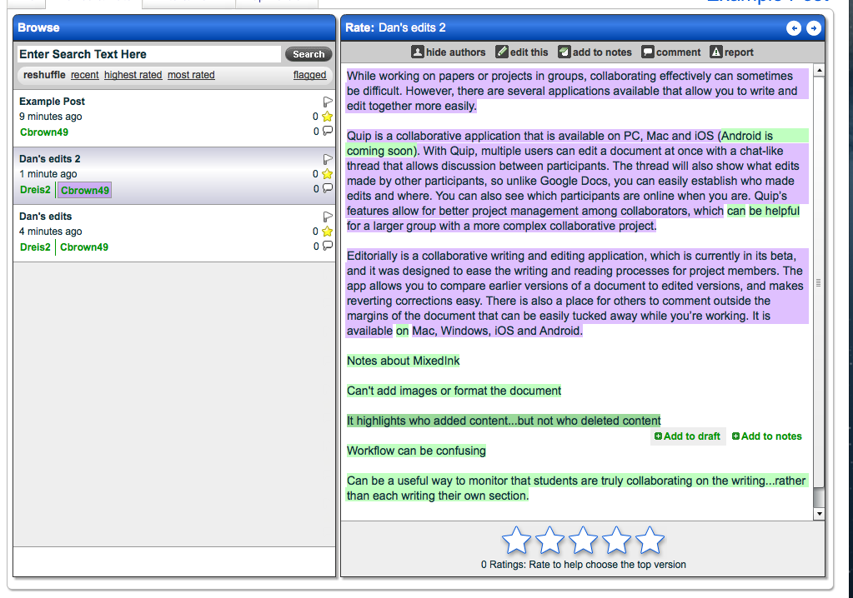
7. Interactive, Collaborative: A. Negotiate Meanings Online (e.g., PiratePad: http://meetingwords.com/) http://blogs.elon.edu/technology/6-collaborative-writing-applications-for-group-projects-or-papers/ MeetingWords, Google Docs, NowComment, MixedInk

Slide 37
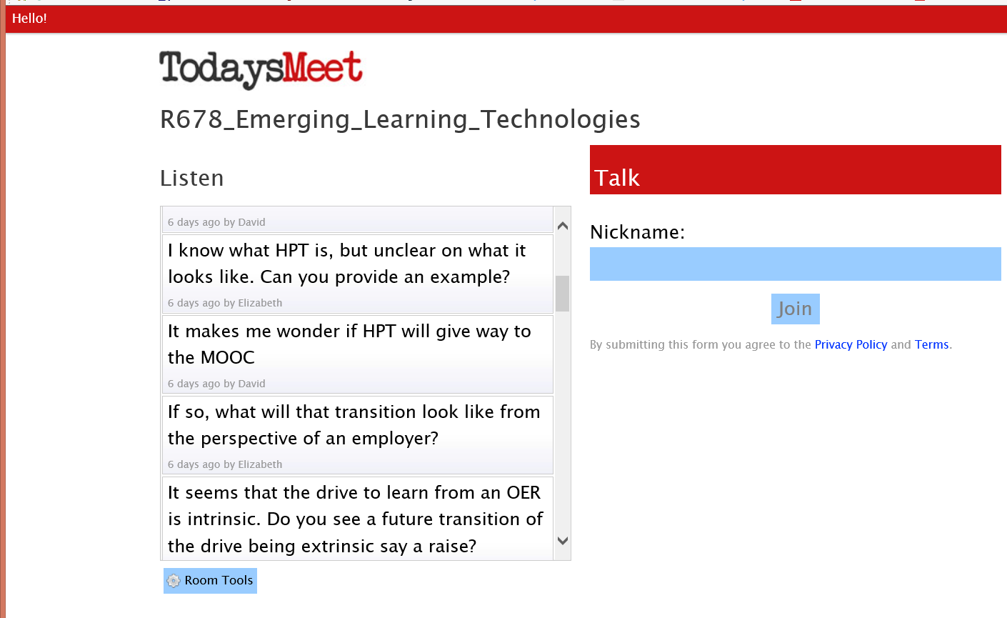
January 27, 2015 7. Interactive, Collaborative: B. Backchannel Chat (TodaysMeet) https://todaysmeet.com/ R678_Emerging_Learning_Technologies https://todaysmeet.com/R678_Emerging_Learning_Technologies

Slide 38
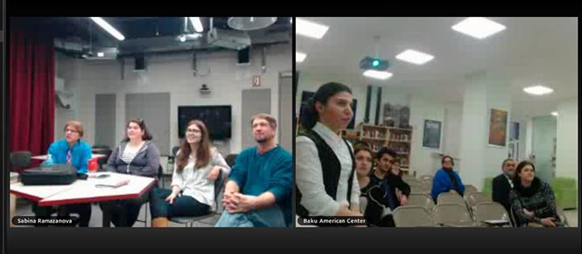
7. Interactive, Collaborative: C. Q&A Web Conferencing (Adobe Connect, Jabber, iMeet, GoToMeeting, etc.) https://connect.iu.edu/p259wpiabg9/

Slide 39
7. Interactive, Collaborative: D. Multiple Guest Experts Sara de Freitas and Jim Hensman, U of Coventry, UK (https://connect.iu.edu/p2ie1yx6z6x/) Jay Cross, Berkeley (https://connect.iu.edu/p4bytsoronh/)

Slide 40
7. Interactive, Collaborative: E. Collaboration and Discussion in Google Hangouts, Jabber, Skype, etc (January 29 and February 25, 2013)

Slide 41
Poll #3: Which of these ideas might you use?
Student designed multimedia glossaries
Article database in Pinterest
Guest chats with former students
Negotiate meanings online (e.g., PiratePad)
Backchannel chat (Todaysmeet)
Class Facebook group
Discussion in Google Hangouts

Slide 42
8. Engagement, Effort: A. Interactive Multimedia E-Books June 10, 2014, Chronicle of HE, 300 images, more than 700 notes and explanations, multimedia annotations, video commentary, and two dozen videos. Digital Dubliners: http://digitaldubliners.com/ James Joyce: http://joyceways.com/

Slide 43
8. Engagement, Effort: B. Guest Speaker Quotes (Rey Junco, February 25, 2013)

Slide 44
8. Engagement, Effort: C. Interactive Map Timelines (adults with college degrees by county, May 7, 2012) http://todayscampus.com/article/Keith_Hampson_Interviews_Josh_Keller_on__Interactive_Graphics_for_Higher_Education

Slide 45
8. Engagement, Effort: D. Google Map Gallery September 16, 2014 http://maps.google.com/gallery/

Slide 46
8. Engagement, Effort: E. Map Trend Interpretations e.g., Global Forest Watch (April 2014) http://www.globalforestwatch.org/map/3/-3.72/27.00/ALL/grayscale/loss/596

Slide 47
8. Engagement, Effort: F. Data Visualization Tools (Harvard and MIT MOOCs) Lawrence Biemiller, February 20, 2014, Chronicle of Higher Education http://chronicle.com/blogs/wiredcampus/harvard-and-mit-release-visualization-tools-for-trove-of-mooc-data/50631?cid=pm&utm_source=pm&utm_medium=en

Slide 48
9. Tension, Challenge, etc.: A. Online Vocabulary and Math Competitions Vocabulary.com: https://www.vocabulary.com/

Slide 49
March 15, 2015 9. Tension, Challenge, etc.: B. Controversial Issue Debates SXSW: Tackling the growing gender gap in technology Mike Snider, USA Today http://www.usatoday.com/story/tech/2015/03/15/sxsw-geek-girls-chic-technology-gender-gap/24808699/

Slide 50
March 13, 2015 9. Tension, Challenge, etc.: C. Controversial Issue Debates Gamification, Jeff Jenkins and Melody Childs, IU https://www.youtube.com/watch?v=DYe85LMiq5w a Content-Driven School?, R511, Nick and Nik https://www.youtube.com/watch?v=Bcr3_aZT_xQ&feature=youtu.be

Slide 51
July 10, 2014 9. Tension, Challenge, etc.: D. Controversial Issue Debates Scholarly journal retracts 60 articles, smashes ‘peer review ring’, Fred Barbash, Washington Post http://www.washingtonpost.com/news/morning-mix/wp/2014/07/10/scholarly-journal-retracts-60-articles-smashes-peer-review-ring

Slide 52
9. Tension, Challenge, etc.: E. Cage Matches or Debates (with online audience topical suggestions) Cage Match on MOOCs at SXSWedu 2013 (Curt Bonk & Chuck Severance) http://chronicle.com/blogs/wiredcampus/at-south-by-southwest-education-event-tensions-divide-entrepreneurs-and-educators/42777 https://soundcloud.com/sxswedu/cage-match-the-massive-open

Slide 53
10. Yields Products, Goals: A. Goal Setting Tools (e.g., I Done This, Milestone Planner, and 43 Things)

Slide 54
10. Yields Products, Goals: B. Student Created Mobile Apps The App Builder: http://www.theappbuilder.com/ Mintian Guo: http://myapp.is/r685final
Videos: Watch selected videos from scholars and educators.
Benefits:
Can easily watch YouTube videos without having to open a separate application
Limitations:
Only accepts YouTube urls

Slide 55
10. Yields Products, Goals: C. Student Created Videos Piercarlo Abate: http://www.youtube.com/watch?v=_-TURzHO0aU Qi Li, Gangnam: http://www.youtube.com/watch?v=7Q429lqxZaU&feature=youtu.be Miguel Lara (Web 2.0 FREEDOM): http://www.youtube.com/watch?v=8cmCFWi9lW8 Kendal Rasnake (Is IT Right For You?): https://www.youtube.com/watch?v=MJ3GUDICIGw

Slide 56
Poll #4: Which of these ideas might you use?
Guest speaker quotes
Data visualization tools
Challenge debates (cage matches?)
Student designed video productions
Student designed e-books
Goal setting tools
Gallery of exemplary work

Slide 57
Commitments: Stop and Share: Which principle(s) of TEC-VARIETY will you use?
Tone/Climate
Encouragement, Feedback
Curiosity
Variety
Autonomy
Relevance
Interactive
Engagement
Tension
Yields Products

Slide 58
Poll #5: Any light bulbs going off in your head…?
Yes definitely***
Yes maybe!
Not yet (but hopefully soon…)

Slide 59
Poll #6: Which do you prefer… (A) TEC-VARIETY or (B) R2D2?

Slide 60
Any Questions or Comments? Try TEC-VARIETY…Try R2D2 Slides at: TrainingShare.com Papers: PublicationShare.com Free Book: http://tec-variety.com/ http://tec-variety.com/TEC-VARIETY-Chinese.pdf Dr. Curt Bonk – CJBonk@Indiana.edu

