Slide 1
Jump-Starting Scholarly Success: Some Suggestions, Simplifications and Celebrations Online Teaching and Learning SIG Business Meeting Monday April 25, 2022
Curtis J. Bonk, Ph.D., Indiana University
cjbonk@indiana.edu
Notes:
All
1

Slide 2
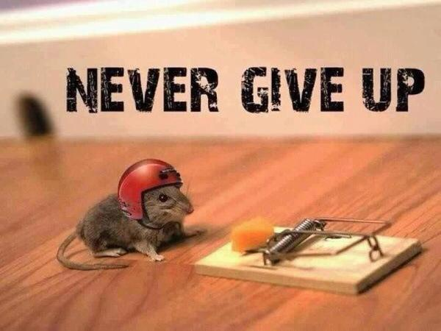
I have often Experienced Failure
Undergraduate accounting homework.
Vrakas, Blum, and Co. (Accounting firm probation).
Kicked out of accounting; kicked out of educational psychology; what’s next?
Turned down for tenure.
Hundreds of rejected or never completed papers (e.g., RER paper).
Notes:
2

Slide 3
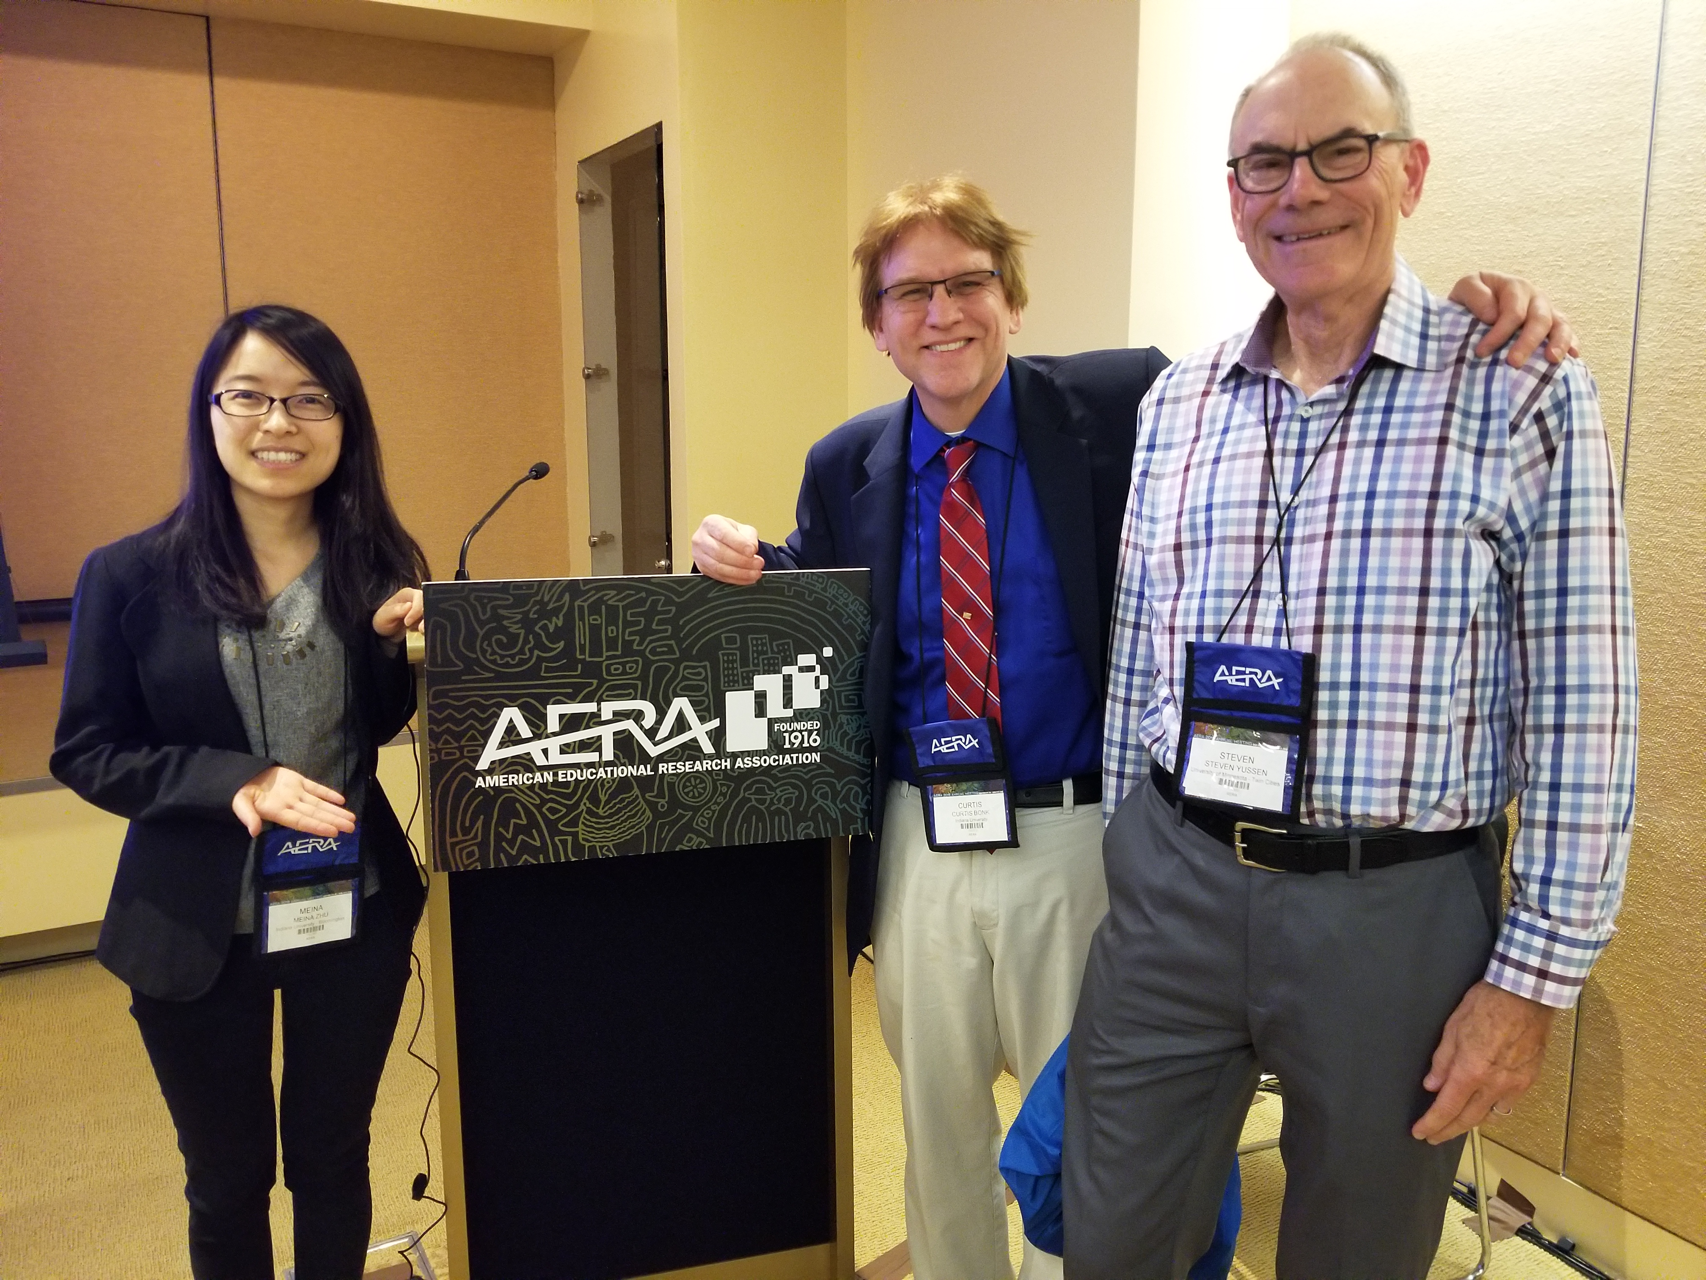
35 years of AERA: Your advisor still matters! Your advisees matter! Thank you Dr. Steve Yussen… and Dr. Meina Zhu…
Notes:
3

Slide 4
30 Tips for Scholarly Success
Try to publish your work before the conference.
Treat AERA as a graduate course you never had or quals prep and talk to primary source.
Never give up on a paper (persistence and grit wins the day).
Save new trends and interesting news and articles in a PowerPoint slide deck.
Save address and contact info in a gigantic Word document. And have subdocuments by country.
Notes:
4

Slide 5
30 Tips for Scholarly Success
Be polite to editor and reviewers with load of thank yous; recap the reviewer points and how you attempted to address them.
There is power in sharing; share your new ideas, articles, accomplishments, models, etc.
Use social media wisely.
Create a flexible timeline of projects in process, in review, in press, and published.
Mark or save days in your planner.
Notes:
5

Slide 6
30 Tips for Scholarly Success
Everyone is a potential friend, mentor, and colleague.
Consider your writing space carefully (e.g., get a standing or hydraulic lift desk). Wherever you go, there is your writing space.
Finish the small and easy stuff first.
Create a list of journals in the field to target and review it often.
Team role can very (you do not have to be #1).
Notes:
6

Slide 7
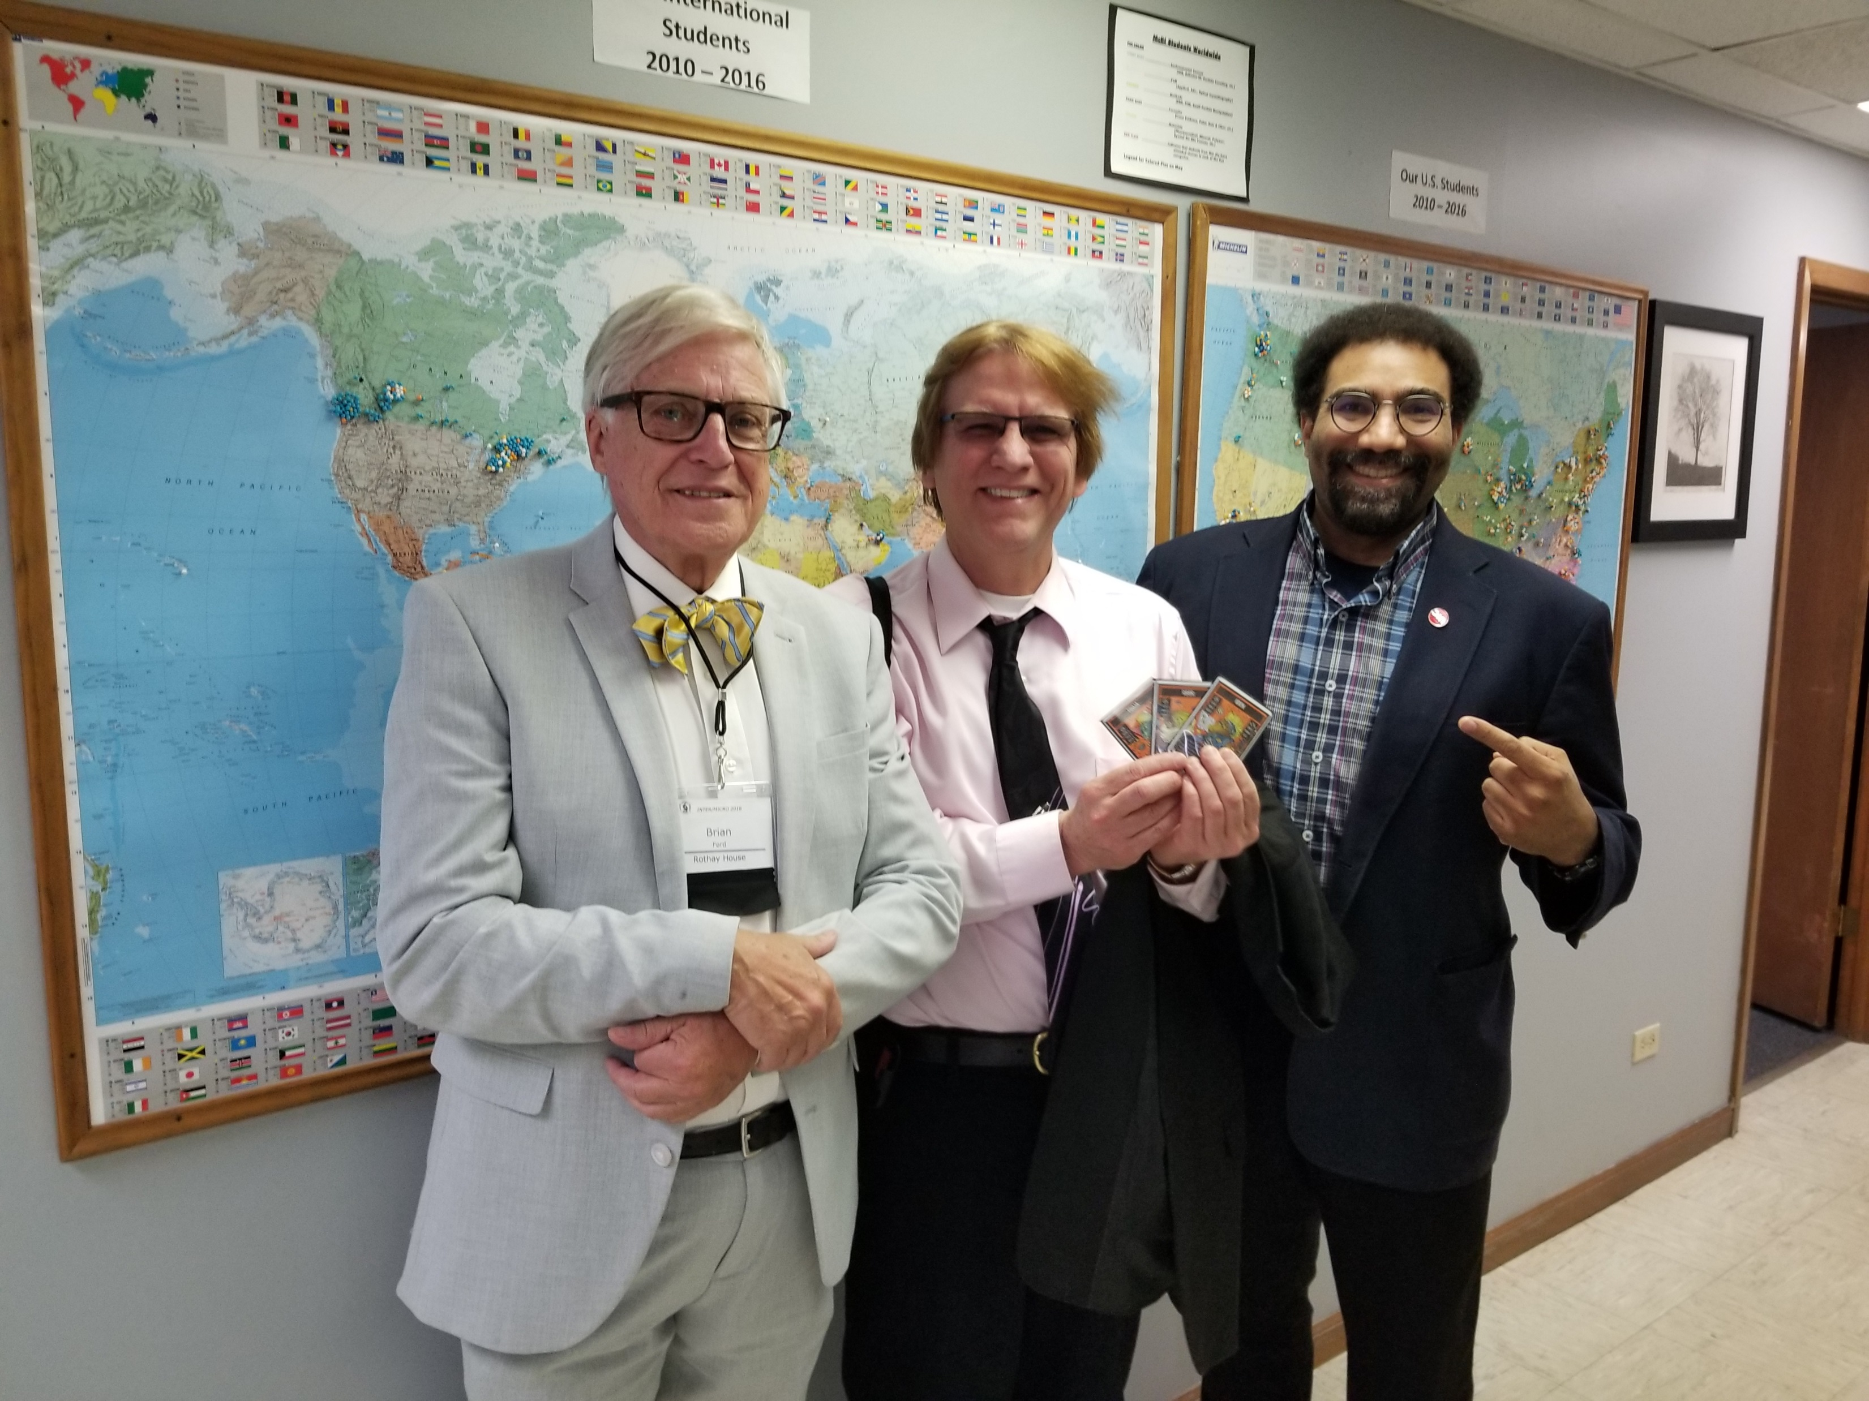
Choose Mentors and Colleagues Wisely

Slide 8
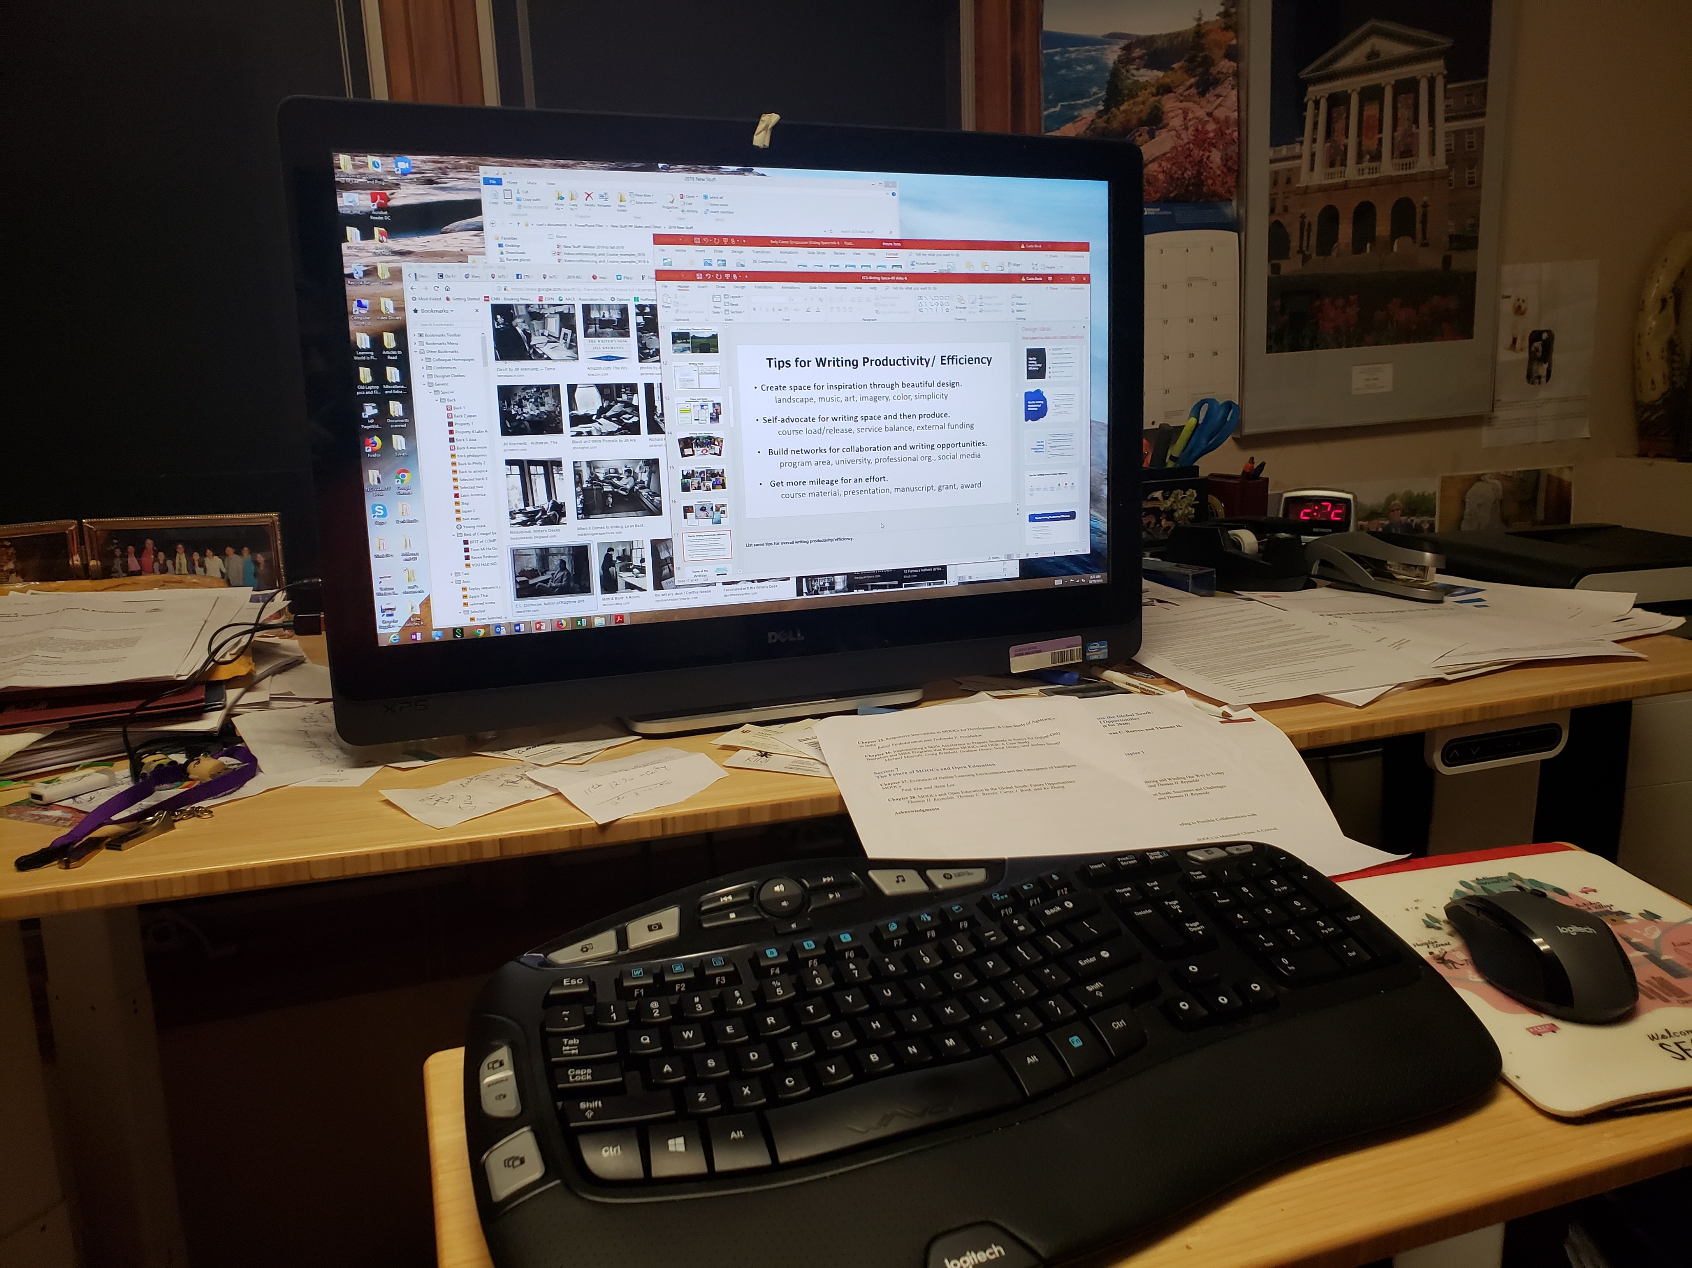
Writing Space Curt Bonk, Indiana University
I having standing desk…power it up and down via hydraulics. And my office looks out into a forest.

Slide 9
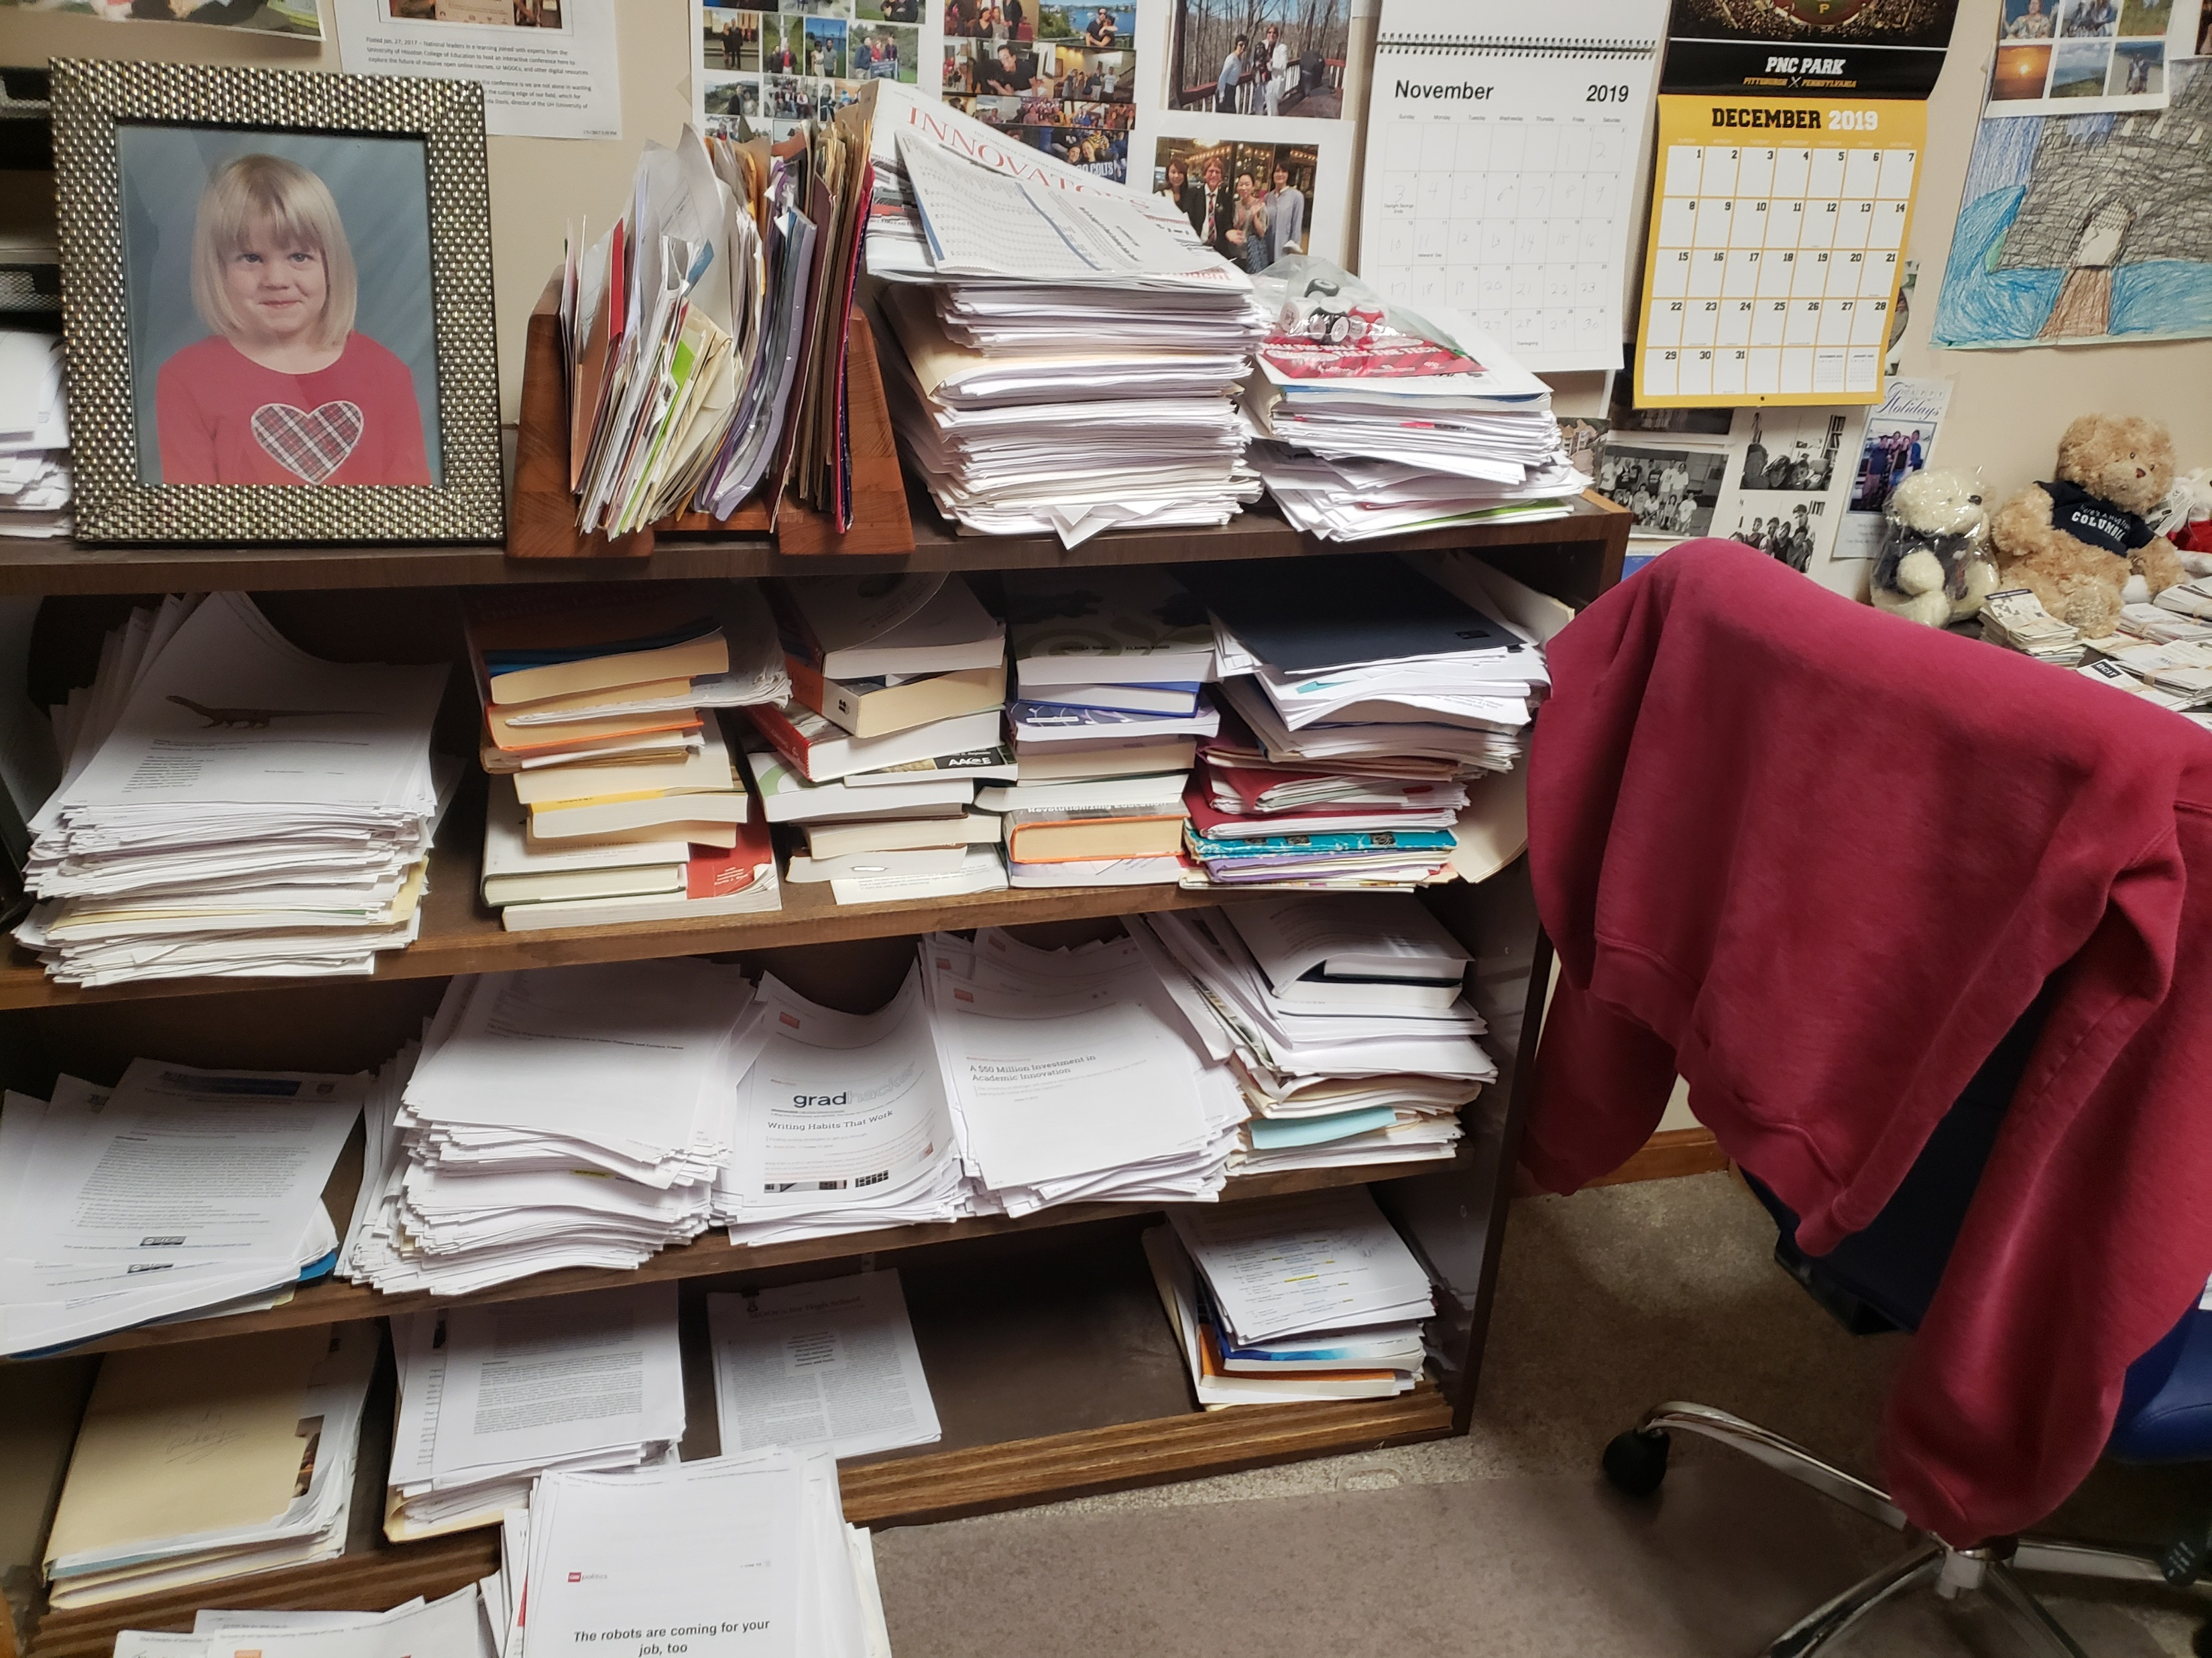
My Writing Space
Paper…I love paper….and my daughter Nicki.

Slide 10
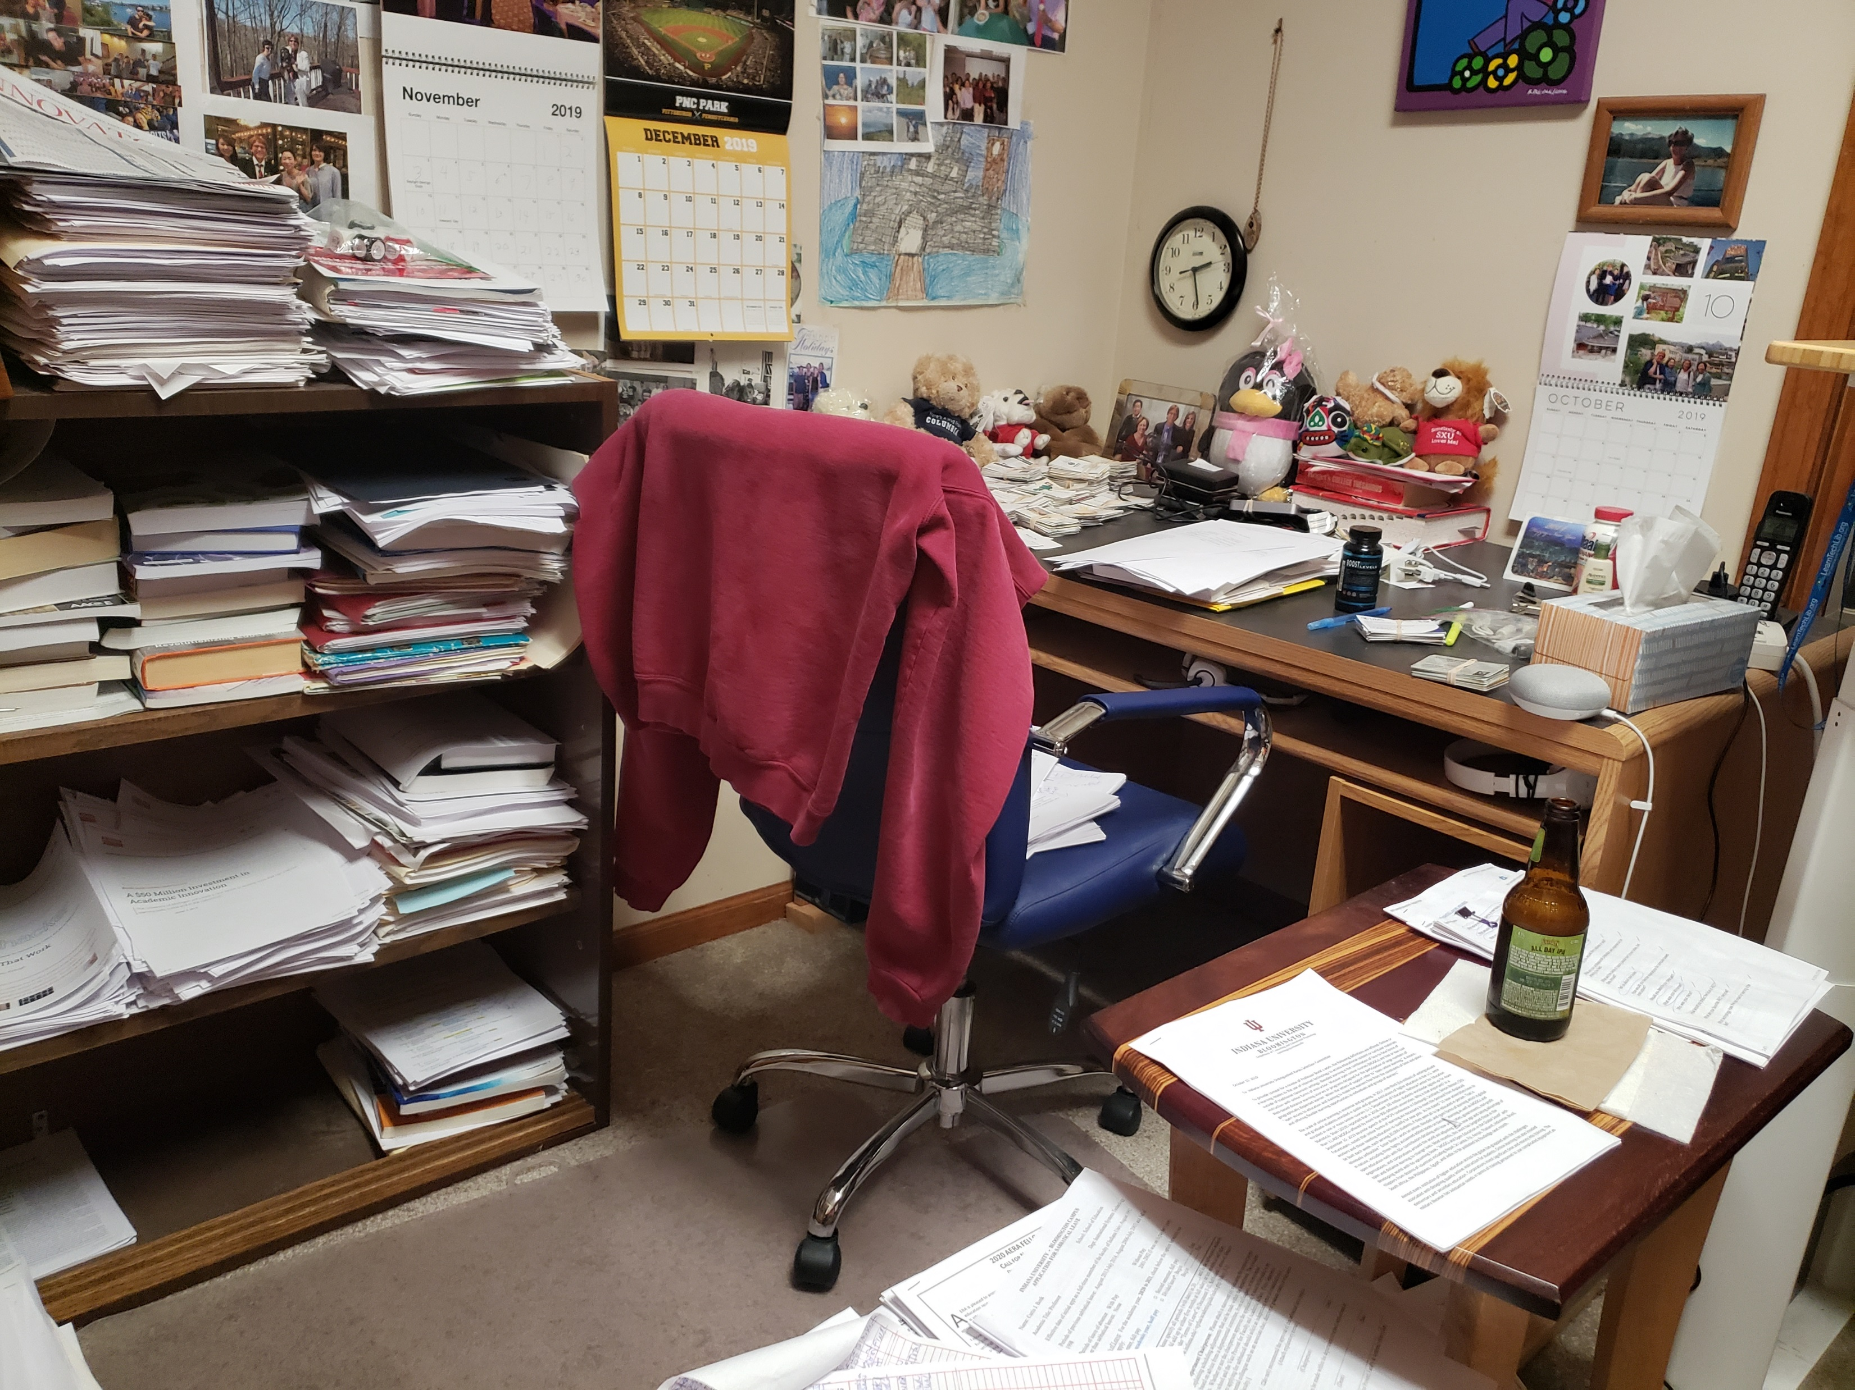
My Writing Space
Desk #2 is available if needed…and a beer.

Slide 11
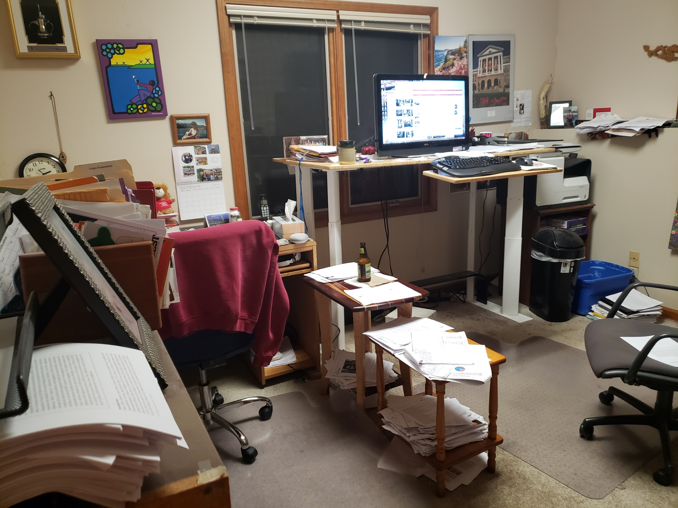
My Writing Space
My office. I save interesting articles to later reference in papers and books.

Slide 12
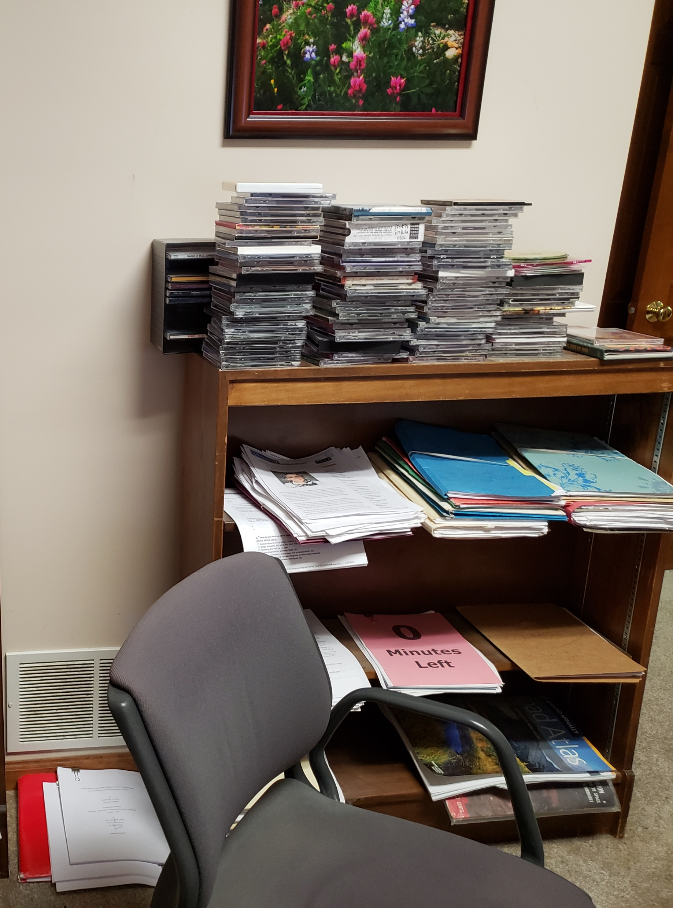
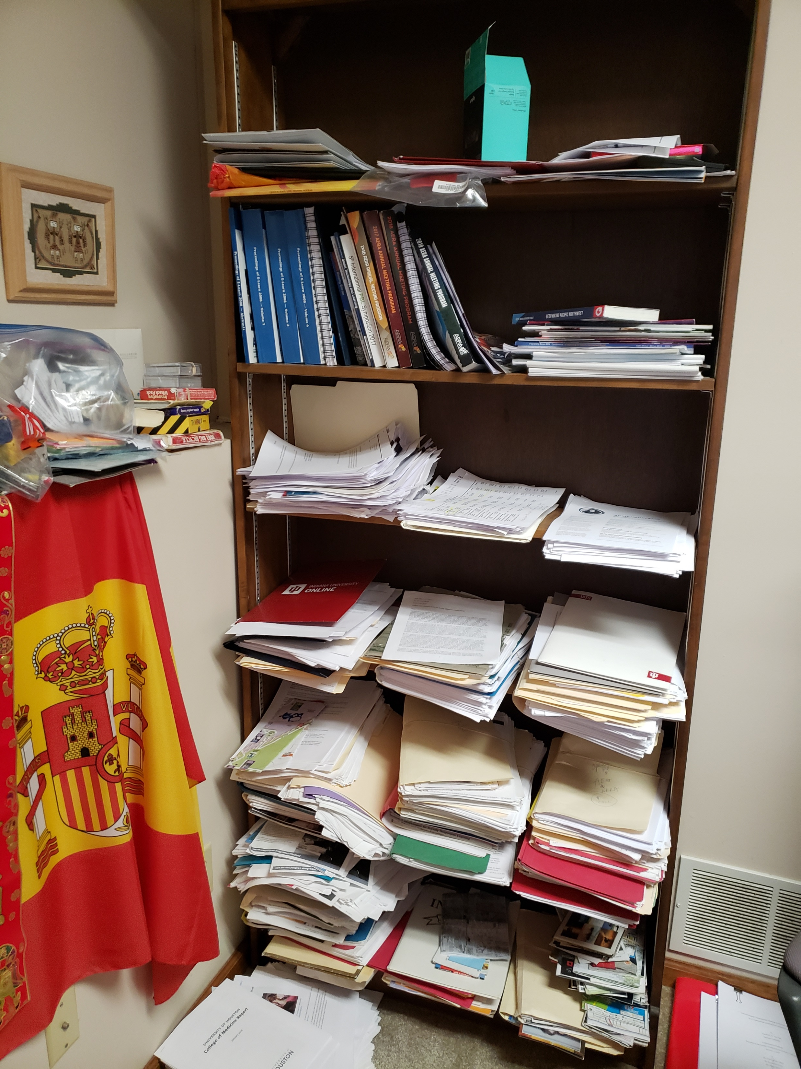
Writing Space: Curt Bonk

Slide 13
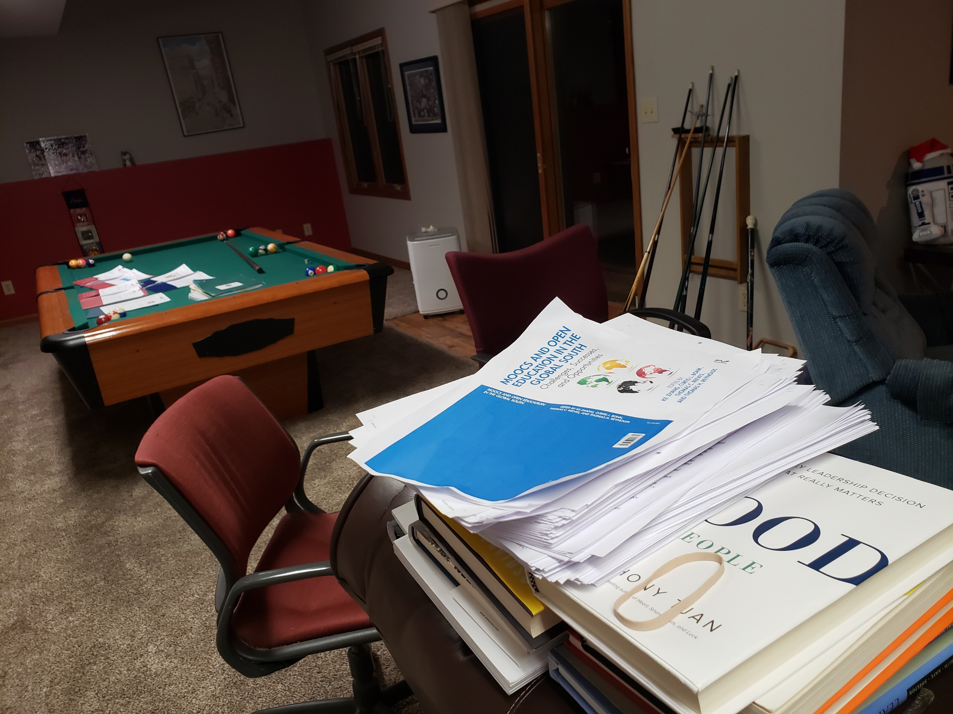
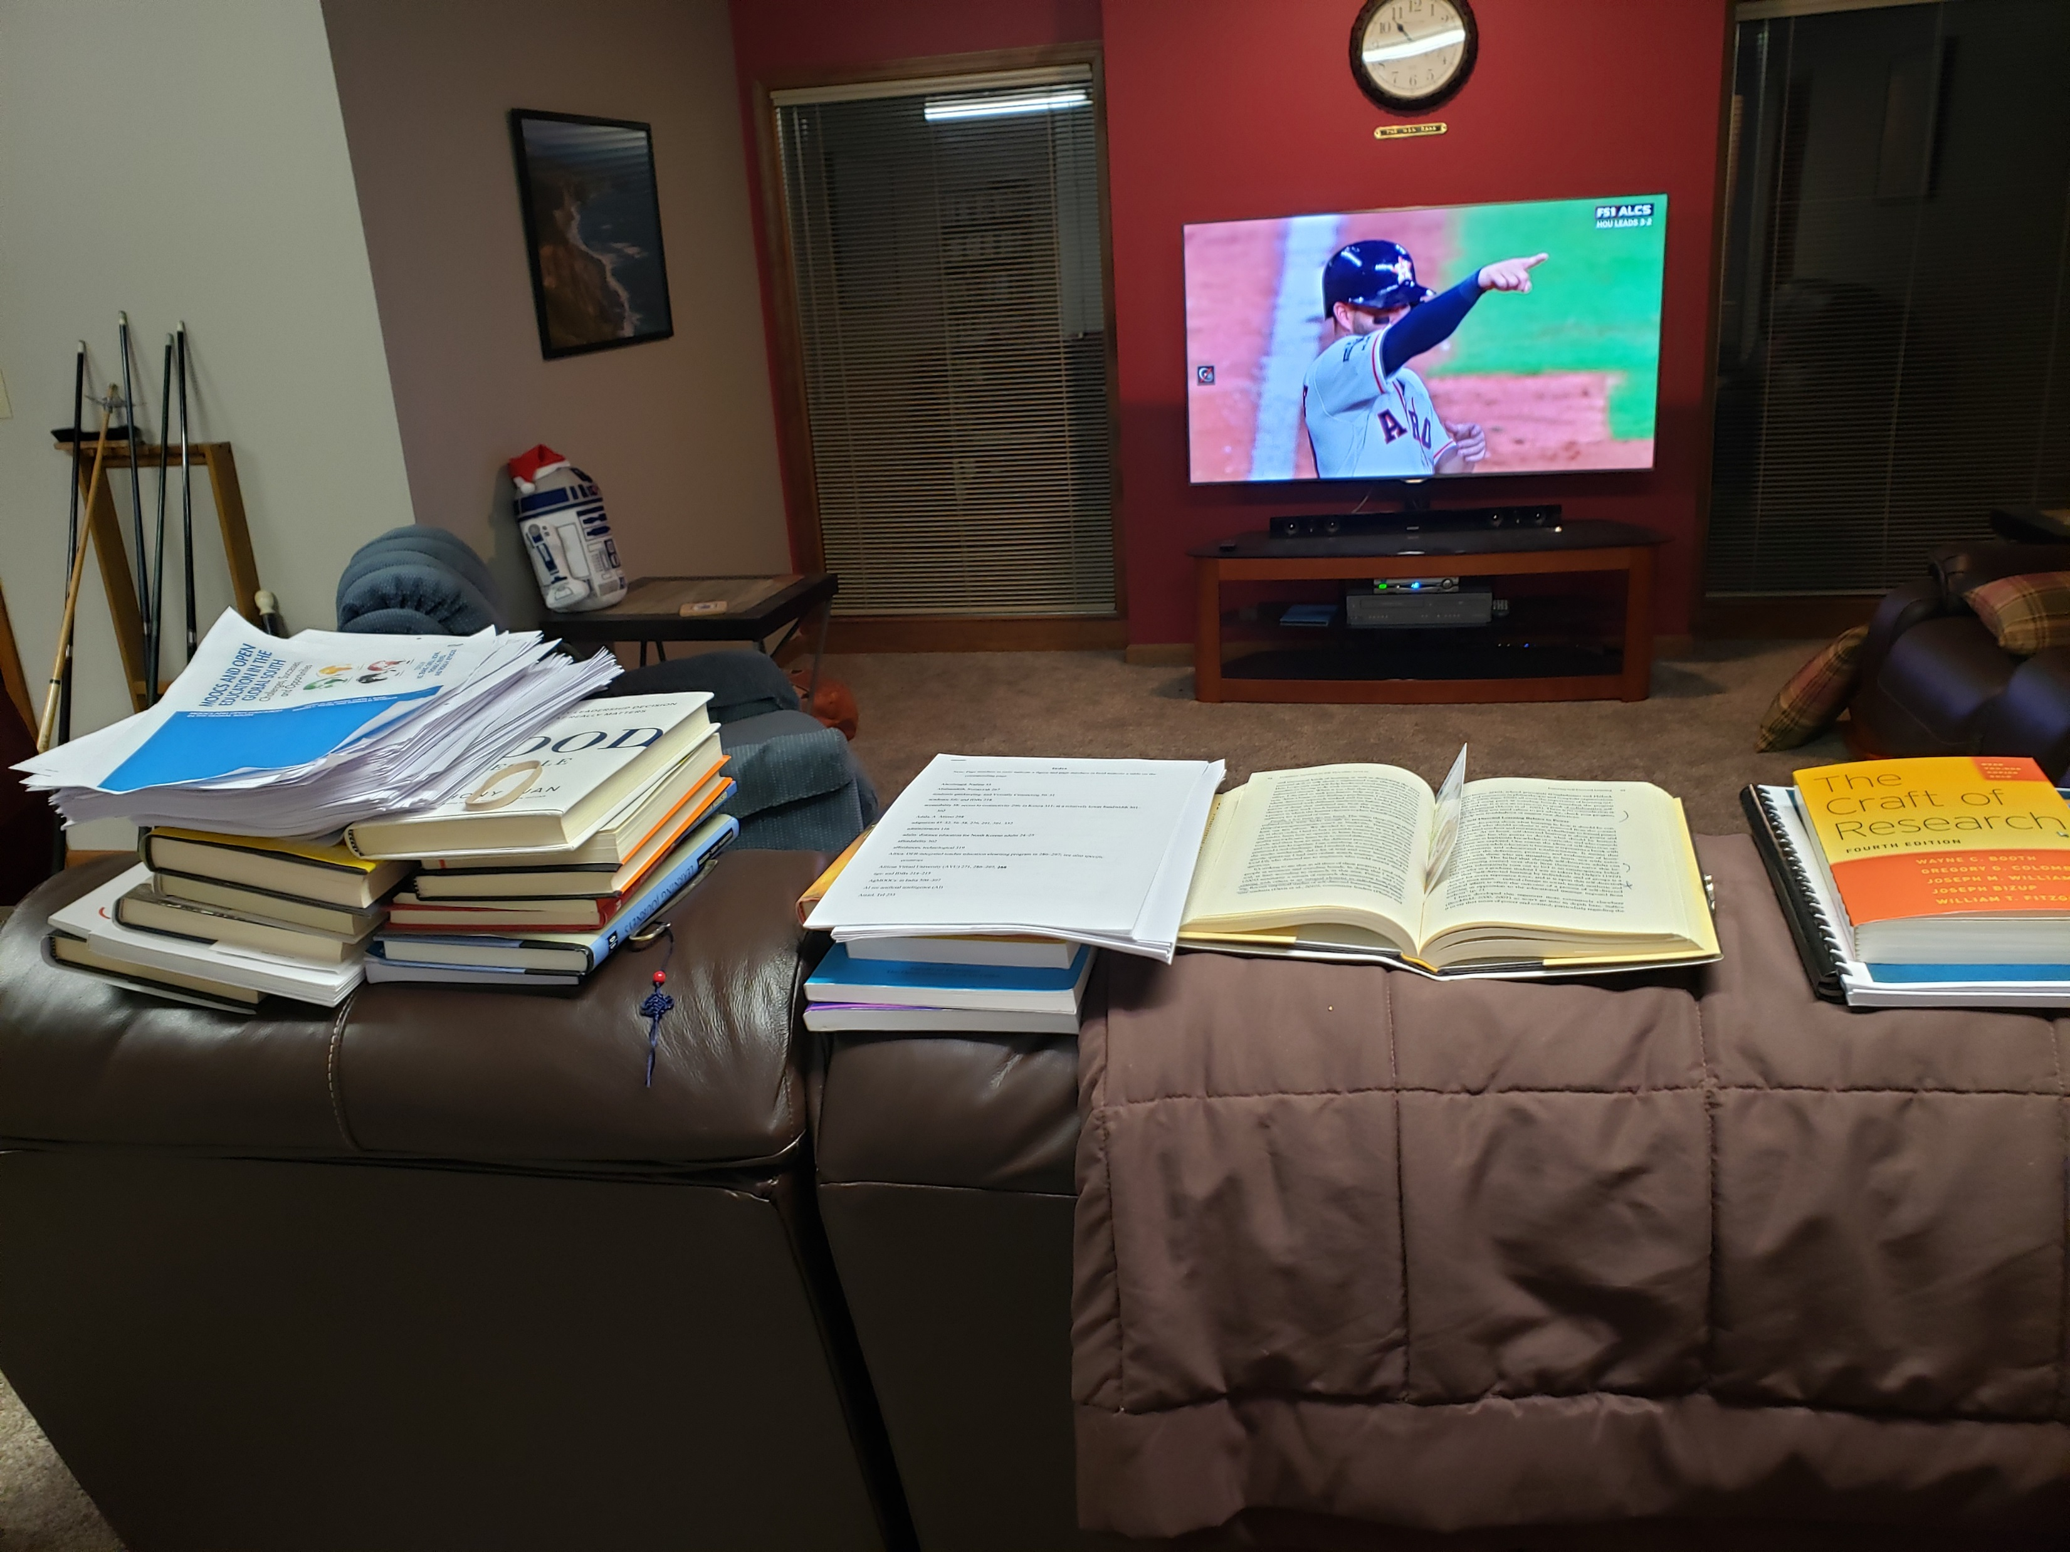
Writing Space

Slide 14
Writing Space: Curt Bonk

Slide 15
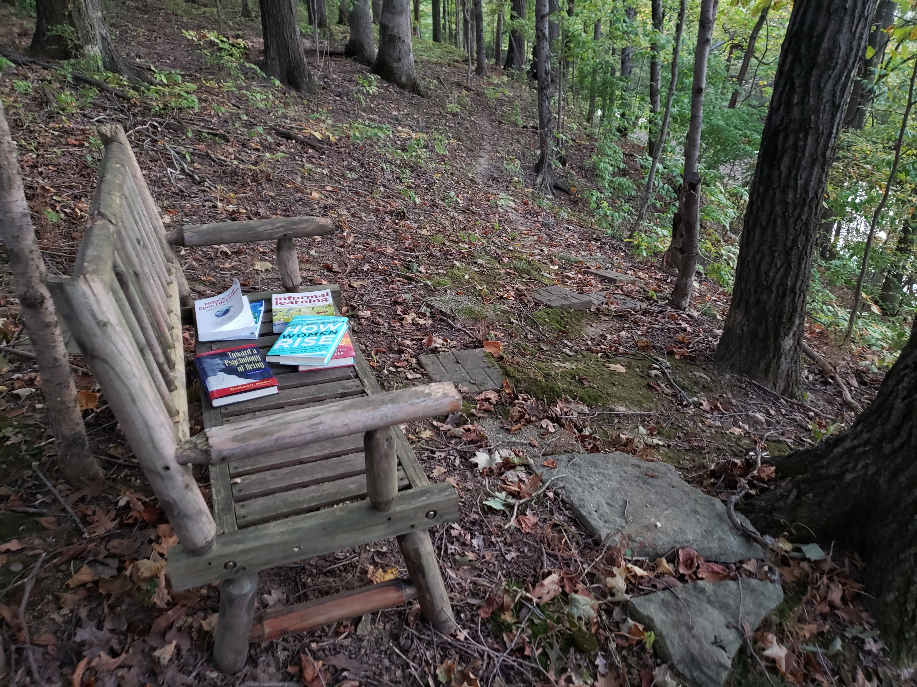
Writing Space: Curt Bonk

Slide 16
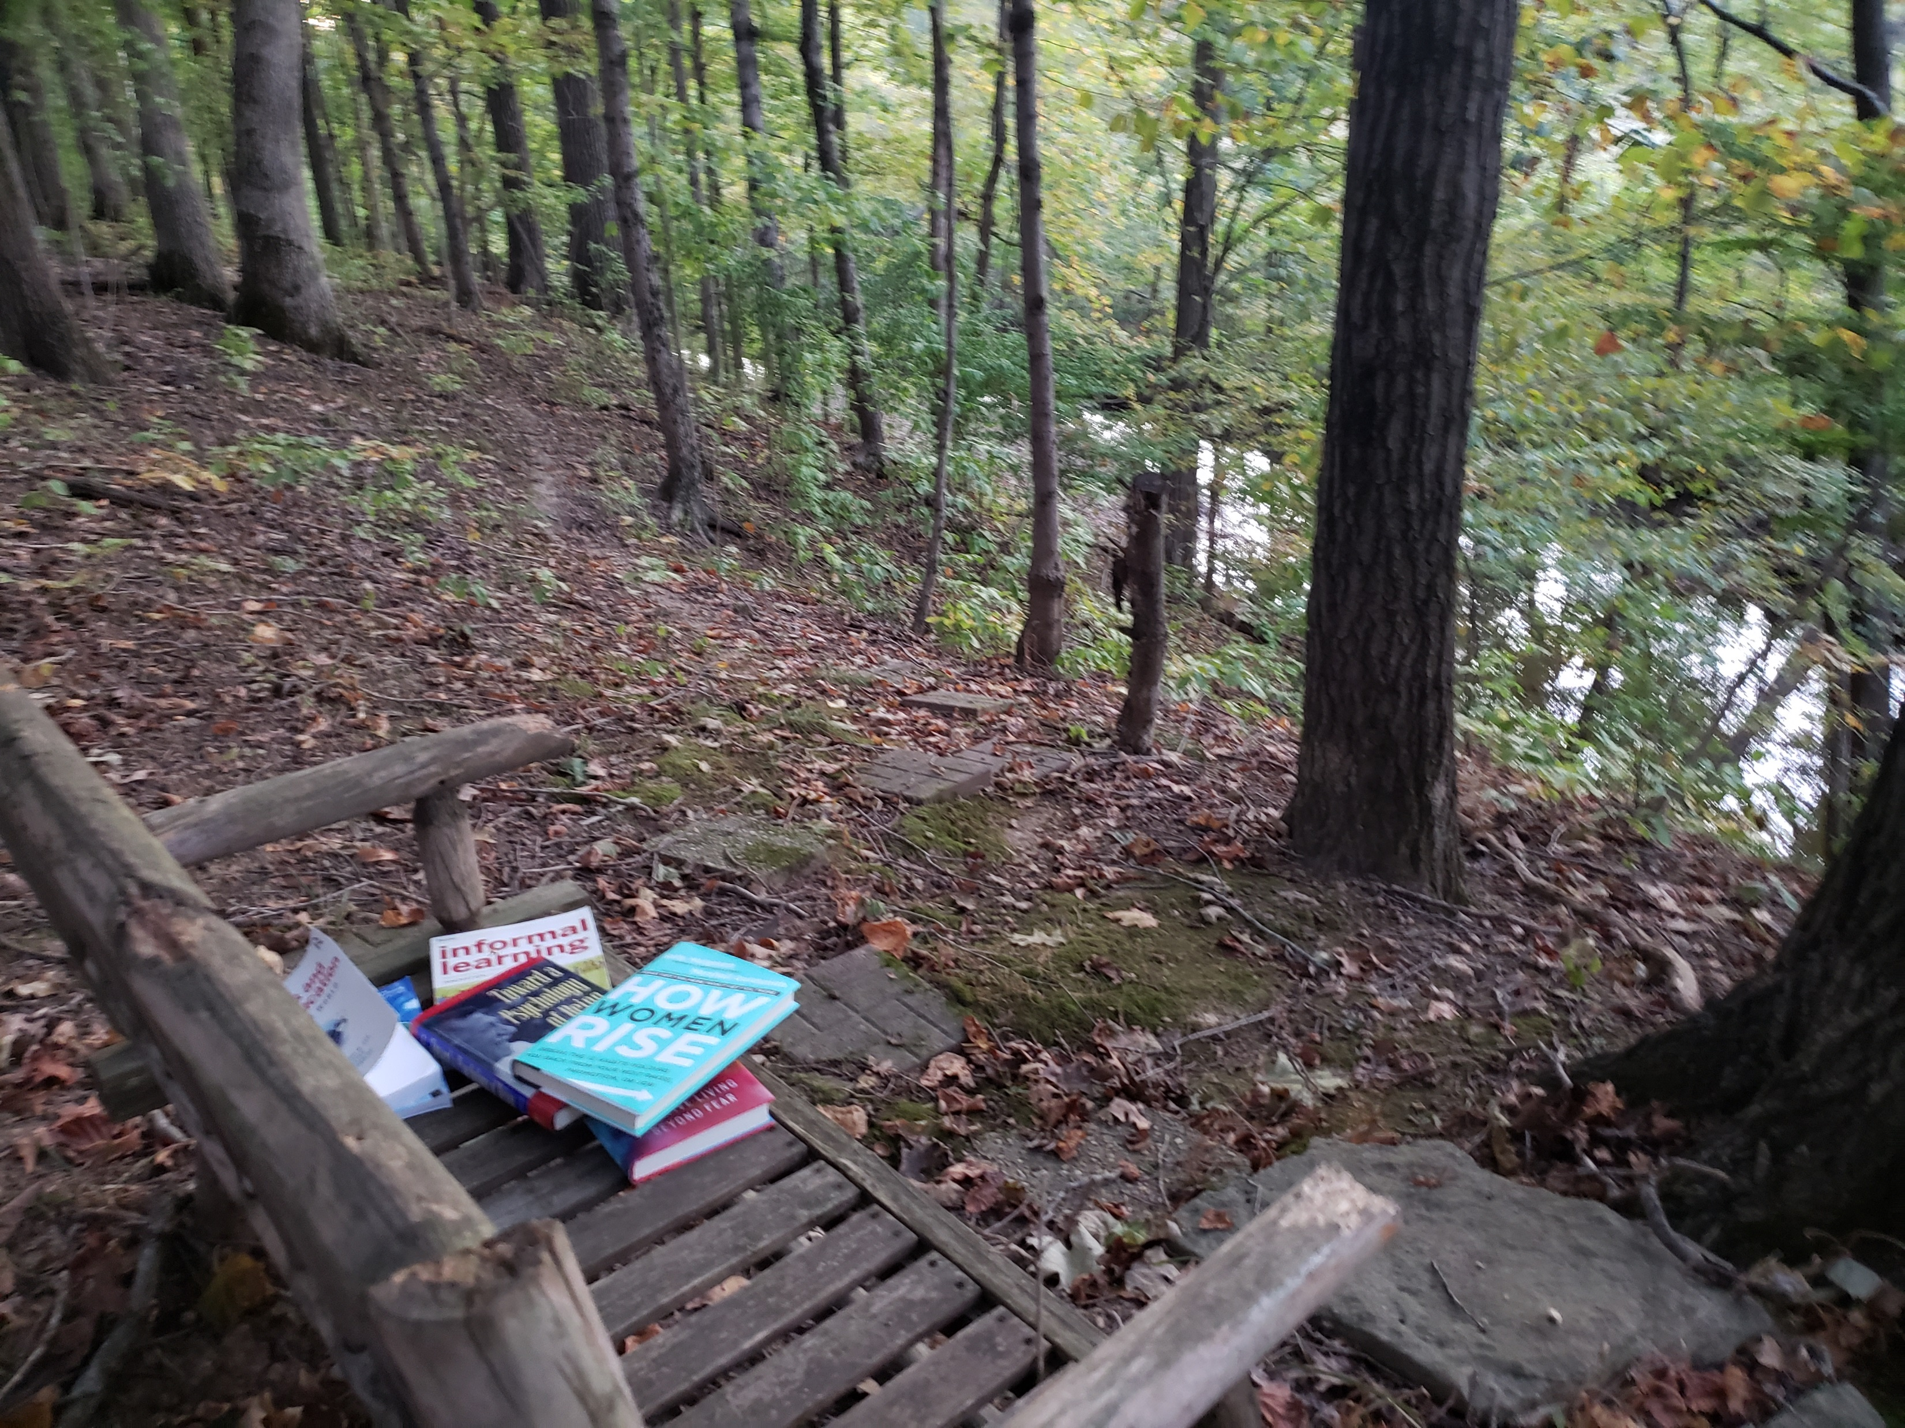
Writing Space: Curt Bonk

Slide 17
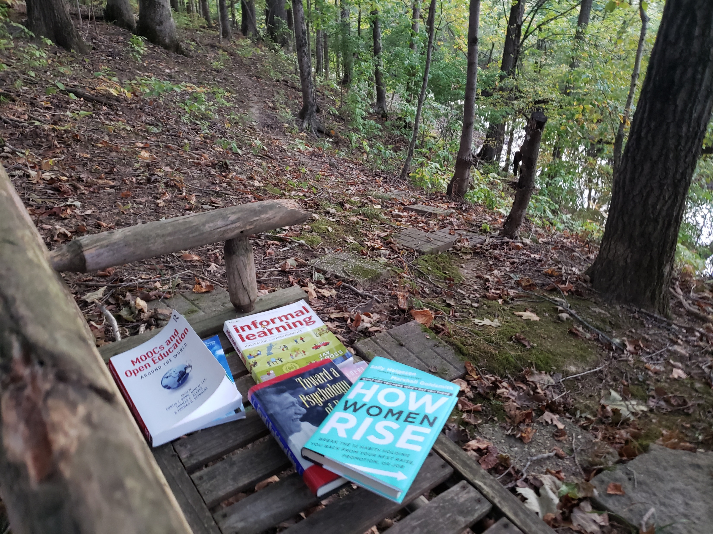
Writing Space: Curt Bonk

Slide 18
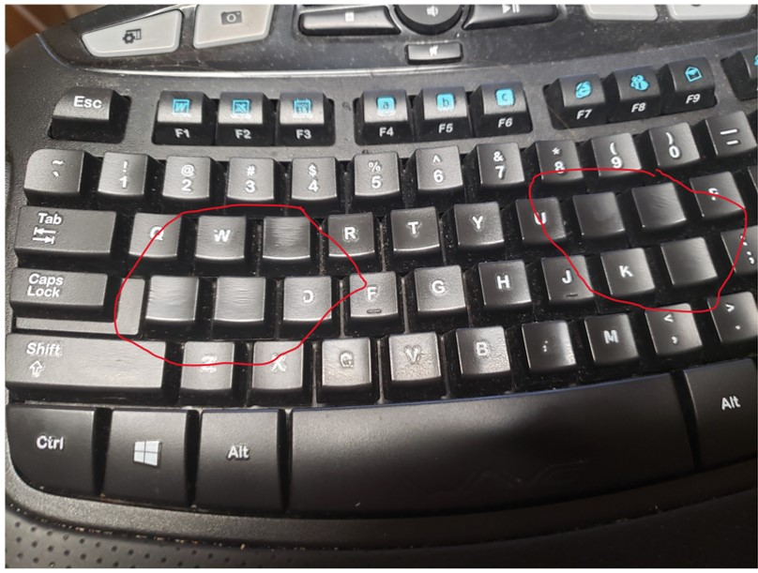
Writing Space
One of my biggest challenges is my tendency to burn through keyboards!

Slide 19
30 Tips for Scholarly Success
Think ahead about the publishing potential of each project (and student’s projects).
Do about one dissertation per year.
Try to stay healthy and things will accumulate (e.g., food, exercise, etc.).
Network widely and across disciplines and maintain a list of potential collaborators.
Create a “work” file by month on desktop.
Notes:
19

Slide 20
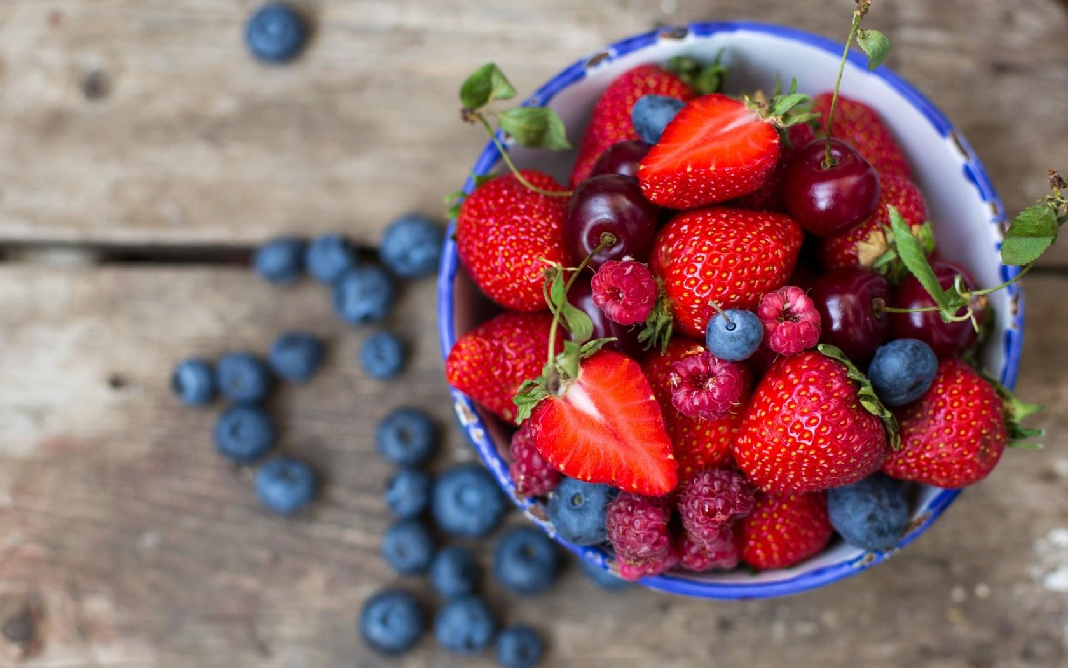
Habits/Rituals/Inspiration: Food How do approach your writing tasks? Any rituals that you use and recommend for inspiration? Anything that really works for you?
Start with a vitamin or health drink.
Grab plate of berries and celery.
Then perhaps tea or coffee.
End with a health drink.
Dilly bars are good after dinner.

Slide 21
30 Tips for Scholarly Success
Challenge yourself to have something creative in every publication (e.g., a unique model, figure, chart, etc.).
Set goals and challenge yourself.
Be bold (asking for endorsements, book chapter authors, etc.).
Save deleted text as starter text.
Work off reminder notes, checklists, and slips of paper.
Notes:
21

Slide 22
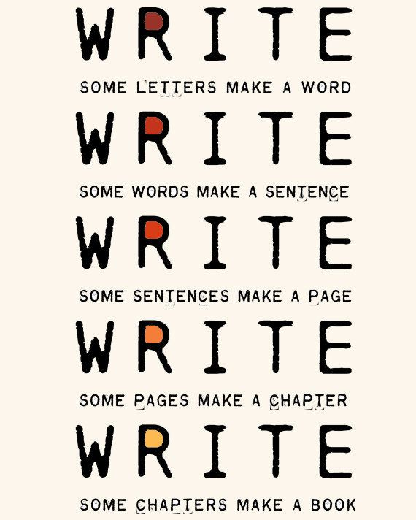
30 Tips for Scholarly Success
Rewrite, rewrite, rewrite.
Review article stacks saves and your own CV and that of others from trends.
Stay curious and explore new things (e.g., listen to audiobooks; enroll in webinars).
Create a list of 10 ways to say no.
Celebrate Your Writing Accomplishments with Friends
Notes:
22

Slide 23
Who wants to go to the 40th Floor to celebrate tonight?
Notes:
Curt
23

Slide 24
Plans and Goals: Curt Bonk How do you schedule your writing? How far in advance do you plan your writing? How do you prioritize your writing? How do you visualize your writing? Do you use a timeline or a planner? Do you have advice for developing a writing plan?
Plan: I save days for writing in my paper planner.
Focus: I say no to things that don’t fit my writing plans.
Track: I note projects in process and completed in my daily Dalia Lama quote of the day.
Monitor: I look at articles I have in review, in revision, and in press in my CV all the time.
Be Responsive: I respond to co-writer requests.
Goals: Put writing plans in annual report.

Slide 25
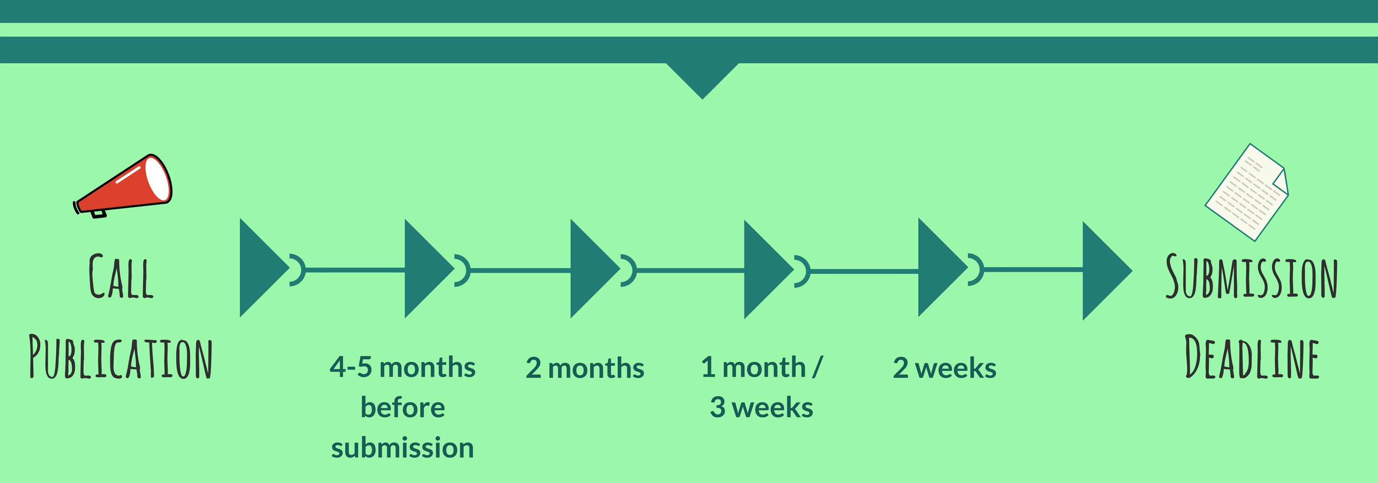
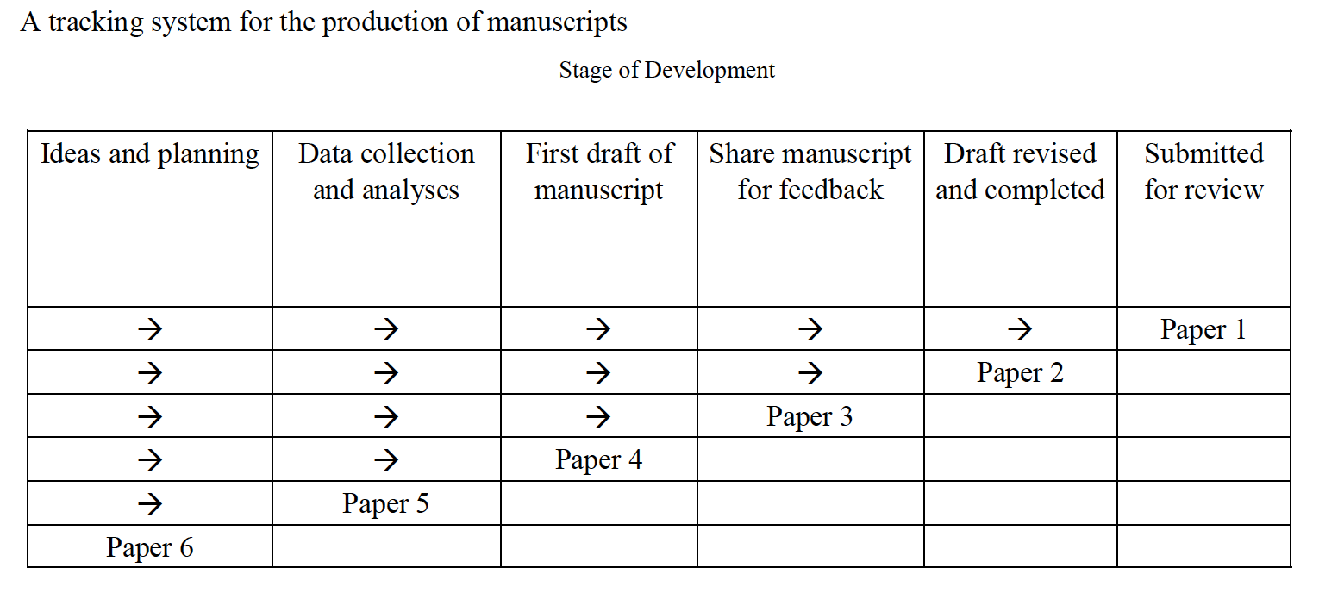
Start Creating your Timelines or Multiple Timelines with Flexible Goals
Notes:
Curt
Screenshot from Cecil’s article
25

Slide 26
Writing Tips: Curt Bonk Anything special that you do?
My top 10 key writing tips:
Create a “Work” file on your desktop.
Save screen shots, dates, and URLs of articles.
Create “Articles to read” folder on your desktop.
Listen to audiobooks for writing ideas.
Watch movies & look for educational issues and ideas.
Always save documents at least twice.
Send draft of document to yourself on email…restart anywhere.
Ask friends to read second or third draft.
Save articles published by year.
Keep drafts of articles in special files.

Slide 27
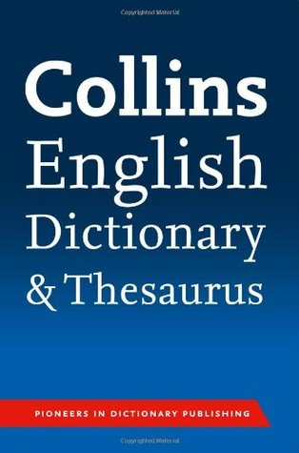
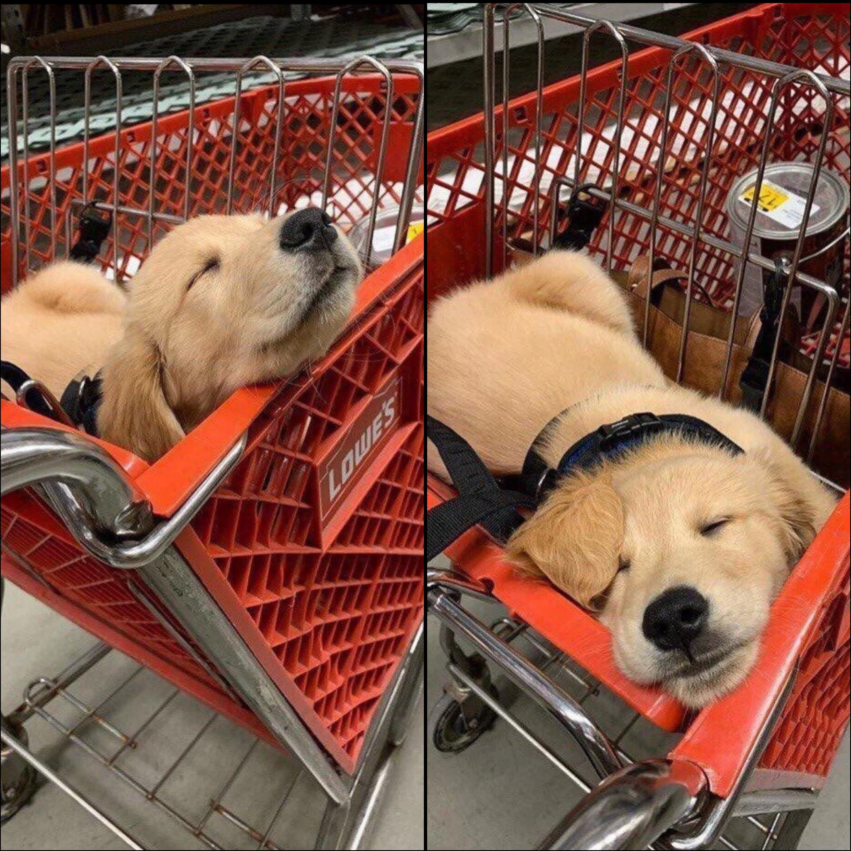
10 More Writing Tips: Curt Bonk Anything special that you do?
My top 20 key writing tips:
11. The Collins thesaurus.
12. Look for historical info online (e.g., Wikipedia and other).
13. Relocate to another room to edit document (i.e., kitchen table).
14. Sometimes sit. Sometimes stand.
15. Print out articles that you read parts of online.
16. Review paper piles on my pool table before you write.
17. Find info and URLs in previous talk slides.
18. Almost be more optimistic than pessimistic.
19. Work when your friends and family are sleeping.
20. Wherever you are is your writing space.

Slide 28
Writing Tools: Curt Bonk What particular writing tools do you use? How have they changed over time? What about tools for collaboration?
My top 10 key writing tools:
Keyboard—buy special letter keys
Microsoft Word
Google Search (I hate Bing)
Email. And forward email to self.
TravelinEdMan blog
Dropbox
Zoom (or Skype for team meetings)
Blue pens and lots of paper
My monster syllabus (R678)
FutureMe: Write a letter to yourself in the future: https://www.futureme.org/

Slide 29
Curt Bonk: Reflections on the Hot Streak
1. Persistence and grit.
2. Sense of now.
3. One at a time.
4. Assemble best team for you. Find comfort.
5. Intense and Relaxed Planning.
6. Explore Possible Journals and Commit.
7. Everyone has clear role.
8. Set bold and audacious goals.
9. Recheck list. Recheck goals.
10. Revel in good luck. Do not sulk if bad luck.
Notes:
29

Slide 30
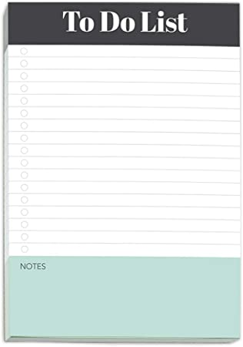
Habits/Rituals/Inspiration: Writing How do approach your writing tasks? Any rituals that you use and recommend for inspiration? Anything that really works for you?
Save writing ideas on slips of paper and look back at them.
Talk about your ideas.
Save starter text.
Clear email and to-do list.
Create checklist of plans.

Slide 31
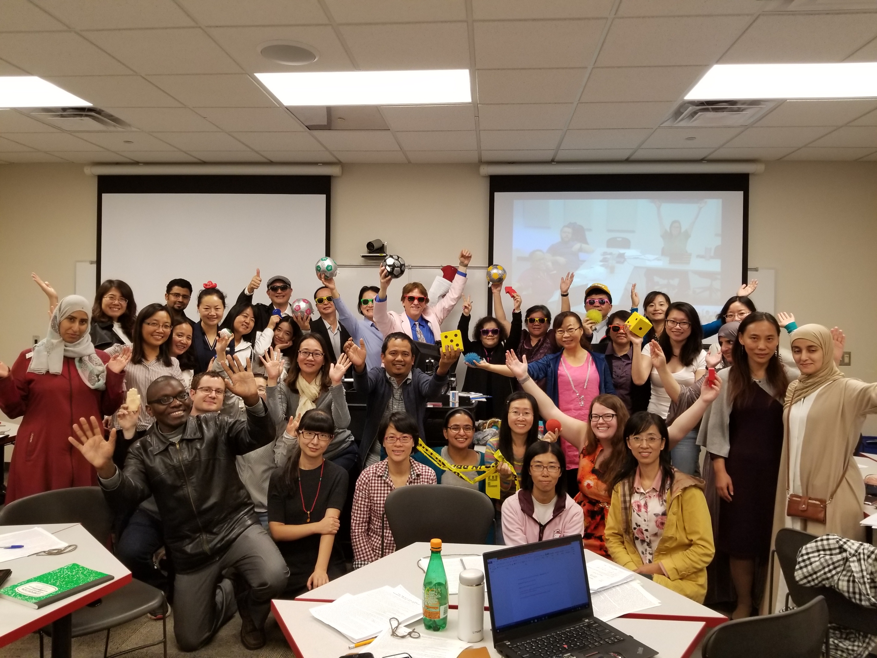
Do What Brings you Joy and Happiness What brings creativity, happiness, and joy to your writing?

Slide 32
How to decide on who to write with?
Notes:
Curt
32

Slide 33
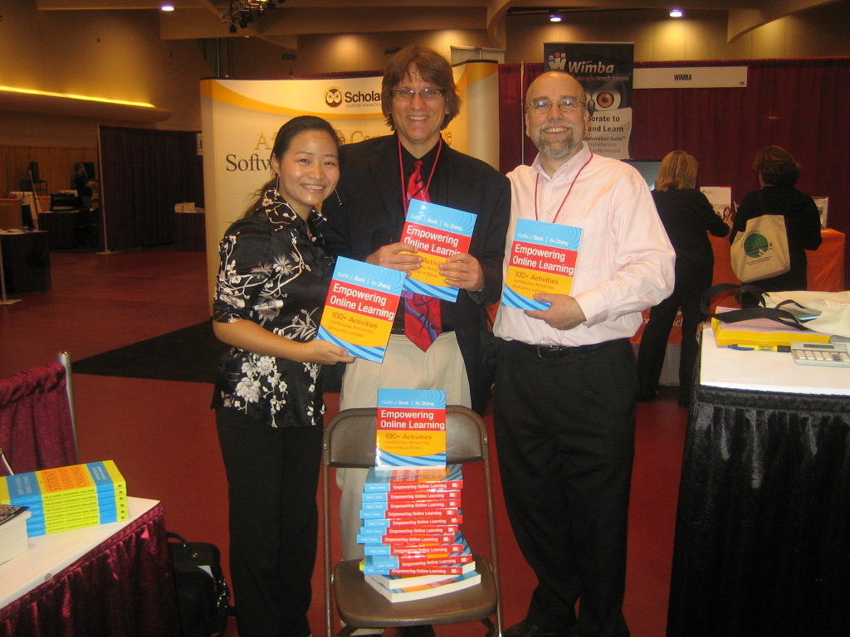
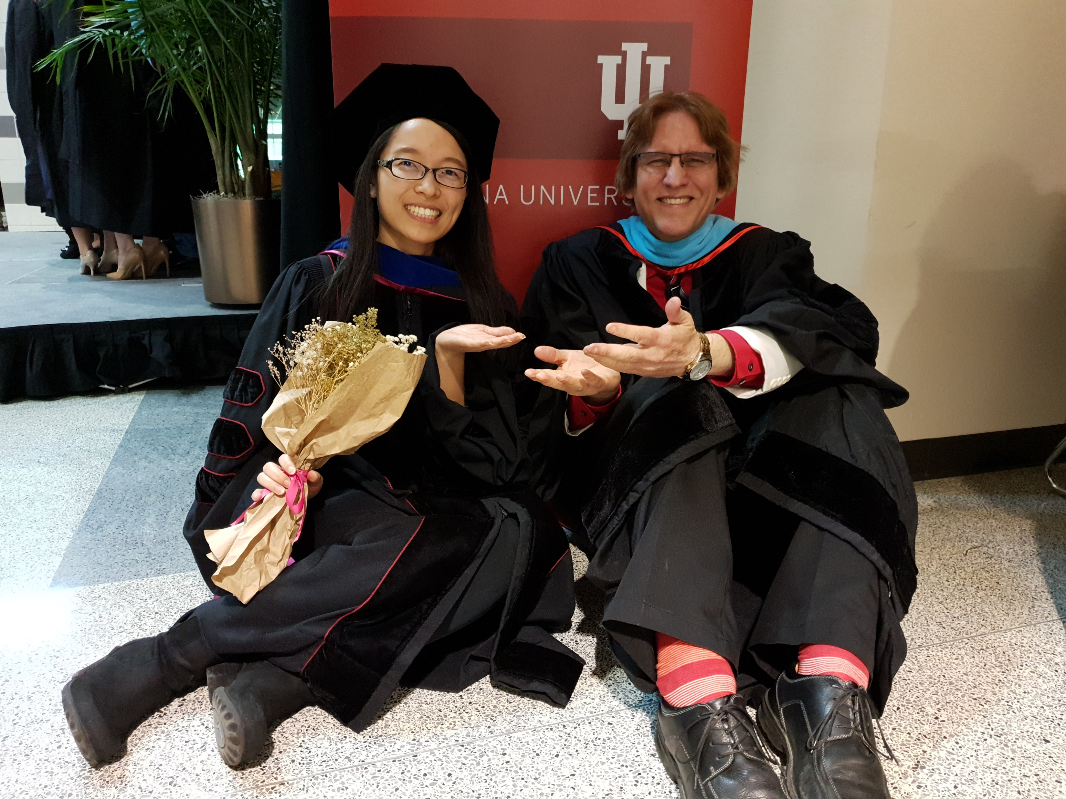
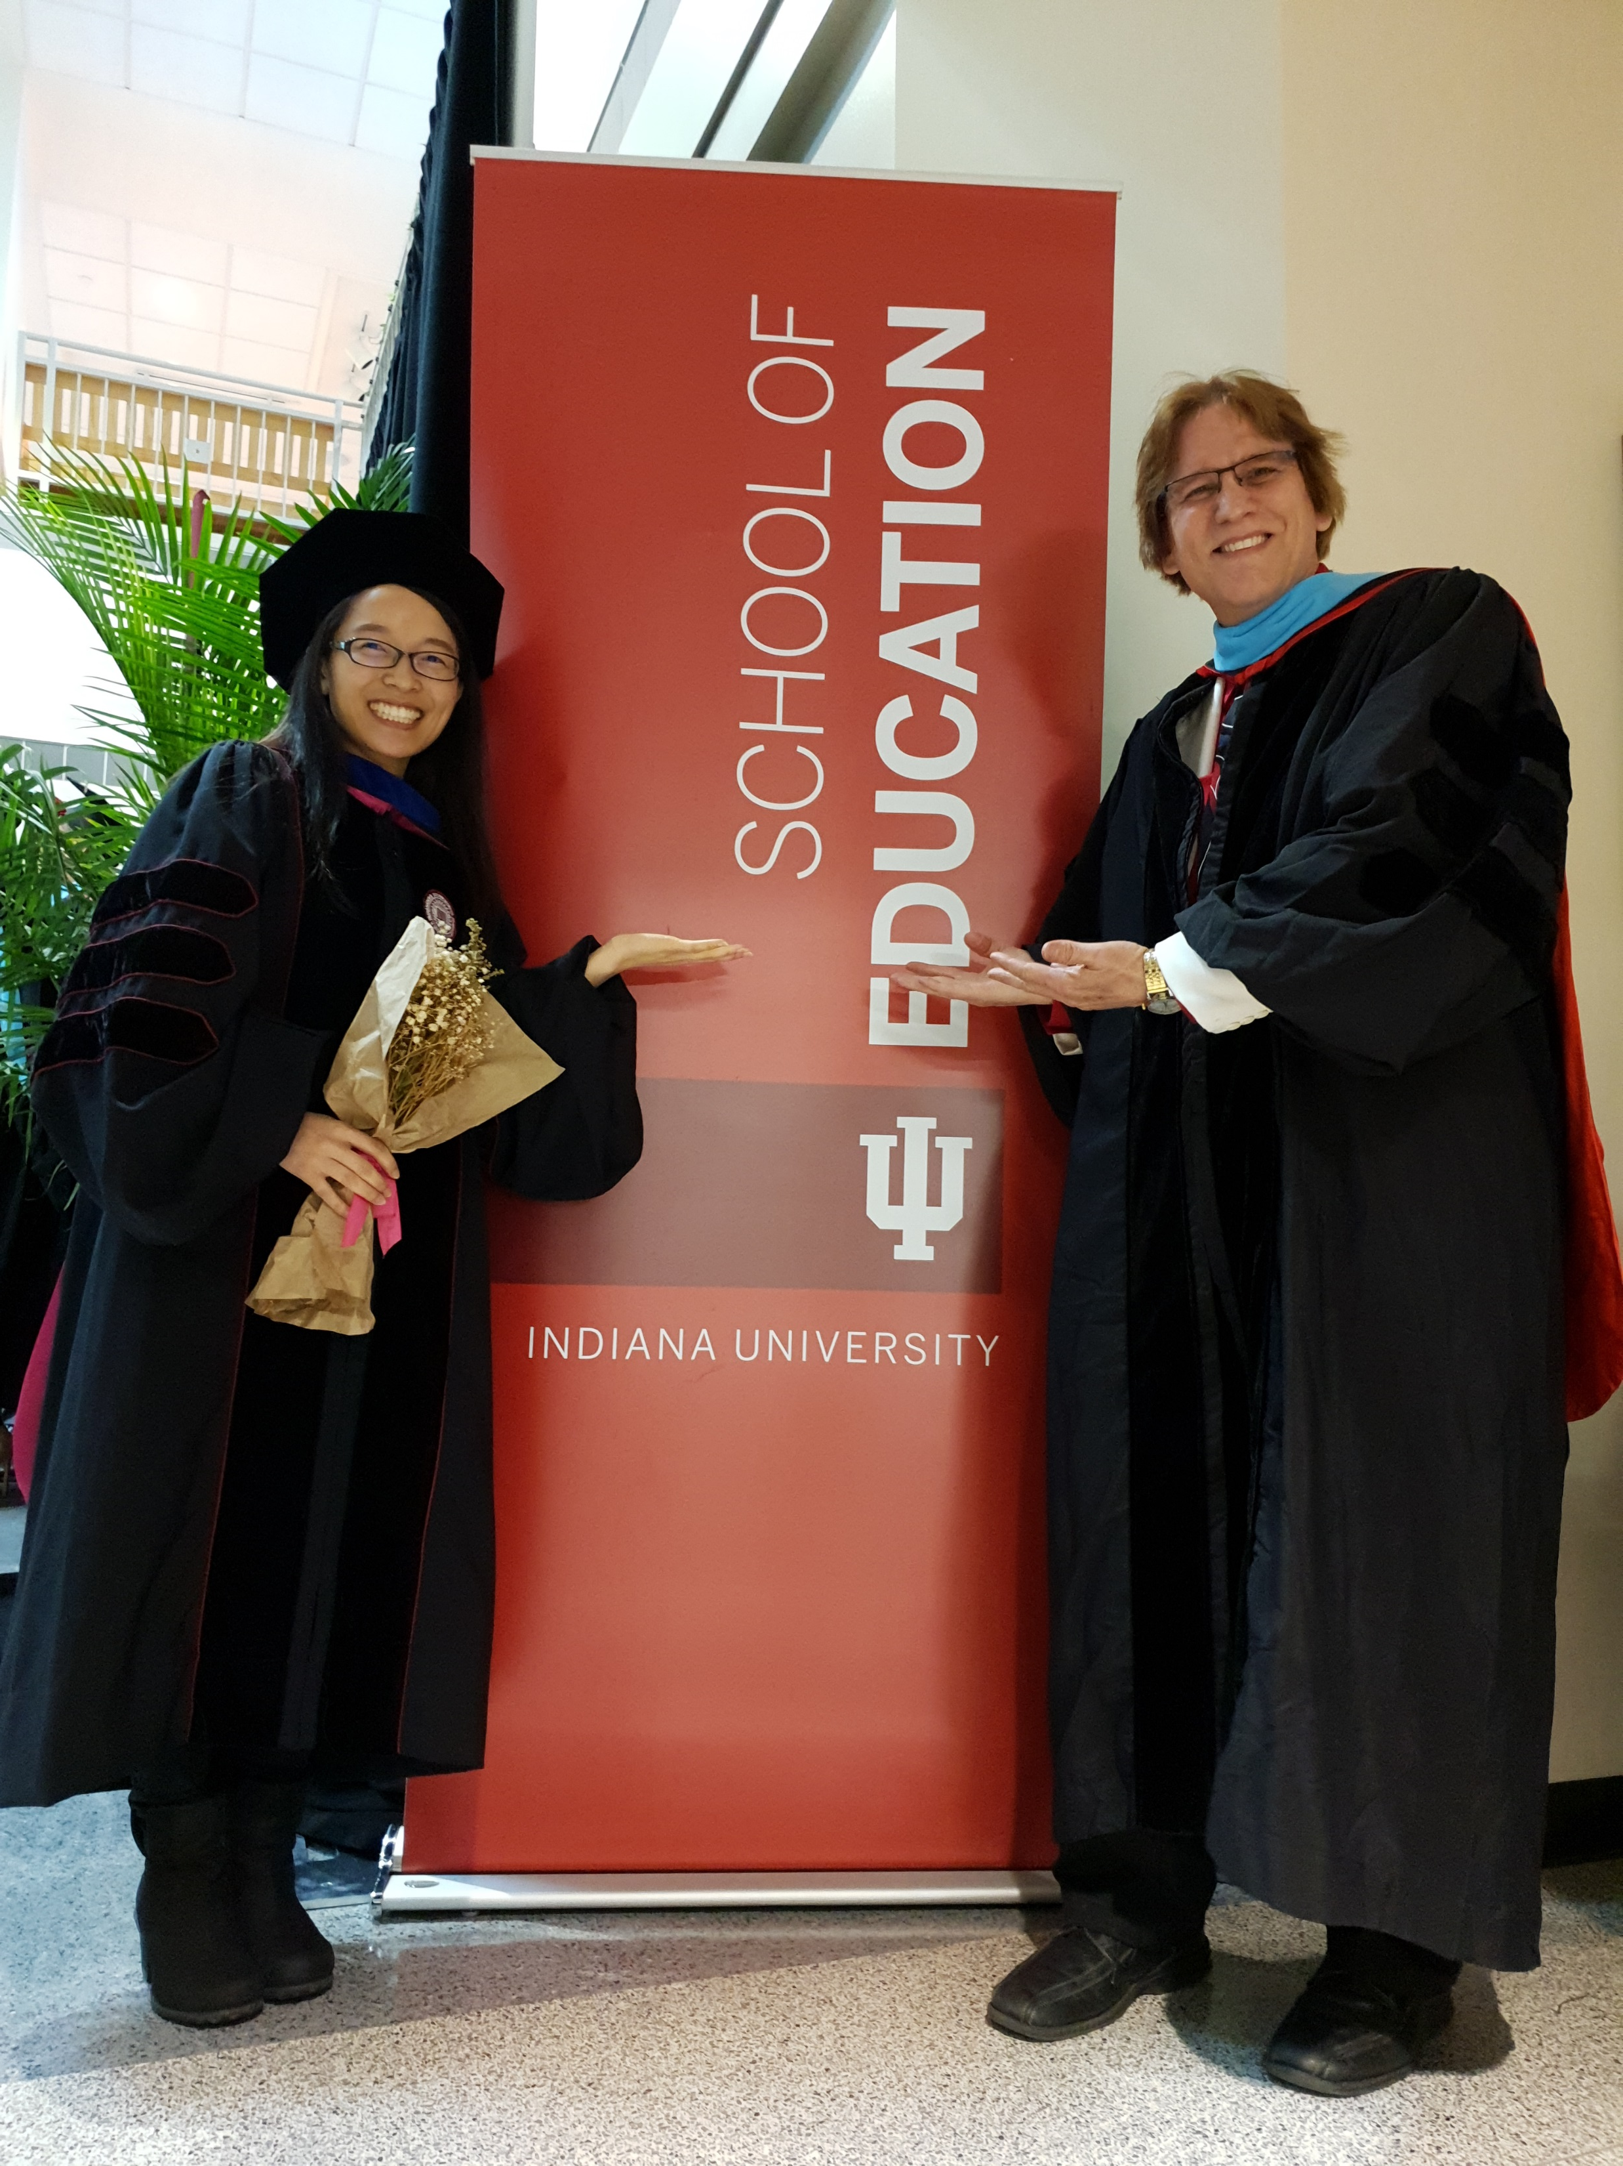
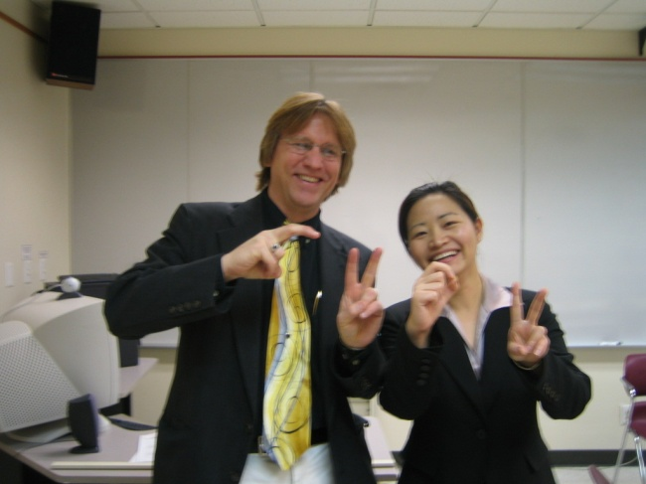
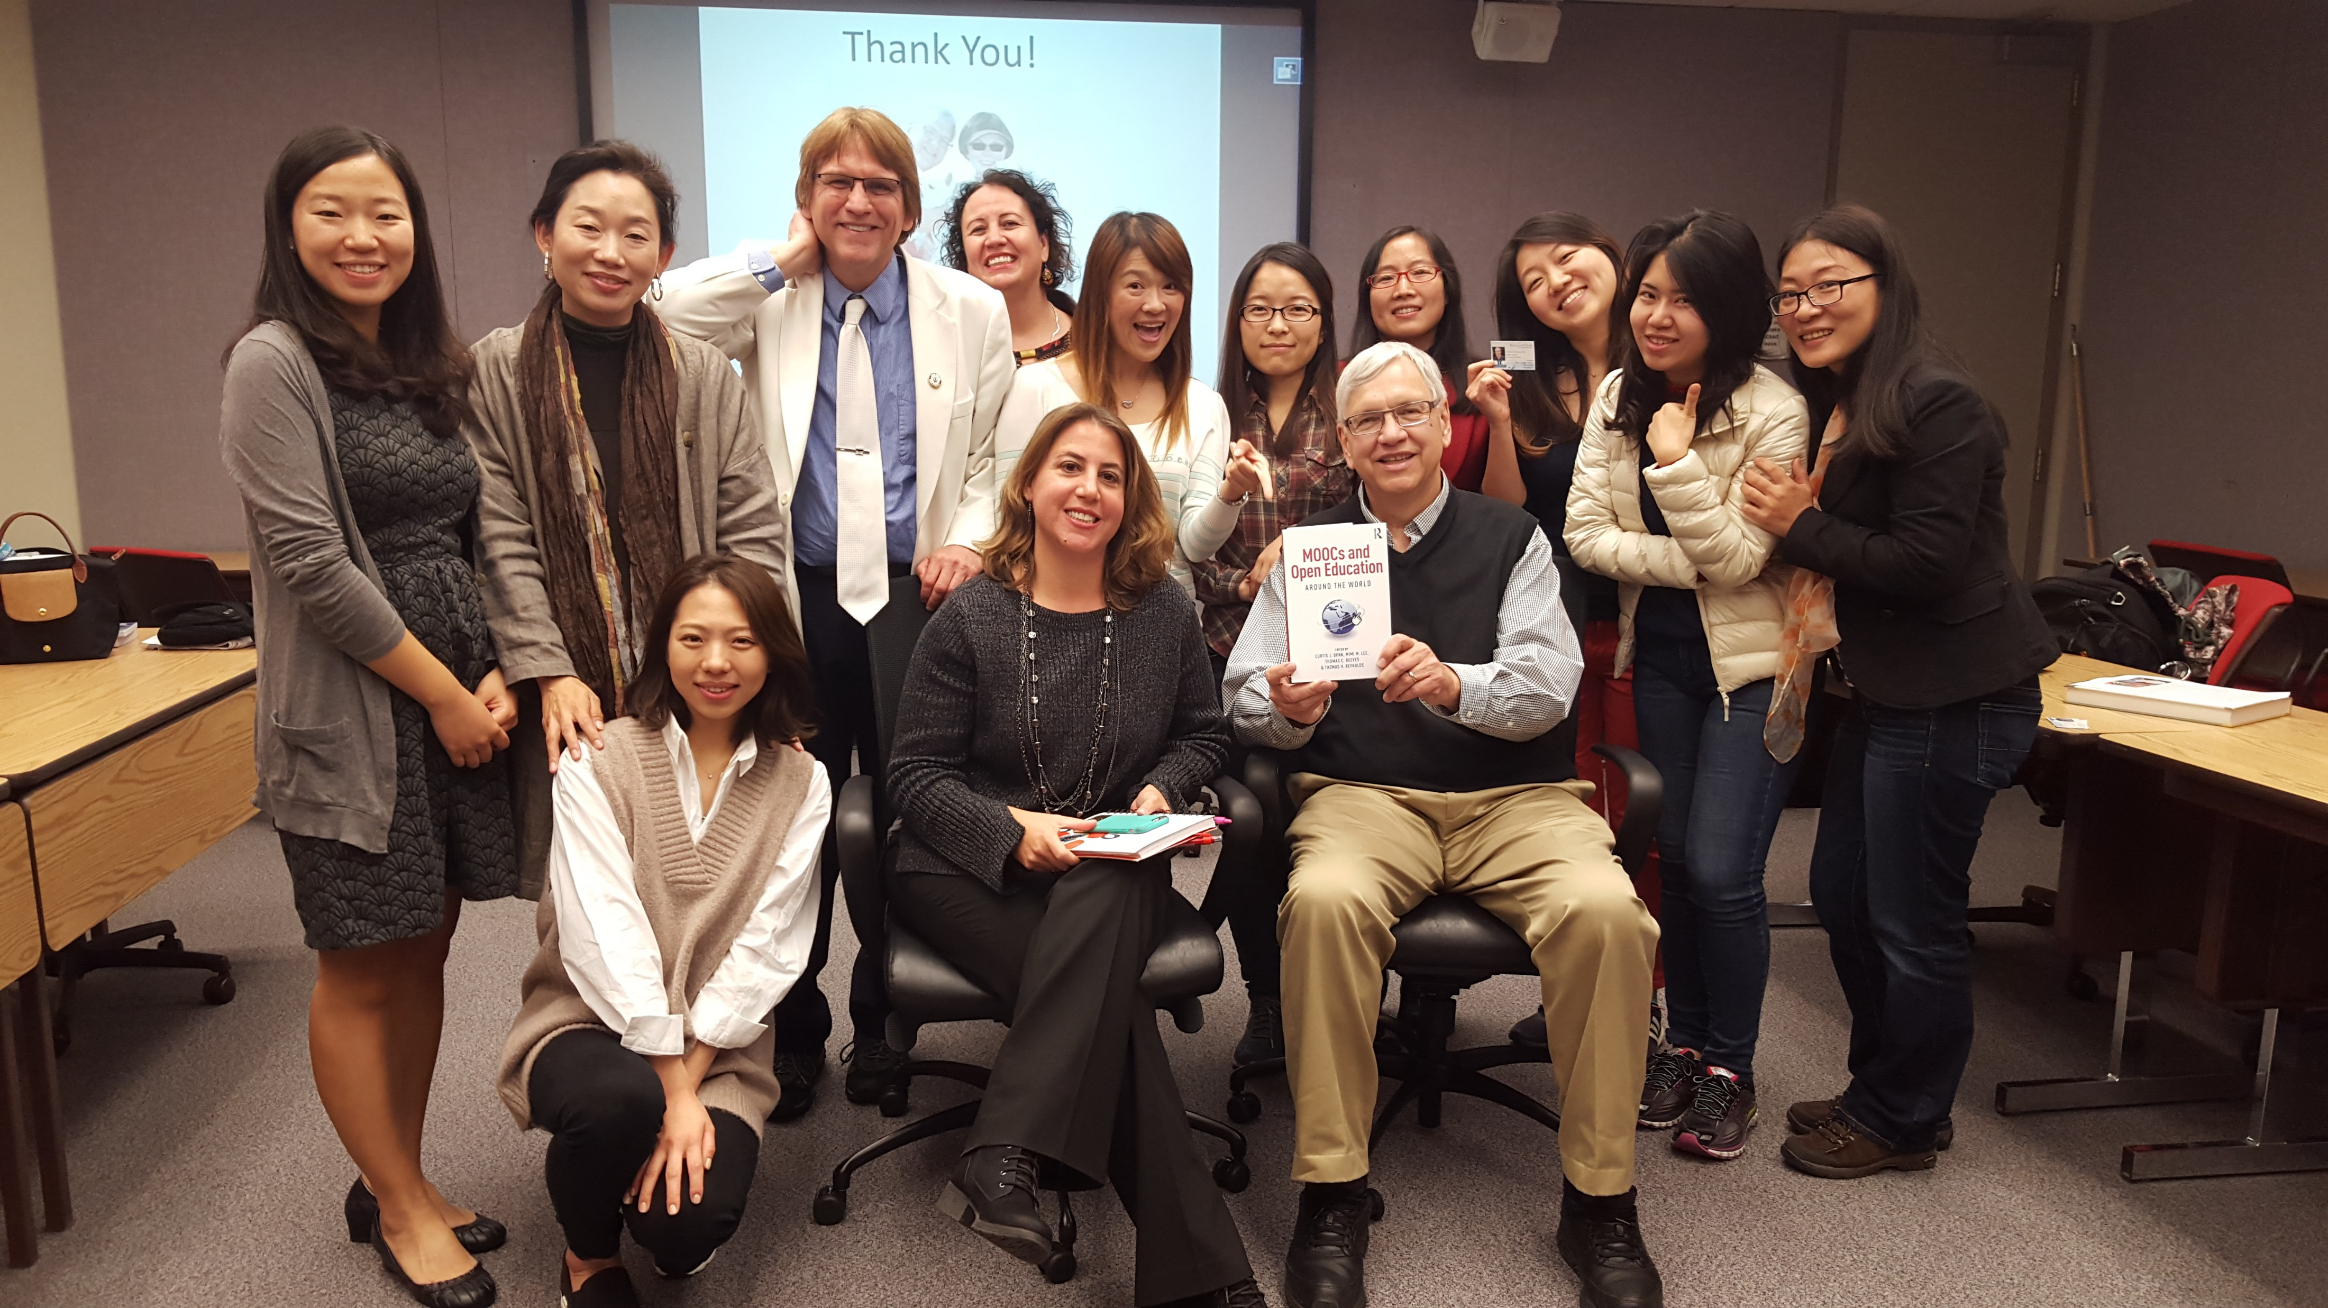
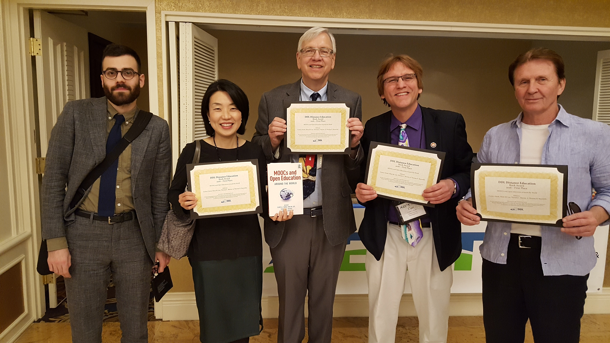
Writing Partners: Life is short: Find kind people who are prompt, positive, and productive and you can trust. How do you determine your collaborative writing partners? And negotiate tasks?

Slide 34
Concerns? Comments?
Commitments?
Time Raffle a book…
Curt Bonk, IU, Email: cjbonk@Indiana.edu
Slides: http://www.trainingshare.com
Notes:
All
34

