Slide 1
MOOC Instructor Motivations, Innovations, and Designs: Surveys, Interviews, and Course Reviews
Curtis J. Bonk
Meina Zhu
Annisa Sari
Indiana University
School of Education, IST INDIANA UNIVERSITY BLOOMINGTON

Slide 2
MOOC Trends and Recent Data

Slide 3
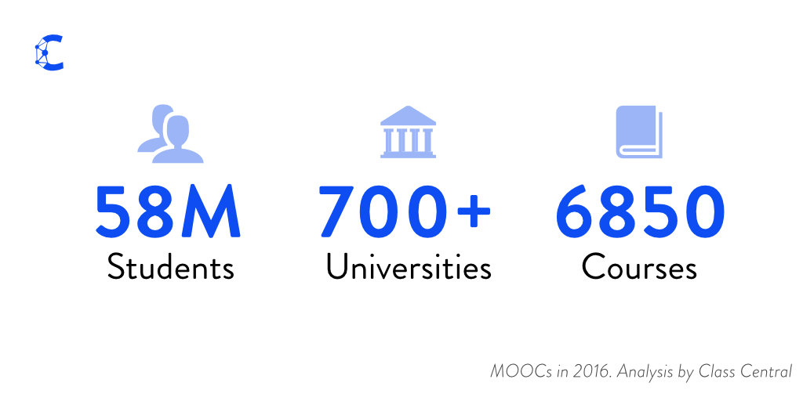
December 25, 2016 A Review of MOOCs Stats and Trends in 2016, Dhawal Shah, Class Central https://www.class-central.com/report/mooc-stats-2016/

Slide 4
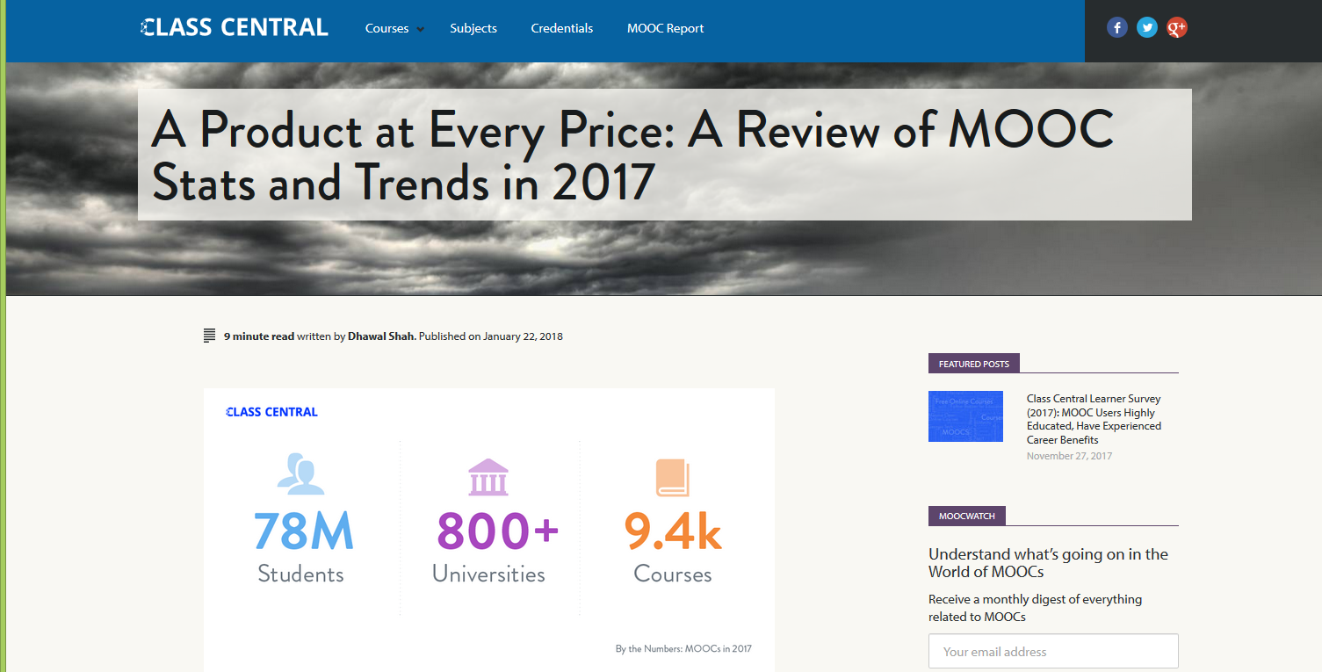
January 22, 2018 A Review of MOOCs Stats and Trends in 2017, Dhawal Shah, Class Central https://www.class-central.com/report/moocs-stats-and-trends-2017/

Slide 5
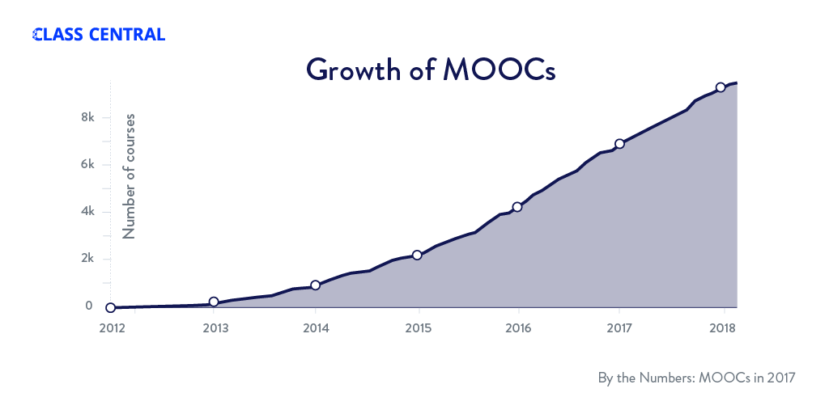
January 22, 2018 A Review of MOOCs Stats and Trends in 2017, Dhawal Shah, Class Central https://www.class-central.com/report/moocs-stats-and-trends-2017/

Slide 6
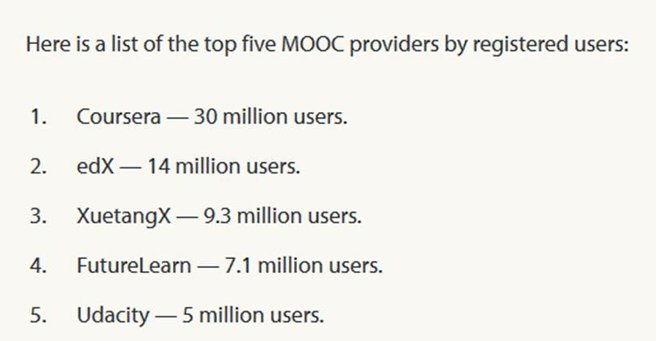
January 22, 2018 A Review of MOOCs Stats and Trends in 2017, Dhawal Shah, Class Central https://www.class-central.com/report/moocs-stats-and-trends-2017/

Slide 7
Subject areas (January 22, 2018)

Slide 8
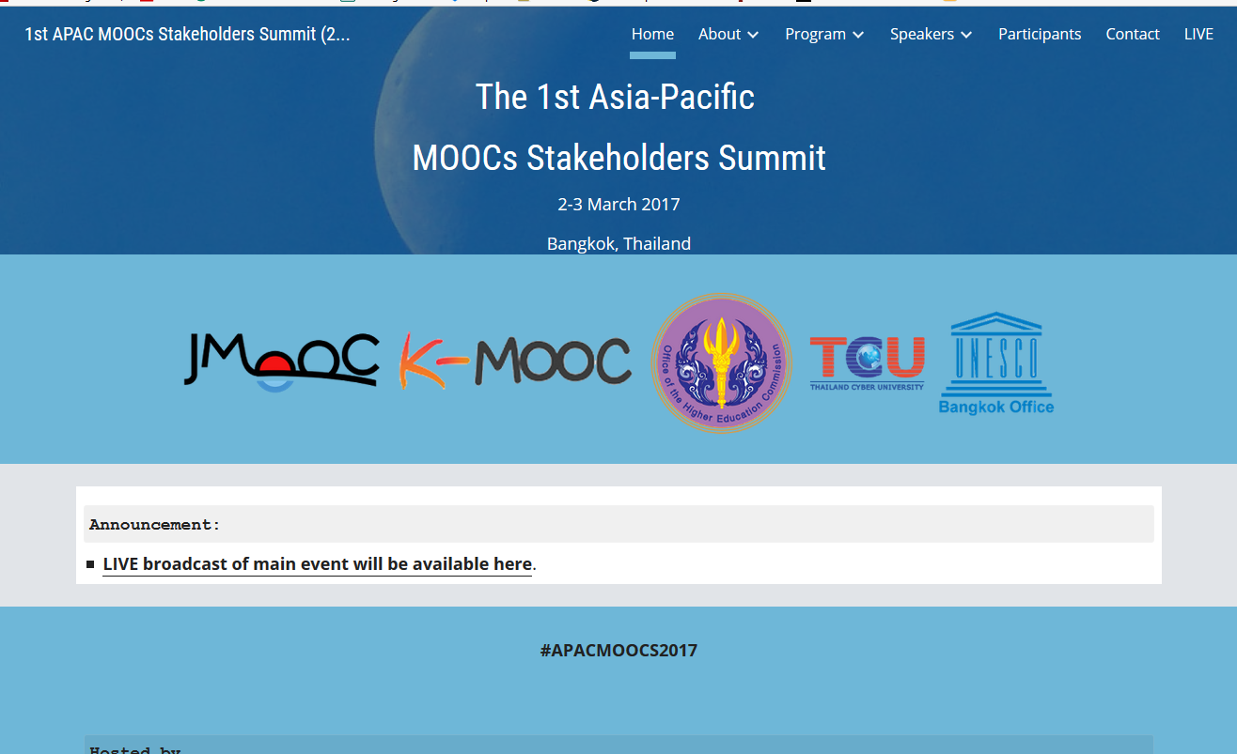
June 15, 2017 Massive List of MOOC Providers Around The World, Class Central JMOOC, K-MOOC, and T-MOOC? https://www.class-central.com/report/mooc-providers-list/

Slide 9
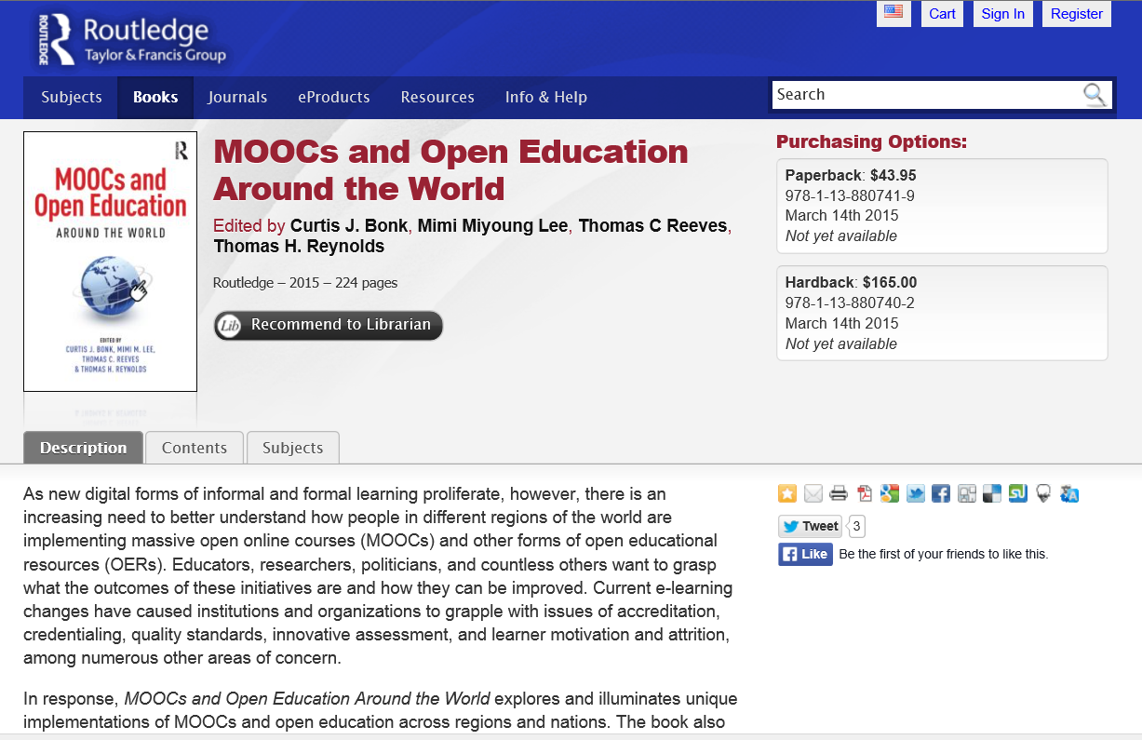
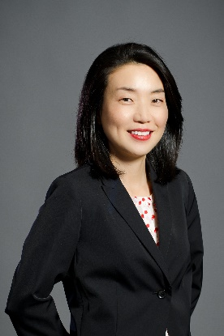
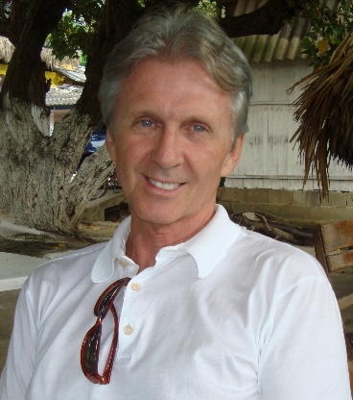
MOOCs and Open Education Around the World (2015) http://moocsbook.com/

Slide 10
Research Background

Slide 11
Research Background
MOOCs can be beneficial to both learners and instructors
(Hew & Cheung, 2014)
Instructors are one of the five main components of MOOCs; the other four are learners, topic, material, and context
(Kop, 2011 )
Few studies have examined instructional design from MOOC instructors’ perspectives
(Margaryan et al., 2015; Ross, Sinclair, Knox, Bayne, & Macleod, 2014; Watson et al., 2016)

Slide 12
Systematic Review of Research Methods in MOOCs (2014-2016) (Zhu, M., Sari, A., & Lee, M. M., 2018)

Slide 13
Systematic Review of Research Methods in MOOCs (2014-2016) (Zhu, M., Sari, A., & Lee, M. M., 2018)
 | Quantitative | Qualitative | Mixed methods
Student-focused | 39 | 9 | 26
Design-focused | 19 | 12 | 17
Context and impact | 9 | 6 | 5
Instructor-focused | 0 | 3 | 2

Slide 14
Quotes: Veletsianos et al. (2015-2016)
“To gain a deeper and more diverse understanding of the MOOC phenomenon, researchers need to use multiple research approaches (e.g., ethnography, phenomenology, discourse analysis) add content to them.” (p. 583.)
Veletsianos, Collier, & Schneider (2015, May), Digging deeper into learners’ experiences in MOOCs: Participation in social networks outside of MOOCs, notetaking and contexts surrounding content consumption. BJET, 46(3), 570-587.
“Dependence on Particular Research Methods May Restrict our Understanding of MOOCs.”
George Veletsianos & Peter Shepherdson’s Study (2016). Systematic Analysis and Synthesis of the Empirical MOOC Literature Published in 2013-2015. IRRODL. http://www.irrodl.org/index.php/irrodl/article/view/2448/3655

Slide 15
Research Purpose and Questions

Slide 16
Research Purpose
This study explores instructor motivations for offering MOOCs and the design innovations in MOOCs to better understand MOOC design practices and to provide suggestions for future MOOC instructors.

Slide 17
Research Questions
What motivates instructors to offer MOOCs?
What instructional innovations do MOOC instructors perceive?
What do instructors perceive as the strengths of their MOOCs?
How would they redesign the MOOC?

Slide 18
Research Design

Slide 19
Research Methods-Design
Sequential mixed methods design (Creswell & Clark, 2007)

Slide 20
Research Methods-Data collection
Data Collection:
(1) surveys, (2) interviews, and (3) course reviews.
Participants:
143 survey participants (10% response rate)
12 interviewees

Slide 21
Research Methods-Data collection
MOOC instructors interviewed
No. | Countries | Subject areas | Platforms
1. | The U.S. | Language and Literacy | Coursera
2. | The U.S. | Education | Coursera
3. | The U.S. | Education | Canvas
4. | The U.S. | Chemistry | Coursera
5. | UK | Public health | FutureLearn
6. | UK | Language and Literacy | FutureLearn
7. | Hong Kong | Math | Coursera
8. | Mainland China | Math | Coursera
9. | Canada | Psychology | Coursera
10. | Australia | Public Health | Open2Study
11. | Sweden | Computer Science | edX
12. | India | Management | edX

Slide 22
Research Methods-Data analysis
RQs | Data Sources | Data analysis
RQ1 | Survey Interview MOOC review | Descriptive statistics Content analysis (Elo & Kyngäs, 2008)
RQ2 | Interview MOOC review | Content analysis
RQ3 | Interview MOOC review | Content analysis
RQ4 | Interview | Content analysis

Slide 23
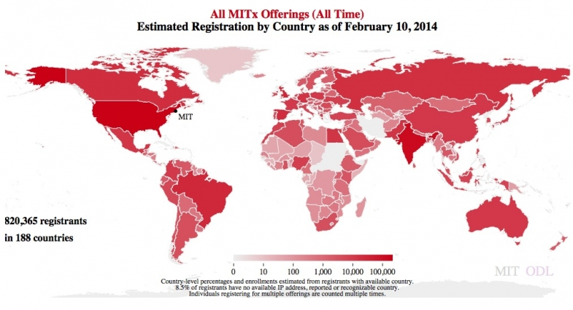
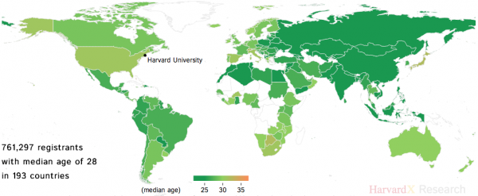
Demographic Information

Slide 24
Prior Online or Blended Experience

Slide 25
Prior MOOC Experience

Slide 26
Subject Area of MOOC Taught

Slide 27
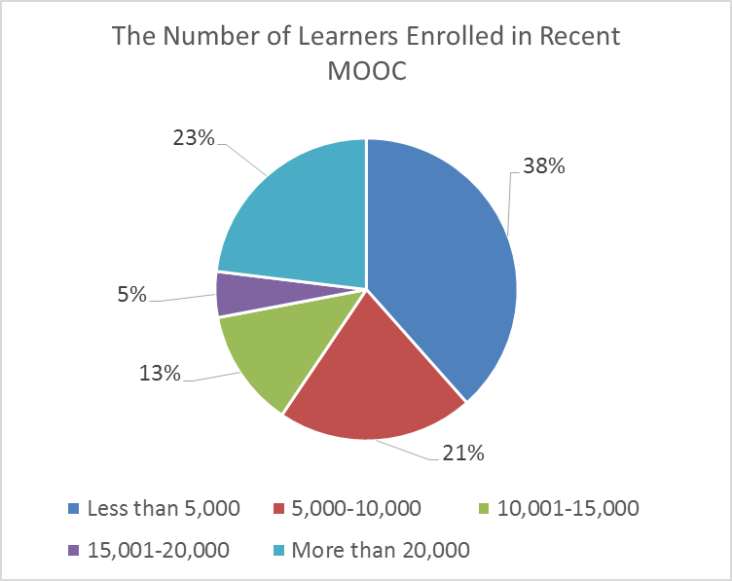
MOOC Enrollments

Slide 28
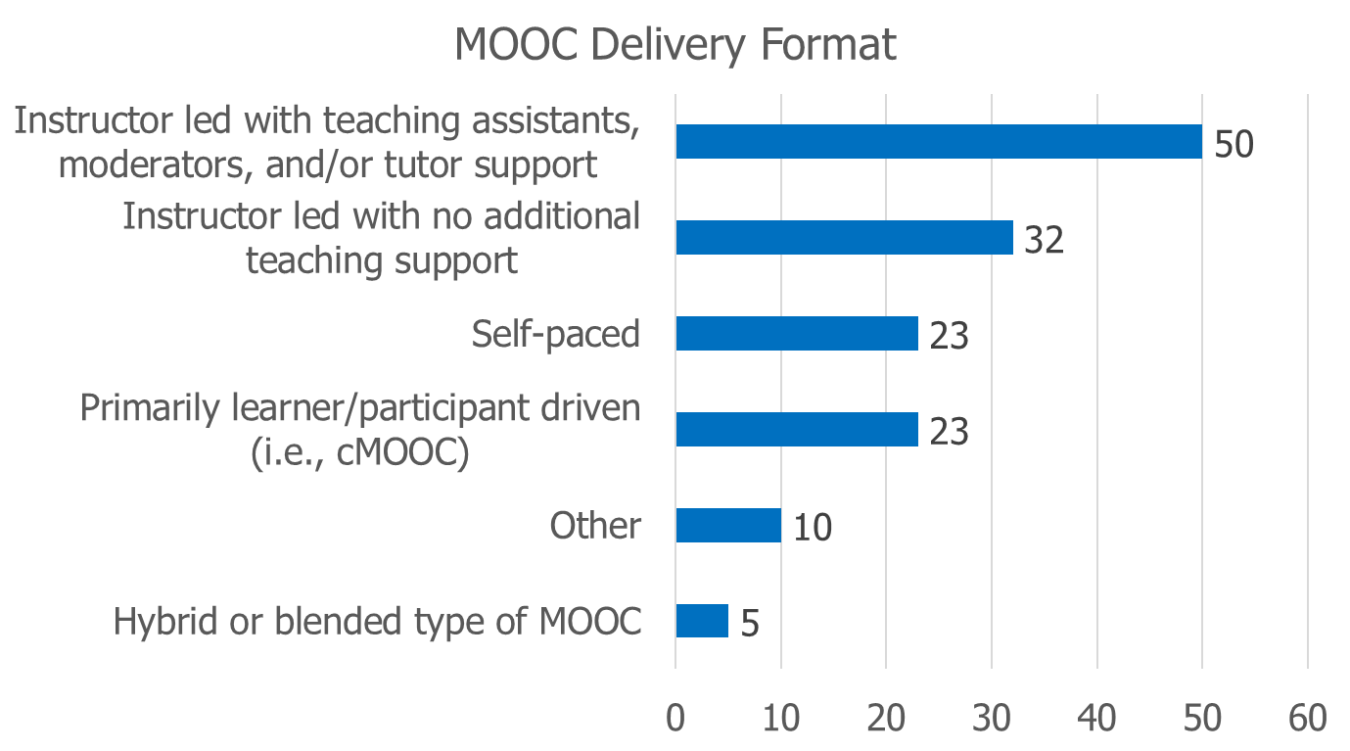
MOOC Delivery Format

Slide 29
Involvement in Course Design

Slide 30
Enjoyment in Designing MOOCs

Slide 31
Additional Findings

Slide 32
1. Motivational Findings
RQ1: What motivated instructors to offer MOOCs?

Slide 33
1. Motivational Findings
RQ1: What motivated instructors to offer MOOCs?
Many of them wanted to experience instructional innovation with MOOCs.
As one instructor from Canada mentioned:
“I'm always interested in how you can provide a deep learning experience in untraditional ways. So when MOOCs came over, I didn't always understand it really well…I thought the best way to understand what was going on was to jump in. So more curiosity and wanting to learn about the world of MOOC.”

Slide 34
1. Motivational Findings
RQ1: What motivated instructors to offer MOOCs?
Many of them wanted to experience instructional innovation with MOOCs.
U.S.: decided to design MOOCs “just to experiment.”
U.S.: “expose your university to broader world.”
Sweden: “summarizes our way to teaching Computer Architecture and then I was very motivated to give a MOOC.”
U.S. “The initial motivation was to make some video resources for my own students.”

Slide 35
2. Innovation Findings
RQ2: What instructional innovations do MOOC instructors perceive?
Cutting videos into small chunks.
Integrating interactive media.
Peer review.
Problem-based learning.
Service learning.

Slide 36
2. Innovation Findings
RQ2: What instructional innovations do MOOC instructors perceive?
One education instructor from the USA remarked about PBL:
“I think it is the problem-based learning. It's sort of, out-of-the-classroom learning, having them go out and do the assignment at their house, in their backyard, or on their sidewalk. So it automatically is integrated into their everyday life.”

Slide 37
3. MOOC Strengths Findings
RQ3: What do instructors perceive as the strengths of their MOOCs?
The topic of the MOOC itself.
The pedagogical methods employed.
The impact on participants.

Slide 38
3. MOOC Strengths Findings
RQ3: What do instructors perceive as the strengths of their MOOCs?
One interviewee from Canada claimed the strengths of his course is making it informal.
“…it is like we are sitting in the same room, having a chat…This is nothing I try to do but I have some comfortable, smile that makes it feel like we're having an informal discussion... A lot of the people that I get emails from say: ‘I love the way you teach. I love the comfortable level, feels like we've been friends. You're welcome to my kitchen anytime.’”

Slide 39
4. MOOC Design Findings
RQ4: How would they redesign the MOOC?
Overall, they were satisfied with the current course, especially with the structure.
One literacy instructor from the UK emphatically stated:
“Actually no. I'm quite happy with it and we've had good feedback from learners.”

Slide 40
4. MOOC Design Findings
RQ4: How would they redesign the MOOC?
Adjusting the difficulty of quizzes.
Adding lab experiences.
Adding international perspectives.
Cancelling peer-grading.
Increasing instructor-student and peer-to-peer interaction.
Inviting guest speakers.
Making the length of the MOOC shorter.
Using learning analytics before redesigning MOOC.

Slide 41
4. MOOC Design Findings
RQ4: How would they redesign the MOOC?
Data from the platform
As one computer science instructor from Sweden explained:
“When I do the revision, I will for sure look at the detailed statistics…For example, you can get statistics [on] how much they rewind. That would be a sign that there is something that is not clearly explained. They have to listen [to] it again and again and then they get there.”

Slide 42
4. MOOC Design Findings
RQ4: How would they redesign the MOOC?
Data from the platform
He further added:
“I probably am a much better teacher than I was before…To think about that [i.e., less interaction with students when using prerecorded video] made me a different teacher. I’m sure I’m a different teacher after that. If you want to become a better teacher, you develop a MOOC.”

Slide 43
Discussion, Significance, and Conclusion

Slide 44
Discussion
Growth and relatedness needs were the primary instructor motivations for offering MOOCs.
Growth needs included curiosity about MOOCs and the exploration of new ways of teaching; such findings align well with the research from Hew and Cheung (2014).
Various pedagogical innovations were mentioned by the interviewees (e.g., guests, PBL, service learning, peer review, interactive media, etc.).
MOOC instructors interviewed were satisfied with the designs of their MOOCs, but did want to make major changes to their course. (Lacking time? And overly rely on positive student feedback.)

Slide 45
Significance & Conclusion
This study provides a window into the decision making of more than 100 MOOC instructors. Few studies have tapped into such a database.
This study provides key insights into instructors’ motivations for offering MOOCs as well as instructional innovations in MOOC design.
The results may inform MOOC stakeholders (i.e., institutions) of how to foster instructor motivation and instructional innovation in MOOCs.
This study can be used to train instructional designers on the design of MOOCs as well as the expectations of MOOC instructors that they may be working with.

Slide 46
Future Research Might Explore…
The relationship between instructor motivation and the types of instructional innovations in MOOC design.
Changes in MOOC instructor motivation across several MOOCs.
MOOC instructor motivation by discipline. MOOC instructor motivation by country or region of the world.
MOOC instructional professional development and instructor teaching skill changes from designing MOOCs.

Slide 47
Curtis J. Bonk, IU, cjbonk@indiana.edu
Meina Zhu, IU, meinzhu@indiana.edu
Annisa Sari, IU, annisa@uny.ac.id
Slides and Paper: http://www.trainingshare.com

