Slide 1
Write as if your life depends on it…. because it does!
Notes:
It is an honor to be invited to speak here at the University of Florida.

Slide 3
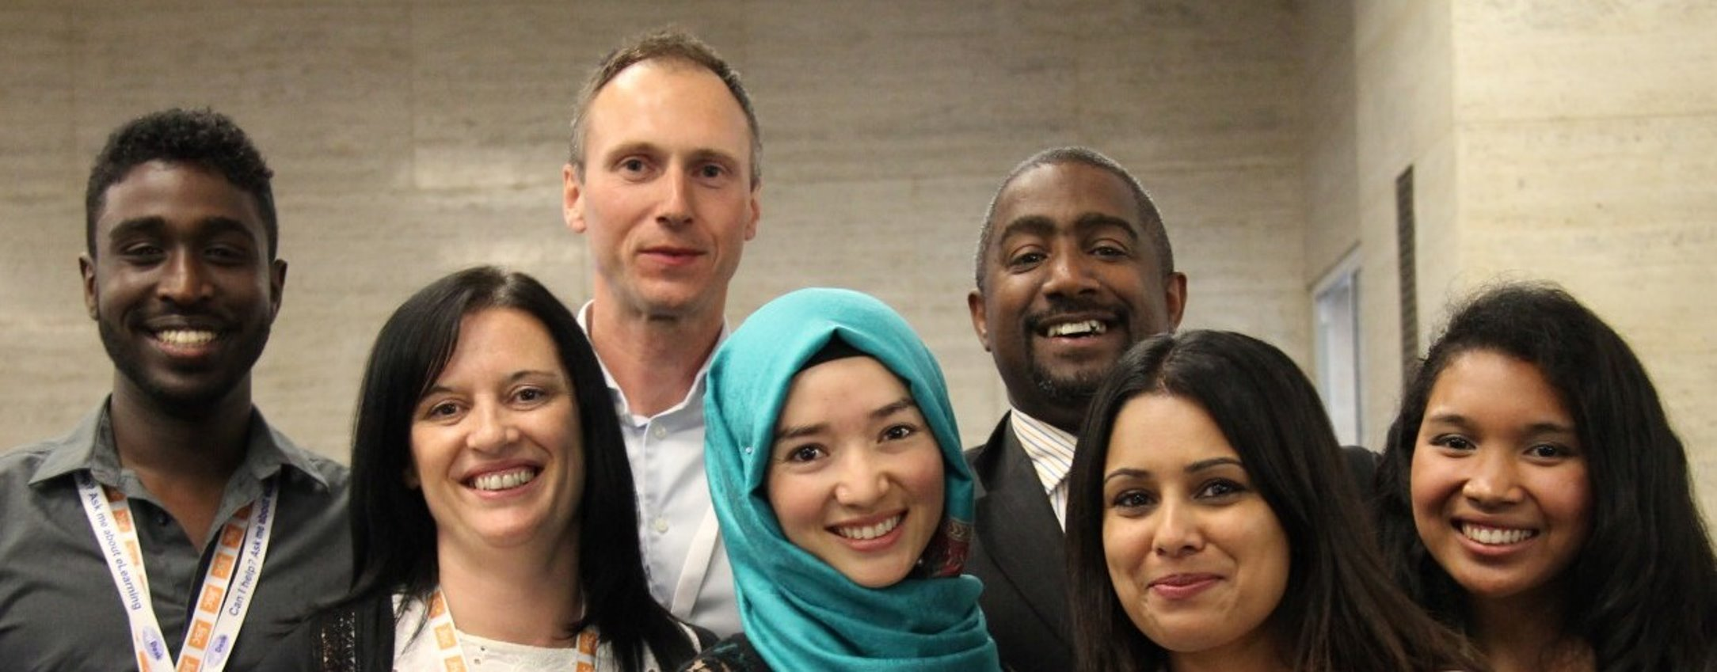
To be a successful as a doctoral student or new academic, you must juggle multiple roles:​
Researcher/Author​
Student/Teacher​
Service provider, and​
Someone ​with a life*​
*optional​

Slide 4
One key to “survival” is leveraging various responsibilities and opportunities to serve multiple purposes, e.g., aligning course assignments with a research project.

Slide 5
Scholarly writing is most often a solitary task, but it doesn’t have to be that way.

Slide 6
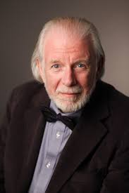
Reeves, T. C., & Clark, R. E. (1977). Research on creativity. Educational Technology, 17(2), 57-58.
Professor Dick Clark

Slide 7
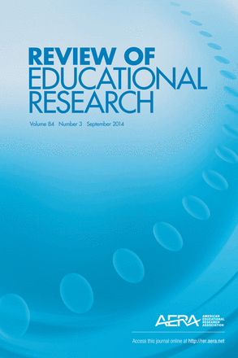
Publication Hierarchy
Refereed journals​
Print​
Online​
Original books​
Edited books​
Other periodicals​
Book chapters​
Refereed conference papers​
Newsletters
Blogs

Slide 8
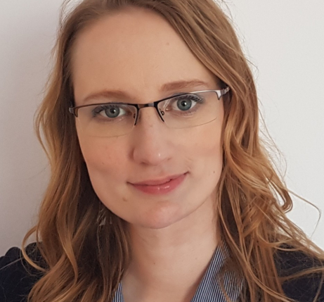
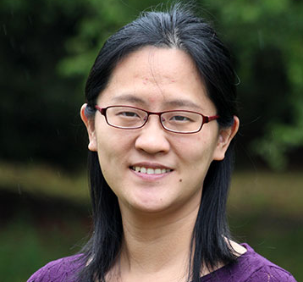
Both Dr. Inken Gast and Dr. Binbin Zhang published RER papers as doctoral students!

Slide 9
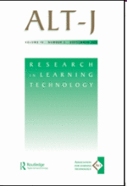
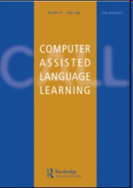
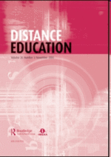
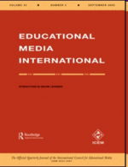
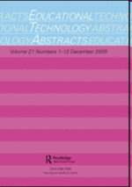
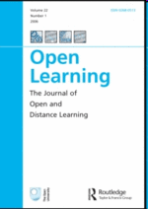
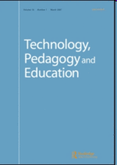
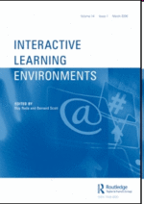
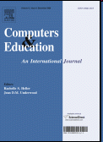
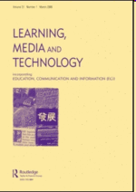
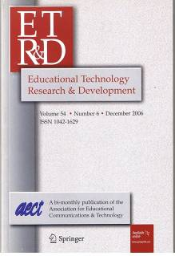
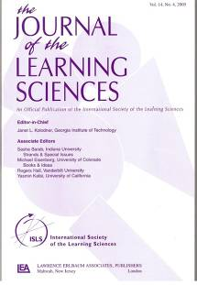
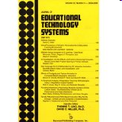
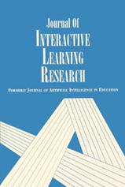

Slide 10
Writing Opportunities
Be actively involved in professional associations like AECT.​
Work with a mentor.
Form a research and writing group.

Slide 11
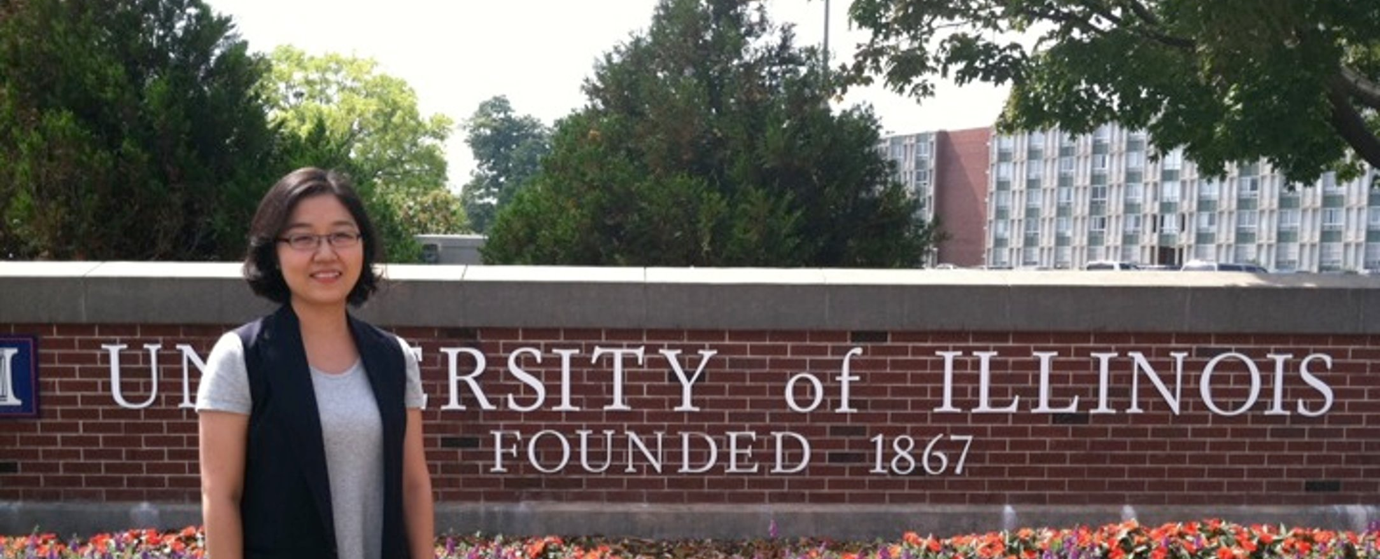
Dr. Eunjung Grace Oh
Article-Based Dissertation is a great option.
Theoretical Framework Paper
Literature Review Paper
Research Study Papers
Practitioner Paper

Slide 14
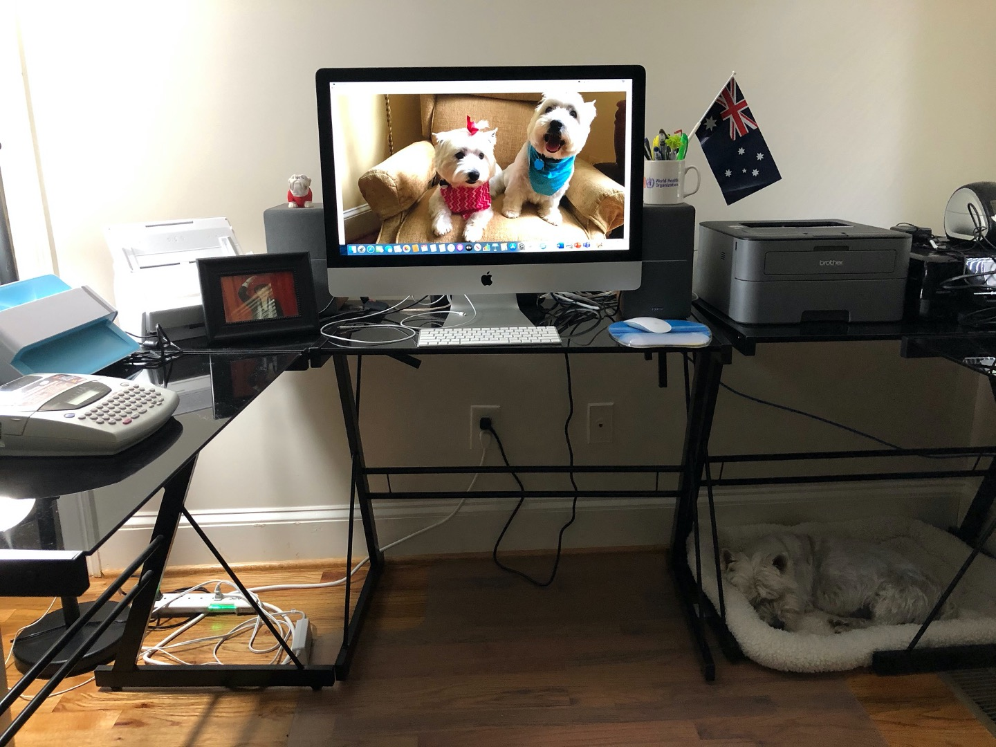

Slide 15
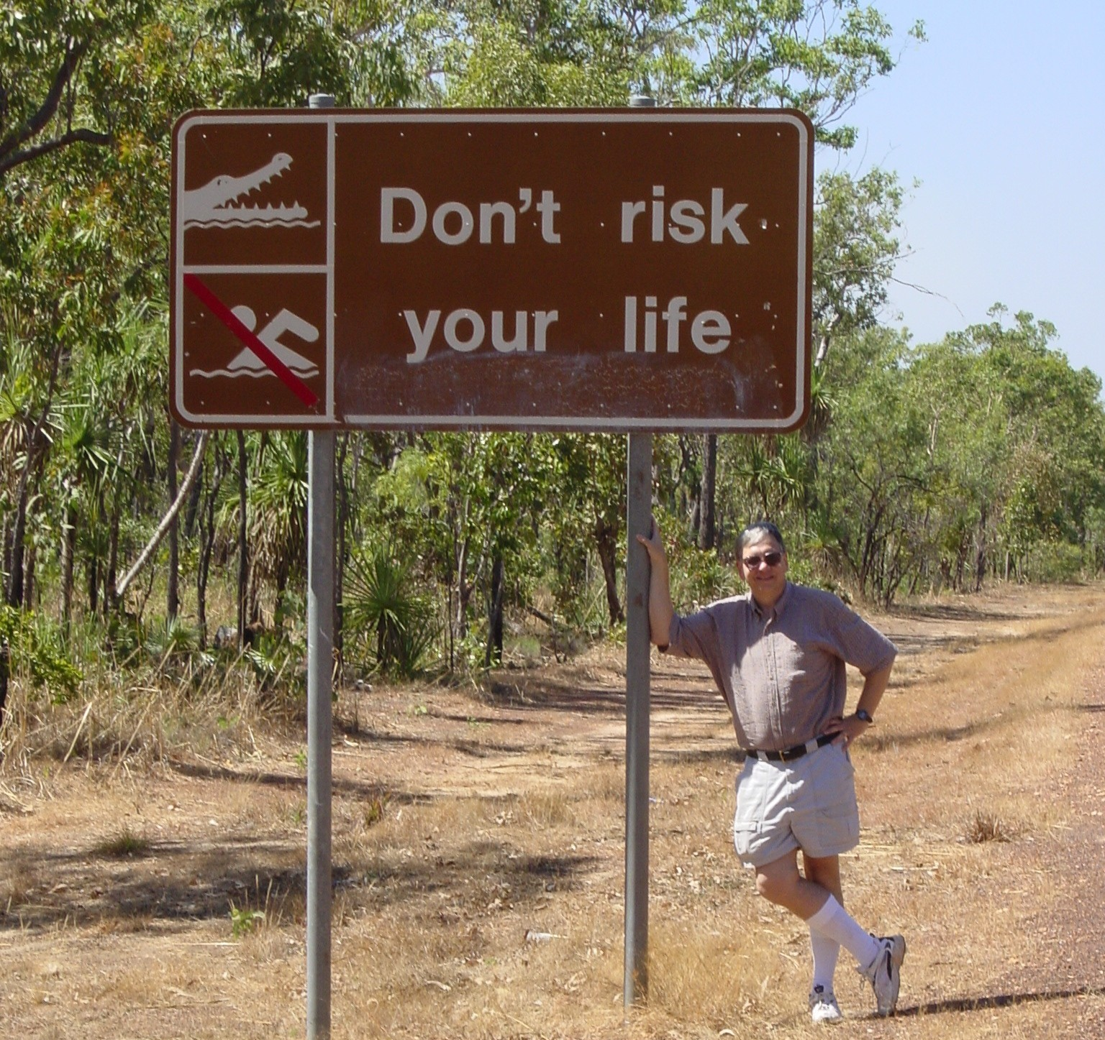
Don’t waste Your time. Write every day!

Slide 16
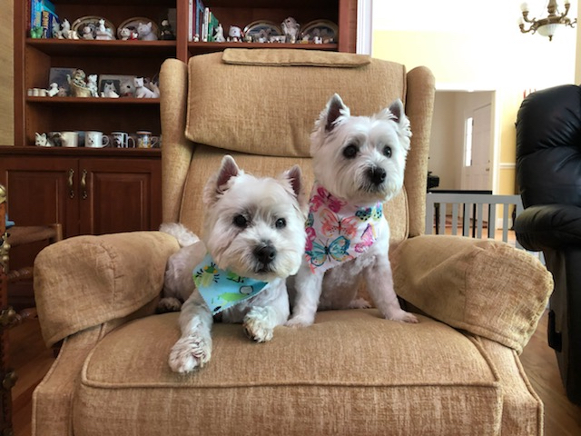
Thank You!
Tom Reeves, The University of Georgia
treeves@uga.edu, www.evaluateitnow.com

