Slide 1
Systematic Review of Research on Learning Environments and Technology: A Very Special Issue (of ETR&D) Curt Bonk, Vanessa Dennen, Meina Zhu, Florence Martin, Tian Luo, Fei Gao, Byron Havard, and colleagues Wednesday November 4, 2020

Slide 2
Special Issue: Martin, F., Dennen, V. P., & Bonk, C, J. (Eds.) (2020). Systematic Reviews of Research on Emerging Learning Environments and Technology. Educational Technology Research and Development (ETR&D) 68(4).
Key Points:
AECT presidential session in 2018 in KC.
Suggested by Lin Lin, UNT and editor of AECT.
80+ reviewer pool (many IU IST alums…thank you!).
Completed 6 months ahead of original schedule.
Published in August 2020.
13 main pieces from 48 submissions.
100 free copies of issue coming soon, some at next year at AECT.
Free preface, intro, and end.
Great people!

Slide 3
Social media, teenagers, and the school context: A scoping review of research in education and related fields
Vanessa P. Dennen
@vdennen
Hajeen Choi
@hajeenzang
Kari Word
@kariword
Florida State University
This Photo by Unknown Author is licensed under CC BY-SA-NC

Slide 4
Research Problem
Educational research on social media and teens seems limited in scope.
Who’s in the conversation?
What aspects of social media use are being investigated?
Are researchers learning from each other across disciplines?
Social Media
School
Home
photo from pixabay: janeb13

Slide 5
Sampling: Web of Science peer-reviewed journals 2009-2018

Slide 6
Publication Trajectory

Slide 7
Top 10 Disciplinary Categories
Category | Number of Articles | Percent of Articles
Education Educational Research | 208 | 18.8%
Public Environmental Occupational Health | 99 | 8.9%
Business | 98 | 8.9%
Communication | 96 | 8.7%
Psychology Multidisciplinary | 62 | 5.6%
Health Care Sciences Services | 53 | 4.8%
Social Sciences Interdisciplinary | 52 | 4.7%
Information Science Library Science | 50 | 4.5%
Education Scientific Disciplines | 48 | 4.3%
Psychology Experimental | 43 | 3.9%

Slide 8
Where’s the Research Conducted?
48%
22%
15%
2%
2%
8%
4% multiple continents

Slide 9
What Data Types and Data Collection Methods Are Being Used?
Data Types and Methods | Percent
Qualitative | 35%
Quantitative | 48%
Mixed Methods | 17%
Survey | 58%
Interview | 31%
Social Media Archives | 18%
Literature | 1%

Slide 10
What Education Levels are Studied?
42%
51%
28%
8%
*adds to more than 100% because of articles spanning multiple grade levels

Slide 11
Topics: Education-related articles
Topic | Number of articles | Percent
Teaching and learning tool | 104 | 46.4%
Adoption, use, and beliefs | 40 | 17.9%
Digital literacy | 19 | 8.5%
Effects of use and exposure | 10 | 4.5%
Identity | 8 | 3.6%
Student-teacher relationships | 7 | 3.1%
Activism and social issues | 5 | 2.2%
Other | 31 | 13.8%
TOTAL | 224 | 100.0%

Slide 12
Top 5 articles topics outside education
Topics | Articles
Negative behaviors | 88
Health issues | 73
Identity development and expression | 28
Social relationships | 28
Digital citizenship | 17

Slide 13
Big takeaways
Limited work done across disciplinary lines
Social media is approached as a discrete phenomenon in a single context
There are many opportunities for connecting across disciplines
EDUCATION + mental health? + info literacy? + identity?

Slide 14
Summary Thoughts
Consider the systemic nature of social media use when situating and communicating research
Conduct studies that bridge disciplines and contexts

Slide 15
Social media, teenagers, and the school context: A scoping review of research in education and related fields
Vanessa P. Dennen
@vdennen
Hajeen Choi
@hajeenzang
Kari Word
@kariword
Florida State University
This Photo by Unknown Author is licensed under CC BY-SA-NC

Slide 16
A Comprehensive Systematic Review of MOOC Research: Research Techniques, Topics, and Trends from 2009 to 2019
Meina Zhu | meinazhu@wayne.edu
Wayne State University
Annisa R. Sari | annsari@iu.edu
Indiana University
Mimi Miyoung Lee | mlee@central.uh.edu
University of Houston

Slide 17
Purpose
The purpose of this study is to offer a comprehensive systematic review of the research on MOOCs to help MOOC researchers better understand the research topics, trends, and typical research methods and to provide some insights and rationale for future MOOC research.

Slide 18
Research questions
The five research questions listed below guided our inquiry:
1. What are the dissemination outlets of empirical MOOC research published in the last ten years?
2. What are the research methods employed in these empirical MOOC?
3. What are the research topics or foci of MOOC studies published in the last ten years?
4. How are researchers of these empirical MOOC studies geographically distributed?
5. What countries attracted the most MOOC research in the last ten years?

Slide 19
Methods
Reviewed 477 empirical MOOCs research published from 2009 to June 2019.
In addition to the above, we will investigate MOOC research from the standpoint of phases of MOOC evolution; Phase 1 (2009-2016): MOOCs primarily were free and open, and Phase 2 (2017-2019): MOOCs increasingly discussed from the standpoint generating revenue and offering credentials (Shah, 2018a)

Slide 20
Data analysis
For Research Question (RQ) #1, the authors calculated the number of publications from each publication outlet.
RQ #2 & 3
Table 2 MOOC research methods and foci coding scheme
Items | Research methods | Research foci
Sub-item | Quantitative | Design-focused
 | Qualitative | Student-focused
 | Mixed methods | Instructor-focused
 |  | Context and impact

Slide 21
Data analysis
To answer RQ #4, we calculated the locations of all the MOOC first authors’ affiliations in this study.
For RQ #5, the researchers calculated the countries of the MOOC being studied. For the studies which did not specify the location of MOOC delivery, the authors coded them as “Global.”

Slide 22
Results
RQ1. What are the dissemination outlets of empirical MOOC research during 2009 and 2019?
The number of empirical MOOCs studies published in each journal (2009 – 2019) (n=541)

Slide 23
Results
RQ1. What are the dissemination outlets of empirical MOOC research during 2009 and 2019?
The number of empirical MOOCs studies published in each journal in two Phases (2009 - 2016 and 2017 - 2019) (n=541)

Slide 24
Results
RQ2. What are the research methods that researchers employed in empirical MOOC studies during 2009 and 2019?
Research methods used in empirical MOOCs studies (2009 – 2019) (n=541)

Slide 25
Results
RQ2. What are the research methods that researchers employed in empirical MOOC studies during 2009 and 2019?
Research methods used in empirical MOOCs studies (2009 - 2016 and 2017 - 2019) (n=541)

Slide 26
Results- Data collection
RQ2. What are the research methods that researchers employed in empirical MOOC studies during 2009 and 2019?
Data collection methods used in empirical MOOCs studies (2009 – 2019) (n=541)

Slide 27
Results- Data analysis
RQ2. What are the research methods that researchers employed in empirical MOOC studies during 2009 and 2019?
Specific data analysis methods for MOOC research (2009 – 2019) (n=541)

Slide 28
Results
RQ3. What are the research foci in MOOC studies during 2009 and 2019?
Primary/general focus of MOOC delivery (2009 – 2019) (n=541)

Slide 29
Results
RQ3. What are the research foci in MOOC studies during 2009 and 2019?
Specific research topics of MOOC studies (2009 – 2016 and 2017-2019) (n=541)

Slide 30
Results
RQ3. What are the research foci in MOOC studies during 2009 and 2019?
Research methods used in each research topic (2009-2019) (n=541)

Slide 31
Results
RQ4. How are researchers of empirical MOOC studies geographically distributed?
The location of the first author of MOOCs studies (2009 – 2019) (n=541)

Slide 32
Results
RQ4. How are researchers of empirical MOOC studies geographically distributed?
The number of authors in one study (2009 – 2019) (n=541)

Slide 33
Results
RQ4. How are researchers of empirical MOOC studies geographically distributed?
Collaboration among the authors of MOOCs studies (2009 – 2019) (n=541)

Slide 34
Results
RQ4. How are researchers of empirical MOOC studies geographically distributed?
The research approaches used by the location of the first author of MOOCs studies (2009 - 2019) (n=541)

Slide 35
Results
RQ5. In terms of the delivery of the MOOC, what are the countries which MOOCs are being researched the most?
Countries of MOOC delivery in which the research was conducted (2009 – 2019) (n=541)

Slide 36
Conclusion
Quantitative methods increased during Phase II and remained the dominant research approach, whereas qualitative studies remained the least employed. Surveys were specified as the most frequently used data collection method, while MOOC research studies using platform database and interviews were the other two data collection methods extensively used in MOOCs. At the same time, learning analytics and data mining appear to be fast emerging data analysis methods in MOOC studies.
Regarding the research topics, most MOOC research to date has focused on learner issues, whereas research on MOOC instructors remains minimal. To address this gap, MOOC researchers in the future might target instructors or design more comprehensive studies of various MOOC stakeholders such as learners, instructors, instructional designers, or program administrators.

Slide 37
Conclusion
Given the growth of MOOCs in the past few years toward revenue models, it is important to extend the previous line of research that concerned the initial era of free and open MOOCs, namely the ones by Liyanagunawardena et al. (2013), Gašević et al. (2014), Veletsianos and Shepherdson (2015, 2016), and by Deng and Benckendorff (2017). This study provided a more comprehensive systematic review by including MOOC empirical research from the first arrival of MOOCs to present. We suggest future research continue to expand upon methodological approaches and topics that are perceived to be critical to MOOC sustainability, growth, and evolution in the coming decade.

Slide 38
THANKS!!

Slide 39
Systematic review of adaptive learning research designs, context, strategies, and technologies from 2009 to 2018
Florence Martin
University of North Carolina Charlotte
Yan Chen
University of New Mexico
Rob Moore
Old Dominion University
Carl Westine
University of North Carolina Charlotte

Slide 40
Adaptive Learning Definition
“An emerging learning technology that dynamically adjusts instructional content to provide interactive and personalized learning paths to the individual to facilitate learning.” (Martin et al., 2020, p. 1910).

Slide 41
 | Authors | Year Published | Article | Years Research Reviewed | Number of Studies Reviewed | Adaptive Focus
1 | Normadhi, Shuib, Nasir, Bimba, & Balakrishnan. | 2019 | Identification of personal traits in adaptive learning environment: Systematic literature review, Computers & Education, 130, 168-190. | 2010 to 2017 | 78 | Personal Traits
2 | Kumar,Singh, & Ahuja | 2017 | Learning styles based adaptive intelligent tutoring systems: Document analysis of articles published between 2001. and 2016. International Journal of Cognitive Research in Science, Engineering, and Education, 5(2). | 2001 to 2016 | 78 | Learning Styles
3 | Nakic, Granic, & Glavinic, | 2015 | Anatomy of student models in adaptive learning systems: A systematic literature review of individual differences from 2001 to 2013. Journal of Educational Computing Research, 51(4), 459-489 | 2001 to 2013 | 98 | Individual Differences
4 | Akbulut & Cardak | 2012 | Adaptive educational hypermedia accommodating learning styles: A content analysis of publications from 2000 to 2011. Computers & Education, 58(2), 835-842. | 2000 to 2011 | 70 | Learning Styles
5 | Vandewaetere, Desmet, & Clarebout | 2011 | The contribution of learner characteristics in the development of computer-based adaptive learning environments. Computers in Human Behavior, 27(1), 118-130. | 1993 to 2009 | 52 | Learning Characteristics
6 | Verdú, Regueras, Verdú,, De Castro, & Pérez | 2008 | Is adaptive learning effective? A review of the research. In WSEAS International Conference. Proceedings. Mathematics and Computers in Science and Engineering (No. 7). World Scientific and Engineering Academy and Society. | 1997 to 2007 | 15 | Effectiveness of Adaptive Learning Systems

Slide 42
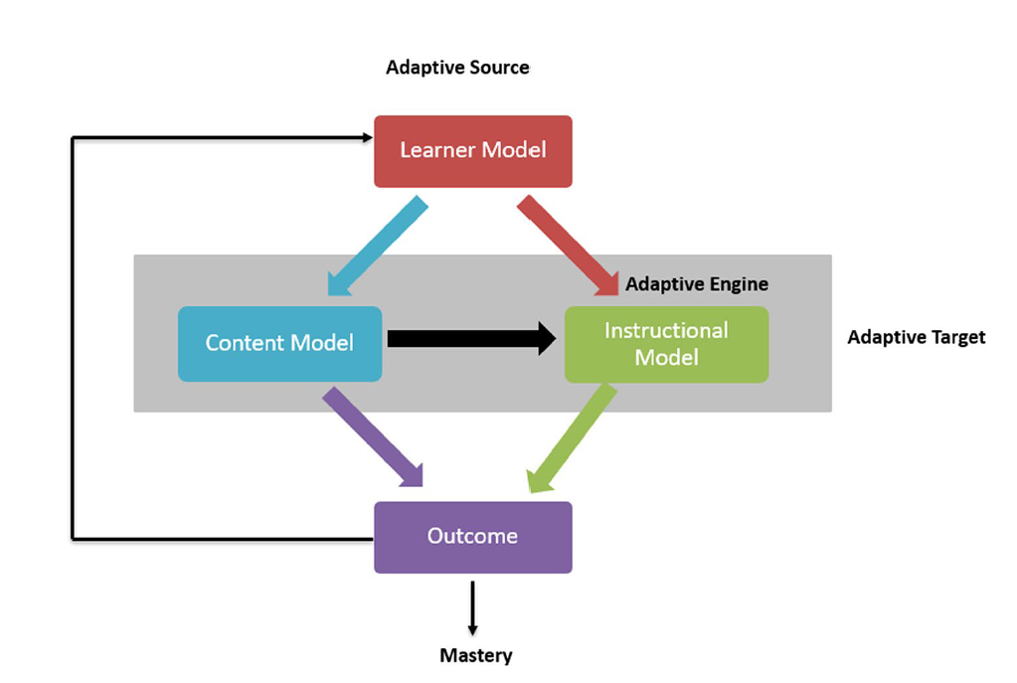
Adaptive Learning Framework
Shute and Towle (2003) and Vandewaetere et al. (2011)

Slide 43
Adaptive Learning Framework
Learner Model, also known as the student model, refers to the learner characteristics of what a student knows and does.
Content Model, also known as the expert or domain model, refers to the content or knowledge base for the course.
Instructional Model, also known as the pedagogical model, refers to the algorithm that assists in adapting the instruction based on the content and learner model. The Instructional Model is also referred to as the adaptation model as it defines what, when, and how adaptation can occur.

Slide 44
Adaptive Source and Target
Adaptive Source - The learner model is referred to as the adaptive source. The content model and the instructional model are together called the adaptive target (Vandewaetere et al. 2011).
Adaptive Target - While the adaptive source refers to the characteristics (“to what will it be adapted”), the adaptive target refers to the content and instruction that will be adapted (“what will be adapted”)
Adaptive Engine can be described as an artificial intelligence (AI) sequence generator where a learning map with instructional content will be created for the learner in the instructional model.

Slide 45
Purpose of this Study
In this review, we also emphasize the instructional model along with the content model for adapting instructional content.
Specifically, we examine the adaptive strategy used in adjusting the instruction.

Slide 46
Research Questions
What are the publication trends of adaptive learning research?
What is the context of adaptive learning research published?
What research outcomes, research design, and data collection methods are used in the studies reviewed?
What is the focus of research on adaptive learning studies?
What adaptive strategies are used in the adaptation of instructional content based on the learner model, content model, and instructional model?
What are the adaptive technologies used in the research published?

Slide 47
Methods
IES Guidelines
Institute of Education Sciences (2017), What Works Clearinghouse Procedures and Standards Handbook, Version 4.0.
developing the review protocol
identifying relevant literature
screening studies
reviewing articles
reporting findings
Databases, Search terms, Years
Education Research Complete and ERIC
“Adaptive Learning”
2009 and 2018

Slide 48
Inclusion/exclusion
Criteria | Inclusion | Exclusion
Publication date | 2009 to 2018 | Prior to 2009 and after 2018
Publication type | Scholarly articles of original research from peer reviewed journals | Book chapters, technical reports, dissertations, or proceedings
Focus of the article | The research focused primarily on adaptive learning for instruction. | Articles that did not include adaptive learning for instruction.
Research Method and Results | There was an identifiable method and results section describing how the empirical study was conducted and the findings. Quantitative and qualitative methods were included. | Reviews of other articles, opinion, or discussion papers that do not include a discussion of the procedures of the empirical study or analysis of data such as product reviews or conceptual articles.
Language | Journal article was written in English | Other languages were not included

Slide 49
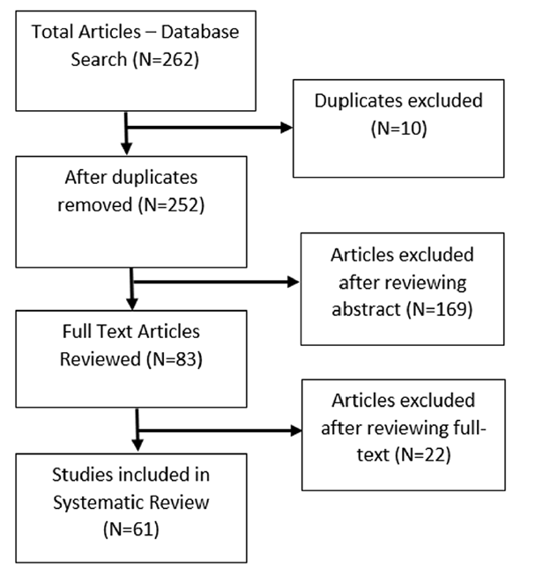
PRISMA Flowchart
(Moher et al. 2009)

Slide 50
Data Coding & Analysis
Multiple coders
Interrater reliability – 89%
Descriptive tables, including frequency and percentage
Thematic Analysis for narrative data

Slide 51
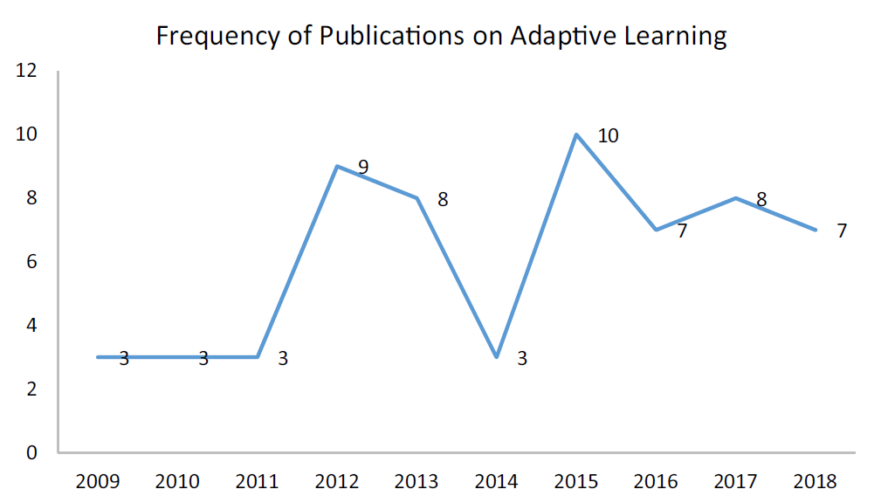
Publication Timeline

Slide 52
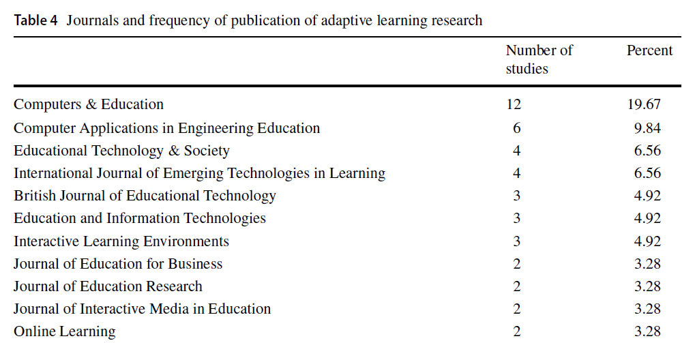
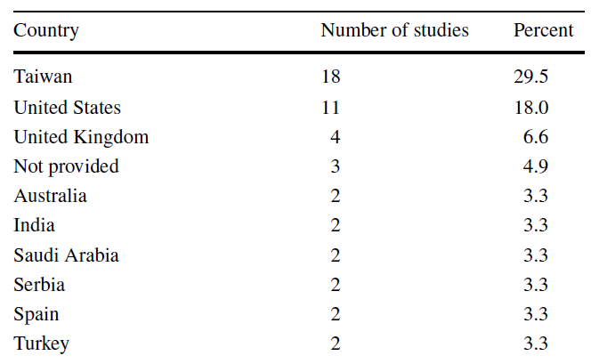
Journal & Locations

Slide 53
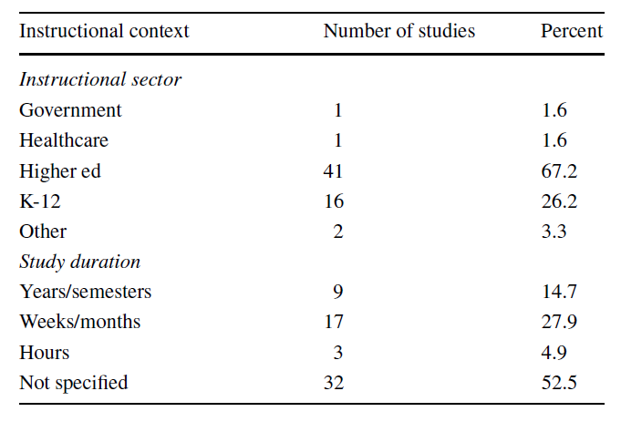
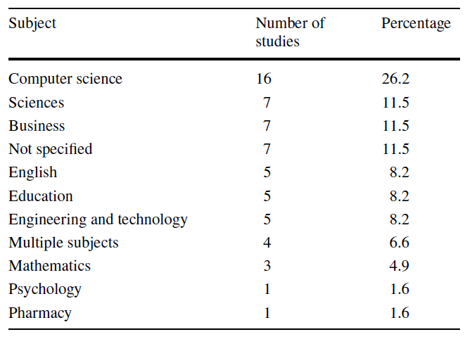
Instructional Context & Subject

Slide 54
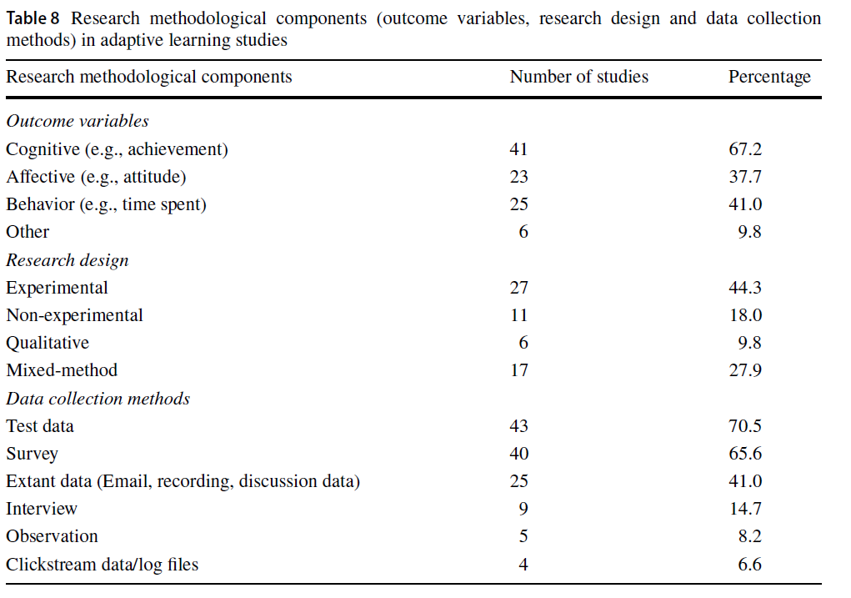
Research Methodology

Slide 55
Research Focus

Slide 56
Adaptive Sources
Learner Characteristics | Number of Studies | Adaptive Source Measuring Learner Characteristics
Learning Style | 14 | Felder-Silverman Learning Style Model, VARK Questionnaire, Kolb's learning style inventory, Solomon and Felder ILS inventory, Keefe’s learning style test
Cognitive Style and Thinking Style | 8 | Swellerm van Merrienboer and Paas, Pask’s Holist–Serialist dimension, Witkin's GEFT test, Student preferences for content and components
Learner Prior Knowledge and Background Knowledge | 8 | Pretest, Knowledge test, psychological tests for initial comprehension level
Learner Knowledge and Metacognitive Knowledge | 6 | Content Result, Semantic description
Learner Preference | 4 | Ignatian Teaching Methods
Learner Behavior | 3 | Time spent
Learner Profile | 3 | Log data
Learner Ability | 2 | Proficiency level
Multiple Learner Characteristics | 2 | Learner needs and personal characteristics, self-efficacy and learning efficiency
Learner Interest | 1 | Student interest survey

Slide 57
Adaptive Targets
What was adapted? | Adaptive Target | Number of Studies
Content | Adaptive Content | 9
Assessment | Adaptive Feedback | 8
Assessment | Adaptive course topic and question difficulty | 4
Navigation | Adaptive Learning Sequence | 5
Navigation | Adaptive Learning Path | 5
Navigation | Adaptive Pacing | 1
Navigation | Adaptive Navigation | 1
Presentation | Adaptive Caption Filtering | 1
Presentation | Adaptive Material Format and Presentation | 4

Slide 58
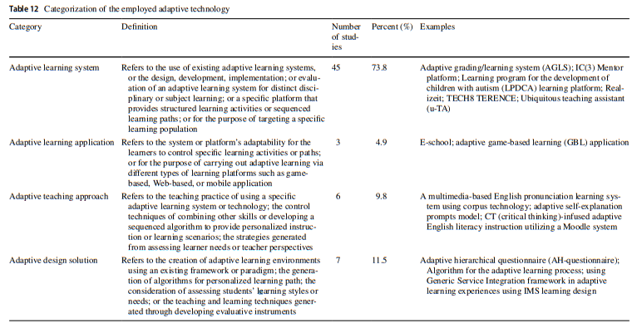
Categorization of Adaptive Technology

Slide 59
Implications and Future Research
Implications
Designers and developers
Instructional designers
Instructors
Researchers
Future Research
Need for more qualitative focused studies
Continue to examine aspects of adaptivity

Slide 60
Adaptive Learning
Martin, F., Chen, Y., Moore, R. L., & Westine, C. D. (2020). Systematic review of adaptive learning research designs, context, strategies, and technologies from 2009 to 2018. Educational Technology Research and Development, 68,1903-1929. https://doi.org/10.1007/s11423-020-09793-2

Slide 61
“Like, Comment, and Share”: Professional Development Through Social Media in Higher Education
Tian Luo (Old Dominion University)
Candice Freeman (Old Dominion University)
Jill Stefaniak (University of Georgia)

Slide 62
Introduction
Expert vs. professors?
Need for PD
Constrained by money and time
Social media-based PD

Slide 63
Research Questions
What are the current trends in research involving social media and faculty professional development in higher education?
What are the main characteristics of reviewed studies explaining higher education faculty’s professional development on social media (i.e., types of studies found, social media tools identified, and academic disciplines of the studies)?
What theoretical frameworks and research methodologies have been utilized to examine research involving social media and faculty professional development in higher education?
What guidelines and implications exist in the literature with regard to facilitating sustainable online faculty development efforts on social media?

Slide 64
Article Identification Process following PRISMA
Searching
Major Databases
(n = 1,269)
Google Scholar (n = 100)
Hand Search 3 Major Journals (n=28)
After Removing Duplicates and Applying Initial Criteria (n = 53)
Abstract Reading
Not empirical (n = 7)
Not focus on both social media (SM) and professional development (PD) (n = 12)
Not in higher education (HE) (n = 6)
Screening
After Screening (n = 33)
Analysis
Full-Text Reading
Not empirical (n = 3)
Not focus both on SM and PD (n= 2)
Not in higher education (n = 3)
After Analyzing
(n = 25)
Not focus on HE (n=2)
Synthesis
Articles inclusion
(n = 23)
PRISMA: Preferred-Reporting of Items for Systematic Reviews and Meta-Analyses Statement

Slide 65
Current trends: Year of Publication

Slide 66
Current trends: Countries of Studies

Slide 67
Types of PD: Formal vs. Informal
Type | # | Studies
Informal PD | 15 | Bombaci et al. (2016); Brock et al. (2014); Gao & Li (2017); Gao & Li (2019); Greenhow, Li & Mai (2019); Gruzd et al. (2012); Li & Greenhow (2015); Meisher-Tal & Pierterse (2018); Schieffer (2016); Trust et al. (2017); Veletsianos (2012); Veletsianos & Kimmons (2013); Weisgerber & Butler (2011); Xie & Luo (2019); Xing & Gao (2018)
Formal PD | 8 | Cahn et al. (2013); Cain et al. (2013); Donelan (2016); Jippes et al. (2013); Klein et al. (2013); Ranieri et al. (2018); Sullivan et al. (2018); Velsamy & Karthikeyan (2016)

Slide 68
Social Media Platform Studied
Social media platform | # | Studies
Twitter | 11 | Bombaci et al. (2016); Cahn et al. (2013); Gao & Li (2017); Gao & Li (2019); Greenhow et al. (2019); Li & Greenhow (2015); Veletsianos (2012); Veletsianos & Kimmons (2016); Velsamy & Kathikeyan (2016); Xie & Luo (2019); Xing & Gao (2018)
Various social media tools | 5 | Cahn et al. (2013); Donelan (2016); Grudz et al. (2012); Schieffer (2016); Veletsianos & Kimmons (2013)
Facebook | 3 | Cain et al. (2013); Klein et al. (2013); Veletsianos & Kimmons (2013)
Academia.edu | 1 | Meisher-Tal & Pierterse (2018)
Google+ | 1 | Sullivan et al. (2018)
Research Gate | 1 | Meisher-Tal & Pierterse (2018)
Not specified | 3 | Jippes et al. (2013); Ranieri et al. (2018); Trust et al. (2017)

Slide 69
Academic Disciplines
Academic Discipline | # | Studies
Education | 6 | Gao & Li (2017); Greenhow, Li & Mai (2019); Li & Greenhow (2015); Veletsianos & Kimmons (2013); Veletsianos & Kimmons (2016); Xing & Gao (2018)
Medical | 5 | Brock et al. (2014); Cahn et al. (2013); Cahn et al. (2013); Jippes et al. (2013); Klein et al. (2013)
Information Science and Technology | 2 | Grudz et al. (2012); Xie & Luo (2019)
STEM | 1 | Donelan (2016)
Biology | 1 | Bombaci et al. (2016)
Business | 1 | Velsamy & Karthikeyan (2016)
Not-specified | 7 | Gao & Li (2019); Meisher-Tal & Pierterse (2018); Ranieri et al. (2018); Schieffer (2016); Sullivan et al. (2018); Trust et al. (2017); Veletsianos (2012)

Slide 70
Theoretical Frameworks
Theoretical Frameworks | # | Studies
Community of Practice (CoP) | 5 | Gao & Li (2017); Greenhow, Li & Mai, (2019); Li & Greenhow, 2015; Xing & Gao (2018); Xie & Luo (2019)
Social Constructivism | 4 | Gao & Li (2017); Li & Greenhow, 2015; Schieffer (2016); Xing & Gao (2018)
Situated Learning | 2 | Greenhow et al. (2019); Trust et al. (2017)
Experiential Learning | 1 | Jippes et al. (2013)
Learning Ecology | 1 | Greenhow, Li & Mai (2019)
Networked Participatory Scholarship | 1 | Veletsianos & Kimmons (2016)
Online Discourse | 1 | Xing & Gao (2018)
Technology Acceptance Model | 1 | Gao & Li (2019)
Unified Theory of Acceptance and Use of Technology | 1 | Gruzd et al. (2012)
Uses and Gratification Theory | 1 | Meisher-Tal & Pieterse (2018)

Slide 71
Research Methodology
Methodology | Data Sources and Analysis | Studies
Quantitative (9) | Survey and Questionnaire (2) Tweets | Cain et al (2013); Gao & Li (2019); Jippes et al. (2013); Meisher-Tal & Pierterse (2018); Sullivan et al. (2018); Trust et al. (2017); Velsamy & Karthikeyan (2016); Xing & Gao (2018)
Qualitative (5) | Interview Tweets qualitative coding | Greenhow, Li & Mai (2019); Gruzd et al. (2012); Schieffer (2016); Veletsianos (2012); Veletsianos & Kimmons (2013)
Mixed methods (4) | Tweets- Content analysis open-ended survey questions; Facebook-posting; Interviews, Surveys | Bombaci et al. (2015); Donelan (2016); Klein et al. (2013); Veletsianos & Kimmons (2016)
Social network analysis (2) |  | Gao & Li (2017); Xie & Luo (2019)
Design-based research (1) |  | Ranieri et al. (2018)
Non-specified (2) | CV searches Website analysis | Brock et al. (2014); Cahn et al. (2013)

Slide 72
Guidelines and Implications
Guidelines and Implications | # | Studies
Choose tools (i.e., social media) wisely and its specific features for its intended use | 5 | Ranieri et al. (2018); Trust et al. (2017); Xing & Gao (2018); Gao & Li (2017); Veletsianos & Kimmons (2012);
Consider learners’ (i.e., faculty members) needs and characteristics within the context of the institution | 4 | Cahn et al. (2013); Donelan (2016); Klein et al. (2013); Sullivan et al. (2018)
Align the tool use with purpose, goals, and outcomes of the PD | 3 | Gao & Li (2017); Gao & Li (2019); Schieffer (2016)
Promote the sharing of member expertise and build a sense of community within the PLN | 2 | Ranieri et al. (2018); Trust et al. (2017)
Foster effective inter- and intragroup interactions | 1 | Xie & Luo (2019)

Slide 73
Link to article: rdcu.be/b42aB
Contact Info:
Tian Luo tluo@odu.edu @tintinluo
Jill Stefaniak Jill.Stefaniak@uga.edu @jillstefaniak

Slide 74
A Systematic Review of
Mobile Game-Based Learning in STEM Education
Fei Gao
Bowling Green State University
Lan Li
Bowling Green State University
Yanyan Sun
East China Normal University
---- 2020 AECT Convention ----

Slide 75
Introduction
1. Research shows positive effects of digital game-based learning, gamification, and mobile-based learning.
2. Reviews have been conducted on mobile learning, game-based learning, or mobile game-based learning in general.
3. Research on mobile game-based learning in STEM education is “at a rather budding stage” (Giannakas, et al., 2018, p. 379), but has increased rapidly.
4. There is a need for a systematic review of the literature to understand the potential of mobile game-based learning in STEM education.

Slide 76
Research Questions
1. Under what contexts were the studies conducted?
2. What are the research foci? What are the research methodologies adopted? What are measured, and how are they measured?
3. What are the factors that affect the nature of mobile game-based learning? How do these factors affect the nature of mobile game-based learning?
4. What are the documented features of the mobile games in these studies? What types of learning theories or principles guide the design of these mobile games?

Slide 77
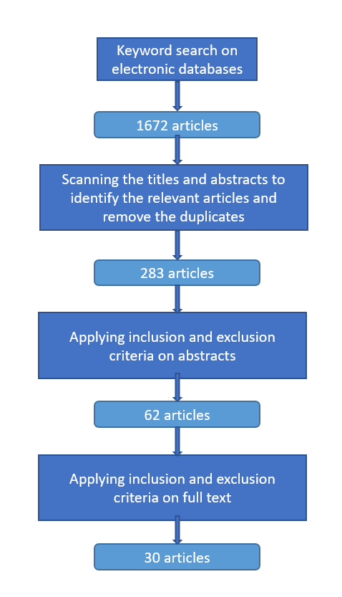
Article Selection
Exclusion Criteria
(a) | articles focused solely on mobile game design and development
(b) | articles exclusively examining the interface and usability of mobile games
(c) | articles focused on students creating mobile games to learn subjects such as programming
(d) | articles not providing sufficient details of research design or data analysis
Inclusion Criteria
(a) | peer-reviewed journal articles
(b) | empirical studies
(c) | related to mobile game-based learning in STEM

Slide 78
Data Coding
 | Years and outlets of the publication
 | Context of studies (formal, informal, semi-formal, multiple settings)
 | Research foci, methodologies, measures and instruments
 | Influencing factors
 | Mobile features (portability, connectivity, etc.)
 | Game features, learning theories/principles, and game types

Slide 79
Findings
Journal Titles | Freq. | Journal Titles | Freq.
Journal of Computer Assisted Learning | 5 | International Journal of Advanced Corporate Learning | 1
Computers & Education | 4 | International Journal of Education in Mathematics, Science and Technology | 1
British Journal of Educational Technology | 2 | International Journal of Educational Development | 1
International Journal of Emerging Technologies in Learning | 2 | International Journal of Engineering Pedagogy | 1
Journal of Science Education and Technology | 2 | International Journal of Science and Mathematics Education | 1
Computer Applications in Engineering Education | 1 | Journal of Computers in Education | 1
Education and Information Technologies | 1 | Personal and Ubiquitous Computing | 1
Environmental Education Research | 1 | Smart Learning Environments | 1
Game and Culture | 1 | Technology, Knowledge and Learning | 1
Interactive Learning Environments | 1 | ZDM: Mathematics Education | 1

Slide 80
Findings
Education Levels | N
Preschool | 1
Elementary School | 13
Middle School | 14
Higher Education | 4
Subject Areas | N
Mathematics | 11
Science | 18
Engineering | 2
Duration of Intervention | N
Within 1 day | 14
More than 1 day and less than 5 days | 7
More than 1 week and less than 4 weeks | 3
More than 5 week and less than 8 weeks | 2
3 months | 1
Settings | N
Formal | 12
Semi-formal | 12
Informal | 2
Multiple Settings | 4
Sample Sizes | N
<25 | 3
25-50 | 6
51-100 | 10
101-150 | 6
151-200 | 1
>200 | 4

Slide 81
Findings
Research Foci | Descriptions | Freq.
Effectiveness of the Mobile Games | Investigating the effectiveness of using mobile games for learning in general | 13
Flow | Focusing mainly on student flow experiences when using mobile games for learning | 3
Perceptions and Experiences | Focusing mainly on the impact of mobile games on students' perceptions and experiences | 7
Collaborative Learning | Investigating the potential of mobile games to support student collaborative learning | 2
Design Features | Investigating the impact of specific design features (i.e. game features, instructional strategies and technological features) | 5
Research Methodologies | Freq.
Experimental Research | 3
Quasi-Experimental Research | 11
Correlational Research | 1
Mixed-Methods Research | 3
Survey Research | 1
Single Subject Research | 3
Case Study | 8

Slide 82
Findings
Measures | Freq.
Student Learning Performance | 15
Student Satisfaction/Attitudes/Perceptions toward the Learning Experience | 13
Student Participation and Interaction | 9
Student Motivation and Engagement | 7
Student Attitudes toward Learning the Targeted Subject (e.g. Positive or Negative Attitude, Self-Efficacy, Anxiety) | 4
Student Flow Experiences | 3
Student Perception of Learning Skills (e.g. Problem-Solving Skills, Collaboration Skills) | 2
Teacher Opinions | 2
Student Emotions in Game Play | 1

Slide 83
Findings
Instruments /Techniques | Examples | Freq.
Learning Assessments | Tests examining student learning performance, or assessments of student work (e.g. projects, reports) | 14
Self-Report | Questionnaires and surveys | 22
Interviews | Discussions between researchers, teachers and students | 11
Observations | All methods of visually examining and documenting actions and discourse of participants, either directly or by video or audio recording | 10
Process Data | Game performance data (time, location, frequency, scores, rankings); log/system data; student generated messages during game play | 13

Slide 84
Findings
Mobile Features | Freq.
P | 2
P + SI | 3
P + SI + CS | 9
P + SI + CS + C | 1
P + SI + C | 2
P + SI + C + I | 1
P + CS | 2
P + CS + I | 1
P + C | 1
P + I | 1
Not Specified | 7
Mobile Feature | Definition
P: portability | can be taken “to different sites and move around within a site”
SI: social interactivity | “can exchange data and collaborate with other people face to face”
CS: context sensitivity | “can gather data unique to the current location, environment, and time, including both real and simulated data”
C: connectivity | “can connect handhelds to data collection devices, other handhelds, and to a common network that creates a true shared environment”
I: individuality | “can provide unique scaffolding that is customized to the individual’s path of investigation”
(Klopfer, et al., 2002, p. 95)

Slide 85
Findings
Game Features
Learning Theories/Principles
18 out of the 30 studies specify the learning theories or principles that guided the game design
Game Features | Freq.
Scores (points, coins, stars) | 21
Narrative | 14
Levels/Stages | 12
Leaderboard | 5
Role-playing | 5
Gardner's theory of multiple intelligence
Gee’s game- based learning principle
Werbach's gamification framework
Csikszent-mihalyi's flow theory
Prensky's digital game-based learning principles

Slide 86
Discussion
Types of Study Needed
Studies that move beyond simple comparison of traditional approach and mobile game-based approach
Studies that base the design of mobile games on learning and motivational theories
Studies that adopt a theoretical framework to categorize learning outcomes
Longitudinal studies and replication studies

Slide 87
Discussion
When is mobile game-based learning an appropriate approach for learning in STEM education and when is not?
the educational context
the content to be taught
the types of learning activities
mobile features
game features

Slide 88
Thank You!
Contact Information:
Fei Gao
gaof@bgsu.edu

Slide 89
A meta‑analysis of wearables research in educational settings published 2016–2019
Byron Havard, University of West Florida Megan Podsiad, University of Florida
Cassie Arnold, University of West Florida

Slide 90
Purpose, Definition, & Process
Problem/Purpose: Provide a synthesis of the quantitative educational research that currently exists regarding the effects of wearable use on learning and motivation outcomes
Wearable definition: “include a variety of body-borne sensory, communication, and computational components that may be worn on the body, under, over, or within clothing”(Havard and Podsiad 2017, p. 356)
Process: (a) problem formulation, (b), literature search, (c) data evaluation, (d), data analysis, (e) interpretation of results, and (f) presentation of results by Cooper et al. (2019)
Research Questions: Six research questions guided this study

Slide 91
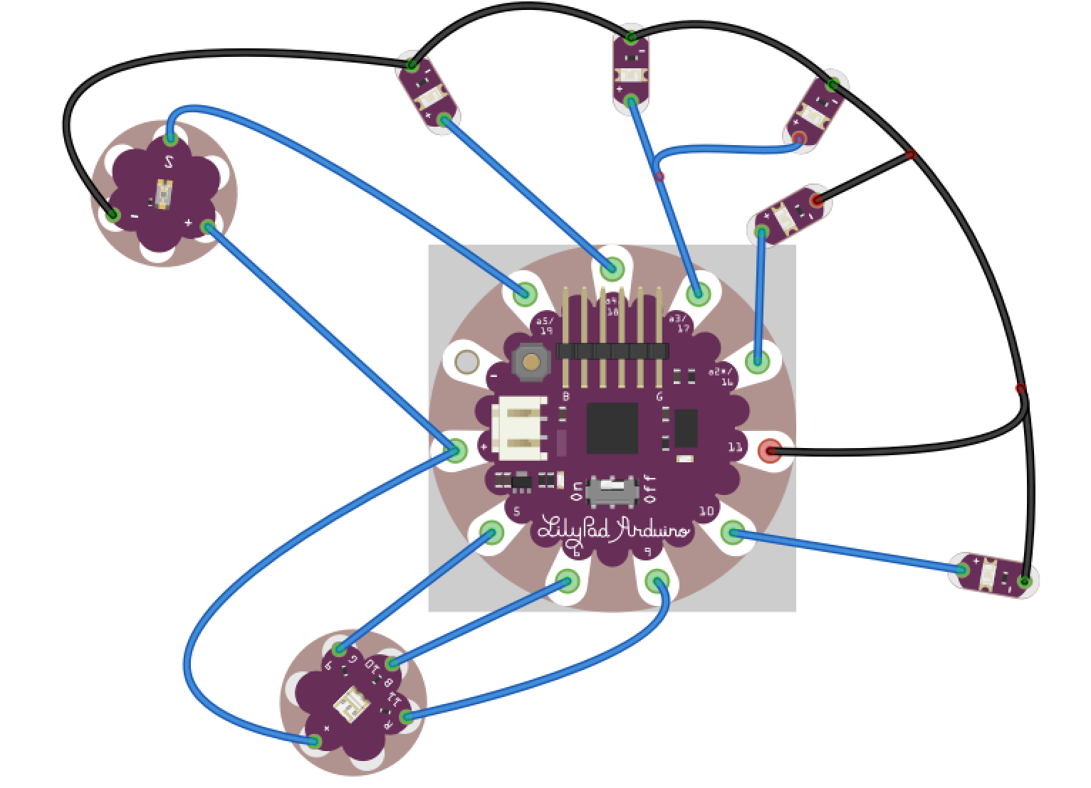
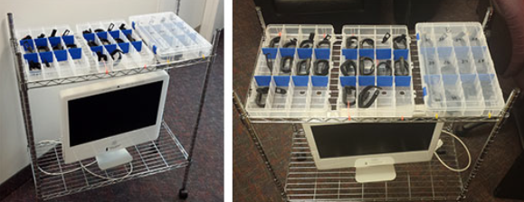
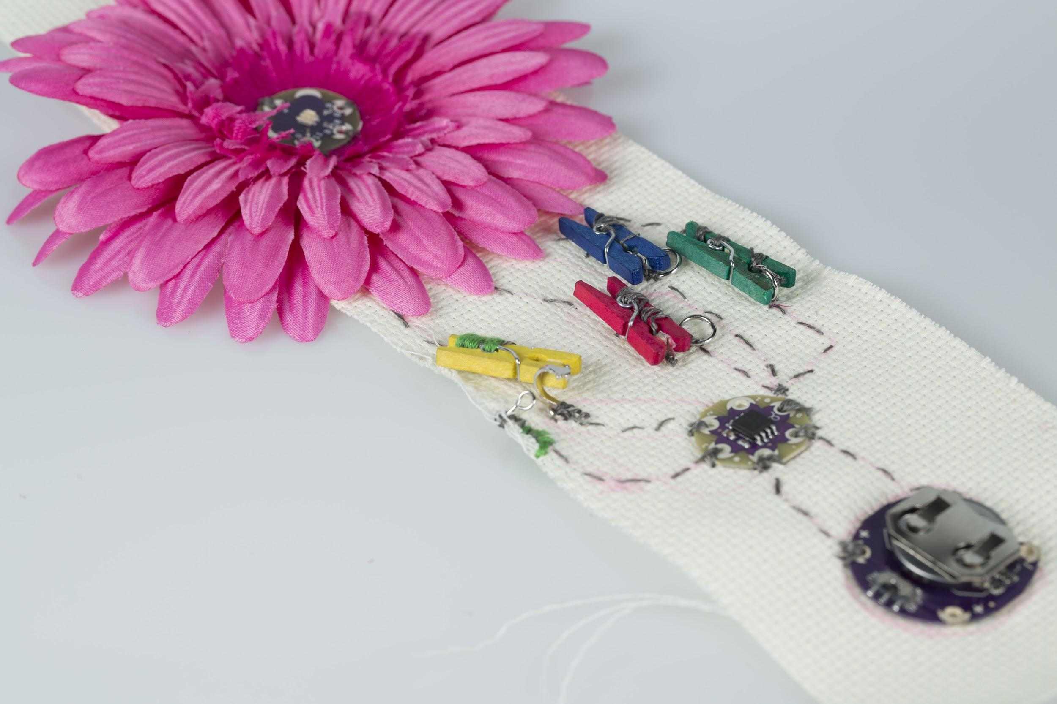
Wearable E-Textiles and Fitness Trackers
(Barker et al., 2015)
(Lee et al., 2016)

Slide 92
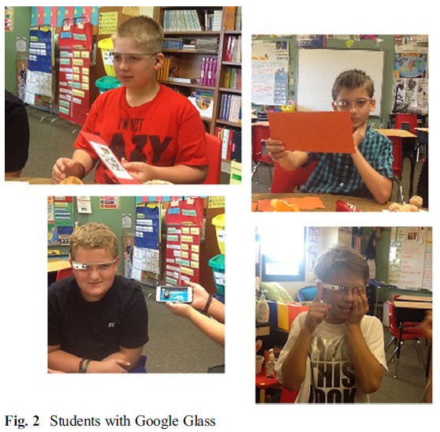
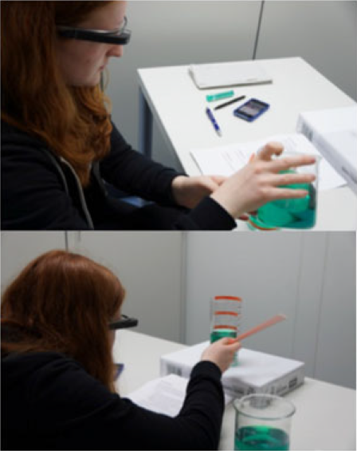
Wearable Headsets/Glasses
(Parton, 2017)
(Kuhn et al., 2016)

Slide 93
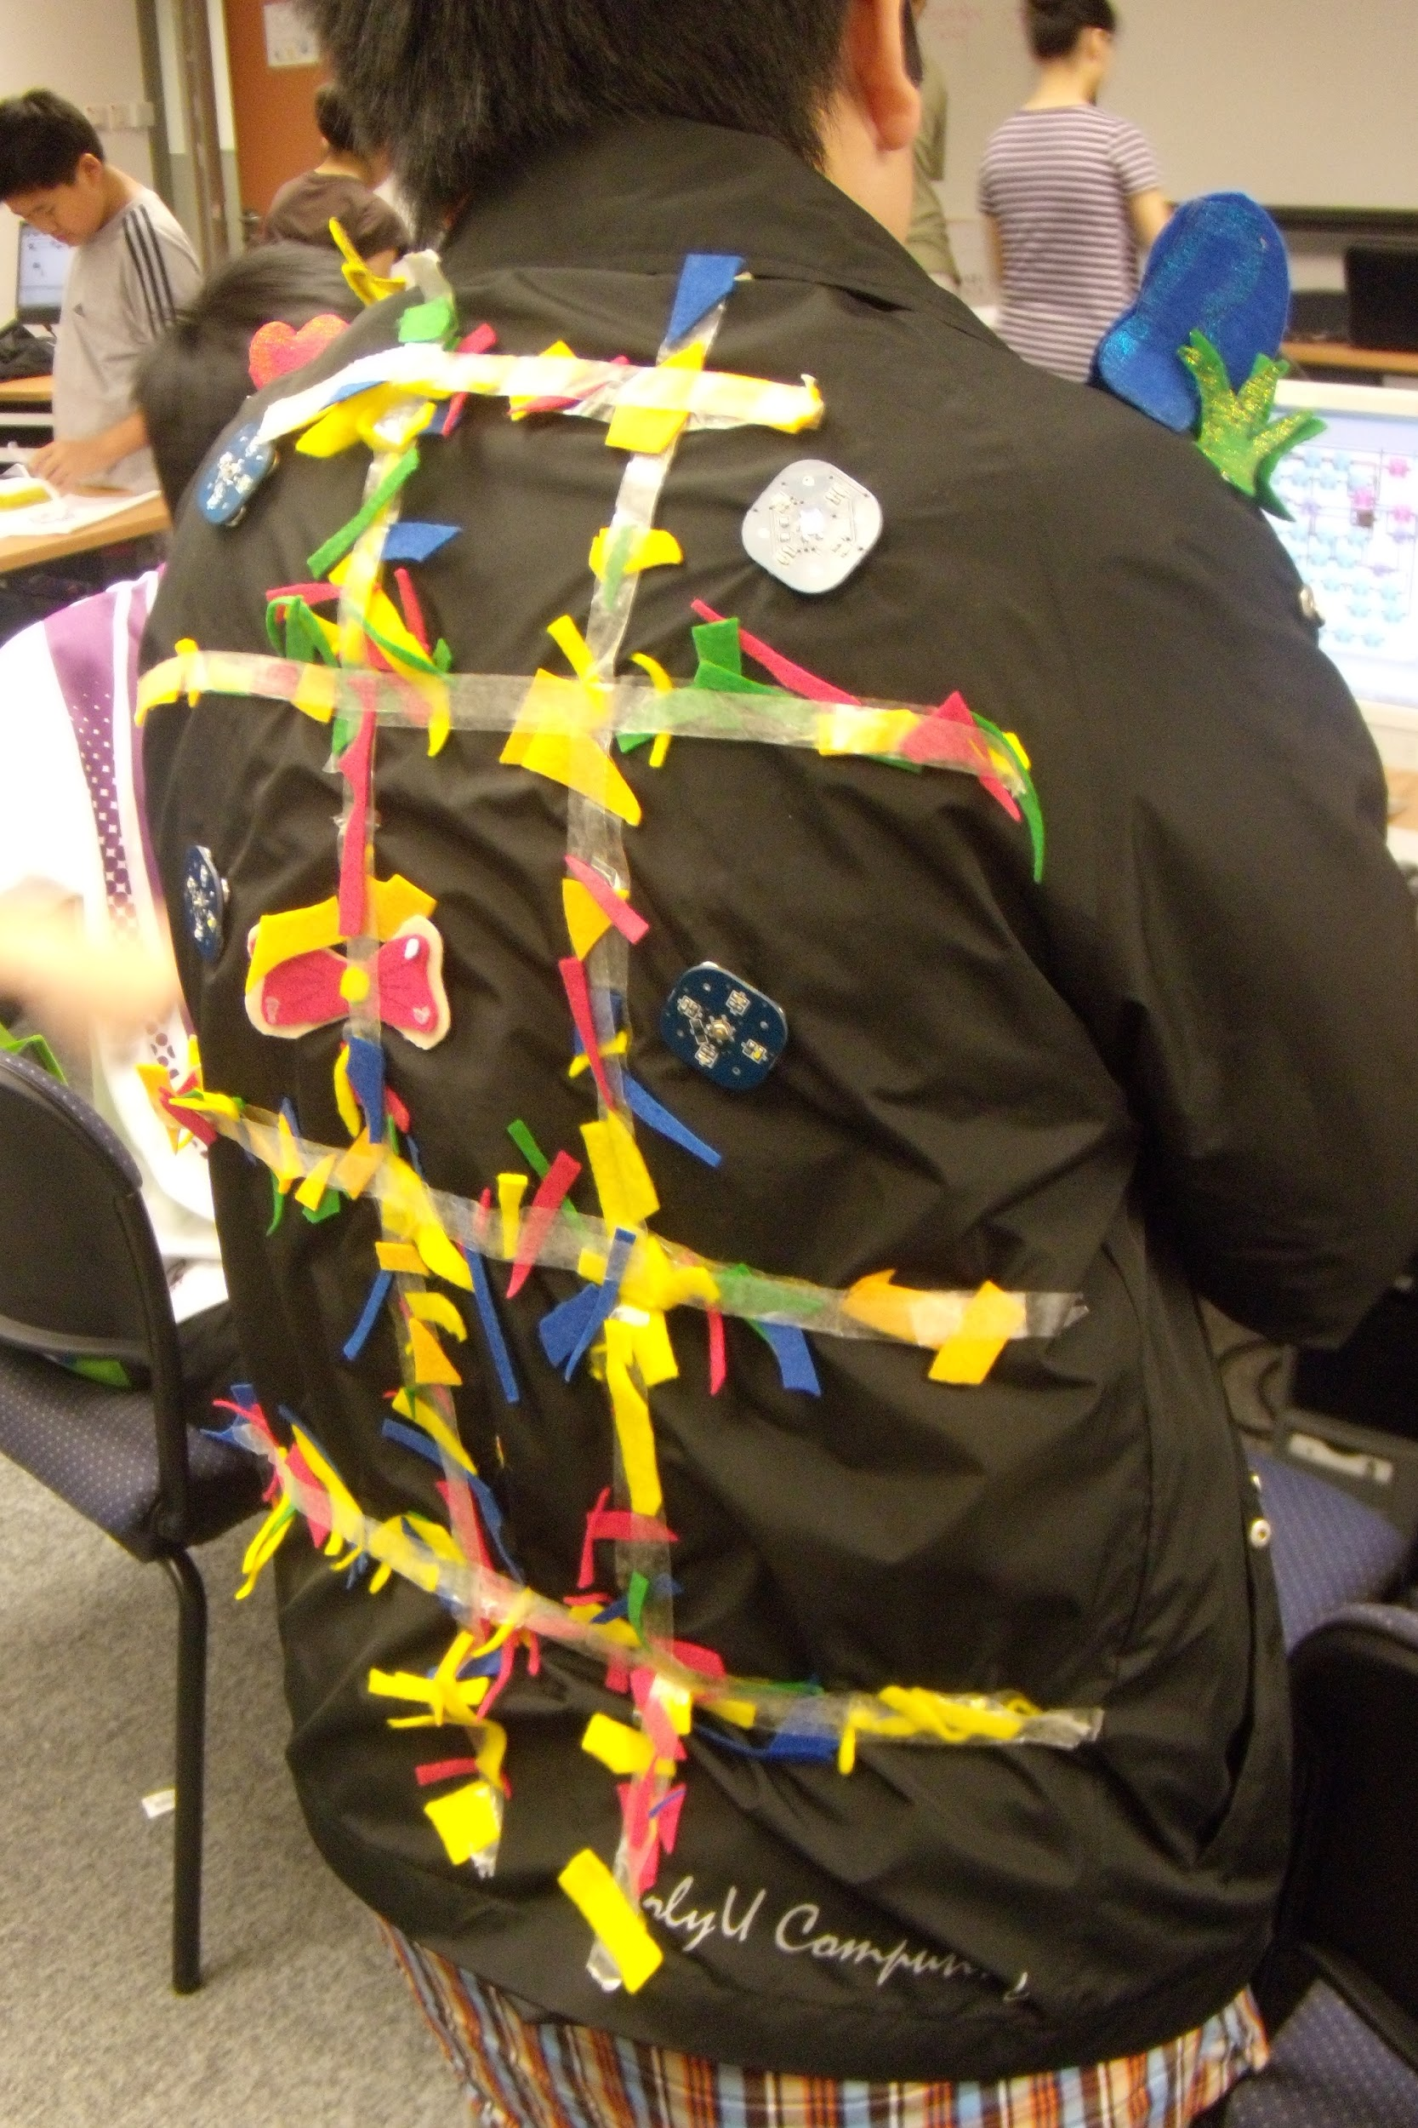
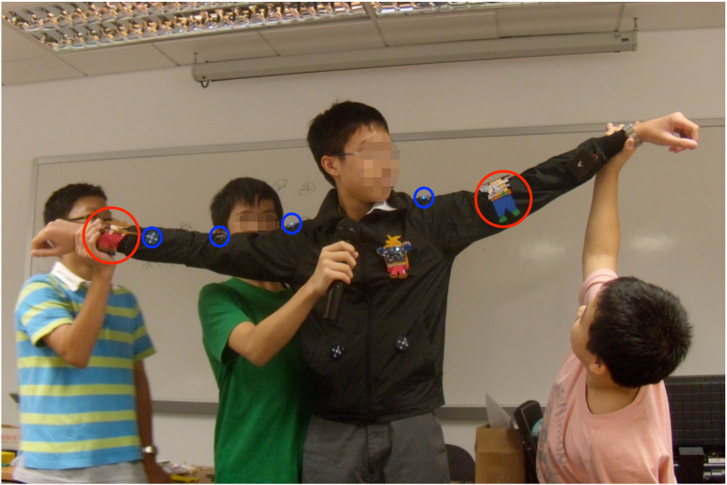
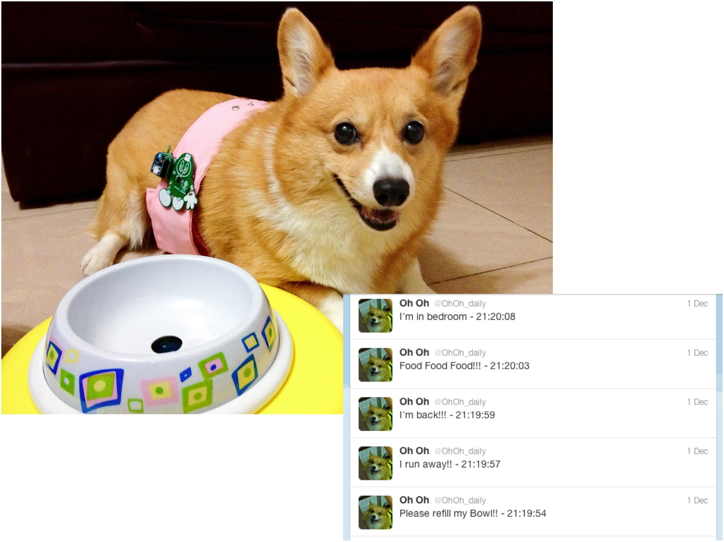
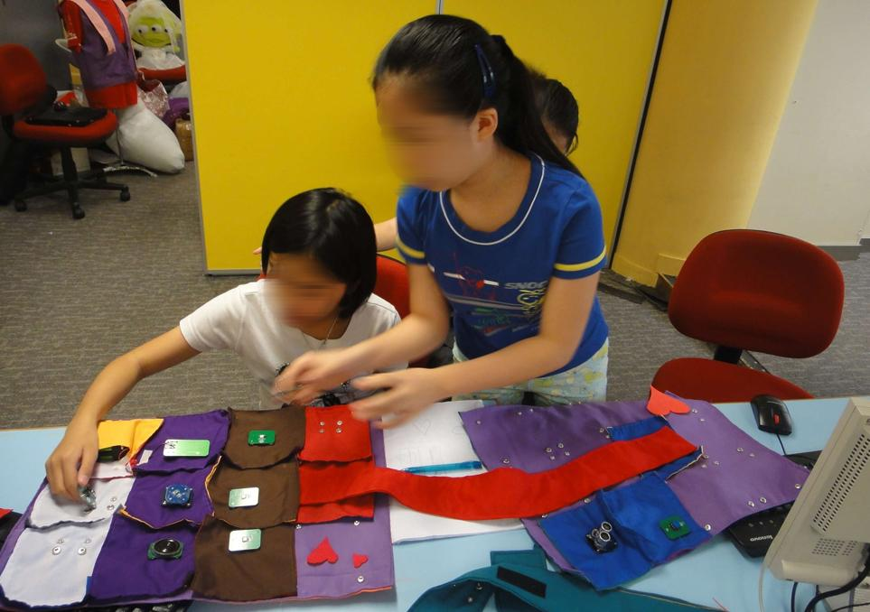
Wearable E-Textiles
(Ngai et al., 2009, 2010)

Slide 94
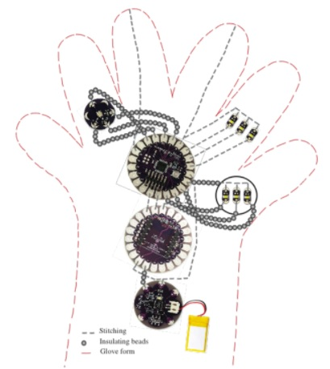
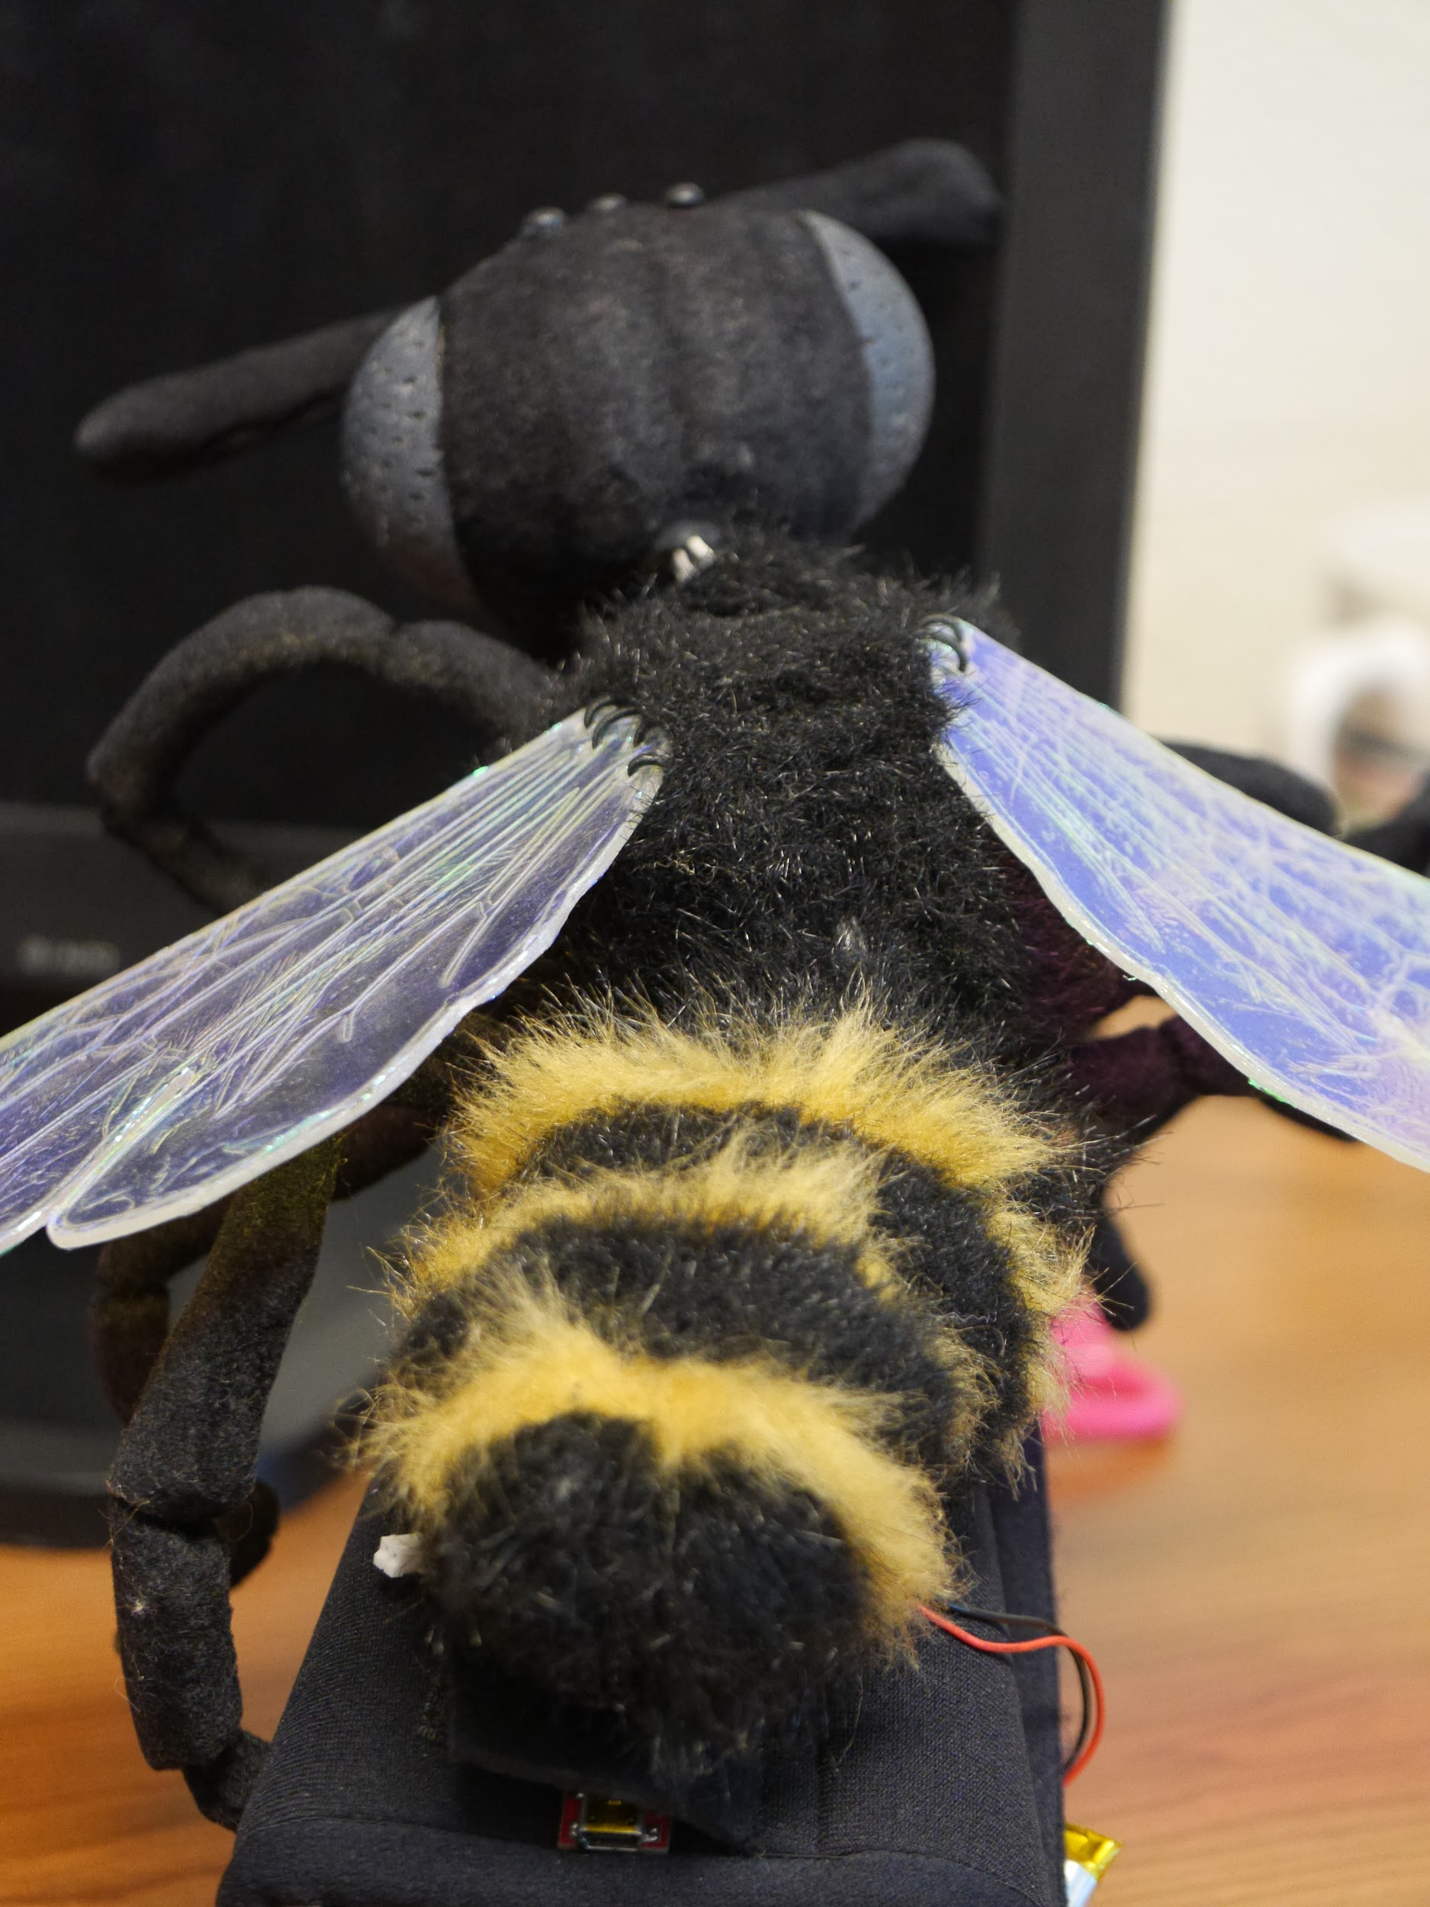
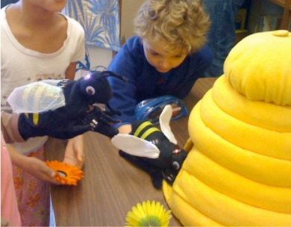
Wearable E-Textiles
(Peppler et al., 2010)

Slide 95
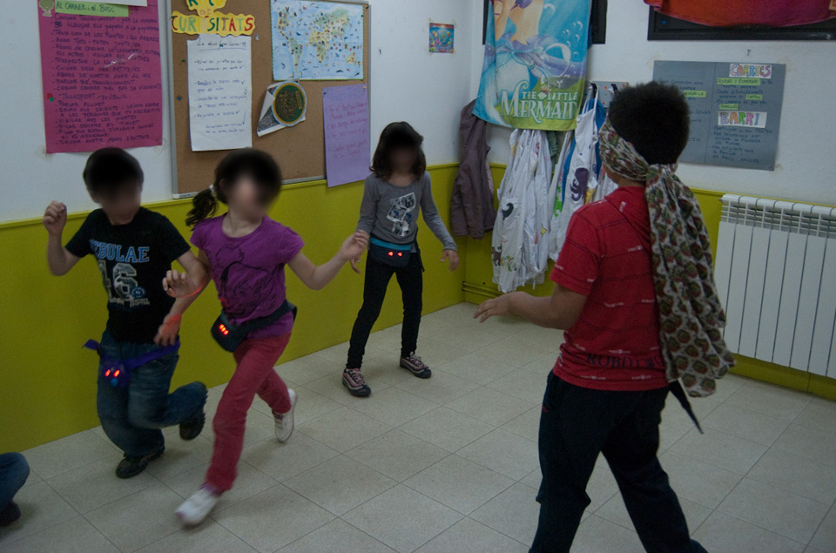
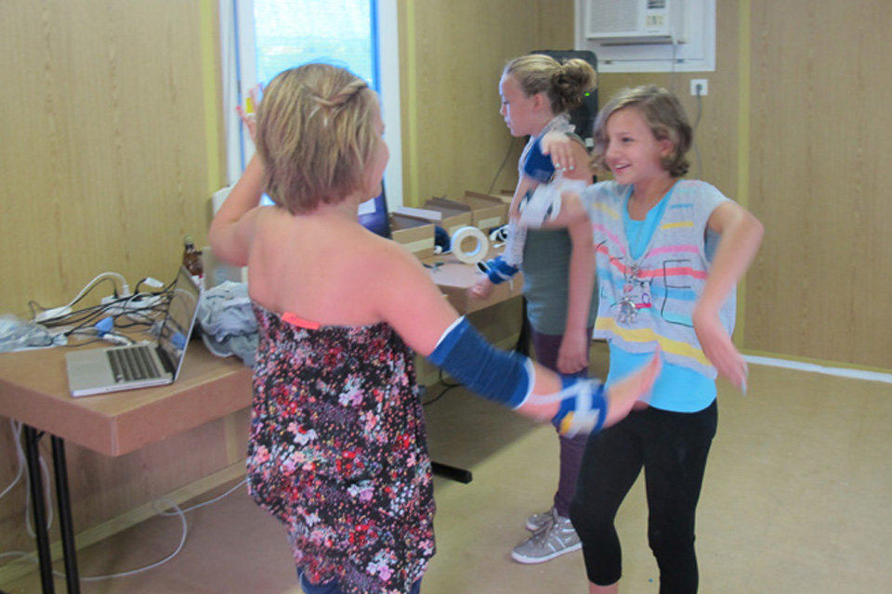
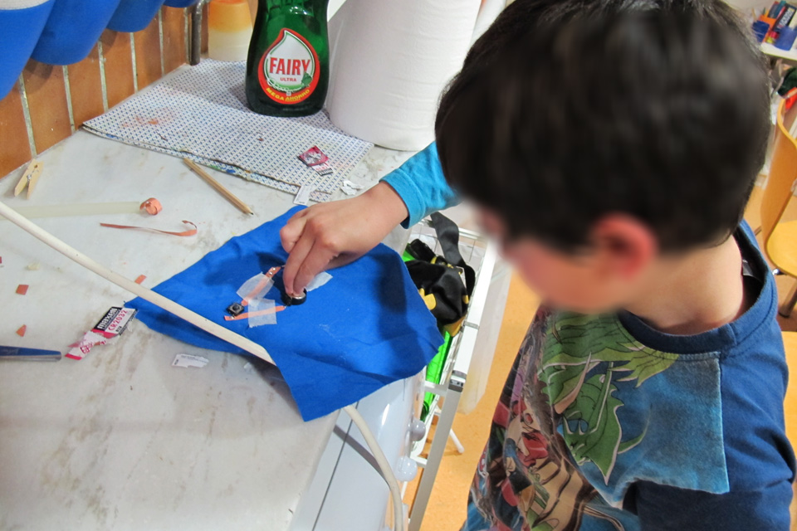
Wearable E-Textiles
(Rosales et al., 2015)

Slide 96
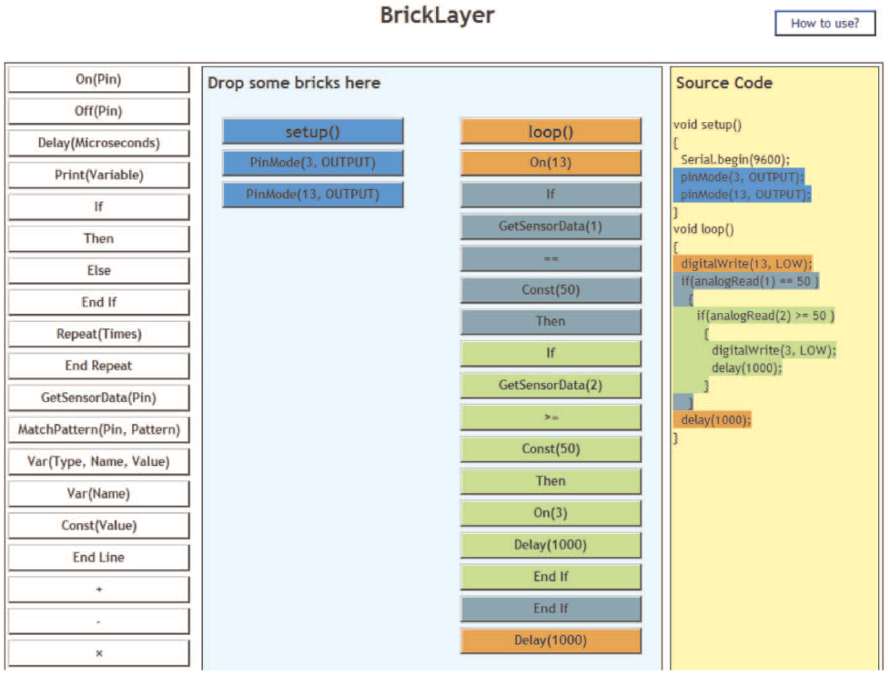
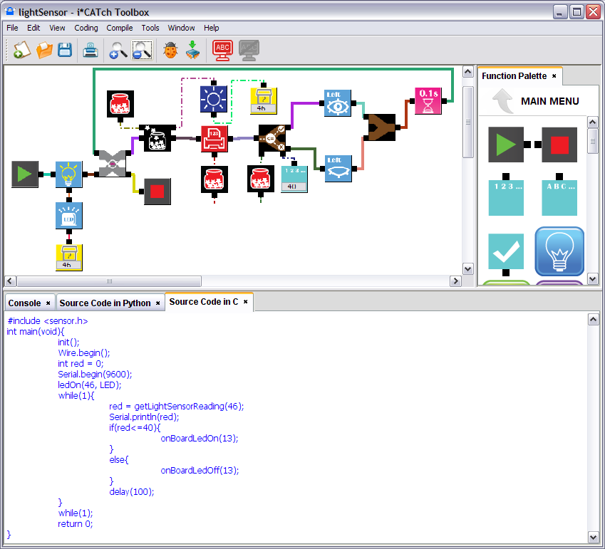
Wearable Interfaces
(Ngai et al., 2009, 2010)

Slide 97
Literature Search & Coding
Literature Search: Institute of Electrical and Electronics Engineers (IEEE) Xplore, Web of Science (WoS), and Education Resources Information Center (ERIC) - 62,000+ results IEEE search for “wearable”
Inclusion criteria: Seven criteria for inclusion
Search results: 171 articles met the search criteria and filters
Coding: Coding manual, field parameters, procedures
Study Characteristics

Slide 98
Data Analysis & Results
Data Analysis: IBM SPSS Statistics Version 25.0, SPSS macros Version 2005.05.23 (Wilson 2006), Comprehensive meta-analysis (CMA) version 3.0 - Hedges’ g - small sample size bias correction factor (Cooper et al. 2019, p. 296)
Wearable outcomes: overall weighted mean effect size for 20 outcomes (g = .6373, SE = .1622), cognitive learning (g = .9986, SE = .2936)

Slide 99
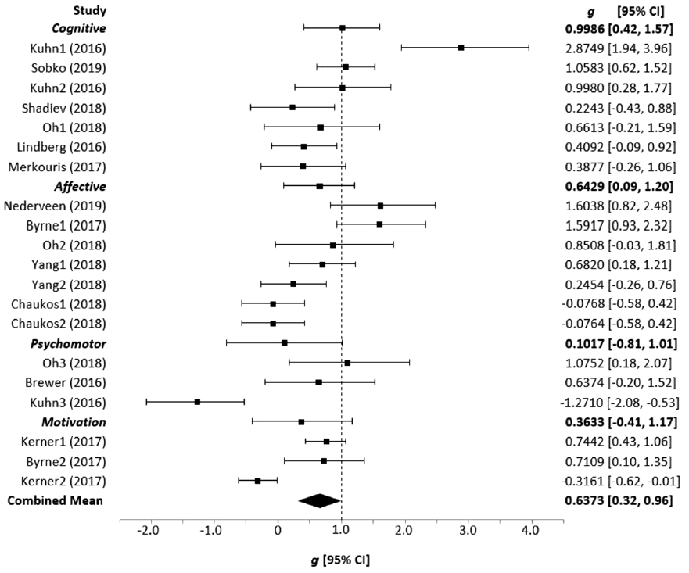
Results Continued
Forest plot
Cognitive
Affective
Psychomotor
Motivation

Slide 100
Results Continued
Research designs: two-group pretest-posttest (g = .9784, SE = .3028)
Wearable types: Head-mounted displays/glasses (g = .7928, SE = .2615).
Educational environments and learners: K-12 environments (g = .6967, SE = .2233), minors (g = .6919, SE = .2127)
Strategies: Project-based strategies (g = .7129, SE = .3622).
Publication bias: Funnel plot, trim and fill procedure, fail-safe N

Slide 101
Discussion, Implications, & Limitations
Effect sizes and research designs
Wearable types
Educational environments and strategies
Research rigor and publication date range
Theoretical foundations for strategies

Slide 102
Thank you from: Curt Bonk, Vanessa Dennen, Meina Zhu, Florence Martin, Tian Luo, Fei Gao, Byron Havard, and colleagues Martin, F., Dennen, V. P., & Bonk, C, J. (Eds.) (2020). Special Issue: Systematic Reviews of Research on Emerging Learning Environments and Technology. Educational Technology Research and Development (ETR&D) 68(4). https://link.springer.com/journal/11423/volumes-and-issues/68-4 Preface, Introduction, and Closing articles are at: http://publicationshare.com/30 or http://www.publicationshare.com/

