Slide 1
AECT Panel: The Rise of Entrepreneurship in Educational Technology
Curtis J. Bonk, Professor, Indiana University
cjbonk@indiana.edu
http://mypage.iu.edu/~cjbonk/

Slide 2
Question #1. Why have you become interested in exploring Ed Tech as a field from an entrepreneurial perspective? What was the motivation behind it?

Slide 3
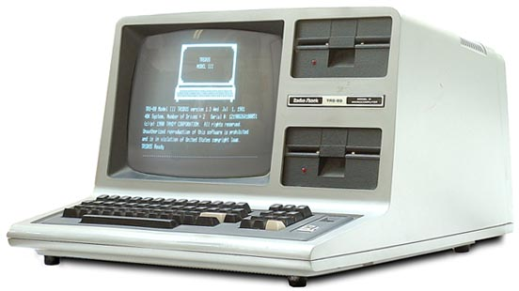
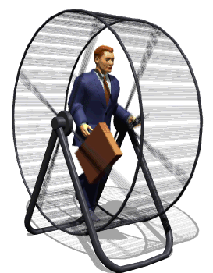
Answer: Imagine my life as an accountant/CPA in a high tech company in the 1980s…

Slide 4
Question #2. How are your views of entrepreneurship brought to life in your work as Educational Technologist? (e.g., entrepreneurial nature through digital scholarship and open educational resources)

Slide 5
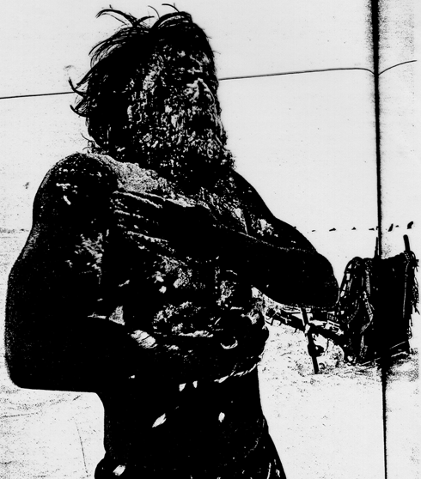
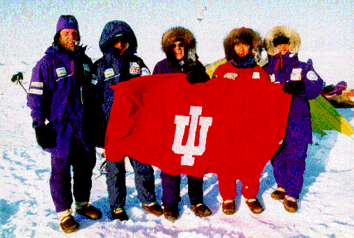
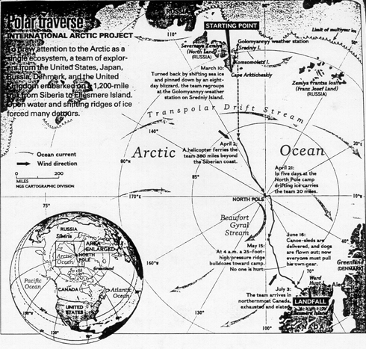
Advice #1: Analyze Existing Data…

Slide 6
Advice #2: Empower Your Students

Slide 7
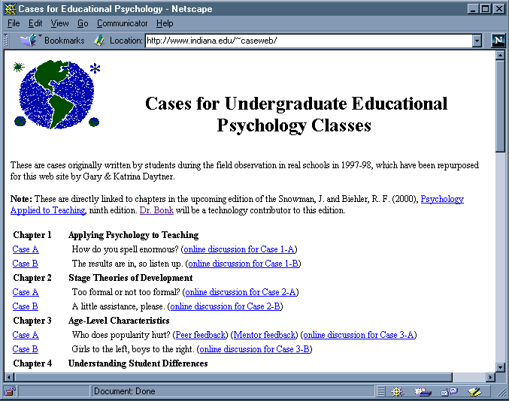
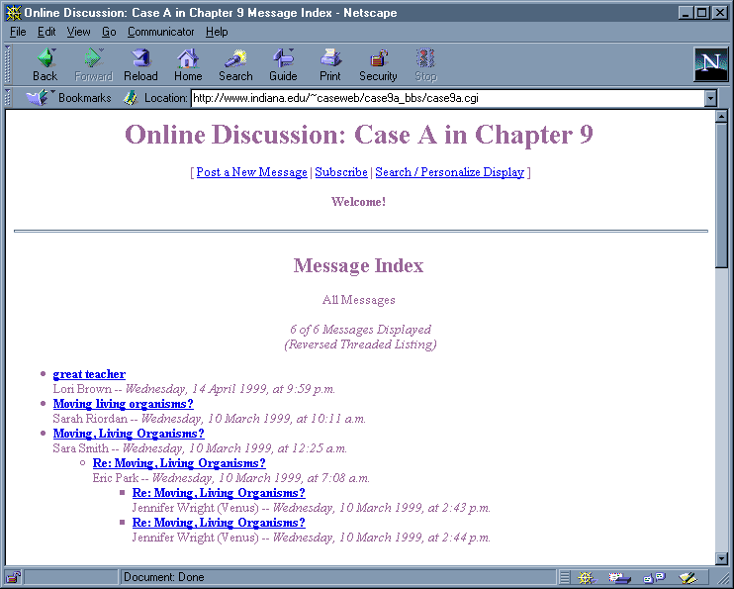
Advice #3: Build on Projects

Slide 8
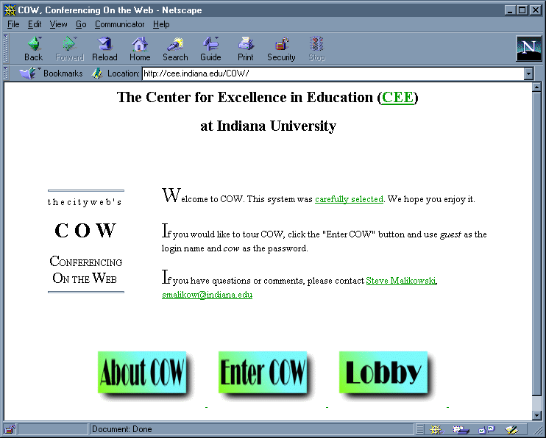
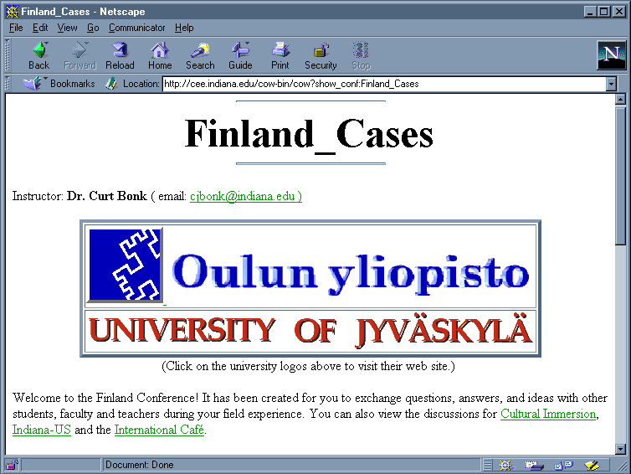
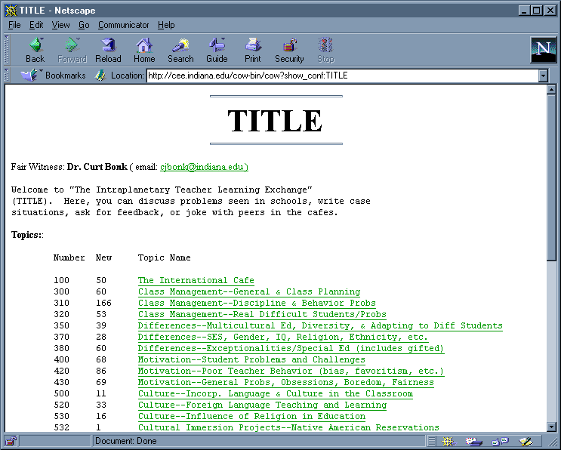
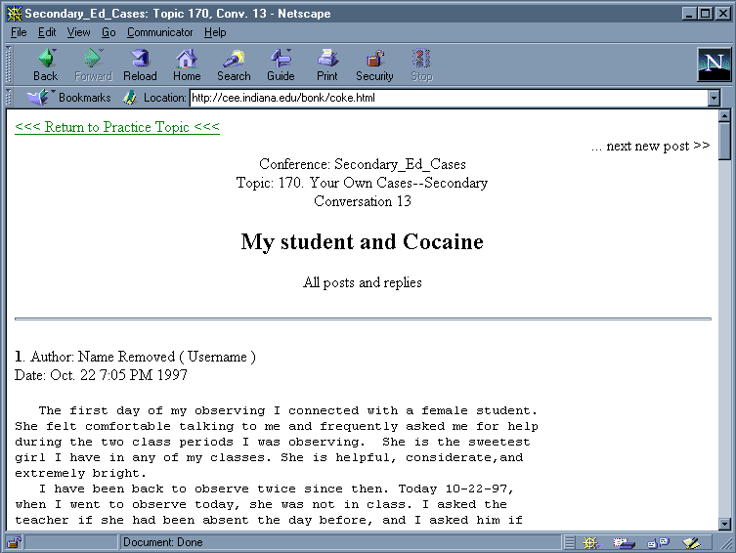
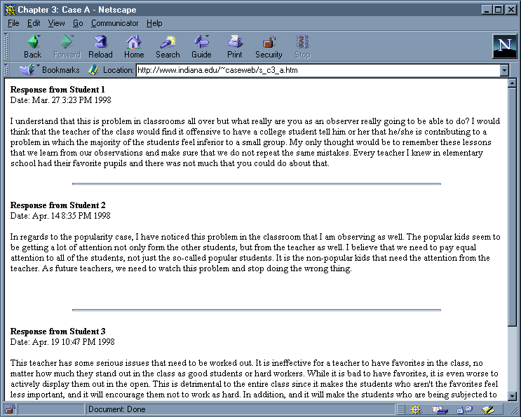
Advice #4: Holy COW: Don’t Ever Ride Your Bike to Work…

Slide 9
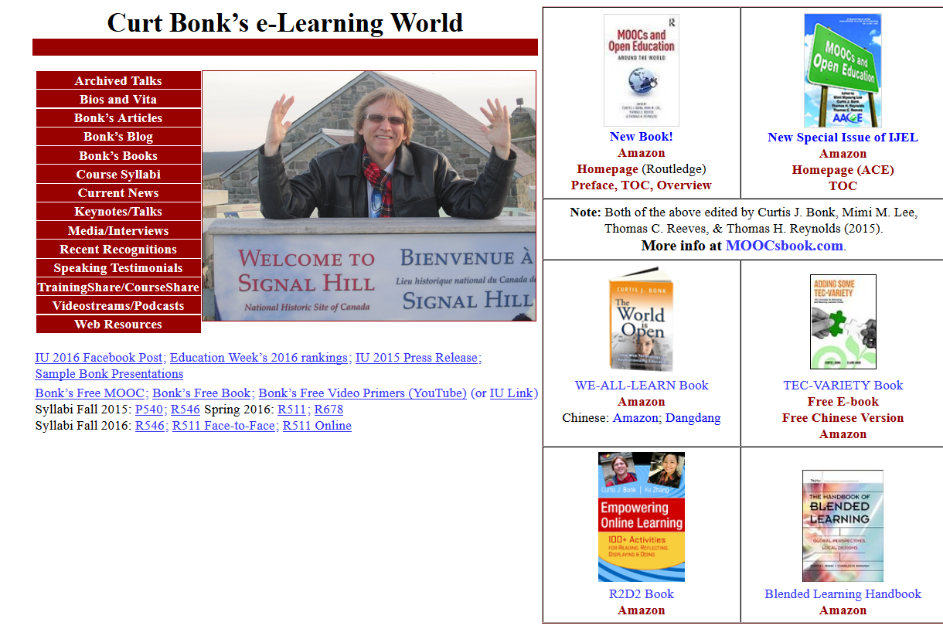
Advice #5: Constantly Update Your Homepage

Slide 10
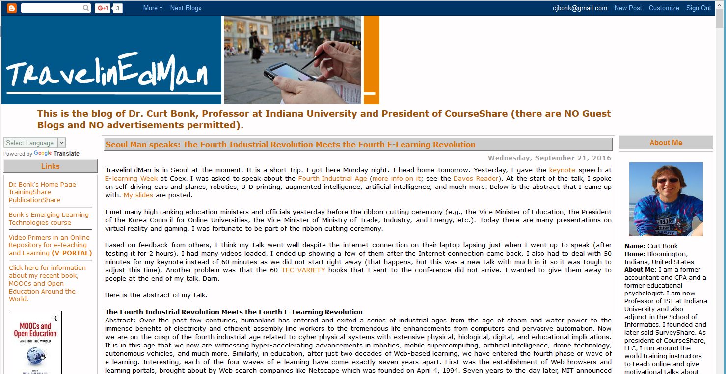
Advice #6: Blog Your Views (e.g., TravelinEdMan)

Slide 11
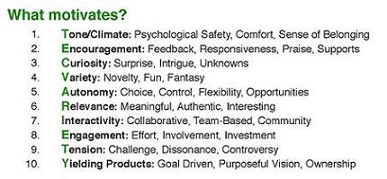
Advice #7: Consider Self-Publishing

Slide 12
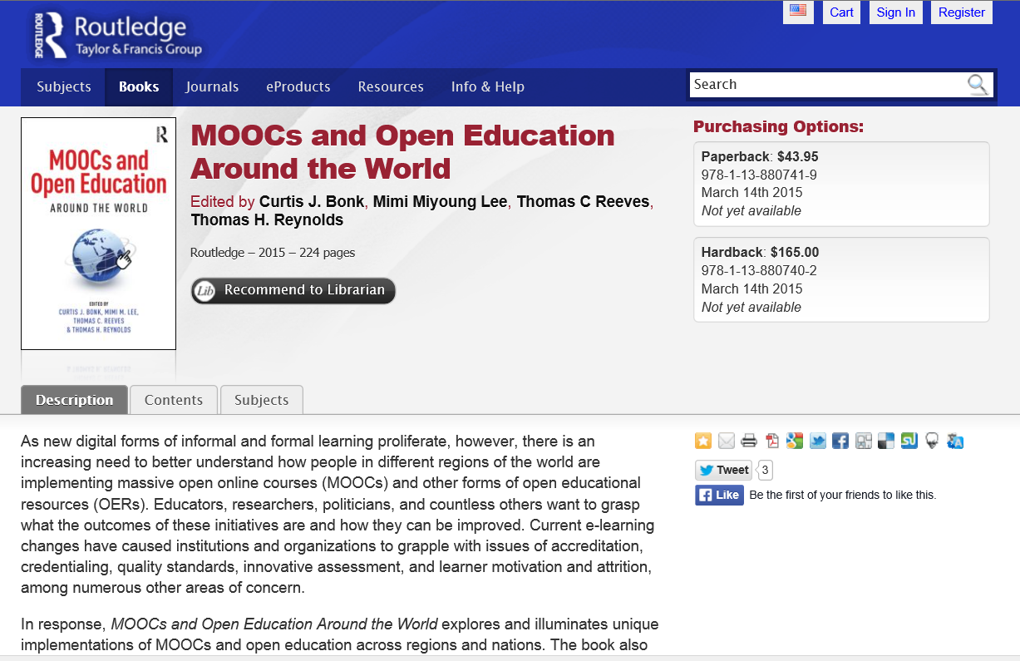
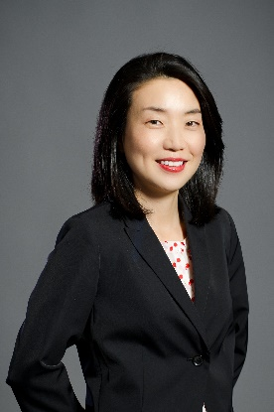
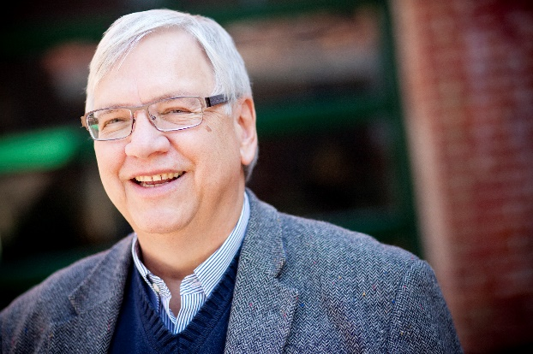
Advice #8: Get a Memorable Homepage URL for your Books MOOCs and Open Education Around the World http://routledge-ny.com/books/details/9781138807419/

Slide 13
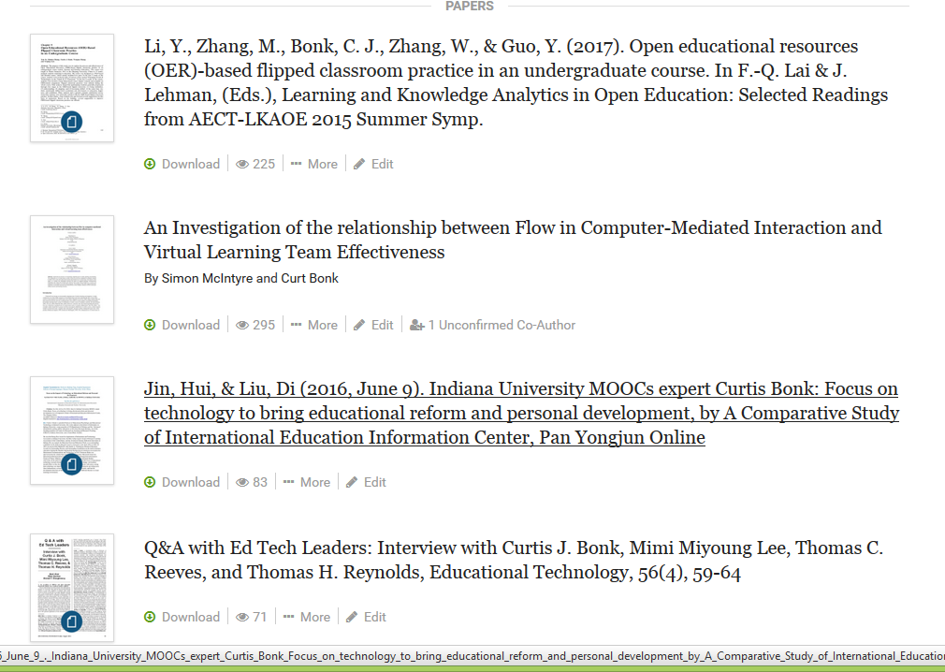
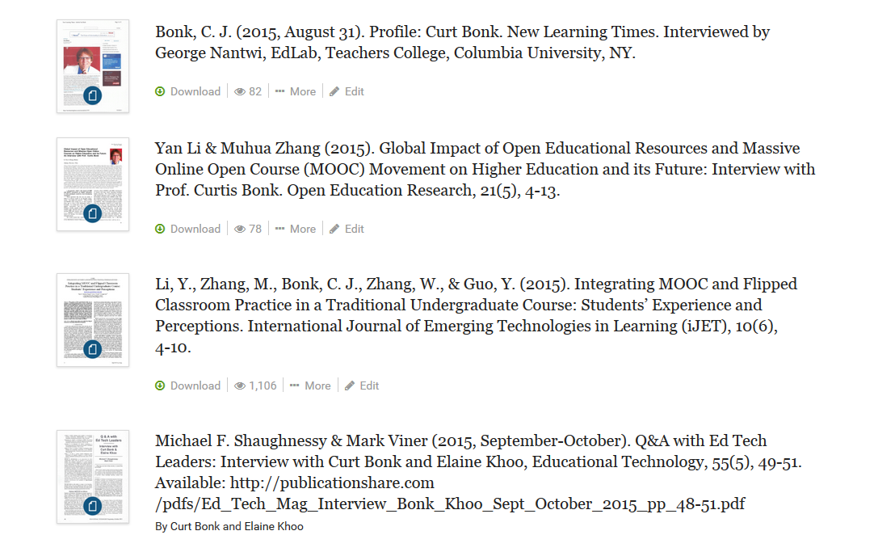
Advice #9: Use Social Media to Share Your Research https://indiana.academia.edu/CurtBonk

Slide 14
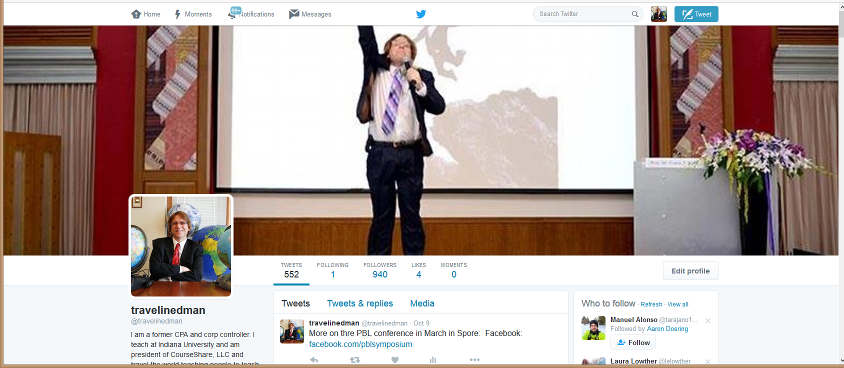
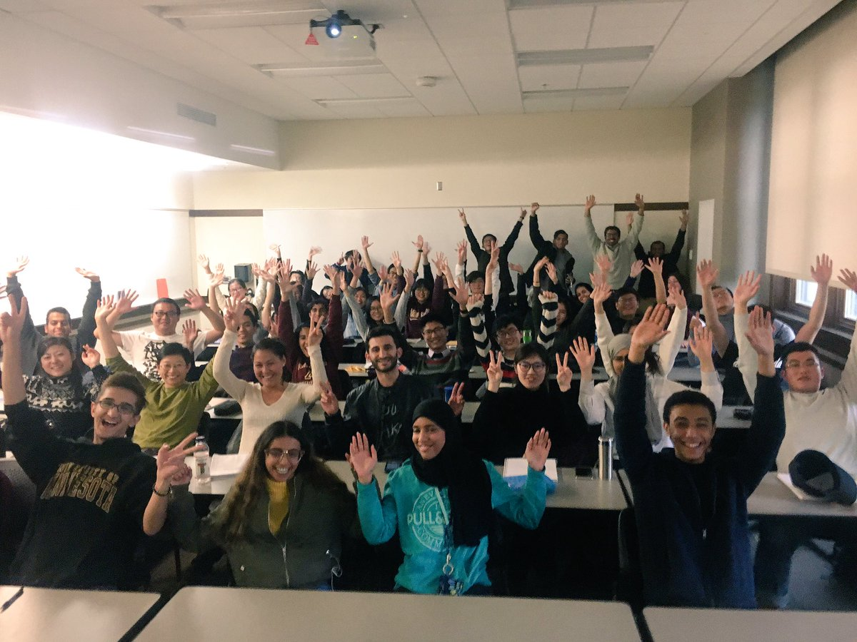
Advice #10: Tweet on Your Travels and Research https://twitter.com/travelinedman

Slide 15
Question #3. What are some of the lessons learned as an Ed Tech entrepreneur?

Slide 16
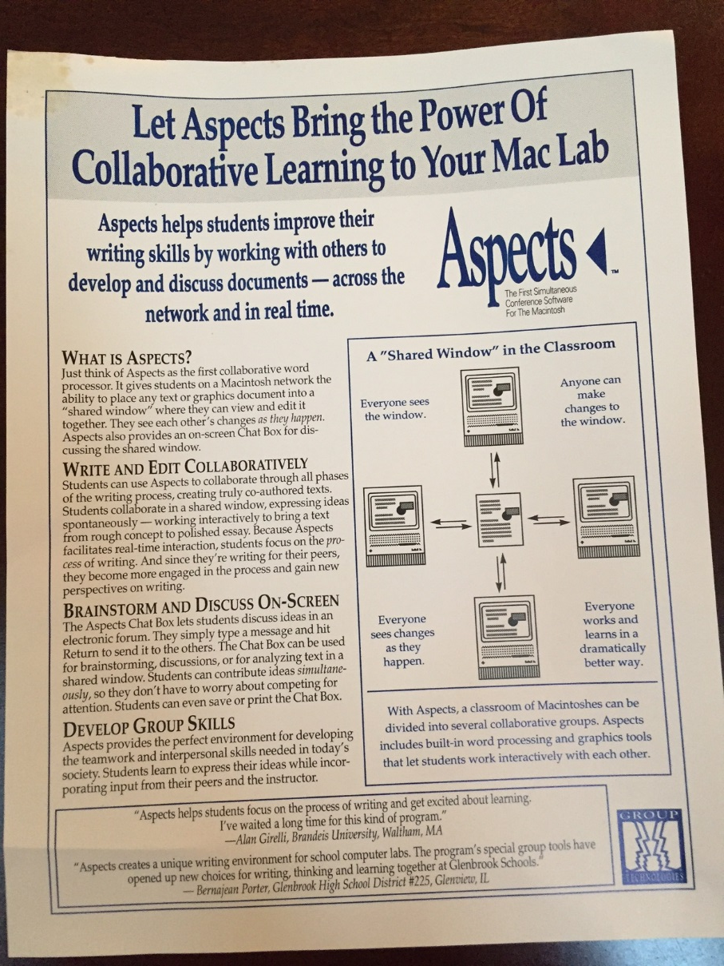
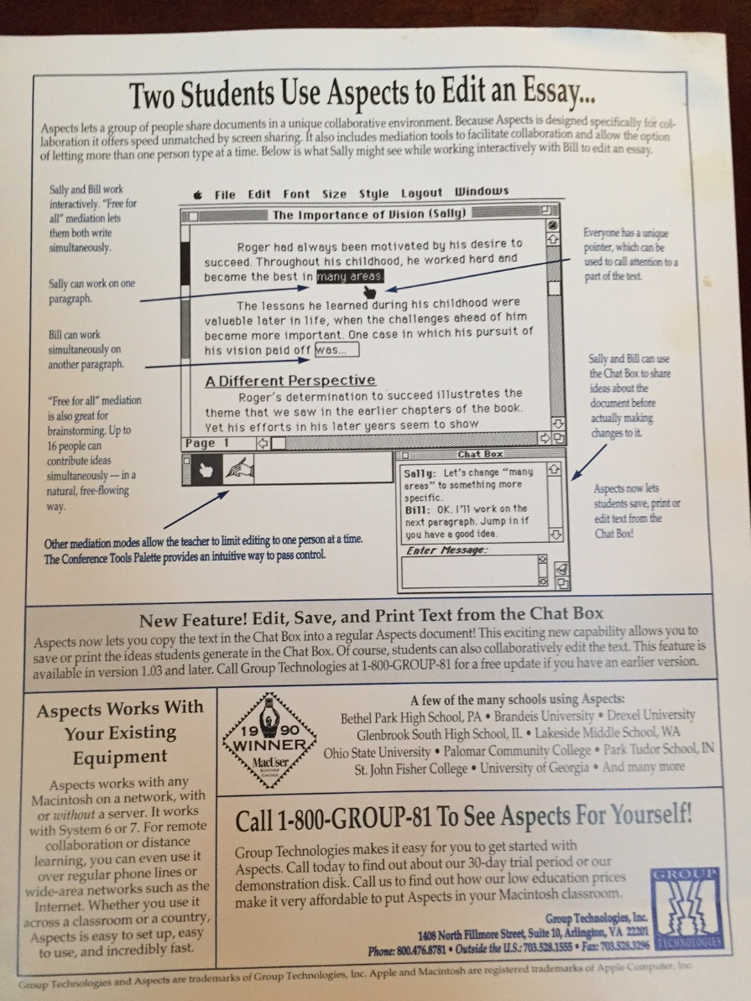
Lesson #1: Write to Vendors… (e.g., Aspects…circa 1991—25 years ago)

Slide 17
Lesson #2: Don’t Expect Blackboard to Do It!

Slide 18
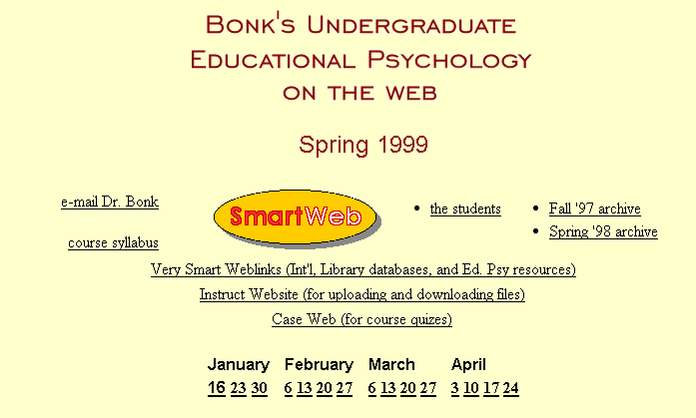
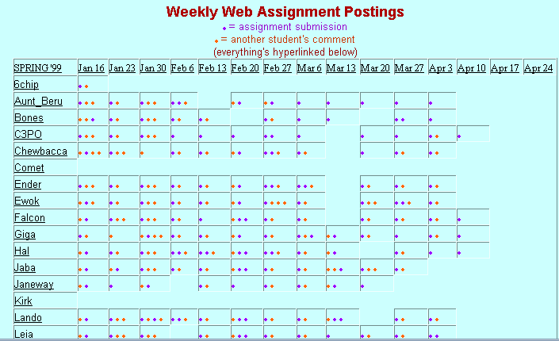
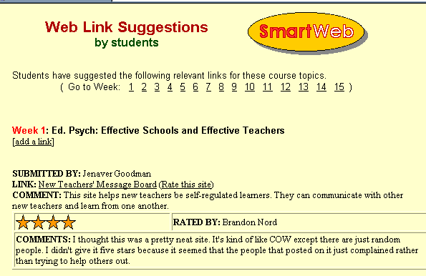
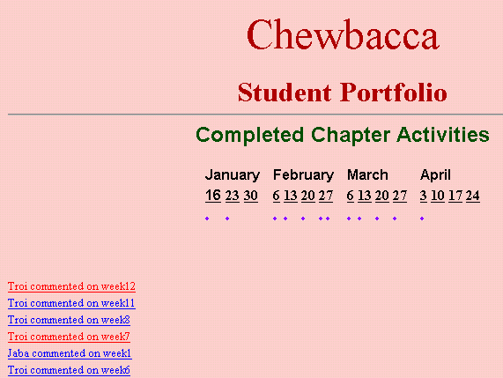
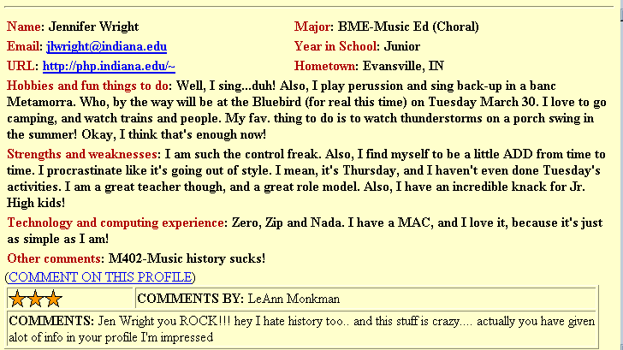
Lesson #3: Nothing Wrong with Beta Testing

Slide 19
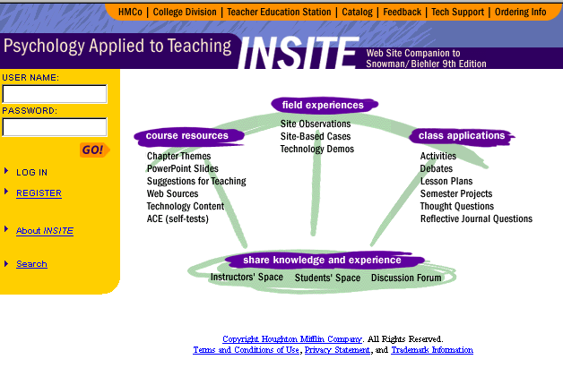
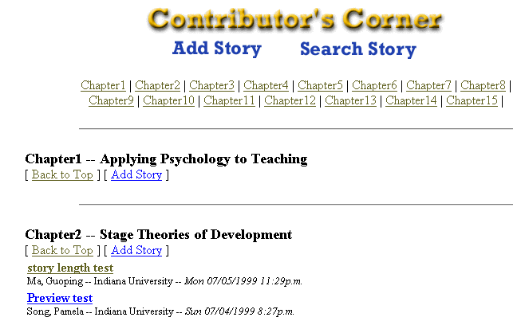
Lesson #4: Get Reimbursed for Your Innovations

Slide 20
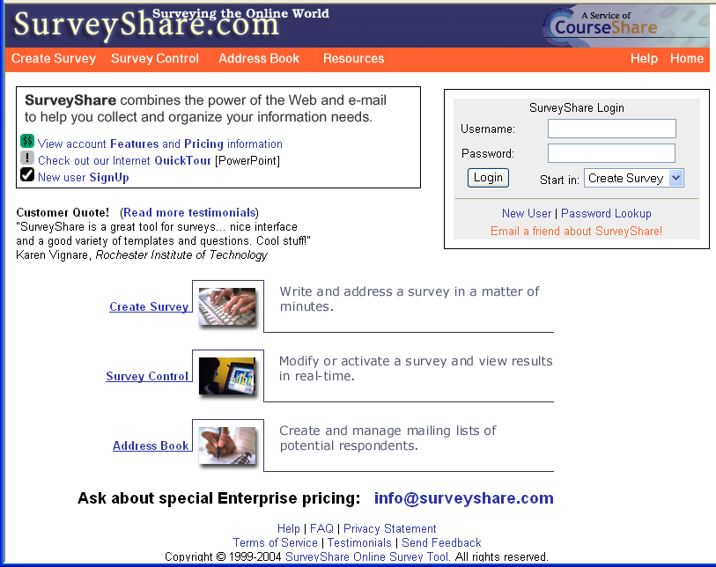
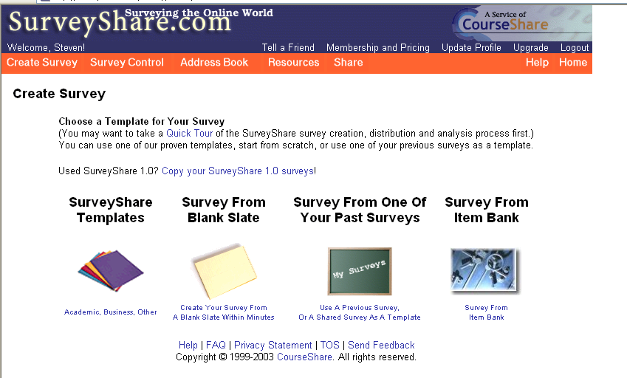
Lesson #5: Don’t Build Software

Slide 21
8 “Share” sites (plus FreelanceShare)
Lesson #6: Be Committed
BookstoreShare
InstructorShare
LibraryShare
PublicationShare
ResourceShare
TrainingShare
UniversityShare
SurveyShare

Slide 22
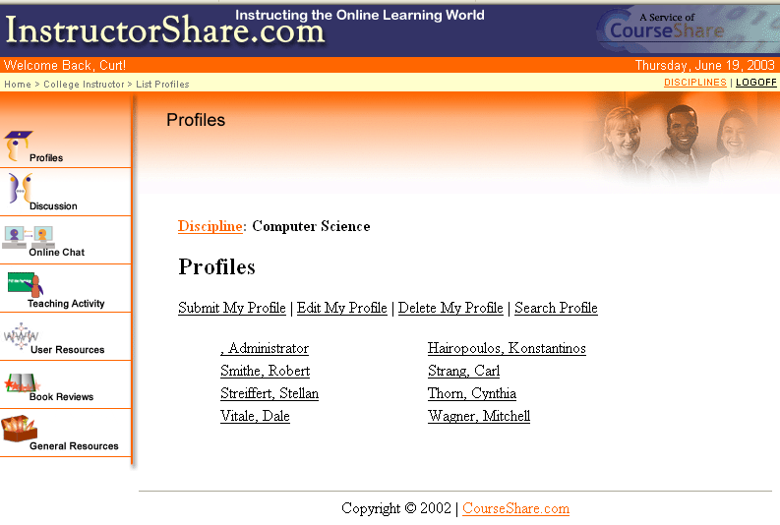
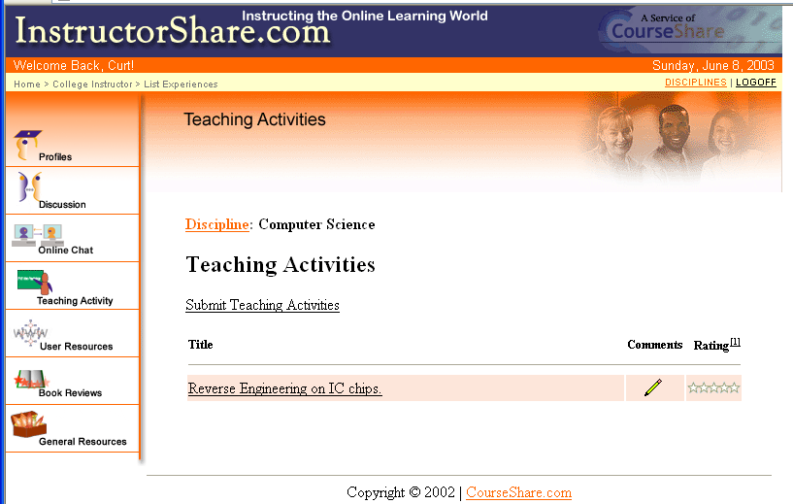
InstructorShare: List of User Profiles for Computer Science Discipline

Slide 23
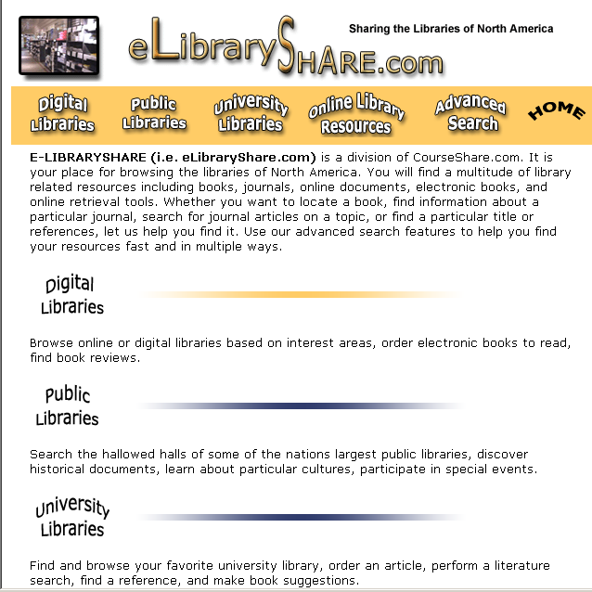
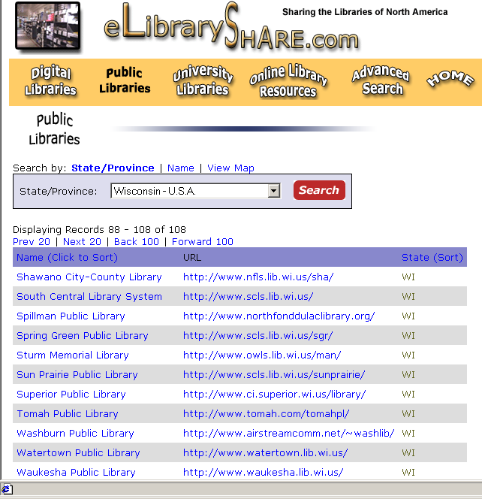
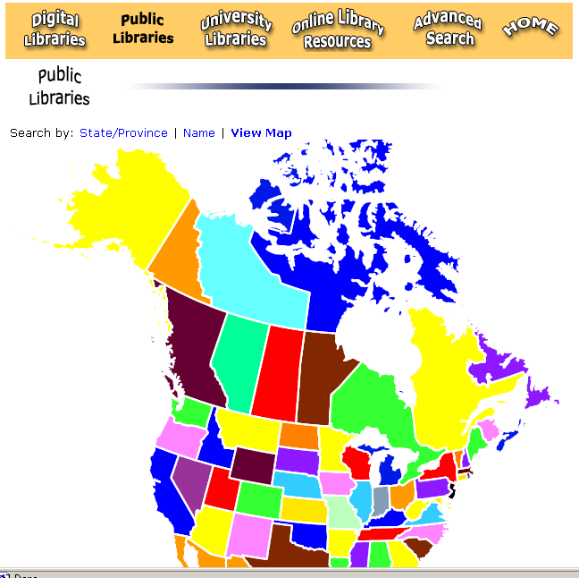
LibraryShare: Digital, Public, and University Libraries

Slide 24
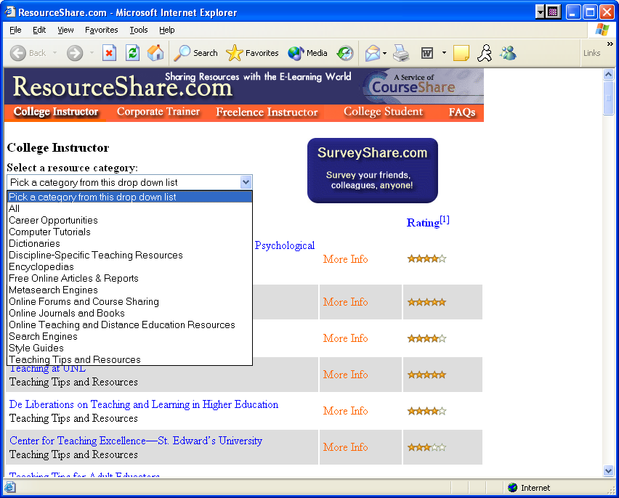
ResourceShare: College Instructor Resource Portal

Slide 25
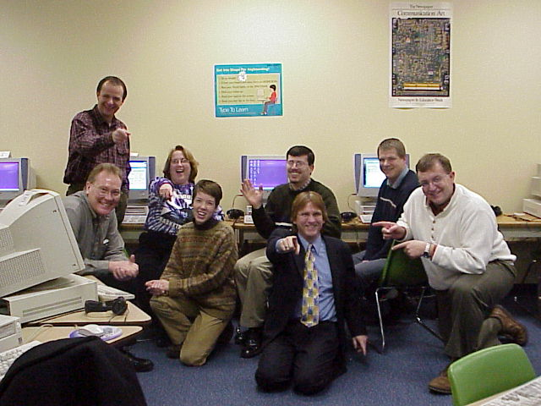
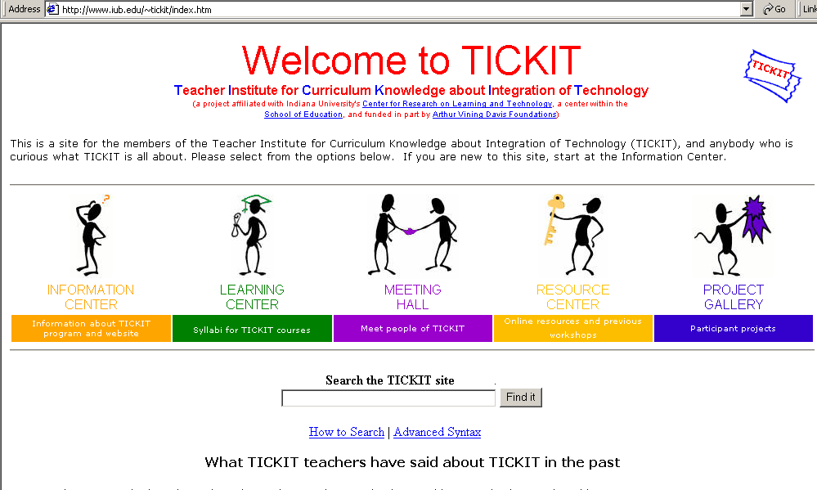
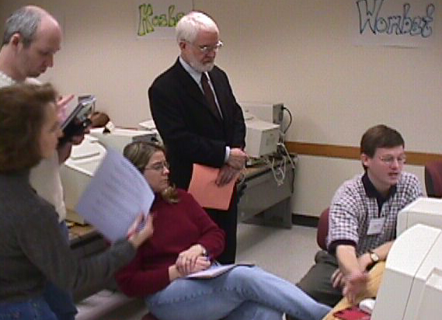
Lesson #7: Find Likeminded Colleagues

Slide 26
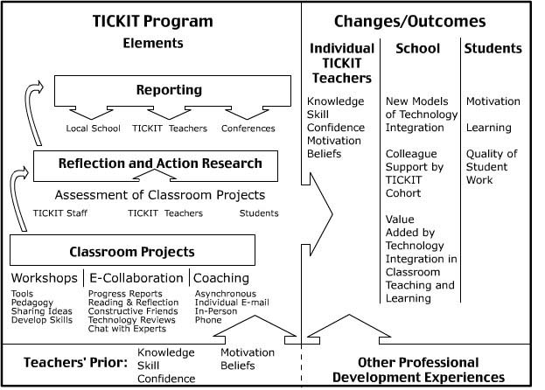
Lesson #8: Some Creative Sparks Need Time to Evolve
Notes:
Curt, this is the end of your introduction.

Slide 27
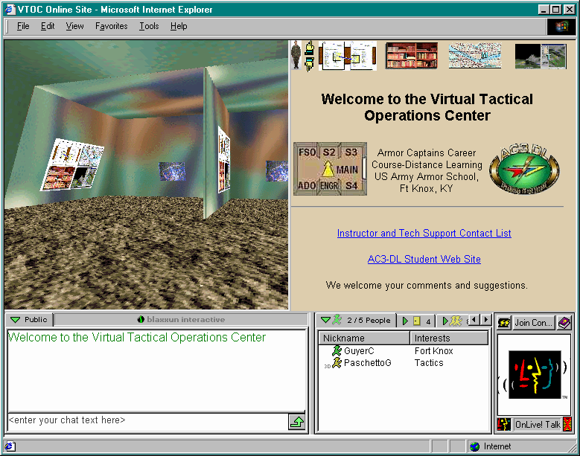
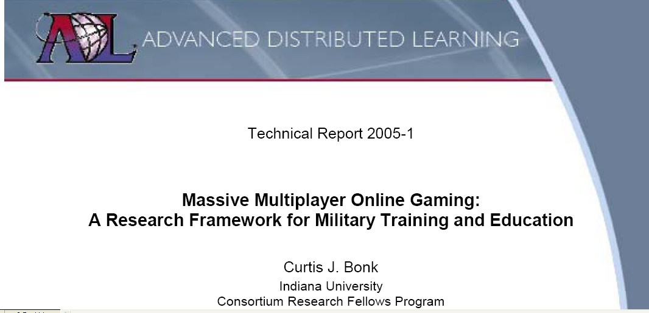
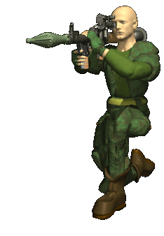
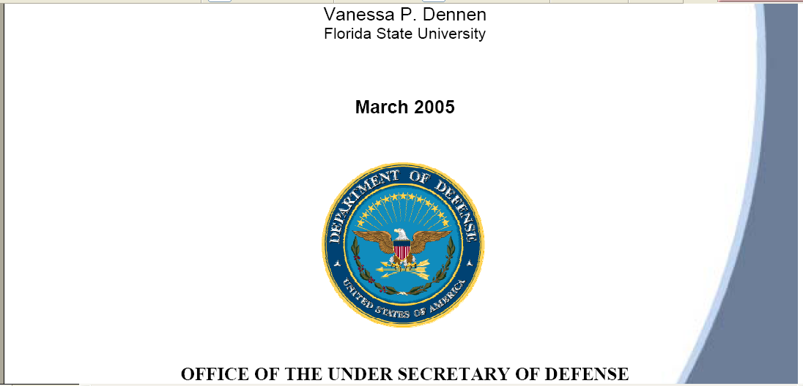
Lesson #9: Be Open to Novel Partnerships…

Slide 28
Lesson #10: Be bold…and connect to people…(e.g., edited books)

Slide 29
Question #4. How do you envision the future of Educational Technology?

Slide 30
Any Questions or Comments? Slides at: TrainingShare.com Papers: PublicationShare.com Free book: http://tec-variety.com/ Email: curt@worldisopen.com

