Slide 1
MOOC Instructor Motivation and Career and Professional Development
Curtis J. Bonk| cjbonk@Indiana.edu
Min Young Doo| scion2006@gmail.com
Meina Zhu| meinzhu@iu.edu
Ying Ting| yingtang@hku.hk
March 14, 2019

Slide 2
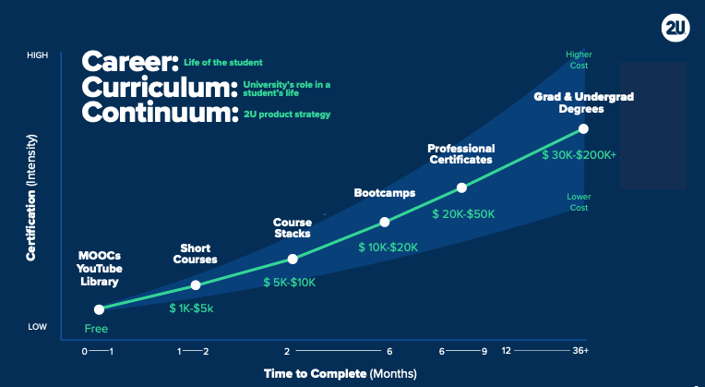
March 13, 2019
The Career Curriculum Continuum
Andrew Hermalyn, Inside Higher Ed https://www.insidehighered.com/digital-learning/views/2019/03/13/how-universities-can-stay-center-learners-lives-opinion

Slide 3
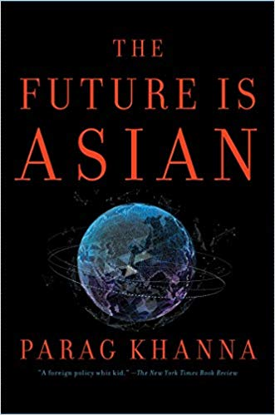
February 27, 2019 Why 'The Future Is Asian' Should Inform Your University's Strategy Joshua Kim, Inside Higher Ed https://www.insidehighered.com/blogs/technology-and-learning/why-future-asian-should-inform-your-universitys-strategy Today, there are about 70 million East Asian and Pacific students enrolled in postsecondary education. By 2040, that number is projected to rise to 257 million.

Slide 4
February 27, 2019 Thinking About 'Massification of Higher Education Revisited’ Joshua Kim, Inside Higher Ed https://www.insidehighered.com/blogs/technology-and-learning/thinking-about-massification-higher-education-revisited%E2%80%99

Slide 5
March 6, 2019 The Maturing MOOC Ray Schroeder, Inside Higher Ed https://www.insidehighered.com/digital-learning/blogs/online-trending-now/maturing-mooc

Slide 6
Talk Outline
MOOC Weird Stuff
MOOC Trends
MOOC Research Study Motivation and Career and PD of MOOC instructors

Slide 7
Polls
Poll #1: Who in here has taken a MOOC? Poll #2: Are you happy or frustrated when you take a MOOC?

Slide 8
Some Weird Things Going On…

Slide 9
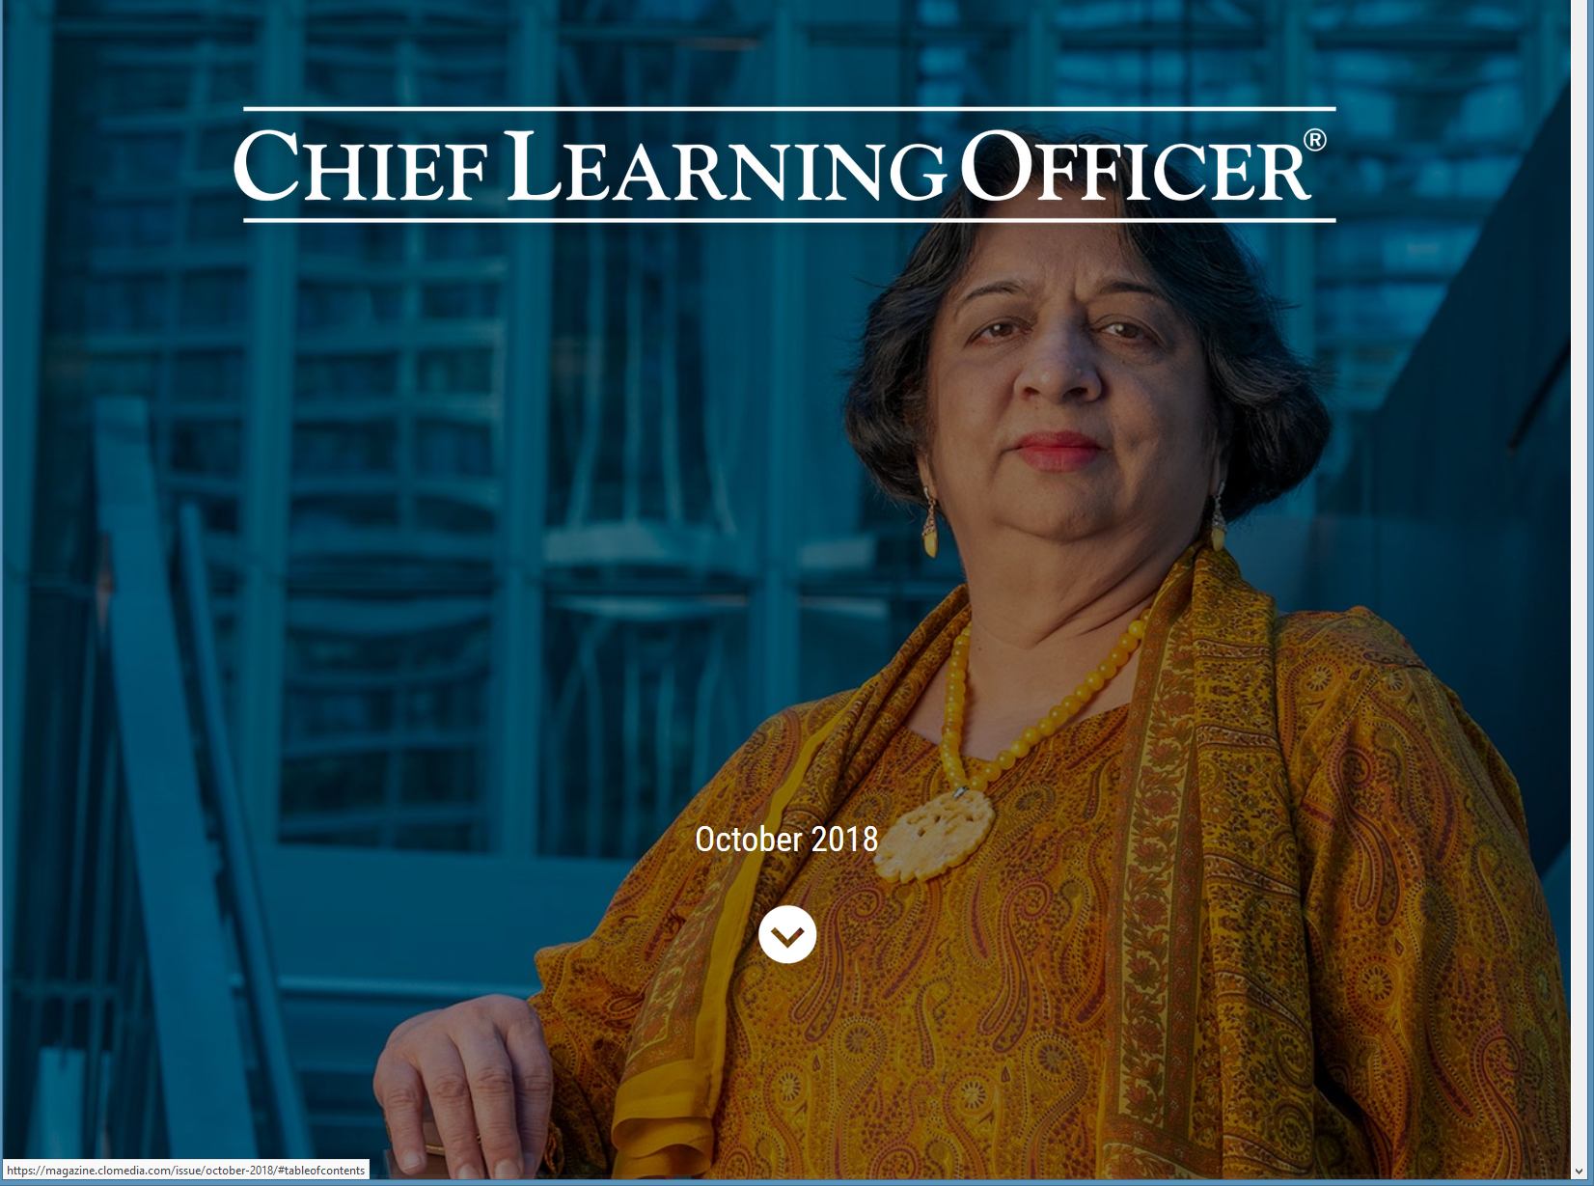
Weirdness #1…We’re Teaching the World October, 2018 Sarah Fister Gale, CLO https://magazine.clomedia.com/issue/october-2018/teaching-the-world/ https://magazine.clomedia.com/issue/october-2018/

Slide 10
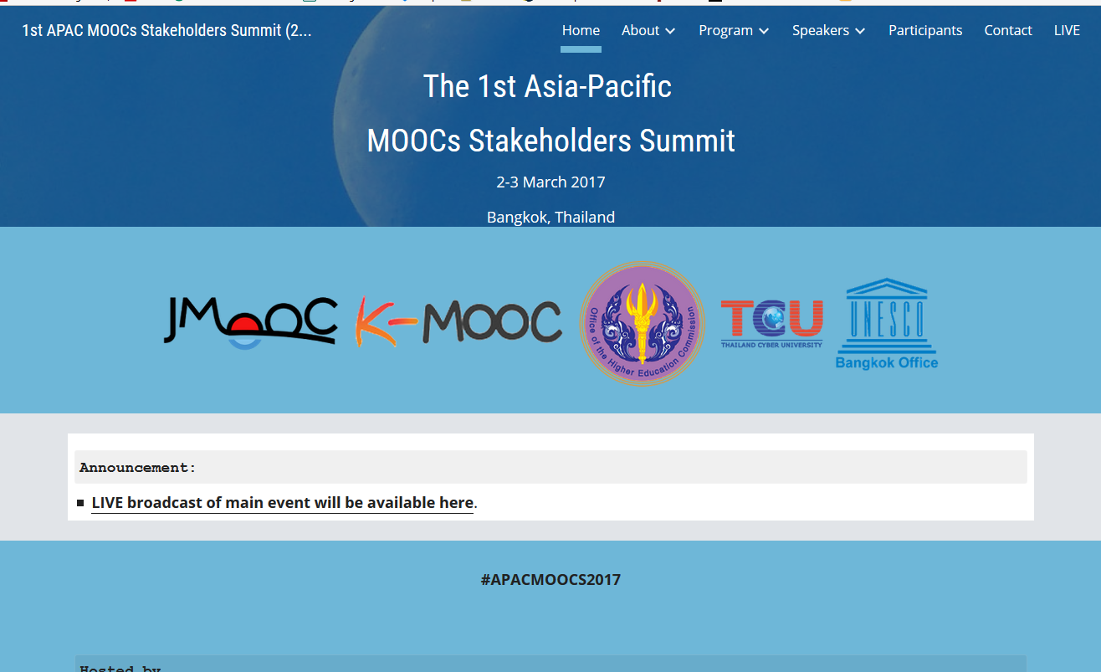
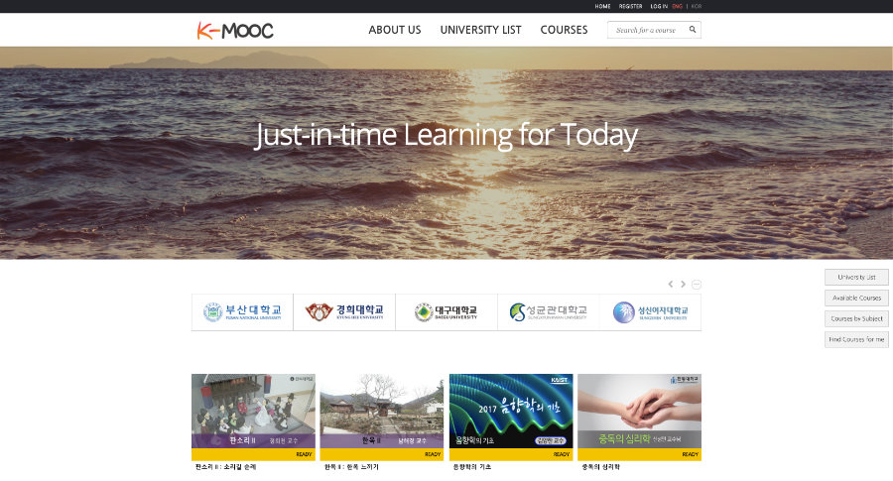
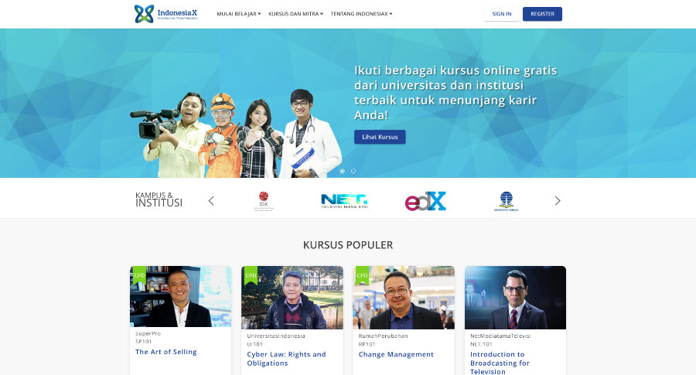
Weirdness #2: Your Friends are doing MOOCs June 15, 2017 Massive List of MOOC Providers Around The World, Class Central JMOOC, K-MOOC, and T-MOOC? https://www.class-central.com/report/mooc-providers-list/

Slide 11
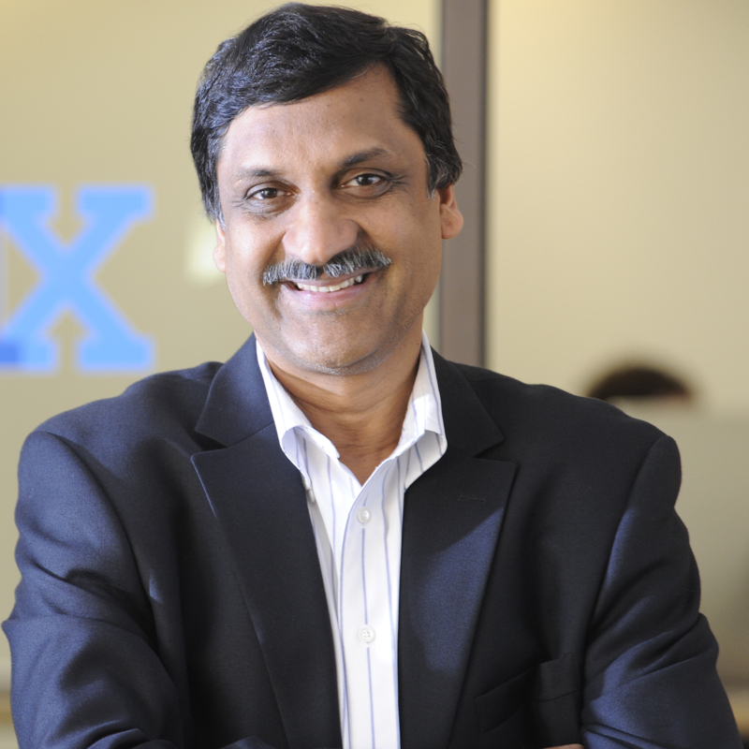
Weirdness #3: Summer MOOC Discounts Email inbox: June 10, 2018 edX (Summer discounts) https://www.edx.org/course

Slide 12
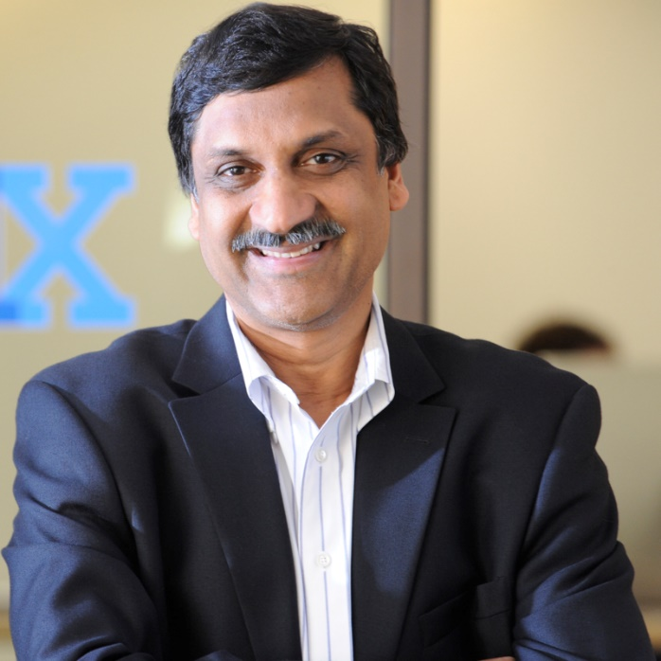
Weirdness #4: Cyber Monday Discounts Email inbox: November 26, 2018 edX (Summer discounts) https://www.edx.org/course

Slide 13
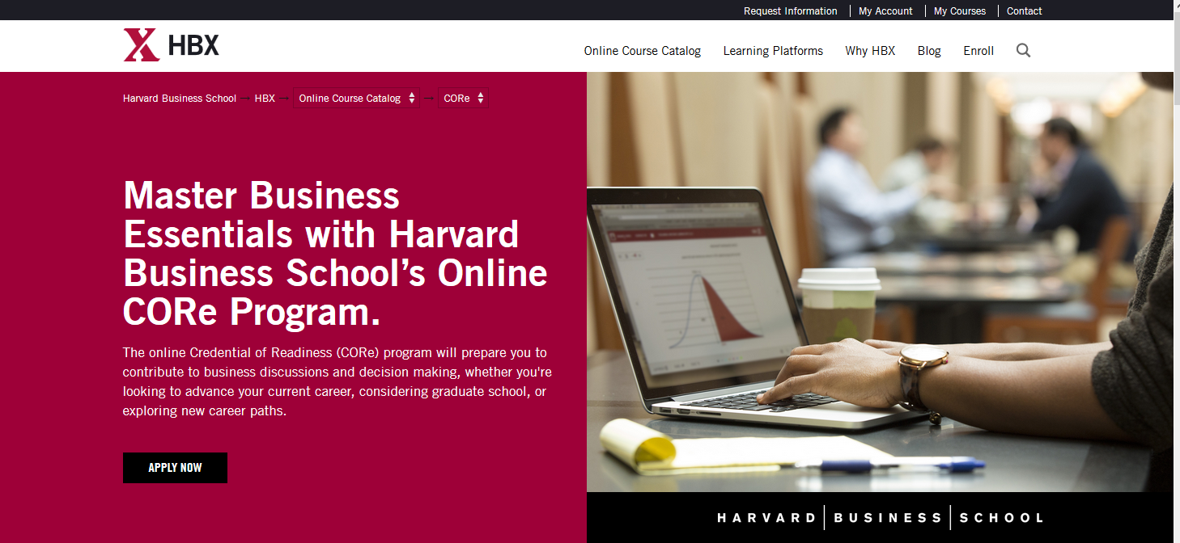
Weirdness #5…MOOCs in Wedding Announcements September 26, 2018 The Future of Professional Credentialing ... in an Engagement Announcement Joshua Kim, Inside Higher Ed https://www.insidehighered.com/digital-learning/blogs/technology-and-learning/future-professional-credentialing-engagement

Slide 14
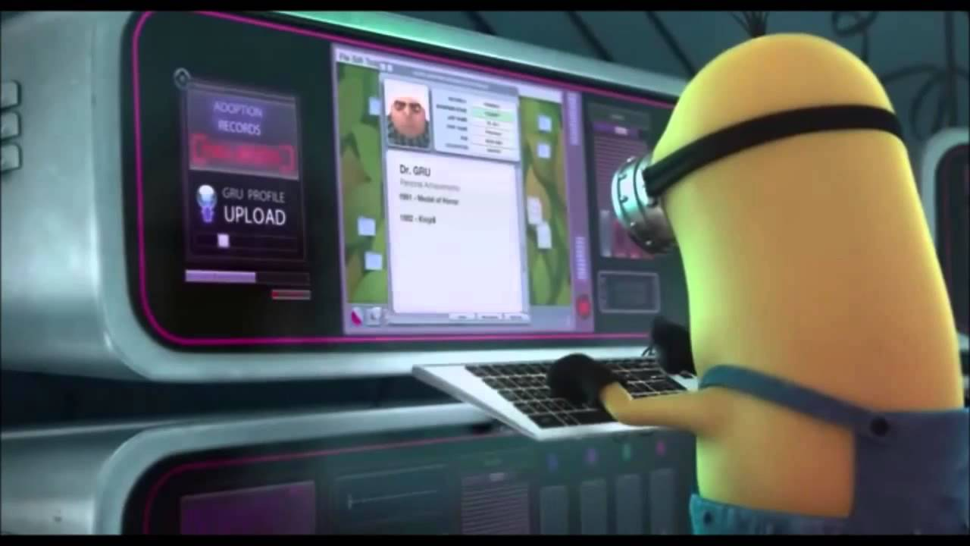
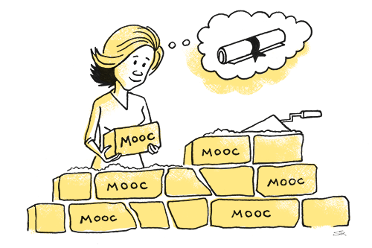
Weirdness #6…The MOOC Wave May 21, 2018 The Second ave of MOOC Hype Is Here, and It’s Online Degrees Dhawal Shah, Class Central https://www.edsurge.com/news/2018-05-21-the-second-wave-of-mooc-hype-is-here-and-it-s-online-degrees

Slide 15
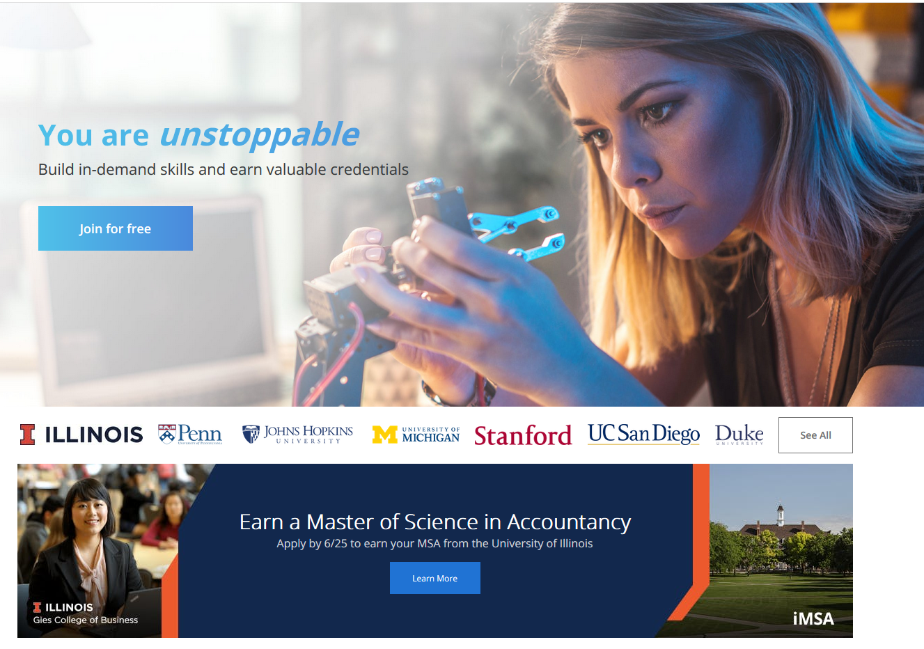
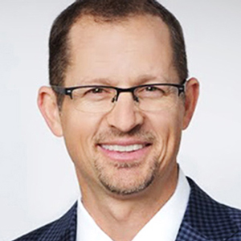
September 12, 2018 Coursera's CEO on the Evolving Meaning of 'MOOC’ Dian Schaffhauser, Campus Technology https://campustechnology.com/articles/2018/09/12/courseras-ceo-on-the-evolving-meaning-of-mooc.aspx
Jeff Maggioncalda, Coursera CEO

Slide 16
October 12, 2018 Weirdness #7…Degrees Via the MOOC EdX: From MicroMasters to Online Master’s Degrees Lindsey McKenzie, Inside Higher Ed https://www.insidehighered.com/news/2018/10/12/edx-launches-nine-low-cost-online-degrees

Slide 17
Weirdness #8…
MOOC-based Pricing Charts December 30, 2018 MOOC-Based Degrees, Pricing Chart IBL News https://www.class-central.com/pricing-charts/mooc-based-degrees

Slide 18
Weirdness #9…
Discounted MOOC-based MBAs August 7, 2017 FutureLearn and Coventry University to Roll Out 50 Online Degrees (Last year Deakin University announced a similar partnership with FutureLearn) Class Central, Dhawal Shah https://www.class-central.com/report/futurelearn-coventry-university-roll-50-online-degrees/

Slide 19
Weirdness #10…Stackable Degrees January 20, 2019 Stackability is a Learning Strategy
Matthew Rascoff and James DeVaney, Inside Higher Ed https://www.class-central.com/report/futurelearn-coventry-university-roll-50-online-degrees/

Slide 20
December 7, 2018 Reinventing the College Degree: A Future with Modular Credentials IBL News https://iblnews.org/2018/12/07/reinventing-the-college-degree-a-future-with-modular-credentials/

Slide 21
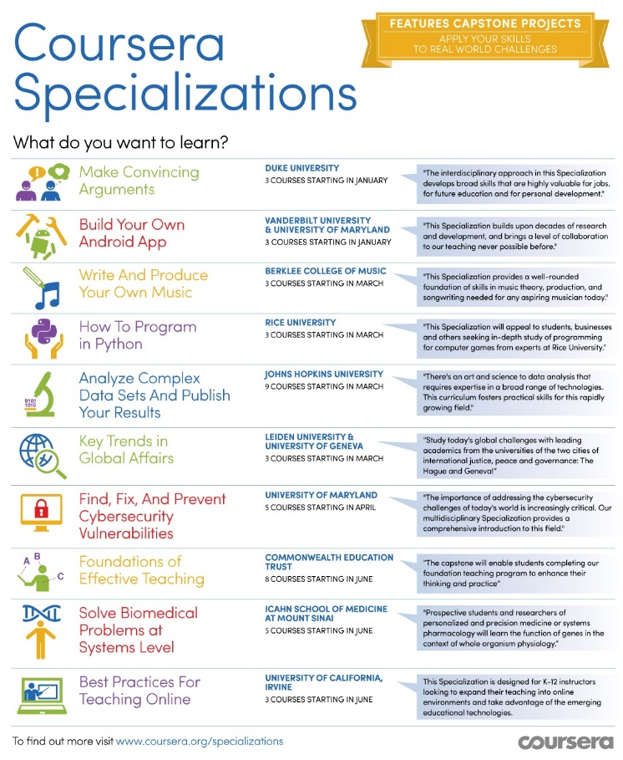
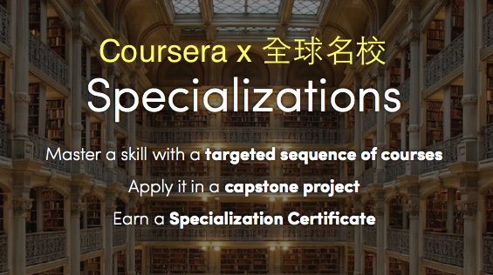
January 20, 2016 Coursera Specializations https://www.coursera.org/browse?utm_medium=email&utm_source=marketing&utm_campaign=aUAR4L-fEeW6i-NodUB9Qw&languages=en

Slide 22
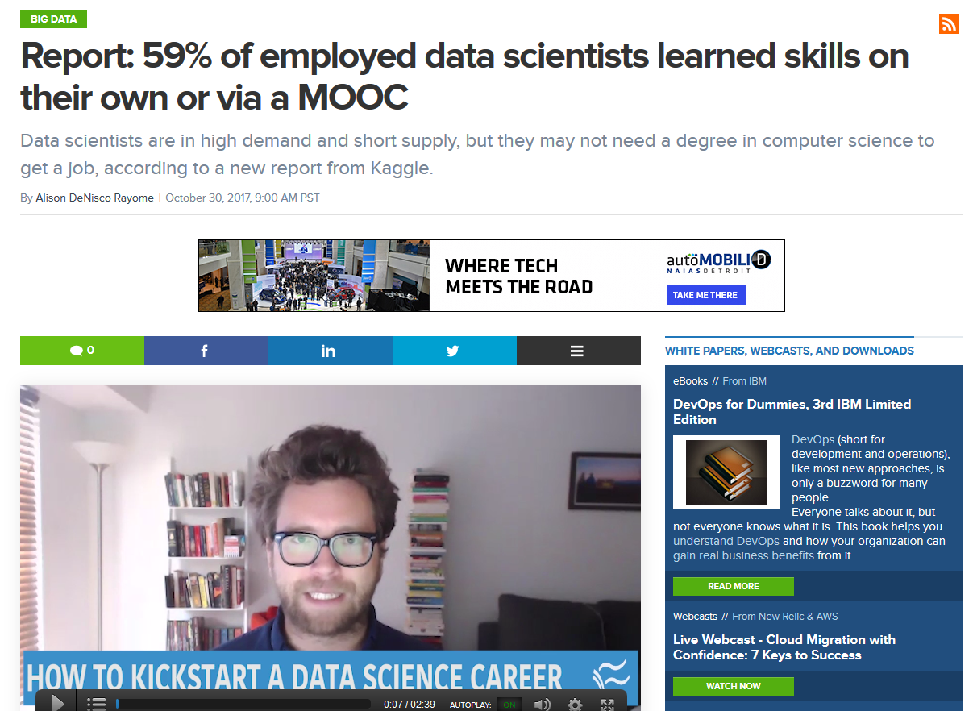
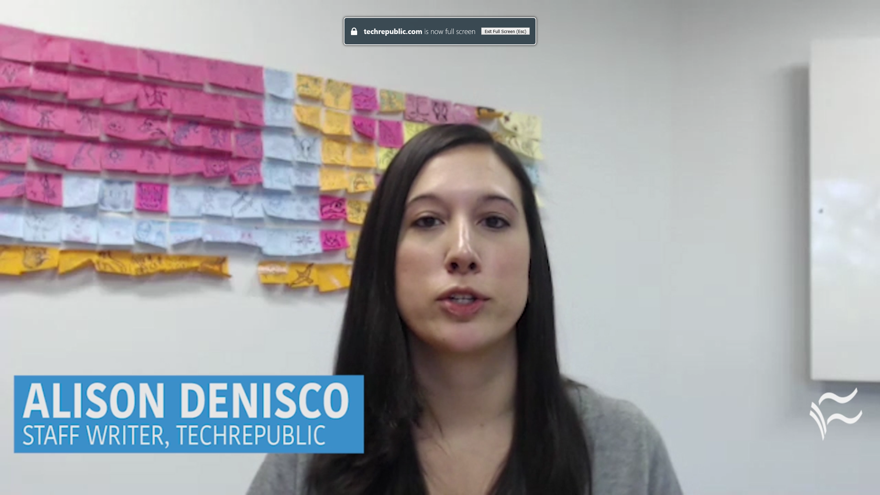
October 30, 2017 MOOCs ramp up new fields Report: 59% of employed data scientists learned skills on their own or via a MOOC Alison DeNisco Rayome https://www.techrepublic.com/article/report-59-of-employed-data-scientists-learned-skills-on-their-own-or-via-a-mooc/

Slide 23
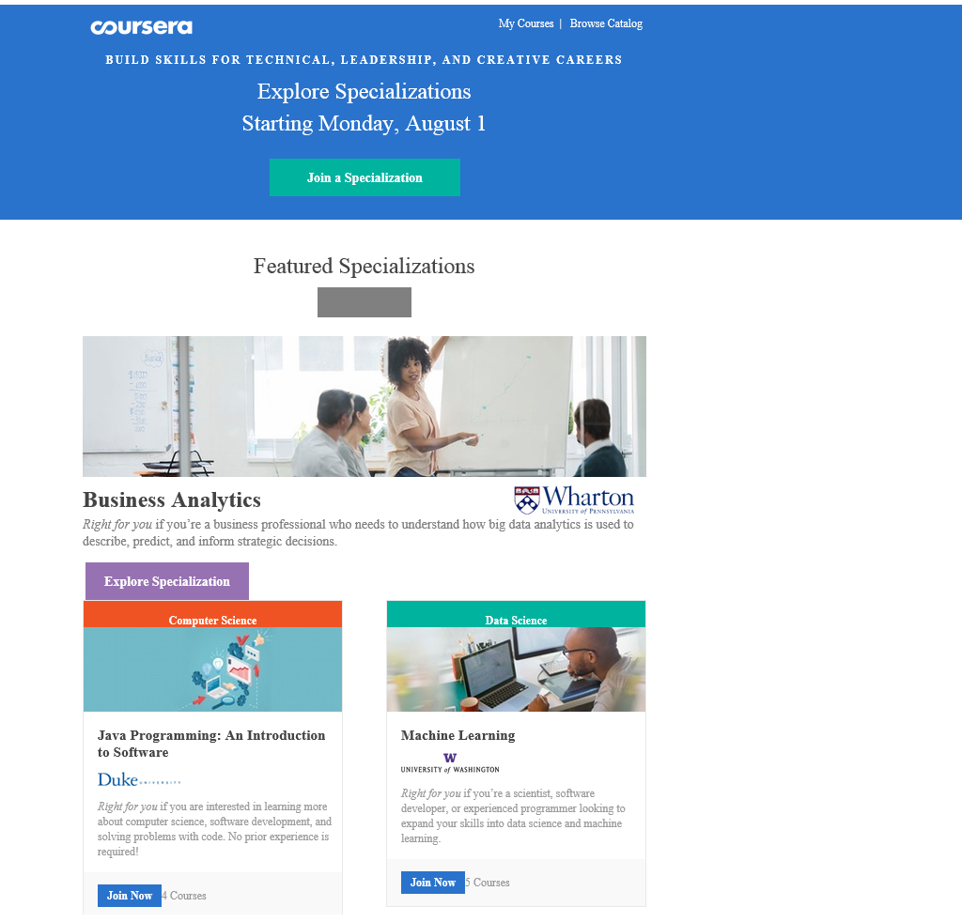
October 12, 2018 Microcredentials and Nanodegrees Learning is More on Modular edX Expands MicroMasters Programs With Data Science (“nanodegrees”) Digital Leadership and More, Sri Ravipati, Campus Technology https://campustechnology.com/articles/2017/03/01/edx-expands-micromasters-programs-with-data-science-digital-leadership-and-more.aspx Lindsey McKenzie, Inside Higher Ed https://www.insidehighered.com/news/2018/10/12/edx-launches-nine-low-cost-online-degrees

Slide 24
January 9, 2018 MicroMaster’s Degrees Learning is More on Modular MIT launches MITx MicroMasters in Principles of Manufacturing, MIT Open Learning http://news.mit.edu/2018/mit-launches-new-mitx-micromasters-program-principles-manufacturing-0109

Slide 25
March 4, 2019 35+ Legit Master’s Degrees You Can Now Earn Completely Online Laurie Pickard, Class Central https://www.class-central.com/report/mooc-based-masters-degree/

Slide 26
February 27, 2019 MOOCs and the Master's Degree Dian Schaffhauser, Campus Technology https://campustechnology.com/articles/2019/02/27/moocs-and-the-masters-degree.aspx

Slide 27
MOOC Trends and Recent Data

Slide 28
MOOCs are not dead August 19, 2018 Cumulative Growth in Number of MOOCs, 2011-18 Almanac 2018, Chronicle of Higher Education https://www.chronicle.com/article/Top-5-MOOC-Providers-by-Number/244090?cid=cp216

Slide 29
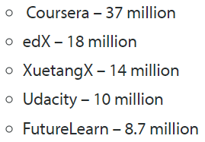
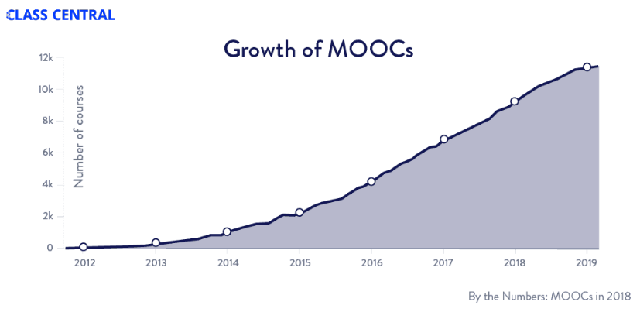
MOOCs Trends
Year of MOOC-based Degrees: A Review of MOOC Stats and Trends in 2018, Dhawal Shah, Class Central--January 6, 2019
Top five MOOC providers

Slide 30
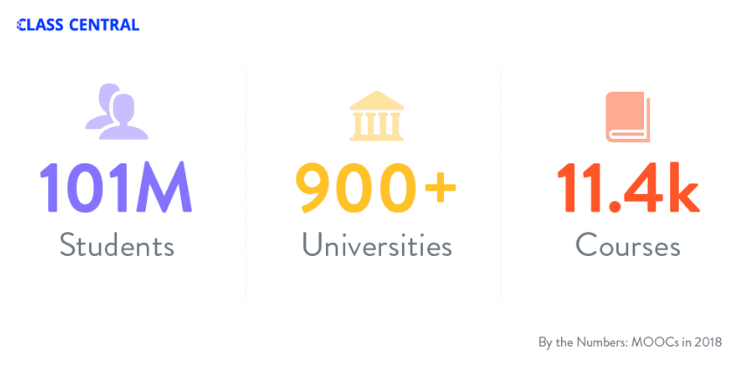
MOOCs Stats
Year of MOOC-based Degrees: A Review of MOOC Stats and Trends in 2018, Dhawal Shah, Class Central--January 6, 2019

Slide 31
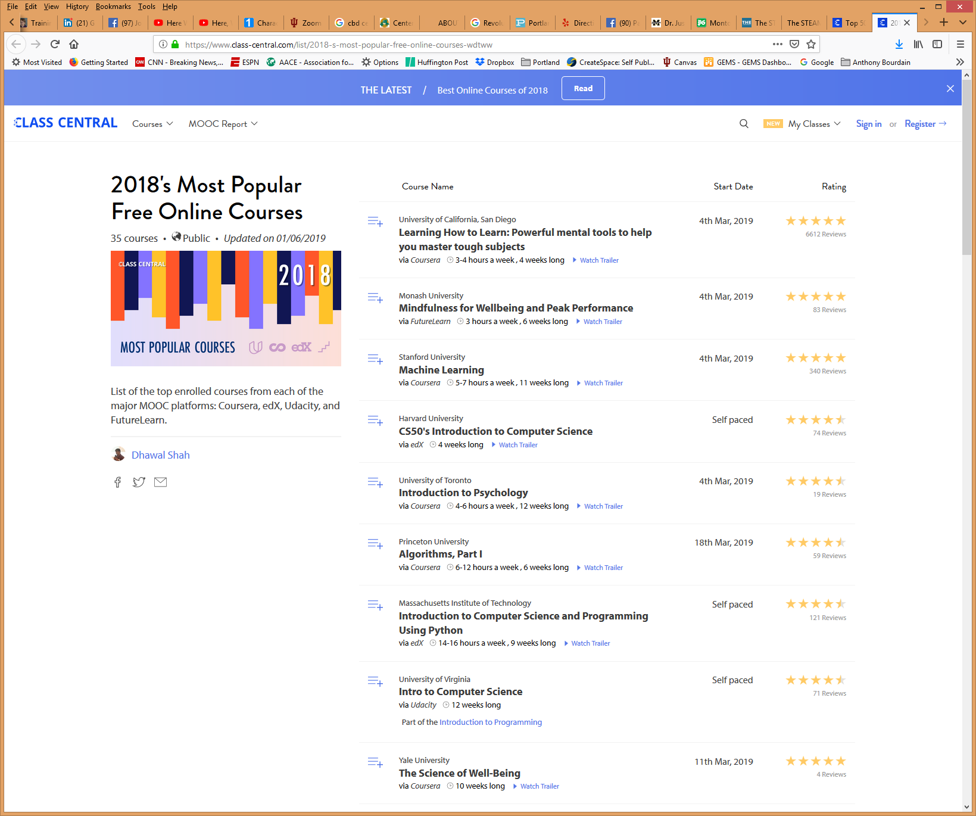
MOOCs Stats
2018's Most Popular Free Online Courses, : Coursera, edX, Udacity, and FutureLearn.
Dhawal Shah, Class Central--January 6, 2019
https://www.class-central.com/list/2018-s-most-popular-free-online-courses-wdtww

Slide 32
MOOCs Stats
2018's Most Popular Free Online Courses: Coursera, edX, Udacity, and FutureLearn.
Dhawal Shah, Class Central--January 6, 2019
https://www.class-central.com/list/2018-s-most-popular-free-online-courses-wdtww

Slide 33
June 19, 2018 How Blockbuster MOOCs Could Shape the Future of Teaching Jeffrey R. Young, EdSurge https://www.edsurge.com/news/2018-06-19-how-blockbuster-moocs-could-shape-the-future-of-teaching

Slide 34
MOOC Research

Slide 35
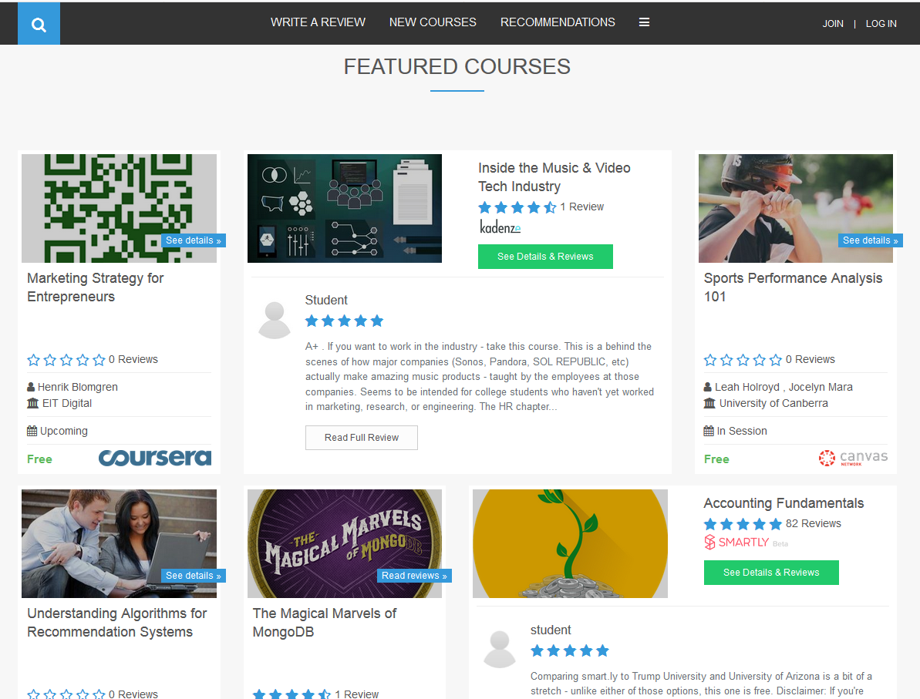
Khe Foon (Timothy) Hew (2018) Hew, K. F. (2018). Unpacking the Strategies of Ten Highly Rated MOOCs: Implications for Engaging Students in Large Online Courses. Teachers College Record, 120(1). https://www.coursetalk.com/
Hew’s (2018, p. 1) analyzed 4,565 coursetalk review comments of 10 highly rated MOOCs. He found “six key factors that can engage online [MOOC] participants and nine reasons for participant disaffection.”
Problem-centric learning supported by clear explanations.
Active learning supported by timely feedback (e.g., assignments, projects, discussion).
Course resources that cater to participants’ learning needs or preferences.
Instructor attributes (e.g., passion, enthusiasm, humor, variety of examples).
Peer interaction.
Instructor availability.

Slide 36
Quotes: Veletsianos et al. (2015-2016)
“To gain a deeper and more diverse understanding of the MOOC phenomenon, researchers need to use multiple research approaches (e.g., ethnography, phenomenology, discourse analysis) add content to them.” (p. 583)
Veletsianos, Collier, & Schneider (2015, May), Digging deeper into learners’ experiences in MOOCs: Participation in social networks outside of MOOCs, notetaking and contexts surrounding content consumption. BJET, 46(3), 570-587.
“Dependence on Particular Research Methods May Restrict our Understanding of MOOCs.”
George Veletsianos & Peter Shepherdson’s Study (2016). Systematic Analysis and Synthesis of the Empirical MOOC Literature Published in 2013-2015. IRRODL. http://www.irrodl.org/index.php/irrodl/article/view/2448/3655

Slide 37
MOOCs Literature Review (2014-2016)
(Meina, Sari, & Lee, 2018)
MOOC research focuses and methods
 | Quantitative | Qualitative | Mixed methods
Student-focused | 39 | 9 | 26
Design-focused | 19 | 12 | 17
Context and impact | 9 | 6 | 5
Instructor-focused | 0 | 3 | 2

Slide 38
Research Methods (Meina, Sari, & Lee, 2018)
Figure 2. Research methods used in empirical MOOCs studies from 2013-2018 (N=321 studies)

Slide 39
Research Project:
Problem statement
Research questions
Methodology
Research findings
Conclusions

Slide 40
Problem Statement
Key beneficiaries of MOOCs are online learners.
Research on MOOCs has almost focused on learners including their experiences, motivations, interaction patterns, and learning outcomes.
What about MOOC instructors?

Slide 41
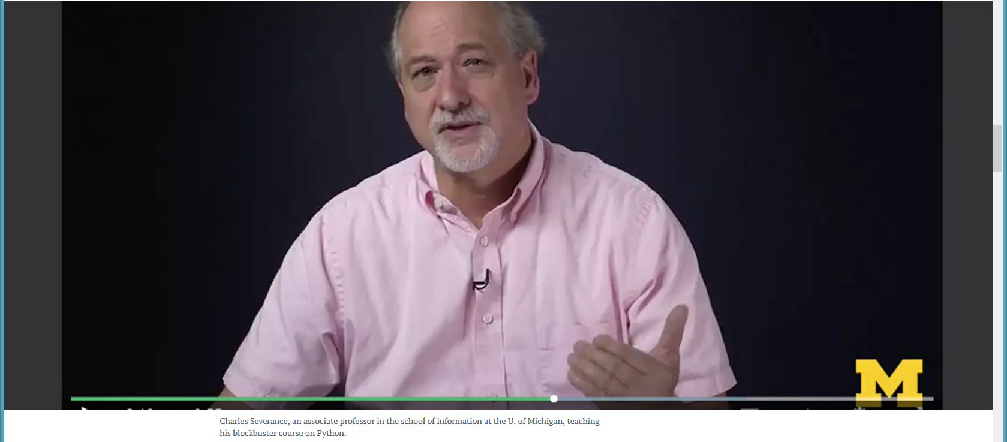
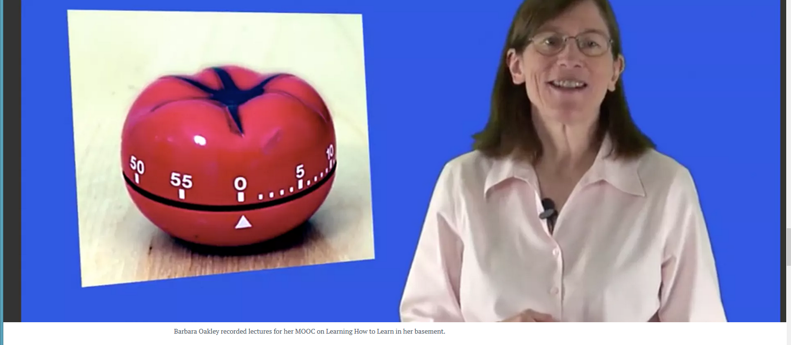
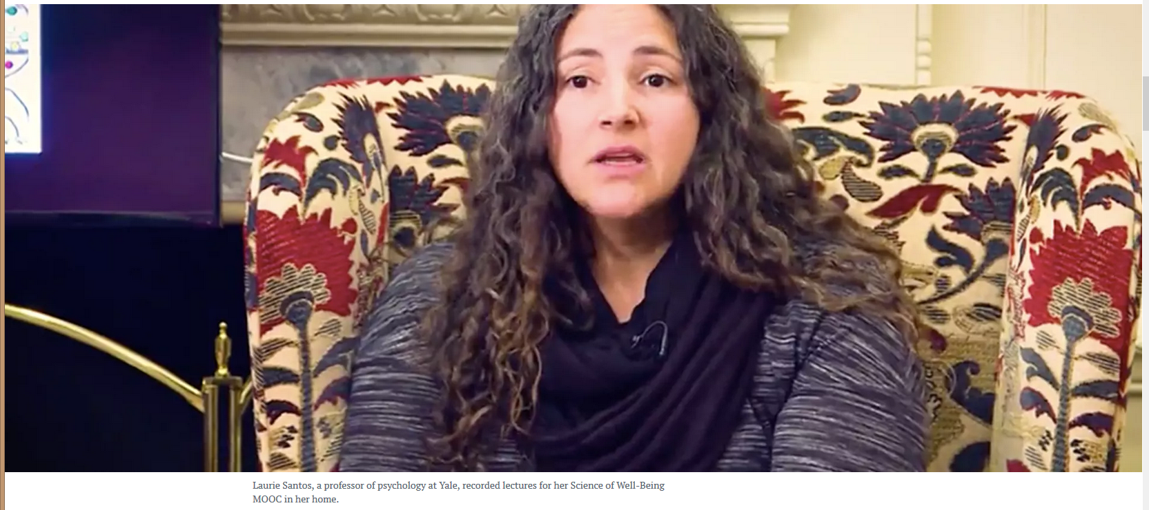
June 19, 2018 How Blockbuster MOOCs Could Shape the Future of Teaching Jeffrey R. Young, EdSurge https://www.edsurge.com/news/2018-06-19-how-blockbuster-moocs-could-shape-the-future-of-teaching

Slide 42
Research questions
The purpose of this study is to suggest ways to encourage instructors to teach MOOCs by investigating their motivations and frustrations when teaching MOOCs.
What motivates instructors to teach MOOCs?
What aspects of teaching MOOCs influence instructors’ career development?
What areas do MOOC instructors want to improve for more effective teaching in terms of professional development?

Slide 43
Methodology

Slide 44
Methodology
A Mixed-Method approach
Survey & in-depth interview
Survey: 20 questions in 3 sections.
(1) Demographic info and MOOCs teaching experiences
(2) Motivation for teaching MOOCs
(3) Career and professional devel of MOOC instructors
3. Interview: 30 minutes
(1) MOOC teaching experiences
(2) Personal opinions about MOOC teaching in terms of motivation and career development

Slide 45
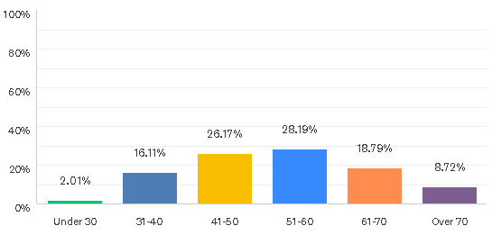
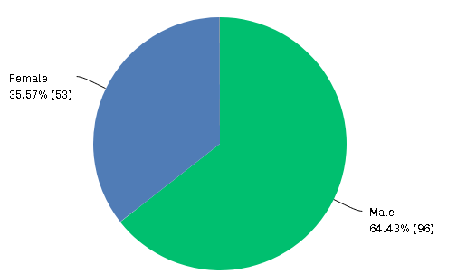
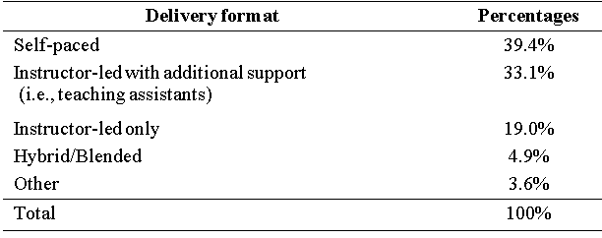
Methodology
Survey Participants : 142 MOOC instructors

Slide 46
Methodology
2. Interview Participants : 6 MOOC instructors

Slide 47
Research Findings

Slide 48
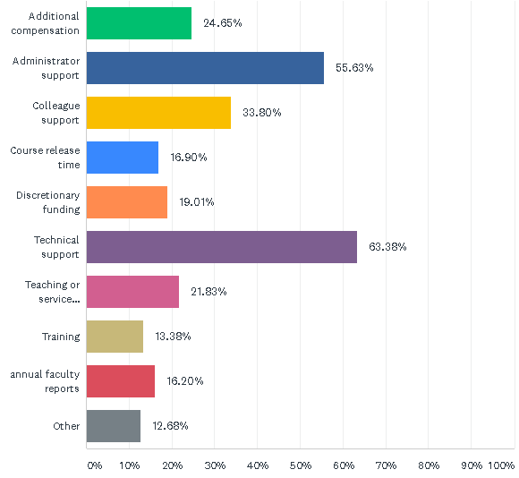
1. Support for teaching MOOCs

Slide 49
2. Motivation for teaching MOOCs

Slide 50
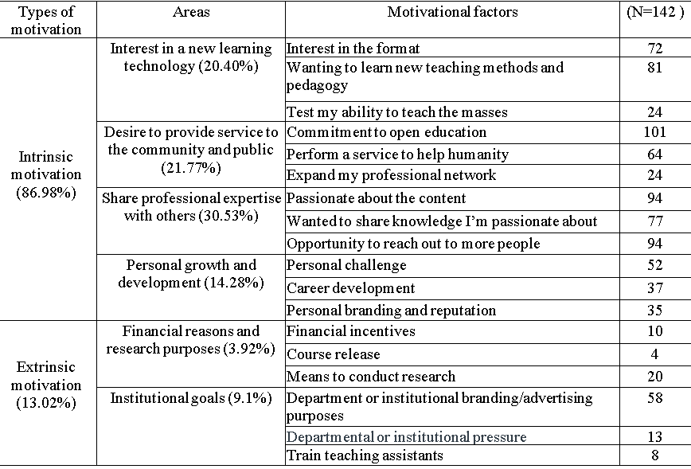
2. Motivation for teaching MOOCs

Slide 51
Quote from an interviewee:
“What happened is that on August 2017, there were suddenly a number of hurricanes approaching the United States. So, I helped them. In a period of two weeks [I] built a MOOC on hurricanes. Because of the timing, because there was so much hurricane news, this MOOC was reasonably popular. With about 5,000 viewers, so it was quite a good experience for me.”

Slide 52
Quote from an interviewee:
“I think most of the universities are interested in getting more students. I think, maybe in the future, some of those people (who took MOOCs offered by our institution) might apply for a Ph.D program here.”

Slide 53
Quote from an interviewee:
Similarly, another MOOC instructor in the UK added: “We hope that some of them will be so interested in our university that they will apply to us and come and study here. That's probably what we call it−advertisement. This raises the kind of university profile, and we hope, if these 1,000,000 people turn up here and take degrees, it pays off. It is helping the reputation of [the] university.”

Slide 54
3. Expected benefits of teaching MOOCs

Slide 55
Quote from an interviewee:
“I think it [teaching MOOCs] helped me to learn how to teach at the level which was a lot lower than university students. What is different is that we pitched at a different level, so I wanted (in the pitch) the content to be understandable for a 14-year-old rather than to academic students. I think that maybe it is better about how we give information to the public about our research and our teaching, so I think my own language style was changed.”

Slide 56
Quote from an interviewee:
“Most of MOOC participants are public. I mean, so we also have people [who] didn't have [a degree]; only a few had been educated to a degree or master's degree or Ph D. So, we have to make it understandable and I think that it's a good thing to learn [as an instructor] because all of our research should be understandable, and teaching should be understandable. I think sometimes we can hide behind clever words rather than teaching these things [that] can be easily understood.”

Slide 57
Quote from an interviewee:
“I was identified as an innovator in technology, so I do use various technologies in my teaching. I've been one of first persons to do [a MOOC] at the university, and I think that is an advantage. That [is a] characterization of me. So when I did go for promotion and I used MOOC parts of the show, I was, you know, using different ways of using teaching and technology. So I think it helped to enhance how I served on teaching and learning and research committee[s] about [the] digital forum—so because of some of the work I've done already.”

Slide 58
4. How did participants learn about creating MOOCs

Slide 59
5. The ways of helping or training other MOOC Instructors

Slide 60
Areas for improvement
“I think we could've done a better job with the filming. So just from a technical aspect, that's something that we could improve on. I would like to increase that documentary feel of the MOOC. I don't like the MOOCs that are just a lecture being filmed, which I find those less interesting.”

Slide 61
Areas for improvement
“I think some of the things about interesting activities [is] students participate. Otherwise, they feel really bored just watching videos and presentation[s]. They need interaction; they need to be involved and I think it's quite hard to keep people engaged, especially when they're working. We did some training on filming, so…a professional came in and told us how to be so on camera performance things like that which is quite helpful.”

Slide 62
Areas for improvement
“I could probably improve the assessment. I don't know how much students get out of it. The purpose of assessment in regular classes is two-fold, rank students and incentivize them to pay attention. I don't know whether we need [it in a MOOC]…It doesn't serve much of a purpose of MOOC compared to regular classes and which means that we used other ways—help them write papers or something could help them more is just that brings in technical challenges in terms of grading.”

Slide 63
Discussion

Slide 64
Discussion
Few MOOC instructors received training prior to their first MOOC teaching experience.
Instructors’ motivation to teach MOOCs were mostly explained by their intrinsic motivation.
Intrinsic motivation | Interest in new learning technology Service to the public and community Desire to promote subject matter Personal growth and development
Extrinsic motivation | Financial incentives and course release Research purposes Institutional goals

Slide 65
Discussion
3. A MOOC is perceived as an effective way to network with professionals who have the same academic interests.
4. Promoting the institutions’ interests was also found to be motivation for MOOC instructors.
5. Primary frustrations of MOOC instructors include…
- The low level of interaction with students
- Lack of recognition for the time for developing and teaching MOOCS
6. MOOC instructors wanted to learn more about how to deliver MOOCs effectively!

Slide 66
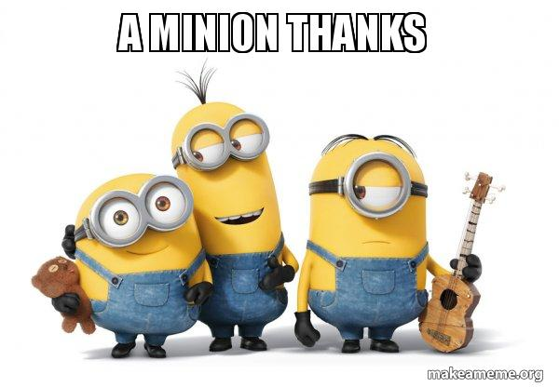
Thank you! Any Questions?
Curtis Bonk| cjbonk@Indiana.edu
Min Young Doo| scion2006@gmail.com
Meina Zhu| meinzhu@iu.edu
Ying Ting| yingtang@hku.hk
Slides at TrainingShare.com: http://www.trainingshare.com (go to “Archived Talks”)

