Slide 1
Concentration, Cafés, Coffee, and Collaboration: A Discussion of the Craft of Supportive Spaces for Academic Writing
Susie Gronseth Curtis J. Bonk Meina Zhu Tiffany Roman Dabae Lee Yeol Huh

Slide 2
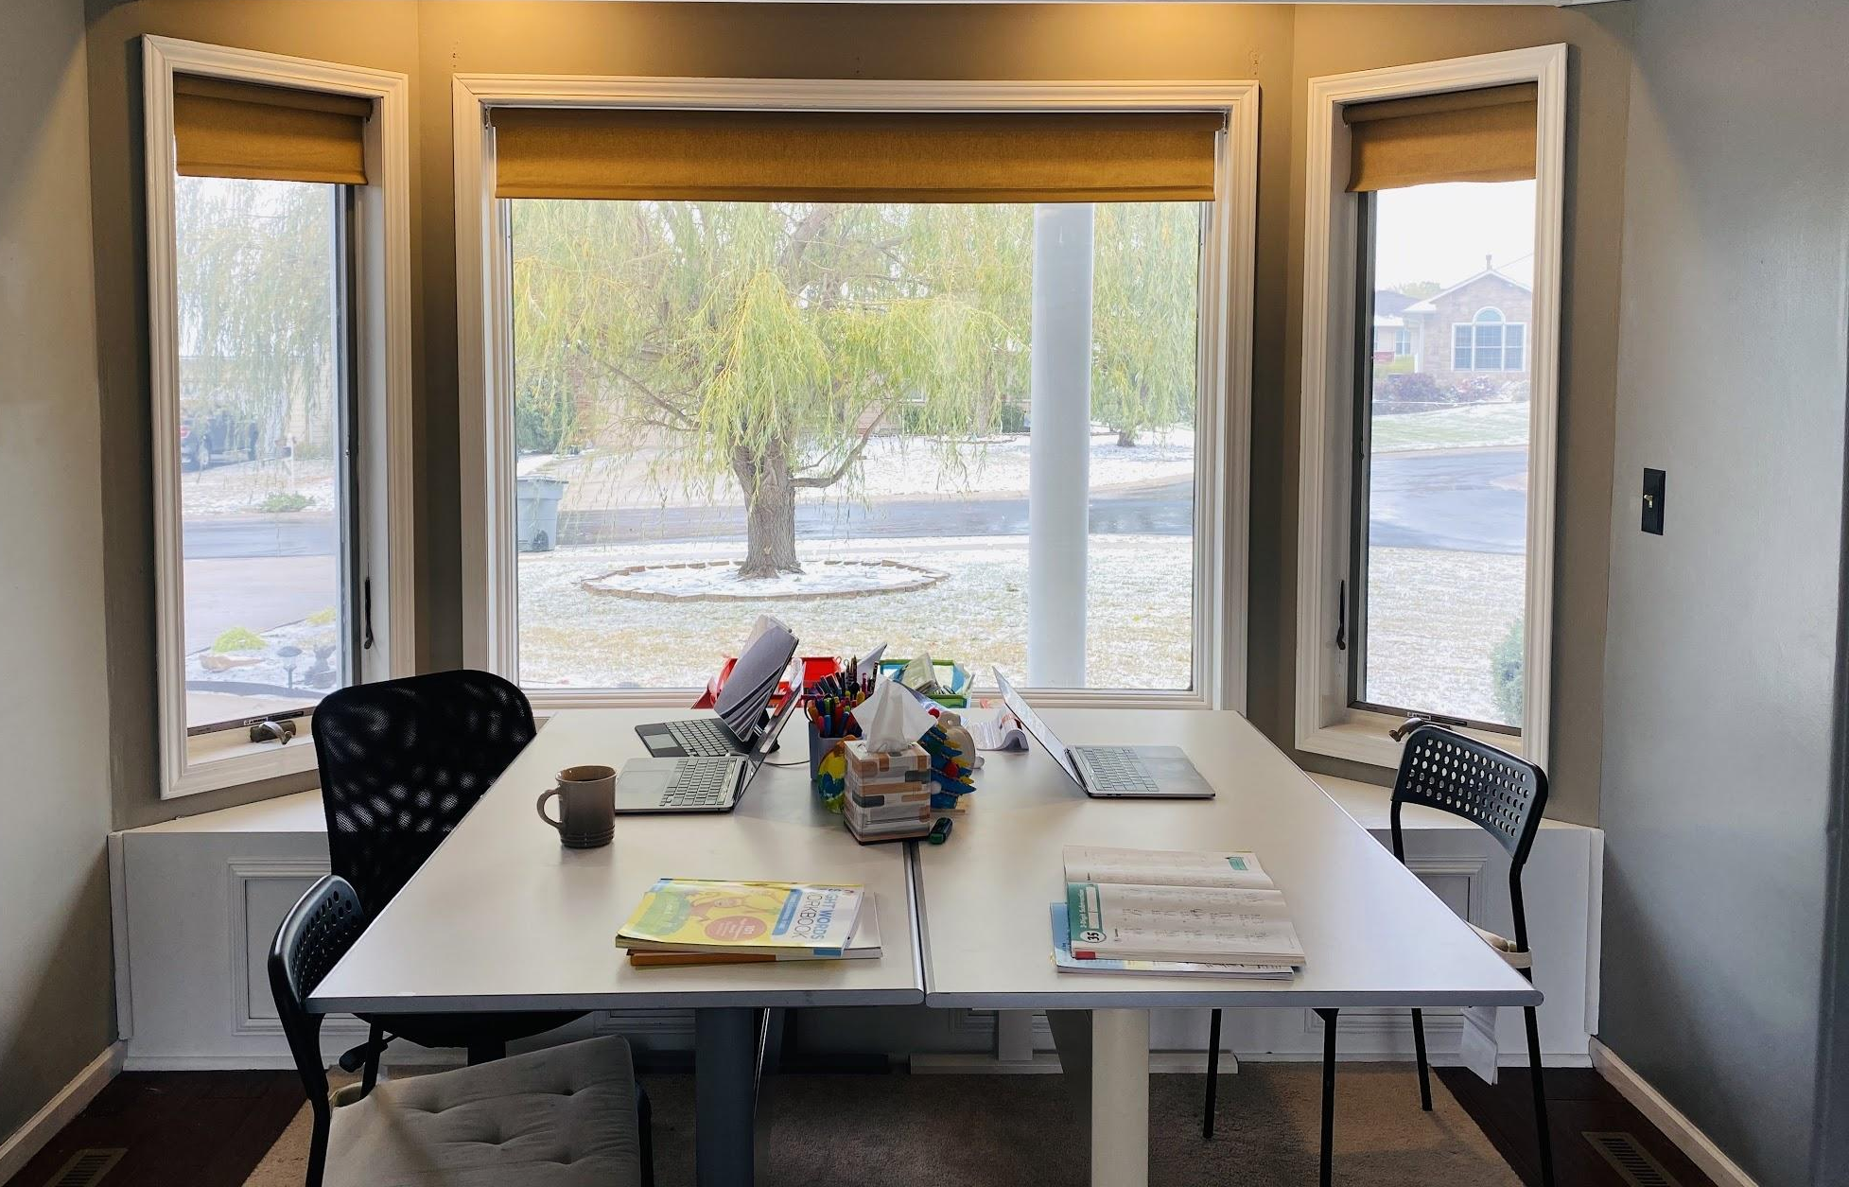
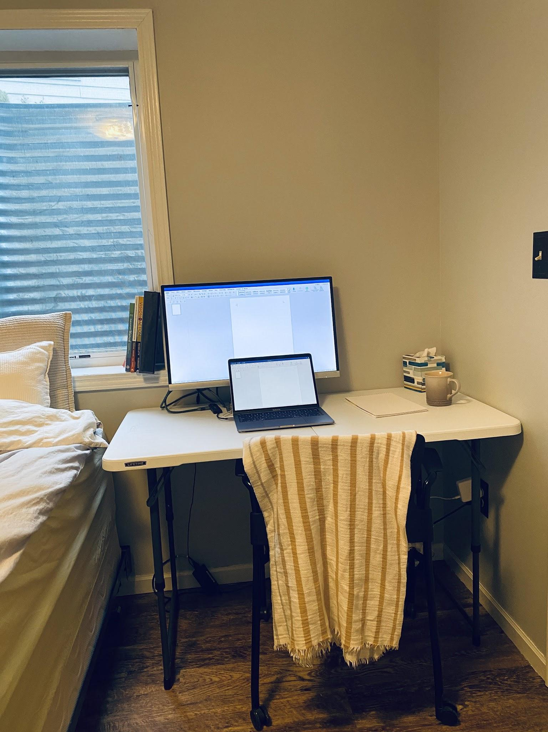
My Writing Spaces During the Pandemic
A writing space that I share with my family.
When I need to be alone -
A guest room in the basement.

Slide 3
Journal Review Process
Rejected
Editor
Assessment
Accepted
Sent to Author
Submission
Initial Screening
by Editor
Peer Review
Revision by Authors
Rejected

Slide 4
Journal Selection
The Journals in Instructional Technology
Educational Technology Journals (Peer Reviewed + SSCI)
Web of Science - Manuscript Matcher
Cabells Scholarly Analytics
Acceptance rate
Time to review
Call for papers
Notes:
Cabell’s
Go from your library’s webpage
Search for “Educational technology”
Filters
Disciplines: Educational Technology & Library Science
Call for Papers
More: Difficulty of Acceptance, Acceptance Rate
Sort: Acceptance Rate, Time to publication
<Copy and paste the following to Chat>
The Journals in Instructional Technology: http://designer.50g.com/journals.htm
Educational Technology Peer-Reviewed Journals: https://educationaltechnology.net/educational-technology-journals-peer-reviewed/
Web of Science (Manuscript Matcher): https://mjl.clarivate.com/home
Cabells Scholarly Analytics https://www2.cabells.com/journalytics

Slide 5
How Technology can Support your Writing
Before you start writing
Writing Templates
Microsoft Word - 6th
Google Docs Template
APA Sample Papers
Journal’s Template
While you are writing
EndNote+EndNoteClick (Kopernio)
Free: Mendeley & Zotero
EndNote:
Cite while you write
Manuscript Matcher
Kopernio: Add to EndNote
After your first draft
Grammarly
Grammarly Apps
Microsoft Word
Chrome
Grammar check
US vs. UK English
Notes:
Writing Templates
Microsoft Word -
EndNote:
Cite while you write: Word > EndNote> Preferences> KeyBoard
Cite while you write command: Insert Citations - Set the most convenient shortcut key.
Show how it works.
Manuscript Matcher
Kopernio
In Google Scholar > Type
collaboration intragroup conflict
Click on the journal’s webpage
Click on “View PDF”
Grammary
Website > Apps
Grammar check
Correctness -article, prepositions, and punctuation marks - commas, etc.
US vs. UK English for journal requirements
Copy and paste the following to Chat
Google Docs Template: http://sunybroome.info/library/guides/apa-and-mla-templates-google-docs
APA Sample Papers: https://apastyle.apa.org/style-grammar-guidelines/paper-format/sample-papers
EndNote Click: https://kopernio.com/
Grammarly Apps: https://app.grammarly.com/apps

Slide 6
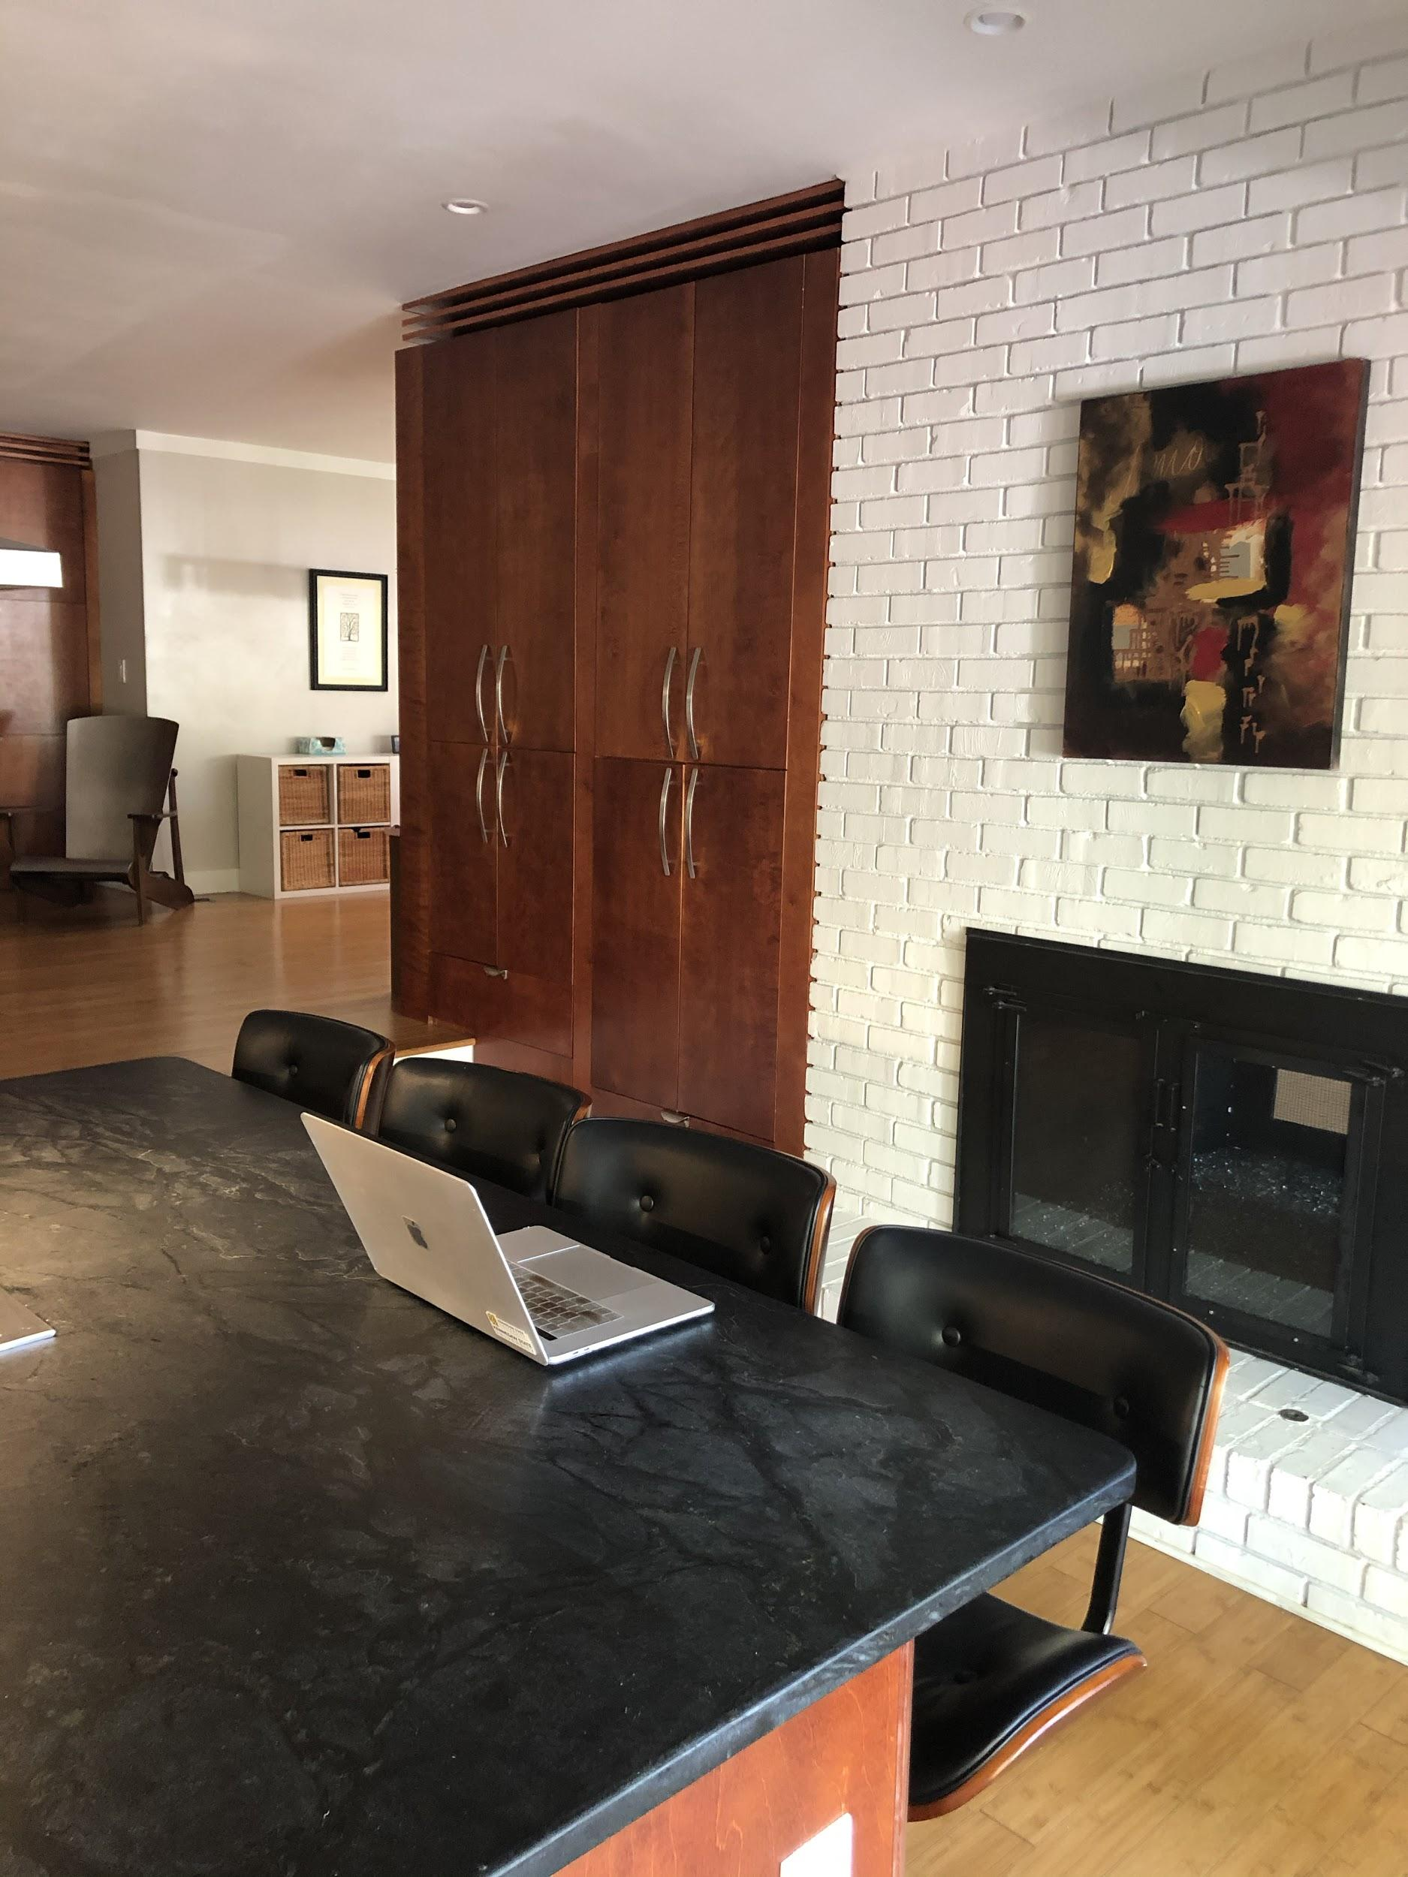
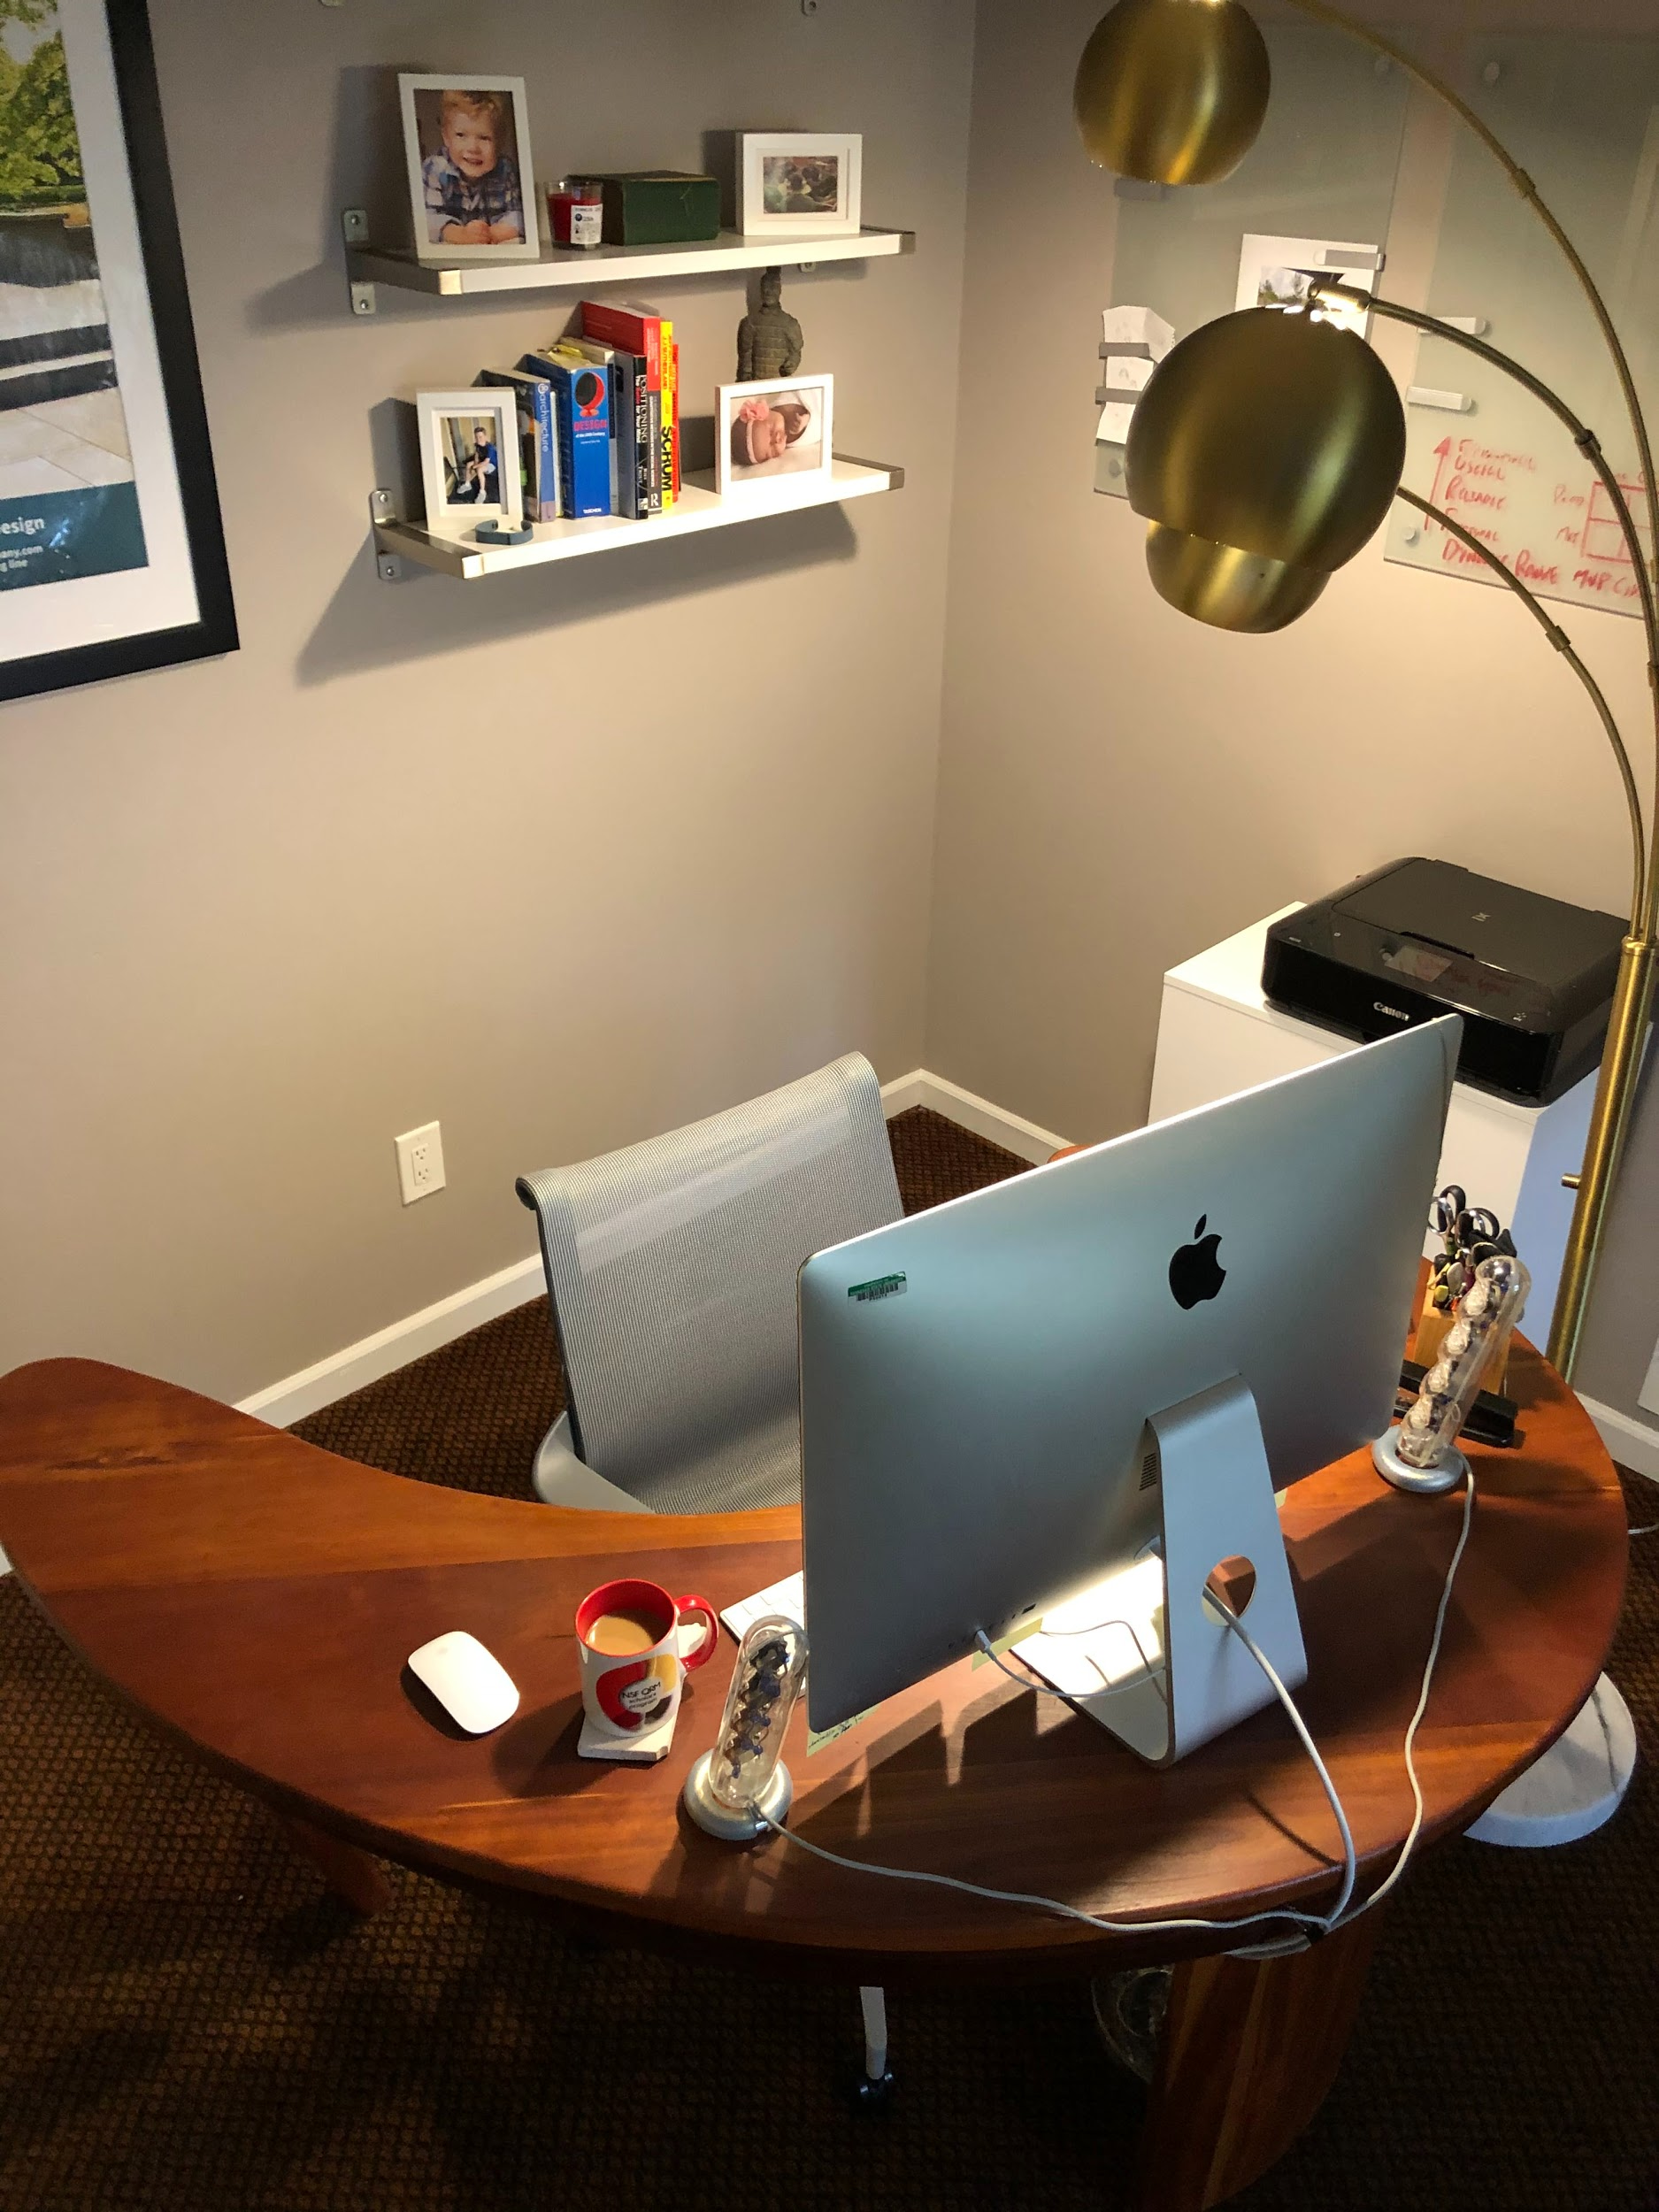
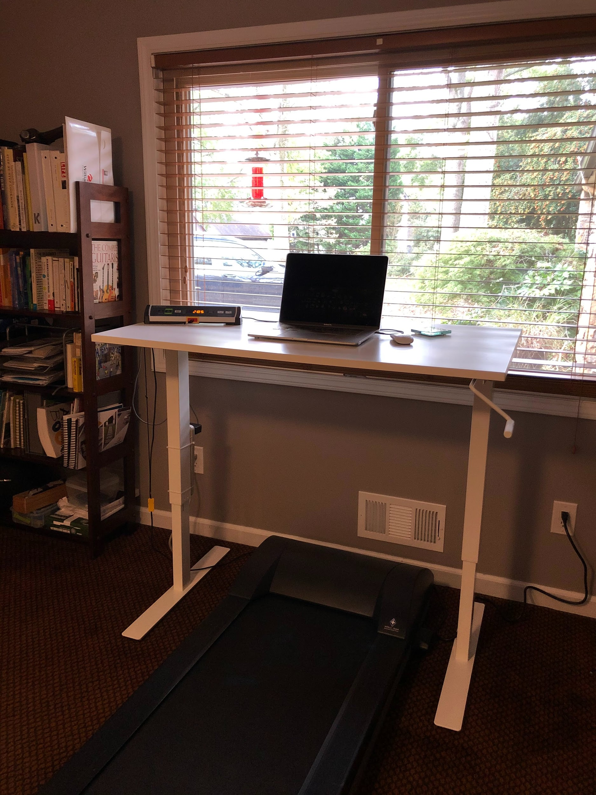
Dr. Tiffany Roman’s Writing Spaces During the Pandemic
Partner’s office space (*borrowing) Walk desk (treadmill base + IKEA desk) Barstool + Kitchen Countertop

Slide 7
Daily Writing Goals

Slide 8
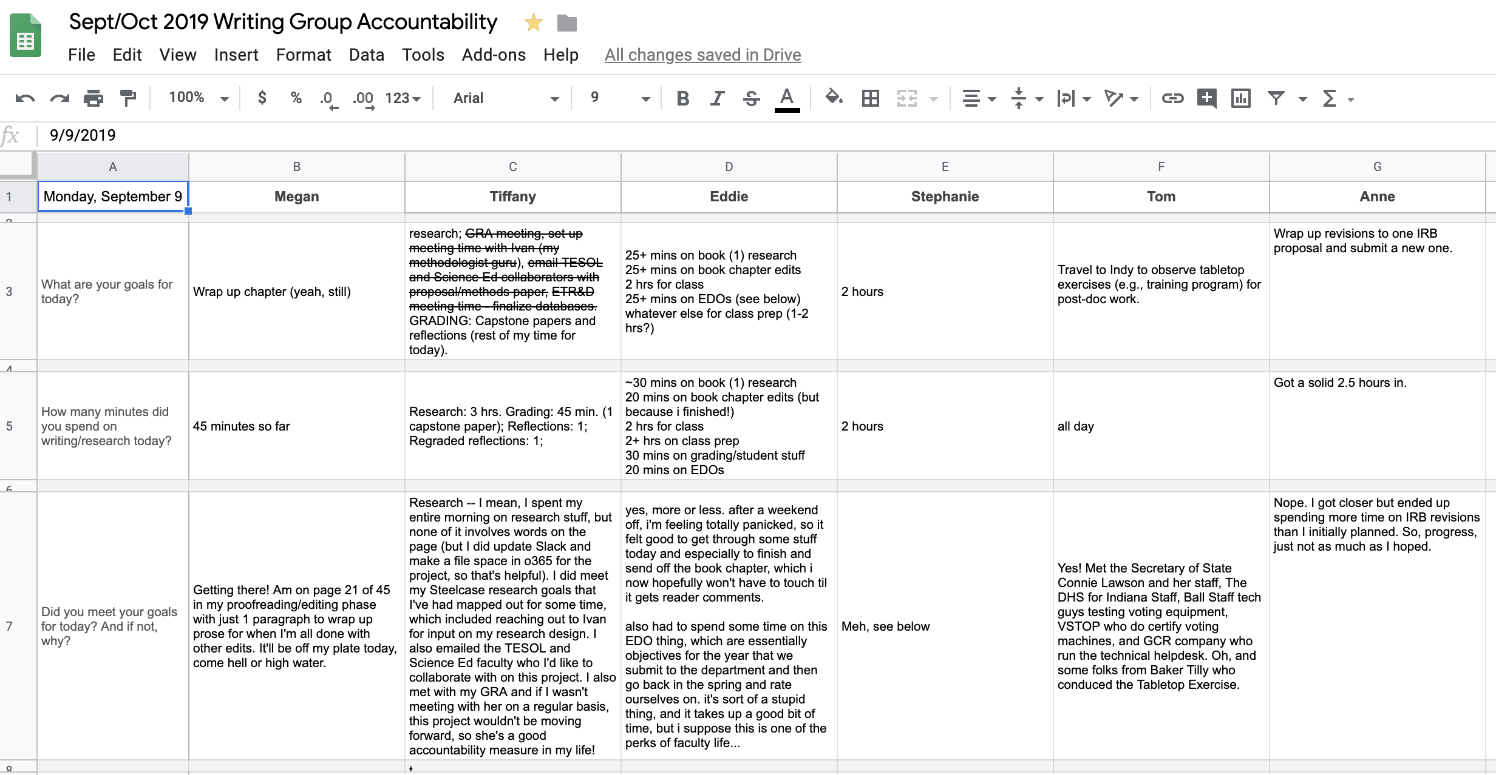
My virtual writing space

Slide 9
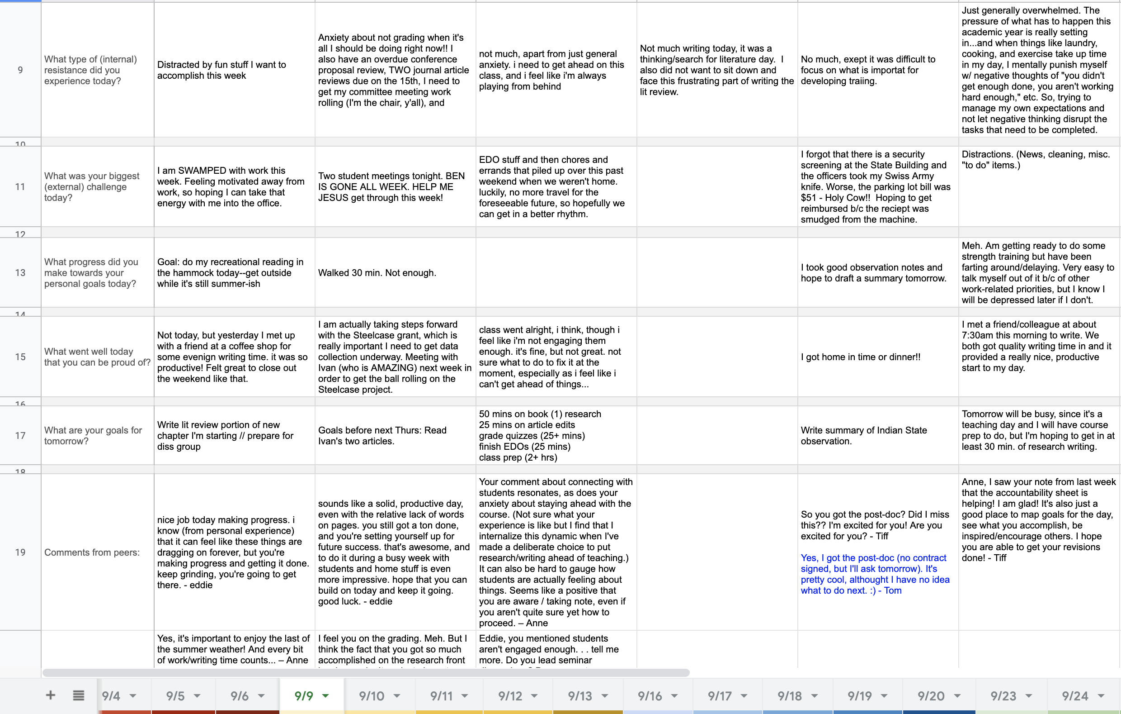

Slide 10
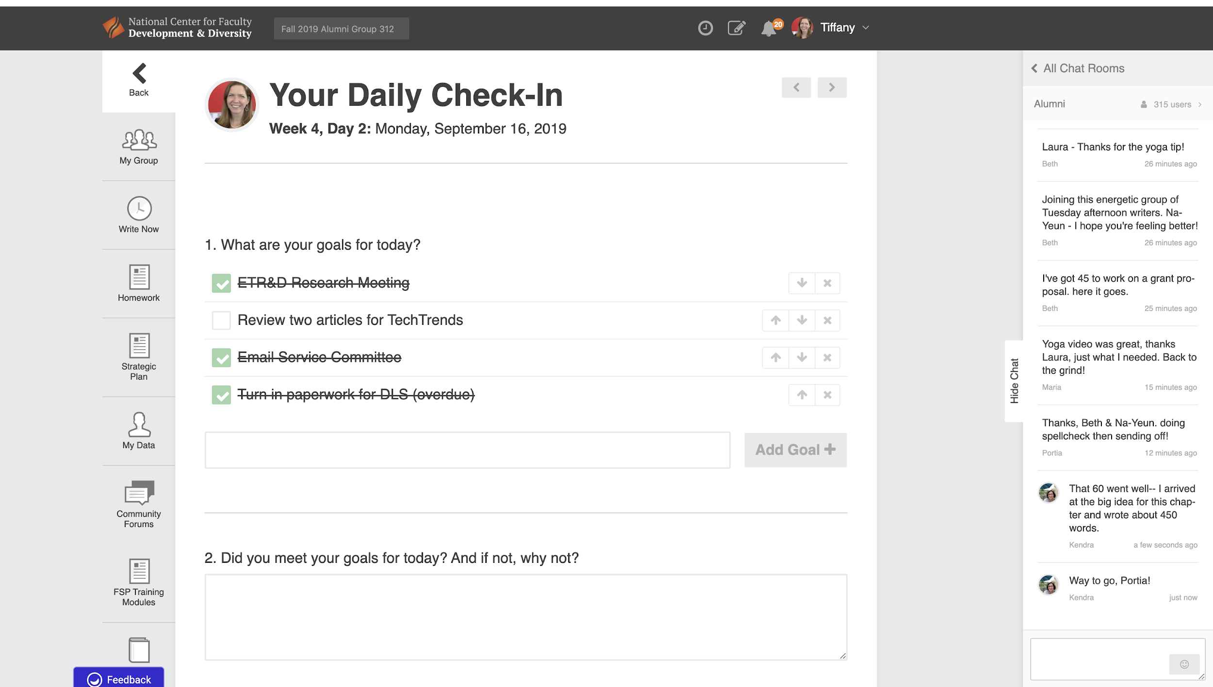
NCFDD writing space

Slide 11
National Center for Faculty Diversity and Development
Institutional Membership (you may have access)
12 week Dissertation Success Curriculum
Core curriculum webinars/recordings
Strategic planning a semester at a time
Establishing a Daily Writing Practice
14 day writing challenge (2x a year)
Writing accountability through forums as well

Slide 12
Core Curriculum

Slide 13
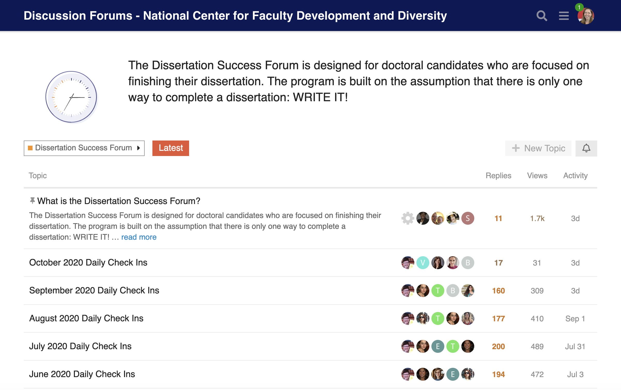
Dissertation Community

Slide 14
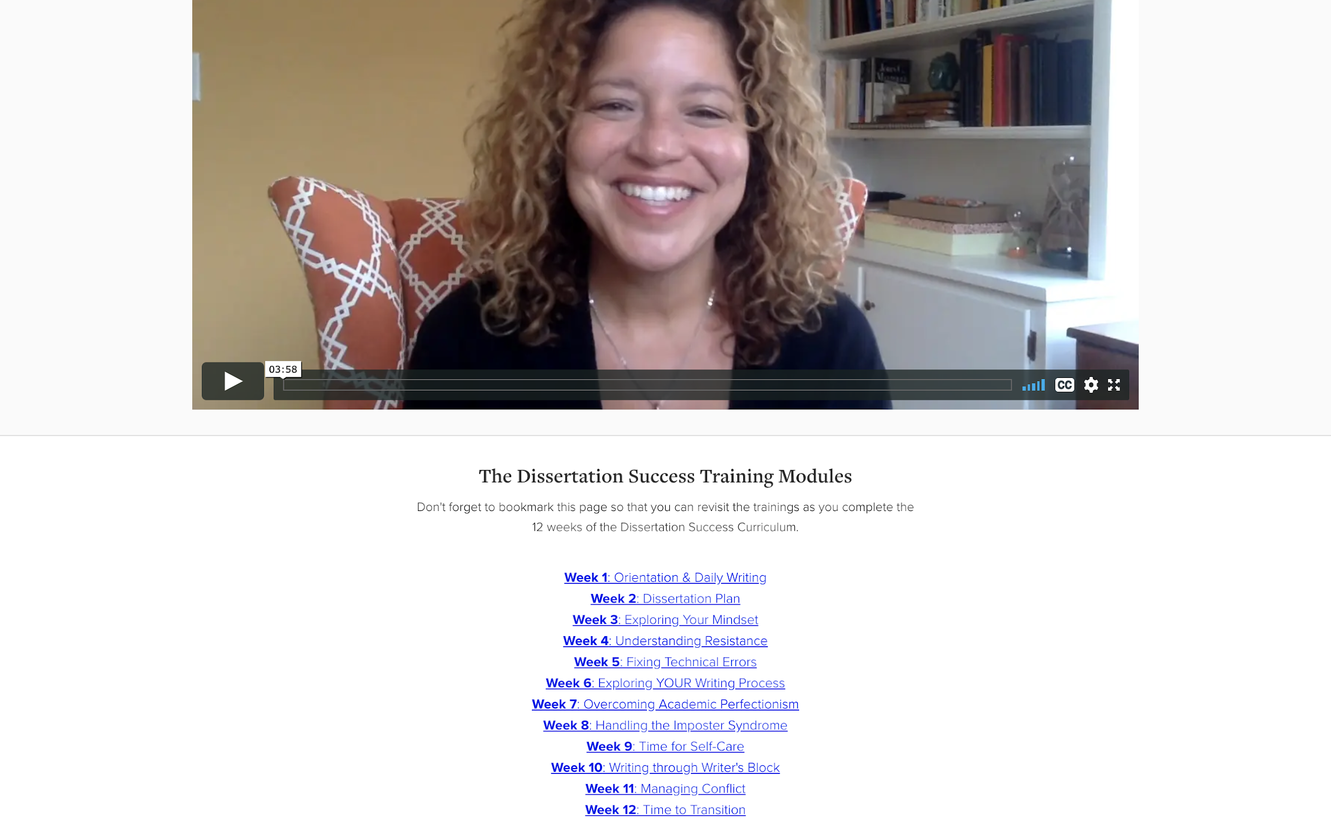
NCFDD

Slide 15
Planning

Slide 16
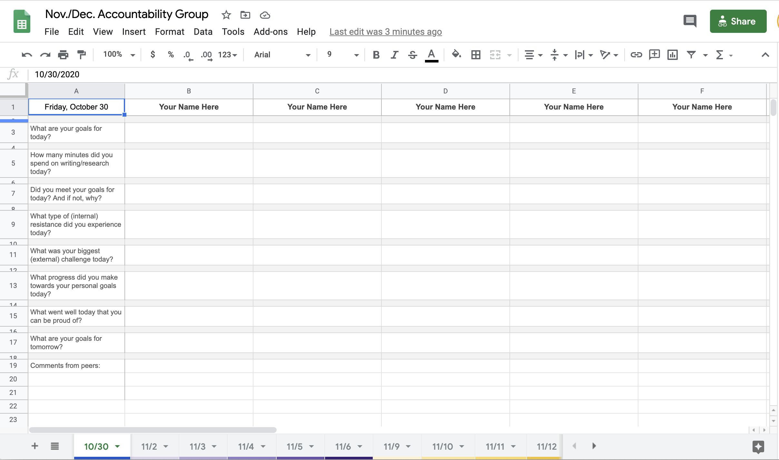
Your virtual community: bit.ly/AECT-GSA

Slide 17
Additional Support Groups

Slide 18
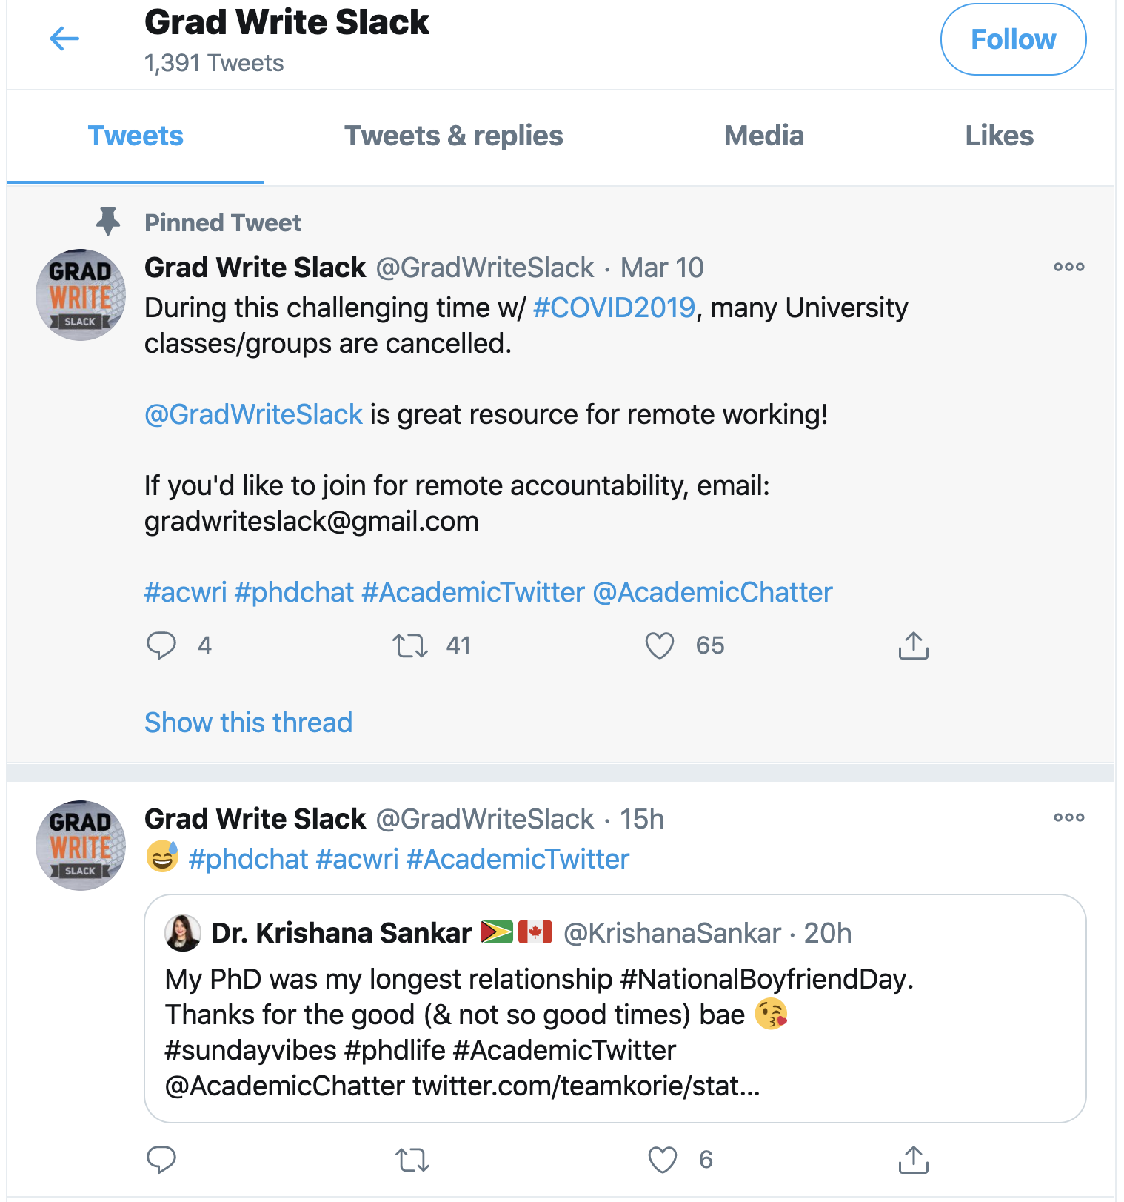
GradWriteSlack on Twitter
Notes:
Let’s take a second and follow Grad Write Slack on Twitter, shall we? Okay, click that blue link above.

Slide 19
GradWriteSlack on Slack
You must email a request to join.
Let’s take 3 minutes to do that now:
gradwriteslack@gmail.com

Slide 20
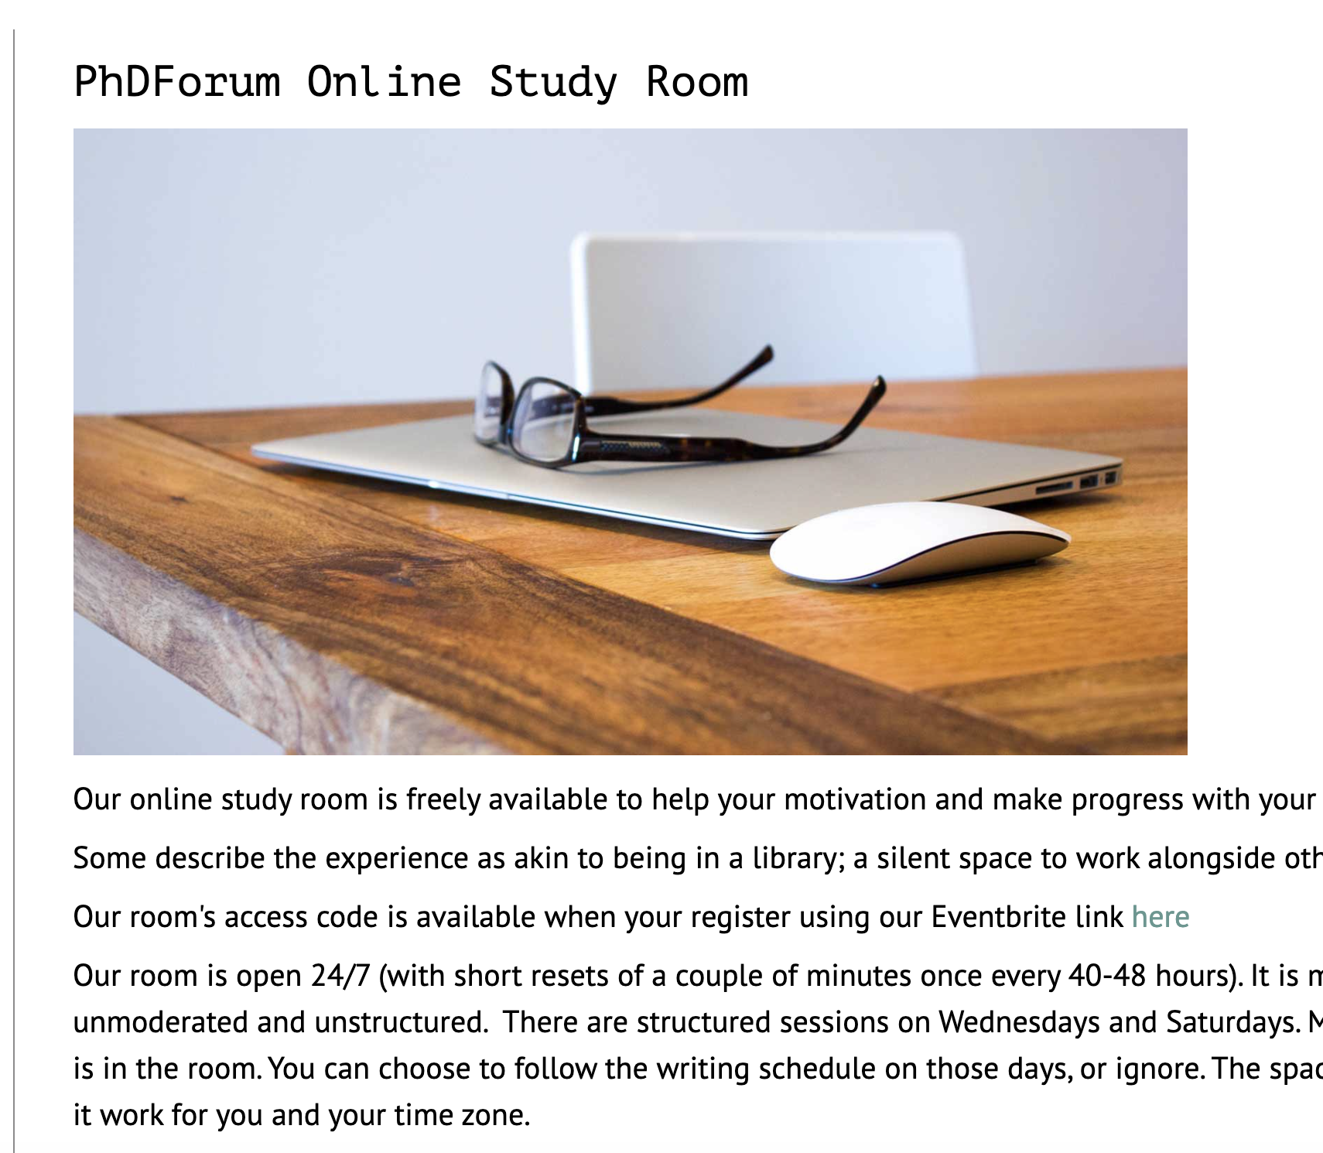
The PhD Forum | @PhDForum
Provides 24/7 study room with other doctoral students.
Register through
Eventbrite.
Let’s take 3 minutes to do that now.
BOOKMARK study site.

Slide 21
Additional tips
Text and confirm the accountability of an academic friend
Person 1: “Want to do a 25 pomodoro with me in 10 min.?”
Person 2: “Sure. Give me a sec. I need to get my laptop open.”
Person 1: “Sounds good.”
IM accountability of friend (see script above)
Work together over Zoom or at an outside location
Schedule for 2 to 3 hours at a time
Be sure to set boundaries on chit chat

Slide 22
Support on Twitter

Slide 23
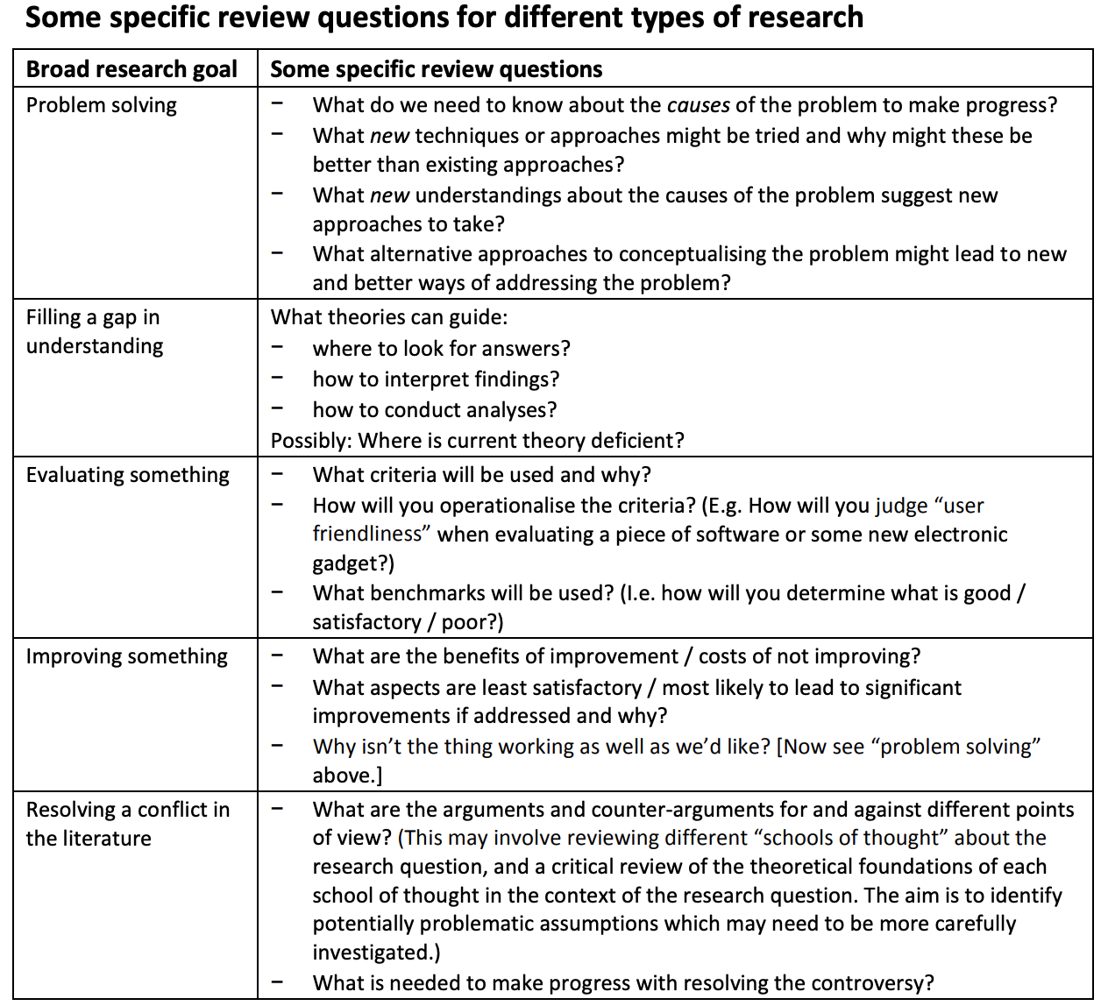
@WriteThatPhD

Slide 24
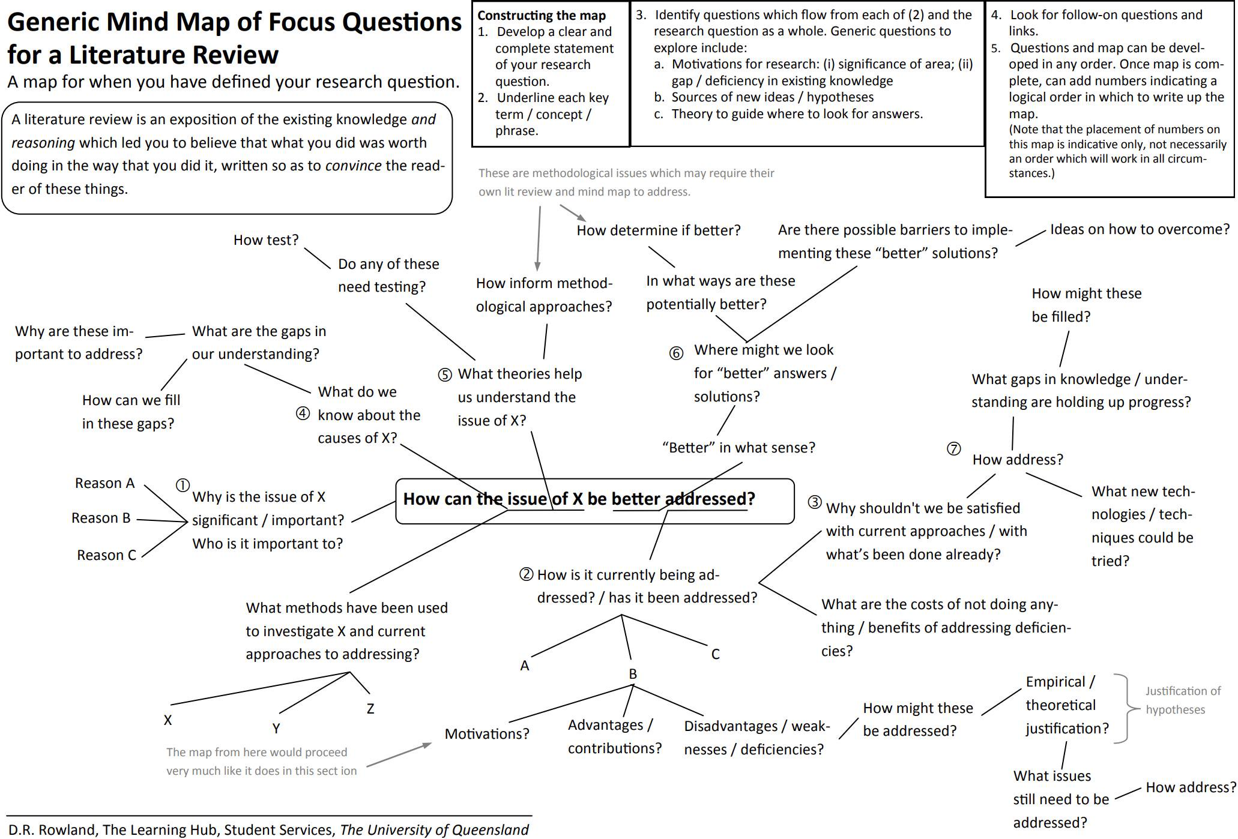
Notes:
EXAMPLE of a useful resource from @WriteThatPhD on Twitter

Slide 25
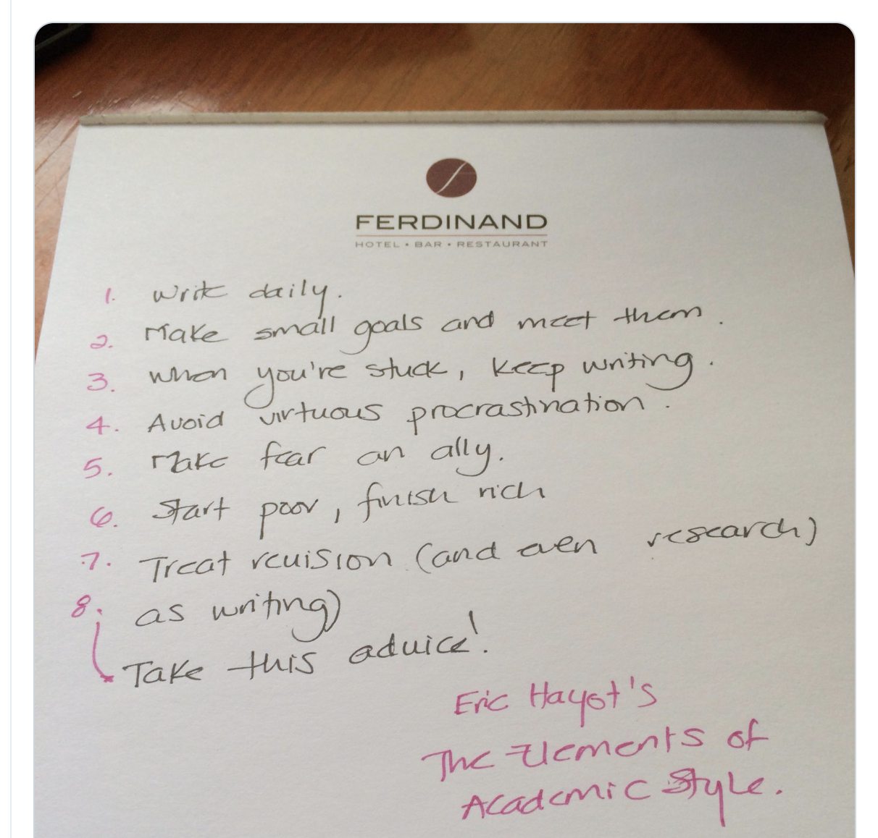
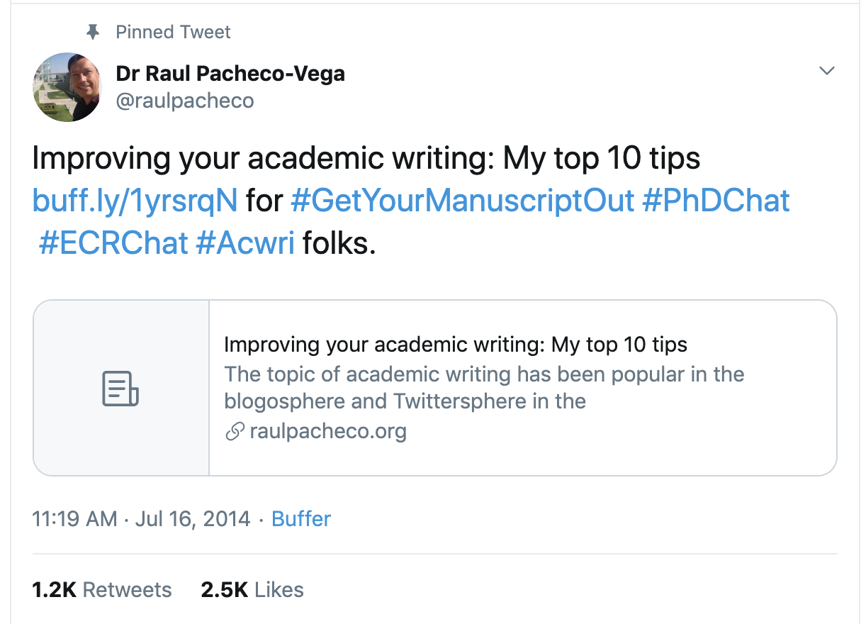
@raulpacheco

Slide 26
Focus Strategies

Slide 27
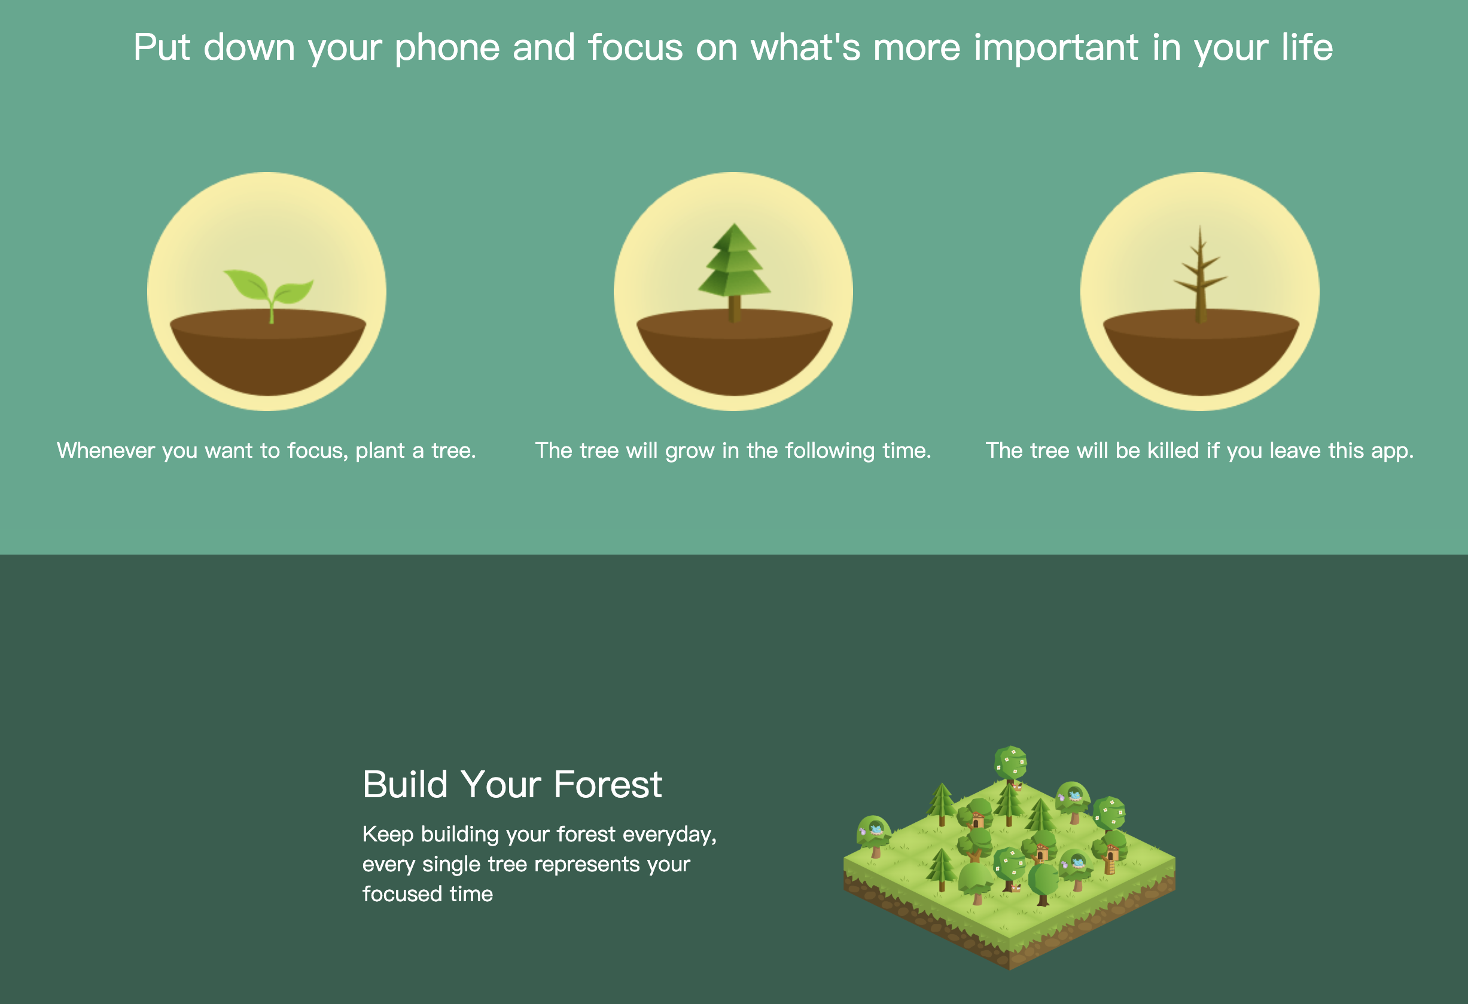
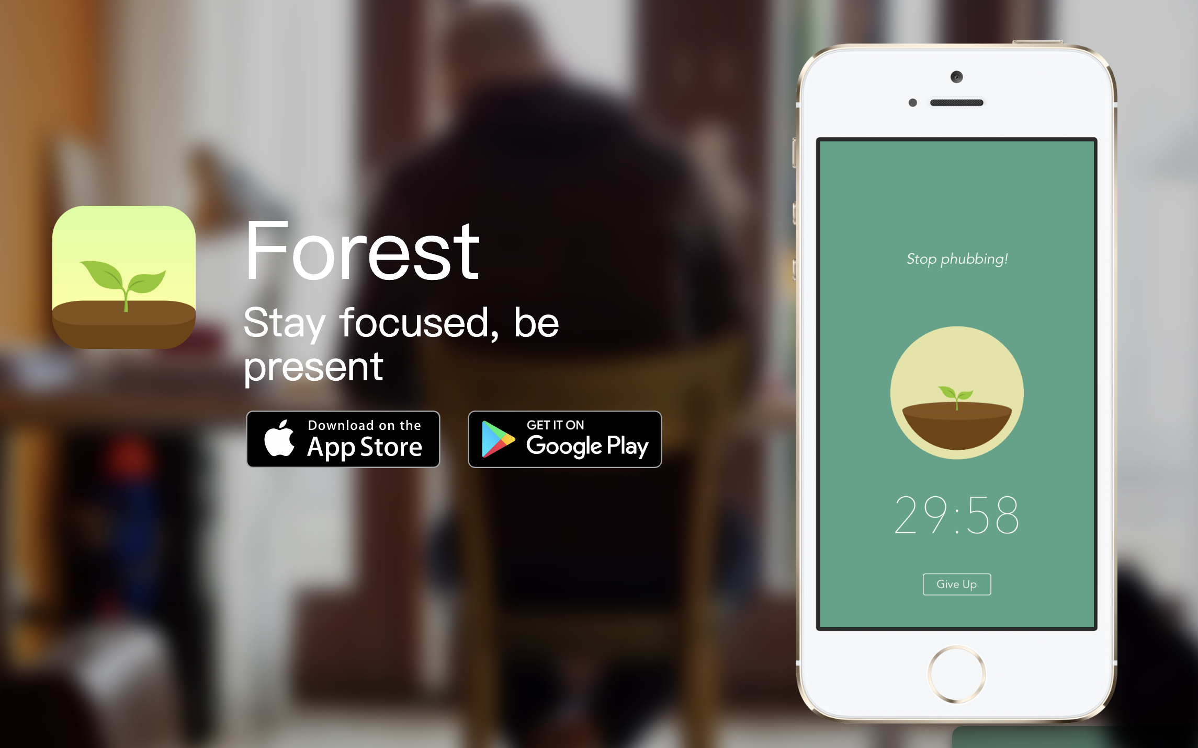
Forest App

Slide 28
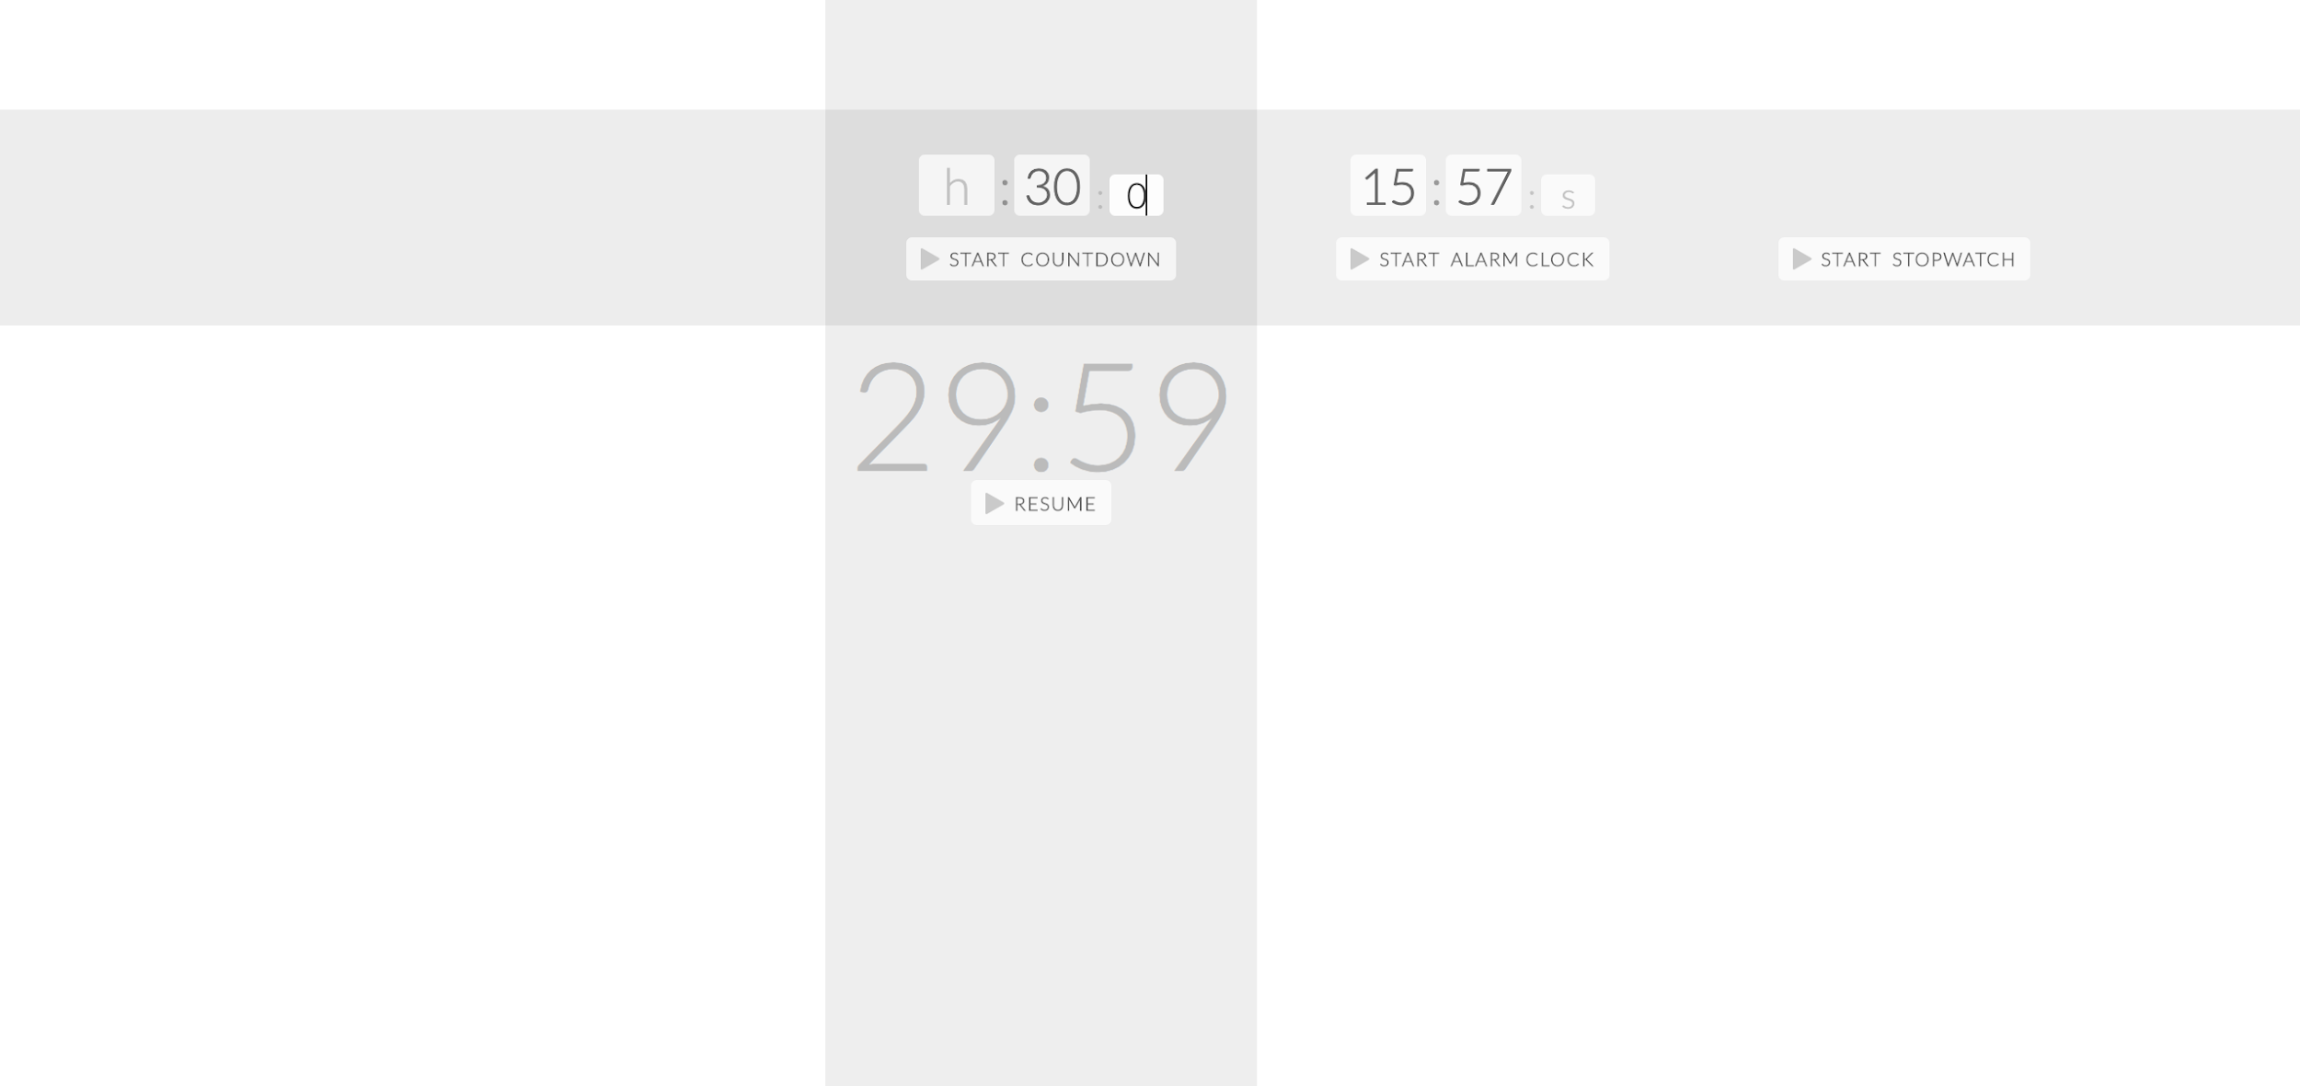
Tab Timer

Slide 29
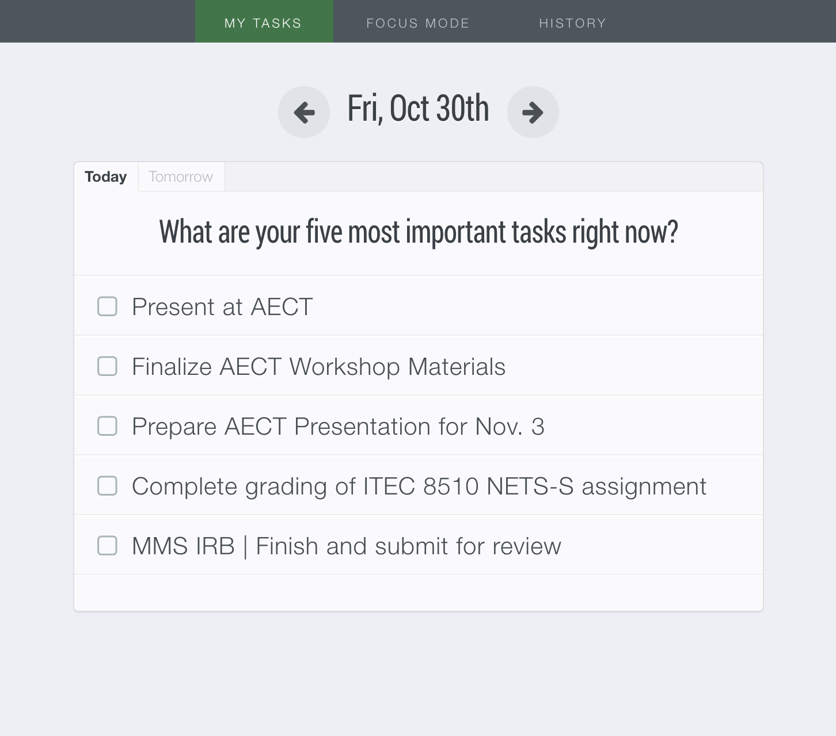
Dayboard

Slide 30
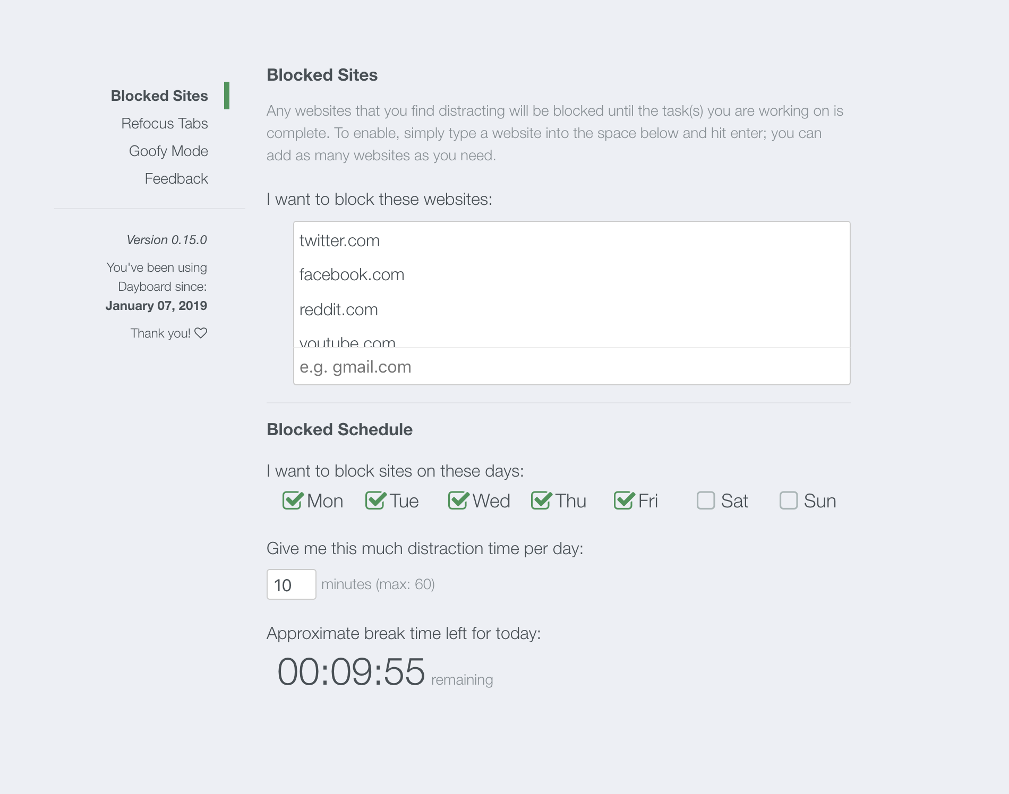
Dayboard

Slide 31
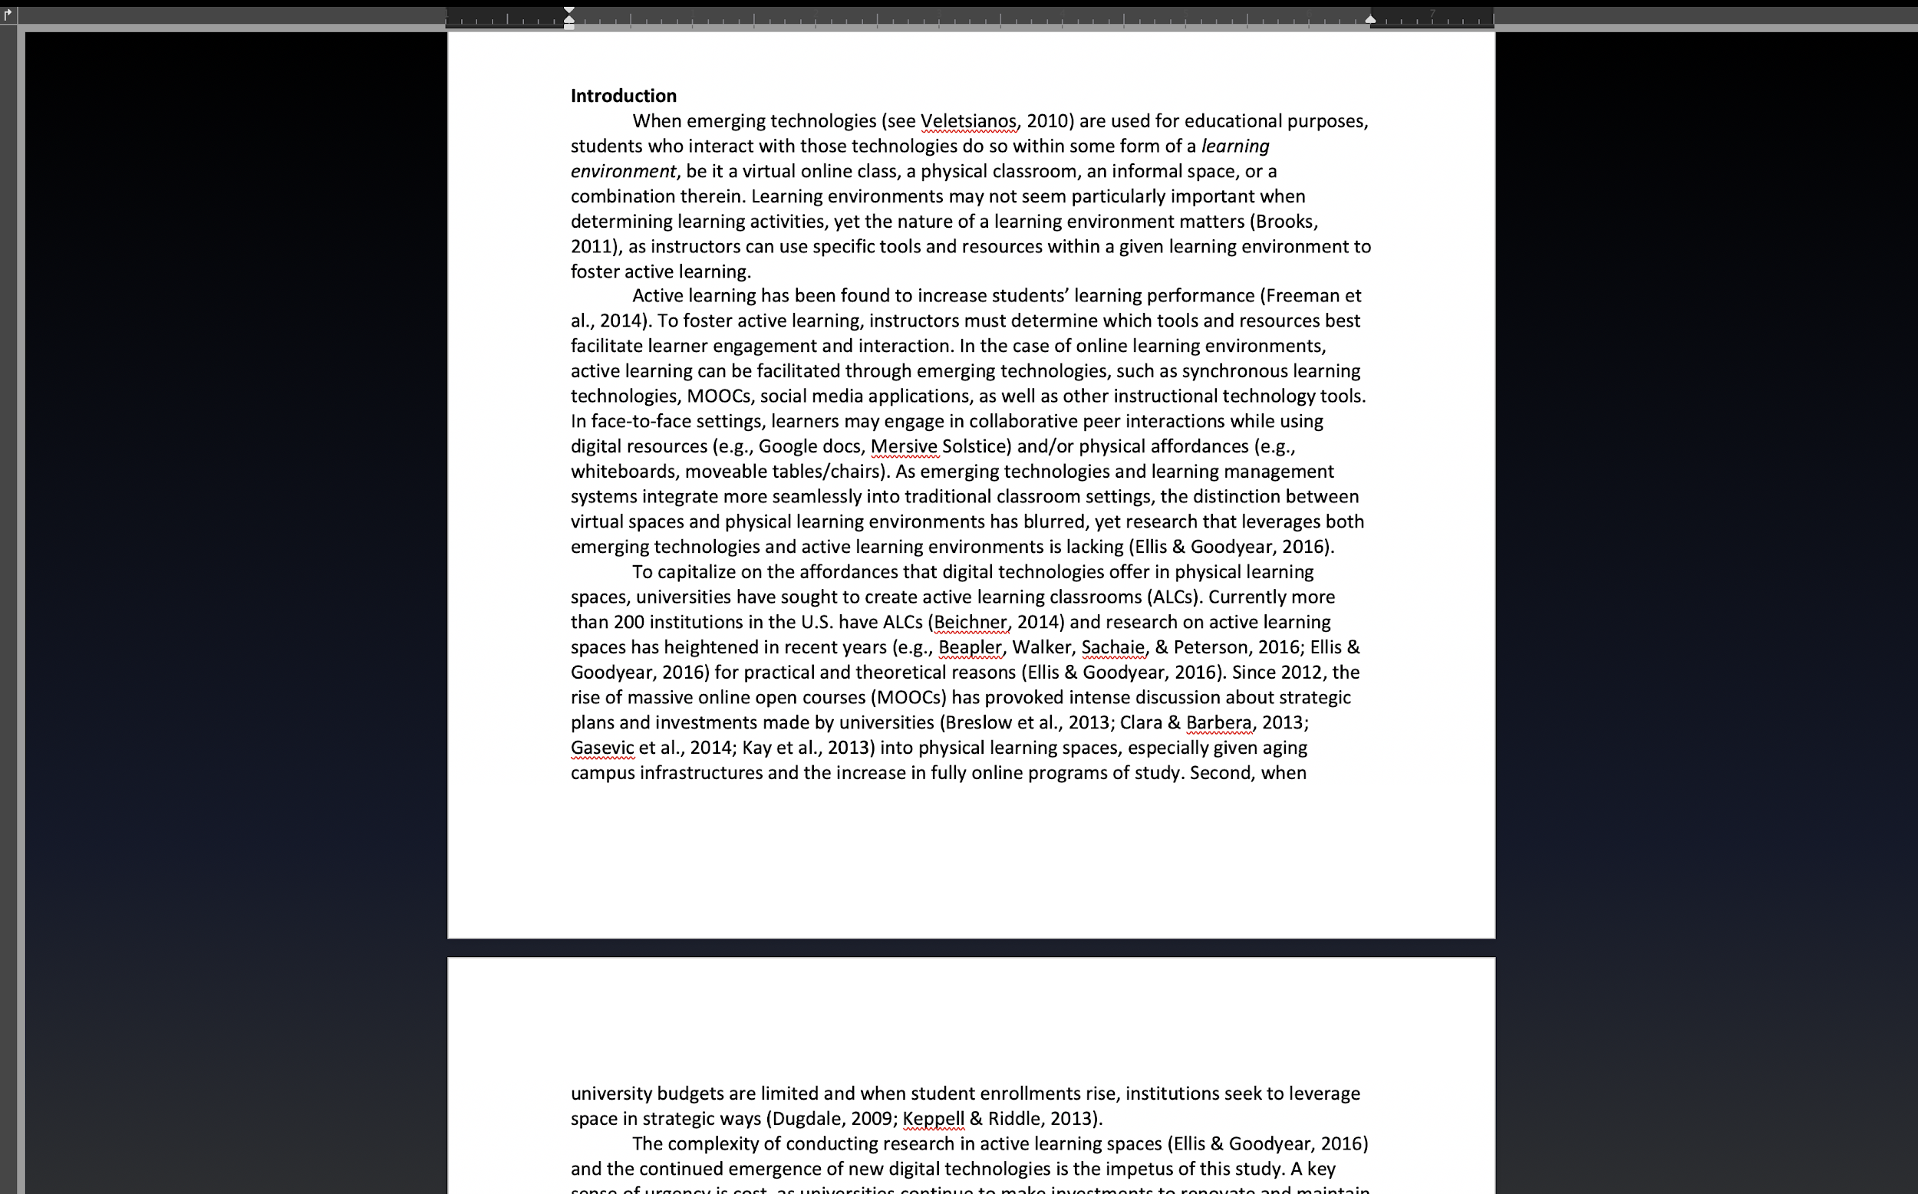
Turn on Focus feature in Word

Slide 32
Extreme action:
Turn off your laptop wifi. Yes, the wifi.

Slide 33
Organizational tools
Take 60 minutes and have a Sunday Meeting (*NCFDD)
If you still don't have a calendar, it's time to acquire one
Gently acknowledge that having more tasks than time is perfectly normal. It is not an individual shortcoming or personal flaw.
Consider saying “no” and/or lower a standard for a given day
Re-commit yourself to 30 (or 10, 15, 25) minutes of writing daily
If you haven't created your semester plan, it is not too late.

Slide 34
Dr. Yeol Huh’s Writing Space
Ultra Wide Monitor
Coffee

Slide 35
Additional Tips...
A unique tip for writing:
A mechanical keyboard (e.g., Cherry MX Brown for office use) that gives you a lively sound and tectile feels when typing. I just wanted to make the act of typing a pleasant task.
To help organize the reading materials for your literature review:
Using a blogging tool with tagging (aka labeling)
Create a short summary of the article and give relevant tags (i.e., K-12, motivation, tech integration etc.) so that later you can sort the literature easily using tags (labels).

Slide 36
Turn teaching, practice, service into publication
Various Roles of a Graduate Student
Instructor, teaching assistant
Instructional designer, consultant, learning technologist
Graduate assistant on campus
Members of organizations
Student
Researcher

Slide 37
Why Important?
Get your own publication experience from start to finish as early as possible.
Make the most out of it!

Slide 38
Example:
Journal of Education for Teaching (JET)
SSCI journal in teacher education, international context
Original Research paper (6000 words)
Research in Progress (1000 words)
Research in Practice (1000 words)
Book Review

Slide 39
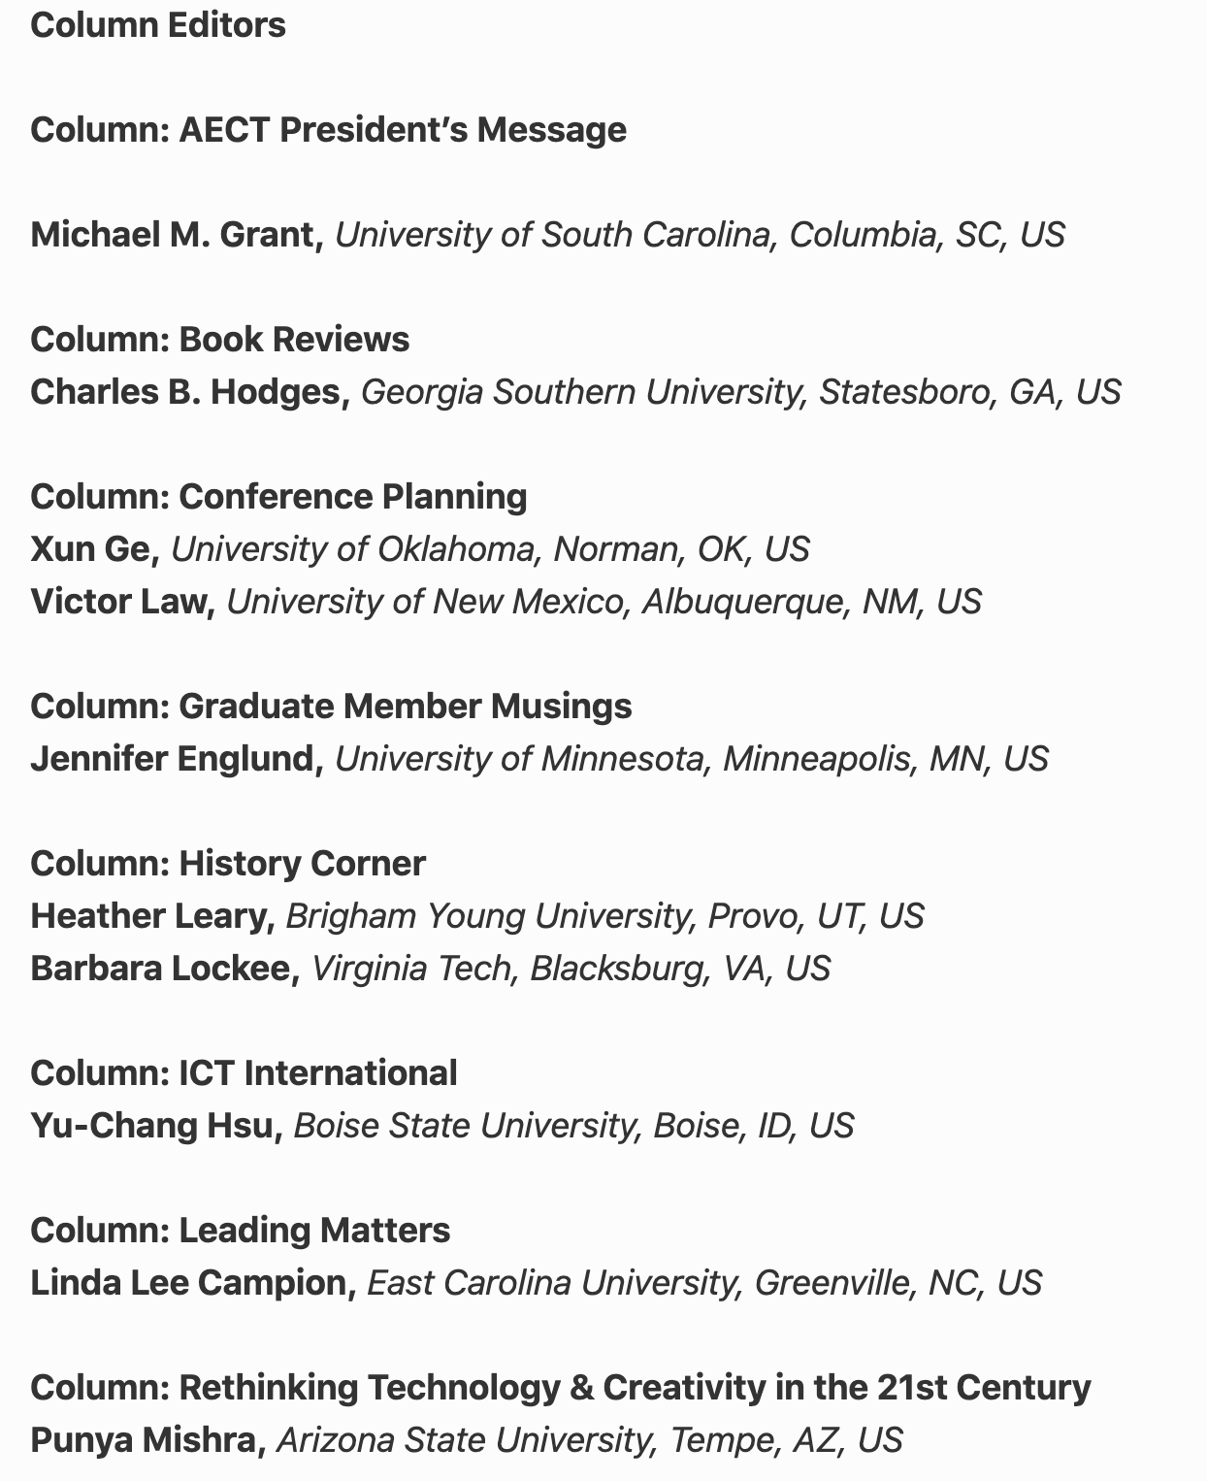
Example of TechTrends
So how can I find this information?

Slide 40
Set up an alert

Slide 41
ETR&D

Slide 42
British Journal of Educational Technology

Slide 43
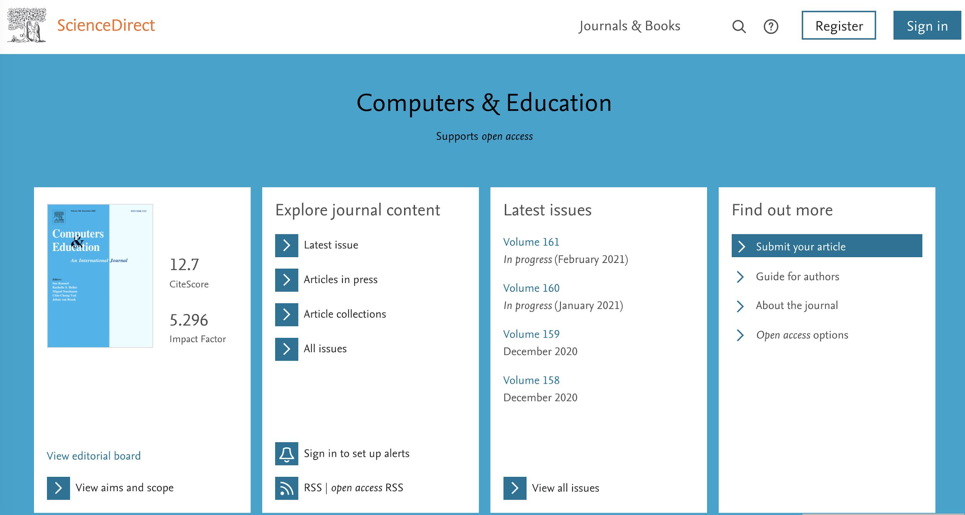
Computers and Education

Slide 44
Talk to your advisor or faculty on record

Slide 45
Create your own opportunity

Slide 46
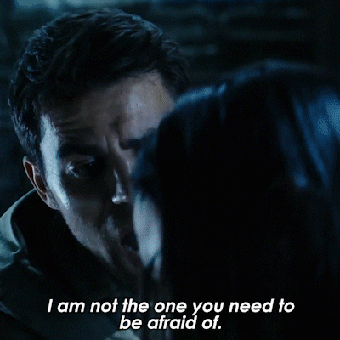
Don’t be afraid of
contacting the editor

Slide 47
Meina- Research Collaboration-Why?
Improve quality of research
Extend research relationships and networks
Foster interdisciplinary and transdisciplinary research
Share expertise and knowledge transfer
Enhance scientific and publishing productivity
Accelerate dissemination of findings for community benefit
Notes:
Retrieved from https://www.google.com/search?q=collaboration&tbm=isch&ved=2ahUKEwj8ivazkeDsAhUI0awKHcTRALsQ2-cCegQIABAA&oq=collaboration&gs_lcp=CgNpbWcQAzIFCAAQsQMyAggAMgIIADICCAAyAggAMgIIADICCAAyAggAMgIIADICCAA6BAgjECc6BAgAEEM6BwgAELEDEEM6CAgAELEDEIMBULmxDliCvQ5gzL4OaABwAHgAgAFPiAHKBpIBAjEzmAEAoAEBqgELZ3dzLXdpei1pbWfAAQE&sclient=img&ei=iQeeX7yiDYiiswXEo4PYCw&bih=881&biw=1965&tbs=il%3Acl&hl=en#imgrc=TBP9Sue5H-FIAM

Slide 48
Meina- Research Collaboration-How?
Identify the skills that you can offer
Identify how the collaboration will meet your needs
Find collaborators
Introduce yourself
Set expectations at the beginning of the collaboration
Leverage tools for collaborations
Keep communicating
Do not be discouraged
Notes:
Retrieved from https://www.google.com/search?q=collaboration&tbm=isch&ved=2ahUKEwj8ivazkeDsAhUI0awKHcTRALsQ2-cCegQIABAA&oq=collaboration&gs_lcp=CgNpbWcQAzIFCAAQsQMyAggAMgIIADICCAAyAggAMgIIADICCAAyAggAMgIIADICCAA6BAgjECc6BAgAEEM6BwgAELEDEEM6CAgAELEDEIMBULmxDliCvQ5gzL4OaABwAHgAgAFPiAHKBpIBAjEzmAEAoAEBqgELZ3dzLXdpei1pbWfAAQE&sclient=img&ei=iQeeX7yiDYiiswXEo4PYCw&bih=881&biw=1965&tbs=il%3Acl&hl=en#imgrc=1C1gKEYxDs39-M&imgdii=FLQg6a_t9CpumM

Slide 49
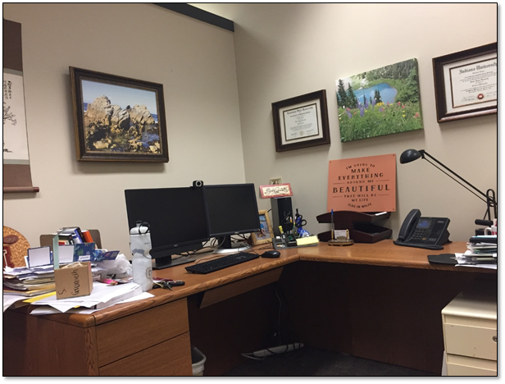
Susie Gronseth - Writing Where I Am
Writing in the spaces where we are...
Campus Office

Slide 50
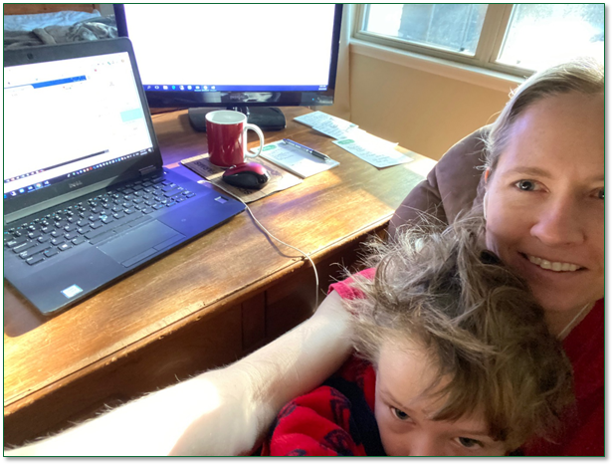
Quarantine Writing at Home

Slide 51
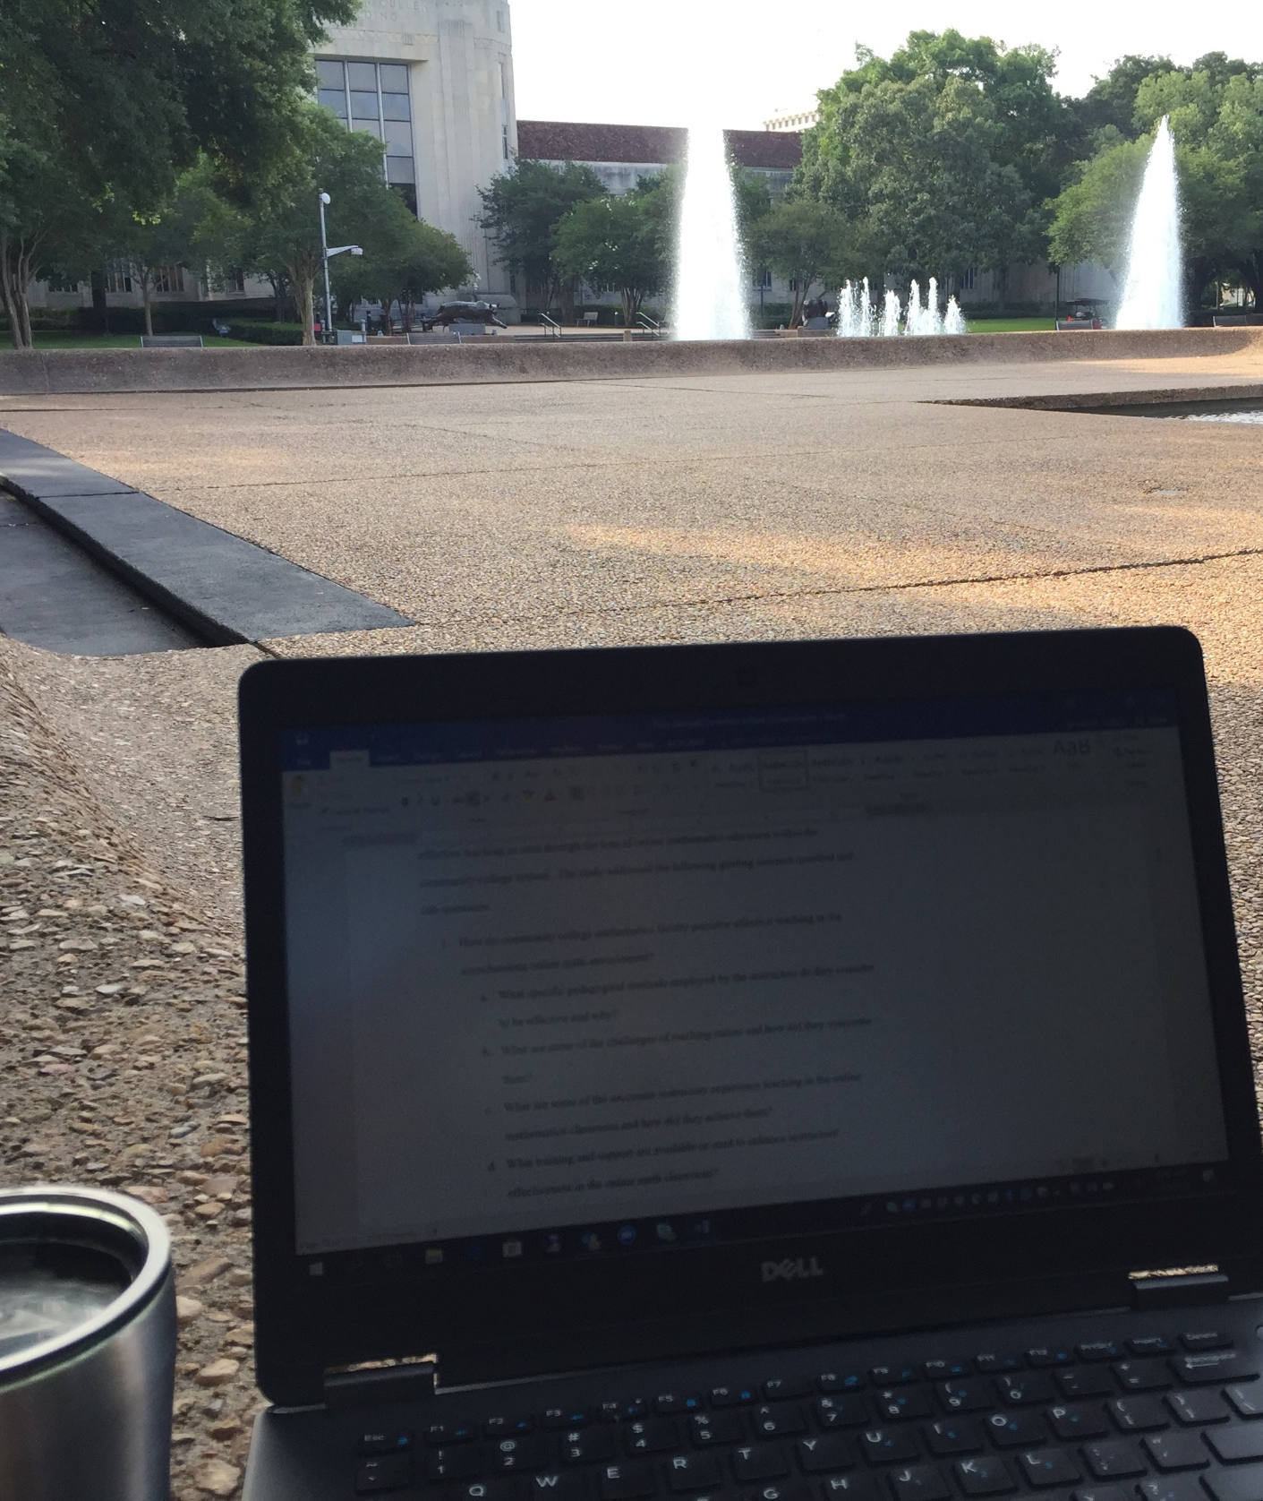
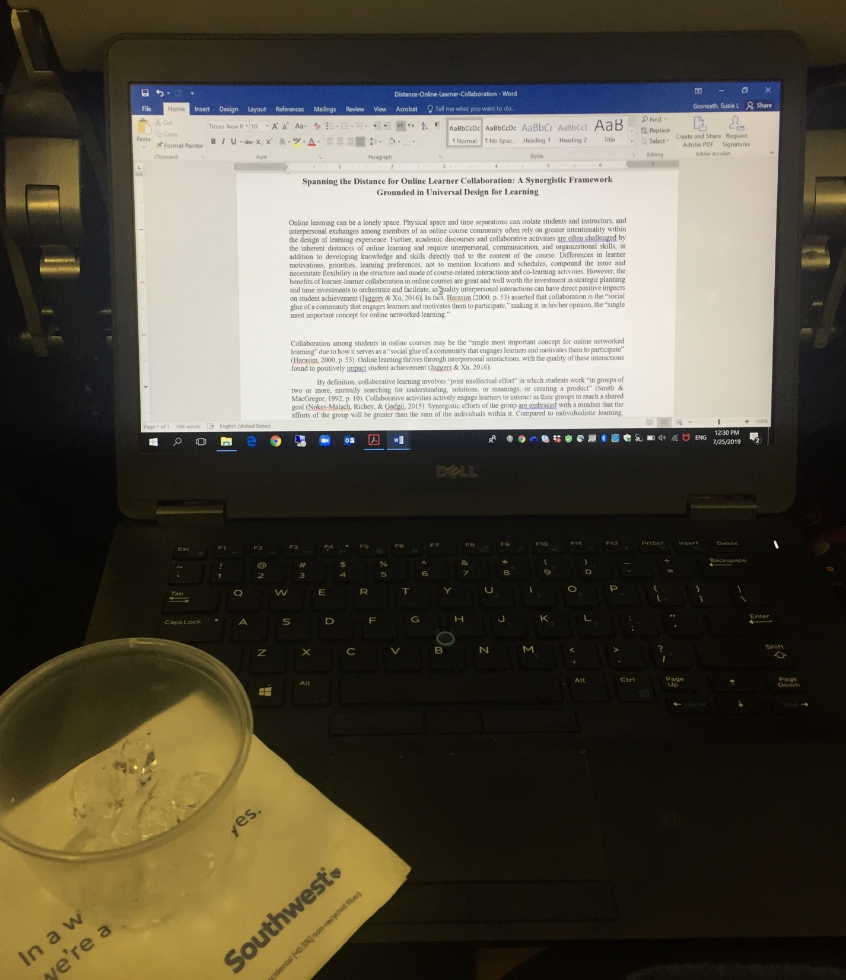
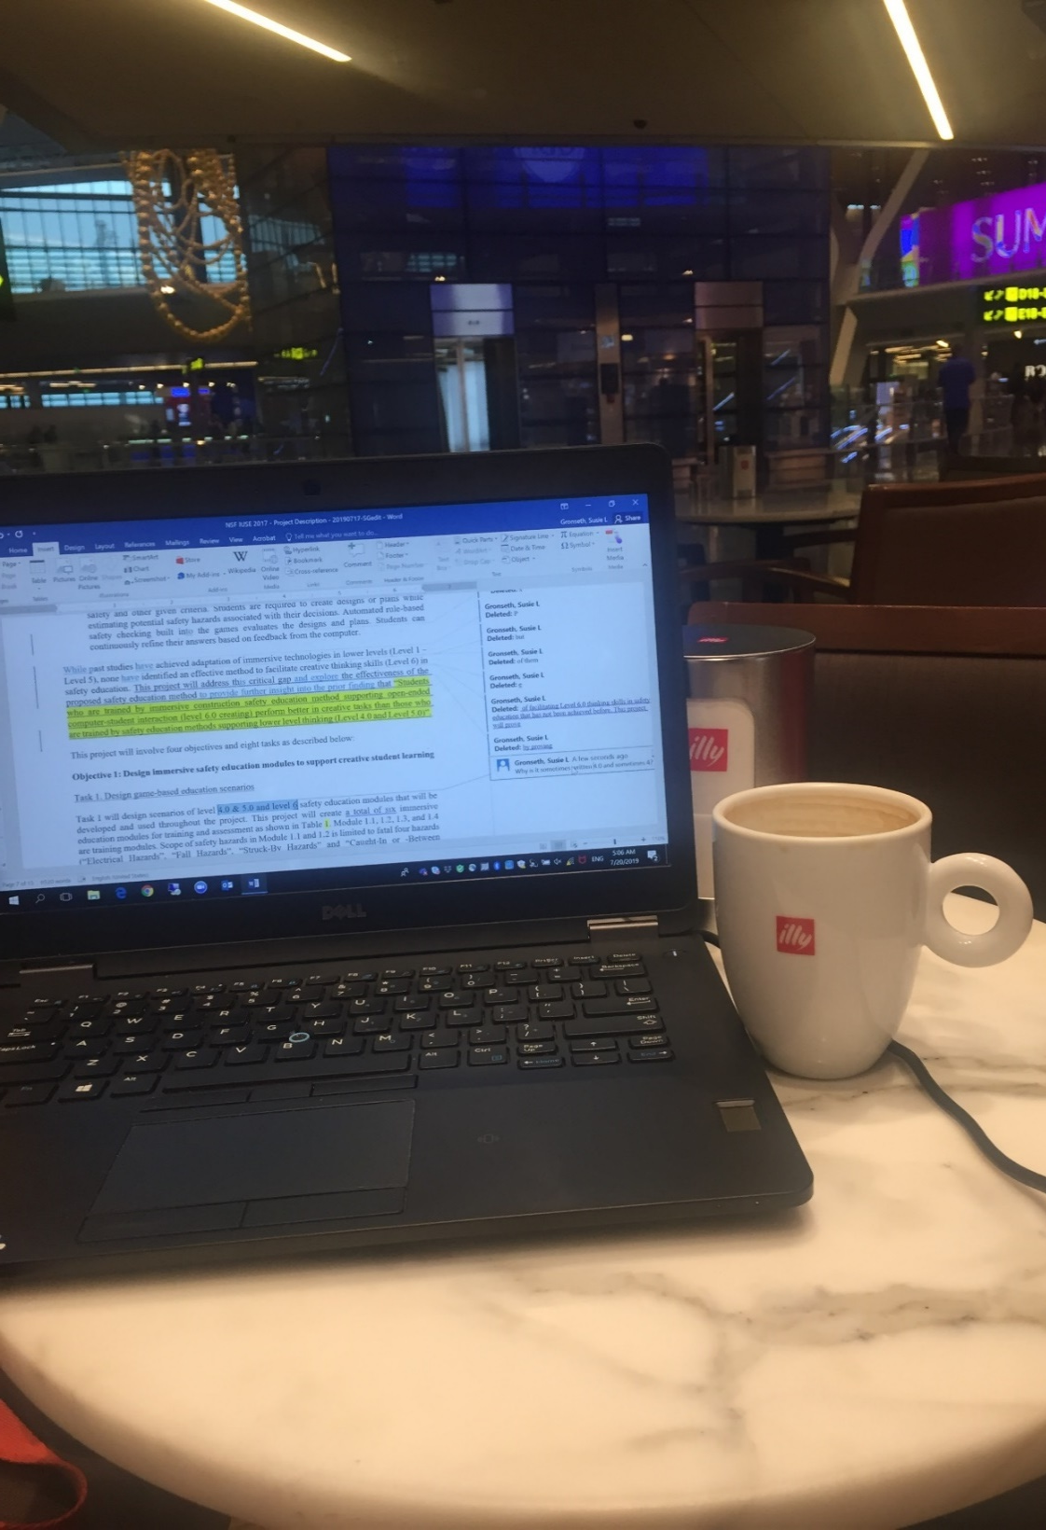
On Campus
In a Plane
At a Cafe
Notes:
What do your writing spaces look like? Are there special writing places you use for different parts of the writing process? How/why do you work in different spaces?

Slide 52
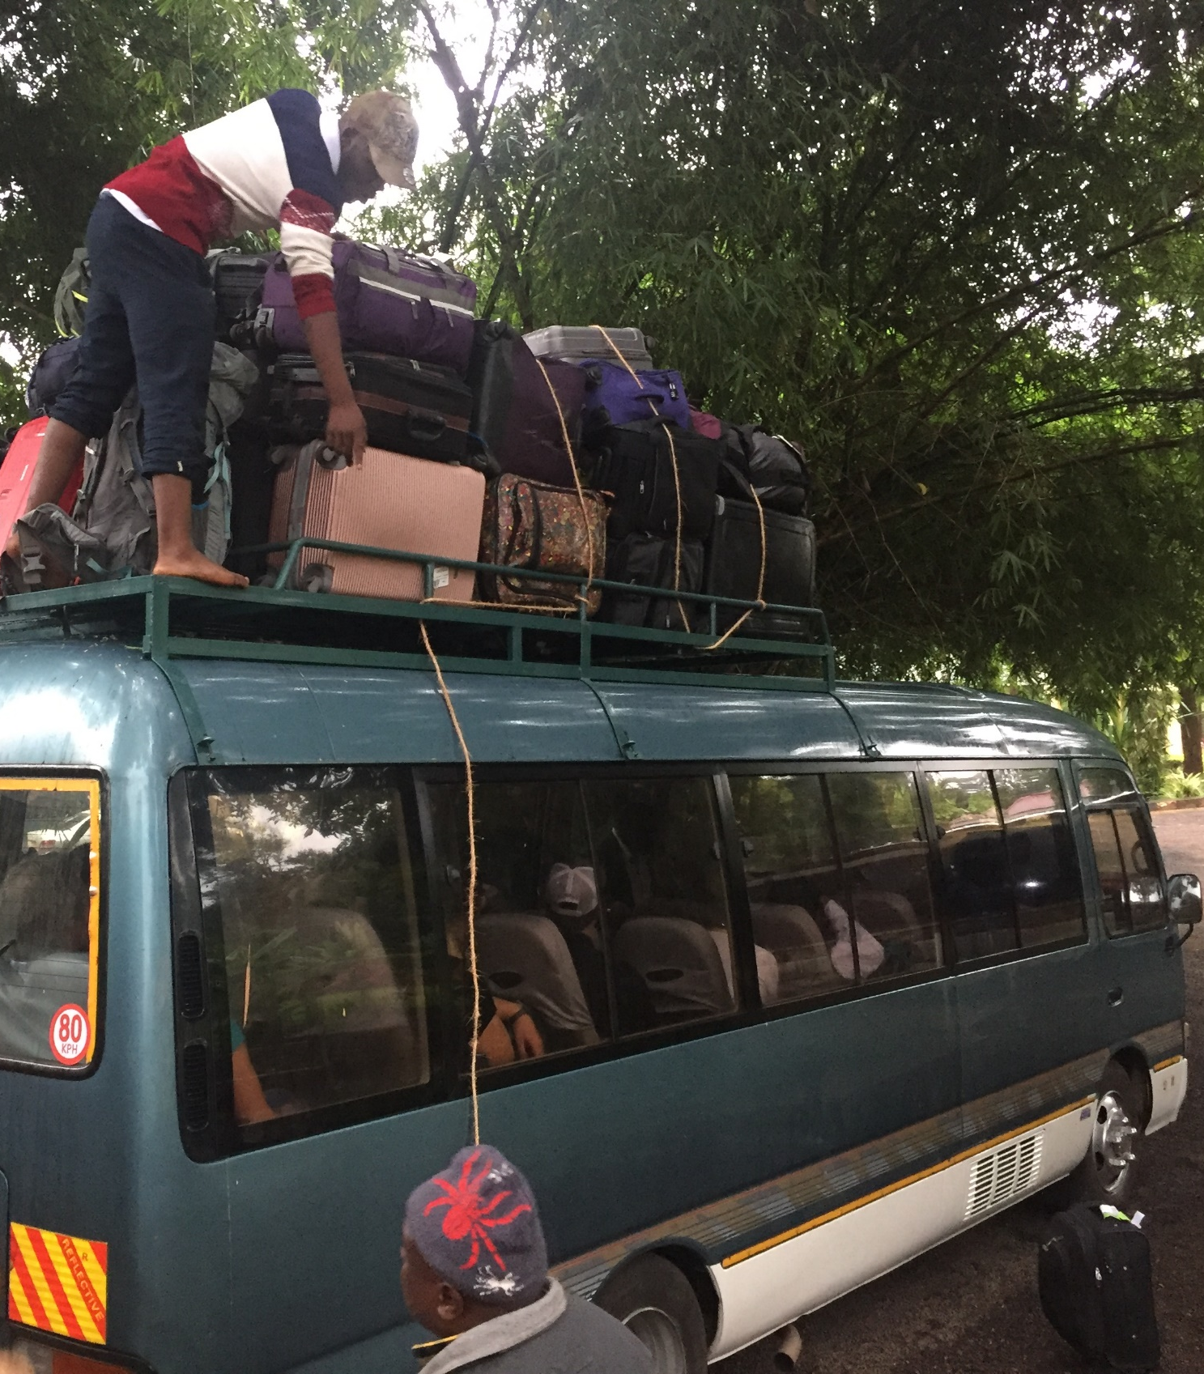
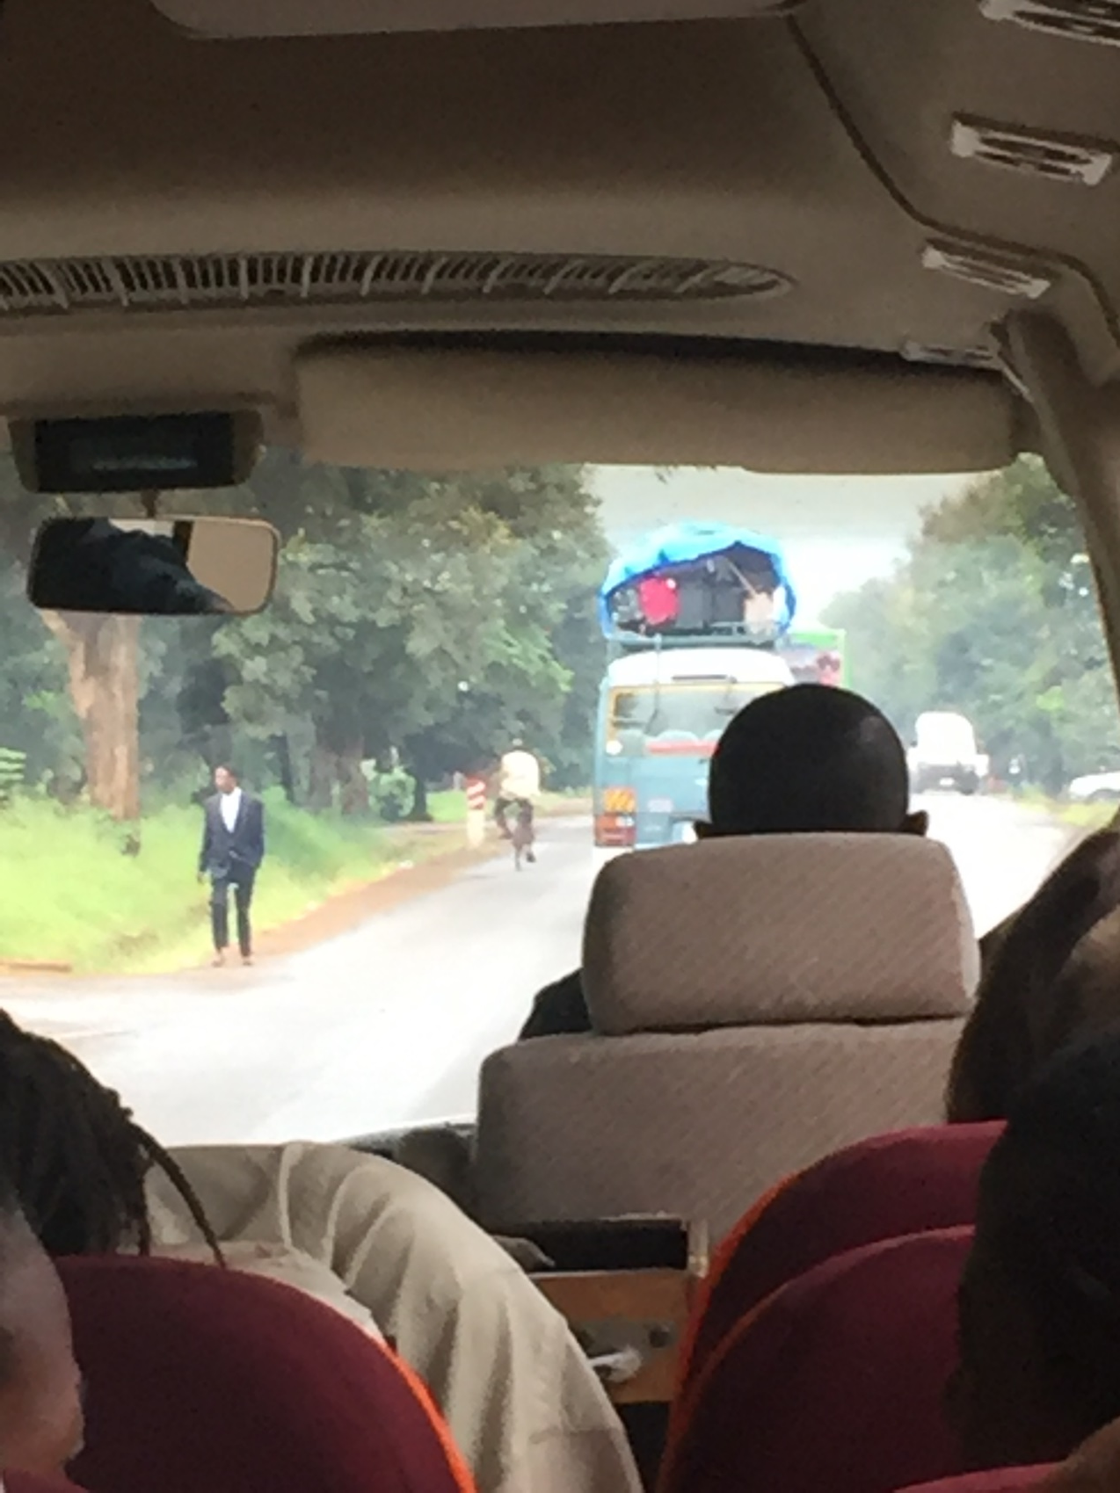
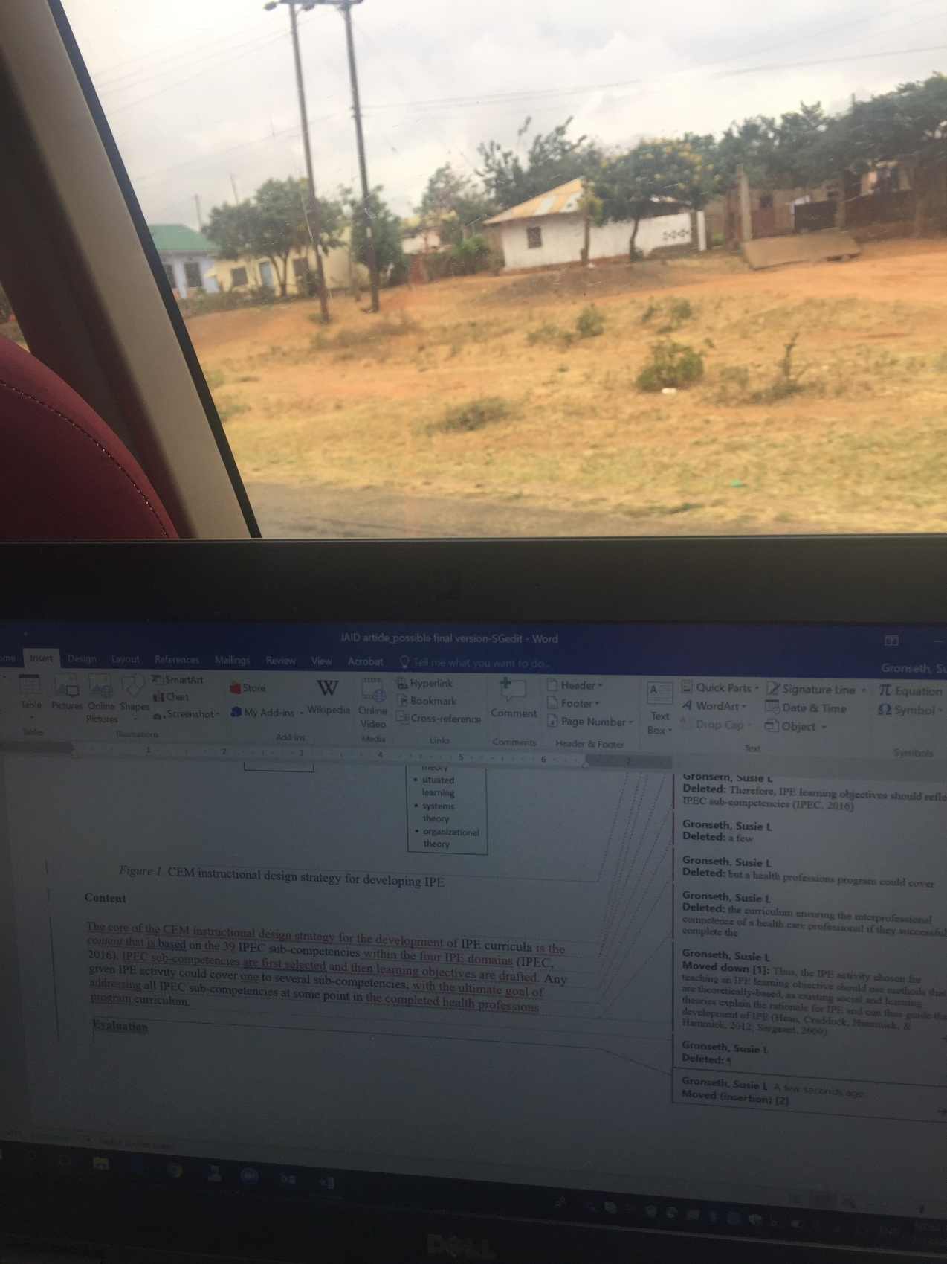
Writing…on a bus…in Africa
Notes:
What do your writing spaces look like? Are there special writing places you use for different parts of the writing process? How/why do you work in different spaces?

Slide 53
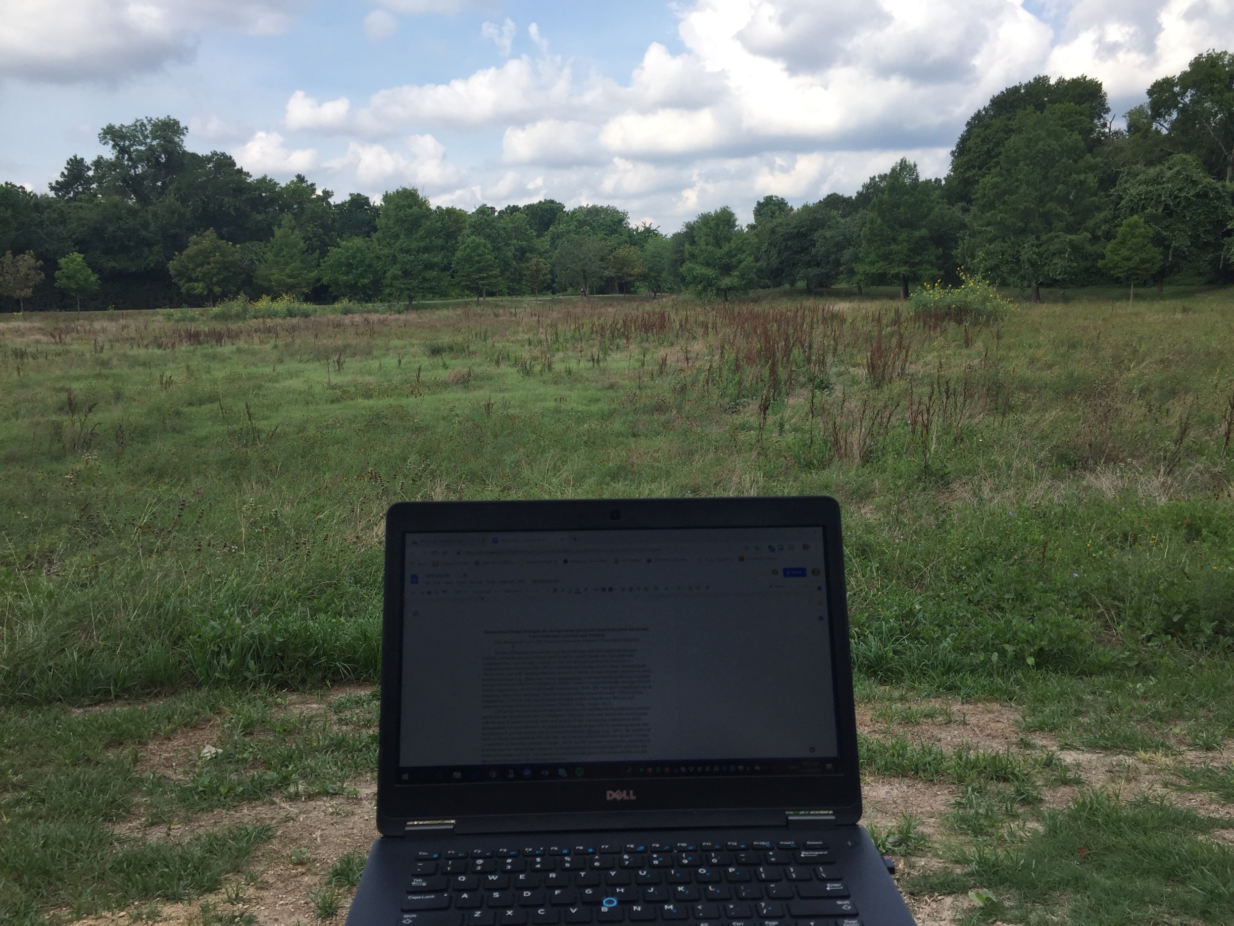
Gaining motivation with a change of scenery
Notes:
Alternative locations. Any hideaways…? Secret locations? Special places?

Slide 54
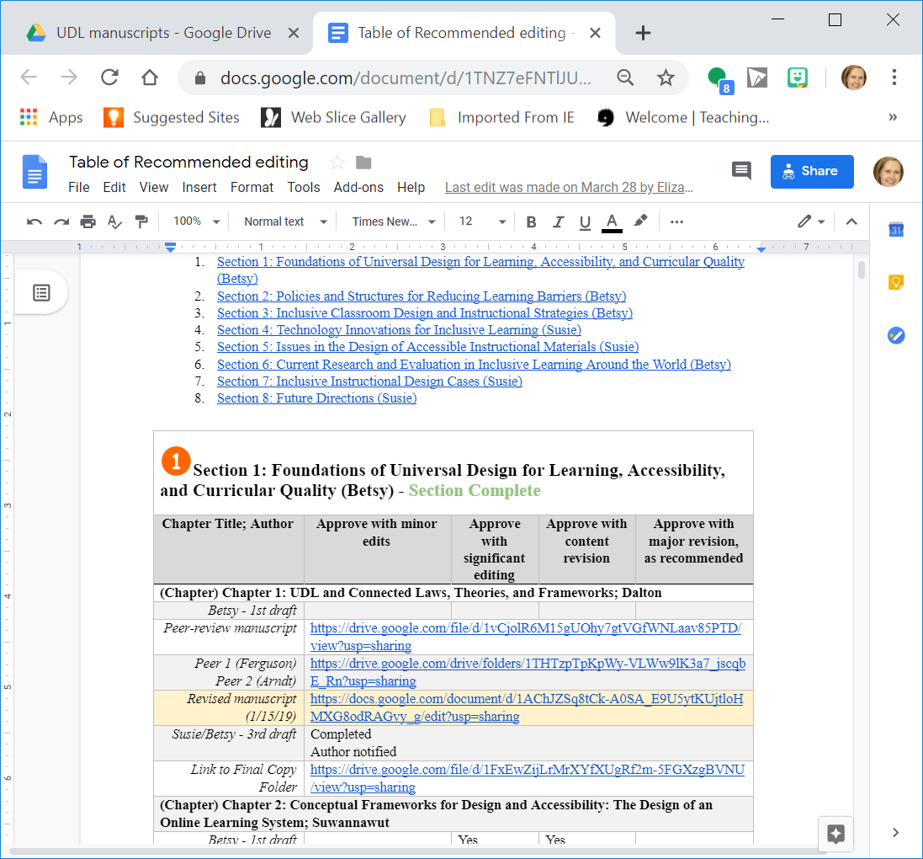
Writing Tools
Cloud-based storage (Google Drive, Dropbox, OneDrive, etc.)
Tables, spreadsheets, direct links, folders, and sub-folders
Notes:
What particular writing tools do you use? How have they changed over time? What about tools for collaboration?

Slide 55
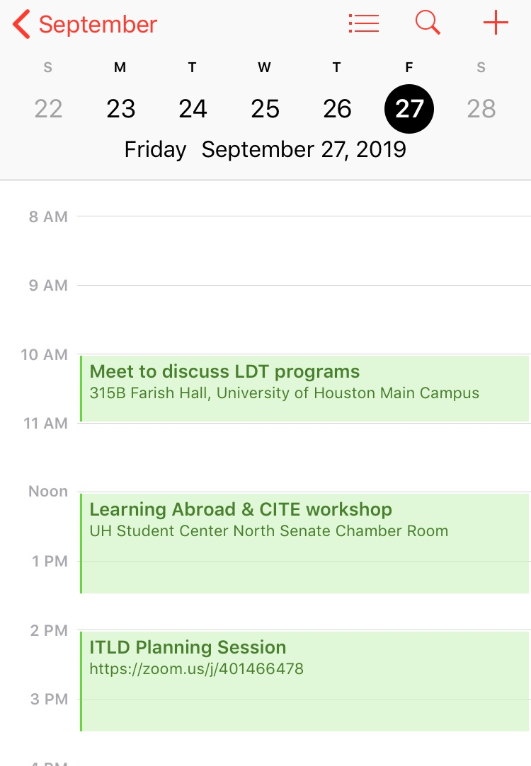
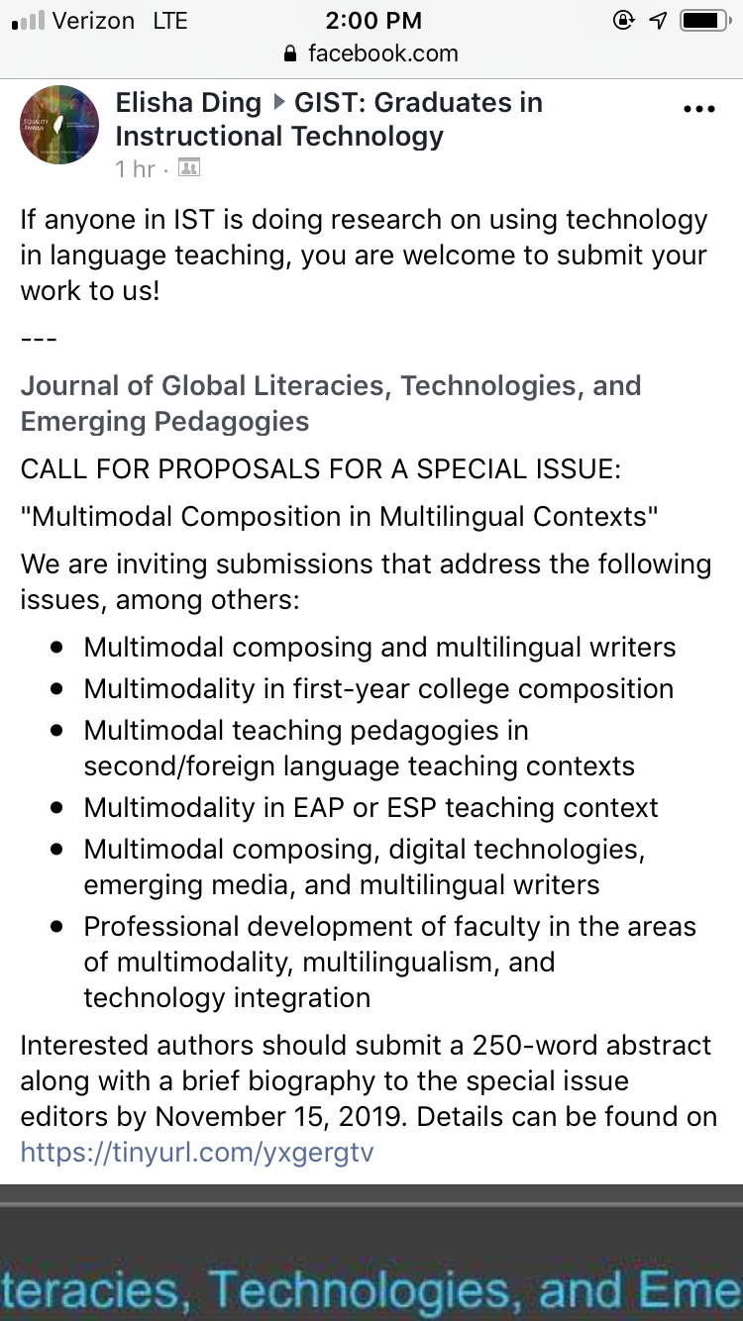
Plans and Goals
Intentionality ↔ Opportunity
Writing Space
Notes:
How do you schedule your writing? How far in advance do you plan your writing? How do you prioritize your writing? How do you visualize your writing? Do you use a timeline or a planner? Do you have advice for developing a writing plan?

Slide 56
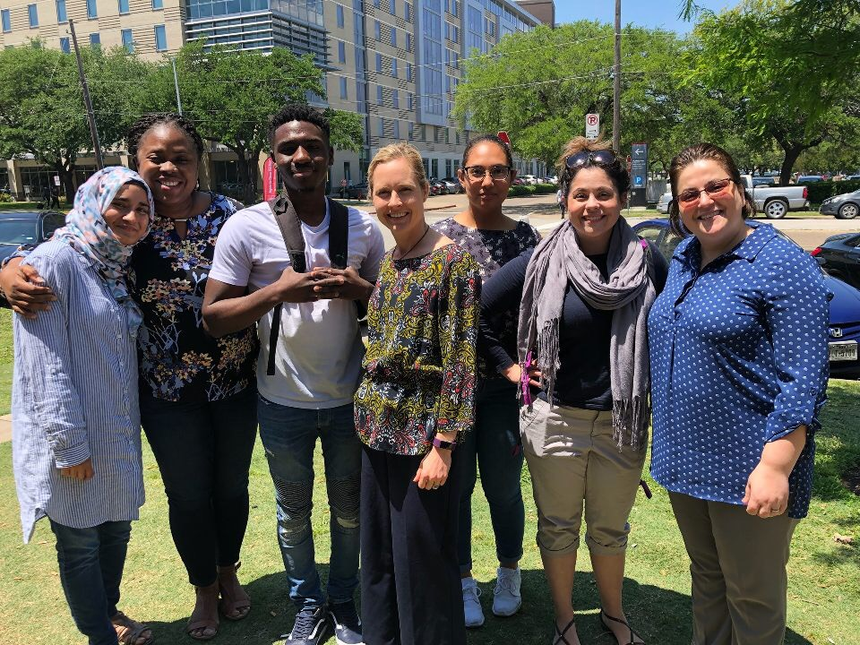
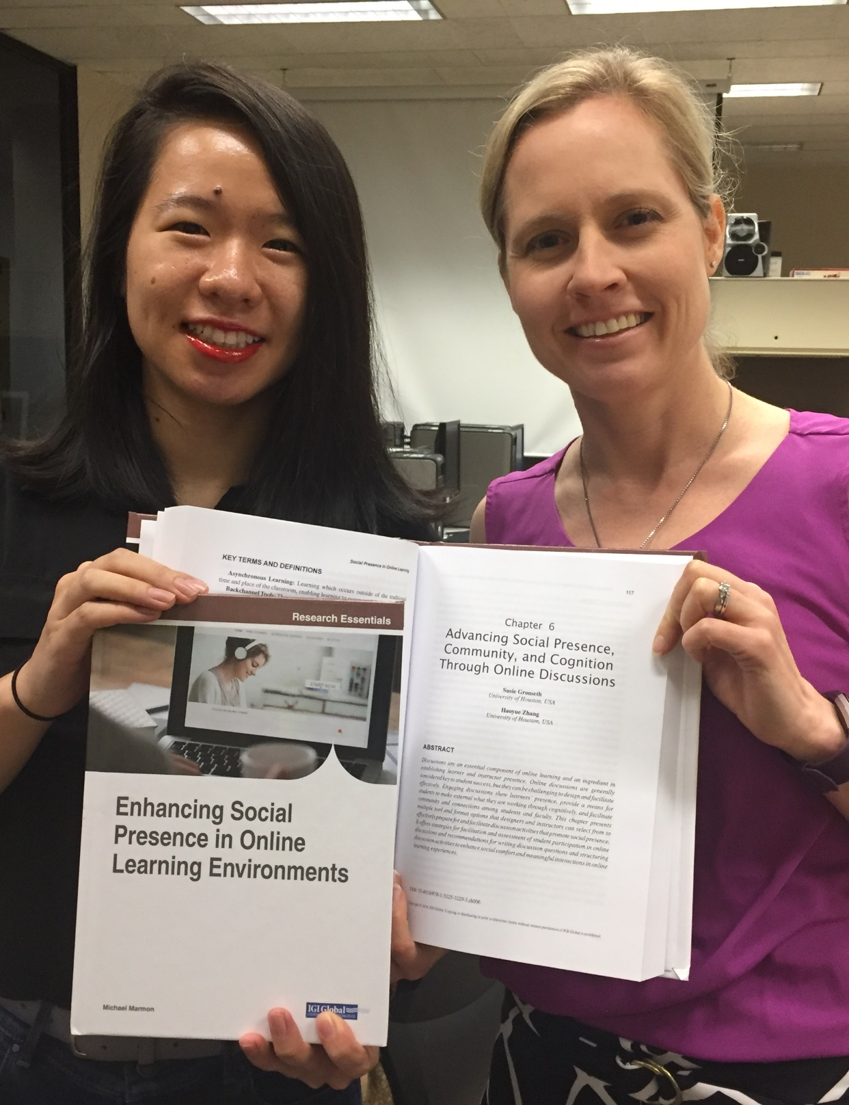
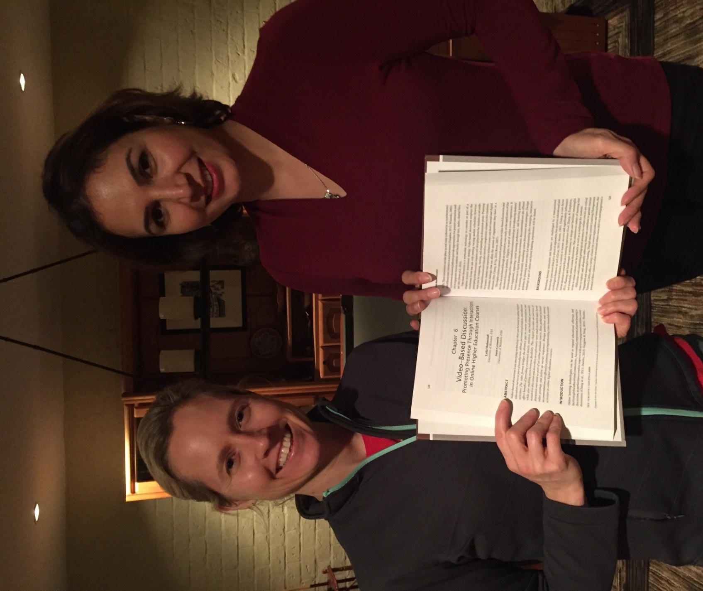
Writing with Students
Notes:
How do you determine your collaborative writing partners? And negotiate tasks?

Slide 57
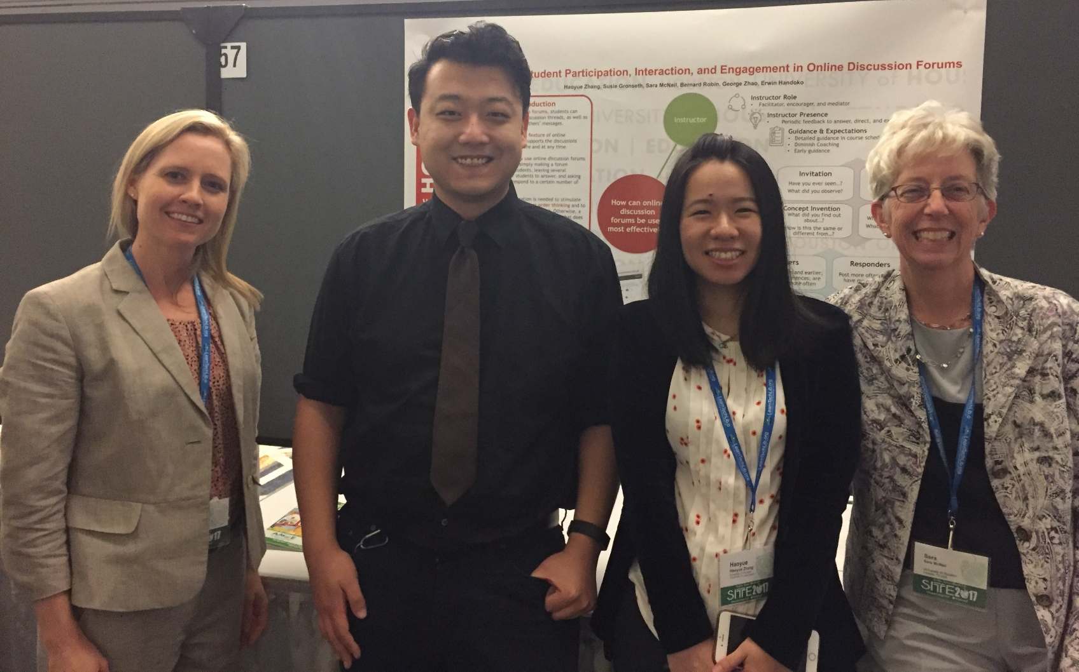
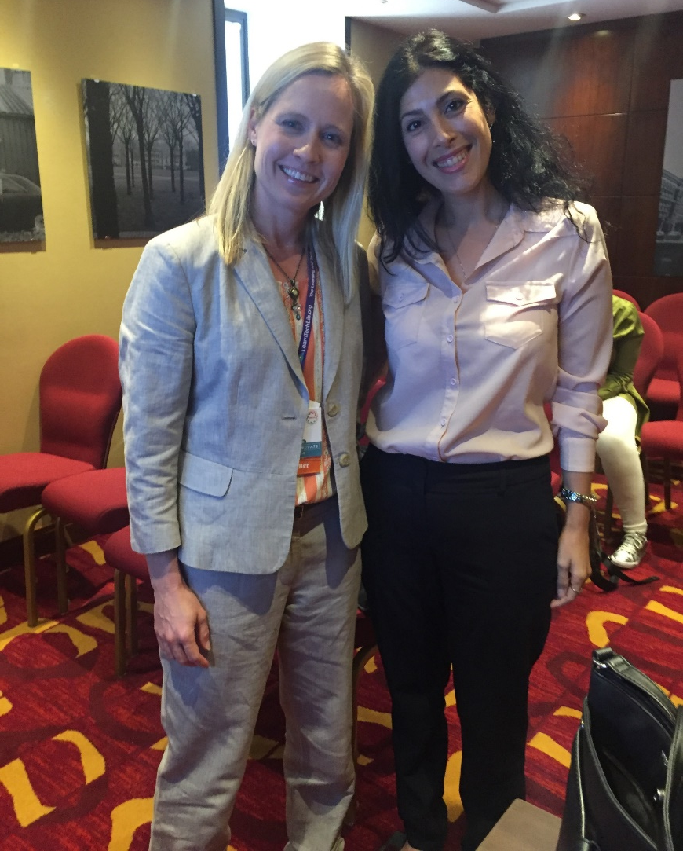
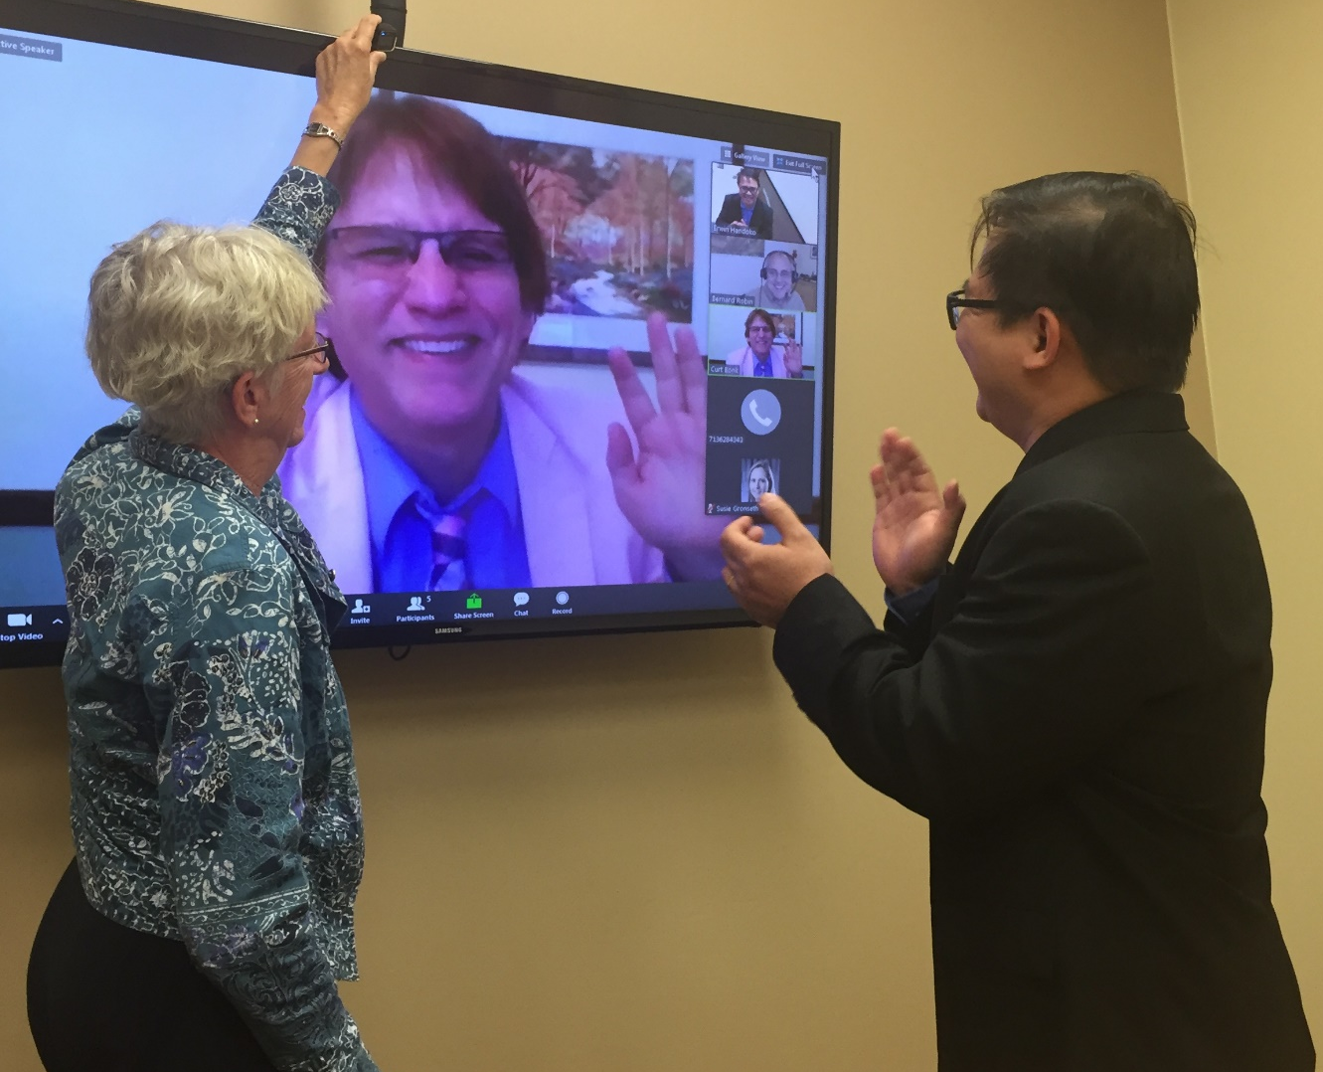
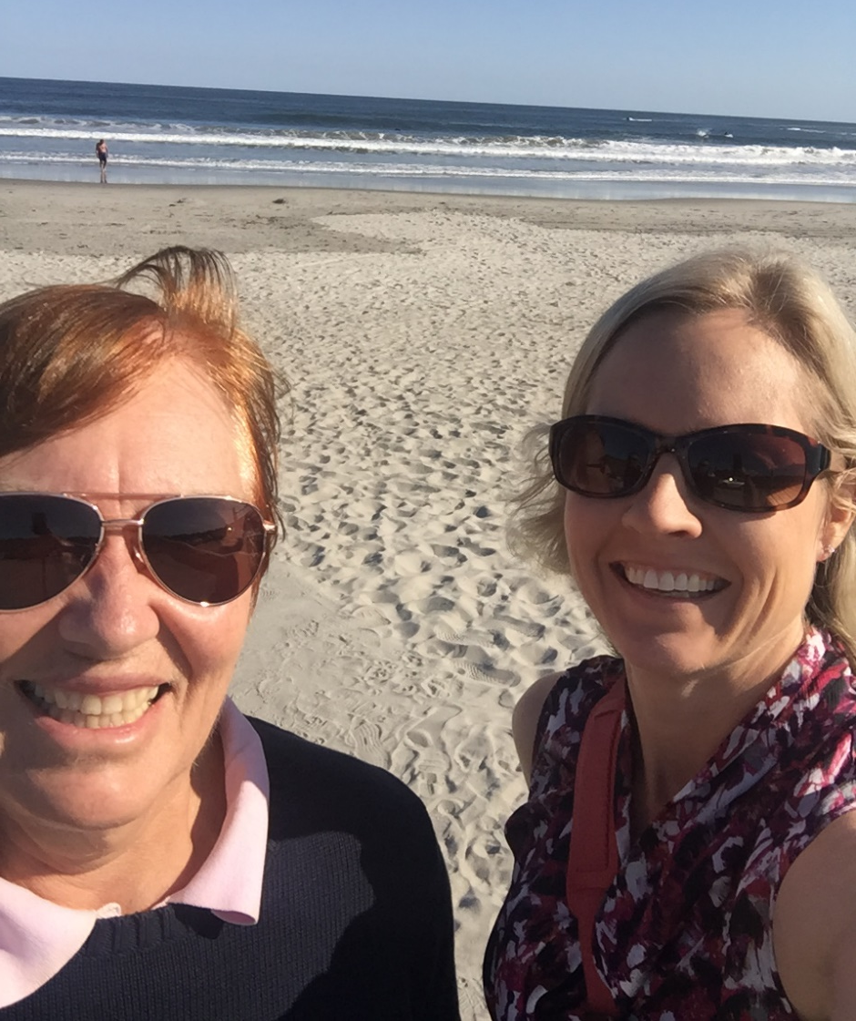
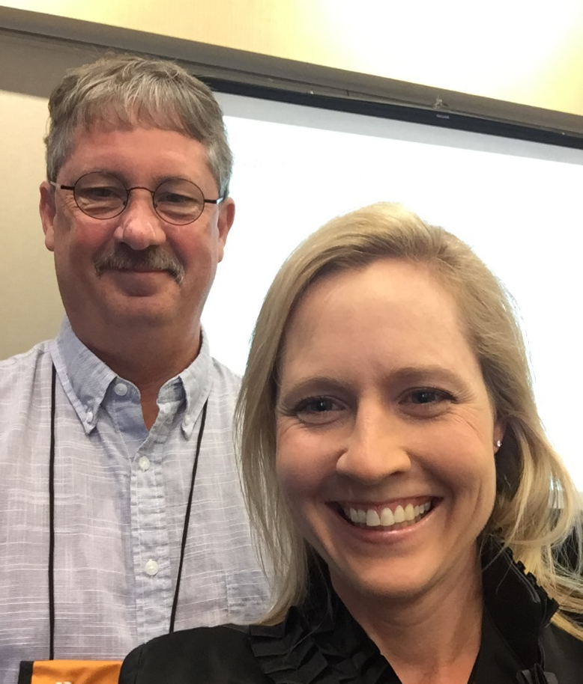
Collaborations
Notes:
How do you determine your collaborative writing partners? And negotiate tasks?

Slide 58
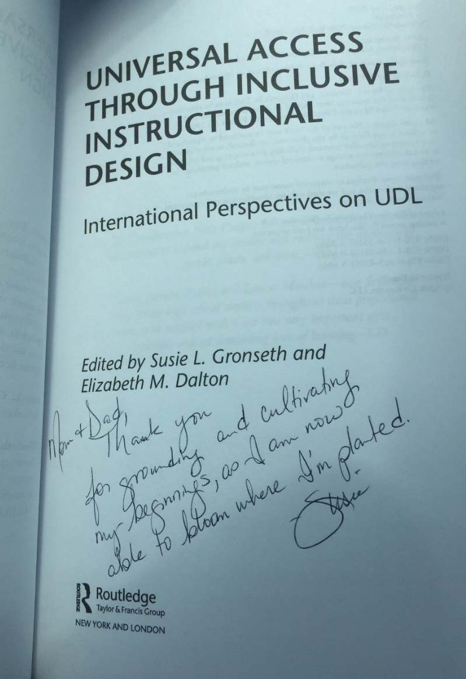
Celebrations!
Notes:
Benefits and things that bring joy

Slide 59
Curt Bonk
Discussion of Writing Tips and Recommendations for Graduate Students
Resource: http://www.trainingshare.com/pdfs/handouts/Tips-on-Writing_Publishing_Curt_Bonk.docx

Slide 60
Happy writing!
😀

