Slide 1
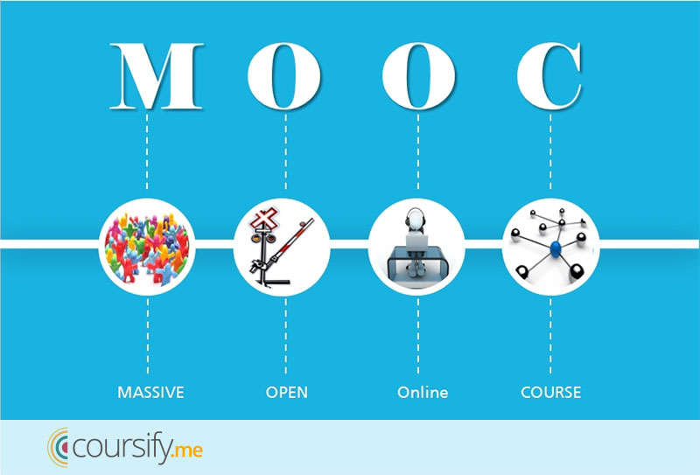
MOOC Research Looking Back: MOOC Research Looking Forward
Meina Zhu and Curtis J. Bonk
IST Department, Indiana University
AECT DDL, January 24, 2018

Slide 2
2015 Instructional quality of Massive Open Online Courses (MOOCs). Margaryan, Bianco, & Littlejohn, Computers & Education, 80, 77-83. http://www.sciencedirect.com/science/article/pii/S036013151400178X
“As MOOCs proliferate, drawing in increasing numbers of faculty and learners worldwide, the issue of their instructional quality becomes increasingly pressing.” (p. 82)

Slide 3
October 2015 Predictors of Retention and Achievement in a Massive Open Online Course Greene, Oswald, & Pomerantz, American Educational Research Journal, 52(5), 925-955. http://aer.sagepub.com/content/early/2015/05/08/0002831215584621
“If MOOCs are to fulfill their promise as a way of providing all learners with opportunities to obtain education at a low cost, much more research is needed regarding how to engage these students and help them to be successful in these environments.” (p. 952)

Slide 4
2015 Digging deeper into learners’ experiences in MOOCs: Participation in social networks outside of MOOCs, notetaking and contexts surrounding content consumption Veletsianos, Collier, & Schneider, BJET, 46(3), 570-587. http://onlinelibrary.wiley.com/doi/10.1111/bjet.12297/abstract
“To gain a deeper and more diverse understanding of the MOOC phenomenon, researchers need to use multiple research approaches (e.g., ethnography, phenomenology, discourse analysis) add content to them.” (p. 583.)

Slide 5
September 2016 MOOCs, Graduate Skills Gaps, and Employability: A Qualitative Systematic Review of the Literature David Santandreu Calonge and Mariam Aman Shah, IRRODL, 17(5), 67-90. http://www.irrodl.org/index.php/irrodl/article/view/2675/3881
“In 2013, research had already indicated that MOOCs offered unprecedented choice, customization and gave thousands of participants the possibility to have greater ownership and control over their learning experiences “rather than being constrained by centralized, instructor-controlled learning based on delivery of pre-fabricated curriculum” (McLoughlin, 2013). (p. 78.)

Slide 6
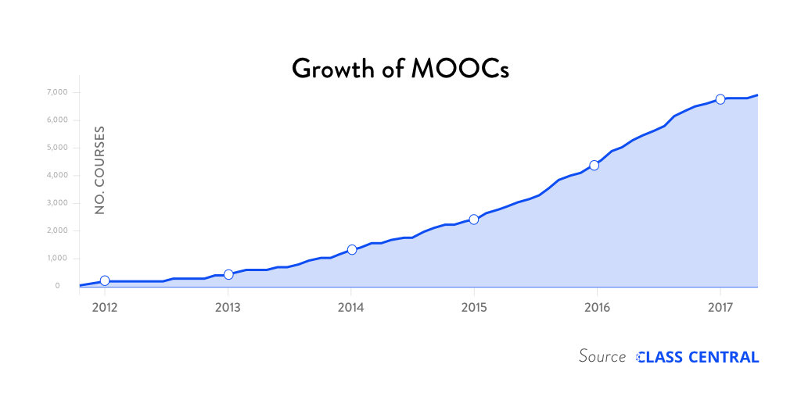
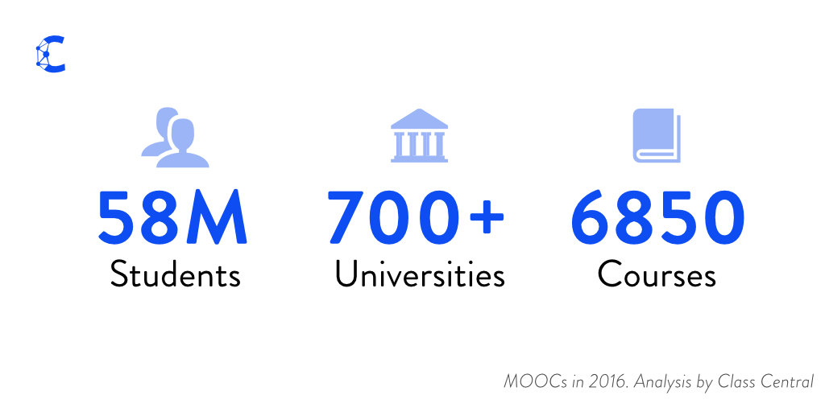
The Numbers: MOOCS in 2016 (Dec 25th, Class Central)
Notes:
Dhawa Shah, Class Central https://www.class-central.com/report/mooc-stats-2016/

Slide 7
Cumulative Growth in Number of MOOCs (2011-2017)
Notes:
Chronicle of Higher Education annual Almanac of data from August.

Slide 8
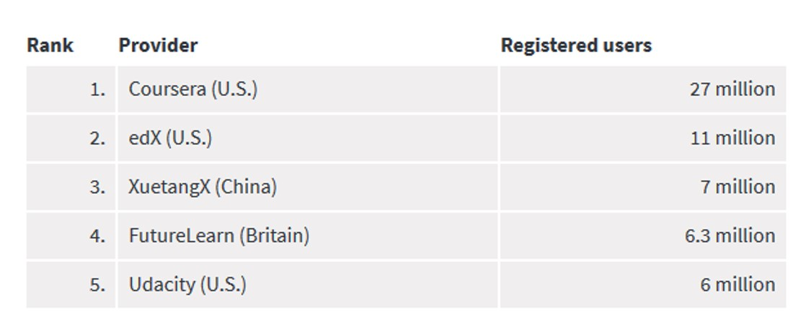
Top 5 MOOC providers by number of registered users (2017)
Notes:
Chronicle of Higher Education annual Almanac of data from August.

Slide 9
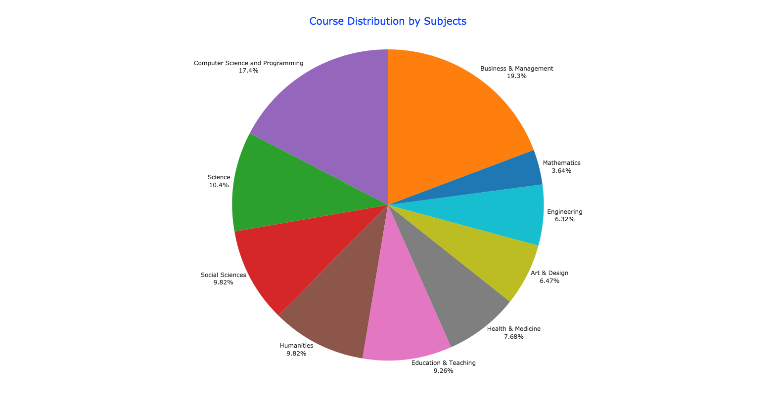
August 17, 2017 By the Numbers: MOOCs in 2016 Class Central, Dhawal Shah https://www.class-central.com/report/mooc-stats-2016/

Slide 10
August 17, 2017 By the Numbers: MOOCs in 2016 Class Central, Dhawal Shah https://www.class-central.com/report/mooc-stats-2016/

Slide 11
August 7, 2017 FutureLearn and Coventry University to Roll Out 50 Online Degrees (Last year Deakin University announced a similar partnership with FutureLearn) Class Central, Dhawal Shah https://www.class-central.com/report/futurelearn-coventry-university-roll-50-online-degrees/

Slide 12
June 15, 2017 Massive List of MOOC Providers Around The World, China and Korea (Where to Find MOOCs: The Definitive Guide to MOOC Providers ) University of China MOOC — icourse163.org / China Class Central, Dhawal Shah https://www.class-central.com/report/mooc-providers-list/

Slide 13
June 15, 2017 Massive List of MOOC Providers Around The World IndonesiaX (Where to Find MOOCs: The Definitive Guide to MOOC Providers ) Class Central, Dhawal Shah https://www.class-central.com/report/mooc-providers-list/

Slide 14
August 7, 2017 FutureLearn and Coventry University to Roll Out 50 Online Degrees (Last year Deakin University announced a similar partnership with FutureLearn) Class Central, Dhawal Shah https://www.class-central.com/report/futurelearn-coventry-university-roll-50-online-degrees/

Slide 15
MOOC Study #1: Looking Back
A Systematic Review of Research Methods and Topics of the Empirical MOOC Literature (2014-2016)
Zhu, M., Sari, A., & Lee, M. M. (2018). A Systematic Review of Research Methods and Topics of the Empirical MOOC Literature (2014-2016). The Internet and Higher Education.

Slide 16
Research Background
MOOC offerings continue to surge (Almanac, 2017-2018; Shah, 2016)
A scarcity of systematic analysis of empirical studies of recent MOOC research that targets all of the following aspects: research methods adopted by MOOC researchers, the research topics, the geographic locations of MOOC researchers, and the regions of the MOOC delivery.

Slide 17
Research Purpose & Questions
To gain a deeper and more diverse understanding of the current MOOC phenomenon by reviewing recent articles.
1. What are the research methods researchers employed in empirical MOOC studies?
2. What are the research topics or focuses in MOOC studies?
3. How are researchers of empirical MOOC studies geographically distributed?
4. In terms of the delivery of the MOOC, what are the countries which are attracting the most research?

Slide 18
Context (Zhu, M., Sari, A., & Lee, M. M., 2018)

Slide 19
Context (Zhu, M., Sari, A., & Lee, M. M., 2018)
No. | Journal | Total
1 | International Review of Research in Open and Distance Learning (IRRODL) | 31
2 | Computers & Education | 12
3 | British Journal of Educational Technology | 9
4 | Online Learning | 7
5 | Distance Education | 5
6 | Educational Media International | 5
7 | Internet and Higher Education | 5
8 | Journal of Computer Assisted Learning | 5
9 | Computers in Human Behavior | 4
10 | Open Learning | 4
11 | Journal of Online Learning and Teaching | 3
12 | Journal of Asynchronous Learning Network | 3
Primary Journals of MOOC Publications (2014-2017)

Slide 20
Context (Zhu, M., Sari, A., & Lee, M. M., 2018)
Location of MOOC Research Team Members (2014-2016)

Slide 21
Country of Origin of MOOC Delivery (2014-2016)
Context (Zhu, M., Sari, A., & Lee, M. M., 2018)

Slide 22
Findings (Zhu, M., Sari, A., & Lee, M. M., 2018)
RQ1: What are the research methods researchers employed in empirical MOOC studies?

Slide 23
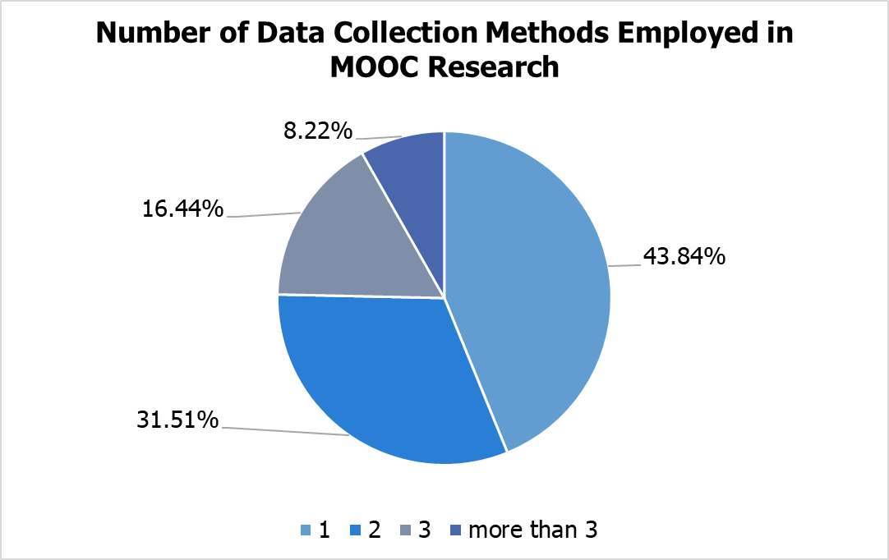
Findings (Zhu, M., Sari, A., & Lee, M. M., 2018)
RQ1: What are the research methods researchers employed in empirical MOOC studies?

Slide 24
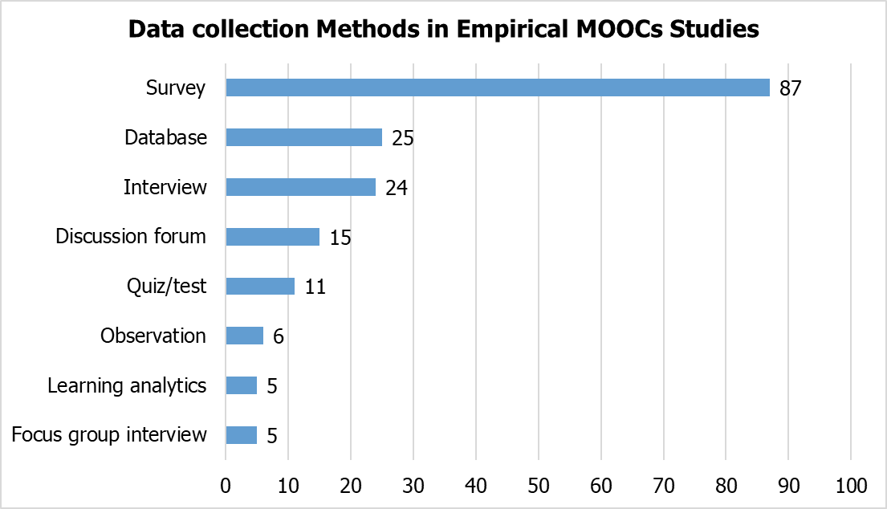
Findings (Zhu, M., Sari, A., & Lee, M. M., 2018)
RQ1: What are the research methods researchers employed in empirical MOOC studies?

Slide 25
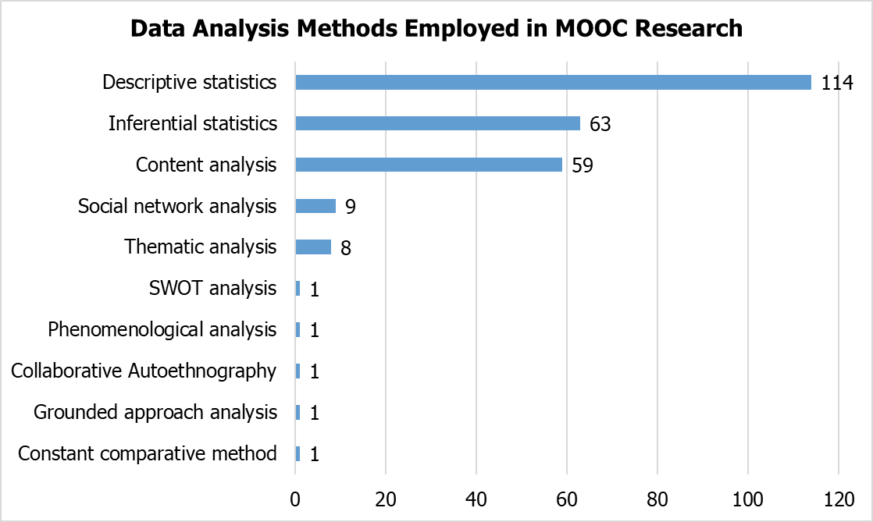
Findings (Zhu, M., Sari, A., & Lee, M. M., 2018)
RQ1: What are the research methods researchers employed in empirical MOOC studies?

Slide 26
Findings (Zhu, M., Sari, A., & Lee, M. M., 2018)
RQ2: What are the research focuses in MOOC studies?
Primary/general focus of MOOC delivery (out of 146 studies)
(note: some studies have more than one area of focus)

Slide 27
Findings (Zhu, M., Sari, A., & Lee, M. M., 2018)
Research methods used in each research topic (out of 146 studies)
 | Quantitative | Qualitative | Mixed methods
Student-focused | 39 | 9 | 26
Design-focused | 19 | 12 | 17
Context and impact | 9 | 6 | 5
Instructor-focused | 0 | 3 | 2

Slide 28
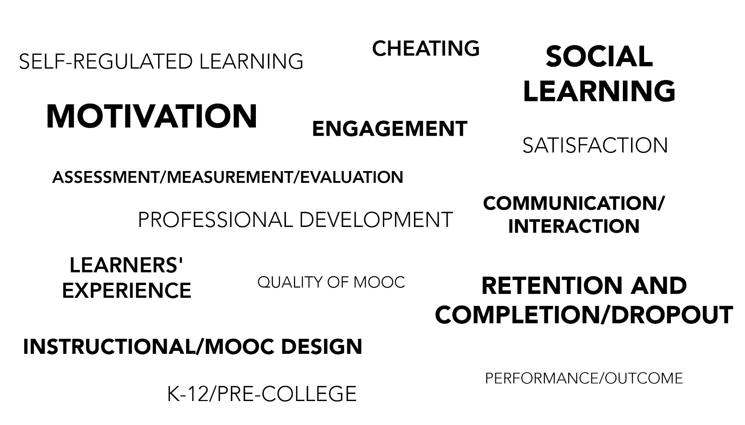
Specific Focus of MOOC Research (2014-2016)

Slide 29
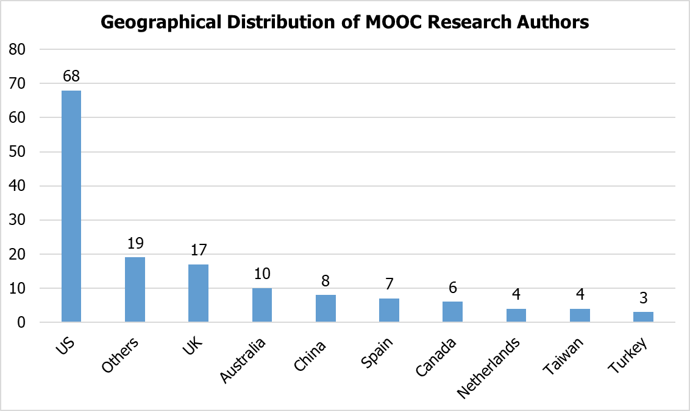
Findings (Zhu, M., Sari, A., & Lee, M. M., 2018)
RQ3: How are researchers of empirical MOOC studies geographically distributed?

Slide 30
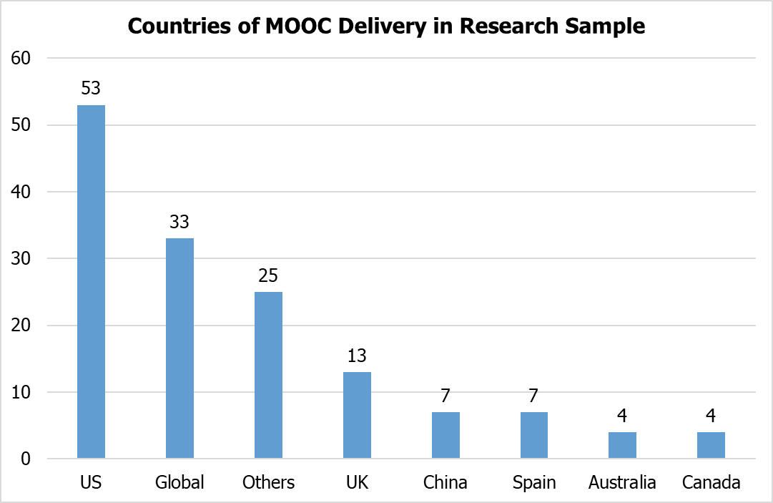
Findings (Zhu, M., Sari, A., & Lee, M. M., 2018)

Slide 31
MOOC Study #2: Looking Forward
MOOC Instructor Experiences and Pedagogical Choices:
Documenting Key Instructional Design Considerations and Challenges
Zhu, Bonk, & Sari (manuscript in review)

Slide 32
Research Background
MOOCs can be beneficial to both learners and instructors (Hew & Cheung, 2014)
Instructional design is critical for online learning (MOOC) (Johnson & Aragon, 2003; Phipps & Merisotis, 1999)
Instructors are one of the five main components of MOOCs; the other four are learners, topic, material, and context (Kop, 2011 )
Few studies have examined instructional design from MOOC instructors’ perspectives (Margaryan et al., 2015; Ross, Sinclair, Knox, Bayne, & Macleod, 2014; Watson et al., 2016)

Slide 33
Research Purposes & Questions
Research Questions:
What are the design considerations of instructors when designing MOOCs?
What challenges do instructors perceive when designing MOOCs?
How do instructors address the challenges that they perceive related to MOOCs?

Slide 34
Research Methods-Design
Sequential mixed methods design (Creswell & Clark, 2007)

Slide 35
Research Methods (Zhu, Bonk, & Sari, in review)
Data Collection:
survey, interview, and course review
Participants:
143 survey participants (10% response rate) and 12 interviewees

Slide 36
Research Methods
MOOC instructors interviewed
No. | Countries | Subject areas | Platforms
1. | The U.S. | Language and Literacy | Coursera
2. | The U.S. | Education | Coursera
3. | The U.S. | Education | Canvas
4. | The U.S. | Chemistry | Coursera
5. | UK | Public health | FutureLearn
6. | UK | Language and Literacy | FutureLearn
7. | Hong Kong | Math | Coursera
8. | Mainland China | Math | Coursera
9. | Canada | Psychology | Coursera
10. | Australia | Public Health | Open2Study
11. | Sweden | Computer Science | edX
12. | India | Management | edX

Slide 37
Data Analysis
RQs | Data Sources | Data analysis
RQ1 | Survey-multiple-choice questions Survey-open-ended questions Interview MOOC review | Descriptive statistics Content analysis (Elo & Kyngäs, 2008) Content analysis Content Analysis
RQ2 | Survey-multiple-choice questions Survey-open-ended questions Interview | Descriptive statistics Content analysis Content analysis
RQ3 | Survey-multiple-choice questions Interview | Descriptive statistics Content analysis

Slide 38
Analytical Framework
Alario-Hoyos, Pérez-Sanagustín, Cormier, and Kloos’ (2014) MOOC design considerations
Design considerations | Example (Alario-Hoyos et al, 2014)
Resources | Technology resources and human resources
Pedagogy | Motivate students, participatory learning, and collaborative community etc.
Logistics | Time required while planning MOOCs and peer assessment

Slide 39
Context

Slide 40
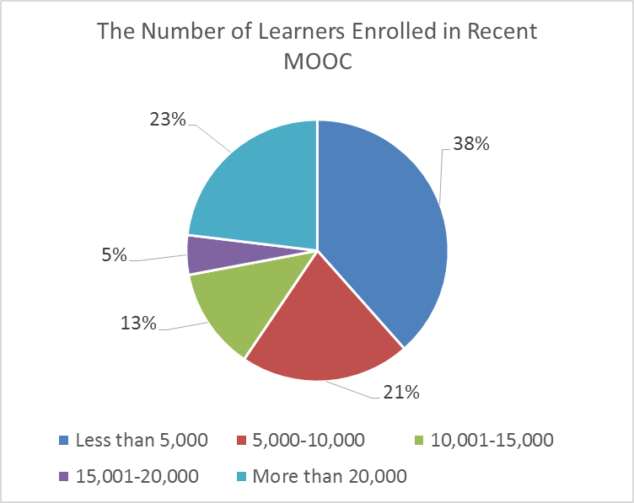
Context

Slide 41
Context

Slide 42
Context

Slide 43
Context

Slide 44
Context

Slide 45
Findings
RQ #1. What are the design considerations of instructors when designing MOOCs?
Learning objectives
Assessment
Time for designing MOOC
Engaging learners

Slide 46
Findings
Engaging learners (One of the 12 interview themes)
One instructor from the UK mentioned:
“When we were designing, we tried to have a hook for each week, a reason for learners to come back each week. So, we built that into our learning design. So what's going to be the big thing that makes you want to join the course in Week One.”

Slide 47
Findings
RQ #1-1. How do MOOC instructors design the course to encourage interaction among learners?
Asynchronous discussion forums
Pair-based types of tasks
Social media

Slide 48
Findings

Slide 49
Findings
Asynchronous discussion forums
One instructor mentioned:
“And then there's also an asynchronous discussion board within each module. So there will be prompt…And then there were a lot of discussions back and forth with students about suggestions on things they could consider, or maybe there were stuck on something and so they would like help…Within discussion forum, there's a showcase and that is the opportunity to get feedback from peers.”

Slide 50
Findings
RQ #1-2. How do MOOC instructors design the course to encourage interaction between instructor and learners?
Online discussion forums
Platform messages
Social media connections

Slide 51
Findings

Slide 52
Findings
Online discussion forum
One instructor mentioned:
“We monitor discussion boards as well. That would not necessarily be like formal assessment. We're just wondering how students are engaging with material. So it's an indicator for us but not a measurable one”

Slide 53
Findings
Not much instructor-learner interaction
One instructor mentioned:
“Because there's not much interaction, even between me and students. When I first launched this MOOC, I paid closer attention. Maybe I replied to some students. Now I think Coursera somehow grabs some students to be mentors or something. There are other people commenting. It seems like I do not have to do anything. Every week, perhaps three hundred more students register. Nobody bothers me.”

Slide 54
Findings
Not much instructor-learner interaction
One instructor from the U.S. mentioned:
“In the classroom there's more of an interaction at least a reaction between like the instructor and the students, students and student, and you can't really simulate that in this kind of MOOC format.”

Slide 55
Findings

Slide 56
Findings

Slide 57
Findings
An instructor from the US mentioned
“Within discussion form, there's a showcase and that is the opportunity to get feedback from peers. And also we have facilitators, who are volunteers, who go in and offer feedback.”

Slide 58
Findings
RQ #1-3. How do MOOC instructors design the course to encourage learner-content interaction?
Discussion forum
Embedded video lectures and tutorials
Article or book readings

Slide 59
Findings

Slide 60
Findings
One professor from the U.S. stated that:
“Besides videos, there was a suggested book.”
Another instructor noted that she used visuals in her MOOC “I had a whole lot of graphical material that I used in class. And I had got them from one of the texts that were published in the area and had been allowed to use them, because I was recommended the textbook.”

Slide 61
Findings
RQ #2. What challenges do instructors perceive when designing MOOCs?
Assessment methods
Engaging students’ learning
Time limitation

Slide 62
Findings
Time limitation (One of the 12 interview themes)
One instructor mentioned:
“I think one of the challenges is time. It does take a lot of time to get the videos done. I did not get a course release when I was doing, and it was a side project at the same time as my regular load. I think it gets to be concentration and balance about what's going on.”

Slide 63
Findings
RQ #3. How do instructors address the challenges that they perceive related to MOOCs?
Explore other MOOC examples
Seek help from the platform/Colleagues/institutions

Slide 64
Findings
Team work (One of the 12 interview themes)
Teamwork. It was amazing to have such support on the development side. There was never a time where I wrote a script for a MOOC. It was like: “OK. Let's go with this.” There was always a discussion…We think examples to clarify that for visual learners or learners who respond better to auditory cues. So the challenges were never greater than the team here.

Slide 65
Discussion
The pedagogical factors were the primary design considerations and challenges in MOOC design (Watson, S. L., Loizzo, J., Watson, W. R., Mueller, C., Lim, J., & Ertmer, P. A., 2016).
The assessment and engagement strategies are the main considerations as well as challenges (Hew & Chung, 2014).
The time limitation of creating MOOCs was the primary logistical consideration (Hew & Chung, 2014; Watson et al., 2016).

Slide 66
Discussion
Most MOOC instructors emphasized a variety of strategies to encourage learner-learner interaction by using asynchronous discussion forums, pair-based assignments or peer reviews, and social media to encourage peer interaction.
Learner-instructor interaction were encouraged through online discussion forum, platform messages, and social media connections.
Learner-content interaction: discussion forums or threads, video lectures and tutorials in the MOOC, readings, practice quizzes and exams were primarily used in MOOCs.

Slide 67
Conclusions
This study indicated that MOOC instructors are trying to encourage online interaction in MOOC; however, there is no universal understanding of strategies of encouraging online interaction and instructor-learner interaction is still not optimal.

Slide 68
Limitations
Limited to MOOCs which are mainly delivered in English
Volunteer bias
Only review 12 MOOC Courses

Slide 69
Implications
For MOOC instructors:
May inform them about what other instructors are most concerned with and tend to target in MOOC design as well as their efforts in addressing the possible design challenges.
For instructional designers:
May help them in the consulting process.

Slide 70
Future Studies
Assessment design
Engaging activity design
Course design that supports self-directed learning
Further observations and analyses are needed to better understand how MOOC instructor design and deliver their MOOCs to encourage online interaction and learner success.

Slide 71
Thank you! Questions and Comments…
AECT Webinar, January 24, 2018
Meina Zhu, IU, meinzhu@umail.iu.edu
Curtis J. Bonk, IU, cjbonk@Indiana.edu

