Slide 1
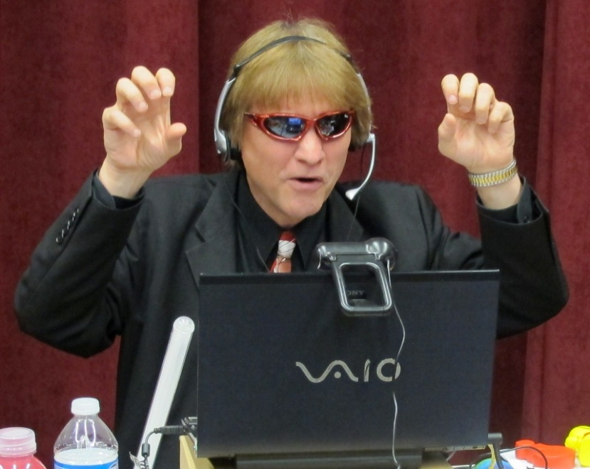
Myths and Magic Moments for Online Learning
Curt Bonk, Professor, Indiana University
cjbonk@indiana.edu
http://curtbonk.com/

Slide 2
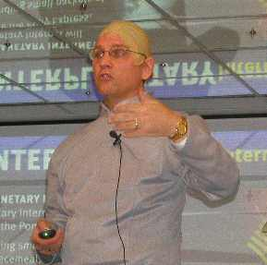
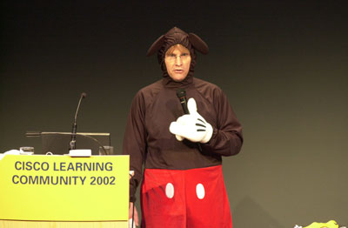
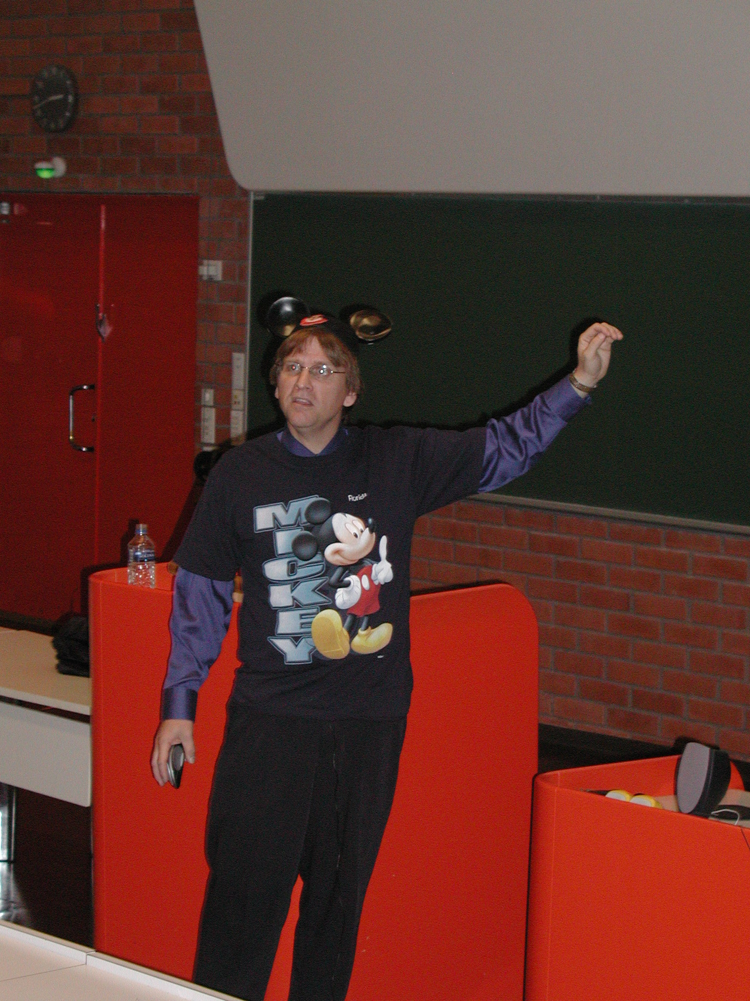
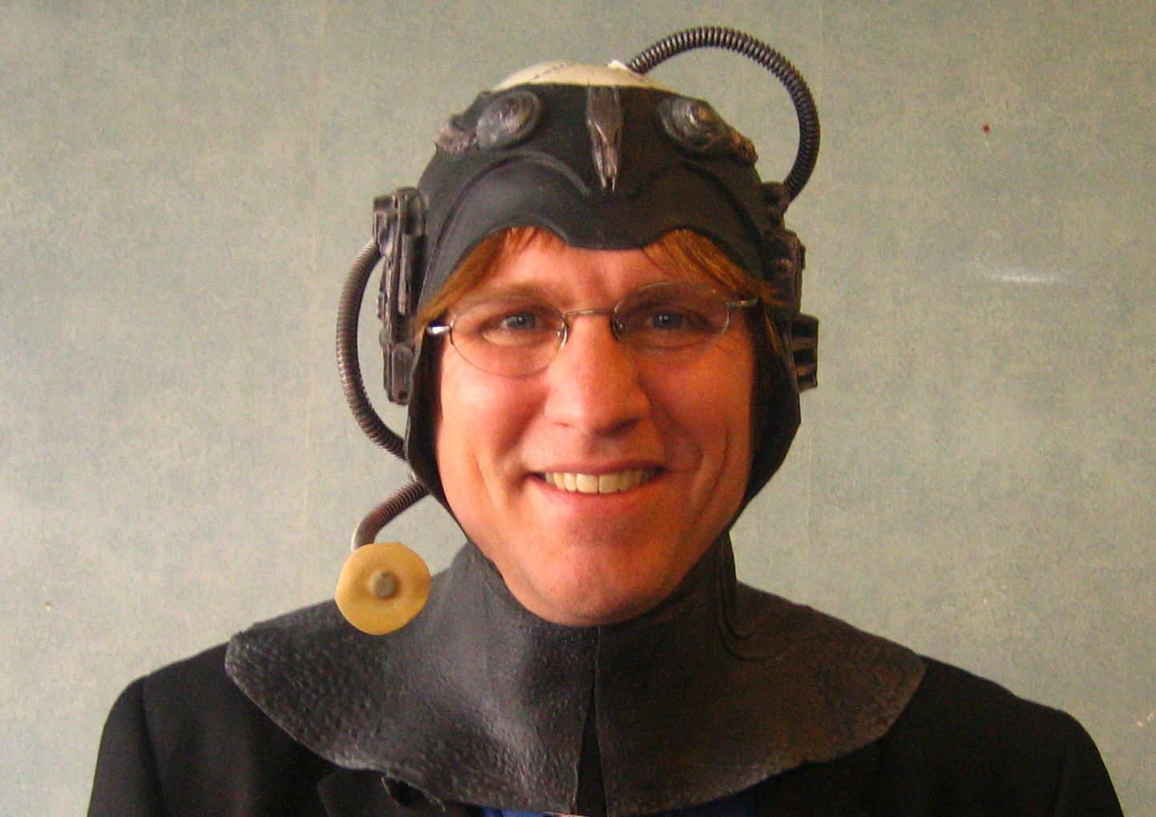
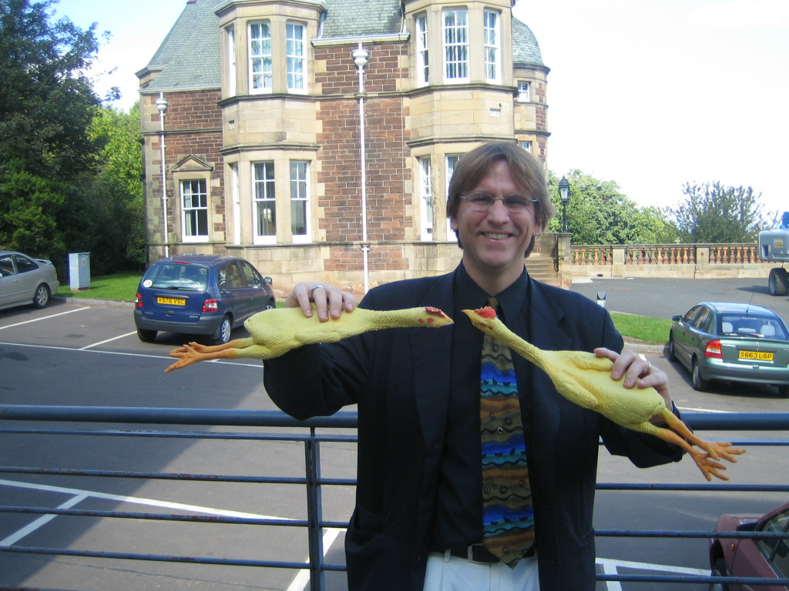
Not a Myth: I used to be fun…now I am serious

Slide 3
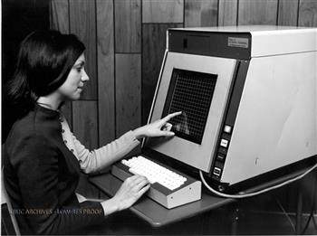
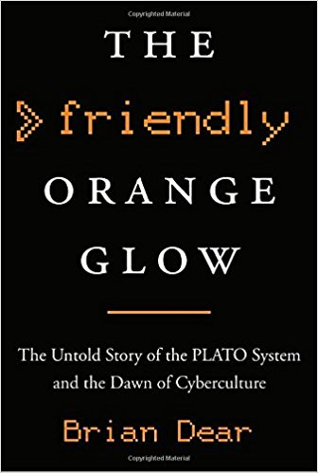
Myth #1: Learning Online is too new! How PLATO changed the World…in 1960 Cait Etherington, ElearningInside News https://news.elearninginside.com/how-plato-changed-the-world-in-1960/

Slide 4
Myth #2: You can’t earn a degree online

Slide 5
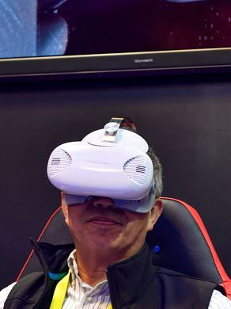
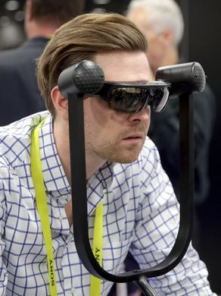
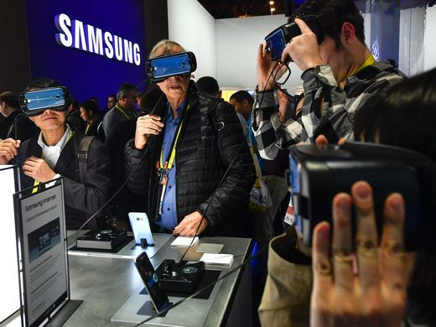
Myth #3: You have to be a tech whiz to complete online courses

Slide 6
Myth #4. You will get behind

Slide 7
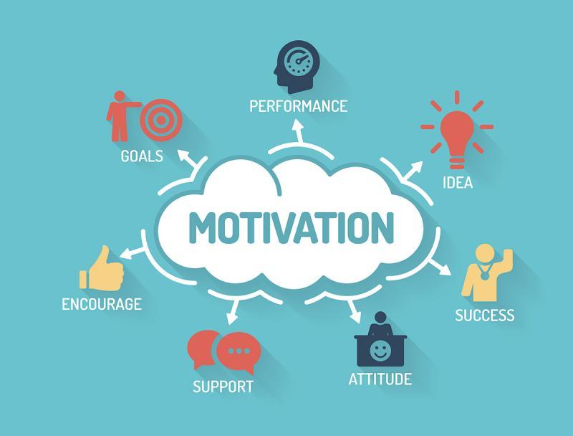
Myth #5. Everyone tends to procrastinate online

Slide 8
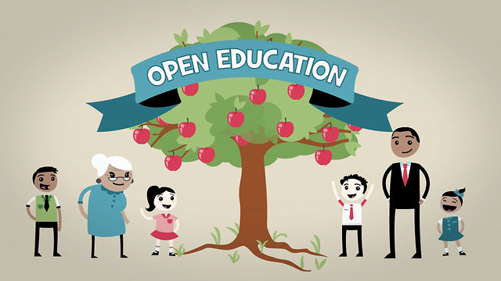
Myth #6: Open textbooks cannot be trusted OER Adoptions on the Rise Lindsay McKenzie, Inside Higher Ed https://www.insidehighered.com/news/2017/12/19/more-faculty-members-are-using-oer-survey-finds

Slide 9
Myth #7: You can’t have a personal life. Focused Ga. Mom Completes College Exam While in Labor, Fox 5, Atlanta http://www.fox5atlanta.com/news/50990044-story

Slide 10
Myth #8: Online learning is too time-consuming 250 MOOCs and Counting: One Man’s Educational Journey, Chronicle of Higher Education If the MOOC movement has faded, nobody told Jima Ngei. Mr. Ngei, who lives in Port Harcourt, Nigeria, has completed and passed 250.
Jima Ngei: “I had this unrelenting fear that this miracle of free access might evaporate soon.”

Slide 11
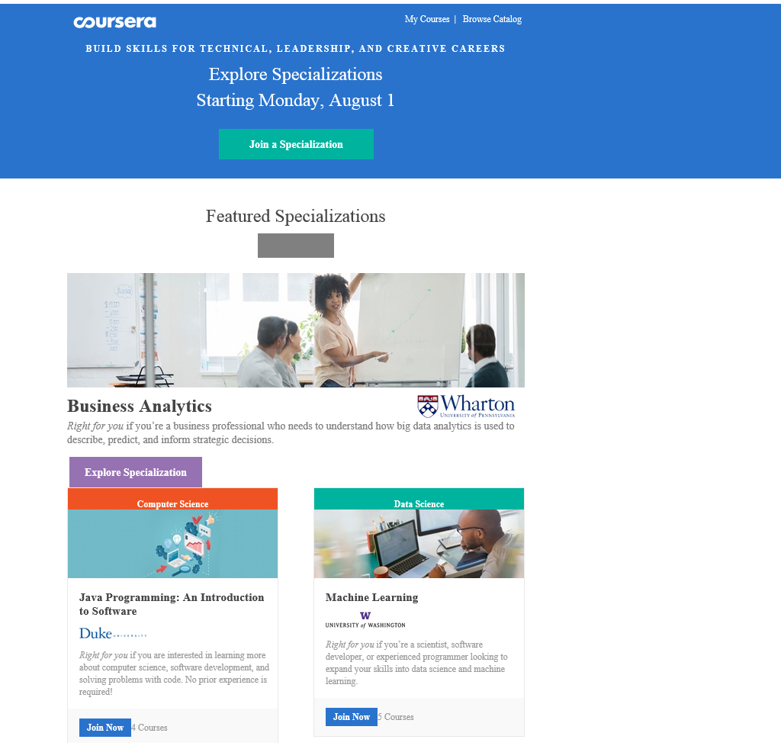
Myths #9: Credentials take too long Microcredentials and Nanodegrees edX Expands MicroMasters Programs With Data Science (“nanodegrees”)

Slide 12
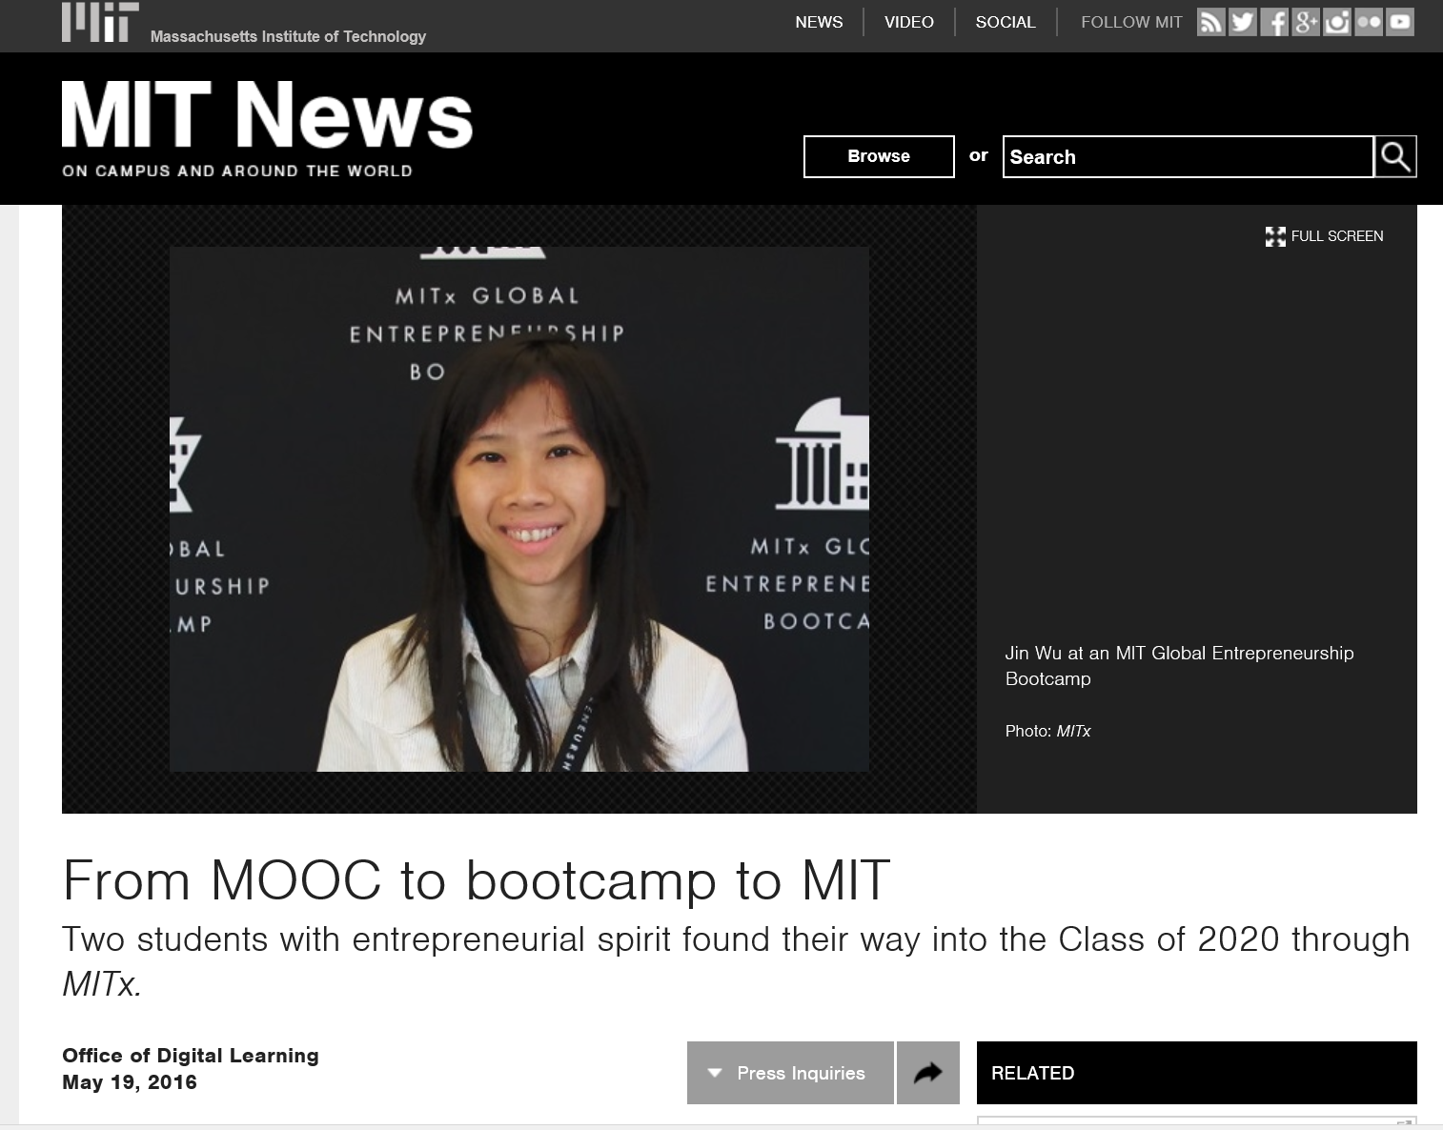
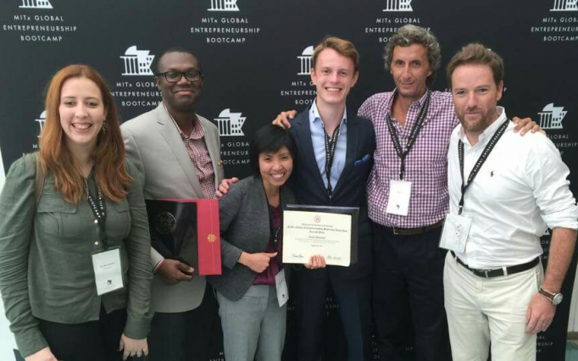
Myth #10: I’m too young to learn online From MOOC to bootcamp to MIT MIT News, Office of Digital Learning (Jin Wu—from MITx to MIT Global Entrepreneurship Bootcamp to master’s student) http://news.mit.edu/2016/mooc-bootcamp-mit-0519

Slide 13
Myth #11: I’m too old to learn online An 80-Year-Old Graduate With an Online Marketing Degree Kept His Promise, The Texas Tribune http://www.nytimes.com/2012/11/30/us/80-year-old-graduate-of-wgu-texas-kept-his-promise.html?ref=education&_r=0

Slide 14
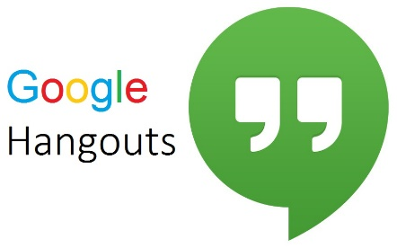
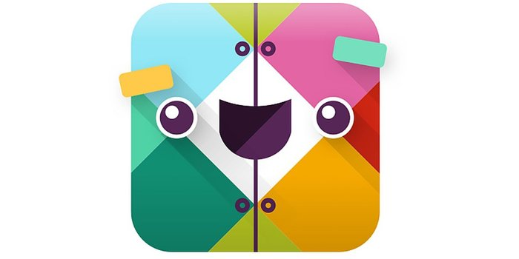
Interaction
Although you are not in a classroom physically, it doesn't mean you can't interact with fellow students and instructors: Phone, messengers, video chats, emails – they all make eLearning interactive. Some educators have online office hours and others have synchronous chats with experts.
Synchronous communication technologies
Google Hangouts YouTube Live
Asynchronous communication technologies
Discussion forum Blog Slackbot Flickr
Notes:
https://elearningindustry.com/7-myths-about-elearning

Slide 15
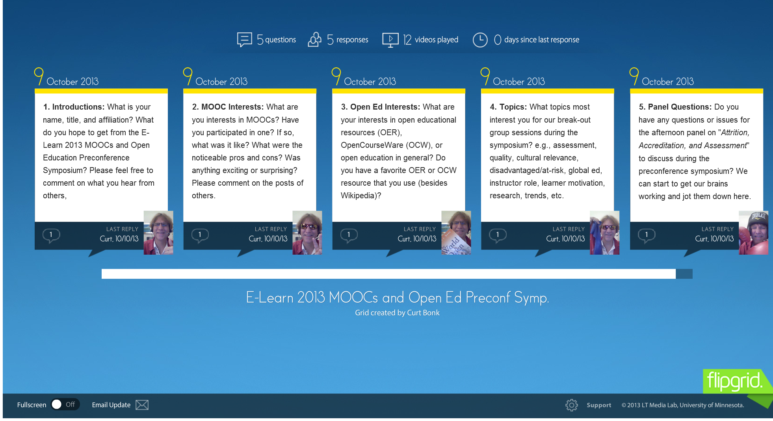
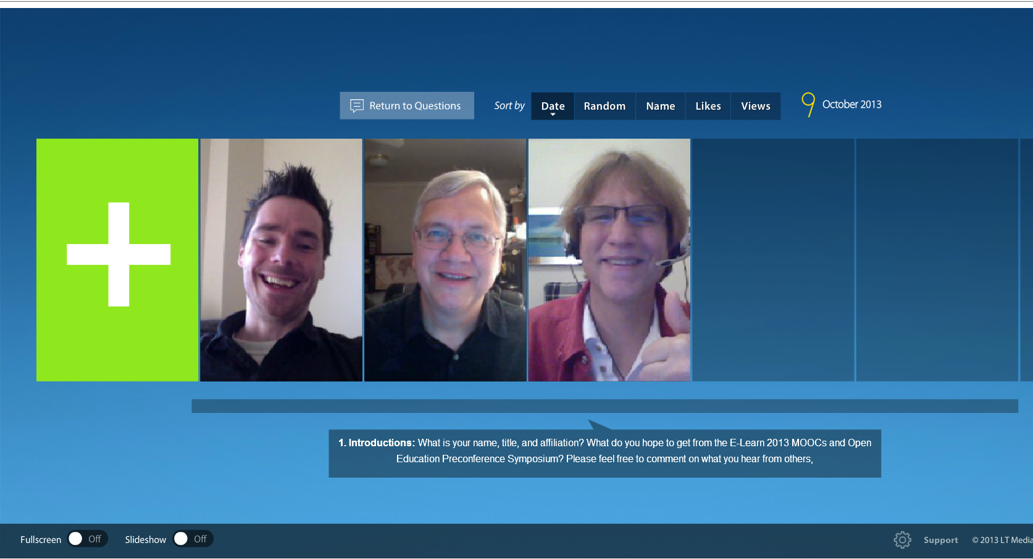
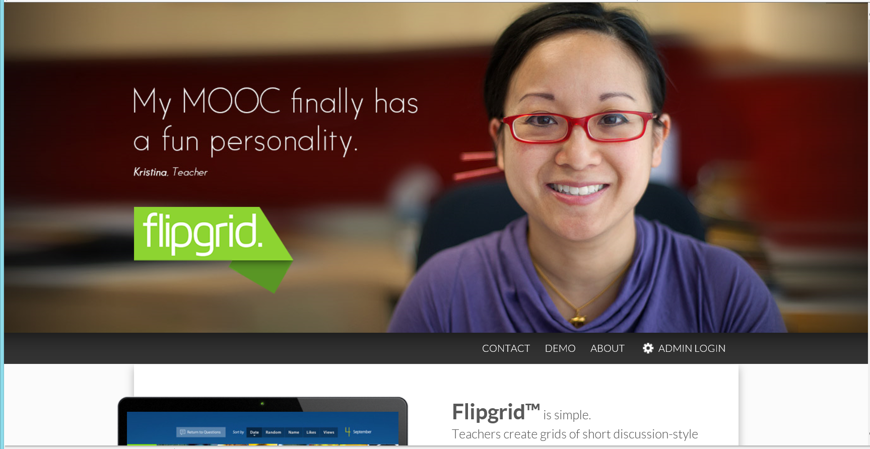
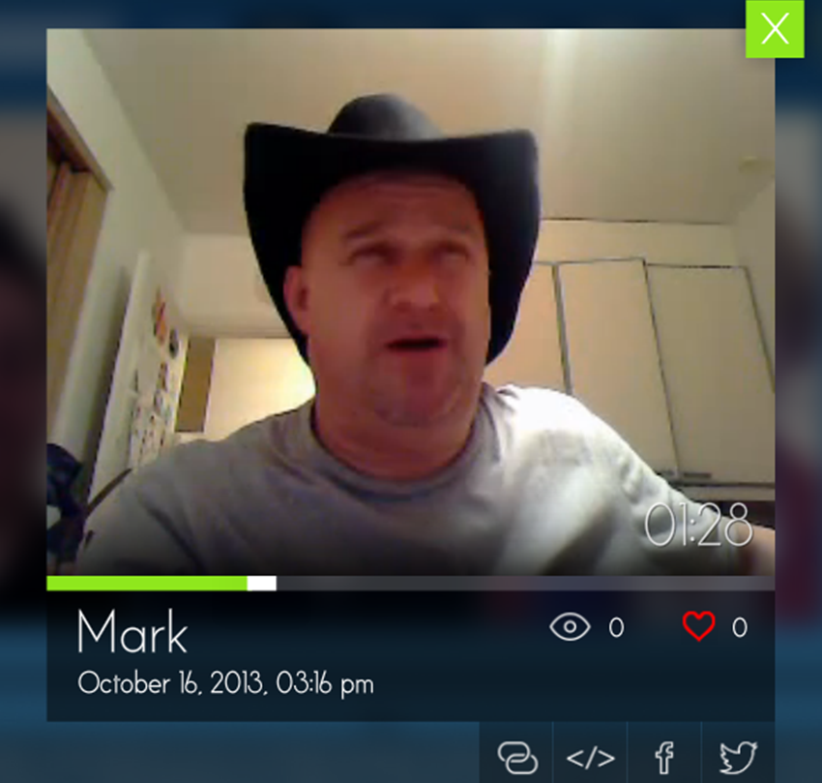
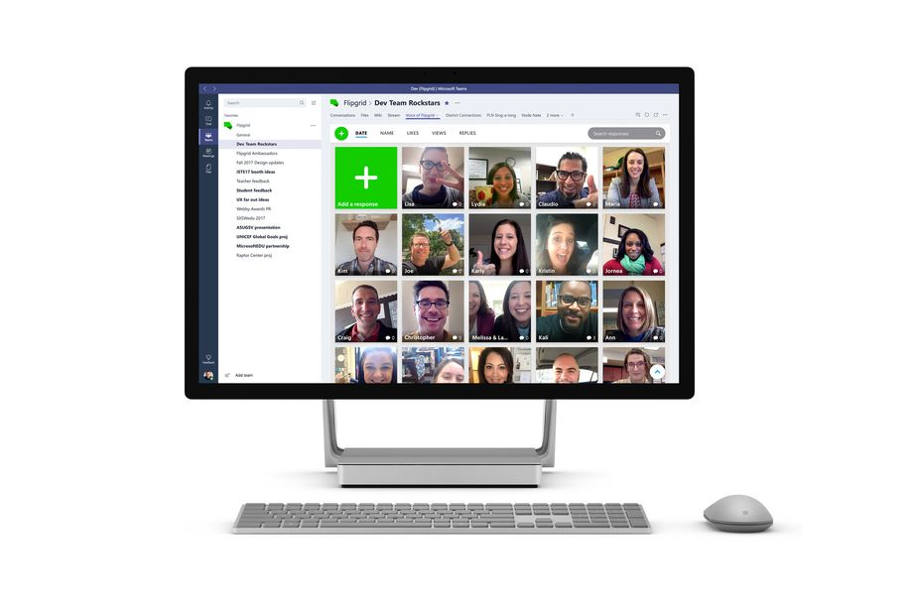
Myth #12. Online learning is lonely and not interactive (e.g., Flipgrid) https://techcrunch.com/2018/06/18/microsoft-acquires-social-learning-platform-flipgrid/

Slide 16
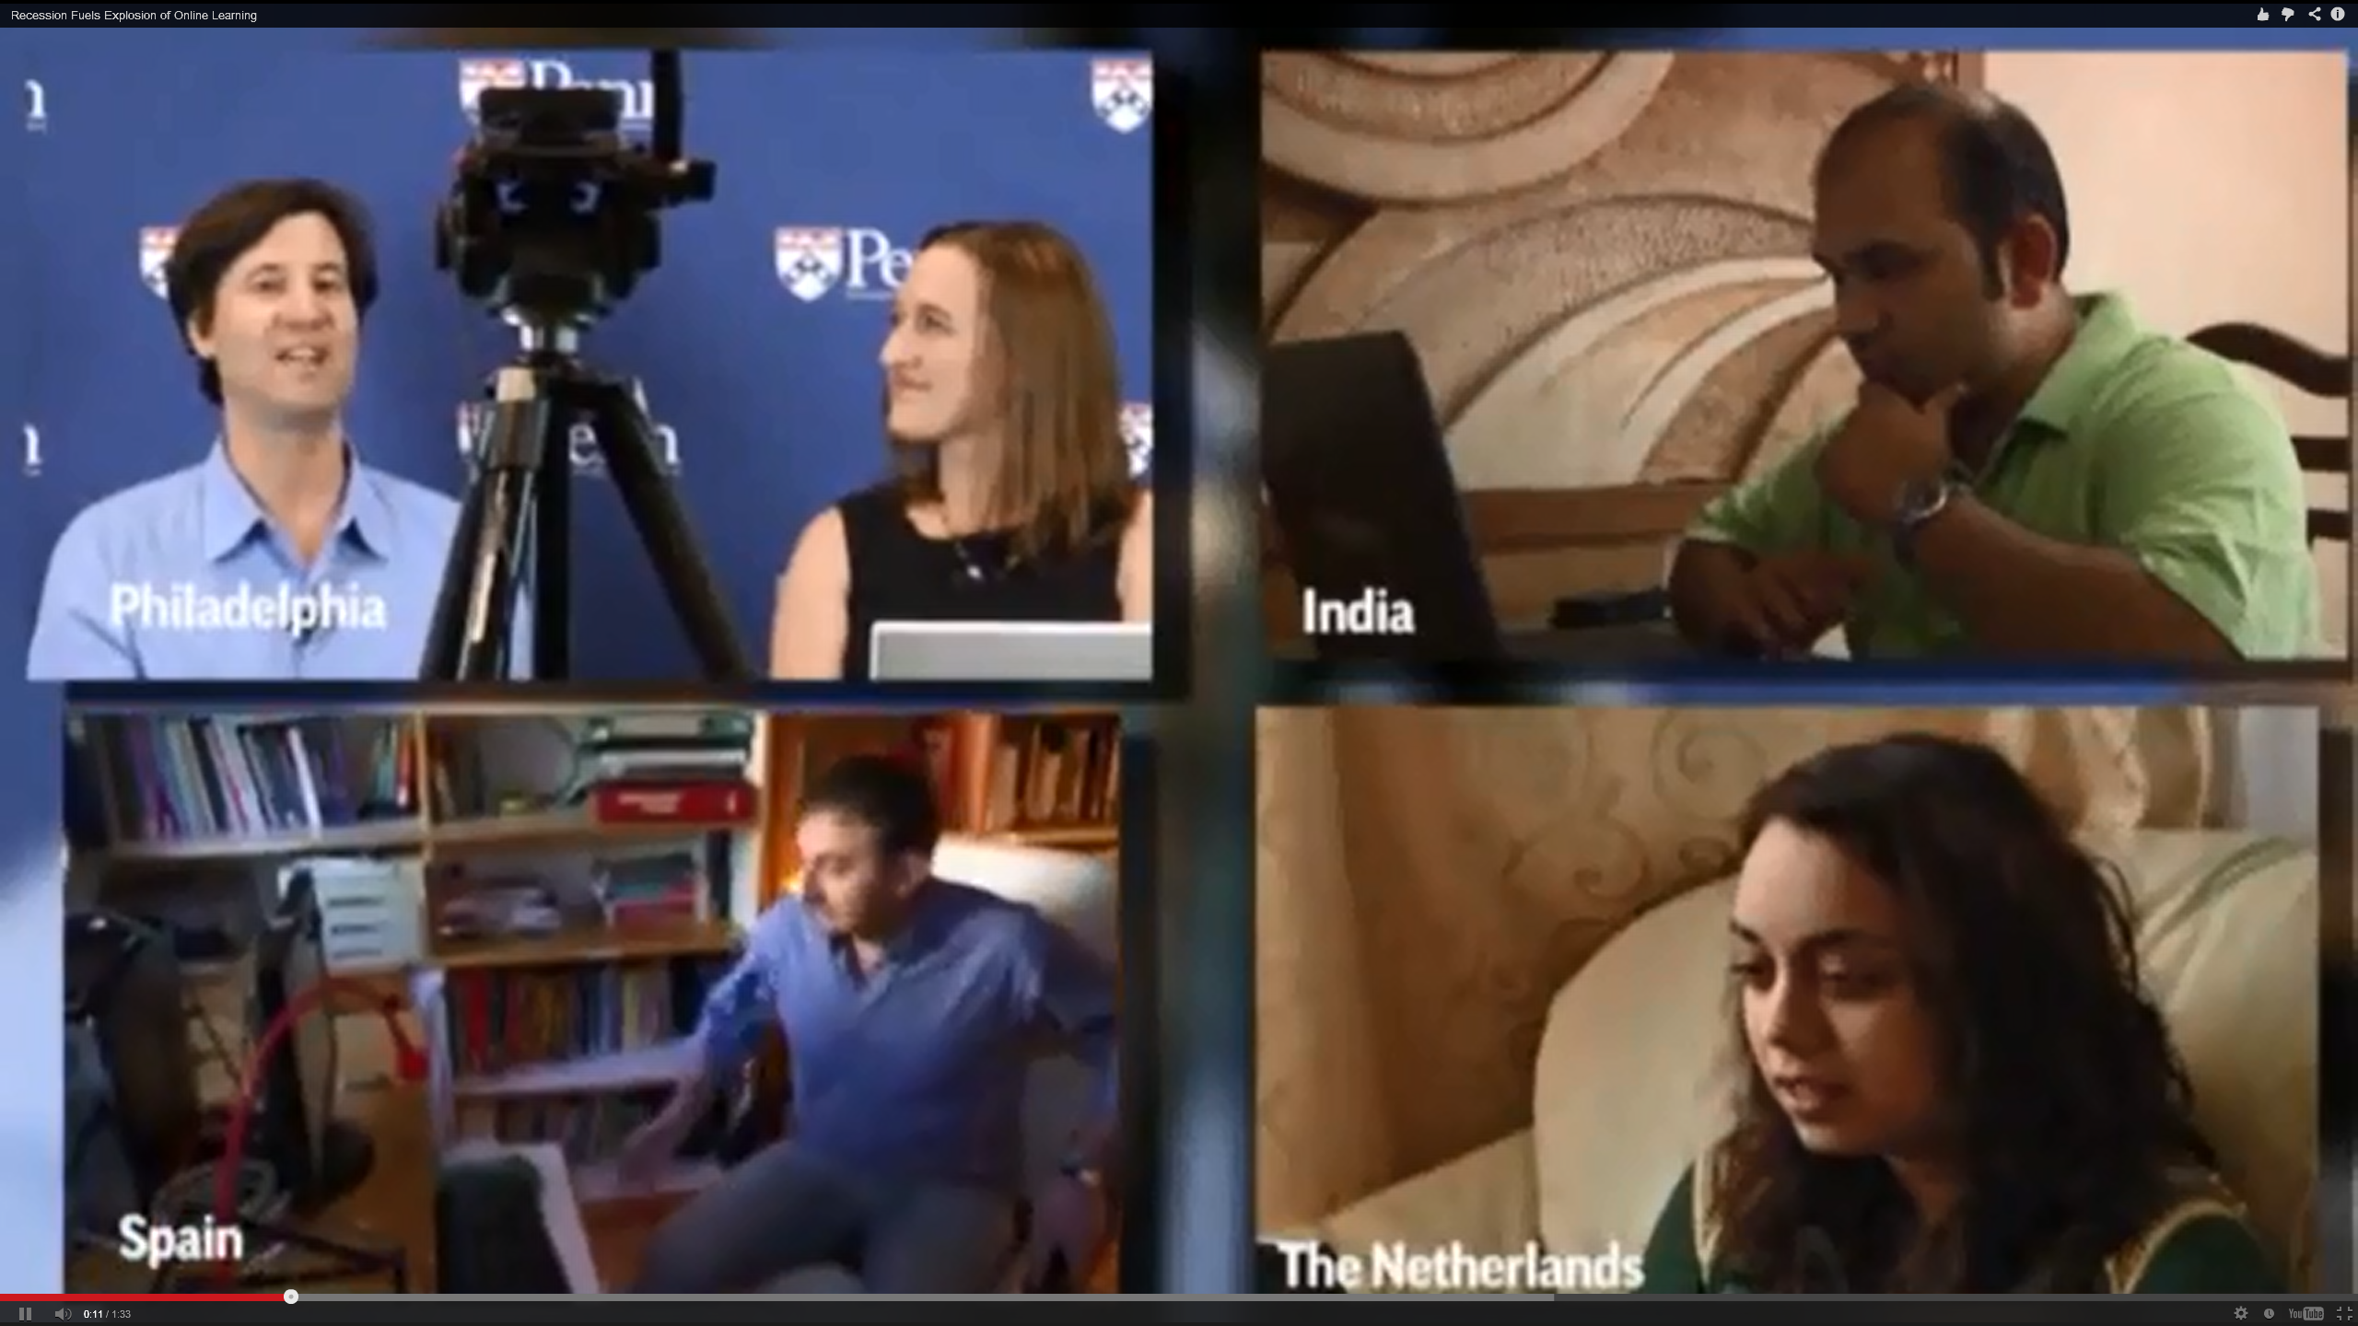
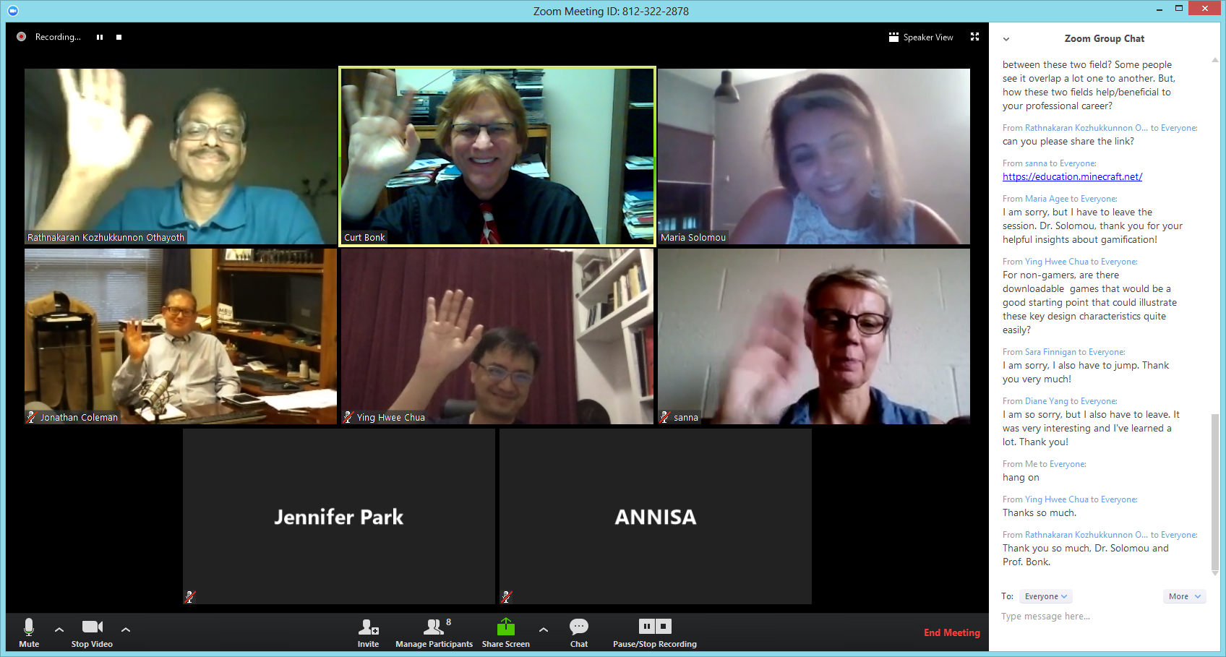
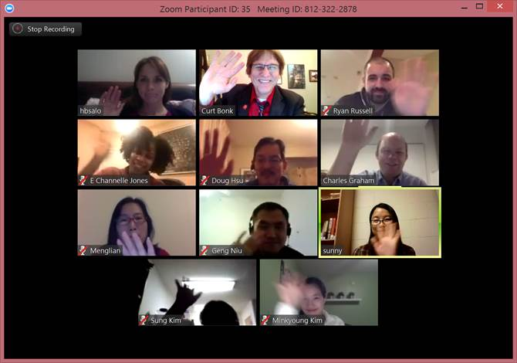
Myth #13: Online courses do not provide for social presence and caring

Slide 17
Myth #14: Students will be bored and sleepy online

Slide 18
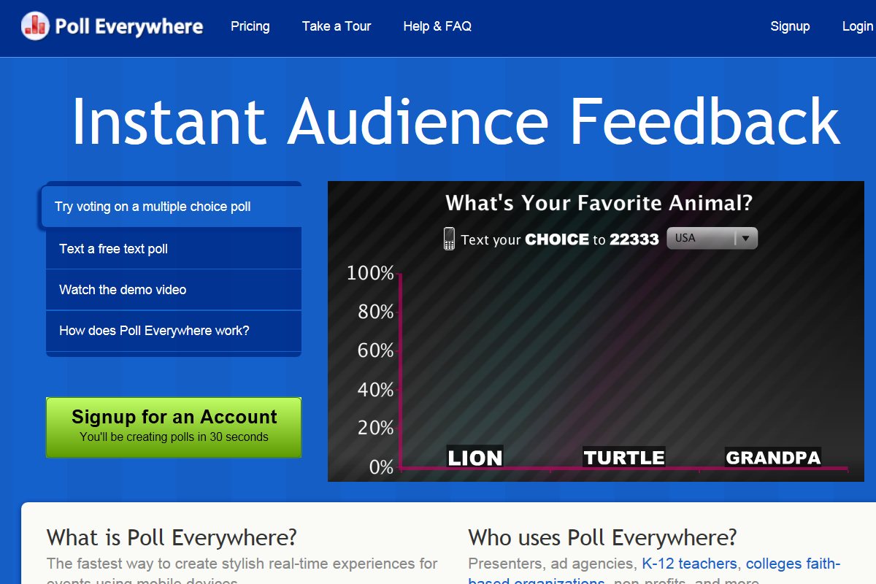
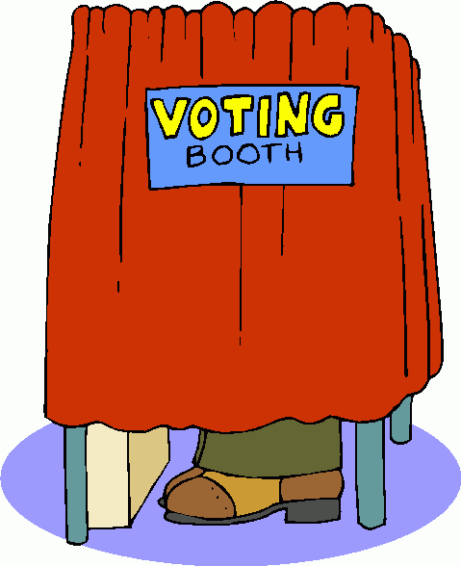
Myth #15. Online learning is lonely (e.g., Poll Everywhere, BlogPolls, BlogPoll, MicroPoll)

Slide 19
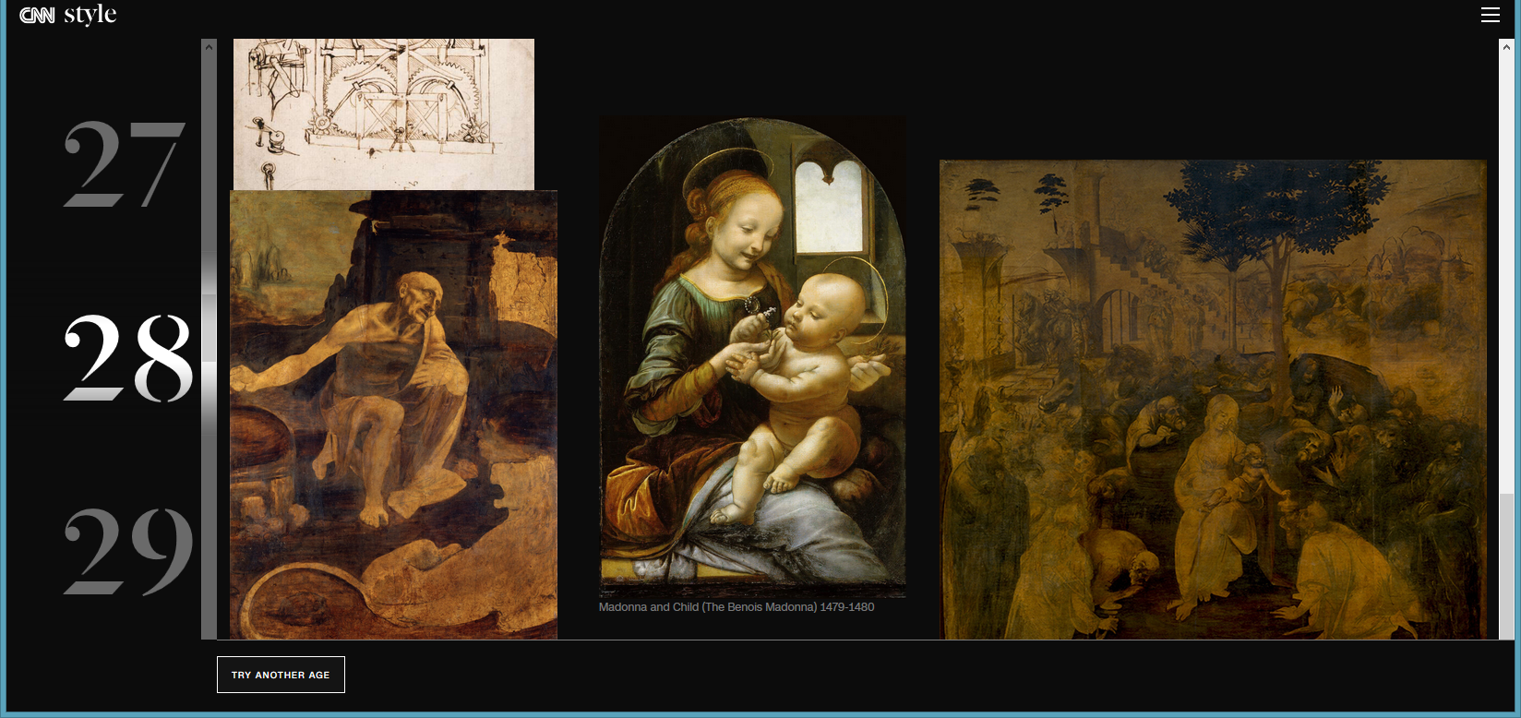
May 2, 2019 Myth #16: The content is not interactive What was Leonardo da Vinci doing at your age?, CNN https://www.cnn.com/interactive/style/leonardo500/

Slide 20
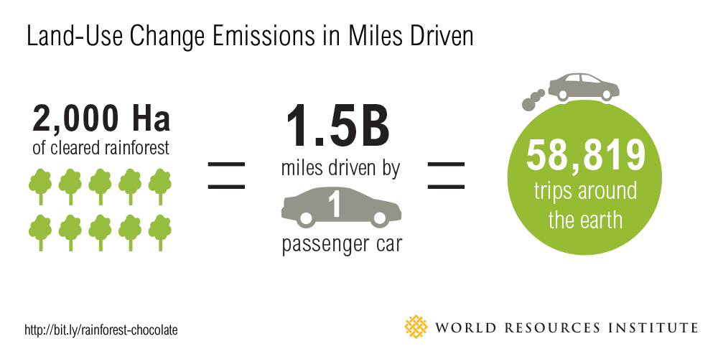
Myth #17: Online learning is too complicated Interpreting Interactive Graphs and Infographics How much rainforest in that chocolate bar?

Slide 21
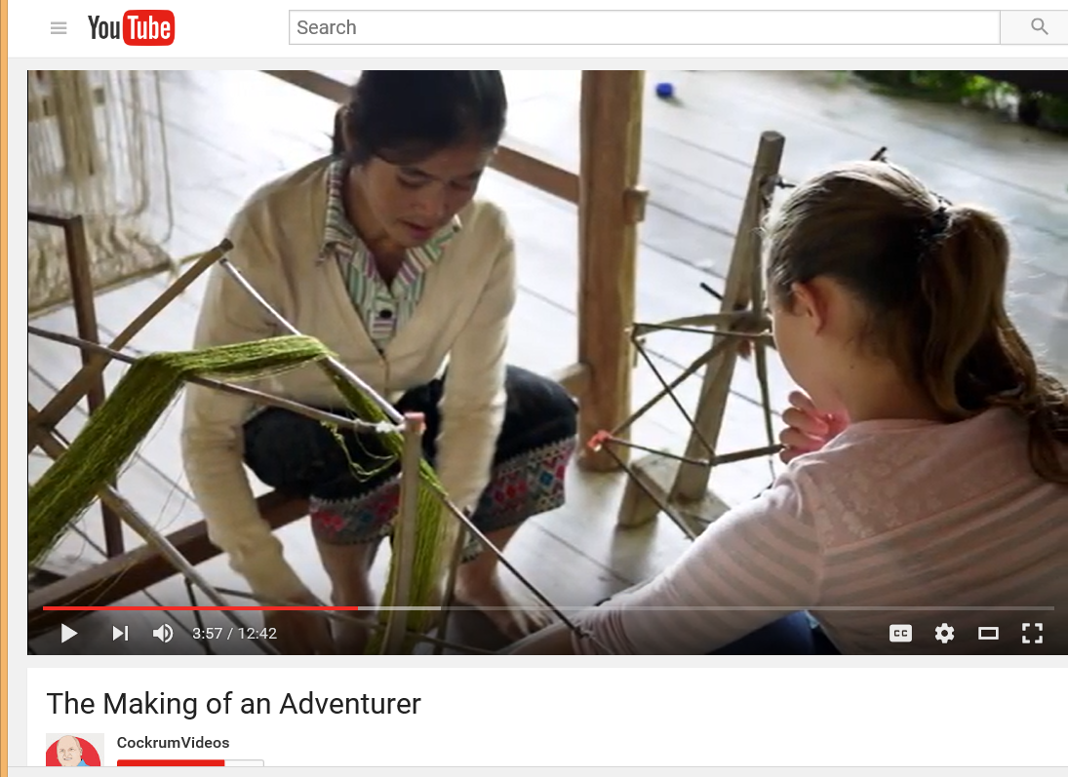
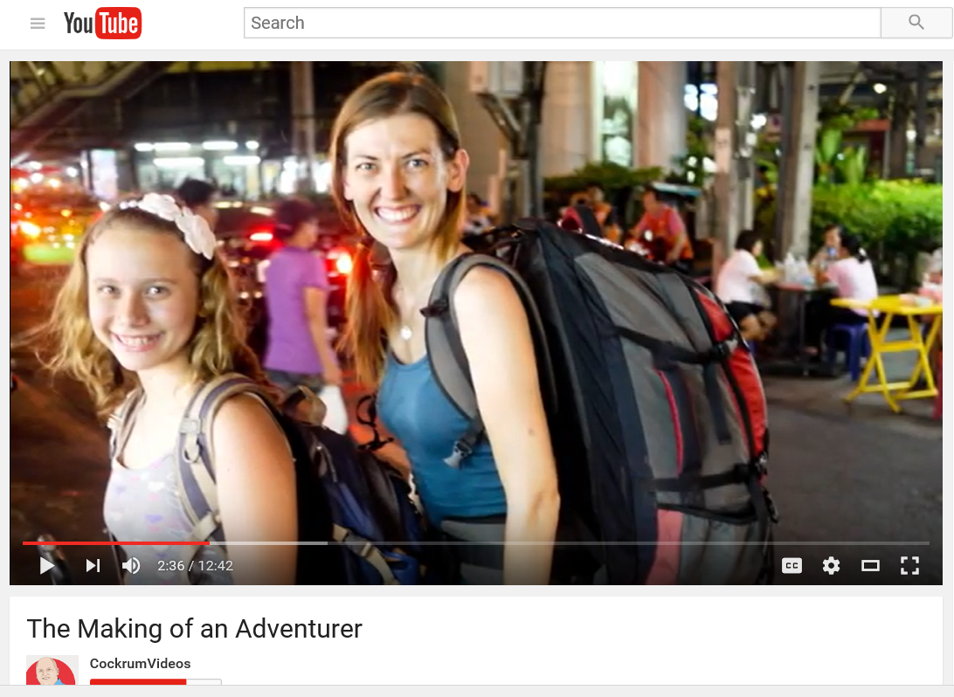
Myth #18: Online learning is too passive (Student created documentaries, videos, projects, designs, podcast shows, books, mobile apps, etc.)

Slide 22
Myth #19. Online courses will not be as rigorous as on campus courses Interactive Labs and Simulations http://phet.colorado.edu/en/simulation/energy-skate-park

Slide 23
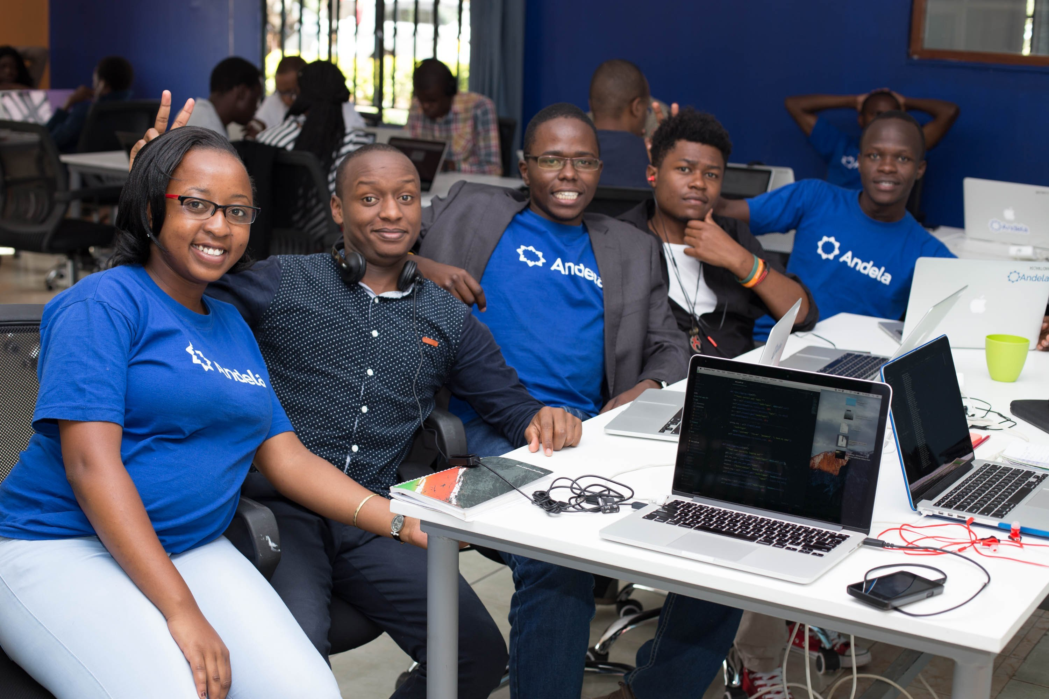
Myth #20: You will never meet your peers (Well…there can be meetups!)

Slide 24
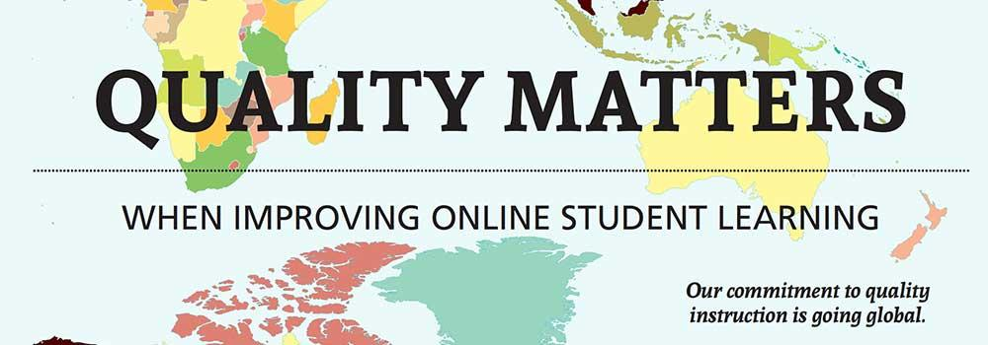
Quality
Educational institutions are strict and serious when it comes to online courses, and they run all courses through a rigorous certification process. Plus, online courses might be even better than traditional ones: They make teachers communicate differently, thinking about engagement and effectiveness of their work.

Slide 25
Myth #21: The quality of education is not good enough Human Embryology Animations (Valerie O’Loughlin, Indiana University)

Slide 26
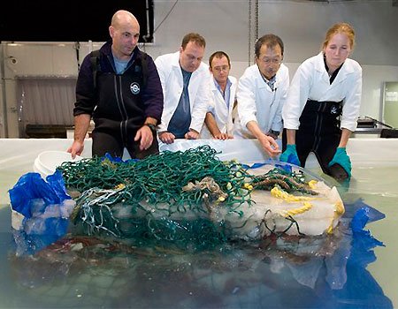
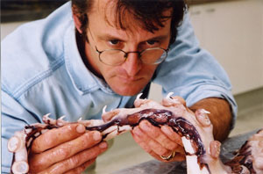
Myth #22: If it is not in a textbook, it cannot be high quality (Nautilus Live allows people to watch expeditions live & listen to scientists in control rooms a discoveries made)

Slide 27
Myth #24: The instructor is in a cramped and small little office Penguin Science (Penguin Cam), Jean Pennycook http://www.penguinscience.com/

Slide 28
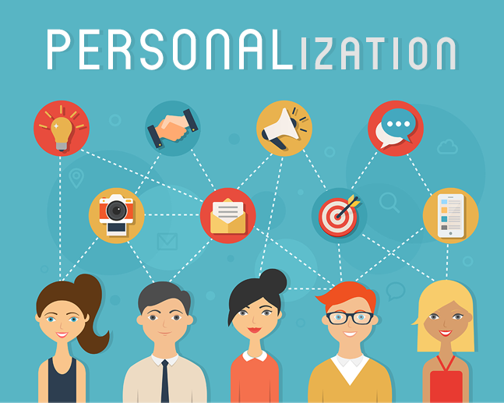
Personalization
Since interactions are not face-to-face in eLearning, they are planned in ways to engage learners in a dialogue. It's impossible to remain anonymous and "quiet" if you want to succeed and make the most out of your online course.

Slide 29
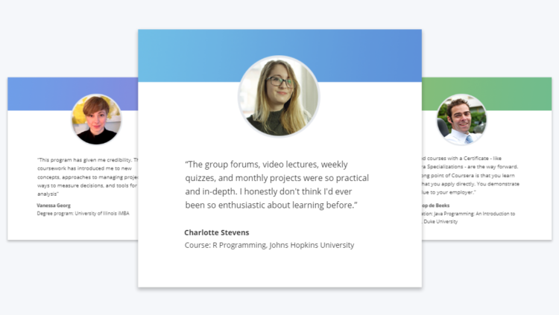
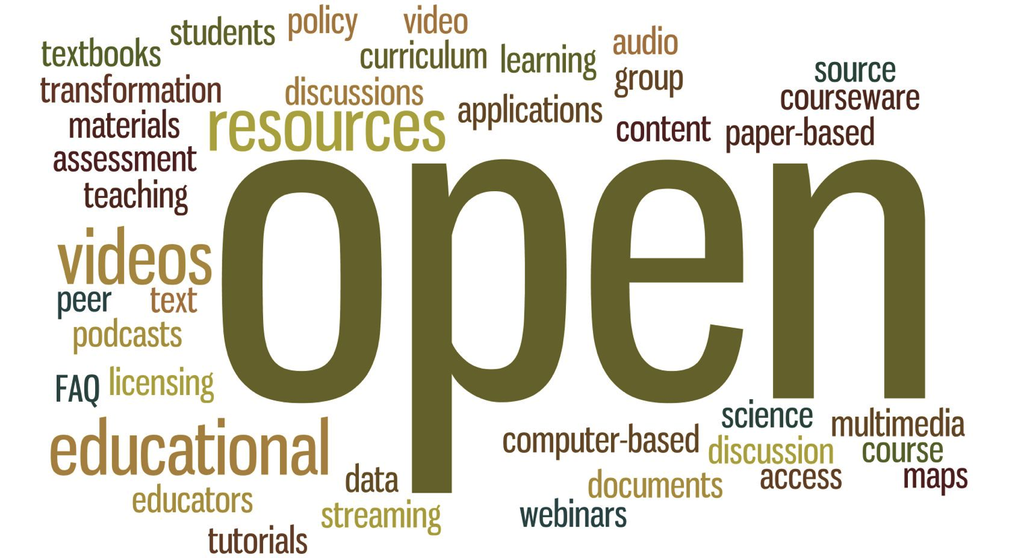
Myth #25: Online courses are impersonal

Slide 30
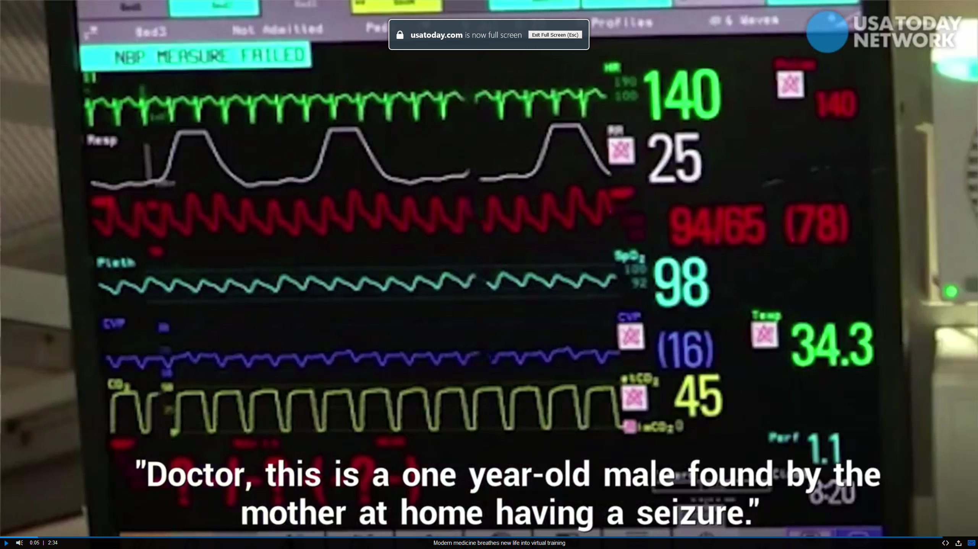
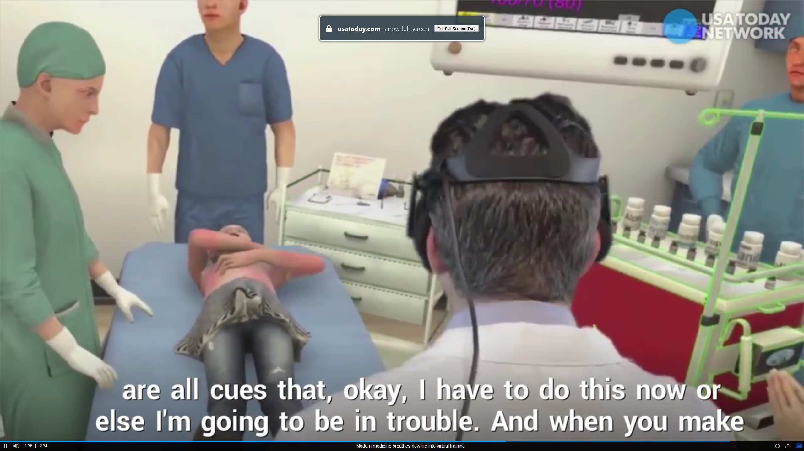
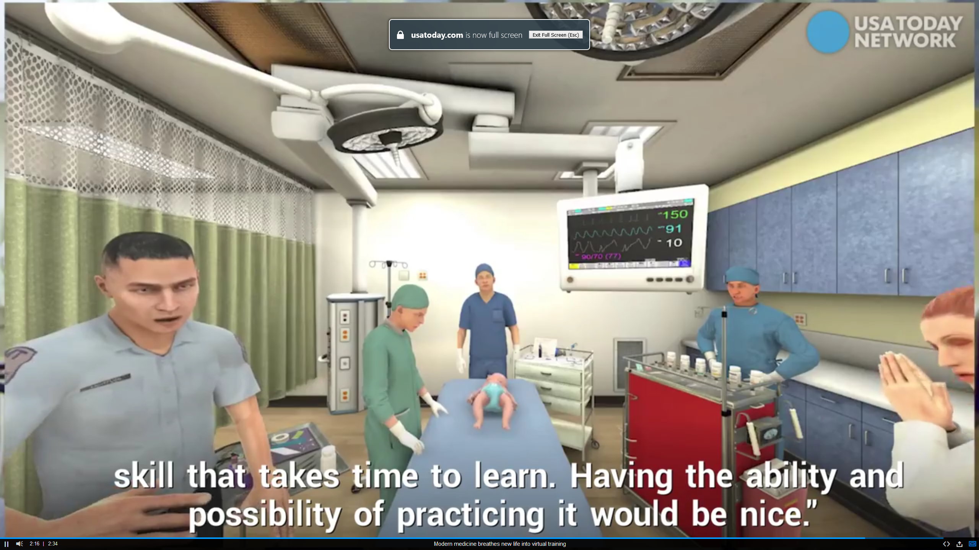
Myth #26: Online Learning is Not Authentic Enough Modern medicine breathes new life into virtual training 2:34 (entire video): http://curtbonk.com/vr-medicine4b.html

Slide 31
Myth #27: Employers will not take online degrees seriously

Slide 32
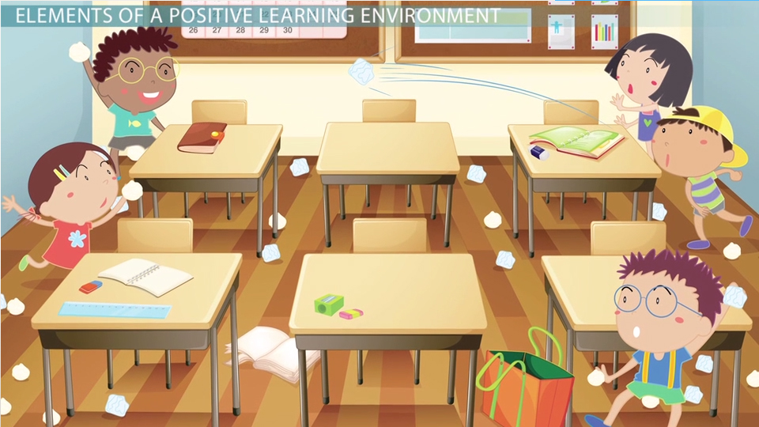
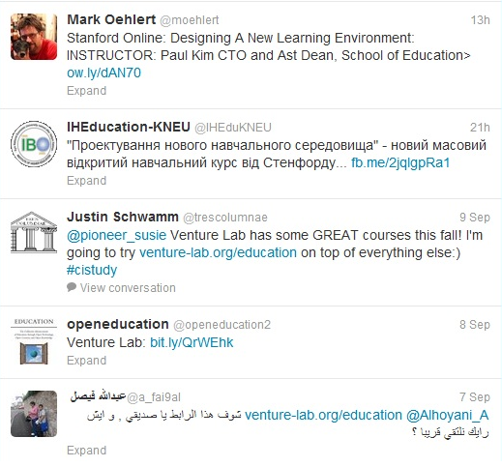
Myth #28: Creating effective online learning environments is too hard! Paul Kim, Stanford University

Slide 33
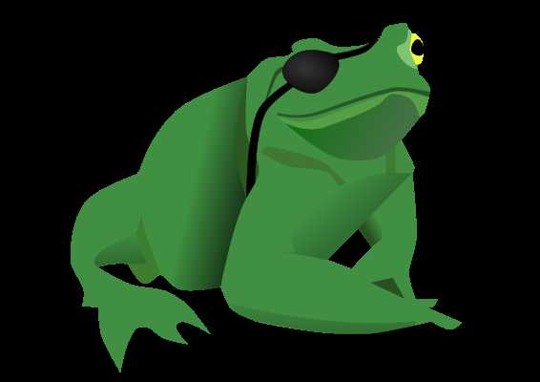
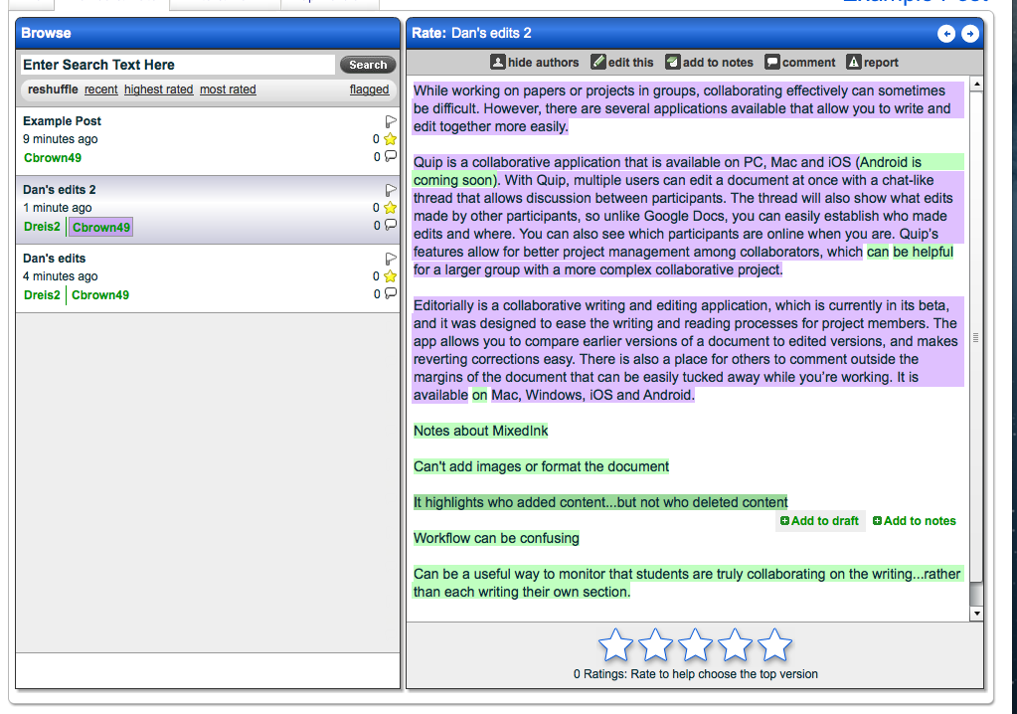
Myth #29: Online learners do not collaborate (e.g., PiratePad: http://meetingwords.com/) MeetingWords, Google Docs, NowComment, MixedInk

Slide 34
Myth #30: Highly ranked universities do not believe in online learning Learning is More Online (Access) Indiana University, Office of Online Education

Slide 35
Myth #31. Online learning limits creativity

Slide 36
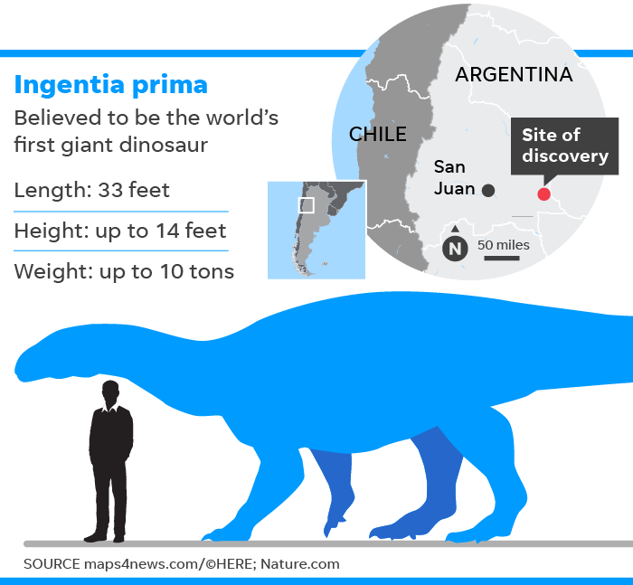
Myth #32: Online learning contents are old November 28, 2018 'Siberian unicorn' once walked among early humans Tara John, CNN https://edition.cnn.com/2018/11/27/europe/siberian-unicorn-humans-scli-intl/index.html

Slide 37
May 13, 2019 Carbon Dioxide Levels In The Atmosphere Hit Highest Mark In Human History Nina Golkowski, The Huffington Post https://www.huffpost.com/entry/co2-levels-hit-new-high_n_5cd9882ae4b0c388e584eb09

Slide 38
Myth #33. Resources are much better on campus than online Online Referenceware: The Magical Power of Dictionaries https://www.chronicle.com/article/The-Magical-Power-of/242513

Slide 39
Myth #34. I am in this alone. E-Mentors, Peers, Tutors, Authors, social media, online support groups, and AI Coaches

Slide 40
Myth #35. eLearning makes it easier to cheat.

Slide 41
Myth #36: Feedback is hard to get online Peer, self, expert, instructor, and system feedback all possible!

Slide 42
Myth #37: Online Learning is mainly Text Based Interactive Maps, Timelines, Concept Maps, and other visuals

Slide 43
Myth #38: Online learning scratches the surface without depth Big Questions Online (BQO) (e.g., Can a Living Creature Be as Big as a Galaxy?) https://www.bigquestionsonline.com/

Slide 44
Myth #39: I will have difficulty reaching my goals Goal Setting Tools (e.g., I Done This, Milestone Planner, and 43 Things)

Slide 45
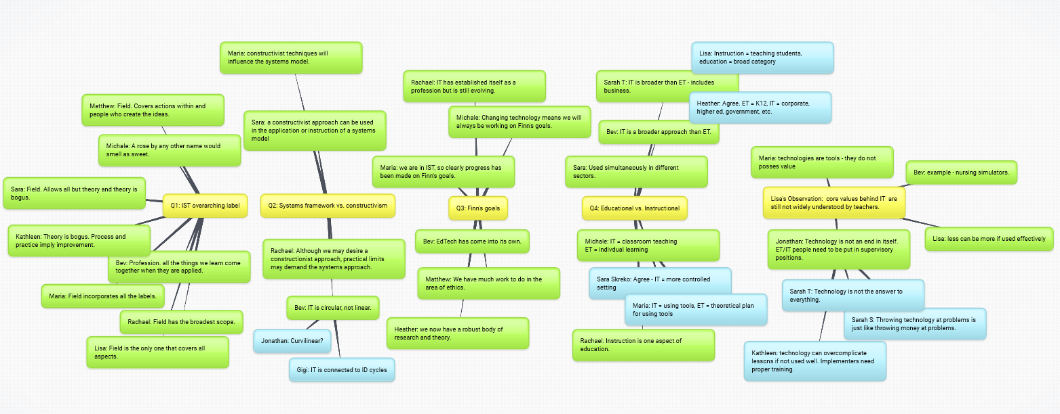
Myth #40: In online learning, you cannot show your learning Mindmap Recaps of Online Discussions

Slide 46
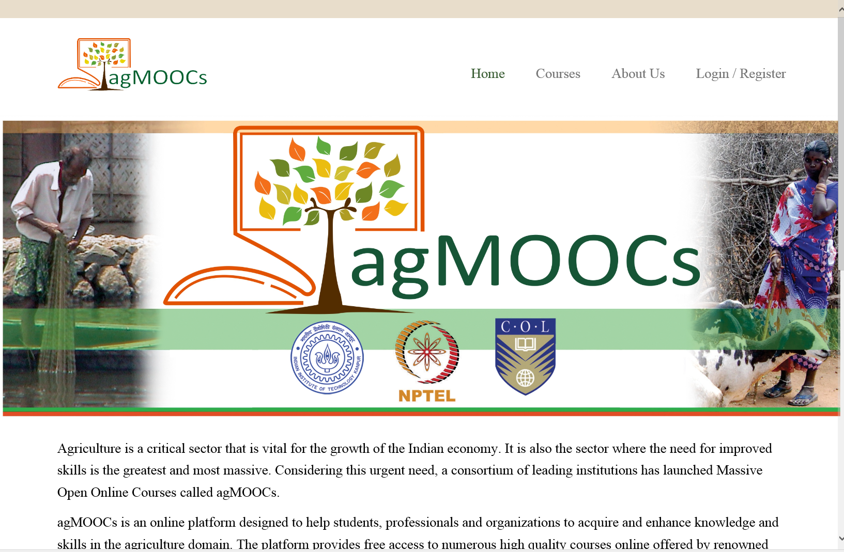
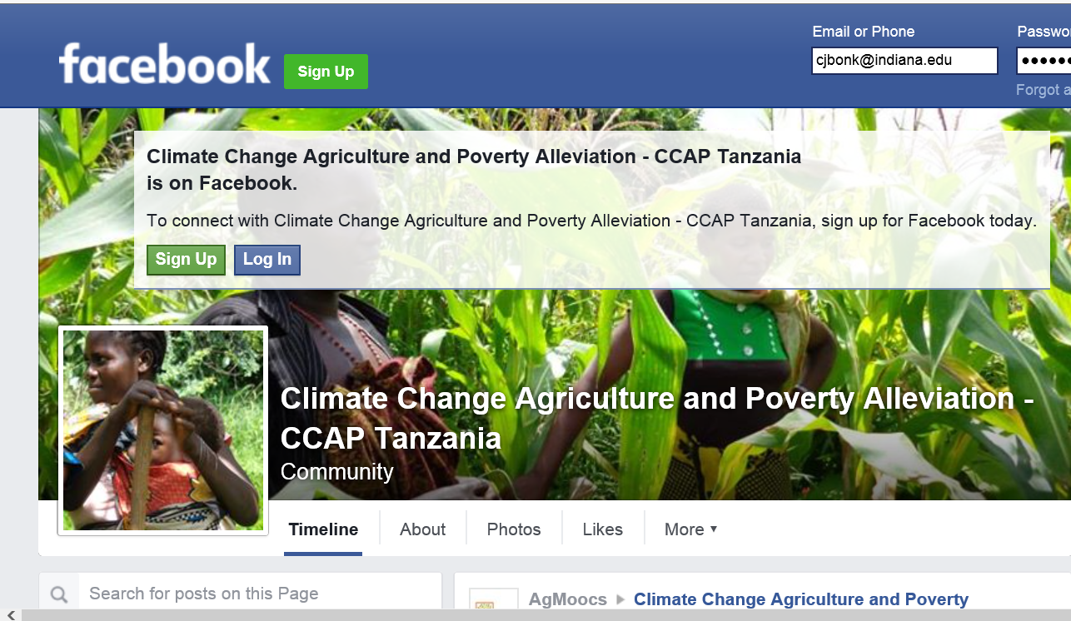
Myth #41: You need broadband access. MOOCs for Human Development? A Case Study (agMOOCs in India) Balaji Venkataraman and Asha Kanwar (COL) http://www.agmoocs.in/

Slide 47
Myth #42: Online learning requires an internet connection
iPod Learning from the Ice using MIT OCW
(e.g., Wendy Ermold, University of Washington)

Slide 48
Myth #43: I cannot afford online learning Open Education's Wide World of Possibilities http://chronicle.com/article/Open-Educations-Wide-World-of/131672/?sid=at&utm_source=at&utm_medium=en

Slide 49
Online Learning Myths all done!

Slide 50
Are you happy? My minions are happy!

Slide 51
The World is Open

Slide 52
We are entering a jumping off point… (South University of Science and Technology of China, Wednesday June 10, 2015)

Slide 53
Introducing the free “TEC-VARIETY” Framework… http://tec-variety.com/ http://tec-variety.com/TEC-VARIETY-Chinese.pdf

Slide 54
Any Questions or Comments? Slides at: TrainingShare.com Papers: PublicationShare.com Free book: http://tec-variety.com/ Email: cjbonk@indiana.edu

