Slide 1
Open Educational Resources: Creating and Synthesizing the Research
John Hilton III, PhD
David Wiley, PhD
The Open Education Group at Brigham Young University
@johnhiltoniii :: @opencontent
Notes:
By John Hilton III and David Wiley. This work is licensed under the Creative Commons Attribution 4.0 International License, except where noted.

Slide 3
Open Educational Resources (OER)
“Open Educational Resources (OERs) are any type of educational materials that are in the public domain or introduced with an open license.”
UNESCO
Notes:
https://unevoc.unesco.org/go.php?q=Open%20Educational%20Resources

Slide 4
Open Educational Resources (OER)
OER is defined in terms of copyright status.
Everyone is freely permitted to copy, edit, and share OER.

Slide 6
Open Educational Resources (OER)
A utter dearth of empirical research on the learning impact of OER use throughout the 2000s allowed publishers and others to spread FUD.
Several hype articles and opinion pieces
Only one empirical article from 2000 - 2010
Notes:
https://unevoc.unesco.org/go.php?q=Open%20Educational%20Resources

Slide 7
Open Educational Resources (OER)
Create the Open Education Group & COUP Framework
Create the OER Research Fellow Program
Create novel research synthesis dissemination strategies
Notes:
https://unevoc.unesco.org/go.php?q=Open%20Educational%20Resources

Slide 8
Improving Course Throughput Rates and Open Educational Resources: Results from the Z Degree Program at Tidewater Community College Hilton, Fischer, Wiley, and Williams (2016) International Review of Research in Open and Distance Learning

Slide 9
Course Throughput Rate
Students
Drop Deadline
Withdraw Deadline
Final Grade
IRRODL (2016)

Slide 10
Traditional © vs OER
(Face to Face)
Drop
2.3% | 1.8%
Withdraw
9.9% | 8.1%
C or Better
68% | 74%
CTR
60% | 66%
IRRODL (2016)
Notes:
30,013 vs 1175

Slide 11
Traditional © vs OER
(Online)
Drop
4.0% | 1.4%
Withdraw
13.7% | 13.1%
C or Better
66% | 70%
CTR
54% | 60%
IRRODL (2016)
Notes:
3333 vs 703

Slide 12
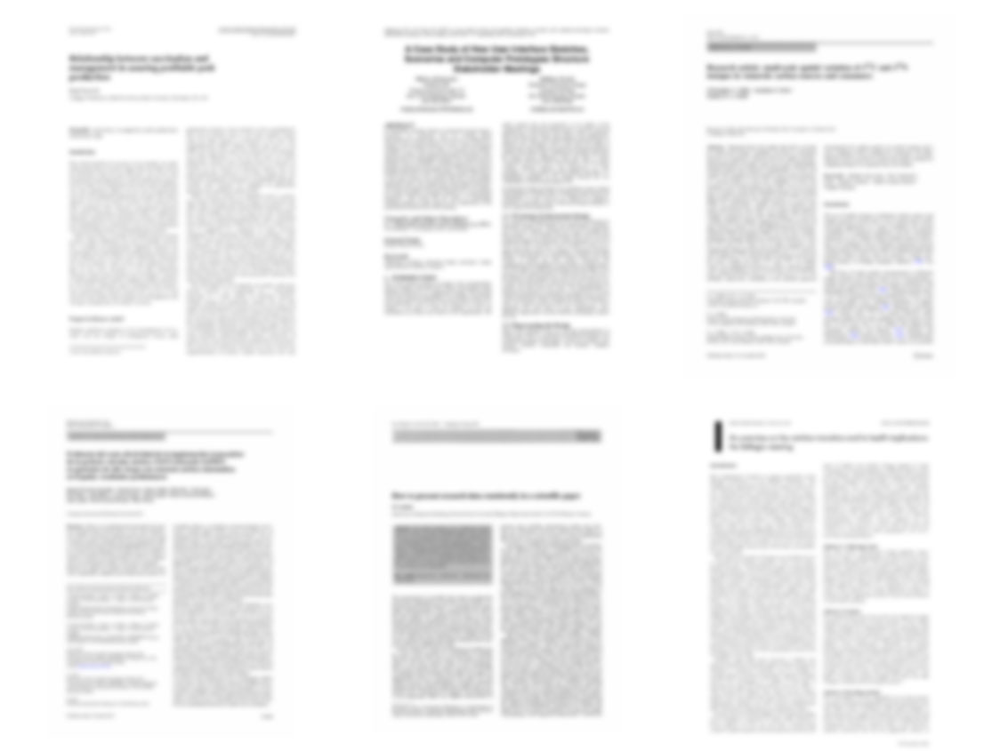
22 Peer Reviewed Studies
http://openedgroup.org/
Notes:
Across eleven academic studies that attempted to measure results pertaining to student learning (with 48,623 students participated) none showed results in which students who utilized OER performed worse than their peers who used traditional textbooks.
Allen, G., Guzman-Alvarez, A., Molinaro, M., Larsen, D. (2015). Assessing the Impact and Efficacy of the Open-Access ChemWiki Textbook Project. Educause Learning Initiative Brief, January 2015. See also this newsletter. Bowen, W. G., Chingos, M. M., Lack, K. A., & Nygren, T. I. (2012). Interactive Learning Online at Public Universities: Evidence from Randomized Trials. Ithaka S+R. Bowen, W. G., Chingos, M. M., Lack, K. A., & Nygren, T. I. (2014). Interactive Learning Online at Public Universities: Evidence from a Six‐Campus Randomized Trial. Journal of Policy Analysis and Management, 33(1), 94-111. Feldstein, A., Martin, M., Hudson, A., Warren, K., Hilton, J., & Wiley, D. (2012). Open textbooks and increased student access and outcomes. European Journal of Open, Distance and E-Learning. Retrieved from http://www.eurodl.org/index.php?p=archives&year=2012&halfyear=2&article=533. Gil, P., Candelas, F., Jara, C., Garcia, G., Torres, F (2013). Web-based OERs in Computer Networks. International Journal of Engineering Education, 29(6), 1537-1550. (OA preprint) Hilton, J., Gaudet, D., Clark, P., Robinson, J., & Wiley, D. (2013). The adoption of open educational resources by one community college math department. The International Review of Research in Open and Distance Learning, 14(4), 37–50. Hilton, J., & Laman, C. (2012). One college’s use of an open psychology textbook. Open Learning: The Journal of Open and Distance Learning, 27(3), 201–217. Retrieved from http://www.tandfonline.com/doi/abs/10.1080/02680513.2012.716657. (Open Repository Preprint). Lovett, M., Meyer, O., & Thille, C. (2008). The open learning initiative: Measuring the effectiveness of the OLI statistics course in accelerating student learning. Journal of Interactive Media in Education, 2008 (1). Pawlyshyn, Braddlee, Casper and Miller (2013). Adopting OER: A Case Study of Cross-Institutional Collaboration and Innovation. Educause Review. Robinson, T.J. (2015). Open Textbooks: The Effects of Open Educational Resource Adoption on Measures of Post-secondary Student Success (Doctoral dissertation). Robinson T. J., Fischer, L., Wiley, D. A., & Hilton, J. (2014). The impact of open textbooks on secondary science learning outcomes. Educational Researcher, 43(7): 341-351. Wiley, D., Hilton, J. Ellington, S., and Hall, T. (2012). “A preliminary examination of the cost savings and learning impacts of using open textbooks in middle and high school science classes.” International Review of Research in Open and Distance Learning. 13 (3), pp. 261-276.

Slide 13
183,539 Students
http://openedgroup.org/
Notes:
Across nine academic studies that attempted to measure results pertaining to student learning (in high school) with 48,623 students participated) none showed results in which students who utilized OER performed worse than their peers who used traditional textbooks.
Allen, G., Guzman-Alvarez, A., Molinaro, M., Larsen, D. (2015). Assessing the Impact and Efficacy of the Open-Access ChemWiki Textbook Project. Educause Learning Initiative Brief, January 2015. See also this newsletter. Bowen, W. G., Chingos, M. M., Lack, K. A., & Nygren, T. I. (2012). Interactive Learning Online at Public Universities: Evidence from Randomized Trials. Ithaka S+R. Bowen, W. G., Chingos, M. M., Lack, K. A., & Nygren, T. I. (2014). Interactive Learning Online at Public Universities: Evidence from a Six‐Campus Randomized Trial. Journal of Policy Analysis and Management, 33(1), 94-111. Feldstein, A., Martin, M., Hudson, A., Warren, K., Hilton, J., & Wiley, D. (2012). Open textbooks and increased student access and outcomes. European Journal of Open, Distance and E-Learning. Retrieved from http://www.eurodl.org/index.php?p=archives&year=2012&halfyear=2&article=533. Gil, P., Candelas, F., Jara, C., Garcia, G., Torres, F (2013). Web-based OERs in Computer Networks. International Journal of Engineering Education, 29(6), 1537-1550. (OA preprint) Hilton, J., Gaudet, D., Clark, P., Robinson, J., & Wiley, D. (2013). The adoption of open educational resources by one community college math department. The International Review of Research in Open and Distance Learning, 14(4), 37–50. Hilton, J., & Laman, C. (2012). One college’s use of an open psychology textbook. Open Learning: The Journal of Open and Distance Learning, 27(3), 201–217. Retrieved from http://www.tandfonline.com/doi/abs/10.1080/02680513.2012.716657. (Open Repository Preprint). Lovett, M., Meyer, O., & Thille, C. (2008). The open learning initiative: Measuring the effectiveness of the OLI statistics course in accelerating student learning. Journal of Interactive Media in Education, 2008 (1). Pawlyshyn, Braddlee, Casper and Miller (2013). Adopting OER: A Case Study of Cross-Institutional Collaboration and Innovation. Educause Review. Robinson, T.J. (2015). Open Textbooks: The Effects of Open Educational Resource Adoption on Measures of Post-secondary Student Success (Doctoral dissertation). Robinson T. J., Fischer, L., Wiley, D. A., & Hilton, J. (2014). The impact of open textbooks on secondary science learning outcomes. Educational Researcher, 43(7): 341-351. Wiley, D., Hilton, J. Ellington, S., and Hall, T. (2012). “A preliminary examination of the cost savings and learning impacts of using open textbooks in middle and high school science classes.” International Review of Research in Open and Distance Learning. 13 (3), pp. 261-276.
person icon by Ferran Brown from the Noun Project

Slide 14
95% Same or Better Outcomes
http://openedgroup.org/
Notes:
Across eleven academic studies that attempted to measure results pertaining to student learning (with 48,623 students participated) none showed results in which students who utilized OER performed worse than their peers who used traditional textbooks.
Allen, G., Guzman-Alvarez, A., Molinaro, M., Larsen, D. (2015). Assessing the Impact and Efficacy of the Open-Access ChemWiki Textbook Project. Educause Learning Initiative Brief, January 2015. See also this newsletter. Bowen, W. G., Chingos, M. M., Lack, K. A., & Nygren, T. I. (2012). Interactive Learning Online at Public Universities: Evidence from Randomized Trials. Ithaka S+R. Bowen, W. G., Chingos, M. M., Lack, K. A., & Nygren, T. I. (2014). Interactive Learning Online at Public Universities: Evidence from a Six‐Campus Randomized Trial. Journal of Policy Analysis and Management, 33(1), 94-111. Feldstein, A., Martin, M., Hudson, A., Warren, K., Hilton, J., & Wiley, D. (2012). Open textbooks and increased student access and outcomes. European Journal of Open, Distance and E-Learning. Retrieved from http://www.eurodl.org/index.php?p=archives&year=2012&halfyear=2&article=533. Gil, P., Candelas, F., Jara, C., Garcia, G., Torres, F (2013). Web-based OERs in Computer Networks. International Journal of Engineering Education, 29(6), 1537-1550. (OA preprint) Hilton, J., Gaudet, D., Clark, P., Robinson, J., & Wiley, D. (2013). The adoption of open educational resources by one community college math department. The International Review of Research in Open and Distance Learning, 14(4), 37–50. Hilton, J., & Laman, C. (2012). One college’s use of an open psychology textbook. Open Learning: The Journal of Open and Distance Learning, 27(3), 201–217. Retrieved from http://www.tandfonline.com/doi/abs/10.1080/02680513.2012.716657. (Open Repository Preprint). Lovett, M., Meyer, O., & Thille, C. (2008). The open learning initiative: Measuring the effectiveness of the OLI statistics course in accelerating student learning. Journal of Interactive Media in Education, 2008 (1). Pawlyshyn, Braddlee, Casper and Miller (2013). Adopting OER: A Case Study of Cross-Institutional Collaboration and Innovation. Educause Review. Robinson, T.J. (2015). Open Textbooks: The Effects of Open Educational Resource Adoption on Measures of Post-secondary Student Success (Doctoral dissertation). Robinson T. J., Fischer, L., Wiley, D. A., & Hilton, J. (2014). The impact of open textbooks on secondary science learning outcomes. Educational Researcher, 43(7): 341-351. Wiley, D., Hilton, J. Ellington, S., and Hall, T. (2012). “A preliminary examination of the cost savings and learning impacts of using open textbooks in middle and high school science classes.” International Review of Research in Open and Distance Learning. 13 (3), pp. 261-276.
person icon by Ferran Brown from the Noun Project

Slide 15
Controlled for teacher variables | Controlled for student variables | Randomized | DV | Results
8 yes 14 no | 9 yes 13 no | 2 yes 20 no | CAOS, CLASS, completion rate, credits taken, quiz score, exam scores, GPA, drop, pass rate, withdrawal rate | 3 studies did not provide results regarding statistical significance 8 reported NSD 10 results favored OER 1 result favored traditionally copyrighted textbooks

Slide 16
24 Peer Reviewed Studies of Perceptions of OER Quality
http://openedgroup.org/
Notes:
In terms of student and teacher perceptions of OER, 2,366 students and 2,144 faculty members were surveyed across the nine peer-reviewed studies. Approximately 50% said that the OER resources were as good as traditional resources, 35% said the OER were superior and 15% said they were inferior.
Allen, I., Seaman, J. (2014). Opening the Curriculum: Open Educational Resources in U.S. Higher Education, 2014. Bliss, T., Robinson, T. J., Hilton, J., & Wiley, D. (2013). An OER COUP: College teacher and student perceptions of Open Educational Resources. Journal of Interactive Media in Education, 1–25. Bliss, T., Hilton, J., Wiley, D., Thanos, K. (2013). The cost and quality of open textbooks: Perceptions of community college faculty and students. First Monday, 18:1. Feldstein, A., Martin, M., Hudson, A., Warren, K., Hilton, J., & Wiley, D. (2012). Open textbooks and increased student access and outcomes. European Journal of Open, Distance and E-Learning. Retrieved from http://www.eurodl.org/index.php?p=archives&year=2012&halfyear=2&article=533. Gil, P., Candelas, F., Jara, C., Garcia, G., Torres, F (2013). Web-based OERs in Computer Networks. International Journal of Engineering Education, 29(6), 1537-1550. (OA preprint). Hilton, J., Gaudet, D., Clark, P., Robinson, J., & Wiley, D. (2013). The adoption of open educational resources by one community college math department. The International Review of Research in Open and Distance Learning, 14(4), 37–50. Lindshield, B., & Adhikari, K. (2013). Online and campus college students like using an open educational resource instead of a traditional textbook. Journal of Online Learning & Teaching, 9(1), 1–7. Petrides, L., Jimes, C., Middleton‐Detzner, C., Walling, J., & Weiss, S. (2011). Open textbook adoption and use: Implications for teachers and learners. Open learning, 26(1), 39-49, Pitt, R., Ebrahimi, N., McAndrew, P., & Coughlan, T. (2013). Assessing OER impact across organisations and learners: experiences from the Bridge to Success project. Journal of Interactive Media in Education, 2013(3).

Slide 17
12,990 Professors and Students
http://openedgroup.org/
Notes:
In terms of student and teacher perceptions of OER, 2,366 students and 2,144 faculty members were surveyed across the nine peer-reviewed studies. Approximately 50% said that the OER resources were as good as traditional resources, 35% said the OER were superior and 15% said they were inferior.
Allen, I., Seaman, J. (2014). Opening the Curriculum: Open Educational Resources in U.S. Higher Education, 2014. Bliss, T., Robinson, T. J., Hilton, J., & Wiley, D. (2013). An OER COUP: College teacher and student perceptions of Open Educational Resources. Journal of Interactive Media in Education, 1–25. Bliss, T., Hilton, J., Wiley, D., Thanos, K. (2013). The cost and quality of open textbooks: Perceptions of community college faculty and students. First Monday, 18:1. Feldstein, A., Martin, M., Hudson, A., Warren, K., Hilton, J., & Wiley, D. (2012). Open textbooks and increased student access and outcomes. European Journal of Open, Distance and E-Learning. Retrieved from http://www.eurodl.org/index.php?p=archives&year=2012&halfyear=2&article=533. Gil, P., Candelas, F., Jara, C., Garcia, G., Torres, F (2013). Web-based OERs in Computer Networks. International Journal of Engineering Education, 29(6), 1537-1550. (OA preprint). Hilton, J., Gaudet, D., Clark, P., Robinson, J., & Wiley, D. (2013). The adoption of open educational resources by one community college math department. The International Review of Research in Open and Distance Learning, 14(4), 37–50. Lindshield, B., & Adhikari, K. (2013). Online and campus college students like using an open educational resource instead of a traditional textbook. Journal of Online Learning & Teaching, 9(1), 1–7. Petrides, L., Jimes, C., Middleton‐Detzner, C., Walling, J., & Weiss, S. (2011). Open textbook adoption and use: Implications for teachers and learners. Open learning, 26(1), 39-49, Pitt, R., Ebrahimi, N., McAndrew, P., & Coughlan, T. (2013). Assessing OER impact across organisations and learners: experiences from the Bridge to Success project. Journal of Interactive Media in Education, 2013(3).
person icon by Ferran Brown from the Noun Project

Slide 18
90% of Professors and Students say OER as good or better than traditional materials
http://openedgroup.org/
Notes:
In terms of student and teacher perceptions of OER, 2,366 students and 2,144 faculty members were surveyed across the nine peer-reviewed studies. Approximately 50% said that the OER resources were as good as traditional resources, 35% said the OER were superior and 15% said they were inferior.
Allen, I., Seaman, J. (2014). Opening the Curriculum: Open Educational Resources in U.S. Higher Education, 2014. Bliss, T., Robinson, T. J., Hilton, J., & Wiley, D. (2013). An OER COUP: College teacher and student perceptions of Open Educational Resources. Journal of Interactive Media in Education, 1–25. Bliss, T., Hilton, J., Wiley, D., Thanos, K. (2013). The cost and quality of open textbooks: Perceptions of community college faculty and students. First Monday, 18:1. Feldstein, A., Martin, M., Hudson, A., Warren, K., Hilton, J., & Wiley, D. (2012). Open textbooks and increased student access and outcomes. European Journal of Open, Distance and E-Learning. Retrieved from http://www.eurodl.org/index.php?p=archives&year=2012&halfyear=2&article=533. Gil, P., Candelas, F., Jara, C., Garcia, G., Torres, F (2013). Web-based OERs in Computer Networks. International Journal of Engineering Education, 29(6), 1537-1550. (OA preprint). Hilton, J., Gaudet, D., Clark, P., Robinson, J., & Wiley, D. (2013). The adoption of open educational resources by one community college math department. The International Review of Research in Open and Distance Learning, 14(4), 37–50. Lindshield, B., & Adhikari, K. (2013). Online and campus college students like using an open educational resource instead of a traditional textbook. Journal of Online Learning & Teaching, 9(1), 1–7. Petrides, L., Jimes, C., Middleton‐Detzner, C., Walling, J., & Weiss, S. (2011). Open textbook adoption and use: Implications for teachers and learners. Open learning, 26(1), 39-49, Pitt, R., Ebrahimi, N., McAndrew, P., & Coughlan, T. (2013). Assessing OER impact across organisations and learners: experiences from the Bridge to Success project. Journal of Interactive Media in Education, 2013(3).

Slide 19
Novel Synthesis and Dissemination Techniques
The Review Project
The OER Adoption Impact Calculator
Notes:
https://unevoc.unesco.org/go.php?q=Open%20Educational%20Resources

Slide 20
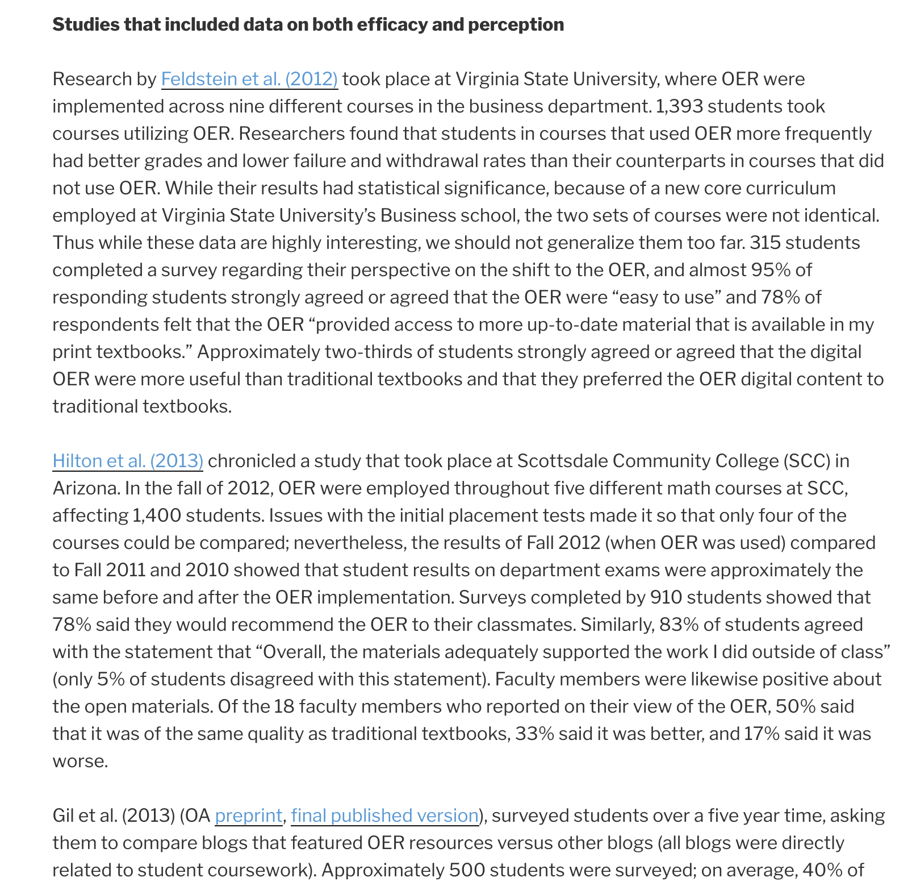

Slide 21
openedgroup.org/review

Slide 22
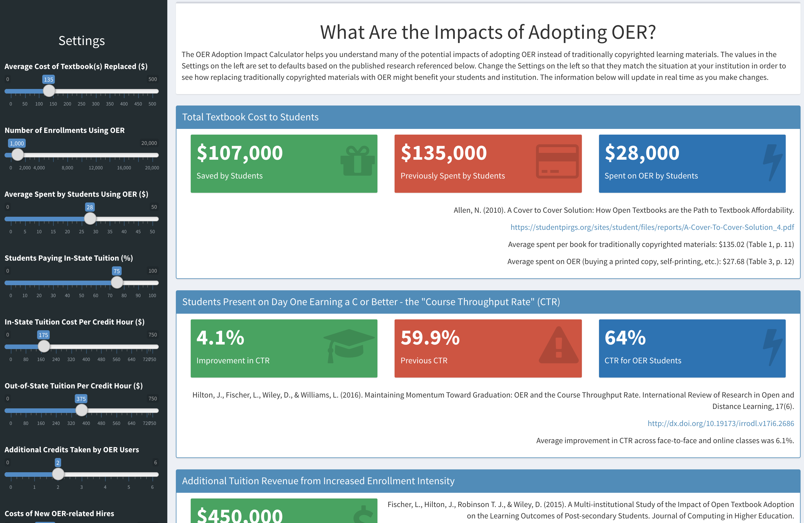

Slide 23
impact.lumenlearning.com

Slide 24
OER Research Takeaways
A growing body of studies show that students who use OER perform as well or better than their peers who use traditionally copyrighted materials.
Moving forward, we need more rigorous research that better accounts for student, teacher, and other potentially confounding variables.

Slide 25
OER Research Takeaways
We need more studies that disaggregate data and allow us to see more clearly the impact of OER on specific populations.
We also need studies examining the interaction between the novel pedagogies afforded by OER and student learning.

Slide 26
OER Research Takeaways
There are fundamental questions to be answered about the degree of impact on learning that can be attributed to educational materials.
Understanding the answer to this absolutely fundamental question is key to understanding much about our (AECT) field.

Slide 27
Thank You
John Hilton III - @johnhiltoniii
David Wiley - @opencontent

