Slide 1
Supporting Learners Self-Management for Self-Directed Language Learning: A Study within Duolingo
Hi!
Aluu!
Salut!
Jambo!
Oi!
Presented by Zixi Li & Curtis J. Bonk, Instructional Systems Technology Dept.,
Indiana University

Slide 2
Background
Globalization
Foreign language learning
is a worldwide phenomenon.
Mobile Learning
Language learning software
is commonly used.
COVID-19 Impact
Staying at home leads to a quick expansion of Duolingo.

Slide 3
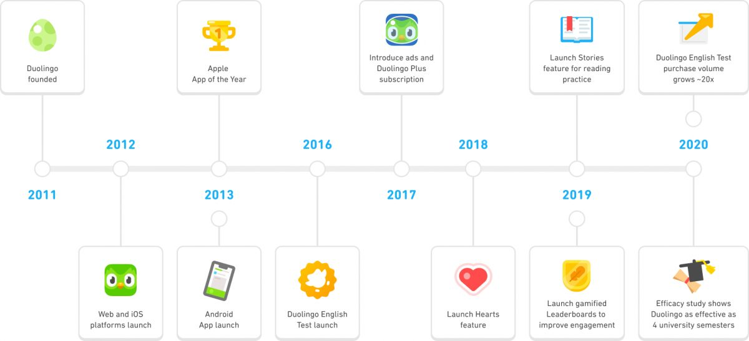
Background
Duolingo (2020)

Slide 4
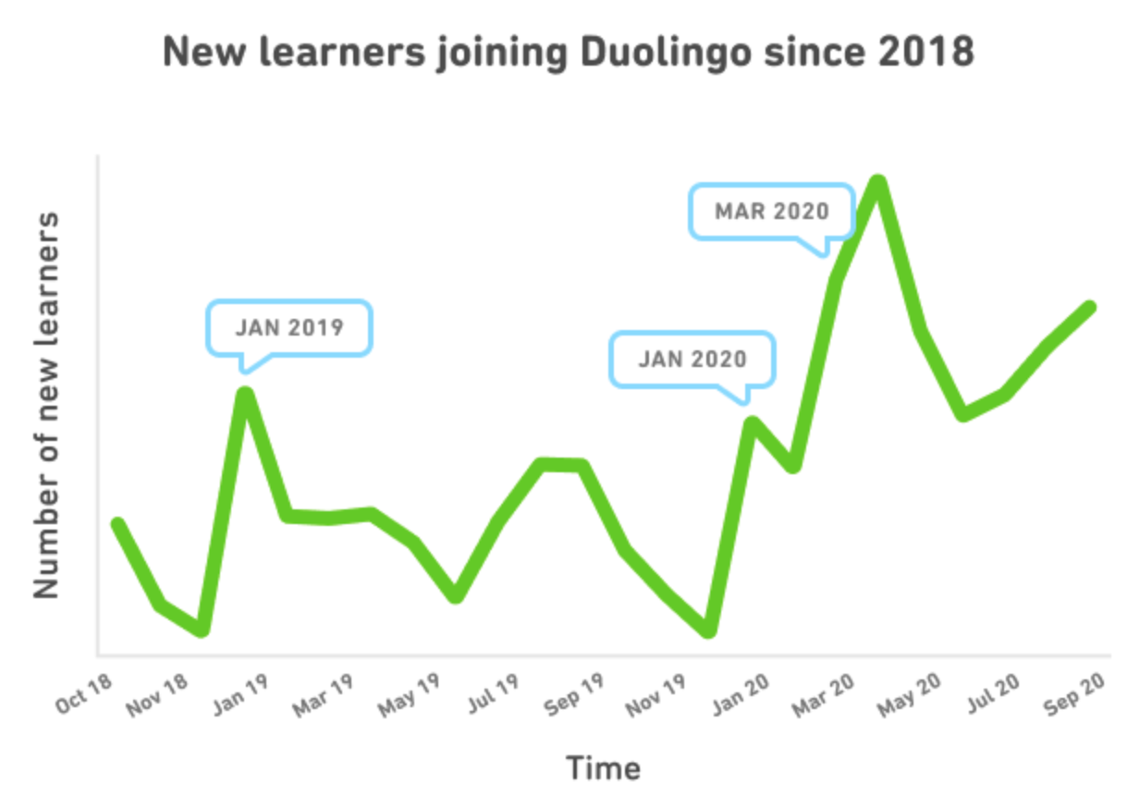
Background
Duolingo (2020)

Slide 5
Background

Slide 6
Overview of the Study
This study examines how do learners self-manage their learning goals, time, resources, and support when they are learning a language using MALL technologies out of the classroom?
A mixed-method approach
84 survey respondents
10 semi-structured interviews

Slide 7
01
Literature
Review
¡Hola!

Slide 8
Self-directed learning (SDL)
SDL refers to a type of learning where individuals are in charge of the planning, implementation, and assessment of one’s own learning process (Hiemstra, 1994; Loyens et al., 2008)
SDL is a critical ability in the learning environments of this new learning age, which are often informal, online, and open (Bonk, 2009, 2020).
Garrison (1997) refined SDL through three dimensions, including self-management, self-monitoring, and motivation.

Slide 9
Garrison’s (1997) Framework of SDL
Self-management is the task control ability that is associated with external activities, such as time, resources, and goal management.
Self-monitoring is the cognitive and metacognitive process of establishing learning strategies and learning paces.
Motivation can initiate and sustain learning efforts towards cognitive goals (Garrison, 1997).

Slide 10
SDL, CALL, and MALL
Computer-assisted language learning (CALL)
(Beatty, 2013; Levy, 1997)
Mobile-assisted language learning (MALL)
(Kukulska-Hulme & Shield, 2008; Miangah & Nezarat, 2012)
Though research has been conducted on CALL, MALL, and self-directed language learning (SDLL) separately, the SDL perspective of using CALL and MALL out of the classroom still remains unexplored.

Slide 11
Goal Management
Goals specify the amount of effort required to succeed and the self-satisfaction anticipated (Schunk, 1990).
Goal setting leads to task assessment and considerations of the appropriate learning strategies from a metacognitive perspective (Ridley et al., 1992).
In MALL, timescales influence the dynamic nature of the learning ecology and so influence the learning goals.
Setting realistic and achievable goals is more likely to lead to a successful SDL.
Notes:
A goal is something that an individual is intentionally attempting to achieve, whereas goal-setting refers to establishing a goal and adjusting it as needed. (Bandura 1986, 1988; Lunenburg, 2011). Goals with specific standards can enhance learning because they specify the amount of effort required to succeed and the self-satisfaction anticipated (Schunk, 1990). Further, goal setting leads to task assessment and considerations of the appropriate learning strategies from a metacognitive perspective (Ridley et al., 1992). In MALL, timescales influence the dynamic nature of the learning ecology and so influence the learning goals. In effect, learners lose motivation when there are not enough accomplishments in a reasonable time towards the learning goals (Isbell et al., 2017). Accordingly, setting realistic and achievable goals is more likely to lead to a successful SDL.

Slide 12
Time Management
MALL provides high flexibility of time management so that learners may coordinate their learning with personal activities at their convenience (Huang et al., 2014).
User-friendly learning management system that explicitly indicates one’s learning progress and is embedded with time control features can motivate and enhance learning (Al-Adwan et al., 2018).
Time management can be challenged when the free learning time conflicts with other personal desires (Loewen et al., 2019).
Learners cannot consistently learn in a MALL environment without a certain level of extrinsic incentives (Botero et al., 2019).
Notes:
Self-management is particularly important in MALL since it allows learning to occur at anytime and anywhere (De Jong et al., 2010). MALL provides high flexibility of time management so that learners may coordinate their learning with personal activities at their convenience (Huang et al., 2014) and support learner information seeking whenever it aligns with learner needs (Wang et al., 2009). Al-Adwan et al.'s (2018) study suggests that a user-friendly learning management system that explicitly indicates one’s learning progress and is embedded with time control features can motivate and enhance learning. However, Loewen et al.’s (2019) recent study reveals that time management can also be challenged by the flexibility of MALL when the free learning time conflicts with other personal desires. Research further indicates that too often learners lack sustainable motivation and time-management skills due to daily life distractions and busy situations, such as schoolwork and deadlines (Botero et al., 2018; Inayah et al., 2020). Some research indicates that learners cannot consistently learn in a MALL environment without a certain level of extrinsic incentives (Botero et al., 2019).

Slide 13
Resource Management
Both human and material resources are important component of SDL (Knowles, 1975).
Others in a learning community can serve as important resources that support learning, including experts and more knowledgeable peers (Bonk et al., 2004; Wenger, 1998).
The zone of proximal development (ZPD) defines the learner’s ability to do something with and without external help (Vygotsky, 1978).
Authentic resources are a crucial motivation factor in language learning (Cross 1984; Gilmore, 2007).
Notes:
Knowles (1975) argues that identifying human and material resources is an important component of SDL. As Brookfield (2013) claimed, self-directed learning does not mean no involvement of other people in the learning process. On the contrary, others in a learning community can serve as important resources that support learning, including experts and more knowledgeable peers (Authors, 2004; Wenger, 1998). From Vygotsky’s (1978) sociocultural perspective, learners can construct a deeper meaning or understanding of new knowledge through social interactions with tutors, mentors, instructors, and other experts as well as with more knowledgeable peers. One key element of this learning theory is the zone of proximal development (ZPD). The ZPD defines the learner’s ability to do something with and without external help (Vygotsky, 1978).
In a MALL community, such as Duolingo, learners hold different levels of expertise. By interacting with each other on Duolingo Forum or Events, expert-novice interactions occur. According to Bransford et al. (2000), experts notice more meaningful patterns and have a richer knowledge base than novices. This expert model nurtures fluent retrieval of information, adaptivity in learning, and metacognition on one’s learning skills and strategies; it also helps to explain how knowledge is organized and retrieved and how humans gain expertise (Soh, 2004). Therefore, with expert and more knowledgeable peer scaffolded assistance, learning is activated within a learner’s ZPD. As this occurs, learners begin to identify what they can achieve with help from others (Lee, 2008) as well as what they can accomplish without such external support. By observing and understanding how people develop expertise, novices start to grasp the potential pathways to successful learning (Bransford et al., 2000). In the process of exchanging knowledge and information, experts facilitate novice learning through varying degrees of scaffolding (Lee, 2008). At the same time, knowledge transfer occurs with the creation of new knowledge (Wilkesmann & Wilkesmann, 2011).
In addition to scaffolded support from others, authentic resources are a crucial motivation factor in language learning (Cross 1984; Gilmore, 2007). A vast amount of available online resources can support just-in-time learning needs, particularly in an informal learning environment (Authors, 2016). Authentic material resources, such as music and literature, can support meaningful language practice because they provide a setting that is similar to the real language usage context (Baird & Redmond, 2004). According to Lombardi and Oblinger (2007), authentic material should include multiple sources and perspectives.

Slide 14
Duolingo
Duolingo is a free language-learning platform, which has become one of the most popular tools for language learning (Jašková, 2014).
It includes a language-learning website and a mobile application, offering free lessons among 40 languages for more than 500 million learners (Blanco, 2021).
Duolingo was designed to be used in the context of a non-classroom learning environment with the scope of “beyond the walls of the classroom” (Brebera, 2017).

Slide 15
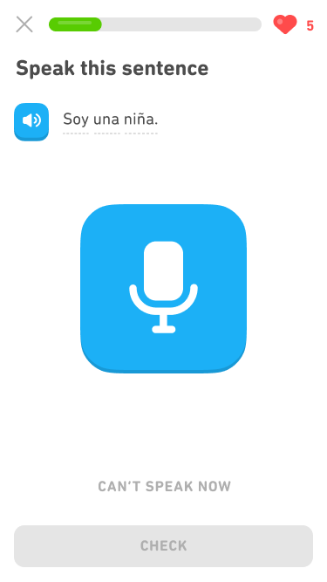
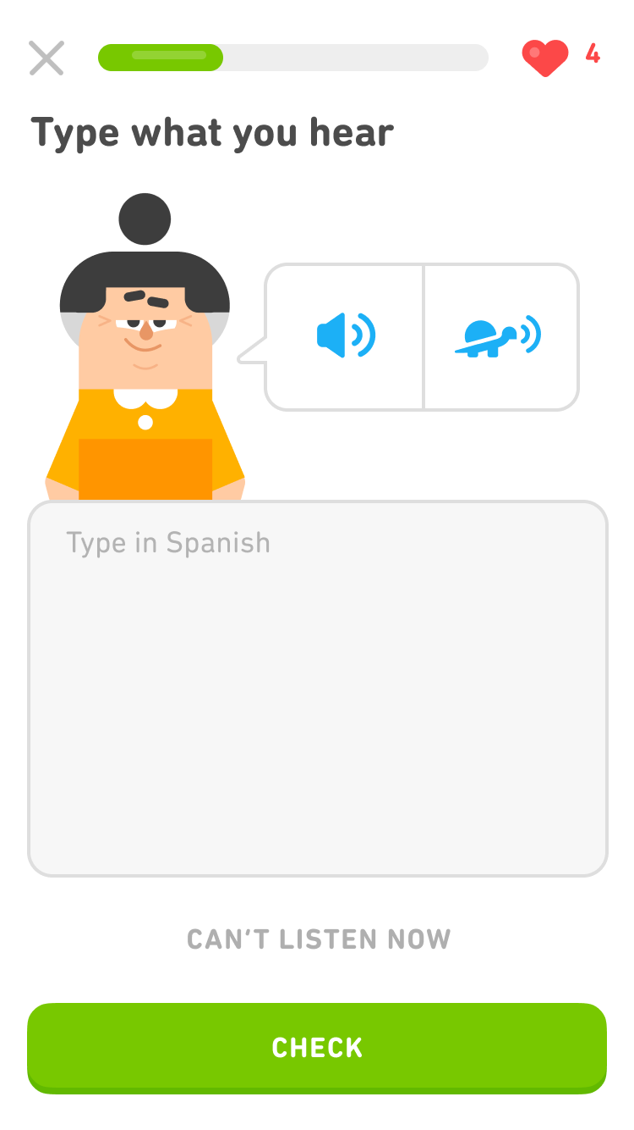
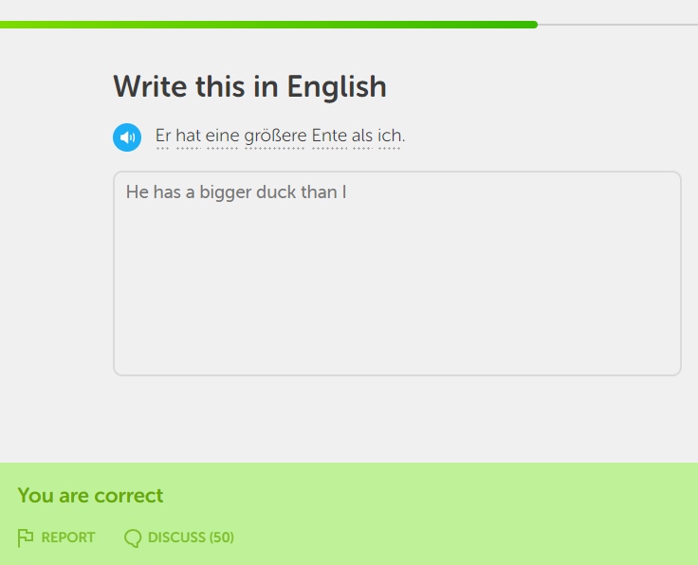
Duolingo Platform

Slide 16
Current Research on Duolingo
Effectiveness
Gamification
(Jašková, 2014; Krashen, 2014; Vesselinov & Grego, 2012)
(Huynh et al., 2016; Huynh & Iida, 2017; Munday, 2017; Shortt et al., 2021)
Microlearning
Features
(Brebera, 2017)
(Nushi & Eqbali, 2017; Savvani, 2018)

Slide 17
02
Method
Jambo!

Slide 18
Overview
An explanatory sequential mixed methods design
(Ivankova et al., 2006)
Quantitative data collection and data analysis followed by qualitative data collection and data analysis
84 valid survey responses & 10 interviewees

Slide 19
The explanatory-sequential approach
Quantitative Data is analyzed by descriptive statistics (i.e. percentages and means) through Qualtrics
Qualitative data is analyzed by thematic analysis through NVivo 12

Slide 20
Participants
USA
UK
China
USA
Germany
China
Mexico
Costa Rica
Singapore
Indonesia

Slide 21
03
Findings
Ni hao!

Slide 22
Goal Management
All interviewees (n=10) had goals, which can be classified into long-term outcome goals, short-term performance goals, and procedural goals.
All three types of goals can be very specific or very vague.
8 interviewees have specific outcome goals, 5 of them can predict procedures that take them to the final outcome and set sub-goals.
Learners who claim that they do not have specific goals are more likely to follow a goal generated by language learning software rather than a goal initiated by themselves.
Notes:
A goal is something that an individual is intentionally attempting to achieve, whereas goal-setting refers to establishing a goal and adjusting it as needed. (Bandura 1986, 1988; Lunenburg, 2011). Goals with specific standards can enhance learning because they specify the amount of effort required to succeed and the self-satisfaction anticipated (Schunk, 1990). Further, goal setting leads to task assessment and considerations of the appropriate learning strategies from a metacognitive perspective (Ridley et al., 1992). In MALL, timescales influence the dynamic nature of the learning ecology and so influence the learning goals. In effect, learners lose motivation when there are not enough accomplishments in a reasonable time towards the learning goals (Isbell et al., 2017). Accordingly, setting realistic and achievable goals is more likely to lead to a successful SDL.

Slide 23
Goal Management
Outcome goals:
“My future goal is to get the C1 CEFR, because I must have it to enter the German university.”
Short-term performance goals:
“I'm more into like in six months, I must read the complete structure (of Duolingo).”
Procedural goals:
“And it's more like I have a goal that I must complete the tree in German. So yeah, I have to make myself discipline[d].”
Interviewee #6
Notes:
For example, P6's goal is specific and highly outcome-oriented, claiming that “my future goal is to get the C1 CEFR, because I must have it to enter the German university.” Specific outcome goals, as opposed to vague goals, are more likely to lead to explicit short-term performance goals. As she said, “I'm more into like in six months, I must read the complete structure (of Duolingo).” To achieve the specified performance goal, she breaks the process down into small procedural goals that prepare and equip her with the necessary skills to meet the higher-level goals. As she explained, “And it's more like I have a goal that I must complete the tree in German. So yeah, I have to make myself discipline[d].”

Slide 24
Time Management
The majority of interviewees (n=8) stated that daily life activities are a constraint to their time management.
The significant obstacle is due to work demands, which have an impact on learners’ physical and emotional ability to complete their learning goals on a consistent basis.
“Because my schedule can be busy. Sometimes, especially during the exam
period in schools, I really have no time. I'm just busy completing my markings.”
Interviewee #10
Notes:
The majority of interviewees (n=8) stated that daily life activities are a constraint to their time management. The significant obstacles that interviewees face relate to time constraints for studying a language and the limited free time due to work demands, both of which have an impact on their physical and emotional ability to complete their learning goals on a consistent basis. P10, for example, stated, “Because my schedule can be busy. Sometimes, especially during the exam period in schools, I really have no time. I'm just busy completing my markings.”
Despite the fact that learners face a variety of physical and physiological challenges when it comes to time management, eight interviewees (n=8) either use technology-assisted time management or a self-developed time management system to overcome time constraints. To cope with the problem, four of them (n=4) even use a combination of technology and individual planning systems to facilitate time management. Six interviewees (n=6) reported that Duolingo notifications via phone push and emails are effective at reminding them to devote time to language learning. As P7 from Germany noted, “Because I wa

Slide 25
Time Management
Eight interviewees (n=8) either use technology-assisted time management or a self-developed time management system to overcome time constraints.
If you have the app on your phone and you have the notification open, and you didn't finish your day, they will send at least three notifications at different times of the day to remind you to do so.”
Interviewee #5
“Because I was getting notified and I knew, okay, I have to do something now.”
Interviewee #7

Slide 26
Resource Management
Authenticity of resources is prioritized in language learning.
Three primary indicators of authentic resources are engagement of experts, realistic and meaningful learning context, and valid content.
“Talk to somebody who's a native speaker. And then you figure out whether they understand you. And they may give some feedback like, ‘Hey, Joe, you know, your language is pretty good’ or they stop you every ten sections to say “no, actually, this is how you say it.” Yeah. So that I think is the most valuable measure of how you're doing in a language.”
Interviewee #9
Notes:
One of the significant findings is that authenticity of resources is prioritized in language learning. Eight interviewees (n=8) demonstrate that they consistently seek for authentic materials and resources when learning a foreign language. Three primary indicators of authentic resources are engagement of experts, realistic and meaningful learning context, and valid content.

Slide 27
Resource Management
More than half of the interviewees (n=6) highly valued the importance of cultural information and representations in the various learning resources in Duolingo.
“And there's no culture. I mean, they could be like, here's a traditional Middle Eastern dish from xxx area… But then they also have sentences with people named Bob and Sam. Why? Just use all Arabic names. Like why, why people go somewhere and talk about Sam. Sam, yeah, which is Arabic, but why do I need to talk about Bob?”
Interviewee #7

Slide 28
04
Discussion
Hi!

Slide 29
Significance of Research
01
02
Literature Gap
Practice
Most existing studies on MALL-based self-directed learning have been conducted in the context of formal school learning (Botero & Questier, 2016; Botero et al., 2019)
The COVID-19 pandemic significantly changes how people approach learning languages and various new online or blended options emerge.

Slide 30
Limitations & Future Research
01
02
03
Instrument Design
Sample Size
Survey Distribution
The survey instrument was not originally designed for this study
500 million users
VS
84 survey participants
Users who uses Duolingo Event, Forum, and Discord are far more likely to observe the recruitment than those who solely use Duolingo lessons.

Slide 31
THANKS
Aluu!
¡Hola!
Do you have any questions?
Zixi Li, lizixi@iu.edu
Curt Bonk, cjbonk@iu.edu
Jambo!
Please keep this slide for attribution

