Slide 1
The G³ of Writing and Publishing Tips: Gentle Guidelines, Great Stories, and Gigantic Scholarly Gains
Curtis J. Bonk, Ph.D.
Indiana University
cjbonk@indiana.edu
Notes:
All
1

Slide 2
Purposes of this Session
Part I: The Process
a. Exploring the process for getting published
b. Selecting a journal for publication
c. Academic information resources
d. Predatory journal issues
e. Taking the plunge
Part II: Writing Tips and Insights
a. Examining 20+ writing tips
b. Making commitments to future writing
III. Slaying I-Monsters
a. Detailing the pros & cons of SSCI publications
Notes:
Ana

Slide 3
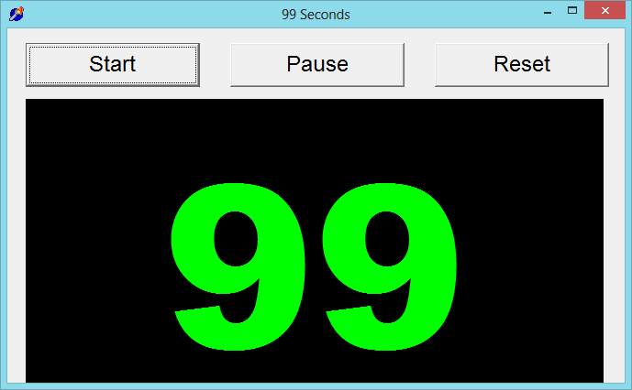
99 Seconds Activity #1
With your next chair neighbor discuss 1 to 2 writing dilemmas currently facing.
Notes:
Ana
Not sure if we want to keep all these activities as we only have 1 hour and 5 minutes and need to leave time for questions. It’s up to you….
3

Slide 4
Part I: The Process
Insights and Advice on Getting Published in Higher Education
Notes:
Ana

Slide 5
Writing Difficulties and Challenges of a Early Career Scholar
Time
Writing habits
Resources
Local/Global Support
Starter text
Reputation
Connections
Journal awareness
Energy/Stamina
Service/Teaching duties
Notes:
Ana
5

Slide 6
Put Forward your Best Work
Collaborative research projects
Literature reviews
Reflections/ conceptual pieces
Grant projects
Class projects
Notes:
Ana
6

Slide 7
Finding a Journal that Fits
What to look for?
Who will be your target readers?
Who are the authors and journals you cite the most related with your research program?
Is there a match between your work and the journal aims and scope?
What is the journal turnaround time?
What is the journal acceptance rate?
Do you know the editor(s)?
Notes:
Ana
https://www.editage.com/insights/how-to-choose-journals-for-submitting-your-paper
Who will be your target readers? Scholarly vs. non-scholarly periodicals
readership and target audience
Look for a match between your work and the journal aims and scope. – journal analysis
What is the journal’s turnaround time?
Acceptance rates? Get familiar with the journals’ acceptance rates
7

Slide 8
Finding a Journal that Fits
Where to look for?
Social Sciences Citation Index (SSCI) is a commercial citation index product of Clarivate Analytics. It was originally developed by the Institute for Scientific Information from the Science Citation Index.
European Reference Index for the Humanities and the Social Sciences (ERIH PLUS) was created and developed by European researchers under the coordination of the Standing Committee for the Humanities of the European Science Foundation.
Notes:
Ana
8

Slide 9
Where to start?
Practitioner Journals
Target practitioners
Deal with problems and issues tied directly to practice
Receive wider circulations and visibility
Refereed or nonrefereed articles
Notes:
Ana
Unlike peer reviewed articles, nonrefereed articles, where publication decisions are made by one or more editors without using a blind review process, are important because they fill an important niche in practice oriented fields like ed tech.
Peer-reviewed or refereed articles undergo a blind review. This means that neither he authors nor reviewers know each other’s identity. This process is designed to endure that a manuscript has been reviewed and accepted in an ethical and unbiased manner by experts from a specific field.
Although refereed articles are often considered the gold standard in faculty promotion and tenure deliberations, nonrefereed articles nevertheless plan an important role within most academic disciplines.
Practitioner journals are targeted toward practitioners and deal with problems and issues tied directly to practice, Thus,, an article appearing in a practitioners journal could receive wider circulations and visibility than one published in a respected academic journal that is narrowly targeted toward a more limited audience.

Slide 10
Where to start?
Peer-Reviewed Journals
Top-tier journals: are SSCI-indexed
Second-tier journals: have an established history in the field
Third-tier journals: often are newer to the field
Notes:
Ana
you should publish everything you do, even if it is only acceptable for a lower tier journal. It demonstrates your commitment to finish a project and makes your work available to everyone else. Lower tier journals are also great outlets for quality undergraduate research that you have directed.

Slide 11
TOP-TIER JOURNALS
British Journal of Educational Technology
Educational Technology Research and Development
The Internet and Higher Education
Instructional Science
Notes:
Ana
Mention:
http://www.trainingshare.com/resources/distance_ed_journals_and_online_learning_books.php
More examples:
Distance EducationDistance Education; The Internet and Higher Education; Asian Journal of Technology InnovationAsian Journal of Technology Innovation ; Australasian Journal of Educational Technology
Educational Technology Research and Development
11

Slide 12
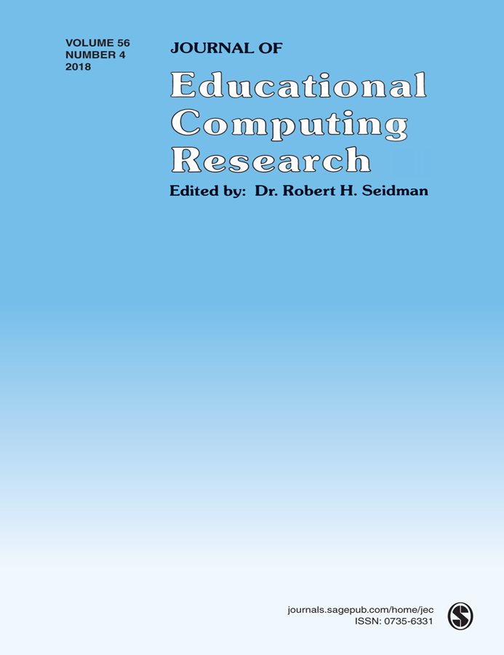
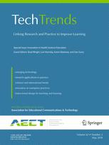
SECOND-TIER JOURNALS
Journal of Educational Computing Research
TechTrends
The American Journal of Distance Education
Notes:
Ana
Journal of Technology and Teacher EducationJournal of Technology and Teacher Education; The Quarterly Review of Distance EducationJournal of Technology and Teacher Education; The Quarterly Review of Distance Education; Science & Education
Journal of Digita Learning in Teacher Education
International Review of Research in Open and Distributed Learning
The American Journal of Distance Education
12

Slide 13
THIRD-TIER JOURNALS (often new journals)
International Journal of Online Pedagogy and Course Design
Contemporary Issues in Technology and Teacher Education
Interactive Technology and Smart Education
Notes:
Ana
International Journal of Gaming and Computer Mediated SimulationsInternational Journal of Gaming and Computer Mediated Simulations; Advances in MultimediaInternational Journal of Gaming and Computer Mediated Simulations; Advances in Multimedia; Learning: Research and Practice
International Journal of Designs for Learning

Slide 14
Resource and Idea Suggestions
Subscribe to news feeds (not too many)
Save links and images to interesting articles
Review saved documents for themes monthly
Share those links in Facebook, Twitter, etc., for peer reactions
Write to people interviewed in articles

Slide 15
Academic information/ Resources
(Feng-Ru Sheu, Kent State University, 2018)
Tools for research
Citation/reference management
Ex. Endnote, Zotero, Refwork, Paper, etc.
Incorporate other software
Ex. Nvivo (qualitative analysis tool, Network analysis i.e.)
Writing Tutorial Services
Tutoring Services
Writing Tools (e.g., Grammarly)

Slide 16
Academic information/ resources (Cont’d)
(Feng-Ru Sheu, Kent State University, 2018)
Journal selection/evaluation
Impact/accreditation (*Predatory Journals)
Citation index (Web of Science, Google Scholar, etc.)
Impact factor
Ranking
Open Access vs. non-Open Access
Directory of Open Access Journals
Open Access Scholarly Publishers Association

Slide 17
Academic information/ resources (Cont’d)
(Feng-Ru Sheu, Kent State University, 2018)
Journal evaluation & legitimacy
Consult with a librarian
Visit & Examine the journal's web site.
Reach out to journal's editorial board members.
Aim and goals of journal. Read the scope of the journal.
Read their peer review policy.
Check to see what "author fees" are being requested
Research industry associations.
DOAJ= Directory of Open Access Journals
OASPA = Open Access Scholarly Publishers Association

Slide 18
Journal Impact Factor (Feng-Ru Sheu, Kent State University, 2018)
Impact = The frequency in which the average article in a journal has been cited in a specific period of time.
Rank or importance of a journal = the higher impact factor, the better rank.
The calculation is to dividing the number of times articles were cited by the number of articles that were citable. It is usually based on a two-year period.
Tools to measure journal impact factor
Journal Citation Report, https://goo.gl/yVw8si
Scimago Journal Rank (SRJ), https://www.scimagojr.com/
Notes:
Feng-Ru

Slide 19
Predatory Journals/ Publishers (Feng-Ru Sheu, Kent State University, 2018)
Be Aware of Predatory Journals/Publishers!
The publishing venue prey on academicians for making money without following scholarly publishing standards, commonly seen in the Open Access world.
Also called “Pseudo-journals,” “fake journals,” and “sham journals.”
(Beager, 2017; Clark & Smith, 2017)
Notes:
Feng-Ru
the “Think. Check. Submit.” checklist developed by a coalition of scholarly publishing organizations
Think
Are you submitting your research to a trusted journal?
Is it the right journal for your work?

Slide 20
Predatory Journals/ Publishers
(Feng-Ru Sheu, Kent State University, 2018)
Be Aware of Predatory Journals/Publishers!
Characteristics
The journal asks for a submission fee
Promises of fast peer review and fast publication
Spam emails to attract potential authors
Small size of editorial board or not indicated clearly
Newness and the quantity: a very new journal that consists of a high quantity of articles in one issue
Inconsistencies in the scope and the content or journal title and contact address
(Beager, 2017; Prater, 2018)
Notes:
Feng-Ru
the “Think. Check. Submit.” checklist developed by a coalition of scholarly publishing organizations
Think
Are you submitting your research to a trusted journal?
Is it the right journal for your work?

Slide 21
March 27, 2013 Investigating journals: The dark side of publishing (The explosion in open-access publishing has fuelled the rise of questionable operators), Declan Butler, Nature http://www.nature.com/news/disciplinary-action-1.12668

Slide 22
March 27, 2013 Sham journals scam authors: Con artists are stealing the identities of real journals to cheat scientists out of publishing fees. Declan Butler, Nature http://www.nature.com/news/sham-journals-scam-authors-1.12681

Slide 23
April 7, 2014 Scientific Articles Accepted (Personal Checks, Too) Gina Kolata, The New York Times http://www.nytimes.com/2013/04/08/health/for-scientists-an-exploding-world-of-pseudo-academia.html?_r=1&

Slide 24
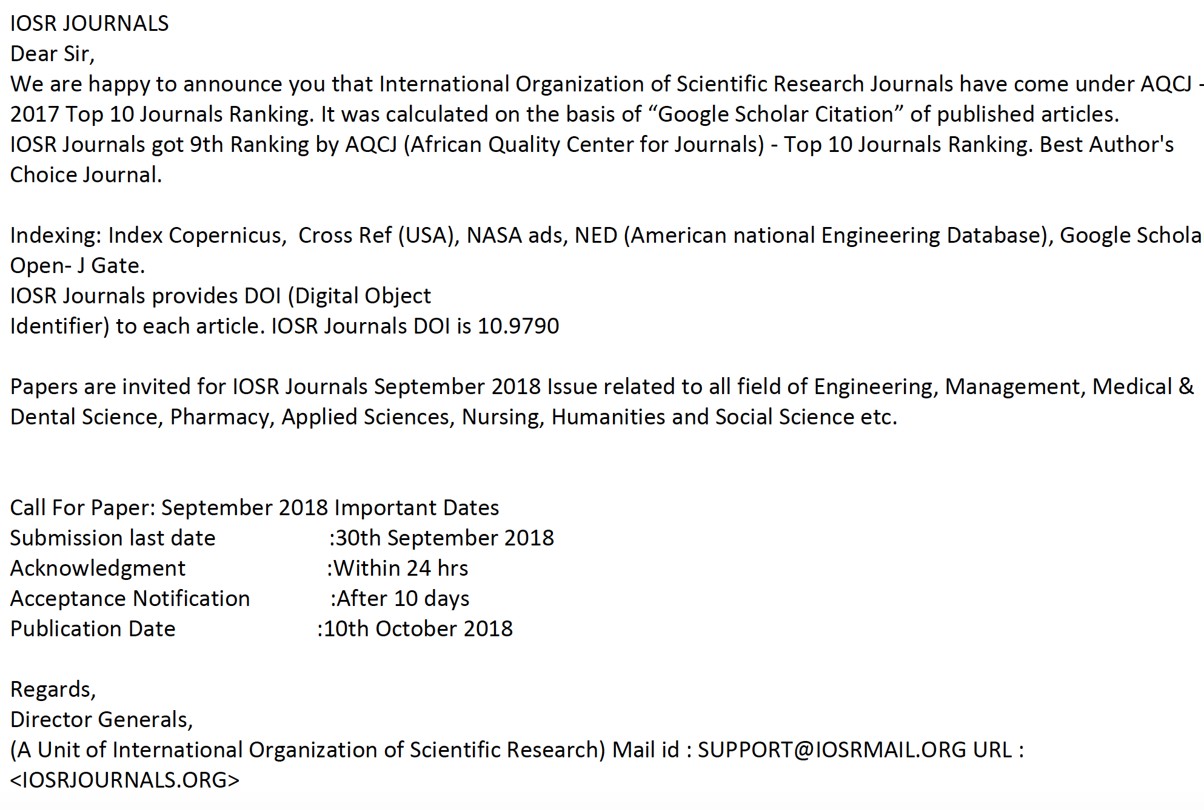
Predatory Journals/ Publishers
(Feng-Ru Sheu, Kent State University, 2018)
Examples of spam emails to attract potential authors
Notes:
Feng-Ru
the “Think. Check. Submit.” checklist developed by a coalition of scholarly publishing organizations
Think
Are you submitting your research to a trusted journal?
Is it the right journal for your work?

Slide 25
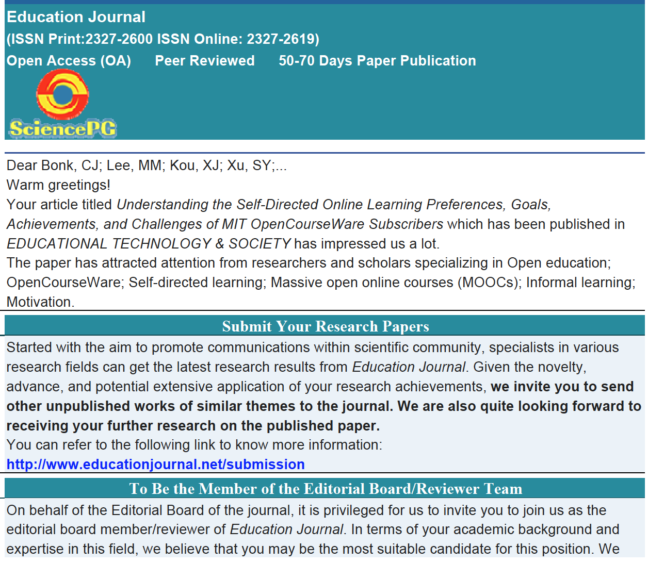
Predatory Journals/ Publishers
(Feng-Ru Sheu, Kent State University, 2018)
Examples of spam emails to attract potential authors
Notes:
Feng-Ru
the “Think. Check. Submit.” checklist developed by a coalition of scholarly publishing organizations
Think
Are you submitting your research to a trusted journal?
Is it the right journal for your work?

Slide 27
Selecting a Journal (Feng-Ru Sheu, Kent State University, 2018)
Be Aware Predatory Journals!
Using the “Think. Check. Submit.” checklist
Developed by a initiative of scholarly publishing organizations
(think.check.submit.org, 2018)
Notes:
Feng-Ru

Slide 28
Selecting a Journal (Feng-Ru Sheu, Kent State University, 2018)
Be Aware Predatory Journals!
Criteria to check the journal
Do you or your colleagues know the journal?
Can you easily identify and contact the publisher?
Is the journal clear about the type of peer review it uses?
Are articles indexed in services that you use?
Is it clear what fees will be charged?
Do you recognize the editorial board?
Is the Publisher a member of a recognized industry initiative?
Access the checklist in detail at http://thinkchecksubmit.org/check/
Notes:
Feng-Ru

Slide 29
Selecting a Journal (Feng-Ru Sheu, Kent State University, 2018)
Two resources to identify the journals and publishers
The Directory of Open Access Journals (DOAJ): https://doaj.org/
Identify legitimate and high quality open access, peer-reviewed journals
Beall’s List of Predatory Journals and Publishers: https://beallslist.weebly.com/
Identify predatory journals/publishers
Notes:
Feng-Ru

Slide 30
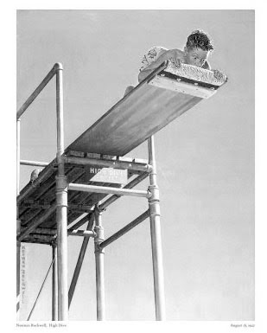
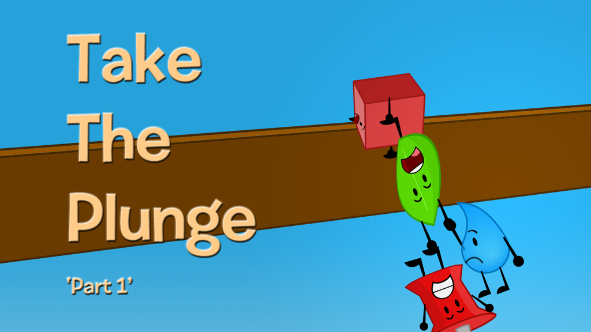
Take the Plunge…Part 1
Look for opportunities to create publishable manuscripts from your dissertation
Contribute with a chapter
Conduct an interview
Write a practical article, newsletter, or book review
Notes:
Ana
Review articles and conference proposals (learn about peer-review criteria and guidelines)
Review book proposals
Do a conference workshop
Organize a symposium
30

Slide 31
Take the Plunge…Part 2
Write a major grant proposal
Lead a special journal issue
Edit a book
Sole author a book
Get your name out there!
Notes:
Curt
31

Slide 32
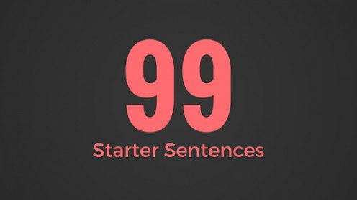
Generate Starter Text…
Author a blog
Use social media
Submit a conference proposal
Write editorials
Write book and software reviews
101
Notes:
Curt

Slide 33
99 Seconds Activity #2
Commit to 1 to 2 things that take the plunge and share them with your next chair neighbor.
Notes:
Curt
Not sure if we want to keep all these activities as we only have 1 hour and 5 minutes and need to leave time for questions. It’s up to you….
33

Slide 34
Part II: Writing Tips and Insights
Insights and Advice on Getting Published Higher Education
Notes:
Curt
34

Slide 35
October 2, 2018 How to Learn to Write Like a Machine Rose Jacobs, Inside Higher Ed https://www.chronicle.com/blogs/linguafranca/2018/10/02/how-to-learn-to-write-like-a-machine/
Notes:
Curt

Slide 36
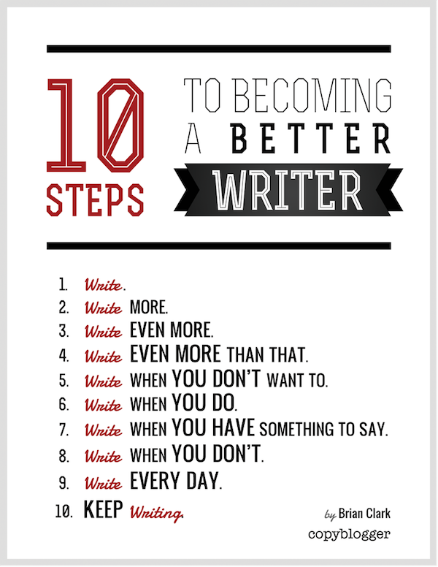
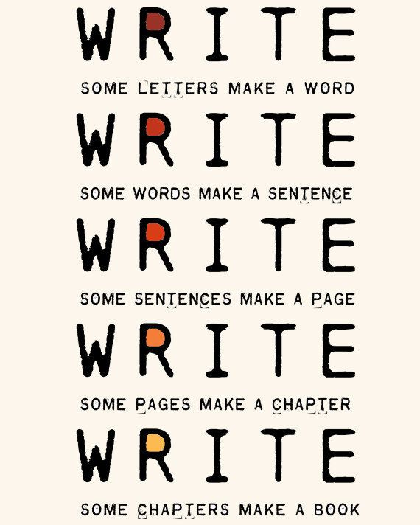
The Top 20 Writing Tips
Notes:
Curt
36

Slide 37
1. Mark Writing Days in Planner
Notes:
Curt
37

Slide 38
2. Maintain a List and Network of Potential Research and Writing Collaborators
Notes:
Curt
38

Slide 39
Sidenote: Find Good People to Work With…Life is Short—Avoid Egomaniacs and People Who Lie
Notes:
Curt
39

Slide 40
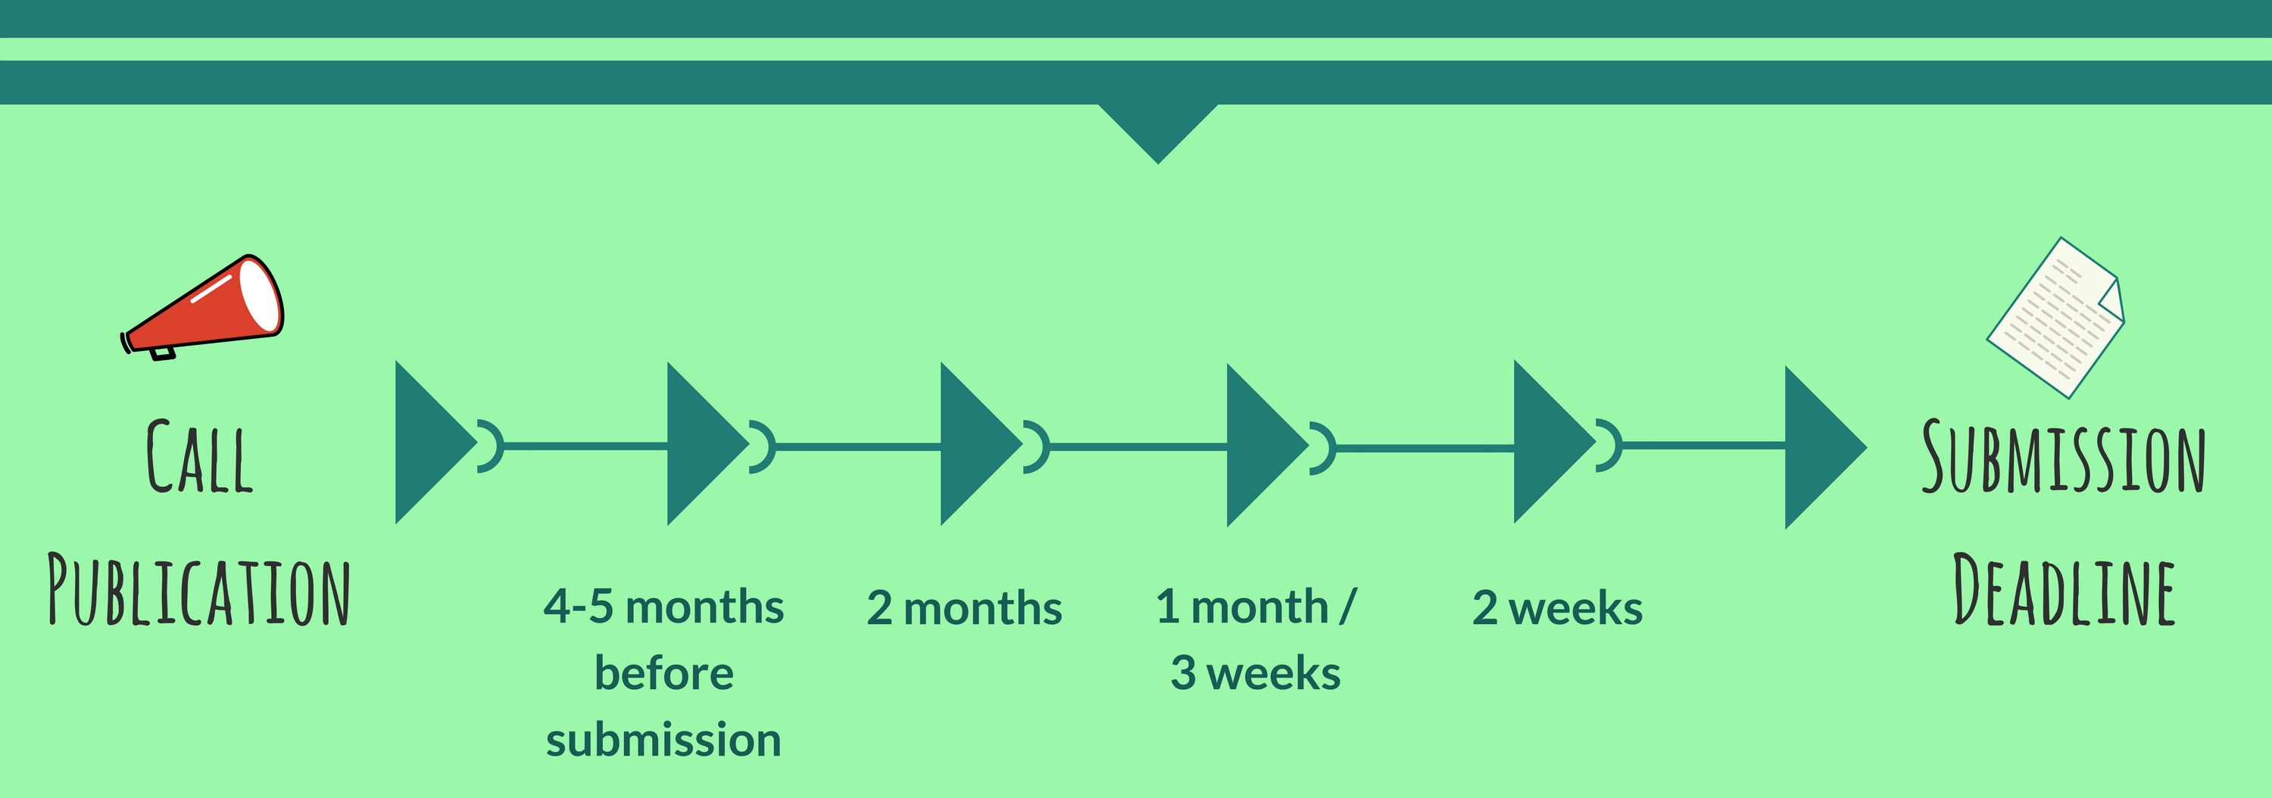
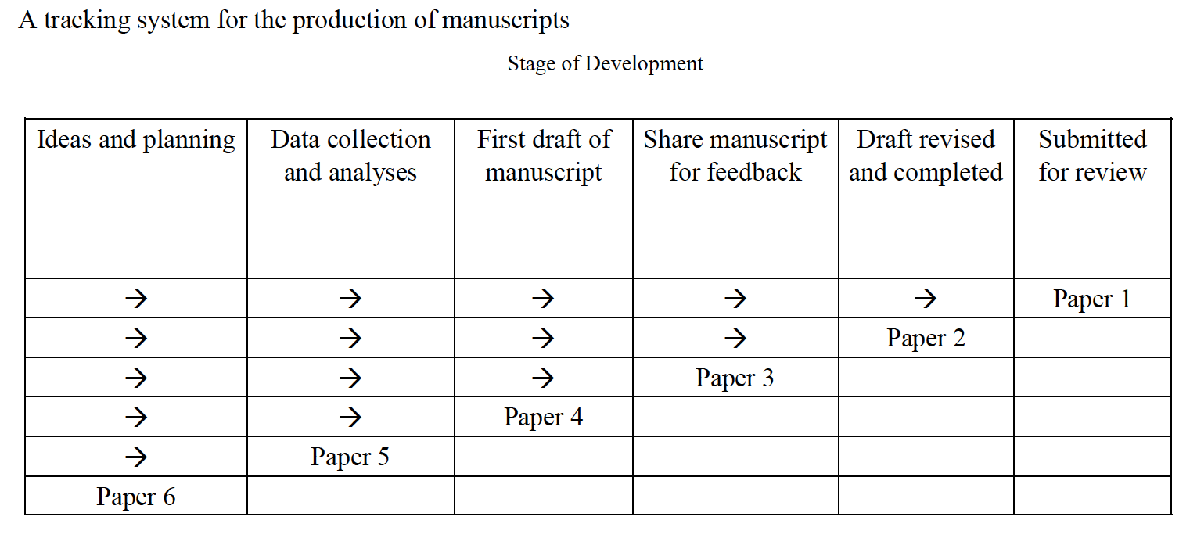
3. Draft a Timeline or Multiple Timelines with Flexible Goals
Notes:
Curt
Screenshot from Cecil’s article
40

Slide 41
October 10, 2018 Perhaps write to your future self about your goals… FutureMe.org Write a letter to the future https://www.futureme.org/
Notes:
Curt
Screenshot from Cecil’s article
41

Slide 42
4. Think Ahead About the Publishing Potential of Each Project
Notes:
Curt
42

Slide 43
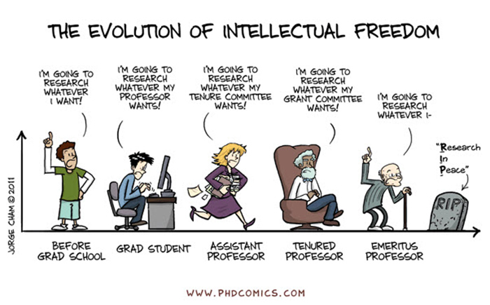
Sidenote: Don’t Just Publish for the Sake of Publishing…
Notes:
Curt
43

Slide 44
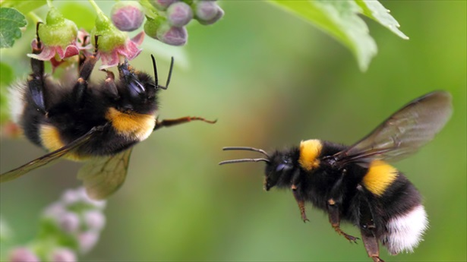
5. Be a Bumblebee and Butterfly
Notes:
Curt
44

Slide 45
6. Find, Save, and Use Starter Text (overcomes writer’s block)
Notes:
Curt
45

Slide 46
7. Always Scan the Reference Sections of Other Articles to See What Journals are Popular
Notes:
Curt
46

Slide 47
8. Avoid High Quality (i.e., SSCI) Journal Fixations
Notes:
Curt
47

Slide 48
9. Be Second or Third Author Sometimes to Spread Limited Resources
Notes:
Curt
48

Slide 49
10. If Need Summer Money, Teach Short Term or Intensive Courses
Notes:
Curt
49

Slide 50
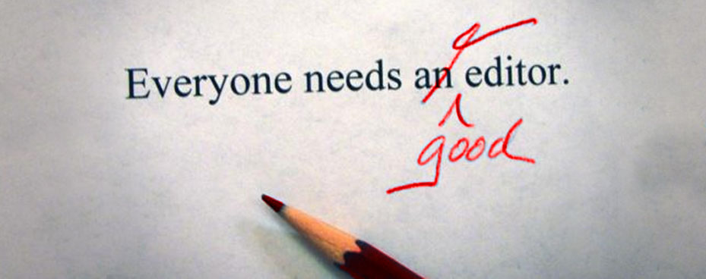
11. Edit Your Papers a Lot! (Mozartian vs. Beethovenian)
Notes:
Curt
50

Slide 51
October 1, 2018 6 Tips to Shape Up Your Writing Two-Minute Tips: Short videos to help you excel in the academic workplace Fernanda Zamudio-Suaréz, The Chronicle of Higher Education https://www.chronicle.com/article/6-Tips-to-Shape-Up-Your/244281?cid=cp221 https://www.chronicle.com/specialreport/Two-Minute-Tips/221
Writing is an exercise (write!).
Set goals based on output not input (e.g., 3 pages double-spaced).
Find a voice (don’t just focus on getting published).
Give yourself time (not deadlines).
Pick a puzzle (your writing is an answer to that puzzle).
Edit your work (over and over and over again…just like Beethoven).
Notes:
Curt

Slide 52
October 8, 2018 How to Improve Your Teaching-Philosophy Statement Two-Minute Tips: Short videos to help you excel in the academic workplace Fernanda Zamudio-Suaréz, The Chronicle of Higher Education https://www.chronicle.com/article/How-to-Improve-Your/244283 https://www.chronicle.com/specialreport/Two-Minute-Tips/221
Notes:
curt

Slide 53
October 15, 2018 How to Become a Highly Productive Writer Two-Minute Tips: Short videos to help you excel in the academic workplace Fernanda Zamudio-Suaréz, The Chronicle of Higher Education https://www.chronicle.com/article/How-to-Become-a-Highly/244351?cid=cp221 https://www.chronicle.com/specialreport/Two-Minute-Tips/221
Notes:
curt

Slide 54
12. Organize Conference Symposia Which Can Lead to Special Journal Issues and Books
Notes:
Curt
54

Slide 55
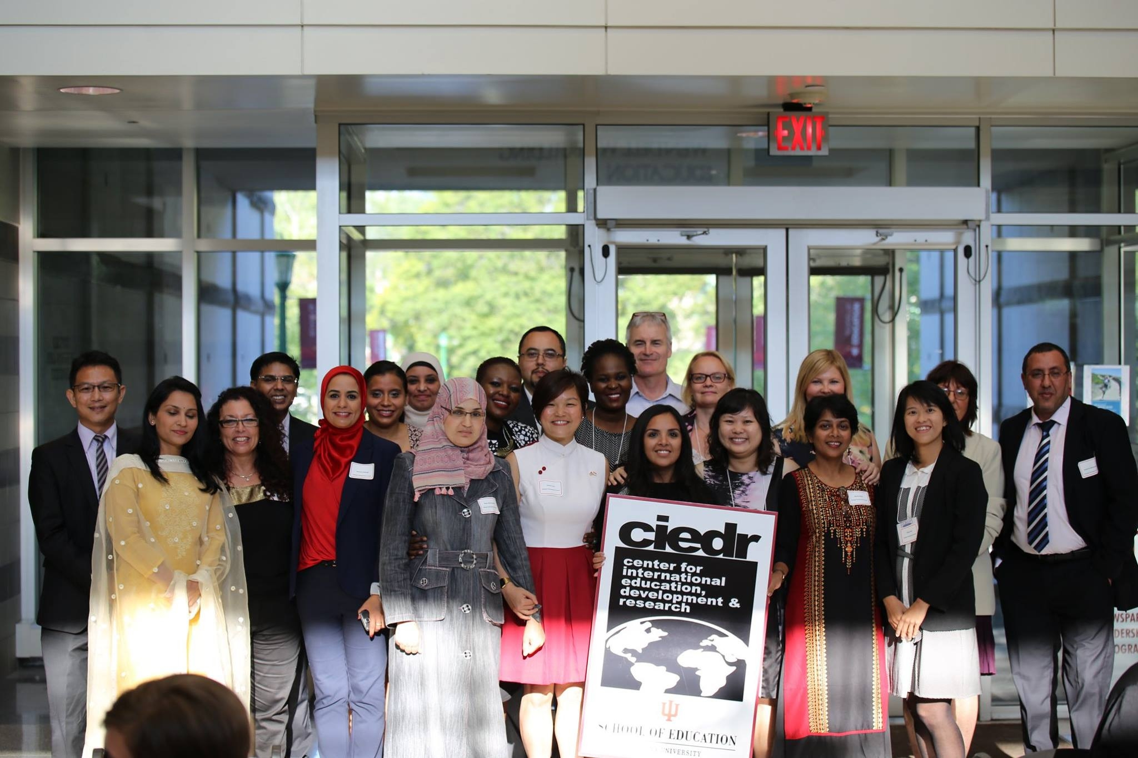
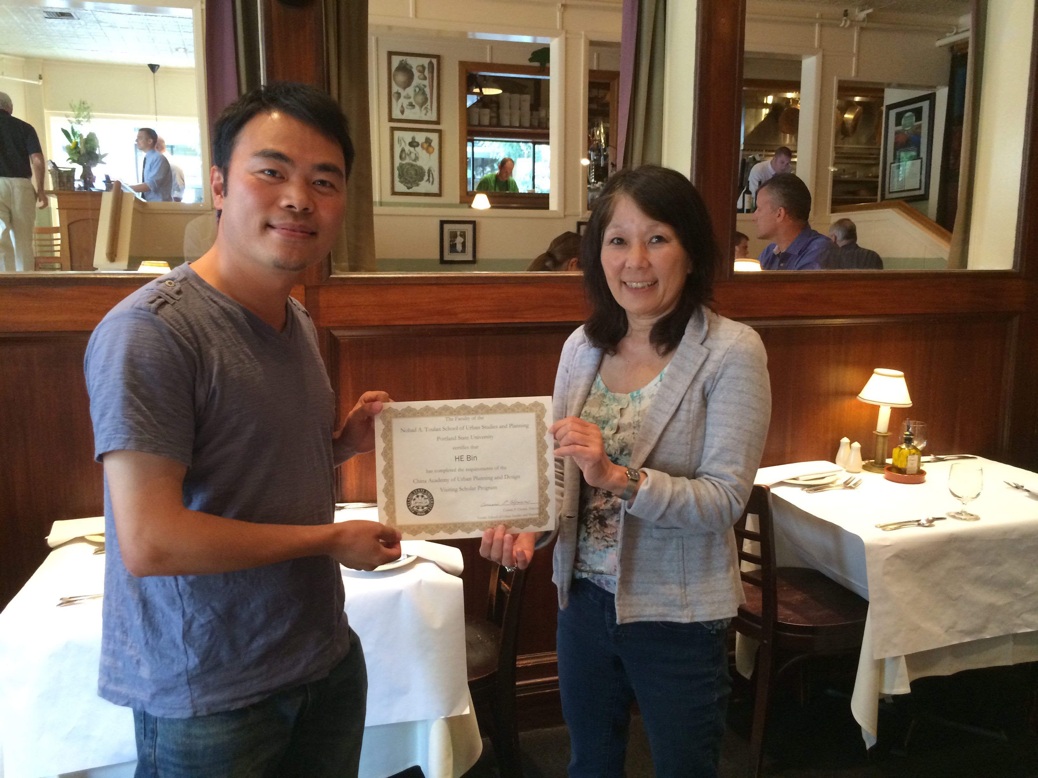
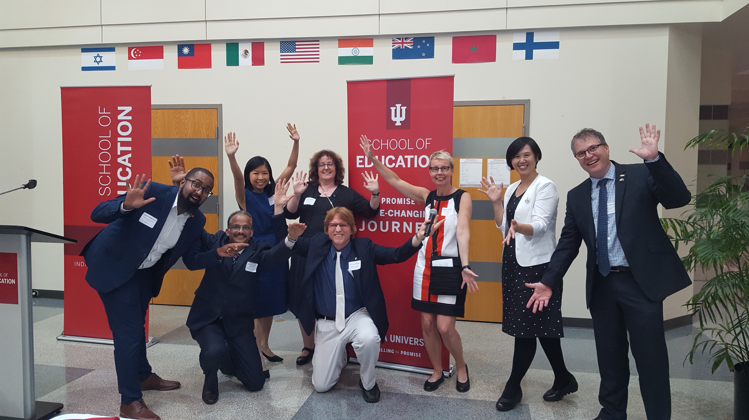
13. Sponsor Visiting Scholars to Work with You; They Often Have Writing Plans
Notes:
Curt
55

Slide 56
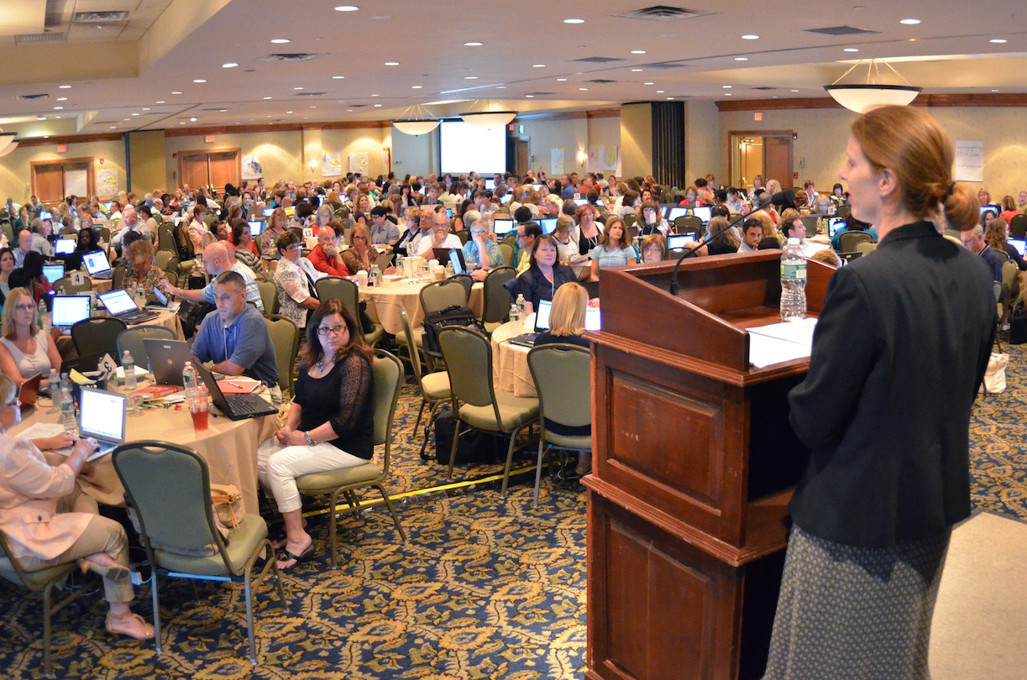
14. Try to Submit or Publish Your Paper Before the Conference
Notes:
Curt
56

Slide 57
15. Be Creative Somewhere (e.g., unique model, figure, chart, etc.)
Notes:
Curt
57

Slide 58
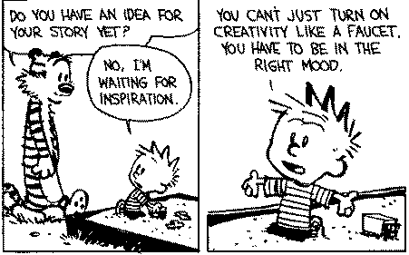
Sidenote: Modify Your Environment (Find or Create Your Personal Sandbox)
Notes:
Curt
58

Slide 59
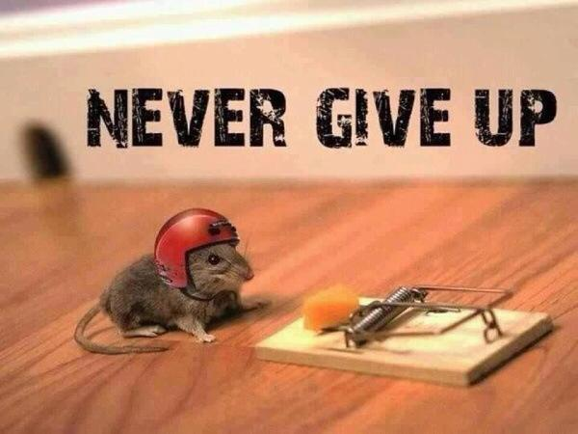
16. Try Not to Give Up: Persistence and Grit Wins the Day
Notes:
Curt
59

Slide 60
17. Be Polite and Thankful to the Journal or Book Chapter Editors
Notes:
Curt
60

Slide 61
18. Recap Reviewer Points and How You Attempted to Address Them
Notes:
Curt
61

Slide 62
October 4, 2018 A New Series on Scholarly Productivity: ‘Are You Writing?’ Rebecca Shuman, The Chronicle of Higher Education https://www.chronicle.com/article/A-New-Series-on-Scholarly/244689
Read as peer reviewer; mark up everything.
Catalog problems on a 1 to 3 difficulty scale (Level 1 takes less than 30 minutes, Level 2 takes 2 hours or less; Level 3 takes more time).
Fix the easy ones and gain momentum for the harder ones!
Take breaks as needed.
Notes:
Curt

Slide 63
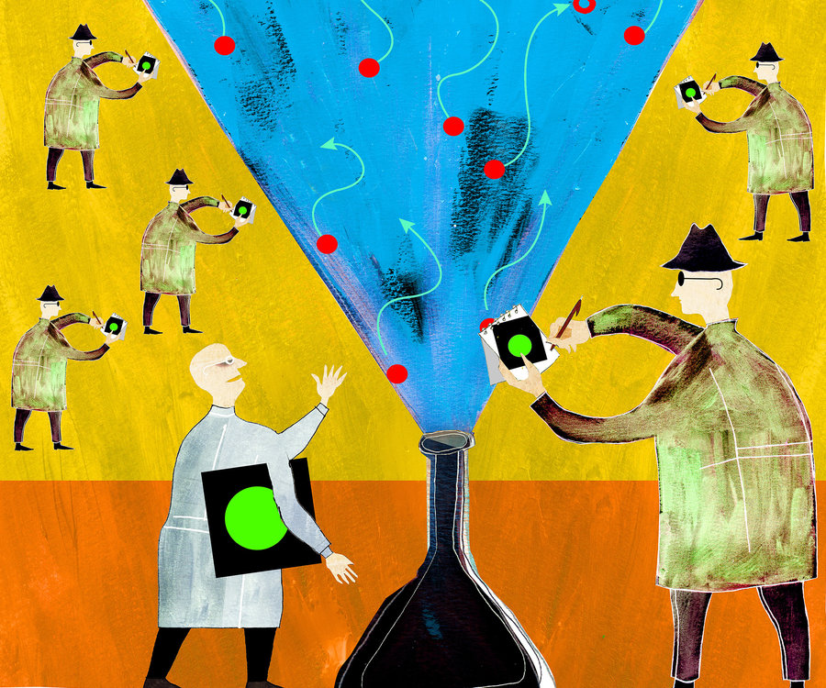
19. Share Your Publication Efforts (e.g., Twitter, Facebook, LinkedIn, email, ResearchGate, Academia.edu, etc.)
Notes:
Curt
63

Slide 64
20. Celebrate Your Writing Accomplishments with Friends
Notes:
Curt
64

Slide 65
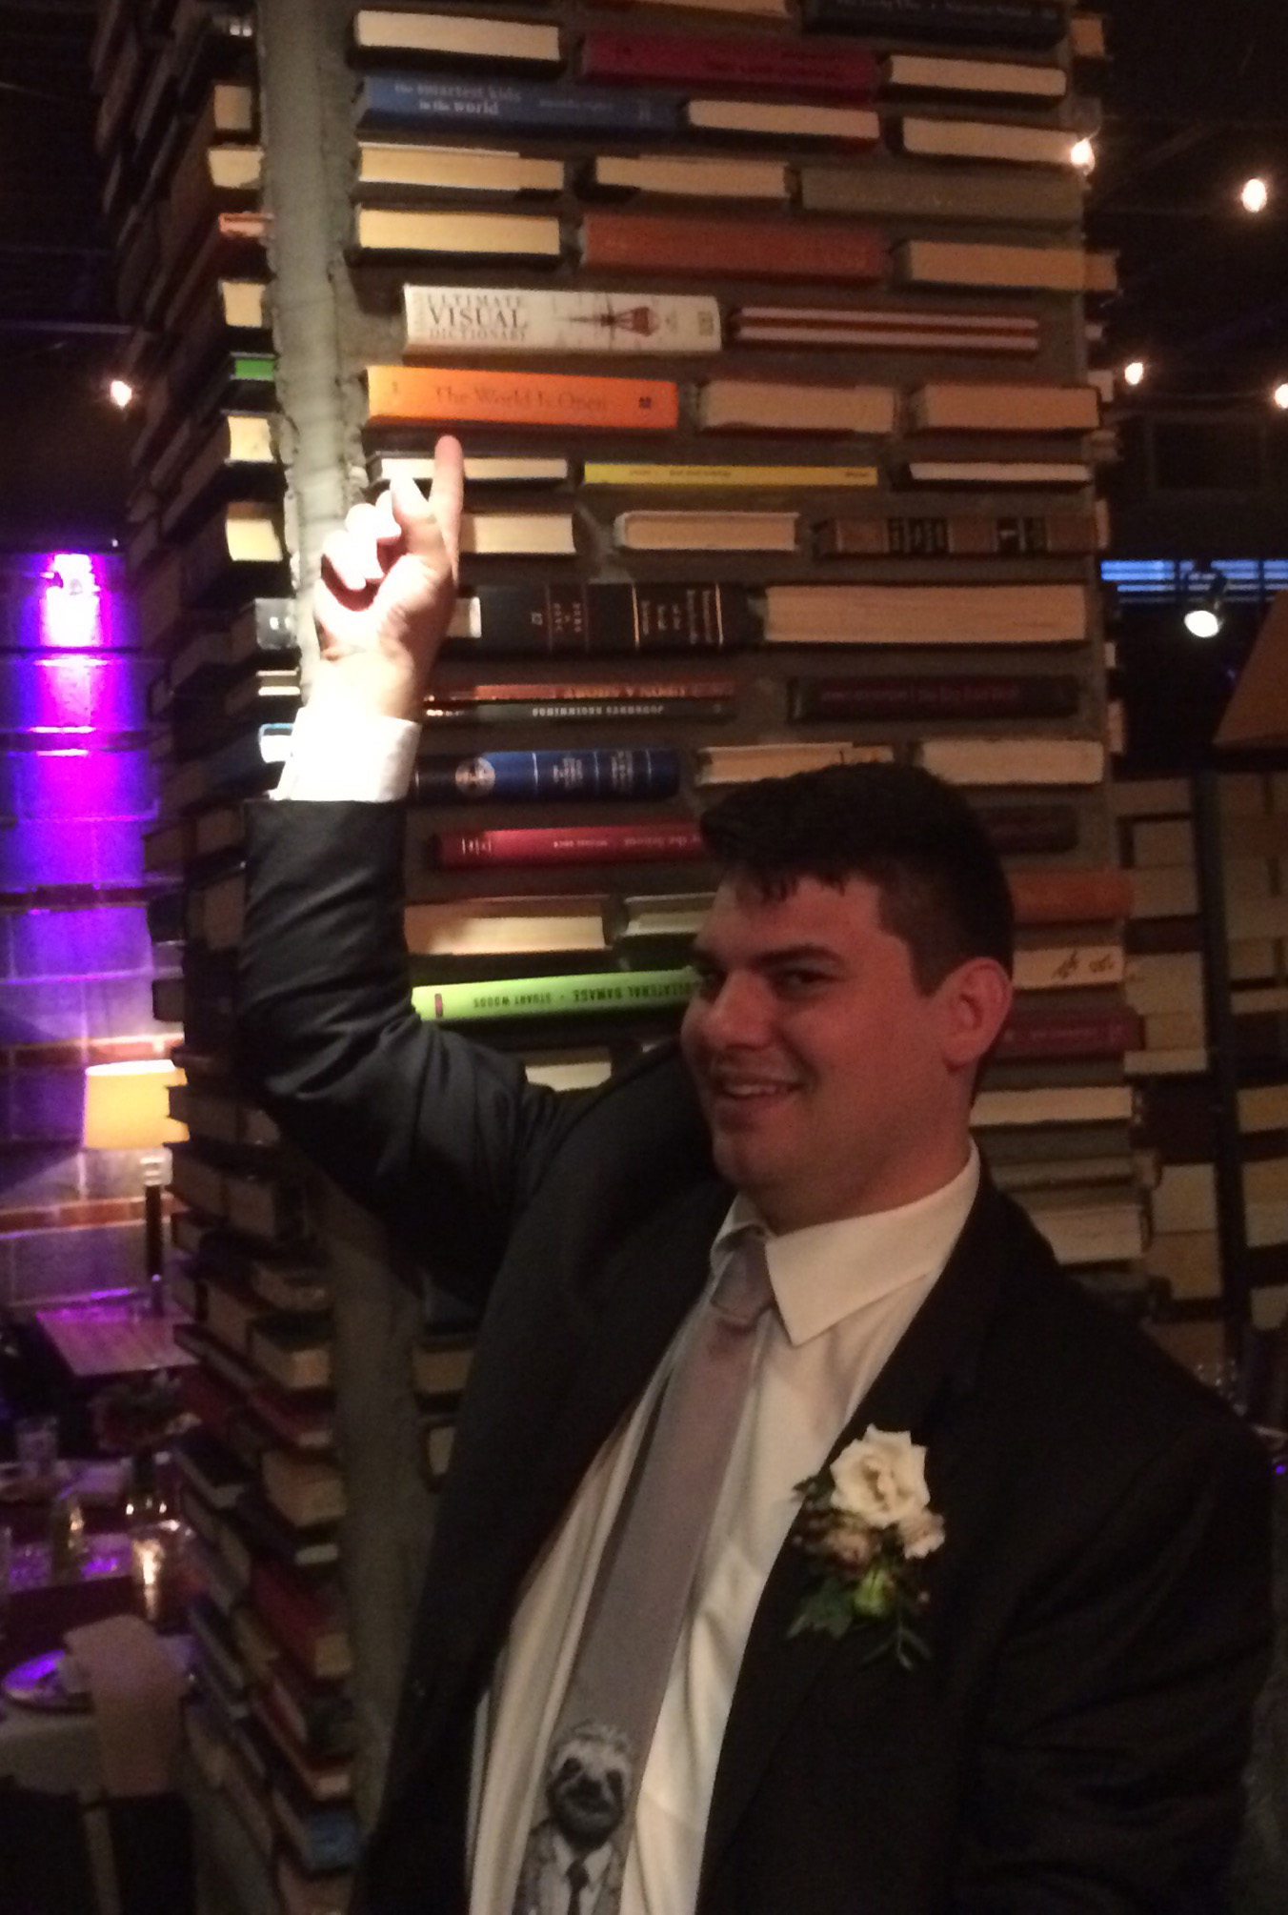
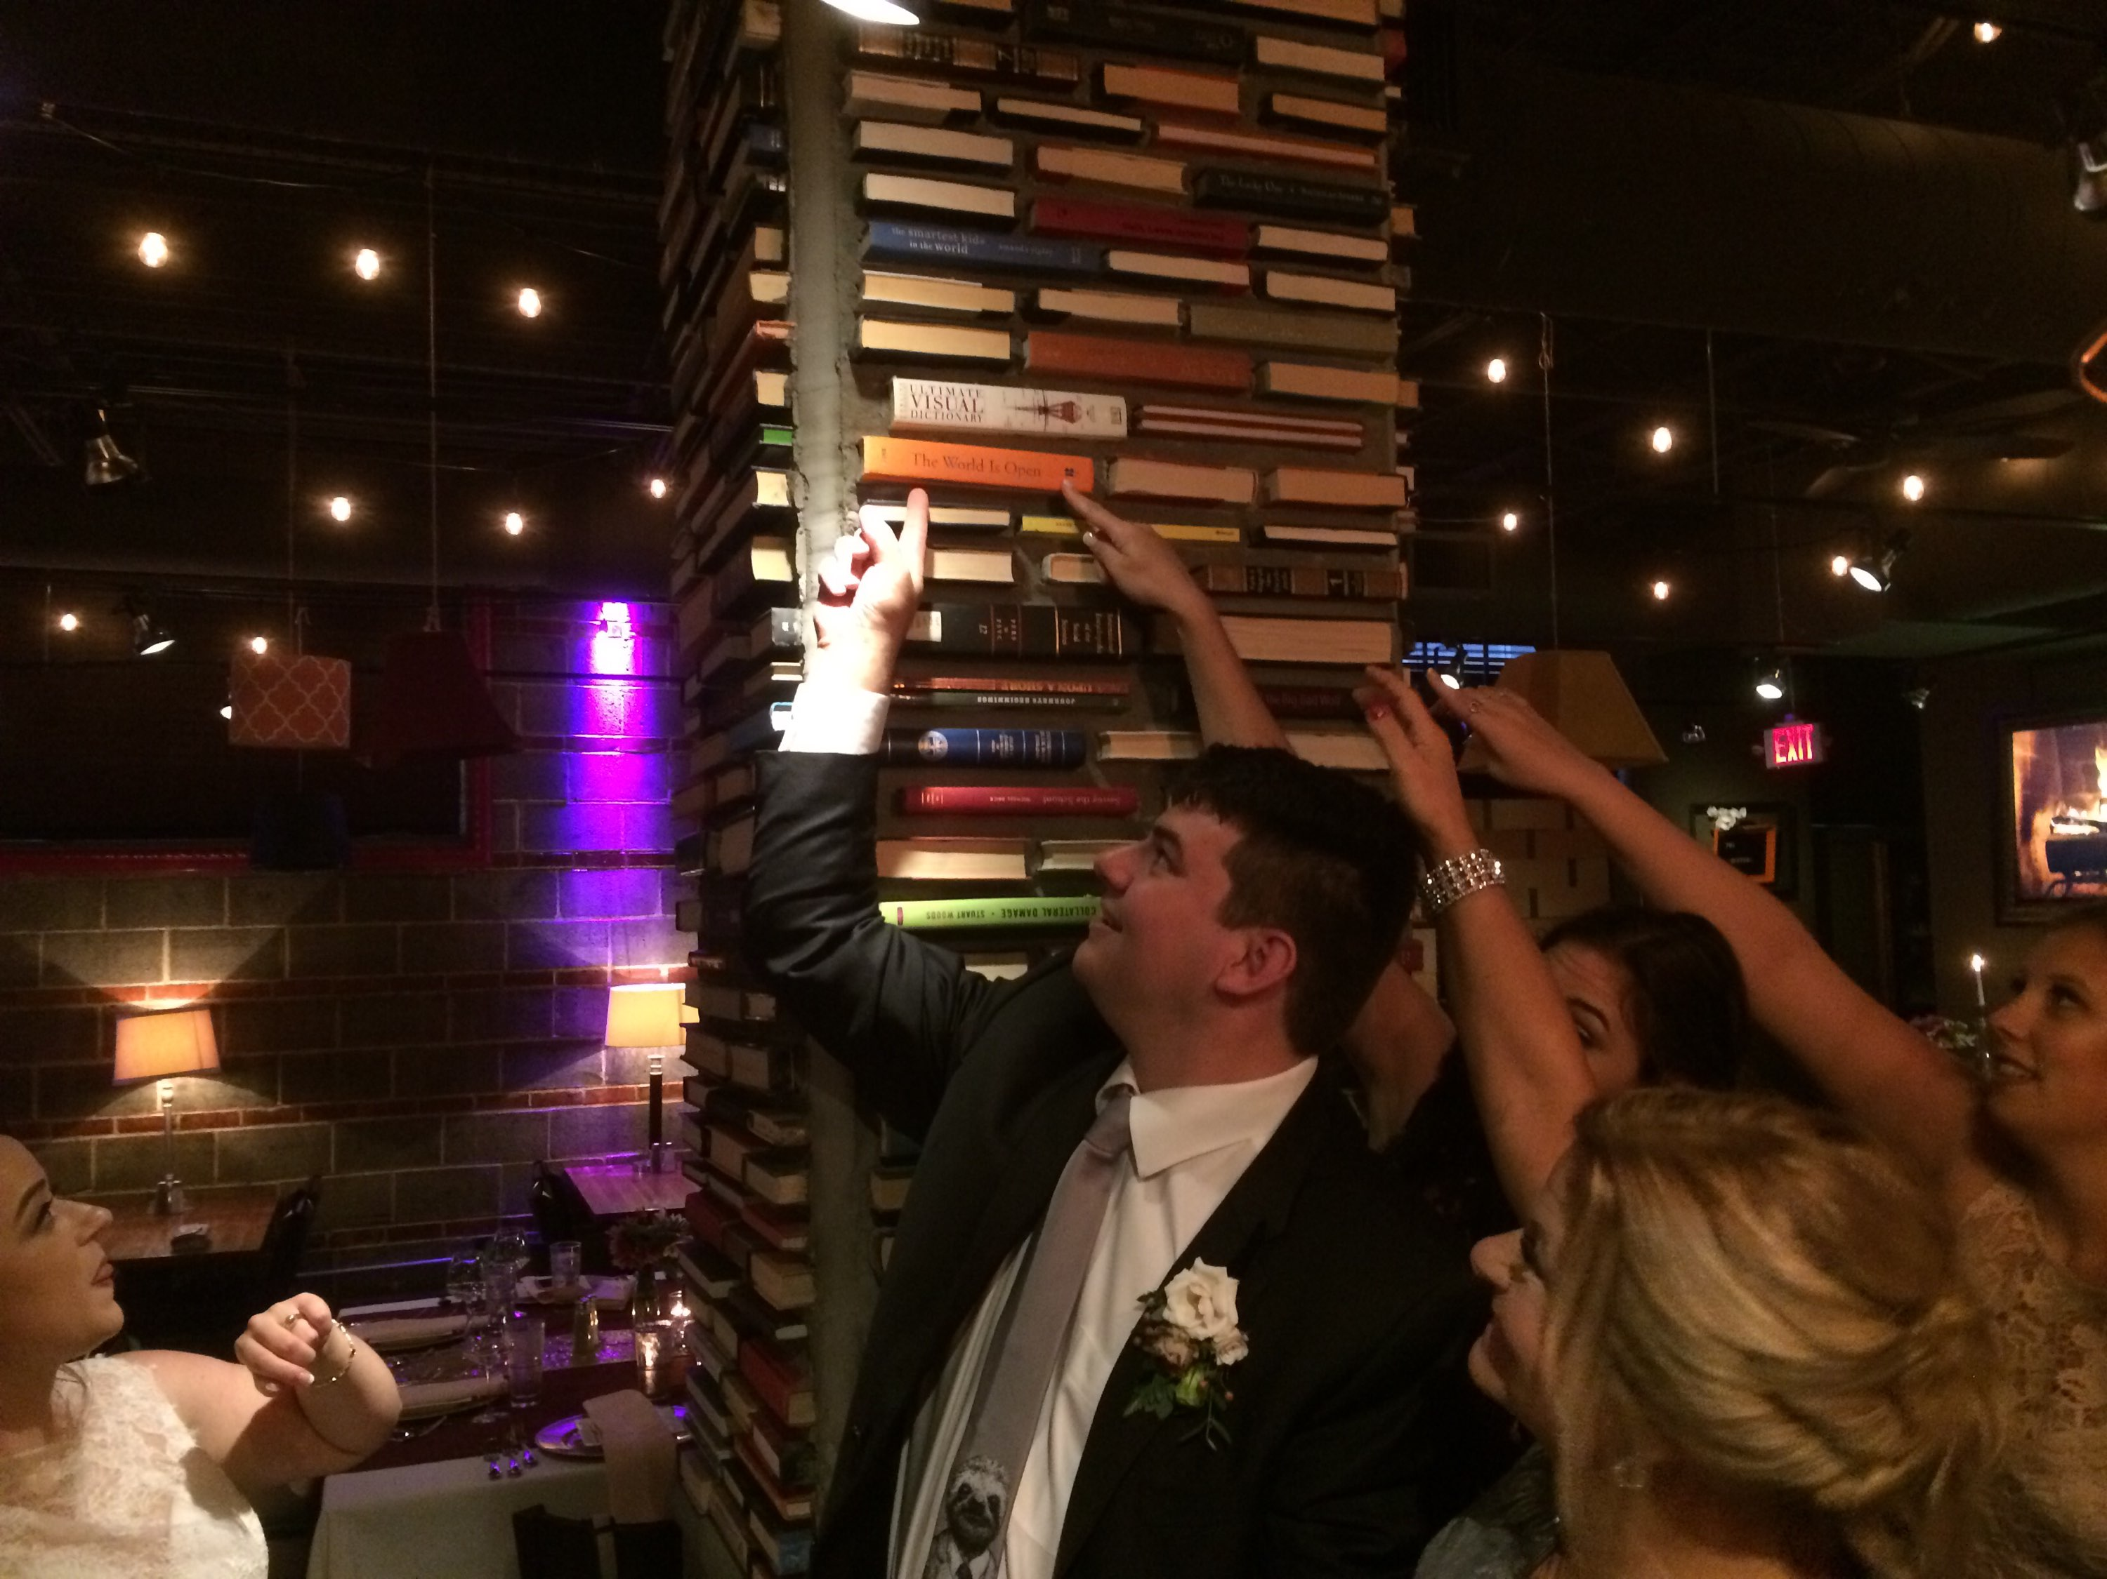
You never know where you’ll be celebrating your writing accomplishments… Even at a wedding of your nephew!
Notes:
Curt
65

Slide 66
Just don’t celebrate too much!
Notes:
Curt
66

Slide 67
Bonus #1. Be Careful Committing to Other People’s Projects (OPP)
Notes:
Curt
67

Slide 68
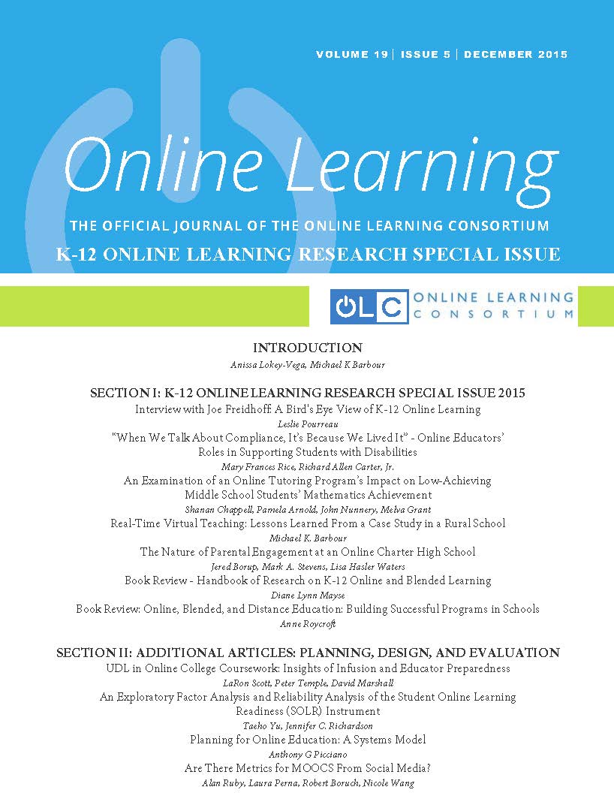
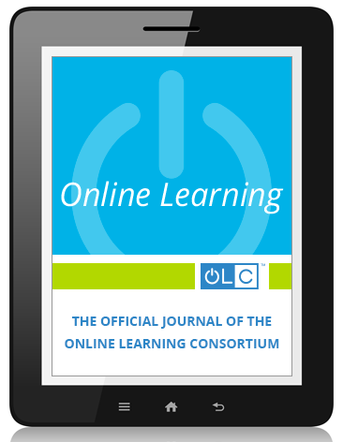
Bonus #2. Look for Special Issues that You Might Contribute To
Notes:
Curt
68

Slide 69
Bonus #3. Save Research Articles for a Rainy Day (file folders on different topics)
Notes:
Curt
69

Slide 70
Bonus #4. Treat Graduate Students as Colleagues (hec, treat everyone as a colleague)
Notes:
Curt
70

Slide 71
Bonus #5. Find a Mentor and Ask Senior People for Advice
Notes:
Curt
71

Slide 72
Time to Recap…
The process for getting published
The process for selecting a journal for publication
Writing tips and insights
Curated resources
You commitments to future writing
Notes:
Ana
Encourage audience to access the resources on GoogleDoc.
72

Slide 73
Additional Bonus Section: Part III. Slaying “I” Monsters

Slide 74
There’s a Global Health Issue

Slide 75
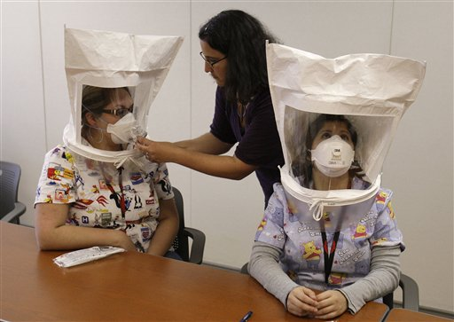
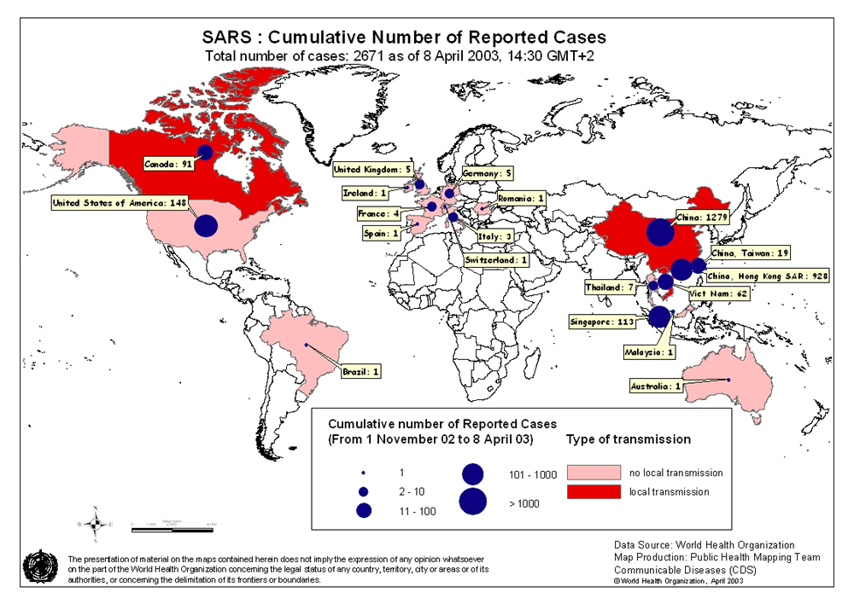
No, it is no longer SARS…

Slide 76
It is not H5N1 (i.e., Bird Flue)…

Slide 77
I first noticed it in Singapore

Slide 78
But more so in East Asia

Slide 79
It is Particularly Acute in Taiwan

Slide 80
It is the use of: Social Science Citation Index (SSCI)

Slide 81
And… Science Citation Index (SCI)

Slide 82
As well as… Arts & Humanities Citation Index (A&HCI)

Slide 83
For much decision making. Per one of my students from Singapore:
“SSCI is very important in Singapore. In order to ramp up the University ranking, the key way to stay in the university is to publish. If SSCI is important for the University ranking system, then it will be important in competitive Singapore. =)” (Quoted from June 14, 2014)

Slide 84
Audience Poll #1:
Have you seen this I- Monster around?

Slide 85
Audience Poll #2: Who wants to help catch and slay a few monsters?

Slide 86
Monsters University Final Trailer https://www.youtube.com/watch?v=xBzPioph8CI

Slide 87
Time to List the Pros and Cons

Slide 88
99 Seconds Activity #3
With your next chair neighbor discuss 1 to 2 Pros and Cons of SSCI.
Notes:
Ana
Not sure if we want to keep all these activities as we only have 1 hour and 5 minutes and need to leave time for questions. It’s up to you….
88

Slide 89
Part I: Pros of SSCI (SCI & A&HCI)

Slide 90
Pro #1. Provides Goals and Targets to Strive Toward (i.e., a focus)

Slide 91
Pro #2. Provides a common Lingo

Slide 92
Pro #3. Measure or Benchmark for Performance (e.g., monthly, quarterly, or annual reports)

Slide 93
Pro #4. Scholarly Accomplishments to Analyze, Compare, Celebrate

Slide 94
Pro #5. Sense of Pride, Identity, or Emotional Lift

Slide 95
Pro #6. Boosts Journal Quality

Slide 96
Pro #7. Impact Factor Receives Increased Attention

Slide 97
Pro #8. Stricter Review Process

Slide 98
Pro #9. Community of Bonded and Supportive Scholars

Slide 99
Pro #10. International Comparisons

Slide 100
Part II: Cons of SSCI (SCI & A&HCI)

Slide 101
I-Monsters in Taiwan
One person later pointed out that the "I" monster in Taiwan not only includes SSCI but also SCI (Science Citation Index) and A&HCI (i.e., Arts & Humanities Citation Index)…this three-headed "I" monster or beast "has totally slayed Taiwan's merit and value system for Taiwanese scholars and professors."

Slide 102
I-Monsters in Taiwan
“Some universities even have adopted an “I” point system, i.e., the promotion and merit of a professor are based on the number of points accumulated by publishing a certain number of “I” articles. One very “strange” requirement in Taiwan’s academia is that a doctoral student is not able to graduate without accumulating enough “I” points.”

Slide 103
I-Monsters in Taiwan
“Some public universities even set a certain number of “I” publications or points as their main Ph.D. candidacy requirement. In this way, the doctoral students in Taiwan, in effect, become “I” slaves, working for their “I” professors. Similarly, there are some public universities which accordingly entitle “distinguished” or “chair” professors with salary raises using the tax payer’s money based on “I” points.”

Slide 104
Con #1. Research Publication Takes Priority over Value Creation http://elitedaily.com/money/4-techniques-to-incorporate-into-your-daily-grind-for-ultimate-productivity/

Slide 105
Con #2. Research-Practice Gap Widens (lack of caring or concern about true impact or reality)

Slide 106
Con #3. Greed Factor (e.g., chasing bonuses, raise, etc.)

Slide 107
Con #4. Values Messed Up (i.e., publications more important than the actual results)

Slide 108
Con #5. Easy Journal Syndrome

Slide 109
Con #6. Limited Journal Selection

Slide 110
Con #7. Field Becomes Narrowly Focused (periphery shortchanged)

Slide 111
Con #8. Journal Editorial Board Dominance

Slide 112
Con #9. English Dominance

Slide 113
Con #10. Creativity and Spontaneity is Shortchanged

Slide 114
Con #11. Lack of Passion and Interest

Slide 115
Con #12. Elitism Reigns Supreme (and, at times, the less important and inferior are known)

Slide 116
Con #13. Rats in a Cage (i.e., do “this” and then “this” and then “THIS!!!”)

Slide 117
Anyone remember the “Outer Limits?” “We control the vertical and the horizontal” https://www.youtube.com/watch?v=8CtjhWhw2I8
“There is nothing wrong with your television set. Do not attempt to adjust the picture. We are controlling transmission. If we wish to make it louder, we will bring up the volume. If we wish to make it softer, we will tune it to a whisper. We will control the horizontal. We will control the vertical. We can roll the image, make it flutter. We can change the focus to a soft blur or sharpen it to crystal clarity. For the next hour, sit quietly and we will control all that you see and hear. We repeat: there is nothing wrong with your television set. You are about to participate in a great adventure. You are about to experience the awe and mystery which reaches from the inner mind to – The Outer Limits.”

Slide 118
Con #14. Industrial or Factory Model (external or extrinsically determined goals; limited freedom to venture into the unknown)

Slide 119
Con #15. “I feel strange”

Slide 120
Con #16. Journal Editors Feel Strange

Slide 121
Con #17. Productivity Slaves

Slide 122
Con #18. SSCI Preparedness Training Programs

Slide 123
Con #19. Publications Skewed toward those with Technology Backgrounds

Slide 124
Con #20. Research-Practice Gap Widens (lack of caring or concern about true impact or reality)

Slide 125
Con #21. Student Issues

Slide 126
Con #22. Personal Growth and Development Curtailed (i.e., negative impact on sense of self, identity, self-actualization, etc.)

Slide 127
Con #23. Limited Teaching Exposure and Experience

Slide 128
Con #24. SSCI is Corporate

Slide 129
Con #25. Impact Factor Ranking Manipulations

Slide 130
Con #26. Distinguished Title and Status Goals (i.e., lack of genuine interest in field)

Slide 131
Con #27. Narrow-Minded Recruitment Practices

Slide 132
Con #28. Unethical Publication Practices

Slide 133
July 16, 2014 Peer Review Scandal Takes Down Taiwanese Minister By Yu-Tzu Chiu, IEEE Spectrum https://spectrum.ieee.org/tech-talk/at-work/tech-careers/peer-review-ring-takes-down-taiwanese-minister

Slide 134
July 16, 2014 Peer Review Scandal Takes Down Taiwanese Minister By Yu-Tzu Chiu, IEEE Spectrum https://spectrum.ieee.org/tech-talk/at-work/tech-careers/peer-review-ring-takes-down-taiwanese-minister
Taiwan's Education Minister Wei-ling Chiang resigned this week over an academic publishing scandal involving a peer review ring plotted by a young Taiwanese researcher.
In early July, 60 academic papers—five of which list Chiang as a co-author—were retracted from the Journal of Vibration and Control (JVC) after an investigation revealed a "peer review and citation ring" involving former National Pingtung University of Education (NPUE) associate professor Peter Chen (Chen-yuan Chen).

Slide 135
July 31, 2017 China cracks down after investigation finds massive peer-review fraud Dennis Normile, Science Magazine https://www.sciencemag.org/news/2017/07/china-cracks-down-after-investigation-finds-massive-peer-review-fraud

Slide 136
Audience Poll #3: Is there any hope? https://www.youtube.com/watch?v=xIFJLMyUwrg
As a result, there is a sense that they care little for the implementation of their research findings and ideas. And the gap continues to widen between researchers and practitioners with each passing day, month, and year. Is there any hope Obi Wan Kenobe?

Slide 137
Audience Poll #4: Should the system be changed?
Yes
Maybe
No

Slide 138
Audience Poll #5: Is there an I-Monster ("I" (i.e., SSCI, SCI, and A&HCI)) under your bed or in your closet?

Slide 139
Are you sure?

Slide 140
Concerns?
Comments?
Commitments?
Curt Bonk, Indiana University
Email: cjbonk@Indiana.edu
Homepage: http://curtbonk.com/
TravelinEdMan in Twitter:
https://twitter.com/travelinedman
Notes:
All
140

